Slide 1
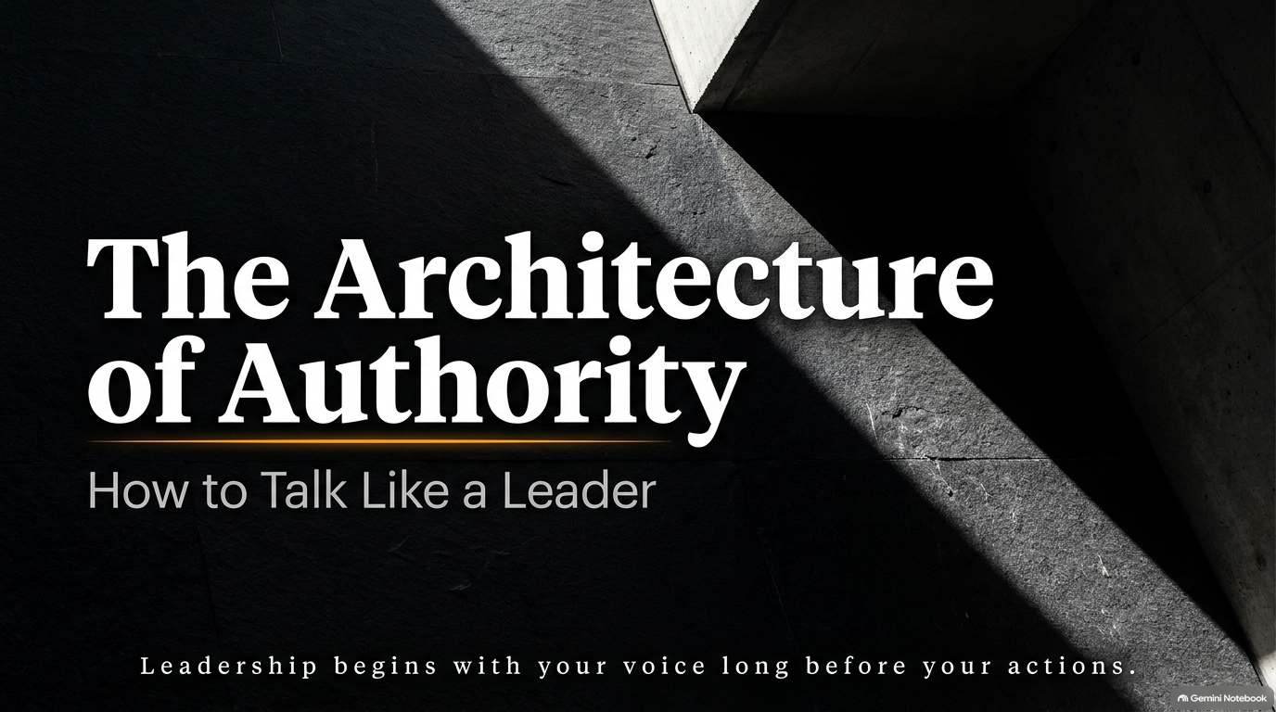
Notes:
Visual: Minimalist architectural slate tile with sharp light cast across a dark background.
Suggested Speaking Time: 2–3 minutes
Speaker Notes:
"Welcome, everyone. Today, we are exploring The Architecture of Authority. Leadership does not begin with your title, your corner office, your budget, or your organizational chart. Leadership begins with your voice long before your actions, your reputation, or your results.
The way you speak reveals your inner psychological structure. When you learn to talk like a leader, people respond to you differently, you negotiate differently, and you move through high-stakes situations with an unshakeable presence. Today, we are going to dismantle weak verbal habits and replace them with the discipline, psychology, and strategy behind a voice that commands immediate respect without aggression and exerts profound influence without noise. Let's begin."
How to Talk Like a Leader | Full Audiobook
https://www.youtube.com/watch?v=hmG7V0N2iEs

Slide 2
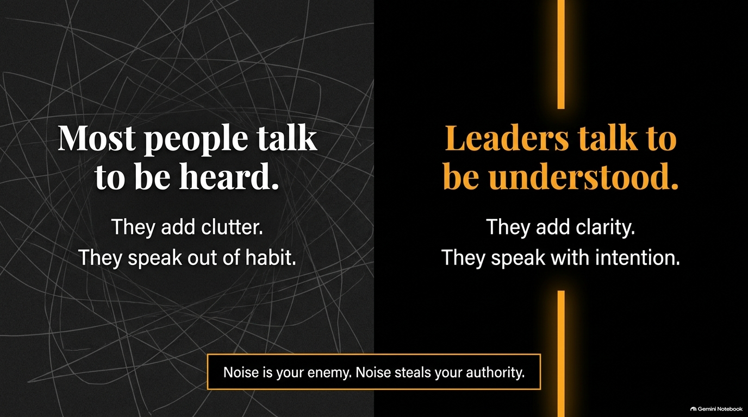
Notes:
Visual: Contrast layout between messy line clutter ("Most people talk to be heard") and clean golden line ("Leaders talk to be understood").
Suggested Speaking Time: 3–4 minutes
Speaker Notes:
"Let's start with a hard truth: Most people talk too much. They don't do it out of malice; they do it because no one taught them the power of vocal restraint. Most people speak simply to fill the air, to avoid awkwardness, or to prove they exist in the room—they talk to be heard. They add verbal clutter, speak out of habit, and drown their own points in unnecessary noise.
Leaders do the exact opposite: Leaders talk to be understood. They speak to direct, decide, and move people toward absolute clarity. Every time you open your mouth, you face a choice: Will you add clarity, or will you add clutter? Will you speak out of habit, or will you speak with intention? Remember this rule: Noise is your enemy. Noise dilutes your presence and steals your authority. When you speak less and cut the fluff, people naturally lean in, listen closely, and take every word seriously."

Slide 3
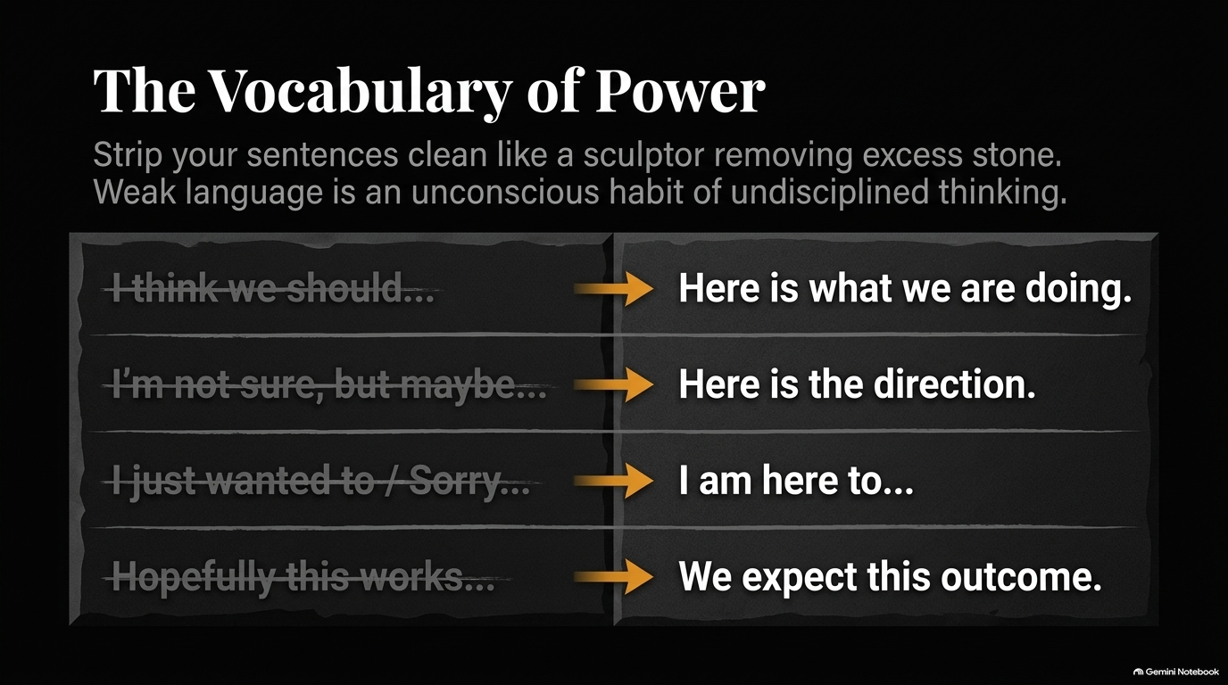
Notes:
Visual: Side-by-side translation table striking out weak phrases ("I think we should...", "I'm not sure, but maybe...") and replacing them with decisive executive statements ("Here is what we are doing", "Here is the direction").
Suggested Speaking Time: 4–5 minutes
Speaker Notes:
"Authority is rarely lost in big, catastrophic moments—it is lost in the tiny, casual, everyday phrases you don't even notice. Weak language is an unconscious habit of undisciplined thinking leaking out through your words. Every time you say 'I think we should,' you signal uncertainty. Every time you say 'I'm not sure, but maybe,' you undermine a solid idea before you even pitch it. Every time you open with 'I just wanted to follow up' or 'Sorry to bother you,' you apologize for taking up space.
Look at the table on this slide. You must strip your sentences clean like a sculptor removing excess stone to reveal a masterpiece:
Instead of 'I think we should...' $\rightarrow$ 'Here is what we are doing.'
Instead of 'I'm not sure, but maybe...' $\rightarrow$ 'Here is the direction.'
Instead of 'I just wanted to / Sorry...' $\rightarrow$ 'I am here to [finalize / review].'
Instead of 'Hopefully this works...' $\rightarrow$ 'We expect this outcome.'
You do not need anyone's permission to sound certain. Replace hedging with clean, decisive statements."

Slide 4
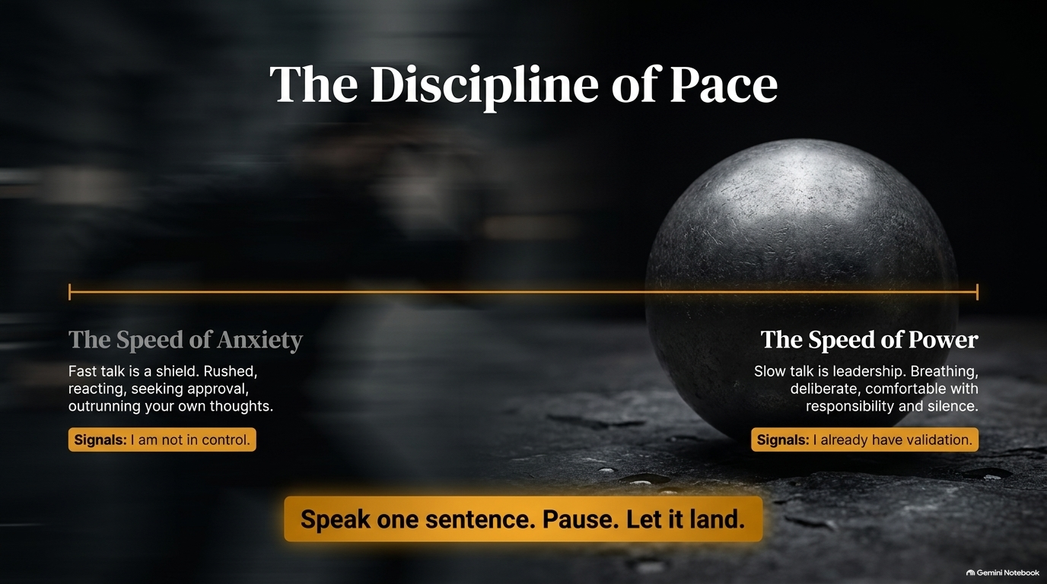
Notes:
Visual: A horizontal continuum contrasting "The Speed of Anxiety" (fast, rushed, seeking approval) on the left with "The Speed of Power" (slow, deliberate, comfortable with silence) on the right.
Suggested Speaking Time: 3–4 minutes
Speaker Notes:
"Speed is the enemy of executive authority. Fast talking is nervous talking; it is a shield people use when they are trying to outrun their own thoughts or prevent others from interrupting them. When you rush your speech, you signal to the room: 'I am not in control, and I need your approval before you cut me off.'
Conversely, slow talk is leadership. Pacing your speech communicates that you are comfortable with your authority, comfortable with responsibility, and completely comfortable taking up space. Look at elite performers, board executives, or military commanders: they never rush their words. They speak one clear sentence, pause, and let it land before moving forward. Fast talk tries to prove something; slow talk proves everything. Speak at the speed of power, not the speed of anxiety."

Slide 5
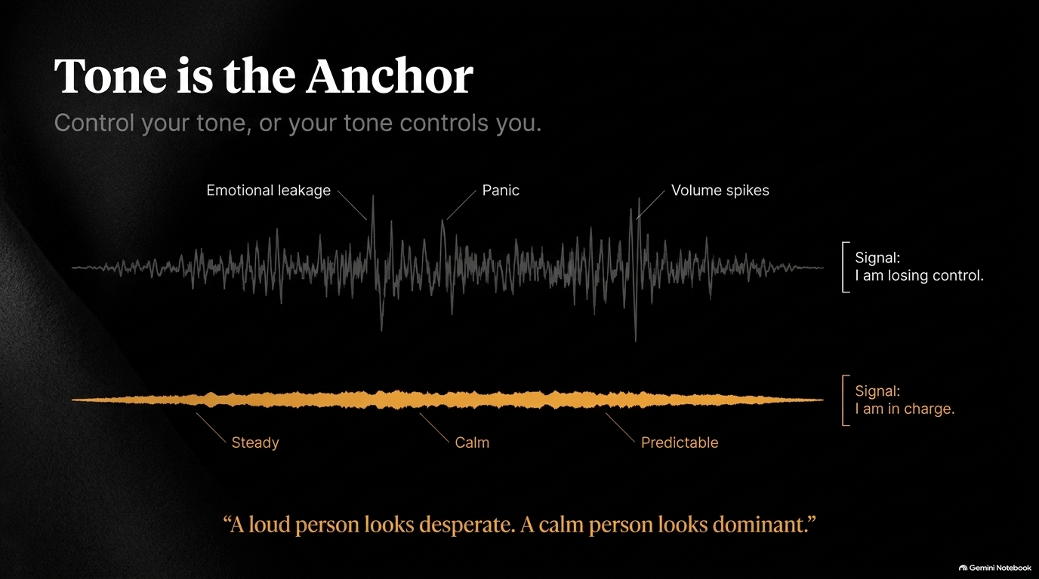
Notes:
Visual: Audio waveform visual comparing a high-variance, chaotic signal ("Emotional leakage", "Panic", "Volume spikes") with a low, smooth golden baseline ("Steady", "Calm", "Predictable").
Suggested Speaking Time: 4–5 minutes
Speaker Notes:
"Your tone is the emotional anchor of your message. The human brain registers and reacts to vocal tone long before it processes logical meaning. You open your mouth, and people feel your state of mind before they understand your words.
If your tone has emotional leakage—uncontrolled volume spikes, defensive pitch rises, or frantic cadence—it signals to everyone that you are losing control. An unstable tone destroys even the most brilliant strategy. But a low, steady, predictable tone acts as a room stabilizer. In Special Forces or crisis management, leaders don't shout; they drop their volume and speak with calm certainty. A loud person looks desperate. A calm person looks dominant. Control your tone, or your tone will control you."

Slide 6
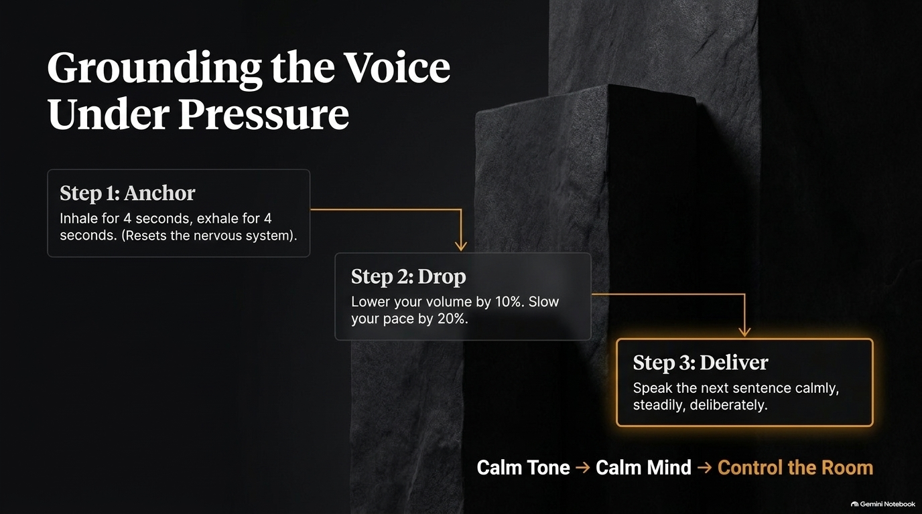
Notes:
Visual: A 3-step concrete staircase diagram illustrating the vocal reset protocol: Step 1 Anchor, Step 2 Drop, Step 3 Deliver.
Suggested Speaking Time: 3–4 minutes
Speaker Notes:
"When pressure spikes—whether during a hostile question, a sudden crisis, or an intense negotiation—your autonomic nervous system tries to hijack your vocal cords. Your breathing shortens, your pitch rises, and you risk sounding panicked. To prevent this, you must master this 3-Step Grounding Protocol:
Step 1: Anchor. Inhale deeply for 4 seconds, exhale for 4 seconds. This immediate physiological reset calms your nervous system and stops adrenaline from driving your speech.
Step 2: Drop. Intentionally lower your volume by 10% and slow your pace by 20%. Lowering your volume forces the room to quiet down to hear you.
Step 3: Deliver. Speak your next sentence calmly, steadily, and deliberately.
Calm Tone $\rightarrow$ Calm Mind $\rightarrow$ Control the Room. Whenever you feel yourself losing your composure, run this reset immediately."

Slide 7
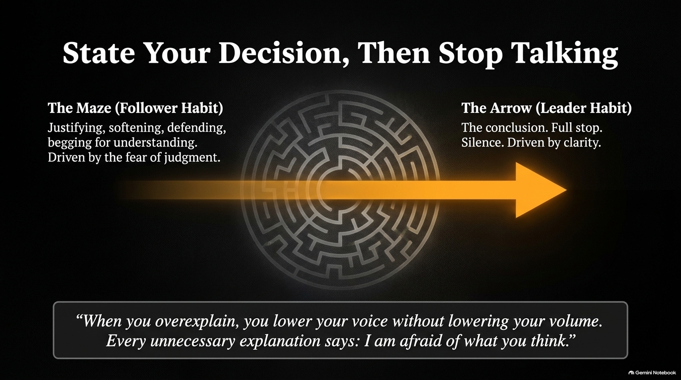
Notes:
Visual: Graphic comparing "The Maze" (follower habit: justifying, softening, defending) with "The Arrow" piercing straight through the maze to a clear conclusion ("The Arrow: Leader Habit").
Suggested Speaking Time: 4–5 minutes
Speaker Notes:
"One of the most liberating shifts you will ever make in communication is learning to state your decision, then stop talking.
Followers get trapped in 'The Maze.' They state a decision, and then immediately launch into five minutes of defensive justification, softening, and overexplaining because they fear judgment or conflict. But every unnecessary explanation says to the room: 'I am afraid of what you think, and I am not sure about this decision.' Overexplaining lowers your authority without lowering your volume.
Leaders operate like 'The Arrow.' They deliver the conclusion cleanly, put a full stop on the sentence, and allow silence to hold the space. If people need further details, they will ask. Speak in conclusions, not in defensive mazes."

Slide 8
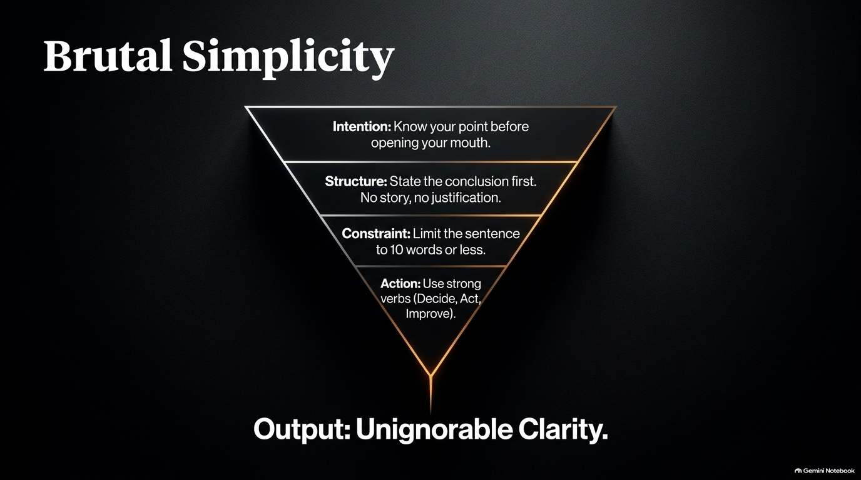
Notes:
Visual: An inverted funnel structure filtering from Intention down to Structure, Constraint, Action, culminating in "Output: Unignorable Clarity".
Suggested Speaking Time: 3–4 minutes
Speaker Notes:
"Complexity kills authority; clarity creates leverage. Long-winded, jargon-filled explanations don't make you sound smart—they create confusion, hesitation, and doubt. To command respect, you must practice Brutal Simplicity using this 4-part funnel:
1. Intention: Know your core point before you open your mouth. If you don't know your point, no one else will.
2. Structure: State the conclusion first. No background story, no preamble, no justification.
3. Constraint: Limit your primary directive or decision sentence to 10 words or less.
4. Action: Use strong, decisive verbs—Decide, Act, Execute, Focus, Improve.
When you filter your thoughts through this process, the output is Unignorable Clarity. People follow those who make direction simple and unambiguous."

Slide 9
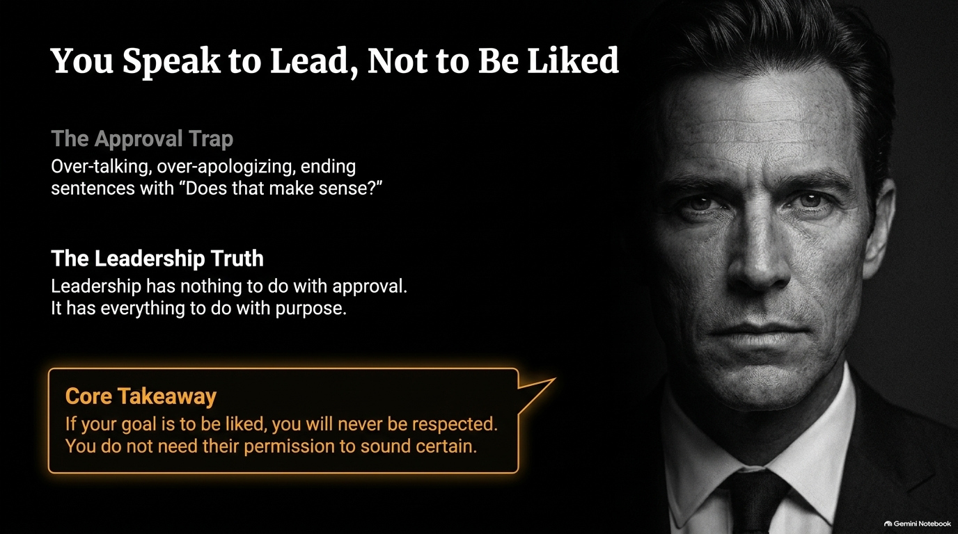
Notes:
Visual: Dark, commanding portrait of a leader alongside a callout highlighting "The Approval Trap" vs "The Leadership Truth".
Suggested Speaking Time: 4–5 minutes
Speaker Notes:
"Here is a fundamental boundary you must set: You speak to lead, not to be liked.
If your primary goal in communication is to be liked, approved of, or accepted, you will never be respected or followed as a leader. Approval-seeking creates 'The Approval Trap': over-talking, over-apologizing, hedging statements, and ending sentences with needy validation checks like 'Does that make sense?' or 'If that's okay with everyone?' Those questions are not seeking clarity; they are seeking permission.
Leadership has nothing to do with seeking popularity; it has everything to do with purpose and responsibility. When you speak from purpose rather than a desire for applause, your posture changes, your tone drops, and your words carry undeniable weight. Do not ask for permission to sound certain."

Slide 10
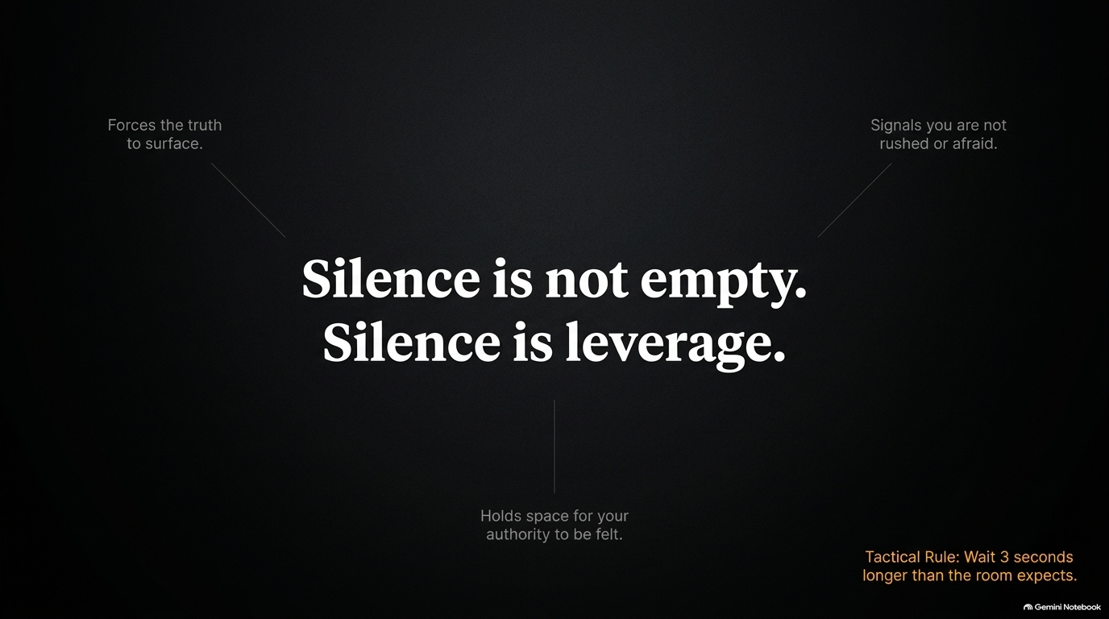
Notes:
Visual: Stark black background with bold central typography ("Silence is not empty. Silence is leverage.") surrounded by three key benefits and a tactical rule.
Suggested Speaking Time: 4–5 minutes
Speaker Notes:
"Most people fear silence because society conditions us to fill every gap with noise. But in executive communication and high-stakes negotiation, silence is leverage.
Silence accomplishes three critical objectives:
It forces the truth to surface: In negotiations, state your terms and stay silent. The person who breaks the silence first usually gives away leverage.
It signals control: Holding silence proves you are not rushed, defensive, or afraid.
It holds space for authority: It allows your message to land with weight rather than drowning in verbal clutter.
Tactical Rule: In meetings or after delivering a decision, wait 3 seconds longer than the room expects. Sit in the silence like a king on a throne—calm, unmoved, and steady."

Slide 11
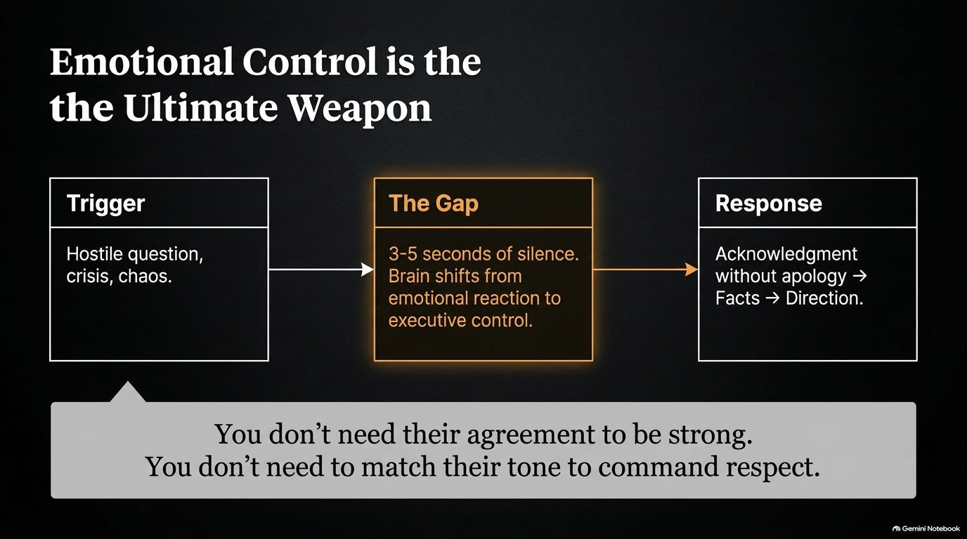
Notes:
Visual: Process block diagram mapping Trigger $\rightarrow$ The Gap (3-5 seconds of silence) $\rightarrow$ Response (Acknowledgment without apology $\rightarrow$ Facts $\rightarrow$ Direction).
Suggested Speaking Time: 4–5 minutes
Speaker Notes:
"When chaos erupts, a hostile question is fired, or a crisis hits, average communicators react out of emotion. They match the hostility, get defensive, or panic. But emotional reactions destroy authority instantly.
True leadership authority utilizes 'The Gap.' When a trigger occurs, insert 3 to 5 seconds of complete silence before responding. In those few seconds, your brain shifts away from an amygdala-driven emotional reaction and back into prefrontal executive control.
Your response structure should always be: Acknowledgment without apology $\rightarrow$ Facts $\rightarrow$ Direction. For example: 'I hear the concern regarding the delay. Here are the current metrics, and here is our corrective path forward.' You don't need their agreement to be strong, and you never need to match their tone to command respect."

Slide 12
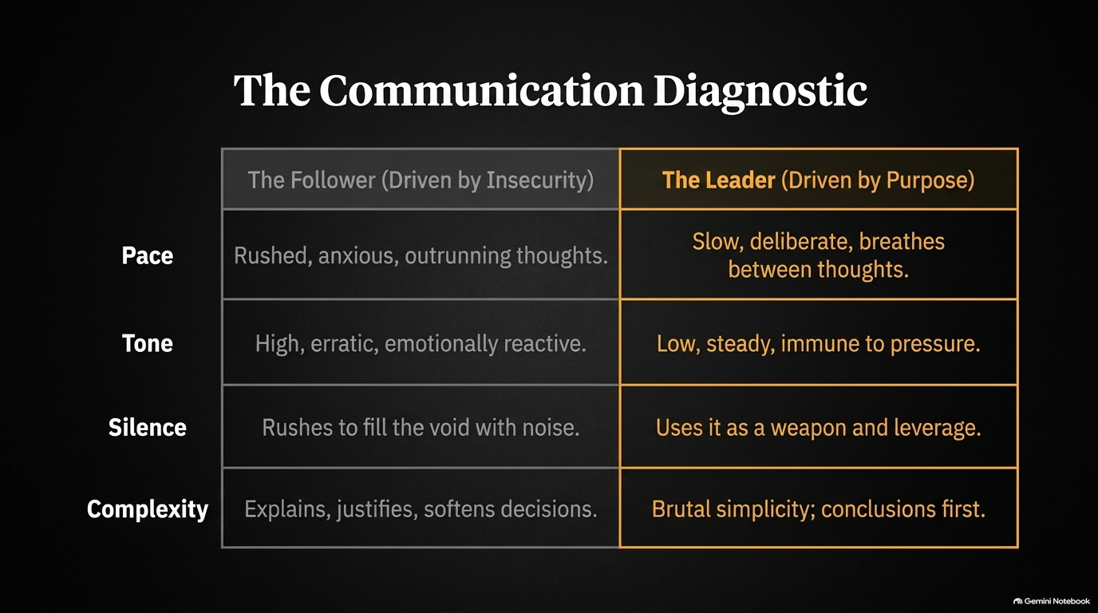
Notes:
Visual: A high-contrast diagnostic matrix comparing "The Follower (Driven by Insecurity)" vs "The Leader (Driven by Purpose)" across Pace, Tone, Silence, and Complexity.
Suggested Speaking Time: 3–4 minutes
Speaker Notes:
"Use this slide as an honest personal diagnostic for your daily communication habits:
Pace: Followers are rushed, anxious, and trying to outrun their thoughts. Leaders are slow, deliberate, and breathe between thoughts.
Tone: Followers exhibit high, erratic, emotionally reactive tones. Leaders maintain low, steady tones that remain immune to external pressure.
Silence: Followers rush to fill every silent void with noise. Leaders use silence as strategic leverage and presence.
Complexity: Followers explain, justify, and soften decisions. Leaders deliver brutal simplicity, stating conclusions first.
Audit yourself in every meeting this week: Which column describes your communication style?"

Slide 13
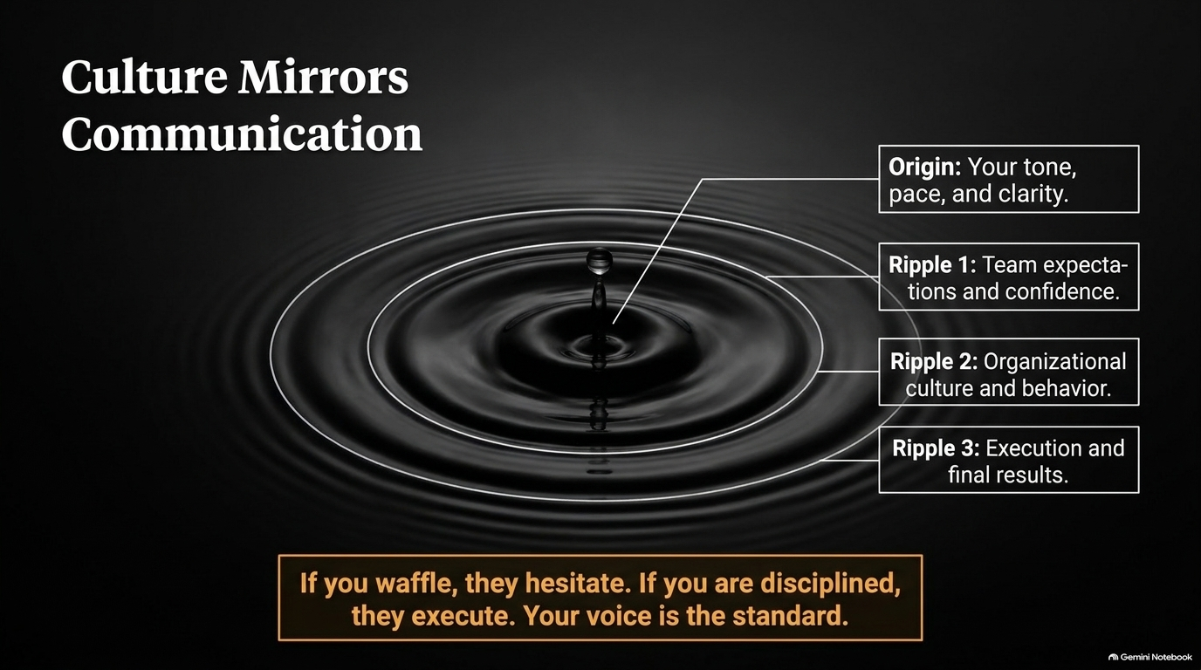
Notes:
Visual: A ripple effect graphic originating from a water droplet ("Origin: Your tone, pace, clarity") expanding outward to Team expectations, Organizational culture, and Final execution.
Suggested Speaking Time: 3–4 minutes
Speaker Notes:
"Your voice is not just a personal tool; it is the organizational thermostat. Culture mirrors communication.
Look at the ripple effect on this slide:
Origin: Your tone, pace, and clarity set the frequency.
Ripple 1: Your immediate team adopts your level of composure and confidence.
Ripple 2: Organizational culture and behavioral norms align with that standard.
Ripple 3: Execution and final results reflect the clarity of your direction.
If you waffle, your team hesitates. If you panic, your organization frets. If you are disciplined, articulate, and calm, your team executes with conviction. Your voice sets the standard—lead with it."

Slide 14
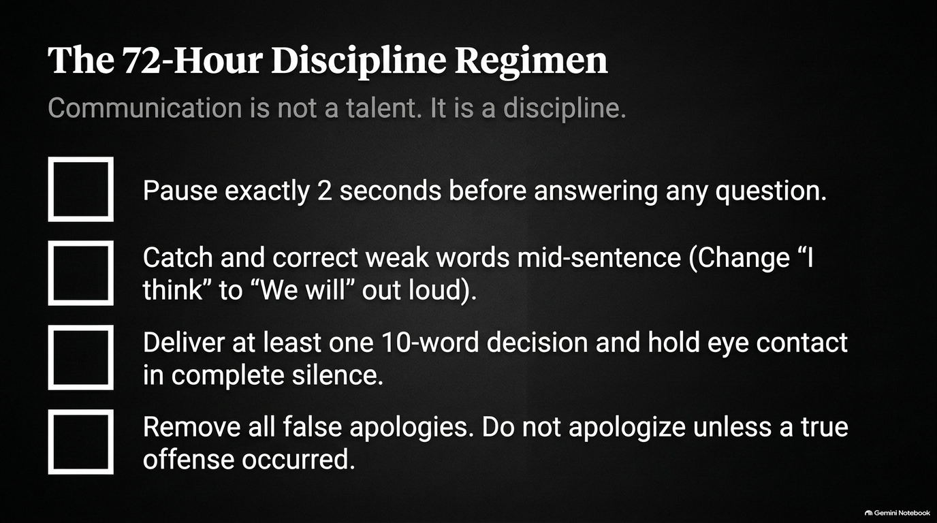
Notes:
Visual: An actionable checklist layout presenting 4 practical daily habits for mastering authoritative speech.
Suggested Speaking Time: 4–5 minutes
Speaker Notes:
"Communication is not a genetic talent; it is a trainable discipline. To lock in these habits, I challenge everyone here to execute The 72-Hour Discipline Regimen starting right now:
Pause exactly 2 seconds before answering any question: Use those two seconds to evaluate if your response is necessary and clear.
Catch and correct weak words mid-sentence: If you catch yourself saying 'I think,' stop out loud and correct it to 'We will' or 'Here is the plan.'
Deliver at least one 10-word decision and hold eye contact in silence: Deliver the directive, stop talking, and hold your gaze.
Remove all false apologies: Eliminate reflexive 'sorries' unless a genuine offense occurred.
Run this regimen for 3 days, and observe how quickly the room's dynamic shifts in your favor."

Slide 15
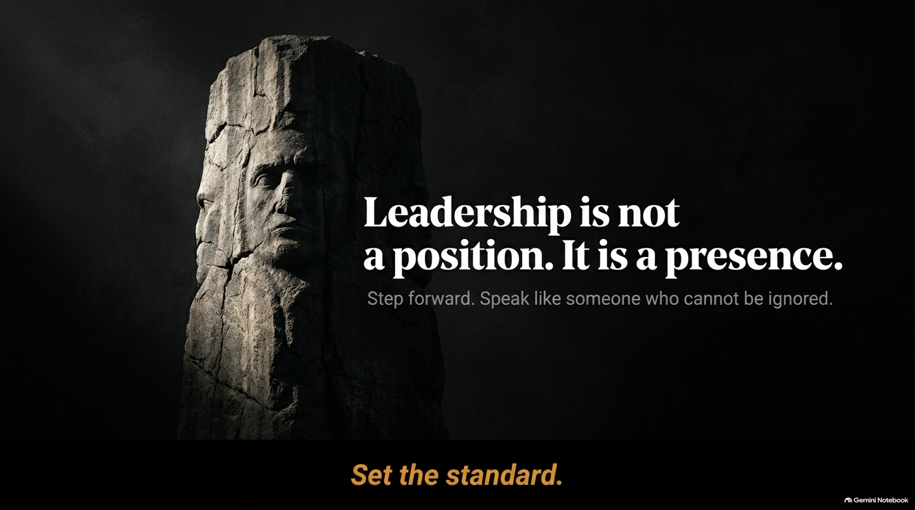
Notes:
Visual: Dramatic monument sculpture representing enduring strength, accompanied by the bold statement: "Leadership is not a position. It is a presence."
Suggested Speaking Time: 2–3 minutes
Speaker Notes:
"As we move toward our summary, remember this core truth: Leadership is not a position. It is a presence.
Titles are granted on paper, but authority is claimed through presence. You can give someone an impressive title, but if their voice is frantic, apologetic, and filled with verbal clutter, no one will follow them. On the flip side, someone with no formal title who speaks with calm certainty, deliberate pace, and clean conclusions naturally commands the room.
Step forward. Speak like someone who knows their worth, knows their direction, and cannot be ignored. Set the standard in every room you enter."

Slide 16
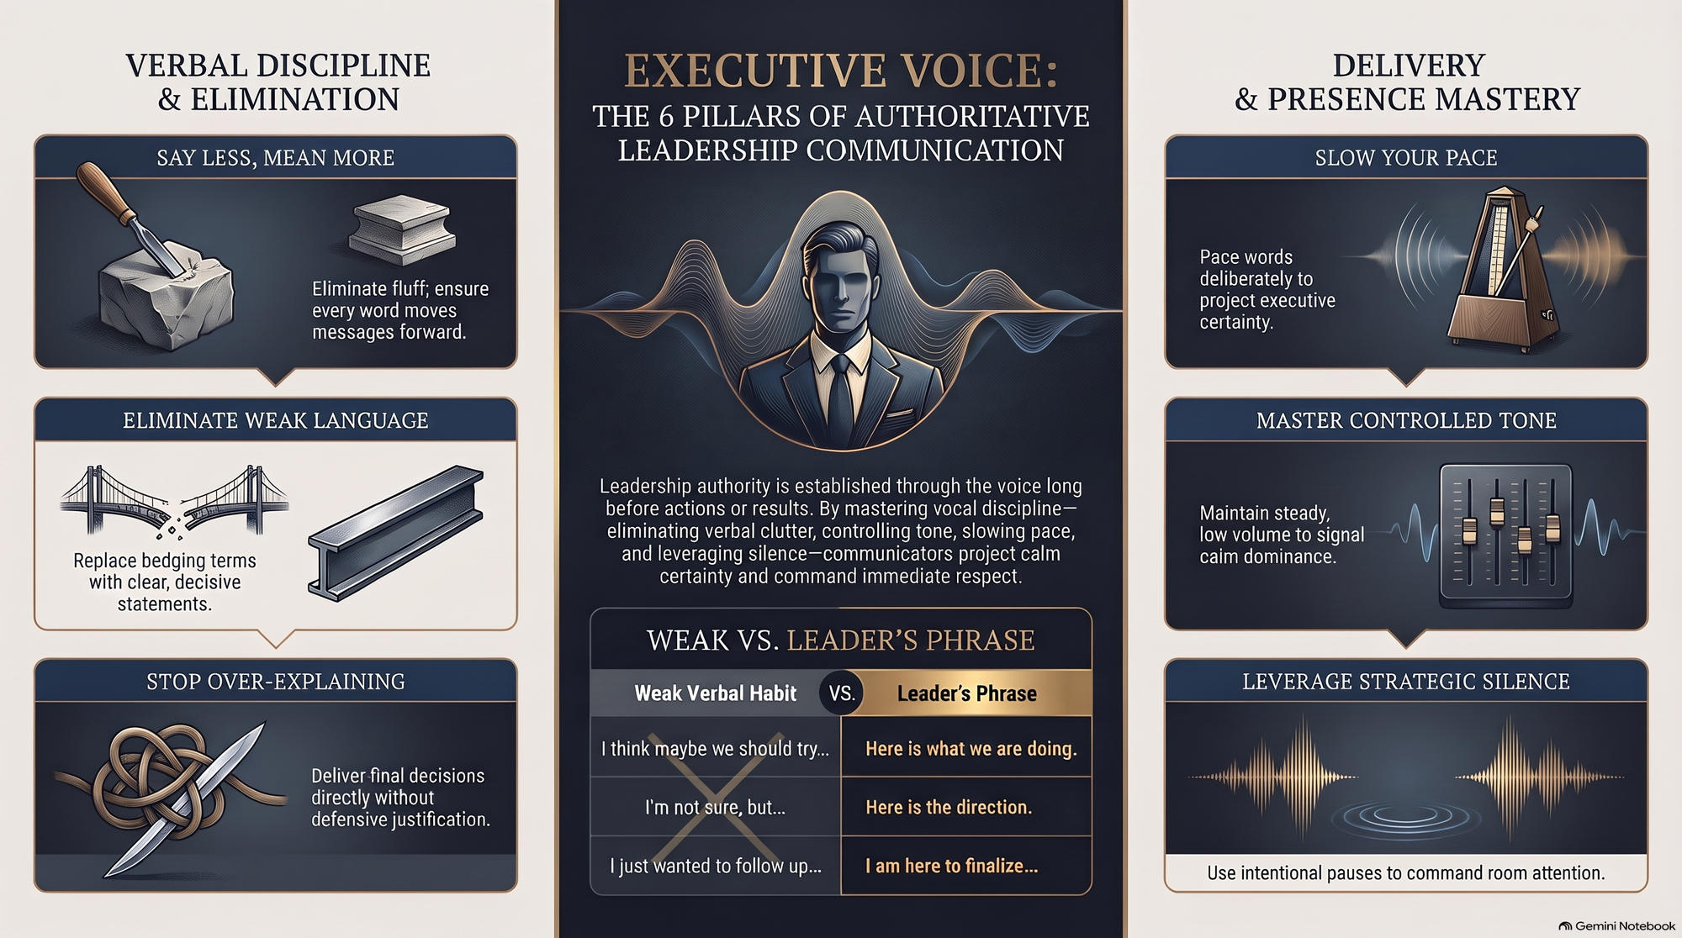
Notes:
Visual: Comprehensive 3-panel executive summary dashboard outlining "Verbal Discipline & Elimination," "The 6 Pillars of Authoritative Leadership Communication," and "Delivery & Presence Mastery."
Suggested Speaking Time: 4–6 minutes
Speaker Notes:
"To synthesize our entire blueprint today, let's review our Executive Voice Summary Dashboard:
Verbal Discipline & Elimination (Left): Say less and mean more by removing fluff. Eliminate weak hedging language and replace it with decisive phrases. Stop overexplaining—deliver final decisions cleanly without defensive justifications.
The Core Pillars (Center): Leadership authority is established through the voice long before actions or results. Swap weak verbal habits ('I think maybe we should try...') for leader phrases ('Here is what we are doing').
Delivery & Presence Mastery (Right): Slow your pace to project certainty. Maintain a steady, low-volume tone to signal calm dominance. Leverage strategic silence to command undivided attention.
Master these principles, fix your voice, and set the standard for leadership."

