Slide 1
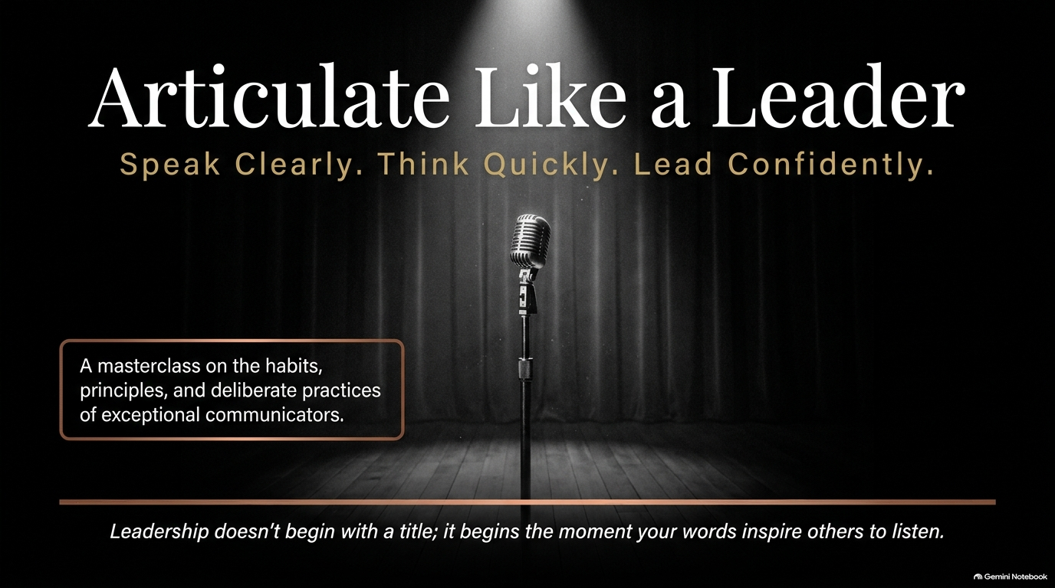
Notes:
Articulate Like a Leader: Speak Clearly, Think Quickly, Lead Confidently | Audiobook
https://www.youtube.com/watch?v=SF6KnkBLqA8

Slide 2
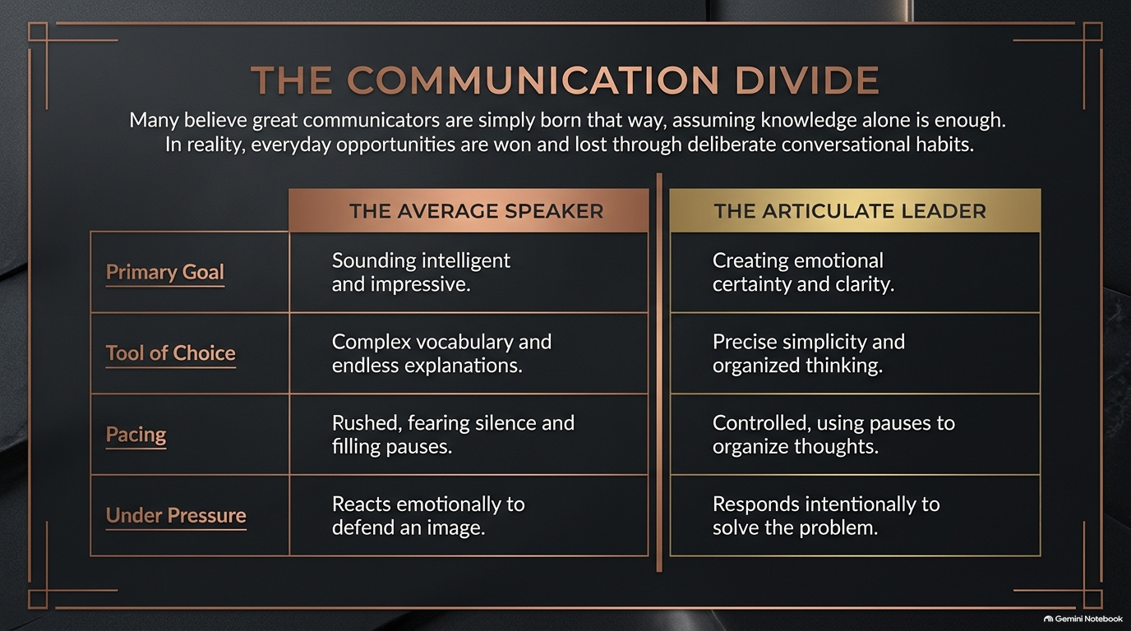
Notes:
Visual: A high-contrast comparative matrix dividing "The Average Speaker" (focus on sounding intelligent, complex vocabulary, rushed pacing, defensive reactions) from "The Articulate Leader" (creating certainty, precise simplicity, controlled pauses, intentional problem-solving).
Suggested Speaking Time: 3–5 minutes
Speaker Notes:
"To understand where we must grow, we first have to analyze The Communication Divide. Every single day, critical opportunities are won or lost in meetings, negotiations, and casual hallway conversations based on which side of this line you operate on.
Let's look at the four fundamental shifts:
Primary Goal: The average speaker is preoccupied with self-preservation. Their primary goal is sounding intelligent, impressive, or clever. The Articulate Leader abandons ego. Their goal is creating emotional certainty and total clarity for their team.
Tool of Choice: The average speaker leans on complex corporate jargon, acronyms, and endless explanatory loops. They mistake complexity for intelligence. The Articulate Leader uses precise simplicity and structured thinking—making difficult concepts effortlessly digestible.
Pacing: The average speaker speaks at the speed of anxiety. They fear silence, rushing through sentences and filling every gap with 'um', 'ah', or 'you know'. The Articulate Leader commands time. They use deliberate 2-second pauses to organize their thoughts before uttering a single word.
Under Pressure: When challenged, the average speaker reacts emotionally to defend their image or ego. The Articulate Leader responds intentionally to solve the core problem.
As we proceed today, ask yourself: Which column reflects your default behavior when the pressure turns up?"

Slide 3
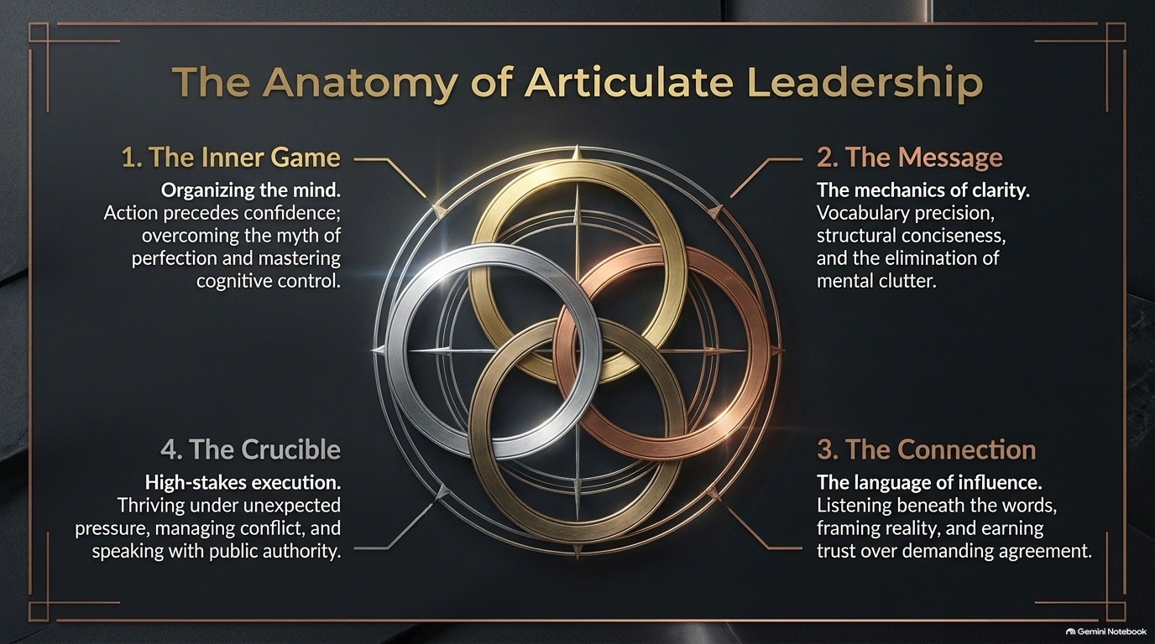
Notes:
Visual: An elegant 4-ring interconnected armillary design linking the four pillars of the curriculum: 1. The Inner Game, 2. The Message, 3. The Connection, and 4. The Crucible.
Suggested Speaking Time: 4–5 minutes
Speaker Notes:
"To master elite communication, we must approach it as an integrated ecosystem. This is The Anatomy of Articulate Leadership, structured into four distinct domains:
Domain 1: The Inner Game (Organizing the Mind). Communication is a downstream reflection of your cognitive state. If your mind is cluttered, anxious, or chasing perfectionism, your speech will be disjointed. We must master cognitive control and realize that action precedes confidence.
Domain 2: The Message (Mechanics of Clarity). This is the structural engineering of your words—vocabulary precision, eliminating verbal clutter, and using frameworks like the Inverted Pyramid and the Rule of Three to deliver razor-sharp points.
Domain 3: The Connection (Language of Influence). Language is a bridge, not a hammer. Here we focus on active listening, reading unspoken signals, framing reality constructively, and earning genuine trust rather than demanding compliance.
Domain 4: The Crucible (High-Stakes Execution). How do you perform when everything goes wrong? In this domain, we build the protocols for thinking quickly under fire, handling hostile Q&A, managing conflict, and speaking with public authority.
Each ring reinforces the others. When all four are aligned, your executive presence becomes unshakeable."

Slide 4
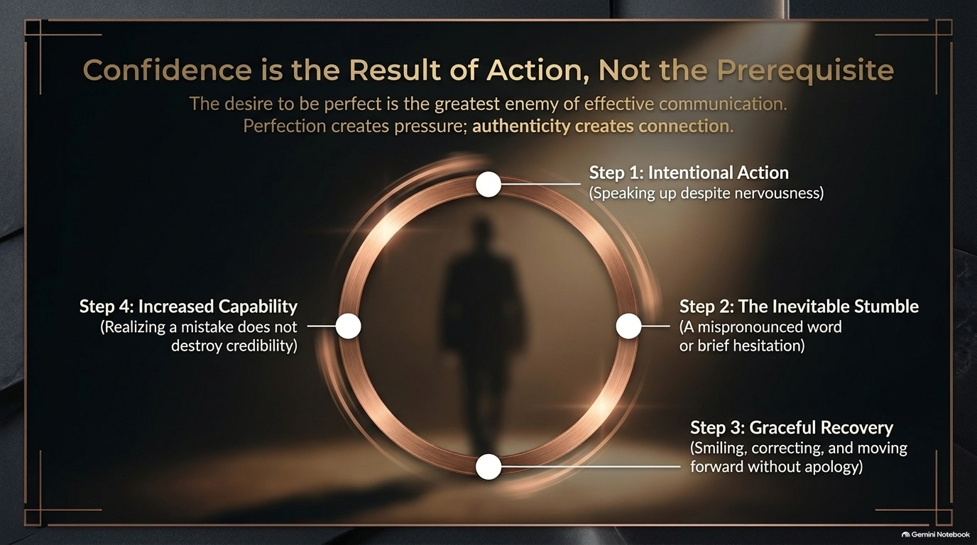
Notes:
Visual: A continuous circular process flow outlining the confidence loop: Step 1: Intentional Action $\rightarrow$ Step 2: The Inevitable Stumble $\rightarrow$ Step 3: Graceful Recovery $\rightarrow$ Step 4: Increased Capability.
Suggested Speaking Time: 4–5 minutes
Speaker Notes:
"Let's enter Domain 1: The Inner Game, starting with the greatest psychological hurdle in public speaking: waiting to 'feel confident' before you speak up.
Here is the reality: Confidence is the result of action, not the prerequisite. If you wait until all nervousness disappears before raising your hand or taking the stage, you will wait your entire life.
Notice the confidence cycle on this slide:
Step 1: Intentional Action. You choose to speak up despite feeling physical nervousness—heart racing, shallow breath. You step into the discomfort.
Step 2: The Inevitable Stumble. Because you are human, you will eventually stumble—mispronounce a word, lose your place for a split second, or pause.
Step 3: Graceful Recovery. Here is where leaders are separated from amateurs. Amateurs panic, over-apologize, and highlight their mistake. Leaders smile, correct the word cleanly, and keep moving forward without an apology.
Step 4: Increased Capability. Your brain registers a profound lesson: 'I made a mistake, the room didn't collapse, and my credibility remains intact.' That realization expands your psychological capacity.
The desire to be perfect is the absolute enemy of effective communication. Perfection creates crippling pressure; authenticity creates real human connection."

Slide 5
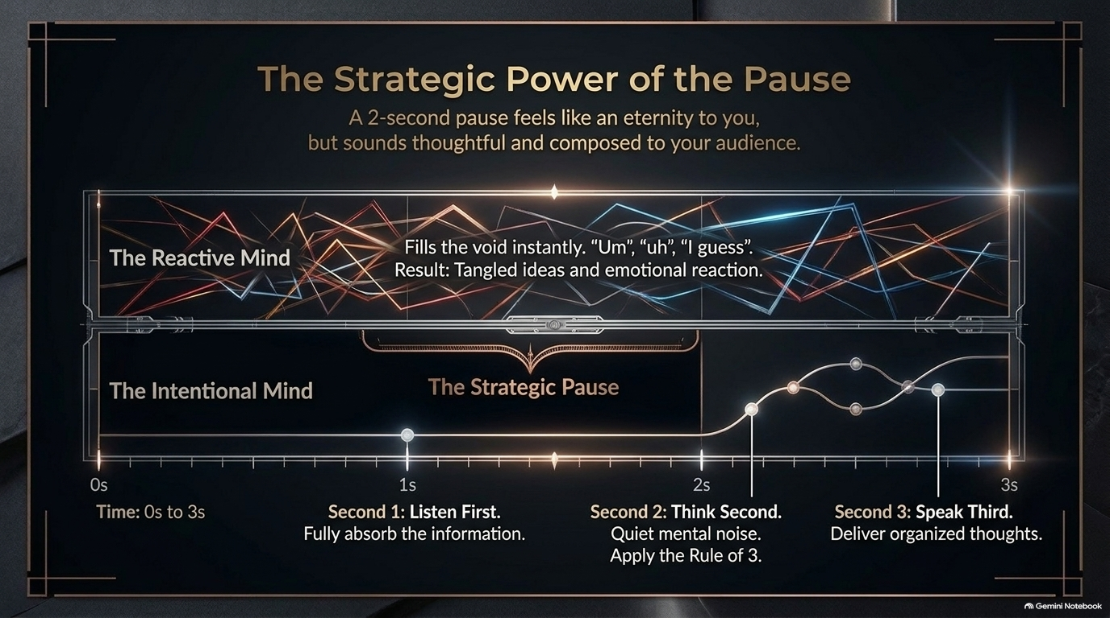
Notes:
Visual: A stark dual timeline comparing "The Reactive Mind" (chaotic, tangled signal lines filling space with "um/uh") against "The Intentional Mind" (a clean, calm line executing a 2-second Strategic Pause broken down into: Second 1: Listen, Second 2: Think, Second 3: Speak).
Suggested Speaking Time: 4–6 minutes
Speaker Notes:
"If you take only one practical mechanic away from today's session, let it be this: Master the 2-Second Strategic Pause.
Look at the timeline contrast on the slide:
When asked a difficult question, The Reactive Mind panics at the silence. To the speaker, a one-second pause feels like an eternity of awkwardness. So their nervous system forces out immediate filler noise—'Um, well, uh, I guess, you know, what I mean is...' The result? Tangled ideas, lost authority, and an emotional reaction.
Now look at The Intentional Mind:
When a question is posed, the leader intentionally holds silence for 2 full seconds. To the audience, this pause does not look weak—it looks thoughtful, authoritative, and completely composed.
How do you use those 2 seconds?
Second 1: Listen First. Absorb the full question without formulating your answer while the other person is speaking.
Second 2: Think Second. Quiet the mental noise. Filter your thoughts into 1 to 3 key buckets.
Second 3: Speak Third. Open your mouth and deliver a clean, structured response.
Replace filler words with deliberate silence. Silence is not empty space; silence is leverage."

Slide 6
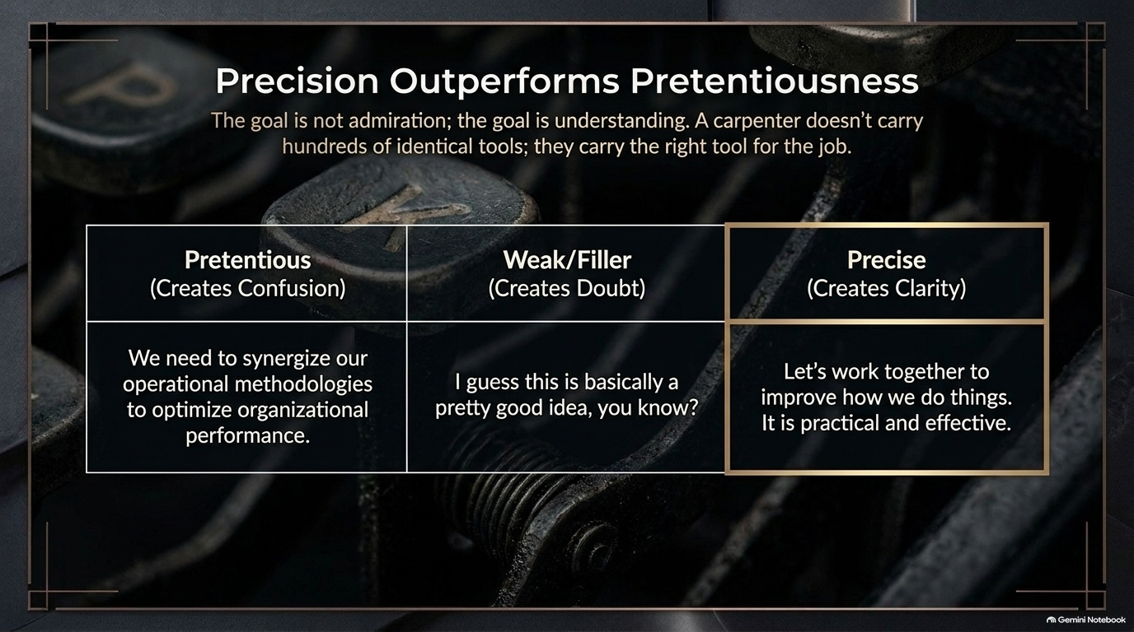
Notes:
Visual: A retro typewriter key background with a 3-column contrast table highlighting "Pretentious (Creates Confusion)", "Weak/Filler (Creates Doubt)", and "Precise (Creates Clarity)".
Suggested Speaking Time: 3–4 minutes
Speaker Notes:
"Now we transition to Domain 2: The Message. Our guiding principle here is simple: Precision outperforms pretentiousness.
Many corporate professionals believe that using complex multi-syllable jargon makes them sound senior. In reality, it masks a lack of clarity. A master carpenter doesn't carry hundreds of duplicate, obscure tools—they carry the exact right tool for the job.
Examine the three examples on screen:
The Pretentious Speaker: 'We need to synergize our operational methodologies to optimize organizational performance.' It sounds heavy, but what does it actually mean? It creates confusion and fatigue.
The Weak/Filler Speaker: 'I guess this is basically a pretty good idea, you know?' This leaks doubt and signals that you don't believe your own pitch.
The Precise Leader: 'Let's work together to improve how we do things. It is practical and effective.'
Your goal in communication is never admiration; your goal is total understanding. Strip away the corporate fluff, eliminate weak qualifiers, and choose precise, simple words that drive immediate action."

Slide 7
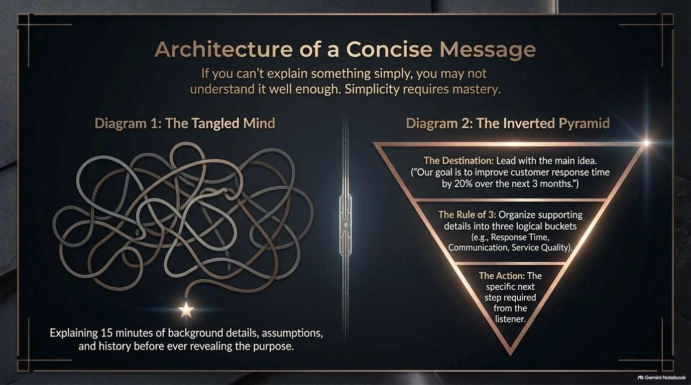
Notes:
Visual: Side-by-side diagrams contrasting "Diagram 1: The Tangled Mind" (a chaotic mess of overlapping loops trying to explain 15 minutes of background) with "Diagram 2: The Inverted Pyramid" (Destination/Main Idea $\rightarrow$ Rule of 3 Supporting Buckets $\rightarrow$ Specific Next Action).
Suggested Speaking Time: 4–5 minutes
Speaker Notes:
"Have you ever asked a colleague a simple status question, only to sit through a 15-minute history lesson before they finally answer? That is The Tangled Mind. They dump every background detail, assumption, and tangent onto you because their own thoughts are unstructured.
As Albert Einstein famously noted, if you can't explain something simply, you don't understand it well enough. Simplicity requires mastery.
To structure concise messages, utilize The Inverted Pyramid:
Start with The Destination (The Bottom Line First): Give your core conclusion or goal in the very first sentence. E.g., 'Our goal is to improve customer response time by 20% over the next 3 months.'
Apply The Rule of Three: Organize all supporting evidence or details into no more than three logical buckets (e.g., Bucket 1: Response Time, Bucket 2: Communication Tools, Bucket 3: Service Quality). The human brain is naturally hardwired to retain information in triads.
End with The Action: Define the exact next step required from the listener.
Flip your communication upside down: conclusions first, context second, action third."

Slide 8
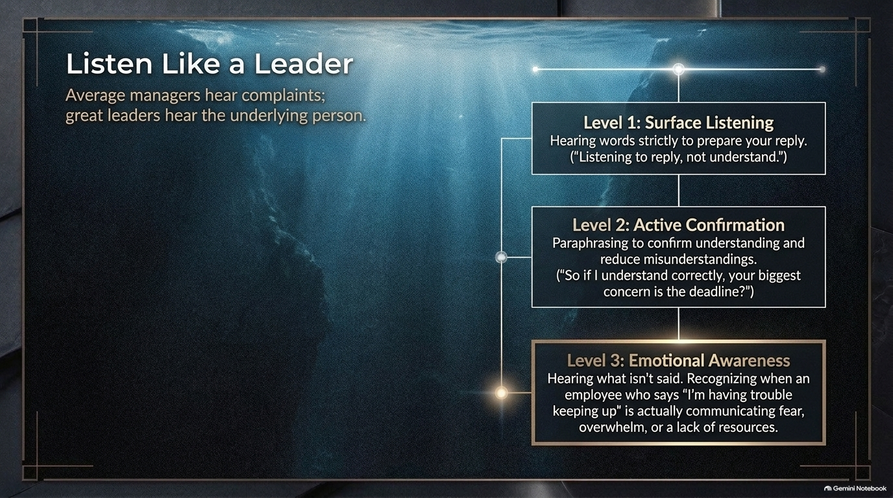
Notes:
Visual: An underwater oceanic gradient illustration showcasing the depth of listening levels: Level 1: Surface Listening (listening to reply), Level 2: Active Confirmation (paraphrasing), and Level 3: Emotional Awareness (hearing what isn't said).
Suggested Speaking Time: 4–5 minutes
Speaker Notes:
"We enter Domain 3: The Connection. Communication is a two-way emotional current, and your ability to influence relies on how deeply you listen.
Average managers hear complaints; great leaders hear the underlying human condition. Look at the three depth levels on this slide:
Level 1: Surface Listening. This is where 80% of poor communication happens. You are listening strictly to prepare your rebuttal or reply. You aren't processing their point; you are waiting for them to pause so you can talk.
Level 2: Active Confirmation. You paraphrase and play back their point to ensure zero misunderstandings. You say: 'So if I understand correctly, your biggest concern with this timeline is the development deadline?' This instantly lowers defensiveness.
Level 3: Emotional Awareness. You hear what isn't being said. When a team member says, 'I'm having trouble keeping up with these reports,' Level 1 managers criticize their efficiency. Level 3 leaders recognize the unspoken signals of fear, burnout, or systemic resource deficits.
Stop listening to respond. Start listening to understand."

Slide 9
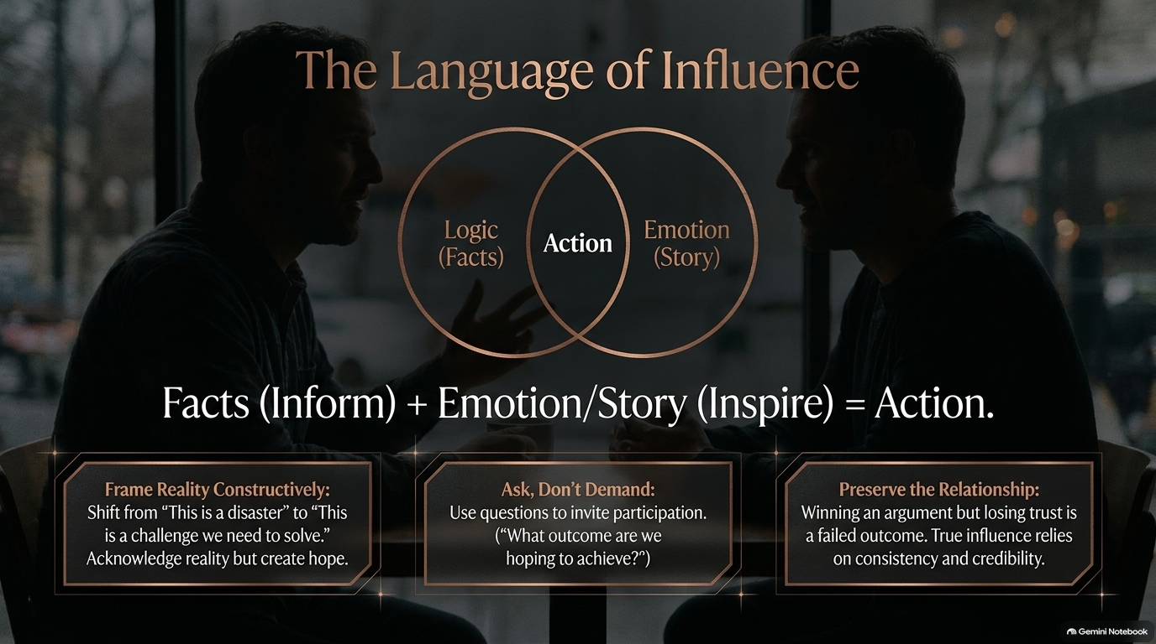
Notes:
Visual: A Venn diagram showing the intersection of Logic (Facts/Inform) and Emotion (Story/Inspire) creating Action, set over a dark, intimate conversational background, supported by 3 action cards.
Suggested Speaking Time: 4–5 minutes
Speaker Notes:
"How do you move people from passive agreement to decisive action? You use The Language of Influence.
Look at our formula: Facts (Inform) + Emotion/Story (Inspire) = Action.
If you rely strictly on logic, data, and spreadsheet numbers, you inform people, but you leave them cold. If you rely strictly on emotion and hype, you inspire people temporarily, but lack strategic rigor. Influence lives at the exact intersection where hard logic is animated by human purpose.
Here are three tactical rules to execute this:
Frame Reality Constructively: When crisis hits, shift the narrative from 'This is an absolute disaster' to 'This is a complex challenge we need to solve together.' Acknowledge grim reality, but inject hope and direction.
Ask, Don't Demand: Direct orders create compliance; thoughtful questions create ownership. Use questions like: 'What outcome are we hoping to achieve here?' or 'How can we solve this constraint?'
Preserve the Relationship: Winning an argument at the expense of destroying trust with a peer is a strategic failure. True influence prioritizes long-term credibility over short-term ego points."

Slide 10
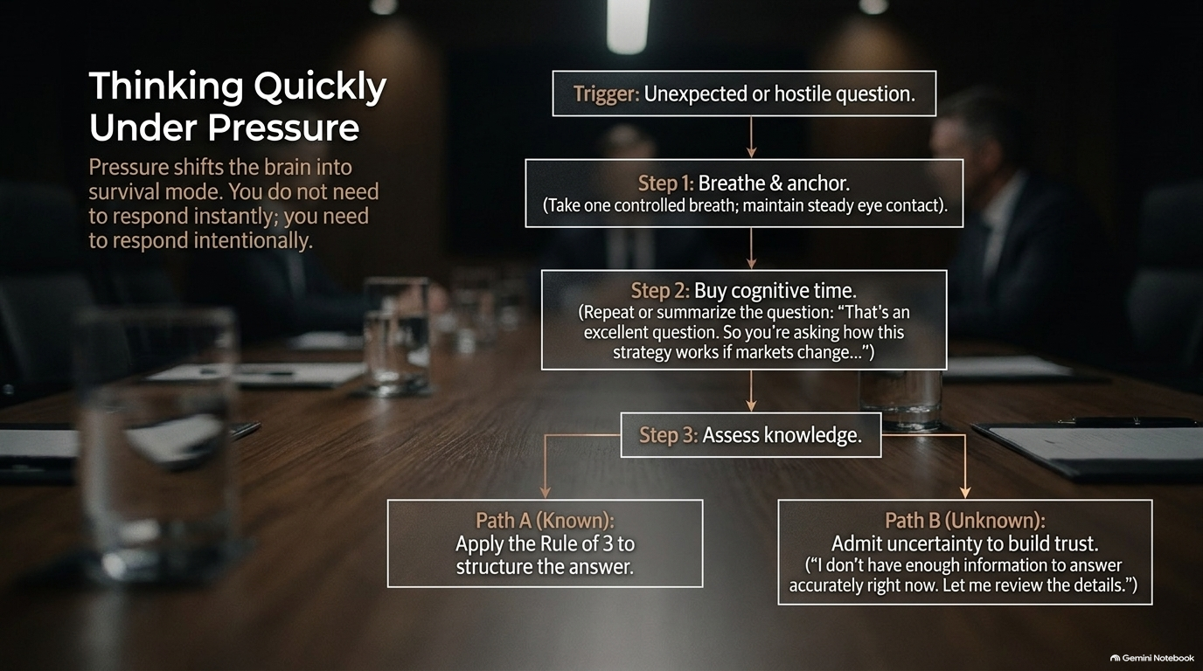
Notes:
Visual: A step-by-step decision tree set in a dark corporate boardroom: Trigger (Hostile/Unexpected Question) $\rightarrow$ Step 1: Breathe & Anchor $\rightarrow$ Step 2: Buy Cognitive Time $\rightarrow$ Step 3: Assess Knowledge $\rightarrow$ Path A (Known: Rule of 3) vs. Path B (Unknown: Admit uncertainty gracefully).
Suggested Speaking Time: 5–6 minutes
Speaker Notes:
"Welcome to Domain 4: The Crucible. This is where executive presence is tested under fire—in high-stakes boardrooms, hostile media Q&A, or sudden organizational crises.
When an unexpected or aggressive question is thrown at you, your brain's amygdala triggers a fight-or-flight response, flooding your system with adrenaline. You do not need to respond instantly; you need to respond intentionally.
Follow this 3-step decision protocol:
Step 1: Breathe & Anchor. Take one controlled breath to reset your heart rate and maintain steady, calm eye contact.
Step 2: Buy Cognitive Time. Repeat or summarize the question back to the room. Say: 'That's an important question. So you're asking how this strategy holds up if market conditions shift next quarter...' This buys your prefrontal cortex 3 to 5 crucial seconds to structure a logical response.
Step 3: Assess Knowledge:
If you know the answer (Path A): Apply the Rule of 3. Give three concise points and stop talking.
If you do NOT know the answer (Path B): Never bluff or make up facts. Bluffing destroys credibility instantly. Say: 'I don't have enough verified data to answer that accurately right now. Let me review the details with the team and get back to you by 3 PM.' Admitting uncertainty with composure builds immense trust."

Slide 11
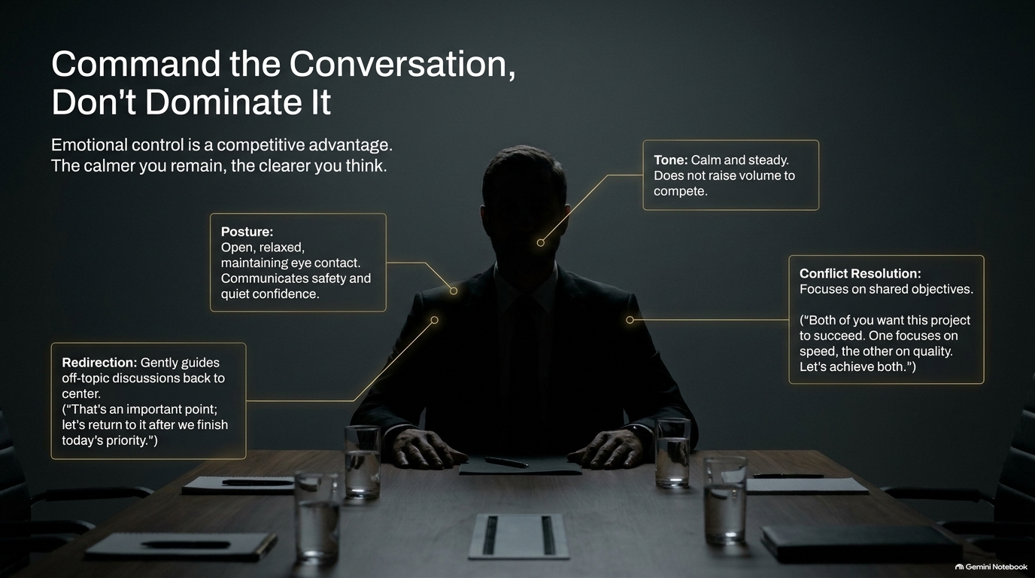
Notes:
Visual: A dark silhouette of an executive sitting at the head of a conference table, annotated with key presence callouts: Tone (calm/steady), Posture (open/relaxed), Redirection ("let's return to..."), and Conflict Resolution (focus on shared objectives).
Suggested Speaking Time: 4–5 minutes
Speaker Notes:
"There is a massive distinction between dominating a room and commanding a conversation. Dominating is loud, aggressive, and insecure. Commanding is quiet, centered, and emotionally controlled.
Emotional control is a competitive advantage in business. The calmer you remain, the clearer you think, and the more the room gravitates toward your voice.
Look at the execution anchors on this slide:
Tone: Keep your tone calm and steady. Never raise your volume to compete with a shouting colleague. When someone raises their voice, lower yours slightly—it forces the room to quiet down to hear you.
Posture: Maintain an open, relaxed posture with stable eye contact. Tension in your shoulders communicates insecurity.
Redirection: When discussions derail into unproductive side-arguments, step in as the air-traffic controller: 'That is an important point; let's log that and return to it after we finish today's primary objective.'
Conflict Resolution: Reframe disputes around shared goals: 'Both of you want this product launch to succeed. One is focused on speed, the other on quality. Let's align on how we achieve both.'"

Slide 12
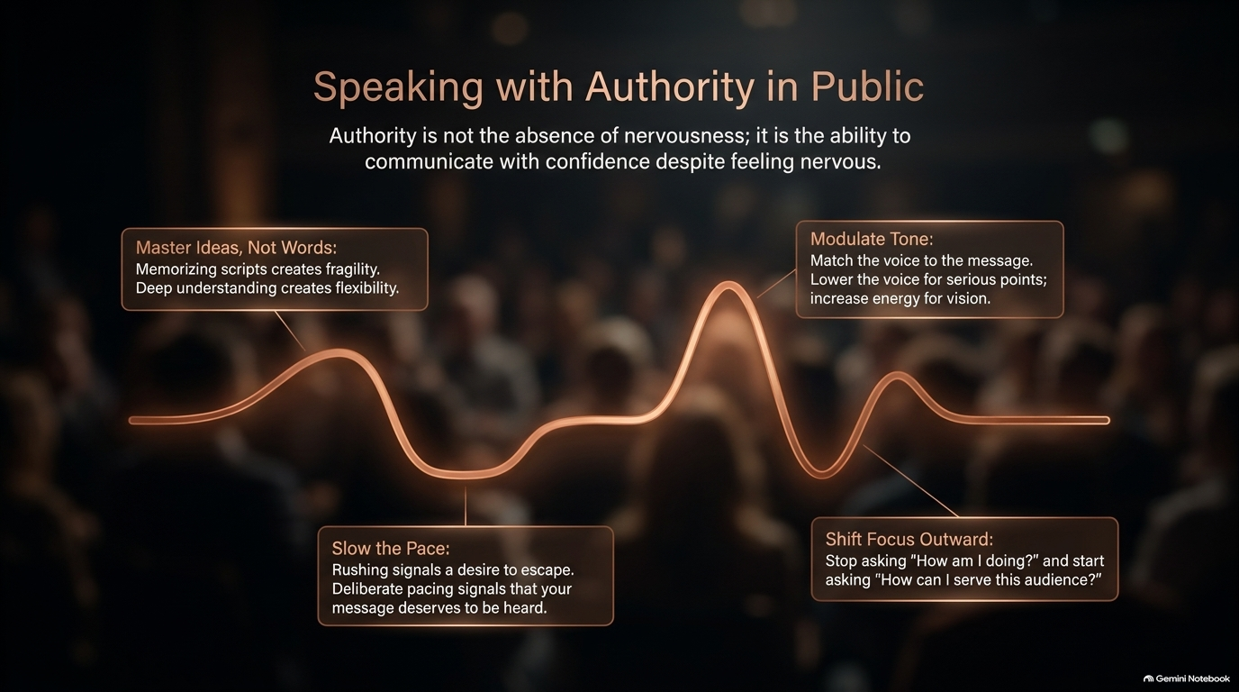
Notes:
Visual: A blurred background of a large audience with a glowing orange soundwave landscape, highlighting four principles: 1. Master Ideas, Not Words, 2. Slow the Pace, 3. Modulate Tone, 4. Shift Focus Outward.
Suggested Speaking Time: 4–5 minutes
Speaker Notes:
"When you step onto a public stage or present to a large audience, authority is not the total absence of nervousness—it is the ability to communicate with compelling confidence despite feeling nervous.
Master these four vocal anchors:
Master Ideas, Not Words: Never memorize a presentation word-for-word. Script memorization creates extreme fragility—if you forget one sentence, your entire talk collapses. Memorize your core concepts and narrative flow so you can adapt dynamically.
Slow the Pace: When nervous, human instinct tells us to speak faster to escape the stage. Rushing signals panic. Deliberate, measured pacing signals that your message deserves space and attention.
Modulate Tone: Match your vocal register to the emotional weight of your content. Drop your volume and pitch for serious operational points; raise your energy and resonance when sharing vision and future strategy.
Shift Focus Outward: Public speaking anxiety occurs when your focus is internal: 'How do I look? Is my voice shaking? Do they like me?' Shift your focus 100% outward to service: 'How can I help this audience solve their problem today?'"

Slide 13
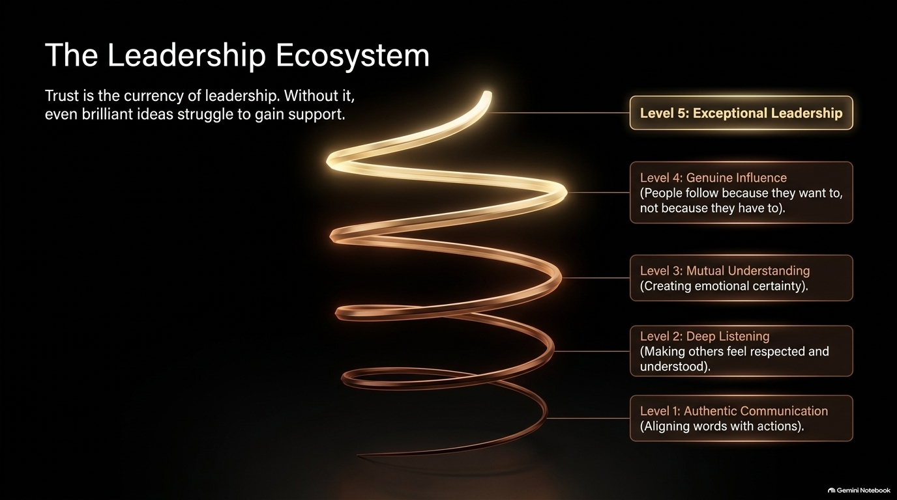
Notes:
Visual: A 3D glowing spiral staircase ascending through five distinct levels: Level 1: Authentic Communication $\rightarrow$ Level 2: Deep Listening $\rightarrow$ Level 3: Mutual Understanding $\rightarrow$ Level 4: Genuine Influence $\rightarrow$ Level 5: Exceptional Leadership.
Suggested Speaking Time: 4–5 minutes
Speaker Notes:
"Communication is not an isolated trick; it is the core driver of The Leadership Ecosystem. Trust is the absolute currency of leadership. Without trust, even the most brilliant strategies fail to gain traction.
Look at how authority ascends this staircase:
Level 1 begins with Authentic Communication: Aligning your daily words with your actual actions. Zero hypocrisy.
Level 2 reaches Deep Listening: Making your team, peers, and clients feel genuinely respected, heard, and validated.
Level 3 creates Mutual Understanding: Establishing emotional certainty and shared operational clarity across departments.
Level 4 yields Genuine Influence: People no longer follow you because of your title or because they have to; they follow you because they want to.
Level 5 achieves Exceptional Leadership: Where your voice and vision build a self-sustaining culture of excellence.
Every conversation you have today is either moving you up or down this staircase."

Slide 14
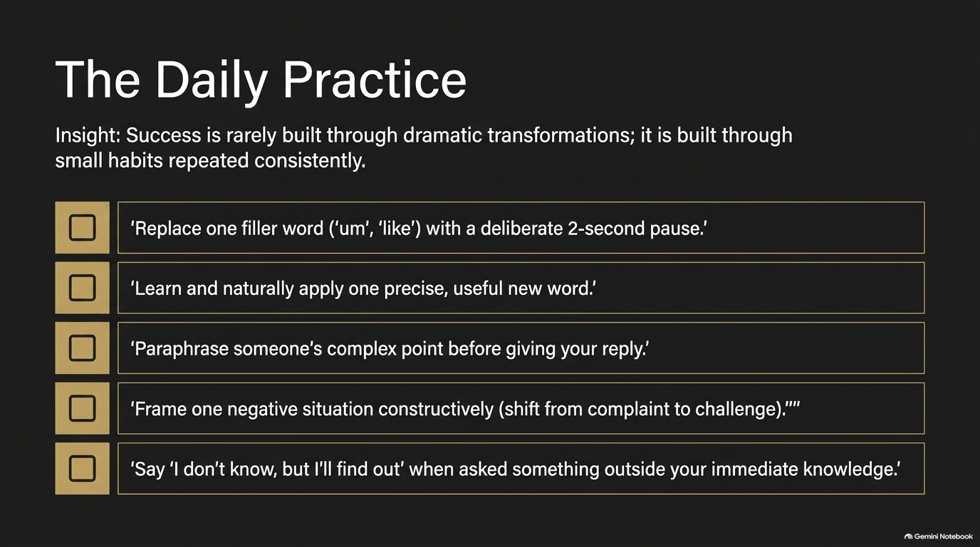
Notes:
Visual: An executive checklist detailing 5 daily actionable micro-habits for continuous improvement.
Suggested Speaking Time: 3–4 minutes
Speaker Notes:
"Transformations rarely happen overnight through dramatic breakthroughs. Executive mastery is built through small, deliberate habits repeated consistently every single day.
Here is your Daily Practice Checklist to implement starting tomorrow morning:
Habit 1: In your very next meeting, identify your default filler words ('um', 'like', 'ah') and intentionally replace just one of them with a clean 2-second pause.
Habit 2: Learn and naturally apply one precise, high-value new word in context each week to expand your precision vocabulary.
Habit 3: Practice Level 2 listening—paraphrase someone's complex point back to them to confirm understanding before offering your reply.
Habit 4: Frame one negative situation constructively. When a crisis breaks, consciously shift your language from a complaint to a problem-solving challenge.
Habit 5: When asked something outside your immediate knowledge, comfortably say: 'I don't know, but I will find out and follow up with you.'
Select two of these micro-habits to focus on this week."

Slide 15
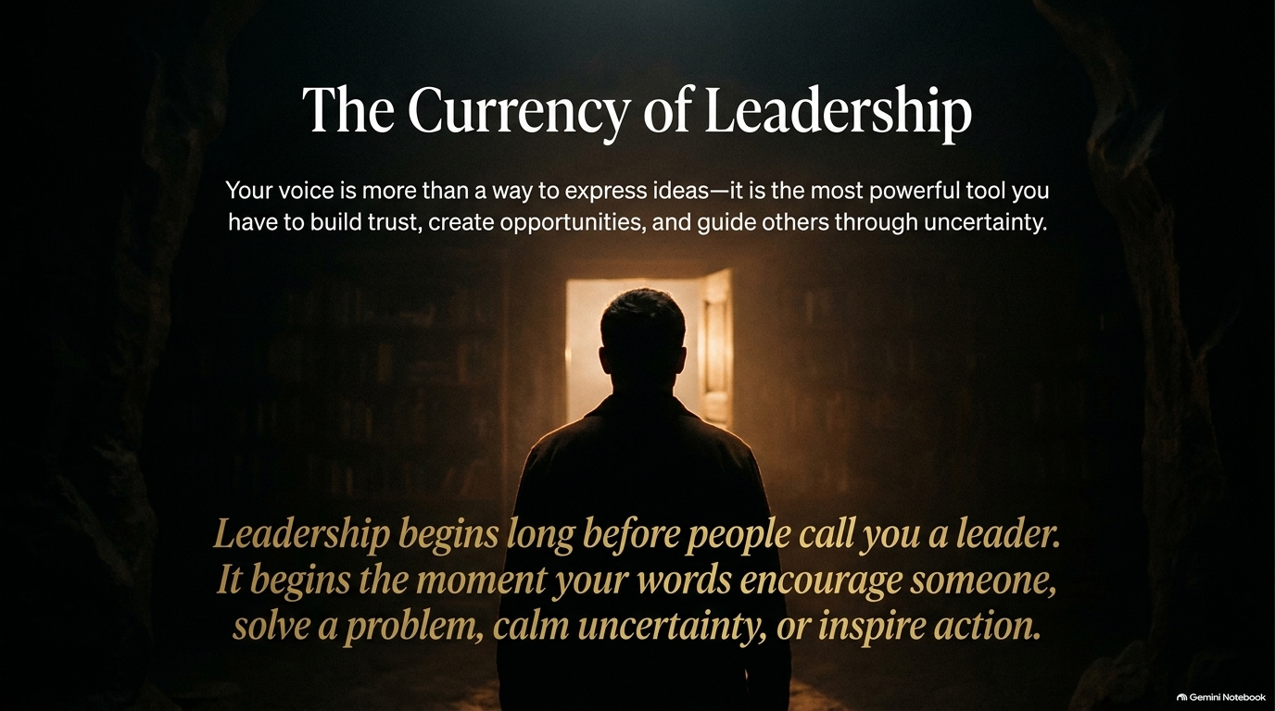
Notes:
Visual: A dark silhouette of a person standing at a threshold looking into a warm, brightly illuminated golden doorway, accompanied by inspiring callout text.
Suggested Speaking Time: 2–3 minutes
Speaker Notes:
"As we prepare for our final summary, look at this image. Your voice is far more than a mechanism for transmitting information—it is the single most powerful tool you possess to build unshakeable trust, create career opportunities, and guide others through uncertainty.
Leadership begins long before people call you a leader.
It begins the exact moment your words encourage someone who is struggling, solve a complex operational problem, calm organizational anxiety, or inspire a team to take decisive action.
You do not need to wait for a promotion to step into this presence. You can choose to speak like an articulate leader in your very next conversation."

Slide 16
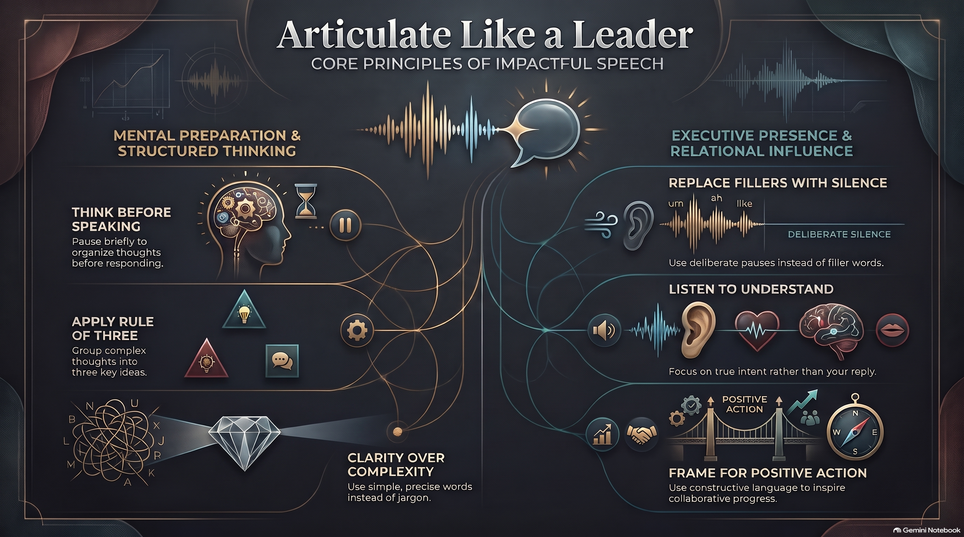
Notes:
Visual: A rich, comprehensive executive summary graphic dividing the core curriculum into two main pillars: "Mental Preparation & Structured Thinking" (Think Before Speaking, Apply Rule of 3, Clarity Over Complexity) and "Executive Presence & Relational Influence" (Replace Fillers with Silence, Listen to Understand, Frame for Positive Action).
Suggested Speaking Time: 4–6 minutes
Speaker Notes:
"To synthesize our entire masterclass, let's review our Executive Core Principles Dashboard. Use this slide as your mental blueprint for future preparation:
Pillar 1: Mental Preparation & Structured Thinking (Left Panel)
Think Before Speaking: Execute the 2-second strategic pause to quiet mental noise and organize your thoughts before opening your mouth.
Apply the Rule of Three: Group complex ideas into three digestible buckets to maximize retention and clarity.
Clarity Over Complexity: Eliminate corporate jargon and weak filler phrases. Choose precise, simple vocabulary.
Pillar 2: Executive Presence & Relational Influence (Right Panel)
Replace Fillers with Silence: Weaponize silence to project confidence, control pacing, and eliminate 'um' and 'uh'.
Listen to Understand: Move from surface listening to deep emotional awareness, hearing the unspoken needs of your audience.
Frame for Positive Action: Use constructive, forward-looking language to de-escalate conflict and inspire collaborative progress.
Master these principles, commit to the daily micro-habits, and go lead with confidence. Thank you very much."

