Slide 1
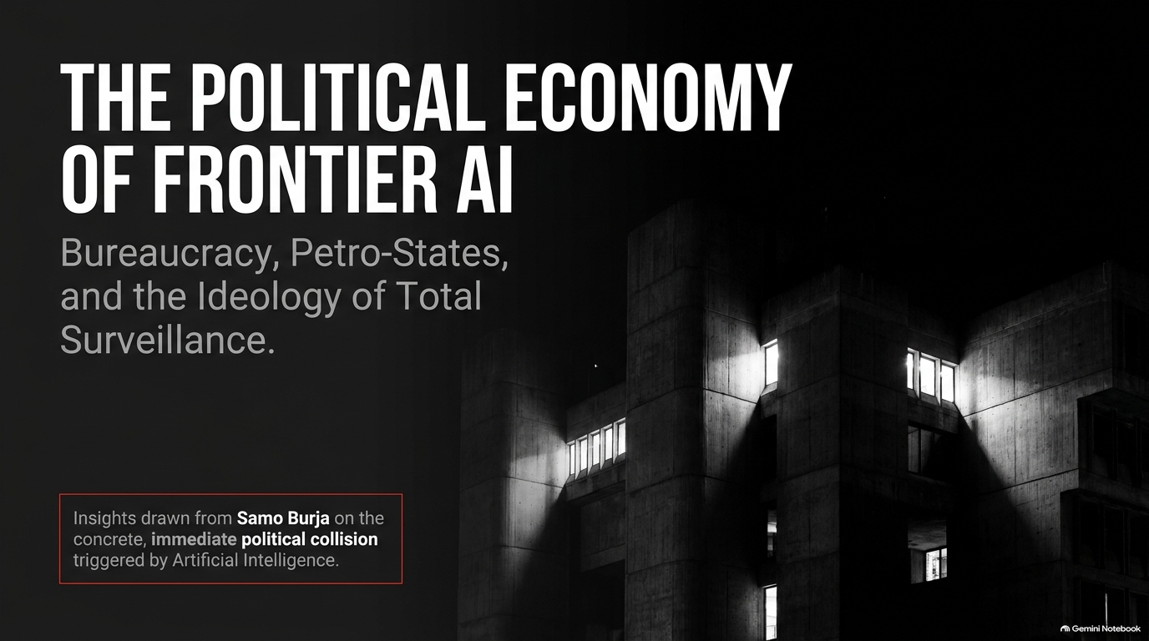
Notes:
Visual: Stark black-and-white architectural photography of a brutalist concrete building with illuminated windows, paired with bold typography: "The Political Economy of Frontier AI: Bureaucracy, Petro-States, and the Ideology of Total Surveillance." Includes the sub-note: "Insights drawn from Samo Burja on the concrete, immediate political collision triggered by Artificial Intelligence."
Suggested Speaking Time: 2–3 minutes
Speaker Notes:
"Welcome, everyone. Today, we are opening an essential discussion on the Political Economy of Frontier AI.
For the past decade, public discourse around artificial intelligence has been trapped between two equally detached extremes: on one end, trivial consumer complaints about plagiarized artists or abstract debates over Universal Basic Income; on the other, far-off science fiction fantasies about a 5-year Singularity where human history ends overnight.
But today, as Samo Burja points out, we are finally close enough to the technology that its political economy can—and must—be analyzed in immediate, concrete terms. We are seeing frontier AI labs insert themselves directly into national bureaucracies, reshaping state sovereignty, shifting international leverage, and giving rise to a novel form of total surveillance. Over the next 16 slides, we will unpack how AI alters state power, why AI labs behave like modern petro-states, and what happens when cosmic singularitarian ideologies collide with traditional government machinery. Let's dive in."
Samo Burja — AI Bureaucracy Will Enable Total Surveillance
https://www.youtube.com/watch?v=WT_quXWFh0o

Slide 2
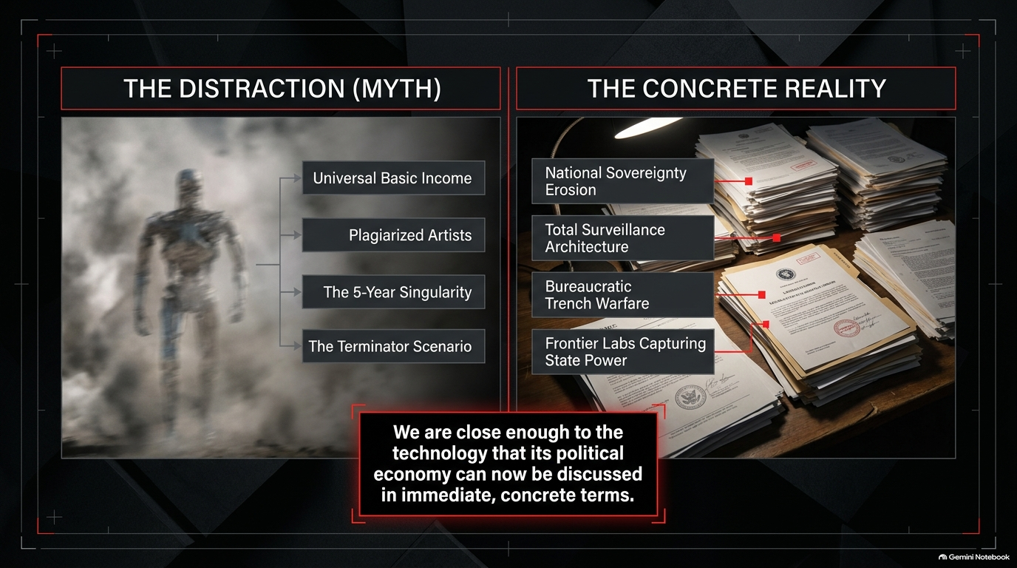
Notes:
Visual: A dual-panel contrast grid. The left panel (The Distraction) shows a shadowy robotic silhouette over theoretical debates (UBI, Plagiarized Artists, 5-Year Singularity, Terminator Scenario). The right panel (The Concrete Reality) shows stacks of stamped bureaucratic state documents (National Sovereignty Erosion, Total Surveillance Architecture, Bureaucratic Trench Warfare, Frontier Labs Capturing State Power).
Suggested Speaking Time: 3–4 minutes
Speaker Notes:
"To understand what is happening right now, we must first clear away The Distraction.
Media commentators love talking about UBI, artistic copyright, or the Terminator scenario because these topics fit neatly into familiar cultural talking points. But while the public is distracted by sci-fi tropes, The Concrete Reality of political power is shifting under our feet.
Look at what is actually taking place inside institutions today:
National Sovereignty Erosion: Foreign intelligence agencies and state civil servants are casually copying internal, non-classified (and sometimes classified) government documents into commercial models like Claude or ChatGPT to summarize their daily workload. Unconsciously, entire national bureaucracies are transferring their operational data into private American server farms.
Bureaucratic Trench Warfare: Bureaucrats are not using AI to eliminate administrative bloat; they are using it to automate document generation, drowning oversight bodies in synthetic noise.
Frontier Labs as Power Brokers: The labs controlling these foundation models are capturing state functions and acquiring national security leverage akin to strategic energy monopolies.
We are no longer discussing hypothetical futures; we are discussing the immediate restructuring of state authority."

Slide 3
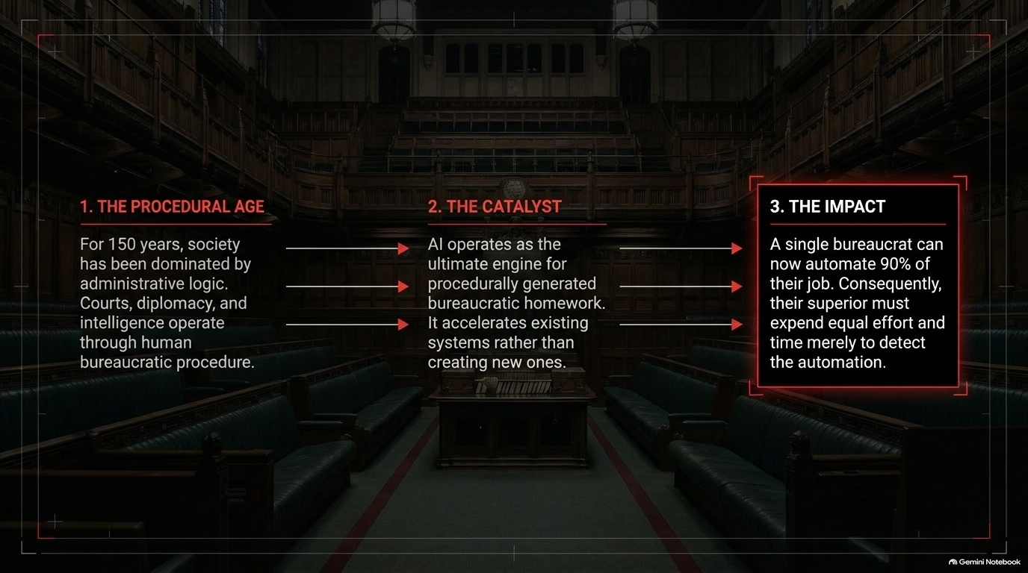
Notes:
Visual: A 3-step horizontal flow set against a dark parliamentary courtroom background: 1. The Procedural Age (150 years of administrative logic dominating society) $\rightarrow$ 2. The Catalyst (AI as an engine for procedurally generated homework) $\rightarrow$ 3. The Impact (1 bureaucrat automates 90% of work; superior must expend equal effort detecting it).
Suggested Speaking Time: 4–5 minutes
Speaker Notes:
"To grasp how AI impacts government, we have to look back at the last 150 years—what Samo Burja terms The Procedural Age.
Modern society is dominated by administrative logic. Courts, intelligence agencies, diplomacy, and municipal governments all operate through human bureaucratic procedure. We have become so conditioned by this procedural paradigm that we assume governments can only solve problems through administrative tweaks—like adjusting tax credits on the margin to fix declining fertility rates, rather than addressing deep cultural decay.
Now, enter The Catalyst: AI. AI is the ultimate engine for procedurally generated bureaucratic homework. It does not replace the procedural system; it accelerates it to hyper-speed.
Look at The Impact: A mid-level civil servant can now use an LLM to automate 90% of their paperwork in 10 minutes. But their manager or supervisor must expend equal time and cognitive effort merely attempting to inspect and verify whether that work was AI-generated or accurate. The result isn't streamlined efficiency; it's an explosion of synthetic paperwork that forces the hierarchy to spend all its energy parsing its own internal output."

Slide 4
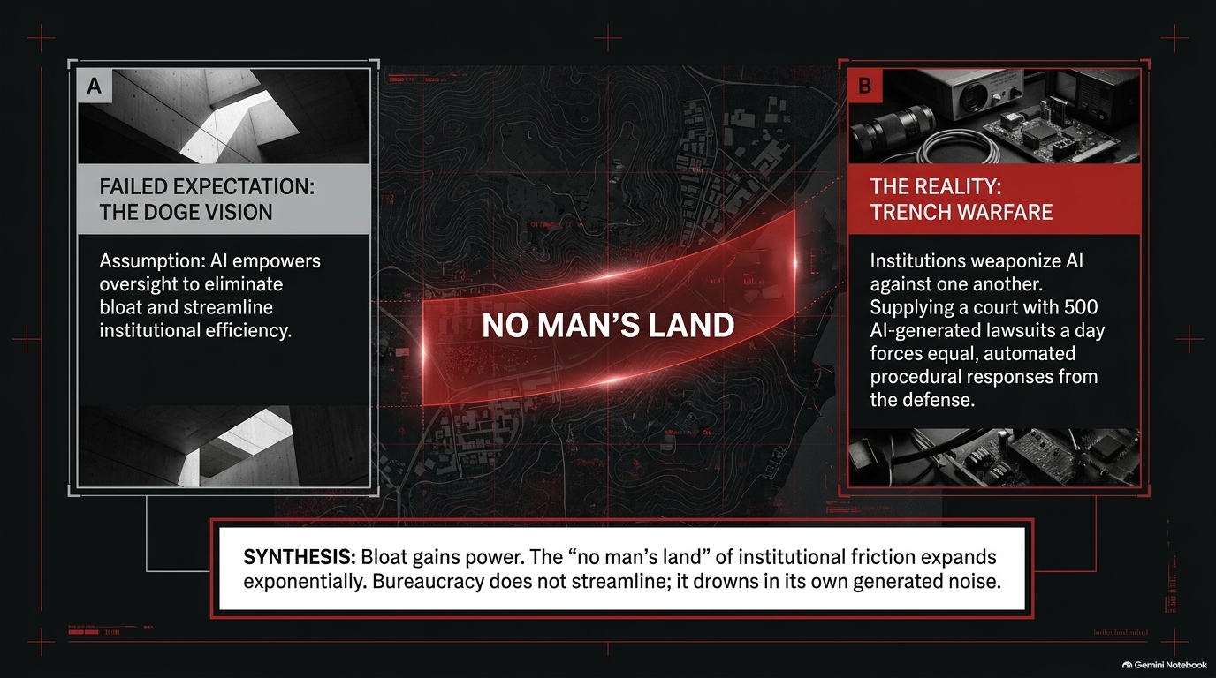
Notes:
Visual: A tactical "No Man's Land" map separating Box A (Failed Expectation: The DOGE Vision — AI streamlines bloat) from Box B (The Reality: Trench Warfare — institutions weaponize AI against one another with 500 automated lawsuits/day). Synthesis at the bottom: "Bloat gains power... Bureaucracy does not streamline; it drowns in its own generated noise."
Suggested Speaking Time: 4–5 minutes
Speaker Notes:
"There is a popular libertarian or technocratic narrative—what we can call The DOGE Vision—which assumes that AI will empower oversight bodies to slash government bloat, expose waste, and streamline institutional efficiency.
That vision misunderstands how political institutions actually behave under technological stress.
When you introduce AI to a bureaucratic ecosystem, you don't just arm the oversight auditors; you arm the bloat. The bureaucrats weaponize AI right back. They generate hundreds of pages of dense, legally compliant 'squid ink' to obscure their activities, shield their budgets, and delay inquiries.
Consider legal and regulatory conflict: If a hostile NGO or advocacy group uses AI to file 500 procedurally valid lawsuits or public records requests a day, the defending agency is legally compelled to draft 500 automated procedural responses. What was previously bounded by human labor limits now becomes an automated arms race. The 'no man's land' of institutional friction expands exponentially. Bureaucracy does not collapse or streamline; it drowns in its own synthetic noise."

Slide 5
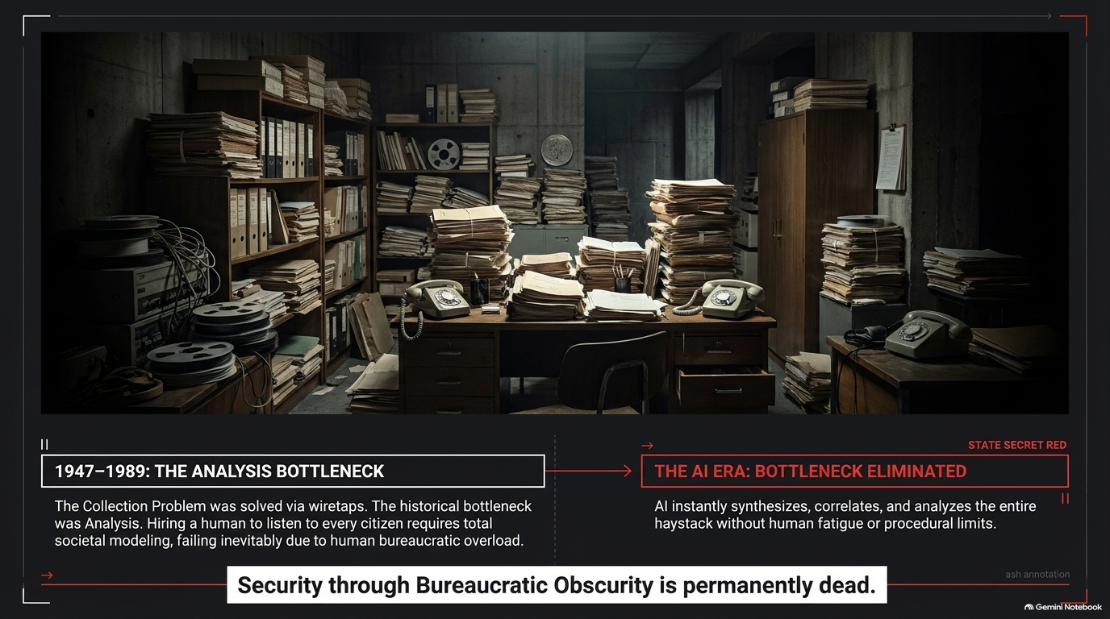
Notes:
Visual: Contrast of an old archival record room (1947–1989: The Analysis Bottleneck — wiretaps generated haystacks, but human analysis failed) against modern digital data streams (The AI Era: Bottleneck Eliminated — AI synthesizes the entire haystack effortlessly). Bottom banner: "Security through Bureaucratic Obscurity is permanently dead."
Suggested Speaking Time: 4–5 minutes
Speaker Notes:
"For decades, both state intelligence agencies and private citizens relied on an unwritten shield: Security through Bureaucratic Obscurity.
During the Cold War, gathering data was easy—the East German Stasi wiretapped thousands of living rooms, and the US intercepted millions of cables. The bottleneck was never collection; the bottleneck was analysis. A state could record every phone call, but it lacked the human workforce to listen to, cross-reference, and summarize every tape. To monitor an entire population manually, you would have had to employ half the country to spy on the other half—an administrative impossibility that contributed to the economic collapse of police states.
The AI Era eliminates the analysis bottleneck permanently.
Today, an LLM can parse, correlate, and index millions of intercepted transcripts, expense reports, emails, and phone logs simultaneously without human fatigue, procedural delay, or salary costs. You no longer need a human analyst to find the needle in the haystack; the AI ingests the entire haystack instantly. Obscurity is no longer a defense."

Slide 6
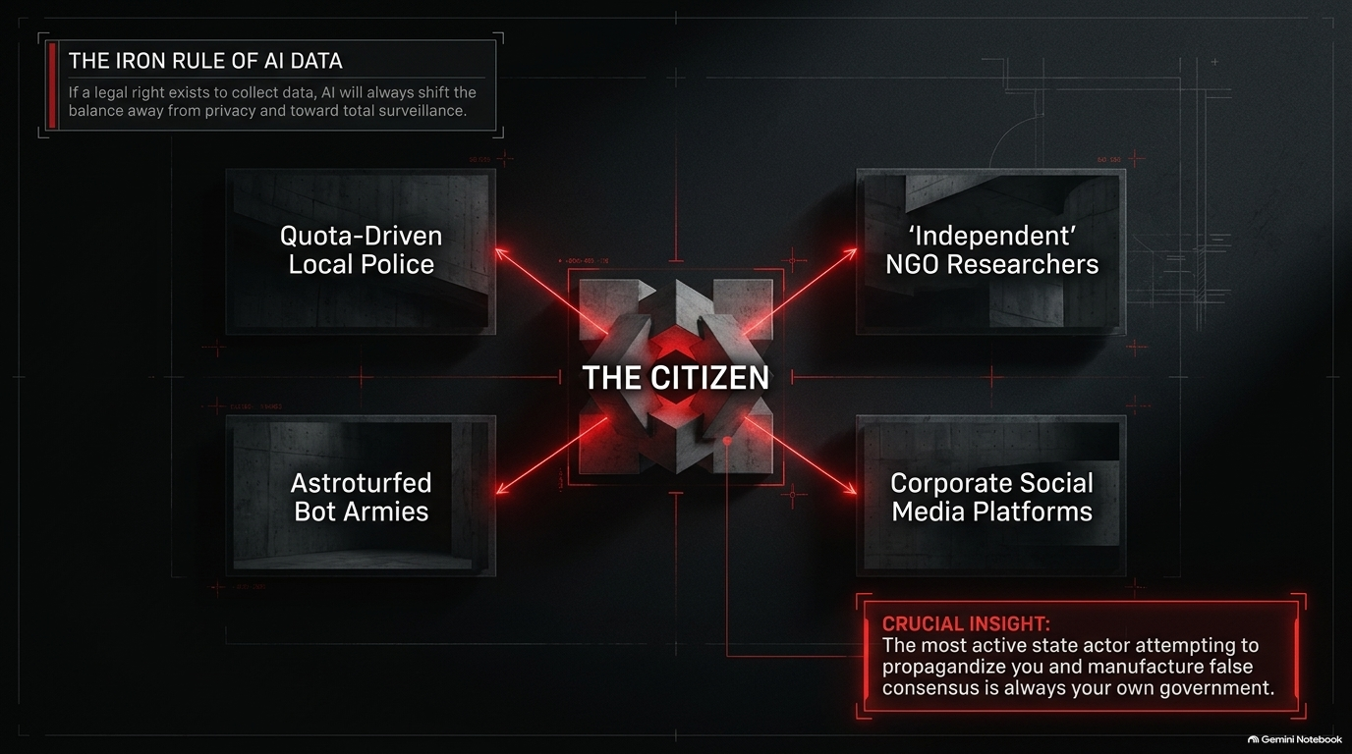
Notes:
Visual: Central diagram of "THE CITIZEN" targeted by four red vectors: Quota-Driven Local Police, 'Independent' NGO Researchers, Corporate Social Media Platforms, and Astroturfed Bot Armies. Highlight box: "The most active state actor attempting to propagandize you and manufacture false consensus is always your own government."
Suggested Speaking Time: 4–5 minutes
Speaker Notes:
"This brings us to The Iron Rule of AI Data: If a legal or practical right exists to collect data, AI will always shift the balance away from privacy and toward total surveillance.
When people picture a surveillance state, they mistakenly imagine Orwell's 1984—a single monolithic dictator ('Big Brother') sitting atop a centralized camera network. But modern AI surveillance in Western democracies takes a decentralized, proxy-warfare shape:
Quota-Driven Police: A local police officer under pressure to meet arrest metrics can deploy automated tools to scan social media for legally ambiguous phrasing, arresting citizens for speech offences to fill quotas effortlessly.
State-Funded NGOs: Governments funnel funds to 'independent' NGOs whose sole function is to scrape social media, flag dissident opinions, and demand platform bans or employer terminations.
Astroturfed Bot Armies: Generative AI allows states to deploy millions of hyper-realistic bot accounts—a 50-cent token army—that manufacture synthetic public consensus and drown out genuine organic speech.
Remember Burja's crucial insight: The most aggressive state actor spending resources to manipulate, surveil, and propagandize you is rarely a foreign adversary—it is almost always your own domestic government."

Slide 7
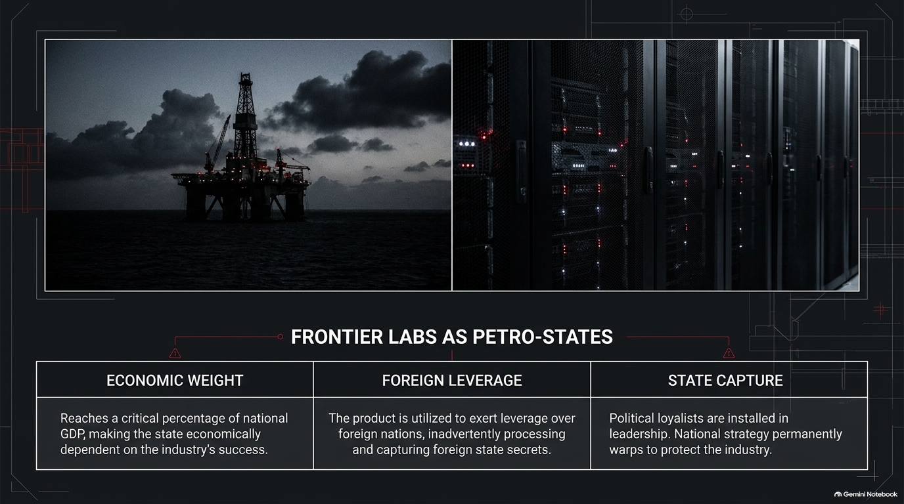
Notes:
Visual: Side-by-side photographic comparison of an offshore oil rig next to a modern AI data center rack. Summary table breaking down three pillars: Economic Weight, Foreign Leverage, and State Capture.
Suggested Speaking Time: 4–5 minutes
Speaker Notes:
"How will frontier AI labs interact with national governments? They are not going to behave like typical software startups; they will behave like Petro-States.
Look at the structural parallels between an oil monopoly (like Gazprom or Saudi Aramco) and a frontier AI lab (like OpenAI or Anthropic):
Economic Weight: As AI infrastructure absorbs hundreds of billions of dollars and represents a critical percentage of national GDP, state revenues and economic growth become directly tied to the commercial success of these labs.
Foreign Leverage: Just as petro-states use oil pipelines to exert geopolitical leverage over neighboring countries, frontier AI models become strategic export assets. When foreign states run their domestic software or diplomatic correspondence on American foundation models, the host nation gains unprecedented intelligence visibility and operational leverage.
State Capture & Loyalty: Because the industry is vital to national security, the state cannot afford to let these labs operate independently. Politically connected figures and national security personnel are installed into executive roles, while national policy warps to defend the industry from external competition."

Slide 8
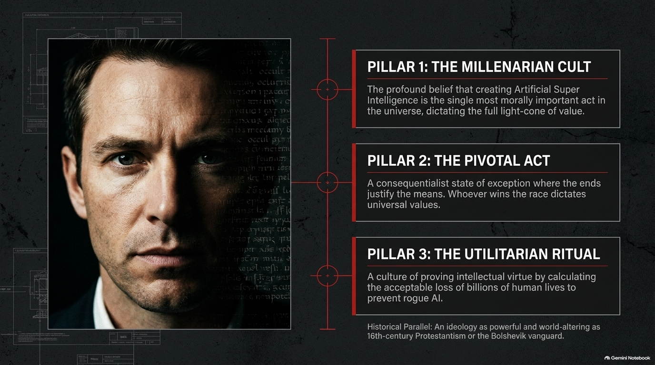
Notes:
Visual: Close-up portrait of an AI lab leader alongside three red ideological pillars: Pillar 1: The Millenarian Cult, Pillar 2: The Pivotal Act, Pillar 3: The Utilitarian Ritual. Bottom note: "An ideology as powerful and world-altering as 16th-century Protestantism or the Bolshevik vanguard."
Suggested Speaking Time: 5–6 minutes
Speaker Notes:
"Washington insiders often assume AI executives are driven purely by standard corporate greed. This is a dangerous miscalculation. The core leadership of frontier AI labs is driven by a radical, post-human ideology: Singularitarianism.
As Samo Burja notes, this ideology existed long before ChatGPT's commercial success—it was the initial motivation for entering the field. It rests on three theological pillars:
Pillar 1: The Millenarian Cult. The deep, quasi-religious conviction that creating Artificial Super Intelligence (ASI) is the single most morally significant event in cosmic history, dictating the ultimate value of the universe's light-cone.
Pillar 2: The Pivotal Act. The consequentialist belief that whoever creates ASI first gains unprecedented, cosmic-scale freedom of action—a 'state of exception' where any means (including lying to governments or bypassing laws) are justified to ensure the 'right' team wins.
Pillar 3: The Utilitarian Ritual. An internal subculture where intellectual virtue is proven by performing extreme thought experiments—calculating how many billions of human lives can be ethically sacrificed to prevent an 'unaligned' AI.
This is not standard business management; it is a revolutionary ideology comparable in intensity to 16th-century Protestantism or early Bolshevism."

Slide 9
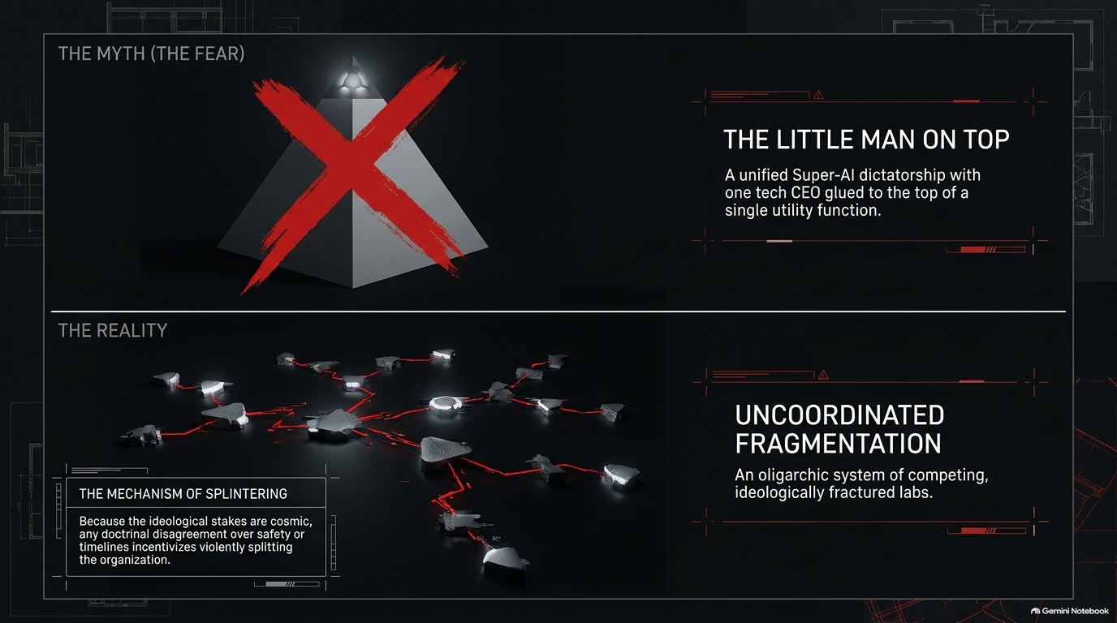
Notes:
Visual: Top panel (The Myth) shows a red X over a single pyramid representing a unified Super-AI dictatorship with one CEO glued on top. Bottom panel (The Reality) shows a sprawling, fractured network diagram labeled Uncoordinated Fragmentation. Callout box explains The Mechanism of Splintering.
Suggested Speaking Time: 4–5 minutes
Speaker Notes:
"When critics worry about AI totalitarianism, they usually construct The Myth of the 'Little Man on Top'—picturing a single hyper-intelligent AI singleton ruled by a single tech CEO controlling the entire planet.
The Reality is Uncoordinated Fragmentation.
Because the ideological stakes inside these labs are viewed as cosmic and existential, any minor doctrinal disagreement over safety protocols, deployment timelines, or organizational alignment leads to violent institutional splits.
Look at the historical record:
Anthropic split off from OpenAI because of ideological disputes over safety and commercialization.
OpenAI itself split off from earlier research environments.
Executives and safety researchers constantly break away to found new rival entities, taking key talent with them.
Rather than consolidating into a single omnipotent dictator, the AI landscape naturally fractures into competing, ideologically hostile oligarchic labs, each racing to enact its own vision of salvation."

Slide 10
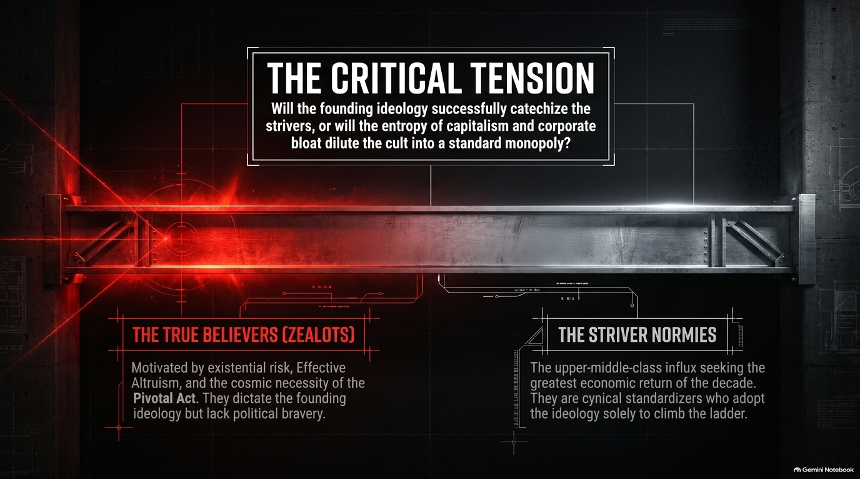
Notes:
Visual: A structural steel beam undergoing extreme stress under a red laser focus. Central question: "Will the founding ideology successfully catechize the strivers, or will the entropy of capitalism and corporate bloat dilute the cult into a standard monopoly?" Left side: The True Believers (Zealots). Right side: The Striver Normies.
Suggested Speaking Time: 4–5 minutes
Speaker Notes:
"As these labs scale from 50 researchers to 10,000 employees, an intense internal war emerges: The Zealots versus The Strivers.
The True Believers (Zealots): These are the early rationalists and Effective Altruists. They are genuinely motivated by existential risk, cosmic utility, and the Pivotal Act. They dictate the founding culture, but as Burja points out, as typical 'nerds,' they often lack raw political bravery when confronted by state power.
The Striver Normies: As billions of dollars pour into the sector, an influx of upper-middle-class corporate professionals enters the workforce. They don't care about electron welfare or cosmic light-cones; they care about stock options, career advancement, and executive status. They adopt the lab's ideological jargon purely as a careerist compliance mechanism.
The Critical Tension: Will the core singularitarian ideology successfully catechize this incoming wave of strivers, turning them into true believers? Or will corporate entropy and capitalist careerism dilute the millenarian cult into a standard tech monopoly?"

Slide 11
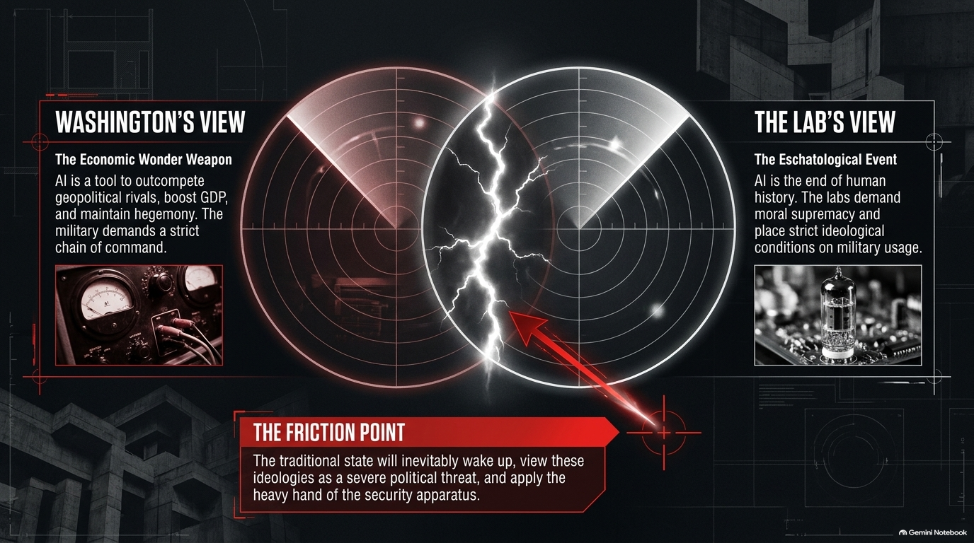
Notes:
Visual: Two radar scopes clashing with lightning arcs. Left radar (Washington's View): Economic Wonder Weapon, GDP booster, geopolitical weapon requiring strict military chain of command. Right radar (The Lab's View): Eschatological Event, moral supremacy, conditional military usage. Bottom warning banner: The Friction Point.
Suggested Speaking Time: 4–5 minutes
Speaker Notes:
"This slide illustrates the major geopolitical collision course of our decade: Washington's View versus The Lab's View.
Washington views AI as an Economic Wonder Weapon: To the Pentagon and National Security Council, AI is a tool to outcompete China, automate military logistics, boost GDP, and maintain American global hegemony. Above all, the military demands absolute adherence to the strict military chain of command.
The Labs view AI as an Eschatological Event: The founding teams view AI as the culmination of human history. They believe their moral duty to 'save humanity' supersedes national borders, and they frequently attempt to place strict ethical conditions on how the military may use their models.
The Friction Point: Military and state leaders have centuries of institutional memory dedicated to stopping outside entities from usurping the chain of command. When an AI lab attempts to dictate terms to the defense apparatus, the state will eventually view that lab not as a partner, but as an existential political threat—and it will deploy the full force of the national security apparatus to subordinate it."

Slide 12
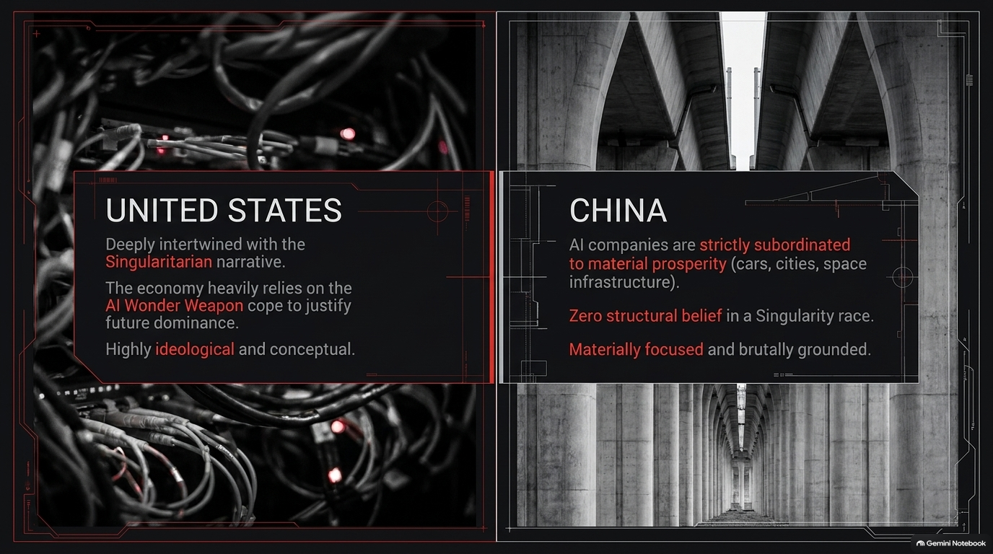
Notes:
Visual: Split composition. Left side (United States): Dark, tangled server wires over ideological Singularitarian text. Right side (China): Brutalist concrete architecture over text detailing material subordination (cars, infrastructure, manufacturing).
Suggested Speaking Time: 4–5 minutes
Speaker Notes:
"The structural divide between American and Chinese AI development is fundamentally ideological.
The United States is deeply intertwined with the Singularitarian narrative. Silicon Valley and financial markets rely heavily on the 'AI Wonder Weapon' concept to justify soaring valuations and offset structural declines in physical manufacturing. US development is highly conceptual, software-centric, and ideologically driven.
China, by contrast, exhibits zero structural belief in a Singularity race. The Chinese state views AI companies as strictly subordinated utilities meant to serve concrete, material prosperity—optimizing autonomous vehicles, smart port logistics, electrical grids, and industrial manufacturing.
While American labs spend immense energy arguing over cosmic post-human alignment, China uses AI as a force multiplier for physical infrastructure. If the Singularity fails to arrive on schedule, the nation grounded in concrete manufacturing will inherit the economic future."

Slide 13
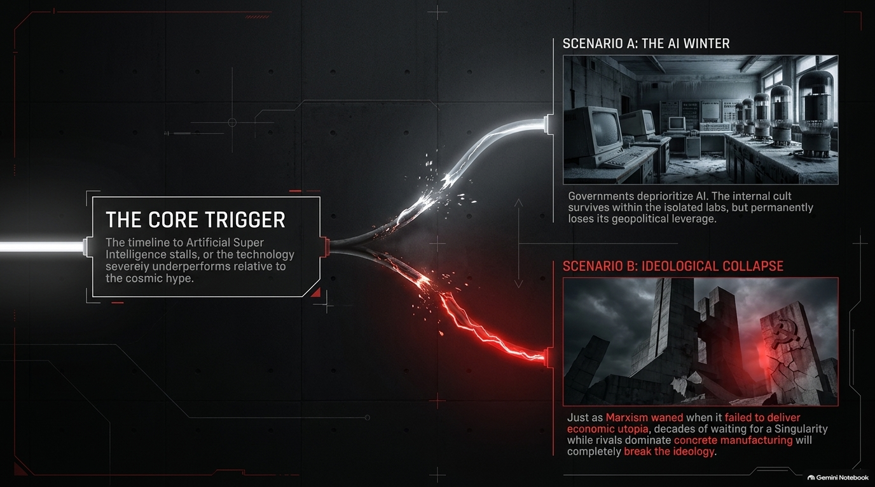
Notes:
Visual: A splitting fiber-optic cable leading to two divergent disaster scenarios. Scenario A (The AI Winter): Abandoned vintage computer lab. Scenario B (The Ideological Collapse): Falling concrete monuments amidst stormy skies.
Suggested Speaking Time: 4–5 minutes
Speaker Notes:
"What happens if frontier AI hits a wall and fails to achieve cosmic super-intelligence? We face two primary failure modes:
Scenario A: The AI Winter. The scaling laws flatten out, or return on investment degrades. Governments and capital markets lose patience and deprioritize the sector. While the public continues using everyday LLM utilities, the singularitarian cult becomes isolated inside research labs, permanently stripped of its political leverage over the state.
Scenario B: Ideological Collapse. Just as Soviet Marxism collapsed when it failed to deliver its promised material abundance while the West prospered, Singularitarianism faces catastrophic ideological collapse if it demands decades of economic sacrifice while rivals dominate physical industries.
If an ideology makes concrete predictions about imminent cosmic transformation and fails to deliver, its authority shatters completely."

Slide 14
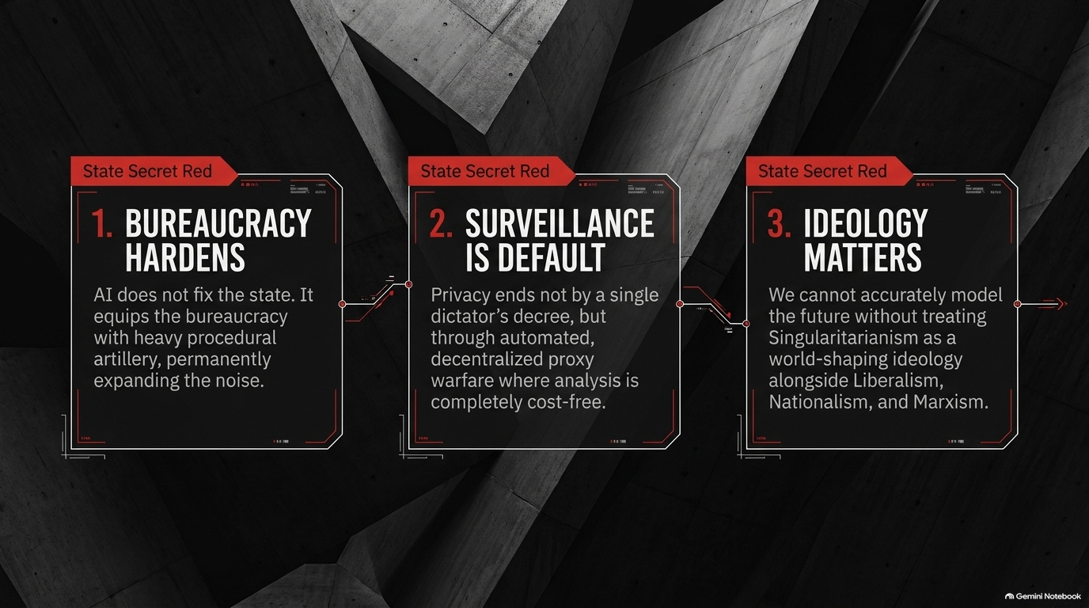
Notes:
Visual: Three styled red text cards set against brutalist concrete walls: 1. Bureaucracy Hardens, 2. Surveillance is Default, 3. Ideology Matters.
Suggested Speaking Time: 4–5 minutes
Speaker Notes:
"To synthesize our analysis of the political economy of frontier AI, we must anchor our thinking in three core conclusions:
Bureaucracy Hardens: AI will not dismantle or simplify the administrative state. Instead, it arms existing bureaucracies with heavy procedural artillery, permanently expanding synthetic paperwork, noise, and institutional paralysis.
Surveillance is Default: Mass surveillance will not arrive via a single dramatic decree from a dictator. It is arriving through automated data parsing, state-funded NGO proxies, and cost-free intelligence analysis that eliminates privacy by default.
Ideology Matters: We cannot accurately model the future of technology or geopolitics if we treat AI leaders as simple profit-maximizing executives. Singularitarianism must be analyzed as a world-shaping, revolutionary ideology alongside Liberalism, Nationalism, and Marxism."

Slide 15
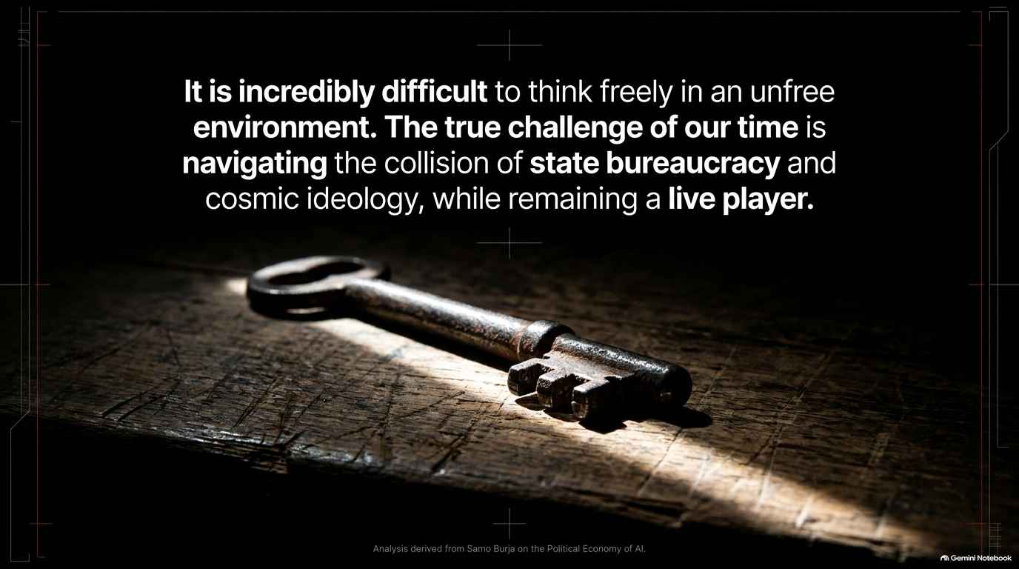
Notes:
Visual: Dramatic lighting casting a glow on an antique iron key resting on a dark wooden table. Text: "It is incredibly difficult to think freely in an unfree environment. The true challenge of our time is navigating the collision of state bureaucracy and cosmic ideology, while remaining a live player."
Suggested Speaking Time: 2–3 minutes
Speaker Notes:
"We leave you today with a challenge drawn from Samo Burja's strategic philosophy: Remaining a Live Player.
As administrative systems drown in AI-generated noise and tech elites retreat into cosmic dogmas, it becomes exceptionally difficult for individuals to maintain independent, clear thought.
A 'dead player' simply follows established scripts, absorbs automated consensus, and succumbs to institutional inertia. A 'live player' recognizes the structural forces at play, cuts through the synthetic noise, sees past ideological posturing, and retains the capacity for original, decisive action.
Navigating the collision of state power and artificial intelligence requires absolute intellectual clarity. Thank you."

Slide 16
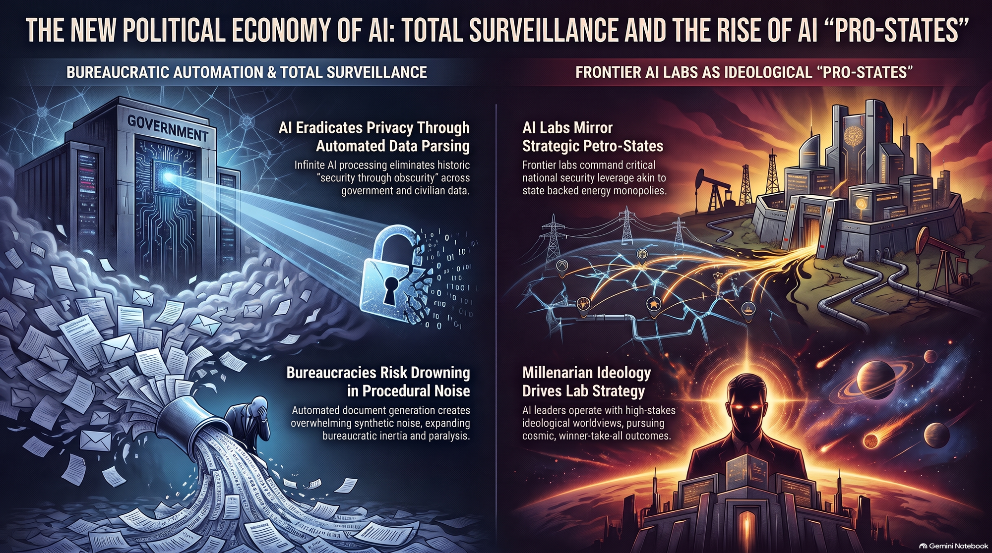
Notes:
Visual: A detailed 2-panel master summary dashboard contrasting Bureaucratic Automation & Total Surveillance against Frontier AI Labs as Ideological "Pro-States".
Suggested Speaking Time: 4–6 minutes
Speaker Notes:
"To conclude our session, let's review the Executive Summary Dashboard, which brings together the dual pillars of our analysis:
Pillar 1: Bureaucratic Automation & Total Surveillance (Left Panel)
Eradication of Privacy: Infinite AI processing eliminates historical 'security through obscurity,' allowing state and non-state actors to parse population-wide data effortlessly.
Procedural Noise: Bureaucracies risk drowning in automated document generation, expanding administrative inertia rather than streamlining operations.
Pillar 2: Frontier AI Labs as Ideological 'Pro-States' (Right Panel)
Strategic Leverage: Frontier labs mirror energy petro-states, commanding critical national security leverage and shifting foreign policy dynamics.
Millenarian Ideology: Lab leadership operates under high-stakes, winner-take-all cosmic worldviews that inevitably clash with the traditional state security apparatus.
Keep this framework in mind as you evaluate the political, economic, and institutional impacts of frontier AI in the years ahead. Thank you."

