Slide 1

Notes:
Think Like a Leader. Not a Worker || Best Motivational Speech By Simon Sinek
https://www.youtube.com/watch?v=KIL1svDaqS4

Slide 2
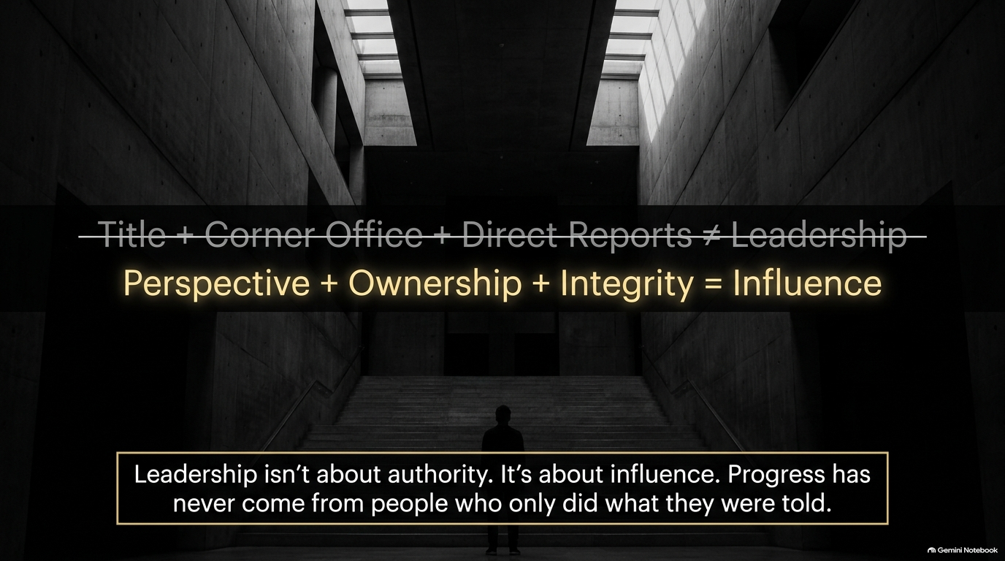

Slide 3
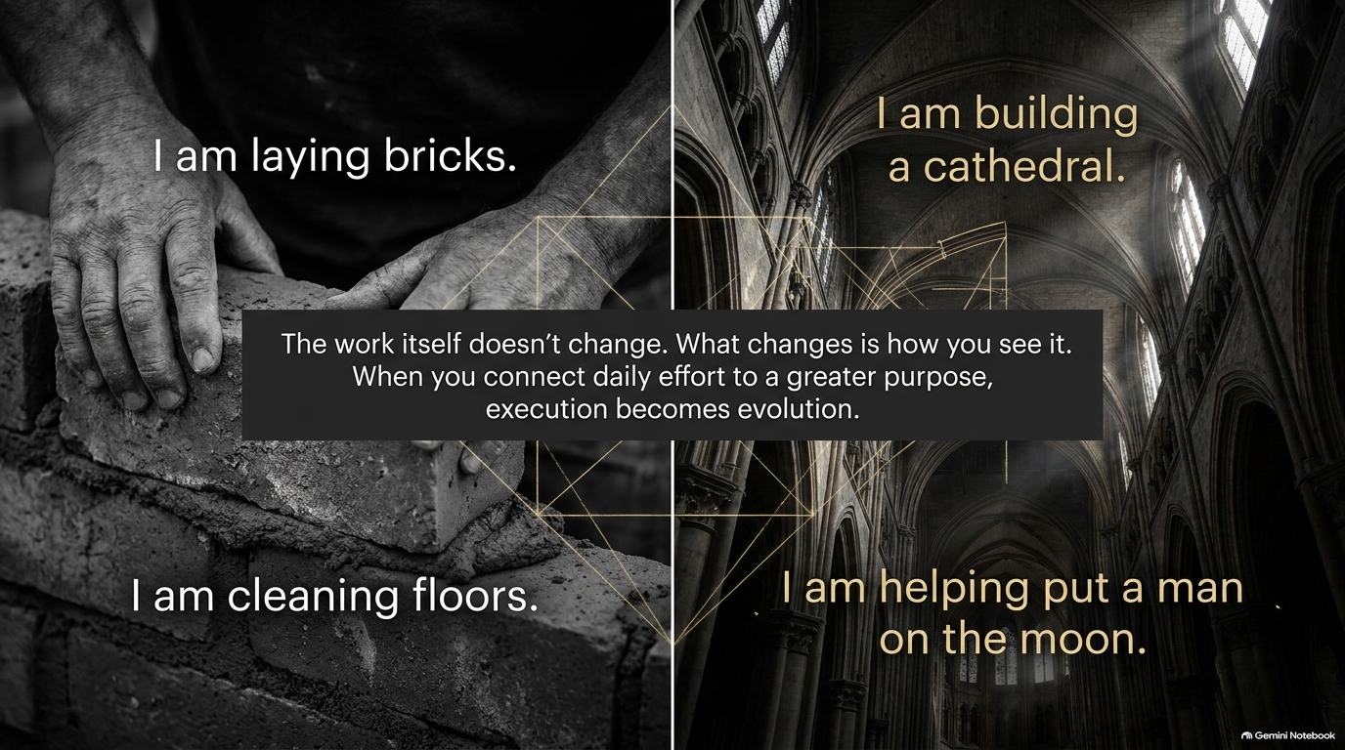

Slide 4
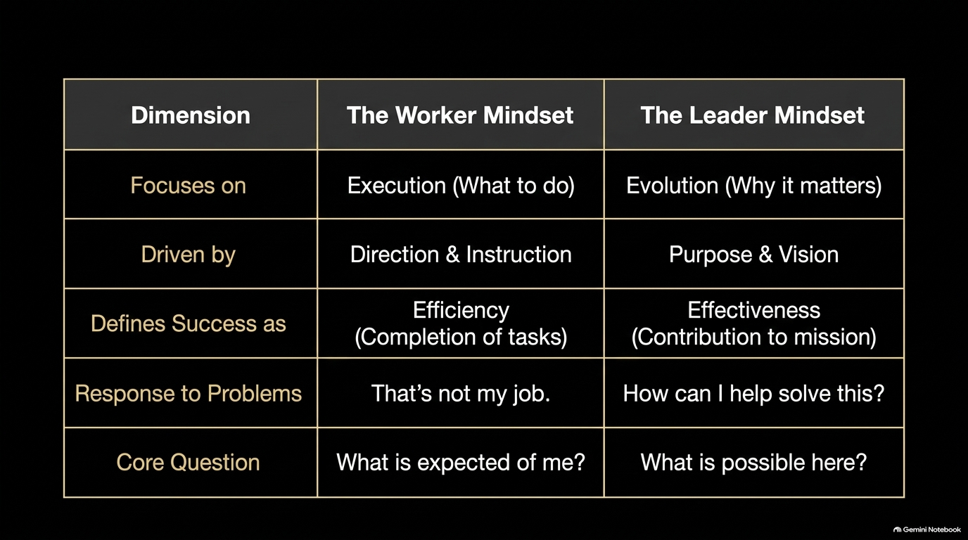

Slide 5


Slide 6
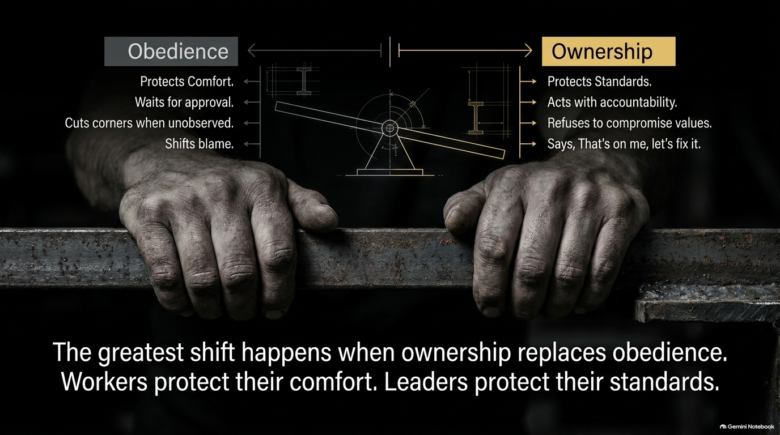

Slide 7
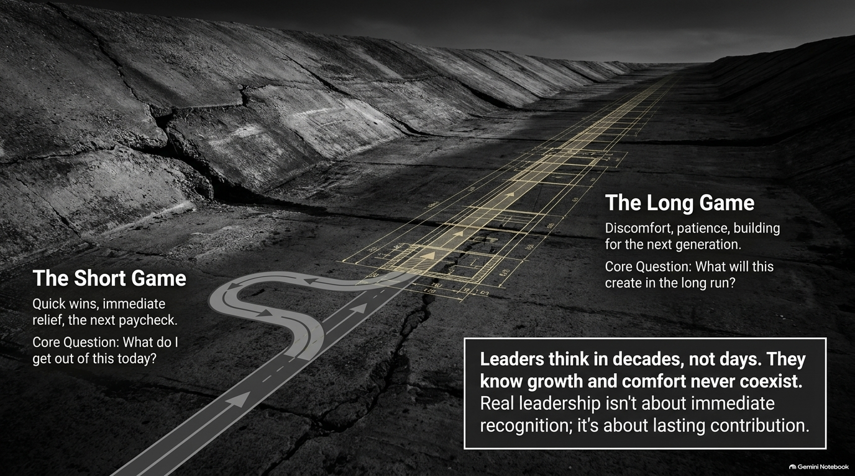

Slide 8


Slide 9
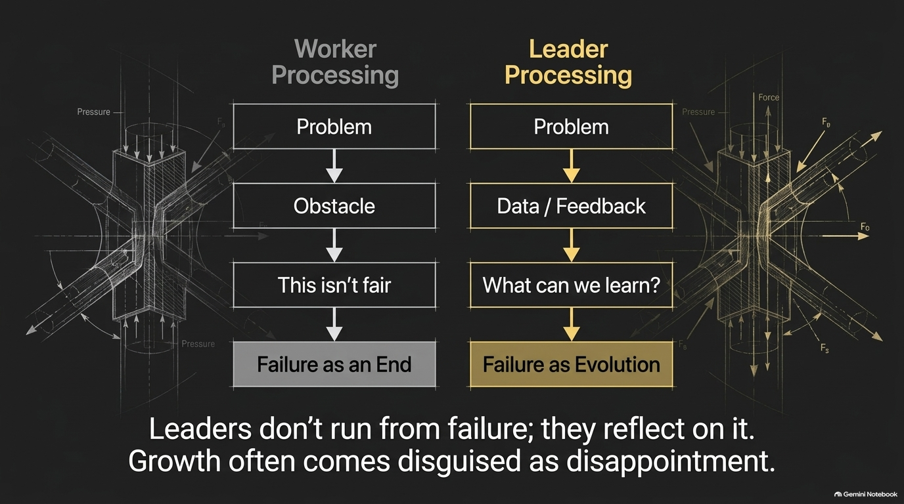

Slide 10
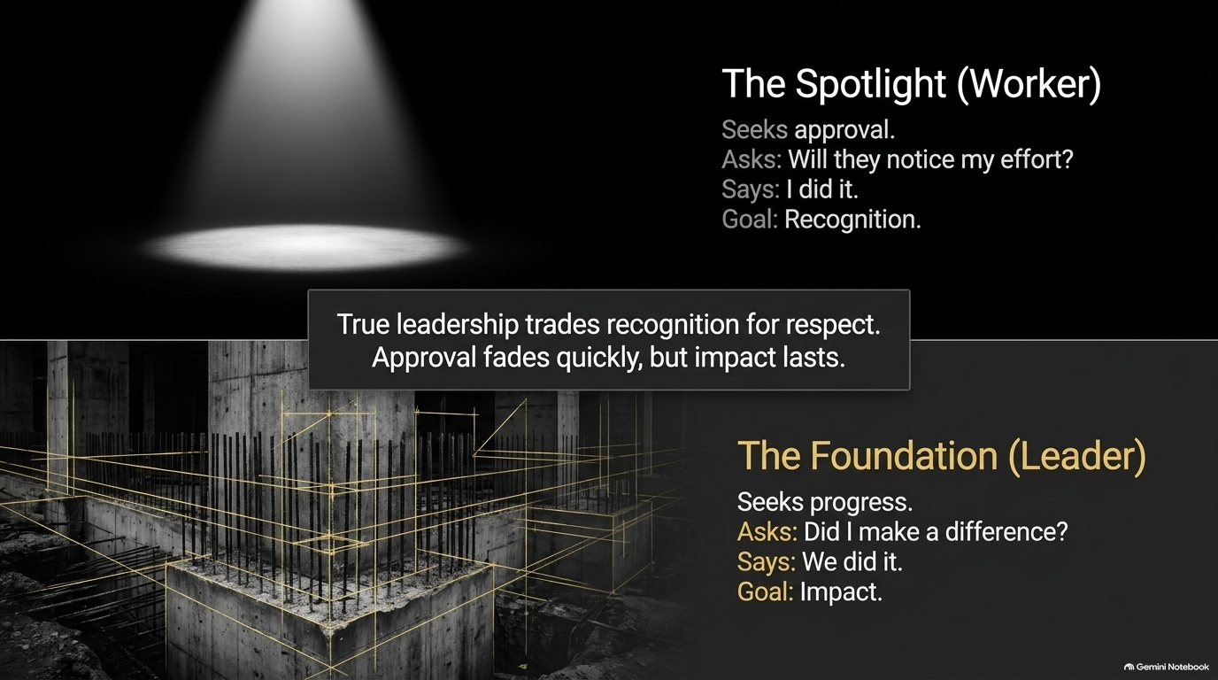

Slide 11
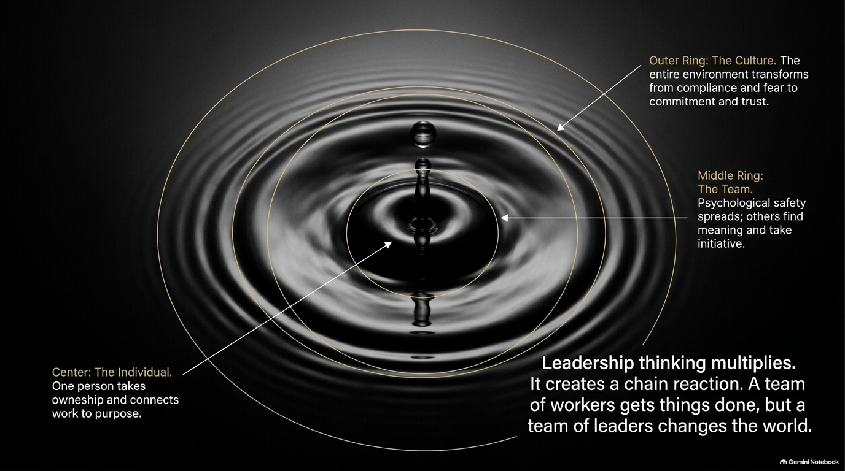

Slide 12


Slide 13
