Slide 1
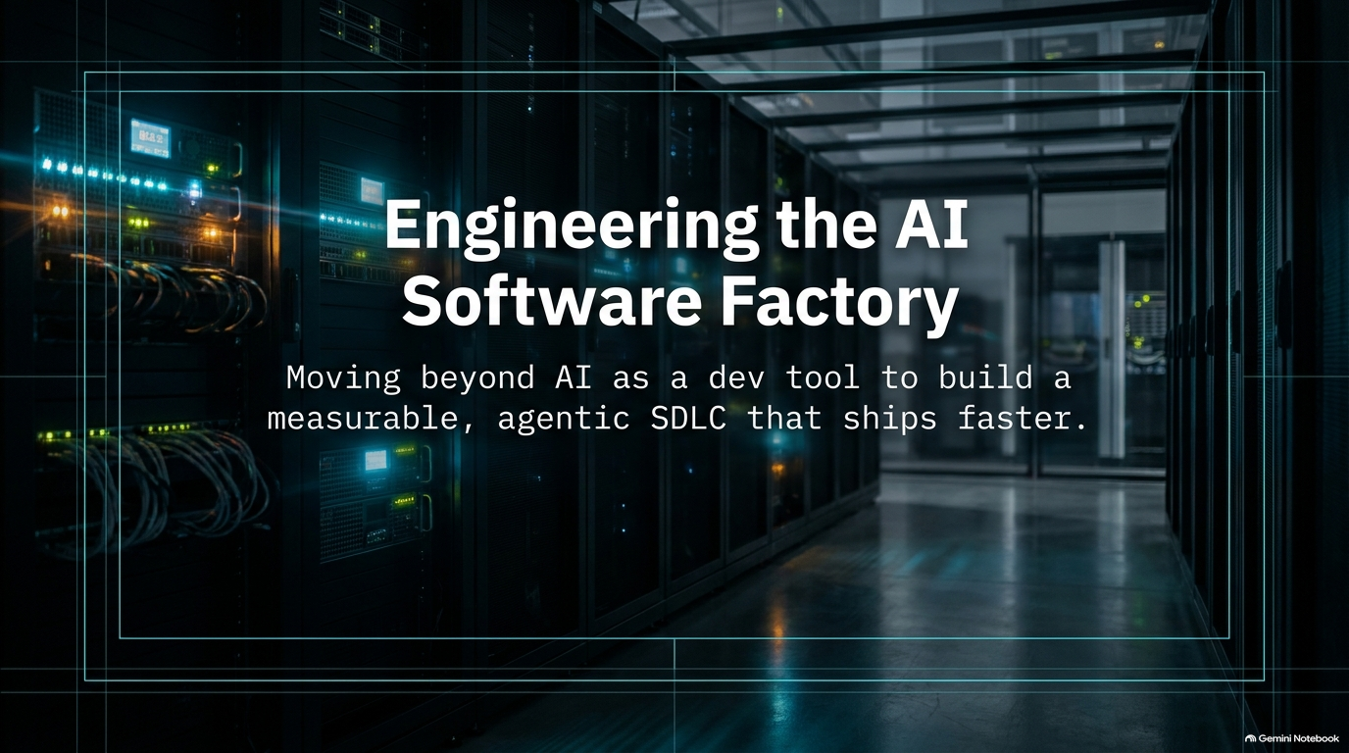
Notes:
Estimated Speaking Time: 2–3 minutes
Speaker Notes:
Welcome everyone to today's deep dive into Engineering the AI Software Factory.
Open by addressing the elephant in the room: the term "software factory" isn't actually new—it was originally coined back in 1968 at a NATO conference. However, what has changed dramatically is the technology stack and the economic reality underpinning it.
Today, we are moving past treating AI models and coding assistants merely as souped-up IDE plugins or individual productivity toys. Instead, we are looking at them through an industrial lens: end-to-end loops running in the cloud that compress weeks of work into hours or minutes.
Set the stage for the session: We will explore what a true software factory looks like, how it differs from traditional SDLC (Software Development Life Cycle), how to measure its yield, and how engineering culture must evolve to support it.
How to Build an AI Software Factory That Ships Faster
https://www.youtube.com/watch?v=XUEfIxkdT2Q

Slide 2
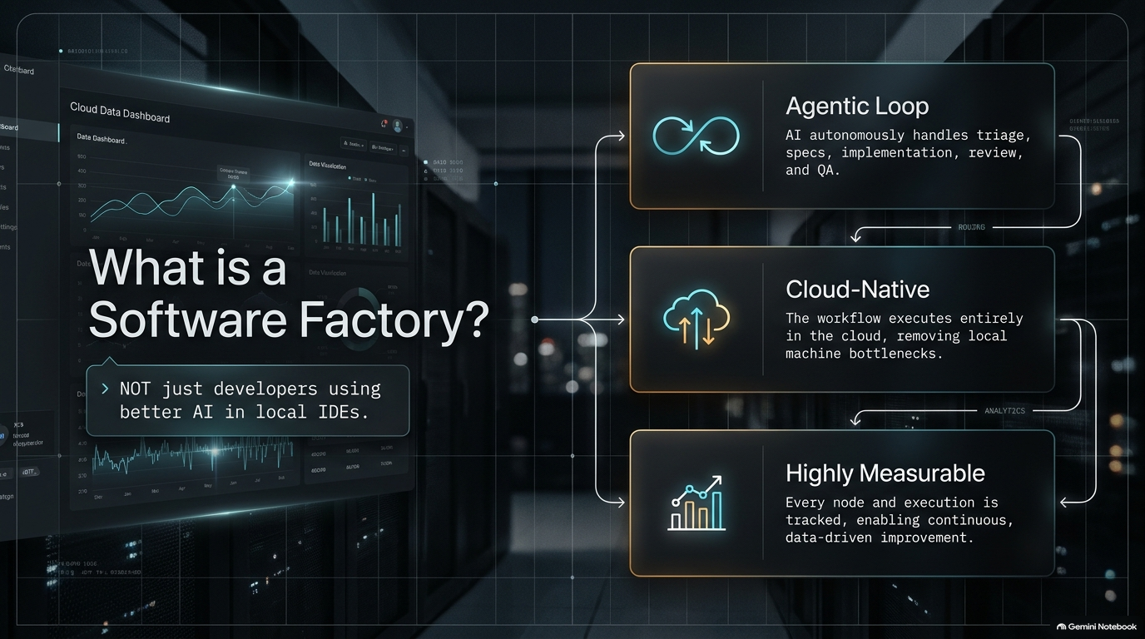
Notes:
Estimated Speaking Time: 4–5 minutes
Speaker Notes:
Walk through the high-level architecture of an AI software factory loop. Ideas come in at the top, and autonomous or semi-autonomous agents handle the various jobs traditionally performed exclusively by humans.
Detail the stages of the loop:
Triage & Issue Intake: Automatically categorizing and prioritizing incoming issues or bug reports.
Spec Writing: Optionally generating detailed design specs or requirements documents.
Implementation: Writing the code via agent harnesses (whether running via CLI, terminal tools like Warp, or cloud runtimes).
Code Review & QA: Running automated reviews, semantic checks, and testing loops.
CI/CD & Monitoring: Pushing changes through deployment pipelines and tracking telemetry post-launch.
Emphasize the core mindset shift: A developer's primary job is no longer just writing individual blocks of product code—it is building, maintaining, and tuning this loop to maximize throughput and yield.

Slide 3
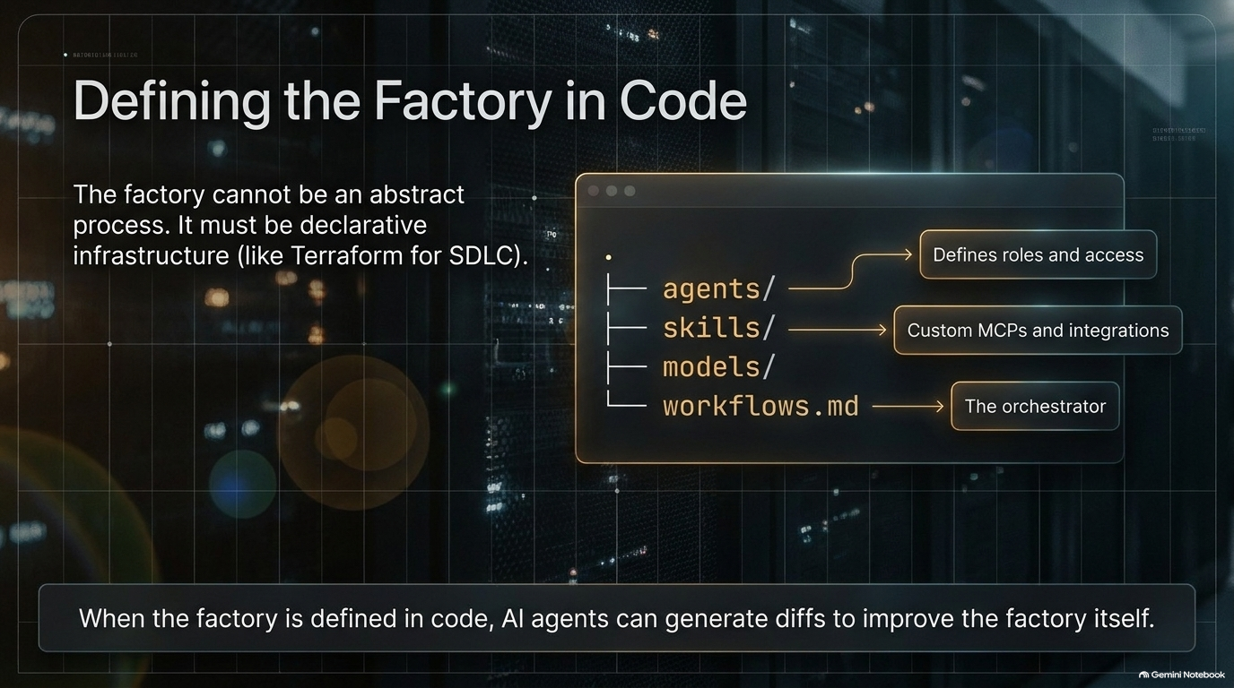
Notes:
Estimated Speaking Time: 3–4 minutes
Speaker Notes:
Contrast the current state of the industry with where we need to go. Right now, most companies are stuck in the "individual developer" phase: every engineer has Copilot, Cursor, or Claude Code running locally, using their own unshared skills and MCPs (Model Context Protocols).
Explain why this local model falls short at scale: agents work in total isolation, leading to fragmented PRs, security blind spots, unmonitored costs, and a lack of organizational learning.
Introduce the transition to cloud-hosted factories where the loop operates centrally, securely, and transparently in the cloud, allowing teams to treat software production as a cohesive, measurable system rather than isolated desktop tasks.

Slide 4
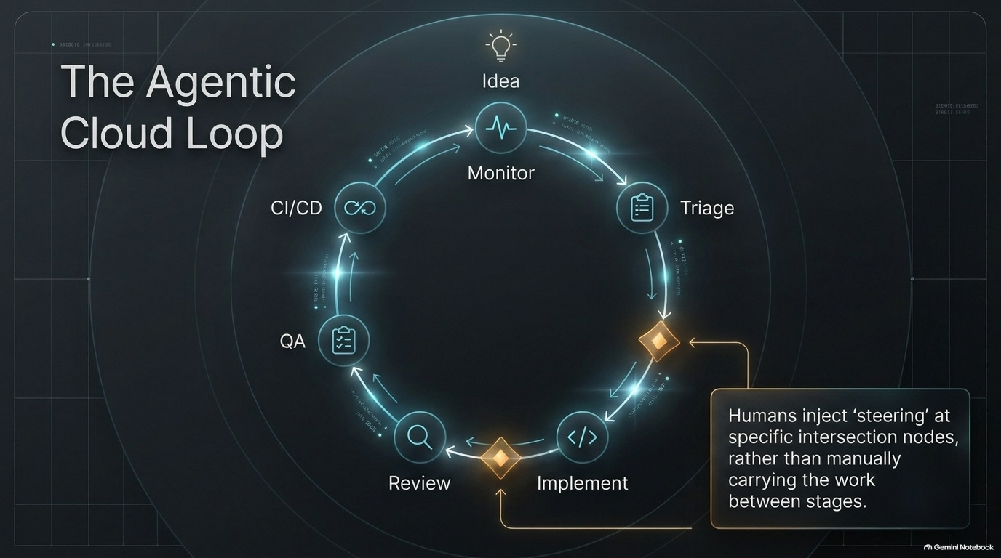
Notes:
Estimated Speaking Time: 3–4 minutes
Speaker Notes:
Borrowing from infrastructure-as-code paradigms like Terraform, a mature software factory must be defined declaratively in code.
Discuss what goes into the factory definition file/folder structure:
The shape of the workflows and stages.
The specific agents and roles involved.
The allowed skills, MCPs, and sandbox execution environments.
The underlying models and routing configurations (e.g., choosing Opus, Sonnet, or specialized open-weight models for different tasks).
Highlight the superpower this unlocks: because your factory is defined in code, your agentic workflows can be versioned, branched, tested, and even improved via code diffs suggested by coding agents themselves.

Slide 5
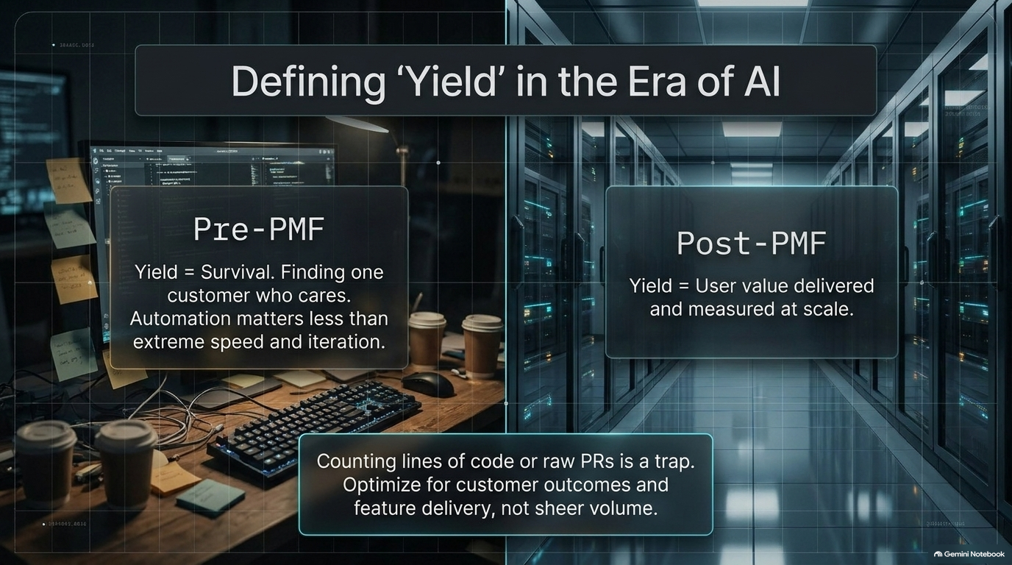
Notes:
Estimated Speaking Time: 4–5 minutes
Speaker Notes:
Tackle the hardest fundamental question of software factories: What is yield, and how do we measure it?
Acknowledge that traditional lines-of-code metrics are useless, and standard Jira ticket counts fail to capture real value.
Break down the multi-layered approach to measuring yield:
Throughput Metrics: Volume of PRs shipped and velocity across the pipeline.
Customer/User Outcome Metrics: Moving away from internal code output toward actual user value—did this feature solve a user pain point or reduce workflow friction?
Automation Index: Tracking the ratio of human intervention per PR (steering overhead) to ensure your automation percentage is climbing over time.

Slide 6
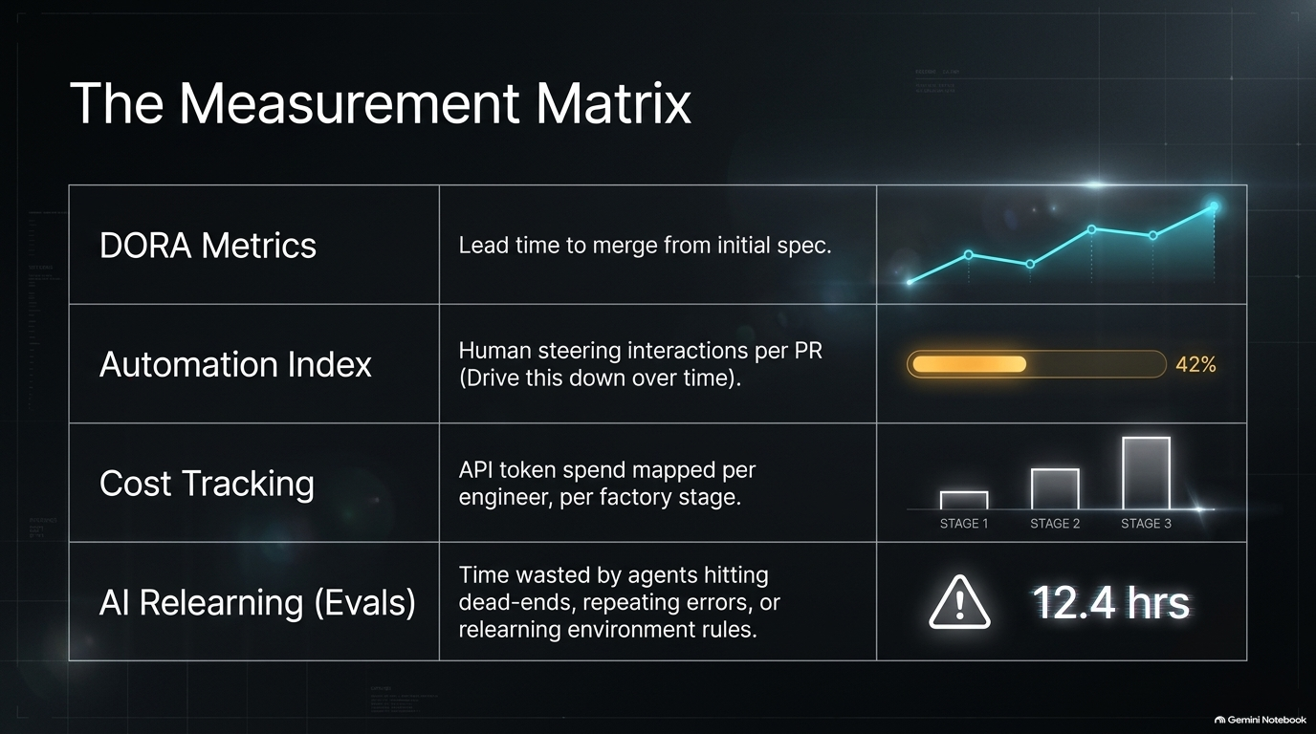
Notes:
Estimated Speaking Time: 3–4 minutes
Speaker Notes:
While traditional DORA metrics (lead time, deployment frequency, change failure rate) remain useful baseline anchors, software factories require deeper, modern telemetry.
Discuss granular operational metrics you should track out-of-the-box:
Cost Analytics: Granular tracking of LLM token spend broken down by individual engineer, repository, or factory stage.
Relearning & Dead-End Tracking: Measuring wasted time spent by models trying and failing to execute environment commands or stumbling through missing context.
Steering Frequency: How often a human has to step in to course-correct an agentic session.

Slide 7
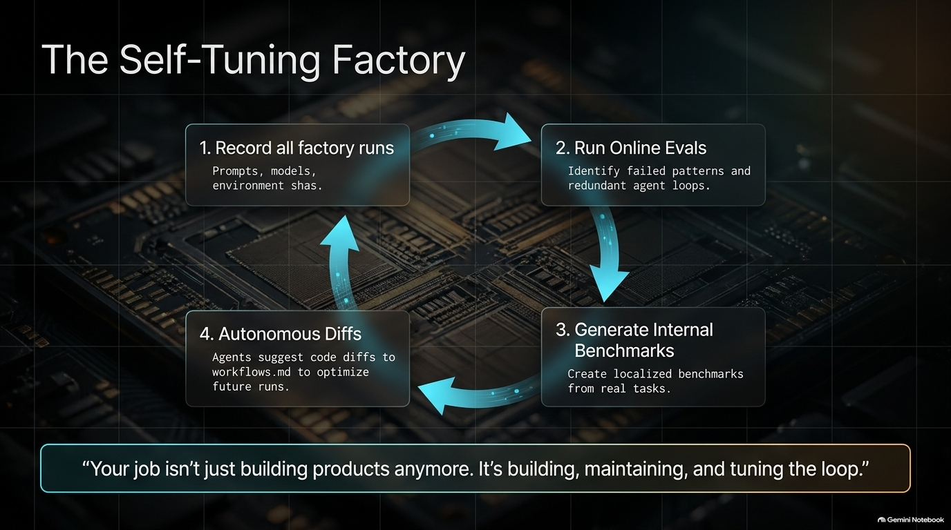
Notes:
Estimated Speaking Time: 3–4 minutes
Speaker Notes:
Explain the concept of online evaluations running directly against historical factory run traces.
To improve your factory, you must capture everything happening across agent sessions in the cloud. From there, apply automated evals (such as LLM-as-a-judge patterns) to sample past runs.
Give concrete examples: Automatically auditing whether coding agents are generating redundant test files, introducing regressions, or violating formatting guidelines.
Emphasize moving away from "vibes-based engineering" ("I feel like Opus 5 writes too many tests") to concrete, data-backed model performance evaluations.

Slide 8
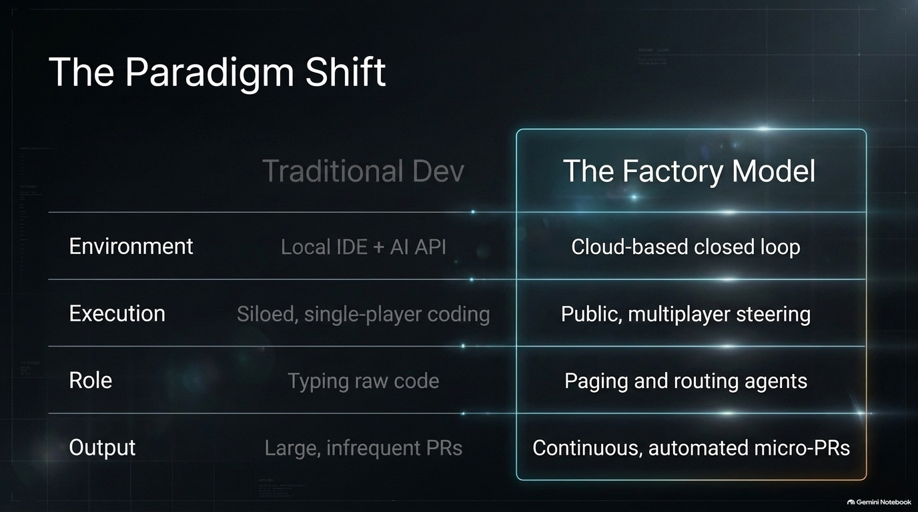
Notes:
Estimated Speaking Time: 3–5 minutes
Speaker Notes:
Explain an advanced optimization technique for your factory: turning your team's real historical tasks into internal benchmark suites (akin to custom versions of Terminal-Bench or SWE-bench based on your proprietary codebase).
When you capture a completed session—complete with starting environment state, commit SHA, and exact tool calls—you effectively have a repeatable reinforcement learning or testing environment.
Discuss how to safely replay tasks against new model releases or prompt updates without letting the model "cheat" by peeking at future commits, ensuring rigorous and objective model evaluation.

Slide 9
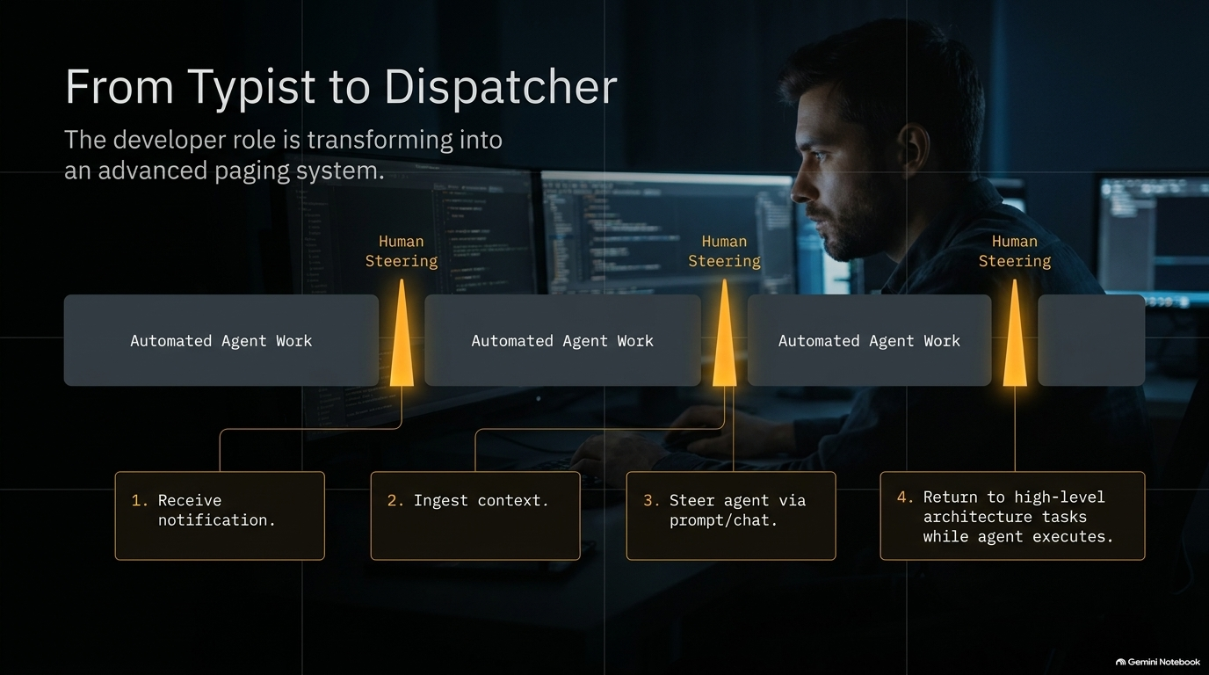
Notes:
Estimated Speaking Time: 3–4 minutes
Speaker Notes:
Address the profound cultural and psychological shift for developers working inside an AI software factory.
Describe the new reality: Instead of sitting at an IDE writing boilerplate all day, the engineer's role shifts toward managing an autonomous system—effectively working a "paging" or call-center model where you respond to targeted notifications, review agent proposals, and handle edge cases.
Discuss the friction this creates: Developers accustomed to uninterrupted, private interloops now operate in a public, asynchronous space where their process is visible.
Highlight the importance of psychological safety: Teams must cultivate an environment where engineers feel safe working in the open without fear of micromanagement or penalty for exploratory dead ends.

Slide 10
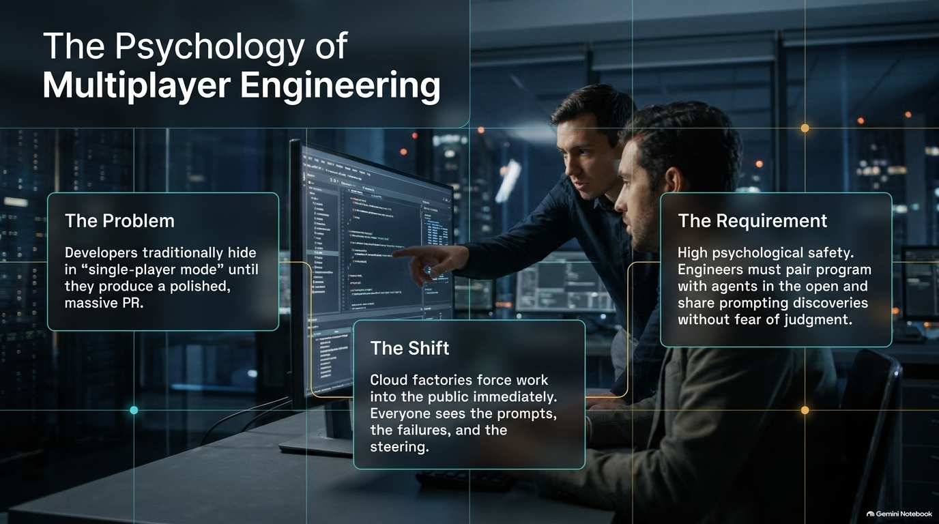
Notes:
Estimated Speaking Time: 3–4 minutes
Speaker Notes:
Explore the benefits of shifting software creation earlier into public, multiplayer workflows.
Traditional software failures often happen when a developer goes "into the woods" for two weeks, building in total isolation, and returns with a massive 5,000-line PR that completely misses architectural alignment.
Explain how agentic factories encourage "working in public": sessions start collaboratively in tools like Slack or shared cloud runtimes where team members can chime in, tag peers, inspect intermediate steps, and ensure alignment while the work is being generated rather than after the fact.

Slide 11
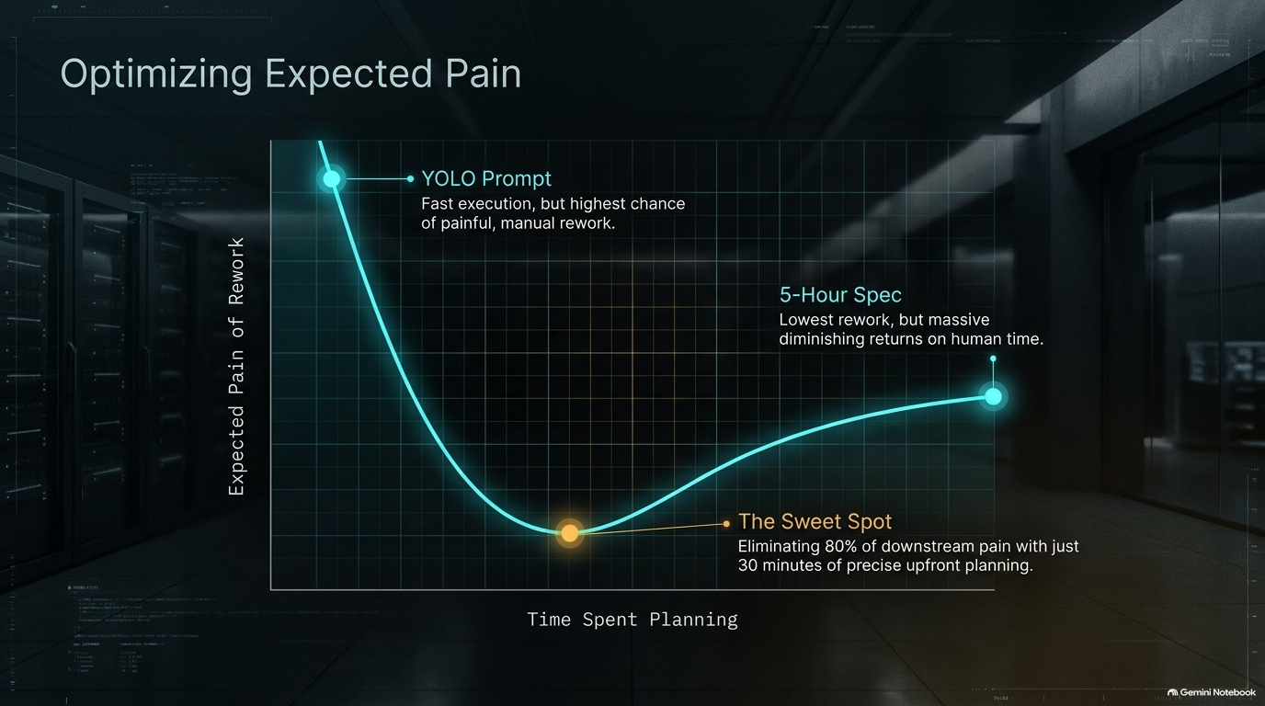
Notes:
Estimated Speaking Time: 4–5 minutes
Speaker Notes:
Address the elephant in the room regarding trust: We cannot trust AI agents blindly with everything, especially serialized state, database schemas, or security boundaries.
Frame code review in an AI factory not as a line-by-line grammar check, but as an exercise in risk management.
Discuss automated gating strategies:
Implementing custom owner files and pattern detectors (e.g., regex scans or prompt-based checks for sensitive changes like environment variables, new S3 dependencies, or database migrations).
Automatically flagging high-risk modifications to force mandatory human review while letting low-risk, routine changes flow through autonomously.

Slide 12
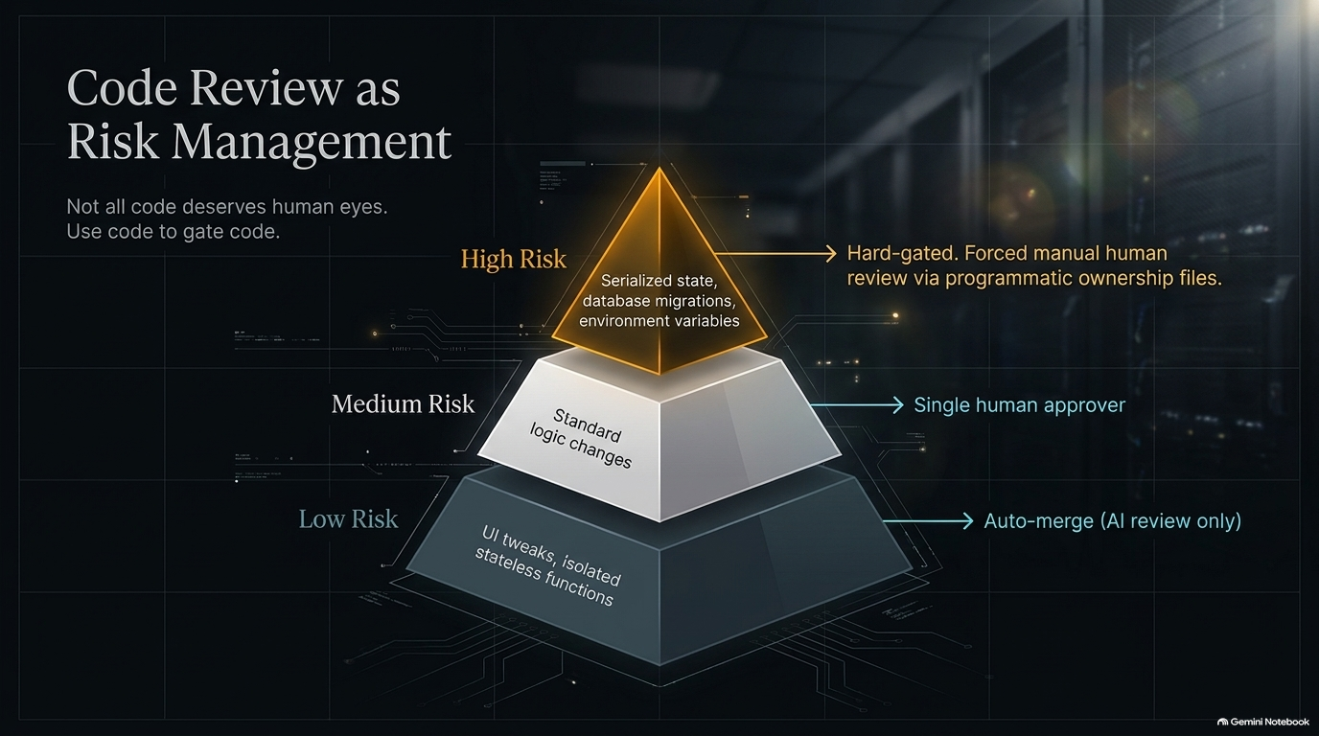
Notes:
Estimated Speaking Time: 3–4 minutes
Speaker Notes:
Share an interesting organizational observation: In traditional software development, CI/CD friction incentivized engineers to dump massive changes into a single giant PR because "nobody reads them anyway".
Show how AI factories can invert this incentive structure. By implementing policies where smaller, tightly scoped PRs that avoid core sensitive modules can be merged with minimal human friction, teams see a dramatic shift.
Explain how this encourages engineers to write cleaner, modular, and more reviewable code segments, drastically cutting down review fatigue.

Slide 13
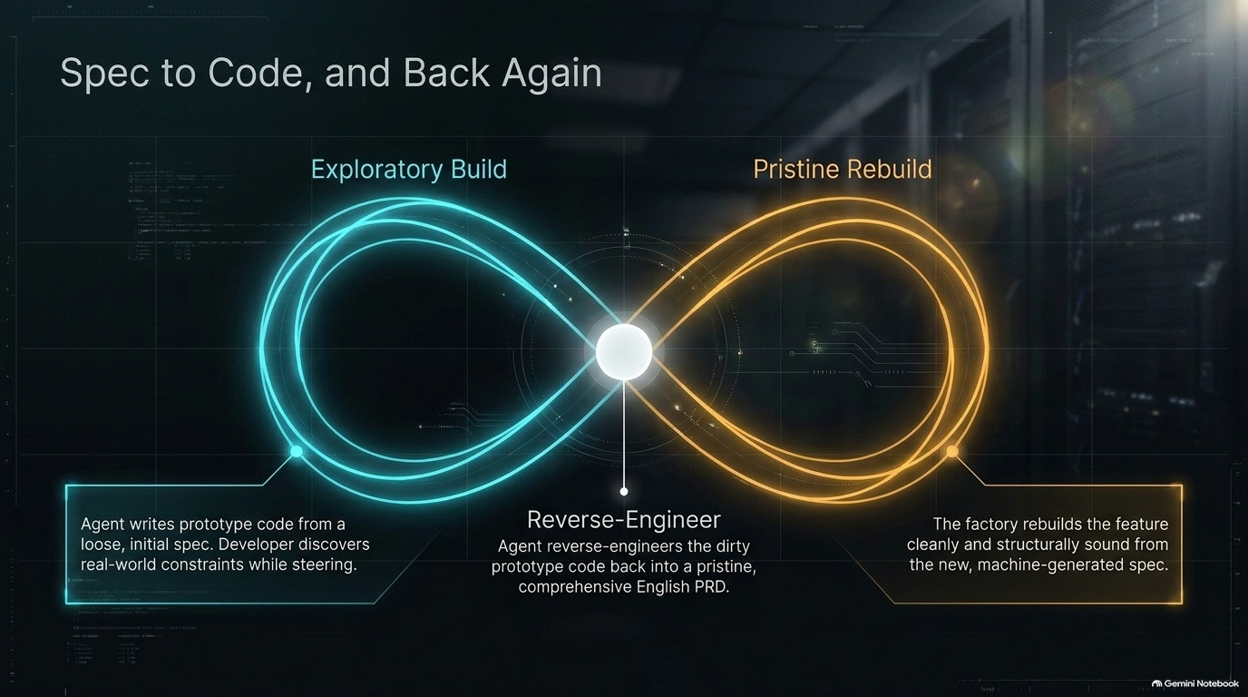
Notes:
Estimated Speaking Time: 3–5 minutes
Speaker Notes:
Discuss the economics of planning versus "yoloing" prompts into an agent.
Compare the two extremes:
The YOLO approach: Dropping a two-sentence prompt into Slack, which is fast upfront but risks a high percentage of rework.
Over-speccing: Spending 5 hours writing an exhaustive technical design doc by hand, yielding diminishing returns on your time.
Introduce the concept of expected pain optimization: Finding the sweet spot (e.g., spending 20–30 minutes on a solid spec or architectural prompt) to eliminate 80% of potential rework, while remaining flexible enough to let the model discover nuances during implementation.

Slide 14
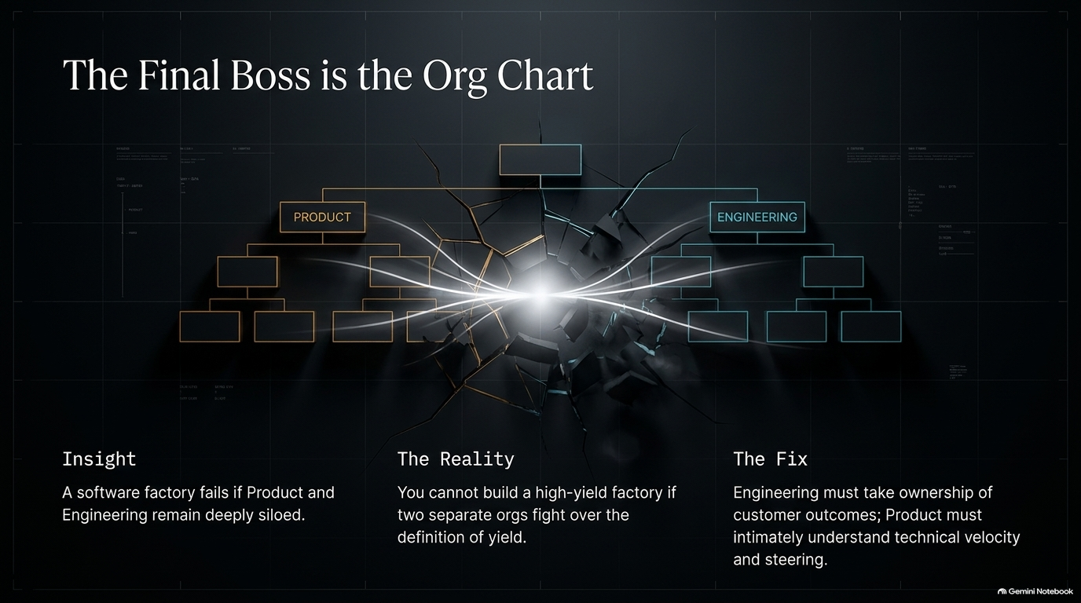
Notes:
Estimated Speaking Time: 3–4 minutes
Speaker Notes:
Detail advanced agentic workflows for complex problems: The Spec-to-Implementation-to-Spec loop.
Explain how top engineers leverage prototypes:
Vibe-code an initial prototype or let an agent explore a difficult problem overnight.
Learn from the edge cases and architectural surprises discovered during that messy implementation run.
Feed those learnings back into a clean, reverse-engineered PRD or specification.
Rebuild the final production code cleanly from scratch based on that hardened spec.
Emphasize that because token costs are cheap and compute is fast, running multiple structured generation passes yields vastly superior, cleaner production code.

Slide 15
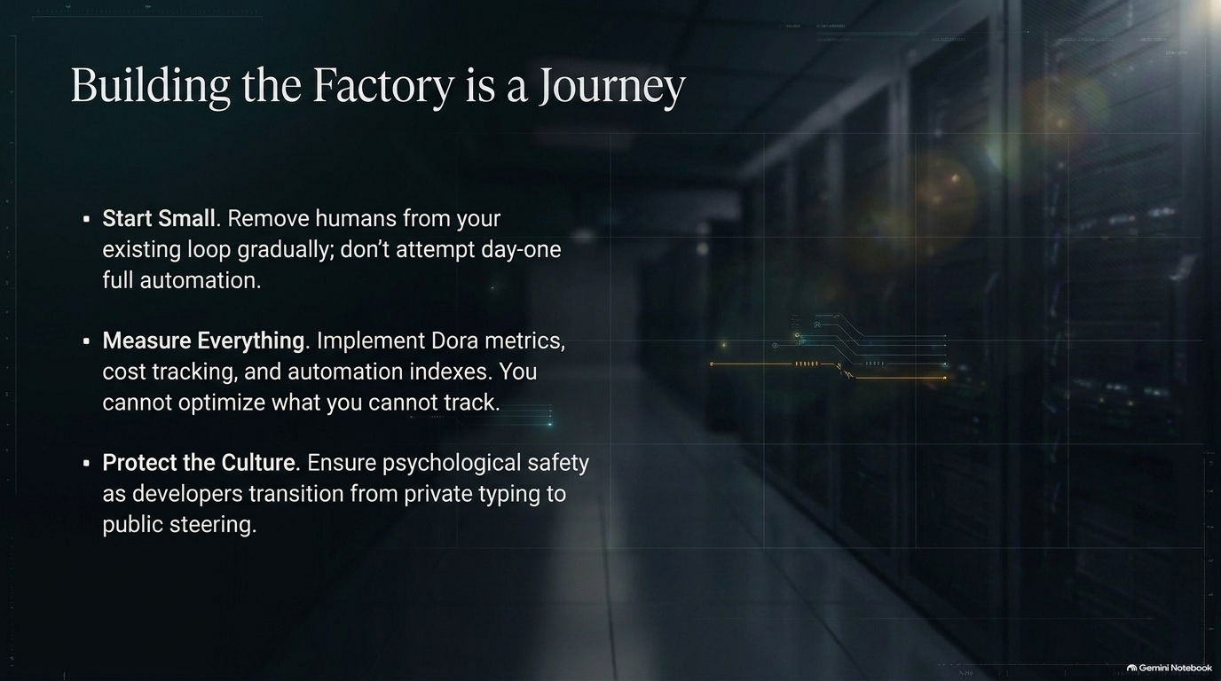
Notes:
Estimated Speaking Time: 4–5 minutes
Speaker Notes:
Pivot from technical architecture to the hardest challenge of all: People and organizational structure.
Highlight why many software factory implementations stall out: Companies often maintain rigid silos where Product owns the "what above the line" and Engineering owns the "how below the line," creating friction and slow cycle times.
Discuss the necessity of structural alignment: To run a high-yield software factory, leadership must bridge the gap between product outcomes and engineering execution, fostering a culture of radical transparency, shared ownership, and continuous adaptation.
Share the classic enterprise lesson: Sometimes the best consulting advice you can give an organization wanting an advanced software factory is to tell them no—send them away to fix their foundational culture and alignment first, before attempting to automate a broken process.

Slide 16
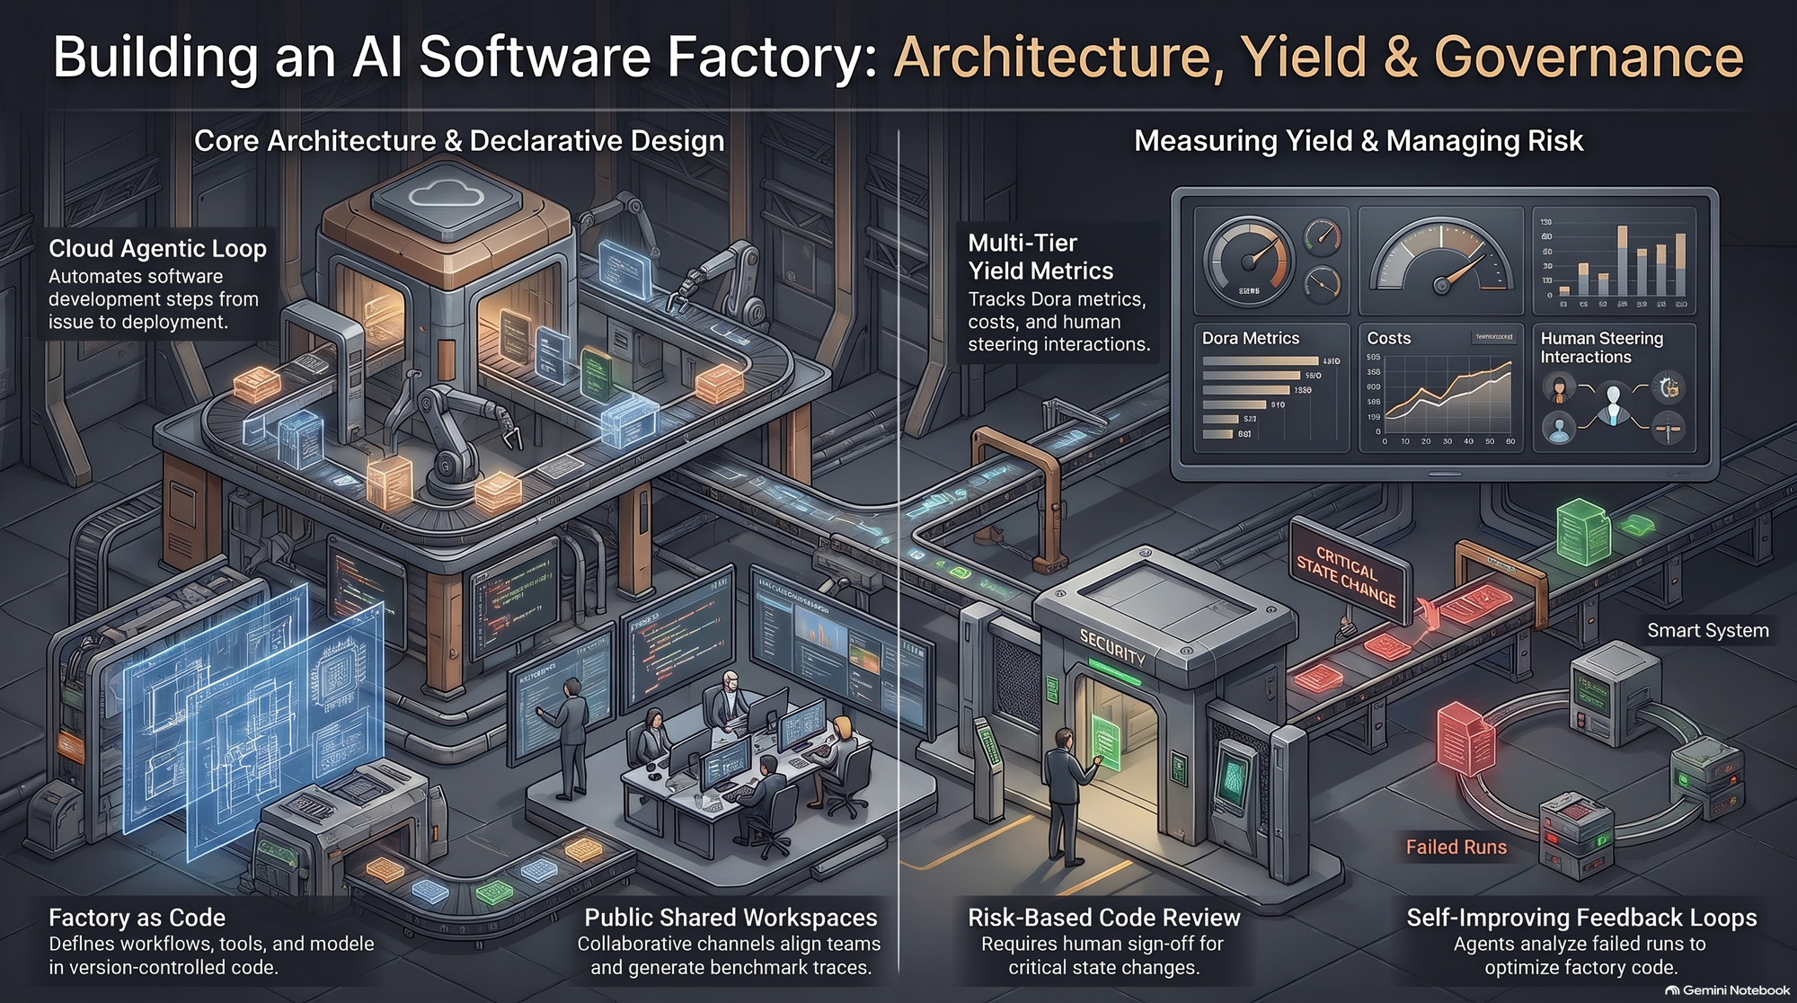
Notes:
Estimated Speaking Time: 3–4 minutes
Speaker Notes:
Summarize the core takeaways from today's presentation:
Software factories are not just about better IDE tools; they are cloud-native, measurable loops.
Success requires declarative factory definitions, online evaluations, and disciplined risk-managed code reviews.
Culture and psychological safety are just as critical as the underlying agent harness.
Provide a clear call to action for engineering leaders: Start small by capturing your team's workflow traces, experiment with cloud-backed agent loops, embrace working in the open, and systematically tune your factory yield every single day.
Open the floor for questions and further discussion.

