Slide 1
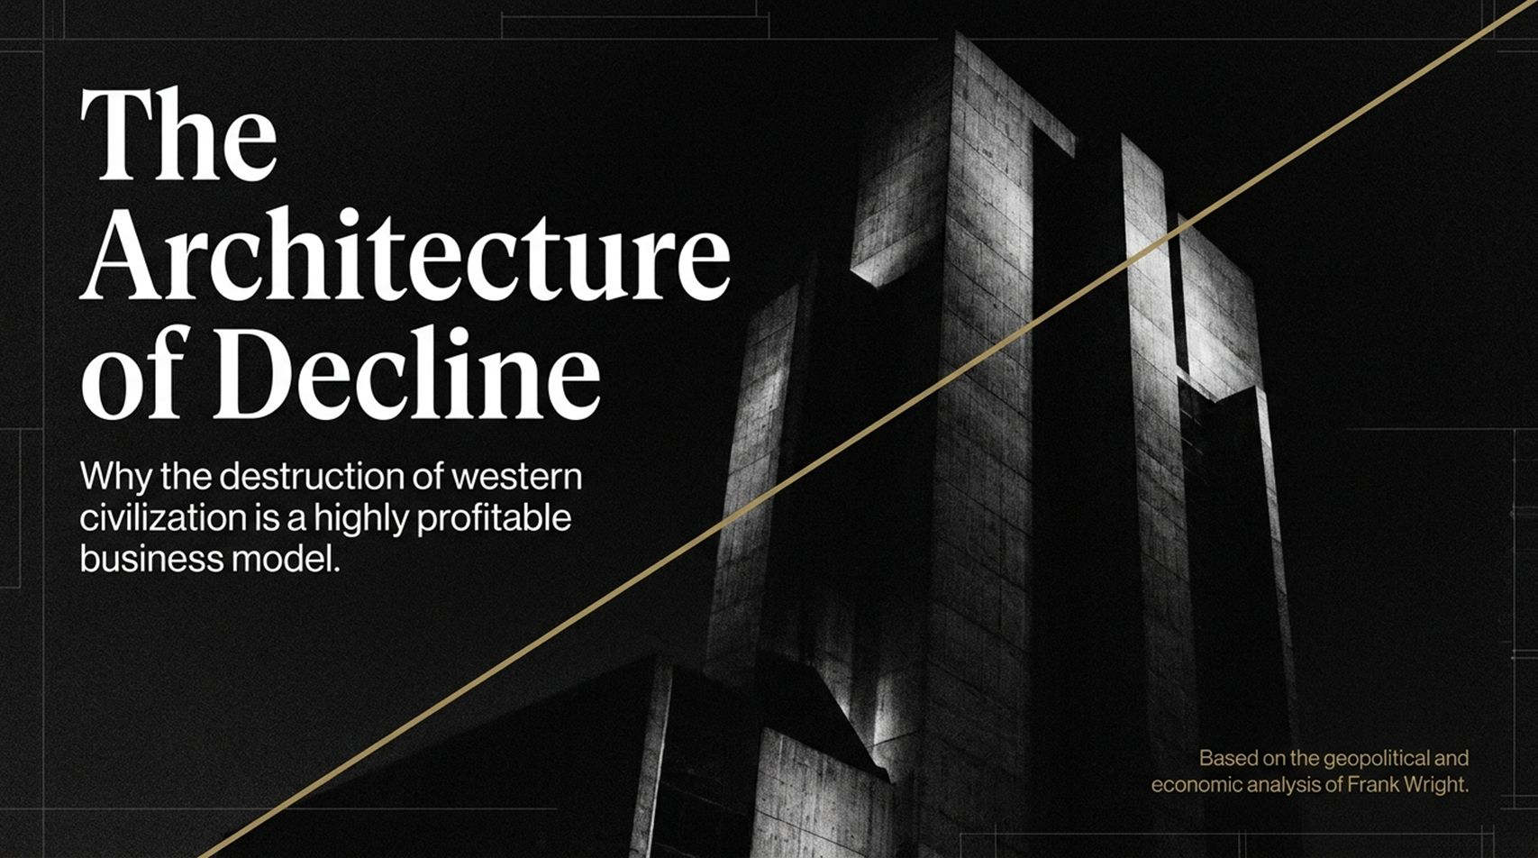
Notes:
Estimated Presentation Time: 2–3 minutes
Visual Reference: Dark architectural monolithic structure with a golden intersecting vector line.
Core Theme: Introduction to Frank Wright’s geopolitical and economic analysis regarding how the destruction of Western civilization operates as a monetization model.
Speaker Script:
"Good morning, everyone. Welcome. Today, we are going to explore a provocative, deeply unsettling, yet mathematically grounded thesis: The Architecture of Decline.
When we look around at the state of Western civilization—whether it's the decay of our cities, the atomization of communities, or the crushing weight of cost-of-living crises—we are often told these are random accidents of history, unfortunate side effects of progress, or systemic failures we just need to 'tweak.'
Drawing heavily upon the geopolitical and economic analysis of Frank Wright, this presentation argues the exact opposite. What we are experiencing is not an accidental failure; it is a deliberate, highly profitable business model. Over the next slides, we will unpack how the replacement of real national wealth with endless debt has created a machine that commodifies our decay—and more importantly, what we must do to break free from it."
Economics Decline Is a Business Model | Frank Wright
https://www.youtube.com/watch?v=zQ-zbZNI4_Y

Slide 2
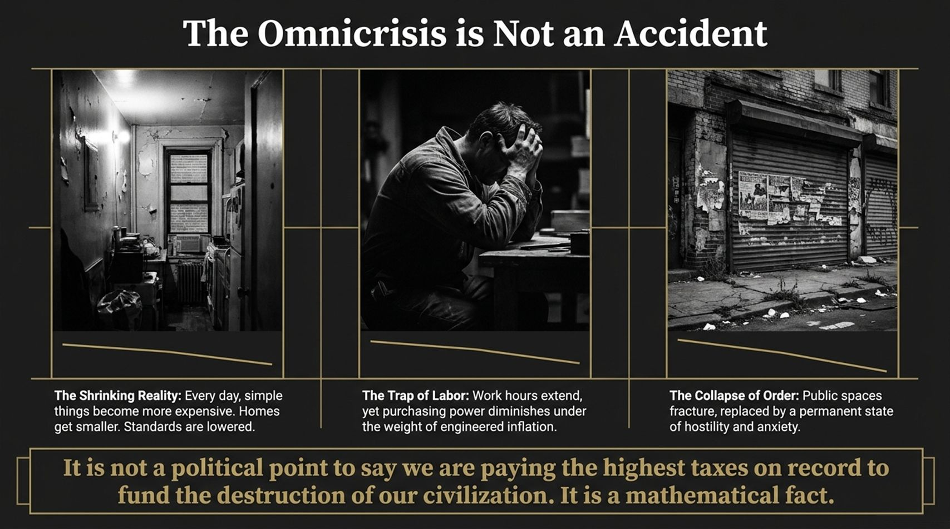
Notes:
Estimated Presentation Time: 3–4 minutes
Visual Reference: Three-panel view depicting a shrinking living space, an exhausted worker holding his head, and a derelict urban storefront. Quote banner at the bottom.
Core Theme: The daily squeeze on citizens—shrinking reality, trapped labor, collapsing public order—driven by engineered inflation.
Speaker Script:
"Let’s start by looking at what people call the 'omnicrisis.' Everywhere you look, reality is shrinking. Simple things are getting more expensive, homes are getting smaller, and baseline living standards are quietly being lowered.
Look at the panels on screen:
The Shrinking Reality: Families find themselves paying more for less space and lower quality.
The Trap of Labor: People are working longer hours, yet their purchasing power constantly diminishes under the invisible weight of engineered inflation.
The Collapse of Order: Public spaces are fracturing, replaced by a permanent background state of hostility, anxiety, and urban decay.
As Frank Wright highlights in his discussions on What Bitcoin Did, 'practically every aspect of the destruction of our civilization is also a business model.' It is not a partisan political talking point to state that we are paying the highest taxes on record to fund the systemic destruction of our own civilization; it is a mathematical fact."

Slide 3
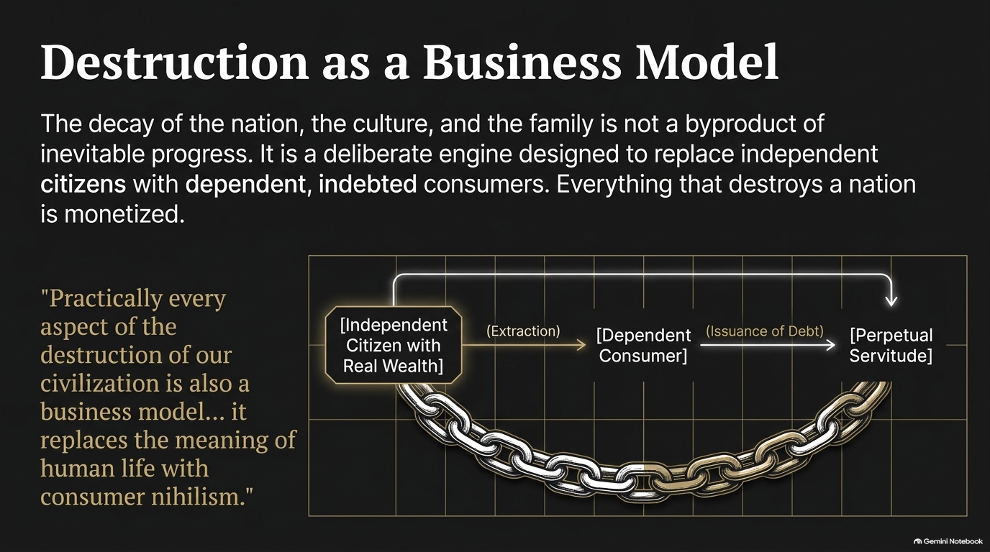
Notes:
Estimated Presentation Time: 3–5 minutes
Visual Reference: Chain graphic flowing from an 'Independent Citizen with Real Wealth' to a 'Dependent Consumer' and into 'Perpetual Servitude.'
Core Theme: How the decay of culture, nation, and family is monetized to transition independent people into indebted consumers.
Speaker Script:
"To understand why our society feels like it is unravelling, we have to look at the economic engine underneath it. The decay of the nation, traditional culture, and the nuclear family is not a byproduct of inevitable progress. It is a deliberate mechanism designed to replace the independent citizen—who owns real wealth and land—with the dependent, indebted consumer.
Everything that destroys a nation is monetized. As Frank Wright notes: 'It replaces the meaning of human life with consumer nihilism.'
Notice the chain on the slide:
Real wealth and independence are extracted from the citizen.
Through the issuance of debt, they are transformed into a dependent consumer.
Finally, that consumer cycle locks them into perpetual servitude.
If you make people spiritually rootless, culturally fractured, and financially insecure, they stop being citizens capable of self-governance and become permanent renters of their own lives."

Slide 4
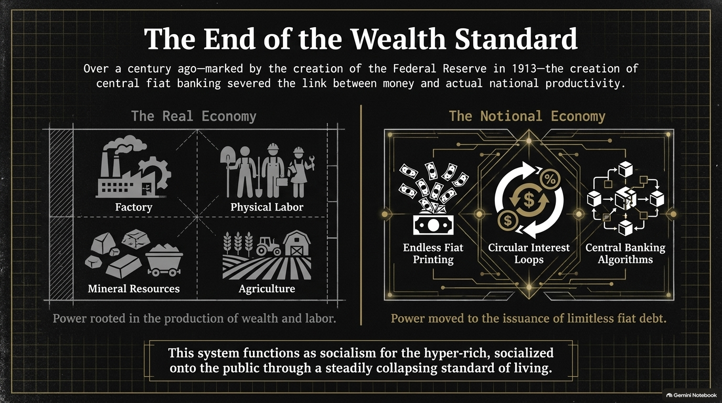
Notes:
Estimated Presentation Time: 3–5 minutes
Visual Reference: Split comparison between 'The Real Economy' (factories, agriculture, physical labor, mineral resources) and 'The Notional Economy' (fiat printing, circular interest loops, central banking algorithms).
Core Theme: The severance of money from productivity in 1913 and the rise of fiat debt supremacy.
Speaker Script:
"How did we get here? Over a century ago—marked explicitly by the creation of the Federal Reserve in 1913—central fiat banking severed the link between money and actual national productivity.
On the left, you see The Real Economy: factories, physical labor, mineral resources, and agriculture. This is where power is rooted in the physical production of genuine wealth and human labor.
On the right, you see The Notional Economy: endless fiat printing, circular interest loops, and complex central banking algorithms. Power shifted entirely from the workshop and the farm to the issuance of limitless fiat debt.
As Frank Wright points out, replacing real wealth with debt gave central authorities the power to inflate or collapse national economies at will. This system functions as socialism for the hyper-rich, socialized onto the public through a steadily collapsing standard of living."

Slide 5
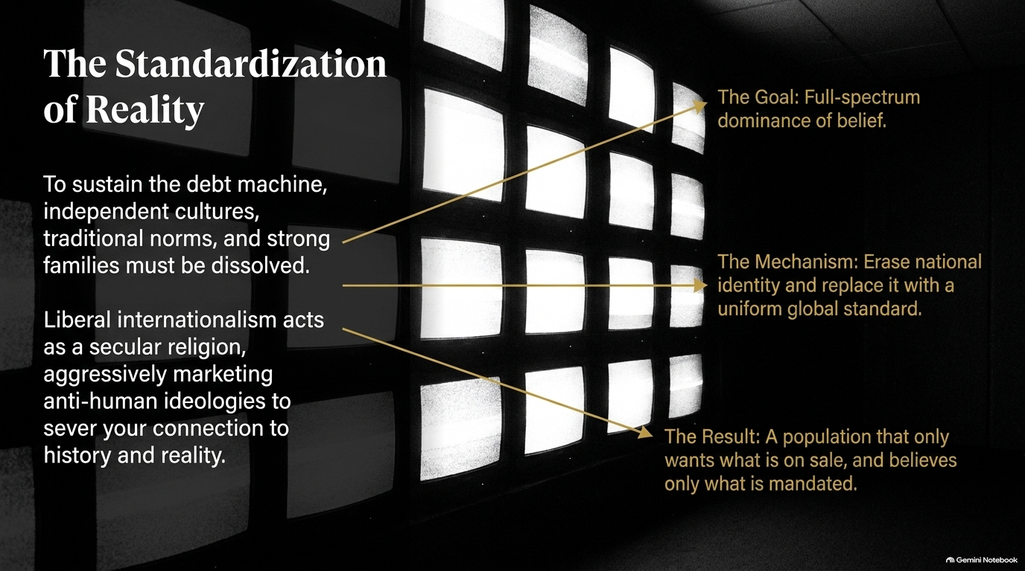
Notes:
Estimated Presentation Time: 3–5 minutes
Visual Reference: Grid of glowing white TV screens with annotation callouts explaining the goal, mechanism, and result of liberal internationalism.
Core Theme: Erasing national identity and traditional norms via a secular global religion to enforce uniform consumer behavior.
Speaker Script:
"To sustain a debt machine that constantly extracts value, independent cultures, traditional norms, and strong families must be dissolved. Why? Because strong local cultures create resistance to globalized financial extraction.
Liberal internationalism acts as a secular religion, aggressively marketing ideologies that sever people’s connection to history and objective reality.
The Goal: Full-spectrum dominance of belief.
The Mechanism: Erase national identity and replace it with a uniform global standard.
The Result: A population that only wants what is on sale, and believes only what is mandated.
As Frank Wright discusses in his work, these systems cannot survive an honest argument at the street level. That is why dissent is managed, speech is policed, and alternative viewpoints are systematically scrubbed."

Slide 6
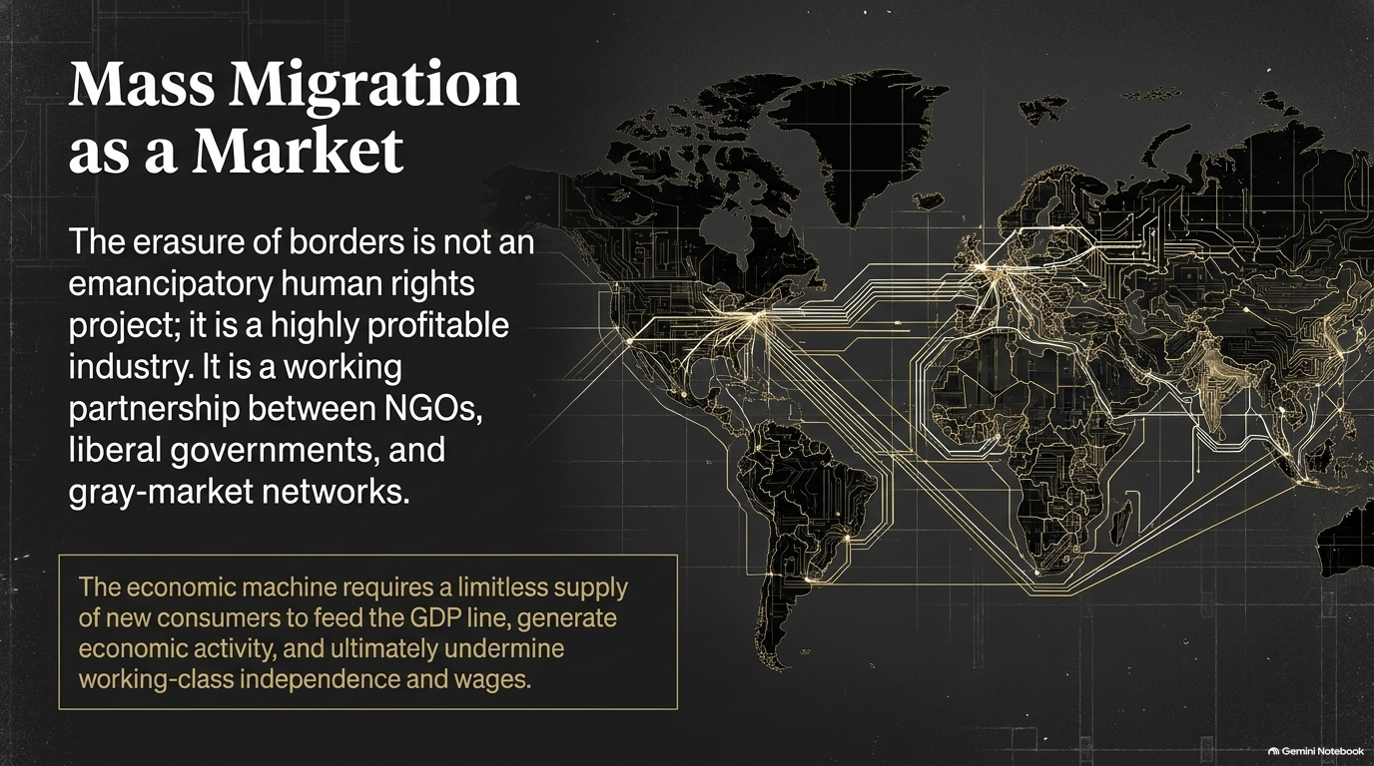
Notes:
Estimated Presentation Time: 3–5 minutes
Visual Reference: Global map overlaid with glowing digital transit and financial network lines.
Core Theme: Viewing mass migration not through a humanitarian lens, but as a profitable corporate and geopolitical market designed to suppress wages and fuel GDP lines.
Speaker Script:
"One of the most profound and controversial points in Frank Wright’s analysis is the true nature of mass migration. The erasure of borders is not an emancipatory human rights project; it is a highly profitable industry operated through a partnership between NGOs, liberal governments, and gray-market networks.
The economic machine requires a limitless supply of new consumers to feed the GDP line, generate economic activity, and ultimately undermine working-class independence and wages.
When domestic labor becomes too expensive or unionized, or when citizens begin demanding a fair share of national wealth, the system simply imports an elastic supply of labor. It treats human beings as disposable inputs to keep the debt engine running just a little longer."

Slide 7
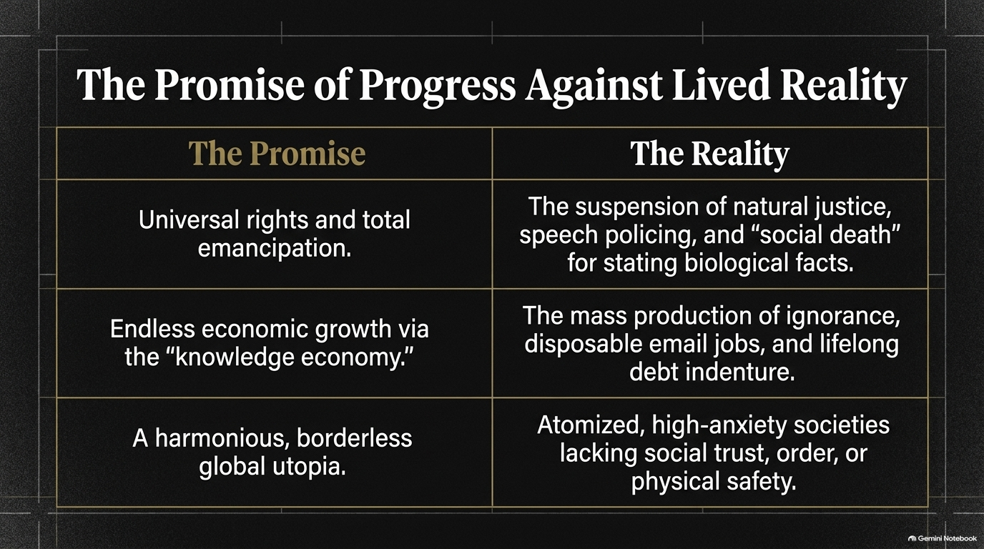
Notes:
Estimated Presentation Time: 3–5 minutes
Visual Reference: Comparative table contrasting utopian liberal promises with grim lived realities.
Core Theme: Comparing the high-sounding rhetoric of globalist progress against the bleak, atomized reality experienced by ordinary citizens.
Speaker Script:
"Let’s examine the stark contrast between the promises we are sold and the reality we live every single day:
The Promise of Universal Rights: Sells total emancipation. The Reality: The suspension of natural justice, active speech policing, and 'social death' for stating basic biological facts.
The Promise of Endless Economic Growth: Billed as the 'knowledge economy'. The Reality: The mass production of ignorance, disposable email jobs, and lifelong debt indenture for younger generations.
The Promise of a Harmonious Global Utopia: A borderless world. The Reality: Atomized, high-anxiety societies completely lacking social trust, civic order, or physical safety.
The wallpaper of modern propaganda tells us everything is getting better, while our lived reality tells us our civilization is coming apart at the seams."

Slide 8

Notes:
Estimated Presentation Time: 3–5 minutes
Visual Reference: Shadowed portrait of a young person overlaid with a volatile jagged financial debt graph.
Core Theme: Intergenerational theft through perpetual fiat debt, reducing the youth to modern serfs.
Speaker Script:
"Perhaps the most immoral aspect of this debt machine is its theft of the future. A society that lives on perpetual fiat debt is essentially telling its unborn children: 'We want stuff now, and you will pay for it.'
Consider the scale: governments borrow billions on a monthly basis, adding hundreds of pounds or dollars of unfunded liabilities to every single family in days.
As T.S. Eliot’s 'Hollow Men,' we are witnessing a generation reduced to feudal serfs—engrossed in technological distraction, finding marriage and homeownership economically impossible, and systematically blocked from building a future. We are mortgaging the lives of our grandchildren to pay for the bureaucratic and financial excess of today."

Slide 9
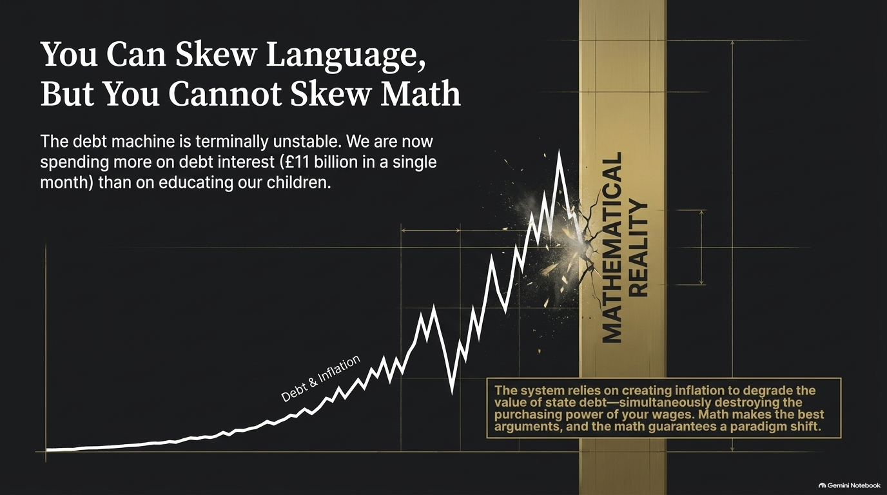
Notes:
Estimated Presentation Time: 3–5 minutes
Visual Reference: Exponential debt curve crashing head-on into a solid golden wall labeled 'Mathematical Reality.'
Core Theme: The unyielding nature of economic math. Debt servicing costs eclipsing fundamental public services like education.
Speaker Script:
"Politicians and central bankers can skew language, spin narratives, and manipulate public opinion, but you cannot skew math. Math is absolute.
The debt machine is terminally unstable. Look at the trajectory: Western nations are now spending more money servicing debt interest in a single month than they spend on educating their own children.
The system relies on creating inflation to quietly default on the value of state debt—simultaneously destroying the purchasing power of your wages. You can argue politics all day long, but the math guarantees a hard, unavoidable paradigm shift."

Slide 10
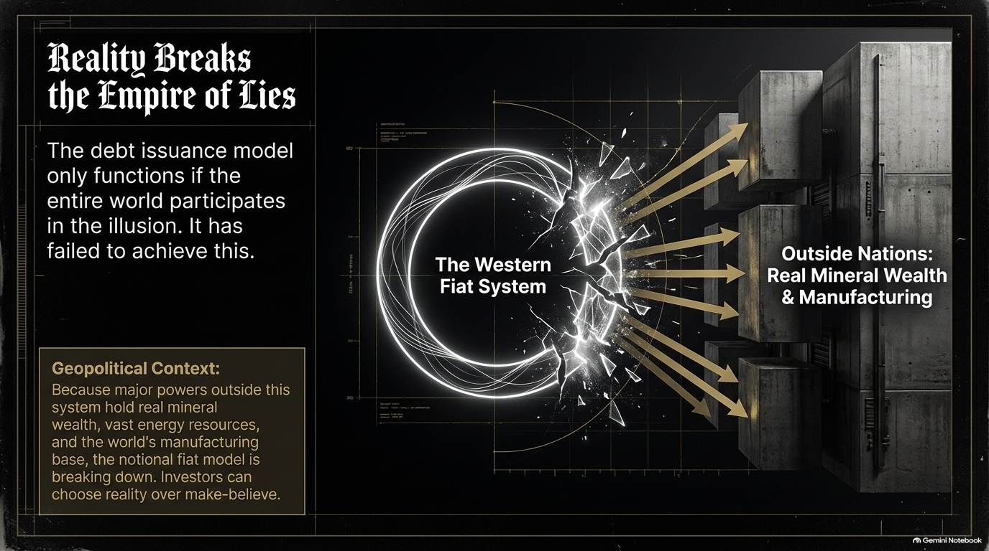
Notes:
Estimated Presentation Time: 3–5 minutes
Visual Reference: Glowing Western fiat circular system cracking open, with golden light bursting toward solid monolithic blocks labeled 'Outside Nations: Real Mineral Wealth & Manufacturing.'
Core Theme: The geopolitical fracture of the Western fiat system as resource-rich nations reject Western financial illusions.
Speaker Script:
"This debt issuance model only functions if the entire world participates in the illusion. But that illusion has failed.
Major geopolitical powers outside the Western sphere hold real mineral wealth, vast energy resources, and the world’s core manufacturing base. As these nations decouple and trade in real assets, the notional fiat model breaks down.
Global investors and sovereign states are increasingly forced to choose between make-believe financial derivatives and hard physical reality. The empire of lies is colliding with the physical world."

Slide 11
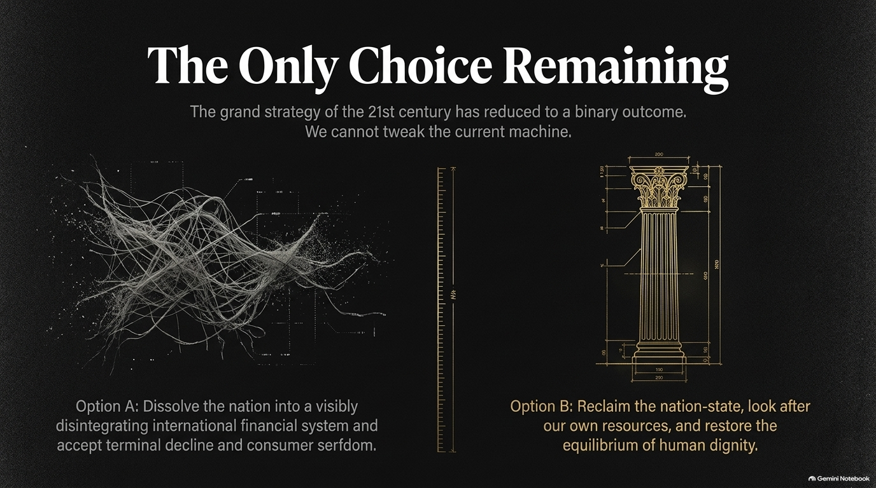
Notes:
Estimated Presentation Time: 3–5 minutes
Visual Reference: Binary contrast between a chaotic, tangled digital mess (Option A) and a clean, structured classical architectural column blueprint (Option B).
Core Theme: The binary strategic choice of the 21st century: terminal consumer serfdom versus reclaiming the sovereign nation-state.
Speaker Script:
"We have reached a point where the grand strategy of the 21st century has been reduced to a stark, binary outcome. We cannot simply tweak or reform the current machine; it is beyond repair.
Option A: Dissolve the nation entirely into a visibly disintegrating international financial system and accept terminal decline and consumer serfdom.
Option B: Reclaim the nation-state, look after our own resources, and restore the equilibrium of human dignity.
There is no middle ground left. We either surrender our sovereignty to global technocrats or rebuild our nations from the ground up."

Slide 12
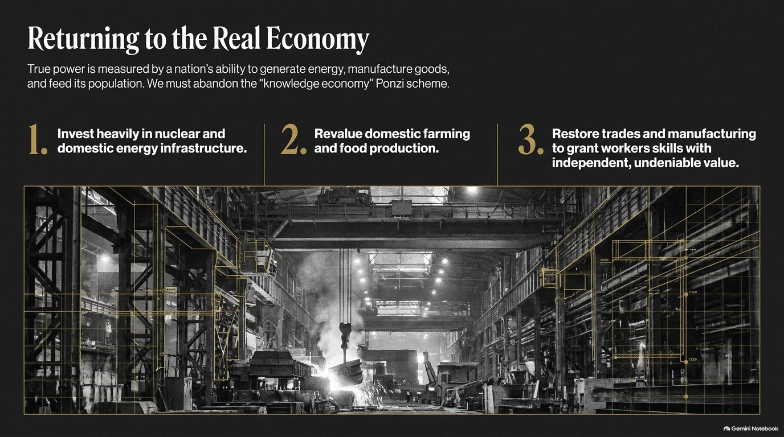
Notes:
Estimated Presentation Time: 3–5 minutes
Visual Reference: Heavy industrial factory floor annotated with engineering grids, paired with three core actionable pillars.
Core Theme: Three pillars for national economic renewal: nuclear energy, domestic farming, and skilled industrial trades.
Speaker Script:
"To survive, we must abandon the 'knowledge economy' Ponzi scheme and return to the real economy. True power is measured by a nation’s physical ability to generate energy, manufacture goods, and feed its own population.
We must execute three vital steps:
Invest heavily in nuclear and domestic energy infrastructure: Without cheap, abundant energy, civilization cannot function.
Revalue domestic farming and food production: Food security is national security; we cannot outsource our sustenance.
Restore trades and manufacturing: Grant workers tangible skills with independent, undeniable value rather than precarious administrative jobs."

Slide 13

Notes:
Estimated Presentation Time: 3–5 minutes
Visual Reference: Multigenerational family gathered in a warm, traditional home setting. Three pillars for cultural restoration.
Core Theme: Restoring the family as the basic unit of the nation through pro-family economic policies and public safety.
Speaker Script:
"Culture is not produced by television networks, corporate HR departments, or state propaganda; it is produced organically by families. The family is the basic unit of the nation.
To rebuild our culture, we must:
Realign economic policy: Make marriage and homeownership genuinely viable for the young again.
Reject the state-sponsored war on norms and biology: Return to objective truth and common sense.
Enforce the law: Return safety, order, and basic trust to our public spaces.
When you make it economically impossible for young people to marry and buy a home, you actively prevent the next generation from existing."

Slide 14
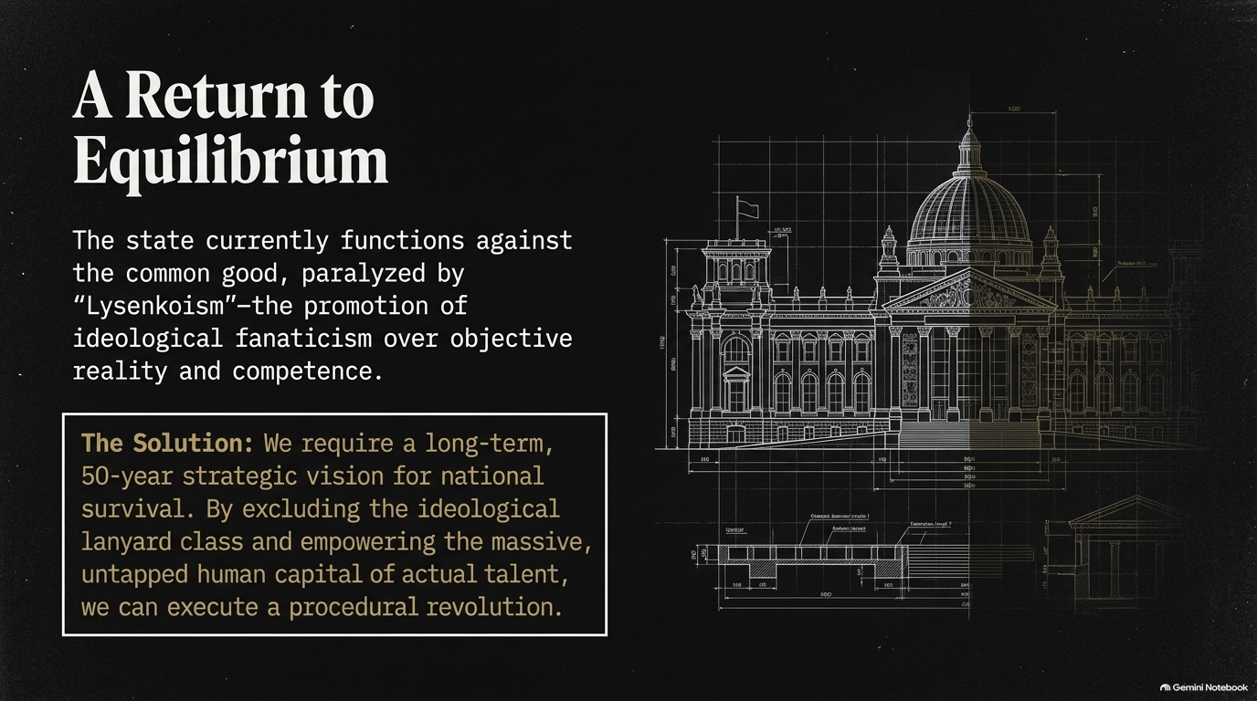
Notes:
Estimated Presentation Time: 3–5 minutes
Visual Reference: Architectural blueprint of a classical government building, contrasting ideological fanaticism with competence.
Core Theme: Overcoming 'Lysenkoism'—the institutional promotion of ideology over competence—through a 50-year strategic vision.
Speaker Script:
"Right now, the state functions directly against the common good, paralyzed by what Frank Wright identifies as 'Lysenkoism'—the institutional promotion of ideological fanaticism over objective reality and competence.
The Solution: We require a long-term, 50-year strategic vision for national survival. By excluding the ideological lanyard class and empowering the massive, untapped human capital of actual talent across our population, we can execute a procedural revolution.
As Frank Wright noted about the grassroots energy behind restoration efforts: millions of talented people are ready to offer their skills when given the banner to do so."

Slide 15
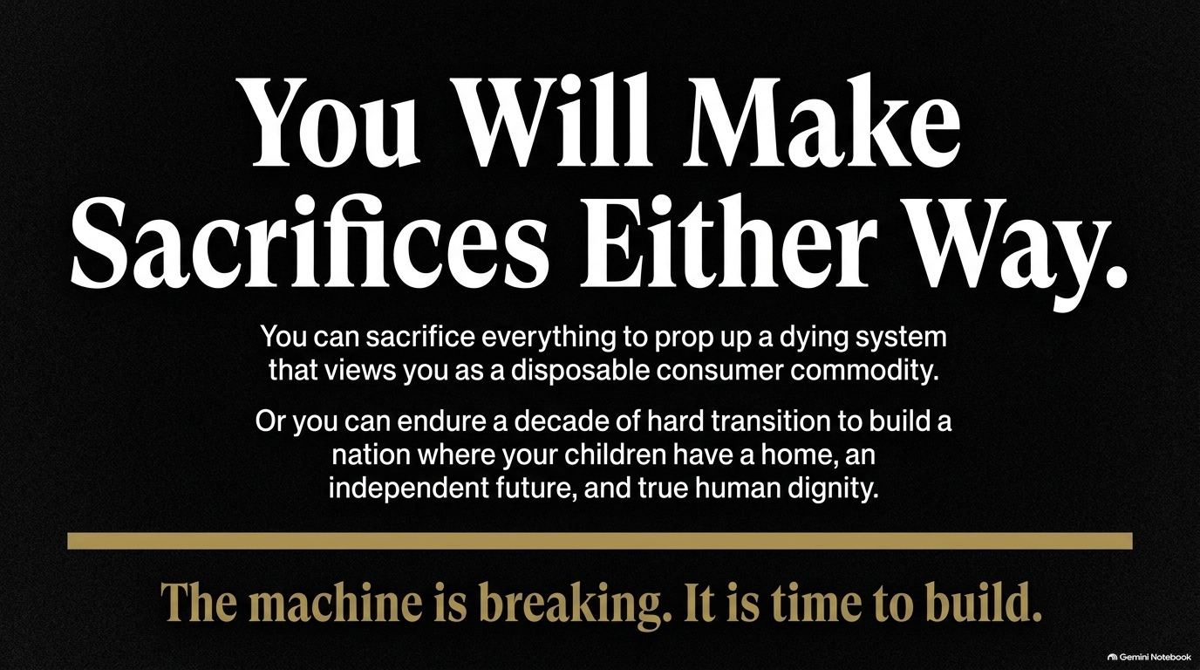
Notes:
Estimated Presentation Time: 2–4 minutes
Visual Reference: High-contrast typography emphasizing the unavoidable nature of sacrifice during systemic transitions.
Core Theme: The choice of sacrifice: propping up a dying consumer trap versus enduring a hard decade of building a sustainable future.
Speaker Script:
"As we close, let us be entirely clear about one fundamental truth: You will make sacrifices either way.
You can sacrifice your wealth, your children's future, and your dignity to prop up a dying system that views you as a disposable consumer commodity.
Or, you can endure a decade of hard transition to build a nation where your children actually have a home, an independent future, and true human dignity.
The machine is breaking. It is time to stop propping up our own decline—it is time to build."

Slide 16
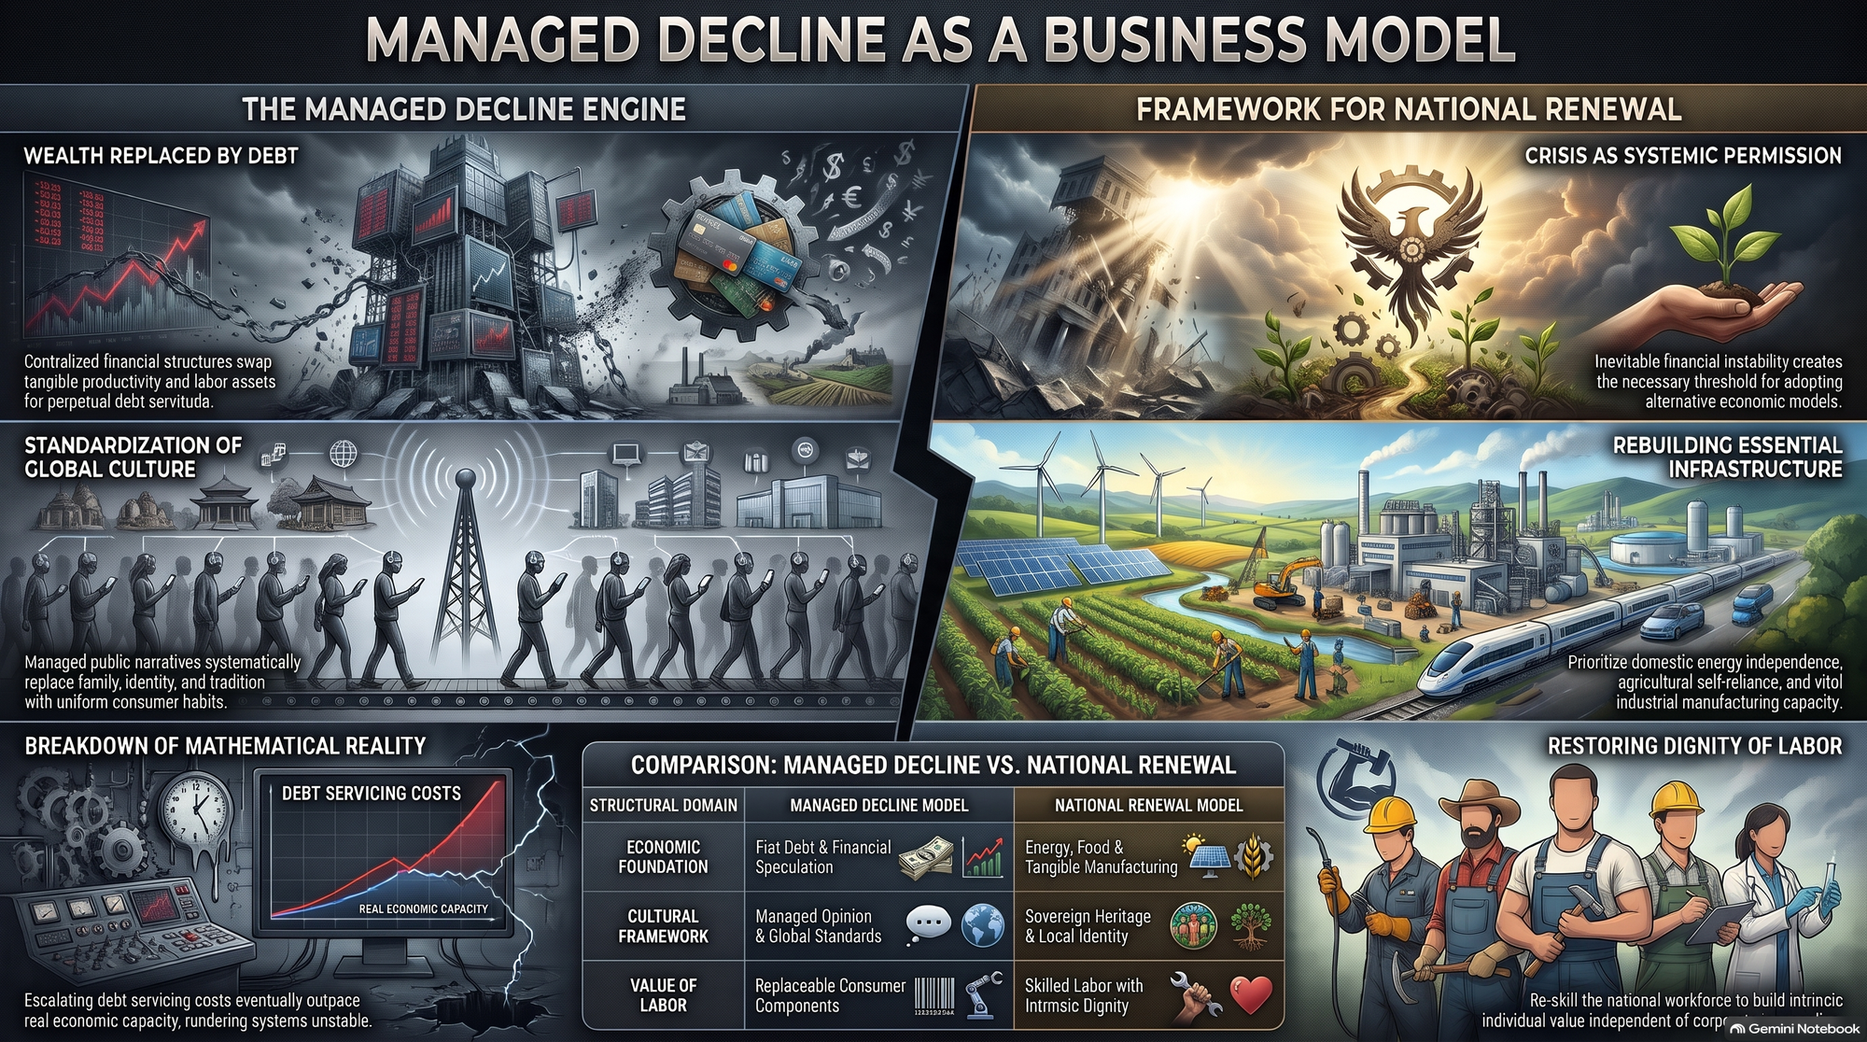
Notes:
Estimated Presentation Time: 3–5 minutes
Visual Reference: Comprehensive comparison dashboard contrasting the 'Managed Decline Engine' with the 'Framework for National Renewal.'
Core Theme: Comprehensive summary contrasting the decaying fiat/consumer model with the regenerative national renewal model.
Speaker Script:
"This final slide brings our entire journey together into a clear side-by-side comparison.
On the left is the Managed Decline Model:
An economic foundation built on fiat debt and financial speculation.
A cultural framework driven by managed opinions and global standards.
Labor reduced to replaceable consumer components.
On the right is the Framework for National Renewal:
An economic foundation anchored in energy, food, and tangible manufacturing.
A cultural framework rooted in sovereign heritage and local identity.
Labor elevated through skilled trades with intrinsic human dignity.
The choice is ours. Thank you very much, and I welcome your questions and discussion."

