Slide 1
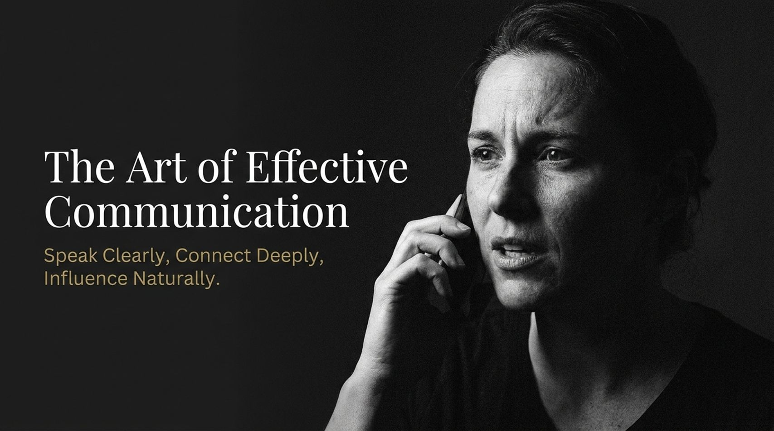
Notes:
Visual: Dark background with subtle water textures and a warm, glowing light source emerging from the bottom center.
Suggested Speaking Time: 2–3 minutes
Speaker Notes:
"Welcome, everyone. Take a deep breath and settle into the space we are sharing today. We are here to explore The Anatomy of Authentic Power. When we hear the word 'power,' many of us immediately think of control, dominance, or external hierarchy. But true, authentic power is entirely different. It is not something you seize, force, or demand from the world. It is something that arises naturally from within when your inner guidance, your truth, and your actions are completely aligned. Over our time together, we are going to look beneath the surface of daily friction, societal noise, and past trauma to examine how authentic power is built piece by piece. Notice the imagery on this screen: light breaking through deep, dark waters. That is what we are after today—bringing your authentic light out of the hidden depths and into your daily life."
The Art of Effective Communication: Speak Clearly, Connect Deeply, Influence Naturally | Audiobook
https://www.youtube.com/watch?v=VKzDL57rYRM

Slide 2
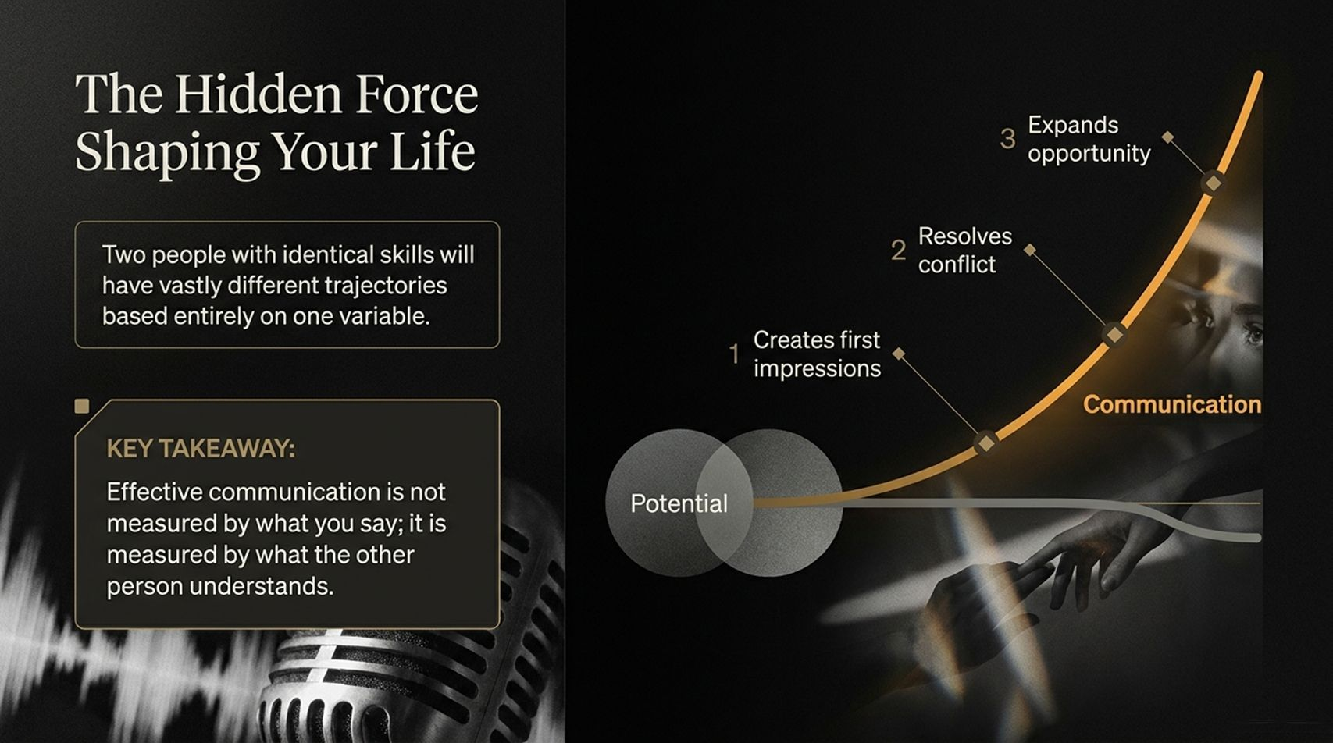
Notes:
Visual: A majestic view of Earth from space with golden light filtering through clouds, accompanied by an Oprah Winfrey quote.
Suggested Speaking Time: 3–4 minutes
Speaker Notes:
"Let's begin with a fundamental truth expressed beautifully by Oprah Winfrey: 'You were born into this planet, into the density of this gravitational pull to fulfill the dream of your life and of the creator's dream of your life here on Earth.' Think about the weight of that statement. You did not arrive here by accident. You were endowed with unique gifts, a specific perspective, and an offering that only you can bring to this world. Yet, how often do we wake up feeling heavy, disconnected, or weighed down by the sheer gravity of daily obligations? We get caught up trying to survive, trying to fit in, or trying to please everyone else. But your soul remembers why it came here. The friction you feel in your life right now—that internal restlessness—is often just your soul reminding you of the promise you made to yourself before you arrived. You were born to fulfill a dream, and everything we discuss today is designed to help you clear the path to that destiny."

Slide 3
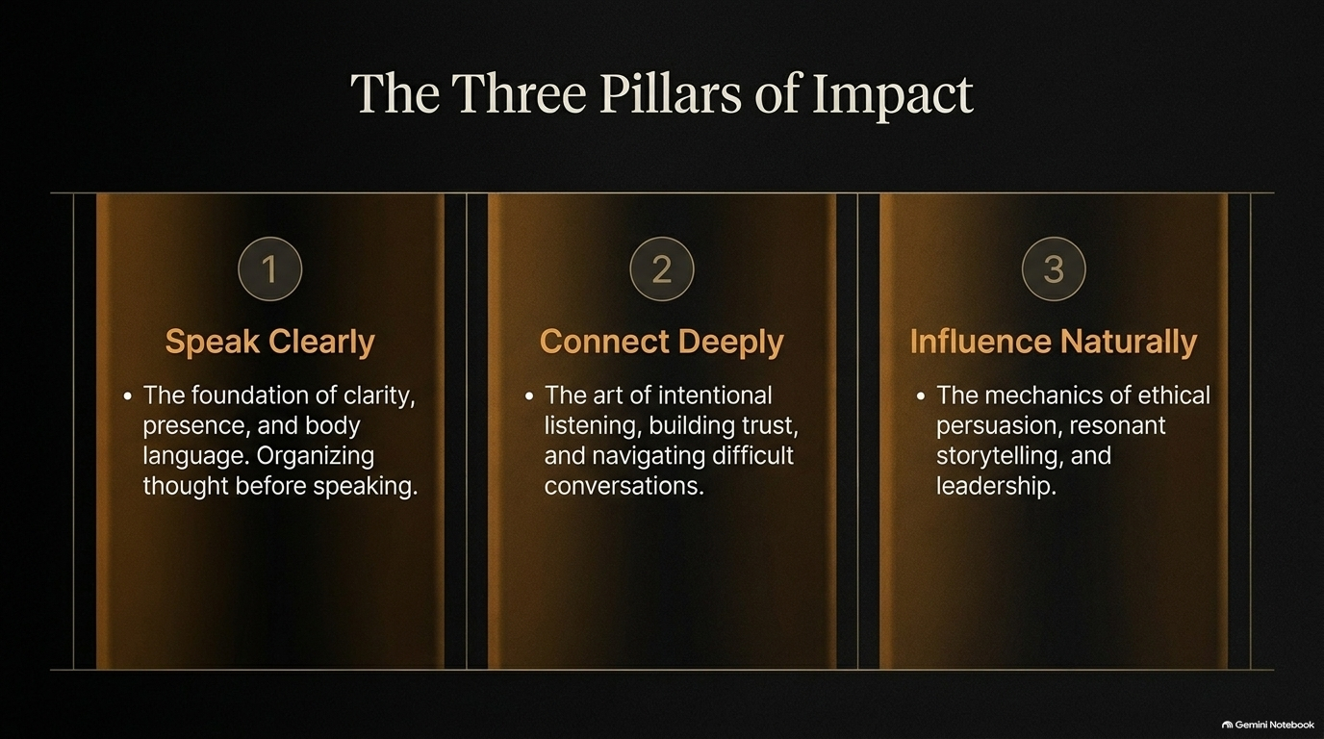
Notes:
Visual: A split composition featuring old tree roots tangled with rusted chains on the left and dark waters on the right, listing symptoms like waking up at 3 AM or numbness.
Suggested Speaking Time: 4–5 minutes
Speaker Notes:
"When you ignore your internal call, life becomes a debilitating force field of friction. Are you currently out of flow? Let's check the symptoms, because resistance rarely whispers forever; eventually, it shouts.
First, do you find yourself waking up at 3 AM, unable to breathe, suddenly struck by the realization that you have committed your precious life energy to something your soul completely rejects?
Second, do you experience numbness to both receiving and giving—feeling as though you are trapped behind an invisible glass wall, watching life happen rather than participating in it?
Third, look at your physical environment. Does your external chaos mirror your internal clutter—is your car floorboard littered with random debris, or is your workspace drowning in disarray because your inner world is overwhelmed?
And finally, are you ignoring the sledgehammer? Are you feeling a sick knot of dread every time a text message notification pops up, or experiencing absolute stomach-churning anxiety as you pull into the parking lot of a job you hate? Recognize these symptoms not as a life sentence, but as diagnostic data. Your body and your environment are telling you loud and clear: you are resisting your truth."

Slide 4
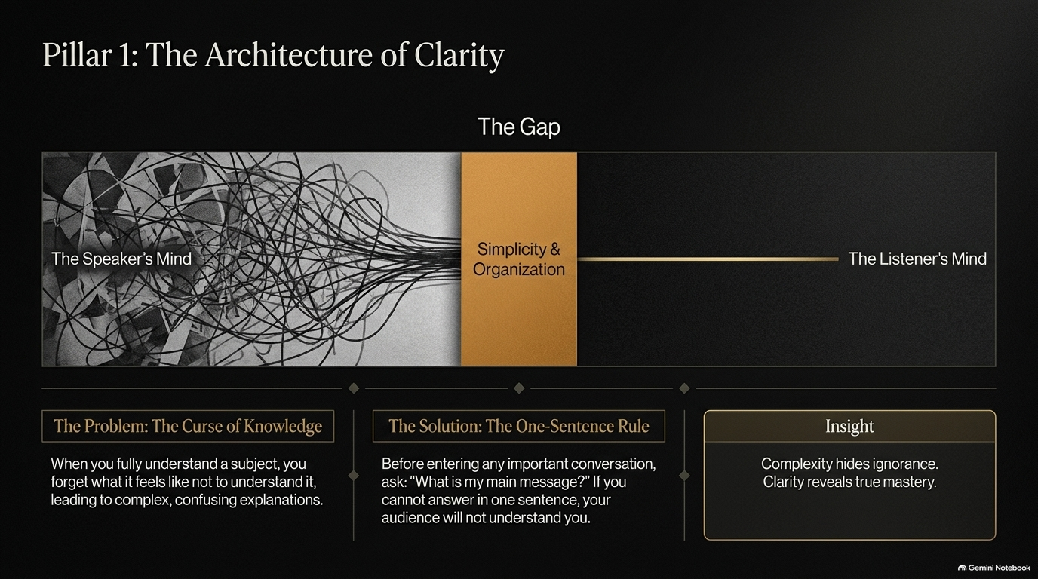
Notes:
Visual: A concentric diagram contrasting the outer layers of societal expectations and the 'disease to please' with the central golden sphere of 'The Inner GPS'.
Suggested Speaking Time: 4–5 minutes
Speaker Notes:
"Silence is the language of truth. You cannot hear your internal navigation system until you actively lower the volume of the world. Look at this diagram. Encasing your core are layers upon layers of static: societal expectations, Instagram myths, the opinions of your family, your peers, and strangers online. Moving inward, we hit the next dense layer—the disease to please, chronic resentment, and the paralyzing fear of looking foolish. But right at the center is your Inner GPS: your intuition, your stillness, your deep felt sense of knowing. The answers you are searching for are not out there on someone else's highlight reel. They are only found when you become still enough, quiet enough, to feel what is trying to get through the static. Stop looking outward for permission or direction. Turn down the external noise and recalibrate to your internal compass."

Slide 5
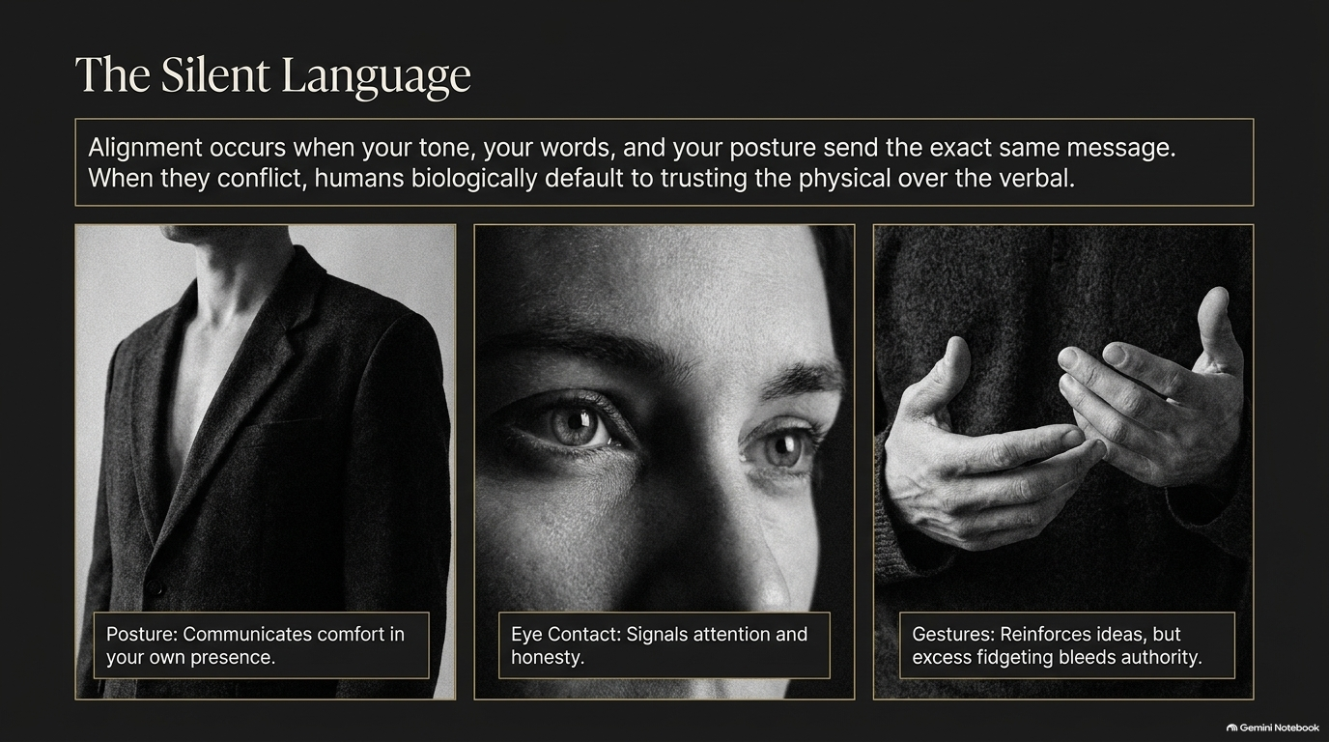
Notes:
Visual: An aged wooden door partially open with warm golden light spilling through, illustrating a story about churning butter and domestic expectations.
Suggested Speaking Time: 4–6 minutes
Speaker Notes:
"If you cannot yet hear an affirmative, crystal-clear calling, don't panic. Start by listening to your absolute 'No.' Identifying what you refuse to accept is vital navigation data. Consider this powerful scene: A four-year-old child is sitting on the floor, churning butter, watching her grandmother boil heavy sheets from grueling domestic labor. The implicit societal expectation hanging in the heavy air is clear: 'One day, you are going to have to learn how to do this for yourself; this is your destiny.' But deep inside the child's spirit, a quiet, unshakeable whisper arises: 'No, you won't. This will not be your life.' Being in a job, a relationship, or a life circumstance that you know deep down you don't want is not a trap with no exit; it is vital information. It is a powerful negative compass coordinate pointing you with absolute precision toward where you actually belong. Your absolute 'No' is the genesis of your liberation."

Slide 6
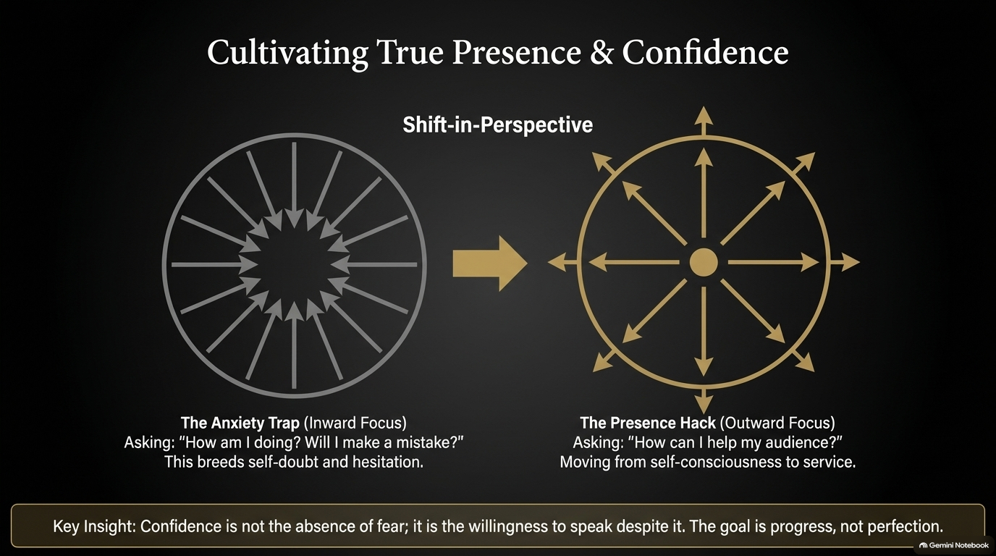
Notes:
Visual: A long, winding dirt road under a starry twilight sky, featuring a 3-step timeline from trauma to transformation and result, paired with a Maya Angelou quote.
Suggested Speaking Time: 4–5 minutes
Speaker Notes:
"As Maya Angelou so powerfully noted: 'I wouldn't take nothing for my journey now.' Think about how we view our past hardships. We often label them as things that happened to us—baggage we must drag around forever. But authentic power requires a radical reframe: viewing your life as happening for you. Look at the trajectory:
The Trauma: Red dirt poverty, outhouses, deep isolation, and profound abuse.
The Transformation: Seeking external validation outside the home, evolving into a master communicator and orator, and building unmatched empathy through suffering.
The Result: 'I was not seen so that I could see other people. All the things I didn't get, I can now give.' Understand this: the universe does not cause your trauma, but once it occurs, it becomes the exact, custom-built curriculum required for your specific offering to the world. Your wound is literally the blueprint of your ministry."

Slide 7
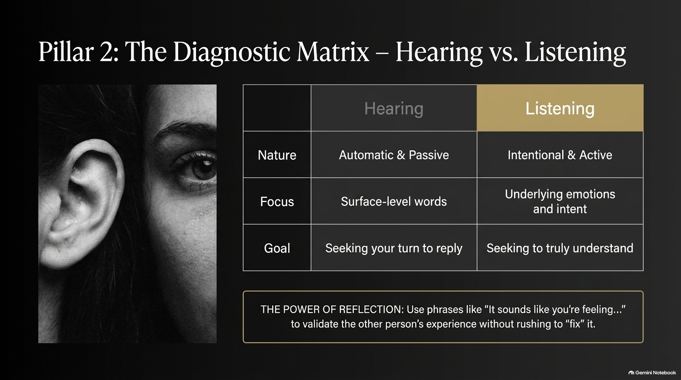
Notes:
Visual: A comparison layout contrasting 'The 10-Gallon Expectation' with 'The Pint-Sized Reality,' anchored by the rule: You cannot extract ten gallons of love from a pint-sized vessel.
Suggested Speaking Time: 3–5 minutes
Speaker Notes:
"Here is a profound relational truth: You cannot extract ten gallons of love from a pint-sized vessel. Think about our deepest disappointments with family members, parents, or partners. We walk around with a 10-gallon expectation—demanding total validation, deep psychological understanding, and absolute acceptance from people who are fundamentally emotionally stunted or operating at a pint-sized capacity. What is the outcome? Perpetual disappointment, triggered trauma, and the agonizing, false belief that you are somehow unlovable. But look at the pint-sized reality: recognizing their actual capacity—whether it's providing a physical roof over your head or cooking a simple meal—and meeting them right there. Acceptance means taking their offering of love on their terms, even if it looks like a plate of food instead of a heartfelt apology. Free your relationships from demands they were never built to fulfill."

Slide 8
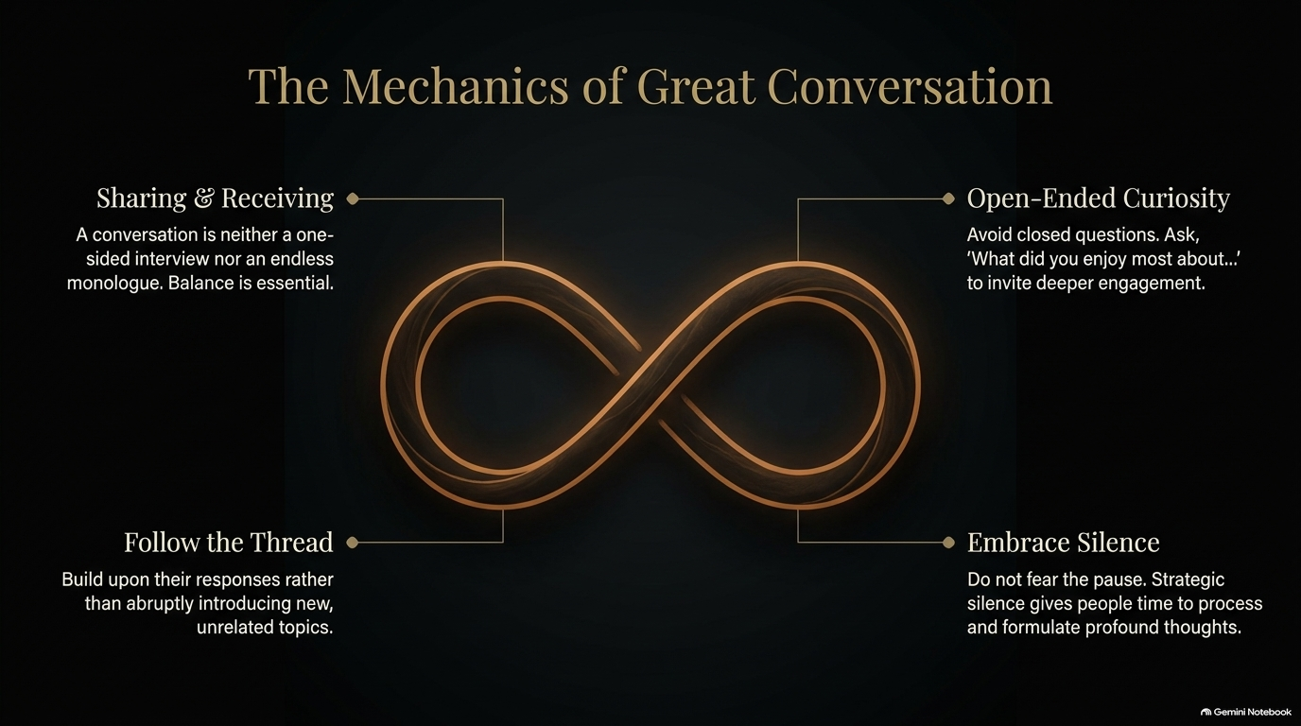
Notes:
Visual: A magnificent stone bridge spanning a misty, starry mountain gorge, broken down into three stages: The Trap, The Pivot, and The Destination.
Suggested Speaking Time: 4–5 minutes
Speaker Notes:
"Forgiveness is giving up the hope that the past could ever be any different. Most people misunderstand forgiveness, viewing it as condoning bad behavior or letting someone off the hook. It is actually an act of fierce self-liberation. Let's cross the Forgiveness Bridge together:
Stage 1: The Trap (Bargaining & Denial): Wishing the tragedy didn't happen. Wishing your parent was a 10-gallon person capable of deep emotional attunement. This fantasy keeps your pain alive and bleeding.
Stage 2: The Pivot (Acceptance): Releasing the exhausting demand for a different history. Acknowledging precisely what happened without requiring it to make logical sense or be fair.
Stage 3: The Destination (Freedom): Taking your vital life energy out of the past prison cell and redirecting it into the vibrant, flowing present moment of your life. Forgiveness isn't for them; it is reclaiming your soul's energy from yesterday so you can live today."

Slide 9
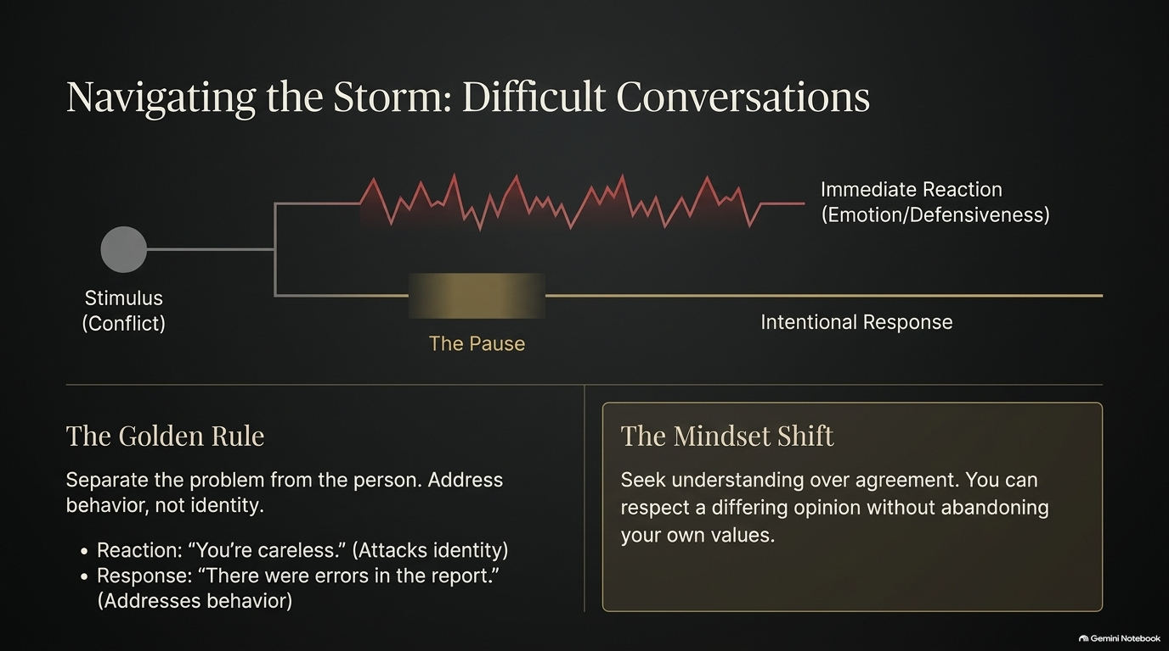
Notes:
Visual: An intricate golden compass gear graphic detailing the cycle of action, hidden motive, energetic output, and life's response.
Suggested Speaking Time: 4–6 minutes
Speaker Notes:
"Intention is inextricably linked with cause and effect—it is the living, irrefutable law of karma. The energetic frequency you put out into the world is precisely what you get back. Let's trace the Intention Engine:
The Action: You say a quick 'Yes' to carpooling, a financial loan, or a burdensome favor.
The Hidden Motive: You didn't act out of genuine desire; you acted from the 'disease to please,' or the paralyzing fear of rejection.
The Energetic Output: Even if you wear a smile, the other person subconsciously feels your underlying acquiescence and pleasure-seeking; while you feel a deep, toxic, silent resentment building inside.
Life's Response: Because your energy is conflicted, they keep asking you for more, sensing your unstable 'yes,' while your own internal friction paralyzes you. The golden rule here is absolute: You must align your external actions with a pure internal motive. If your 'yes' is not clean, your 'yes' is toxic."

Slide 10
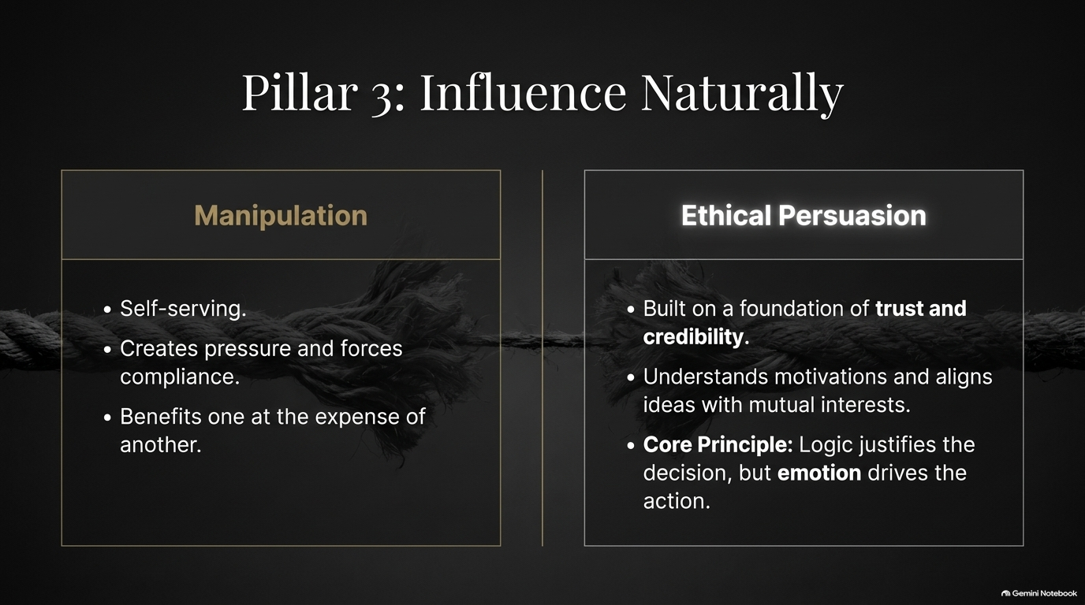
Notes:
Visual: A side-by-side comparison of a drab, grey desk setup ('Before the Shift') versus a sunlit, golden-hued desk setup ('After the Shift').
Suggested Speaking Time: 3–5 minutes
Speaker Notes:
"Every single person has a platform. A mundane job or an ordinary daily task is never a life trap; it is an active arena for your intention. Look at the visual contrast on this slide. Before the shift, you sit at a cold, gray desk thinking: 'I am doing this boring, irritating job just to pay the bills and survive.' The energetic output? Stagnation, heaviness, and deep resistance. But look what happens after the shift in perspective: 'I do this to offer my family safety and stability. I am a provider. Every step I take here is in direct service of love.' Suddenly, the exact same computer, the exact same desk, and the exact same tasks are flooded with warm, golden light. Why? Because your internal energy output has shifted from resentment to flow and lightness. You don't always need to change your job to change your life; you just need to change the intention behind why you show up."

Slide 11
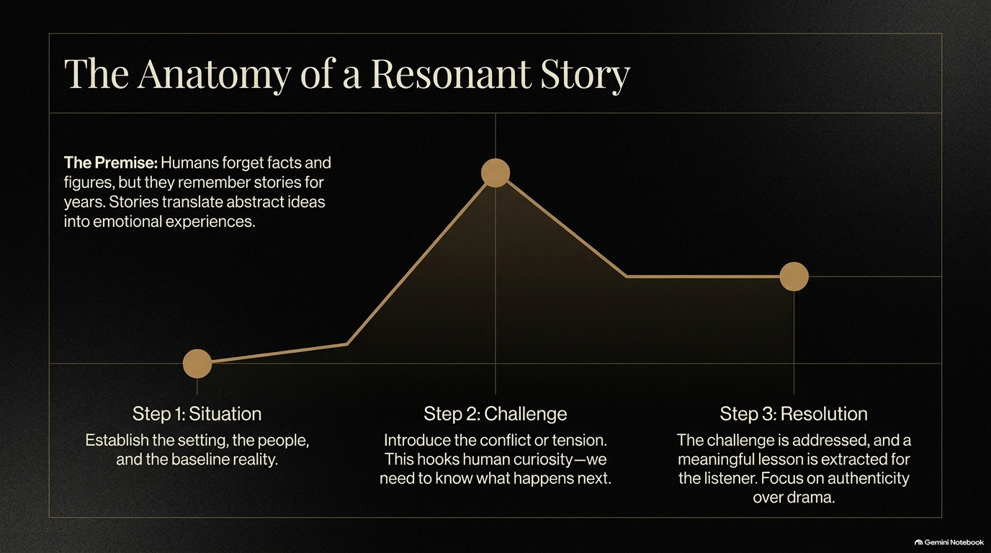
Notes:
Visual: Microscopic cell-like background imagery contrasting 'The Instagrammable Myth' on the left with 'The Authentic Heartprint' on the right.
Suggested Speaking Time: 4–5 minutes
Speaker Notes:
"Purpose is not simply the thing that you do. Purpose is the profound thing that happens in others when you do what you do. We have been sold a dangerous illusion—let's call it The Instagrammable Myth. This myth teaches us that purpose is about grand scales: flashy titles, follower counts, and visible public achievements. It treats purpose like an external treasure chest waiting to be discovered, measured entirely by what you have acquired. But contrast that with The Authentic Heartprint. Authentic purpose focuses entirely on micro-interactions: how you speak to the dry cleaner, how you treat the parking attendant, how you talk to your roommate or coworker. It recognizes that purpose is the living energy you carry into every room you enter, measured by a single metric: How did you make people feel before you left? That is your true heartprint."

Slide 12
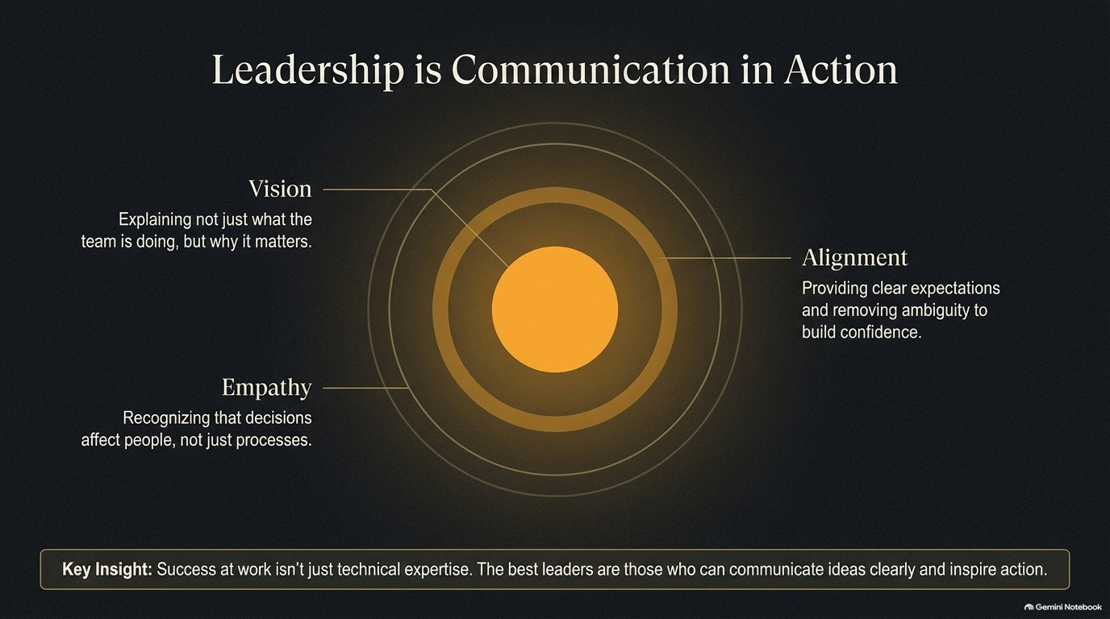
Notes:
Visual: Two glowing golden timelines illustrating the connecting dots of life's experiences for Oprah and Mel, ending with a prompt for the reader.
Suggested Speaking Time: 4–5 minutes
Speaker Notes:
"If you were to pass away today, the people standing at your eulogy would effortlessly connect the dots of your life story. You are already weaving a golden thread of purpose, whether you realize it or not. Look at Example 1: Oprah's thread of inspiration connects a four-year-old child reciting verses in a Kosciusko church, to winning school oratory contests, to giving up sensationalist daytime TV to uplift audiences, to creating an immersive spiritual experience at the Sphere in 2023. Look at Example 2: Mel's thread of encouragement connects deep personal understandings of lacking self-belief to loaning unshakeable belief to others so they can completely rewrite their lives. Here is the prompt for you today, sitting in this room: What is the golden theme that has quietly carried through the entire course of your life? Name your thread, and you own your power."

Slide 13
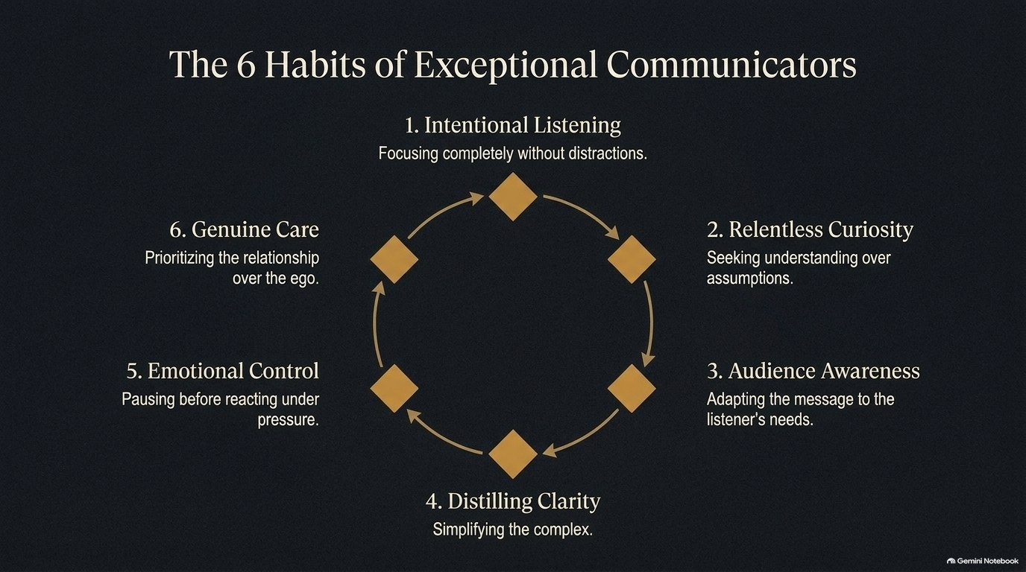
Notes:
Visual: A small glass terrarium containing six tiny glowing trees resting on moss, contrasted against a vast, majestic, sun-dappled ancient forest.
Suggested Speaking Time: 3–5 minutes
Speaker Notes:
"Surrender your tiny, ego-driven dream to the vast life force that brought you here. The universe's dream for your life is infinitely larger, wilder, and more expansive than anything your fearful mind could ever manufacture. Look at the visual metaphor on screen: on the left, a delicate glass terrarium holding six neatly trimmed trees—safe, controlled, and miniature. On the right, the infinite, breathing forest filled with ancient redwoods and golden morning light. Do not live out your little 6-tree dream. Live boldly in the forest of possibilities that the universe holds for you. Your life does not belong to your small ego; your life belongs to the world. Step out of the glass box."

Slide 14
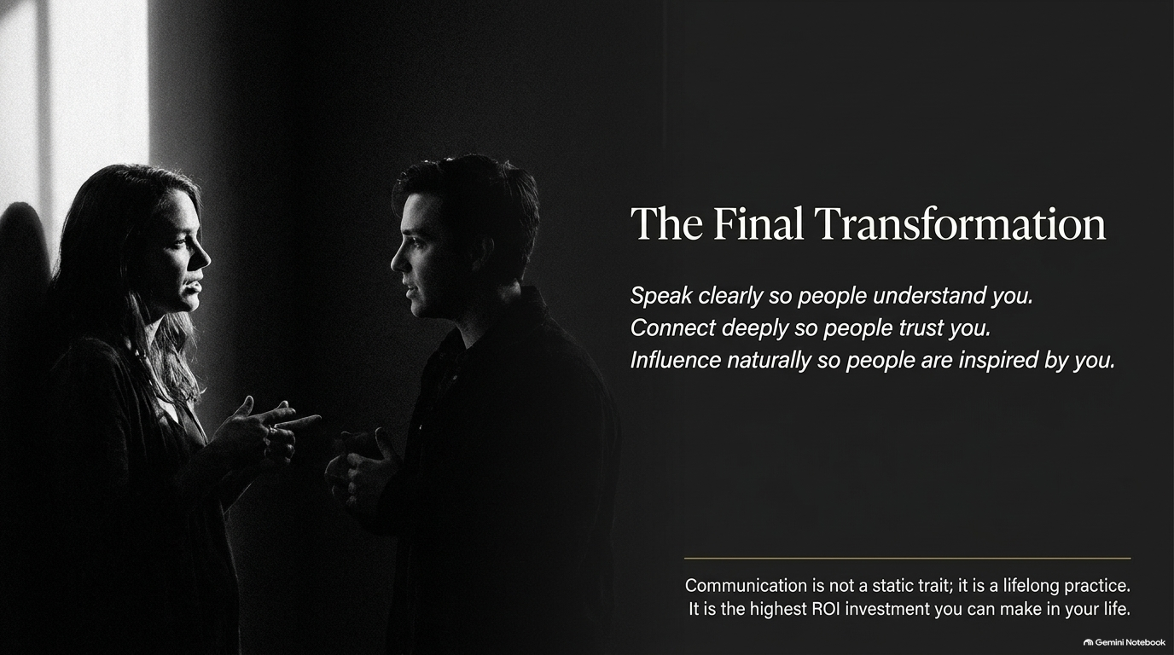
Notes:
Visual: A complex mechanical clockwork gear system with four outer gears feeding into a central glowing gear labeled 'The Heartprint'.
Suggested Speaking Time: 4–6 minutes
Speaker Notes:
"Authentic power is not some mysterious, genetic gift bestowed on a lucky few; it is a precise, dependable mechanism. When you align the gears of your inner machinery, you produce a timeless legacy. Let's examine the four interlocking gears that create your calling:
Gear 1: The Guide (Inner GPS): Cultivating the stillness and courage to know what you don't want.
Gear 2: The Fuel (Reframed Hardship): Actively accepting your past suffering to transmute personal trauma into universal empathy.
Gear 3: The Engine (Intention): Ensuring every daily action is driven by a pure motive rather than the exhausting disease to please.
Gear 4: The Action (Golden Thread): Applying your unique life theme consistently to your daily platform. When these four gears mesh seamlessly, they drive the central wheel: The Heartprint—your ultimate, irreplaceable offering to the planet."

Slide 15
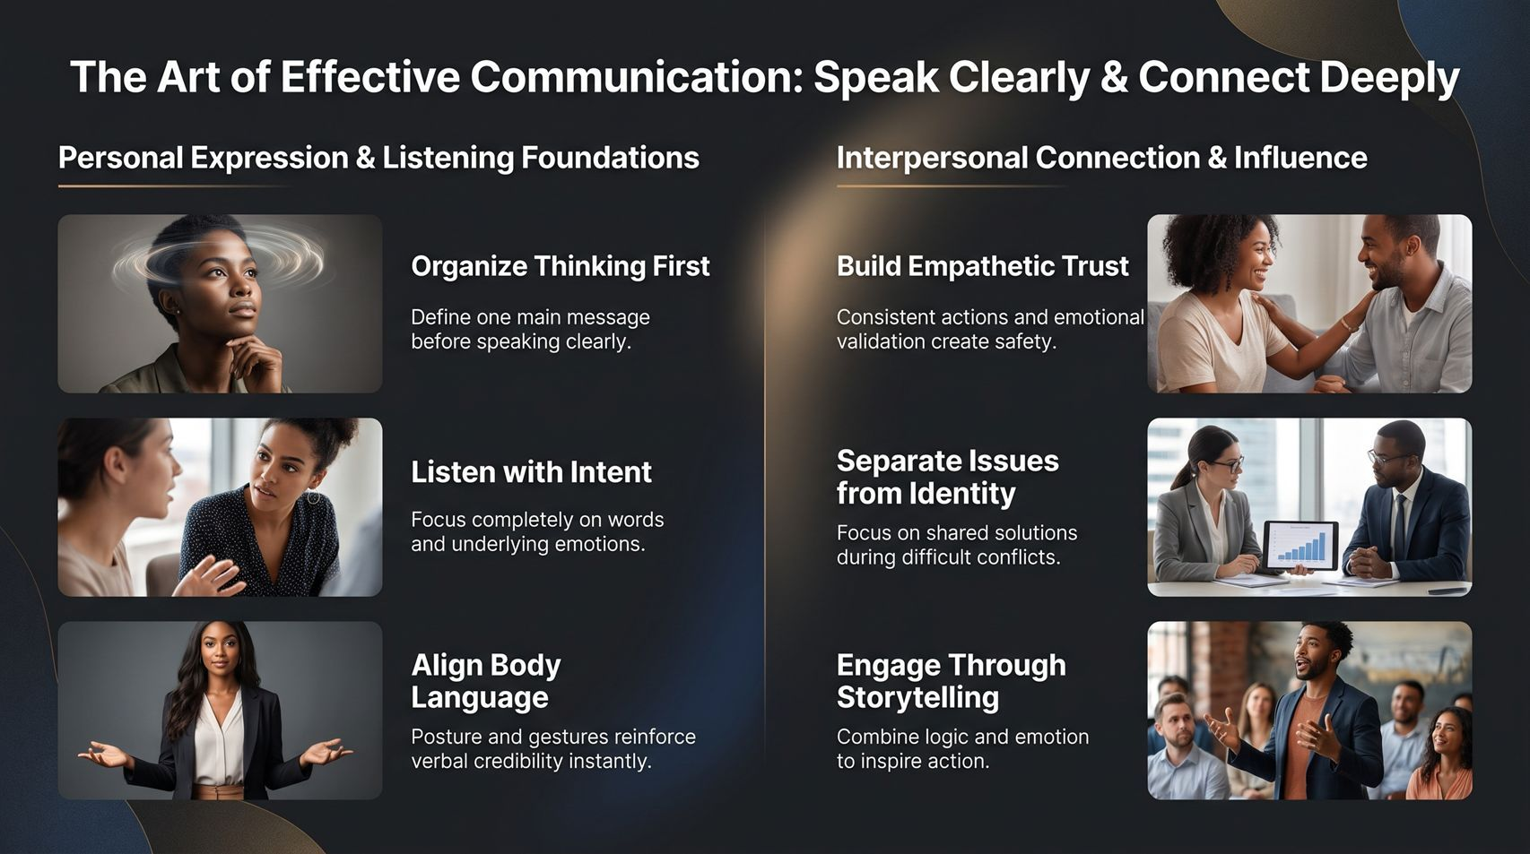
Notes:
Visual: A rich synthesis summary slide featuring a central compass surrounded by visual vignettes representing inner guidance, rejected paths, reframed hardship, forgiveness bridges, and heartprints.
Suggested Speaking Time: 4–6 minutes
Speaker Notes:
"As we bring our journey full circle on this final summary slide, let's lock in the master principles of authentic power. Unlocking your calling boils down to a few essential pillars:
First, Align with Inner Guidance: Trust your inner GPS by remaining quiet enough to hear the internal voice directing you. Lead with clear intention rather than seeking external approval, and gain essential clarity through rejection, recognizing that what you don't want is pointing you home.
Second, Master Perspective and Impact: Reframe your past hardships into active service, knowing every struggle prepared you to uplift others. Practice universal forgiveness by dropping the wish for a different history, and leave daily heartprints wherever you go because your immediate family, community, and everyday interactions form your ultimate platform for legacy. Walk out of this room today knowing that your life matters, your story is your fuel, and your power is entirely authentic."

