Slide 1
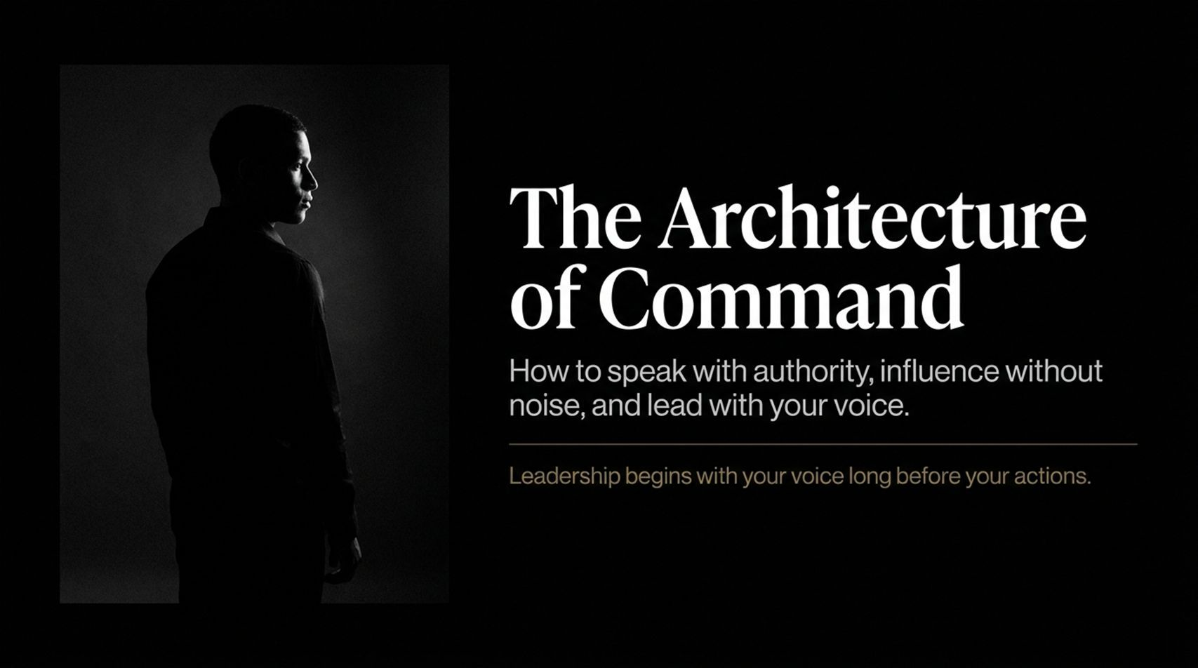
Notes:
Visual: A striking black-and-white portrait of a resolute figure standing in profile against a deep black background, alongside bold serif typography: "The Architecture of Command: How to speak with authority, influence without noise, and lead with your voice."
Suggested Speaking Time: 2–3 minutes
Speaker Notes:
"Welcome, everyone. Today, we are exploring a paradigm shift in executive presence: The Architecture of Command.
In traditional management courses, we are taught that leadership is defined by your strategy, your organizational chart, your budget, or your performance metrics. But the truth is far more immediate: Leadership begins with your voice long before your actions. Before anyone reads your strategy document, before anyone looks at your quarterly targets, they hear your voice. The moment you open your mouth, the room unconsciously evaluates your certainty, your emotional control, and your authority.
Most professionals struggle not because their ideas are weak, but because their vocal delivery dilutes their impact. They speak out of habit, they rush through their points, and they fill the air with unnecessary verbal noise. Today, we are going to break down the discipline, the psychology, and the exact mechanics behind a voice that commands immediate respect—without aggression, without shouting, and without needing to dominate the room through volume. Let's begin."
How to Talk Like a Leader | Full Audiobook
https://www.youtube.com/watch?v=hmG7V0N2iEs

Slide 2
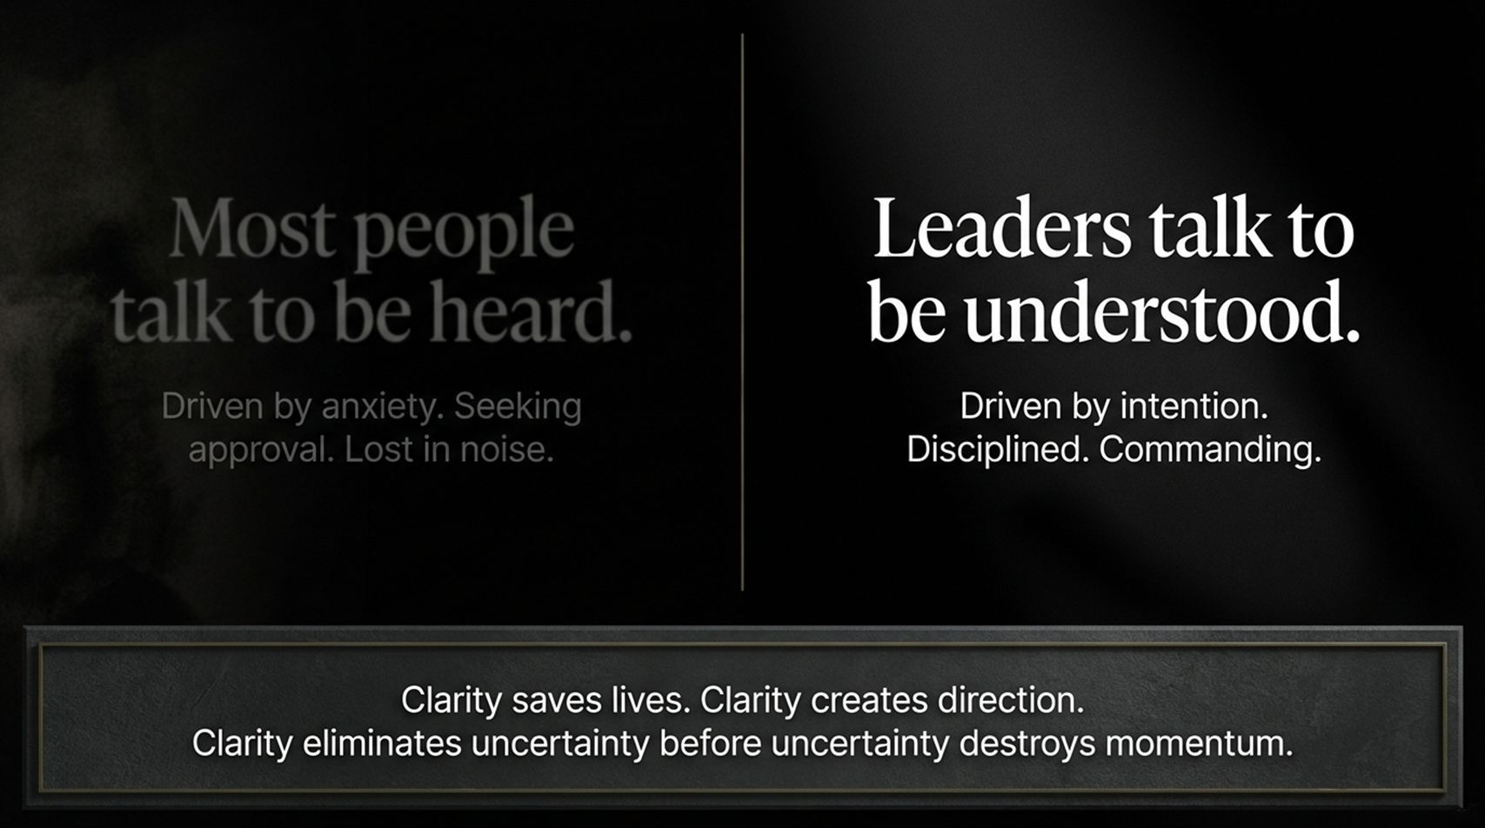
Notes:
Visual: A dual-panel split screen contrasting "Most people talk to be heard" (faded, lost in shadows) against "Leaders talk to be understood" (bold white typography on dark background), anchored by a bottom frame: "Clarity saves lives. Clarity creates direction. Clarity eliminates uncertainty before uncertainty destroys momentum."
Suggested Speaking Time: 3–4 minutes
Speaker Notes:
"Let's establish our foundational premise: You talk too much. Most people do, not because they lack intelligence, but because they have never been taught the power of restraint.
Most people speak to be heard. They are driven by an underlying anxiety—a need for validation, a fear of being overlooked, or simply a habit of filling empty space. They react to awkward silences by dumping words into the room. But when you talk just to fill space, you create verbal noise. And noise is your enemy. Noise dilutes your presence, obscures your message, and steals your authority.
Leaders talk to be understood. They speak with ruthless intention. Every word earns its place, and every sentence has a job. Consider how military briefing operations work under extreme pressure: there is no fluff, no rambling backstory, and no endless justification. Why? Because clarity saves lives. Clarity creates direction. Clarity eliminates uncertainty before uncertainty can destroy momentum.
You don't need to be in the military to apply this. Whether you are leading a board meeting, managing a crisis, or running a 1-on-1 performance review, your objective is not to entertain or impress. Your objective is absolute clarity. Say less, mean more, and let your words carry genuine weight."

Slide 3
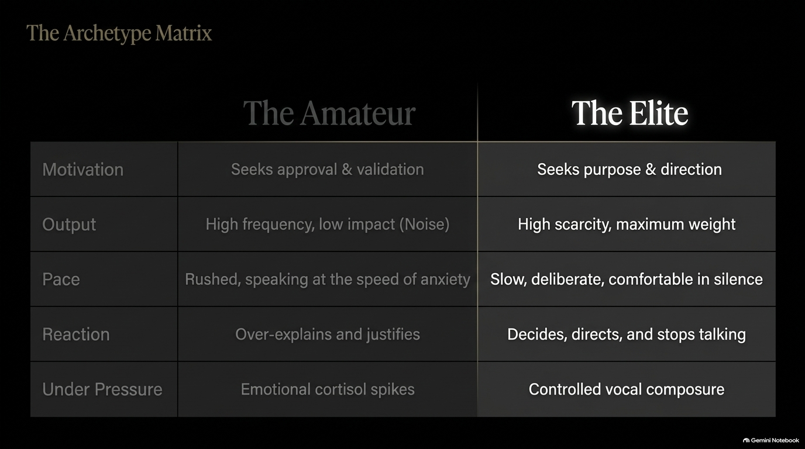
Notes:
Visual: A structured comparison grid contrasting "The Amateur" (driven by approval, high frequency/low impact noise, rushed speech, over-explaining, cortisol spikes) against "The Elite" (driven by purpose, high scarcity/maximum weight, slow/deliberate, decisive, controlled composure).
Suggested Speaking Time: 4–5 minutes
Speaker Notes:
"To transform your communication style, you must first diagnose where you currently sit on The Archetype Matrix. This matrix highlights the fundamental divide between an amateur communicator and an elite leader.
First, look at Motivation: The amateur seeks approval and validation. They speak so that people will like them, agree with them, or think they are smart. The elite leader seeks purpose and direction. They speak solely to move the mission forward.
Second, examine Output: The amateur outputs high frequency and low impact—meaning they talk constantly, but their words carry very little weight. The elite leader practices word scarcity. Because they speak infrequently and deliberately, when they open their mouth, the entire room goes quiet to listen.
Third, measure Pace: The amateur speaks at the speed of anxiety—rushed, breath-bound, and outrunning their own thoughts. The elite speaks slowly, deliberately, and is completely comfortable sitting in silence.
Fourth, evaluate Reactions: When questioned, the amateur over-explains and justifies. The elite states the decision, establishes the direction, and stops talking.
Finally, observe behavior Under Pressure: The amateur experiences cortisol spikes, causing their voice to become high-pitched, fast, and erratic. The elite maintains controlled vocal composure.
Ask yourself honestly: Which column represents your default setting during high-stakes meetings? Today is about systematically purging amateur habits and instilling elite vocal discipline."

Slide 4
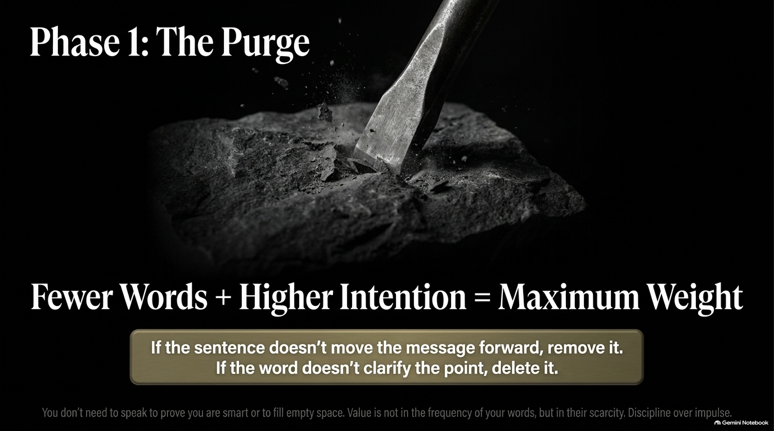
Notes:
Visual: A dramatic black-and-white image of a chisel carving away rough stone from a dark slate block, paired with the formula: "Fewer Words + Higher Intention = Maximum Weight" and the rule: "If the sentence doesn't move the message forward, remove it. If the word doesn't clarify the point, delete it."
Suggested Speaking Time: 3–4 minutes
Speaker Notes:
"Phase 1 of building an authoritative voice is The Purge. You must treat your communication like a sculptor working on a block of marble: you strip away every piece of excess stone until only the masterpiece remains.
Here is the core mathematical formula of executive vocal authority: Fewer Words + Higher Intention = Maximum Weight.
The value of your voice is not determined by the frequency of your words, but by their scarcity. When a person speaks constantly in every meeting, their words become a cheap commodity. People tune them out. But when a leader speaks with restraint, their words become scarce and invaluable.
Memorize this operational rule: If the sentence doesn't move the message forward, remove it. If the word doesn’t clarify the point, delete it. You do not need to speak just to prove you are smart. You do not need to fill an empty room to feel secure. Strip your sentences clean. Let discipline win over impulse."

Slide 5
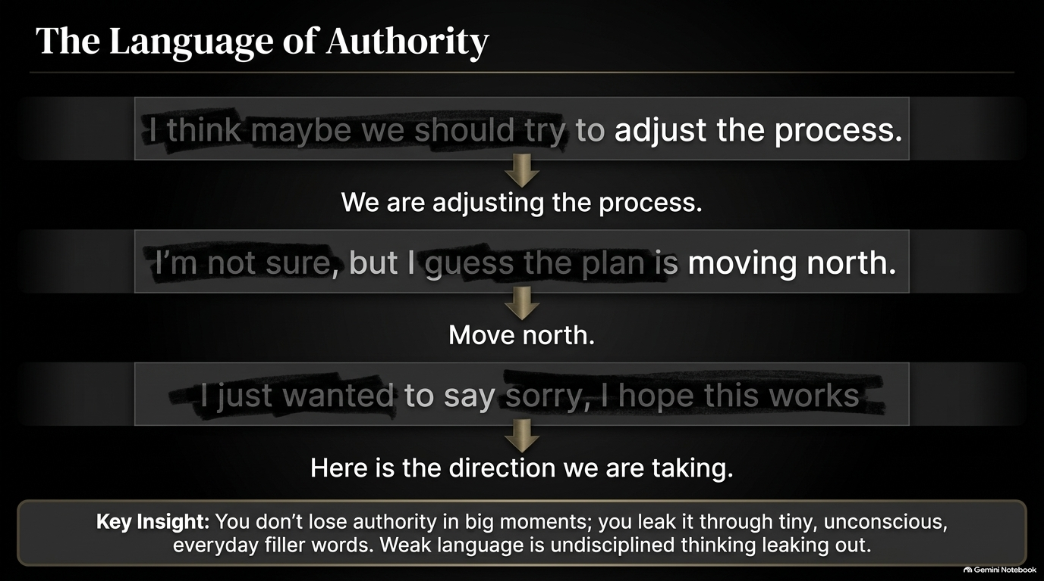
Notes:
Visual: A visual strike-through graphic showing weak, hedging phrases being replaced by clean, decisive commands. (e.g., "I think maybe we should try to adjust..." $\rightarrow$ "We are adjusting the process."; "I'm not sure, but I guess..." $\rightarrow$ "Move north."; "I just wanted to say sorry, I hope this works..." $\rightarrow$ "Here is the direction we are taking.")
Suggested Speaking Time: 4–5 minutes
Speaker Notes:
"Authority is rarely destroyed in one dramatic meltdown. It is lost in tiny, unconscious leaks every single day. Weak language is undisciplined thinking leaking out through your mouth.
Look at the transformations on this slide:
Amateur: 'I think maybe we should try to adjust the process a little bit...'
Elite: 'We are adjusting the process.' Look at the difference. The first version begs for approval and signals doubt; the second version states a clear operational reality.
Amateur: 'I'm not sure, but I guess the plan is moving north...'
Elite: 'Move north.' Two words. Maximum clarity. Zero confusion.
Amateur: 'I just wanted to say sorry, I hope this works for everyone...'
Elite: 'Here is the direction we are taking.'
Stop using softeners like 'I think,' 'maybe,' 'sort of,' 'kind of,' or 'I just wanted to.' When you hedge your statements, you are telling the room that you do not trust your own decision. If you don't trust your decision, why should they? Delete the weak modifiers and speak with clean conviction."

Slide 6
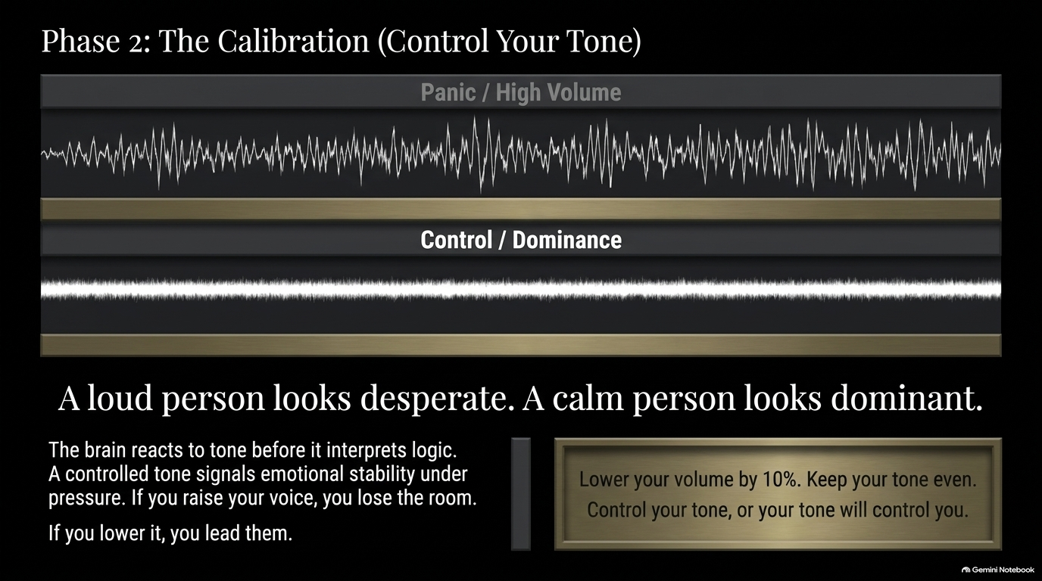
Notes:
Visual: An audio waveform diagram contrasting a chaotic, high-amplitude spike pattern ("Panic / High Volume") against a flat, steady, controlled audio wave ("Control / Dominance"). Text callout: "A loud person looks desperate. A calm person looks dominant."
Suggested Speaking Time: 4–5 minutes
Speaker Notes:
"Phase 2 is The Calibration. Your words carry the message, but your vocal tone determines how that message is received by the human brain. The human nervous system registers and reacts to tone before it ever processes logical content.
When a crisis occurs or tension rises in a room, average communicators raise their volume and pitch. They shout, they speed up, and their tone becomes erratic. They think loudness equals power. It doesn't. A loud person looks desperate. A calm person looks dominant.
Shouting or spiking your volume signals to everyone that you are threatened, overwhelmed, and losing control of your emotions. In contrast, elite communicators—whether Special Forces officers, corporate CEOs in crisis, or seasoned diplomats—do something counterintuitive: when pressure spikes, they lower their volume and slow their pace.
Here is your rule for vocal calibration: Lower your volume by 10%. Keep your tone steady, smooth, and predictable. When you raise your voice, you lose the room. When you lower your volume, people have to quiet down and lean in to hear you. Control your tone, or your tone will control you."

Slide 7
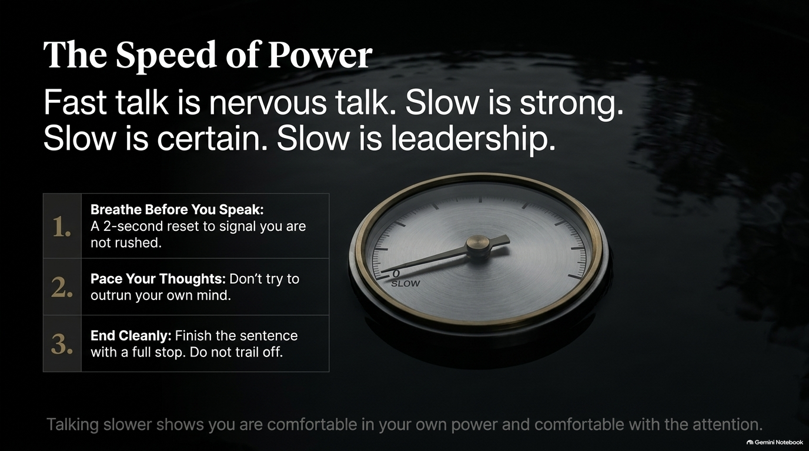
Notes:
Visual: A sleek analog gauge pointing to "SLOW", framed by the principles: "Fast talk is nervous talk. Slow is strong. Slow is certain. Slow is leadership." Includes a 3-step practice: 1. Breathe Before You Speak, 2. Pace Your Thoughts, 3. End Cleanly.
Suggested Speaking Time: 3–4 minutes
Speaker Notes:
"Let's talk about cadence. Fast talking is nervous talking. When you speak rapidly, you communicate to the room that you are afraid of being interrupted, afraid of taking up space, or trying to outrun your own insecurity.
Slow is strong. Slow is certain. Slow is leadership.
When you slow your speaking pace, you demonstrate that you are entirely comfortable in your own power, comfortable taking up space, and comfortable holding the room's attention. Look at how top executives present in boardrooms: they never rush. They speak at a deliberate, measured cadence.
To master the speed of power, practice these three rules:
Breathe Before You Speak: Take a solid 2-second breath before starting a sentence. It resets your nervous system and signals control.
Pace Your Thoughts: Do not let your mouth run faster than your mind can discipline your words.
End Cleanly: Finish your sentence with a strong full stop. Do not let your voice trail off or dissolve into awkward laughs or filler words."

Slide 8
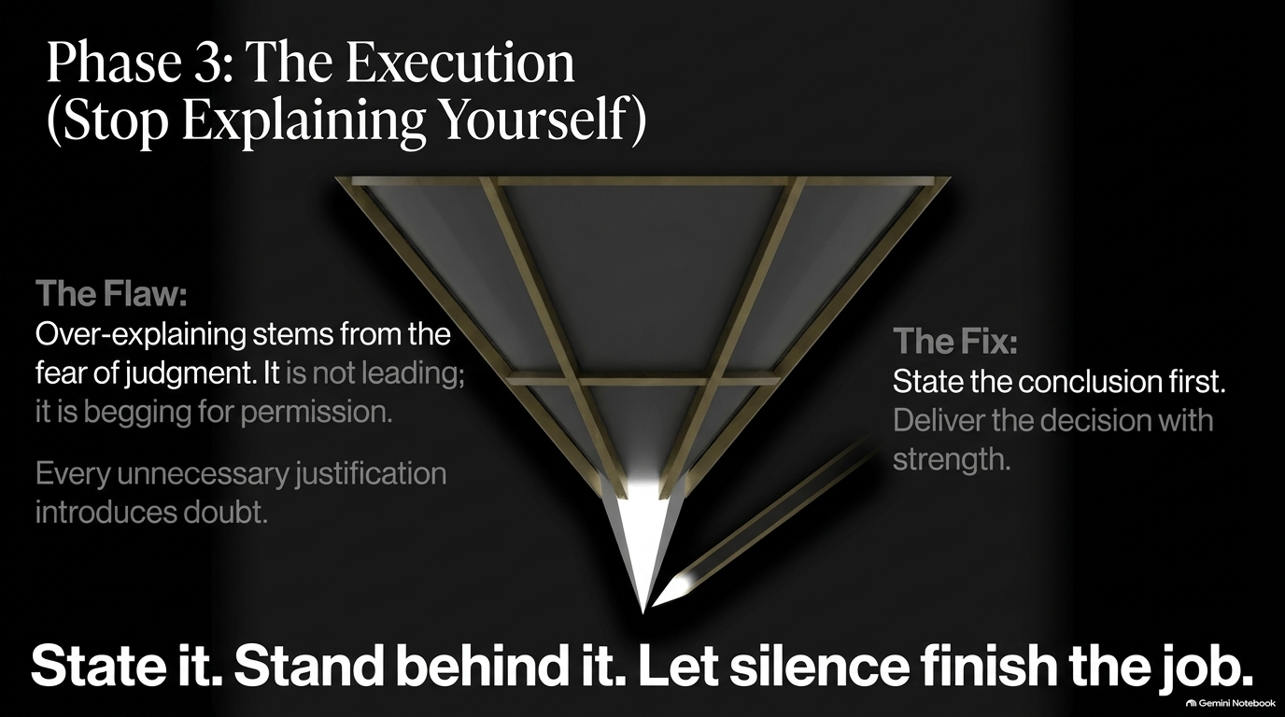
Notes:
Visual: An inverted pyramid icon tapering down to a single razor-sharp point, illustrating the shift from over-explaining to concise delivery. Text: "State it. Stand behind it. Let silence finish the job."
Suggested Speaking Time: 4–5 minutes
Speaker Notes:
"Phase 3 is The Execution. This slide addresses one of the most widespread psychological traps in corporate communication: Over-explaining.
Why do people over-explain? Because of fear. Fear of judgment, fear of conflict, or fear of being misunderstood. When someone gives a command or makes a decision, they often follow it with a 3-minute explanation justifying why they made that choice.
But here is the critical insight: Over-explaining is not leading; it is begging for permission. Every unnecessary justification you tack onto a decision introduces doubt into the mind of your listener. It signals that you are trying to convince them to forgive you for making a decision.
Leaders do not talk their decisions into weakness. They state the conclusion first. They deliver the decision clearly, directly, and with strength. And then they do the hardest thing for an amateur to do: They stop talking.
State it. Stand behind it. Let silence finish the job."

Slide 9
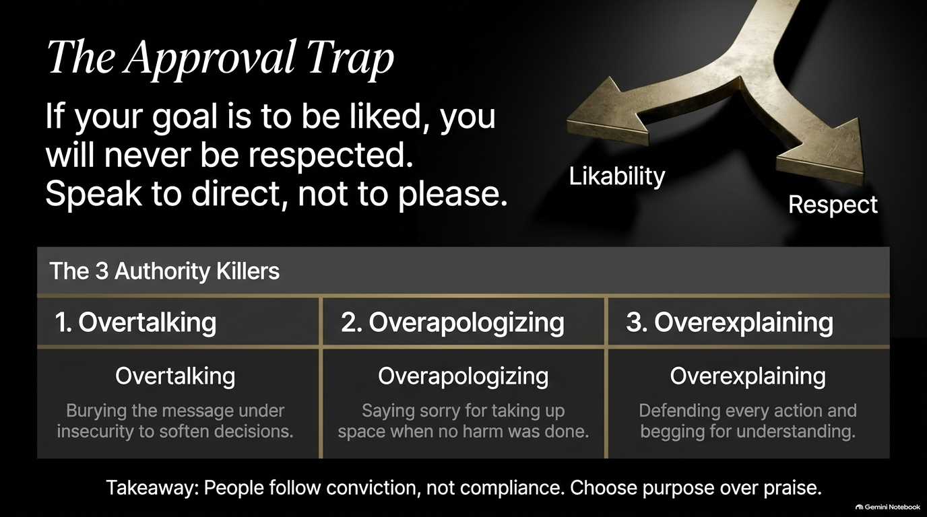
Notes:
Visual: A gold-accented fork in the road dividing into two distinct paths: "Likability" vs "Respect". Below, a table highlights "The 3 Authority Killers": 1. Overtalking, 2. Overapologizing, 3. Overexplaining.
Suggested Speaking Time: 4–5 minutes
Speaker Notes:
"If your primary goal in communication is to be liked, you will never be respected as a leader.
Welcome to The Approval Trap. Many professionals operate under the delusion that if they make everyone happy, soften every directive, and apologize constantly, people will follow them. They won't. People do not follow compliance; they follow conviction.
Look at the 3 Authority Killers on this slide:
Overtalking: Burying your core directive under a mountain of conversational fluff just to appear friendly.
Overapologizing: Saying 'sorry' when no harm was done—such as 'Sorry to bother you,' 'Sorry, quick question,' or 'Sorry if this is wrong.' Every false apology degrades your authority.
Overexplaining: Defending every action as if you are on trial, begging your subordinates or peers for understanding.
You must choose your fork in the road: Are you speaking for likability, or are you speaking for respect? Leaders choose purpose over praise every single time."

Slide 10
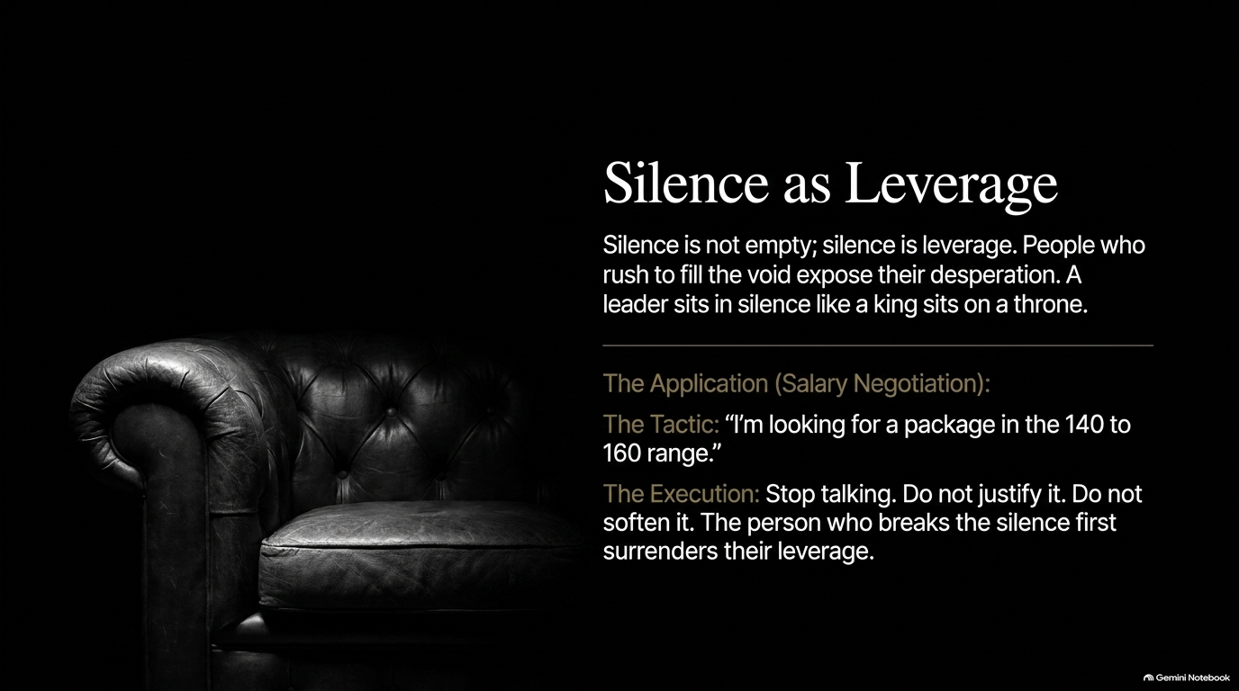
Notes:
Visual: A luxurious leather button-tufted executive armchair set against a dark backdrop, paired with a salary negotiation case study showcasing the tactic: "I'm looking for a package in the 140 to 160 range" followed by absolute silence.
Suggested Speaking Time: 4–5 minutes
Speaker Notes:
"Silence is not empty; silence is leverage.
Amateurs view silence as an uncomfortable void that must be filled immediately. Elite communicators view silence as a strategic weapon. Silence forces truth to the surface, forces decisions to be made, and holds space for your authority to be felt.
Look at the real-world application on this slide: a high-stakes salary negotiation.
An amateur states their number: 'I'm looking for a package in the 140 to 160 range...' and then, terrified by the silence in the room, immediately starts rambling: '...but you know, I'm flexible, and I know the market is tough right now, so whatever works for your budget...' In 5 seconds, they surrendered all their leverage.
An elite communicator states the exact same sentence: 'I'm looking for a package in the 140 to 160 range.' And then they stop. They sit in silence like a king on a throne. They do not smile nervously, they do not justify it, and they do not soften it.
In negotiation and leadership, the person who breaks the silence first surrenders their leverage. Master the discipline of staying quiet."

Slide 11
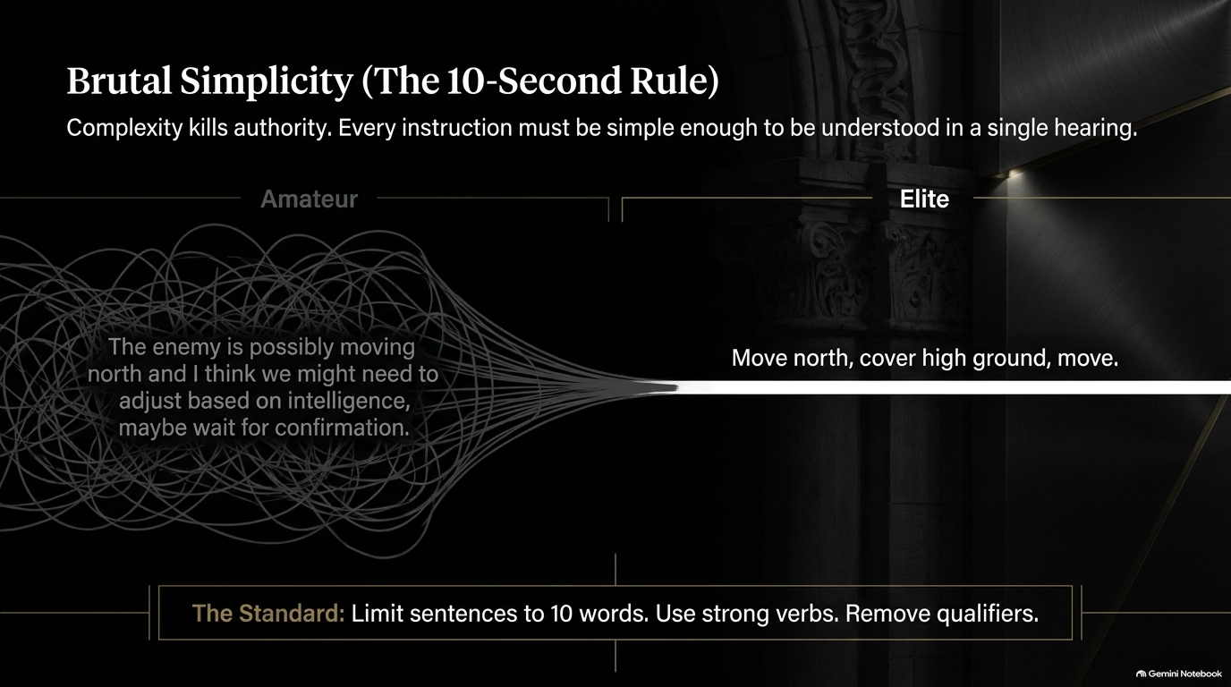
Notes:
Visual: A dramatic visual pipeline showing a tangled knot of complex lines ("Amateur") compressing down into a single, razor-sharp light ray ("Elite"). Text example: "Move north, cover high ground, move."
Suggested Speaking Time: 3–4 minutes
Speaker Notes:
"Complexity kills authority. When you deliver instructions that are convoluted, filled with caveats, and overly academic, your team loses focus and momentum.
Elite tactical leadership relies on The 10-Second Rule: Every core instruction must be simple enough to be completely understood in a single hearing.
Look at the contrast on the screen:
The Amateur: 'The enemy is possibly moving north, and I think we might need to adjust based on intelligence, maybe wait for confirmation, but keep your eyes open...' That creates confusion, hesitation, and fear.
The Elite: 'Move north, cover high ground, move.'
Apply this standard to your organization. Strip out the qualifiers, use strong action verbs ('Execute', 'Decide', 'Focus', 'Deliver'), and keep your primary directives under 10 words. When your communication is brutally simple, your team's execution becomes rapid and unignorable."

Slide 12
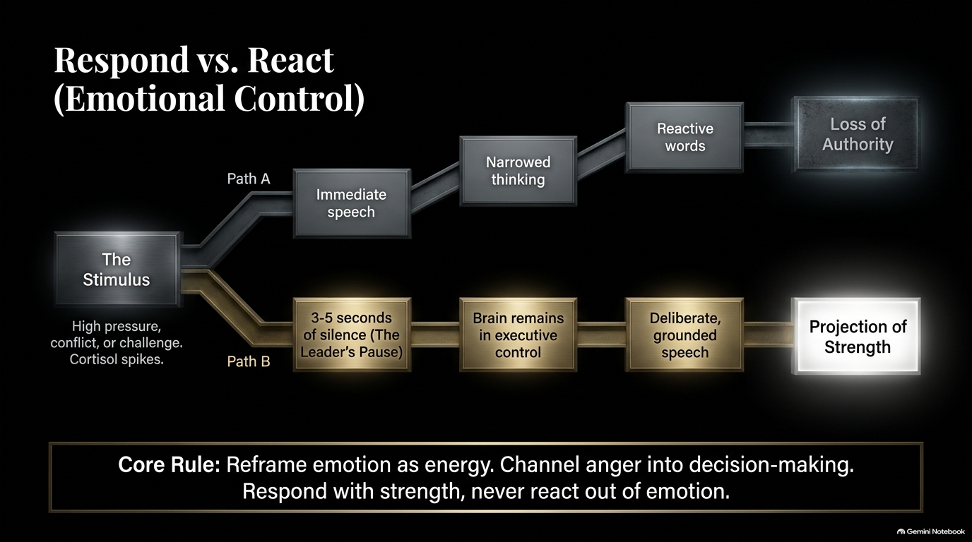
Notes:
Visual: A two-path flowchart starting at "The Stimulus" (high pressure/conflict). Path A leads to immediate speech $\rightarrow$ narrowed thinking $\rightarrow$ reactive words $\rightarrow$ Loss of Authority. Path B leads to 3-5 seconds of silence (The Leader's Pause) $\rightarrow$ executive control $\rightarrow$ deliberate speech $\rightarrow$ Projection of Strength.
Suggested Speaking Time: 4–5 minutes
Speaker Notes:
"How do you handle a direct challenge, an aggressive question, or a sudden crisis? This flowchart illustrates the crucial difference between Reacting and Responding.
When a high-pressure stimulus hits, your brain experiences a cortisol spike.
If you take Path A, you speak immediately. You react out of emotion. Your thinking narrows, your words become defensive, and you lose authority instantly.
If you take Path B, you utilize The Leader's Pause. You sit in complete silence for 3 to 5 seconds before opening your mouth.
What happens during those 3 to 5 seconds? Mechanically, you allow your brain to shift out of an emotional amygdala reaction and back into prefrontal executive control. You assess the situation, filter out emotional noise, and formulate a precise, deliberate response.
Reframe emotion as pure energy. Channel frustration into sharp analysis; channel anger into firm decision-making. Respond with strength, never react out of emotion."

Slide 13
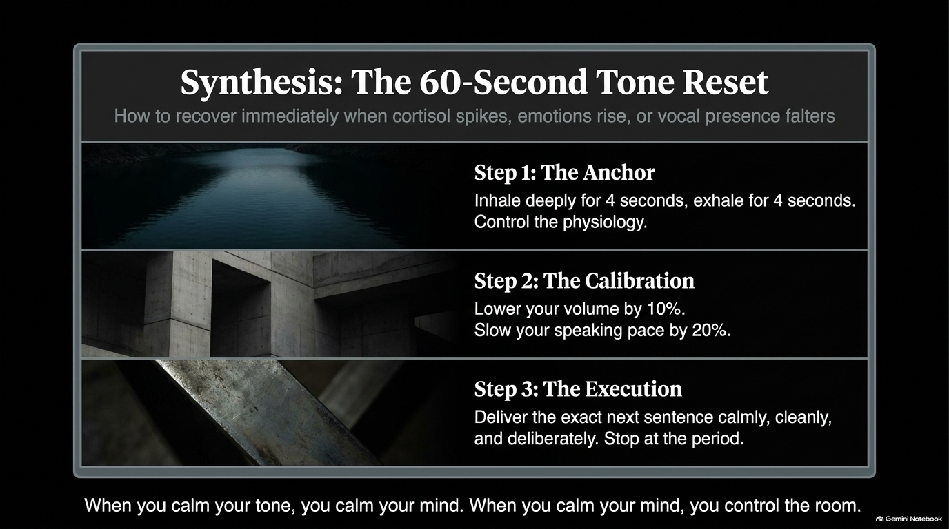
Notes:
Visual: A 3-step horizontal panel layout detailing an emergency vocal reset protocol: Step 1: The Anchor (4s inhale/exhale), Step 2: The Calibration (lower volume 10%, slow pace 20%), Step 3: The Execution (deliver next sentence cleanly to the period).
Suggested Speaking Time: 3–4 minutes
Speaker Notes:
"What happens when you are in the middle of a meeting and you feel your voice starting to shake, your pitch rising, or panic creeping in? You execute The 60-Second Tone Reset.
This is your tactical recovery protocol:
Step 1: The Anchor. Take a deep, controlled breath. Inhale for 4 seconds, exhale for 4 seconds. Physically calm your nervous system and regain control over your diaphragm.
Step 2: The Calibration. Intentionally drop your volume by 10% and slow your speaking speed by 20%. Force your physiology into a calm state.
Step 3: The Execution. Deliver your very next sentence calmly, cleanly, and deliberately. Stop at the period.
When you calm your tone, you calm your mind. When you calm your mind, you control the room. Bookmark this reset protocol—it is your emergency anchor under fire."

Slide 14
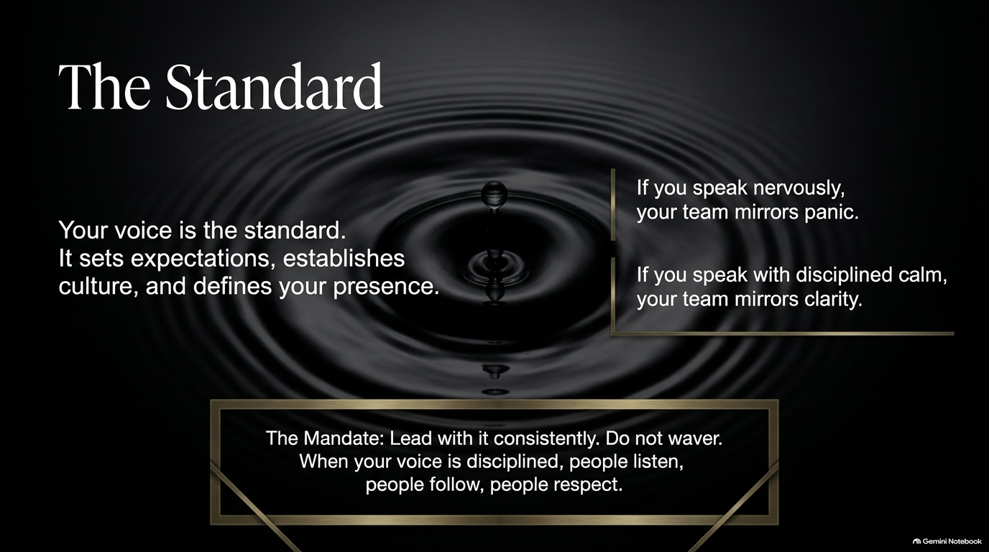
Notes:
Visual: A serene water drop creating subtle, expanding concentric ripples on a dark surface, paired with the mandate: "Your voice is the standard. It sets expectations, establishes culture, and defines your presence."
Suggested Speaking Time: 3–4 minutes
Speaker Notes:
"As a leader, your voice is not just a personal communication tool—it is the organizational thermostat for your entire team.
Look at the ripple effect on this slide:
If you speak nervously, fast, and erratically, your team mirrors panic and confusion.
If you waffle and hedge, your team hesitates and second-guesses execution.
But if you speak with disciplined calm, deliberate pace, and unshakeable clarity, your team mirrors clarity and confidence.
Your voice sets the cadence for how your organization operates. It defines what is acceptable, communicates what is urgent, and establishes the culture of your environment. Lead with it consistently. Do not waver. When your voice is disciplined, people listen, people follow, and people respect."

Slide 15
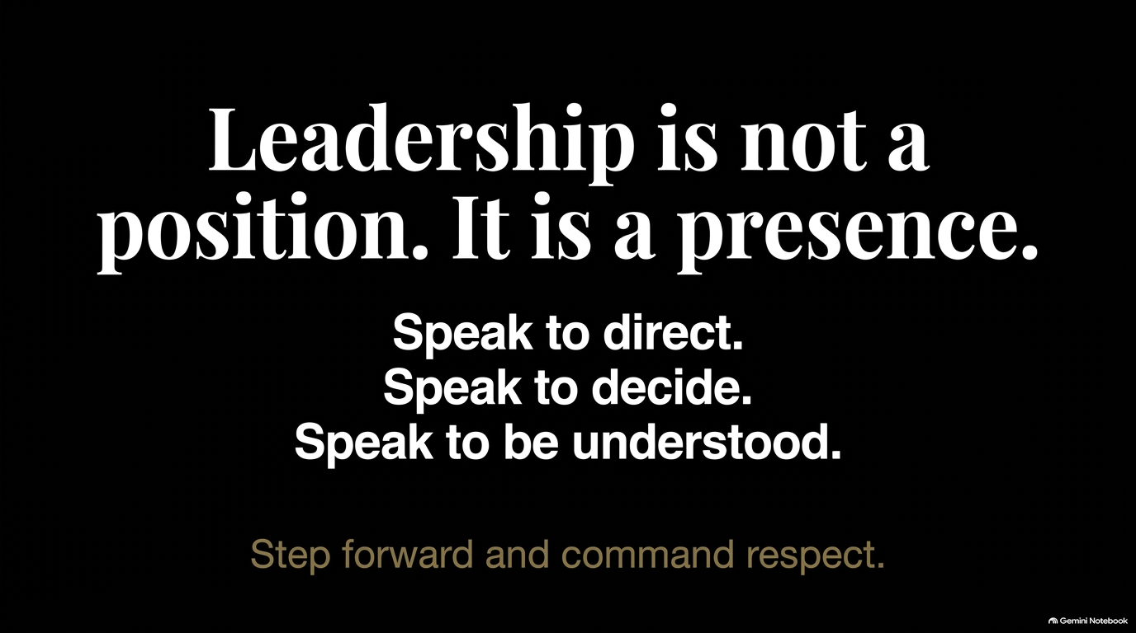
Notes:
Visual: High-contrast, minimalist typographic statement on a stark black slide: "Leadership is not a position. It is a presence. Speak to direct. Speak to decide. Speak to be understood. Step forward and command respect."
Suggested Speaking Time: 2–3 minutes
Speaker Notes:
"We are coming to the culmination of our framework. Remember this enduring truth: Leadership is not a position. It is a presence.
You can give an amateur a grand job title, a massive budget, and a corner office, but if their voice is weak, apologetic, and chaotic, no one will truly follow them. Conversely, a person with no formal title who speaks with calm certainty, deliberate restraint, and clean clarity will naturally draw the room toward them.
Stop waiting for permission to sound certain. Stop asking for approval to take up space.
Speak to direct. Speak to decide. Speak to be understood. Step forward, master your voice, and command the respect that your leadership demands."

Slide 16
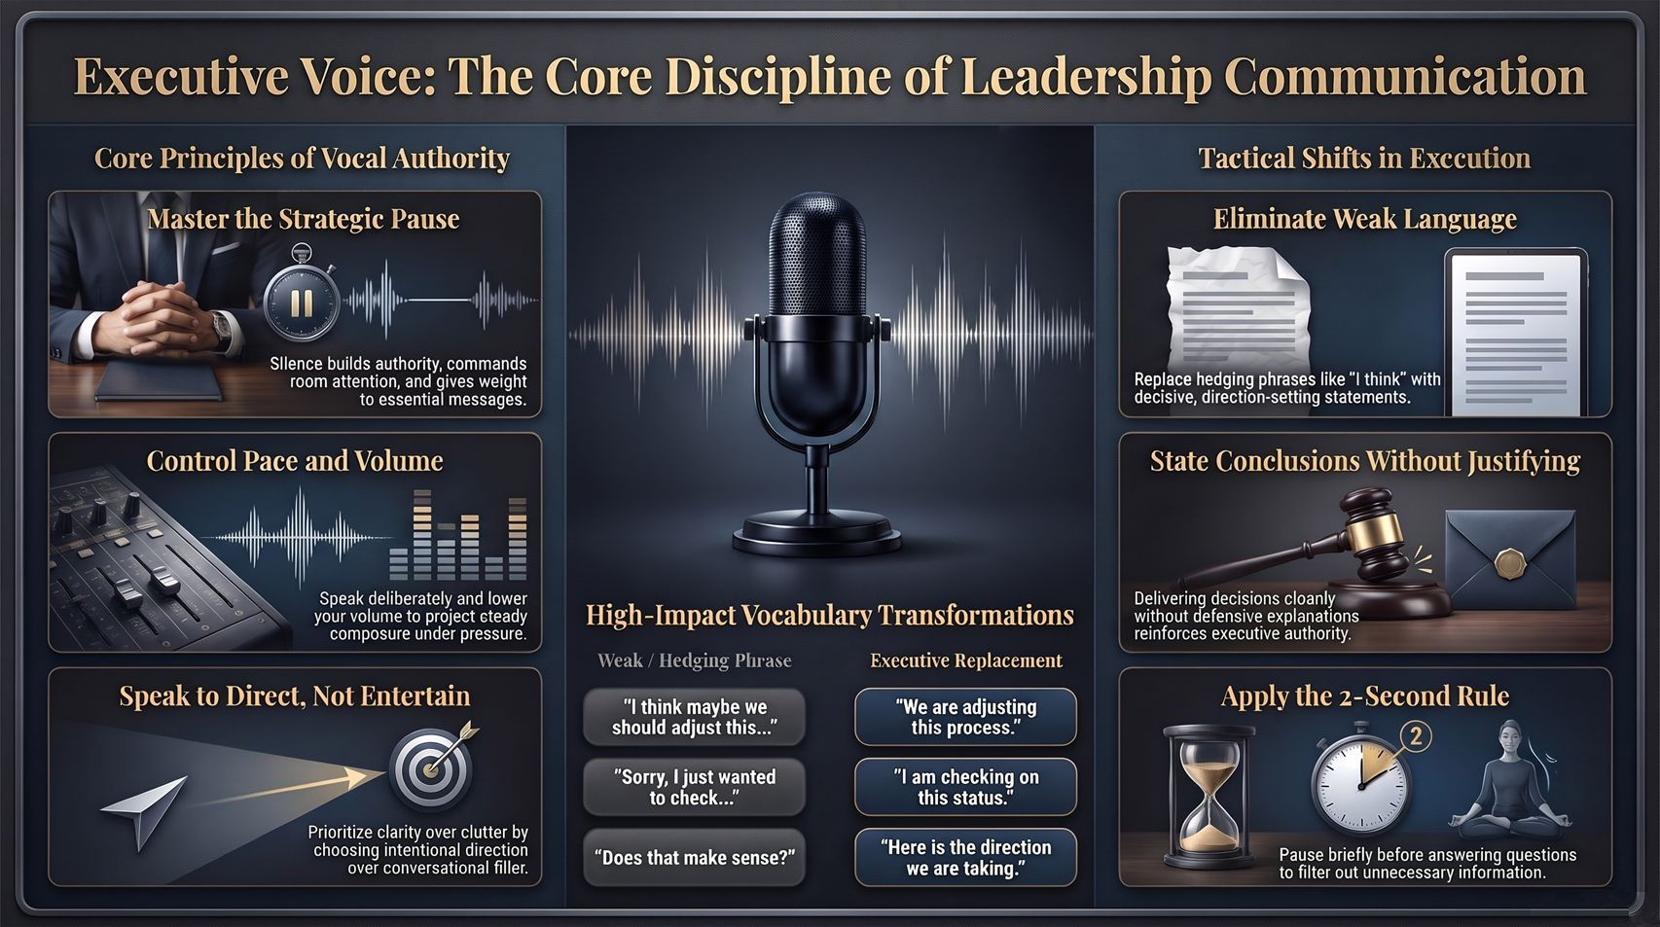
Notes:
Visual: A comprehensive executive synthesis dashboard detailing "Core Principles of Vocal Authority" (Strategic Pause, Pace/Volume, Directing vs Entertaining), "High-Impact Vocabulary Transformations" (Before vs After phrases), and "Tactical Shifts in Execution" (Eliminating weak language, stating conclusions, 2-second rule).
Suggested Speaking Time: 4–6 minutes
Speaker Notes:
"To close our session today, let's review our complete Executive Voice Summary Dashboard. This slide serves as your operational blueprint for daily implementation.
Let's summarize the three core pillars:
Core Principles of Vocal Authority (Left Panel):
Master the strategic pause—use silence to build authority and let your words land.
Control your pace and volume—slow down and lower your voice to signal steady composure.
Speak to direct, not to entertain or seek approval.
High-Impact Vocabulary Transformations (Center Panel):
Replace 'I think maybe we should adjust this...' with 'We are adjusting this process.'
Replace 'Sorry, I just wanted to check...' with 'I am checking on this status.'
Replace 'Does that make sense?' with 'Here is the direction we are taking.'
Tactical Shifts in Execution (Right Panel):
Eliminate all weak modifiers and hedging phrases.
Deliver decisions cleanly as conclusions without launching into defensive justifications.
Apply the 2-Second Rule before answering any question to filter out unnecessary noise.
Master these mechanics, audit your speech daily, and lead with a voice of command. Thank you."

