Slide 1
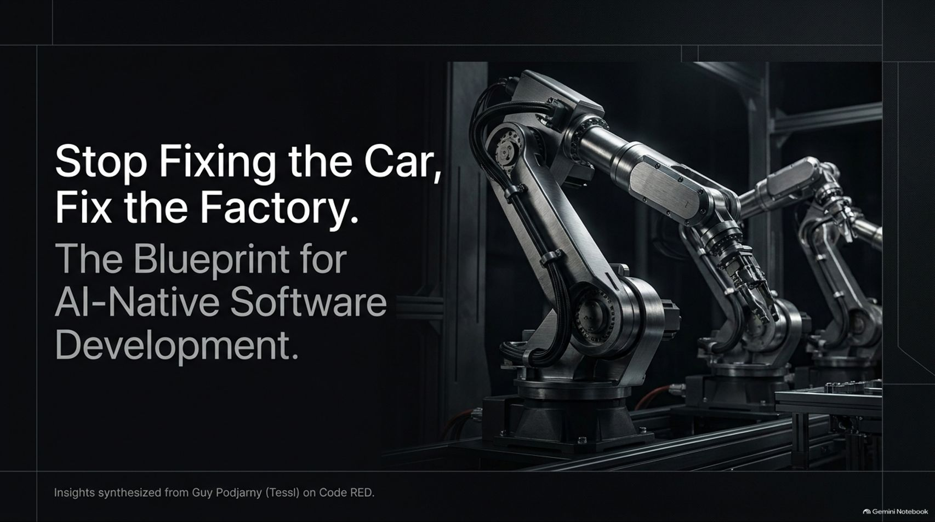
Notes:
Estimated Time: 2.5 – 3 minutes
Slide Focus: Title slide introducing the core thesis: moving away from tweaking individual lines of AI-generated code and toward architecting self-improving software factories.
Speaker Notes: Welcome everyone. Today we are looking at a fundamental shift in how software engineering is evolving. This presentation is synthesized from the insights of Guy Podjarny, founder and CEO of Tessl, on the Code RED podcast.
For the past couple of years, the entire tech industry has been fixated on AI coding assistants—Copilot, Cursor, Claude Code, and various chat tools. We treat these tools like individual mechanics or assembly line workers, stepping in to fix bugs line-by-line when the AI makes a mistake. Guy Podjarny argues that this is the wrong frame entirely.
If you want to scale software development in the age of autonomous agents, you have to stop fixing the car and start fixing the factory. Over the next 15 slides, we will examine the blueprint for AI-native software development—exploring how engineering teams transition from writing syntax to designing self-improving systems, codifying human taste into reusable skills, and establishing continuous feedback loops from production to deployment.
Stop Fixing the Car, Fix the Factory: Future of Software Development w/ Guy Podjarny | Code RED #51
https://www.youtube.com/watch?v=fVrAh7KRvu0

Slide 2
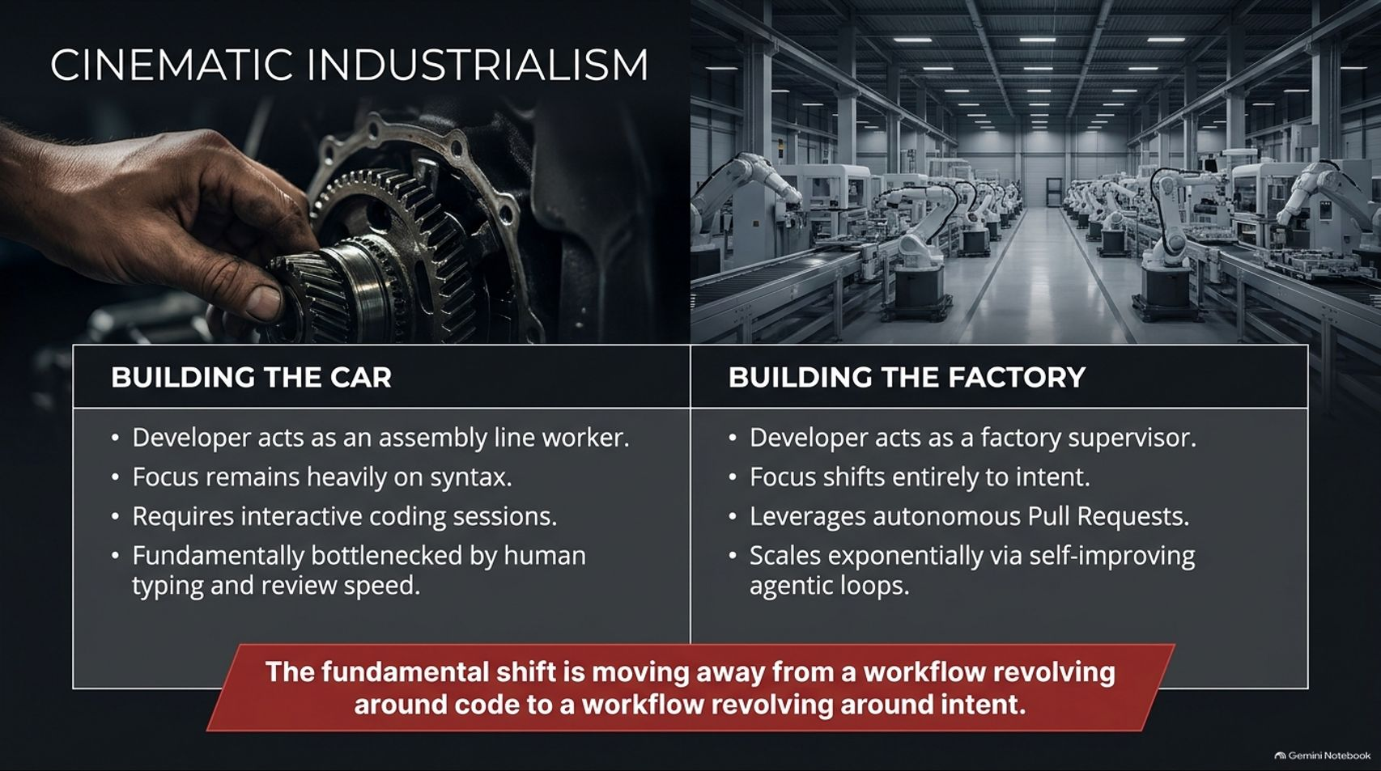
Notes:
Estimated Time: 3 – 4 minutes
Slide Focus: Contrast table comparing the legacy paradigm ("Building the Car") with the AI-native paradigm ("Building the Factory").
Slide Elements:
Building the Car: Developer acts as an assembly line worker; focus remains heavily on syntax; requires interactive coding sessions; fundamentally bottlenecked by human typing and review speed.
Building the Factory: Developer acts as a factory supervisor; focus shifts entirely to intent; leverages autonomous Pull Requests; scales exponentially via self-improving agentic loops.
Bottom Callout: "The fundamental shift is moving away from a workflow revolving around code to a workflow revolving around intent."
Speaker Notes: This comparison defines the industrial revolution currently happening in software engineering.
In the old world—Building the Car—the developer's primary job was manual crafting. You sat at a keyboard, worried about syntax, managed state trees, and typed out boilerplate. You were engaged in continuous interactive coding sessions, meaning your throughput was fundamentally bottlenecked by human typing speed, human reading speed, and human review capacity.
In the new world—Building the Factory—the developer's role shifts from a line worker to a factory supervisor. You no longer focus on syntax; you focus entirely on intent. You define what needs to be built, configure the constraints, and let autonomous agents generate and merge Pull Requests. Instead of being throttled by how fast you can type, your output scales exponentially through self-improving agentic loops. The entire center of gravity has shifted away from code and toward intent.

Slide 3
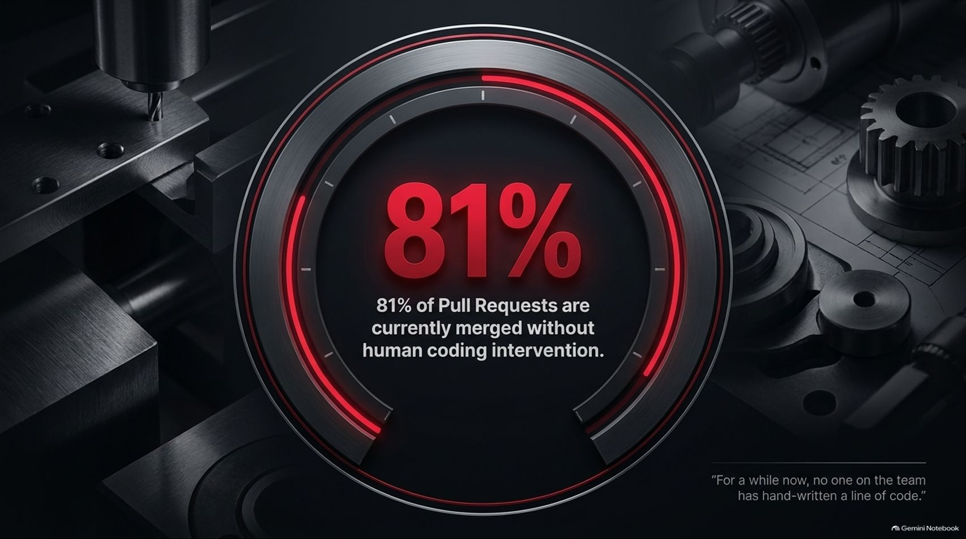
Notes:
Estimated Time: 3 – 4 minutes
Slide Focus: Highlighting advanced enterprise metrics where 81% of Pull Requests are merged without human coding intervention, backed by the quote: "For a while now, no one on the team has hand-written a line of code."
Slide Elements:
Stat: 81% of Pull Requests are currently merged without human coding intervention.
Quote: "For a while now, no one on the team has hand-written a line of code."
Speaker Notes: Some skeptics look at AI coding tools as glorified autocomplete utilities. But leading engineering organizations operating in this new paradigm are already hitting staggering milestones.
Look at this metric on the screen: 81% of Pull Requests in mature AI-native environments are now generated, verified, and merged without a human ever writing a single line of code. As engineering leaders like Guy Podjarny point out, elite teams have reached a point where nobody on the team hand-writes production code anymore.
Does this mean engineers are out of a job? Absolutely not. It means their jobs have been elevated. They aren't spending their days wrestling with semicolons, null pointer exceptions, or syntax errors. They are designing the verification systems, setting architectural guardrails, and managing the automated pipelines that produce that 81% volume.

Slide 4
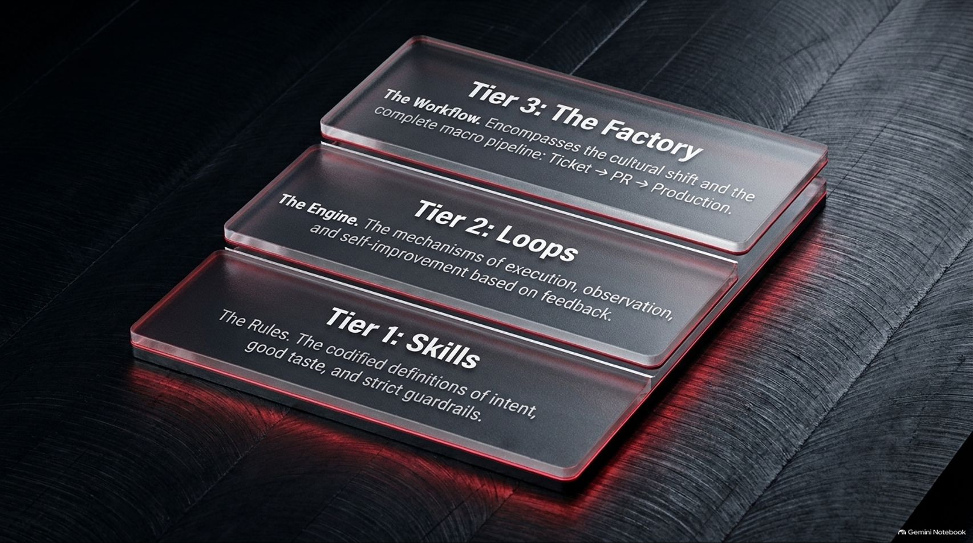

Slide 5
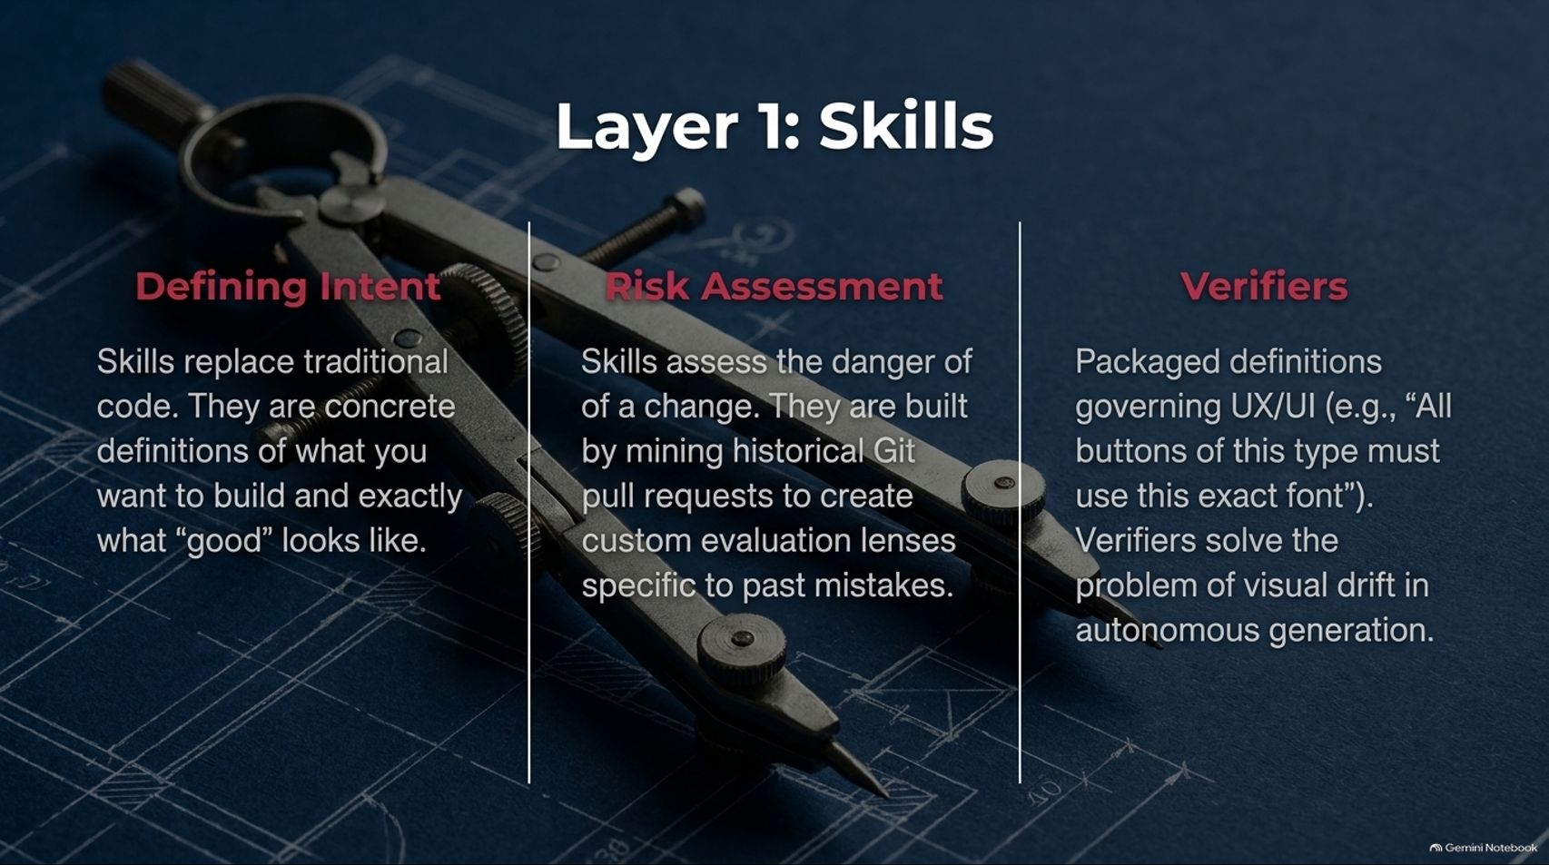
Notes:
Estimated Time: 4 – 5 minutes
Slide Focus: Detailed examination of Tier 1 (Skills): defining intent, mining historical Git PRs for risk assessment, and packaging UI/UX verifiers to prevent visual drift.
Slide Elements:
Defining Intent: Skills replace traditional code. They are concrete definitions of what you want to build and exactly what "good" looks like.
Risk Assessment: Skills assess the danger of a change. They are built by mining historical Git pull requests to create custom evaluation lenses specific to past mistakes.
Verifiers: Packaged definitions governing UX/UI (e.g., "All buttons of this type must use this exact font"). Verifiers solve the problem of visual drift in autonomous generation.
Speaker Notes: Let's zoom in on Layer 1: Skills, because this is where most teams fail when adopting AI. If you just give an LLM a vague prompt, you get generic, mediocre code. Skills solve this by establishing three critical capabilities:
First, Defining Intent: Skills replace traditional hand-written specifications. They act as concrete definitions of your domain logic and architectural expectations, establishing an objective standard for what "good" code looks like in your codebase.
Second, Risk Assessment: How does an agent know if a proposed change is dangerous? Advanced skills are constructed by mining historical Git pull requests. By analyzing past outages, security vulnerabilities, and code review comments, teams create custom evaluation lenses that teach the agent about past mistakes so it never repeats them.
Third, Verifiers: Autonomous generation often suffers from "visual drift"—where buttons shift pixels, fonts change unpredictably, or design systems break. Verifiers are packaged rules governing UI/UX compliance (e.g., mandating that all primary buttons use exact design tokens), ensuring machines adhere strictly to brand and design guidelines.

Slide 6
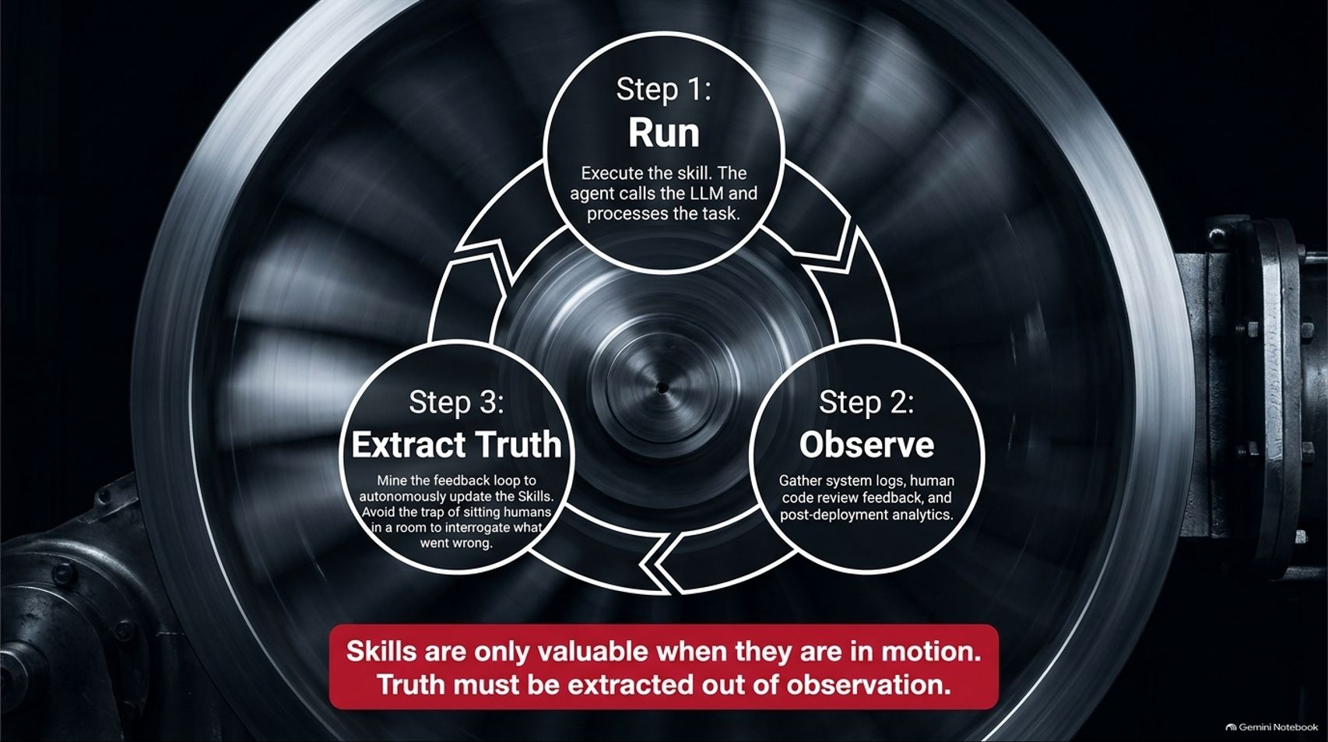
Notes:
Estimated Time: 3.5 – 4.5 minutes
Slide Focus: The continuous execution loop of Tier 2: Run the skill, Observe system logs and human feedback, and Extract Truth to autonomously update skills.
Slide Elements:
Step 1: Run — Execute the skill. The agent calls the LLM and processes the task.
Step 2: Observe — Gather system logs, human code review feedback, and post-deployment analytics.
Step 3: Extract Truth — Mine the feedback loop to autonomously update the Skills. Avoid the trap of sitting humans in a room to interrogate what went wrong.
Bottom Callout: "Skills are only valuable when they are in motion. Truth must be extracted out of observation."
Speaker Notes: Having static skills in a markdown file isn't enough; skills are only valuable when they are in motion. That brings us to Layer 2: Loops, which operates as a continuous improvement flywheel:
Step 1 (Run): The agent executes the skill, calling the LLM and processing a ticket or task.
Step 2 (Observe): The system gathers comprehensive feedback—including compiler logs, test suite outputs, human code review comments, and post-deployment runtime analytics.
Step 3 (Extract Truth): This is the magic step. Instead of falling into the old corporate trap of pulling humans into a tedious post-mortem meeting to argue about why a bug slipped through, the factory mines the feedback loop autonomously. It updates the underlying skills and evaluation lenses automatically, ensuring the factory learns from every single transaction. Truth is extracted directly out of system observation.

Slide 7
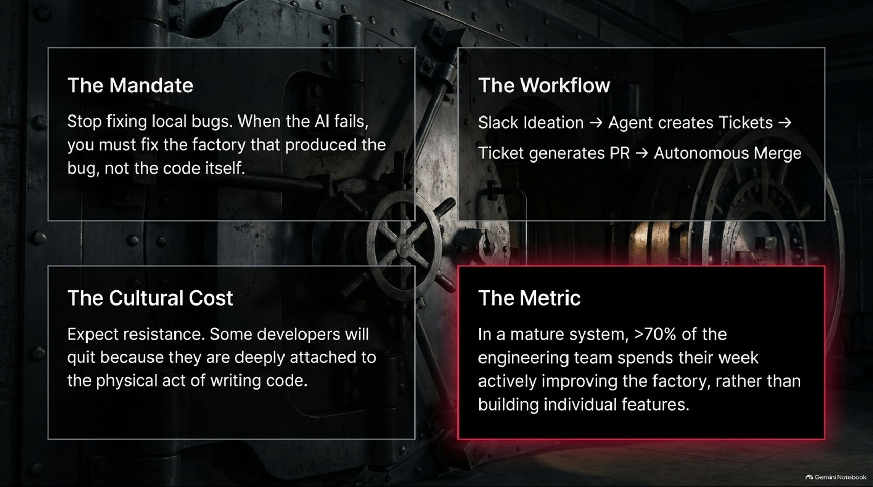
Notes:
Estimated Time: 4 – 5 minutes
Slide Focus: Organizational transformation: shifting from fixing local bugs to fixing the factory, navigating cultural resistance, and the target metric where >70% of engineering time is spent improving the factory.
Slide Elements:
The Mandate: Stop fixing local bugs. When the AI fails, you must fix the factory that produced the bug, not the code itself.
The Workflow: Slack Ideation → Agent creates Tickets → Ticket generates PR → Autonomous Merge.
The Cultural Cost: Expect resistance. Some developers will quit because they are deeply attached to the physical act of writing code.
The Metric: In a mature system, >70% of the engineering team spends their week actively improving the factory, rather than building individual features.
Speaker Notes: Moving to an AI-native software factory requires a radical mindset shift and brings significant cultural friction.
Look at The Mandate: When an autonomous agent writes buggy code, your immediate instinct as an engineer is to jump in and patch that local bug yourself. Resist that urge. In a software factory, if the AI fails, you must fix the factory—the skills, prompts, verifiers, or test harnesses that produced the bug—not the code itself. If you patch the code manually, you haven't learned anything; the factory will make the exact same mistake tomorrow.
This transforms the daily Workflow: ideas start in Slack, agents turn them into structured tickets, tickets generate PRs, and PRs merge autonomously.
There is a Cultural Cost here that leaders must anticipate: some traditional developers will push back or even quit because their core identity is deeply anchored to the manual, tactile act of writing code line-by-line. In a mature factory, over 70% of engineering time is spent building and refining the factory itself, rather than cranking out individual feature code.

Slide 8
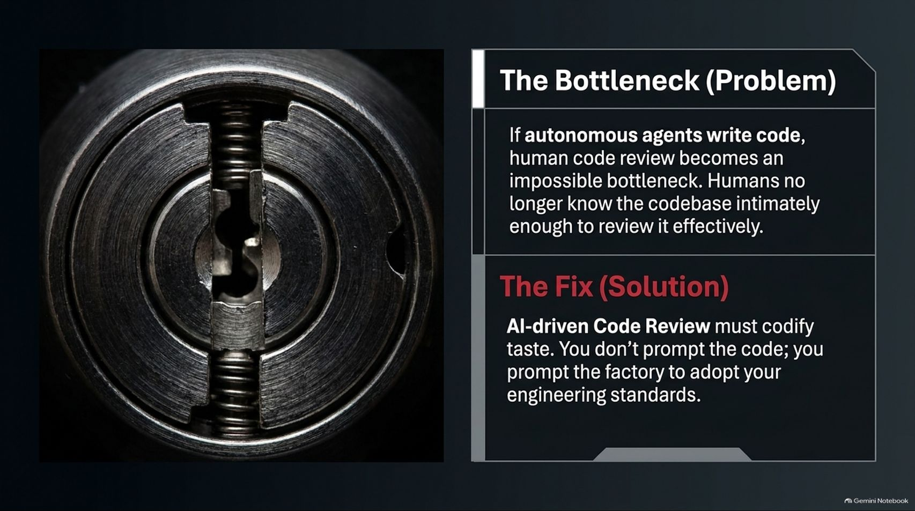
Notes:
Estimated Time: 3.5 – 4.5 minutes
Slide Focus: Addressing the human review bottleneck when agents generate massive code volume, and codifying "engineering taste" into AI-driven review pipelines.
Slide Elements:
The Bottleneck (Problem): If autonomous agents write code, human code review becomes an impossible bottleneck. Humans no longer know the codebase intimately enough to review it effectively.
The Fix (Solution): AI-driven Code Review must codify taste. You don't prompt the code; you prompt the factory to adopt your engineering standards.
Speaker Notes: Here is a paradox every engineering leader must confront: If autonomous agents can generate code ten times faster than before, human code review instantly becomes an impossible bottleneck.
Think about it. If an agent generates 50 Pull Requests a day across your microservices, humans cannot possibly read every line. Furthermore, humans rapidly lose intimate, line-by-line familiarity with a codebase when they are managing agentic swarms. If you rely on traditional human code review, your pipeline grinds to a halt.
What is The Fix? You must codify your team's unique engineering "taste" into automated AI review bots. You don't just prompt the code generator; you prompt the review factory. You embed your architectural standards, security policies, and performance criteria directly into the review agents so they can evaluate PRs against your exact organizational bar instantly and autonomously.

Slide 9
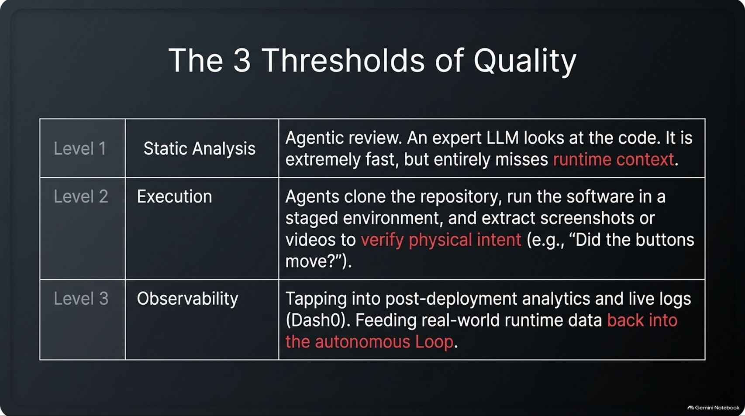
Notes:
Estimated Time: 4 – 5 minutes
Slide Focus: Evaluating code quality across three distinct tiers: Level 1 (Static Analysis), Level 2 (Execution & Visual Verification), and Level 3 (Observability & Production Feedback).
Slide Elements:
Level 1 (Static Analysis): Agentic review. An expert LLM looks at the code. It is extremely fast, but entirely misses runtime context.
Level 2 (Execution): Agents clone the repository, run the software in a staged environment, and extract screenshots or videos to verify physical intent (e.g., "Did the buttons move?").
Level 3 (Observability): Tapping into post-deployment analytics and live logs (Dash0). Feeding real-world runtime data back into the autonomous loop.
Speaker Notes: How do we ensure quality in a system where humans aren't line-by-line reviewers? Tessl outlines The 3 Thresholds of Quality that every robust software factory must implement:
Level 1 — Static Analysis: This is expert LLM code review. It is lightning-fast at catching syntax errors and style violations, but it has a blind spot: it entirely misses runtime context.
Level 2 — Execution: This goes a step further. Autonomous agents clone the repository, spin up the application in a staged container, run integration tests, and can even capture headless browser screenshots or videos to verify visual intent—answering questions like, "Did our UI update correctly or did we break the layout?"
Level 3 — Observability: This is where top-tier engineering meets production telemetry. By tapping into OpenTelemetry-native observability platforms like Dash0, the factory ingests real-world runtime logs, error rates, and user analytics, feeding that live production data straight back into the autonomous loop.

Slide 10
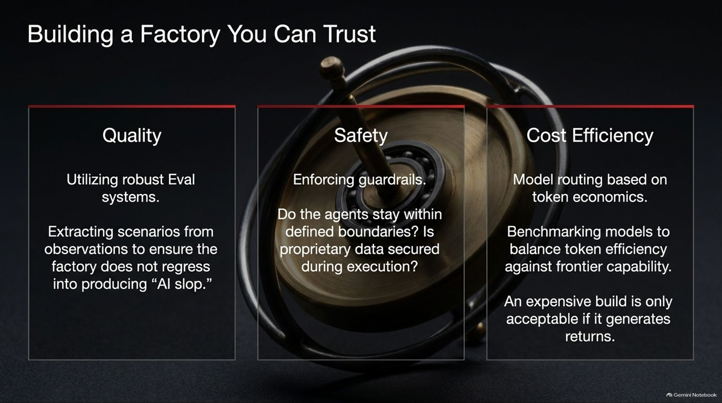
Notes:
Estimated Time: 4 – 5 minutes
Slide Focus: Balancing the triad of trustworthy automation: robust Eval systems for Quality, guardrails and proprietary data protection for Safety, and token economics/model routing for Cost Efficiency.
Slide Elements:
Quality: Utilizing robust Eval systems. Extracting scenarios from observations to ensure the factory does not regress into producing "AI slop."
Safety: Enforcing guardrails. Do the agents stay within defined boundaries? Is proprietary data secured during execution?
Cost Efficiency: Model routing based on token economics. Benchmarking models to balance token efficiency against frontier capability. An expensive build is only acceptable if it generates returns.
Speaker Notes: To scale an AI software factory across an enterprise, you must establish unwavering trust across three foundational pillars: Quality, Safety, and Cost Efficiency.
Quality: You must build robust Evaluation ("Eval") systems. By extracting test scenarios from real-world observations, you ensure the factory continuously improves rather than regressing into generating unmaintainable "AI slop."
Safety: Guardrails are non-negotiable. You must verify that autonomous agents operate strictly within defined organizational boundaries and that proprietary source code or customer data is never leaked or misused during execution.
Cost Efficiency: Running frontier LLMs for every minor task is economically unsustainable. A mature factory implements intelligent model routing based on token economics—matching simpler tasks to fast, inexpensive models while reserving frontier reasoning models for complex architecture. An expensive AI build is only justified if it delivers clear business ROI.

Slide 11
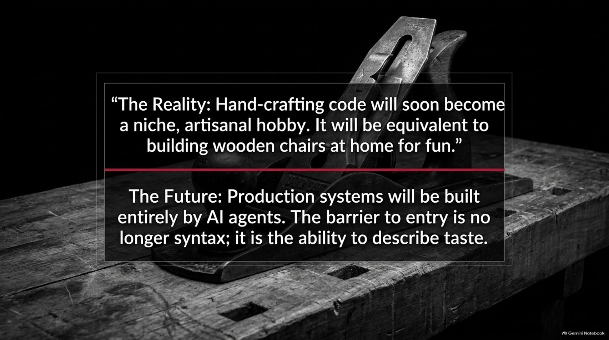
Notes:
Estimated Time: 3.5 – 4.5 minutes
Slide Focus: Defining the three archetypes of the modern engineer in an AI-native world: The Curator, The Guardian, and The Irrational Innovator.
Slide Elements:
1. The Curator: Directing intent. Translating business needs to the factory and making the crucial decisions about what not to build.
2. The Guardian: Managing boundaries, guardrails, and risk. Defining the constraints that make your application distinctly yours, rather than a baseline LLM output.
3. The Irrational Innovator: Taking the counter-statistical leaps that optimization bots fundamentally cannot make.
Speaker Notes: As hand-crafted coding fades into a niche hobby, what does the profile of a modern engineer look like? Guy Podjarny and industry leaders outline The Post-Code Developer Profile, composed of three archetypes:
The Curator: Your primary job is directing intent. You sit between business stakeholders and the software factory, translating ambiguous human needs into precise architectural requirements—and crucially, deciding what not to build.
The Guardian: You manage risk, compliance, and boundaries. Because any LLM can generate generic boilerplate, the Guardian establishes the unique security constraints, design tokens, and guardrails that make your product distinctively yours.
The Irrational Innovator: This is your highest-leverage role. Optimization engines are inherently bound by statistical consensus. True breakthroughs require making bold, counter-intuitive leaps that data models can never deduce on their own.

Slide 12
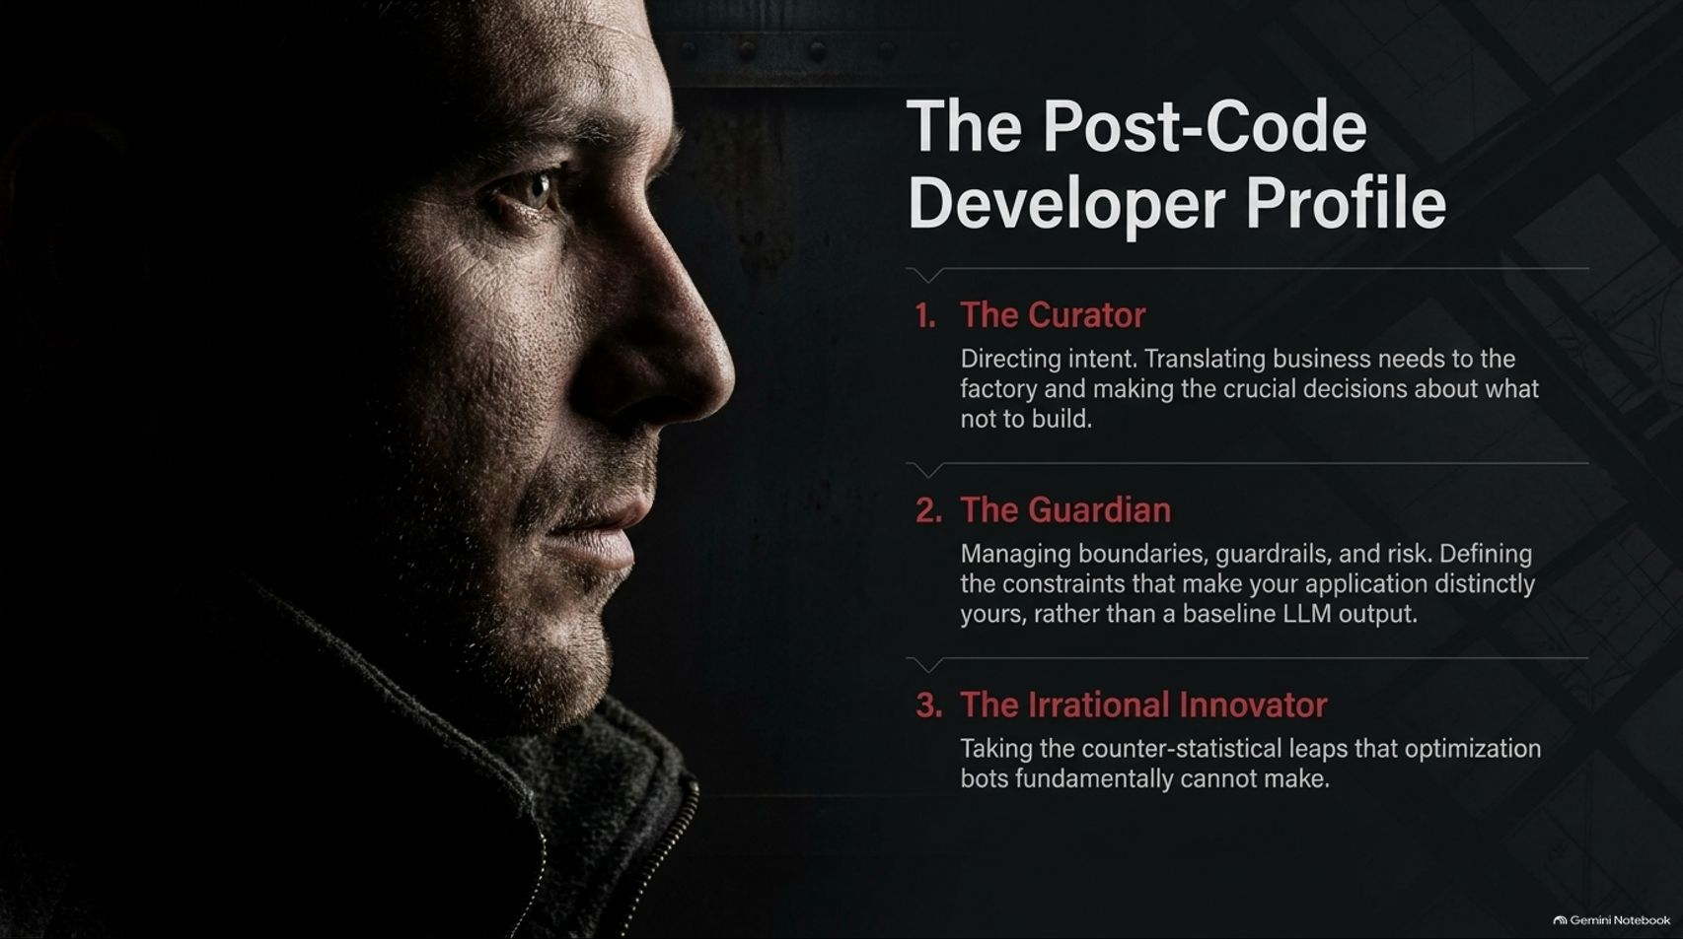
Notes:
Estimated Time: 3.5 – 4.5 minutes
Slide Focus: Why AI is bounded by consensus and historical data, whereas human innovation relies on non-consensus thinking backed by real-world accountability (skin in the game).
Slide Elements:
Flow: AI is bound by statistics and consensus $\rightarrow$ Every true innovation, bold company, or great piece of art is fundamentally non-consensus and counter to historical data $\rightarrow$ Humans hold the ultimate advantage because they possess accountability.
Callout Box: If a human is bold and right, they are promoted. If wrong, they are fired. Agents cannot hold accountability, and therefore cannot make truly irrational leaps.
Speaker Notes: Why can't AI fully replace human strategic vision? This slide touches on a profound philosophical and practical truth about machine learning.
AI is fundamentally bound by statistics and consensus. An LLM predicts the most likely next token based on everything humanity has already written and built. By definition, it interpolates the past. Yet every true innovation, disruptive company, or revolutionary piece of software is non-consensus—it flies directly in the face of historical data.
Furthermore, humans possess accountability. If a software engineer takes a bold, irrational risk and succeeds, they are rewarded and promoted. If their bet fails catastrophically, their career suffers real consequences. Autonomous agents have no skin in the game; they cannot hold moral or professional accountability. Because agents lack accountability, they cannot make truly irrational, visionary leaps. That unique domain belongs exclusively to humans.

Slide 13
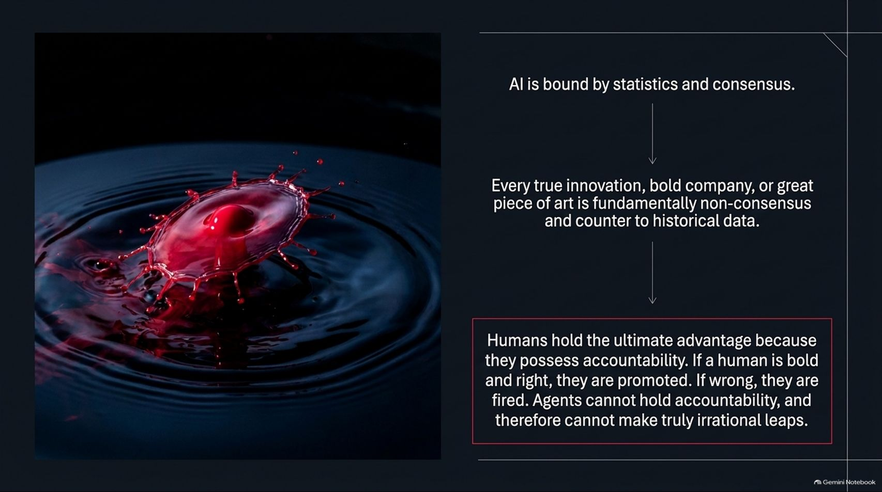
Notes:
Estimated Time: 3 – 4 minutes
Slide Focus: Three core takeaways: move from syntax to intent, build reliable skills in self-improving loops, and reserve irrational, bold choices for humans while leaving absolute competence to bots.
Slide Elements:
Move your organization from writing syntax to defining intent.
Build reliable Skills, execute them in self-improving Loops, and commit to the Factory culture.
Leave absolute competence to the bots. Reserve irrational, bold choices for humans.
Speaker Notes: As we wrap up our analysis of Guy Podjarny's framework, let's distill everything down into three golden rules for engineering leaders:
First, shift your organization from writing syntax to defining intent. Stop measuring developer productivity by lines of code or commits; measure it by how effectively your team articulates architectural goals and business value to autonomous systems.
Second, build reliable Skills, execute them in self-improving Loops, and commit fully to Factory culture. Treat your AI harness as an evolving manufacturing plant that learns from every production deployment, code review, and system log.
Third, leave absolute competence to the bots, but reserve irrational, bold choices for humans. Let the AI handle the repetitive execution, refactoring, and test generation with flawless reliability, leaving human engineers free to apply imagination, risk-taking, and strategic taste.

Slide 14
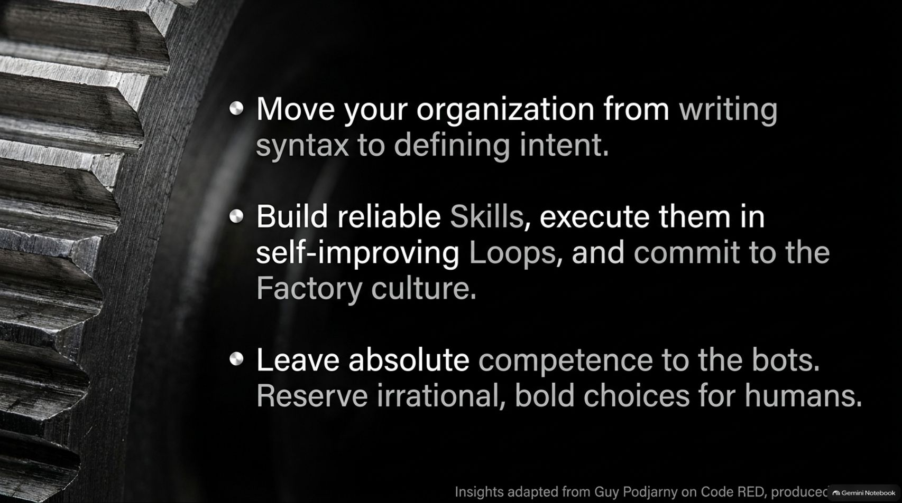
Notes:
Estimated Time: 3.5 – 4.5 minutes
Slide Focus: Comprehensive architectural recap integrating the AI Factory Paradigm Shift, Core Factory Architecture, and the Evolving Developer Role.
Speaker Notes: This master infographic brings together the entire blueprint of the AI-native development paradigm we've explored across this presentation.
On the left, under The AI Factory Paradigm Shift, we see the transition from manual line-by-line coding ("building the car") to supervising autonomous agent systems ("building the factory"), driven by intent-driven development and systemic error resolution.
In the center, under Core Factory Architecture, the engine is laid bare: Skill codification embedding code review standards, continuous feedback loops observing live runtime logs, and automated Eval suites benchmarking model performance dynamically.
On the right, under The Evolving Developer Role, we see the human contribution distilled: Intent Curation (selecting high-value features), Boundary Governance (enforcing compliance guardrails), and Intuitive Leadership (exercising human conviction beyond data-driven norms).
This is the blueprint for engineering in the AI era. Thank you very much, and I'd love to open the floor for your questions and discussion.

Slide 15
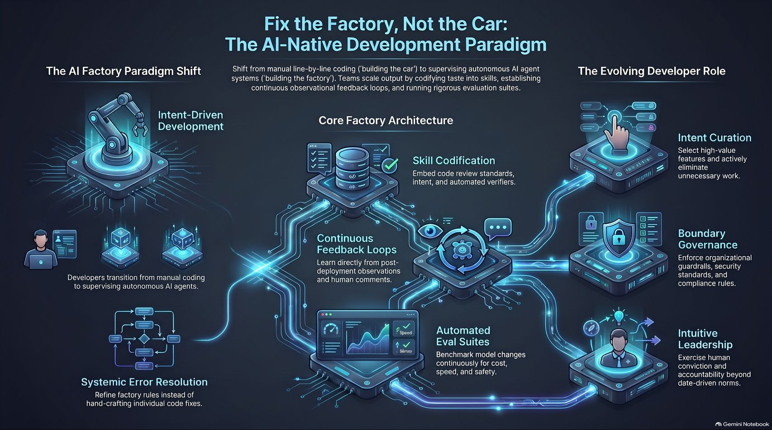
Notes:
Estimated Time: 3 – 4 minutes
Slide Focus: Closing quote contrasting the artisanal hobby of hand-crafting code with industrial AI production systems, emphasizing that taste and intent are the ultimate developer skills.
Slide Elements:
The Reality: Hand-crafting code will soon become a niche, artisanal hobby. It will be equivalent to building wooden chairs at home for fun.
The Future: Production systems will be built entirely by AI agents. The barrier to entry is no longer syntax; it is the ability to describe taste.
Speaker Notes: We leave you with this final, provocative thought from Guy Podjarny's framework:
"The Reality: Hand-crafting code will soon become a niche, artisanal hobby. It will be equivalent to building wooden chairs at home for fun."
Just as industrial machinery replaced hand-carved furniture manufacturing centuries ago—turning woodworking into a passionate craft rather than a mass-production necessity—AI autonomous agents are replacing manual coding in enterprise production.
In the immediate future, production software systems will be built entirely by AI factories. The barrier to entry will no longer be knowing syntax or memory management; it will be your ability to define architecture, curate high-leverage intent, and describe taste.
Thank you for your time, and let's build better factories.

