Slide 1
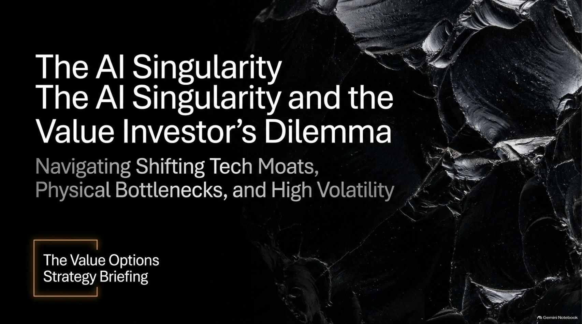
Notes:
Estimated Time: 2.5 – 3 minutes
Slide Focus: Title slide introducing the core challenge for value investors: balancing awe for the AI singularity with disciplined valuation amidst shifting moats and physical limits.
Speaker Notes: Welcome everyone. Today we are tackling one of the most paradoxical market environments in financial history: The AI Singularity and the Value Investor’s Dilemma.
We are living through a breathtaking technological revolution. Yet, for disciplined value investors schooled in the traditions of Benjamin Graham and Warren Buffett, the current market presents a profound psychological and analytical challenge. How do you participate in a world-changing technological wave without falling victim to hyper-inflated valuations, capital destruction, and shifting competitive moats?
Over the next 15 slides, we will break down the structural mechanics of this transition. We will examine the "Moat Breaker" concept, the brutal economic reality of the 2% rule, physical infrastructure bottlenecks, and a tactical options framework that allows disciplined investors to manufacture entry prices out of market volatility. Let’s dive in.
The AI Singularity Is Coming. Is This $400 Stock Is Still Mispriced?
https://www.youtube.com/watch?v=ntuQsoRPdjk

Slide 2
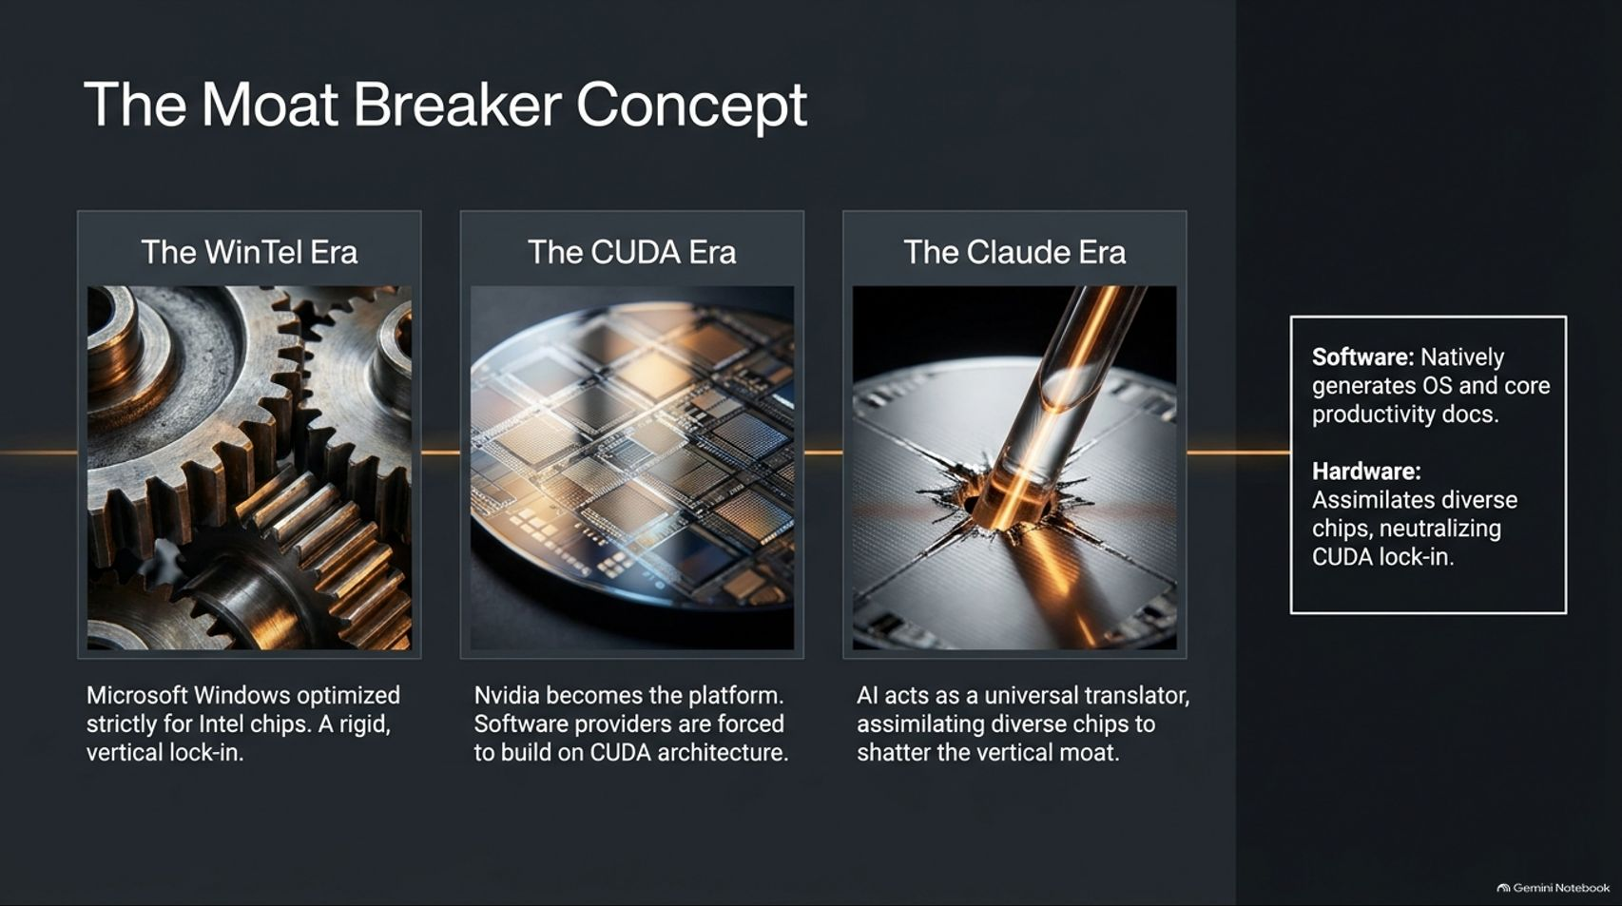
Notes:
Estimated Time: 3.5 – 4.5 minutes
Slide Focus: Tracing the evolution of platform lock-in from the WinTel era through the CUDA hardware era to the AI universal translator ("The Claude Era").
Slide Elements:
The WinTel Era: Microsoft Windows optimized strictly for Intel chips. A rigid, vertical lock-in.
The CUDA Era: Nvidia becomes the platform. Software providers are forced to build on CUDA architecture.
The Claude Era: AI acts as a universal translator, assimilating diverse chips to shatter the vertical moat.
Software / Hardware Callout: Software natively generates OS and core productivity docs; Hardware assimilates diverse chips, neutralizing CUDA lock-in.
Speaker Notes: To understand why traditional tech moats are fracturing, we must look at how platform dominance has evolved across three distinct eras.
In the WinTel Era, power was built on vertical lock-in: Microsoft Windows was tightly optimized for Intel silicon, creating an almost impenetrable duopoly. In the CUDA Era, Nvidia replicated this playbook at the hardware level, making CUDA the mandatory software layer for training large language models and forcing the entire tech ecosystem into its proprietary ecosystem.
Now, we have entered The Claude Era (the AI universal translator). Advanced generative models and coding agents act as universal software translators. They can port code across languages, emulate legacy systems, and natively generate operating system scripts and productivity documents. At the hardware level, AI compilation layers make it trivial to route workloads across diverse chips—custom ASICs, TPUs, and AMD GPUs—effectively neutralizing hardware lock-in and shattering traditional vertical moats.

Slide 3
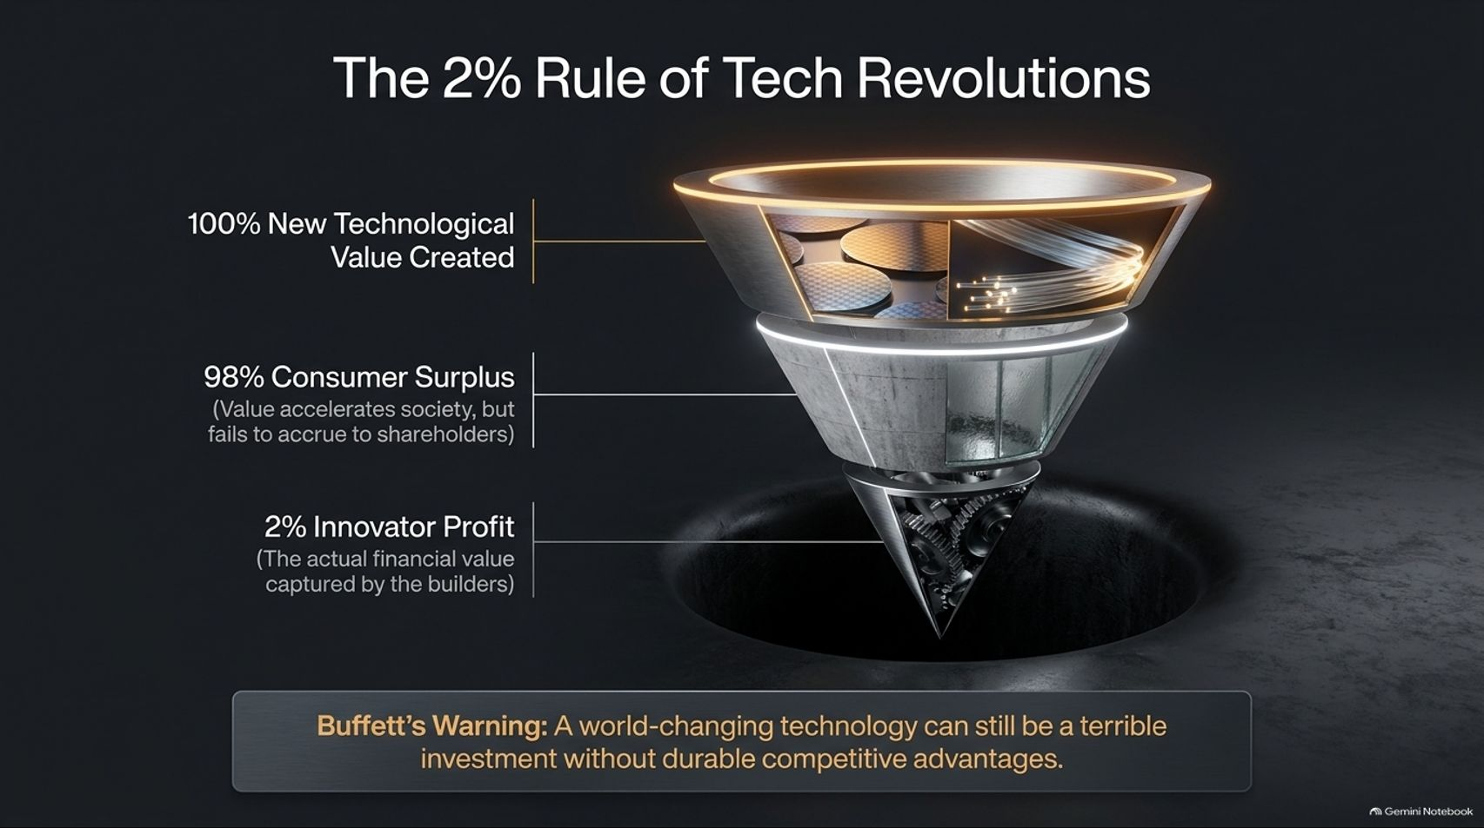
Notes:
Estimated Time: 3.5 – 4.5 minutes
Slide Focus: Examining the economic funnel of technological revolutions: 100% technological value created, 98% consumer surplus, and only 2% innovator/builder profit, referencing Warren Buffett's warning.
Slide Elements:
100% New Technological Value Created
98% Consumer Surplus: Value accelerates society, but fails to accrue to shareholders.
2% Innovator Profit: The actual financial value captured by the builders.
Buffett's Warning: "A world-changing technology can still be a terrible investment without durable competitive advantages."
Speaker Notes: This is perhaps the most crucial slide for any investor in the room. History teaches us a humbling economic lesson known as The 2% Rule of Tech Revolutions.
When a monumental breakthrough occurs—whether it was the railroad boom, early aviation, the dot-com fiber optic buildout, or generative AI—it creates 100% massive technological value. Society changes forever. Consumers reap 98% of that value through hyper-efficient tools, free information, and soaring productivity.
However, the actual innovator and builder profit capture is a razor-thin 2%. Why? Because intense competition, rapid commoditization, and low barriers to entry drive prices to marginal cost. As Warren Buffett famously warned: "A world-changing technology can still be a terrible investment without durable competitive advantages." A soaring Total Addressable Market (TAM) does not automatically equal shareholder returns.

Slide 4
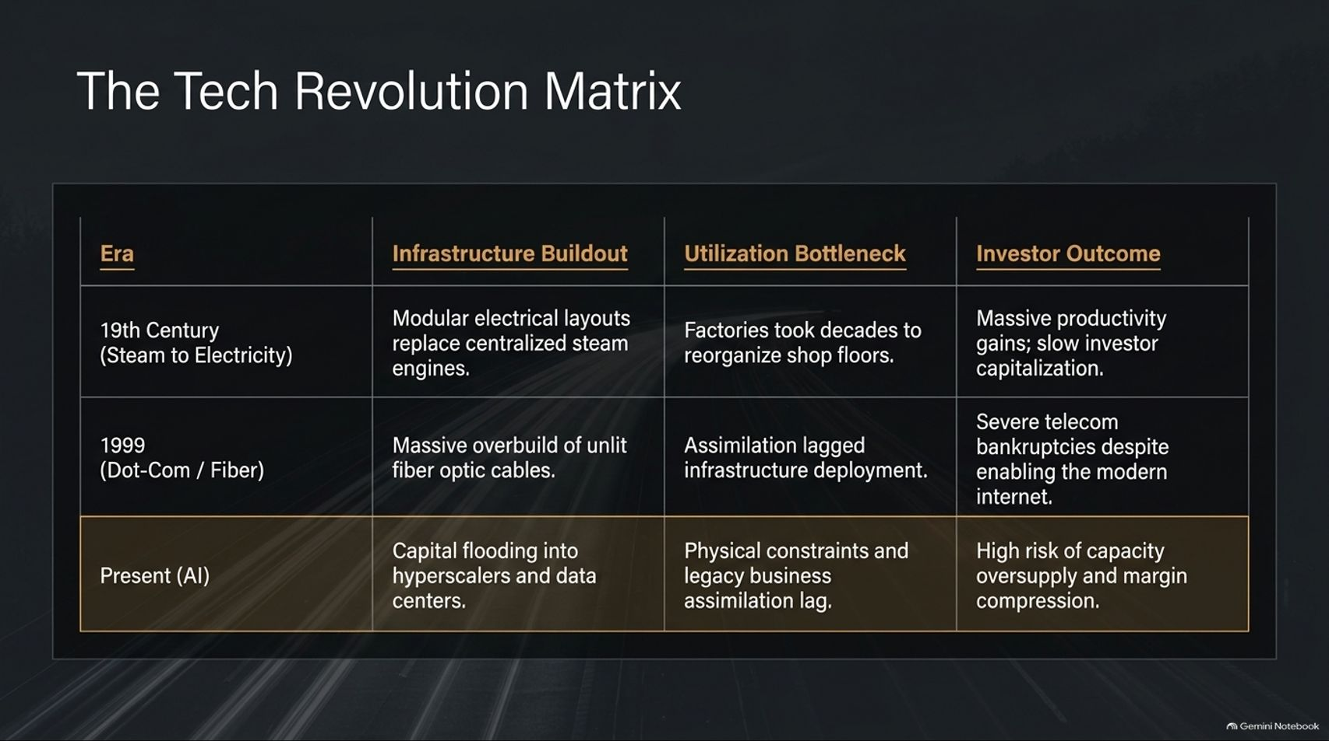
Notes:
Estimated Time: 3.5 – 4.5 minutes
Slide Focus: Comparing historical infrastructure buildouts (19th-century steam/electricity, 1999 dot-com fiber optic overbuild) with the present AI capital flood and utilization bottlenecks.
Slide Elements:
19th Century (Steam to Electricity): Modular electrical layouts replaced steam engines. Factories took decades to reorganize shop floors. Result: Massive productivity gains; slow investor capitalization.
1999 (Dot-Com / Fiber): Massive overbuild of unlit fiber optic cables. Assimilation lagged infrastructure deployment. Result: Severe telecom bankruptcies despite enabling the modern internet.
Present (AI): Capital flooding into hyperscalers and data centers. Physical constraints and legacy business assimilation lag. Result: High risk of capacity oversupply and margin compression.
Speaker Notes: To gauge where we are in the AI cycle, let's place it in historical context using our Tech Revolution Matrix.
Look back at the 19th-century transition from steam to electricity. While electrical grids were built quickly, it took enterprises decades to completely reorganize their factory floors to utilize modular power. Productivity surged, but early investors suffered from slow capital回报. Fast-forward to 1999: Wall Street funded a massive overbuild of unlit fiber optic cables across the ocean. Demand lagged infrastructure by years, leading to severe telecom bankruptcies—even though those exact cables ultimately enabled the modern internet economy.
Today, we are witnessing an identical dynamic in Present AI. Hundreds of billions of dollars are flooding into hyperscaler data centers. Yet, enterprise software assimilation and physical power constraints lag far behind the capex deployment. The historical precedent suggests we face a severe near-term risk of capacity oversupply and margin compression before long-term economic stability takes hold.

Slide 5
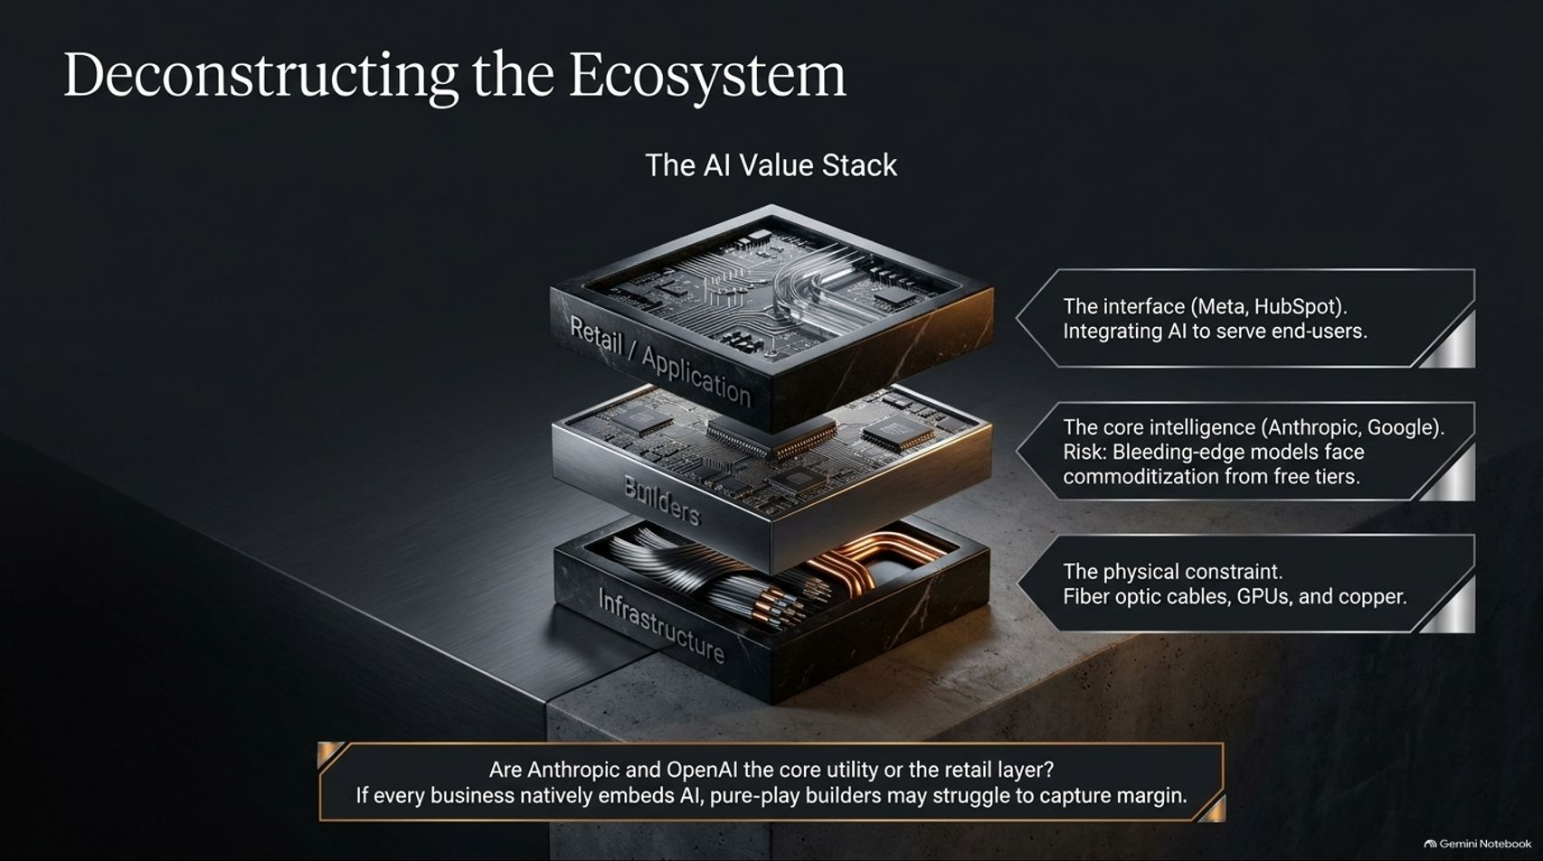
Notes:
Estimated Time: 3.5 – 4.5 minutes
Slide Focus: Breaking down the AI Value Stack into Retail/Application, Builders, and Infrastructure layers, addressing whether foundation model builders can protect margins.
Slide Elements:
Retail / Application Layer: Meta, HubSpot. Integrating AI to serve end-users.
Builders Layer: Anthropic, Google. The core intelligence. Risk: Bleeding-edge models face commoditization from free tiers.
Infrastructure Layer: Fiber optic cables, GPUs, and copper (the physical constraints).
Bottom Callout: "Are Anthropic and OpenAI the core utility or the retail layer? If every business natively embeds AI, pure-play builders may struggle to capture margin."
Speaker Notes: Where does economic value actually pool in the AI value stack? Let's deconstruct the ecosystem into three distinct layers.
At the top is the Retail/Application Layer (companies like Meta or HubSpot), which integrates AI intelligence to serve end-users within established workflows. At the bottom is the Infrastructure Layer—the heavy physical constraints of copper mines, fiber optic backbones, and advanced semiconductor fabs.
Sandwiched in the middle is the Builders Layer—the frontier model creators like Anthropic and OpenAI. Here lies the value investor's dilemma: While these models represent the pinnacle of human engineering, they face severe commoditization risks as open-source models and free tier capabilities catch up. If foundation models become a ubiquitous commodity utility, pure-play builders will struggle to capture sustainable economic margins.

Slide 6
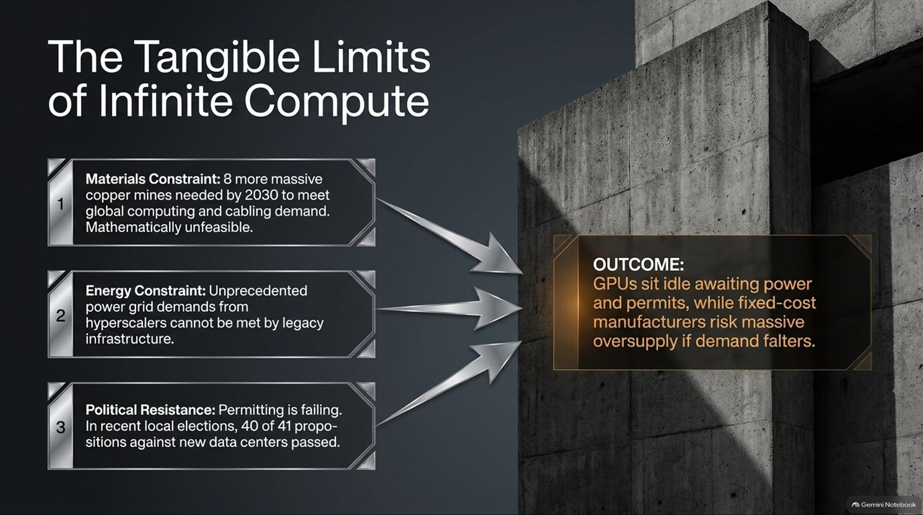
Notes:
Estimated Time: 3.5 – 4.5 minutes
Slide Focus: Examining physical constraints—materials (copper), energy grid capacity, and political resistance/permitting—and their impact on hardware oversupply risks.
Slide Elements:
1. Materials Constraint: 8 more massive copper mines needed by 2030 to meet global computing and cabling demand. Mathematically unfeasible.
2. Energy Constraint: Unprecedented power grid demands from hyperscalers cannot be met by legacy infrastructure.
3. Political Resistance: Permitting is failing. In recent local elections, 40 of 41 propositions against new data centers passed.
Outcome: GPUs sit idle awaiting power and permits, while fixed-cost manufacturers risk massive oversupply if demand falters.
Speaker Notes: Tech evangelists speak of "infinite compute" as if digital scaling has no physical bounds. But reality is grounded in the physical world, where three immovable constraints are colliding with AI ambition.
First is the Materials Constraint: Meeting projected data center cabling and transformer demand by 2030 requires opening roughly eight massive new copper mines—an objective that is mathematically and environmentally unfeasible in that timeframe. Second is the Energy Constraint: Hyperscaler data centers demand gigawatt-scale power loads that legacy electrical grids simply cannot support without massive multi-year overhauls. Third is Political Resistance: Local communities are pushing back aggressively. In recent municipal elections, 40 out of 41 zoning propositions opposing new data center construction passed.
The net outcome? Thousands of expensive GPUs risk sitting idle in warehouses awaiting power connections and zoning permits, while fixed-cost semiconductor manufacturers face severe inventory oversupply if demand growth stumbles.

Slide 7
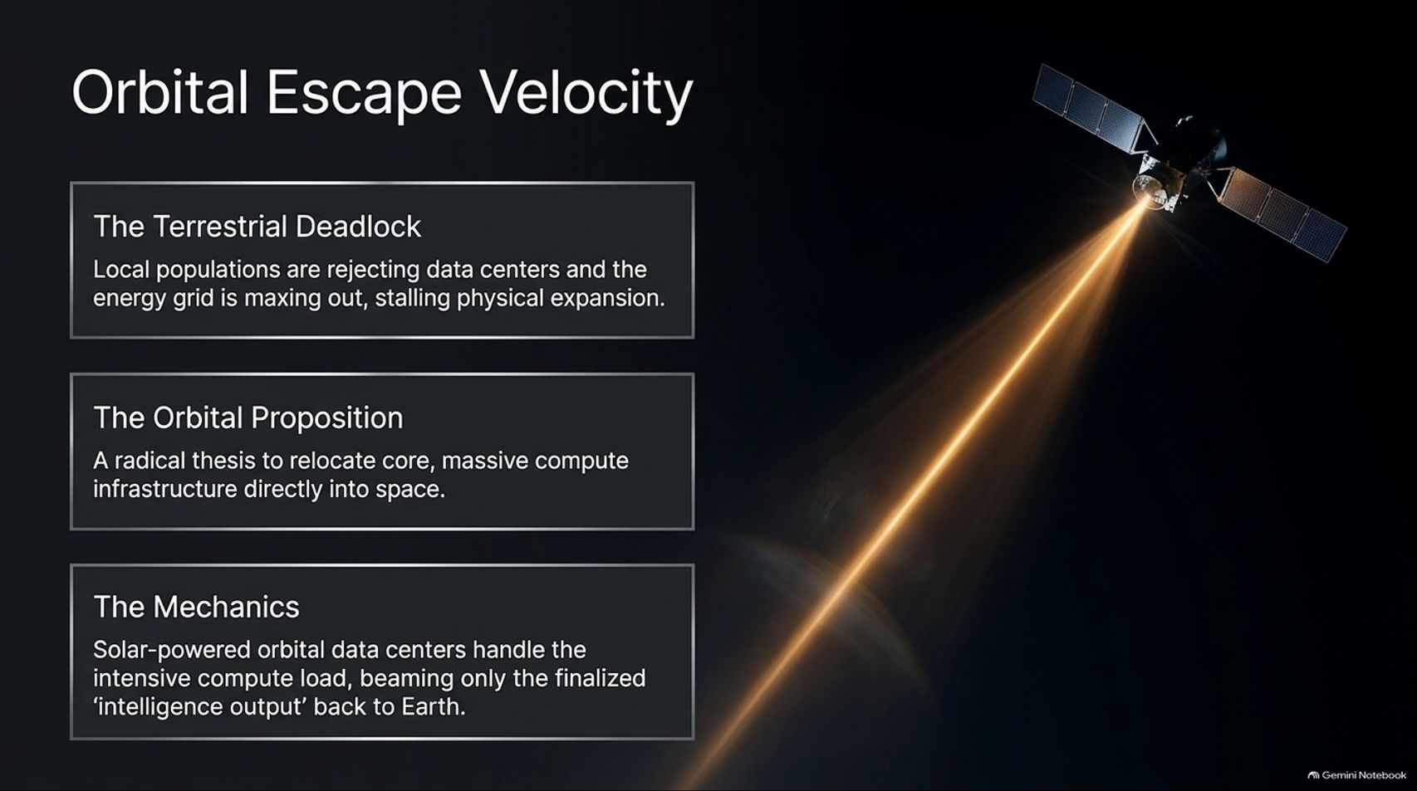
Notes:
Estimated Time: 3 – 4 minutes
Slide Focus: Exploring the radical thesis of relocating massive compute infrastructure into space powered by solar arrays, beaming only finalized intelligence back to Earth.
Slide Elements:
The Terrestrial Deadlock: Local populations are rejecting data centers and the energy grid is maxing out, stalling physical expansion.
The Orbital Proposition: A radical thesis to relocate core, massive compute infrastructure directly into space.
The Mechanics: Solar-powered orbital data centers handle the intensive compute load, beaming only the finalized "intelligence output" back to Earth.
Speaker Notes: When terrestrial limits become absolute, engineers look to radical solutions. Welcome to the thesis of Orbital Escape Velocity.
Because local populations are rejecting terrestrial data centers and Earth's electrical grids are maxing out, forward-thinking technologists are proposing a bold alternative: moving heavy compute infrastructure entirely off-planet.
The mechanics are straightforward in theory: place massive GPU clusters in low-Earth orbit where they have uninterrupted 24/7 access to unfiltered solar energy without atmospheric attenuation, completely bypassing terrestrial zoning laws, water cooling shortages, and grid bottlenecks. These orbital data centers would shoulder the heavy training and compute load, beaming only the compact, finalized "intelligence output"—the finished weights and answers—back down to Earth via high-bandwidth laser links. It sounds like science fiction, but it illustrates how severely physical bottlenecks are straining terrestrial assumptions.

Slide 8
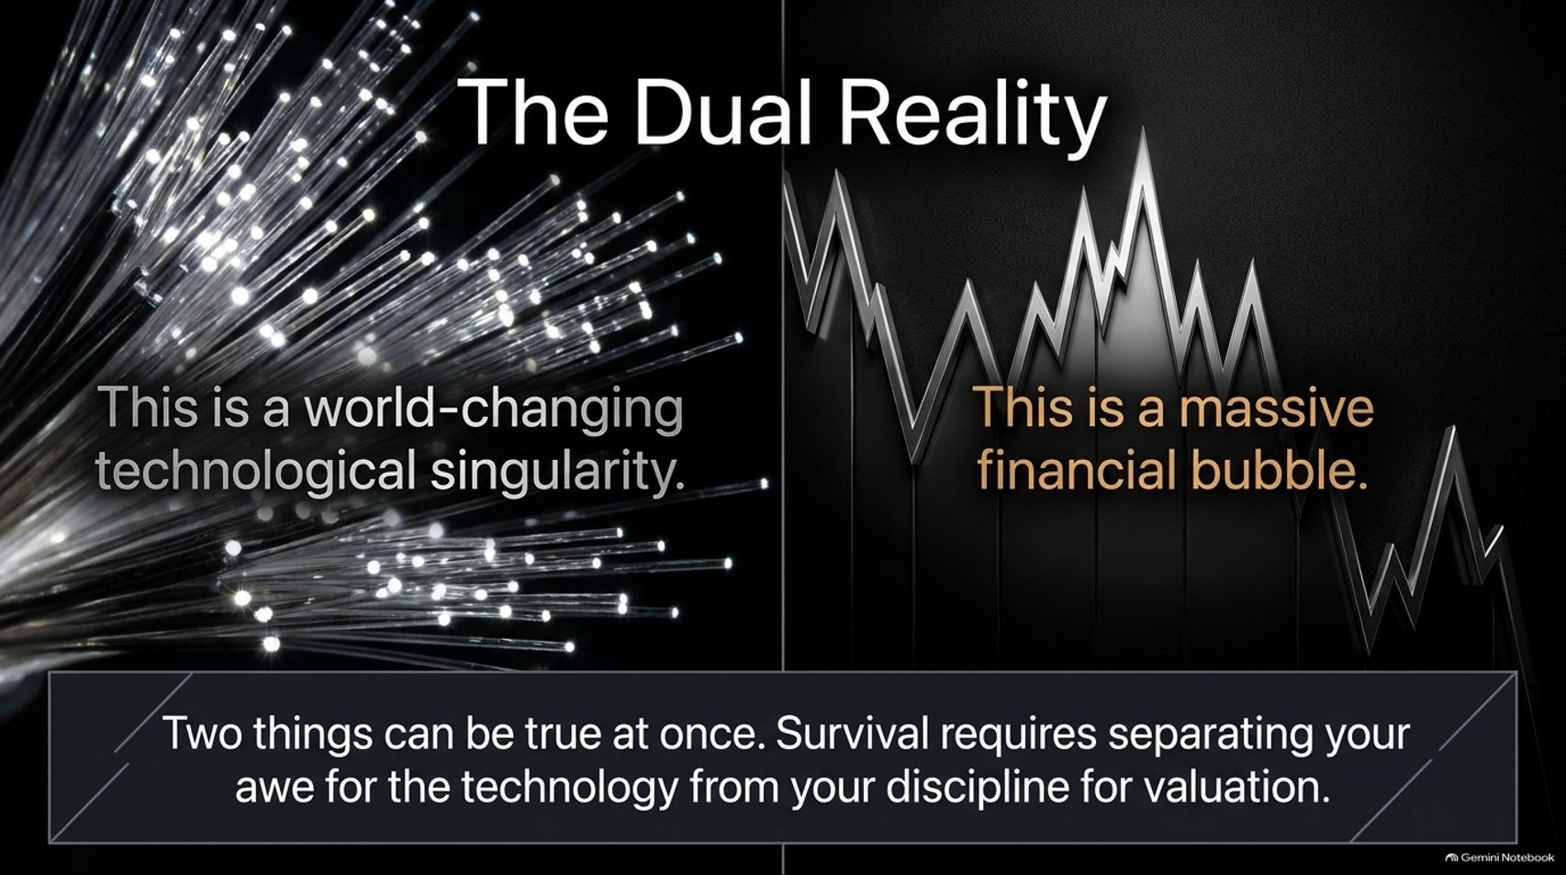
Notes:
Estimated Time: 3.5 – 4.5 minutes
Slide Focus: Reconciling the dual truth: AI is a world-changing technological singularity and a massive financial bubble, requiring separation of awe from valuation discipline.
Slide Elements:
Left: This is a world-changing technological singularity.
Right: This is a massive financial bubble.
Bottom Callout: "Two things can be true at once. Survival requires separating your awe for the technology from your discipline for valuation."
Speaker Notes: This slide is the emotional and analytical anchor of our entire briefing. Investors often fall into a cognitive trap: they assume that because a technology is revolutionary, its stock prices must be rational.
We must hold two opposing thoughts in our heads simultaneously: This is a world-changing technological singularity, and this is a massive financial bubble.
The internet in 1999 was equally revolutionary—it completely transformed human civilization. Yet buying Cisco, WorldCom, and Pets.com at peak valuations in March 2000 resulted in catastrophic capital destruction that took over a decade to recover from. Two things can be true at once. Surviving and thriving as a value investor requires ruthlessly separating your awe for what AI can do from your rigorous discipline for cash-flow valuation.

Slide 9
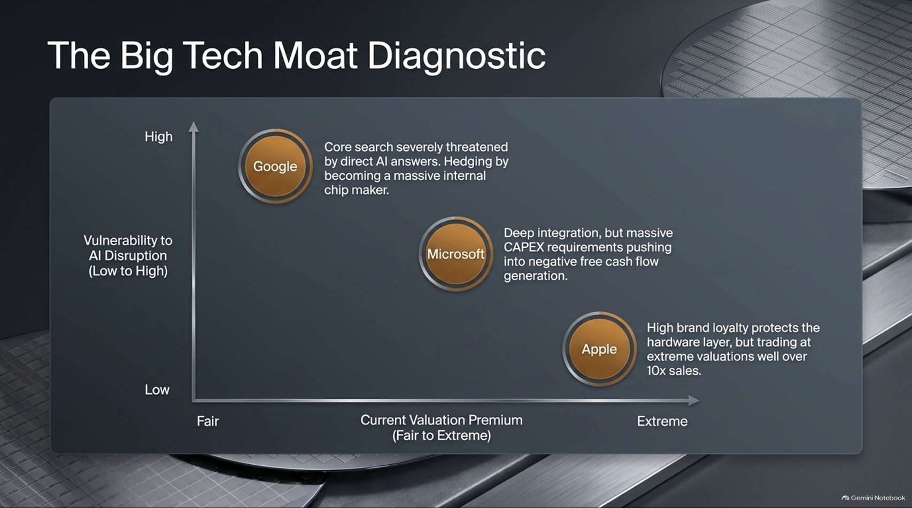
Notes:
Estimated Time: 3.5 – 4.5 minutes
Slide Focus: Mapping Big Tech giants on a matrix of vulnerability to AI disruption vs. valuation premium (Google, Microsoft, Apple).
Slide Elements:
Google (Low Valuation / High Vulnerability): Core search severely threatened by direct AI answers. Hedging by becoming a massive internal chip maker.
Microsoft (Fair-to-High Valuation / Moderate Vulnerability): Deep integration, but massive CAPEX requirements pushing into negative free cash flow generation.
Apple (Extreme Valuation / Low Vulnerability): High brand loyalty protects the hardware layer, but trading at extreme valuations well over 10x sales.
Speaker Notes: Let's run a diagnostic on the "Magnificent Seven" through the lens of our Big Tech Moat Diagnostic matrix.
Google: Sits in the high-vulnerability quadrant because generative AI threatens its core search advertising cash cow directly. However, its valuation remains relatively fair as it hedges by manufacturing custom TPU chips.
Microsoft: Commands a moderate valuation premium, deeply integrating AI across enterprise software. Yet its Achilles' heel is staggering CAPEX commitments that temporarily push its core divisions into negative free cash flow generation.
Apple: Exhibits low near-term vulnerability due to impenetrable hardware ecosystem loyalty and proprietary user devices. However, its valuation has stretched into extreme territory—trading well over 10x sales, leaving zero margin of safety for value buyers.

Slide 10
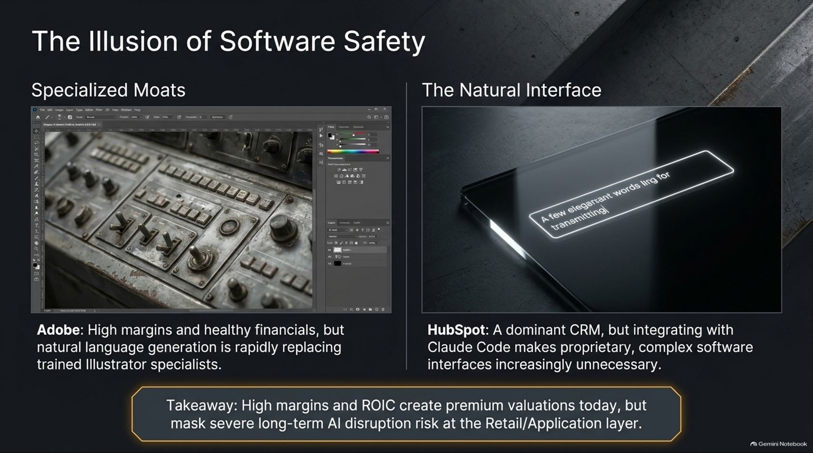
Notes:
Estimated Time: 3.5 – 4.5 minutes
Slide Focus: Examining how natural language interfaces threaten traditional software moats, contrasting Adobe's complex UI with HubSpot's vulnerability to autonomous coding agents.
Slide Elements:
Adobe (Specialized Moats): High margins and healthy financials, but natural language generation is rapidly replacing trained Illustrator specialists.
HubSpot (The Natural Interface): A dominant CRM, but integrating with coding agents like Claude Code makes proprietary, complex software interfaces increasingly unnecessary.
Bottom Callout: "Takeaway: High margins and ROIC create premium valuations today, but mask severe long-term AI disruption risk at the Retail/Application layer."
Speaker Notes: Many investors believe traditional enterprise software (SaaS) companies are safe havens because they boast high operating margins and sticky customer relationships. This is The Illusion of Software Safety.
Consider Adobe: For decades, its complex UI filled with intricate toolbars was an unassailable moat requiring years of professional training to master. Today, simple natural language prompts generate publication-grade vector graphics instantly, threatening that specialized expertise. Look at HubSpot: A dominant CRM, but as autonomous AI agents like Claude Code become capable of spinning up custom database schemas and internal tools on the fly, proprietary enterprise software interfaces face severe long-term disintermediation. High ROIC today masks existential structural disruption tomorrow.

Slide 11
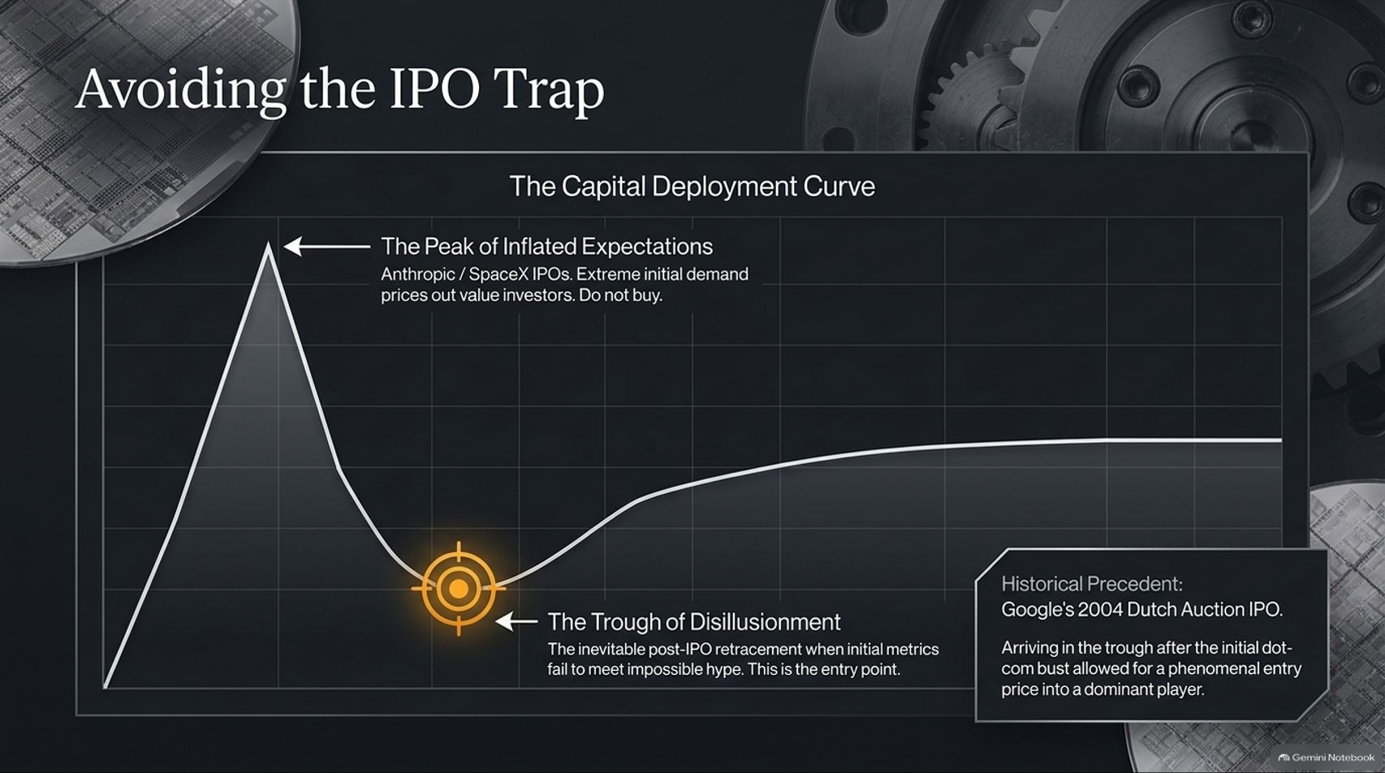
Notes:
Estimated Time: 3.5 – 4.5 minutes
Slide Focus: Analyzing the hype cycle curve for high-profile AI IPOs (Anthropic, SpaceX), avoiding the peak of inflated expectations, and waiting for the "Trough of Disillusionment" (referencing Google's 2004 Dutch Auction).
Slide Elements:
The Peak of Inflated Expectations: Anthropic / SpaceX IPOs. Extreme initial demand prices out value investors. Do not buy.
The Trough of Disillusionment: The inevitable post-IPO retracement when initial metrics fail to meet impossible hype. This is the entry point.
Historical Precedent: Google's 2004 Dutch Auction IPO. Arriving in the trough after the initial dot-com bust allowed for a phenomenal entry price into a dominant player.
Speaker Notes: When prominent AI pioneers like Anthropic or SpaceX eventually transition toward public markets, Wall Street will experience massive FOMO. Value investors must avoid The IPO Trap.
The capital deployment curve for disruptive tech IPOs always follows the same cruel trajectory. They debut at the absolute Peak of Inflated Expectations, fueled by media hype and retail mania that prices value investors out completely.
Patience is required. We wait for The Trough of Disillusionment—that inevitable post-IPO shakeout six to eighteen months later when initial earnings fail to meet unrealistic Wall Street projections and the stock gets abandoned. Think back to Google’s 2004 Dutch Auction IPO: investors who refused to chase the initial mania and instead picked up shares during post-listing disillusionment captured generational returns.

Slide 12
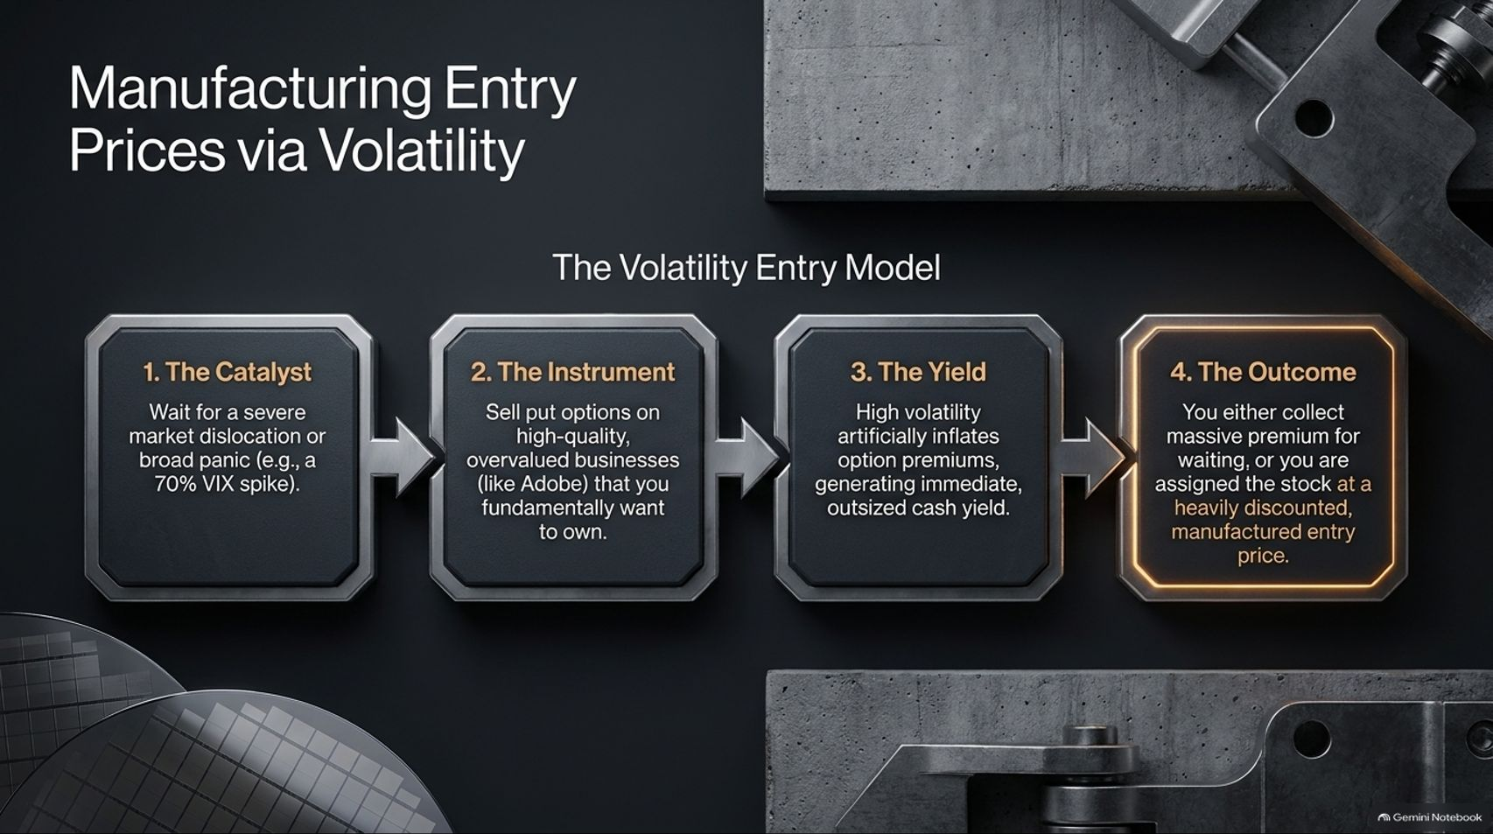
Notes:
Estimated Time: 4 – 5 minutes
Slide Focus: A 4-step options strategy (Catalyst, Instrument, Yield, Outcome) to turn market panic and volatility spikes into discounted entry prices for wonderful businesses.
Slide Elements:
1. The Catalyst: Wait for a severe market dislocation or broad panic (e.g., a 70% VIX spike).
2. The Instrument: Sell put options on high-quality, overvalued businesses (like Adobe) that you fundamentally want to own.
3. The Yield: High volatility artificially inflates option premiums, generating immediate, outsized cash yield.
4. The Outcome: You either collect massive premium for waiting, or you are assigned the stock at a heavily discounted, manufactured entry price.
Speaker Notes: How do we actually execute value investing when wonderful businesses rarely trade cheaply? We manufacture our own entry prices using market volatility.
Here is the four-step Volatility Entry Model inspired by Warren Buffett’s preferred options mechanics:
The Catalyst: Wait patiently for macro panic—such as a geopolitical shock or a 70% spike in the VIX volatility index.
The Instrument: Instead of buying overvalued equities outright, sell cash-secured put options on high-quality compounders (like Adobe or Microsoft) that you have thoroughly researched and genuinely want to own.
The Yield: Market panic artificially inflates implied volatility, allowing you to collect extraordinarily fat option premiums upfront.
The Outcome: It’s a win-win structure. If the market recovers, you pocket rich cash yield for your patience. If the market stays depressed, you are forced to buy a world-class business at your pre-selected strike price—effectively manufacturing a deep margin of safety.

Slide 13
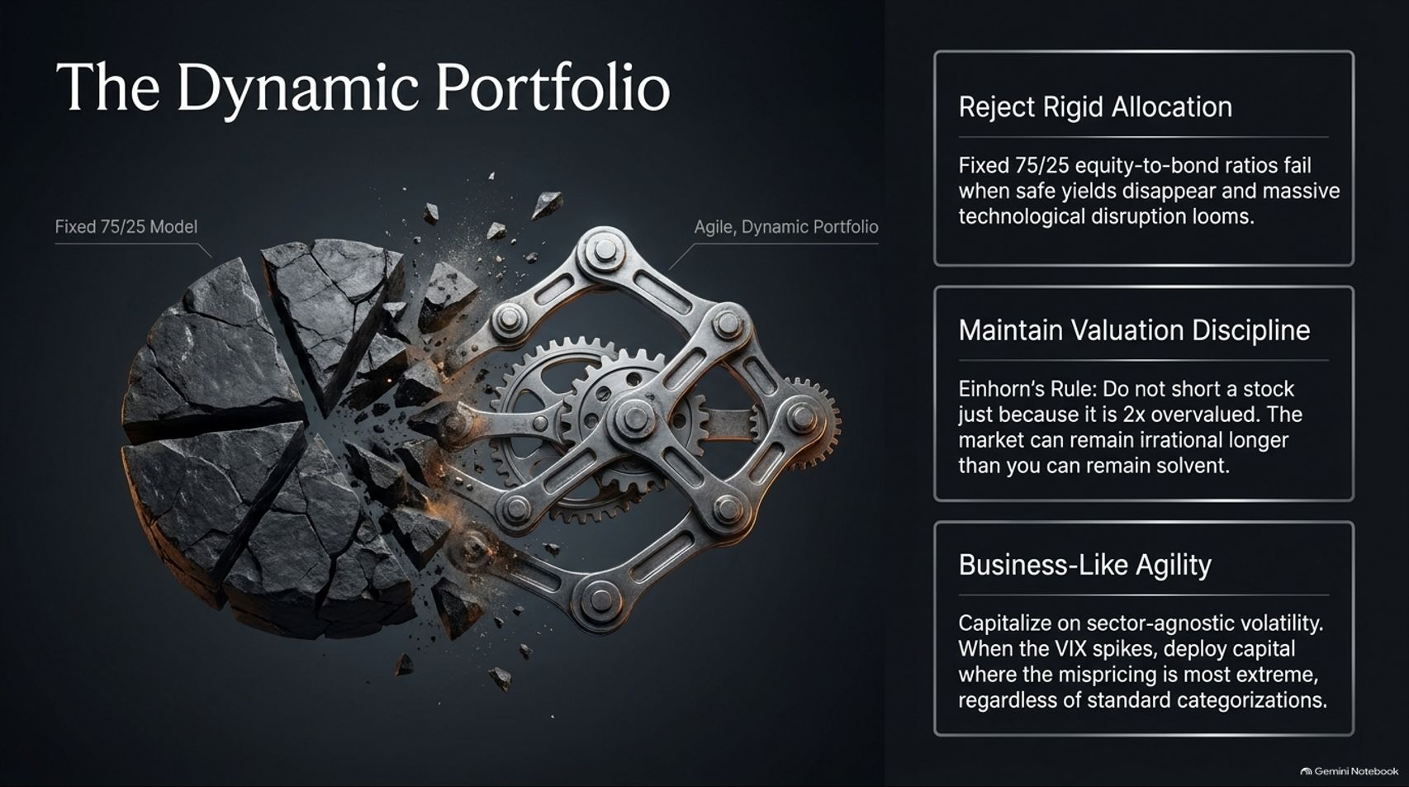
Notes:
Estimated Time: 3.5 – 4.5 minutes
Slide Focus: Shifting from rigid 75/25 asset allocation to an agile, dynamic portfolio that maintains valuation discipline and exploits sector-agnostic volatility.
Slide Elements:
Reject Rigid Allocation: Fixed 75/25 equity-to-bond ratios fail when safe yields disappear and massive technological disruption looms.
Maintain Valuation Discipline: Einhorn's Rule: Do not short a stock just because it is 2x overvalued. The market can remain irrational longer than you can remain solvent.
Business-Like Agility: Capitalize on sector-agnostic volatility. When the VIX spikes, deploy capital where the mispricing is most extreme, regardless of standard categorizations.
Speaker Notes: Traditional financial planning preaches rigid diversification—like a fixed 75/25 equity-to-bond asset allocation. In the age of AI disruption, rigid models fail.
We must build Dynamic Portfolios grounded in three principles:
Reject Rigid Allocation: When technological dislocation threatens entire software sectors, blindly rebalancing into broken business models destroys capital.
Maintain Valuation Discipline: Remember David Einhorn’s golden rule: Never short a stock simply because it is expensive. The market can remain irrational much longer than you can remain solvent. Instead of shorting overvalued hype, wait for mispriced value.
Business-Like Agility: Be sector-agnostic. When market panics spike volatility, deploy capital aggressively wherever the mispricing is most extreme, treating cash as optionality.

Slide 14
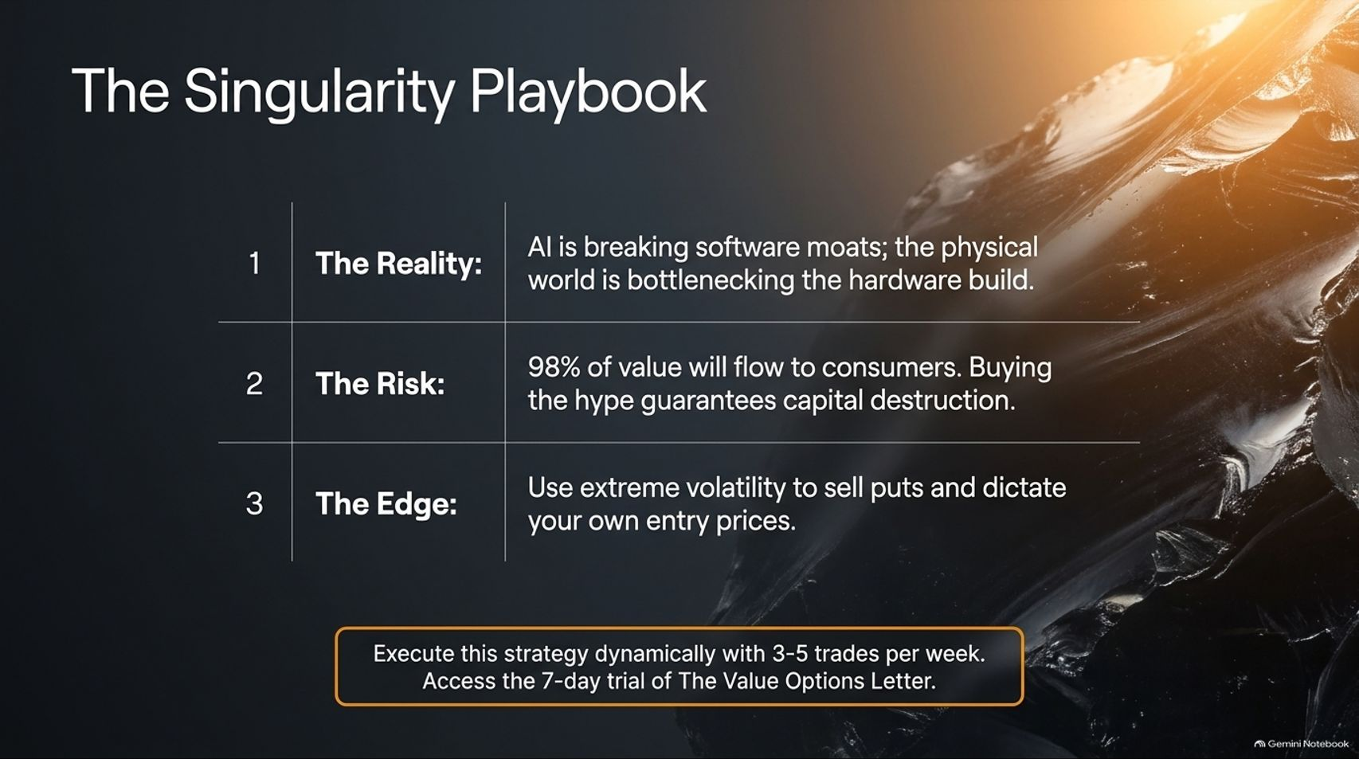
Notes:
Estimated Time: 3 – 4 minutes
Slide Focus: Summarizing the three core pillars of the Singularity Playbook: Reality (AI breaks moats / physical limits), Risk (98% value to consumers), and Edge (using volatility to sell puts).
Slide Elements:
1. The Reality: AI is breaking software moats; the physical world is bottlenecking the hardware build.
2. The Risk: 98% of value will flow to consumers. Buying the hype guarantees capital destruction.
3. The Edge: Use extreme volatility to sell puts and dictate your own entry prices.
Bottom Callout: "Execute this strategy dynamically with 3-5 trades per week. Access the 7-day trial of The Value Options Letter."
Speaker Notes: Let's synthesize our entire strategy into The Singularity Playbook:
The Reality: Acknowledge that generative AI is systematically breaking traditional software moats, while physical power grids and copper shortages bottleneck hardware expansion.
The Risk: Remember the 2% rule. 98% of economic surplus flows to consumers, meaning blind hype-chasing guarantees long-term capital destruction.
The Edge: Stop paying retail prices for overhyped equities. Use market panics and elevated volatility to sell cash-secured puts, collecting rich yields while dictating your own entry prices.
By combining rigorous fundamental research with disciplined options execution, value investors can not only survive the AI singularity—they can turn its volatility into their greatest competitive advantage.

Slide 15
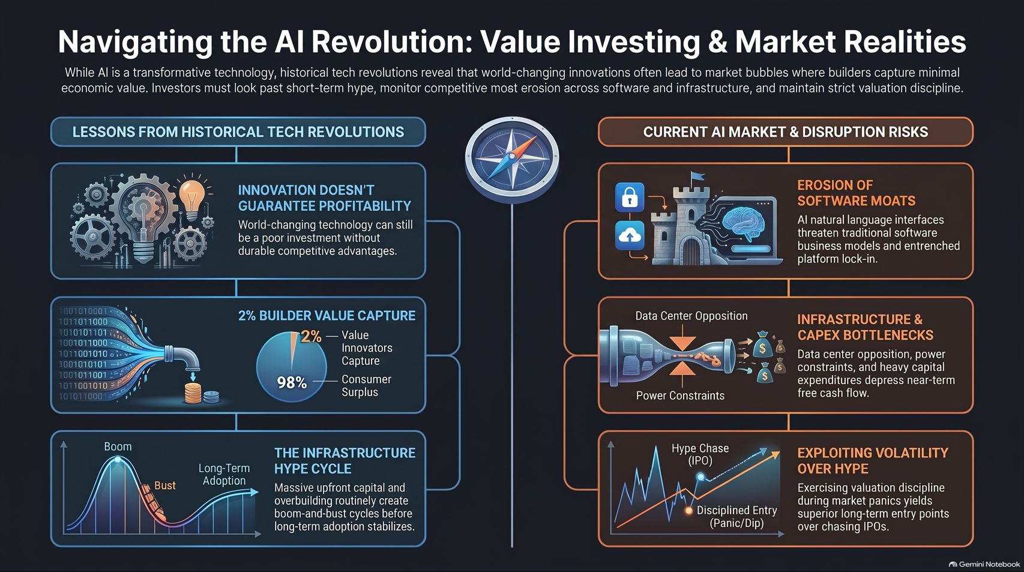
Notes:
Estimated Time: 3.5 – 4.5 minutes
Slide Focus: Comprehensive master summary infographic connecting historical tech lessons, infrastructure hype cycles, software moat erosion, CAPEX bottlenecks, and volatility exploitation.
Speaker Notes: To conclude, this master summary infographic captures the complete roadmap for navigating the AI revolution as a value investor.
On the left, we review Lessons from Historical Tech Revolutions: reminding ourselves that innovation does not guarantee profitability, that builders capture only 2% of economic surplus, and that upfront infrastructure overbuilding always creates violent boom-and-bust hype cycles.
On the right, we examine Current AI Market & Disruption Risks: the erosion of software moats through natural language interfaces, heavy CAPEX and power grid bottlenecks depressing cash flows, and the tactical imperative to exploit market volatility rather than chasing retail IPO hype.
This is how we reconcile the promise of the future with the discipline of value investing. Thank you very much for your time and attention, and I look forward to your questions.

