Slide 1
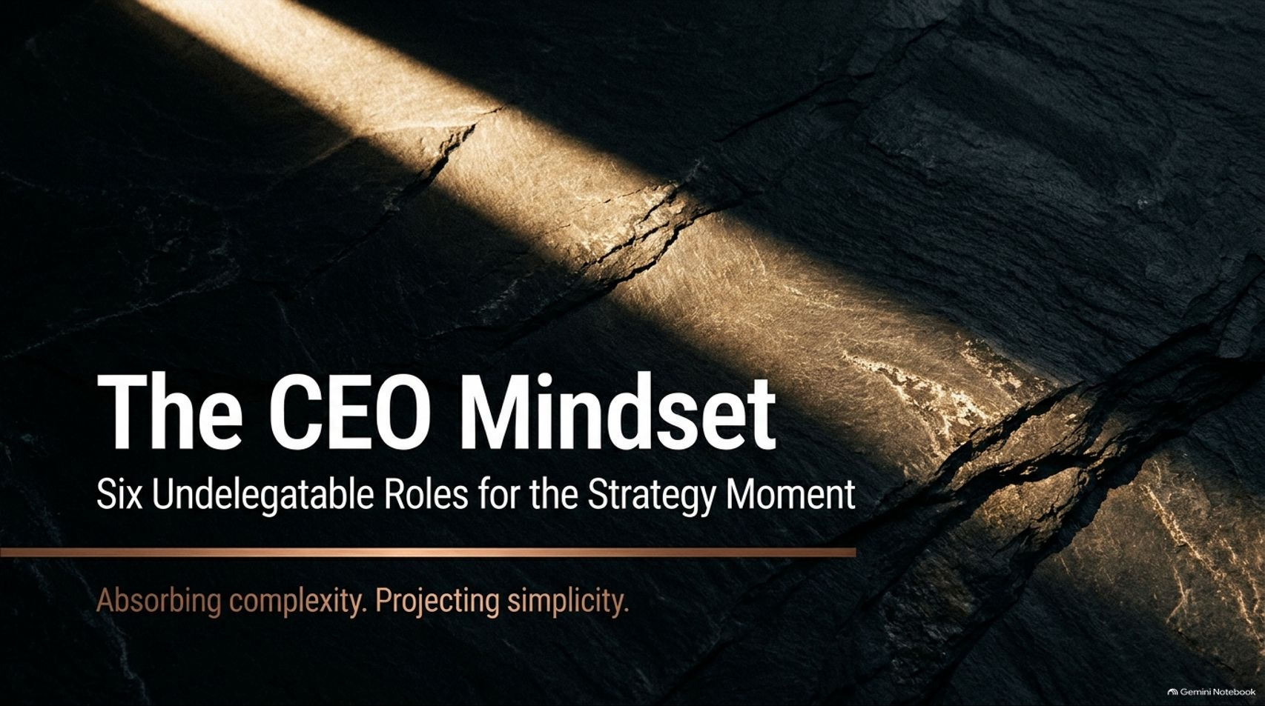
Notes:
Estimated Time: 2.5 – 3 minutes
Slide Focus: Title slide introducing the core thesis: why chief executives cannot delegate core strategic functions during moments of existential disruption, and how they must absorb external complexity to project clarity.
Slide Elements:
Title: The CEO Mindset — Six Undelegatable Roles for the Strategy Moment.
Tagline: Absorbing complexity. Projecting simplicity.
Speaker Notes: Welcome everyone. Today we are going to examine what separates transformational chief executives from average operators when an industry hits an inflection point. This presentation draws directly from McKinsey & Company's latest research and their book Strategy and Value, specifically focusing on the Six Undelegatable Roles in Strategy that only a CEO can play.
A common misconception in corporate leadership is that strategy is purely a team sport—something you can hand off entirely to a Chief Strategy Officer, a planning committee, or external consultants while the CEO focuses on daily operations. While strategy certainly requires organizational alignment, McKinsey’s research proves that there are six distinct strategic functions that lose their potency the moment a CEO tries to delegate them.
At the heart of this mindset is a simple but demanding mandate: Absorbing complexity and projecting simplicity. Over the next 15 slides, we will explore why we are living in a generational "strategy moment," dissect each of the six undelegatable roles with real-world case studies from JPMorgan, Microsoft, Netflix, Walmart, and Amazon, and outline how leaders shift from chasing certainty to mastering probability.
The CEO Mindset: Six Undelegatable Roles in Strategy
https://www.youtube.com/watch?v=pugDuZuGQ0I

Slide 2
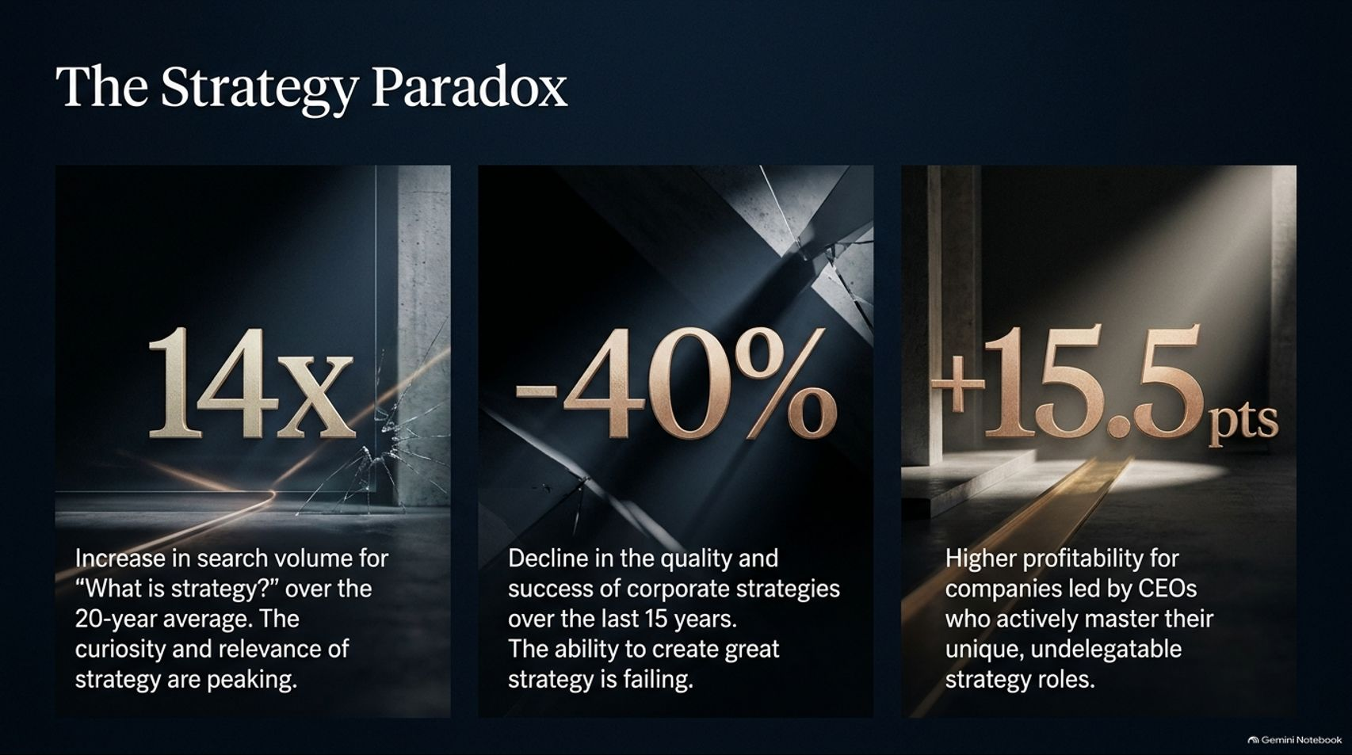
Notes:
Estimated Time: 3.5 – 4.5 minutes
Slide Focus: Presenting three key McKinsey research metrics: the 14x surge in searches for "What is strategy?", the 40% decline in corporate strategy quality over 15 years, and the +15.5 percentage point profitability advantage for CEOs who own their strategy roles.
Slide Elements:
14x: Increase in search volume for "What is strategy?" over the 20-year average. The curiosity and relevance of strategy are peaking.
-40%: Decline in the quality and success of corporate strategies over the last 15 years. The ability to create great strategy is failing.
+15.5 pts: Higher profitability for companies led by CEOs who actively master their unique, undelegatable strategy roles.
Speaker Notes: Look closely at the three numbers on this slide, because together they reveal what McKinsey researchers call The Strategy Paradox.
First, 14x: Global search volume for the basic question "What is strategy?" has surged fourteenfold over its 20-year average. Why? Because geopolitical shifts, macroeconomic volatility, and rapid AI disruption have forced executives everywhere to realize their old playbooks no longer work. Curiosity and urgency around strategy are at an all-time high.
Second, -40%: Despite this surging interest, McKinsey’s longitudinal tracking shows that the actual quality and execution success of corporate strategies has dropped by roughly 40% over the past 15 years. Organizations are producing thicker slide decks and more complex initiatives, yet fewer companies are achieving genuine strategic breakthroughs.
Third, +15.5 percentage points: This is the payoff. Companies led by CEOs who actively step into and master their six undelegatable strategy roles generate 15.5 percentage points higher profitability—alongside roughly 10% higher enterprise and employee growth—compared to peers. When a new CEO steps into a company and adopts these exact behaviors, performance moves measurably. Strategy isn't broken; leadership ownership of strategy is what's missing.

Slide 3
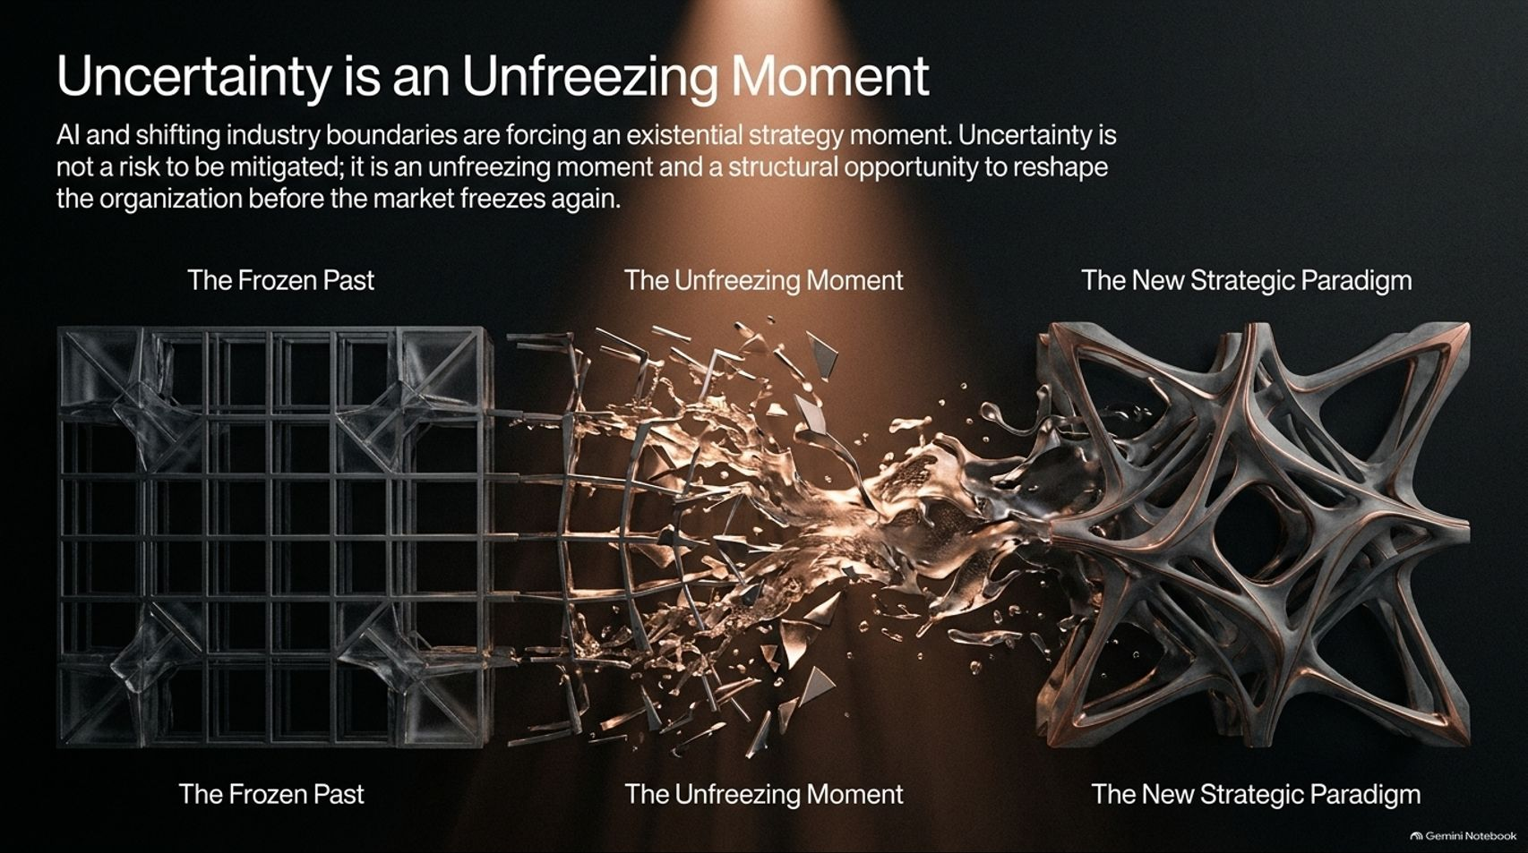
Notes:
Estimated Time: 3 – 4 minutes
Slide Focus: Reframing uncertainty from a defensive risk into an "unfreezing moment" where industry boundaries dissolve and organizations can reshape themselves before the market freezes again.
Slide Elements:
Visual Flow: The Frozen Past $\rightarrow$ The Unfreezing Moment $\rightarrow$ The New Strategic Paradigm.
Core Message: AI and shifting industry boundaries are forcing an existential strategy moment. Uncertainty is not a risk to be mitigated; it is an unfreezing moment and a structural opportunity to reshape the organization before the market freezes again.
Speaker Notes: Most executives treat uncertainty like a disease to be quarantined. When markets become volatile or technology disrupts an industry, the default corporate reflex is to hunker down, preserve cash, and wait for the fog to clear before making big decisions.
Great strategists see the exact opposite. As McKinsey senior partner Andy West explains, uncertainty is not merely a risk to be mitigated—it is an unfreezing moment. During stable periods, industry boundaries, customer habits, and competitive moats are frozen solid. Trying to steal market share or reinvent a business model during a frozen era is an exhausting uphill battle.
Today, artificial intelligence and shifting global economics have shattered the ice. Everything is fluid. For a prepared CEO, this unfreezing moment is a rare structural window to reshape the organization, redefine competitive advantage, and capture new territory before the market freezes into its next steady state. If you wait for certainty, you will arrive after the new winners have already locked in their positions.

Slide 4
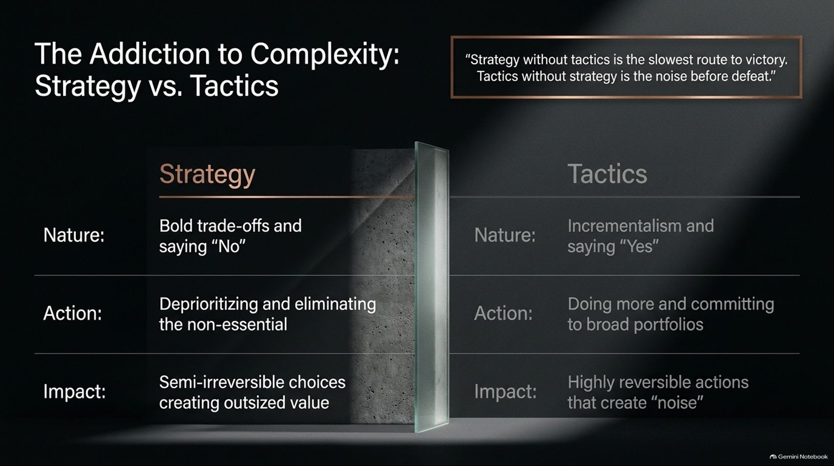
Notes:
Estimated Time: 4 – 5 minutes
Slide Focus: Distinguishing true strategy (bold trade-offs, saying "No", semi-irreversible bets) from tactics (incrementalism, saying "Yes", reversible noise), featuring Sun Tzu’s classic quote.
Slide Elements:
Quote: "Strategy without tactics is the slowest route to victory. Tactics without strategy is the noise before defeat."
Strategy: Bold trade-offs and saying "No"; deprioritizing and eliminating the non-essential; semi-irreversible choices creating outsized value.
Tactics: Incrementalism and saying "Yes"; doing more and committing to broad portfolios; highly reversible actions that create "noise".
Speaker Notes: Why has corporate strategy quality declined by 40% over the last 15 years? When McKinsey researchers debated this question, they landed on a single root cause: organizations are addicted to complexity, and executives are addicted to saying "Yes."
In McKinsey's study of 28 core strategic capabilities, the single hardest capability for leadership teams to execute was deprioritizing and eliminating initiatives that didn't align with their strategy. Instead of making painful choices, companies confuse tactics with strategy.
Look at the sharp line drawn on this slide: Tactics are about incrementalism—saying "Yes" to every customer request, committing to broad, hedged portfolios, and taking highly reversible actions that generate corporate busyness and noise. Strategy, by contrast, is about bold trade-offs and saying "No." True strategy requires making semi-irreversible choices that change your company’s trajectory. Remember the classic military maxim: "Strategy without tactics is the slowest route to victory. Tactics without strategy is the noise before defeat." Especially now—when AI makes it trivial to launch dozens of side projects—ruthless subtraction is the hallmark of strategic leadership.

Slide 5
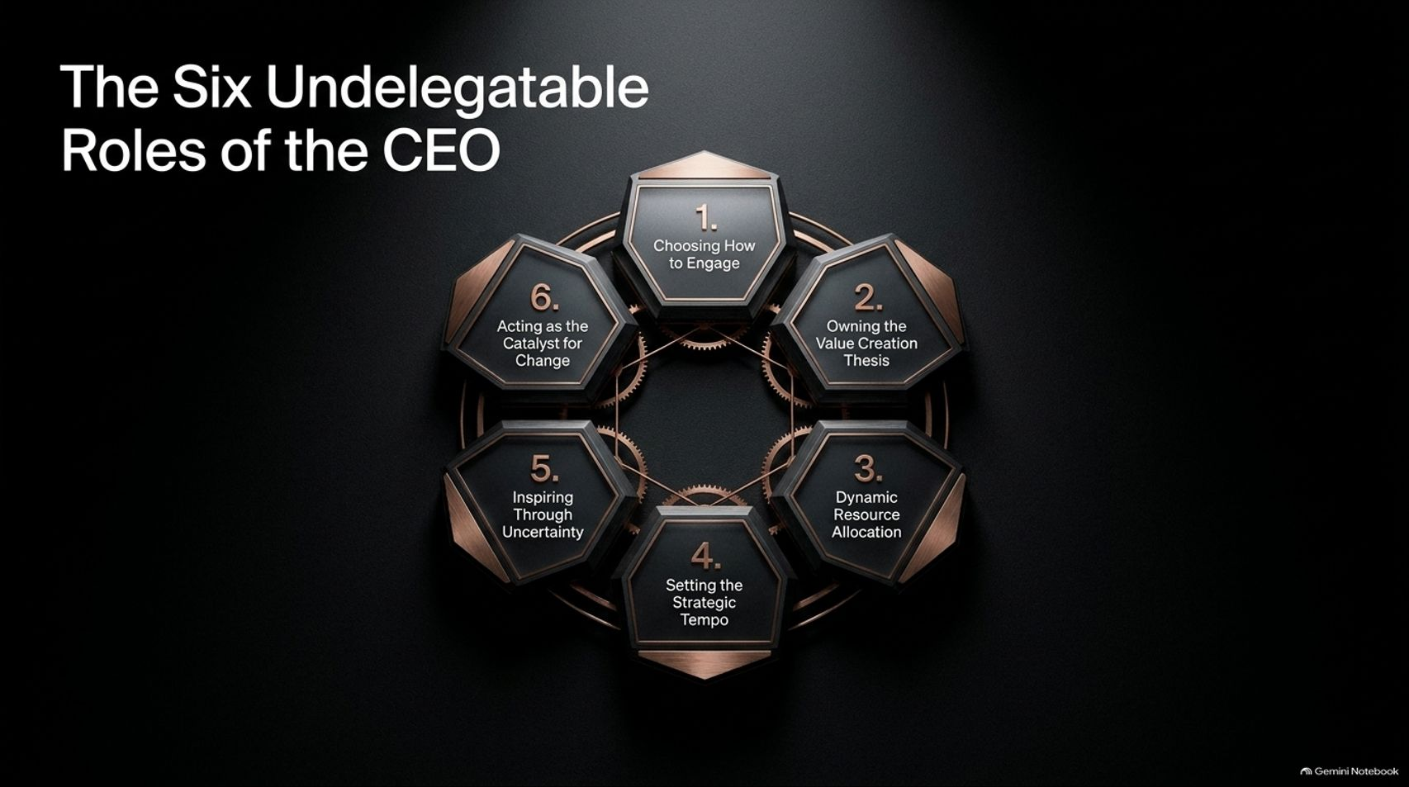

Slide 6
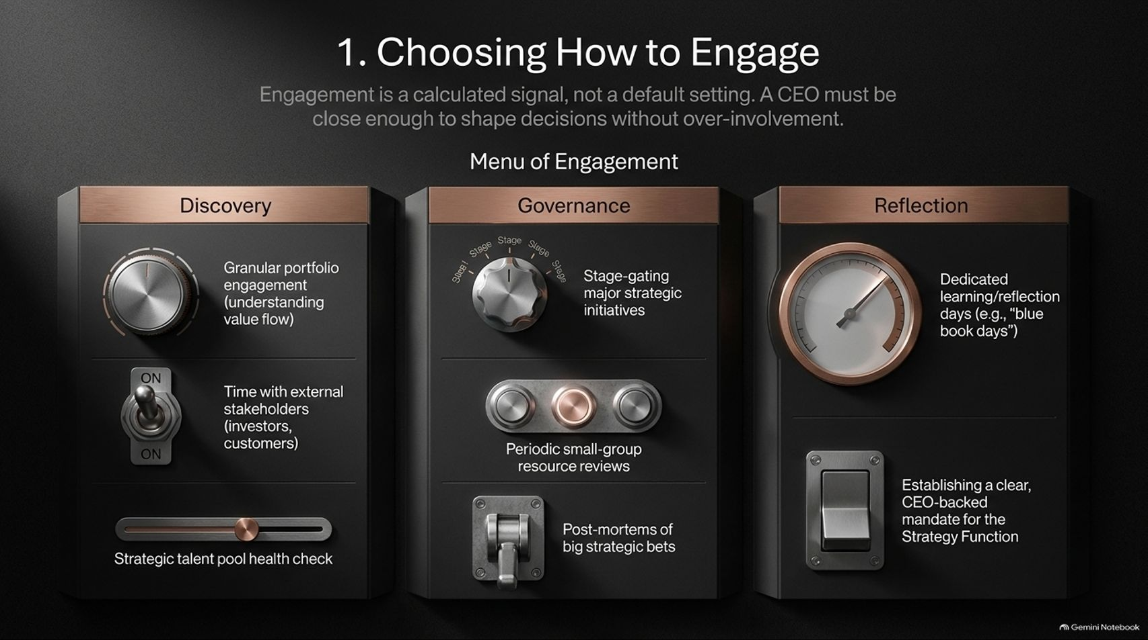
Notes:
Estimated Time: 4 – 5 minutes
Slide Focus: Treating CEO engagement as a deliberate signal rather than an inherited default; balancing Discovery, Governance, and Reflection practices.
Slide Elements:
Header: Engagement is a calculated signal, not a default setting. A CEO must be close enough to shape decisions without over-involvement.
Discovery: Granular portfolio engagement (understanding value flow); time with external stakeholders (investors, customers); strategic talent pool health check.
Governance: Stage-gating major strategic initiatives; periodic small-group resource reviews; post-mortems of big strategic bets.
Reflection: Dedicated learning/reflection days (e.g., "blue book days"); establishing a clear, CEO-backed mandate for the Strategy Function.
Speaker Notes: The first foundational role is Choosing How to Engage. When CEOs take the helm, they usually inherit a calendar packed with legacy review meetings. If you don't intentionally redesign how you engage, you either get sucked into operational micromanagement or become detached from ground truth.
How a CEO allocates their attention is the loudest signal in the company. You must be close enough to shape key decisions without smothering your team. McKinsey outlines a "Menu of Engagement" across three buckets:
Discovery: Engaging granularly with the portfolio to see how value actually flows (beyond sanitized slide decks), spending unvarnished time with customers and investors, and auditing the health of your strategic talent pipeline.
Governance: Acting as a stage-gate on major strategic bets, holding small-group resource reviews, and running blameless post-mortems on past bets to institutionalize learning.
Reflection: Blocking sacred calendar time to think—like former Honeywell CEO Dave Cote’s famous "blue book days" dedicated purely to strategic reflection—and giving your internal Strategy Function an explicit, CEO-backed mandate (something only 24% of companies actually do, yet it dramatically multiplies strategic effectiveness).

Slide 7
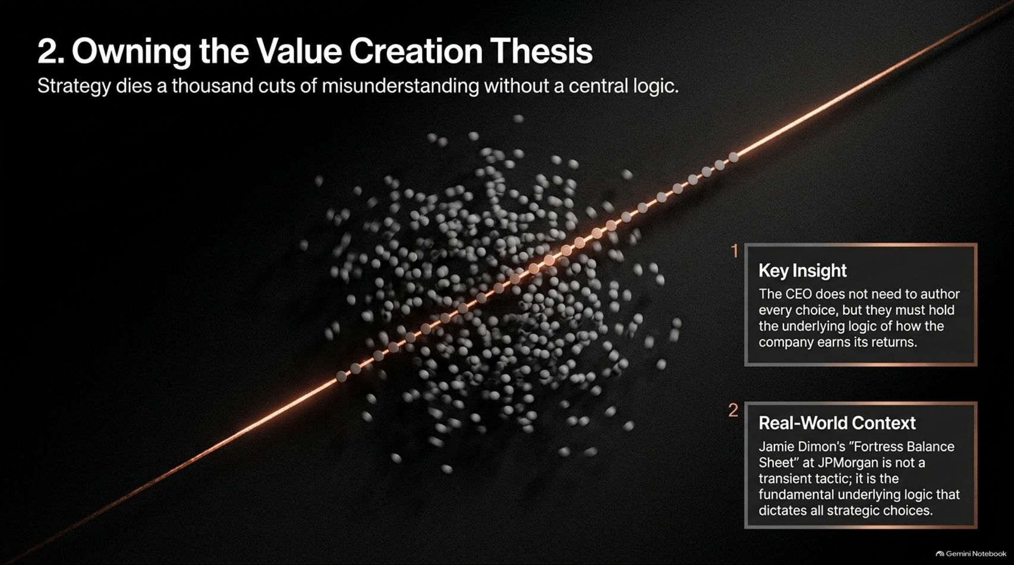
Notes:
Estimated Time: 3.5 – 4.5 minutes
Slide Focus: Holding the core underlying economic logic of how the business earns returns so thousands of daily decentralized decisions align without dying of misunderstanding; JPMorgan example.
Slide Elements:
Header: Strategy dies a thousand cuts of misunderstanding without a central logic.
1. Key Insight: The CEO does not need to author every choice, but they must hold the underlying logic of how the company earns its returns.
2. Real-World Context: Jamie Dimon’s "Fortress Balance Sheet" at JPMorgan is not a transient tactic; it is the fundamental underlying logic that dictates all strategic choices.
Speaker Notes: Role number two is Owning the Value Creation Thesis. Notice the phrasing: the CEO does not need to personally write every business unit strategy or author every product roadmap. However, the CEO must hold and articulate the core underlying economic logic of why the company wins and how its choices translate into long-term returns.
In any large enterprise, thousands of employees make decentralized micro-decisions every single day. Without a crystal-clear central thesis, a brilliant boardroom strategy will die a thousand cuts of misunderstanding on the front lines.
Consider Jamie Dimon at JPMorgan Chase. For decades, Dimon has anchored the bank around the concept of a "Fortress Balance Sheet." That isn't a quarterly tactic or a specific product launch; it is an overarching value creation thesis. Because every division head understands that capital resilience is non-negotiable, leaders across the globe can make fast, autonomous decisions during financial crises without waiting for headquarters to micromanage them.

Slide 8
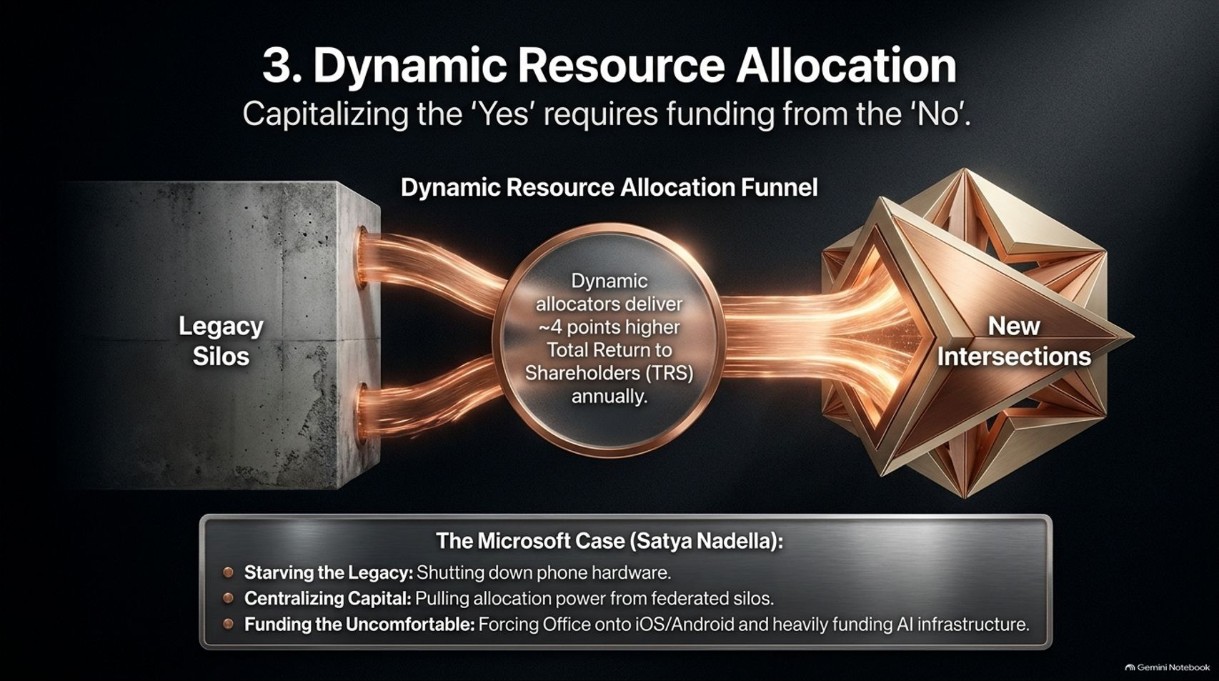
Notes:
Estimated Time: 4 – 5 minutes
Slide Focus: Pulling capital, talent, and executive attention away from legacy silos to fund new strategic intersections; the ~4% annual TRS premium; Satya Nadella’s transformation of Microsoft.
Slide Elements:
Header: Capitalizing the "Yes" requires funding from the "No."
Funnel Metric: Dynamic allocators deliver ~4 points higher Total Return to Shareholders (TRS) annually.
The Microsoft Case (Satya Nadella): Starving the Legacy (shutting down phone hardware); Centralizing Capital (pulling allocation power from federated silos); Funding the Uncomfortable (forcing Office onto iOS/Android and heavily funding AI infrastructure).
Speaker Notes: As Andy West bluntly puts it: "A great strategy without funding just dies on the vine—it's just a report." Role three is Dynamic Resource Allocation. Capitalizing your strategic "Yes" requires ruthlessly extracting funding, engineering talent, and executive mindshare from your "No."
McKinsey’s data shows that companies that dynamically reallocate capital year over year generate roughly 4 percentage points higher Total Return to Shareholders (TRS) annually—a massive compounding advantage over a decade. Yet inertia is fierce because legacy divisions have political clout and established relationships, while emerging bets look small and unproven.
Look at how Satya Nadella executed this when he took over Microsoft:
Starving the Legacy: He made the painful, semi-irreversible call to write off and shut down Microsoft’s struggling phone hardware business.
Centralizing Capital: He dismantled rigid, federated capital budgeting where divisions hoarded their own cash, pulling allocation authority back to the center.
Funding the Uncomfortable: He broke sacred Windows orthodoxy by launching Office on iOS and Android, while pouring billions into cloud and AI infrastructure. Only a CEO has the structural authority to break those internal fiefdoms.

Slide 9
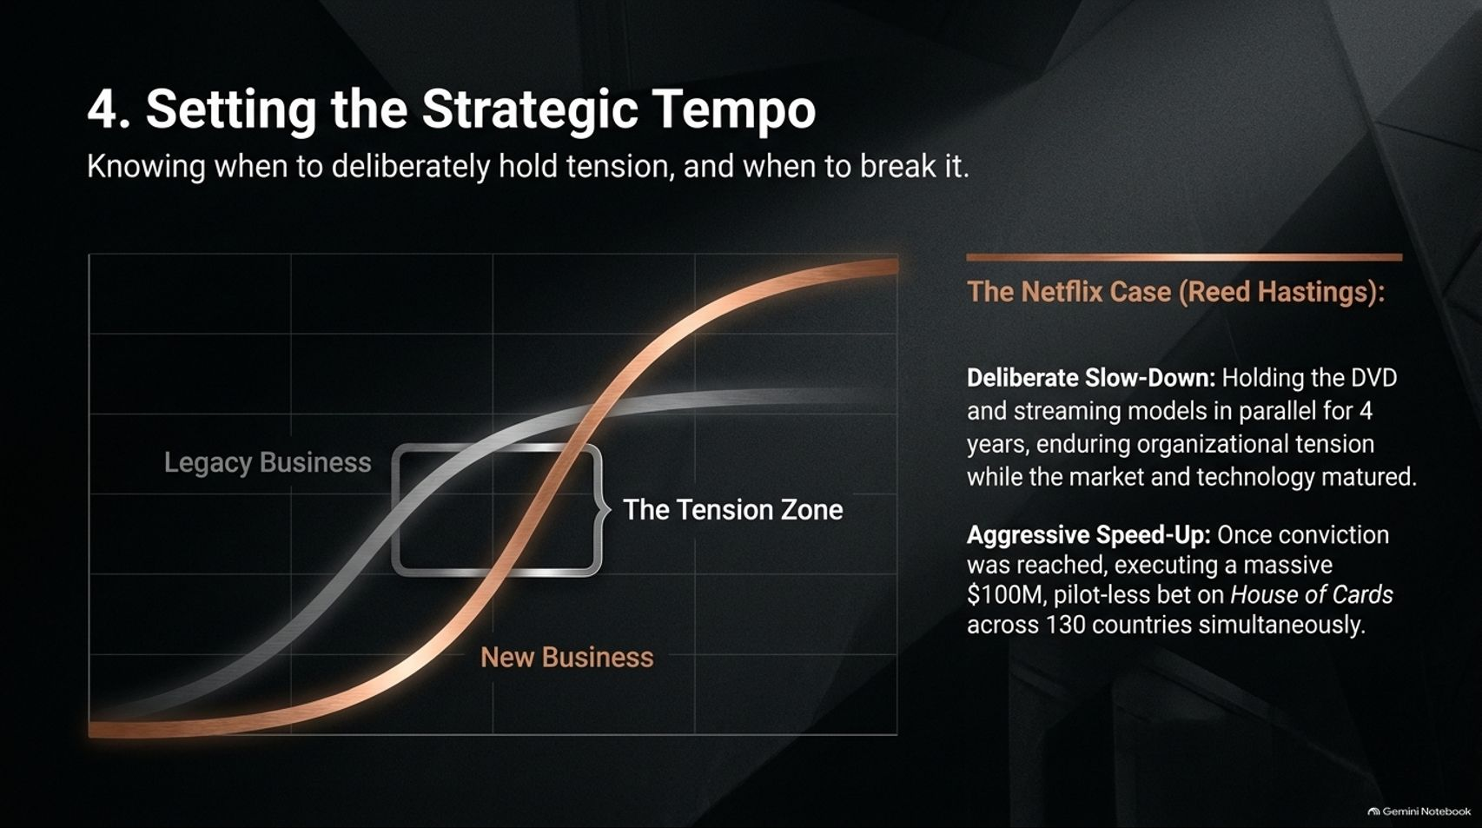
Notes:
Estimated Time: 4 – 5 minutes
Slide Focus: Mastering corporate pacing—knowing when to hold organizational tension and deliberately slow down versus when to execute an all-in speed-up; Reed Hastings’ Netflix pivot.
Slide Elements:
Header: Knowing when to deliberately hold tension, and when to break it.
Graph: Legacy Business curve vs. New Business curve intersecting in "The Tension Zone."
The Netflix Case (Reed Hastings): Deliberate Slow-Down (holding DVD and streaming models in parallel for 4 years, enduring organizational tension while market/tech matured) $\rightarrow$ Aggressive Speed-Up (executing a massive $100M, pilot-less bet on House of Cards across 130 countries simultaneously).
Speaker Notes: Role four is one of the most misunderstood levers in executive leadership: Setting the Strategic Tempo. Most leadership books preach only one speed: move faster. But great CEOs know that tempo is about calibration—knowing both when to accelerate and when to deliberately slow down and hold organizational tension.
Look at Reed Hastings’ transformation of Netflix. As early as 2007, Hastings possessed deep conviction that streaming would replace physical DVDs. Many inside the company wanted to abandon DVDs immediately. Instead, Hastings enforced a deliberate slow-down. For four years, he held both the legacy DVD business and the nascent streaming service in parallel—enduring intense internal friction and market skepticism—because broadband speeds, smart TV penetration, and licensing ecosystems weren't quite ready.
Then, the moment the curves crossed and conviction met market readiness, Hastings broke the tension with an aggressive speed-up. He committed $100 million without even filming a pilot to produce House of Cards and launched Netflix across 130 countries simultaneously. Holding tension without prematurely snapping—and then moving with overwhelming force—is an art only the CEO can conduct.

Slide 10
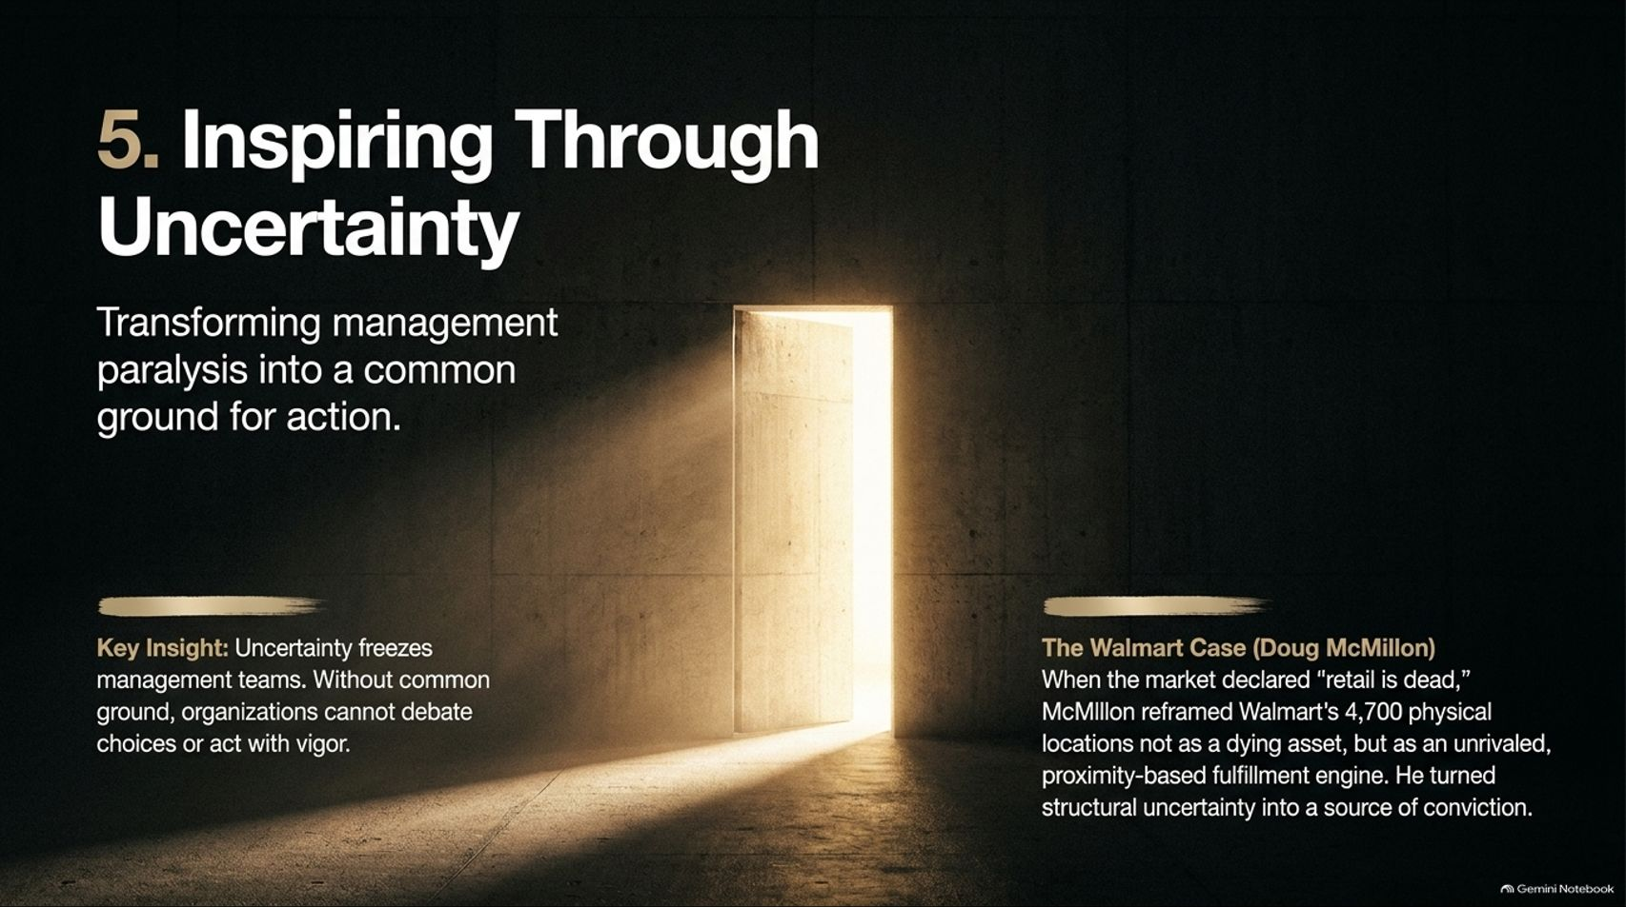
Notes:
Estimated Time: 3.5 – 4.5 minutes
Slide Focus: Overcoming management paralysis during ambiguous market shifts by reframing threats into unique competitive advantages; Doug McMillon’s turnaround at Walmart.
Slide Elements:
Header: Transforming management paralysis into a common ground for action.
Key Insight: Uncertainty freezes management teams. Without common ground, organizations cannot debate choices or act with vigor.
The Walmart Case (Doug McMillon): When the market declared "retail is dead," McMillon reframed Walmart’s 4,700 physical locations not as a dying asset, but as an unrivaled, proximity-based fulfillment engine. He turned structural uncertainty into a source of conviction.
Speaker Notes: Role five is Inspiring Through Uncertainty. When an industry faces existential disruption, fear spreads quietly through the executive ranks. Managers worry about their careers, their budgets, and their relevance. That psychological uncertainty creates management paralysis—teams stop debating bold options because they lack shared confidence in the future.
The CEO must step in to establish common ground and reframe the narrative. Consider Doug McMillon at Walmart. When e-commerce surged and Wall Street analysts loudly declared that "brick-and-mortar retail is dead," Walmart’s 4,700 massive supercenters looked like stranded liabilities.
McMillon completely reframed the conversation. He pointed out to his team that having 4,700 stores located within 10 miles of 90% of the U.S. population wasn't a legacy anchor—it was an unrivaled, proximity-based last-mile fulfillment engine that pure-play digital competitors could never replicate. By turning a perceived existential threat into an asymmetric strategic weapon, he unlocked organizational conviction and ignited Walmart’s omnichannel resurgence.

Slide 11
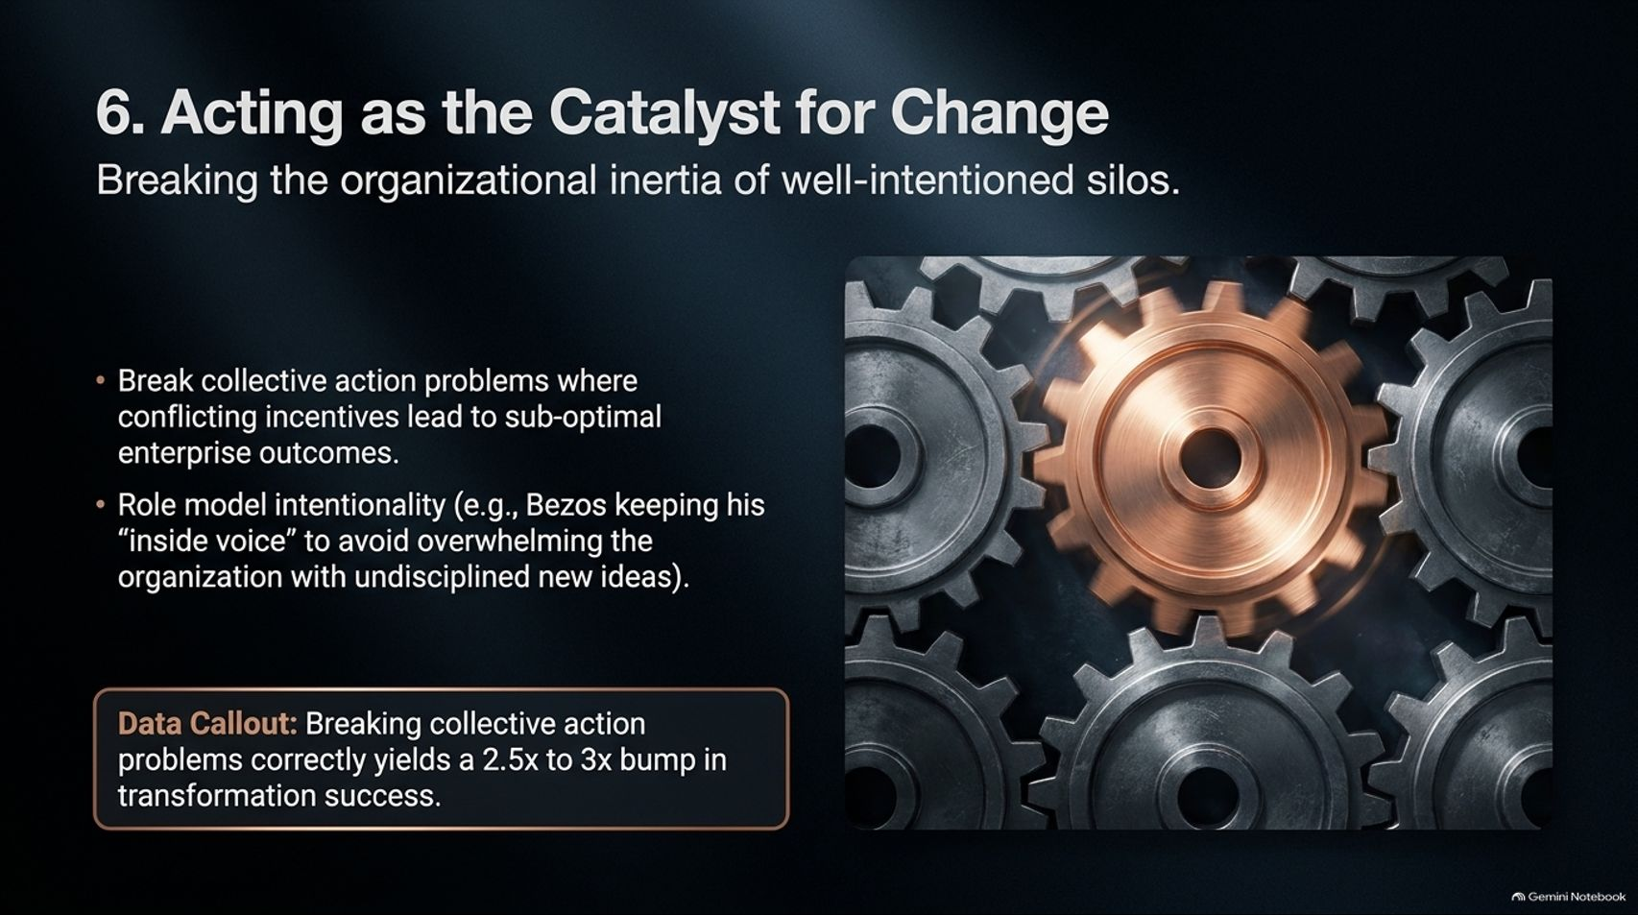
Notes:
Estimated Time: 3.5 – 4.5 minutes
Slide Focus: Breaking collective action problems across well-intentioned silos, role-modeling leadership discipline (Jeff Bezos's "inside voice"), and unlocking a 2.5x–3x bump in transformation success.
Slide Elements:
Header: Breaking the organizational inertia of well-intentioned silos.
Bullets: Break collective action problems where conflicting incentives lead to sub-optimal enterprise outcomes; role model intentionality (e.g., Bezos keeping his "inside voice" to avoid overwhelming the organization with undisciplined new ideas).
Data Callout: Breaking collective action problems correctly yields a 2.5x to 3x bump in transformation success.
Speaker Notes: The sixth undelegatable role is Acting as the Catalyst for Change. Even when an organization has a clear thesis and allocated capital, transformations frequently stall due to collective action problems. Well-intentioned division leaders, optimizing rationally for their own local KPIs and quarterly bonuses, inadvertently produce a sub-optimal outcome for the enterprise as a whole.
McKinsey’s research demonstrates that when a CEO actively steps in to break these structural deadlocks and align incentives, the odds of transformation success jump by 2.5x to 3x.
Equally critical is intentional role modeling. Employees scrutinize every word and behavior of the CEO. If your strategy demands focus and saying "No," you cannot walk into Monday morning meetings throwing out 18 random brainstorms. Early in Amazon’s history, Jeff Bezos received tough coaching that his constant stream of ideas was overwhelming his teams—so he learned to keep speculative ideas in his "inside voice" until he was ready to commit. Discipline at the top creates clarity throughout the ranks.

Slide 12
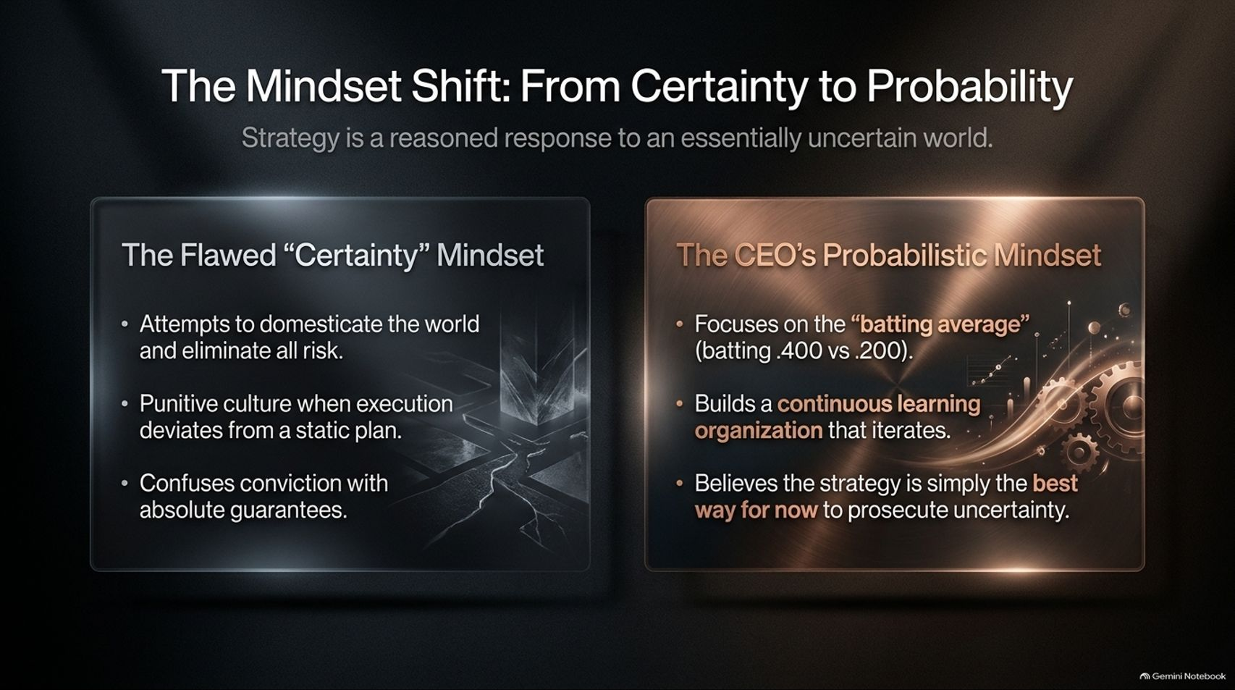
Notes:
Estimated Time: 3.5 – 4.5 minutes
Slide Focus: Contrasting the flawed "certainty" mindset (demanding static guarantees, punishing variance) with the probabilistic CEO mindset (focusing on batting average, continuous learning, and "best way for now").
Slide Elements:
The Flawed "Certainty" Mindset: Attempts to domesticate the world and eliminate all risk; punitive culture when execution deviates from a static plan; confuses conviction with absolute guarantees.
The CEO's Probabilistic Mindset: Focuses on the "batting average" (batting .400 vs .200); builds a continuous learning organization that iterates; believes the strategy is simply the best way for now to prosecute uncertainty.
Speaker Notes: Underlying all six roles is a profound psychological shift: moving From Certainty to Probability.
Traditional corporate planning often falls into the trap of the "Certainty" Mindset. Executives write a five-year strategic plan, treat it as an infallible blueprint, and build a punitive culture that punishes managers whenever reality deviates from the spreadsheet. This approach confuses strategic conviction with absolute guarantees—an illusion in a chaotic world.
Great CEOs operate with a Probabilistic Mindset. They recognize that strategy is a reasoned bet against an uncertain future. You are never going to bat 1.000; your goal is to raise your organizational batting average from .200 to .400. Instead of treating a strategy document as carved in stone, a probabilistic CEO treats it as "our best hypothesis for now"—building a non-punitive, continuous learning organization that tests assumptions, absorbs feedback, and recalibrates rapidly.

Slide 13
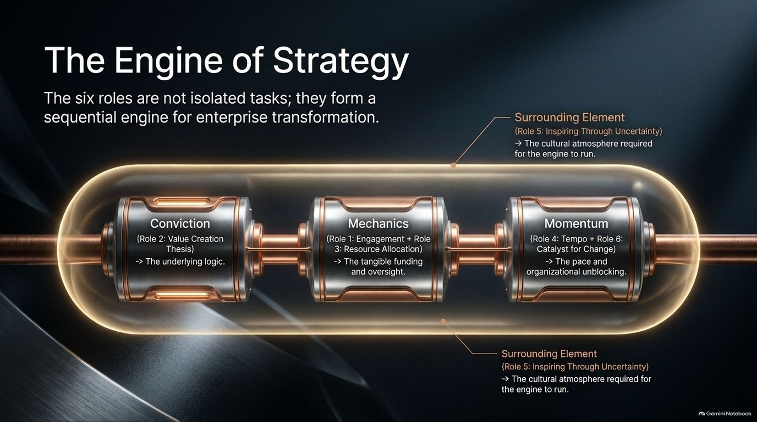
Notes:
Estimated Time: 3.5 – 4.5 minutes
Slide Focus: Visualizing how the six roles interlock into a cohesive operational system: Conviction (Role 2) $\rightarrow$ Mechanics (Roles 1 & 3) $\rightarrow$ Momentum (Roles 4 & 6), surrounded by Role 5 (Inspiring Through Uncertainty).
Slide Elements:
Core Pipeline: Conviction (Role 2: Value Creation Thesis) $\rightarrow$ Mechanics (Role 1: Engagement + Role 3: Resource Allocation) $\rightarrow$ Momentum (Role 4: Tempo + Role 6: Catalyst for Change).
Surrounding Element: Role 5: Inspiring Through Uncertainty (the cultural atmosphere required for the engine to run).
Speaker Notes: These six roles are not disconnected items on a checklist; they function together as a sequential Engine of Strategy.
It starts with Conviction (Role 2): The CEO establishes the underlying Value Creation Thesis—the clear economic logic of how the company will win.
Conviction powers Mechanics (Roles 1 & 3): The CEO chooses where to engage personally and dynamically reallocates capital and talent to back that thesis.
Mechanics generate Momentum (Roles 4 & 6): The CEO sets the right strategic tempo—accelerating or holding tension—and acts as the catalyst to break siloed inertia.
Wrapping around the entire engine is Role 5 (Inspiring Through Uncertainty)—the cultural oxygen that replaces organizational fear with shared confidence, allowing the machinery to run at full power.

Slide 14
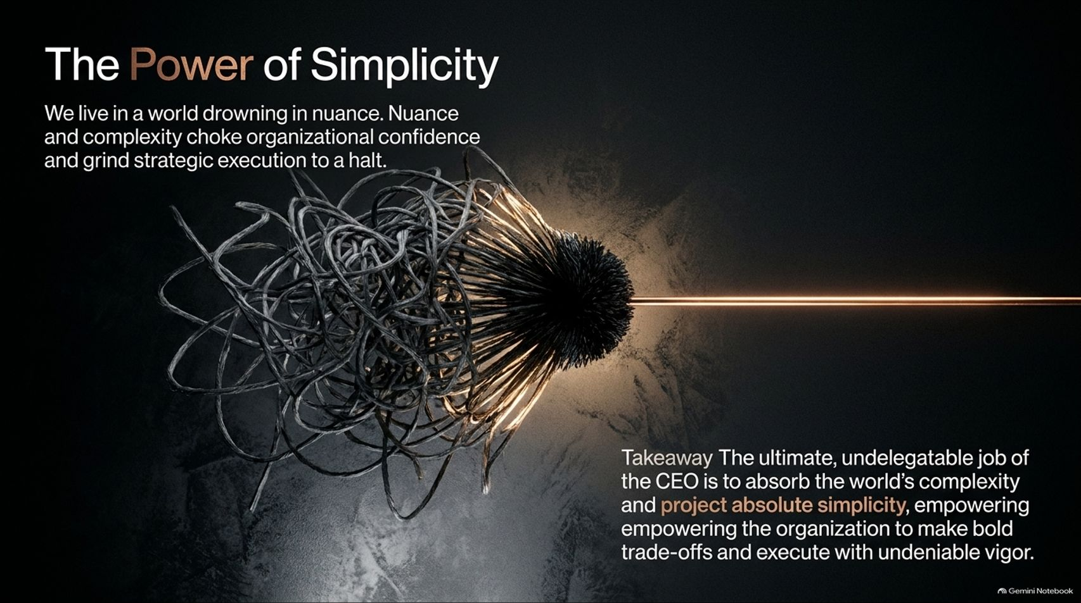
Notes:
Estimated Time: 3 – 4 minutes
Slide Focus: Concluding strategic principle: why nuance and complexity paralyze execution, and how the CEO’s highest duty is to absorb chaos and project absolute simplicity.
Slide Elements:
Header: We live in a world drowning in nuance. Nuance and complexity choke organizational confidence and grind strategic execution to a halt.
Takeaway: The ultimate, undelegatable job of the CEO is to absorb the world's complexity and project absolute simplicity, empowering the organization to make bold trade-offs and execute with undeniable vigor.
Speaker Notes: We live in an era drowning in data, geopolitical noise, and technological nuance. When leaders pass all that raw ambiguity unfiltered down to their teams, it chokes organizational confidence and grinds execution to a halt.
When Andy West was asked what single takeaway he wanted executives to remember from Strategy and Value, his answer was unequivocal: The Power of Simplicity.
A CEO does not prove their intelligence by making a strategy sound complicated. The ultimate, undelegatable job of the chief executive is to step into the storm, absorb the world’s complexity on their own shoulders, and project absolute, crystalline simplicity back to the organization. When your people have a simple, coherent north star, they gain the courage to say "No" to distractions and execute with undeniable vigor.

Slide 15
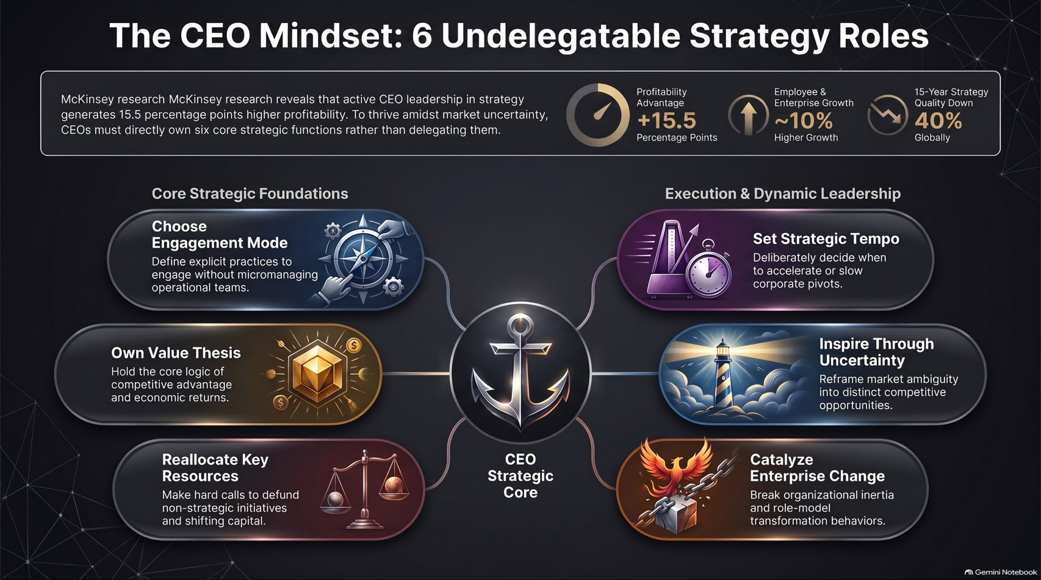
Notes:
Estimated Time: 3 – 4 minutes
Slide Focus: Master visual recap integrating the McKinsey empirical benchmarks (+15.5 pts profitability, ~10% growth, -40% global strategy quality) with the six core strategic foundations and dynamic leadership roles.
Speaker Notes: To wrap up, this summary infographic captures the complete blueprint of The CEO Mindset.
At the top, we see the empirical stakes: while global corporate strategy quality has declined by 40% over the past 15 years, CEOs who actively own their strategic mandate unlock 15.5 percentage points higher profitability and 10% stronger enterprise growth.
Anchored around the CEO Strategic Core, the framework balances two halves:
On the left, Core Strategic Foundations: Choosing your engagement mode deliberately, owning the value creation thesis, and dynamically reallocating capital away from legacy silos.
On the right, Execution & Dynamic Leadership: Setting the right strategic tempo, inspiring teams through market ambiguity, and catalyzing enterprise-wide change.
By stepping boldly into these six undelegatable roles, leaders turn periods of historic uncertainty into their company’s greatest competitive advantage. Thank you very much for your time, and I welcome your questions.

