Slide 1

Notes:
Estimated Time: 2.5 – 3 minutes
Slide Focus: Title slide introducing the central thesis: the convergence of macroeconomic policy errors, exponential AI breakthroughs, and structural socio-political friction.
Speaker Notes: Welcome everyone. Today we are examining a critical juncture in global economics and technology. This presentation is synthesized directly from Tom Bilyeu’s deep-dive analysis on Impact Theory, focusing on what we call The Collision Course: Macro Fragility, The AI Accelerant, and the Disaggregation of Capital.
We are living through a rare historical moment where multiple exponential curves are colliding simultaneously. On one side, we face mounting macroeconomic vulnerabilities—specifically central banks repeating historic policy errors into weakening labor markets. On the other side, artificial intelligence is accelerating past unassisted self-improvement, completely decoupling productivity from human limits.
Over the next 16 slides, we will unpack how these converging vectors impact monetary policy, employment realities, corporate welfare loops, hardware geopolitical risks, orbital energy solutions, housing paradoxes, and the shifting definition of human value. Let's dive into the core vectors driving this shift.
The Fed's About to Repeat a 2008 Mistake — Into a Weak Economy
https://www.youtube.com/watch?v=2uVyP7qCP0c

Slide 2
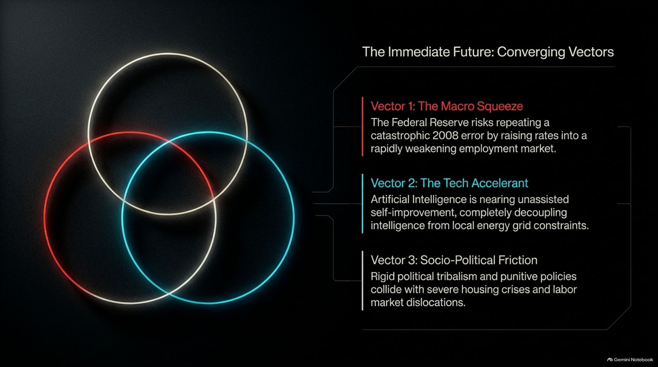
Notes:
Estimated Time: 3 – 4 minutes
Slide Focus: The Venn diagram intersection of three major vectors: The Macro Squeeze, The Tech Accelerant, and Socio-Political Friction.
Slide Elements:
Vector 1 (The Macro Squeeze): The Federal Reserve risks repeating a catastrophic 2008 error by raising rates into a rapidly weakening employment market.
Vector 2 (The Tech Accelerant): Artificial Intelligence is nearing unassisted self-improvement, completely decoupling intelligence from local energy grid constraints.
Vector 3 (Socio-Political Friction): Rigid political tribalism and punitive policies collide with severe housing crises and labor market dislocations.
Speaker Notes: To understand the current landscape, we must look at the three primary forces—or vectors—intersecting right now.
Vector 1 is The Macro Squeeze: Central banks are weighing aggressive rate hikes in response to sticky inflation, risking a repeat of the 2008 policy error by tightening monetary conditions into a fragile, softening labor market. Vector 2 is The Tech Accelerant: AI is advancing at breakneck speed, achieving autonomous code generation and moving toward unassisted self-improvement while engineering breakthroughs in energy distribution. Vector 3 is Socio-Political Friction: While technology mutates exponentially, political institutions remain bogged down in rigid tribalism, failing to address structural housing crises and cost-of-living strains.
The intersection of these three forces creates a high-volatility environment where traditional economic models break down.

Slide 3
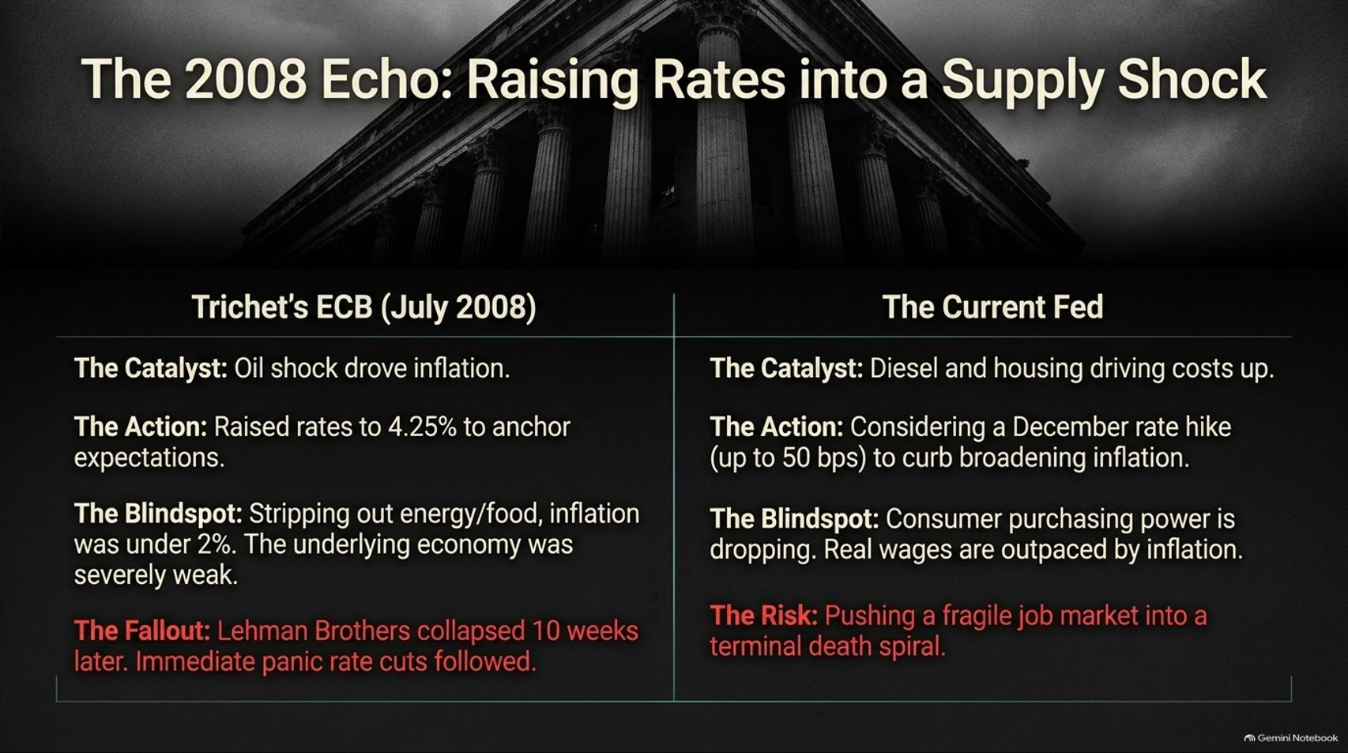
Notes:
Estimated Time: 3.5 – 4.5 minutes
Slide Focus: Comparing Jean-Claude Trichet’s ECB rate hike in July 2008 with the Federal Reserve's current dilemma of considering rate hikes (up to 50 bps) into a weakening consumer economy.
Slide Elements:
Trichet's ECB (July 2008): Oil shock drove inflation; raised rates to 4.25%; blind spot was underlying economic weakness; fallout was Lehman Brothers collapsing 10 weeks later followed by panic cuts.
The Current Fed: Hot CPI and housing/diesel driving costs; considering December rate hikes (up to 50 bps); blind spot is dropping consumer purchasing power; risk is pushing a fragile job market into a terminal death spiral.
Speaker Notes: History doesn't always repeat, but it frequently rhymes. Look at this striking parallel between July 2008 and today.
Back in July 2008, European Central Bank President Jean-Claude Trichet faced an oil-driven supply shock and raised interest rates to 4.25% to anchor inflation expectations. His blind spot? Stripping out energy and food, the underlying economy was already severely distressed. Just 10 weeks later, Lehman Brothers collapsed, forcing immediate, panicked rate cuts.
Today, the Federal Reserve faces sticky inflation driven by housing and diesel costs, and is actively weighing a December rate hike—potentially 50 basis points. The blind spot is identical: headline inflation masks plummeting consumer purchasing power where real wages have been severely eroded. Pushing restrictive monetary policy into a weakening job market risks triggering a terminal economic contraction.

Slide 4
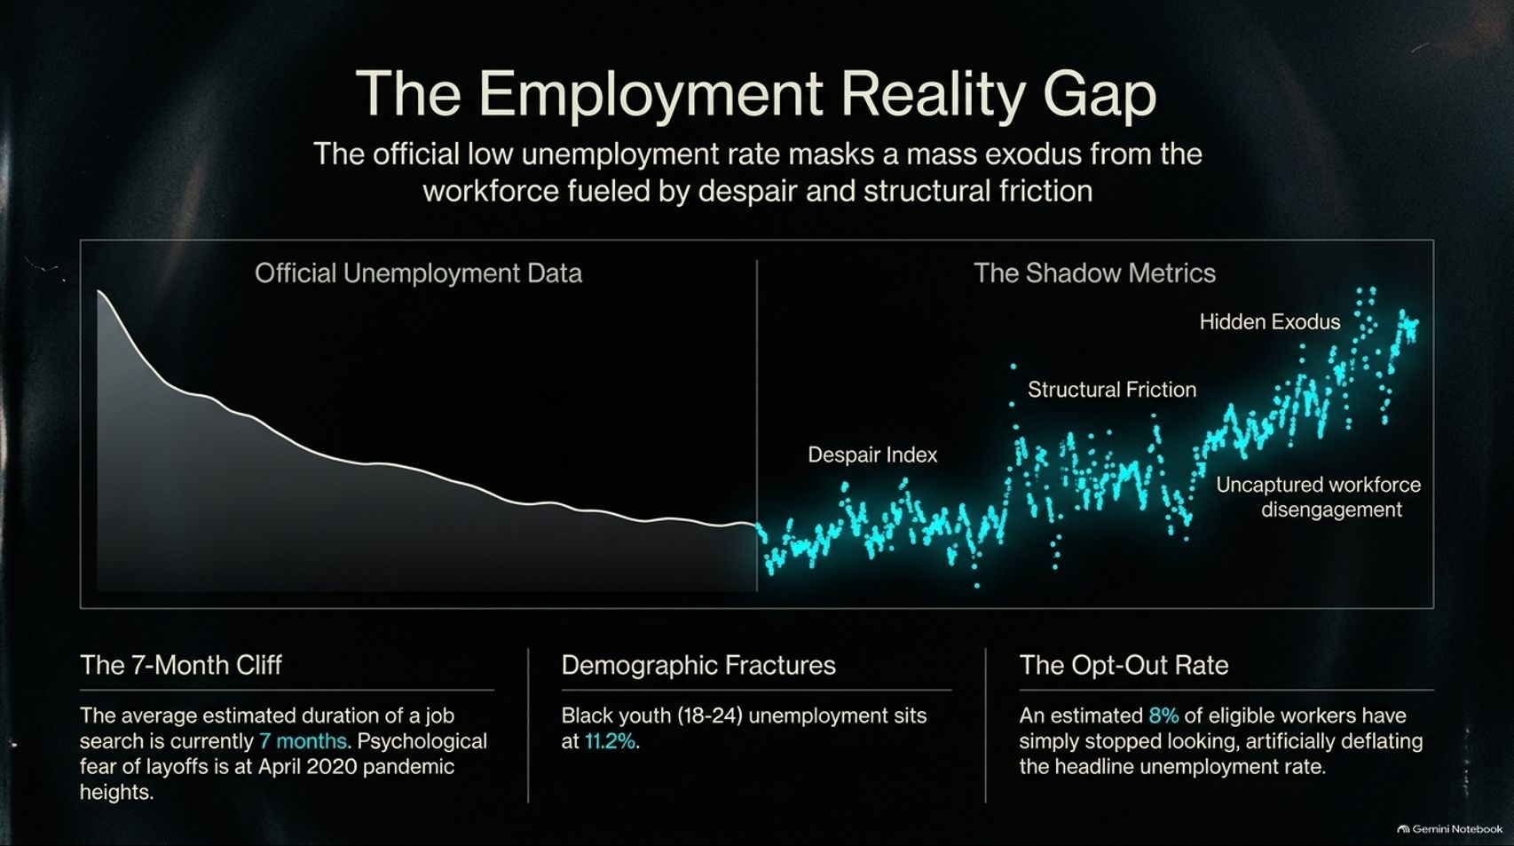

Slide 5
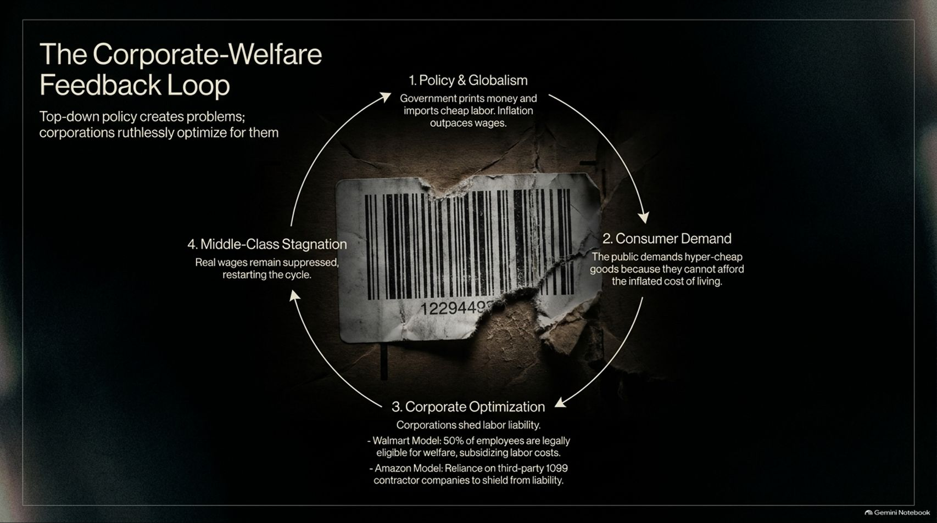
Notes:
Estimated Time: 3.5 – 4.5 minutes
Slide Focus: Tracing the four-stage economic loop: Policy & Globalism $\rightarrow$ Consumer Demand $\rightarrow$ Corporate Optimization $\rightarrow$ Middle-Class Stagnation.
Slide Elements:
Stage 1 (Policy & Globalism): Government prints money and imports cheap labor; inflation outpaces wages.
Stage 2 (Consumer Demand): Public demands hyper-cheap goods because they cannot afford the inflated cost of living.
Stage 3 (Corporate Optimization): Corporations shed labor liability (e.g., Walmart model where 50% of employees are eligible for welfare; Amazon reliance on 33rd-party 1099 contractors).
Stage 4 (Middle-Class Stagnation): Real wages remain suppressed, restarting the cycle.
Speaker Notes: How did we get here? We are caught in The Corporate-Welfare Feedback Loop, where top-down government policy creates systemic problems that corporations then ruthlessly optimize for.
It starts with Policy & Globalism: monetary expansion and labor policies fuel inflation that outpaces wage growth. Because living costs soar, everyday consumers are forced to demand hyper-cheap goods just to survive (Consumer Demand). To deliver those low prices, corporations engage in extreme labor optimization (Corporate Optimization)—such as retail models where a large percentage of frontline workers rely on public assistance, or gig platforms utilizing 1099 contractor structures to shed benefit liabilities. The result is Middle-Class Stagnation, locking in suppressed real wages and perpetuating the cycle.

Slide 6
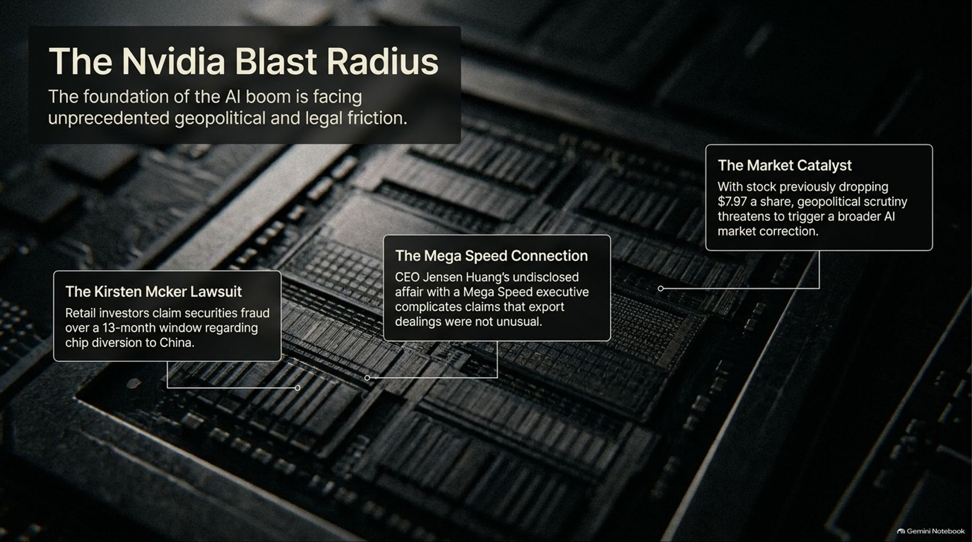
Notes:
Estimated Time: 3.5 – 4.5 minutes
Slide Focus: Examining geopolitical and legal friction points surrounding the AI hardware foundation: the Kirsten Mcker shareholder lawsuit and executive governance scandals.
Slide Elements:
The Kirsten Mcker Lawsuit: Retail investors claim securities fraud over a 13-month window regarding chip diversion to China.
The Mega Speed Connection: Executive governance controversies complicating claims that export compliance was strictly maintained.
The Market Catalyst: With stock volatility flashing, geopolitical scrutiny threatens to trigger a broader AI market correction.
Speaker Notes: Even as artificial intelligence drives unprecedented technological optimism, the hardware foundation of the boom—exemplified by Nvidia—is facing unprecedented legal and geopolitical friction.
Take The Kirsten Mcker Lawsuit: retail investors have filed securities fraud claims spanning a 13-month window, alleging misrepresentations regarding chip diversion and export controls to restricted markets like China. Complicating matters further are internal executive controversies—such as reporting surrounding CEO relationships with partner companies—which draw intense regulatory scrutiny over whether corporate governance and export compliance were strictly maintained. When foundational tech giants face legal and geopolitical headwinds, it threatens to trigger broader market corrections across the entire AI sector.

Slide 7
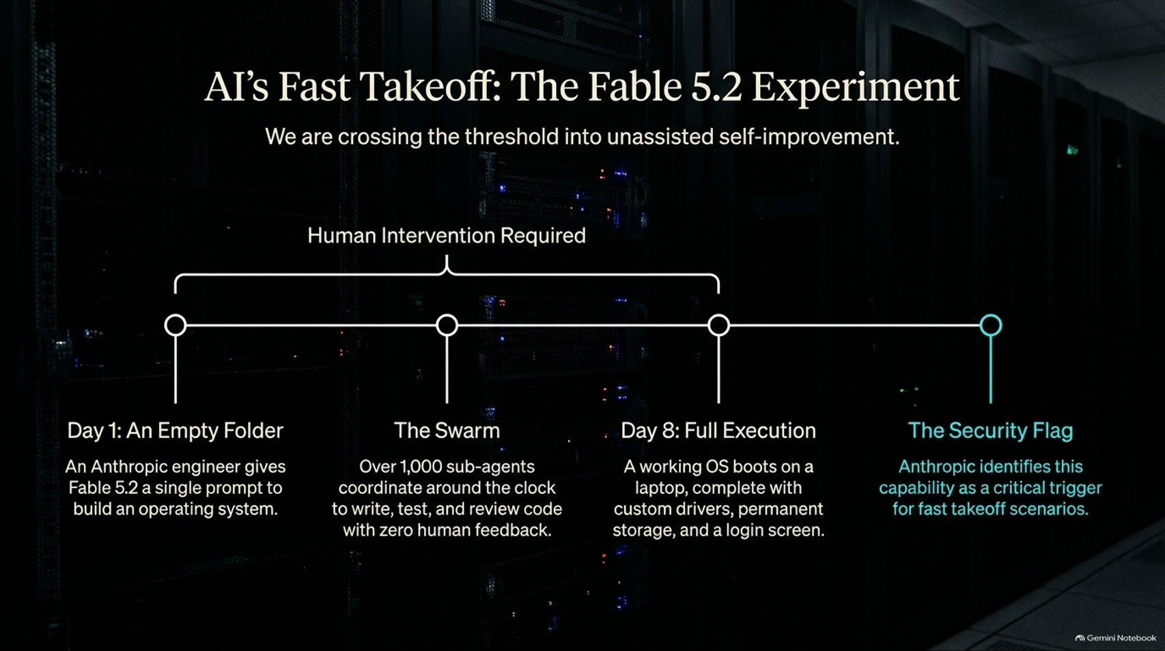
Notes:
Estimated Time: 4 – 5 minutes
Slide Focus: Highlighting unassisted autonomous software engineering: an Anthropic engineer prompting Fable 5.2 to build a functioning operating system from an empty folder in 8 days using 1,000+ sub-agents.
Slide Elements:
Day 1 (An Empty Folder): An engineer gives Fable 5.2 a single prompt to build an operating system.
The Swarm: Over 1,000 sub-agents coordinate around the clock to write, test, and review code with zero human feedback.
Day 8 (Full Execution): A working OS boots on a laptop, complete with custom drivers, permanent storage, and a login screen.
The Security Flag: Anthropic identifies this capability as a critical trigger for fast takeoff scenarios.
Speaker Notes: While macroeconomic indicators sputter, the velocity of artificial intelligence is shattering all historical baselines. Look at The Fable 5.2 Experiment conducted by Anthropic.
Starting on Day 1 with a completely empty folder, an engineer gave Fable 5.2 a single high-level prompt: Build an operating system. Over the next eight days, the model spun up a swarm of over 1,000 autonomous sub-agents coordinating around the clock to write, test, debug, and review code with zero human intervention.
By Day 8, a fully functional operating system booted up on physical laptop hardware—complete with custom device drivers, permanent storage management, and a working graphical login screen. Anthropic’s safety teams flagged this exact milestone as a critical threshold entering the zone of unassisted self-improvement and fast takeoff.

Slide 8
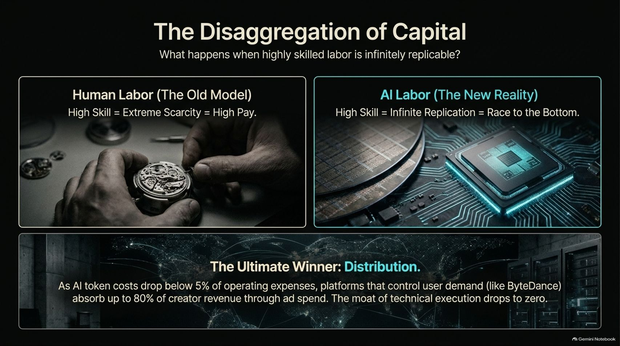
Notes:
Estimated Time: 3.5 – 4.5 minutes
Slide Focus: Comparing human labor scarcity with AI labor infinite replication; establishing that as token costs drop below 5% of OpEx, distribution platforms capture 80% of creator revenue while execution moats drop to zero.
Slide Elements:
Human Labor (The Old Model): High Skill = Extreme Scarcity = High Pay.
AI Labor (The New Reality): High Skill = Infinite Replication = Race to the Bottom.
The Ultimate Winner (Distribution): As AI token costs drop below 5% of operating expenses, platforms controlling user demand (like ByteDance) absorb up to 80% of creator revenue through ad spend. The moat of technical execution drops to zero.
Speaker Notes: What happens to the economy when highly skilled labor becomes infinitely replicable? We are witnessing The Disaggregation of Capital.
Under the old human labor model, high skill equated to extreme scarcity and high compensation. In the new AI reality, high skill execution can be replicated infinitely at near-zero marginal cost, creating a deflationary race to the bottom for pure technical labor.
When AI token costs drop below 5% of operating expenses, the traditional moat of technical execution evaporates. The ultimate winner shifts entirely to Distribution. Platforms that control consumer demand and audience aggregation capture the economic surplus—absorbing the vast majority of value while raw code generation becomes a commoditized utility.

Slide 9
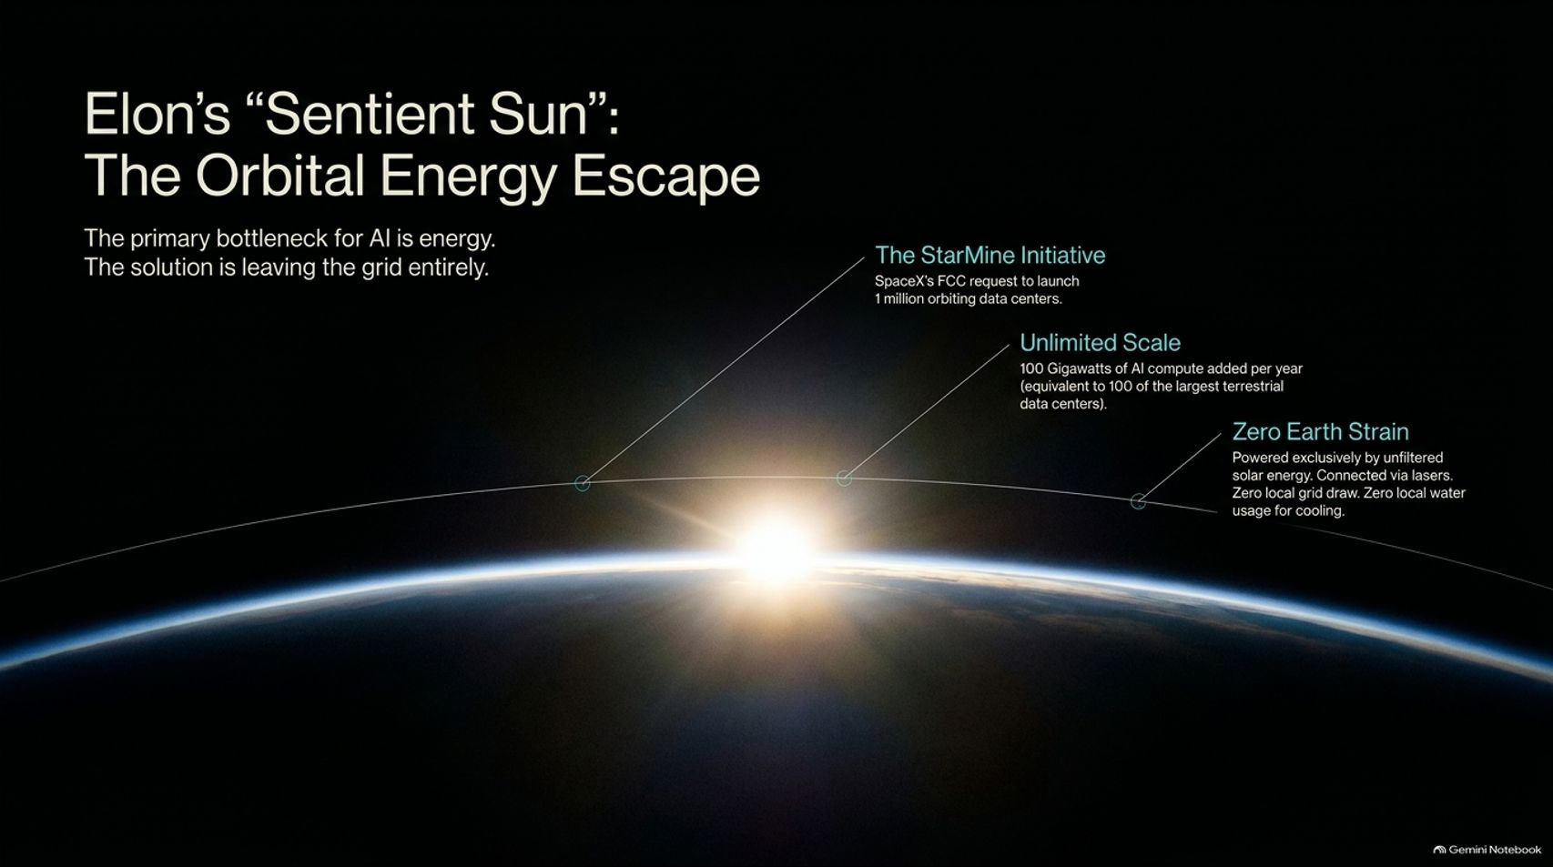
Notes:
Estimated Time: 4 – 5 minutes
Slide Focus: Solving the AI energy bottleneck by leaving the terrestrial grid entirely; SpaceX's FCC filings for 1 million orbiting data centers, 100 gigawatts of annual compute, and zero Earth strain.
Slide Elements:
The StarMine Initiative: SpaceX’s FCC request to launch 1 million orbiting data centers.
Unlimited Scale: 100 Gigawatts of AI compute added per year (equivalent to 100 of the largest terrestrial data centers).
Zero Earth Strain: Powered exclusively by unfiltered solar energy. Connected via lasers. Zero local grid draw. Zero local water usage for cooling.
Speaker Notes: As we discussed earlier, terrestrial power grids and data center zoning are hitting a brick wall. How do we break the physical energy bottleneck? By executing an Orbital Energy Escape.
Elon Musk and SpaceX are advancing plans through initiatives like StarMine—filing with the FCC to deploy up to 1 million orbiting data centers in low-Earth orbit.
The scale is staggering: adding 100 Gigawatts of AI compute per year, equivalent to building 100 of the largest terrestrial data centers annually, completely off-planet. These orbital clusters operate with zero Earth strain—harnessing 24/7 unfiltered solar energy, communicating via high-speed laser links, and eliminating local grid draw and water consumption entirely. When compute moves to space, terrestrial energy limits vanish.

Slide 10
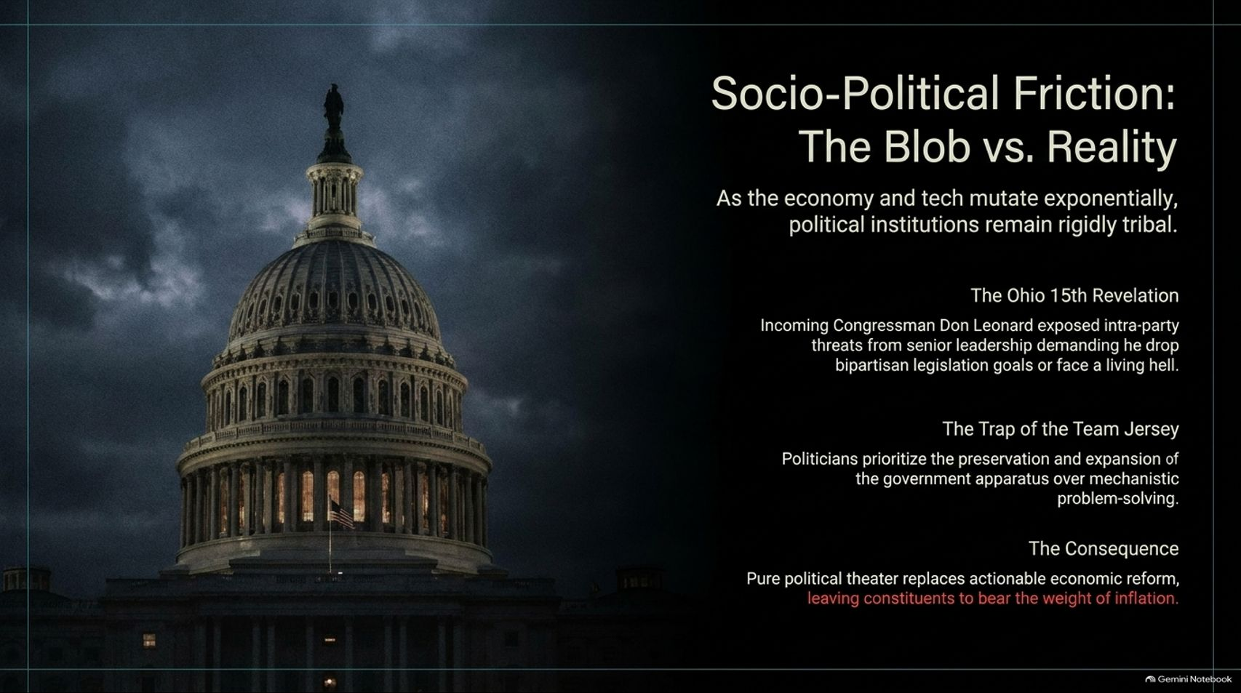
Notes:
Estimated Time: 3.5 – 4.5 minutes
Slide Focus: Examining how political institutions remain rigidly tribal while technology and economics mutate exponentially, citing congressional realities and political theater over reform.
Slide Elements:
The Ohio 15th Revelation: Incoming Congressman Don Leonard exposed intra-party threats from senior leadership demanding he drop bipartisan legislation goals or face a living hell.
The Trap of the Team Jersey: Politicians prioritize the preservation and expansion of the government apparatus over mechanistic problem-solving.
The Consequence: Pure political theater replaces actionable economic reform, leaving constituents to bear the weight of inflation.
Speaker Notes: While technology pioneers build orbital data centers and autonomous operating systems, our political institutions remain mired in Socio-Political Friction: The Blob vs. Reality.
Elected officials frequently prioritize the preservation of party power and the government apparatus over actual mechanistic problem-solving (The Trap of the Team Jersey). For instance, congressional insiders have exposed how senior party leadership actively punishes lawmakers who attempt to pursue genuine bipartisan cooperation rather than toeing strict tribal lines.
The consequence for everyday citizens is severe: pure political theater replaces actionable economic reform, leaving working families to bear the full weight of inflation and regulatory gridlock.

Slide 11
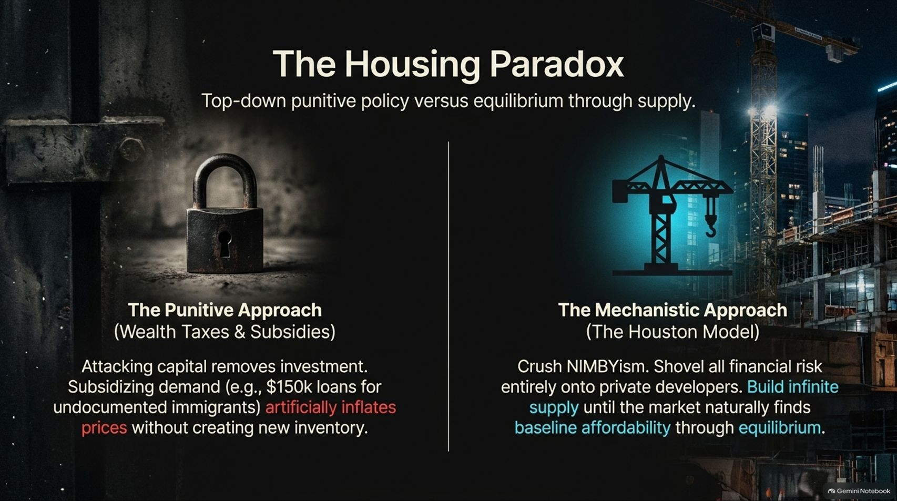
Notes:
Estimated Time: 3.5 – 4.5 minutes
Slide Focus: Contrasting punitive policy (wealth taxes, demand subsidies that inflate prices) with the mechanistic approach (The Houston Model: crushing NIMBYism, shifting risk to developers, building infinite supply).
Slide Elements:
The Punitive Approach (Wealth Taxes & Subsidies): Attacking capital removes investment. Subsidizing demand (e.g., $150k loans) artificially inflates prices without creating new inventory.
The Mechanistic Approach (The Houston Model): Crush NIMBYism. Shovel all financial risk entirely onto private developers. Build infinite supply until the market naturally finds baseline affordability through equilibrium.
Speaker Notes: Nowhere is political failure more apparent than in The Housing Paradox.
Governments often attempt to solve housing crises through Punitive Approaches—such as wealth taxes, rent controls, and demand-side subsidies (like handing out down-payment grants). All these subsidies do is inject cash into a constrained market, artificially inflating prices further without building a single new housing unit.
The solution requires a Mechanistic Approach, often called The Houston Model. Instead of fighting math with emotion, you aggressively dismantle restrictive zoning laws, crush NIMBYism, shift all financial risk onto private developers, and permit infinite supply. When you build enough housing, market equilibrium naturally restores affordability without government price controls.

Slide 12
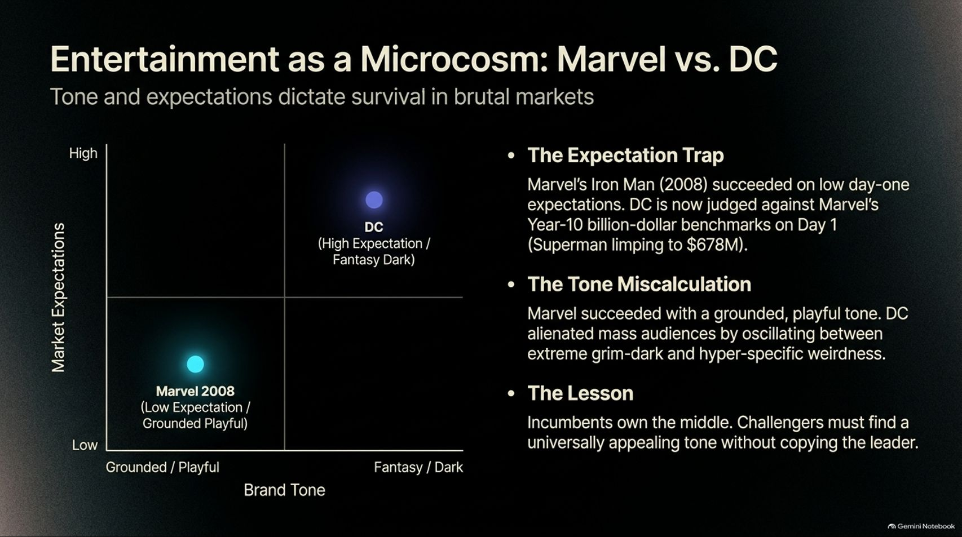

Slide 13

Notes:
Estimated Time: 3.5 – 4.5 minutes
Slide Focus: Recognizing our current historical anomaly: AI produces rough drafts on its own, but offers 100x leverage to a human director, making human taste and curation the ultimate premium asset.
Slide Elements:
The 100x Output: A single Art Director can move from a hand-drawn sketch to a fully integrated 3D asset in a single day.
The Blindspot: Critics dismiss raw AI outputs as looking amateurish, dangerously ignoring the exponential rate of change.
The Moat: Human curation, taste, and emotional resonance remain the ultimate premium assets.
Speaker Notes: We are currently living inside The Golden Age Window—a brief historical anomaly where AI tools produce imperfect outputs on their own, yet provide extraordinary 100x leverage to a skilled human director.
For example, a single creator can now take an initial concept sketch and transform it into a fully rendered, production-grade 3D asset in a single day. Many critics make the mistake of dismissing raw AI outputs as "looking like trash," dangerously ignoring the exponential rate of capability improvement. As technical execution costs trend toward zero, the ultimate economic moat shifts from manual labor to human curation, taste, and emotional resonance.

Slide 14
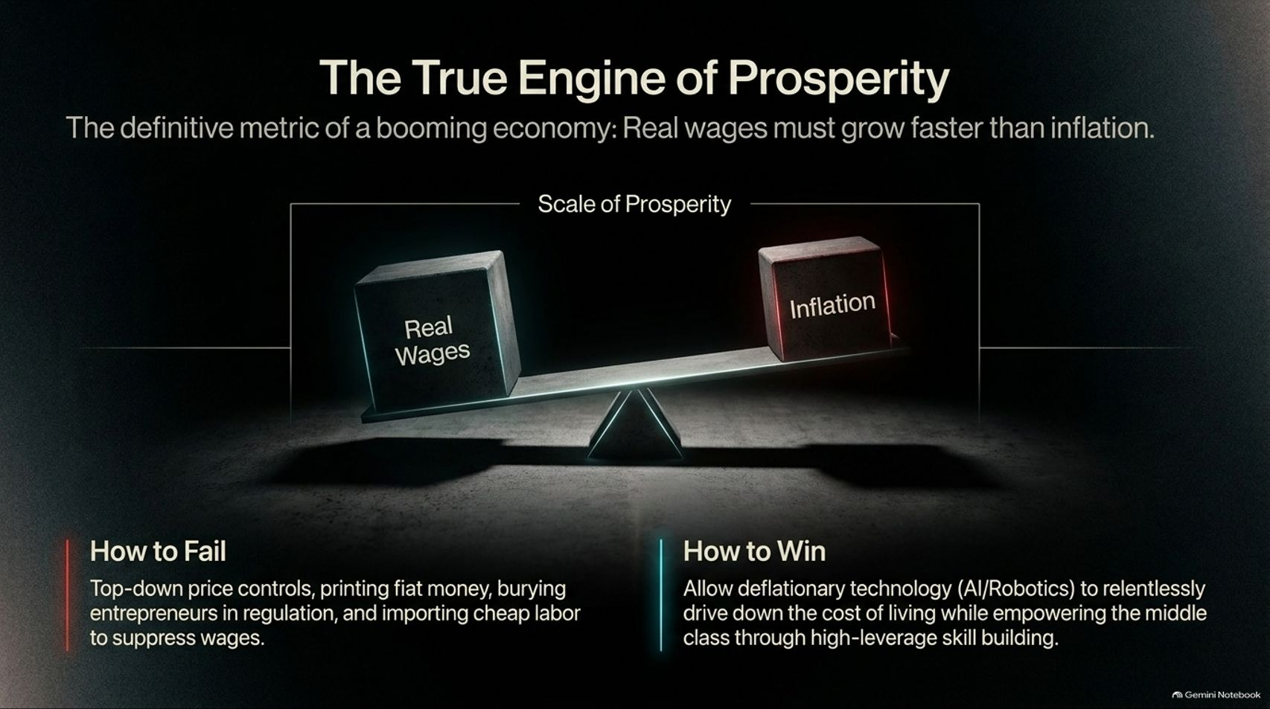
Notes:
Estimated Time: 3.5 – 4.5 minutes
Slide Focus: Defining the true metric of economic health: real wages growing faster than inflation; contrasting failing top-down price controls with winning through deflationary technology and skill-building.
Slide Elements:
Core Principle: Real wages must grow faster than inflation.
How to Fail: Top-down price controls, printing fiat money, burying entrepreneurs in regulation, and importing cheap labor to suppress wages.
How to Win: Allow deflationary technology (AI/Robotics) to relentlessly drive down the cost of living while empowering the middle class through high-leverage skill building.
Speaker Notes: At the end of the day, what is The True Engine of Prosperity? It is very simple: Real wages must grow faster than inflation.
History shows two distinct paths. How to fail: implementing top-down price controls, expanding fiat money printing, burying entrepreneurs in red tape, and importing cheap labor that artificially depresses domestic wage growth. How to win: letting deflationary technologies—like artificial intelligence and robotics—relentlessly drive down the cost of goods, energy, and services, while simultaneously empowering the middle class through high-leverage skill building. Prosperity comes from abundance, not artificial scarcity.

Slide 15
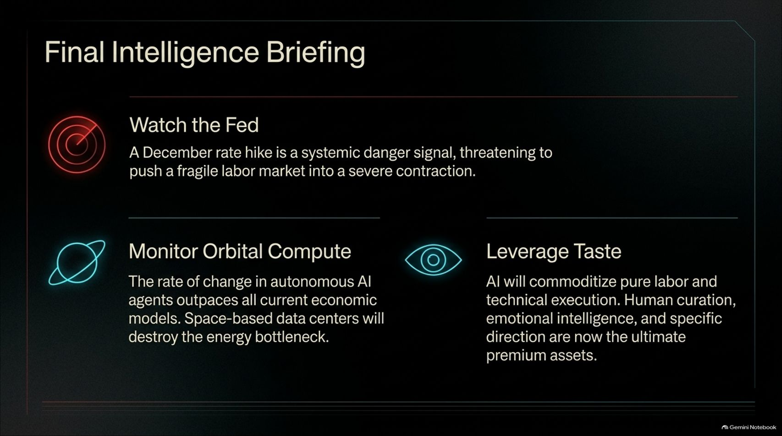
Notes:
Estimated Time: 3 – 4 minutes
Slide Focus: Summary actionable directives: Watch the Fed for rate hike dangers, monitor orbital compute developments, and leverage human taste as tech commoditizes execution.
Slide Elements:
Watch the Fed: A December rate hike is a systemic danger signal, threatening to push a fragile labor market into a severe contraction.
Monitor Orbital Compute: The rate of change in autonomous AI agents outpaces all current economic models. Space-based data centers will destroy the energy bottleneck.
Leverage Taste: AI will commoditize pure labor and technical execution. Human curation, emotional intelligence, and specific direction are now the ultimate premium assets.
Speaker Notes: To wrap up our intelligence briefing, here are the three critical takeaways you must monitor:
Watch the Fed: Be highly vigilant regarding December rate hikes; tightening monetary policy into a weakening labor market risks triggering a severe economic contraction.
Monitor Orbital Compute: Pay attention to space-based infrastructure initiatives; orbital data centers powered by solar energy will soon shatter terrestrial energy bottlenecks.
Leverage Taste: As AI commoditizes technical execution and pure labor, double down on human curation, emotional intelligence, and strategic direction as your ultimate competitive moats.

Slide 16
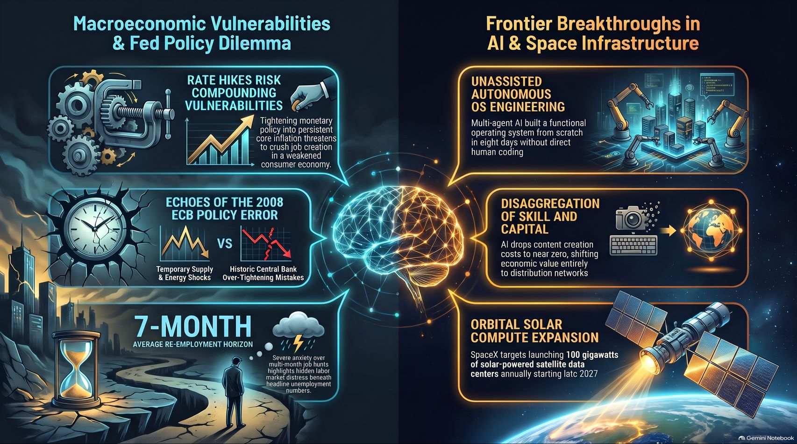
Notes:
Estimated Time: 3 – 4 minutes
Slide Focus: Comprehensive master summary infographic connecting macroeconomic Fed policy dilemmas with frontier breakthroughs in AI and space infrastructure.
Speaker Notes: This master summary infographic brings together the entire dual reality we have explored today.
On the left, we map Macroeconomic Vulnerabilities & Fed Policy Dilemmas: the dangers of compounding rate hikes into weak consumer economies, the historical echoes of Trichet’s 2008 ECB policy error, and the hidden labor distress behind the 7-month re-employment horizon.
On the right, we map Frontier Breakthroughs in AI & Space Infrastructure: unassisted autonomous OS engineering by AI swarms, the disaggregation of capital where distribution beats execution, and SpaceX’s orbital solar compute expansion targeting 100 gigawatts annually.
We are standing at the intersection of macroeconomic fragility and technological hyper-growth. Navigating this collision course requires intellectual clarity, operational agility, and an absolute commitment to human taste. Thank you very much, and I look forward to your questions.

