Slide 1

Notes:
Estimated Time: 2.5 – 3 minutes
Slide Focus: Title slide introducing the core premise: macroeconomic bifurcation, passive investor complacency, and the impending rotation toward the "Old Era Economy," based on Jim Paulsen’s research.
Slide Elements:
Title: What Could End Technology’s 20-Year Market Run: Bifurcation, Complacency, and the Dawn of the Old Era Economy.
Subtitle: Based on Macroeconomic Insights by Jim Paulsen.
Speaker Notes: Welcome everyone. Today we are exploring a profound structural shift in global capital markets. This presentation is based on the macroeconomic insights of veteran market strategist Jim Paulsen, as discussed on Excess Returns.
For the past two decades, technology has enjoyed an uninterrupted reign as the undisputed engine of market returns. Investors have grown accustomed to a simple rule: buy tech, buy growth, and ignore the macro noise. But beneath the headline indices, a violent economic and market bifurcation is taking place.
Over the next 16 slides, we will examine why the U.S. economy is currently operating at two completely different speeds, why headline GDP is masking a silent recession across 86% of the economy, how the Federal Reserve is using a blunt demand-side tool on a supply-side reality, and why capital is quietly beginning its greatest rotation in a decade toward the neglected Old Era economy. Let's unpack the data.
We Haven’t Seen This in 100 Years | Jim Paulsen on What Could End Tech’s 20-Year Run
https://www.youtube.com/watch?v=eYYGCxT3JUY

Slide 2
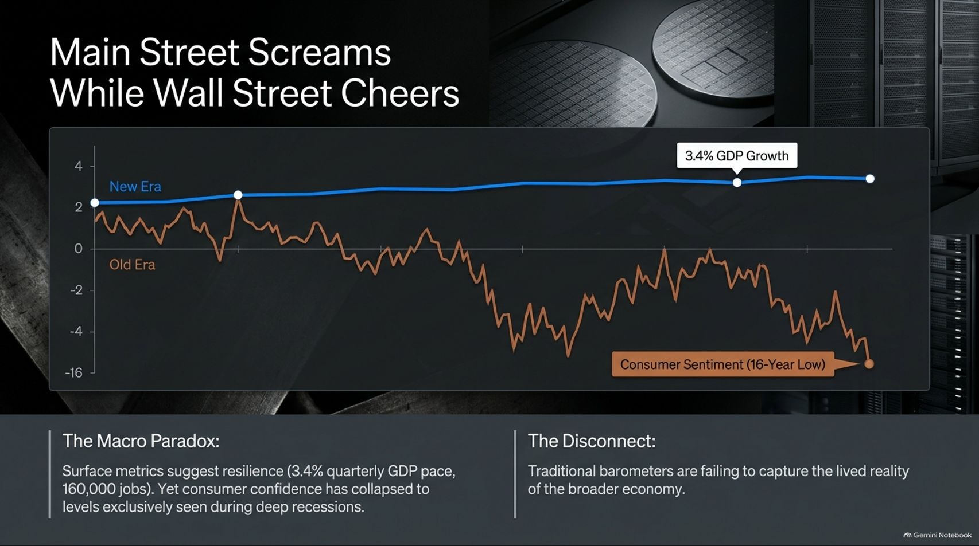
Notes:
Estimated Time: 3.5 – 4.5 minutes
Slide Focus: Highlighting the macro paradox: resilient surface metrics (3.4% GDP growth) versus collapsed consumer sentiment sitting at a 16-year low.
Slide Elements:
Chart: Divergence between the upward-sloping New Era GDP line and the plunging Old Era / Consumer Sentiment line.
The Macro Paradox: Surface metrics suggest resilience (3.4% quarterly GDP pace). Yet consumer confidence has collapsed to levels exclusively seen during deep recessions.
The Disconnect: Traditional barometers are failing to capture the lived reality of the broader economy.
Speaker Notes: Have you ever looked at a robust GDP report and wondered why everyday consumers and small business owners feel like they are in a recession? That is The Macro Paradox, and it forms the foundation of Jim Paulsen’s recent research.
On Wall Street, headline numbers look fantastic: quarterly GDP growth printing at 3.4%, powered by massive corporate capital expenditures in artificial intelligence and software. But look at the bottom half of that chart. Consumer sentiment has crashed to levels historically associated with deep economic recessions.
This disconnect occurs because traditional macroeconomic barometers are averaging two entirely different worlds. Wall Street is cheering the explosive capitalization of a tiny technological vanguard, while Main Street is absorbing the brutal squeeze of persistent inflation, high borrowing costs, and stagnant purchasing power. When Main Street screams while Wall Street cheers, a structural reckoning is never far behind.

Slide 3
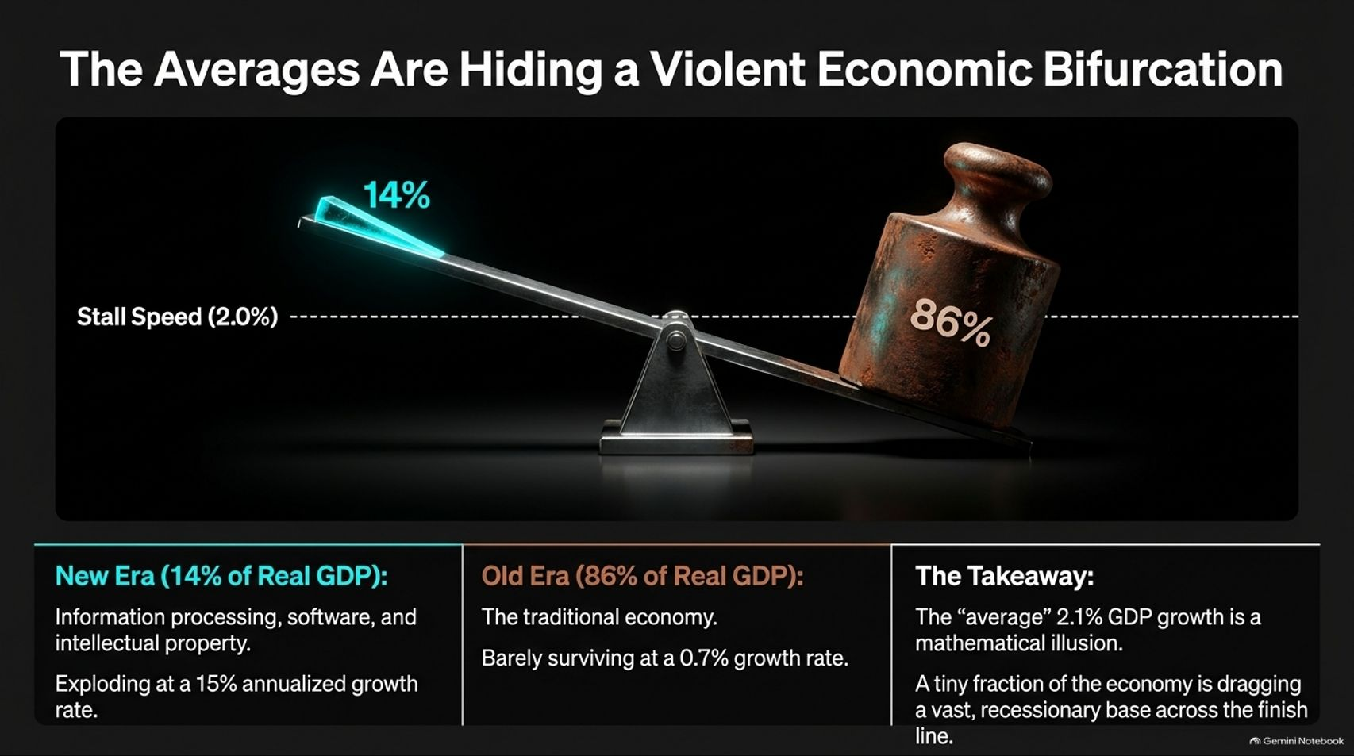
Notes:
Estimated Time: 4 – 5 minutes
Slide Focus: Deconstructing real GDP: the 14% New Era tech sector exploding at 15% annualized growth versus the 86% traditional economy stalling at 0.7% growth.
Slide Elements:
The Seesaw Graphic: 14% New Era (light) vs. 86% Old Era (heavy weight sitting below stall speed).
New Era (14% of Real GDP): Information processing, software, and intellectual property exploding at a 15% annualized growth rate.
Old Era (86% of Real GDP): The traditional economy barely surviving at a 0.7% growth rate.
The Takeaway: The "average" 2.1% GDP growth is a mathematical illusion. A tiny fraction of the economy is dragging a vast, recessionary base across the finish line.
Speaker Notes: To understand why the macroeconomic data feels so contradictory, we have to separate the U.S. economy into its two constituent parts, as Jim Paulsen meticulously calculates.
If you look at the aggregate 2.1% real GDP growth rate, it appears modest but stable. But that number is a mathematical illusion.
The New Era (just 14% of real GDP)—consisting of information processing, software, and intellectual property—is exploding at an incredible 15% annualized growth rate.
The Old Era (the remaining 86% of real GDP)—representing the traditional industrial, manufacturing, consumer, and service economy—is barely surviving at a 0.7% growth rate, well below the 2.0% stall speed.
Think about what this means: a tiny 14% technological vanguard is single-handedly dragging a massive, 86% recessionary economic base across the finish line. Without tech’s colossal capital spending boom, the broader U.S. economy would already be flashing deep red.

Slide 4
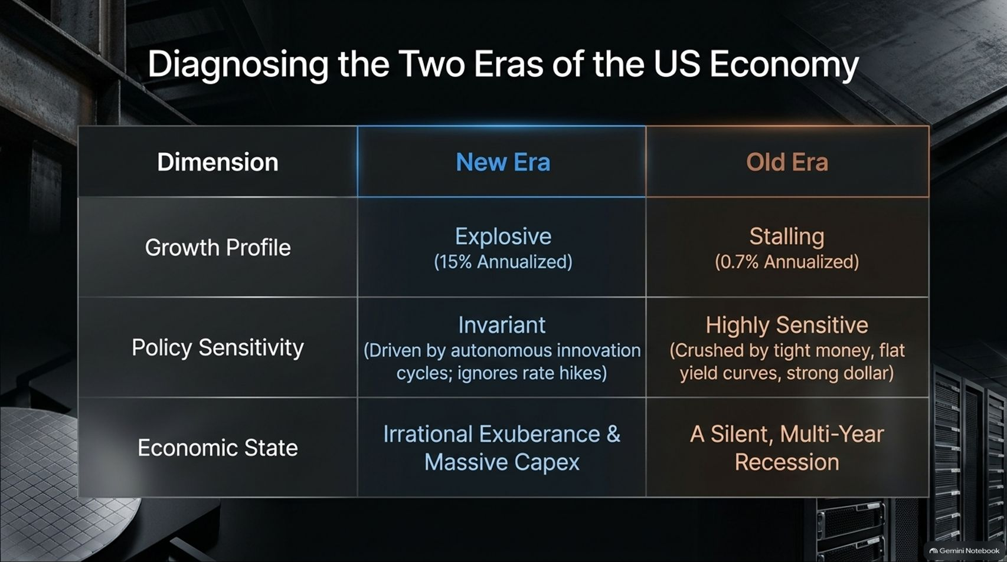

Slide 5
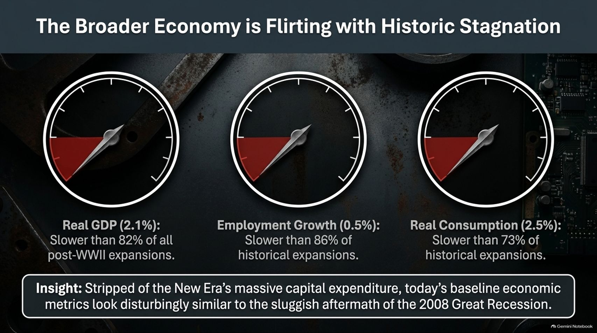
Notes:
Estimated Time: 3.5 – 4.5 minutes
Slide Focus: Benchmarking baseline economic metrics against post-WWII history: real GDP, employment growth, and real consumption lagging behind historical expansions.
Slide Elements:
Real GDP (2.1%): Slower than 82% of all post-WWII expansions.
Employment Growth (0.5%): Slower than 86% of historical expansions.
Real Consumption (2.5%): Slower than 73% of historical expansions.
Insight: Stripped of New Era capex, today’s baseline economic metrics look disturbingly similar to the sluggish aftermath of the 2008 Great Recession.
Speaker Notes: When you strip away the dazzling capital expenditure of the tech sector and look at baseline economic vitals, the picture is sobering.
As Jim Paulsen points out, baseline U.S. economic metrics are severely lagging behind historical norms. Real GDP growth of 2.1% is slower than 82% of all post-WWII economic expansions. Employment growth at 0.5% lags behind 86% of historical expansions, and real consumption trails 73% of past cycles.
If you remove the Artificial Intelligence capex boom from the equation, today’s underlying economic engine looks disturbingly sluggish—resembling the prolonged, painful recovery period following the 2008 Great Recession rather than a dynamic, broad-based economic expansion.

Slide 6

Notes:
Estimated Time: 4 – 5 minutes
Slide Focus: Explaining the monetary mismatch: the Fed using blunt demand-side tightening (rates, yield curves) to fix pandemic-induced supply shocks, missing tech while crushing the Old Era.
Slide Elements:
The Double Mistake: Treating New Era tech strength as general economic overheating.
The Mismatch: Applying blunt demand-side tightening to fix a supply-side problem.
The Result: The tightening cycle completely misses self-sustaining New Era tech while driving the Old Era further into systemic contraction.
Speaker Notes: Here we arrive at a critical policy error: The Fed is applying a demand-side wrench to a supply-side problem.
Central bankers look at booming stock markets, high tech sector spending, and sticky inflation, and assume the entire U.S. economy is overheating. Consequently, they maintain tight monetary policy—holding interest rates high and keeping yield curves inverted.
This is a profound mismatch. The inflation we experienced originated from pandemic supply chain fractures and structural supply shocks, not runaway consumer demand. By applying blunt demand-side tightening, the Fed commits a double mistake: its restrictive policies completely fail to cool self-sustaining, cash-rich tech giants, yet they act like a tourniquet on the 86% Old Era economy, driving traditional sectors deeper into contraction.

Slide 7
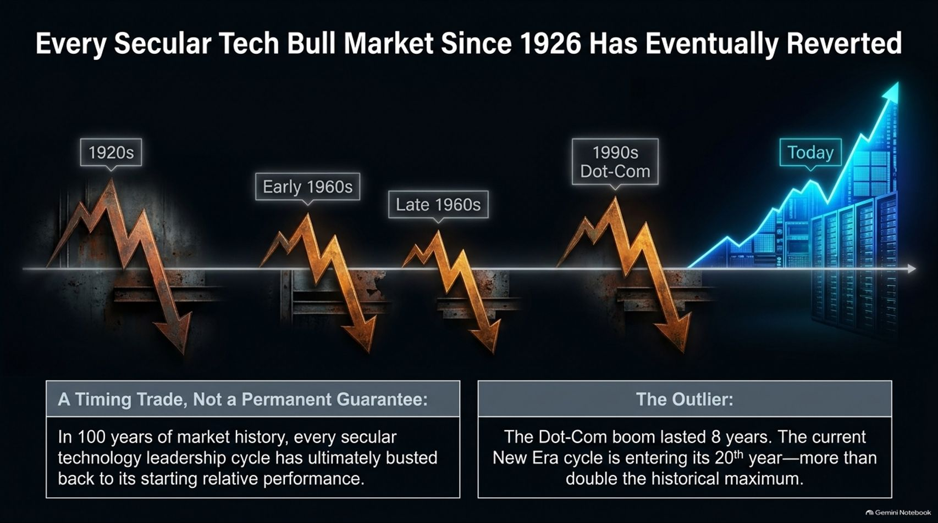

Slide 8
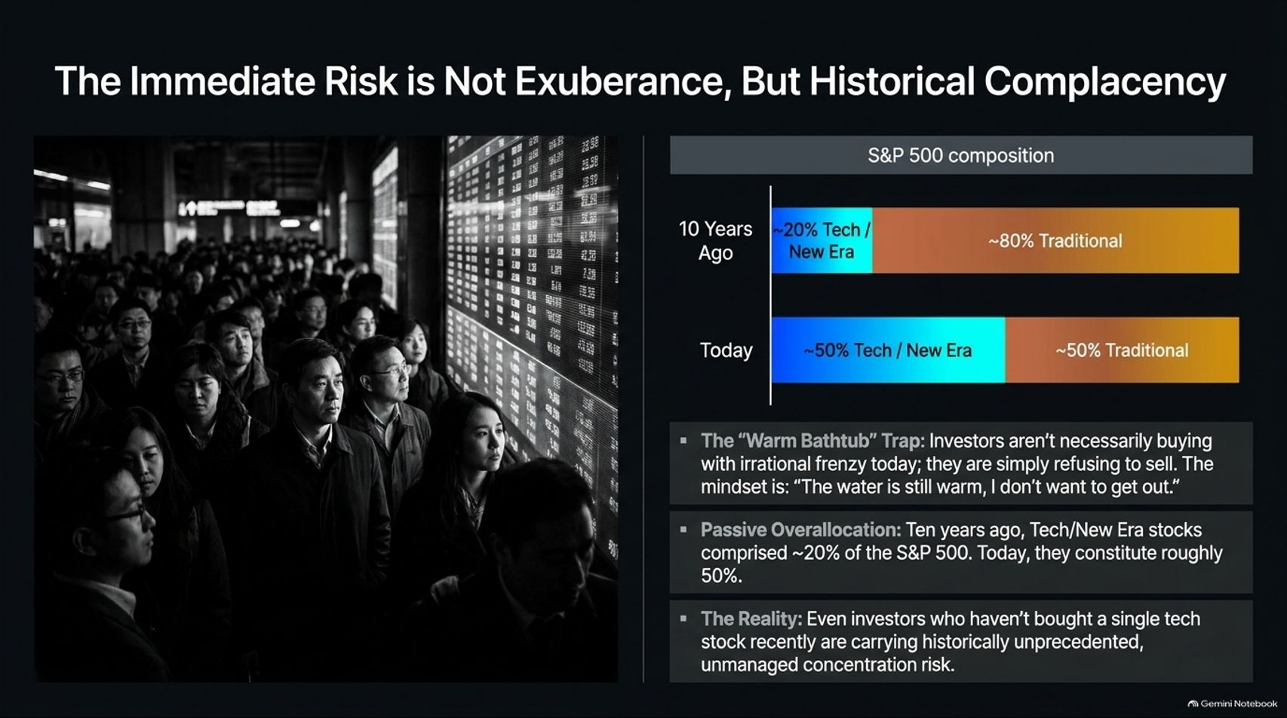
Notes:
Estimated Time: 4 – 5 minutes
Slide Focus: Analyzing S&P 500 composition shift from ~20% tech/new era a decade ago to ~50% today; introducing the "Warm Bathtub" trap and passive over-allocation risk.
Slide Elements:
Composition Shift: 10 years ago (~20% Tech / ~80% Traditional) vs. Today (~50% Tech / ~50% Traditional).
The "Warm Bathtub" Trap: Investors aren't necessarily buying with irrational frenzy today; the mindset is: "The water is still warm, I don't want to get out."
Passive Over-allocation: Passive index flows automatically concentrated portfolios into Tech without investors lifting a finger.
The Reality: Even investors who haven't bought a single tech stock recently carry historically unprecedented, unmanaged concentration risk.
Speaker Notes: When people talk about tech bubbles, they look for irrational retail speculation or 1999-style frenzy. But Jim Paulsen points out that the immediate risk today is not exuberant mania, but historical complacency.
Look at how the S&P 500 composition has mutated over the last decade. Ten years ago, technology and communications represented roughly 20% of the index, while traditional sectors made up 80%. Today, thanks to decades of outperformance and passive index inflows, tech and new era stocks constitute nearly 50% of the entire S&P 500.
This has trapped investors in the "Warm Bathtub" Trap. People aren't panic-buying tech; they are simply comfortable. The water feels warm, and nobody wants to get out and trigger tax events. Consequently, even conservative index investors who haven’t purchased a single tech share in years are walking around with historically unprecedented, unmanaged portfolio concentration risk.

Slide 9
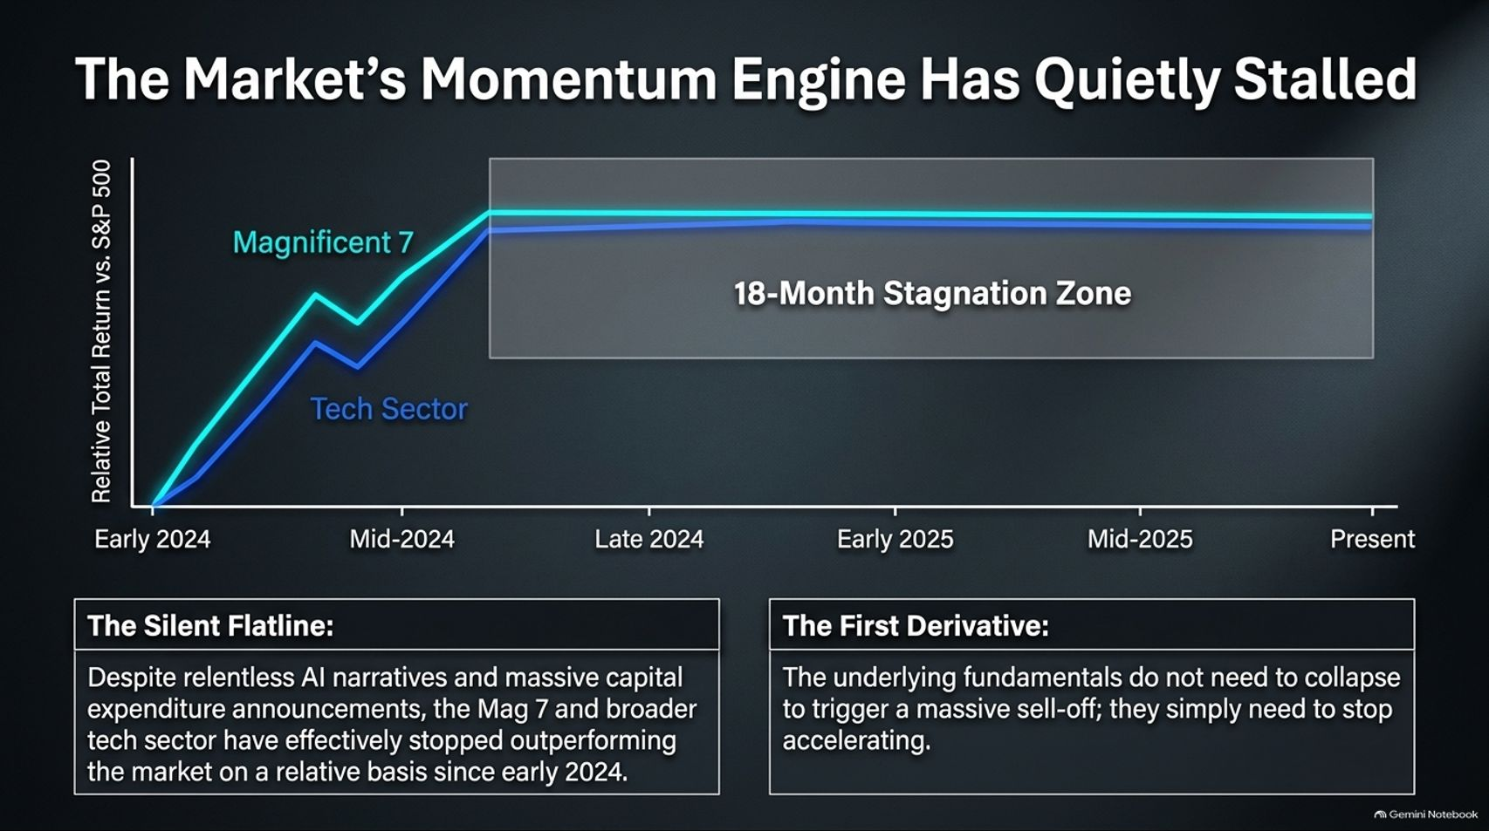
Notes:
Estimated Time: 3.5 – 4.5 minutes
Slide Focus: Examining the 18-month relative stagnation of the Magnificent 7 and broader tech sector since early 2024; why fundamentals don't need to collapse—they just need to stop accelerating.
Slide Elements:
Chart: Relative total return vs. S&P 500 showing an 18-month stagnation zone from early 2024 to present.
The Silent Flatline: Despite relentless AI narratives and massive capex announcements, Mag 7 and tech have stopped outperforming on a relative basis.
The First Derivative: Underlying fundamentals do not need to collapse to trigger a massive sell-off; they simply need to stop accelerating.
Speaker Notes: Here is one of the most vital technical insights from Jim Paulsen’s recent work: the market’s momentum engine has quietly stalled.
If you look at the relative total return of the Magnificent 7 and the broader tech sector against the S&P 500, a fascinating pattern emerges. Since early 2024, despite relentless headlines about artificial intelligence breakthroughs and record capital expenditure announcements, tech has entered a flatline stagnation zone lasting over 18 months.
Tech is no longer pulling away from the rest of the market on a relative basis. In market dynamics, remember the rule of the first derivative: fundamentals do not need to collapse to trigger a correction; they simply need to stop accelerating. When perfection is already priced into a 50% index weighting, deceleration is enough to invite a rotation.

Slide 10
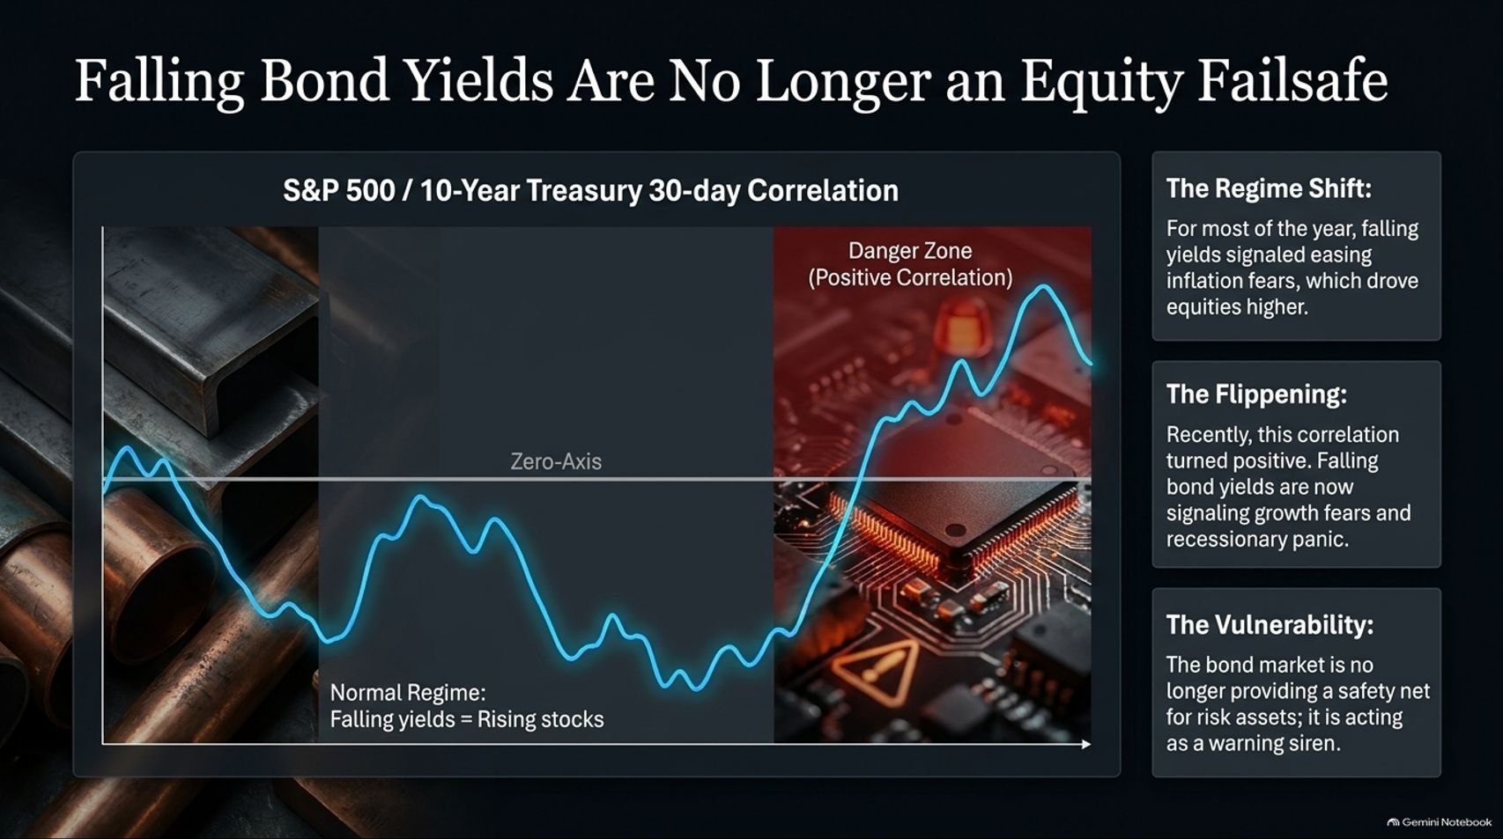
Notes:
Estimated Time: 4 – 5 minutes
Slide Focus: The regime shift in S&P 500 / 10-Year Treasury correlation: moving from normal negative correlation (falling yields = rising stocks) into the danger zone of positive correlation (falling yields = growth/recession panic).
Slide Elements:
Normal Regime: Falling yields = Rising stocks (easing inflation fears).
The Flippening: Correlation turns positive. Falling bond yields signal growth fears and recessionary panic.
The Vulnerability: The bond market is no longer providing a safety net for risk assets; it is acting as a warning siren.
Speaker Notes: For the last decade, equity investors relied on a comforting safety blanket: whenever stocks wobbled, bond yields fell as the Fed cut rates, rescuing the stock market. That historical relationship has officially broken.
Look at the S&P 500 and 10-Year Treasury 30-day correlation chart. For most of the past decade, we operated in a normal regime where falling yields meant easing inflation fears, which drove stock prices higher.
Recently, that correlation flipped firmly into positive territory—entering the Danger Zone. Now, falling bond yields are no longer signaling relief; they are signaling growth fears and recessionary panic. When bond yields drop because the economy is cracking, safe-haven bond buying acts as a warning siren for equities rather than a safety net.

Slide 11
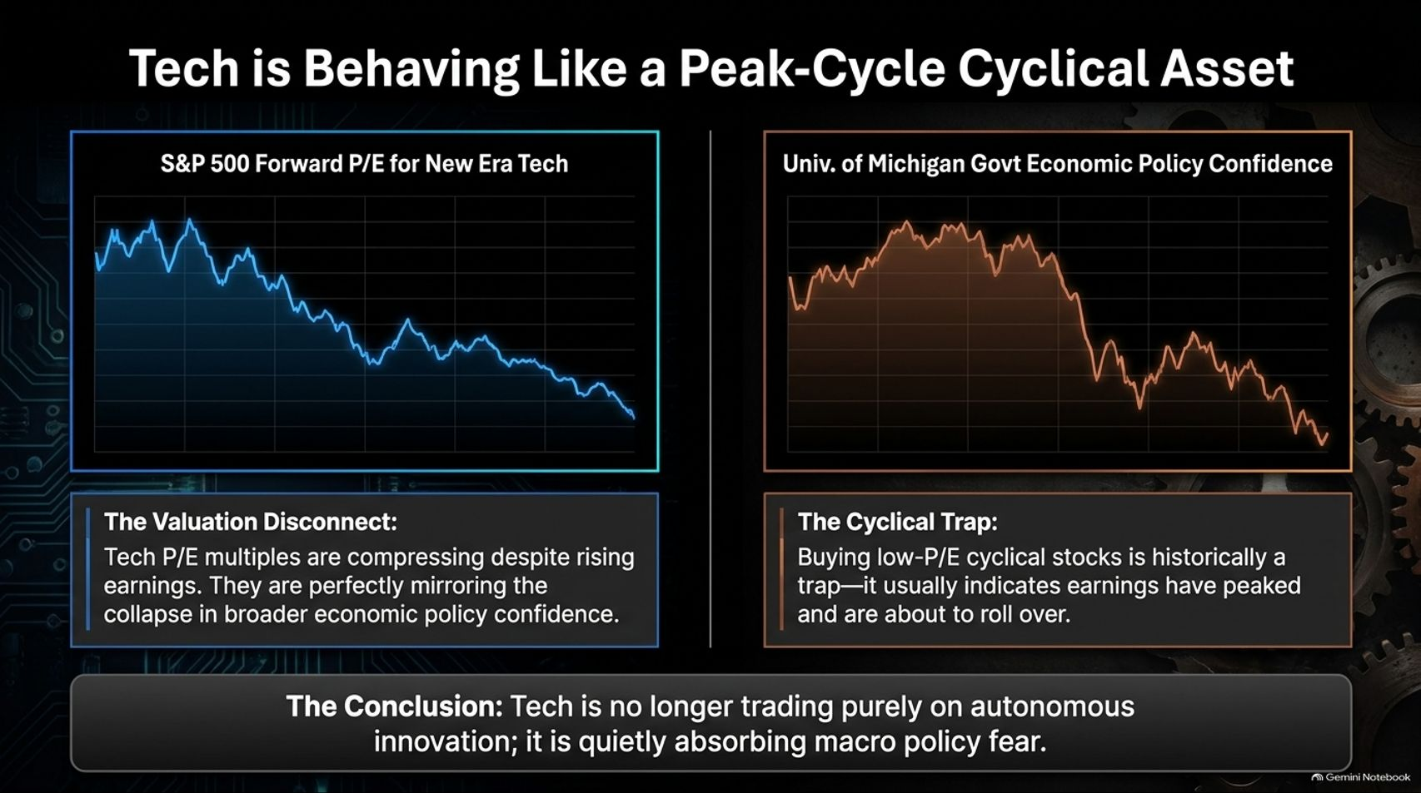

Slide 12
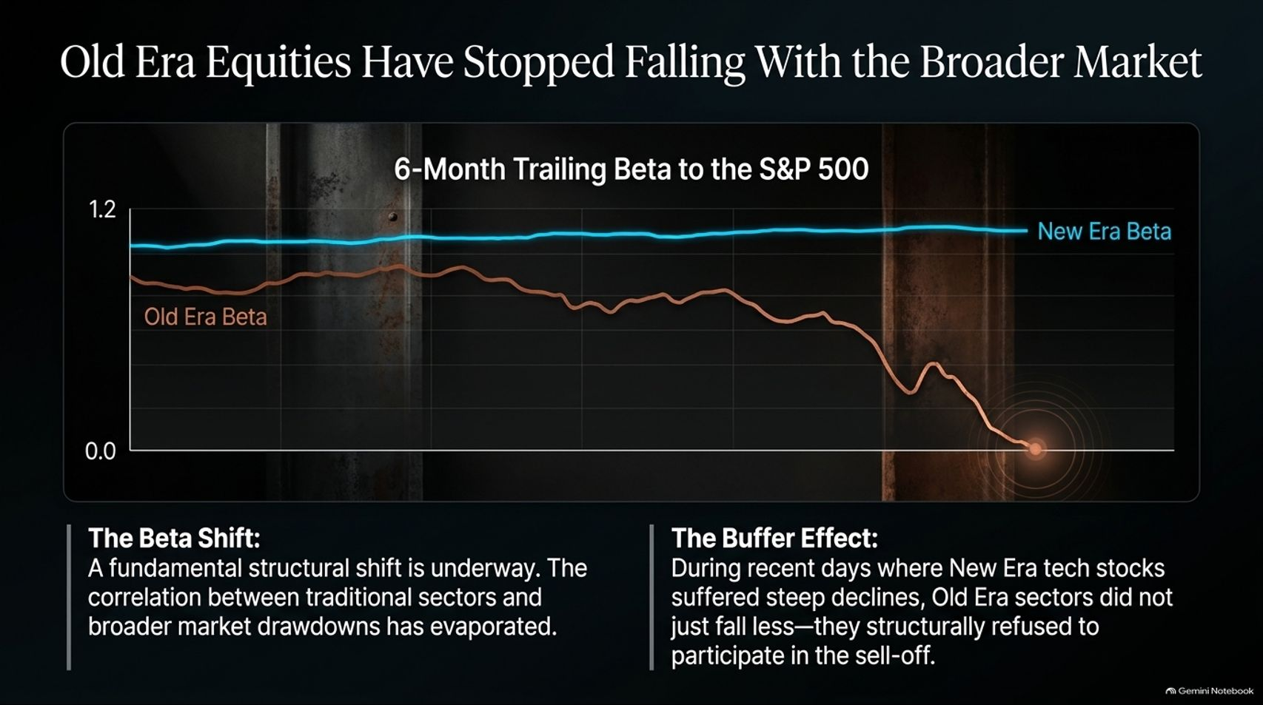
Notes:
Estimated Time: 3.5 – 4.5 minutes
Slide Focus: Examining 6-month trailing beta: Old Era equity beta dropping toward zero as traditional sectors structurally refuse to participate in recent tech drawdowns.
Slide Elements:
The Beta Shift: Correlation between traditional sectors and broader market drawdowns has evaporated.
The Buffer Effect: During recent days where New Era tech stocks suffered steep declines, Old Era sectors did not just fall less—they structurally refused to participate in the sell-off.
Speaker Notes: Here is where the narrative shifts from risk to opportunity. While tech experiences increased volatility and valuation compression, Old Era equities have stopped falling with the broader market.
Look at the 6-month trailing beta to the S&P 500. While New Era tech beta remains elevated above 1.0, the beta for Old Era industrial, value, and cyclical sectors has steadily drifted downward, approaching zero.
This represents a fundamental structural break. During recent market sessions where tech stocks experienced sharp pullbacks, Old Era sectors didn't merely fall less—they demonstrated a genuine Buffer Effect, structurally refusing to participate in the downside. Traditional value is finding a hard economic floor.

Slide 13
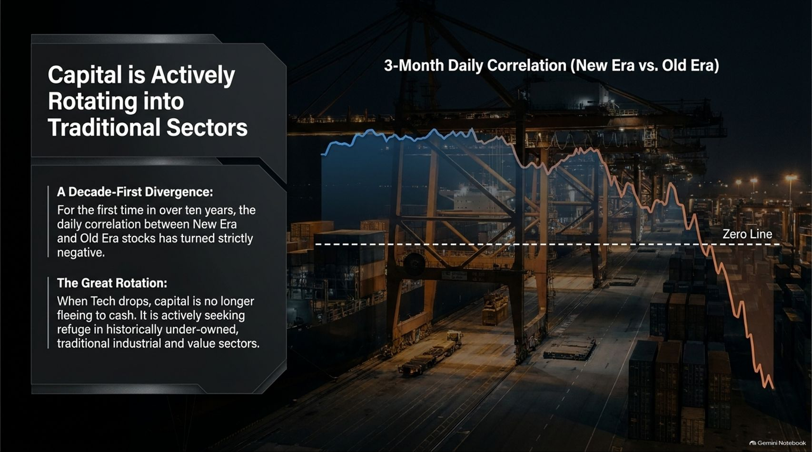
Notes:
Estimated Time: 3.5 – 4.5 minutes
Slide Focus: Highlighting a decade-first divergence: 3-month daily correlation between New Era and Old Era stocks turning strictly negative ("The Great Rotation").
Slide Elements:
A Decade-First Divergence: For the first time in over ten years, the daily correlation between New Era and Old Era stocks has turned strictly negative.
The Great Rotation: When Tech drops, capital is no longer fleeing to cash. It is actively seeking refuge in historically under-owned, traditional industrial and value sectors.
Speaker Notes: This chart captures what Jim Paulsen calls The Great Rotation—a phenomenon we haven't witnessed in over a decade.
For more than ten years, when stocks moved, they moved together; the correlation between growth tech and traditional value remained positive. Today, that correlation has broken through the zero line and turned strictly negative.
This is a massive signal for portfolio managers. When tech experiences a drawdown, institutional capital is no longer fleeing entirely to cash or sidelines. Instead, money is actively rotating out of crowded tech holdings and seeking refuge in historically under-owned, cash-flowing traditional industrial and value sectors. Capital is redistributing across the two-speed economy.

Slide 14
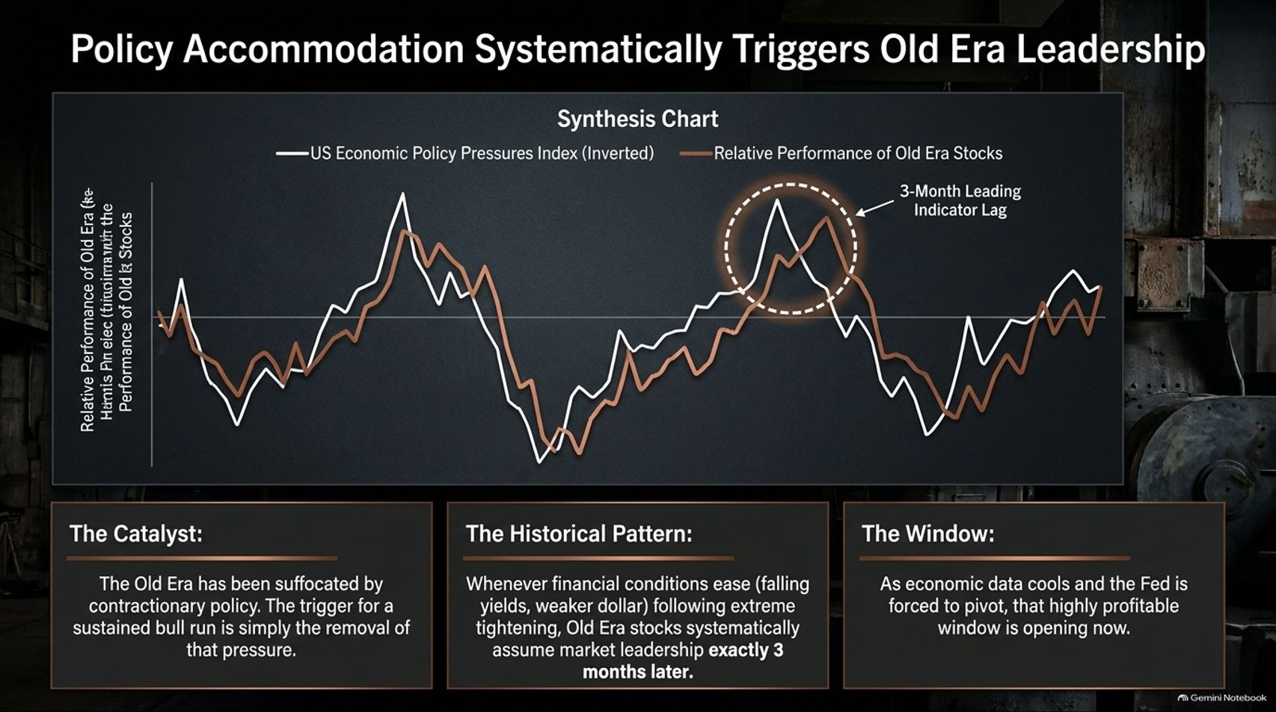
Notes:
Estimated Time: 4 – 5 minutes
Slide Focus: Synthesis chart showing economic policy pressures index (inverted) lagging Old Era relative performance by 3 months; why Fed rate cuts unlock Old Era leadership.
Slide Elements:
The Catalyst: The Old Era has been suffocated by contractionary policy. The trigger for a sustained bull run is simply the removal of that pressure.
The Historical Pattern: Whenever financial conditions ease (falling yields, weaker dollar) following extreme tightening, Old Era stocks systematically assume market leadership exactly 3 months later.
The Window: As economic data cools and the Fed is forced to pivot, that highly profitable window is opening now.
Speaker Notes: What is the ultimate catalyst that will ignite the Old Era economy? Policy accommodation.
Look at this synthesis chart comparing inverted economic policy pressures against the relative performance of Old Era stocks. Notice the uncanny historical pattern: whenever the Federal Reserve transitions from extreme monetary tightening to easing financial conditions—falling bond yields, a softer dollar, and lower rates—Old Era stocks systematically assume market leadership exactly three months later.
The Old Era hasn't been structurally broken; it has been suffocated by restrictive monetary policy. As economic data cools and the Fed is inevitably forced into a policy pivot, the window for a massive leadership rotation into traditional, cash-generating value assets is opening right now.

Slide 15
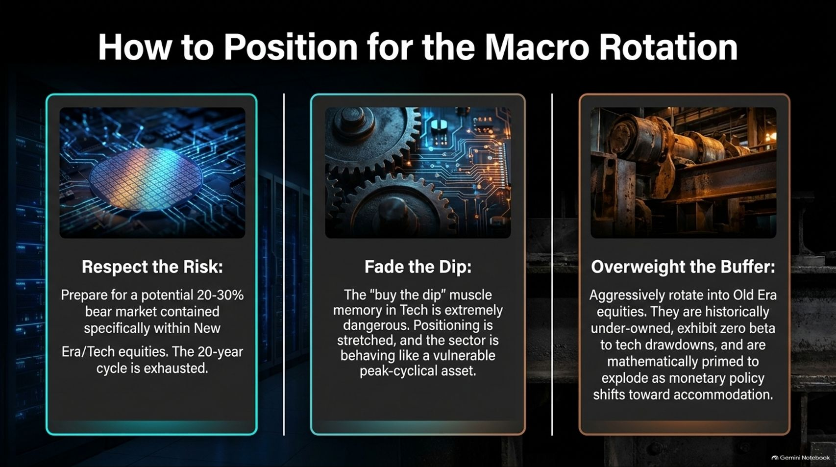
Notes:
Estimated Time: 4 – 5 minutes
Slide Focus: Actionable portfolio strategy: Respect the Risk (20-30% tech bear market potential), Fade the Dip (tech behaving like a cyclical asset), Overweight the Buffer (rotate into Old Era equities).
Slide Elements:
1. Respect the Risk: Prepare for a potential 20-30% bear market contained specifically within New Era/Tech equities. The 20-year cycle is exhausted.
2. Fade the Dip: The "buy the dip" muscle memory in Tech is extremely dangerous. Positioning is stretched, and the sector is behaving like a vulnerable peak-cyclical asset.
3. Overweight the Buffer: Aggressively rotate into Old Era equities. They are historically under-owned, exhibit zero beta to tech drawdowns, and are mathematically primed to explode as monetary policy shifts.
Speaker Notes: How should investors position their portfolios for this macro rotation? Jim Paulsen’s framework boils down to three essential rules:
Respect the Risk: Prepare yourself for a potential 20% to 30% correction or bear market contained specifically within New Era and mega-cap tech equities. After a historic 20-year run, leadership exhaustion is real.
Fade the Dip: The reflexive "buy the dip" muscle memory that has rewarded tech investors for a decade is now extremely dangerous. When a secular growth leader begins trading like a peak-cycle cyclical asset, buying every dip sets you up for severe value traps.
Overweight the Buffer: Aggressively rotate capital into Old Era equities. These traditional sectors are historically under-owned, exhibit zero beta correlation to tech drawdowns, and offer extraordinary upside leverage as monetary policy shifts from restriction to accommodation.

Slide 16
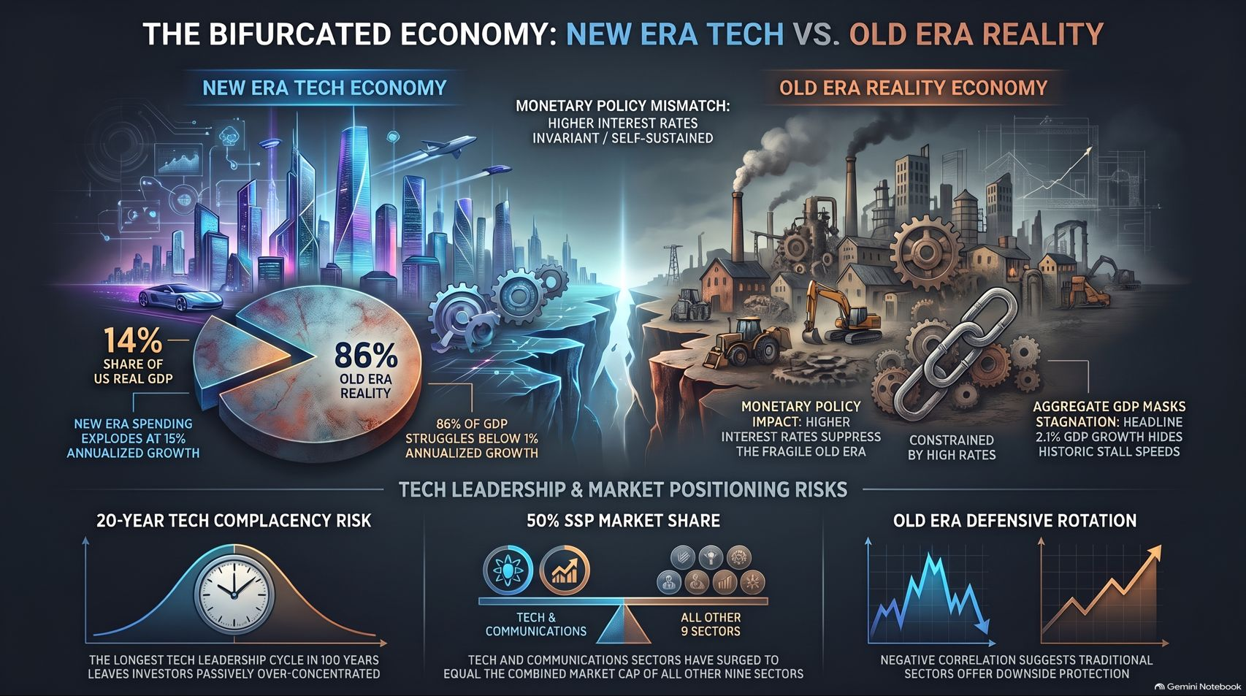
Notes:
Estimated Time: 3.5 – 4 minutes
Slide Focus: Comprehensive master summary infographic synthesizing the two-speed economy, monetary policy mismatch, tech complacency risks, and Old Era defensive rotation.
Slide Elements:
Visual Split: New Era Tech Economy (14% GDP, 15% growth, autonomous/invariant) vs. Old Era Reality Economy (86% GDP, 0.7% growth, rate-sensitive/constrained).
Key Takeaways: 20-year tech complacency risk, 50% S&P index concentration, and Old Era negative correlation offering downside protection.
Speaker Notes: This master summary infographic brings together the entire architecture of Jim Paulsen’s macroeconomic thesis.
On the left, we see the New Era Tech Economy: representing just 14% of real GDP but expanding at a blistering 15%, driven by autonomous innovation and insulated from traditional monetary tightening.
On the right sits the Old Era Reality Economy: representing 86% of GDP, starved by high interest rates, struggling below a 1% growth rate, yet forming the bedrock of American employment and traditional consumption.
The bridge between them is breaking. With tech representing nearly 50% of the S&P 500, passive complacency is at an all-time high. But as monetary policy forces a pivot, the negative correlation of Old Era equities provides both a defensive cushion and a generational rotation opportunity. Recognizing this bifurcated reality is the key to surviving and thriving in the next market cycle. Thank you very much, and I open the floor to your questions.

