Slide 1
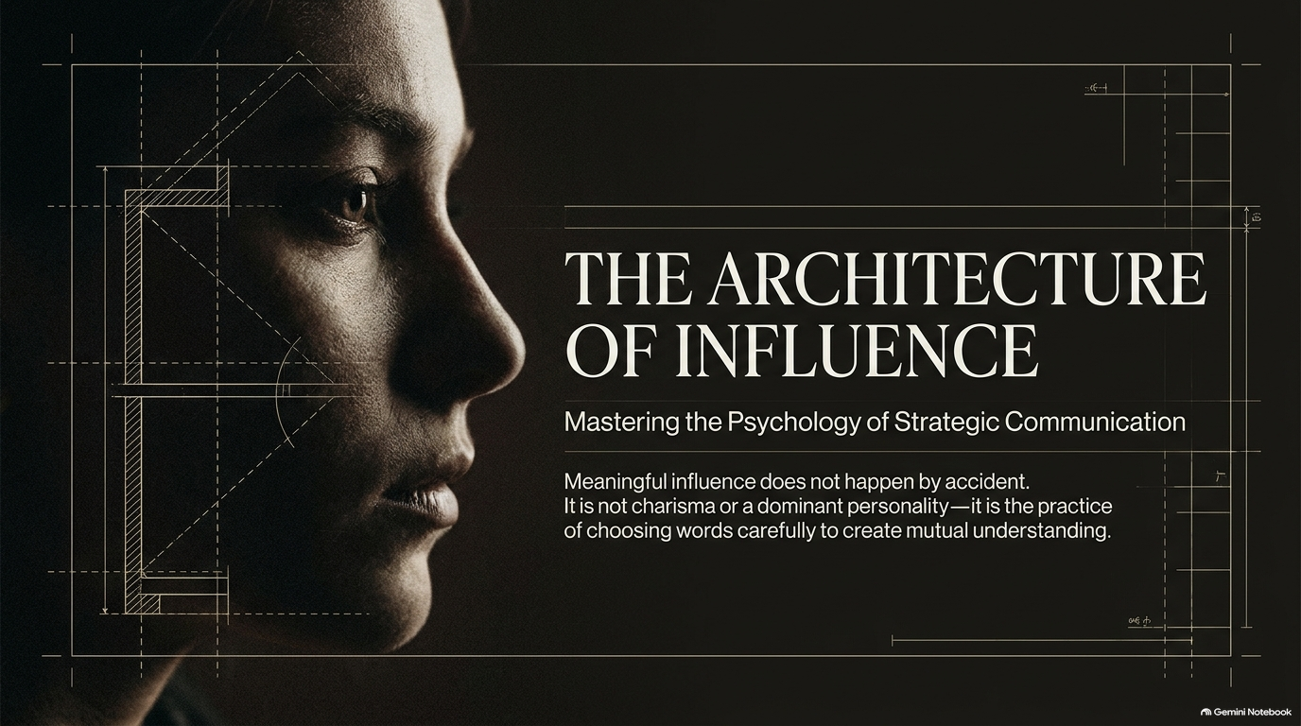
Notes:
Visual: A cinematic, high-contrast profile of a person's face set against a dark architectural blueprint grid background.
Suggested Speaking Time: 2–3 minutes
Speaker Notes:
"Welcome, everyone. Today, we are exploring a vital discipline: The Architecture of Influence: Mastering the Psychology of Strategic Communication.
Meaningful influence does not happen by accident. It is not a matter of raw charisma, loud personality traits, or dominant energy. True influence is the deliberate practice of choosing your words carefully to create mutual understanding. Throughout this masterclass, we are going to dismantle the myths of persuasion and look at communication through an architectural lens—where every word, pause, and strategic choice serves a specific purpose. Let’s dive in."
How to Speak Strategically: Master the Psychology of Powerful Influence | Full Audiobook
https://www.youtube.com/watch?v=zoreOhQ9Y-k

Slide 2
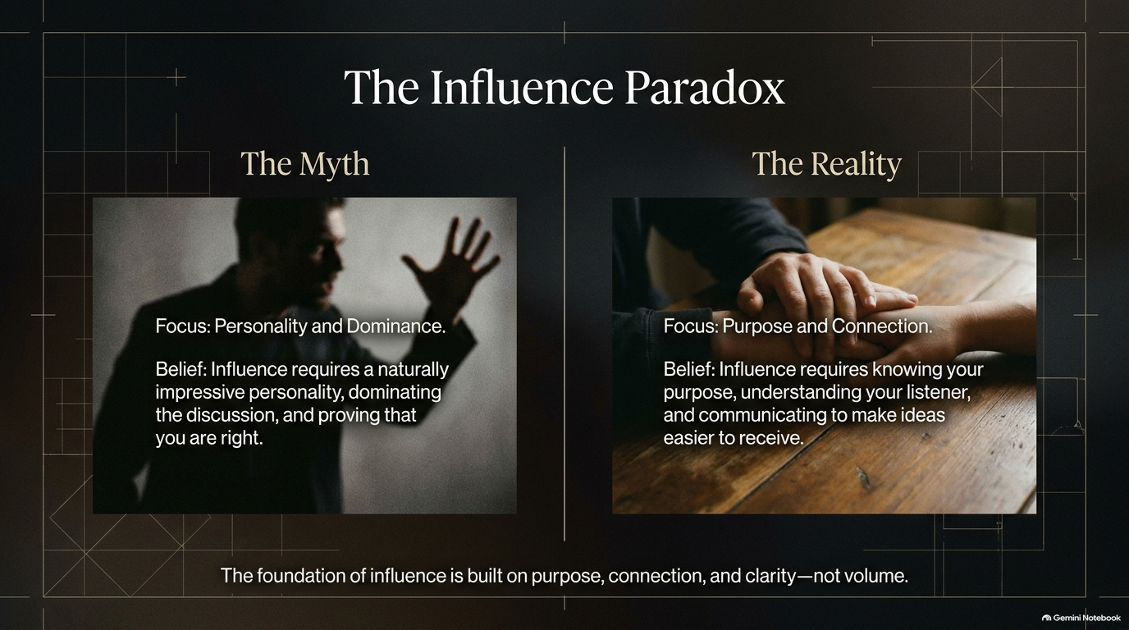
Notes:
Visual: A split-screen layout contrasting 'The Myth' (a shadowy, aggressive figure arguing with hand raised) with 'The Reality' (two hands meeting warmly over a wooden table).
Suggested Speaking Time: 3–4 minutes
Speaker Notes:
"Let's start by confronting what I call The Influence Paradox.
The Myth tells us that influence requires a naturally impressive personality, dominating the conversation, and fighting to prove that you are right. We see loud, aggressive talkers and mistake their volume for authority.
But The Reality is completely different. Real influence focuses entirely on purpose and connection. It requires knowing your core objective, deeply understanding your listener, and communicating in a way that makes your ideas easy to receive. As the core rule at the bottom reminds us: The foundation of influence is built on purpose, connection, and clarity—not volume. When you stop trying to dominate the room, you finally begin to lead it."

Slide 3
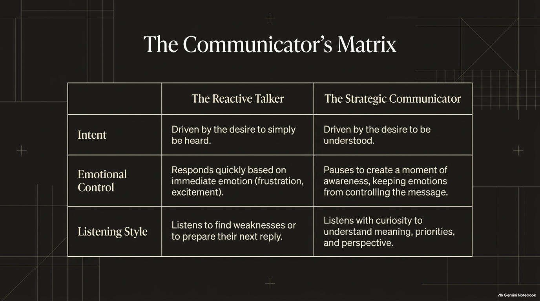
Notes:
Visual: A clear 3-row comparative table contrasting 'The Reactive Talker' against 'The Strategic Communicator' across Intent, Emotional Control, and Listening Style.
Suggested Speaking Time: 4–5 minutes
Speaker Notes:
"To understand where your communication breaks down or succeeds, look at The Communicator's Matrix. This matrix contrasts the amateur reactive talker with the master strategic communicator across three dimensions:
Intent: The reactive talker is driven simply by the desire to be heard—to get their thoughts out regardless of the room. The strategic communicator is driven by the desire to be understood.
Emotional Control: The reactive talker responds instantly based on immediate emotion, frustration, or excitement. The strategic communicator pauses to create a moment of awareness, preventing emotions from dictating the message.
Listening Style: The reactive talker listens only to find weaknesses in an argument or to prep their next snappy reply. The strategic communicator listens with genuine curiosity to uncover meaning, underlying priorities, and different perspectives.
Shift your internal setting from reactive to strategic."

Slide 4
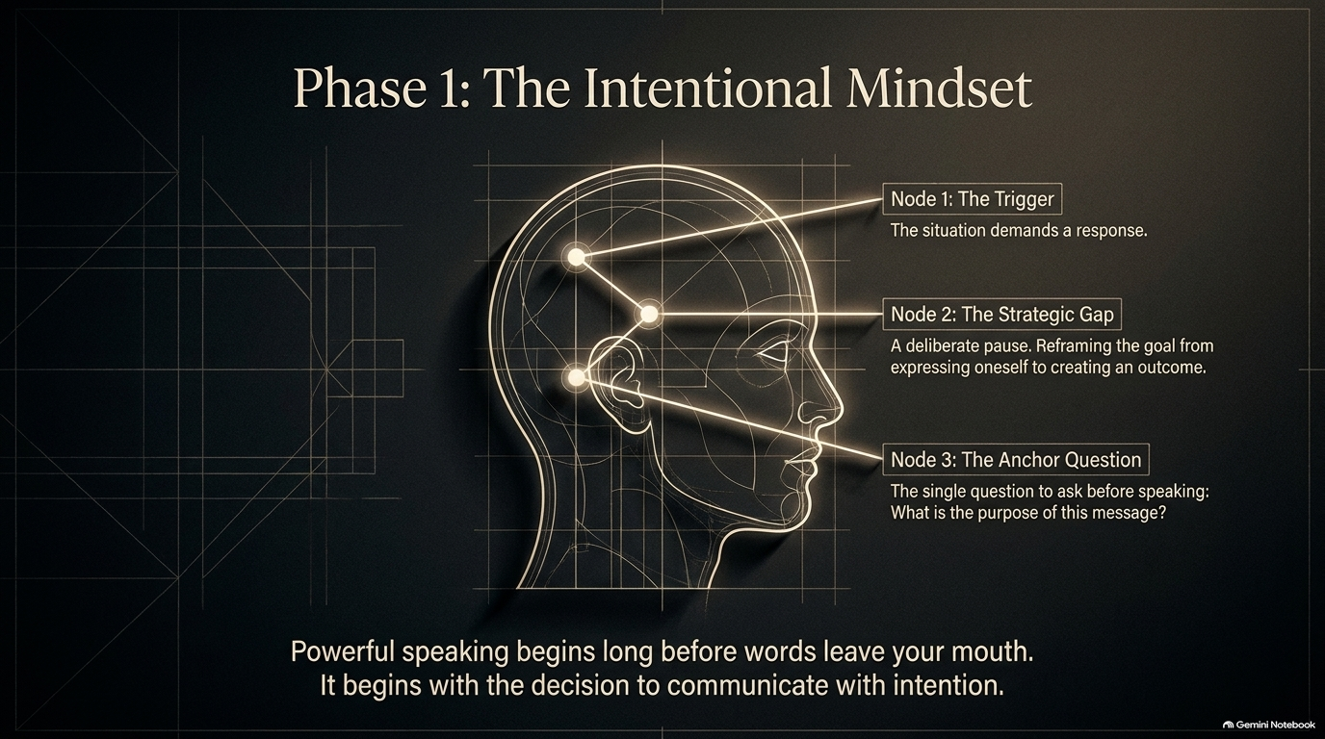
Notes:
Visual: A detailed technical line diagram of a human head featuring three glowing anatomical nodes (Node 1: The Trigger, Node 2: The Strategic Gap, Node 3: The Anchor Question).
Suggested Speaking Time: 4–5 minutes
Speaker Notes:
"We enter now into Phase 1: The Intentional Mindset. Powerful speaking begins long before words ever leave your mouth; it begins with the decision to communicate with intention.
Look at the three neurological nodes on this slide:
Node 1: The Trigger. An external situation or difficult question demands a response from you.
Node 2: The Strategic Gap. Instead of blurting out an immediate reaction, you insert a deliberate pause. You reframe your goal from merely expressing yourself to creating a specific, productive outcome.
Node 3: The Anchor Question. You ask yourself one vital question before speaking: 'What is the purpose of this message?'
If your message doesn't have a defined purpose, silence is always more powerful."

Slide 5
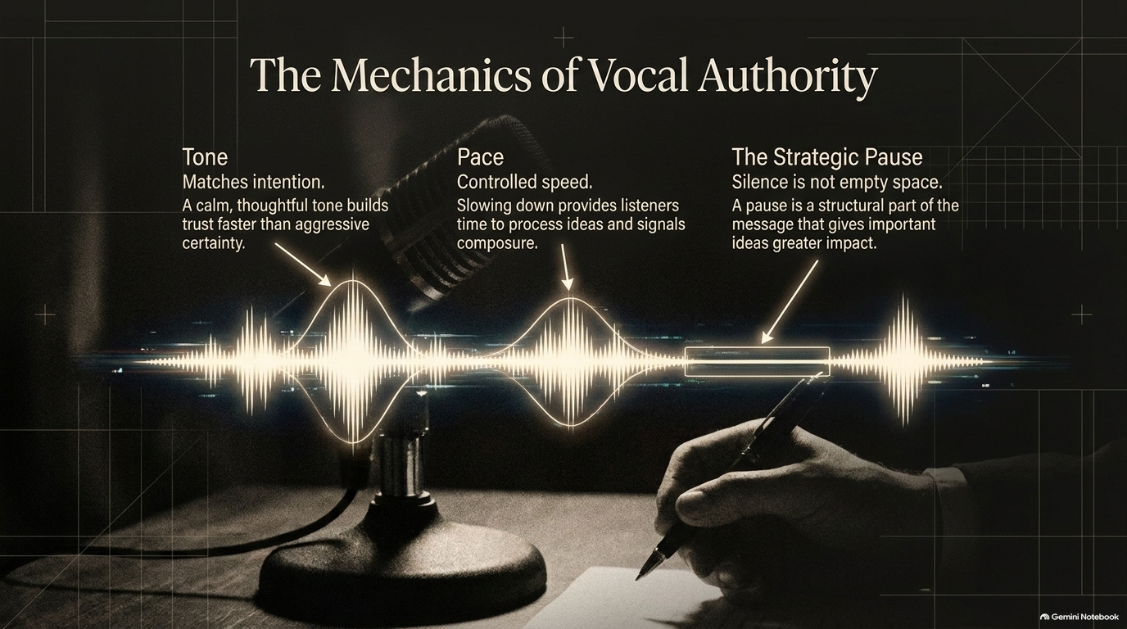
Notes:
Visual: A dynamic audio waveform graphic intersecting with a microphone and a handwritten notepad, annotating Tone, Pace, and The Strategic Pause.
Suggested Speaking Time: 4–5 minutes
Speaker Notes:
"Next, let's examine The Mechanics of Vocal Authority. How you deliver your message is just as important as the words you select. We focus on three critical mechanics:
Tone: Your tone must match your intention. A calm, thoughtful tone builds trust infinitely faster than aggressive certainty.
Pace: Maintain controlled speed. Slowing down provides your listeners the necessary time to process complex ideas while signaling your own internal composure.
The Strategic Pause: Silence is never empty space. A well-placed pause is an active structural part of your message that gives critical ideas maximum emotional impact.
Master your tone, control your pace, and weaponize strategic silence."

Slide 6
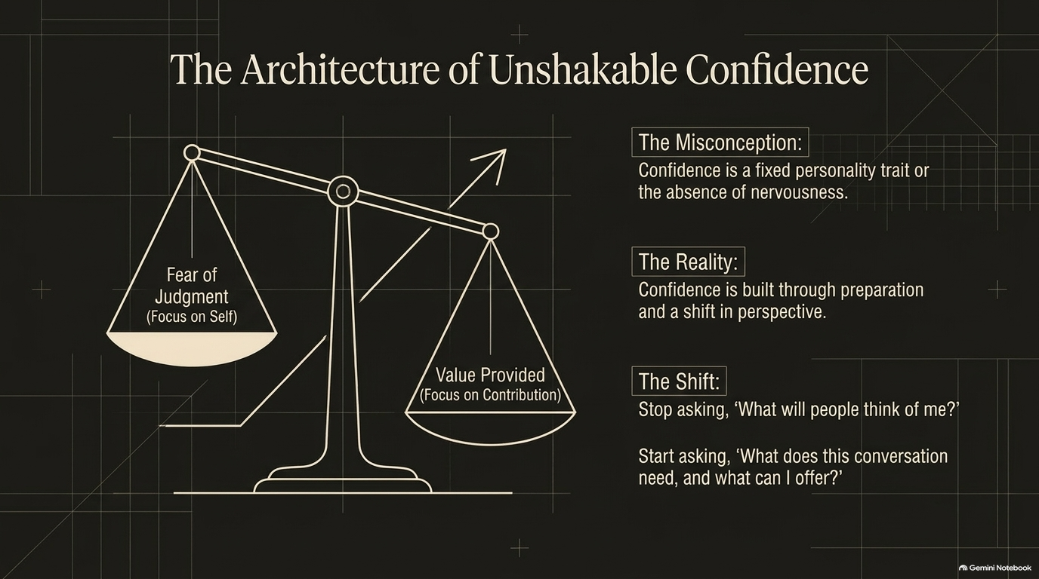
Notes:
Visual: A classical balance scale weighing 'Fear of Judgment (Focus on Self)' against 'Value Provided (Focus on Contribution)'.
Suggested Speaking Time: 4–5 minutes
Speaker Notes:
"Confidence is one of the most misunderstood concepts in leadership. The Misconception is that confidence is a fixed personality trait or the total absence of nervousness.
The Reality is that confidence is built through rigorous preparation and a fundamental shift in mental perspective. Look at our scale: when you focus on the Fear of Judgment, your anxiety skyrockets because your focus is entirely trapped on self. But when you shift the weight to Value Provided, your focus moves outward to contribution.
The daily mental shift is simple: Stop asking, 'What will people think of me?' Instead, start asking, 'What does this conversation need, and what value can I offer?' That shift instantly dissolves stage fright."

Slide 7
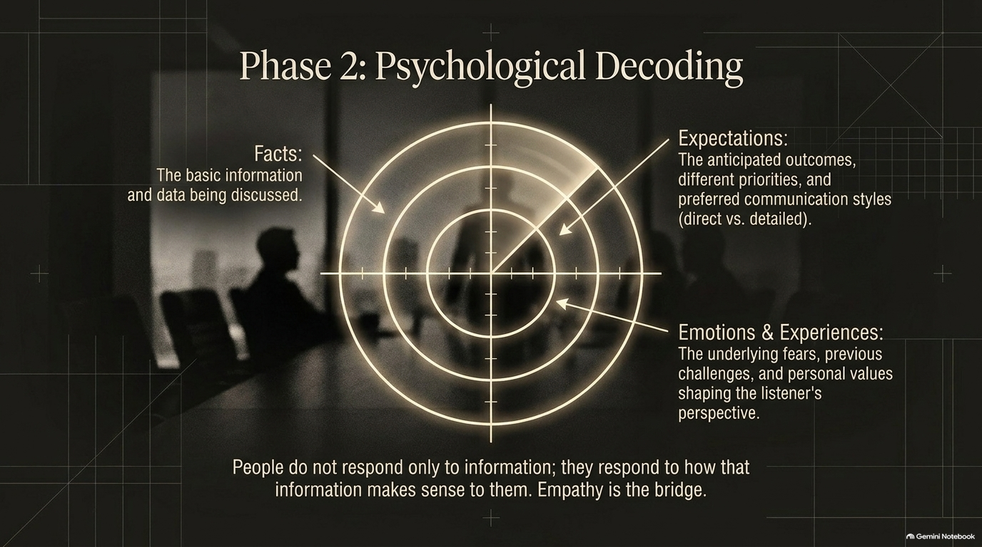
Notes:
Visual: A high-tech concentric radar screen targeting three layers in a corporate boardroom setting: Facts, Expectations, and Emotions & Experiences.
Suggested Speaking Time: 4–5 minutes
Speaker Notes:
"Moving to Phase 2: Psychological Decoding. People never respond purely to raw information; they respond to how that information makes sense within their own internal world. Empathy is the bridge.
Think of this radar screen as three layers of human communication:
Facts: The basic surface-level data and information being discussed.
Expectations: The anticipated outcomes, differing priorities, and preferred communication styles (direct vs. detailed) of your listener.
Emotions & Experiences: The underlying fears, past professional trauma, and personal values shaping their perspective.
If you only address the facts while ignoring emotions and expectations, your message will bounce off your listener. Decode the whole person."

Slide 8
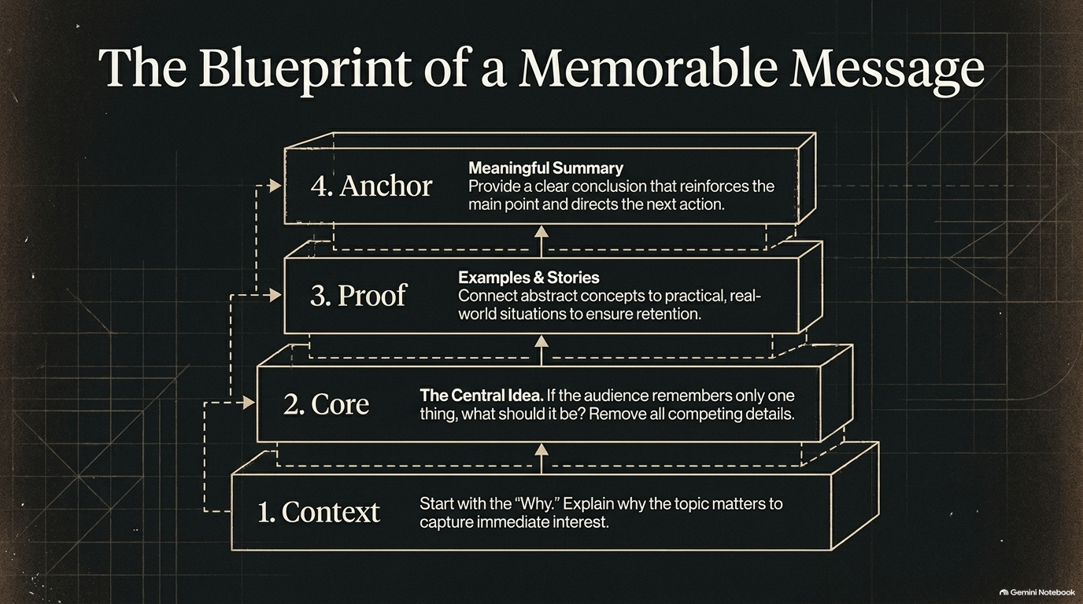
Notes:
Visual: A 4-tier architectural block pyramid outlining Context, Core, Proof, and Anchor, with dotted interconnecting feedback loops.
Suggested Speaking Time: 4–5 minutes
Speaker Notes:
"When you need to deliver a critical update, pitch an idea, or structure a presentation, use The Blueprint of a Memorable Message:
1. Context: Always start with the 'Why.' Explain why the topic matters immediately to capture attention.
2. Core: Deliver your Central Idea. If your audience remembers only one thing from your meeting, what should it be? Strip away competing details.
3. Proof: Provide examples and stories. Connect abstract concepts to practical, real-world situations to ensure high retention.
4. Anchor: Provide a Meaningful Summary. Conclude with a clear wrap-up that reinforces your main point and directs the next action.
Structure builds retention; clarity drives action."

Slide 9
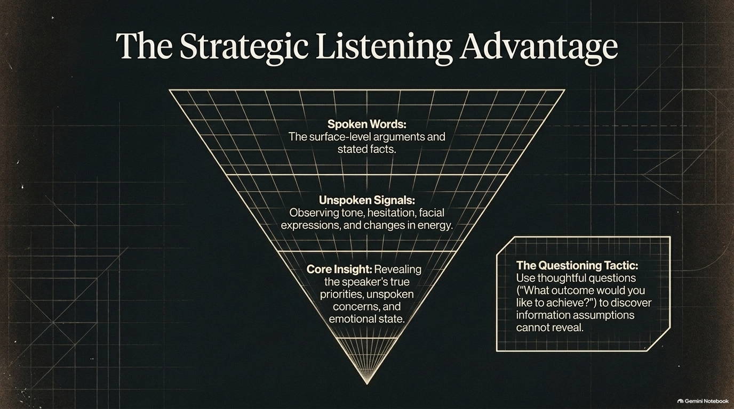
Notes:
Visual: An inverted pyramid diagram breaking down listening into Spoken Words, Unspoken Signals, and Core Insight, accompanied by a callout box for 'The Questioning Tactic'.
Suggested Speaking Time: 4–5 minutes
Speaker Notes:
"Listening is not passive hearing; it is a tactical advantage. Most people listen at the surface level, but strategic communicators dig deep into the inverted pyramid:
Spoken Words: The surface-level arguments and stated facts.
Unspoken Signals: Observing tone shifts, hesitation, facial tension, and changes in vocal energy.
Core Insight: Revealing the speaker's true hidden priorities, unspoken concerns, and underlying emotional state.
The Questioning Tactic: Use thoughtful, open-ended questions like 'What outcome would you like to achieve?' to uncover vital information that assumptions can never reveal. Listen to understand what isn't being said."

Slide 10
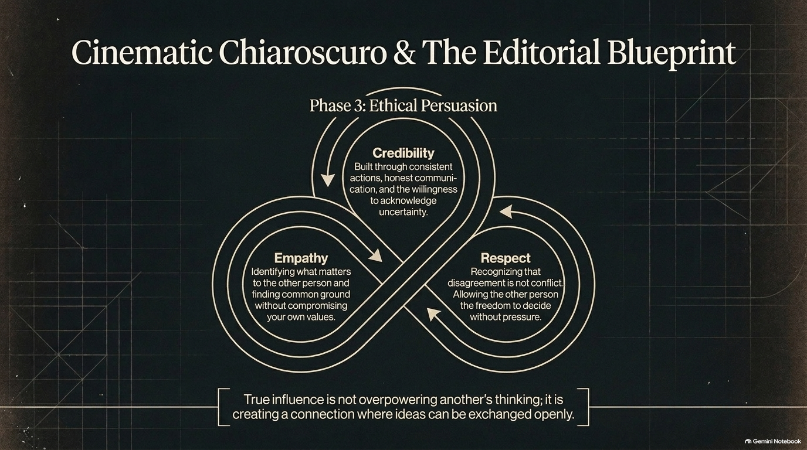
Notes:
Visual: A continuous interlaced infinity-loop Venn diagram linking Credibility, Empathy, and Respect, framed by cinematic chiaroscuro lighting.
Suggested Speaking Time: 4–5 minutes
Speaker Notes:
"We arrive at Phase 3: Ethical Persuasion. True influence is never about overpowering another person's thinking; it is about creating a connection where ideas can be exchanged openly.
Look at the three interconnected pillars of persuasion:
Credibility: Built through consistent actions, honest communication, and the humility to acknowledge uncertainty.
Empathy: Identifying what genuinely matters to the other person and finding common ground without compromising your core values.
Respect: Recognizing that professional disagreement is not personal conflict. Allowing the other person the absolute freedom to decide without aggressive pressure.
Influence built on manipulation collapses; influence built on credibility, empathy, and respect lasts."

Slide 11
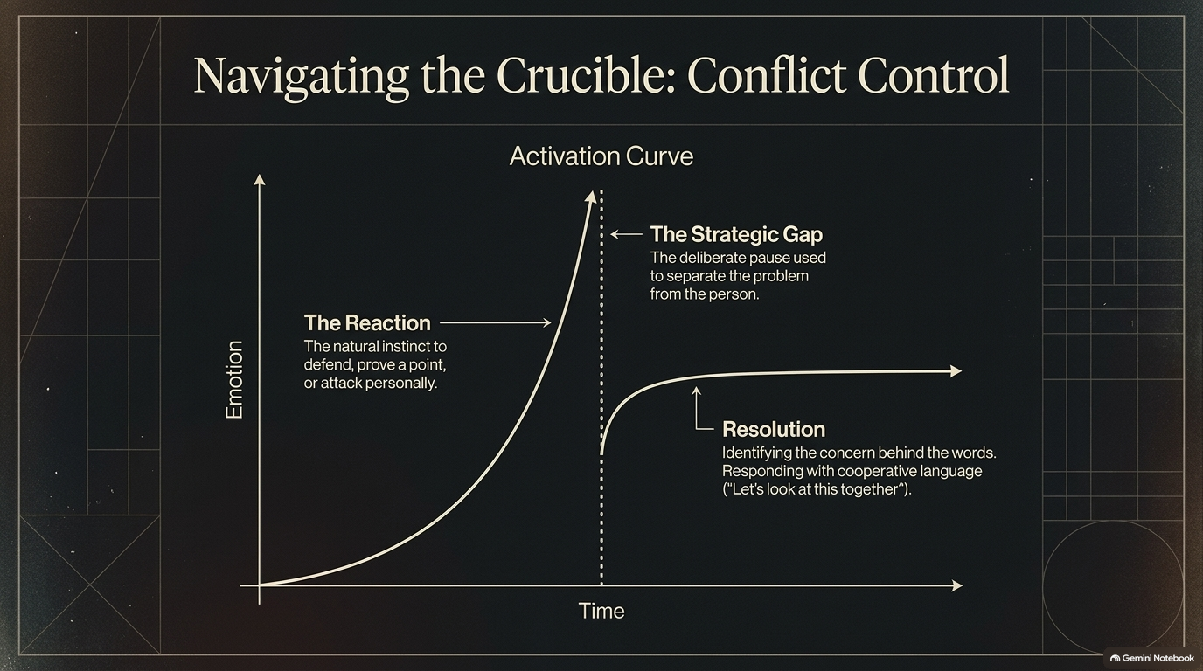
Notes:
Visual: An activation curve graph plotting Emotion against Time, highlighting 'The Reaction' curve, 'The Strategic Gap' vertical divider, and the post-pause 'Resolution' curve.
Suggested Speaking Time: 4–5 minutes
Speaker Notes:
"Conflict is the ultimate crucible for communication. When a tense situation arises, notice what happens on our Activation Curve:
Left unchecked, human emotion follows a steep upward trajectory—The Reaction—where our natural biological instinct is to defend ourselves, prove a point, or attack personally. If you engage on that upward curve, conflict explodes.
The secret to conflict control is The Strategic Gap—the deliberate, calm pause used to separate the problem from the person. By inserting that pause, you short-circuit the emotional spike.
Resolution: Once calmness is restored, you identify the real concern hidden behind the heated words and respond with cooperative language, such as: 'Let's look at this together.'"

Slide 12
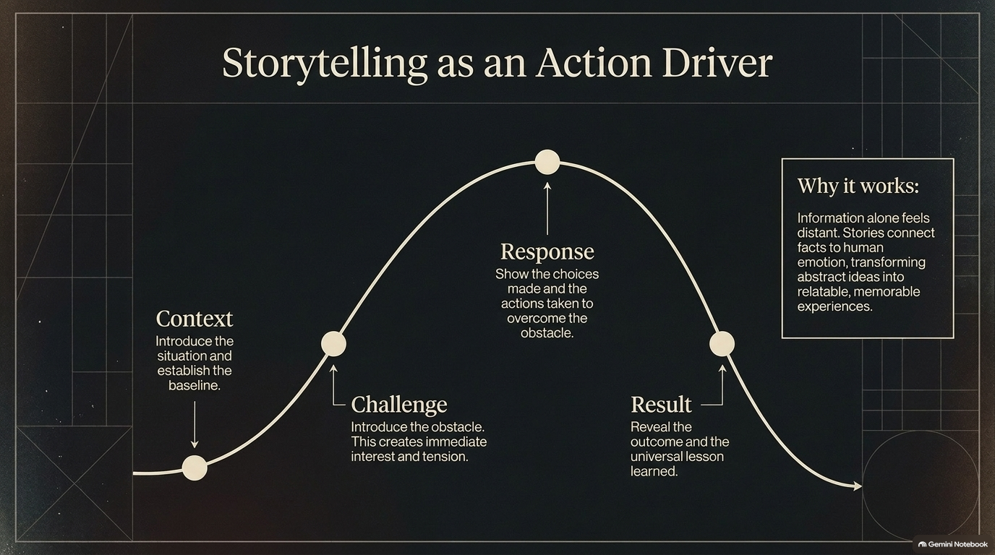
Notes:
Visual: A classic bell-curve narrative arc tracking Context, Challenge, Response, and Result, supported by a callout explaining why storytelling drives action.
Suggested Speaking Time: 4–5 minutes
Speaker Notes:
"Facts and figures inform, but stories move people to act. Let's examine Storytelling as an Action Driver across our narrative arc:
Context: Introduce the situation and establish the baseline reality.
Challenge: Introduce the core obstacle or friction point. This creates immediate interest and high tension.
Response: Walk through the specific choices made and actions taken to overcome that obstacle.
Result: Reveal the final outcome and the universal lesson learned.
Why does this structure work so powerfully? Because raw information alone feels distant and cold. Stories bridge data to human emotion, transforming abstract business ideas into relatable, memorable experiences."

Slide 13
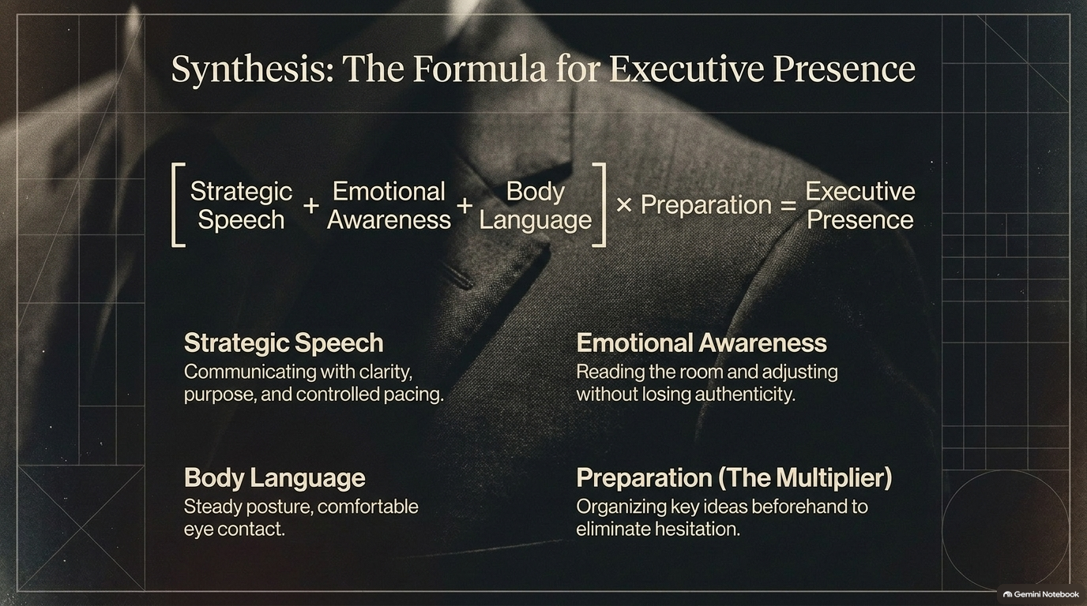
Notes:
Visual: An executive formula graphic: [Strategic Speech + Emotional Awareness + Body Language] × Preparation = Executive Presence, broken down into four foundational quadrants.
Suggested Speaking Time: 4–5 minutes
Speaker Notes:
"Let's synthesize our framework into The Formula for Executive Presence:
[Strategic Speech + Emotional Awareness + Body Language] × Preparation = Executive Presence.
Strategic Speech: Communicating with absolute clarity, clear purpose, and controlled pacing.
Emotional Awareness: Reading the emotional temperature of the room and adjusting dynamically without losing your authentic voice.
Body Language: Maintaining a steady, grounded posture and comfortable, confident eye contact.
Preparation (The Multiplier): Organizing your core ideas beforehand to completely eliminate hesitation. Preparation acts as the multiplier that activates all other elements."

Slide 14
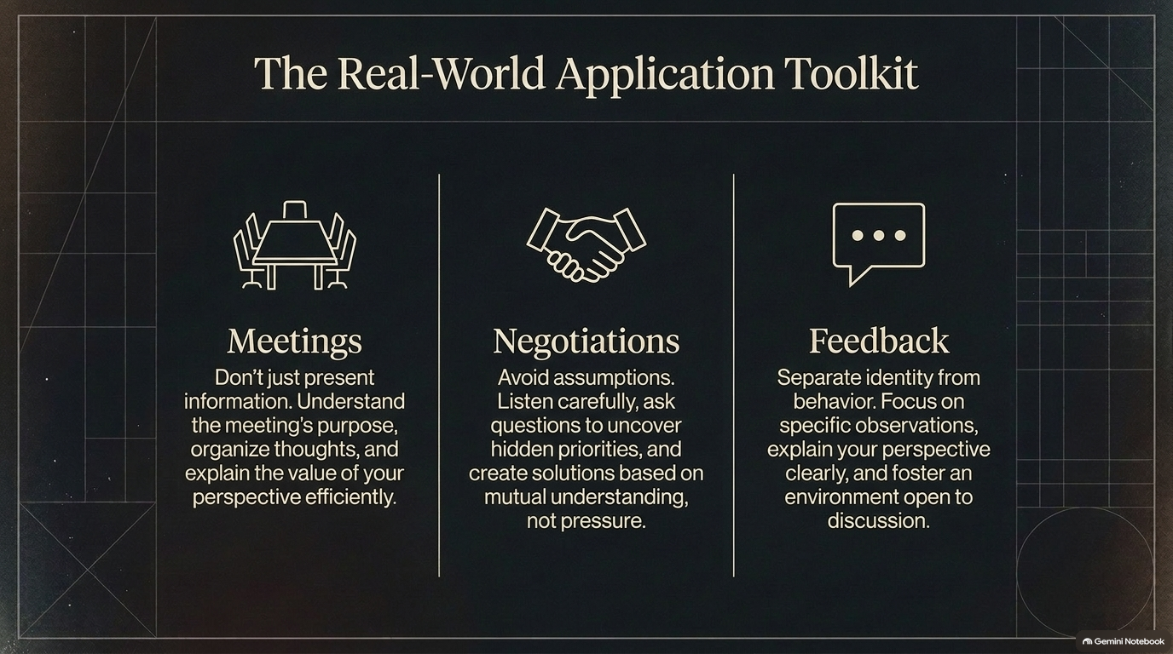
Notes:
Visual: A 3-column operational toolkit layout detailing practical strategies for Meetings, Negotiations, and Feedback.
Suggested Speaking Time: 4–5 minutes
Speaker Notes:
"Theory is only valuable when applied. Let's look at The Real-World Application Toolkit:
Meetings: Never walk in just to present raw information. Understand the meeting's true purpose, organize your thoughts in advance, and explain the value of your perspective efficiently.
Negotiations: Avoid assumptions. Listen intently, ask targeted questions to uncover hidden priorities, and build solutions based on mutual understanding rather than pressure.
Feedback: Always separate identity from behavior. Focus exclusively on specific, objective observations, explain your perspective clearly, and foster an environment open to two-way discussion.
Use these tools daily to anchor your communication."

Slide 15
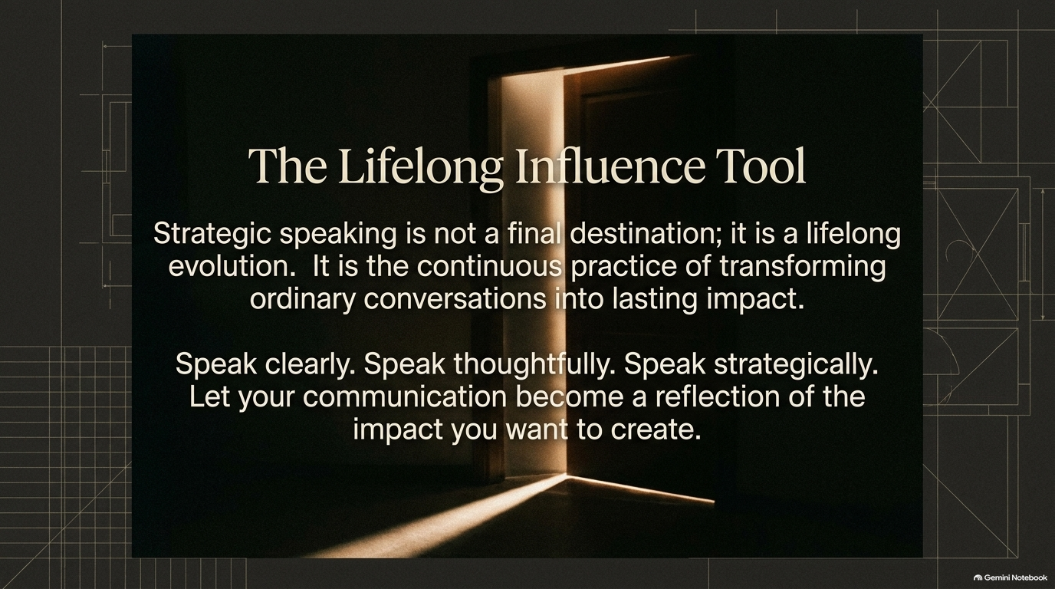
Notes:
Visual: A dramatic cinematic image of a heavy wooden door cracked open, letting a bright stream of light pour into a dark room.
Suggested Speaking Time: 2–3 minutes
Speaker Notes:
"As we approach our conclusion, remember this: Strategic speaking is not a final destination; it is a lifelong evolution.
Influence is the continuous practice of transforming ordinary, everyday conversations into lasting, positive impact.
Speak clearly. Speak thoughtfully. Speak strategically. Let your communication become a true reflection of the leadership impact you want to create in your organization and your life. The door to powerful influence is wide open—it is up to you to walk through it."

Slide 16
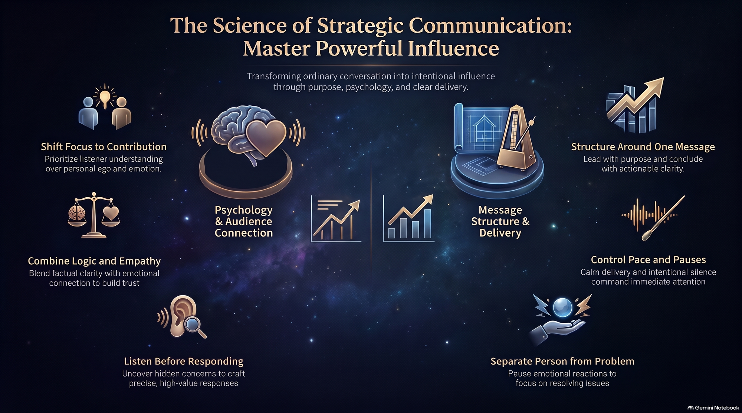
Notes:
Visual: A comprehensive summary dashboard featuring 6 illustrated thematic pillars covering psychology, message structure, listening, and emotional control.
Suggested Speaking Time: 4–6 minutes
Speaker Notes:
"To synthesize our entire masterclass, let's review our Summary Dashboard for Powerful Influence:
Shift Focus to Contribution: Prioritize listener understanding over personal ego and emotional reactivity.
Combine Logic and Empathy: Blend factual clarity with genuine emotional connection to build unshakeable trust.
Listen Before Responding: Uncover hidden concerns so you can craft precise, high-value responses.
Structure Around One Message: Lead with purpose and conclude with actionable clarity.
Control Pace and Pauses: Use calm delivery and intentional silence to command immediate room attention.
Separate Person from Problem: Pause emotional triggers to focus squarely on resolving structural issues.
Master these architectural principles, and you will transform your communication permanently. Thank you."

