Slide 1
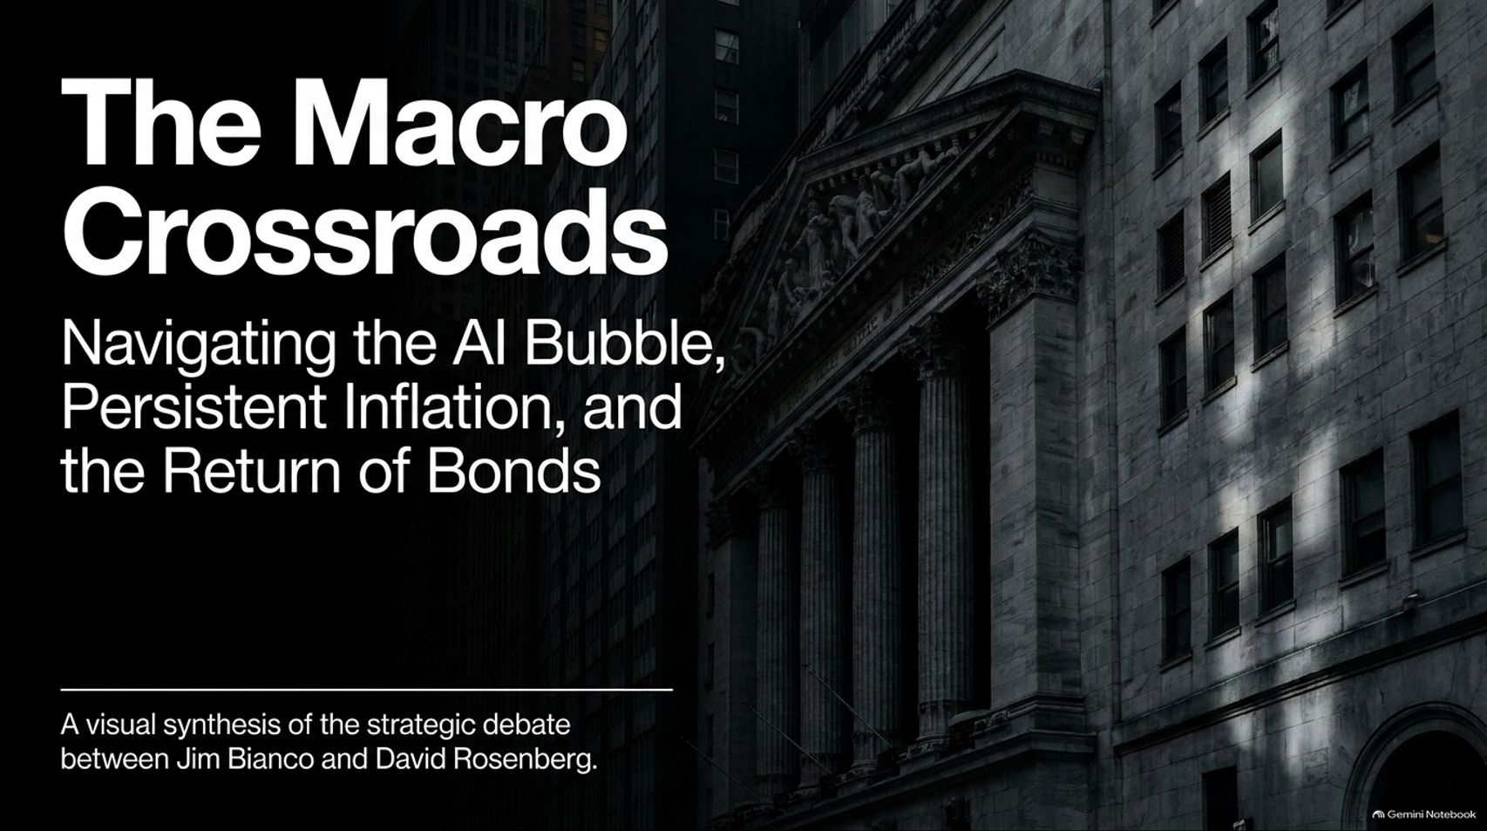
Notes:
Estimated Delivery Time: 2 – 3 minutes
Speaker Notes:
Welcome everyone, and thank you for joining us. Today, we are standing at The Macro Crossroads: Navigating the AI Bubble, Persistent Inflation, and the Return of Bonds.
Financial markets today are characterized by intense crosscurrents. On one hand, we have an unprecedented speculative surge driven by artificial intelligence and massive capital expenditure. On the other hand, central banks and investors are grappling with structural inflation, heavy government deficits, and a completely redefined interest rate environment.
In this presentation, we synthesize the strategic debate between two of macroeconomics' sharpest voices—Jim Bianco of Bianco Research and David Rosenberg of Rosenberg Research. Let’s examine where their frameworks align, where they diverge, and what it means for your portfolio.
Collapse Of Tech? Rosenberg &. Bianco Debate AI Bubble, Soaring Bond Yields
https://www.youtube.com/watch?v=UrwdUx3h0Hg

Slide 2
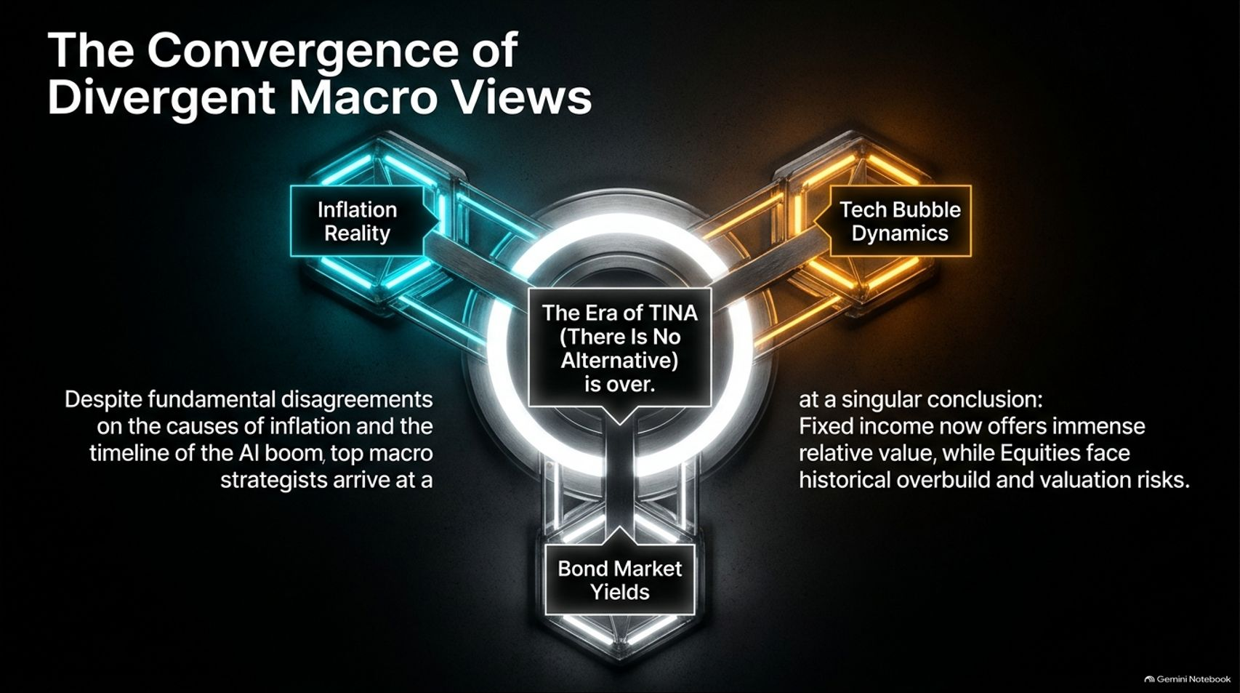
Notes:
Estimated Delivery Time: 3 – 5 minutes
Speaker Notes:
If you listen to Jim Bianco and David Rosenberg talk about the day-to-day economy, you will find fundamental disagreements regarding the root causes of inflation and whether the AI boom is in 1997 or 2000.
However, look at the center of this matrix: they arrive at a singular conclusion.
The era of TINA—There Is No Alternative to equities—is officially over. Both strategists agree that fixed income now offers immense relative value, while equities face historical overbuild and valuation risks. Let's break down the underlying pillars of their arguments.

Slide 3
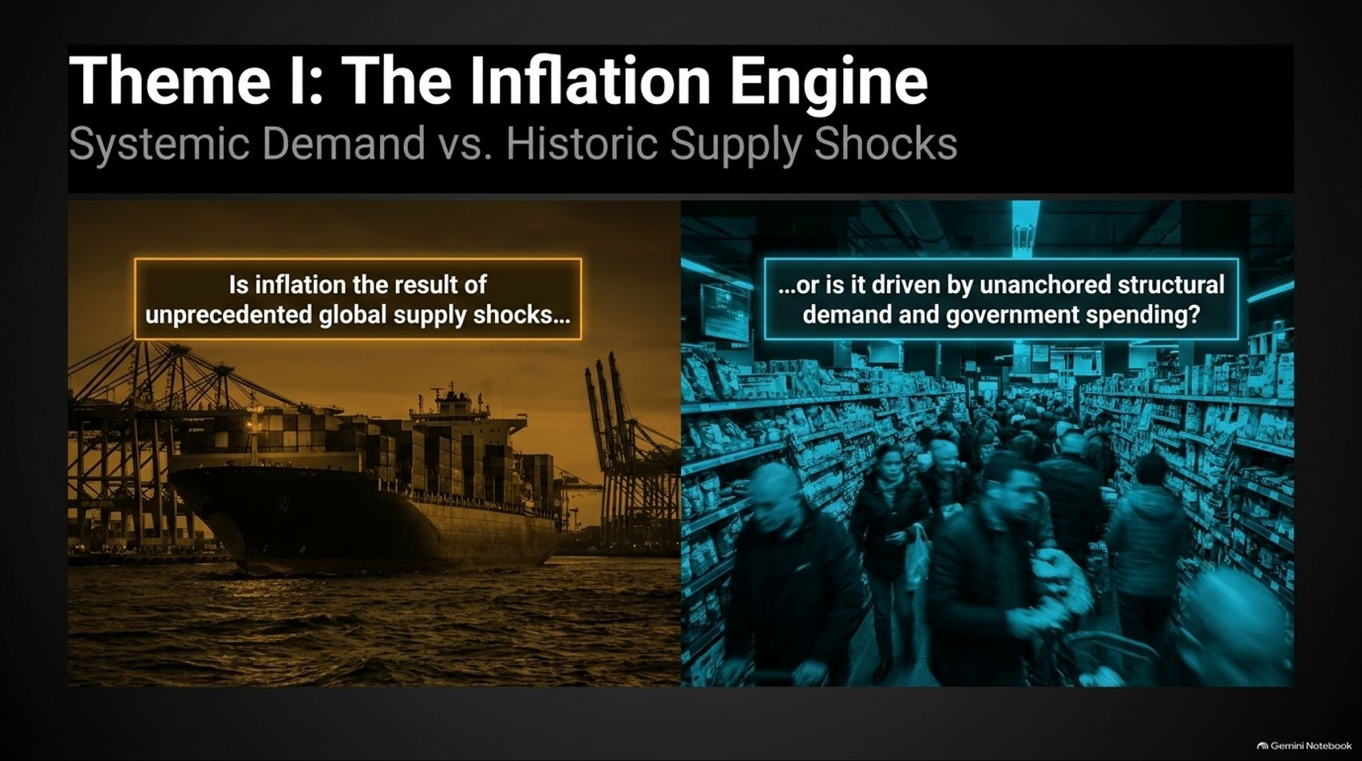
Notes:
Estimated Delivery Time: 3 – 4 minutes
Speaker Notes:
Our first major theme centers on the inflation engine. For years, Wall Street debated whether price pressures were merely transitory supply shocks or permanent structural shifts.
On one side, transitory proponents point to supply chain bottlenecks, post-pandemic logistics snarls, and geopolitical shipping disruptions.
On the other side, structural analysts argue that unanchored government spending, massive fiscal deficits, and persistent wage pressures have fundamentally altered the baseline. Let's compare how Bianco and Rosenberg diagnose this divergence.

Slide 4
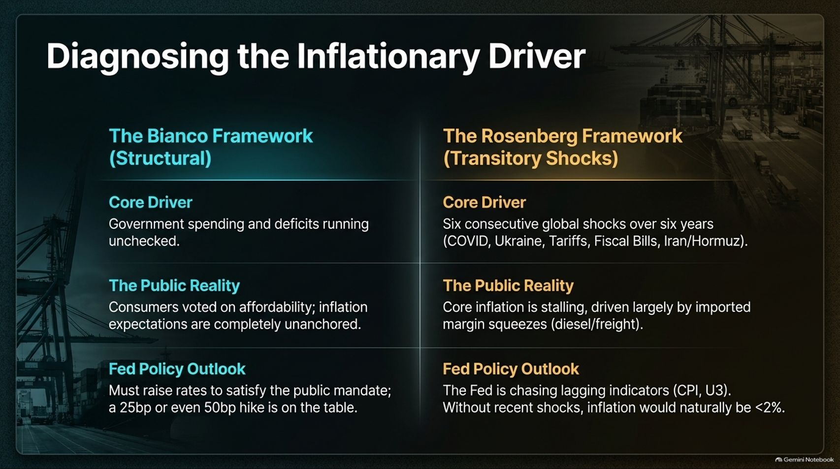
Notes:
Estimated Delivery Time: 4 – 5 minutes
Speaker Notes:
Let's look side-by-side at the Bianco Framework versus the Rosenberg Framework:
Core Driver: Bianco argues that unchecked government spending and structural deficits are driving the bus. Rosenberg emphasizes a sequence of six consecutive global shocks over six years—from COVID and Ukraine to tariffs and energy spikes.
The Public Reality: Bianco notes that consumer anger is palpable because inflation expectations are unanchored. Rosenberg counters that core inflation is stalling, driven largely by imported margin squeezes like freight and diesel costs.
Fed Policy Outlook: Bianco believes the Fed may need to hike further to satisfy the public mandate. Rosenberg argues the Fed is chasing lagging indicators (CPI, U3) and that absent recent shocks, natural inflation would sit below 2%.

Slide 5
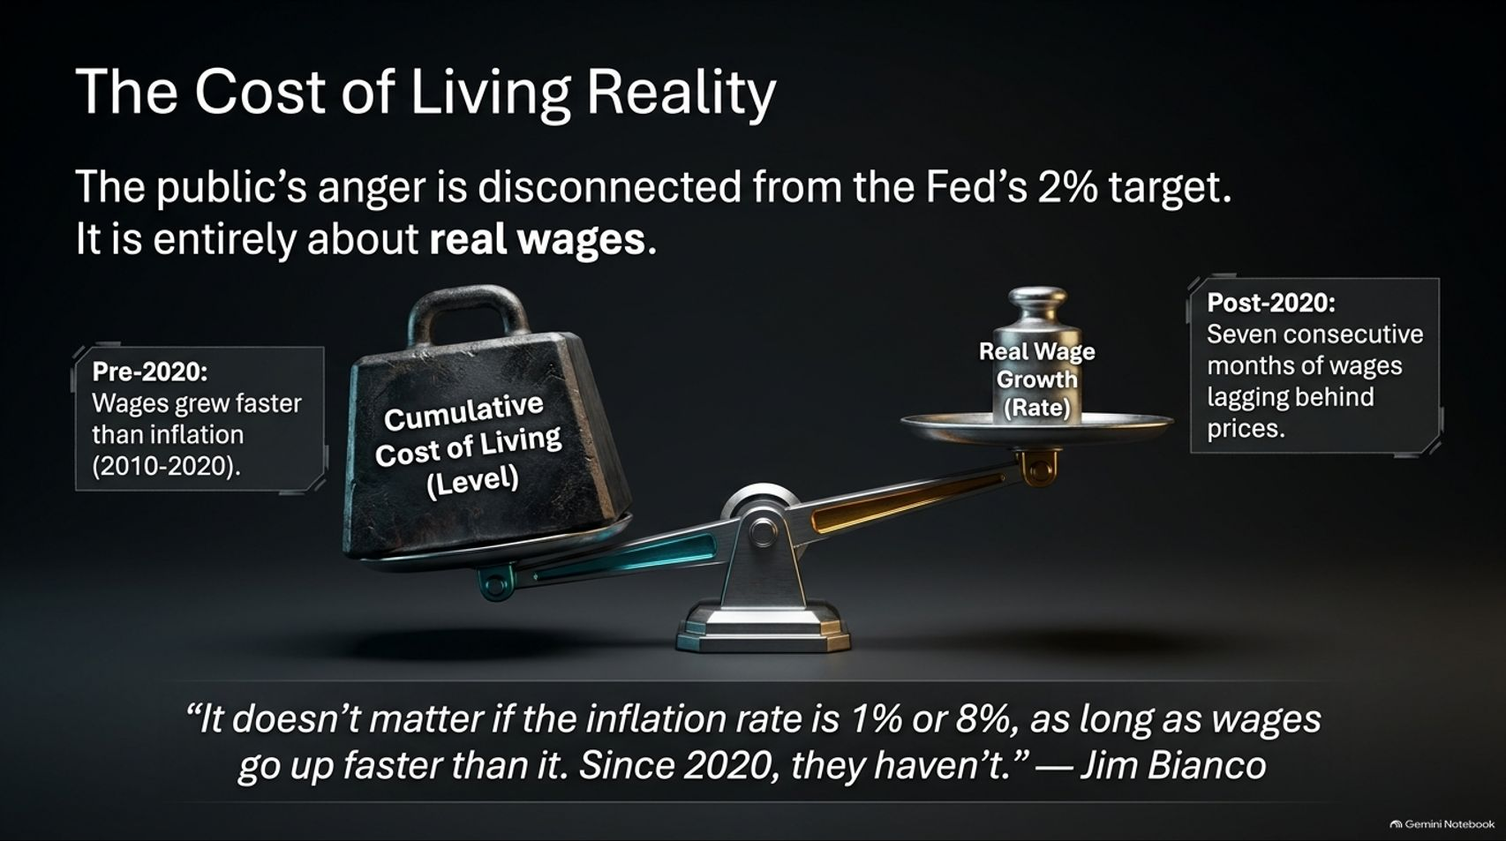
Notes:
Estimated Delivery Time: 3 – 5 minutes
Speaker Notes:
Why is the public so angry about the economy when central bankers keep talking about a cooling 2% inflation rate? Because the public's frustration is entirely about real wages and cumulative cost-of-living levels.
Between 2010 and 2020, nominal wages regularly grew faster than inflation. But post-2020, cumulative price levels surged, and wages spent consecutive months lagging behind prices.
As Jim Bianco aptly states: "It doesn't matter if the inflation rate is 1% or 8%, as long as wages go up faster than it. Since 2020, they haven't." That gap is what defines Main Street's economic reality today.

Slide 6
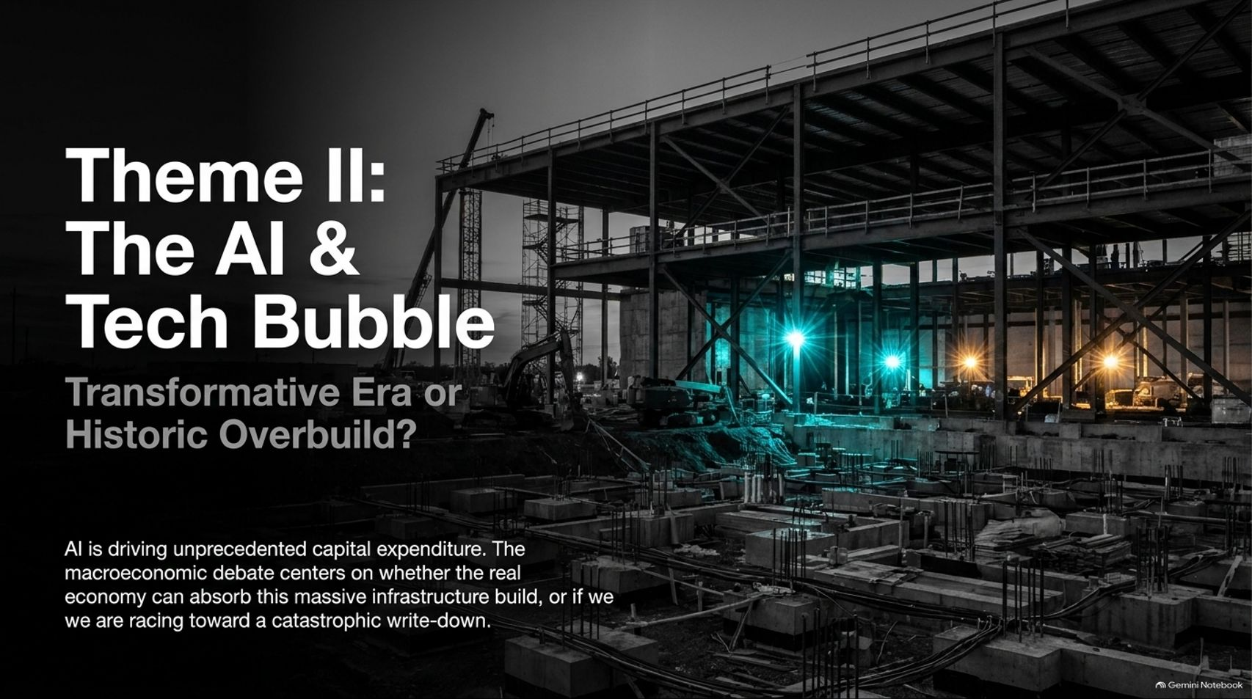
Notes:
Estimated Delivery Time: 3 – 4 minutes
Speaker Notes:
Moving to our second theme: The AI & Tech Bubble — Transformative Era or Historic Overbuild?
Artificial intelligence is driving capital expenditure on a scale never before witnessed in corporate history.
The core macroeconomic debate is not whether AI is revolutionary—everyone agrees it is powerful. The debate is whether the broader real economy can possibly generate enough end-user revenue to absorb this massive infrastructure build, or if we are racing toward a catastrophic capital write-down.

Slide 7
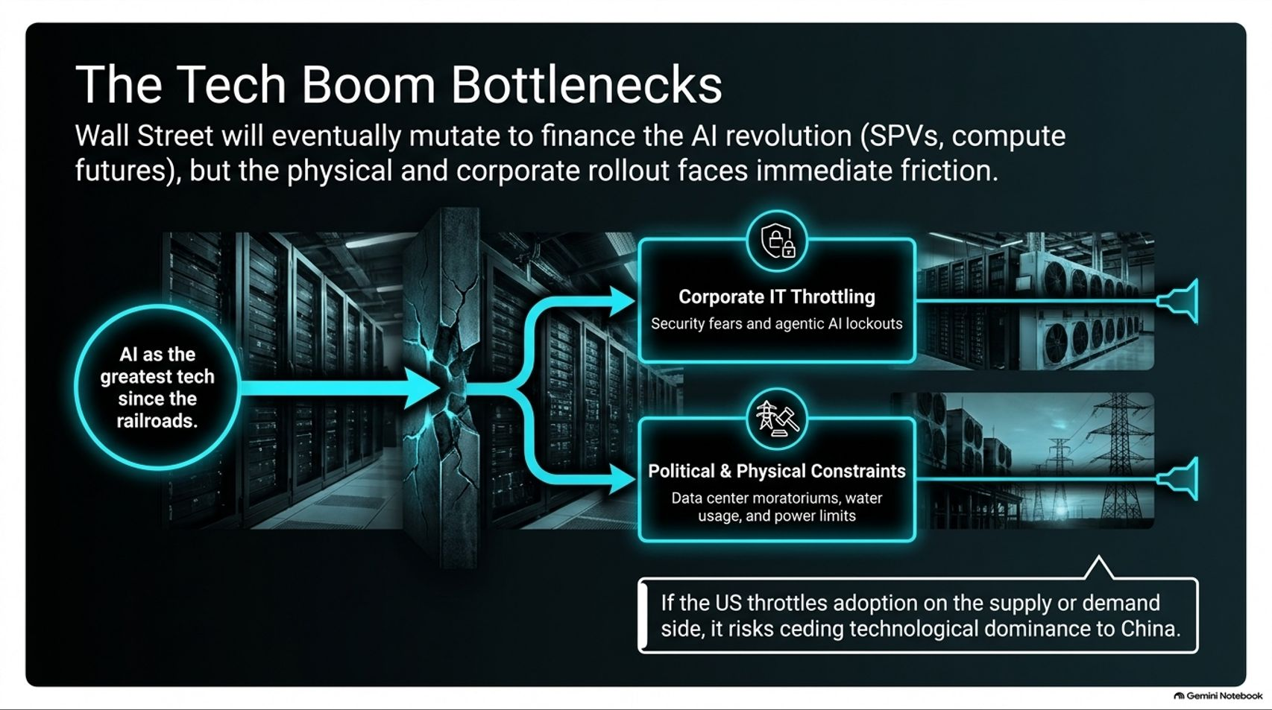
Notes:
Estimated Delivery Time: 3 – 5 minutes
Speaker Notes:
While Wall Street will inevitably mutate to finance this revolution through new instruments like Special Purpose Vehicles (SPVs) and compute futures, the physical and corporate rollout faces severe friction.
On the corporate side, we see IT throttling—where enterprise security fears and agentic AI lockouts slow down adoption.
On the physical side, data center buildouts hit hard walls: local water usage limits, grid power constraints, and municipal moratoria. Furthermore, if the US throttles adoption due to these bottlenecks, it risks ceding technological dominance to global competitors like China.

Slide 8
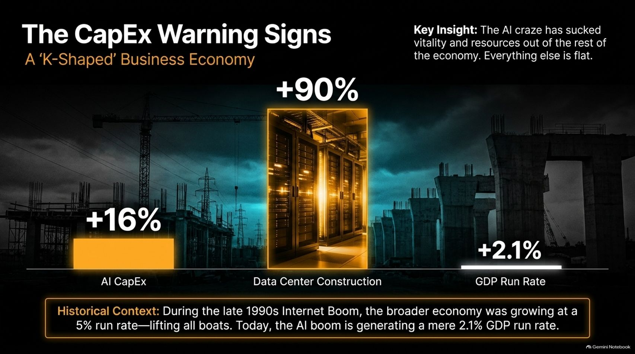
Notes:
Estimated Delivery Time: 3 – 5 minutes
Speaker Notes:
A closer look at capital expenditures reveals a stark 'K-Shaped' Business Economy.
While AI CapEx is up roughly 16% and data center construction is surging at an eye-watering +90%, the broader economy's GDP run rate limps along at a modest +2.1%.
Look at the historical context: during the late 1990s Internet Boom, the broader economy was growing at a healthy 5% clip, lifting all boats. Today, the AI boom is absorbing vast resources while the rest of the economy remains relatively flat.

Slide 9
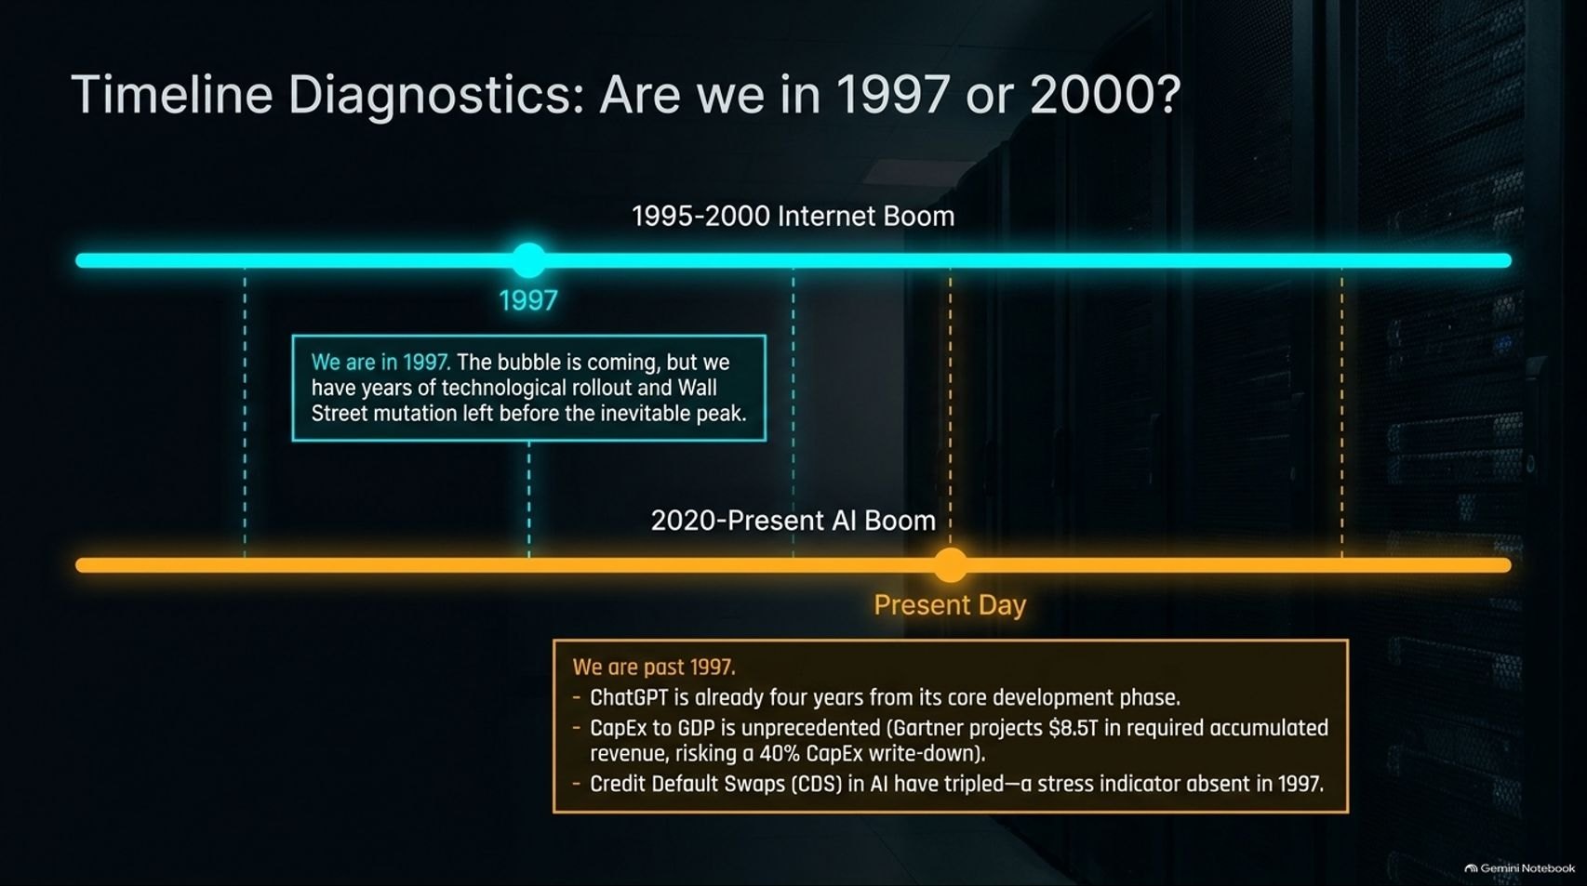
Notes:
Estimated Delivery Time: 4 – 6 minutes
Speaker Notes:
A central debate in the market is whether today's tech environment mirrors 1997 or 2000.
Jim Bianco argues we are closer to 1997—the bubble is forming, but we still have years of technological rollout and financial innovation ahead before reaching the ultimate peak.
Conversely, David Rosenberg warns we are closer to 2000 peak fragility. He points out that ChatGPT is already four years past its core development phase, Gartner projects an astronomical $8.5 trillion in required accumulated revenue to justify current CapEx (risking a massive 40% write-down), and Credit Default Swaps (CDS) on tech are rising—a stress indicator absent in 1997.

Slide 10
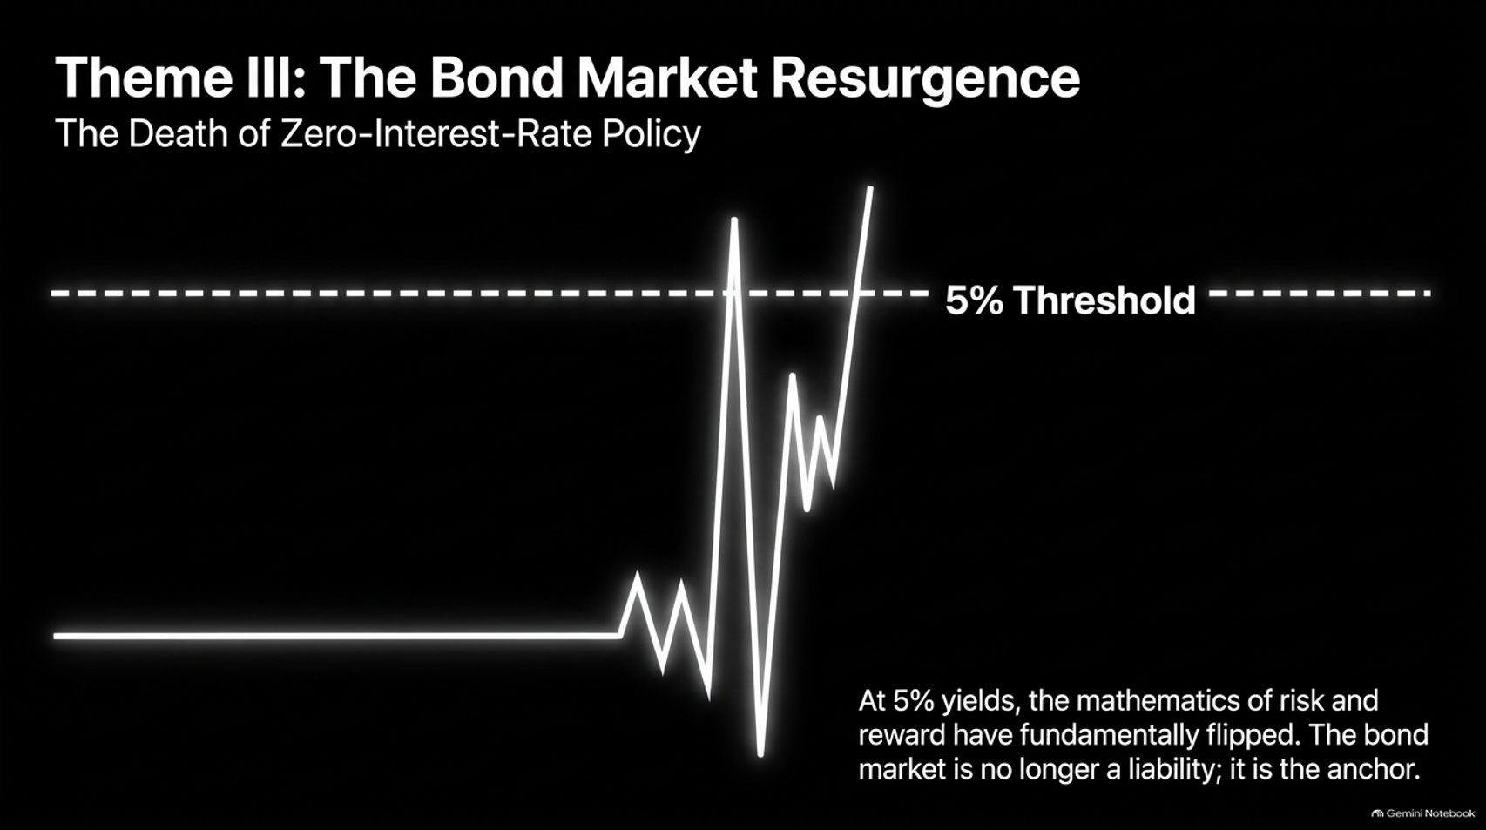

Slide 11
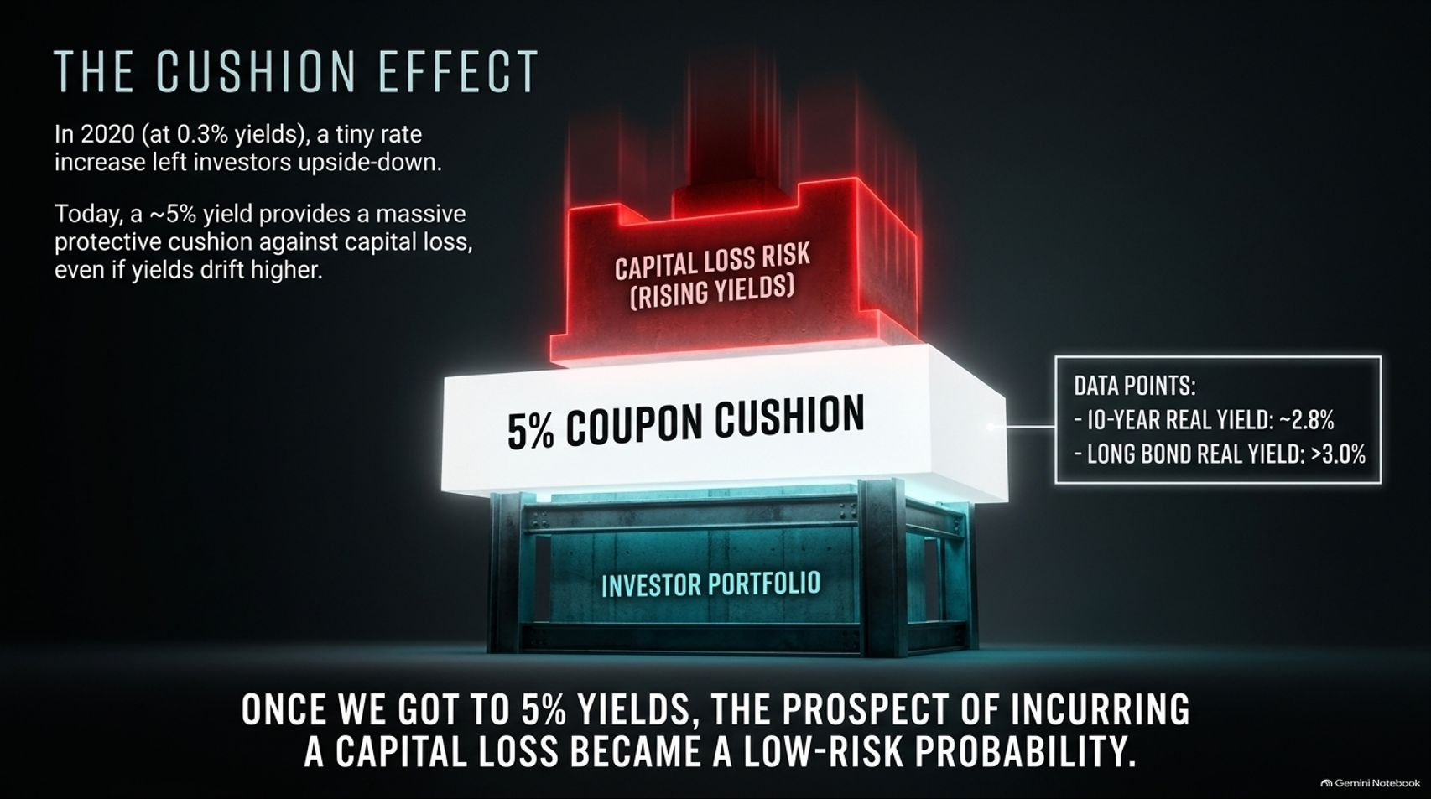

Slide 12
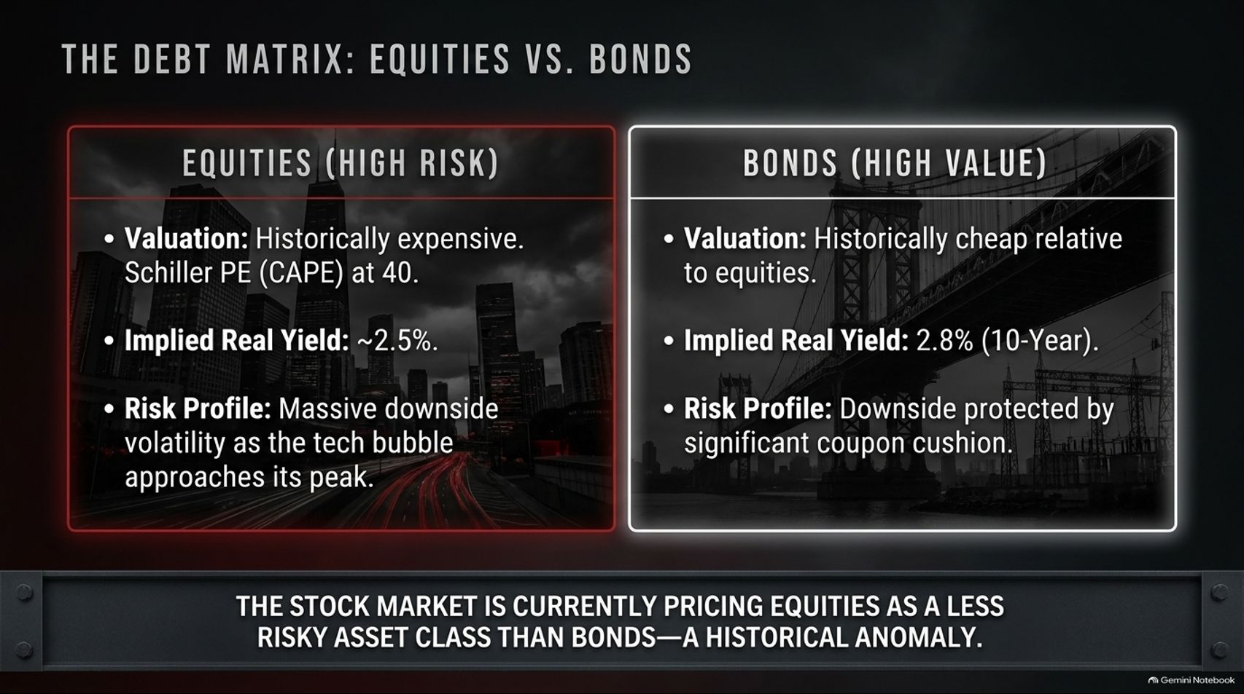

Slide 13
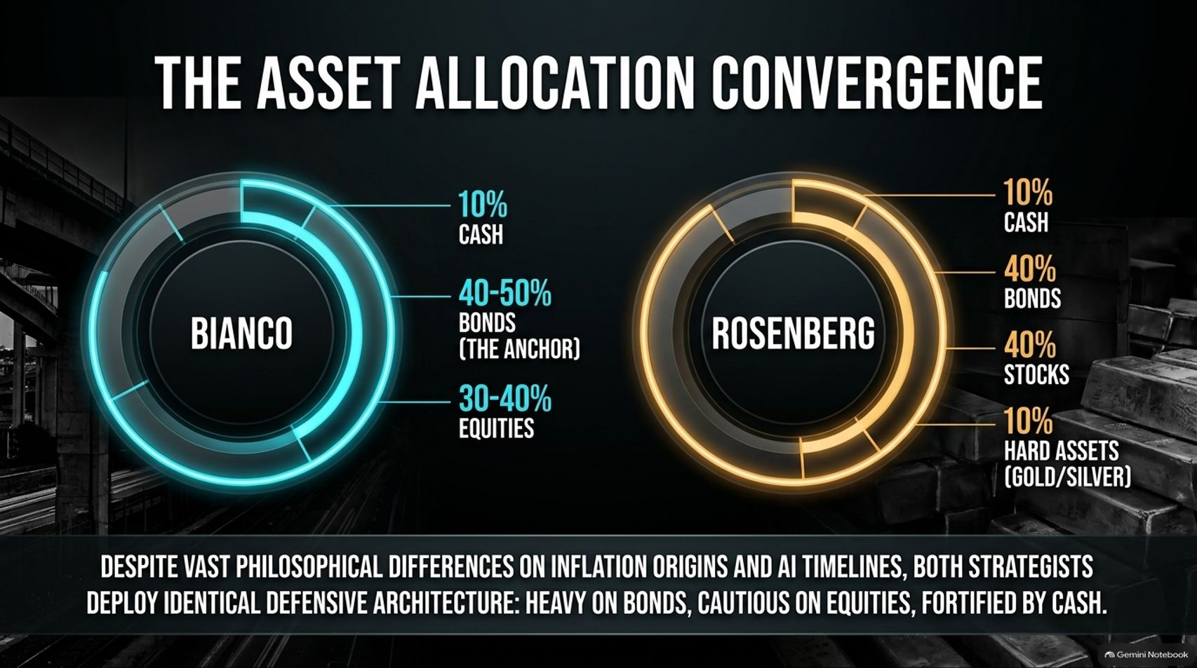
Notes:
Estimated Delivery Time: 3 – 5 minutes
Speaker Notes:
Despite their philosophical differences on inflation origins and AI timelines, both Jim Bianco and David Rosenberg arrive at a remarkably similar defensive asset allocation:
Jim Bianco: Allocates roughly 40–50% to bonds as the core anchor, 30–40% to equities, and ~10% in cash.
David Rosenberg: Allocates 40% to bonds, 40% to stocks, 10% to hard assets like gold and silver, and 10% in cash.
Notice the parallel: both strategists are heavily anchored in fixed income, cautious on equities, and fortified by cash or hard assets.

Slide 14
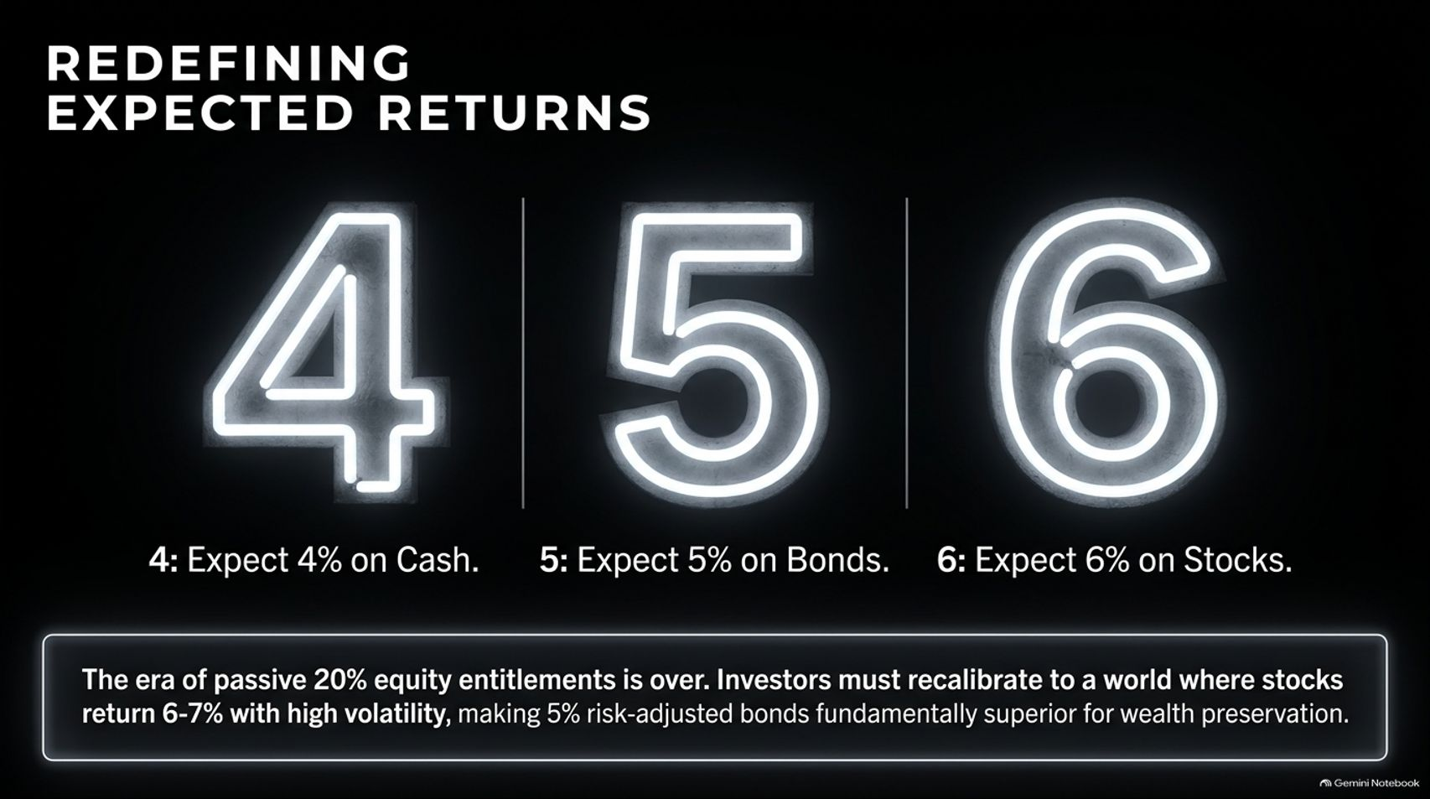
Notes:
Estimated Delivery Time: 3 – 4 minutes
Speaker Notes:
Investors must recalibrate their return expectations for the years ahead. Welcome to the "4-5-6" Framework:
4: Expect roughly 4% returns on cash.
5: Expect 5% risk-adjusted returns safely locked in bonds.
6: Expect 6% to 7% annualized returns on stocks, but paired with significantly higher volatility.
The era of passive 20% equity entitlement is over. When stocks return 6-7% with massive drawdown risk, a 5% risk-adjusted bond yield becomes fundamentally superior for wealth preservation.

Slide 15
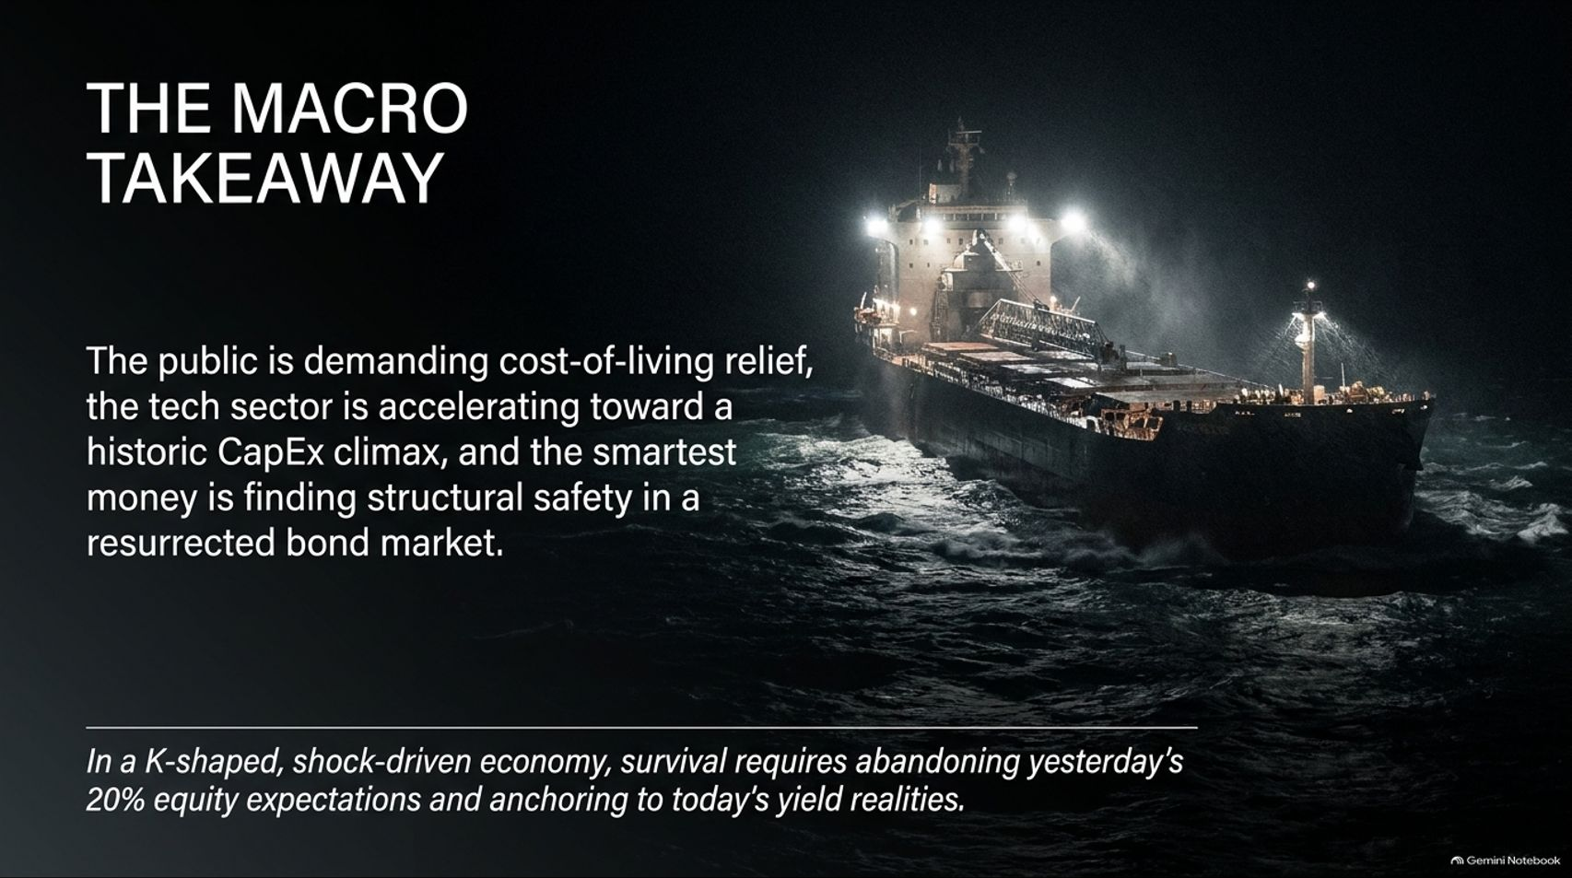
Notes:
Estimated Delivery Time: 3 – 4 minutes
Speaker Notes:
Let's synthesize our core takeaways: Main Street is demanding cost-of-living relief, the tech sector is accelerating toward a historic CapEx climax, and smart money is finding structural safety in a resurrected bond market.
In a K-shaped, shock-driven economy, financial survival requires abandoning yesterday's 20% equity return assumptions and anchoring firmly to today's yield realities.

Slide 16


