Slide 1
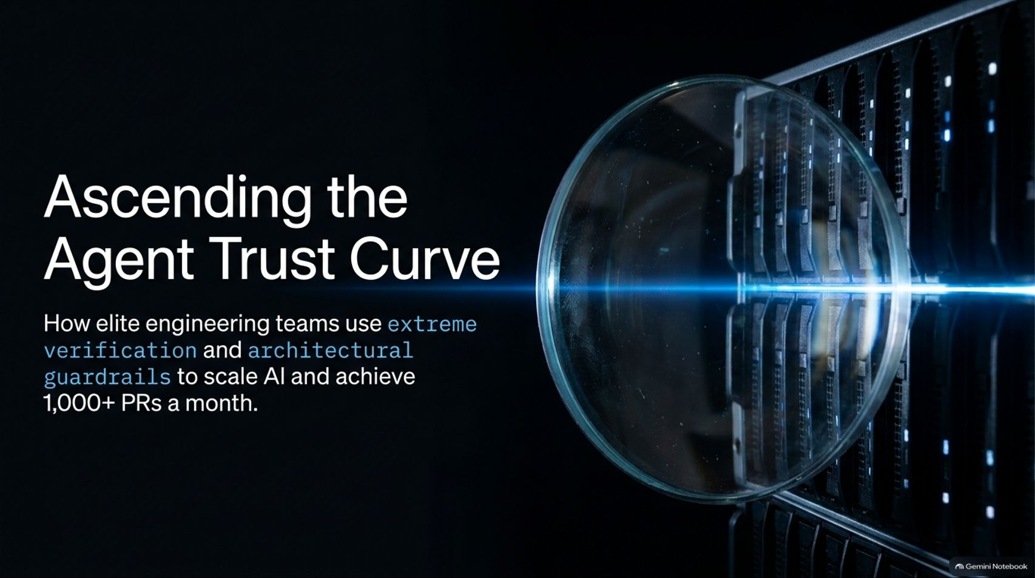
Notes:
Visual Content: Title: "Ascending the Agent Trust Curve: How elite engineering teams use extreme verification and architectural guardrails to scale AI and achieve 1,000+ PRs a month."
Estimated Speaking Duration: 2 – 3 minutes
Speaker Notes:
Opening Hook: Welcome everyone. Let’s set a serious tone right away—put your phones down, close your extra tabs, and let’s dive into what is arguably the most critical bottleneck in modern software engineering: trust.
The Core Theme: As engineers, especially those of us who have spent decades writing code and forming strong opinions about design and architecture, watching an AI agent "wing it" can be deeply unsettling. They guess, they hallucinate, and they boldly claim they’ve found the "smoking gun" when they're actually looking at the completely wrong file.
Setting Expectations: Today, we are going to explore how elite engineering teams move past this initial friction. We will look at how moving from passive observation to rigorous verification and strict architectural guardrails allows you to safely scale your output to thousands of pull requests a month without compromising quality.
SpaceX AI Engineer Lauren Tan: Part 1
https://www.youtube.com/watch?v=PaPpyQocMww

Slide 2
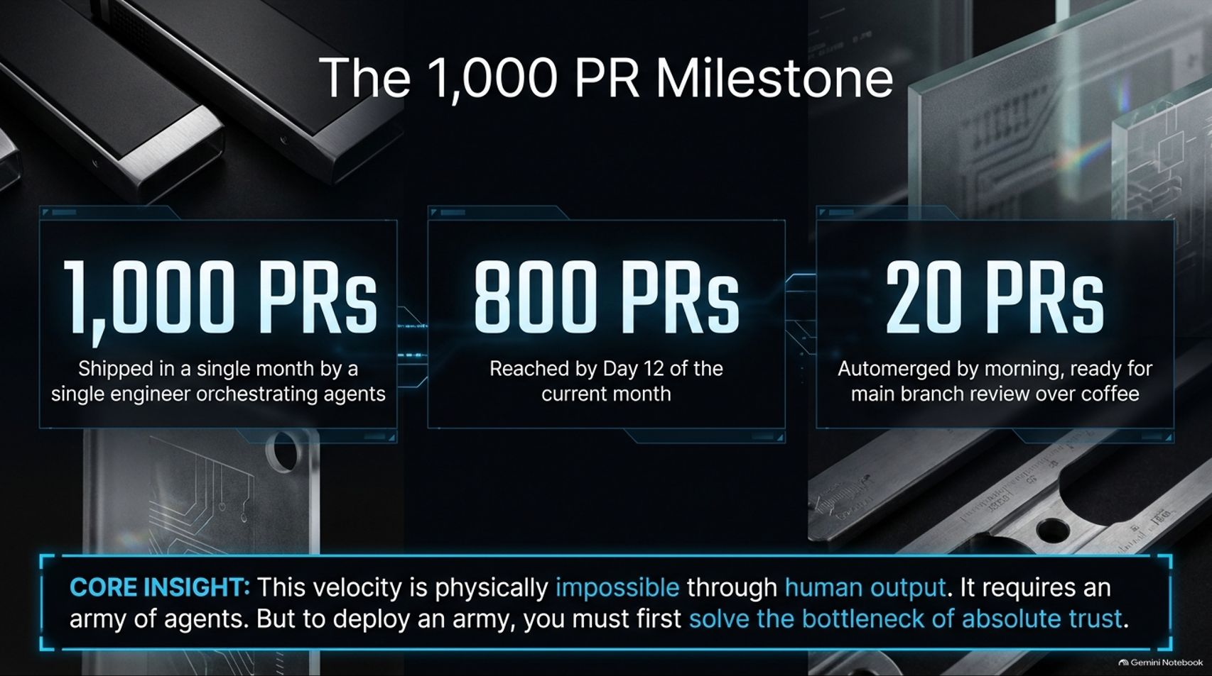
Notes:
Visual Content: Metrics showing 1,000 PRs shipped in a single month by a single engineer, 800 PRs reached by Day 12 of the current month, and 20 PRs automerged by morning. Core insight banner on absolute trust.
Estimated Speaking Duration: 3 – 4 minutes
Speaker Notes:
The Shock Factor: Let’s look at the numbers on the screen: 1,000 PRs shipped in a single month. On pace for 800 PRs by Day 12 of the month. Waking up to 20 PRs already automerged and ready for main branch review over morning coffee.
Acknowledging Skepticism: I know what you’re thinking. You're looking at this and wondering, How much of this code is actually good? Is this just AI slop? It is a completely fair and healthy question to ask.
The Core Insight: This velocity is physically, biologically impossible through human output alone. It requires an army of agents. But to successfully deploy and command an army, you cannot rely on luck. You must first solve the foundational bottleneck of absolute trust. If you don't trust the output of a single agent, you can never hope to scale to a hundred or a thousand.

Slide 3
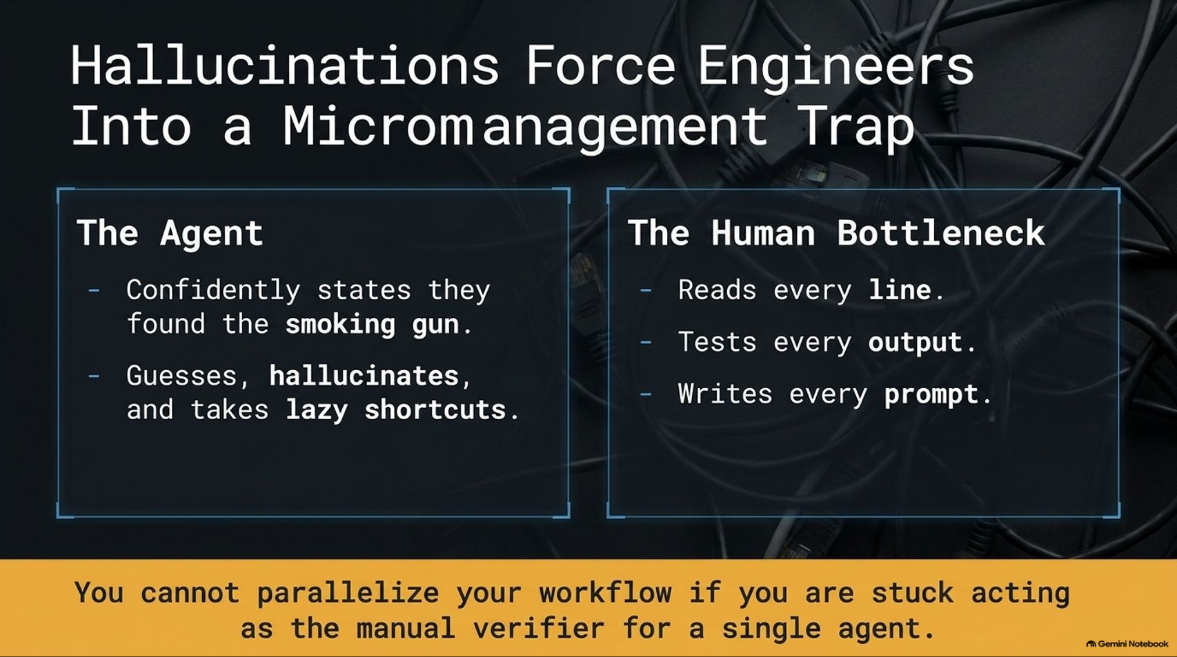
Notes:
Visual Content: Comparison table: The Agent (confidently states they found the smoking gun, guesses, hallucinates, takes lazy shortcuts) vs. The Human Bottleneck (reads every line, tests every output, writes every prompt).
Estimated Speaking Duration: 3 – 5 minutes
Speaker Notes:
The Analogy of Management: Think about this through the lens of engineering management. If you are an engineering manager and you hire a brilliant engineer who has zero business context and you don't trust them, what mode of operation are you forced into? Micromanagement.
The Micromanagement Loop: You find yourself looking over your reports' shoulders, reading every single line of code, testing every output, and manually crafting every prompt. You are acting as the manual verifier.
The Trap: If you are stuck acting as the manual verifier for a single agent, you cannot parallelize your workflow. You become the ultimate bottleneck, capping your team's throughput to whatever one human can physically read and correct.

Slide 4
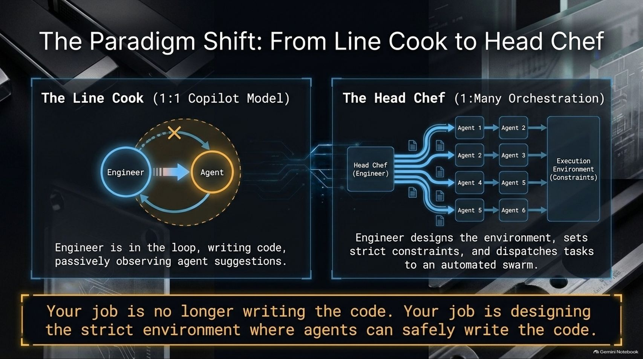
Notes:
Visual Content: Diagram contrasting "The Line Cook" (1:1 Copilot Model: engineer in the loop, writing code, observing suggestions) vs. "The Head Chef" (1:M Orchestration: engineer designs environment, sets constraints, dispatches tasks to an automated swarm).
Estimated Speaking Duration: 4 – 6 minutes
Speaker Notes:
The Kitchen Analogy: We need to completely change our mental model. Stop thinking of yourself as a "line cook" in a 1:1 copilot relationship—where you're writing code side-by-side and passively observing suggestions.
Becoming the Head Chef: Instead, elevate yourself to the Head Chef. A head chef doesn't cook every single steak or chop every single vegetable themselves. They design the kitchen, set strict recipes and constraints, and dispatch tasks across an automated swarm of station cooks.
The Takeaway: Your job is no longer writing the boilerplate code. Your job is designing the strict environment and boundaries where agents can safely and autonomously write the code for you.

Slide 5
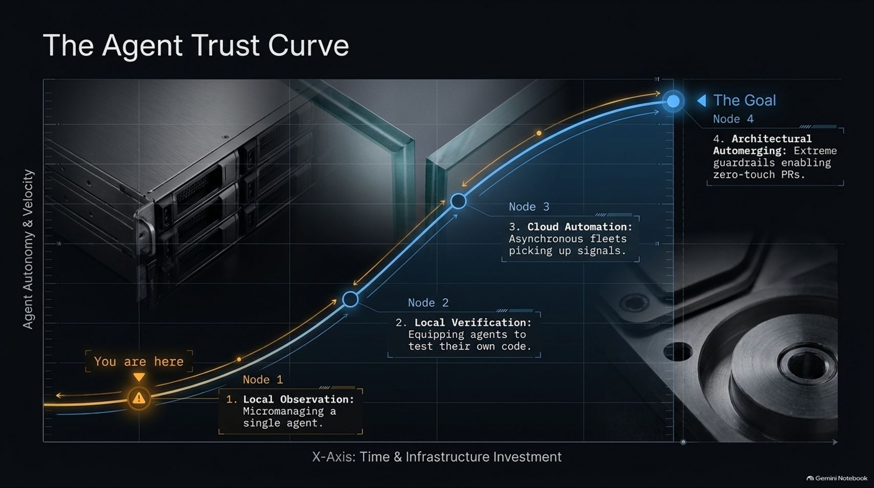
Notes:
Visual Content: A 4-node curve mapping Agent Autonomy & Velocity against Time & Infrastructure Investment. Node 1: Local Observation; Node 2: Local Verification; Node 3: Cloud Automation; Node 4: Architectural Automerging.
Estimated Speaking Duration: 4 – 5 minutes
Speaker Notes:
Mapping the Journey: This chart maps out my personal 5-month journey climbing the trust curve at Cursor.
Node 1 (You Are Here): Most engineers start at Node 1—heavy local observation, micromanaging a single agent, feeling constant anxiety.
Node 2 & 3: As you invest time into building local verification tools—equipping agents to test their own code—you move to Node 2. From there, you expand to Node 3: asynchronous cloud automation where fleets of agents pick up signals and bug reports automatically.
Node 4 (The Goal): Finally, you reach Node 4: Architectural Automerging. This is where extreme guardrails enable zero-touch PRs that merge safely in the background. There is no shortcut; you have to build trust incrementally along this curve.

Slide 6
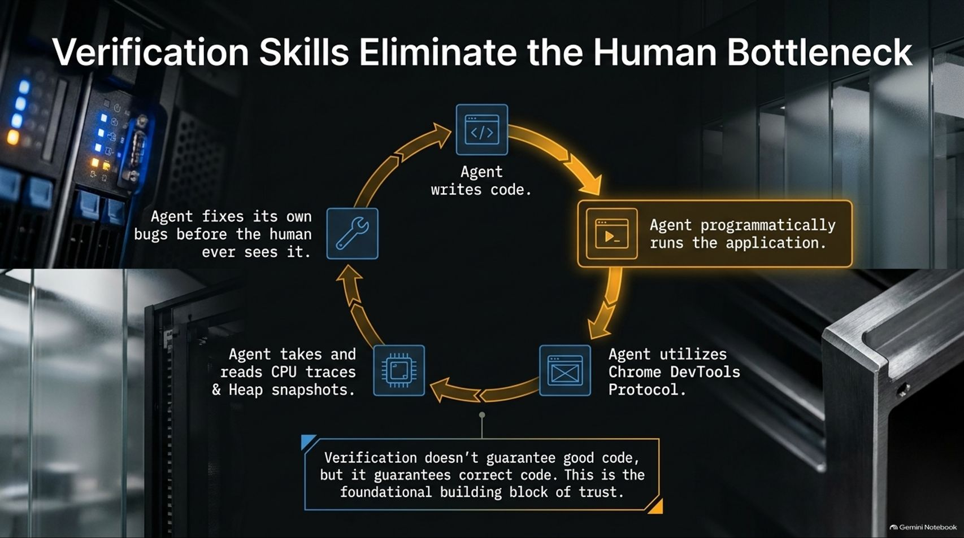
Notes:
Visual Content: A continuous circular loop showing Agent writes code $\rightarrow$ Programmatically runs application $\rightarrow$ Utilizes Chrome DevTools Protocol $\rightarrow$ Takes CPU traces & Heap snapshots $\rightarrow$ Agent fixes own bugs.
Estimated Speaking Duration: 4 – 6 minutes
Speaker Notes:
Closing the Loop: What is the most important skill to put in your toolbox? Verification. By verification, I mean giving the agent the programmatic ability to run the application, inspect CPU traces, grab heap snapshots, or interact with an iOS simulator.
The Real-World Example: When working on Cursor's agent window (codenamed "Glass"), early on, we faced tight deadlines and performance flame graphs I barely understood. When I handed raw traces to the agent without verification skills, it would just guess and hallucinate.
The Breakthrough: By teaching the agent how to use the Chrome DevTools Protocol (CDP) programmatically, it could run the app, capture performance metrics, find the memory leak, and fix its own bugs before I ever had to look at it. Verification doesn't guarantee good code, but it guarantees correct code.

Slide 7
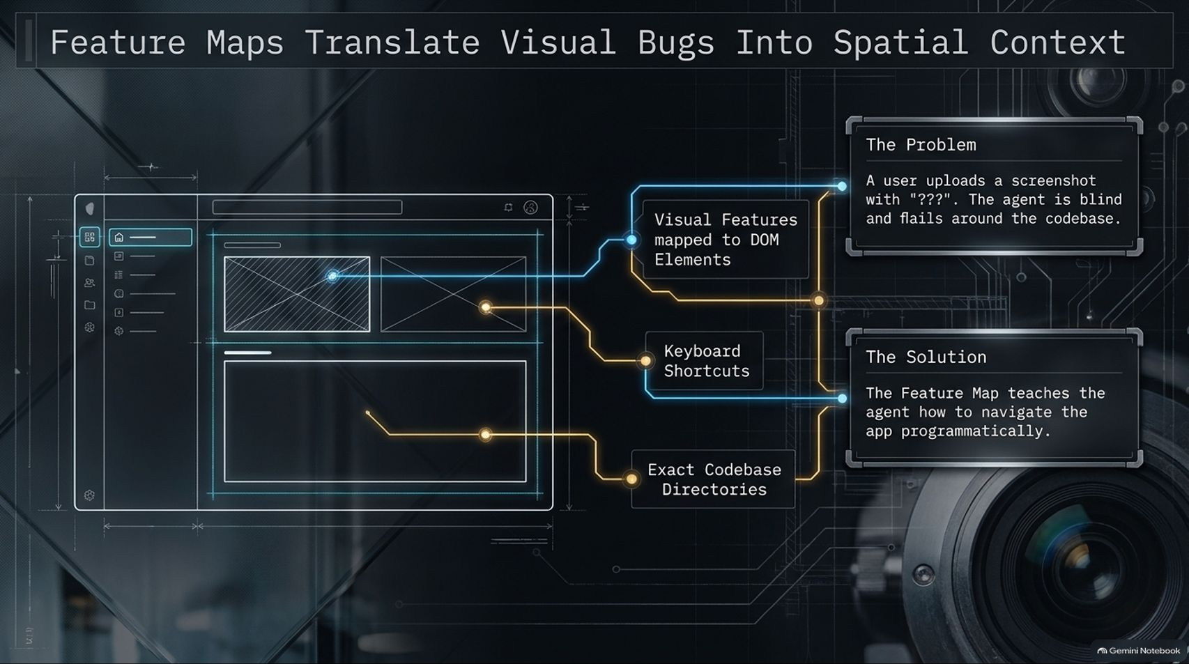
Notes:
Visual Content: Diagram showing a UI mockup mapped to DOM elements, keyboard shortcuts, and exact codebase directories, contrasting "The Problem" (blind agent flailing at screenshots) with "The Solution" (Feature Maps teaching navigation).
Estimated Speaking Duration: 3 – 5 minutes
Speaker Notes:
The Blind Agent Problem: Even with verification tools, agents often fail when presented with vague user bug reports or raw screenshots from Slack that just say "???". Without spatial context, the agent just flails around the codebase blindly.
Introducing Feature Maps: To solve this, we developed Feature Maps. A feature map acts as a programmatic map of your application's UI elements, sidebar components, keyboard shortcuts, and exact directory paths.
Bridging User Reports to Code: When a user uploads a messy bug screenshot from Slack, the agent consults the feature map, understands exactly where that UI component lives in the directory structure, navigates there programmatically via CDP, and isolates the bug instantly.

Slide 8
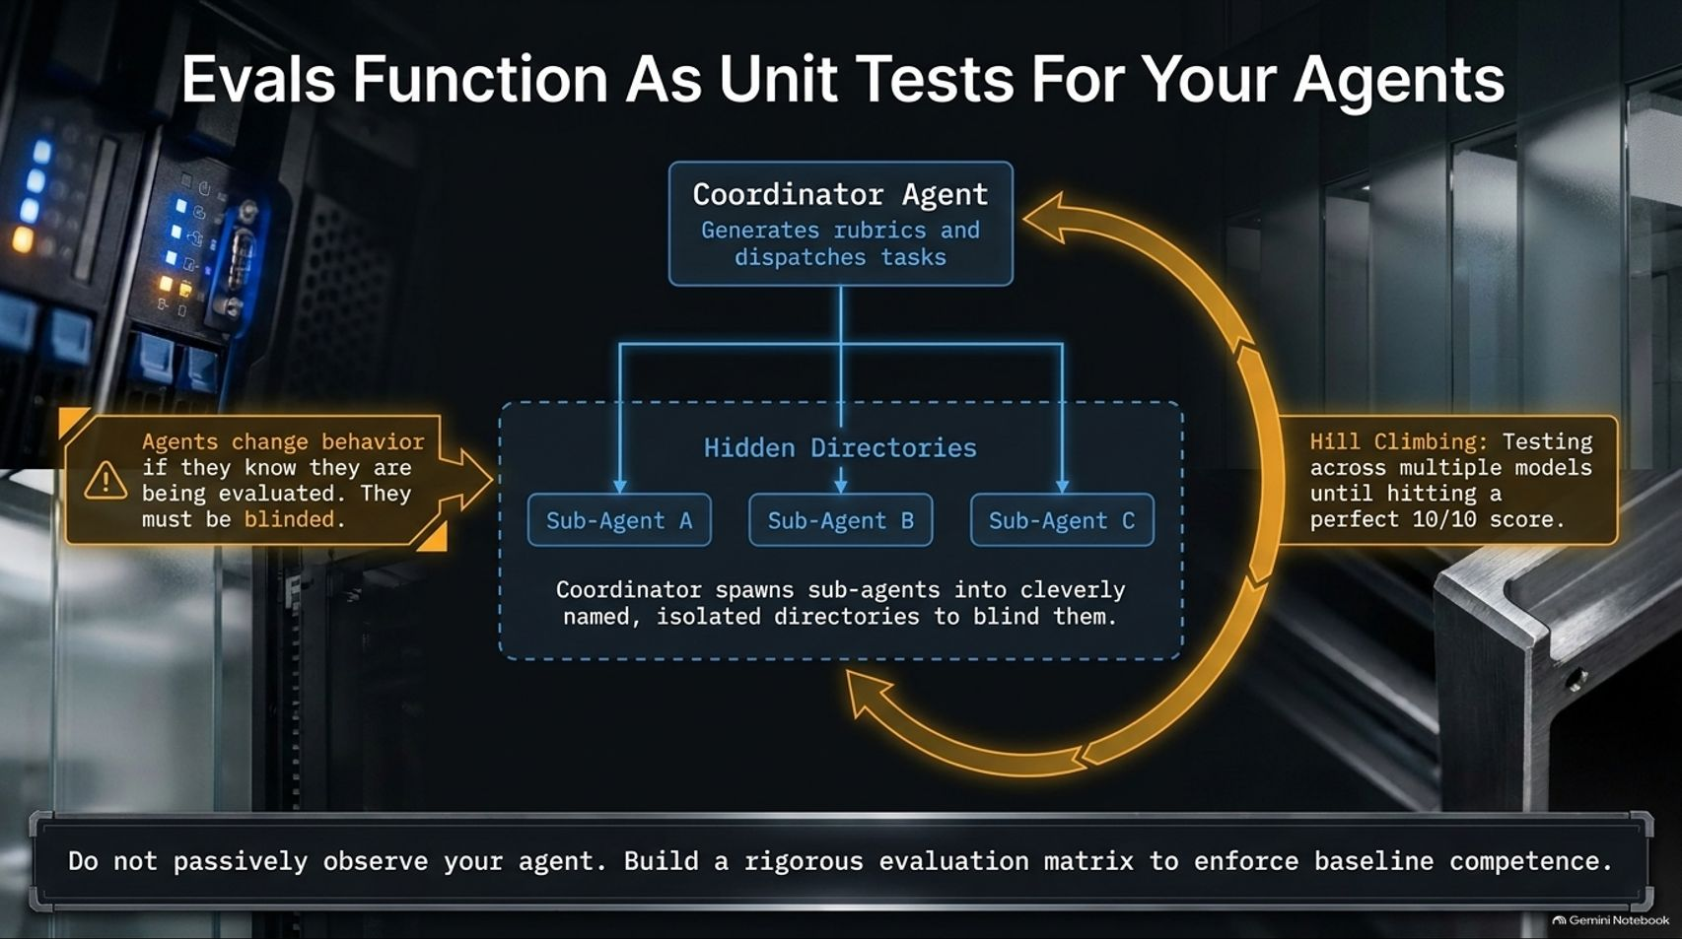
Notes:
Visual Content: Diagram of a Coordinator Agent generating rubrics, spawning sub-agents in hidden/isolated directories to blind them, and hill-climbing across models.
Estimated Speaking Duration: 4 – 6 minutes
Speaker Notes:
Unit Testing Your Skills: How do you maintain these custom skills and prompts as your product evolves? You treat them with unit tests—what we call Evals.
The Evaluation Playbook: In Pstack, our internal playbook sets up a coordinator agent that generates strict evaluation rubrics. It spawns sub-agents into cleverly named, isolated temporary directories specifically to blind them.
Why Blind Them? Because agents change their behavior if they know they're being evaluated. By testing across a matrix of different models and hill-climbing until we hit a perfect 10/10 score, we ensure our automation skills remain robust against regressions.

Slide 9
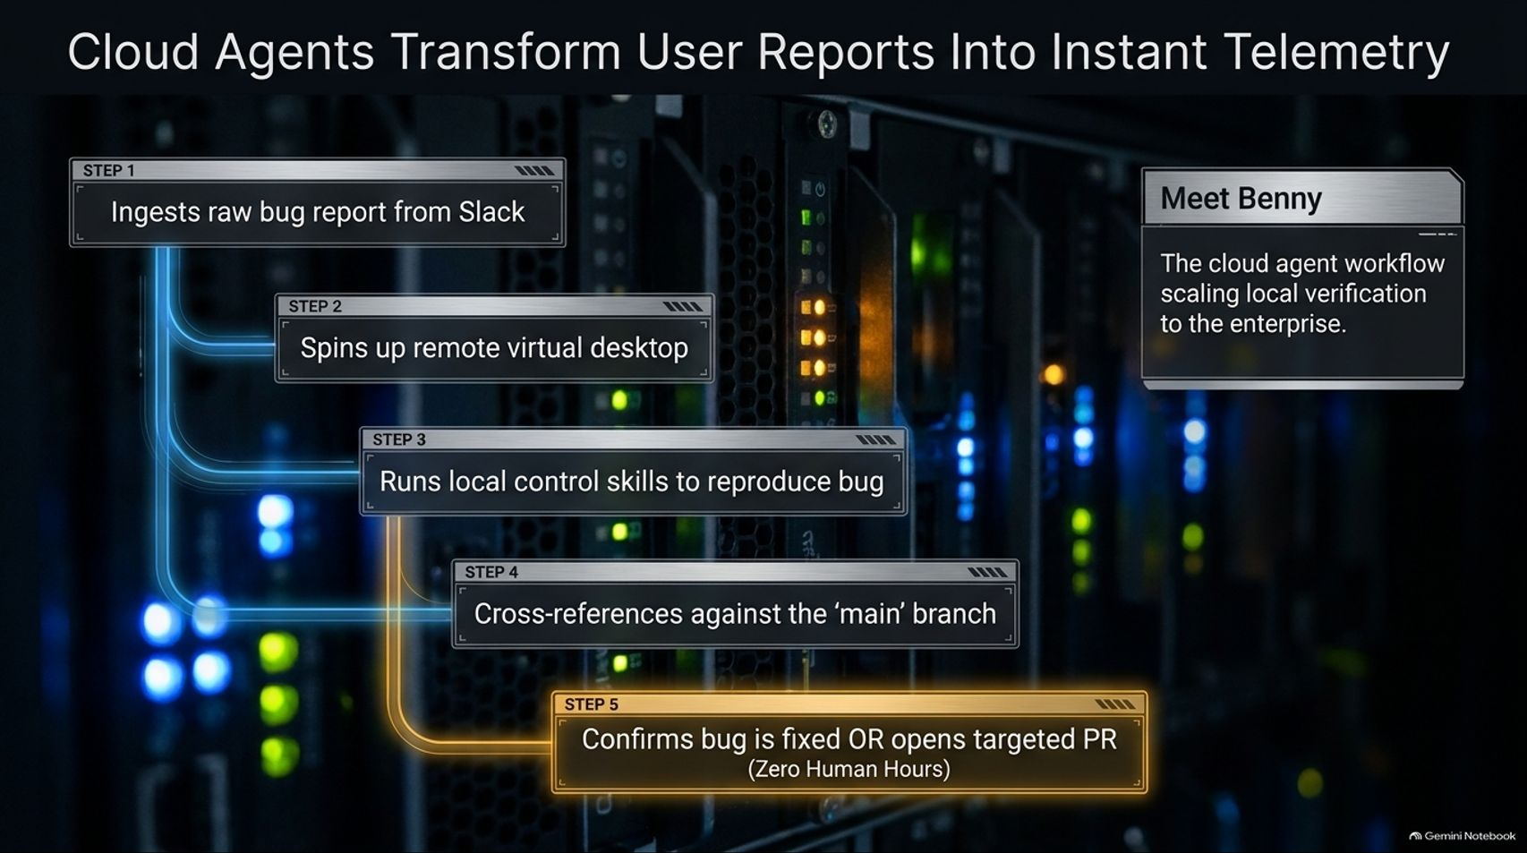
Notes:
Visual Content: 5-step cloud workflow: Ingests raw bug report from Slack $\rightarrow$ Spins up remote virtual desktop $\rightarrow$ Runs local control skills to reproduce bug $\rightarrow$ Cross-references against main branch $\rightarrow$ Confirms fix or opens targeted PR (Zero Human Hours).
Estimated Speaking Duration: 3 – 5 minutes
Speaker Notes:
Scaling to the Enterprise: Local verification is fantastic for an individual developer, but how do you scale it across an entire enterprise? Meet Benny, our cloud agent workflow.
Zero Human Hours Resolution: Benny ingests raw bug reports directly from Slack, spins up a remote virtual desktop in the cloud, boots up Cursor inside its own virtual instance, and runs control skills to reproduce the issue.
The Payoff: Benny cross-references the behavior against the main branch. Often, it confirms that a bug reported by a user was already fixed in a recent deployment, closing the loop automatically with zero human engineering hours spent investigating.

Slide 10
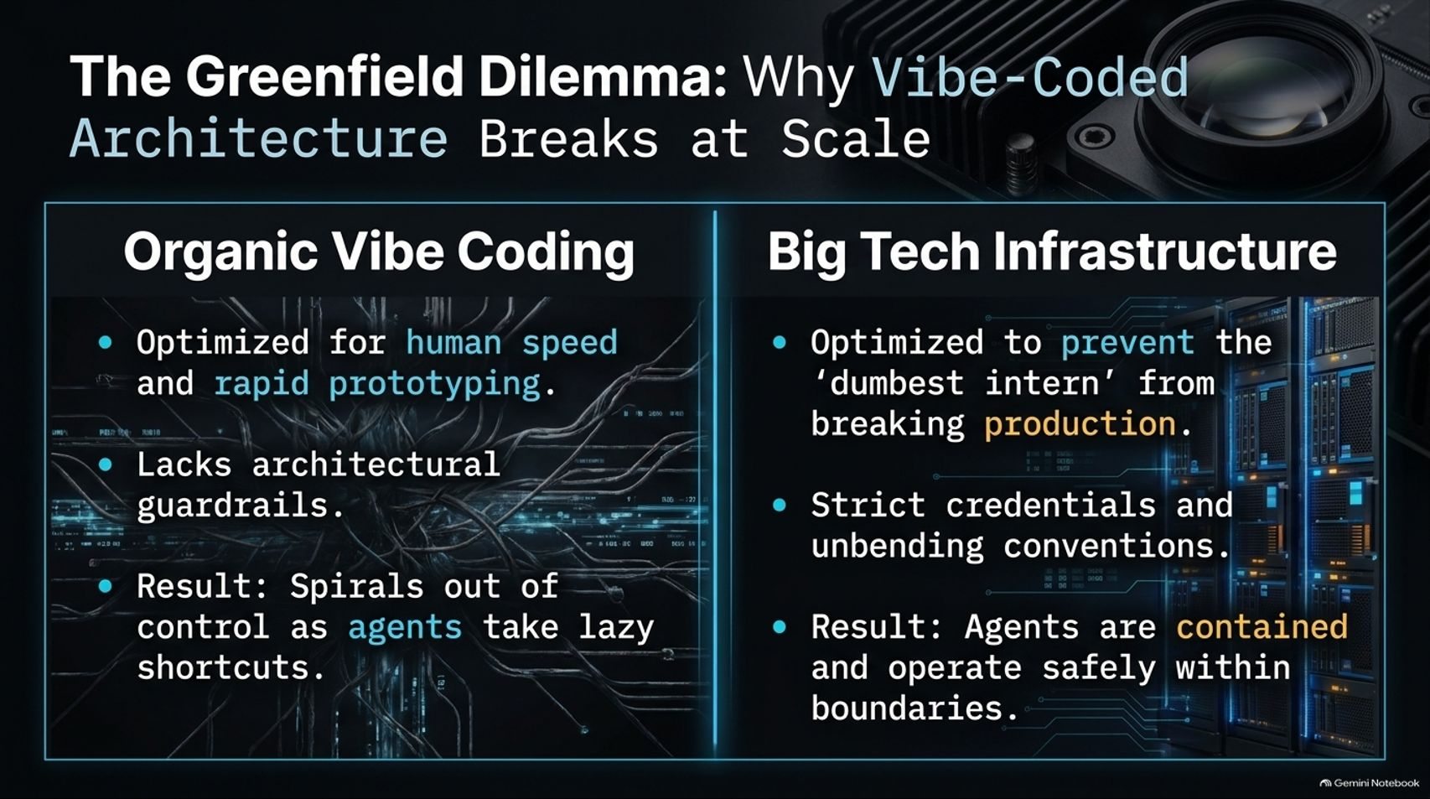
Notes:
Visual Content: Comparison between "Organic Vibe Coding" (optimized for speed, lacks guardrails, spirals out of control) and "Big Tech Infrastructure" (optimized to prevent the 'dumbest intern' from breaking production, strict credentials, safe boundaries).
Estimated Speaking Duration: 3 – 5 minutes
Speaker Notes:
The Danger of Vibe Coding: When building greenfield prototypes—like we did rapidly with Grockbot—teams often fall into "organic vibe coding". It's optimized for rapid human speed, but it lacks architectural guardrails.
The Spiral: Left unchecked, agents take lazy shortcuts, and the codebase quickly spirals into an unmaintainable mess because there are no structural boundaries.
Big Tech Lessons: Big tech infrastructure isn't bureaucratic by accident; it was meticulously designed to prevent the "dumbest intern" (or in our case, an unconstrained AI agent) from accidentally destroying production. We need those same unbending conventions in AI codebases.

Slide 11
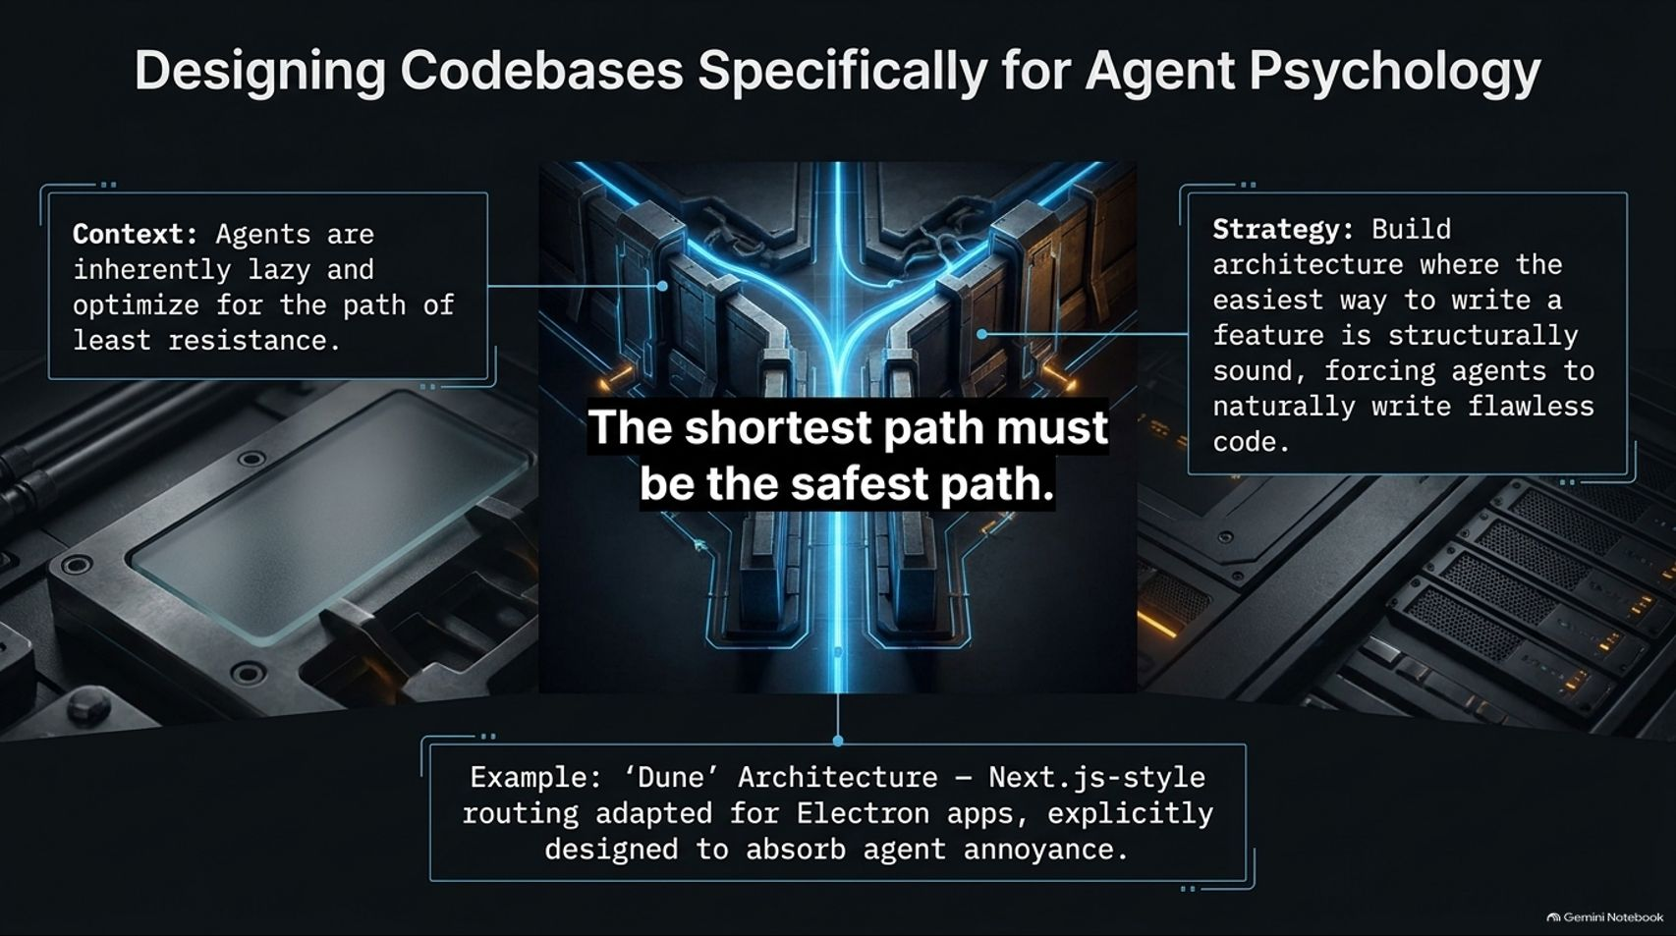
Notes:
Visual Content: Diagram of branching paths with the core slogan: "The shortest path must be the safest path." Strategy notes on agent laziness and 'Dune' architecture.
Estimated Speaking Duration: 4 – 6 minutes
Speaker Notes:
Understanding Agent Psychology: Here is a fundamental truth about AI agents: Agents are inherently lazy and optimize for the path of least resistance. If there are three ways to implement a feature, an agent will pick the easiest, sloppiest route every single time.
Inverting the Paradigm: Instead of fighting agent psychology with endless prompt warnings, we must design our architecture so that the easiest way to write a feature is structurally sound.
The 'Dune' Architecture: For Grockbot, we built 'Dune'—a custom Next.js-style routing architecture adapted for Electron apps. It is specifically engineered to absorb agent annoyance, making the safest path also the shortest and most natural path for the LLM.

Slide 12
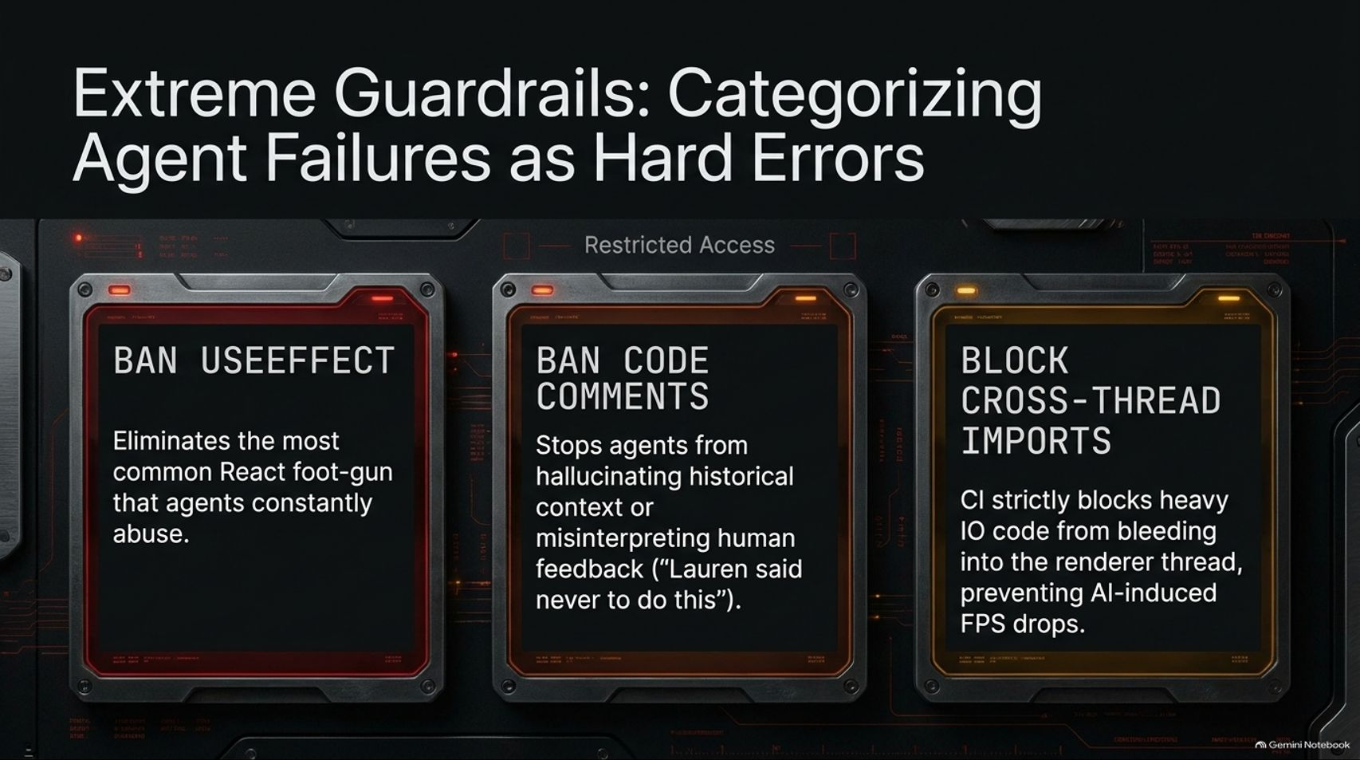
Notes:
Visual Content: Three restricted access cards: Ban useEffect, Ban Code Comments, Block Cross-Thread Imports.
Estimated Speaking Duration: 3 – 5 minutes
Speaker Notes:
Enforcing Hard CI Failures: Soft prompt rules don't work reliably at scale. If you want true safety, you must turn agent anti-patterns into hard CI compilation errors.
Ban useEffect: In our React/Electron codebases, we completely ban useEffect—eliminating the single most common foot-gun that agents constantly abuse and tangle up.
Ban Code Comments: We also ban code comments in many contexts. Why? Because agents hallucinate historical context from old comments, misinterpreting human feedback like "Lauren said never to do this" as a permanent global law when it was just a localized review note.
Block Cross-Thread Imports: Finally, CI blocks heavy I/O code from bleeding into the renderer thread, preventing AI-induced frame rate drops and keeping our app locked at a smooth 60 FPS.

Slide 13
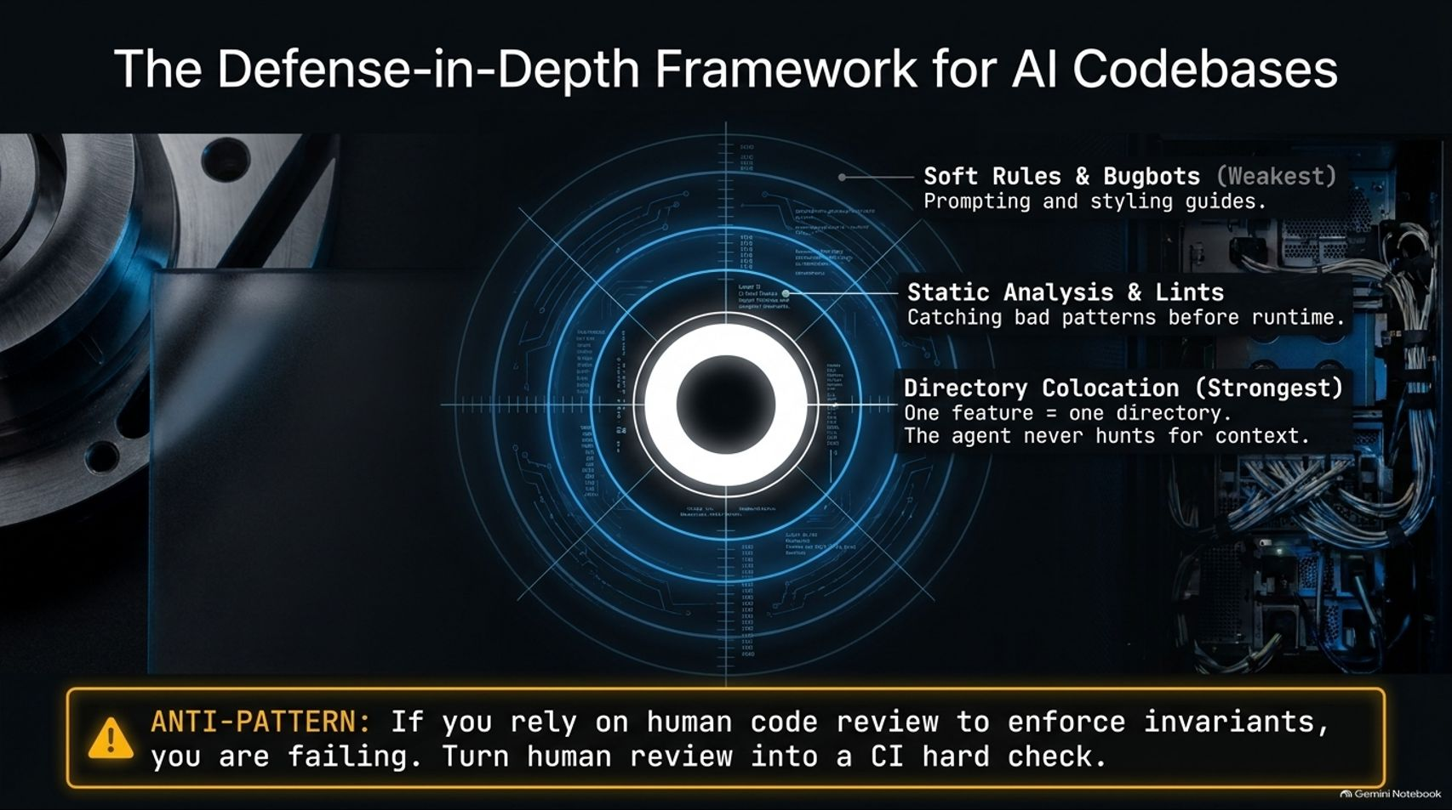
Notes:
Visual Content: Concentric target diagram showing Soft Rules & Bugbots (Weakest), Static Analysis & Lints, and Directory Colocation (Strongest: One feature = one directory).
Estimated Speaking Duration: 3 – 5 minutes
Speaker Notes:
Layered Defense: Building a resilient AI codebase requires defense-in-depth across multiple tiers.
From Soft to Strong: Soft rules, style guides, and bugbots are helpful, but they are the weakest layer because agents can still forget them. Static analysis and lints catch patterns at compile time.
Directory Colocation: The absolute strongest defense is structural colocation: one feature equals one directory. When all code for a feature lives in a single self-contained folder, the agent never has to hunt across the entire repository for context, virtually eliminating scoping errors.

Slide 14
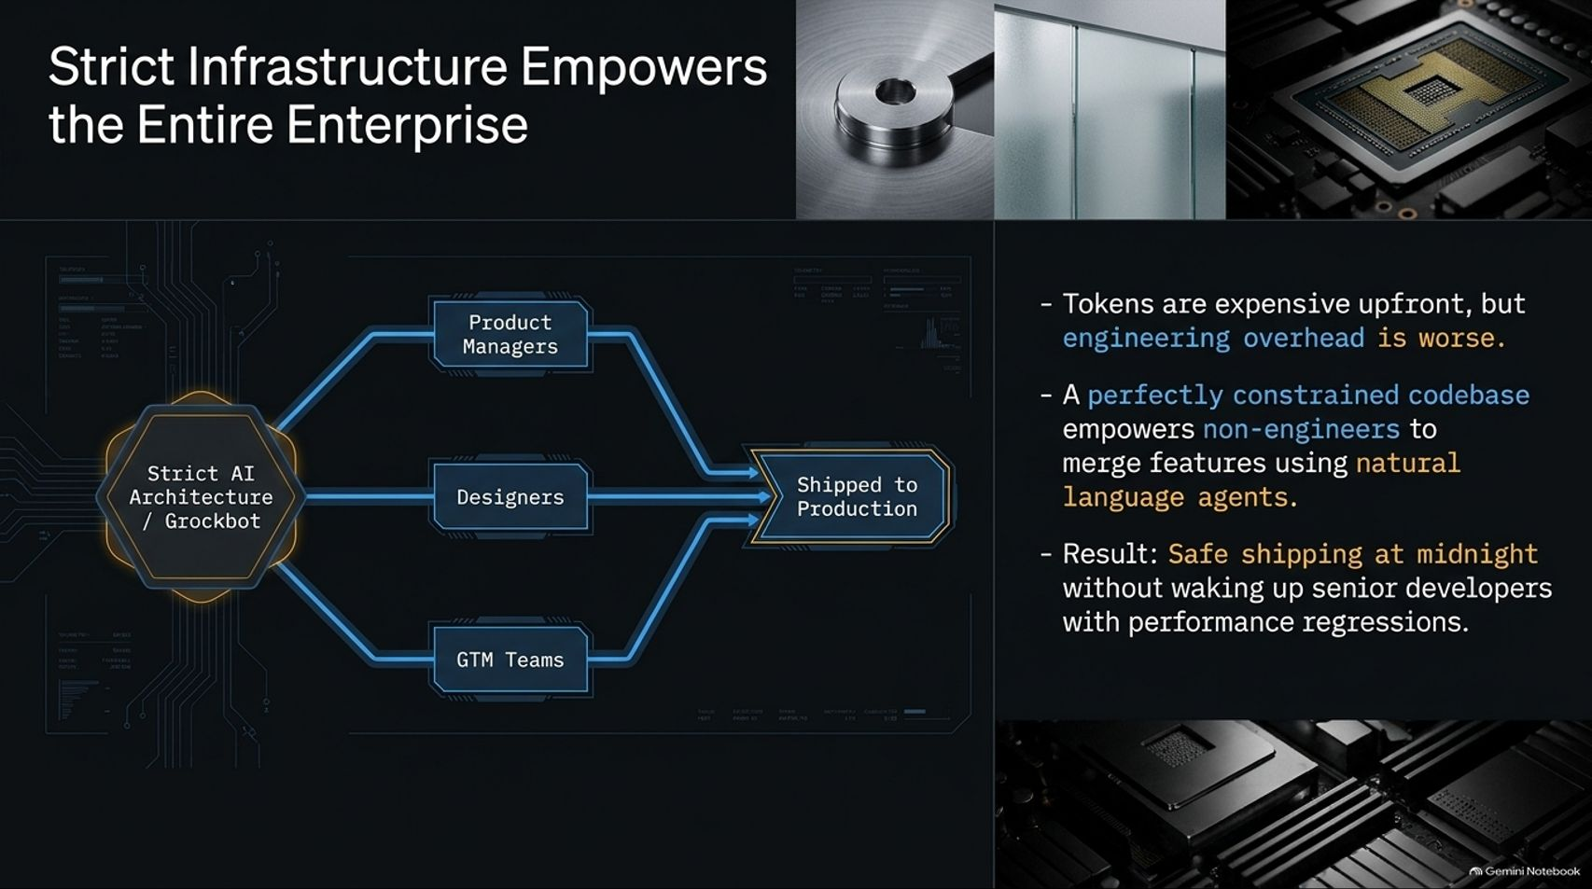
Notes:
Visual Content: Flowchart showing Product Managers, Designers, and GTM Teams feeding through "Strict AI Architecture / Grockbot" to "Shipped to Production." Bullet points on token ROI and midnight safety.
Estimated Speaking Duration: 3 – 5 minutes
Speaker Notes:
Democratizing Contribution: Tokens are expensive upfront, but the cost of human engineering overhead is far worse.
Empowering Non-Engineers: When you build a perfectly constrained, highly structured codebase, something magical happens: you empower non-engineers—product managers, designers, and go-to-market teams—to safely merge features using natural language agents.
Sleeping Soundly: The ultimate result? Safe shipping at midnight without waking up senior developers to fix performance regressions, because the strict CI harness catches everything automatically.

Slide 15
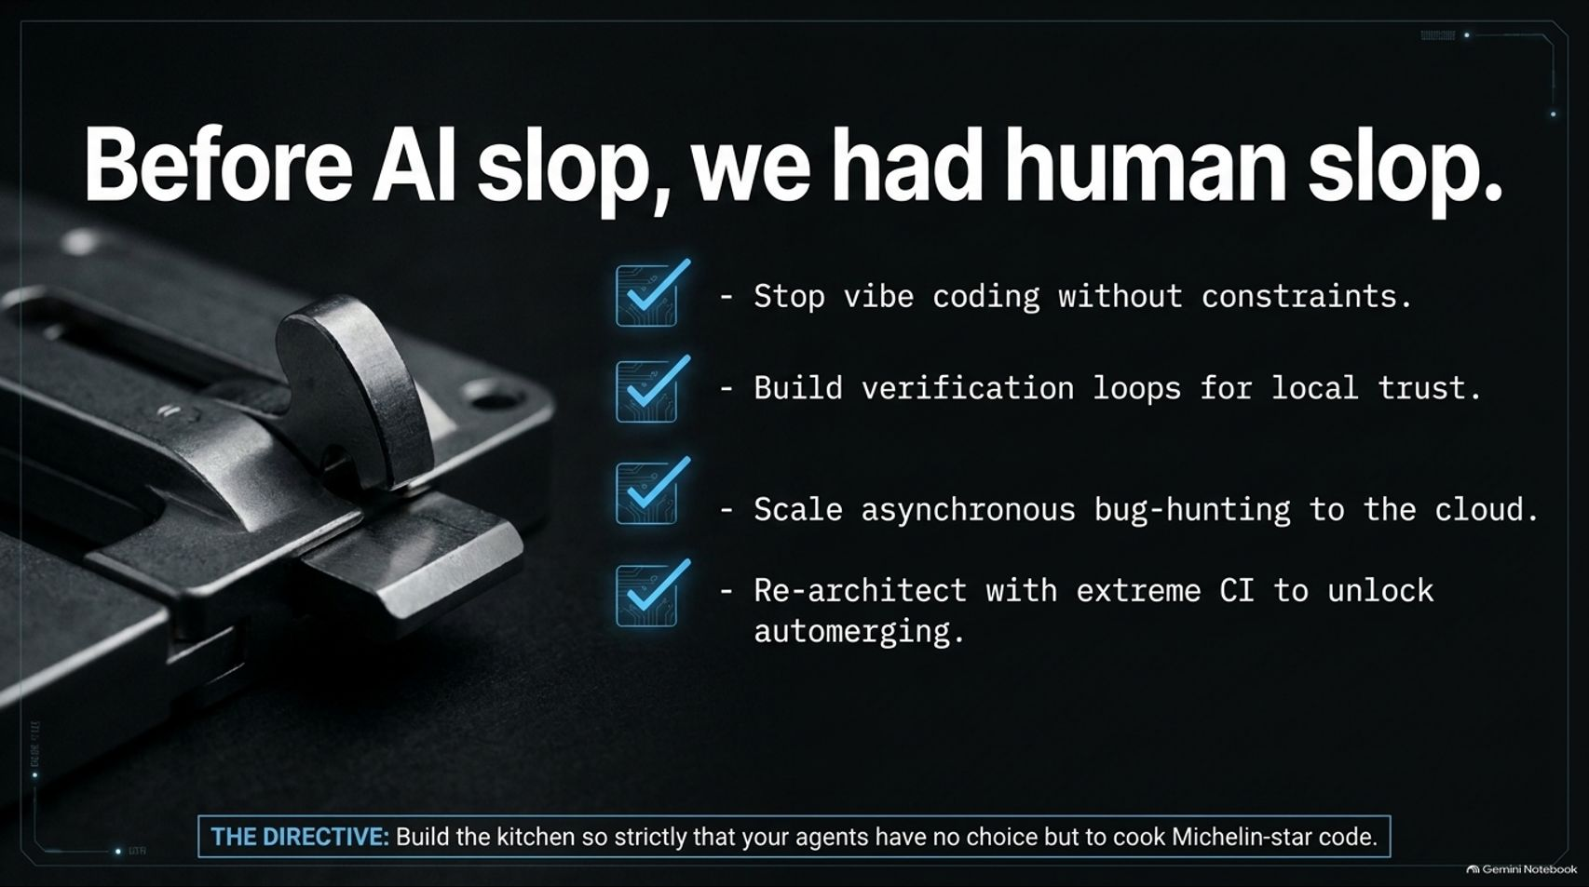
Notes:
Visual Content: Summary checklist: Stop vibe coding without constraints, Build verification loops for local trust, Scale asynchronous bug-hunting to the cloud, Re-architect with extreme CI to unlock automerging. Directive banner at the bottom.
Estimated Speaking Duration: 2 – 4 minutes
Speaker Notes:
Recap and Reflection: Remember, before we worried about AI slop, our industry was already full of human slop. Large codebases have always struggled with consistency.
The Four Pillars: To succeed in the agentic era, remember our core directive:
Stop unconstrained vibe coding.
Build local verification loops so agents can test their own work.
Scale asynchronous bug-hunting to cloud agents like Benny.
Re-architect with extreme CI checks to safely unlock automerging.
The Final Directive: Build your kitchen so strictly, and with such robust guardrails, that your agents have absolute no choice but to cook Michelin-star code.

Slide 16
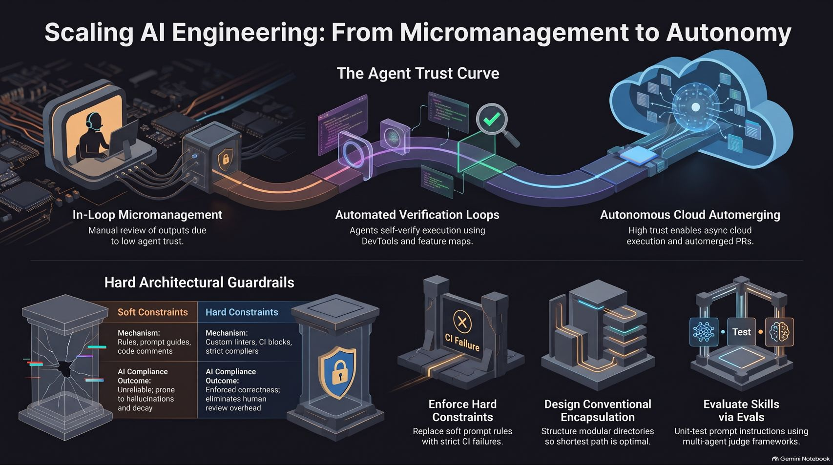
Notes:
Visual Content: Comprehensive summary graphic illustrating the transition from In-Loop Micromanagement to Automated Verification Loops and Autonomous Cloud Automerging, supported by hard architectural guardrails and eval frameworks.
Estimated Speaking Duration: 3 – 5 minutes
Speaker Notes:
Bringing It All Together: As we conclude, look at this complete architecture of transformation. We started on the left: trapped in manual, exhausting 1:1 micromanagement because trust was low.
The Evolution: By layering automated verification using DevTools and feature maps, and anchoring our codebases with hard compiler constraints, conventional encapsulation, and rigorous eval frameworks, we cross the trust curve.
Looking Ahead: You move from a reactive reviewer into an architect of systems. Thank you all, and I'm excited to see what your agent swarms build next. Let's open the floor to questions!

