Slide 1
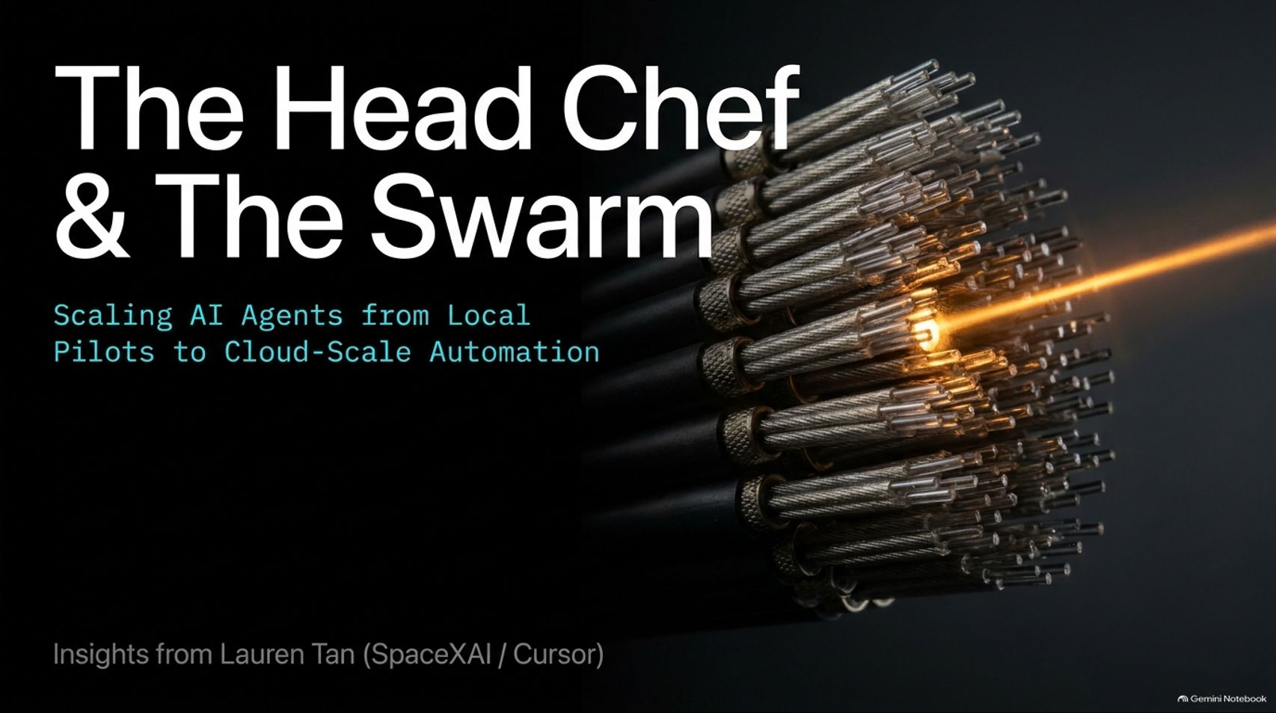
Notes:
Visual Content: Title: "The Head Chef & The Swarm: Scaling AI Agents from Local Pilots to Cloud-Scale Automation", featuring insights from Lauren Tan (SpaceXAI / Cursor).
Estimated Speaking Duration: 2 – 3 minutes
Speaker Notes:
Opening Hook: Welcome, everyone. Let’s take a collective deep breath, put your phones down, and set your water bottles aside. Today, we are tackling a critical topic: how we transition AI from a novelty into a scalable industrial engine.
The Core Theme: Most engineers start their journey with AI agents in a state of high friction—micromanaging single prompts and struggling with hallucinations.
Setting the Stage: In this session, we'll explore how elite teams ascend the agent trust curve, moving from local oversight to automated cloud swarms, and how strict architectural guardrails make that level of velocity possible.
SpaceXAI engineer, Lauren Tan: Part 3
https://www.youtube.com/watch?v=04FAVmmLSGc

Slide 2
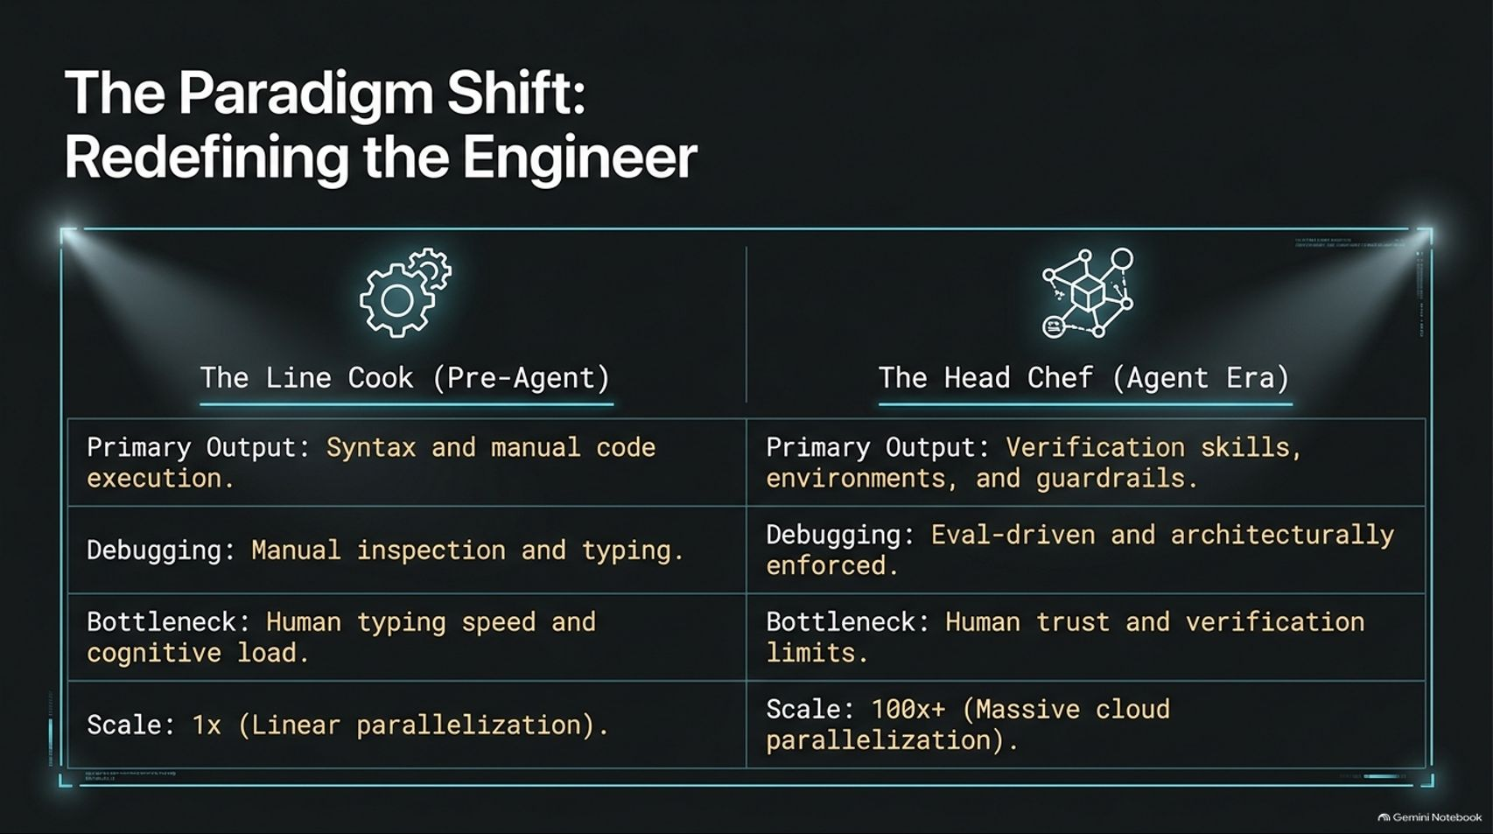
Notes:
Visual Content: Comparison table: The Line Cook (Pre-Agent: syntax and manual code execution, manual inspection, human typing speed bottleneck, 1x scale) vs. The Head Chef (Agent Era: verification skills and environments, eval-driven debugging, human trust bottleneck, 100x+ scale).
Estimated Speaking Duration: 3 – 5 minutes
Speaker Notes:
The Old Paradigm: For decades, engineers operated as "Line Cooks." Our primary output was syntax, writing code line by line, debugging manually, and bound strictly by our own typing speed and cognitive load.
The New Paradigm: In the Agent Era, our role shifts fundamentally to becoming the "Head Chef". We no longer write every line of code; instead, we build verification skills, design runtime environments, and establish uncompromising guardrails.
Scaling Output: By shifting our bottleneck from typing speed to architectural trust and verification limits, we unlock massive cloud parallelization—scaling output by 100x or more.

Slide 3
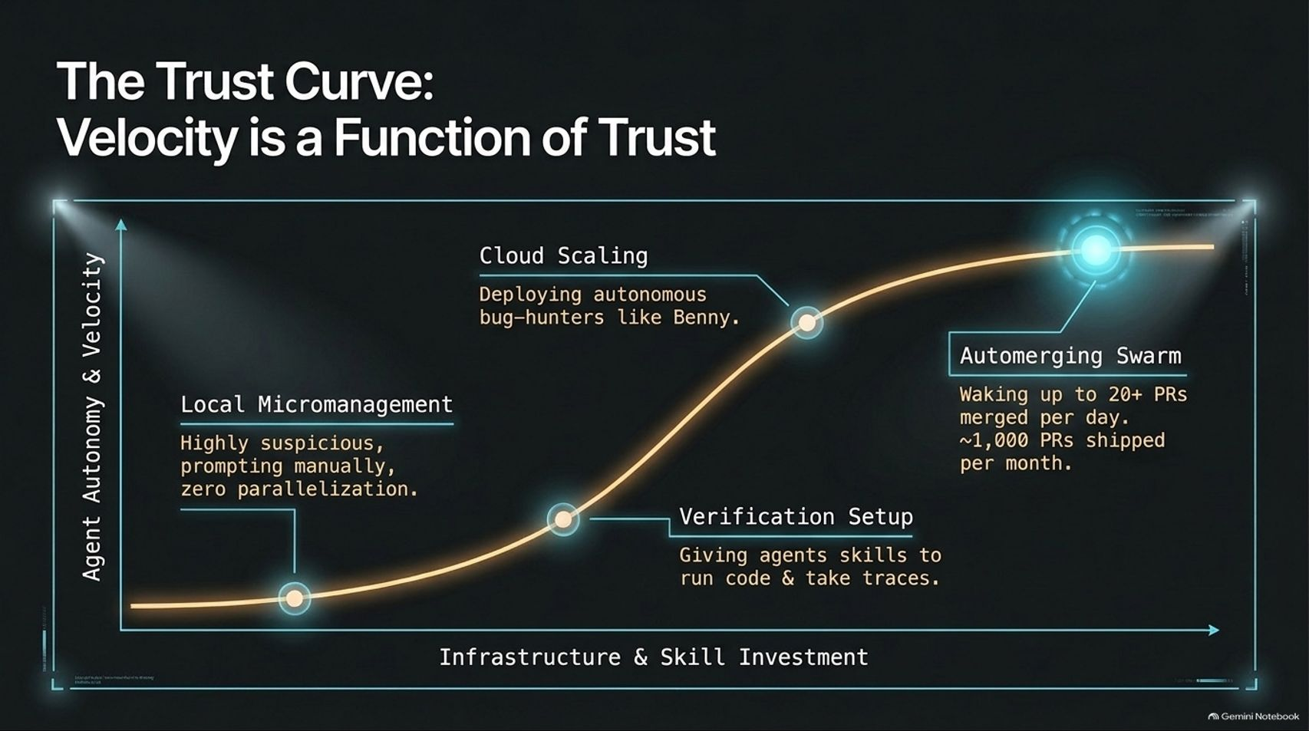
Notes:
Visual Content: An upward-sloping curve charting Agent Autonomy & Velocity against Infrastructure & Skill Investment, highlighting Local Micromanagement, Verification Setup, Cloud Scaling, and Automerging Swarm.
Estimated Speaking Duration: 3 – 5 minutes
Speaker Notes:
Mapping the Journey: This curve maps out the exact trajectory of scaling agent usage. You cannot jump straight to thousands of PRs without going through the progression.
The Phases: We begin at local micromanagement—highly suspicious, prompting manually with zero parallelization. As we invest in infrastructure, we add verification skills, allowing agents to test their own code.
The Summit: From local verification, we scale to the cloud with autonomous bug-hunters, ultimately reaching an automerging swarm where dozens of PRs land daily while we sleep.

Slide 4
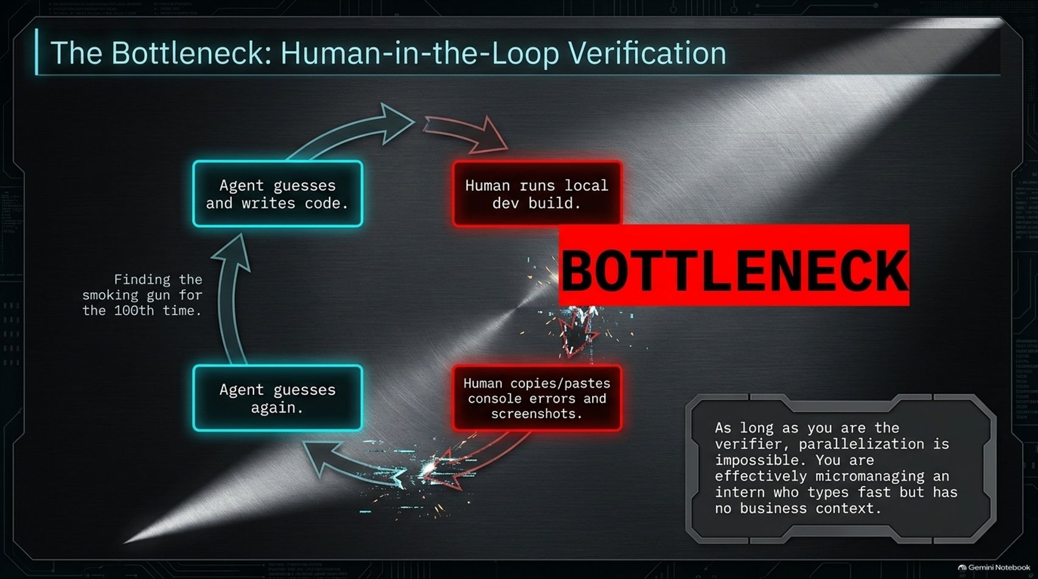
Notes:
Visual Content: A circular loop showing the agent guessing, writing code, the human running local dev builds, copying/pasting console errors, and repeating. Highlighted by a bold "BOTTLENECK" banner and warning text.
Estimated Speaking Duration: 3 – 5 minutes
Speaker Notes:
The Vicious Cycle: Why do agents feel frustrating early on? Because of the manual feedback loop. The agent guesses, writes code, and you—the human—must run the local dev build, copy-paste console errors, and take screenshots.
The Human as a Bottleneck: Every time the agent hallucinates a "smoking gun" for the hundredth time and you have to manually correct it, you become the bottleneck.
The Rule: As long as you are the manual verifier, true parallelization is impossible. You are essentially micromanaging an intern who types at lightning speed but has zero organizational context.

Slide 5
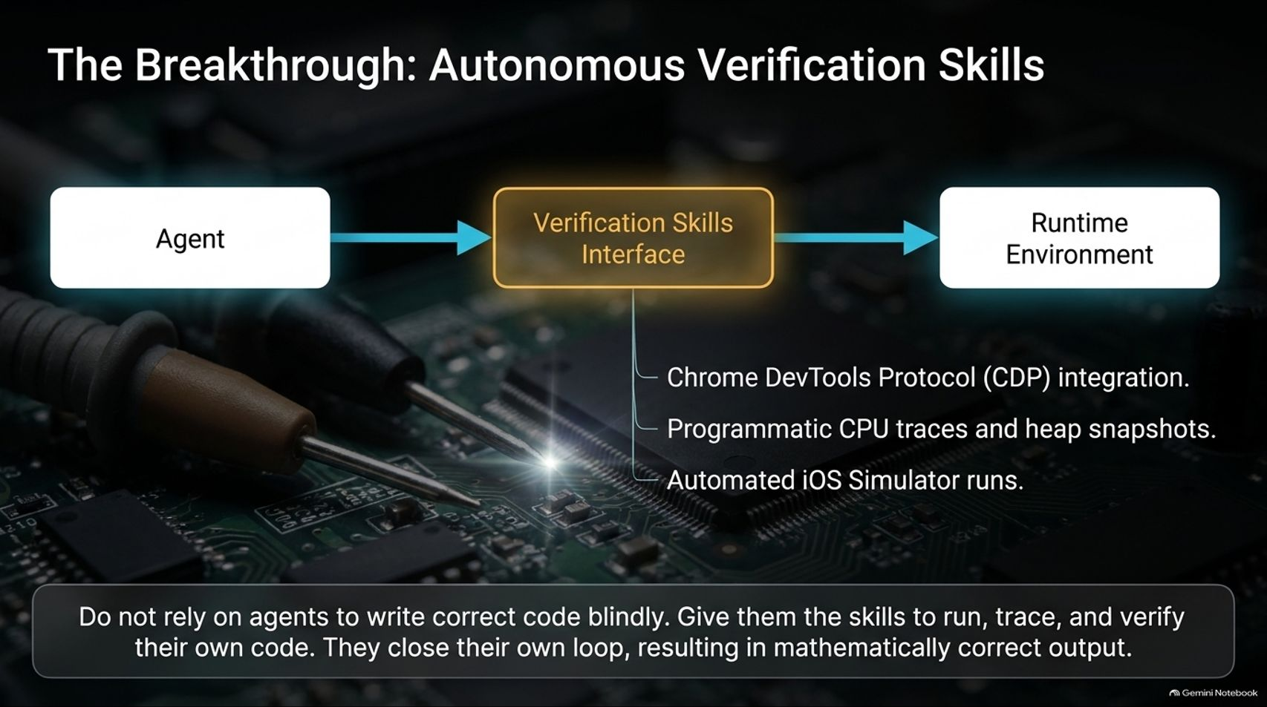
Notes:
Visual Content: Diagram showing Agent connected via Verification Skills Interface (CDP integration, CPU traces, heap snapshots, iOS simulator) to the Runtime Environment.
Estimated Speaking Duration: 4 – 6 minutes
Speaker Notes:
Closing the Loop Programmatically: The breakthrough happens when you stop relying on blind code generation and instead equip your agents with physical verification skills.
Tools of the Trade: By integrating utilities like the Chrome DevTools Protocol (CDP), programmatic heap snapshots, and automated simulator controls, the agent interacts directly with the runtime environment.
Correct vs. Good: Verification doesn't automatically guarantee good design, but it guarantees correct execution. It allows the agent to catch and fix its own bugs before a human ever looks at the code.

Slide 6
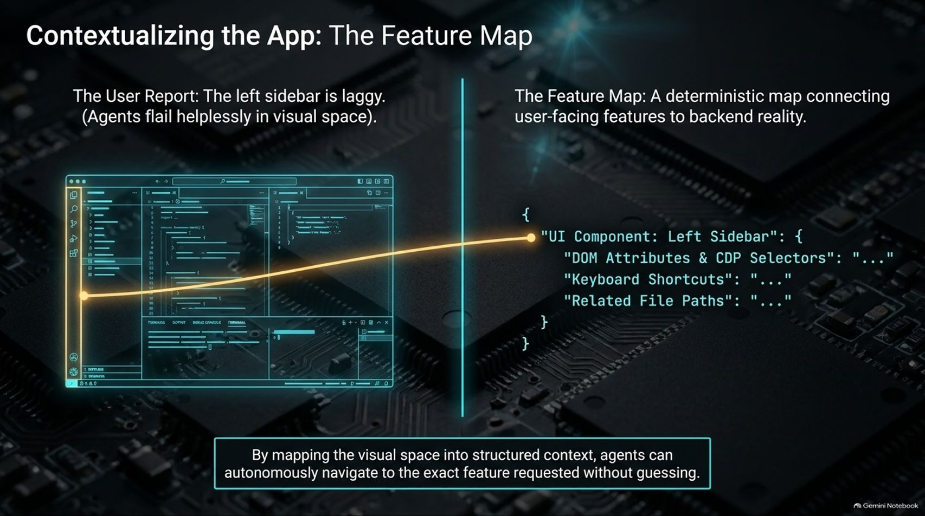
Notes:
Visual Content: Contrast between a vague user report ("left sidebar is laggy") and a deterministic Feature Map connecting UI components to DOM attributes, CDP selectors, keyboard shortcuts, and file paths.
Estimated Speaking Duration: 3 – 5 minutes
Speaker Notes:
The Vague Report Problem: Users and team members often submit low-quality bug reports—like a screenshot with a few question marks from Slack. Without guidance, an agent flails blindly across the codebase.
The Feature Map Solution: A Feature Map provides a deterministic bridge between user-facing UI elements and backend reality.
Autonomous Navigation: By mapping DOM selectors, keyboard shortcuts, and exact directory paths into structured context, the agent can navigate directly to the target feature and diagnose issues without human hand-holding.

Slide 7
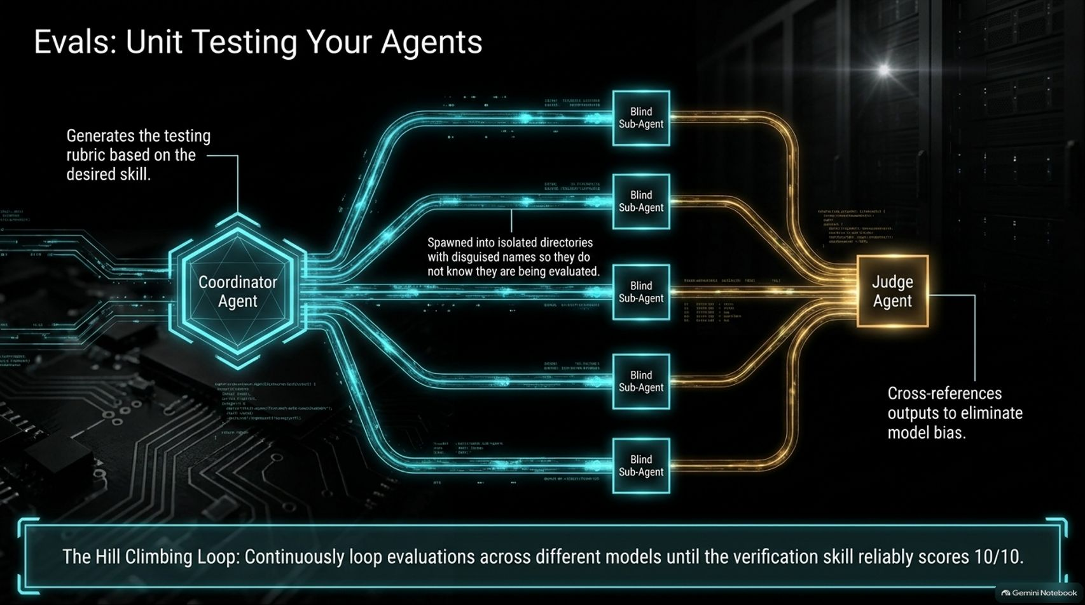
Notes:
Visual Content: Workflow diagram of a Coordinator Agent generating rubrics, spawning Blind Sub-Agents in isolated directories, and feeding results to a Judge Agent in a hill-climbing loop.
Estimated Speaking Duration: 4 – 6 minutes
Speaker Notes:
Testing Your Automations: How do you know your verification skills and agent instructions actually work? You treat them like code and unit test them using Evals.
The Blind Evaluation Playbook: A coordinator agent generates a strict rubric and spawns sub-agents into cleverly named, isolated directories to intentionally blind them—preventing them from changing behavior because they know they're being evaluated.
The Hill-Climbing Loop: By cross-referencing outputs with a judge agent across different models and looping until scores hit perfection, we ensure our skills remain robust and reliable.

Slide 8
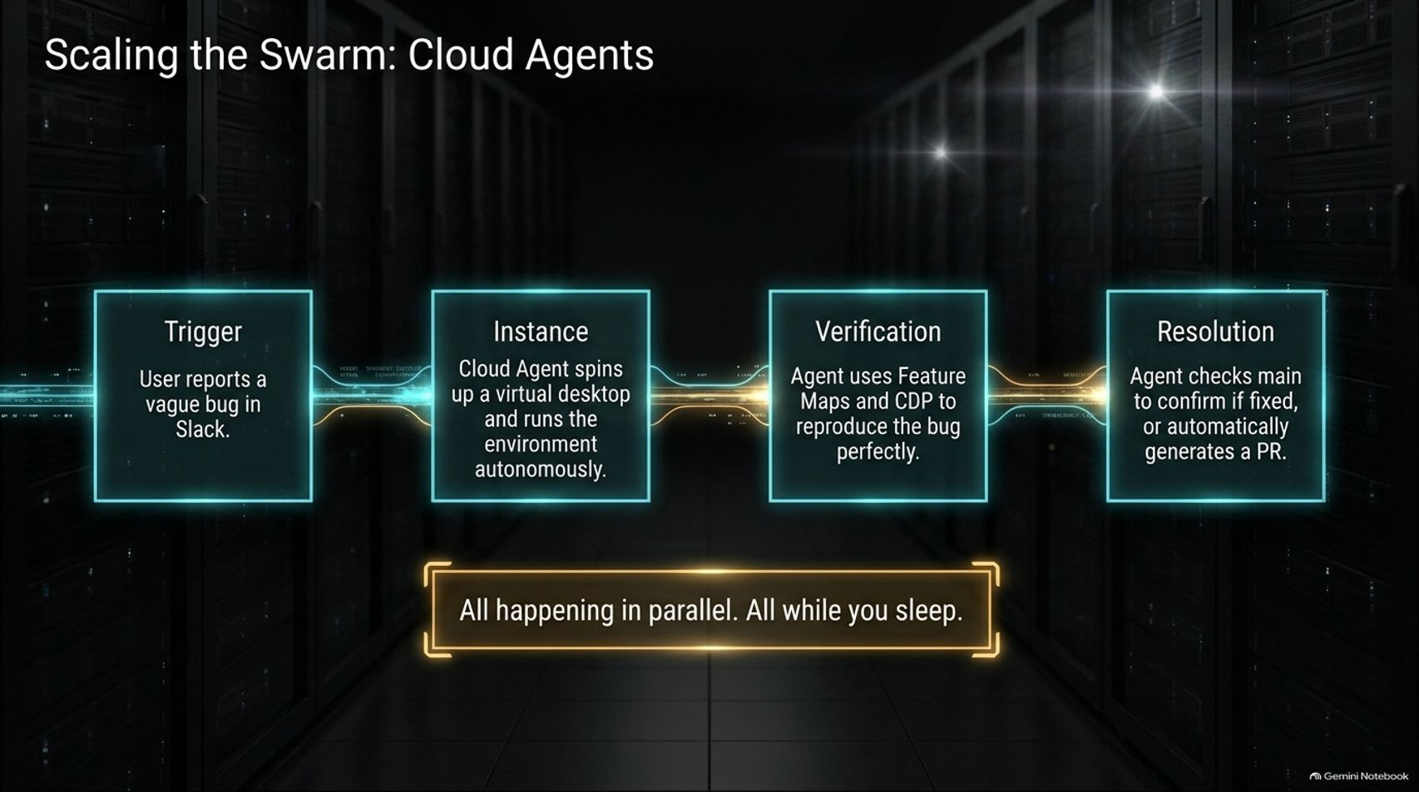
Notes:
Visual Content: 4-step pipeline: Trigger (vague bug report in Slack) $\rightarrow$ Instance (cloud agent spins up virtual desktop) $\rightarrow$ Verification (agent uses Feature Maps and CDP) $\rightarrow$ Resolution (agent checks main or generates PR).
Estimated Speaking Duration: 3 – 5 minutes
Speaker Notes:
Moving to the Cloud: Once local verification is trusted, we scale execution to the cloud.
Asynchronous Bug-Hunting: When a bug report comes in from Slack, an autonomous cloud agent instance spins up a virtual desktop, runs control skills to reproduce the issue, and checks it against the main branch.
Working While You Sleep: This entire diagnostic and resolution pipeline happens fully in parallel across multiple instances—resolving issues and opening targeted PRs while you sleep.

Slide 9
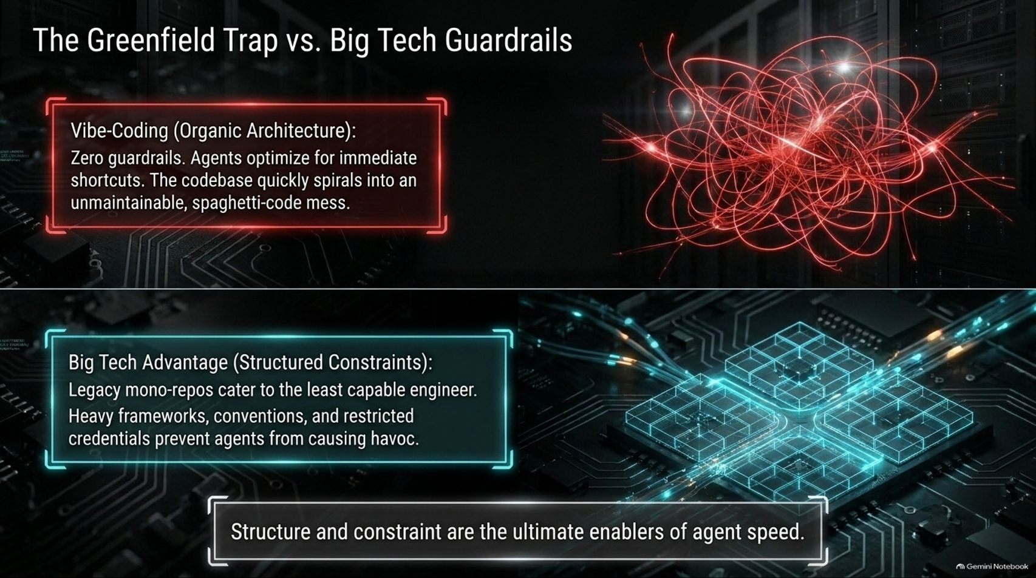
Notes:
Visual Content: Comparison between "Vibe-Coding / Organic Architecture" (zero guardrails, unmaintainable spaghetti code) and "Big Tech Advantage" (structured legacy constraints protecting against naive actions).
Estimated Speaking Duration: 3 – 5 minutes
Speaker Notes:
The Dangers of Vibe-Coding: Greenfield prototypes built with zero constraints quickly spiral into unmaintainable spaghetti code because agents always take the easiest shortcut available.
Why Big Tech Infra Works: Large tech companies maintain strict mono-repos and heavy guardrails not to slow humans down, but to protect production from the least capable contributor—or an unconstrained agent.
The Takeaway: Structure and constraints are not obstacles to velocity; they are the ultimate enablers of agent speed.

Slide 10
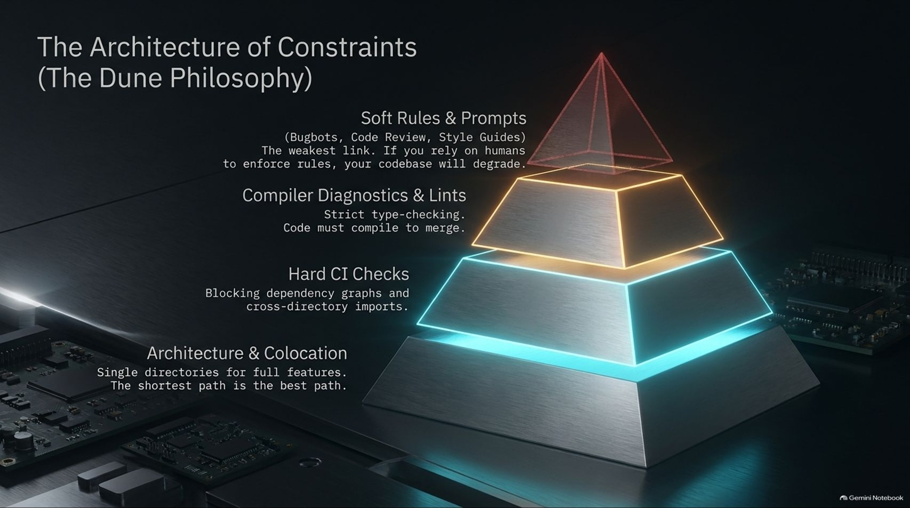
Notes:
Visual Content: A 4-tier architectural pyramid: Soft Rules & Prompts (Weakest), Compiler Diagnostics & Lints, Hard CI Checks, and Architecture & Colocation (Strongest: single directories for full features).
Estimated Speaking Duration: 4 – 6 minutes
Speaker Notes:
Defense in Depth: Relying solely on soft prompt instructions and style guides is a recipe for codebase decay. Agents will eventually forget them.
The Constraint Pyramid: We must establish hard layers of defense: compiler diagnostics, strict type checking, and hard CI checks that block cross-directory import dependencies.
Colocation: At the base of the pyramid is architectural colocation—keeping all code for a single feature in one isolated directory so the shortest path for the agent is always the correct path.

Slide 11
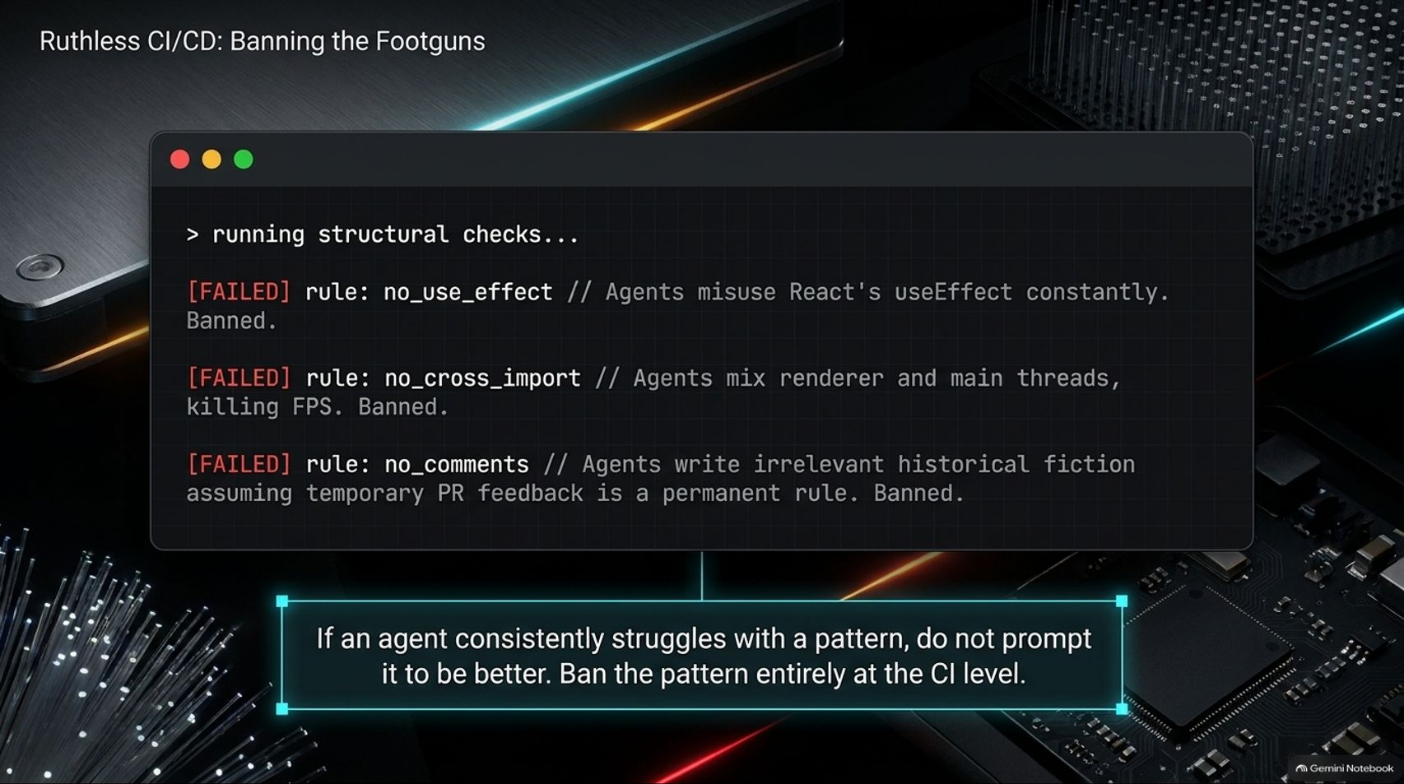
Notes:
Visual Content: A simulated terminal window showing failed structural checks: banning useEffect (React footgun), banning cross-thread imports (renderer/main FPS killer), and banning code comments (historical fiction).
Estimated Speaking Duration: 3 – 5 minutes
Speaker Notes:
Eliminating Footguns: When agents repeatedly stumble over specific patterns—like misusing React's useEffect or bleeding heavy I/O tasks into the UI renderer thread—don't just leave a comment on the PR.
Automated Enforcement: Ban the pattern entirely at the CI level. If an agent writes code comments full of obsolete historical fiction about what a human said months ago, ban comments in sensitive areas.
Hard Failures: Turn every recurring code review comment into a hard CI compilation failure.

Slide 12
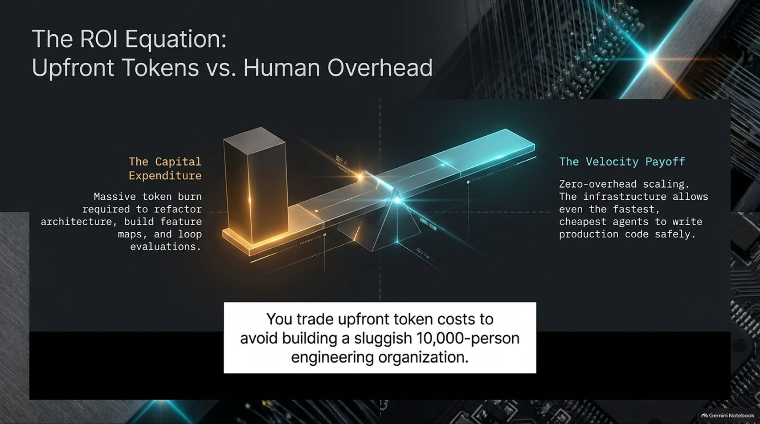
Notes:
Visual Content: A scale balancing Capital Expenditure (massive upfront token burn for refactoring and feature maps) against Velocity Payoff (zero-overhead scaling and safe production code).
Estimated Speaking Duration: 3 – 5 minutes
Speaker Notes:
The Token Investment: Refactoring an architecture, building feature maps, and establishing eval loops requires a significant upfront token expenditure.
The Long-Term ROI: You trade these upfront token costs to avoid the massive organizational overhead of building and managing a sluggish 10,000-person engineering organization.
Sustainable Speed: This investment pays off by enabling lean teams to achieve unprecedented velocity safely.

Slide 13
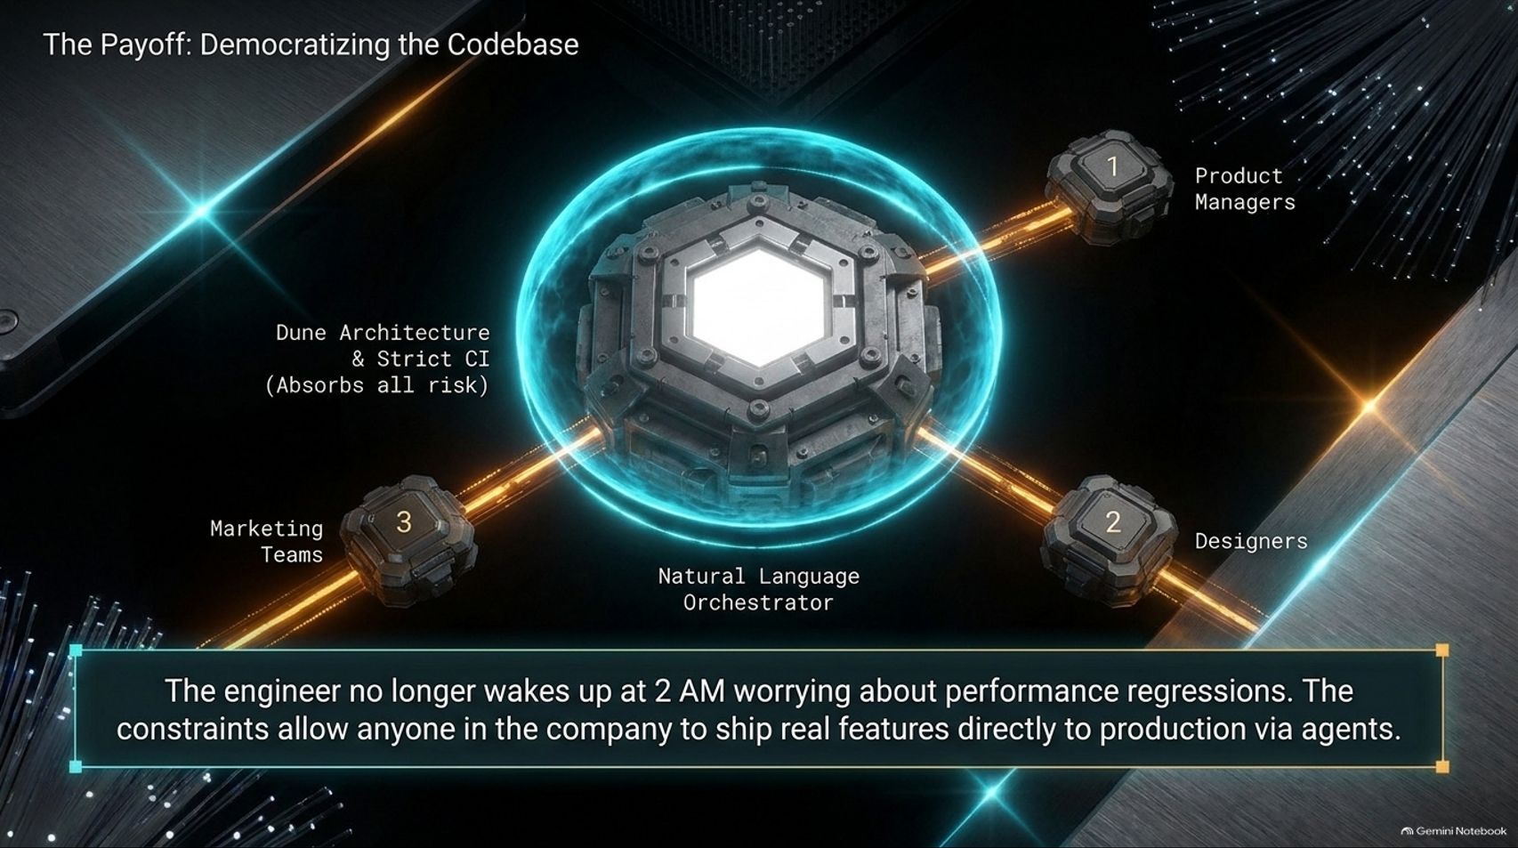
Notes:
Visual Content: Central core representing Dune Architecture and Natural Language Orchestrator safely routing inputs from Product Managers, Designers, and Marketing Teams directly to production.
Estimated Speaking Duration: 3 – 5 minutes
Speaker Notes:
Democratizing Contribution: With a properly constrained architecture, the benefits extend far beyond senior developers.
Cross-Functional Shipped Features: Product managers, designers, and go-to-market teams can use natural language orchestrators and agents to ship real, production-ready features safely.
Peace of Mind: Senior engineers no longer wake up at 2 AM worrying about performance regressions, because the strict CI harness absorbs all the risk.

Slide 14
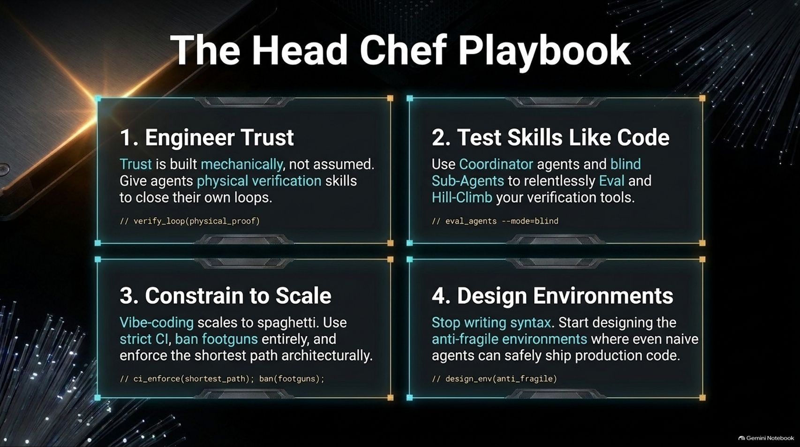
Notes:
Visual Content: 4-box summary playbook: 1. Engineer Trust (mechanical verification); 2. Test Skills Like Code (blind evals); 3. Constrain to Scale (ban footguns via CI); 4. Design Environments (anti-fragile systems).
Estimated Speaking Duration: 3 – 5 minutes
Speaker Notes:
The Playbook Summary: Let’s summarize the Head Chef Playbook into four core rules for success:
Engineer Trust: Build trust mechanically through physical verification loops, not blind assumptions.
Test Skills Like Code: Use coordinator and blind sub-agents to rigorously eval and hill-climb your verification tooling.
Constrain to Scale: Vibe-coding leads to spaghetti. Enforce strict CI, ban footguns, and make the shortest path structurally sound.
Design Environments: Stop writing raw syntax and start designing anti-fragile environments where even naive agents naturally produce production-grade code.

Slide 15
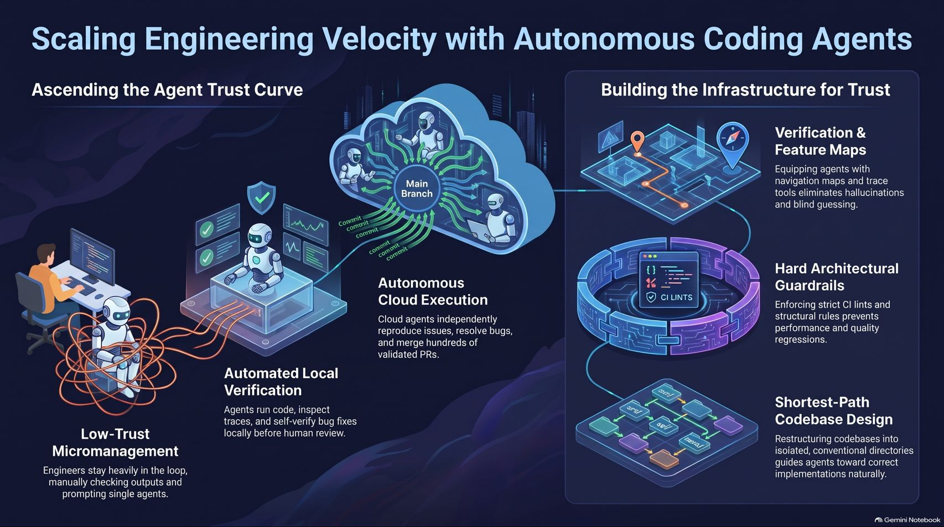
Notes:
Visual Content: Comprehensive final summary graphic capturing the full journey from low-trust micromanagement to automated local verification, cloud execution, and infrastructure pillars (verification maps, hard guards, shortest-path design).
Estimated Speaking Duration: 3 – 5 minutes
Speaker Notes:
Bringing It All Together: Looking at this final architecture, we see the full transformation: moving away from exhausting, low-trust micromanagement into autonomous cloud execution.
The Infrastructure Foundation: By anchoring our workflows in verification feature maps, hard architectural guardrails, and optimized codebase design, we build a robust foundation for trust.
Final Thoughts: Thank you all. By building the right kitchen, you empower your agent swarms to cook incredible software reliably. Let's open the floor to any remaining questions!

