Slide 1

Notes:
Visual Content: Title: "The Architecture of Quiet Confidence: Mastering the psychology of silent attractiveness and authentic social influence".
Estimated Speaking Duration: 2 – 3 minutes
Speaker Notes:
Opening & Hook: Welcome everyone. Let's begin by addressing a fundamental truth about human social dynamics: true attractiveness begins long before you ever speak a single word.
The Myth of Loud Dominance: Society often teaches us that to be noticed, influential, or attractive, we must be the loudest person in the room, dominate every conversation, and constantly prove our worth. But real presence doesn't scream; it anchors.
Setting the Intention: In this presentation, we are exploring "The Architecture of Quiet Confidence." This isn’t about adopting fake mysterious personas or withholding your personality. It’s about building an internal character so grounded, a mind so composed, and a presence so genuine that you no longer depend on constant external validation to feel valuable. Let’s dive into how you cultivate this transformation from the inside out.
BE SILENTLY ATTRACTIVE: Master the Psychology of Quiet Confidence and Social Influence | Audiobook
https://www.youtube.com/watch?v=BIlQ2VODEz0

Slide 2
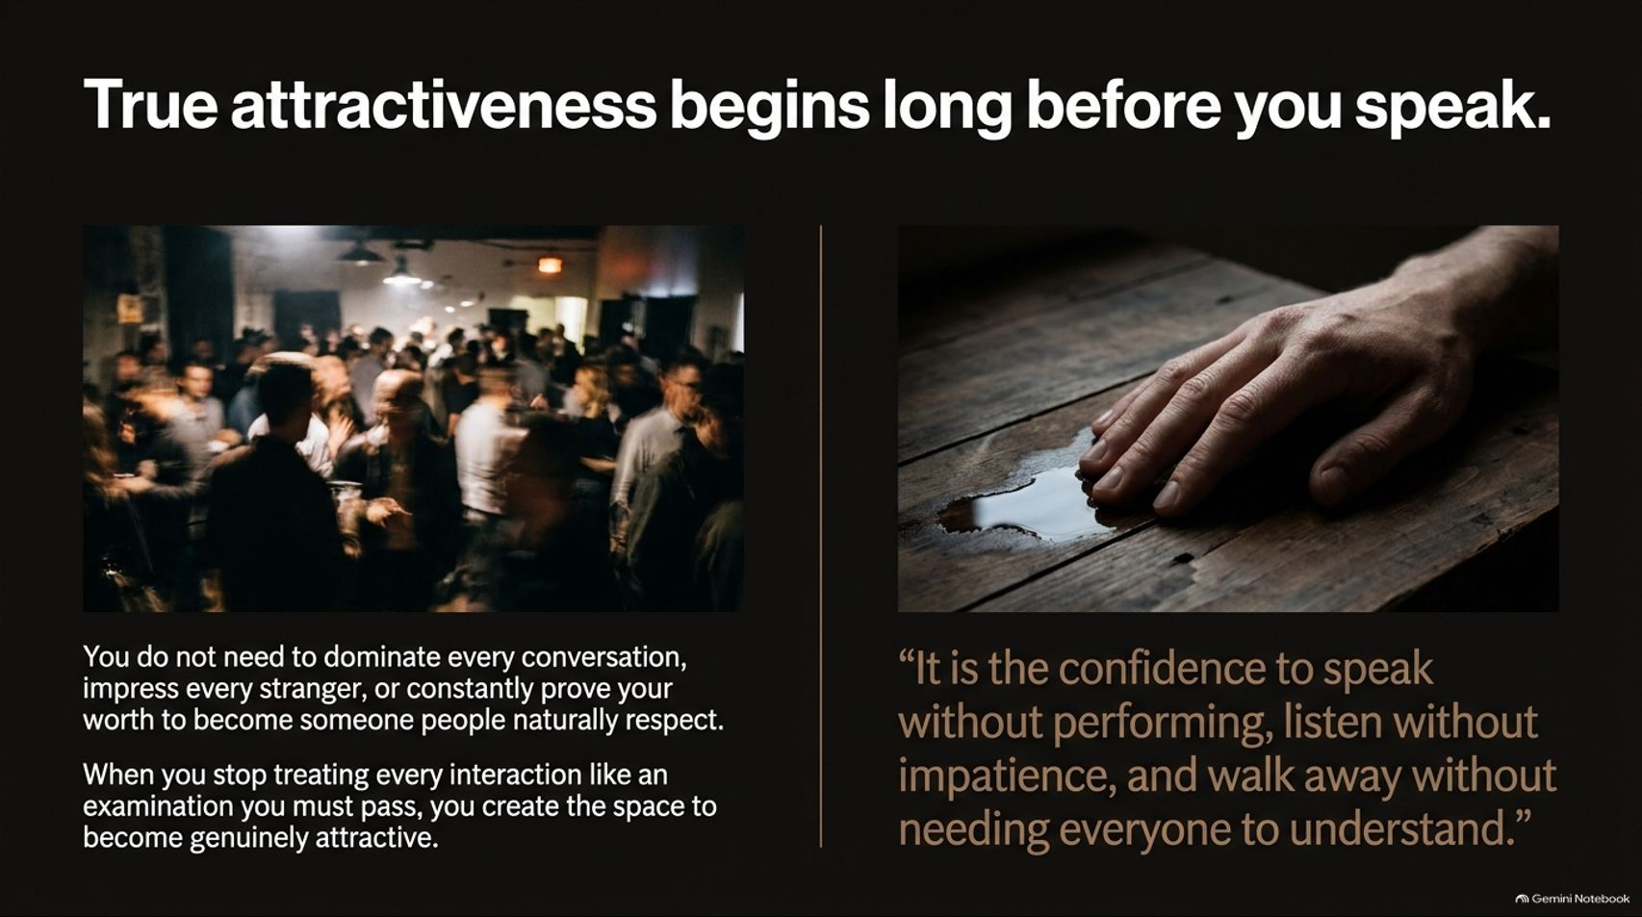
Notes:
Visual Content: Two-column layout contrasting a crowded, chaotic social setting with a calm, grounded hand on a wooden table, emphasizing the confidence to speak without performing, listen without impatience, and walk away without needing everyone to understand.
Estimated Speaking Duration: 3 – 5 minutes
Speaker Notes:
The Physicality of Presence: People absorb your energy, your composure, and your comfort level before your message even registers. You do not need to impress every stranger you meet.
Stopping the Performance: When you treat every social interaction like an examination you are desperate to pass, you project anxiety. Conversely, when you stop treating conversations as tests, you create the psychological breathing room needed to become genuinely attractive.
Three Core Pillars: Look closely at the quote on screen: "It is the confidence to speak without performing, listen without impatience, and walk away without needing everyone to understand your decision." Mastery means letting go of the exhausting burden of managing every single person's perception of you.

Slide 3
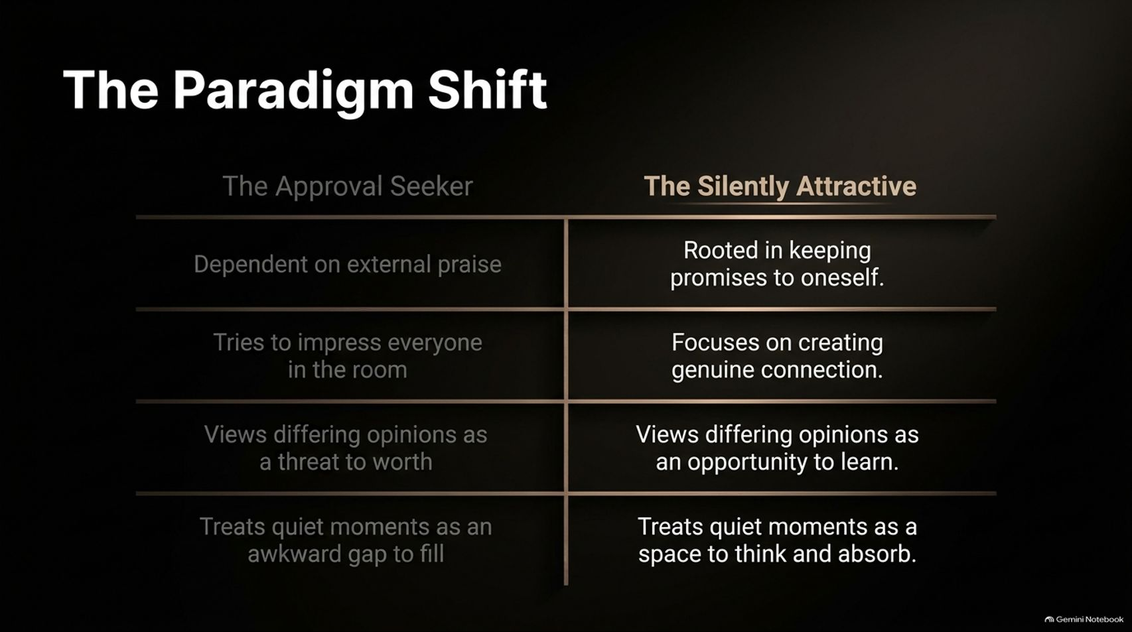
Notes:
Visual Content: A comparison table contrasting "The Approval Seeker" (dependent on praise, tries to impress everyone, views differing opinions as threats, views quiet moments as awkward gaps) against "The Silently Attractive" (rooted in self-promises, creates genuine connection, views differing opinions as learning opportunities, treats quiet moments as space to think).
Estimated Speaking Duration: 3 – 5 minutes
Speaker Notes:
Analyzing the Split: Let's look at the stark contrast between two mindsets. The approval seeker lives as a slave to external praise. If the room likes them, they feel worthy; if someone disagrees or remains unimpressed, their entire emotional stability crumbles.
The Shift to Internal Anchoring: In contrast, the silently attractive person derives stability from keeping promises to themselves. They don't view a differing opinion as a personal attack or a threat to their worth; they view it as an interesting perspective or an opportunity to learn.
Embracing Silence: Notice how each archetype handles quiet moments. The approval seeker panics, treating silence as an awkward gap that must be filled with nervous chatter. The silently attractive person welcomes quiet spaces as a natural, comfortable environment to absorb and think.

Slide 4
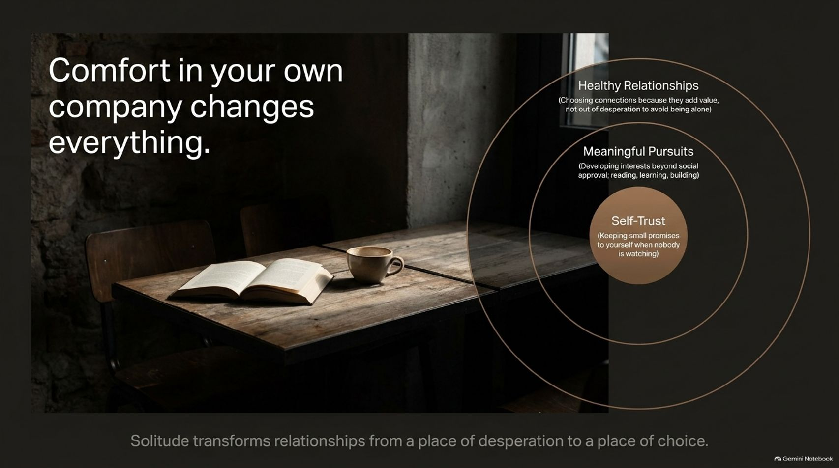
Notes:
Visual Content: Warm, rustic interior scene with an open book and coffee cup, alongside concentric circles depicting the expansion from Self-Trust (keeping small promises) to Meaningful Pursuits and Healthy Relationships.
Estimated Speaking Duration: 4 – 6 minutes
Speaker Notes:
The Foundation of Solitude: Solitude is the ultimate test of emotional independence. If you cannot stand being alone with your own thoughts, you will constantly accept toxic relationships, bad friendships, and unfulfilling circles simply to avoid the fear of being left out.
The Three Concentric Rings:
Self-Trust: It starts at the core—keeping small promises to yourself when nobody is watching.
Meaningful Pursuits: Developing genuine interests, reading, learning, and building skills beyond social approval.
Healthy Relationships: Only when the inner two rings are established can you choose connections because they add genuine value, not out of desperation.
Transforming Solitude: Solitude transforms relationships from a desperate bid for survival into a conscious, empowered choice.

Slide 5
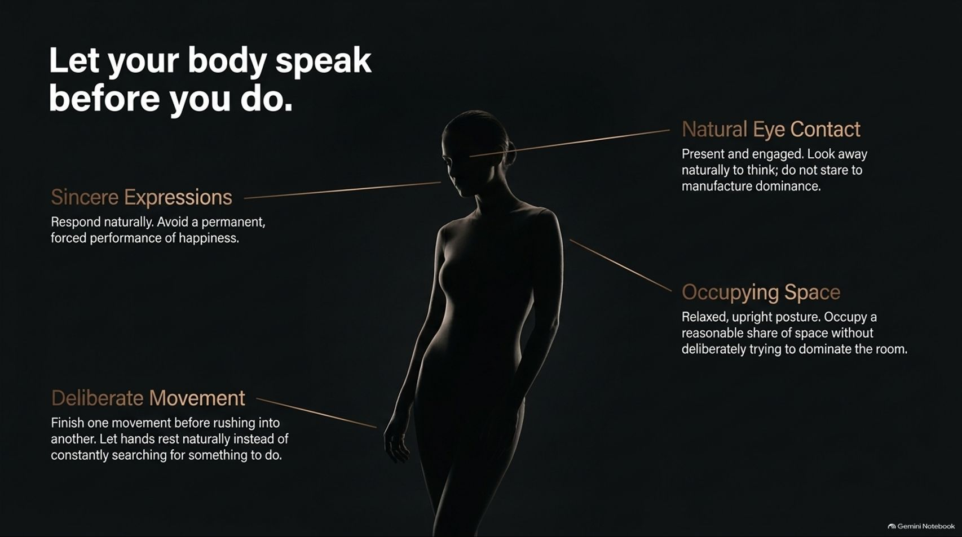
Notes:
Visual Content: Silhouette diagram outlining key non-verbal anchors: Sincere Expressions, Deliberate Movement, Natural Eye Contact, and Occupying Space.
Estimated Speaking Duration: 3 – 5 minutes
Speaker Notes:
Non-Verbal Congruence: Your body communicates long before your lips move. Nervous fidgeting, darting eyes, or collapsing posture instantly telegraph insecurity.
Breaking Down the Elements:
Occupying Space: Stand with an upright, relaxed posture. Take up a reasonable share of space without aggressively trying to dominate or intimidate the room.
Deliberate Movement: Slow down. Finish one physical movement before rushing into another. Let your hands rest naturally instead of constantly searching for your phone or fidgeting.
Natural Eye Contact: Stay present and engaged. Look away naturally when thinking rather than engaging in aggressive, manufactured stares designed to prove dominance.
Sincere Expressions: Avoid permanent, forced performances of happiness. Let your face respond naturally to the actual flow of conversation.

Slide 6
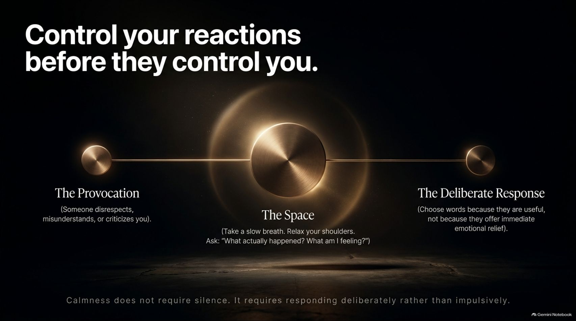
Notes:
Visual Content: Flowchart illustrating emotional regulation: The Provocation $\rightarrow$ The Space (take a slow breath, ask "What actually happened?") $\rightarrow$ The Deliberate Response.
Estimated Speaking Duration: 4 – 6 minutes
Speaker Notes:
The Power of the Pause: When someone disrespects, misunderstands, or criticizes you, your immediate biological impulse is defensive reaction—anger, embarrassment, or biting back. Quiet confidence inserts a vital gap between stimulus and response.
Creating "The Space": In that micro-moment, take a slow breath, relax your shoulders, and ask yourself two grounding questions: "What actually happened?" and "What am I feeling right now?"
Choosing Deliberate Action: Calmness does not mean you are a doormat or that you never speak up. It means you choose your words because they are genuinely useful and strategic, not because you are leaking raw emotional distress seeking immediate relief.

Slide 7
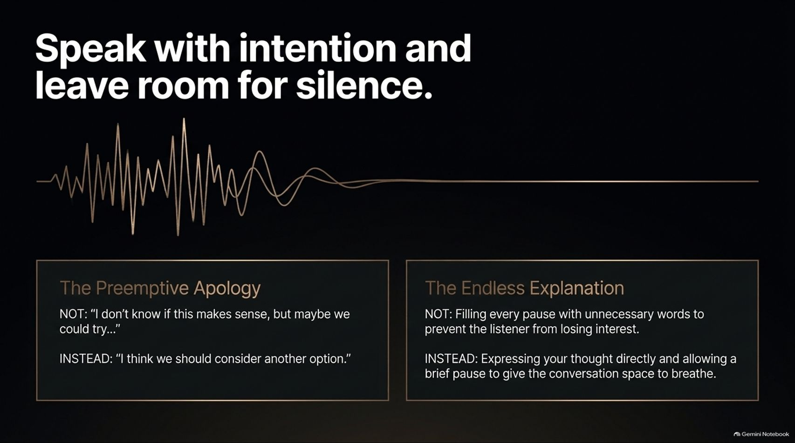
Notes:
Visual Content: Audio waveform visualizer contrasting bad communication habits—"The Preemptive Apology" and "The Endless Explanation"—against direct, intentional communication paired with deliberate pauses.
Estimated Speaking Duration: 3 – 5 minutes
Speaker Notes:
Dropping the Preemptive Apology: How often do you start sentences with, "I don't know if this makes sense, but..." or "I'm probably wrong, but..."? You undermine your own ideas before they even leave your mouth. Replace hedging with direct statement: "I think we should consider another option."
Stopping the Endless Explanation: Insecure communicators feel a compulsive need to fill every silence, over-explaining simple points out of fear that the listener will lose interest.
The Power of the Stop: Express your thought clearly, make your point, and then stop talking. Allow the conversation room to breathe. Silence is not an enemy to be defeated; it's a punctuation mark that lends weight to your words.

Slide 8
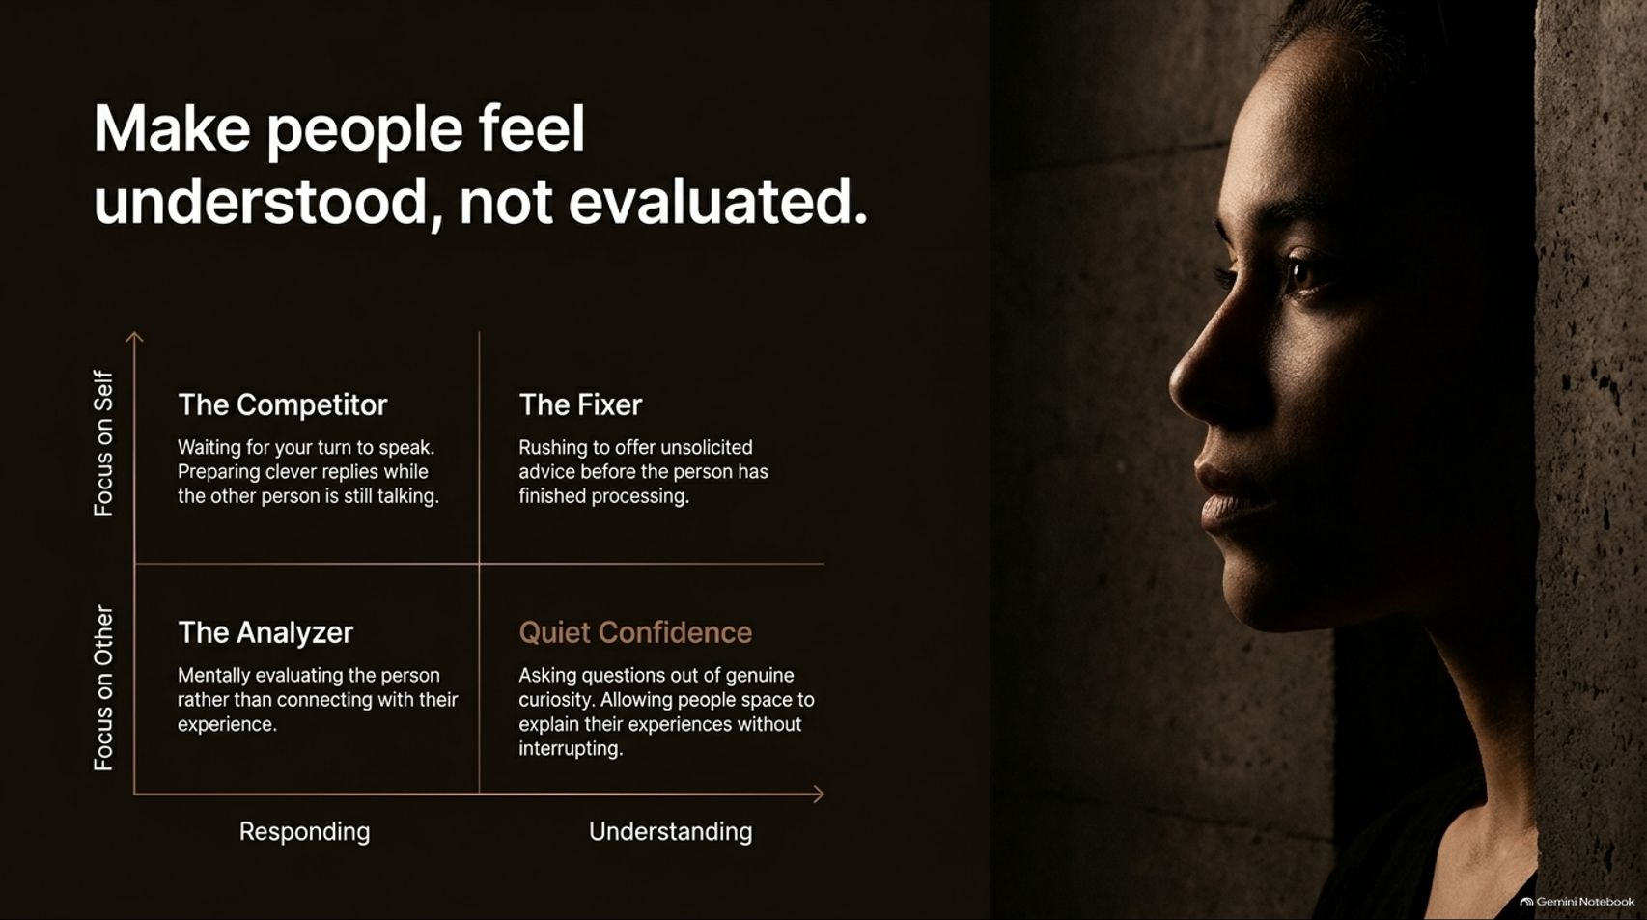
Notes:
Visual Content: A 2x2 behavioral matrix mapping Focus on Self vs. Focus on Other against Responding vs. Understanding. Highlights: The Competitor, The Fixer, The Analyzer, and Quiet Confidence.
Estimated Speaking Duration: 4 – 6 minutes
Speaker Notes:
Deconstructing the Matrix: Let's look at how people show up in conversation.
The Competitor: Focused on self and responding; waiting impatiently for their turn to speak while rehearsing a clever comeback.
The Fixer: Rushing in with unsolicited advice before the other person has even finished processing their emotions.
The Analyzer: Mentally evaluating, judging, and grading the other person instead of connecting.
The Quiet Confidence Quadrant: Focus on the other person with the intent to understand. Ask questions out of genuine curiosity, allow people space to express their experiences fully, and banish the urge to interrupt. When people feel understood rather than judged, they naturally gravitate toward your presence.

Slide 9
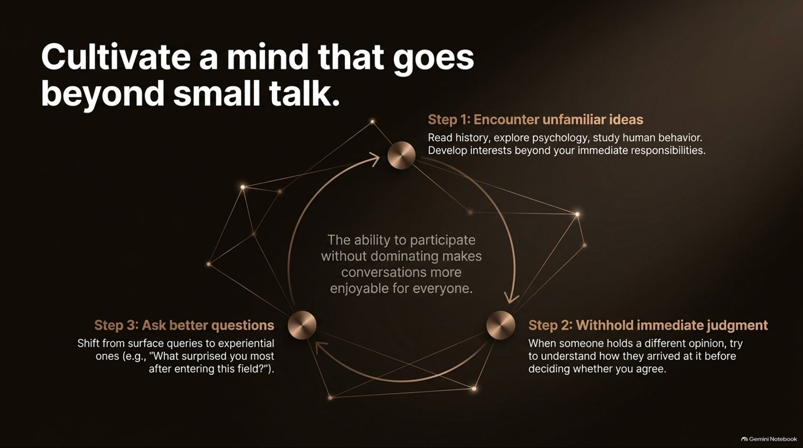
Notes:
Visual Content: Circular feedback loop illustrating 3 steps: Encounter unfamiliar ideas $\rightarrow$ Withhold immediate judgment $\rightarrow$ Ask better questions (shifting from surface queries to experiential ones).
Estimated Speaking Duration: 3 – 5 minutes
Speaker Notes:
Escaping Surface Dialogue: Small talk is comfortable, but it rarely builds deep influence. To be compelling, you must cultivate a genuinely curious mind.
The Three-Step Intellectual Cycle:
Encounter Unfamiliar Ideas: Read history, study psychology, and explore human behavior outside your immediate professional silo.
Withhold Immediate Judgment: When faced with an opposing view, seek to understand how the other person arrived at that conclusion before deciding whether you agree.
Ask Better Questions: Move past surface queries ("What do you do?") to experiential ones ("What surprised you most after entering this field?").
Intellectual Humility: True confidence welcomes learning; insecurity pretends to already know everything.

Slide 10

Notes:
Visual Content: A scale weighing "Protecting an Image" (competing for status, correcting others, defending flawed ideas) against "Building Character" (following through, giving credit, acknowledging mistakes, disagreeing without humiliation).
Estimated Speaking Duration: 4 – 6 minutes
Speaker Notes:
Status vs. Substance: There is a stark gulf between demanding respect through rank or title and commanding respect through unshakeable character.
The Trap of Protecting an Image: Insecure professionals spend massive amounts of energy correcting colleagues, fighting to defend original ideas even when proven wrong, and elbowing for status.
The Character-Driven Approach: Build respect by following through on your commitments, gracefully admitting mistakes without shifting blame, giving credit where it's due, and disagreeing with people in a way that preserves their dignity. You don't need to stand above others to be a person worth respecting.

Slide 11
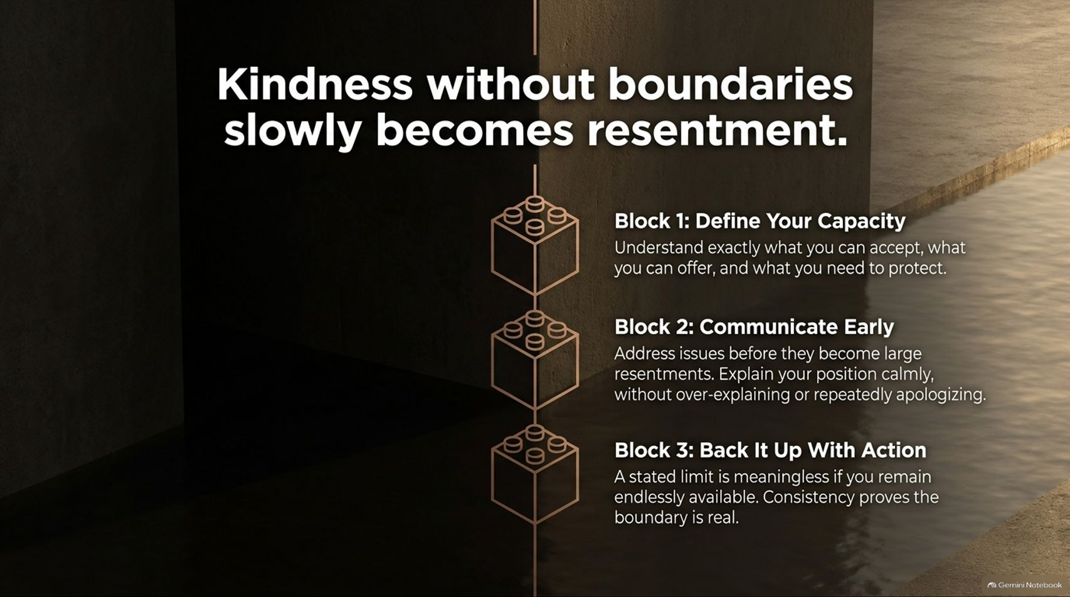
Notes:
Visual Content: Three stacked Lego-like building blocks: Block 1 (Define Your Capacity), Block 2 (Communicate Early), and Block 3 (Back It Up With Action).
Estimated Speaking Duration: 4 – 6 minutes
Speaker Notes:
The Trap of Chronic Yes-Saying: Many people believe that being kind means saying yes to every request, favor, or demand. Over time, unconstrained kindness curdles into bitter resentment.
The Three Boundary Blocks:
Block 1: Define Your Capacity: Know precisely what you can accept, what you can offer, and what you must protect.
Block 2: Communicate Early: Address friction points calmly before they turn into towering resentments, without over-explaining or apologizing excessively.
Block 3: Back It Up With Action: A boundary is useless if you remain endlessly available. Consistency proves your limits are real.

Slide 12
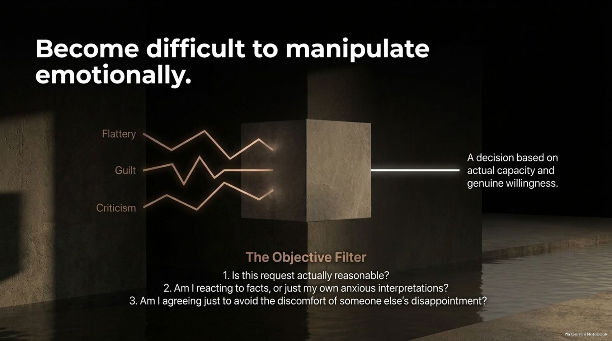
Notes:
Visual Content: A graphic showing jagged lines of Flattery, Guilt, and Criticism passing through "The Objective Filter" (a central stone block) resulting in a clean, steady decision based on actual capacity.
Estimated Speaking Duration: 4 – 6 minutes
Speaker Notes:
Navigating Emotional Pressure: Manipulators and high-stress environments rely on emotional levers—flattery, guilt trips, and harsh criticism—to force compliance.
The Objective Filter Questions: When pressure mounts, run the situation through three objective check-questions:
Is this request actually reasonable?
Am I reacting to objective facts, or just my own anxious interpretations?
Am I agreeing simply to avoid the temporary discomfort of someone else's disappointment?
Decoupling from Guilt: When you filter out emotional manipulation, your decisions stem from genuine willingness and capacity rather than fear.

Slide 13
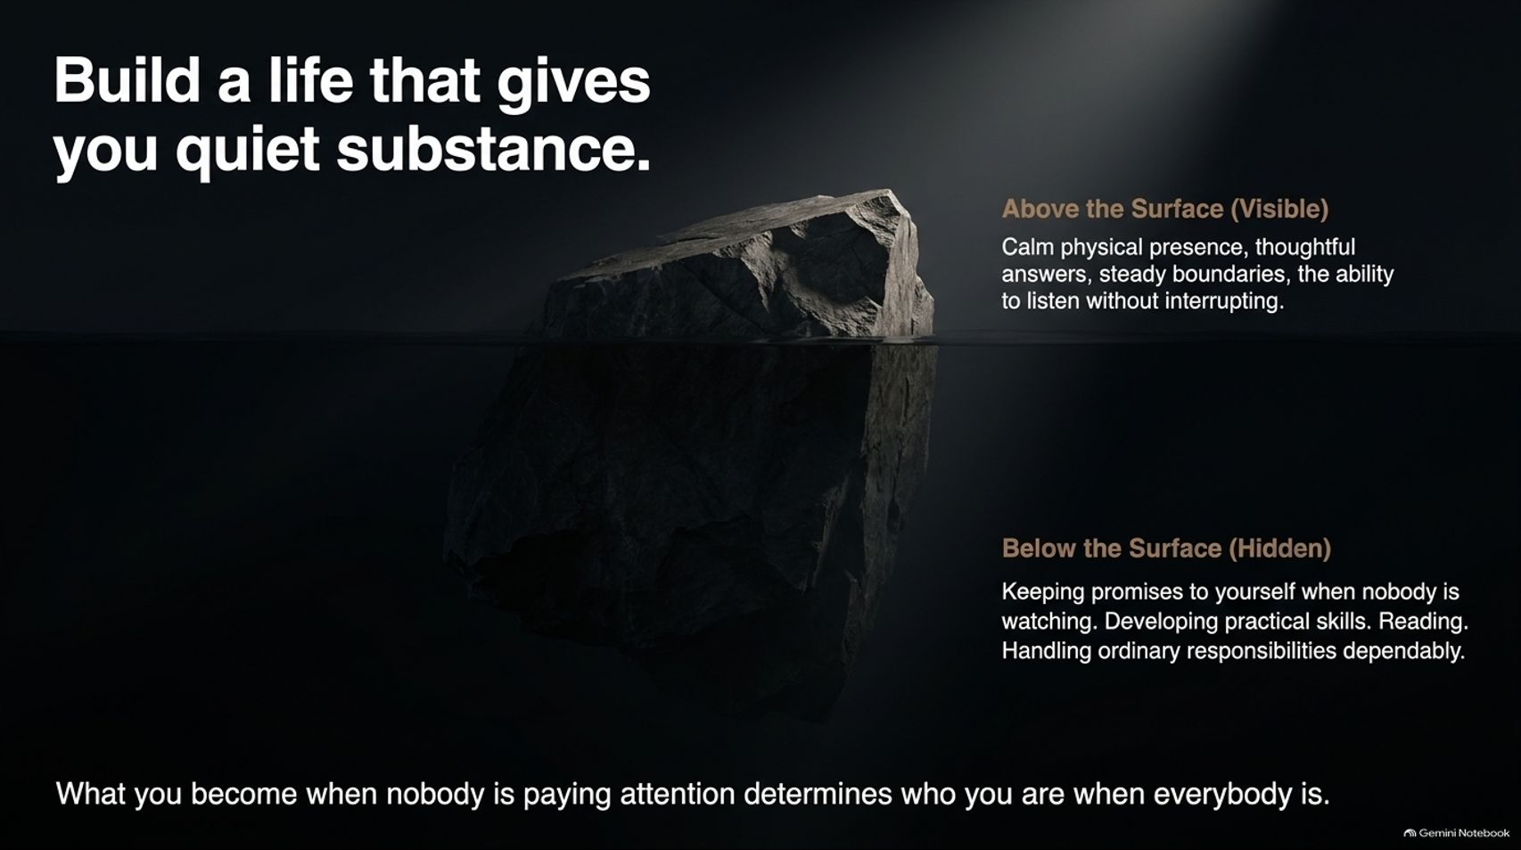
Notes:
Visual Content: An iceberg graphic illustrating "Above the Surface (Visible)"—calm presence, thoughtful answers, steady boundaries—versus "Below the Surface (Hidden)"—keeping private promises, skill building, reading, and dependable responsibility.
Estimated Speaking Duration: 4 – 6 minutes
Speaker Notes:
The Iceberg Principle: What people see above the surface—your calm demeanor, poised speech, and strong boundaries—is only the tiny visible tip of the iceberg.
Substance Below the Waterline: The massive bulk of your confidence rests underwater: keeping private promises to yourself when nobody is watching, reading, developing practical skills, and handling ordinary responsibilities without applause.
The Core Motto: "What you become when nobody is paying attention determines who you are when everybody is." Substance cannot be faked; it must be built day by quiet day.

Slide 14
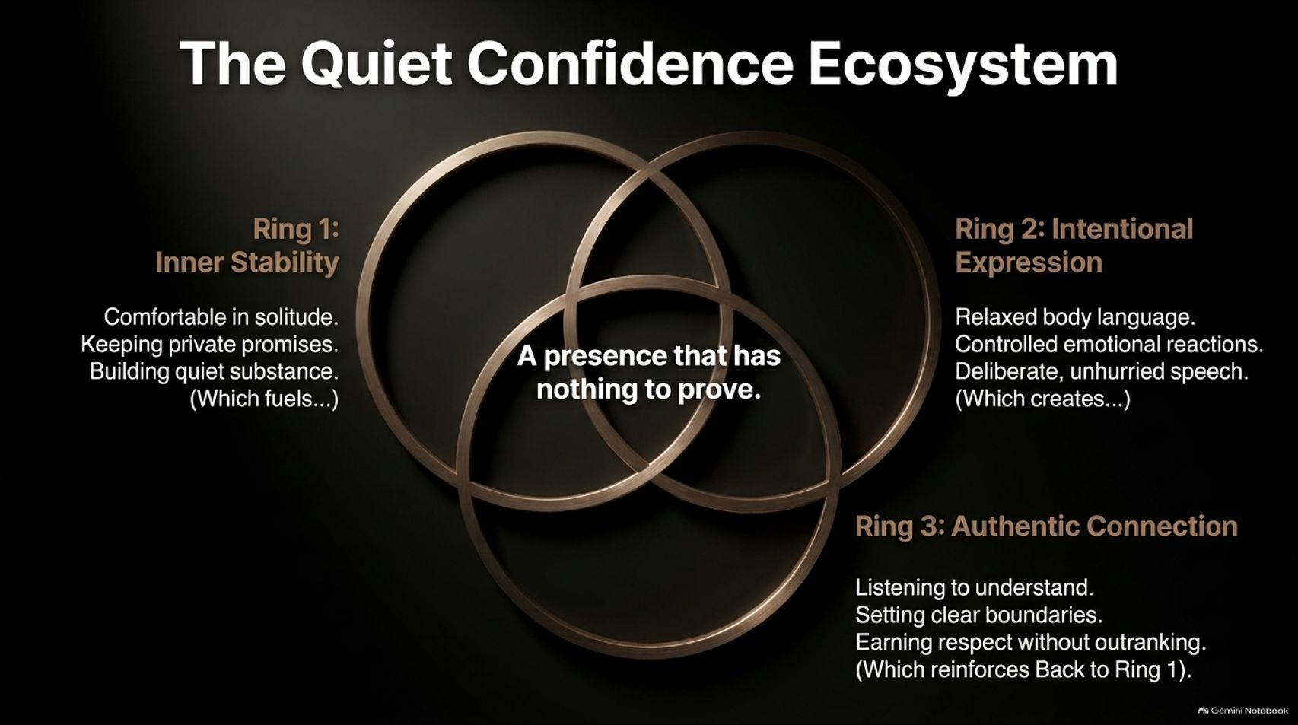
Notes:
Visual Content: A Venn diagram of three interlocking gold rings: Ring 1 (Inner Stability), Ring 2 (Intentional Expression), and Ring 3 (Authentic Connection), intersecting at the center: "A presence that has nothing to prove."
Estimated Speaking Duration: 4 – 6 minutes
Speaker Notes:
The Interlocking Ecosystem: Quiet confidence isn't a single isolated trick; it's a closed-loop ecosystem composed of three supporting pillars:
Ring 1 (Inner Stability): Solitude comfort, private promise-keeping, and building quiet substance.
Ring 2 (Intentional Expression): Relaxed body language, controlled reactions, unhurried speech.
Ring 3 (Authentic Connection): Listening to understand, setting firm boundaries, and earning respect without outranking.
The Center Point: When these three rings overlap seamlessly, you unlock the ultimate state: A presence that has nothing to prove.

Slide 15
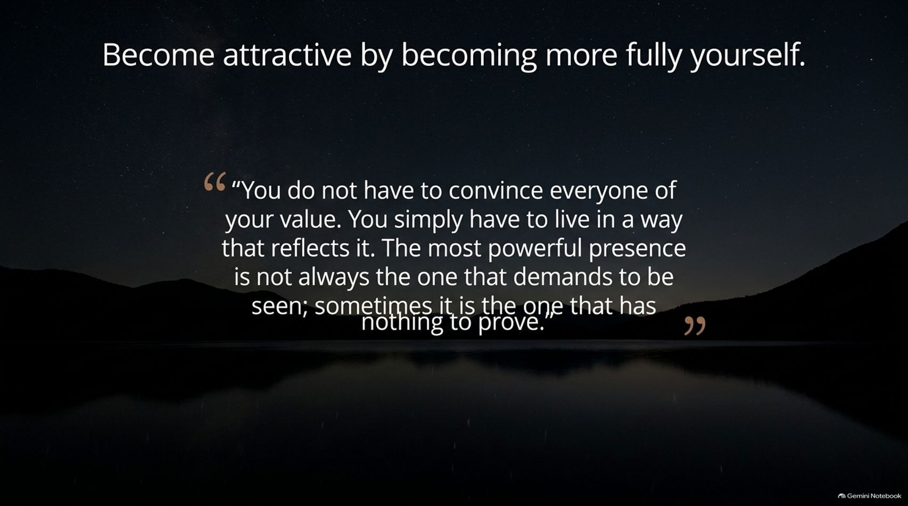
Notes:
Visual Content: A reflective quote card set against a serene night landscape: "You do not have to convince everyone of your value. You simply have to live in a way that reflects it..."
Estimated Speaking Duration: 3 – 5 minutes
Speaker Notes:
Dropping the Mask: Personal development often fails when people treat it as an attempt to construct a fake, perfect personality. Real attractiveness is an act of un-masking.
Removing Performance Anxiety: You stop exhausting yourself trying to convince every single person in your orbit that you are valuable. Instead, you shift focus entirely to living out your values consistently.
The Ultimate Liberation: The most powerful presence in any room is rarely the one demanding to be seen; it is the quiet, anchored presence of someone who simply has nothing left to prove.

Slide 16
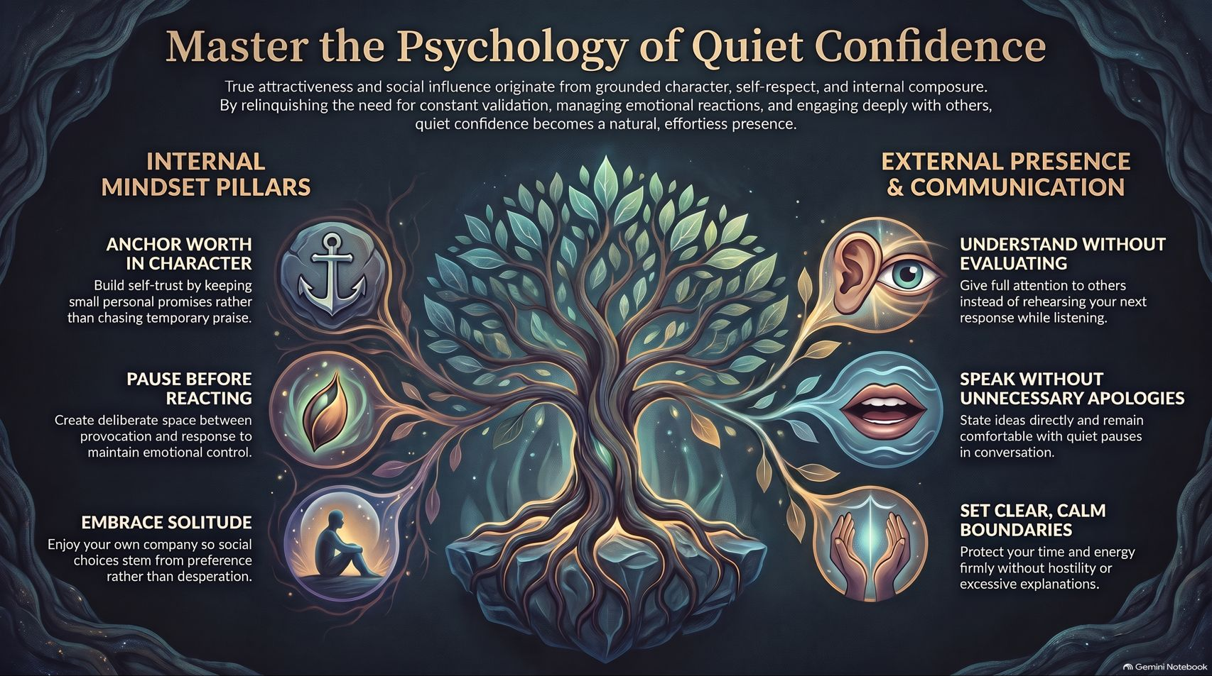
Notes:
Visual Content: A comprehensive summary dashboard organized around a glowing tree of life, linking Internal Mindset Pillars (Anchor Worth in Character, Pause Before Reacting, Embrace Solitude) with External Presence & Communication (Understand Without Evaluating, Speak Without Unnecessary Apologies, Set Clear Boundaries).
Estimated Speaking Duration: 4 – 6 minutes
Speaker Notes:
Synthesizing the Journey: Let's pull everything together. Mastering quiet confidence requires balancing internal psychological anchors with external communicative mastery.
Internal Pillars: Anchor your worth in unyielding character, create space before reacting to provocation, and embrace solitude so your social choices stem from free preference rather than emotional desperation.
External Pillars: Listen to understand rather than evaluate, eliminate weak apologies and filler words, and hold calm, unshakeable boundaries.
Final Charge: True influence isn't forced—it radiates naturally from a grounded character. Go forth, stop performing, and let your quiet substance speak for itself.

