Slide 1
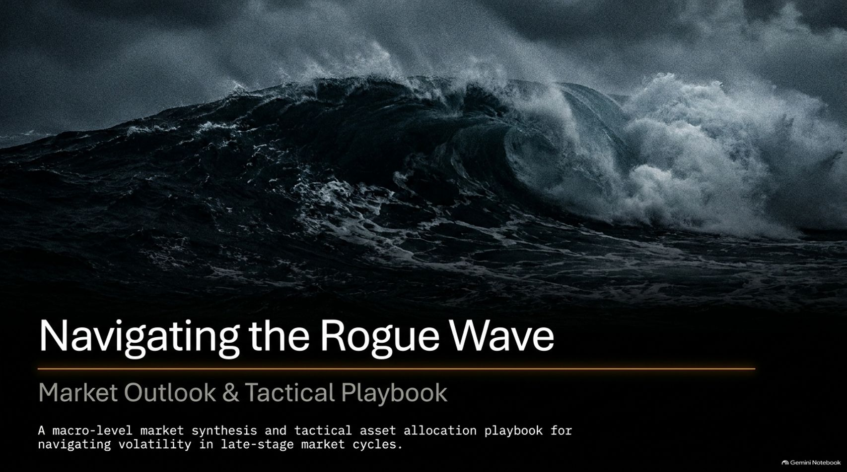
Notes:
Visual: Dark, turbulent ocean wave with dramatic storm lighting. Title: Navigating the Rogue Wave: Market Outlook & Tactical Playbook.
Suggested Speaking Time: 2 – 3 minutes.
Speaker Notes:
Welcome everyone to today’s macro-level market synthesis and tactical asset allocation update.
We are titling today's session “Navigating the Rogue Wave” because recent market action—including massive single-day drops and violent whipsaws—feels like a sudden, unexpected wave hitting an over-leveraged vessel.
Markets are sitting at a historic crossroads. While the surface narrative changes day by day, underlying valuations and systemic debt structures are flashing serious warning signs for late-stage market cycles.
Our goal today is to look past emotional headlines, examine the actual technical and fundamental data, and walk through a disciplined playbook for protecting capital while capturing tactical opportunities.
All The Market Tinder Needs Is A Spark To Crash | New Harbor Financial
https://www.youtube.com/watch?v=VVCJ_jPBbjQ

Slide 2
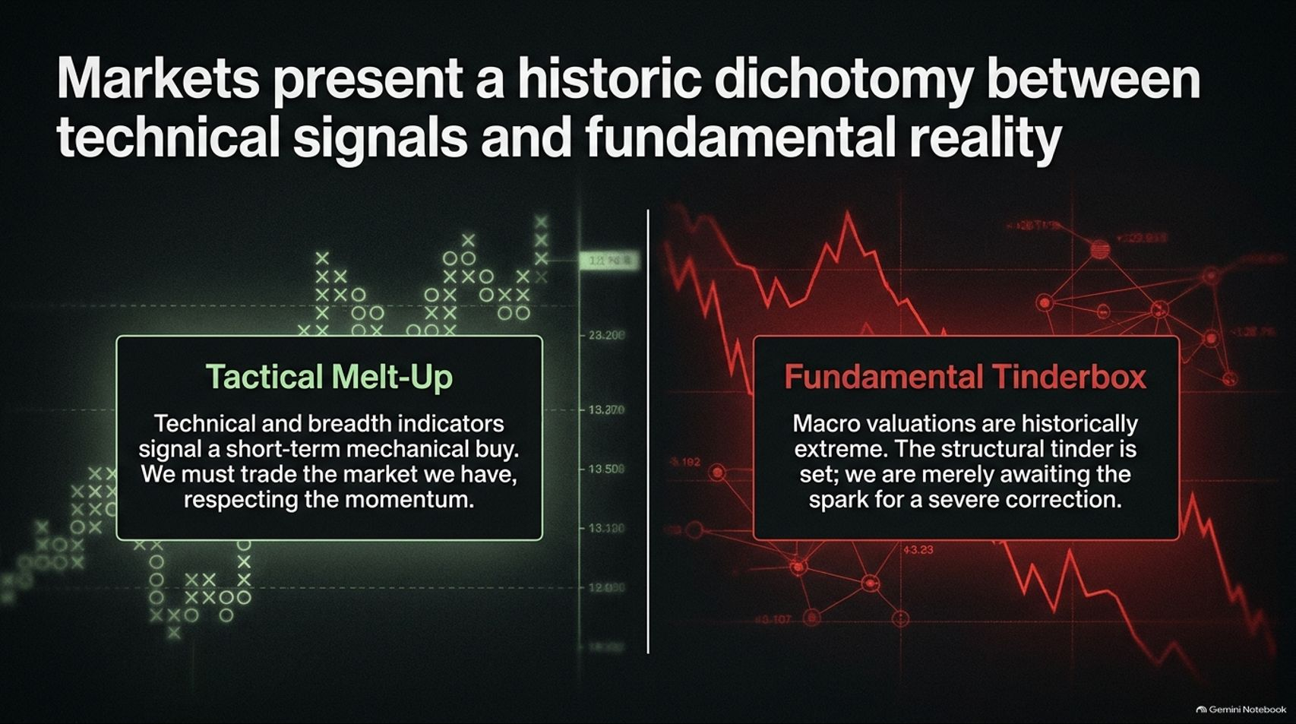
Notes:
Visual: Split screen. Left: Green tactical chart showing Tactical Melt-Up. Right: Red valuation chart showing Fundamental Tinderbox.
Suggested Speaking Time: 3 – 4 minutes.
Speaker Notes:
To understand where we are right now, you have to recognize a historic dichotomy currently playing out in the financial markets: the battle between short-term technical momentum and long-term fundamental reality.
On the left, we have the Tactical Melt-Up: Technical breadth indicators and mechanical point-and-figure signals frequently flash short-term buy opportunities. As professional managers, we must trade the market we have, respecting momentum rather than fighting it out of stubbornness.
On the right, we face a Fundamental Tinderbox: Macro valuations are at historically extreme levels. The structural tinder is completely set; we are merely awaiting the spark for a severe, systemic correction.
Juggling these two opposing forces requires discipline. We cannot ignore short-term bullish technical setups, but we also cannot blind ourselves to the massive fundamental risks lurking underneath.

Slide 3
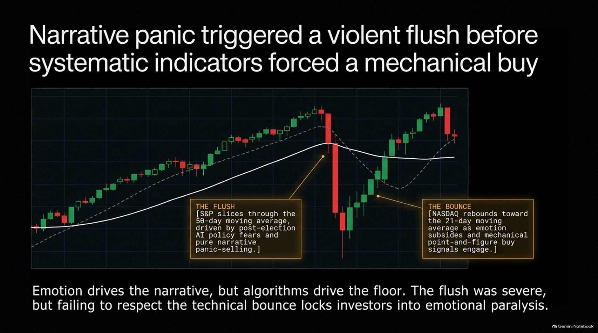
Notes:
Visual: Candlestick chart illustrating "The Flush" through the 50-day moving average and "The Bounce" back toward the 21-day moving average.
Suggested Speaking Time: 3 – 5 minutes.
Speaker Notes:
Let’s look at how this dynamic played out during the recent market bloodletting. Emotion always drives the short-term narrative, but algorithms and systematic indicators drive the floor.
Last Thursday's sell-off was severe. Driven by post-election political fears regarding data center restrictions, AI policy crackdowns, and pure narrative panic-selling, major indices sliced straight through their 50-day moving averages.
However, notice what happened immediately after: as emotion subsided, mechanical point-and-figure buy signals engaged. The NASDAQ and S&P rebounded strongly toward their short-term moving averages.
The lesson here is critical: the flush was terrifying for undisciplined investors, but failing to respect the technical bounce locks people into emotional paralysis. You cannot let a temporary panic trap you into permanent inaction.

Slide 4
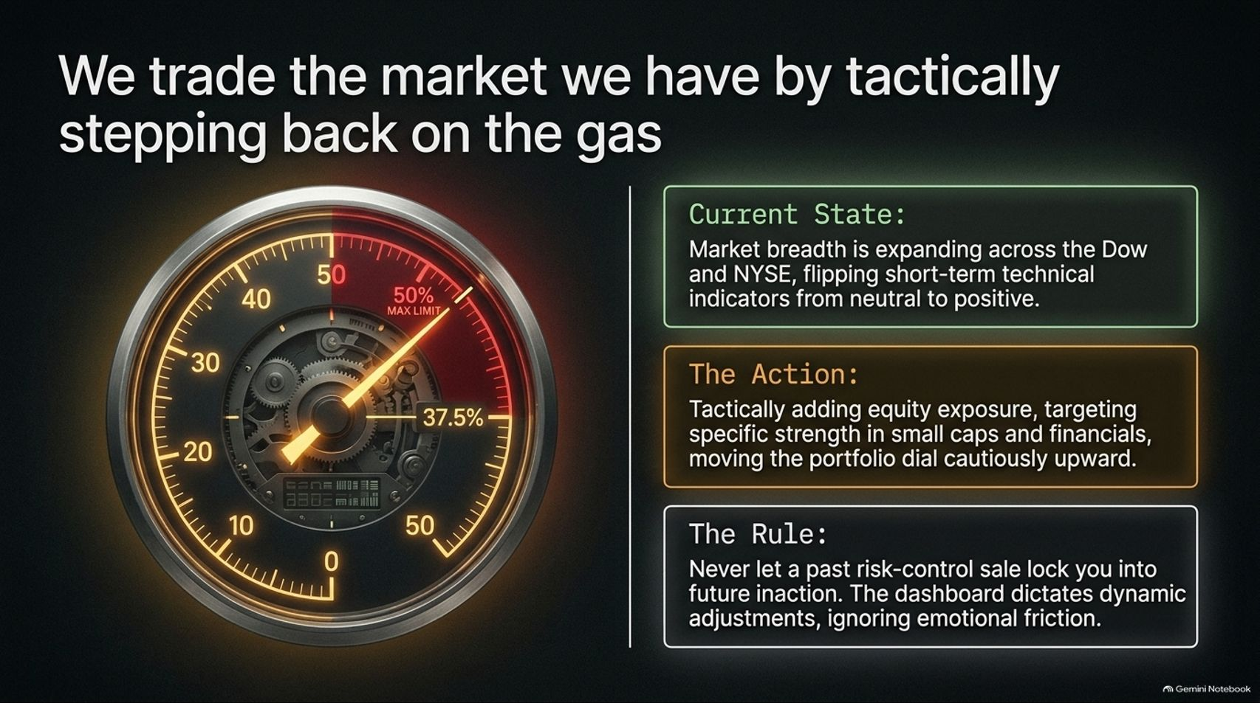
Notes:
Visual: An intricate instrument dial/gauge pointing at 37.5%, accompanied by current state, action, and rule text boxes.
Suggested Speaking Time: 3 – 4 minutes.
Speaker Notes:
How do we translate this into portfolio action? We trade the market we actually have, not the market we wish we had, which means tactically stepping back on the gas when our dashboard tells us to.
Current State: Market breadth is expanding across the Dow and NYSE, flipping short-term technical indicators from neutral back to positive.
The Action: We are tactically adding equity exposure, targeting specific relative strength in areas like small caps and financials, moving our portfolio dial cautiously upward from 37.5% toward the low 40s.
The Rule: Never let a past risk-control sale—such as taking a loss on an energy position that subsequently bounced—lock you into future inaction. Our dashboard dictates dynamic adjustments while completely ignoring emotional friction.

Slide 5
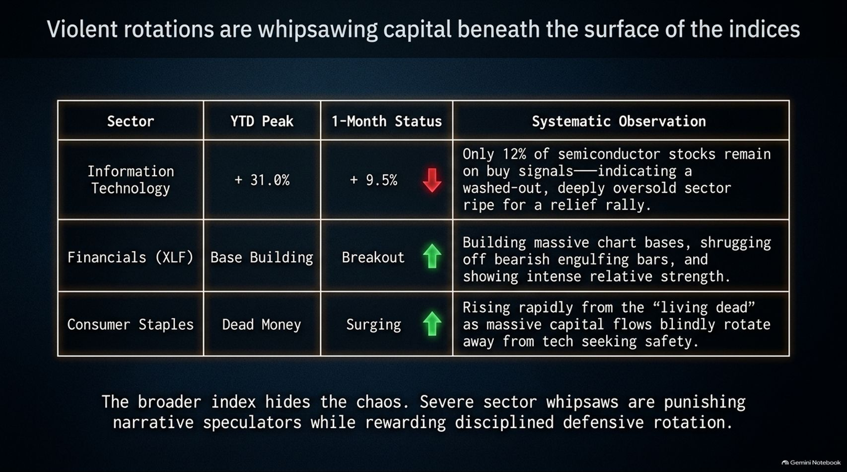
Notes:
Visual: Data table comparing Information Technology, Financials (XLF), and Consumer Staples across YTD Peak, 1-Month Status, and Systematic Observations.
Suggested Speaking Time: 3 – 5 minutes.
Speaker Notes:
If you only look at headline index numbers, you miss the absolute chaos happening underneath. Violent sector rotations are whipsawing capital across the board.
Look at Information Technology: peaked at +31.0% YTD, but dropped 9.5% in a single month. Only 12% of semiconductor stocks remain on buy signals, indicating a washed-out, deeply oversold sector ripe for a relief rally.
Meanwhile, Financials (XLF) are building massive chart bases, shrugging off bearish engulfing bars, and showing intense relative strength.
Consumer Staples—long considered "dead money"—have surged rapidly as massive capital flows blindly rotate away from tech seeking safety.
The broader index hides this turmoil. Severe sector whipsaws punish narrative speculators while rewarding disciplined defensive rotation.

Slide 6
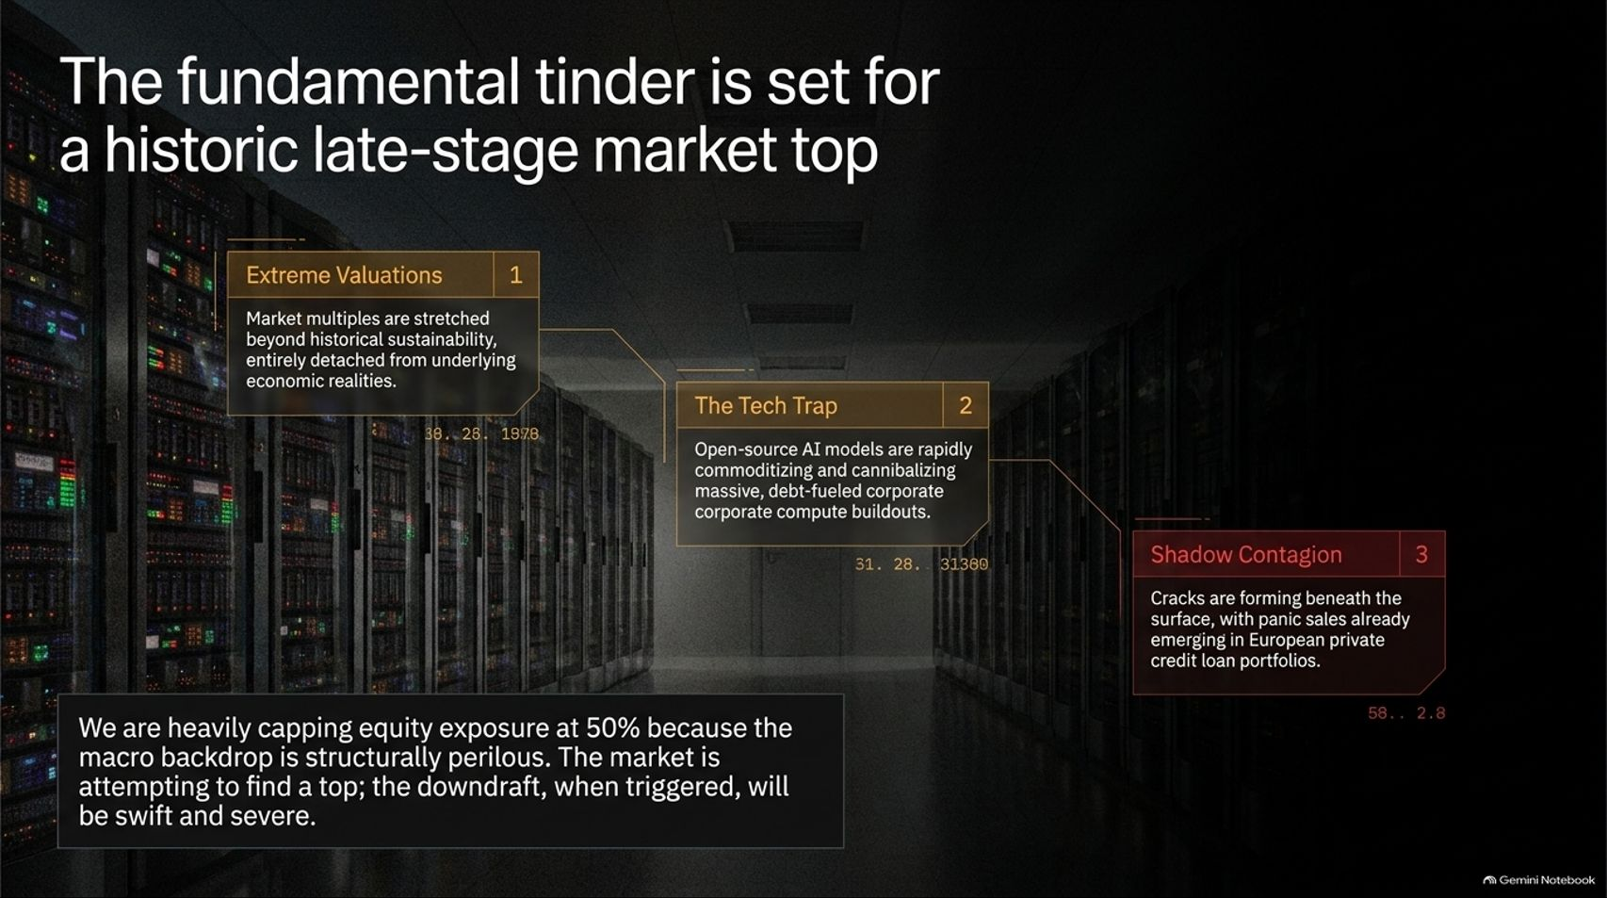
Notes:
Visual: Background of server racks with three callout boxes highlighting Extreme Valuations, The Tech Trap, and Shadow Contagion.
Suggested Speaking Time: 4 – 6 minutes.
Speaker Notes:
Even though our short-term indicators are leaning green and we are adding modest equity exposure, we must never lose sight of the big picture: the fundamental tinder is set for a historic late-stage market top.
Let's break down the three primary risk pillars here:
Extreme Valuations: Market multiples are stretched far beyond historical sustainability, completely detached from underlying economic realities.
The Tech Trap: Open-source AI models are rapidly commoditizing and cannibalizing massive, debt-fueled corporate compute buildouts.
Shadow Contagion: Cracks are forming beneath the surface, with panic sales already emerging in areas like European private credit loan portfolios.
This is why we heavily cap our total equity exposure at 50%. The market is desperately trying to find a top, and when the downdraft finally triggers, it will be swift and severe.

Slide 7
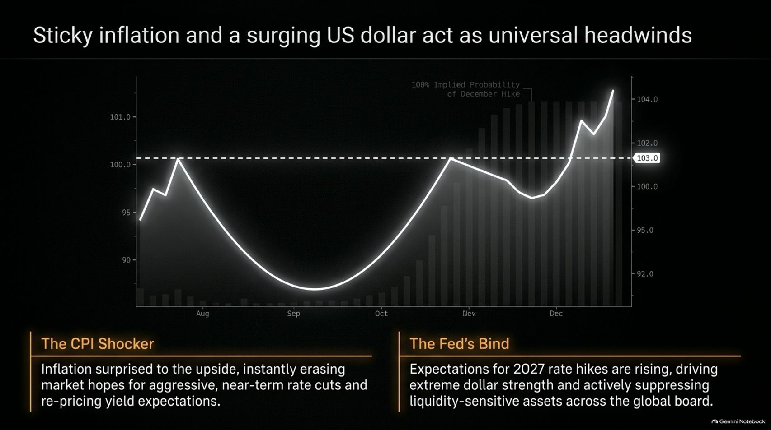
Notes:
Visual: Line chart of the US Dollar Index showing a sharp upward breakout toward 104.0, paired with callouts for "The CPI Shocker" and "The Fed's Bind".
Suggested Speaking Time: 3 – 5 minutes.
Speaker Notes:
Macro headwinds are compounding across the global economy, led by sticky inflation and a surging U.S. dollar.
The CPI Shocker: Recent inflation data surprised significantly to the upside, instantly erasing market hopes for aggressive, near-term rate cuts and completely re-pricing yield expectations.
The Fed's Bind: Expectations for rate hikes have surged, driving extreme dollar strength (testing key breakout levels above 103) and actively suppressing liquidity-sensitive assets across the board.
When short-term rate expectations spike, money floods into the dollar, creating a hostile environment for risk assets, commodities, and precious metals in the short term.

Slide 8
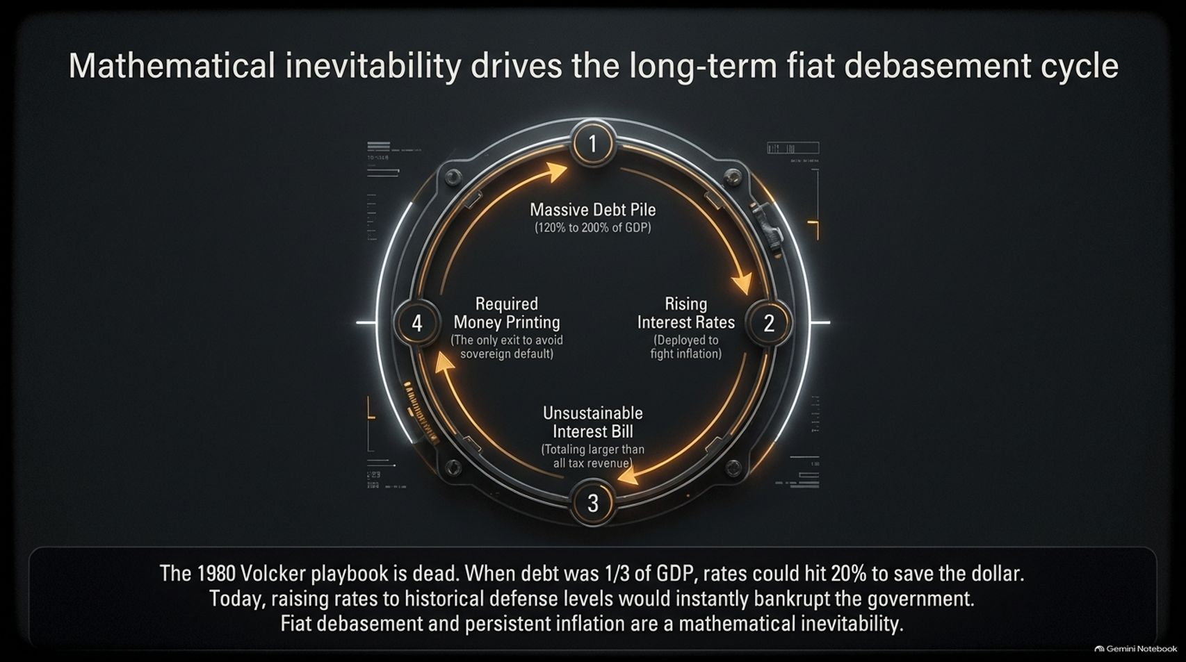
Notes:
Visual: A circular mechanical gear infographic mapping the four stages of the debt cycle: Massive Debt Pile $\rightarrow$ Rising Interest Rates $\rightarrow$ Unsustainable Interest Bill $\rightarrow$ Required Money Printing.
Suggested Speaking Time: 4 – 6 minutes.
Speaker Notes:
While the U.S. dollar can experience strong short-term rallies, the long-term trajectory of fiat currency is dictated by mathematical inevitability.
The 1980 Volcker playbook is entirely dead. Back then, federal debt was roughly one-third of GDP, allowing Paul Volcker to hike interest rates to nearly 20% to crush inflation and save the dollar.
Today, with federal debt exceeding 120% to 200% of GDP when factoring in unfunded liabilities, raising rates to historical defense levels would instantly bankrupt the government.
Look at the cycle on the slide: Massive debt requires rising rates to fight inflation, which creates an interest bill larger than total tax revenues, forcing inevitable central bank money printing. Fiat debasement is locked in.

Slide 9
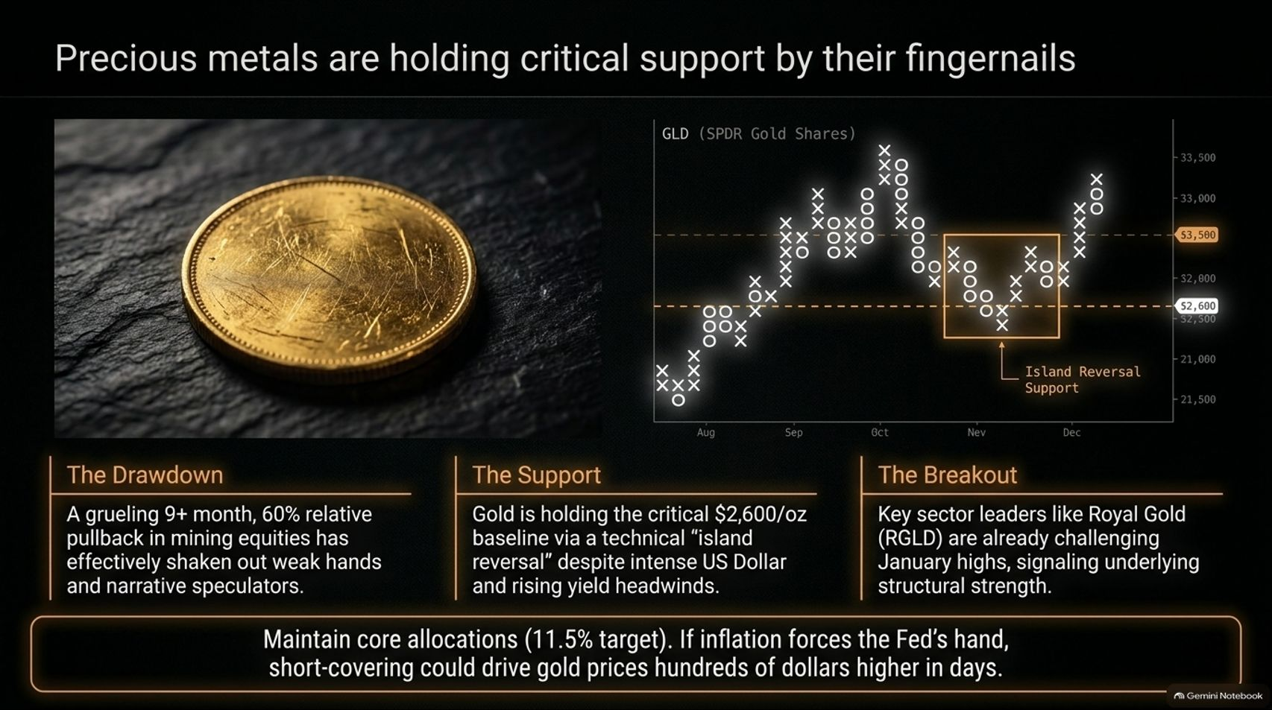
Notes:
Visual: Gold coin image paired with a point-and-figure chart of GLD highlighting an Island Reversal Support zone around $2,600/oz.
Suggested Speaking Time: 4 – 5 minutes.
Speaker Notes:
Precious metals have endured a grueling 9-month, 60% relative pullback in mining equities, shaking out weak hands and narrative speculators.
Despite intense U.S. dollar and rising yield headwinds, gold is holding its critical baseline via a technical island reversal pattern.
Furthermore, sector leaders like Royal Gold (RGLD) are already challenging previous highs, signaling underlying structural strength beneath the consolidation.
We maintain our core 11.5% target allocation in precious metals. If sticky inflation ultimately forces the Fed’s hand or breaks the Treasury market, short-covering could drive gold prices hundreds of dollars higher in a matter of days.

Slide 10
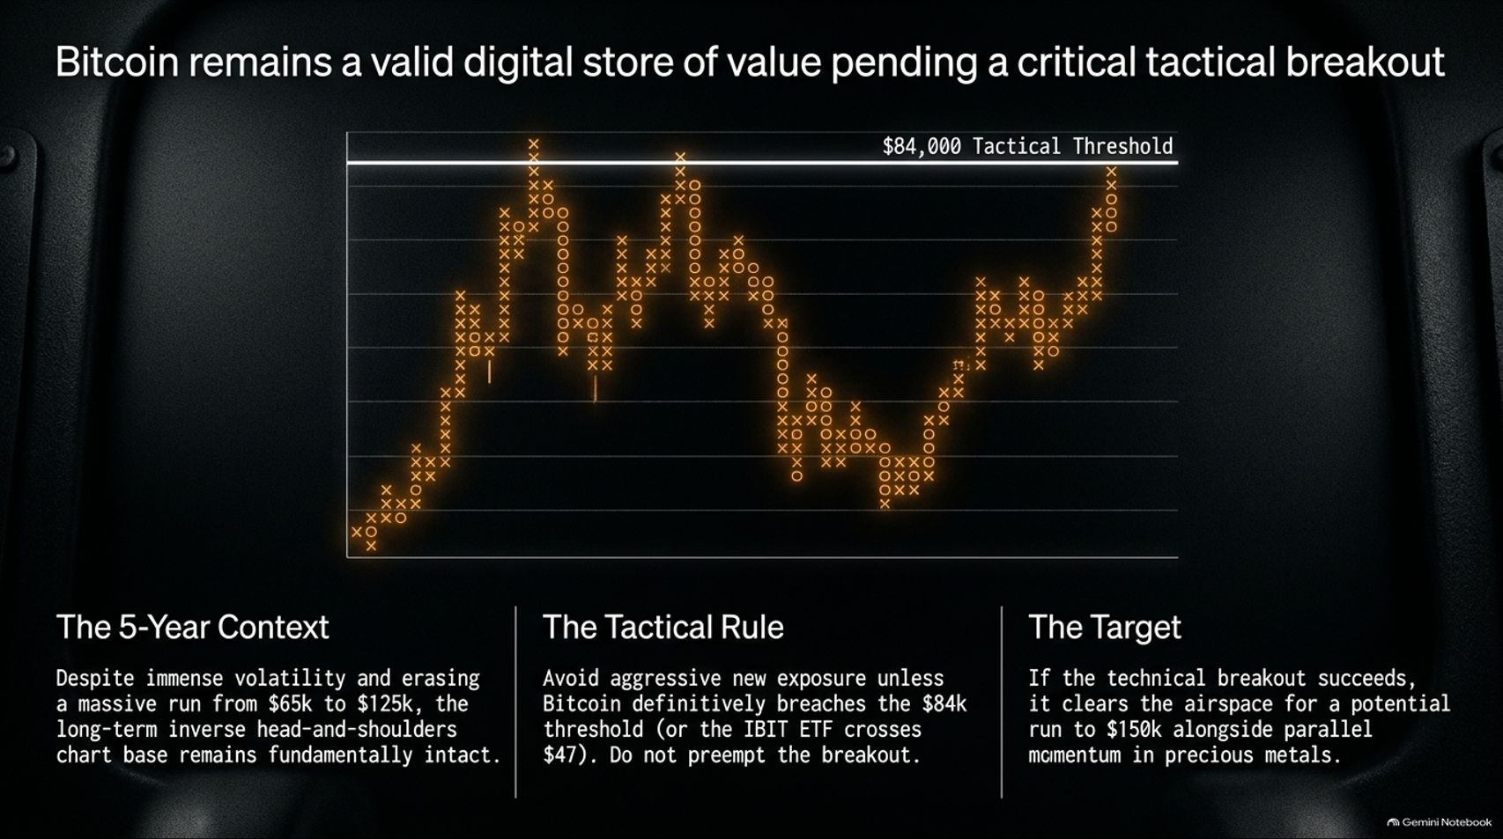
Notes:
Visual: Point-and-figure chart of Bitcoin/IBIT highlighting the $84,000 tactical threshold ($47 on the IBIT ETF).
Suggested Speaking Time: 3 – 5 minutes.
Speaker Notes:
Let's examine Bitcoin, which is positioned as another primary digital store of value against fiat debasement.
The 5-Year Context: Despite massive volatility and wiping out runs from $65k up to $125k and back down, the long-term inverse head-and-shoulders chart base remains fundamentally intact.
The Tactical Rule: Do not preempt the breakout. We avoid aggressive new exposure unless Bitcoin definitively breaches the $84,000 threshold (or the IBIT ETF crosses $47).
The Target: If this technical breakout succeeds, it clears the airspace for a potential run toward $150,000, moving in parallel with momentum in precious metals. Until then, we remain disciplined on the sidelines.

Slide 11
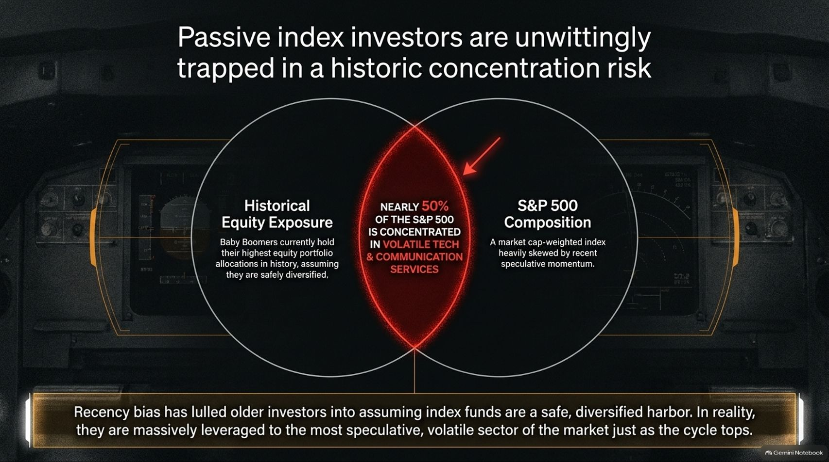
Notes:
Visual: Venn diagram showing the overlap between historical equity exposure and S&P 500 composition, highlighting that nearly 50% of the index is concentrated in volatile Tech and Communication Services.
Suggested Speaking Time: 4 – 6 minutes.
Speaker Notes:
One of the greatest dangers in today's market is the false sense of security held by passive index investors.
Baby Boomers currently hold some of their highest equity portfolio allocations in history, assuming they are safely diversified because they own index funds.
In reality, because the S&P 500 is market-cap weighted, nearly 50% of the index is concentrated in volatile technology and communication services.
Recency bias has lulled older investors into ignoring this risk. When tech experiences a sharp reversal—like wiping out two-thirds of its relative outperformance in weeks—passive investors take the full brunt of the crash, completely exposed at the exact cycle top.

Slide 12
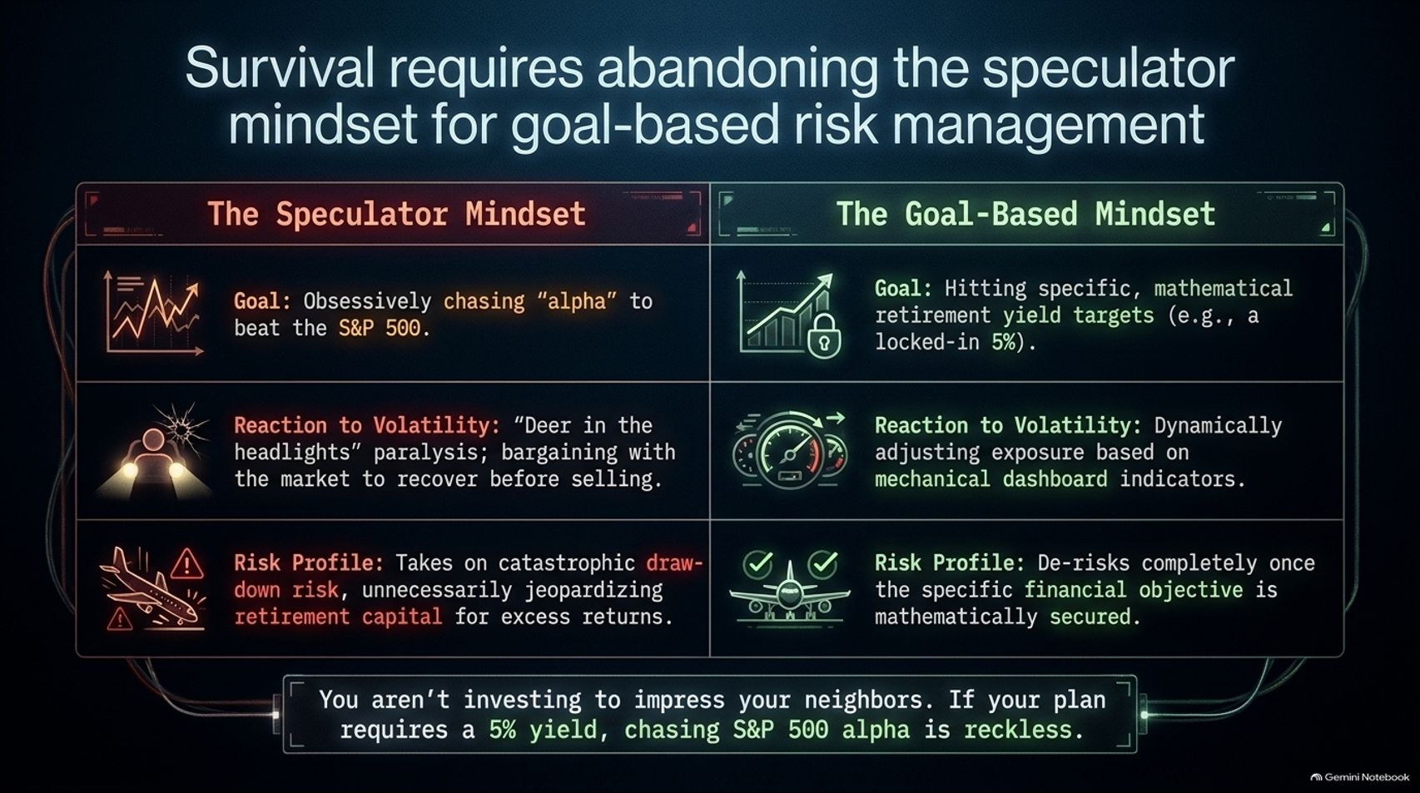
Notes:
Visual: Comparative table contrasting The Speculator Mindset (red) against The Goal-Based Mindset (green across goals, reactions to volatility, and risk profiles).
Suggested Speaking Time: 4 – 5 minutes.
Speaker Notes:
To survive the turbulence ahead, investors must completely abandon the speculator mindset and adopt goal-based risk management.
The Speculator: Obsessively chases "alpha" to beat the S&P 500, freezes like a deer in the headlights during drawdowns, and takes on catastrophic risk that jeopardizes retirement capital.
The Goal-Based Investor: Focuses on hitting specific, mathematical retirement yield targets—such as a secure 5%. They react to volatility by dynamically adjusting exposure using mechanical indicators, and they de-risk completely once their financial objectives are secured.
You aren’t investing to impress your neighbors or beat an arbitrary benchmark. If your financial plan requires a 5% yield, chasing S&P 500 alpha at the cycle peak is reckless.

Slide 13
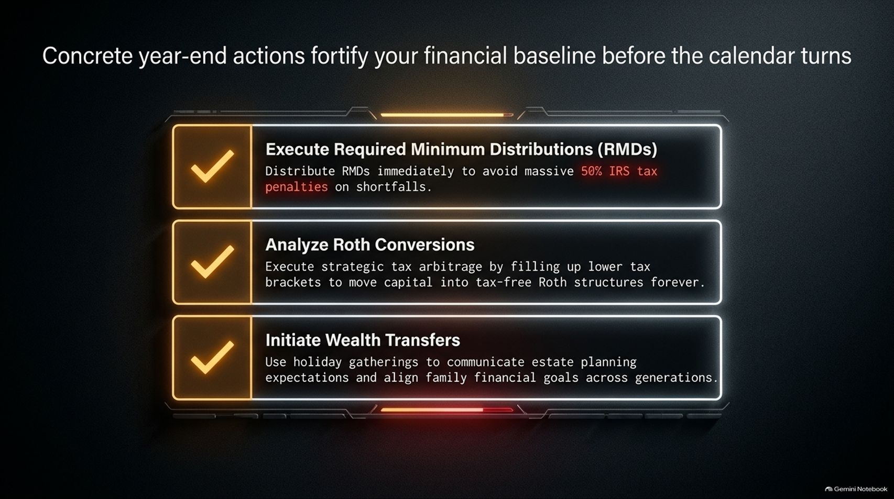
Notes:
Visual: Three highlighted action boxes with checkmarks: Execute RMDs, Analyze Roth Conversions, and Initiate Wealth Transfers.
Suggested Speaking Time: 3 – 4 minutes.
Speaker Notes:
As we approach year-end, there are concrete administrative and strategic actions you must execute to fortify your financial baseline:
Execute Required Minimum Distributions (RMDs): Distribute RMDs immediately. Failing to do so triggers a massive, punitive 50% IRS tax penalty on shortfalls.
Analyze Roth Conversions: Execute strategic tax arbitrage by filling up lower tax brackets to permanently move capital into tax-free Roth structures.
Initiate Wealth Transfers: Use upcoming holiday family gatherings to communicate estate planning expectations and align cross-generational financial goals.
Getting these items handled now removes unnecessary stress before the new year begins.

Slide 14
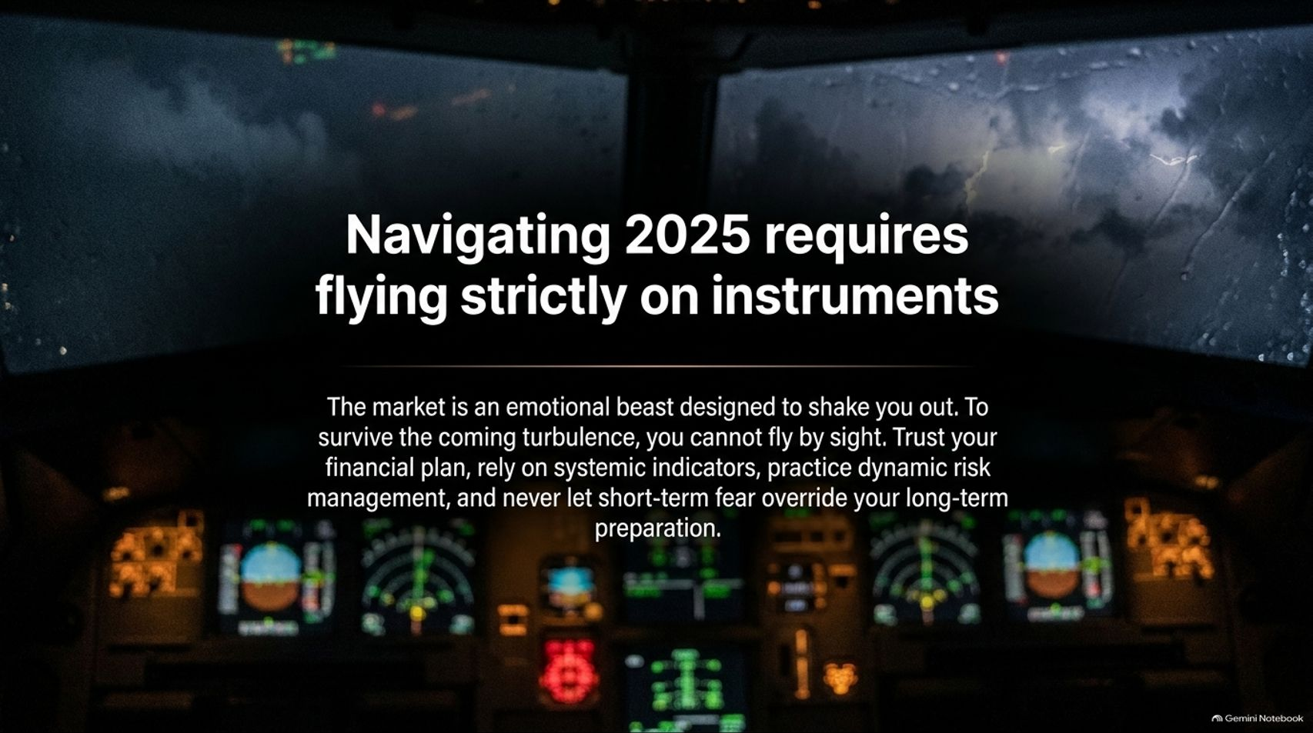
Notes:
Visual: Cockpit view through windshield showing stormy skies above, with illuminated instrument dashboard glowing below. Text emphasizes flying strictly on instruments.
Suggested Speaking Time: 3 – 4 minutes.
Speaker Notes:
To wrap this all together: navigating late-stage market cycles requires flying strictly on instruments.
The market is an emotional beast specifically designed to shake you out of your positions.
If you try to fly by sight—reacting to every news headline, social media post, or panic-inducing blog—you will crash.
Trust your financial plan, rely on systemic technical indicators, practice dynamic risk management, and never let short-term fear override your long-term preparation.

Slide 15
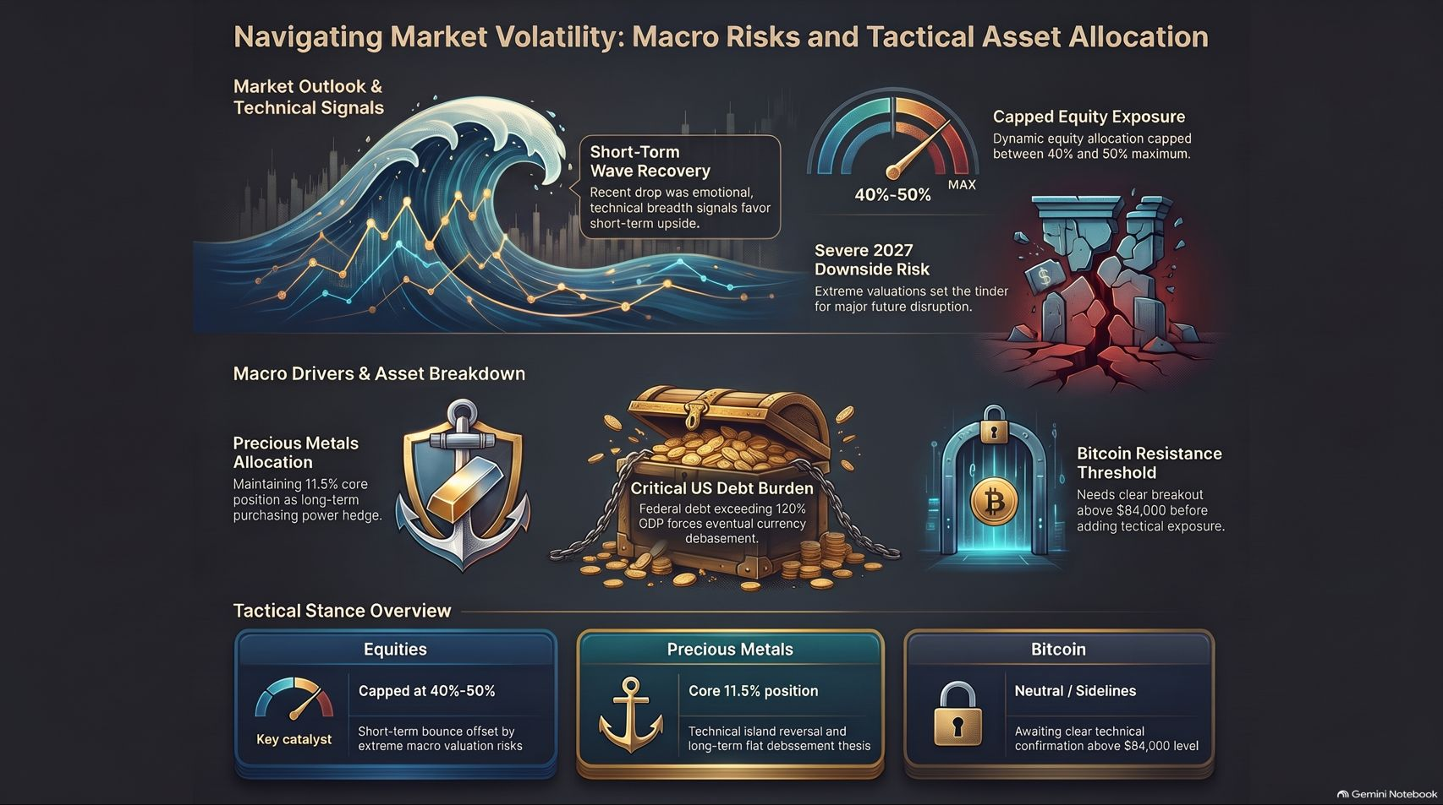
Notes:
Visual: Comprehensive dashboard summary slide bringing together the wave graphic, instrument dials, broken pillar graphic, precious metals shield, debt chest, and asset allocation breakdown tables.
Suggested SpeakingTime: 3 – 5 minutes.
Speaker Notes:
On our final summary slide, you can see the complete blueprint of our tactical stance:
Equities: Capped dynamically between 40% and 50% max. Short-term technical bounce signals are respected, but offset by extreme long-term macro valuation risks.
Precious Metals: Maintained at a core 11.5% position, acting as our primary long-term purchasing power hedge against fiat debasement while technical island reversals play out.
Bitcoin: Held on the sidelines (neutral) until a definitive breakout above the $84,000 threshold confirms the next structural leg up.
Thank you for your time and attention today. Stay disciplined, rely on your dashboard, and enjoy a wonderful holiday season with your families!

