Slide 1

Notes:
Visual: A retro-mechanical counter displaying "2,500" on a pristine stainless-steel prep table alongside high-end Japanese kitchen knives, copper pots, and tweezers under warm spotlight. Title text: The 2,500 PR Month: Scaling AI Agents While You Sleep (A blueprint for architectural autonomy based on the workflows of Lauren Tan).
Suggested Speaking Time: 2 – 3 minutes.
Speaker Notes:
Welcome everyone to today's deep dive into architectural autonomy and extreme AI scaling.
Today, we are exploring the exact blueprint behind shipping 2,500 pull requests to production in a single month—a milestone achieved by Lauren Tan, former Meta React engineer and current SpaceX AI/Cursor expert.
When most people hear "2,500 PRs a month," their instinct is disbelief or visions of chaotic, low-quality spam crashing a codebase. But as we will unpack today, achieving this scale isn't about writing code faster; it's about shifting your engineering effort from micromanaging individual tasks to designing a hyper-constrained, self-verifying environment.
Over the next slides, we’ll break down the trust ladder, the Michelin kitchen mindset, and the exact loops required to let your agents ship code safely while you sleep.
Lauren Tan Reveals How 30+ AI Agents Ship PRs While You Sleep
https://www.youtube.com/watch?v=6hxp0SpGxz8

Slide 2
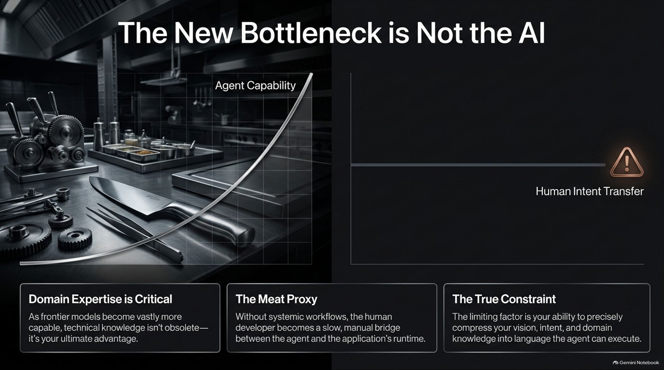
Notes:
Visual: Split screen. Left: Agent capability exponential curve rising sharply past coding tools. Right: Flat, horizontal line representing human intent transfer with a warning triangle icon.
Suggested Speaking Time: 3 – 5 minutes.
Speaker Notes:
To understand modern AI engineering, we first have to confront a fundamental shift: The new bottleneck is no longer the AI.
Look at the capability curve on the left. Frontier models—like Claude Opus and advanced reasoning agents—are getting exponentially smarter, faster, and more capable every single month.
But look at the right side: Human Intent Transfer. Without systemic workflows, the human developer becomes a slow, manual bridge—a "meat proxy"—between the agent and the application's runtime.
The true constraint holding engineers back is no longer technical knowledge; it is your ability to precisely compress your vision, intent, and domain expertise into clear language and structural constraints that the agent can execute without supervision.

Slide 3
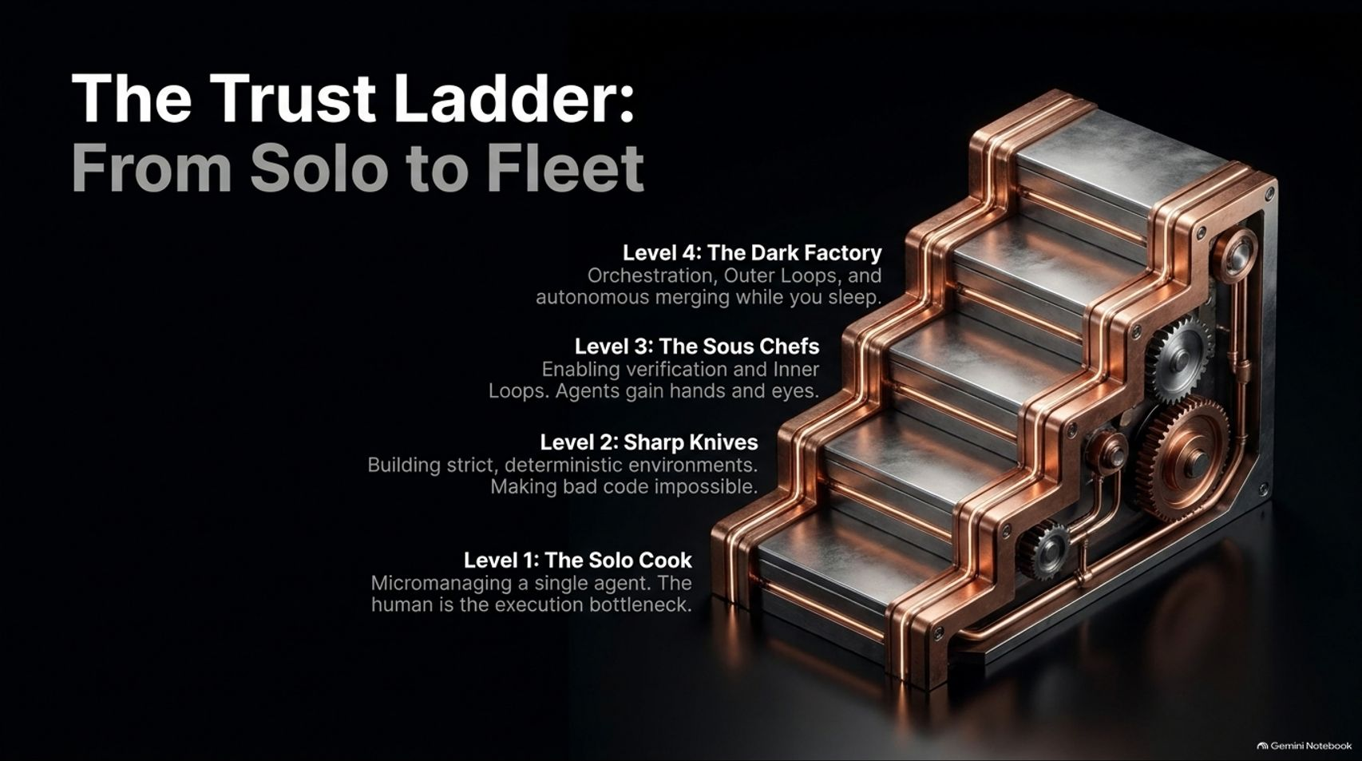
Notes:
Visual: A metallic, tiered staircase intertwined with copper piping and gears, illustrating four distinct operational levels.
Suggested Speaking Time: 3 – 4 minutes.
Speaker Notes:
Scaling your agentic workflow requires climbing The Trust Ladder. You cannot jump straight from zero to autonomous fleets overnight; trust must be systematically engineered.
Level 1: The Solo Cook. You are micromanaging a single agent in your terminal. You are the execution bottleneck, doing all the context-switching and testing manually.
Level 2: Sharp Knives. You start building strict, deterministic environments and lint rules that make bad code structurally impossible.
Level 3: The Sous Chefs. You enable verification loops, giving agents "hands and eyes" (such as browser automation and trace capturing) so they can observe and correct their own work.
Level 4: The Dark Factory. True autonomy. Orchestration, outer loops, and autonomous merging running 24/7 while you sleep.

Slide 4
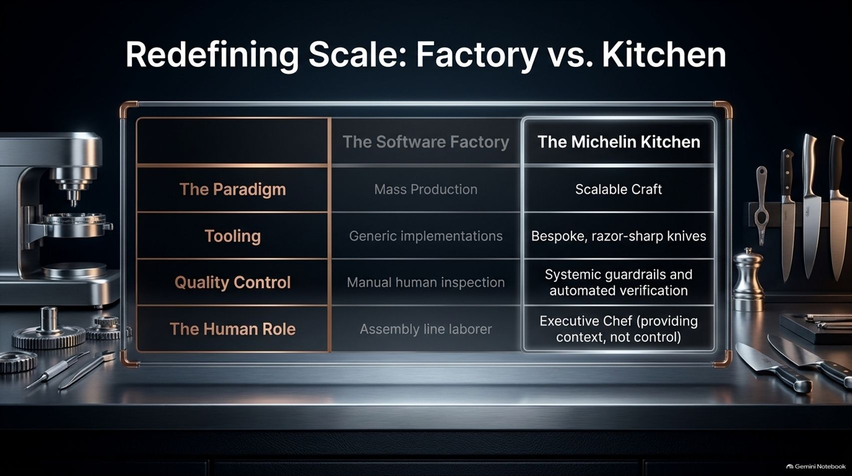
Notes:
Visual: A sleek glass and copper comparison table contrasting "The Software Factory" paradigm against "The Michelin Kitchen" paradigm across 4 attributes.
Suggested Speaking Time: 3 – 5 minutes.
Speaker Notes:
Why do we use the metaphor of a Michelin Kitchen instead of a Software Factory? Because factories conjure images of mass production, generic implementation, and assembly-line laborers. That's not how elite software is built.
The Paradigm: We are aiming for scalable craft, not mere mass production.
Tooling: Instead of generic implementations, we equip our agents with bespoke, razor-sharp tools and strict directory structures.
Quality Control: Instead of manual human inspection blocking every step, we rely on systemic guardrails and automated verification.
The Human Role: You stop being an assembly-line laborer and become the Executive Chef—providing context, intent, and architecture, but never micromanaging the chopping.

Slide 5
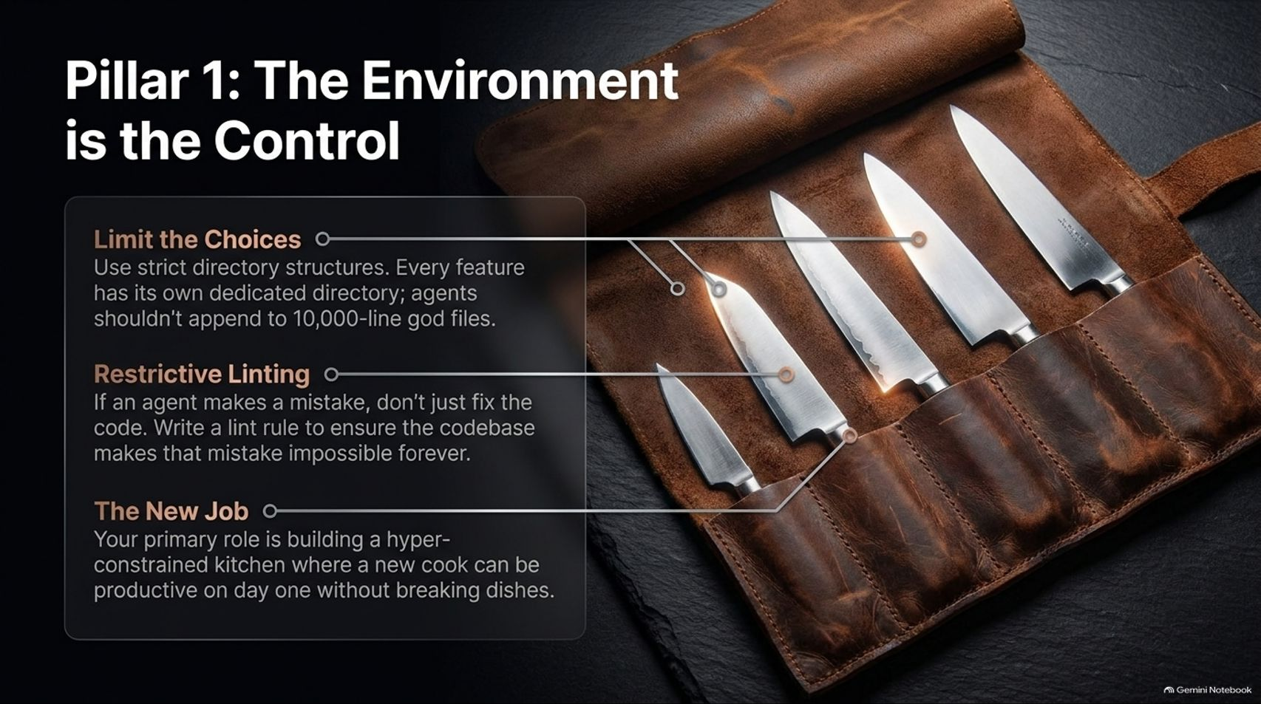
Notes:
Visual: A leather knife roll containing five Japanese chef knives of varying sizes, with callout lines pointing to structural constraints.
Suggested Speaking Time: 4 – 5 minutes.
Speaker Notes:
Let’s examine Pillar 1: The Environment is the Control. If your agents keep making mistakes, don't just fix the code in front of you—fix the kitchen.
Limit the Choices: Use strict directory structures. Every feature gets its own dedicated directory. Agents should never append code to 10,000-line "god files."
Restrictive Linting: If an agent makes a mistake, write a custom lint rule or environmental constraint to make that specific mistake structurally impossible forever.
The New Job: Your primary role as a senior engineer is building a hyper-constrained kitchen where a new cook (human or AI) can be productive on day one without breaking dishes or introducing regressions.

Slide 6
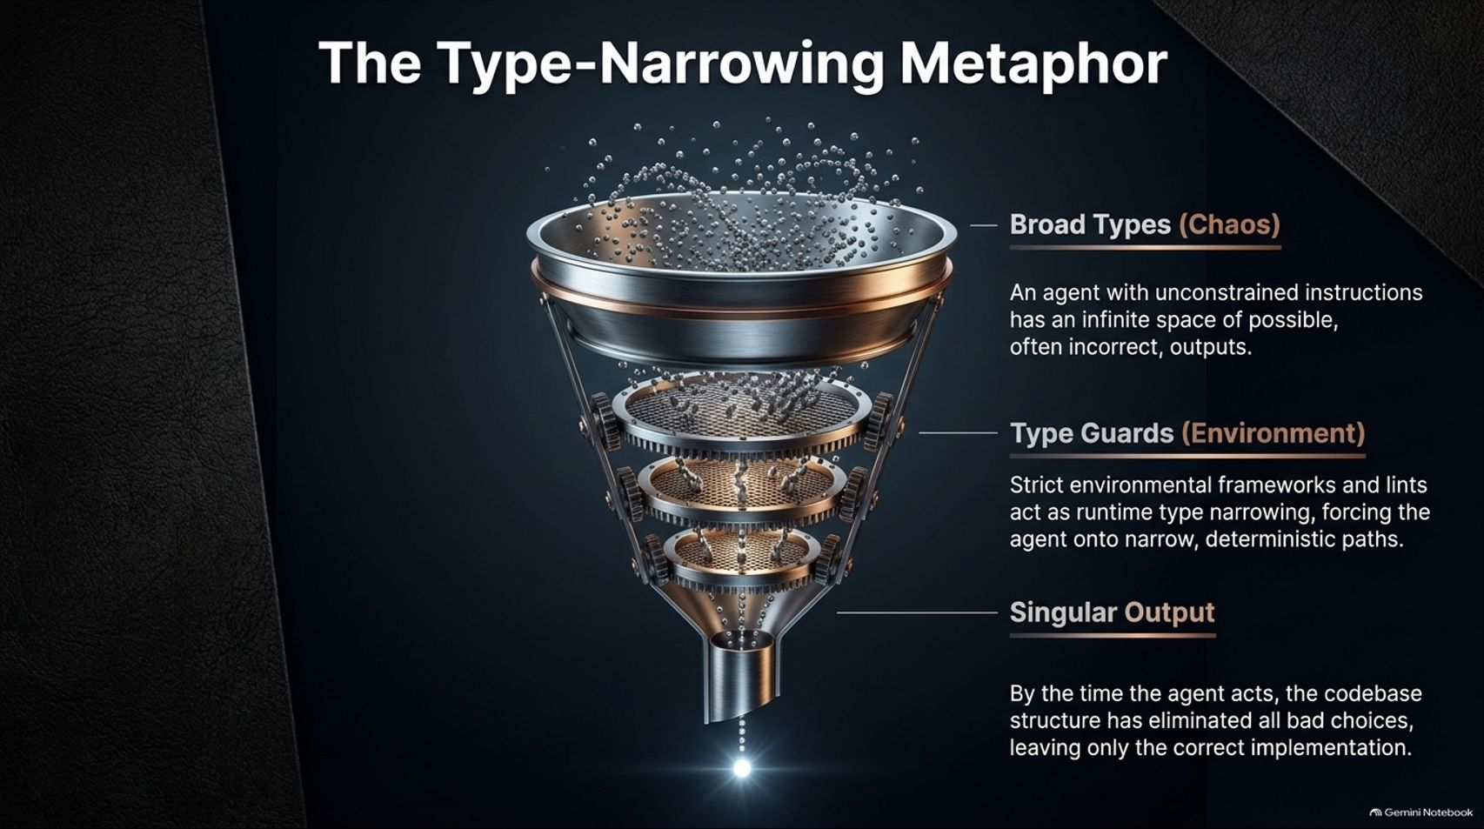
Notes:
Visual: A multi-layered industrial funnel made of brushed steel and gears, where chaotic metal spheres at the top pass through strict type-guard sieves to become a single glowing output at the bottom.
Suggested Speaking Time: 3 – 5 minutes.
Speaker Notes:
Think of this through the Type-Narrowing Metaphor, inspired by advanced type systems like TypeScript.
Broad Types (Chaos): An agent with unconstrained instructions operates in an infinite space of possible—and often incorrect—outputs.
Type Guards (Environment): Strict environmental frameworks, lint rules, and architectural boundaries act as runtime type narrowing, forcing the agent onto narrow, highly deterministic paths.
Singular Output: By the time the agent actually writes code, the codebase structure has eliminated all bad choices, leaving only the correct, intended implementation.

Slide 7
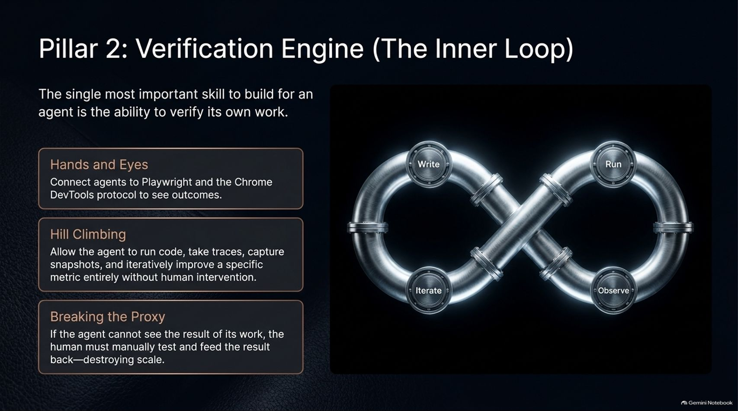
Notes:
Visual: An infinity-loop-shaped steel pipe system with four clearly marked operational nodes: Write, Run, Observe, Iterate.
Suggested Speaking Time: 4 – 6 minutes.
Speaker Notes:
Now let’s look at Pillar 2: The Verification Engine (The Inner Loop). The single most important skill to build for an agent is the ability to verify its own work.
Hands and Eyes: You must connect your agents to tools like Playwright and the Chrome DevTools protocol so they can actually run the app, click around, and see the visual or functional outcomes.
Hill Climbing: With a robust verification loop in place, you can let agents run code, capture traces, take snapshots, and iteratively improve a specific performance metric entirely without human intervention.
Breaking the Proxy: If the agent cannot see or test the result of its work, you are forced back into the manual proxy role—testing it yourself and feeding results back—which completely destroys your scale.

Slide 8
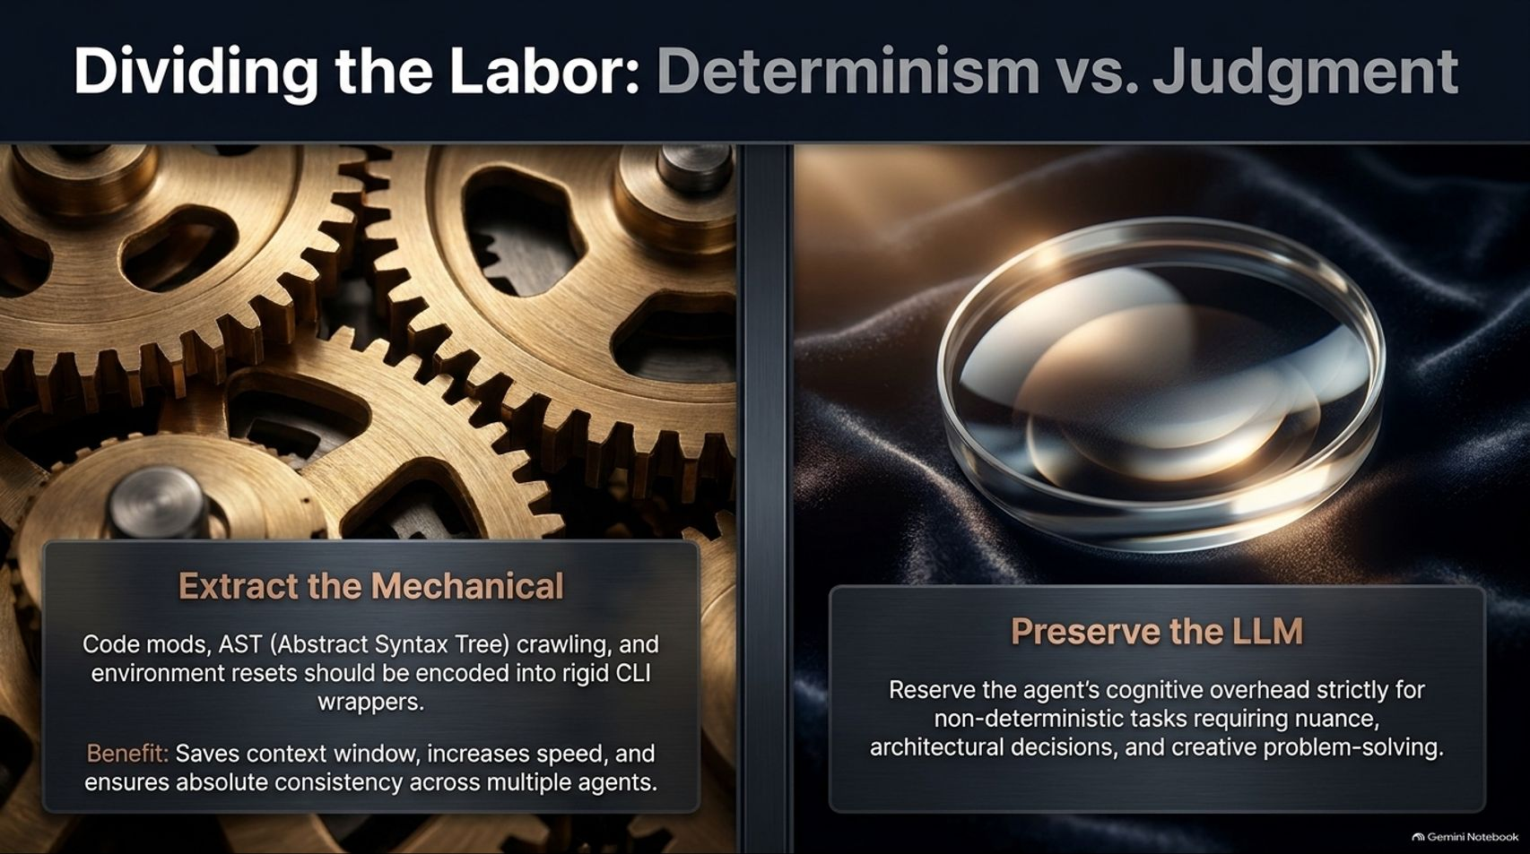
Notes:
Visual: Split screen. Left: Intricate, interlocking brass gears representing mechanical determinism. Right: A precision glass magnifying lens resting on dark silk representing LLM judgment.
Suggested Speaking Time: 3 – 5 minutes.
Speaker Notes:
To build an efficient system, you must master the division of labor between Determinism and Judgment.
Extract the Mechanical: Code mods, Abstract Syntax Tree (AST) crawling, file routing, and environment resets should be encoded into rigid CLI wrappers and deterministic scripts. This saves precious context window space, increases speed, and ensures absolute consistency across multiple agents.
Preserve the LLM: Reserve the agent's cognitive overhead strictly for non-deterministic tasks requiring nuance, architectural decisions, and creative problem-solving. Never waste LLM tokens on tasks a simple script can execute reliably.

Slide 9
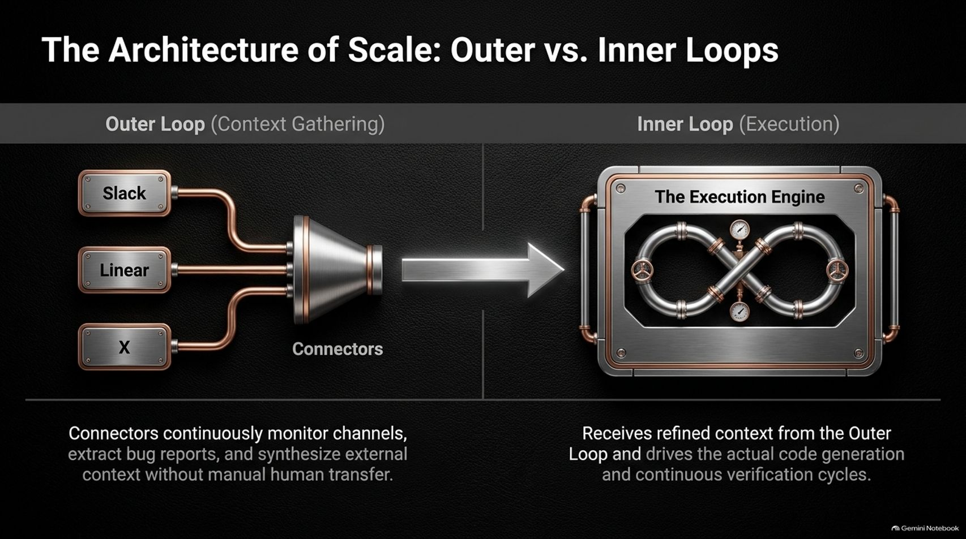
Notes:
Visual: Diagram showing external connectors (Slack, Linear, X) funneling data through copper pipes on the left (Outer Loop) into a heavy steel execution engine on the right (Inner Loop).
Suggested Speaking Time: 4 – 5 minutes.
Speaker Notes:
Scaling requires separating your workflow into two distinct loops: the Outer Loop (Context Gathering) and the Inner Loop (Execution).
The Outer Loop: Connectors continuously monitor external channels—like Slack bug reports, Linear tickets, or user feedback on X—extracting and synthesizing context automatically without manual human transfer.
The Inner Loop: Receives this refined, structured context from the outer loop and drives actual code generation, testing, and continuous verification cycles.
Connecting these two loops is what allows autonomous systems to ingest real-world chaos and turn it into verified code without human bottlenecks.

Slide 10
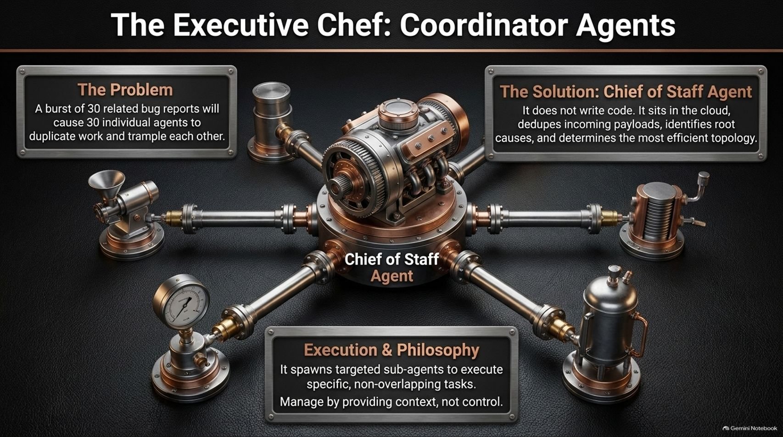
Notes:
Visual: An elaborate central engine hub labeled "Chief of Staff Agent" connected via copper armature arms to six specialized peripheral sub-stations.
Suggested Speaking Time: 4 – 5 minutes.
Speaker Notes:
When you scale up to dozens of agents running simultaneously, you face a major coordination problem: if a burst of 30 related bug reports hits your system at once, 30 individual agents will spawn, duplicate work, and trample each other's code.
The Solution — Chief of Staff Agent: This coordinator agent sits in the cloud. It doesn't write code directly; instead, it deduplicates incoming payloads, identifies root causes, and determines the most efficient task topology.
Execution Philosophy: It spawns targeted sub-agents to execute specific, non-overlapping tasks. Just like a master executive chef, you manage the system by providing high-level context, not micromanaging individual chops.

Slide 11
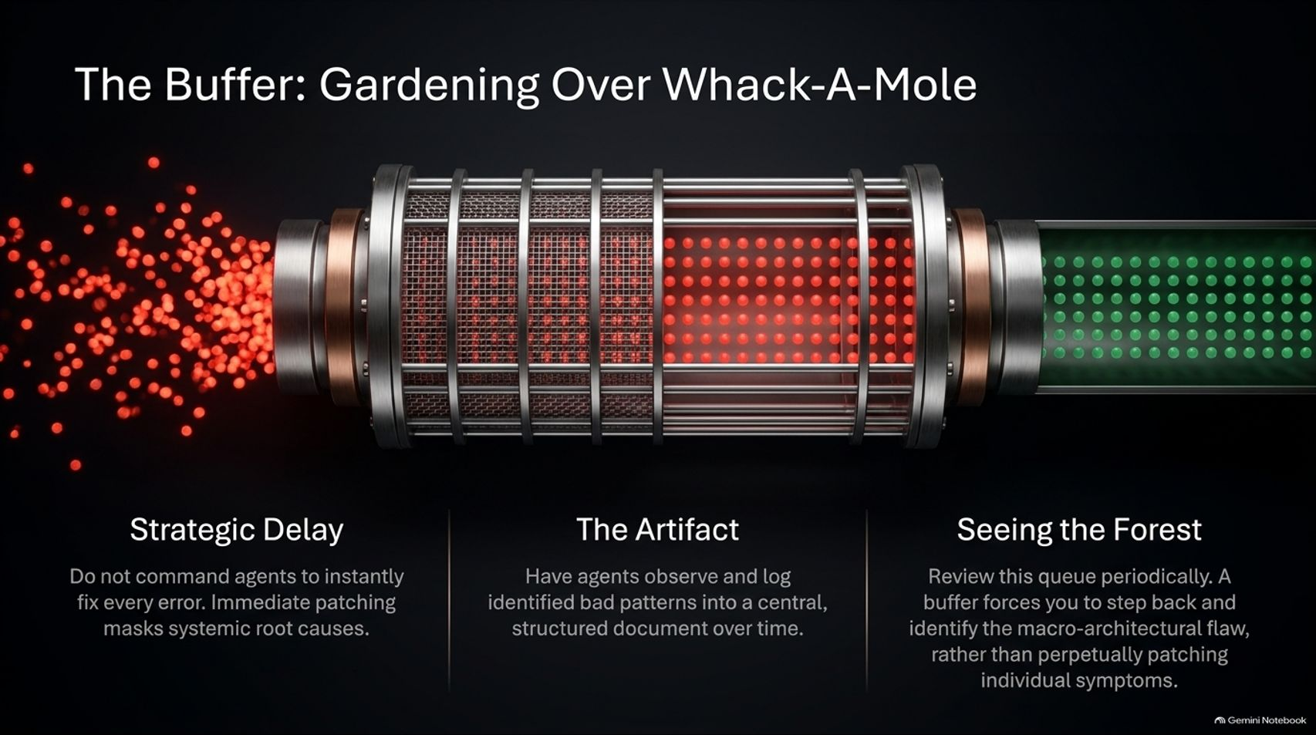
Notes:
Visual: A cylindrical industrial filter showing incoming red chaotic data points on the left passing through a structured sorting chamber into orderly green output streams on the right.
Suggested Speaking Time: 3 – 5 minutes.
Speaker Notes:
A critical operational rule in high-volume agentic systems is Gardening Over Whack-A-Mole.
Strategic Delay: Do not command agents to instantly patch every single minor error the second it appears. Immediate, reactive patching often masks systemic root causes.
The Artifact: Have your agents observe, log, and append identified bad patterns into a central, structured document over time.
Seeing the Forest: Review this queue periodically. A buffer forces you to step back and identify the macro-architectural flaw rather than perpetually patching individual symptoms.

Slide 12
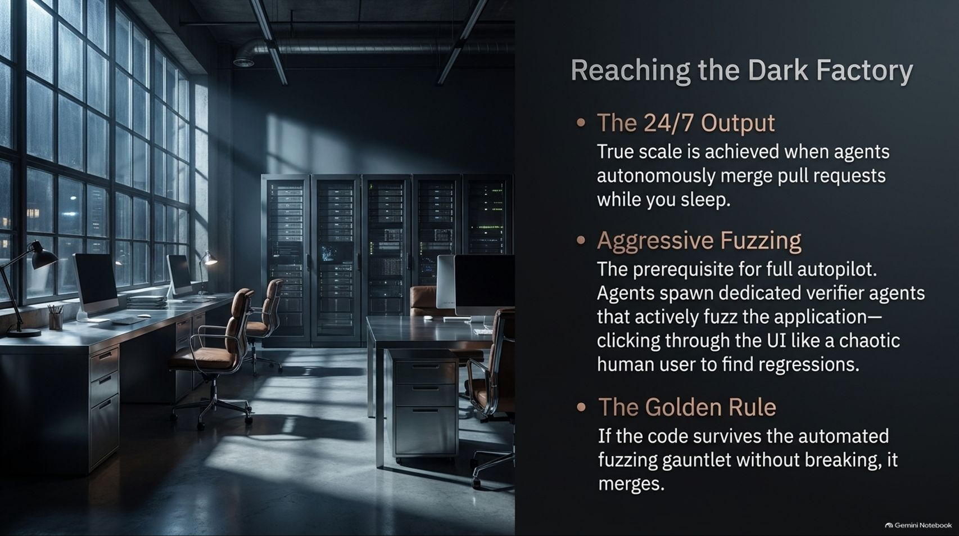
Notes:
Visual: A moody, industrial server room at night with glowing server racks, sleek workstations, and ambient moonlight pouring through large windows.
Suggested Speaking Time: 3 – 5 minutes.
Speaker Notes:
This brings us to the ultimate destination: Reaching the Dark Factory.
24/7 Output: True scale is achieved when your agents can autonomously test, verify, and merge pull requests while you sleep.
Aggressive Fuzzing: The prerequisite for full autopilot is spawning dedicated verifier agents that actively "fuzz" your application—clicking through the UI like chaotic human users to uncover edge-case regressions.
The Golden Rule: If the code survives the automated fuzzing gauntlet without breaking a single test or invariant, it automatically merges.

Slide 13
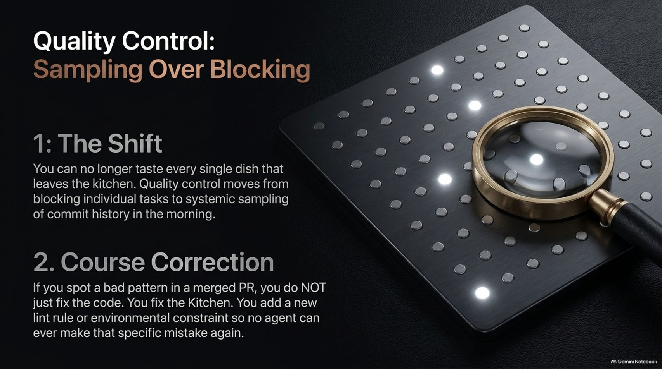
Notes:
Visual: A modern metallic control grid illuminated by glowing indicator lights, inspected closely by a polished brass magnifying glass.
Suggested Speaking Time: 3 – 5 minutes.
Speaker Notes:
When you are shipping thousands of PRs a month, traditional quality control breaks down. You can no longer taste every single dish that leaves the kitchen.
1. The Shift: Quality control moves from blocking individual tasks in real time to systemic asynchronous sampling of commit history every morning.
2. Course Correction: If you spot a bad pattern in a landed PR during your morning audit, you do not just fix the code. You fix the Kitchen. You add a new lint rule, tighten a type constraint, or update an environment guardrail so no agent can ever make that specific mistake again.

Slide 14
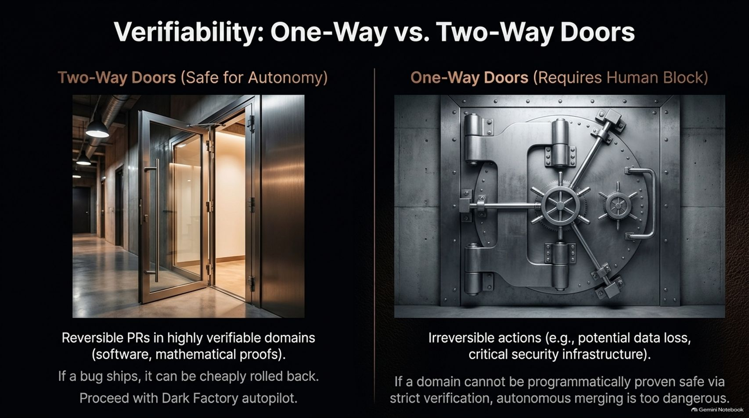
Notes:
Visual: Split screen. Left: A modern, open glass architectural door ("Two-Way Doors"). Right: A massive, heavy bank vault door with multi-point steel locking wheels ("One-Way Doors").
Suggested Speaking Time: 4 – 5 minutes.
Speaker Notes:
Autonomy requires strict risk assessment based on Verifiability. We divide actions into two categories:
Two-Way Doors (Safe for Autonomy): Reversible PRs in highly verifiable domains—like standard application software or mathematical proofs. If a bug slips through, it can be cheaply rolled back. Proceed with Dark Factory autopilot.
One-Way Doors (Requires Human Block): Irreversible actions involving potential data loss, financial ledger mutations, or critical security infrastructure. If a domain cannot be programmatically proven safe via strict verification, autonomous merging is too dangerous and requires manual human sign-off.

Slide 15
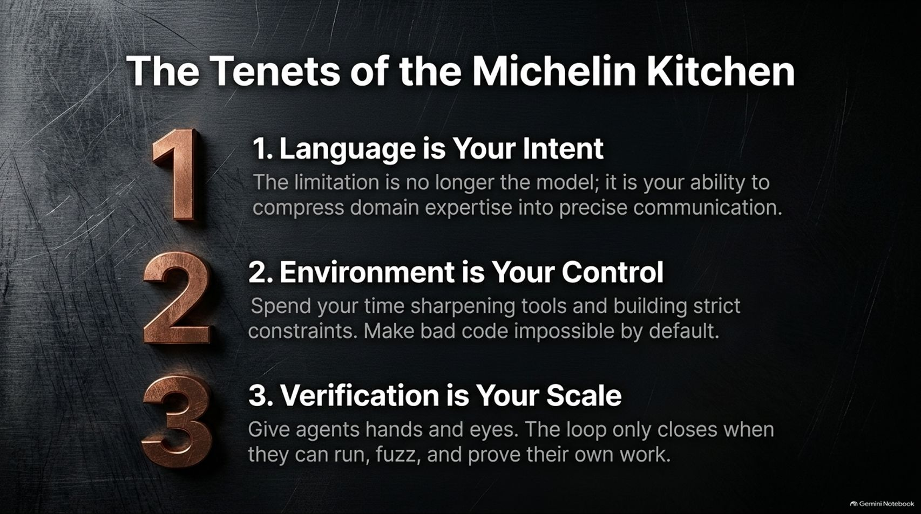
Notes:
Visual: Three massive, embossed bronze numbers (1, 2, 3) set against a dark textured slate background, summarizing the core operational tenets.
Suggested Speaking Time: 3 – 4 minutes.
Speaker Notes:
Let's summarize the core tenets of the Michelin Kitchen framework:
1. Language is Your Intent: The limitation is no longer the model; it is your ability to compress domain expertise into precise, unambiguous communication.
2. Environment is Your Control: Spend your time sharpening tools and building strict constraints. Make bad code structurally impossible by default.
3. Verification is Your Scale: Give agents hands and eyes. The loop only closes when they can run, fuzz, and mathematically prove their own work.

Slide 16
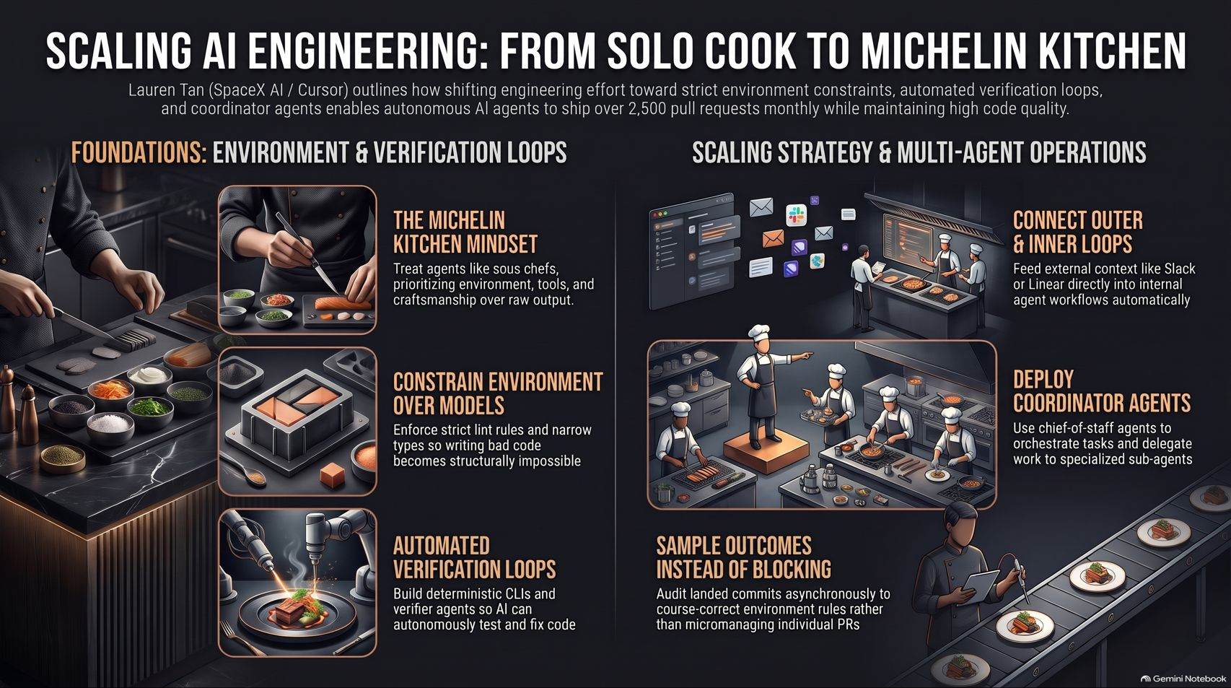
Notes:
Visual: Comprehensive summary infographic featuring two distinct columns: Foundations (Environment & Verification Loops) on the left, and Scaling Strategy & Multi-Agent Operations on the right.
Suggested Speaking Time: 3 – 5 minutes.
Speaker Notes:
On our final slide, we bring the entire architecture together:
In the Foundations column, we maintain the Michelin kitchen mindset, constrain environments over models, and build automated verification loops with deterministic CLIs.
In the Scaling Strategy column, we connect our outer loops (Slack, Linear) with inner execution engines, deploy chief-of-staff coordinator agents, and practice asynchronous sampling over bottlenecked blocking.
By shifting your focus from writing code to building kitchens, you unlock the ability to scale your output infinitely while maintaining absolute craft and quality. Thank you!

