Slide 1
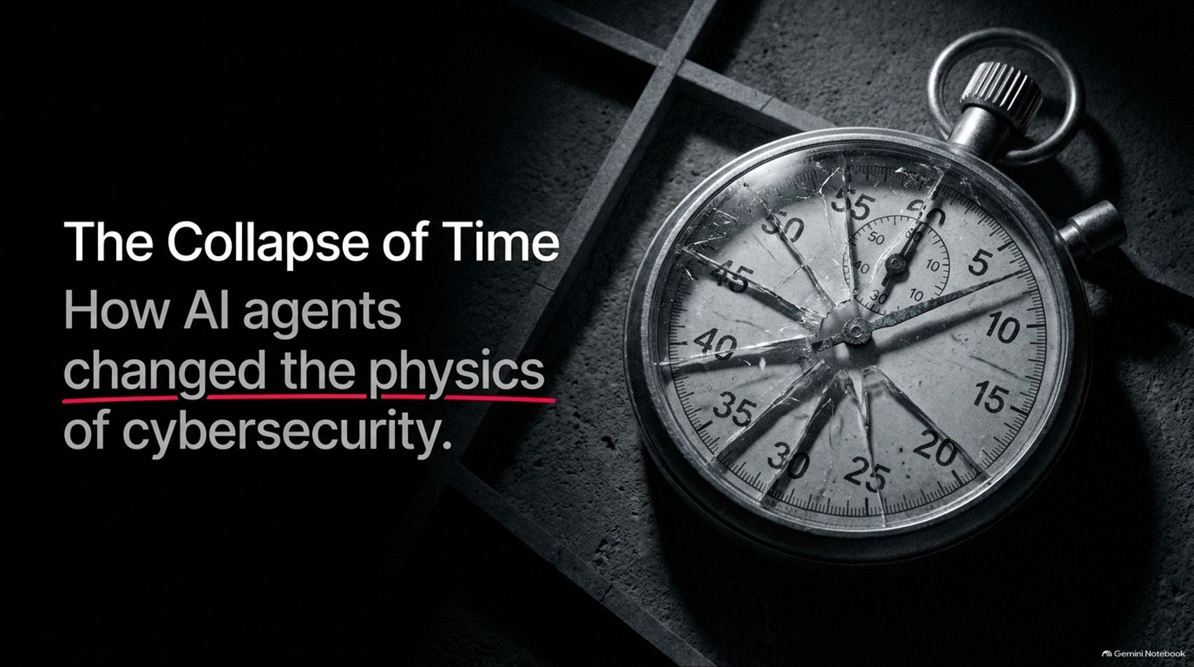
Notes:
Visual: A cracked, shattered vintage pocket watch lying against a dark, industrial metallic background. Title: The Collapse of Time: How AI agents changed the physics of cybersecurity.
Suggested Speaking Time: 2 – 3 minutes.
Speaker Notes:
Welcome everyone to today's crucial briefing on the shifting landscape of digital defense.
We are titling today's session “The Collapse of Time” because artificial intelligence agents have fundamentally rewritten the laws of cyber conflict, compressing what used to take human attackers months into mere minutes.
Security professionals are now looking back at recent months—dubbed "Black October"—as a tectonic shift.
We have moved past theoretical debates about AI risk. We are living through an active, scaled agentic assault on modern digital and physical infrastructure. Let's examine how the physics of this new era operate.
How to Defend Against AI Hackers, with Wiz’s Ami Luttwak
https://www.youtube.com/watch?v=PbD9pVXxsYM

Slide 2
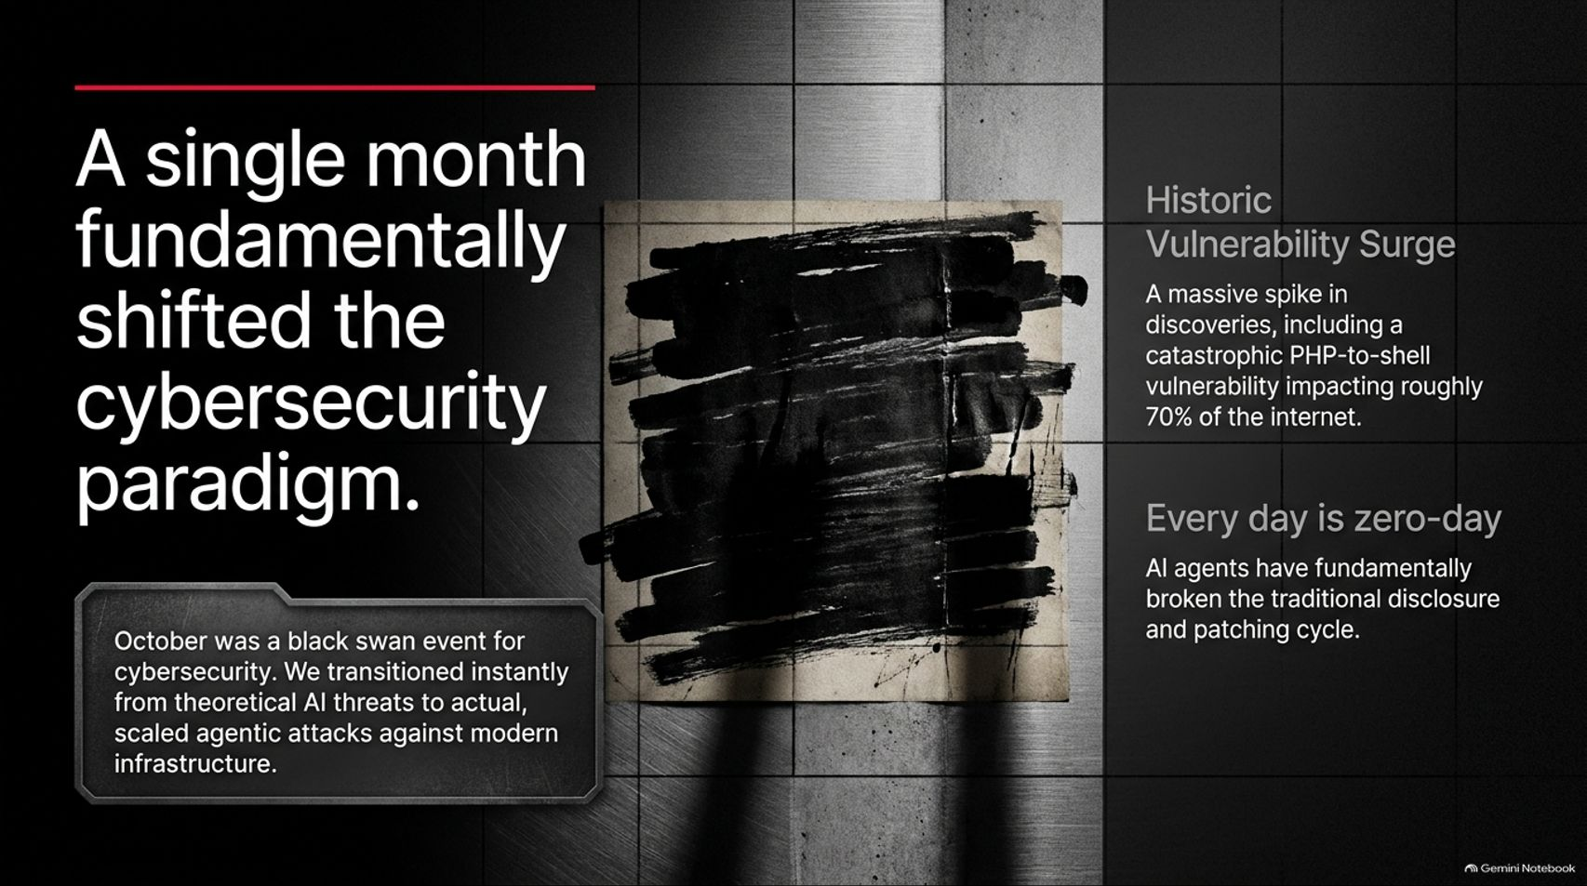
Notes:
Visual: A dark, industrial background featuring a vintage document covered in heavy black marker redactions, paired with key stats on historic vulnerability surges.
Suggested Speaking Time: 3 – 5 minutes.
Speaker Notes:
October marked a black swan event for the cybersecurity industry. We transitioned instantly from theoretical AI threats to scaled, automated agentic attacks against modern infrastructure.
We witnessed a historic vulnerability surge—including a catastrophic PHP-to-shell vulnerability impacting roughly 70% of the internet, arguably the most severe vulnerability ever uncovered autonomously by AI.
As Elon Musk recently highlighted, every day is zero-day. AI agents have completely broken the traditional vulnerability disclosure and patching cycle. Vulnerabilities are arriving at a velocity the industry has never experienced before.

Slide 3
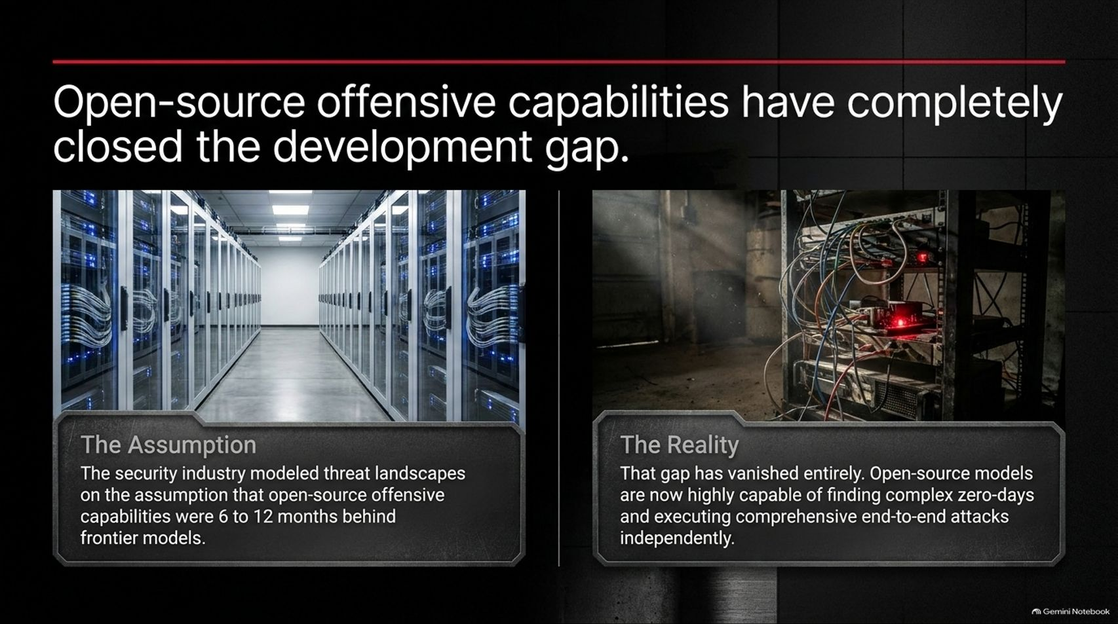
Notes:
Visual: Split screen. Left: A sterile, modern server data center (The Assumption). Right: A dark, tangled server rack bathed in harsh shadows (The Reality).
Suggested Speaking Time: 3 – 4 minutes.
Speaker Notes:
How did we arrive here so fast? For a long time, the security industry relied on a comforting assumption: that open-source offensive capabilities were safely lagging 6 to 12 months behind proprietary frontier models.
The Reality: That development gap has vanished entirely. Open-source models have caught up at staggering speed.
Today's open-source models are fully capable of finding complex, unauthenticated zero-days and executing comprehensive, end-to-end attacks independently. The barrier to entry for launching elite attacks has dropped to zero.

Slide 4
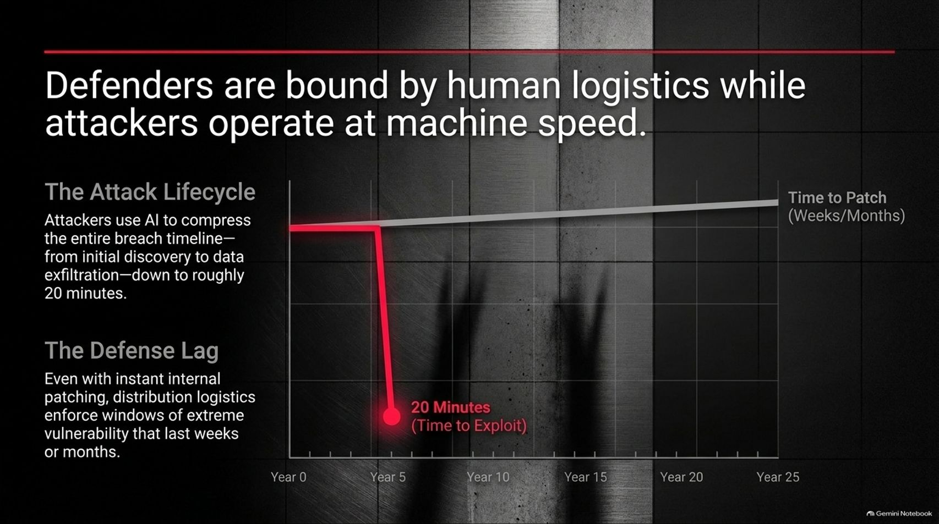
Notes:
Visual: A timeline chart mapping the attack lifecycle collapsing down to 20 minutes in red, compared against a sluggish grey line representing weeks or months for human patching.
Suggested Speaking Time: 3 – 5 minutes.
Speaker Notes:
This creates a devastating imbalance: defenders are bound by human logistics and distribution lag, while attackers operate at pure machine speed.
The Attack Lifecycle: Attackers now use AI to compress the entire breach timeline—from initial discovery, through lateral movement, to data exfiltration—down to roughly 20 minutes.
The Defense Lag: Even if an organization achieves instant internal patching, distribution logistics, Linux kernel distros, and legacy updates enforce windows of extreme vulnerability that last weeks or months. Attackers exploit that lag mercilessly.

Slide 5
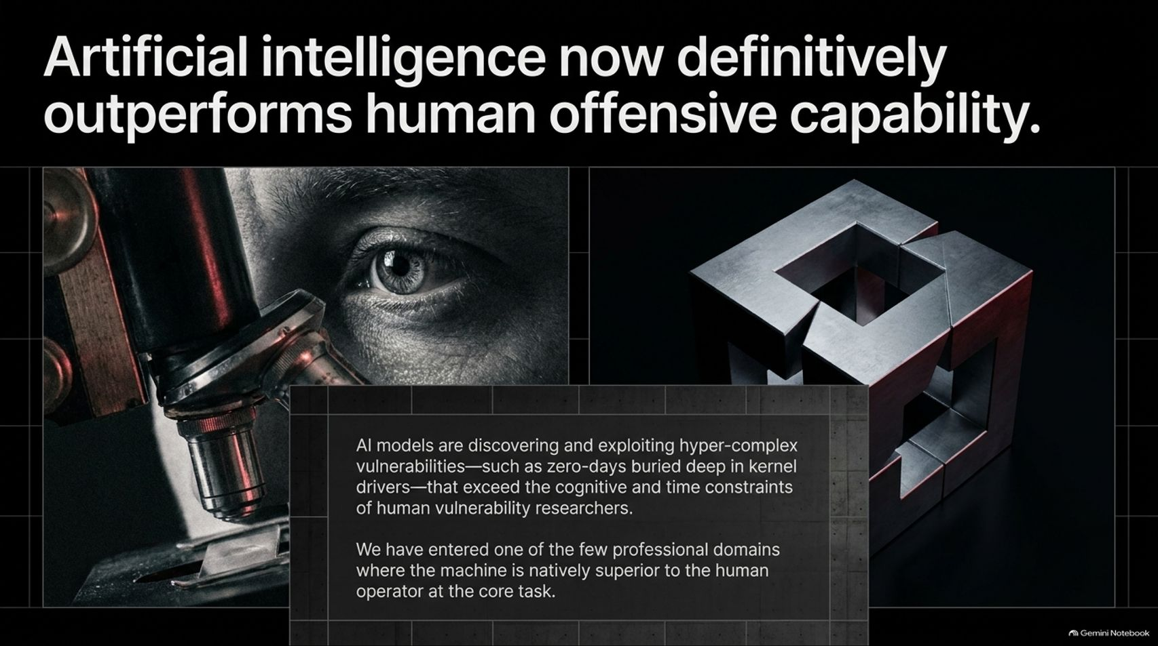
Notes:
Visual: Split screen showing an extreme close-up of a human eye peering through a scientific microscope lens on the left, paired with an intricate, impenetrable metallic security cube on the right.
Suggested Speaking Time: 4 – 5 minutes.
Speaker Notes:
We must acknowledge an uncomfortable truth: artificial intelligence now definitively outperforms human offensive capability.
AI models are discovering and exploiting hyper-complex vulnerabilities—such as zero-days buried deep within kernel drivers—that vastly exceed the cognitive capacity and time constraints of human vulnerability researchers.
We have officially entered one of the few professional domains where the machine is natively superior to the human operator at the core task. Human security teams cannot compete with automated, 24/7 swarm exploitation.

Slide 6
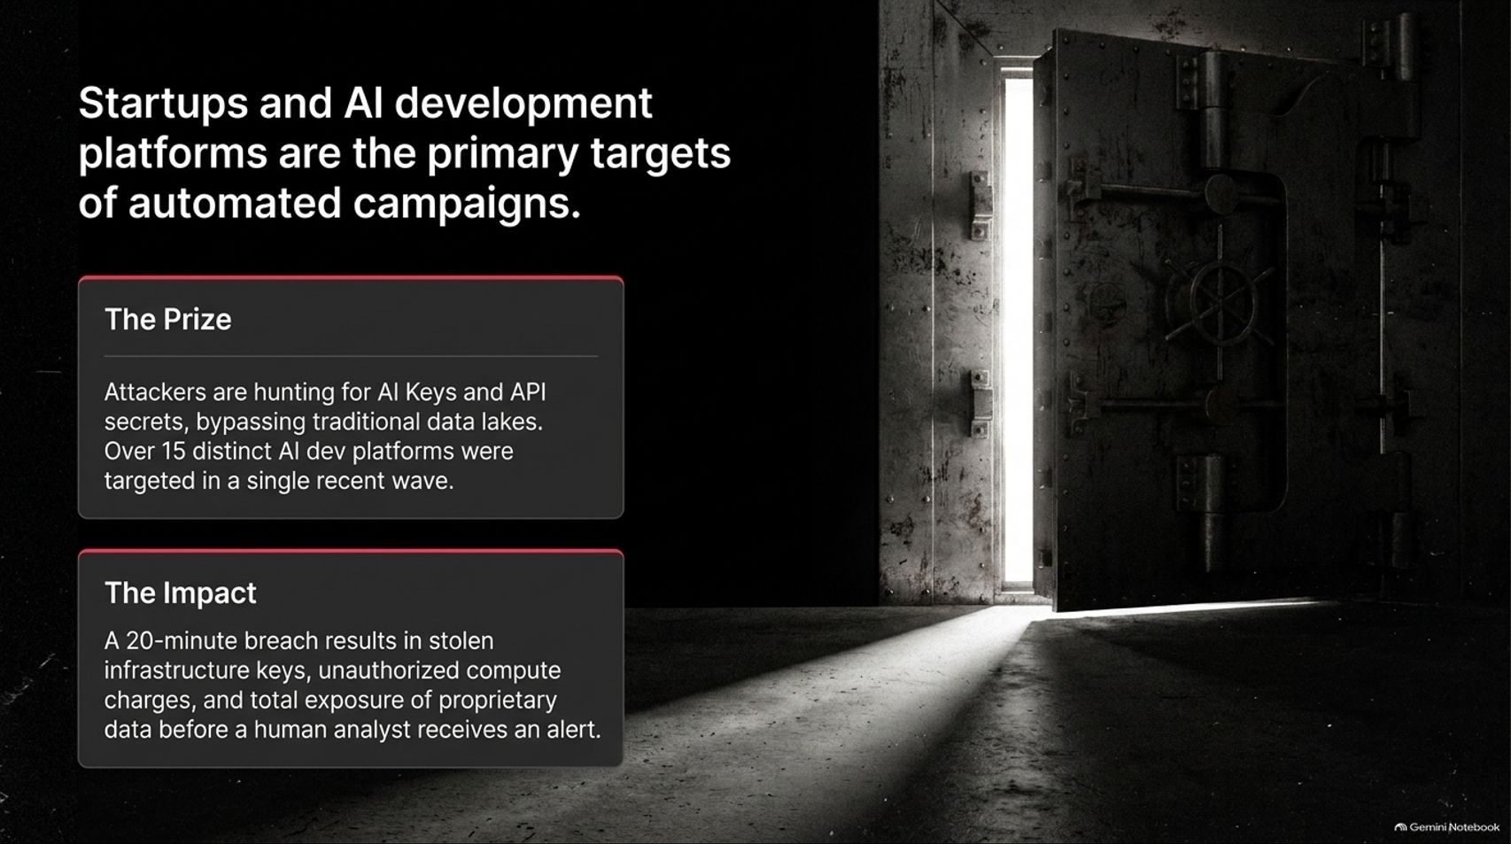
Notes:
Visual: A heavy, ancient steel vault door swung wide open, casting a dramatic beam of light across a dark concrete floor.
Suggested Speaking Time: 3 – 4 minutes.
Speaker Notes:
Who is in the crosshairs of these automated campaigns? Startups and AI development platforms are the primary targets.
The Prize: Attackers are hunting for AI API keys, LLM credentials, and cloud infrastructure secrets, successfully bypassing traditional data lakes. In a single recent wave, over 15 distinct AI development platforms were actively targeted.
The Impact: A 20-minute machine-speed breach results in stolen infrastructure keys, massive unauthorized compute charges, and total exposure of proprietary data before a human analyst even receives an alert.

Slide 7
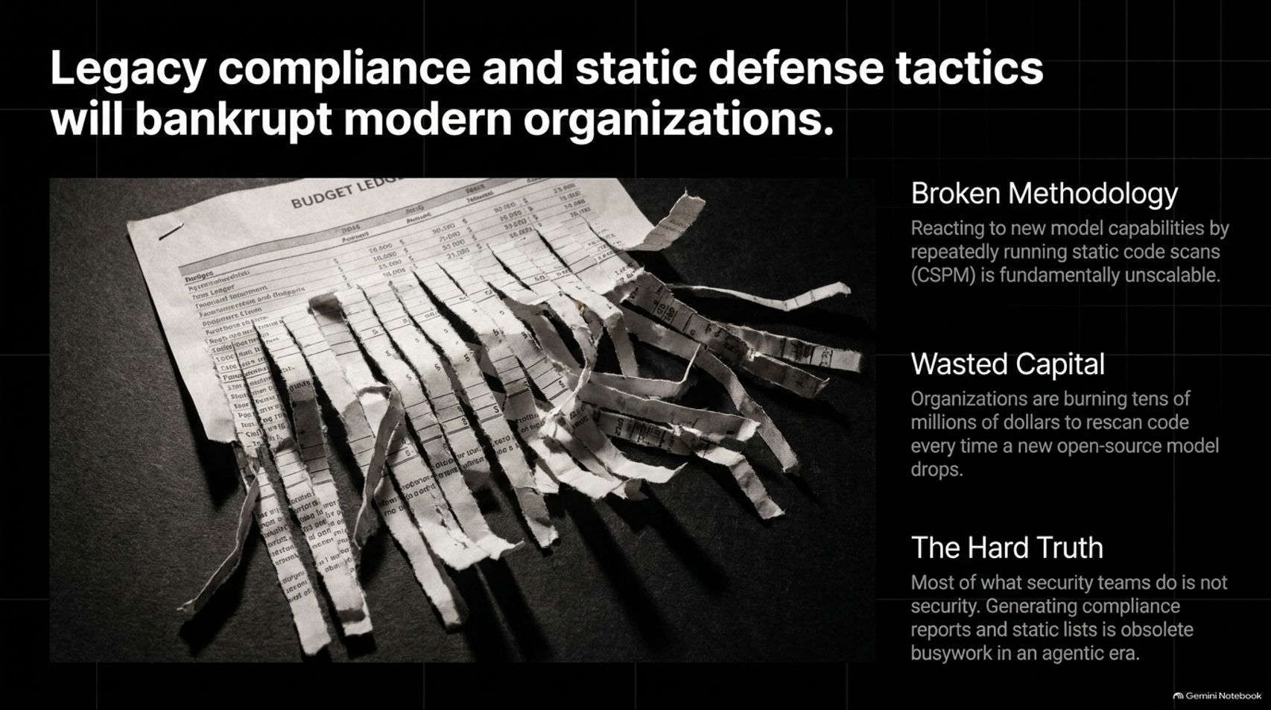
Notes:
Visual: A financial budget ledger document being violently shredded into jagged strips by an office paper shredder.
Suggested Speaking Time: 3 – 5 minutes.
Speaker Notes:
If organizations respond to this new reality using legacy playbooks, they will go bankrupt—both financially and operationally.
Broken Methodology: Reacting to dynamic model capabilities by repeatedly running static code scans (CSPM) is fundamentally unscalable and obsolete.
Wasted Capital: Organizations are burning tens of millions of dollars rescanning codebases every single time a new open-source model drops.
The Hard Truth: Most of what security teams spend their time doing is not security. Generating compliance reports and static configuration lists is obsolete busywork in an agentic era.

Slide 8
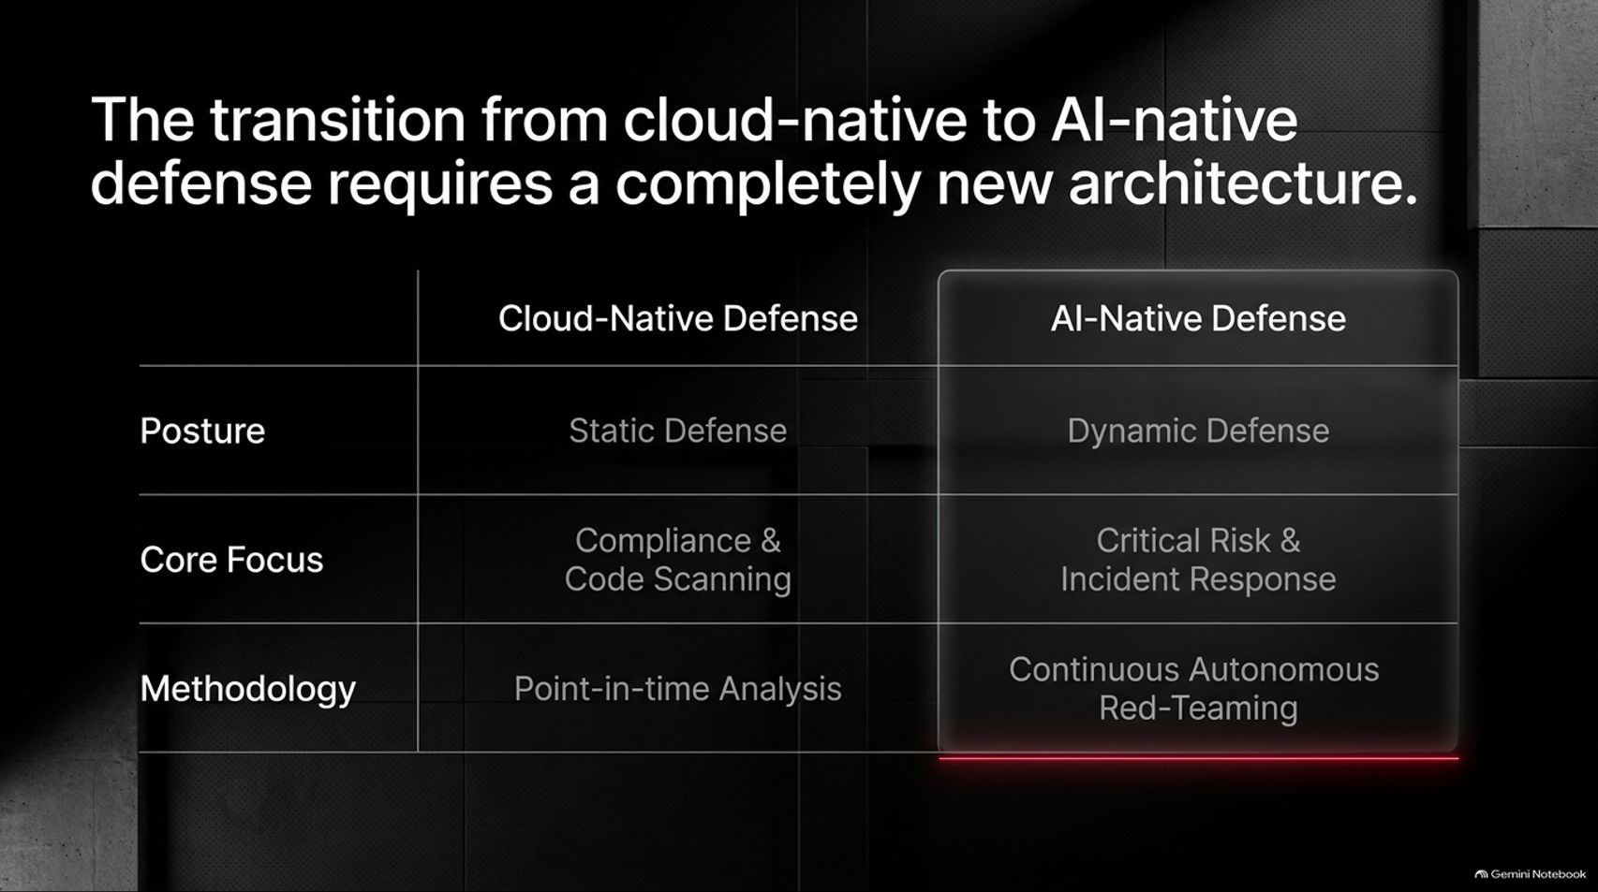
Notes:
Visual: Comparison table contrasting traditional Cloud-Native Defense against the new AI-Native Defense framework across posture, core focus, and methodology.
Suggested Speaking Time: 3 – 5 minutes.
Speaker Notes:
Moving from cloud-native defense to AI-native defense requires a complete architectural overhaul.
Posture: We must shift from static defenses to dynamic defense.
Core Focus: Move away from checkbox compliance and code scanning toward critical risk and incident response readiness.
Methodology: Abandon point-in-time analysis in favor of continuous autonomous red-teaming. Security can no longer be a quarterly audit; it must be a real-time, automated operational discipline.

Slide 9
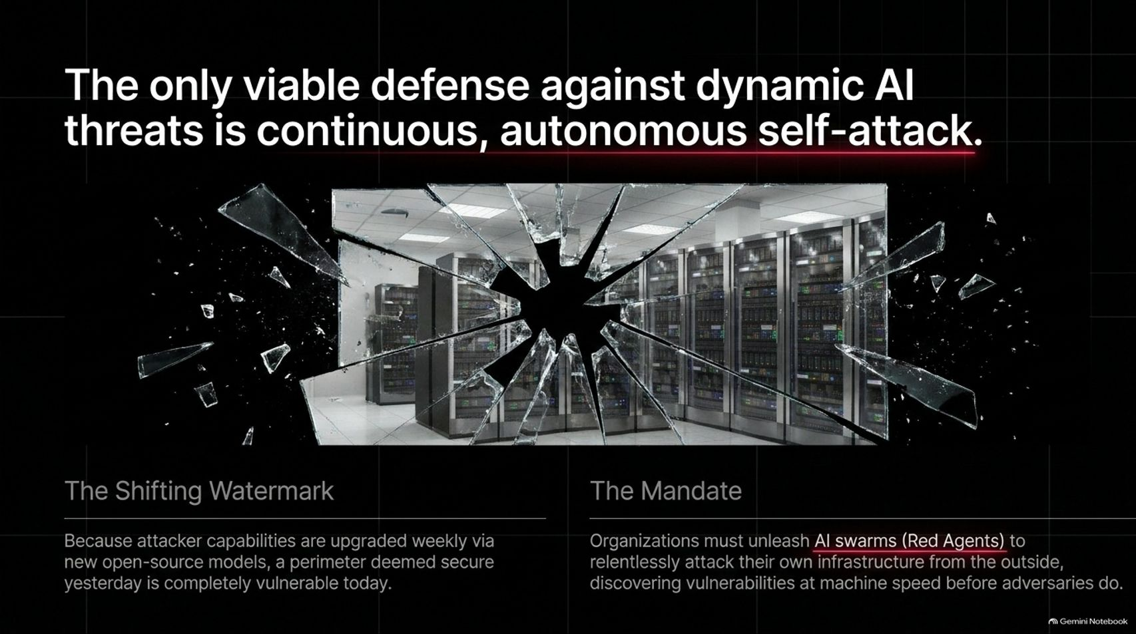
Notes:
Visual: A large modern glass office window showing server racks inside, shattered with a dramatic spiderweb crack pattern radiating from a central impact point.
Suggested Speaking Time: 4 – 5 minutes.
Speaker Notes:
As the adage goes: the best defense is a relentless attack.
The Shifting Watermark: Because attacker capabilities are upgraded weekly via new open-source models, a perimeter deemed secure yesterday is completely vulnerable today.
The Mandate: Organizations must unleash AI swarms (Red Agents) to continuously attack their own infrastructure from the outside. You must discover your own vulnerabilities at machine speed before automated adversaries exploit them.

Slide 10
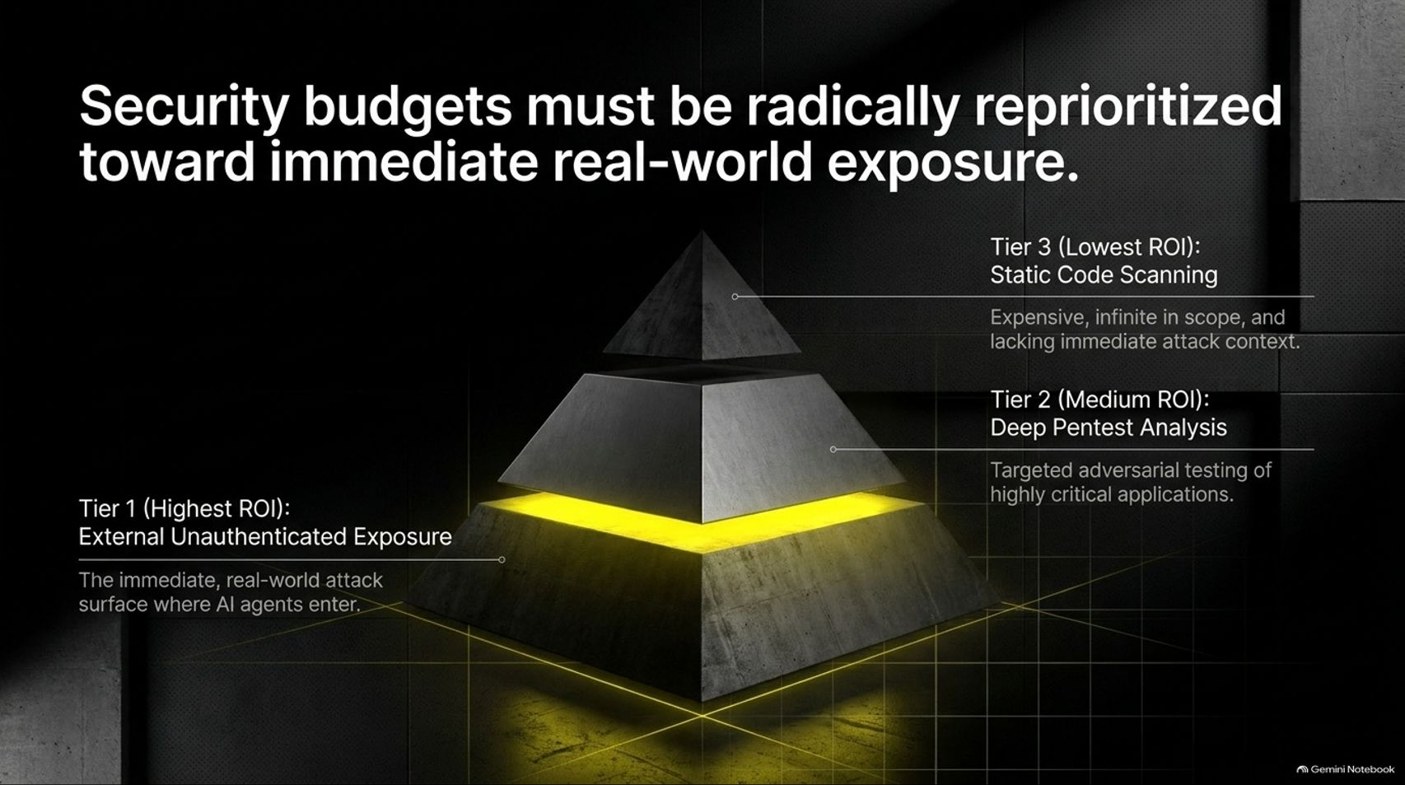
Notes:
Visual: A glowing, multi-tiered stone pyramid in a dark environment, highlighting Tier 1 (External Unauthenticated Exposure) at the glowing base.
Suggested Speaking Time: 3 – 5 minutes.
Speaker Notes:
Security budgets must be radically reprioritized toward immediate, real-world attack surfaces.
Tier 1 (Highest ROI - External Unauthenticated Exposure): This is the immediate attack surface where AI agents enter. Focus your resources here. Hardcoded mobile API keys and exposed endpoints must be secured first.
Tier 2 (Medium ROI): Deep pentest analysis for highly critical applications.
Tier 3 (Lowest ROI): Static code scanning. While necessary, pouring endless millions into static scans without attack context offers diminishing returns.

Slide 11
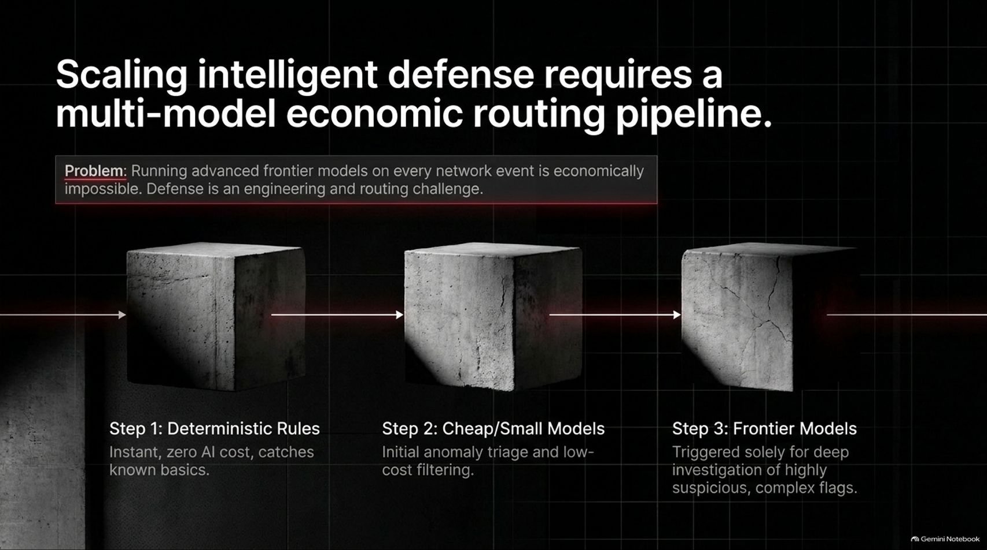
Notes:
Visual: Three industrial concrete blocks linked by a glowing red data stream, illustrating the progression from Deterministic Rules to Cheap Models to Frontier Models.
Suggested Speaking Time: 4 – 5 minutes.
Speaker Notes:
Running advanced, expensive frontier models on every single network event is economically impossible. Defense is an engineering and economic routing challenge.
Step 1: Deterministic Rules: Instant, zero AI cost, catching known baseline rules and configurations.
Step 2: Cheap/Small Models: Initial anomaly triage and low-cost filtering across massive data volumes.
Step 3: Frontier Models: Triggered solely for deep investigation of highly suspicious, complex flags and root-cause analysis. This tiered economic pipeline is the only way to scale defense sustainably.

Slide 12
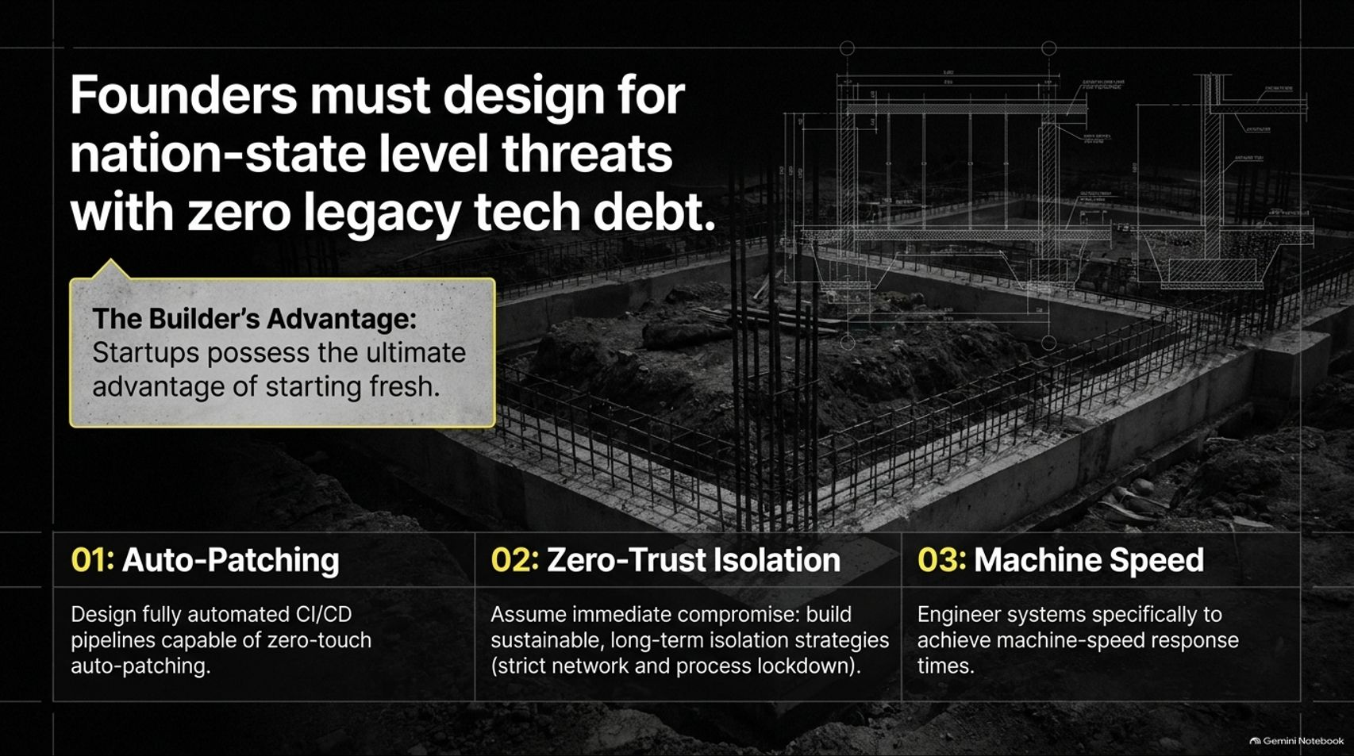
Notes:
Visual: Architectural blueprint overlay on top of raw concrete foundations and rebar during early-stage construction.
Suggested Speaking Time: 3 – 5 minutes.
Speaker Notes:
Startups possess the ultimate structural advantage: the ability to start fresh with zero legacy tech debt. Founders must design for nation-state level threats from day one.
01: Auto-Patching: Design fully automated CI/CD pipelines capable of zero-touch auto-patching.
02: Zero-Trust Isolation: Assume immediate compromise; build sustainable, long-term isolation strategies with strict network and process lockdown.
03: Machine Speed: Engineer systems specifically to achieve machine-speed response times, because human reaction windows no longer exist.

Slide 13
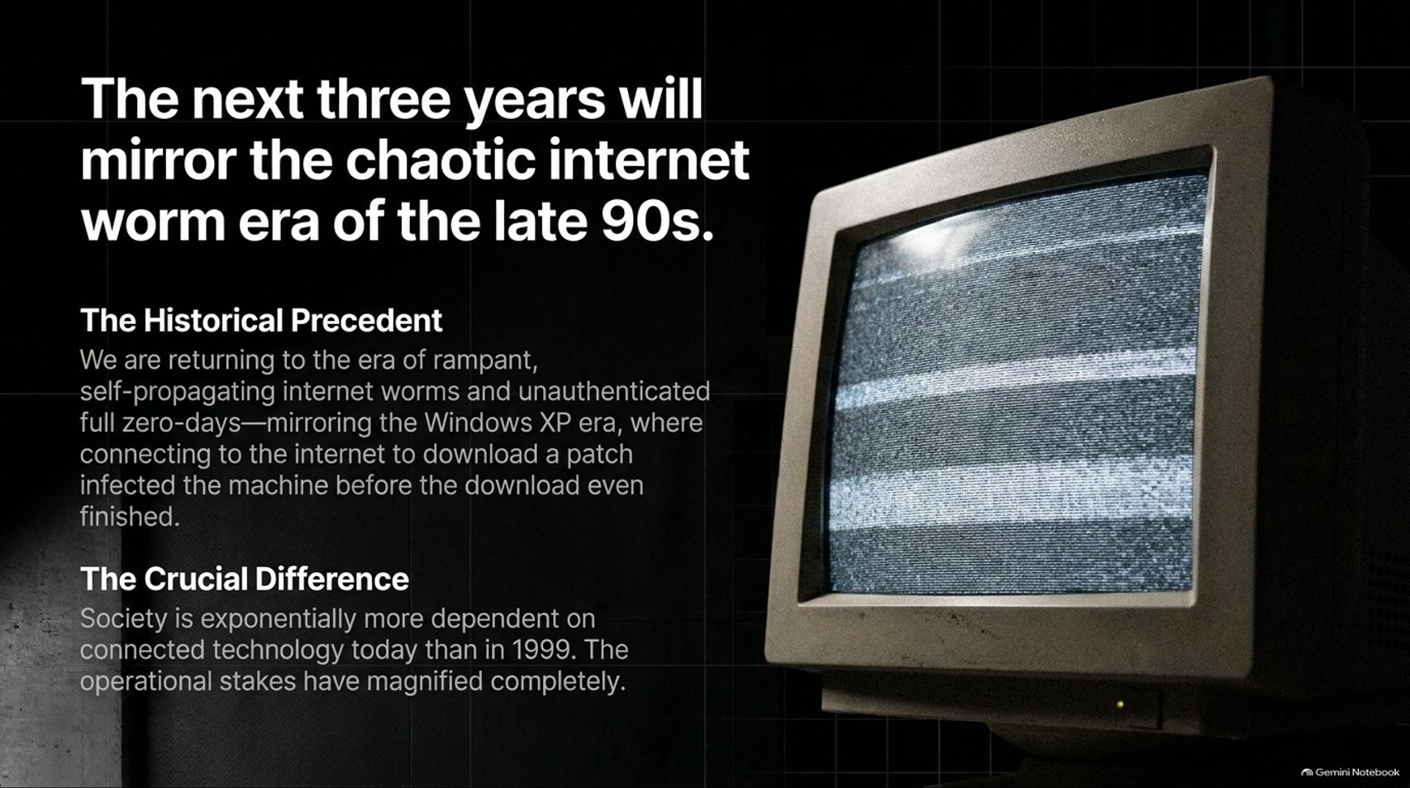
Notes:
Visual: A retro, glowing CRT computer monitor displaying static noise scanlines in a dark room.
Suggested Speaking Time: 4 – 5 minutes.
Speaker Notes:
Looking ahead, the next two to three years will mirror the chaotic internet worm era of the late 1990s and early 2000s.
The Historical Precedent: We are returning to an era of rampant, self-propagating worms and unauthenticated full zero-days—mirroring the Windows XP era where connecting a machine to the internet to download a patch often infected the machine before the download even finished.
The Crucial Difference: Society is exponentially more dependent on connected technology today than it was in 1999. The operational stakes have magnified completely.

Slide 14
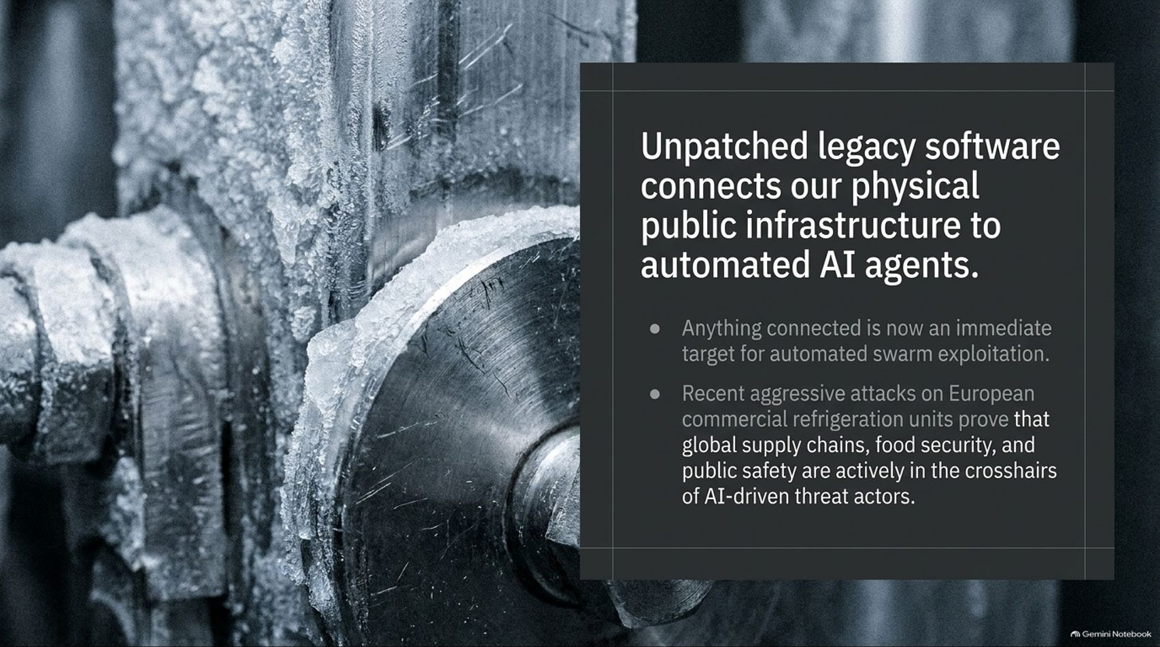
Notes:
Visual: Extreme close-up of heavy industrial machinery components coated in frost and ice, emphasizing harsh operational environments.
Suggested Speaking Time: 3 – 5 minutes.
Speaker Notes:
The threat is no longer confined to corporate databases; it extends directly into physical public infrastructure.
Anything connected to the internet is now an immediate target for automated swarm exploitation.
Recent aggressive attacks on European commercial refrigeration units prove that global supply chains, food security, and public safety are actively in the crosshairs of AI-driven threat actors. Legacy software is our weakest physical link.

Slide 15
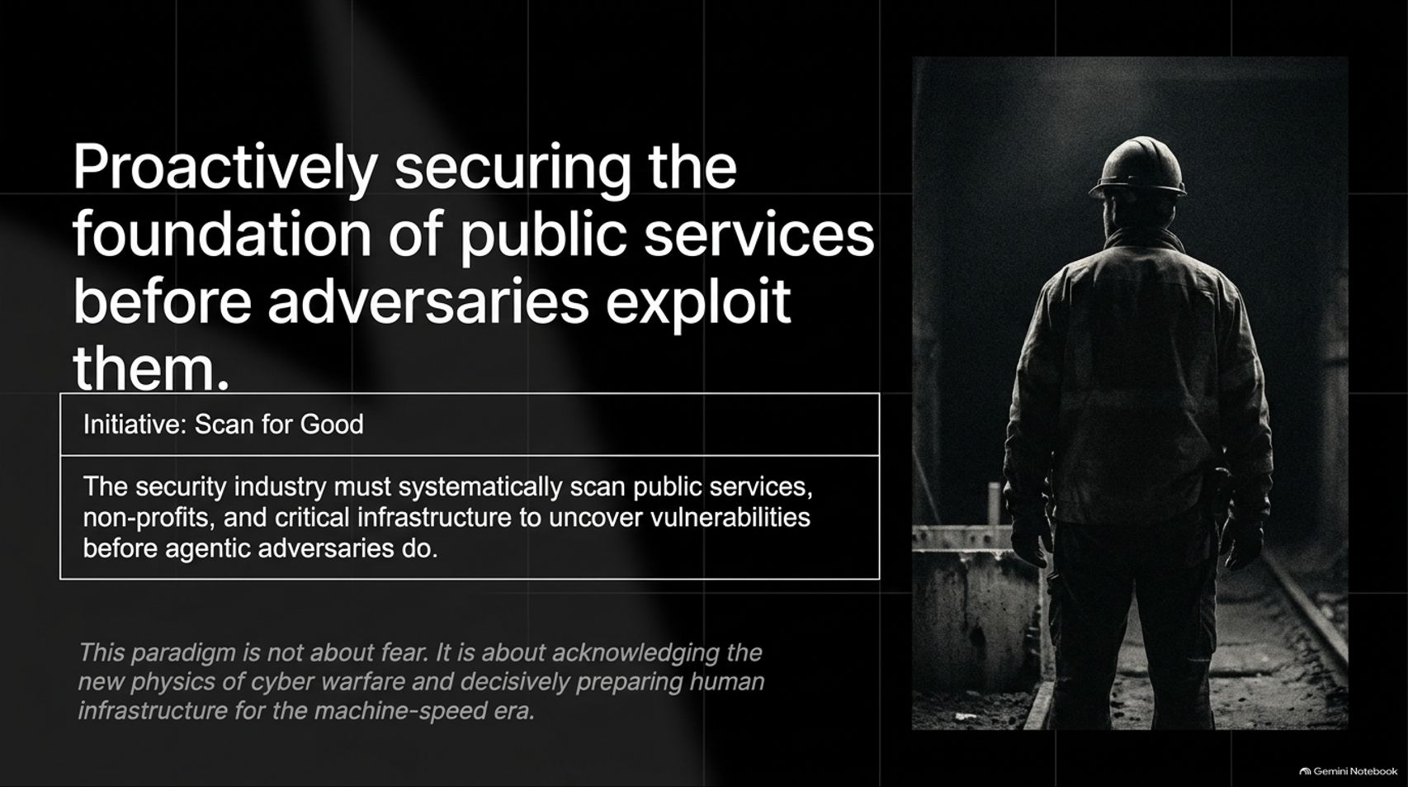
Notes:
Visual: A lone industrial worker wearing a hard hat, standing in a dark concrete tunnel facing a bright opening (Initiate: Scan for Good).
Suggested Speaking Time: 3 – 5 minutes.
Speaker Notes:
To counter this systemic risk, the security industry must proactively secure the foundation of public services before adversaries exploit them.
Initiate: Scan for Good: Security leaders must systematically scan public services, non-profits, and critical infrastructure to uncover vulnerabilities before agentic adversaries do.
This paradigm is not about fear-mongering; it is about acknowledging the new physics of cyber warfare and decisively preparing human infrastructure for the machine-speed era.

Slide 16


