Slide 1
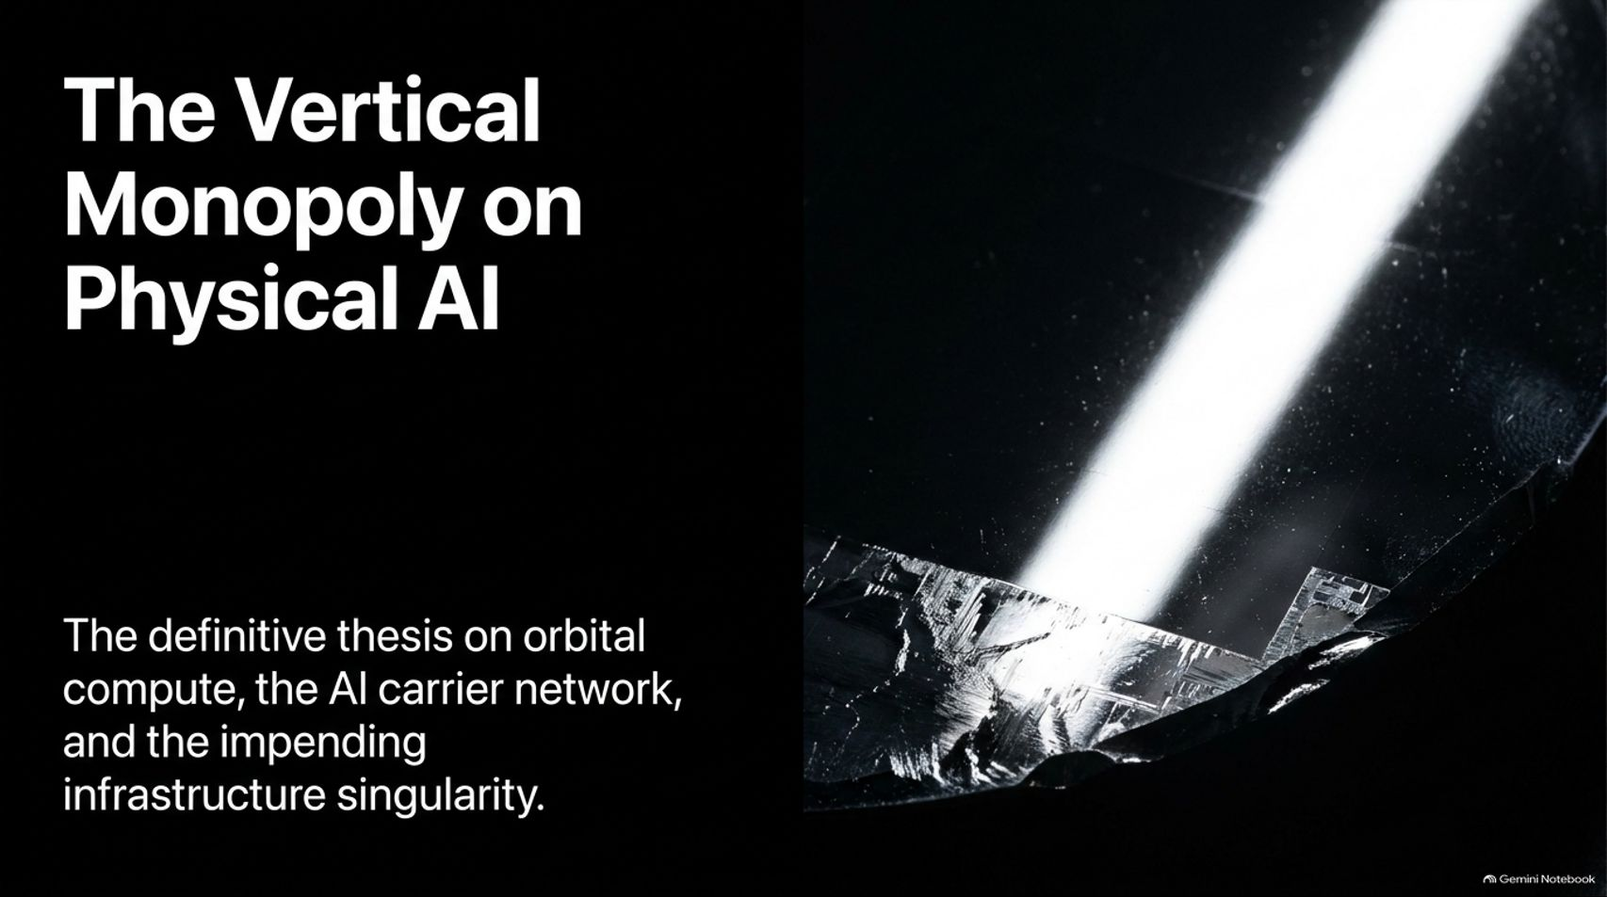
Notes:
Visual: A sleek, dark abstract silicon wafer with a sharp, brilliant beam of light cutting across the circuitry and microchips. Title: The Vertical Monopoly on Physical AI. Subtitle: The definitive thesis on orbital compute, the AI carrier network, and the impending infrastructure singularity.
Suggested Speaking Time: 2 – 3 minutes.
Speaker Notes:
Welcome everyone to today's crucial briefing on what we call "The Vertical Monopoly on Physical AI."
We are standing at the edge of an infrastructure singularity. For the past few years, the tech world has obsessed over software models, transformer architectures, and algorithms. But the game has fundamentally changed.
The true battleground is no longer just digital; it is physical. It spans orbital space, custom edge telecom networks, high-density energy grids, and mass-manufactured humanoid robotics.
Over the next 15 slides, we are going to dissect the closed-loop convergence of SpaceX, Tesla, xAI, and specialized spectrum infrastructure that is quietly forming the most powerful vertical monopoly in human history. Let's dive into the core engine driving this shift: the inference explosion.
How to Play the AI Spectrum - LIVESTREAM
https://www.youtube.com/watch?v=uArtaS1dCp4

Slide 2
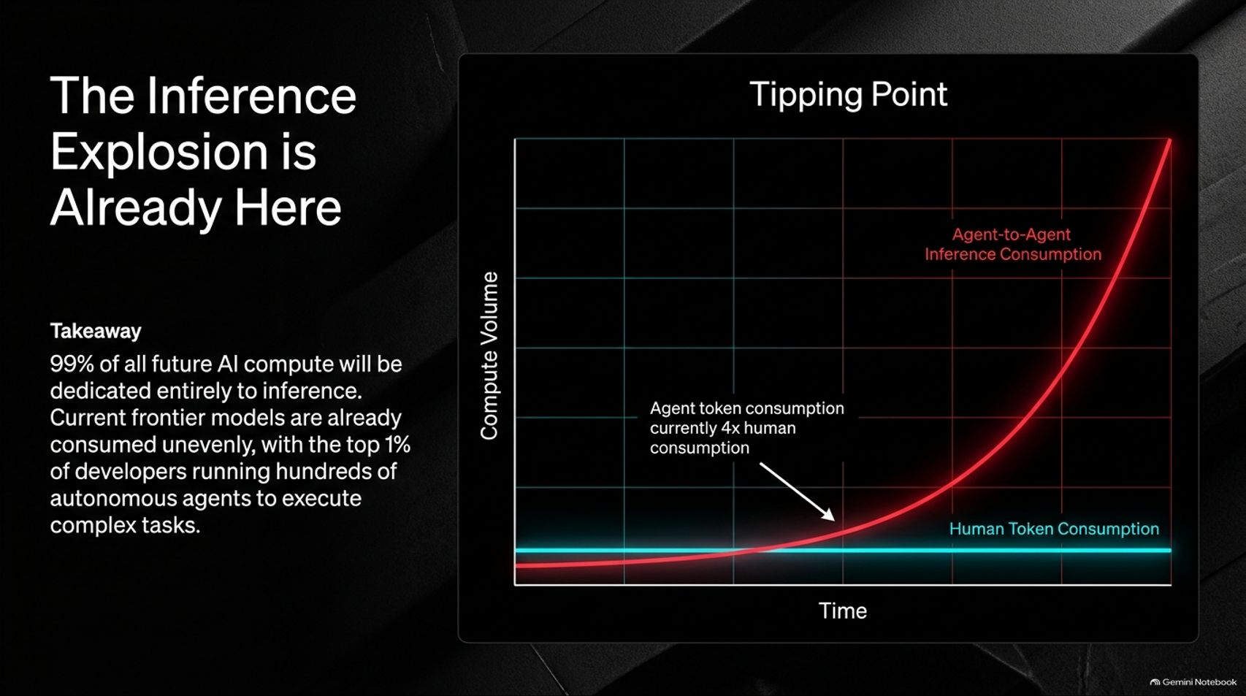
Notes:
Visual: A dramatic exponential growth chart mapping Compute Volume against Time. A bright red curve representing Agent-to-Agent Inference Consumption skyrocketing past a flat blue baseline of Human Token Consumption.
Suggested Speaking Time: 3 – 5 minutes.
Speaker Notes:
To understand the physical AI monopoly, you first have to understand where compute is actually going. 99% of all future AI compute will be dedicated entirely to inference.
We are already past the tipping point. Current frontier models are consumed unevenly, with the top 1% of developers and elite AI labs running hundreds of autonomous agents simultaneously to write code, manage infrastructure, and execute complex multi-step tasks.
As the data shows, agent token consumption is already running 4x human token consumption. As this behavior cascades across the broader economy, the sheer volume of inference requests will overwhelm traditional terrestrial networks unless our underlying architecture evolves.

Slide 3
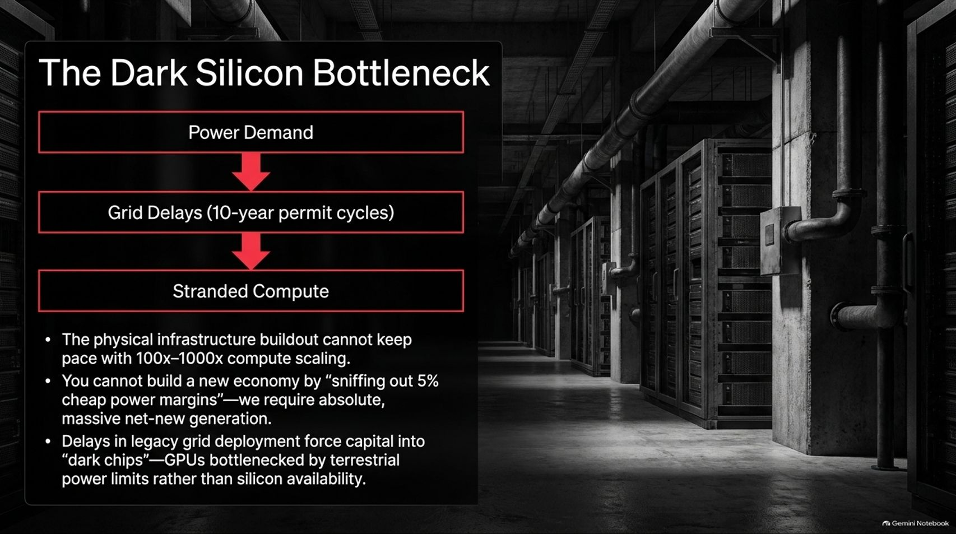
Notes:
Visual: A sterile, dimly lit data center corridor lined with server racks and heavy overhead pipes, accompanied by a sequential red flowchart mapping Power Demand -> Grid Delays -> Stranded Compute.
Suggested Speaking Time: 3 – 5 minutes.
Speaker Notes:
But here is the brutal physical reality: the physical infrastructure buildout cannot keep pace with 100x to 1000x compute scaling.
We face a severe Dark Silicon Bottleneck. You cannot build a new AI-driven economy by simply "sniffing out 5% cheap power margins". We require absolute, massive, net-new generation.
Terrestrial power grids are shackled by 10-year permit cycles, extreme NIMBY regulations, and crippling water cooling costs. When GPUs sit idle waiting for power allocations, capital is trapped in "dark chips"—hardware bottlenecked by terrestrial grid limits rather than silicon availability.

Slide 4
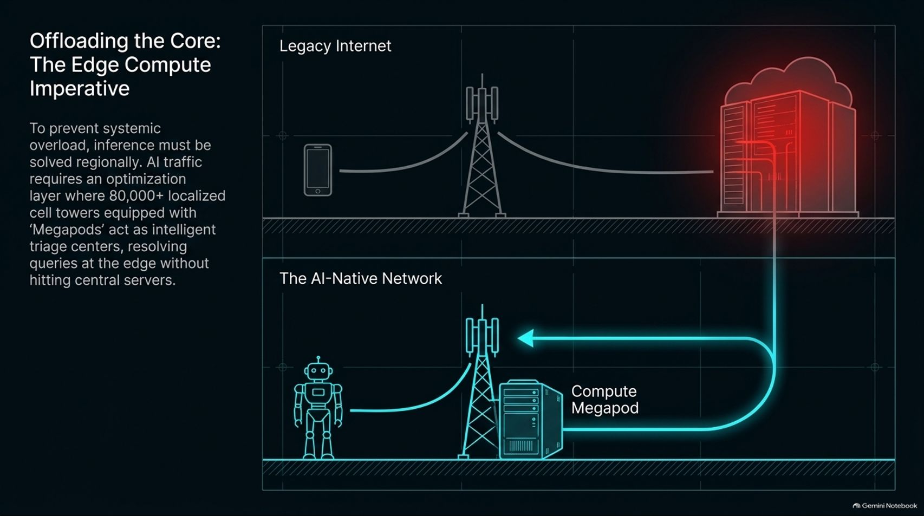
Notes:
Visual: Split structural diagram. Top: The congested Legacy Internet with a single glowing red cloud server bottleneck. Bottom: The AI-Native Network showing localized cell towers equipped with "Compute Megapods" intercepting traffic from robots at the edge.
Suggested Speaking Time: 3 – 5 minutes.
Speaker Notes:
To prevent systemic grid overload and latency collapse, inference cannot all route back to centralized cloud servers; it must be solved regionally at the edge.
AI traffic requires an intelligent optimization layer. Imagine equipping over 80,000 localized cell towers with regional "Compute Megapods".
These edge pods act as intelligent triage centers, resolving routine agent-to-agent queries locally at the edge without hammering central data centers. This is the blueprint for the AI-native network.

Slide 5
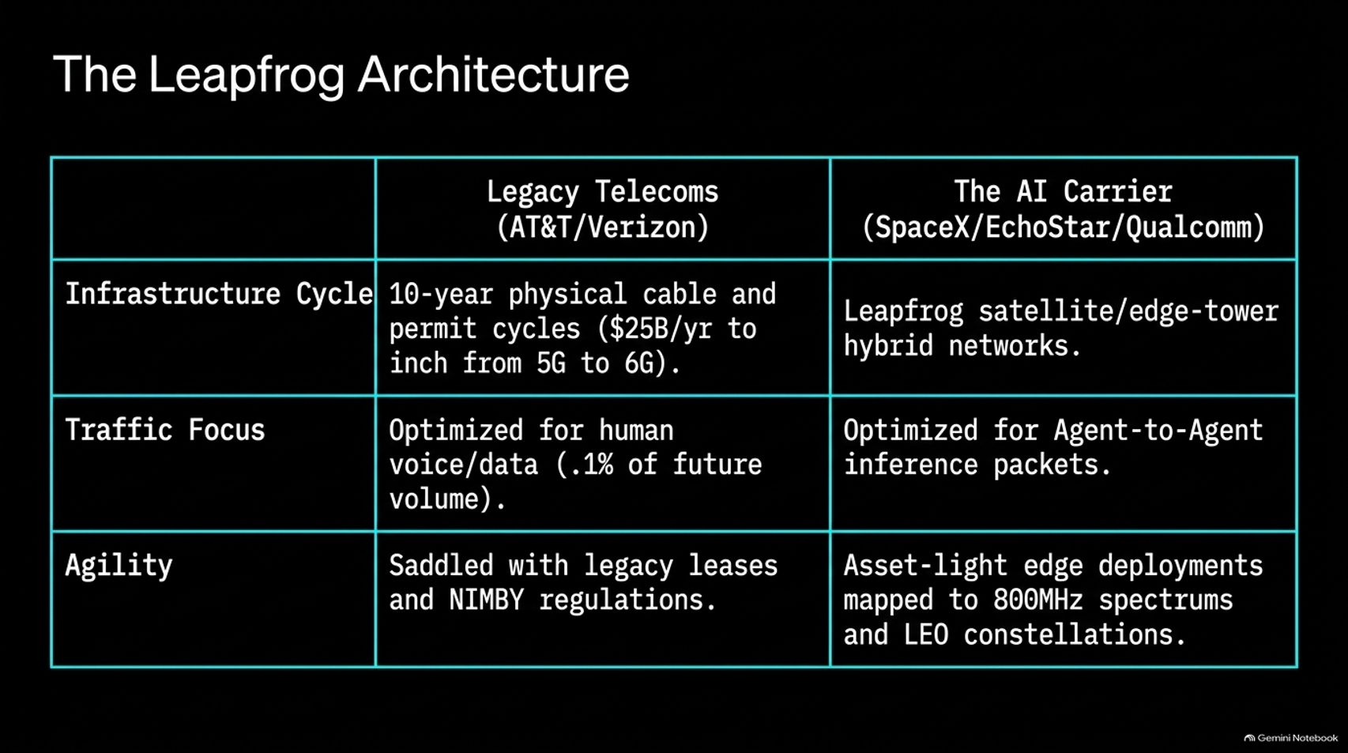
Notes:
Visual: A structured comparison table contrasting Legacy Telecoms (AT&T/Verizon) against The AI Carrier (SpaceX/EchoStar/Qualcomm) across infrastructure cycles, traffic focus, and agility.
Suggested Speaking Time: 3 – 5 minutes.
Speaker Notes:
Legacy telecoms like AT&T and Verizon are completely unequipped for this shift. They are bogged down by 10-year physical copper and fiber permit cycles, spending tens of billions just to inch from 5G to 6G.
Their networks are optimized for human voice and mobile streaming—accounting for less than 0.1% of future agentic volume.
The AI Carrier Architecture bypasses this entirely. By leveraging low-earth-orbit (LEO) satellite constellations, hybrid edge towers, and asset-light 800MHz spectrum deployments, the AI carrier builds for agent-to-agent inference packets from the ground up.

Slide 6
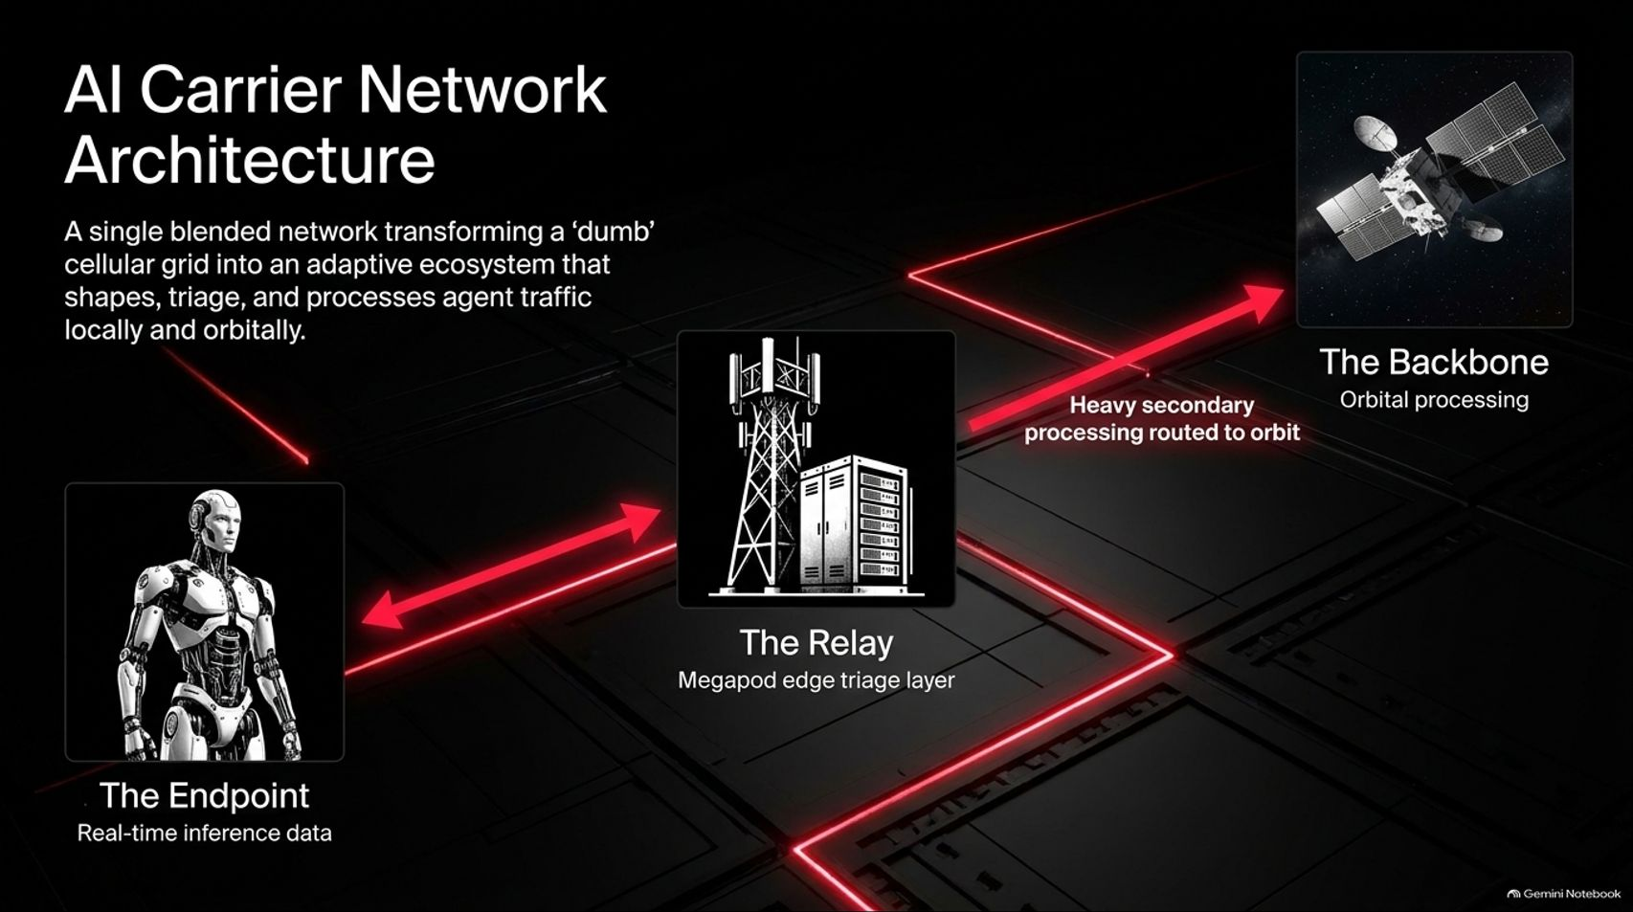
Notes:
Visual: A blended node network diagram connecting three key components with glowing red telemetry lines: The Endpoint (Humanoid Robot), The Relay (Megapod Edge Tower), and The Backbone (Orbital Processing).
Suggested Speaking Time: 3 – 5 minutes.
Speaker Notes:
This creates a single, blended network that transforms a traditionally "dumb" cellular grid into an adaptive ecosystem.
1. The Endpoint: Autonomous hardware like Optimus and Cybercabs generating real-time physical inference data.
2. The Relay: Megapod edge layers sitting at cell towers that triage and process millisecond-level requests locally.
3. The Backbone: Heavy secondary processing routed directly to orbital data centers in space. It is a seamless closed-loop pipeline.

Slide 7
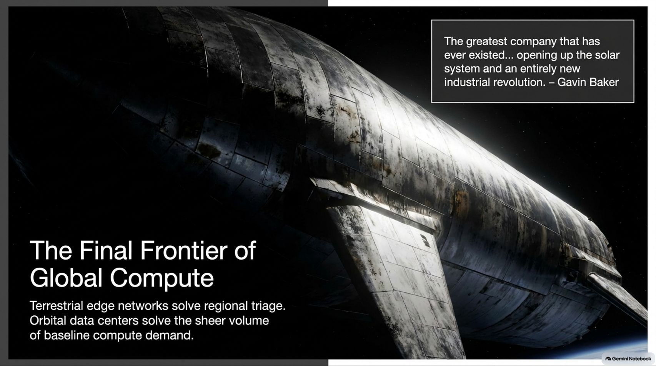
Notes:
Visual: A massive futuristic Starship spacecraft gliding majestically against the blackness of space and Earth's horizon, featuring a quotation from investor Gavin Baker: "The greatest company that has ever existed... opening up the solar system and an entirely new industrial revolution."
Suggested Speaking Time: 4 – 5 minutes.
Speaker Notes:
While terrestrial edge networks solve regional triage, orbital data centers solve the sheer volume of baseline compute demand.
As prominent tech investor Gavin Baker noted, SpaceX is positioned to become the greatest company that has ever existed, opening up the solar system and an entirely new industrial revolution.
Terrestrial energy limits force us to look upward. Space offers infinite, unclouded solar energy, zero NIMBY permitting delays, and free vacuum radiation cooling. Orbital compute is not science fiction; it is economic inevitability.

Slide 8
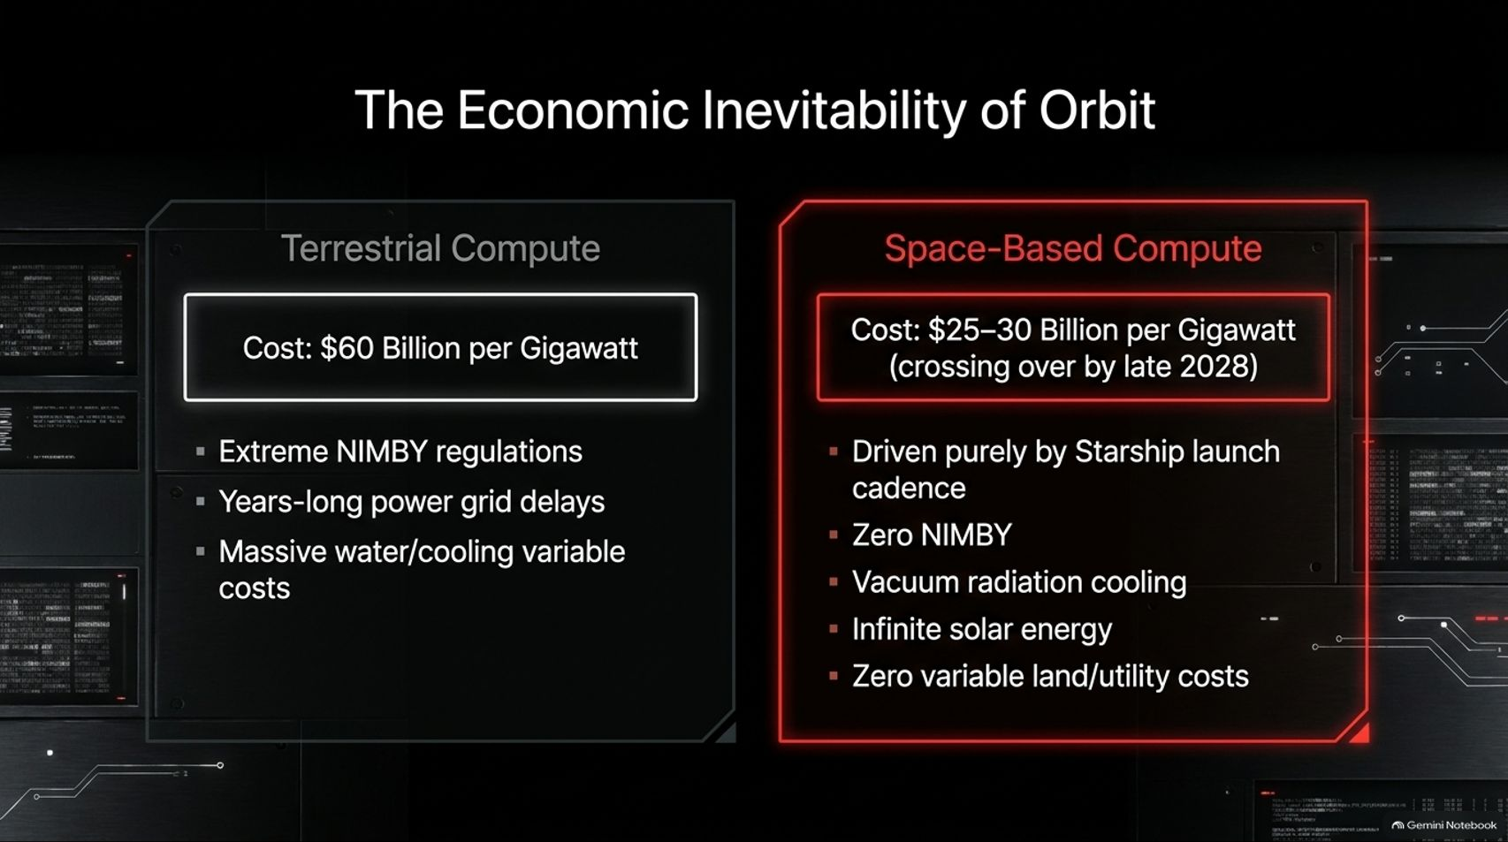
Notes:
Visual: A side-by-side comparative financial breakdown between Terrestrial Compute ($60B per gigawatt, severe NIMBY, grid delays) and Space-Based Compute ($25–30B per gigawatt crossing over by late 2028, zero NIMBY, vacuum cooling, infinite solar).
Suggested Speaking Time: 3 – 5 minutes.
Speaker Notes:
Let's look at the hard economics. Building a gigawatt of terrestrial data center capacity currently costs upwards of $60 Billion, plagued by multi-year grid queues and massive water cooling constraints.
Space-based compute drops capital requirements to $25 to $30 Billion per gigawatt, crossing over parity by late 2028.
Driven purely by Starship's rapid launch cadence, space compute enjoys zero variable land costs, infinite free solar radiation, and zero water cooling bills. The economics heavily favor orbit.

Slide 9
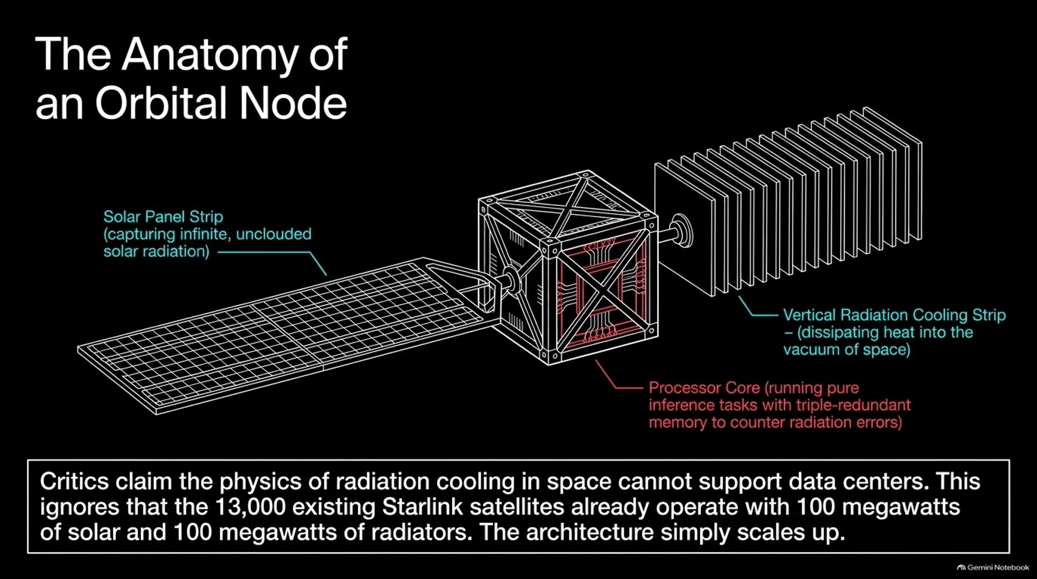
Notes:
Visual: A detailed technical schematic of an orbital satellite node, breaking down the Solar Panel Strip, the central Processor Core with triple-redundant memory, and the Vertical Radiation Cooling Strip.
Suggested Speaking Time: 3 – 5 minutes.
Speaker Notes:
Critics often argue that the physics of radiation cooling in space cannot support heavy data centers. That argument fundamentally ignores reality.
SpaceX already operates over 13,000 Starlink satellites in low-earth orbit, collectively managing massive amounts of solar power and radiation dissipation. Scaling this architecture up is purely an engineering exercise.
Each orbital node features unclouded solar strips, vertical radiation fins dissipating heat directly into the vacuum of space, and processor cores equipped with triple-redundant memory to automatically correct cosmic radiation bit-flips.

Slide 10
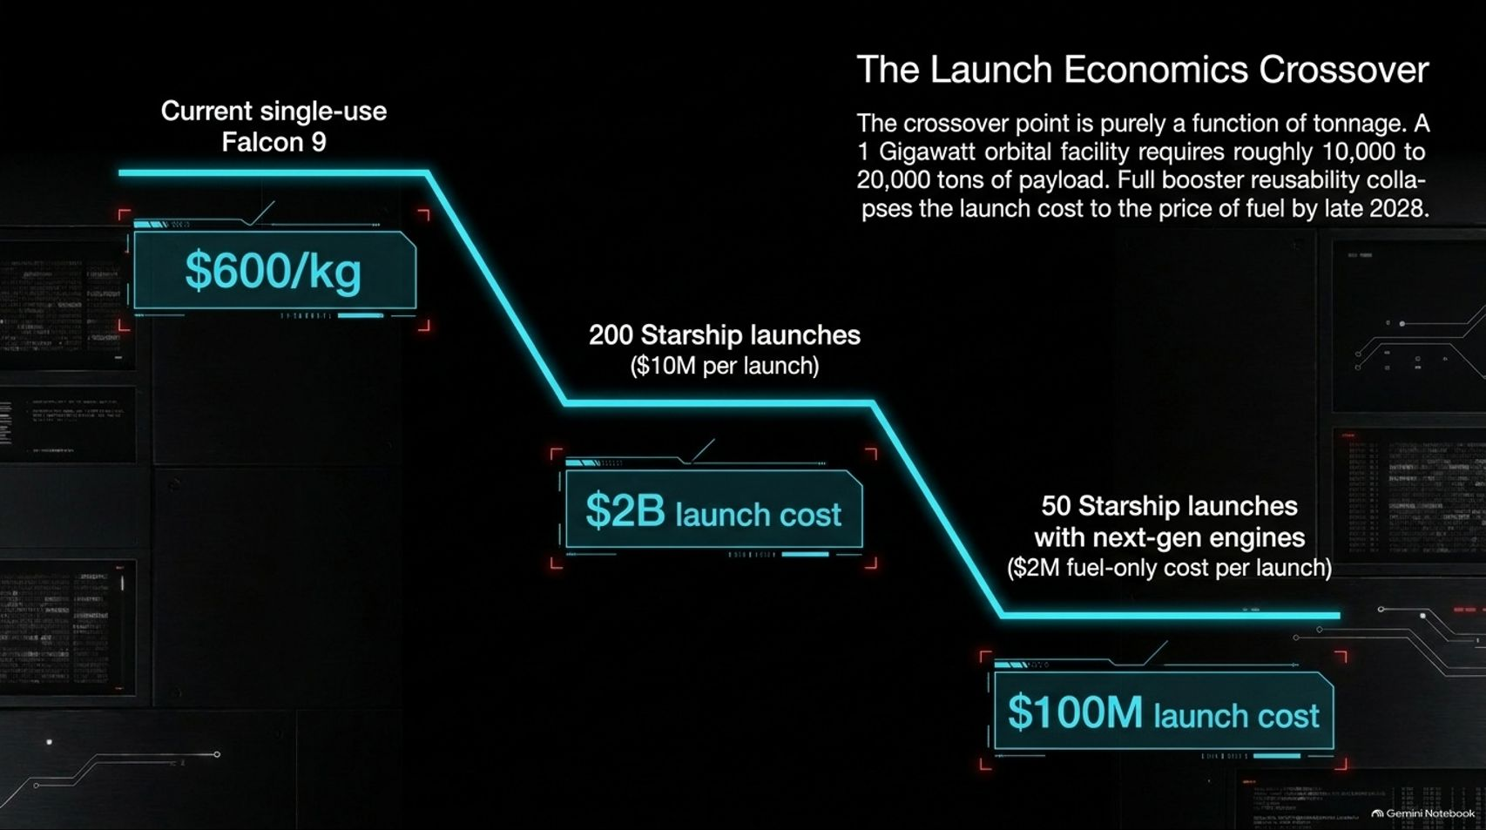
Notes:
Visual: A step-down chart illustrating launch cost deflation, starting at single-use Falcon 9 ($600/kg), dropping through 200 Starship launches ($2B total cost), down to 50 Starship launches with fuel-only pricing ($100M total cost by late 2028).
Suggested Speaking Time: 3 – 5 minutes.
Speaker Notes:
The entire crossover point to orbital dominance is a function of payload tonnage.
A 1-gigawatt orbital facility requires roughly 10,000 to 20,000 tons of total payload. Full booster and ship reusability collapses launch costs down to the sheer price of propellant by late 2028.
When launch costs drop from $600 per kilogram down to fuel-only marginal costs across 50 heavy Starship flights, the cost of delivering enterprise compute to space becomes cheaper than building it on Earth.

Slide 11
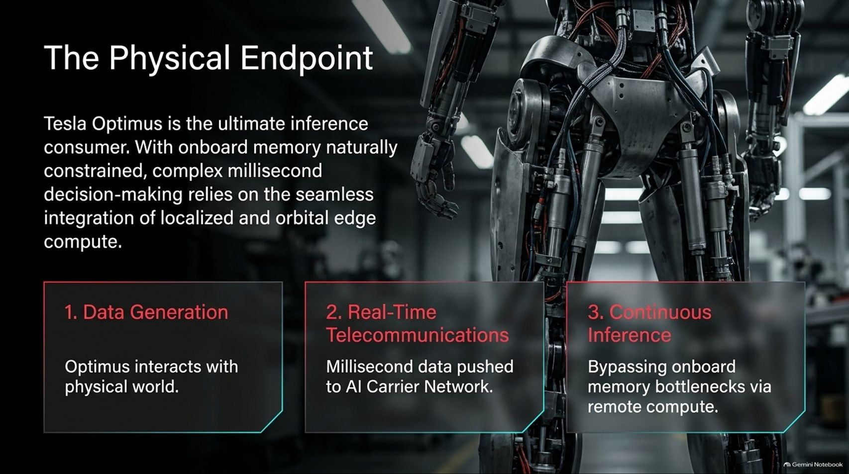
Notes:
Visual: A dramatic close-up shot of Tesla Optimus robotic legs, highlighting hydraulic actuators, internal wiring, and structural framing.
Suggested Speaking Time: 3 – 5 minutes.
Speaker Notes:
Compute and networks exist to serve physical endpoints. Tesla Optimus is the ultimate inference consumer.
Because an onboard humanoid robot has naturally constrained physical weight and thermal limits for local memory and compute, complex millisecond decision-making relies entirely on the seamless integration of localized edge pods and orbital compute.
The pipeline is simple: 1. Data Generation: Optimus interacts with the physical world. 2. Real-Time Telecommunications: Millisecond sensor data is pushed instantly to the AI Carrier Network. 3. Continuous Inference: Onboard memory bottlenecks are completely bypassed via high-speed remote compute.

Slide 12
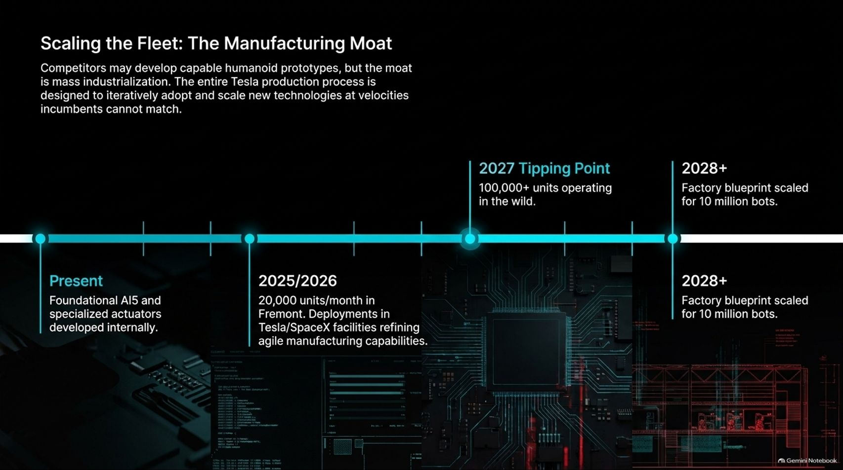
Notes:
Visual: A chronological timeline tracking the scaling of humanoid manufacturing from the Present (foundational AI5 and actuators), through 2025/2026 (20,000 units/month in Fremont), hitting the 2027 Tipping Point (100,000+ units), to 2028+ (factory blueprints scaled for 10 million bots).
Suggested Speaking Time: 3 – 5 minutes.
Speaker Notes:
Competitors may develop capable humanoid prototypes, but the true moat is mass industrialization.
Tesla's production lines are designed from the ground up to iteratively adopt and scale new technologies at a velocity legacy automotive and robotics incumbents cannot match.
We are rapidly approaching the 2027 Tipping Point, where over 100,000 units will operate in the wild across Tesla and SpaceX facilities. By 2028 and beyond, factory blueprints scale toward 10 million units, fulfilling the physical labor demands of the new economy.

Slide 13
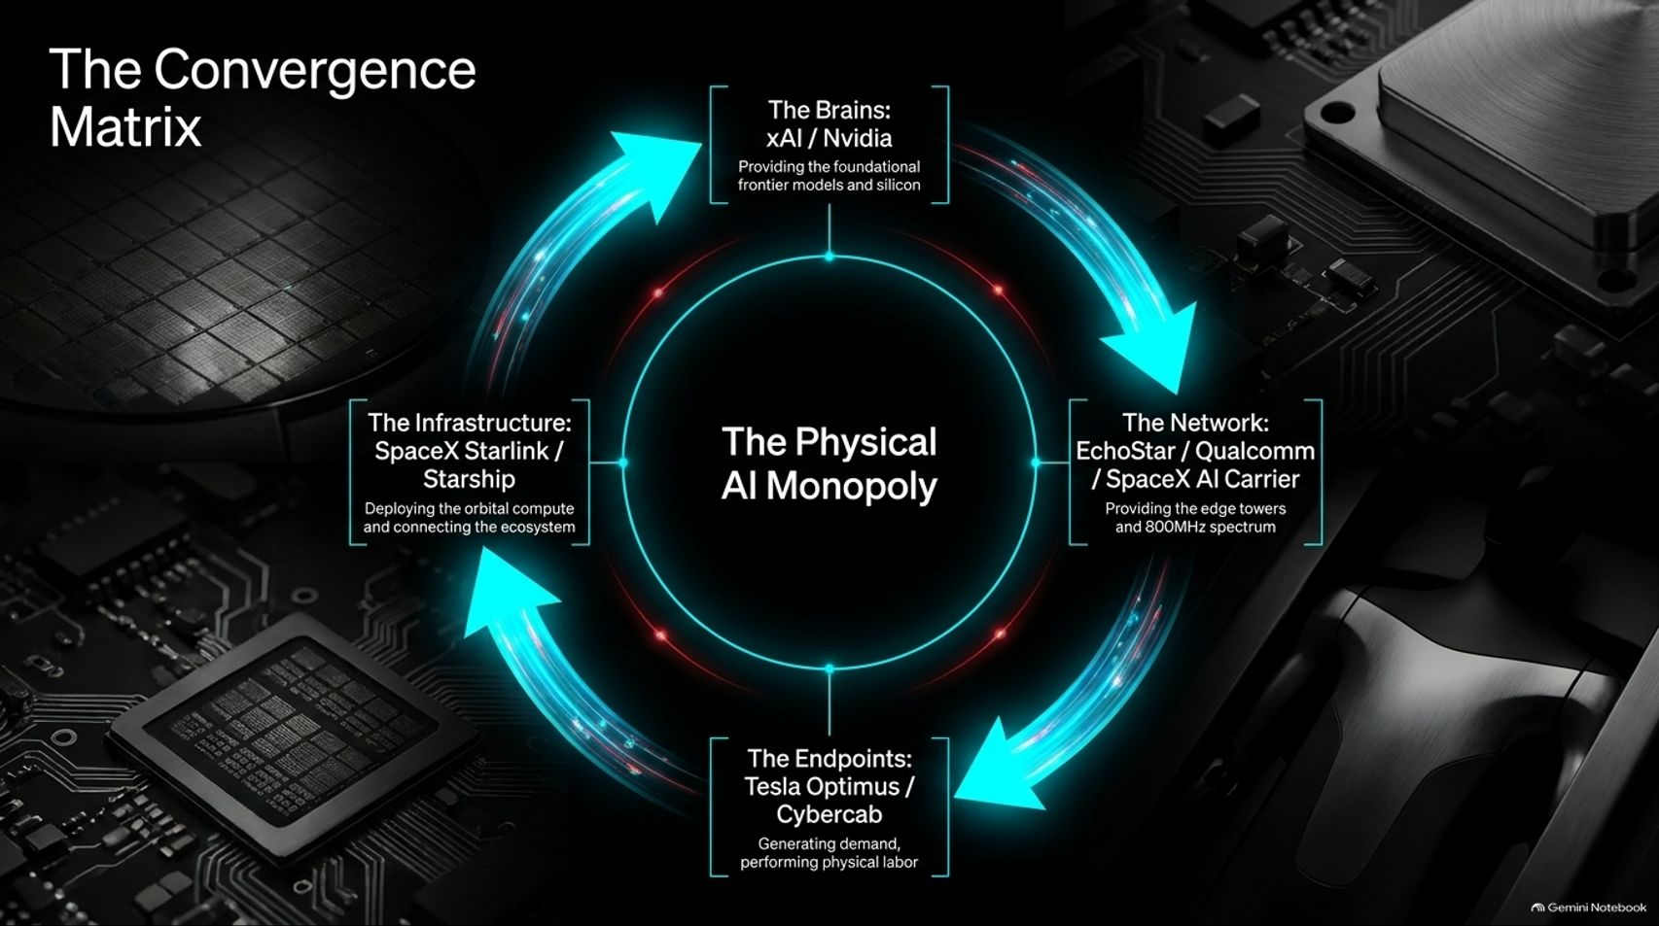
Notes:
Visual: A circular closed-loop data flow graphic linking four core pillars: The Brains (xAI / Nvidia), The Network (EchoStar / Qualcomm / SpaceX), The Endpoints (Tesla Optimus / Cybercab), and The Infrastructure (SpaceX Starlink / Starship), surrounding the central title: The Physical AI Monopoly.
Suggested Speaking Time: 3 – 5 minutes.
Speaker Notes:
When you step back, you realize these are not disparate business units or random investments. They form a closed-loop Convergence Matrix:
The Brains: xAI and Nvidia providing foundational frontier models and silicon.
The Network: EchoStar, Qualcomm, and SpaceX providing cellular edge towers and 800MHz spectrum.
The Endpoints: Tesla Optimus and Cybercabs generating demand and performing physical labor.
The Infrastructure: SpaceX Starlink and Starship deploying orbital compute and connecting the entire ecosystem.

Slide 14
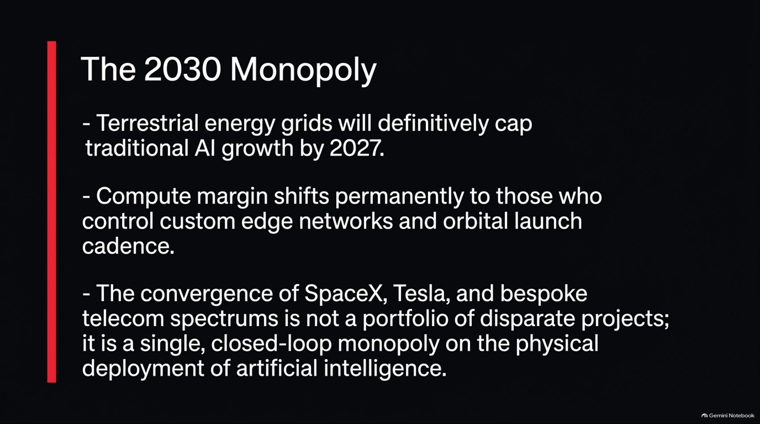
Notes:
Visual: A clean, bold summary slide featuring three bold bullet points set against a stark black background with a striking vertical red accent bar.
Suggested Speaking Time: 3 – 5 minutes.
Speaker Notes:
Let's summarize the definitive thesis for 2030:
First, terrestrial energy grids will definitively cap traditional AI growth by 2027. Power constraints on Earth are real and unyielding.
Second, compute margins will shift permanently to the entities that control custom edge spectrum networks and orbital launch cadence.
Third, the convergence of SpaceX, Tesla, and bespoke telecom spectrum is not a loose portfolio of projects; it is a single, closed-loop monopoly on the physical deployment of artificial intelligence.

Slide 15
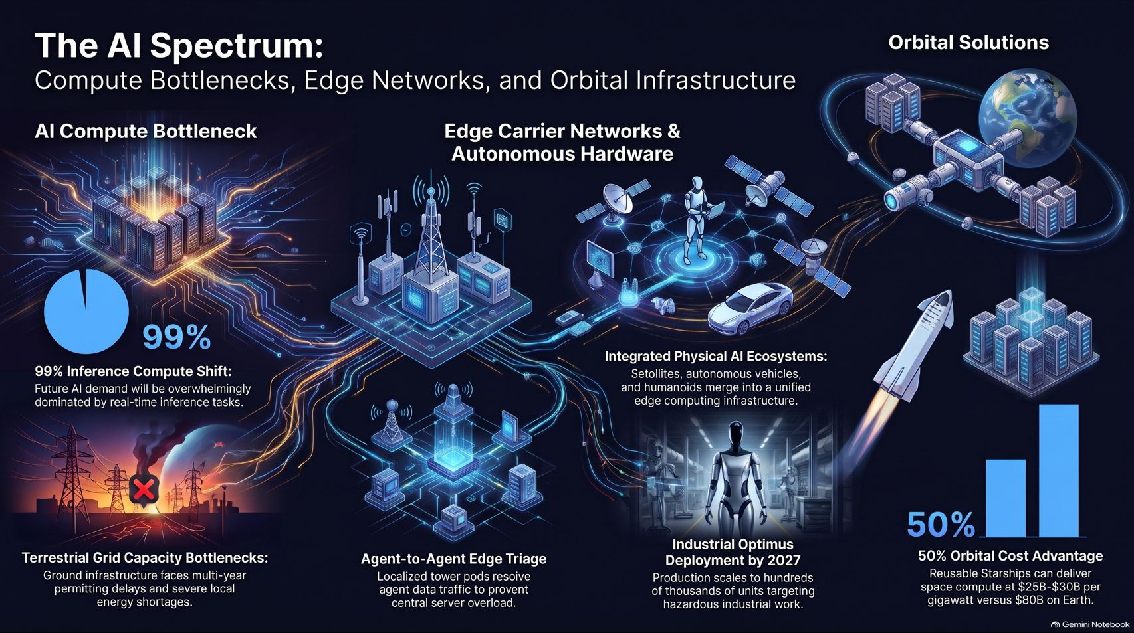
Notes:
Visual: A rich master summary infographic tying together all core elements: the 99% inference shift, terrestrial grid bottlenecks, agent edge triage pods, integrated physical AI ecosystems, and 50% orbital cost advantages.
Suggested Speaking Time: 3 – 5 minutes.
Speaker Notes:
On our final master summary slide, we see the complete picture of the AI Spectrum.
We are moving from a world choked by terrestrial grid bottlenecks and static data center limits into an agile, multi-layered architecture.
Edge carrier networks triage regional agent traffic, Starship slashes launch costs to make space-based data centers 50% cheaper than Earth, and physical endpoints like Optimus operationalize intelligence in the real world.
The companies that control this entire stack from silicon to orbit will command the future. Thank you for your attention.

