Slide 1
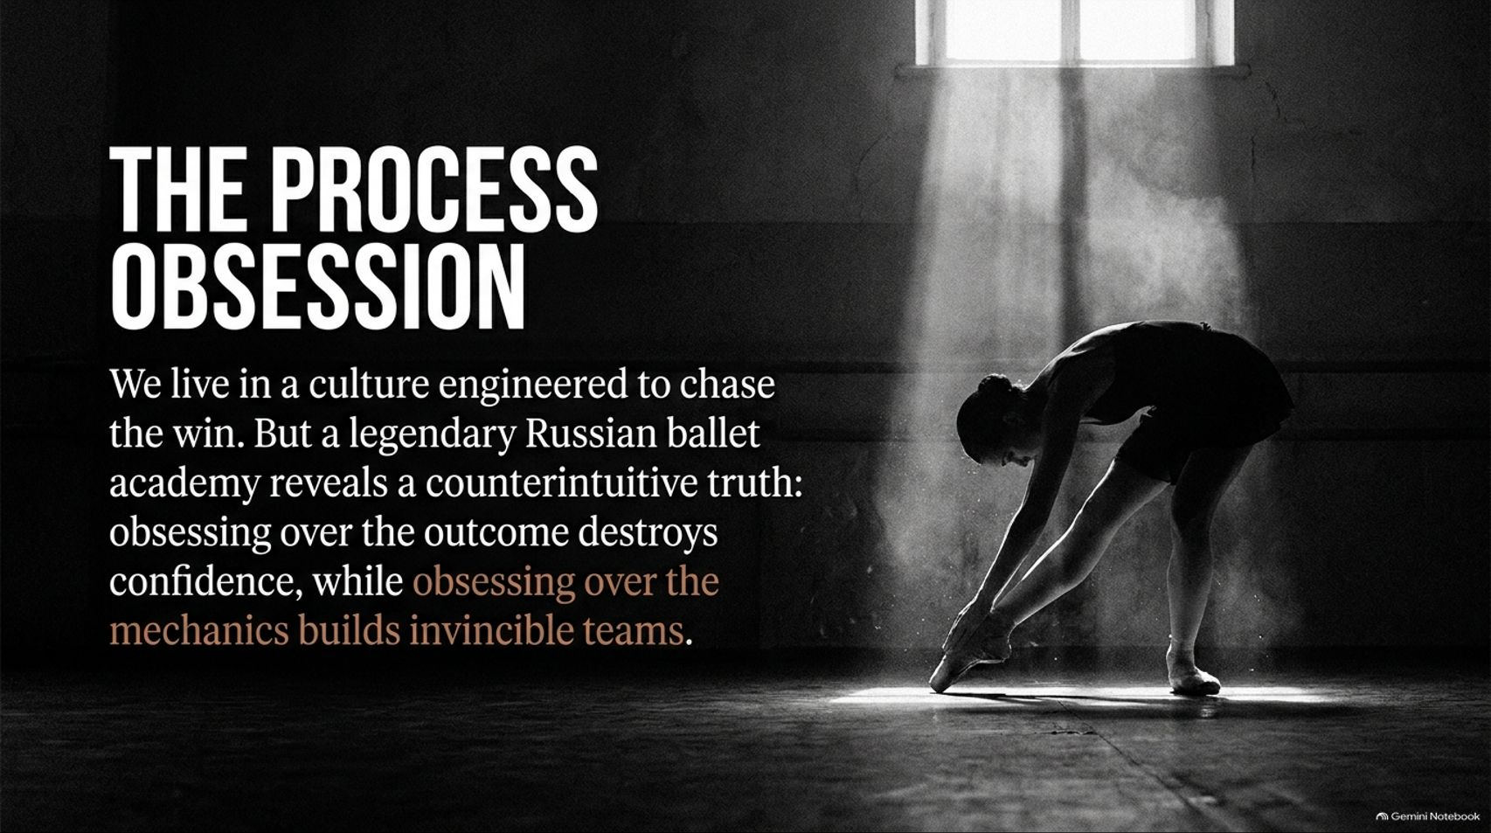
Notes:
Visual: A dramatic, moody black-and-white photograph of a ballerina stretching in a sunlit studio, framed by a high window casting a strong shaft of light. Title: The Process Obsession. Subtitle: We live in a culture engineered to chase the win. But a legendary Russian ballet academy reveals a counterintuitive truth: obsessing over the outcome destroys confidence, while obsessing over the mechanics builds invincible teams.
Suggested Speaking Time: 2 – 3 minutes.
Speaker Notes:
Welcome everyone to today's masterclass on "The Process Obsession."
We live in a modern culture engineered from the ground up to chase the win—whether it's the promotion, the funding round, or the viral social media metric.
But looking inside legendary training environments, such as the historic Vaganova Ballet Academy in Russia, reveals a deeply counterintuitive truth: obsessing over the outcome destroys human confidence, while obsessing over the mechanics builds invincible teams.
Over the next 16 slides, we are going to explore why chasing outcomes leads to fragility, and how shifting to a process-driven mindset completely alters leadership, resilience, and personal mastery.
What Confident People Focus on Instead of Winning | Ballerina Isabella McGuire Mayes
https://www.youtube.com/watch?v=fwTVrJafRpE

Slide 2
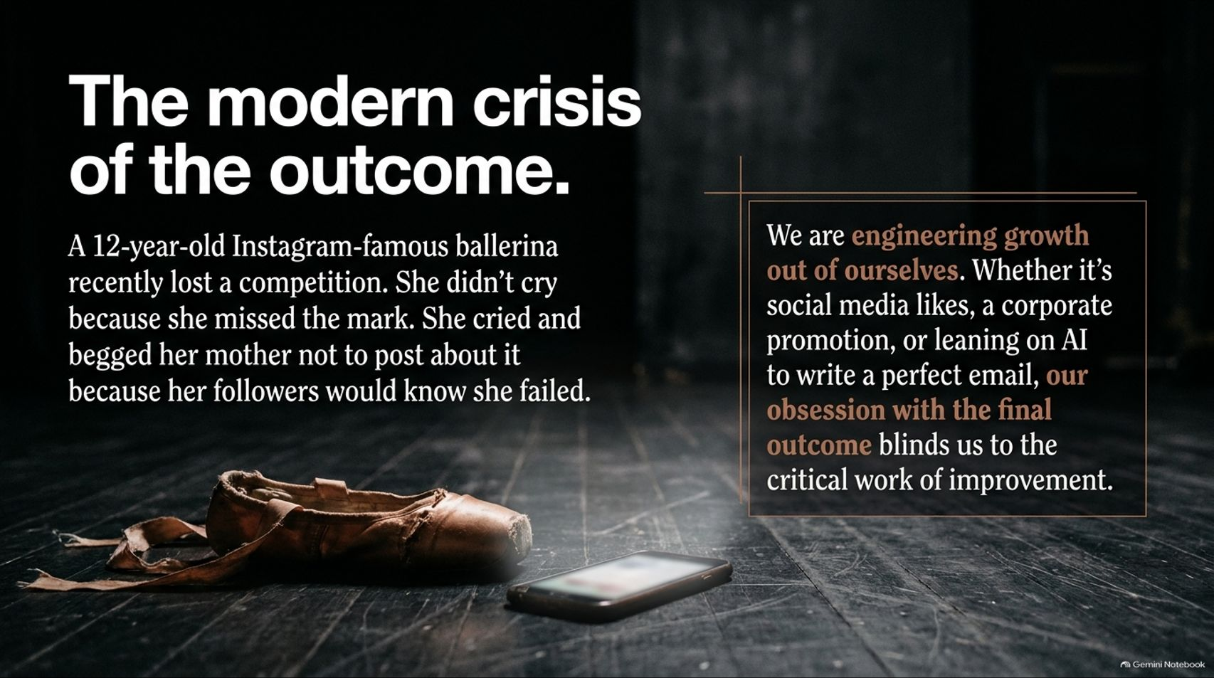
Notes:
Visual: A close-up on a worn, dusty ballet shoe lying on a dark wooden floor next to a discarded smartphone glowing softly in the shadows. A side text box reads: We are engineering growth out of ourselves... our obsession with the final outcome blinds us to the critical work of improvement.
Suggested Speaking Time: 3 – 5 minutes.
Speaker Notes:
Consider a real-world story shared by ballerina Isabella McGuire Mayes: A 12-year-old Instagram-famous ballerina recently lost a competition.
She didn't just cry because she missed the mark; she broke down begging her mother not to post about it because she was terrified her online followers would know she failed. At 12 years old, her entire self-worth was anchored to public outcomes.
We are engineering growth out of ourselves. Whether it's social media likes, a corporate performance review, or leaning on AI to write a perfect email, our obsession with the final outcome blinds us to the critical, gritty work of actual human improvement.

Slide 3
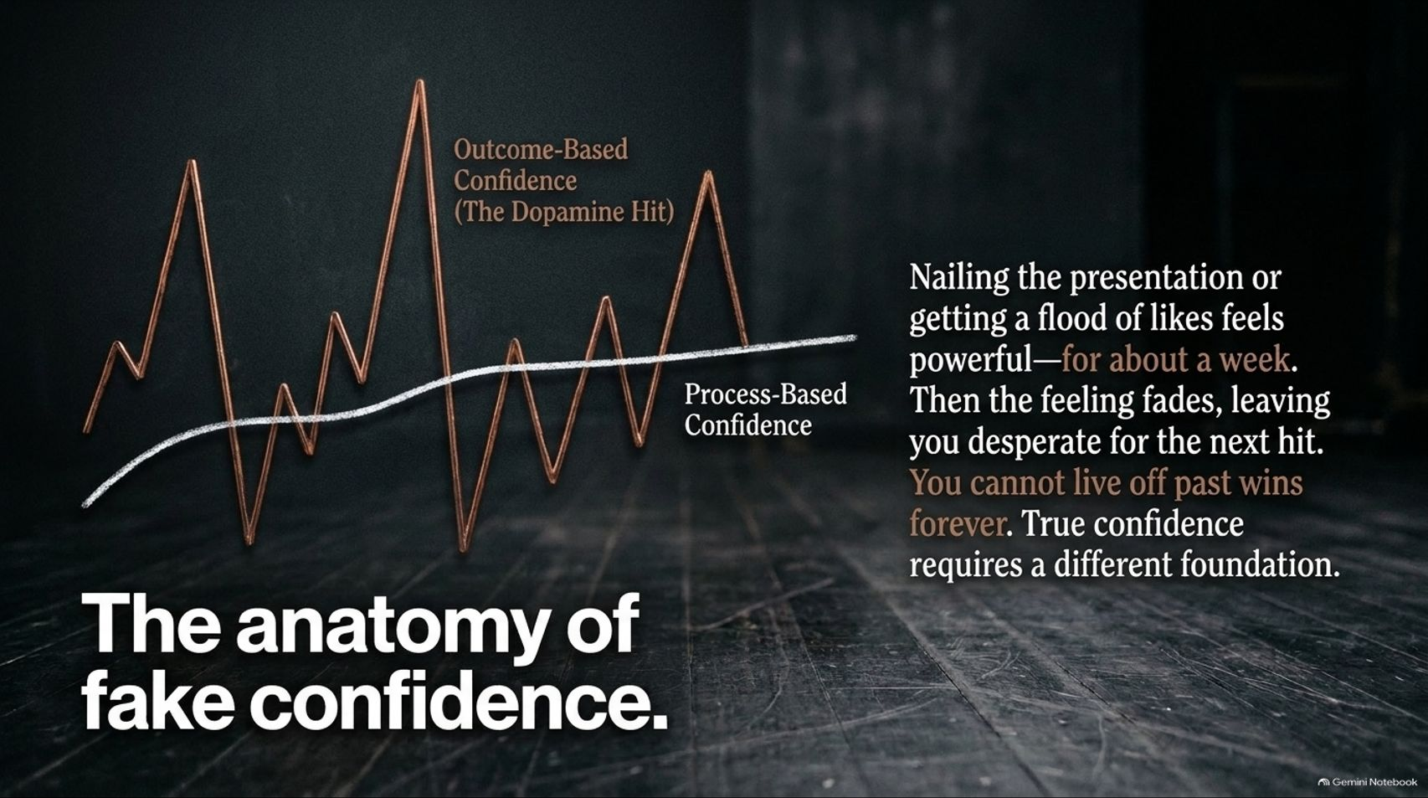
Notes:
Visual: A chart overlay contrasting a jagged, volatile red line labeled Outcome-Based Confidence (The Dopamine Hit) against a smooth, rising white line labeled Process-Based Confidence.
Suggested Speaking Time: 3 – 5 minutes.
Speaker Notes:
Where does confidence actually come from? Most people believe it comes from winning.
Nailing a presentation, closing a deal, or getting a flood of likes feels powerful—for about a week.
Then that emotional high fades, leaving you desperate for the next hit, the next validation, the next dopamine spike. You cannot live off past wins forever.
Outcome-based confidence creates volatile peaks and valleys. True, unshakable confidence requires an entirely different, structural foundation built on daily mechanics.

Slide 4
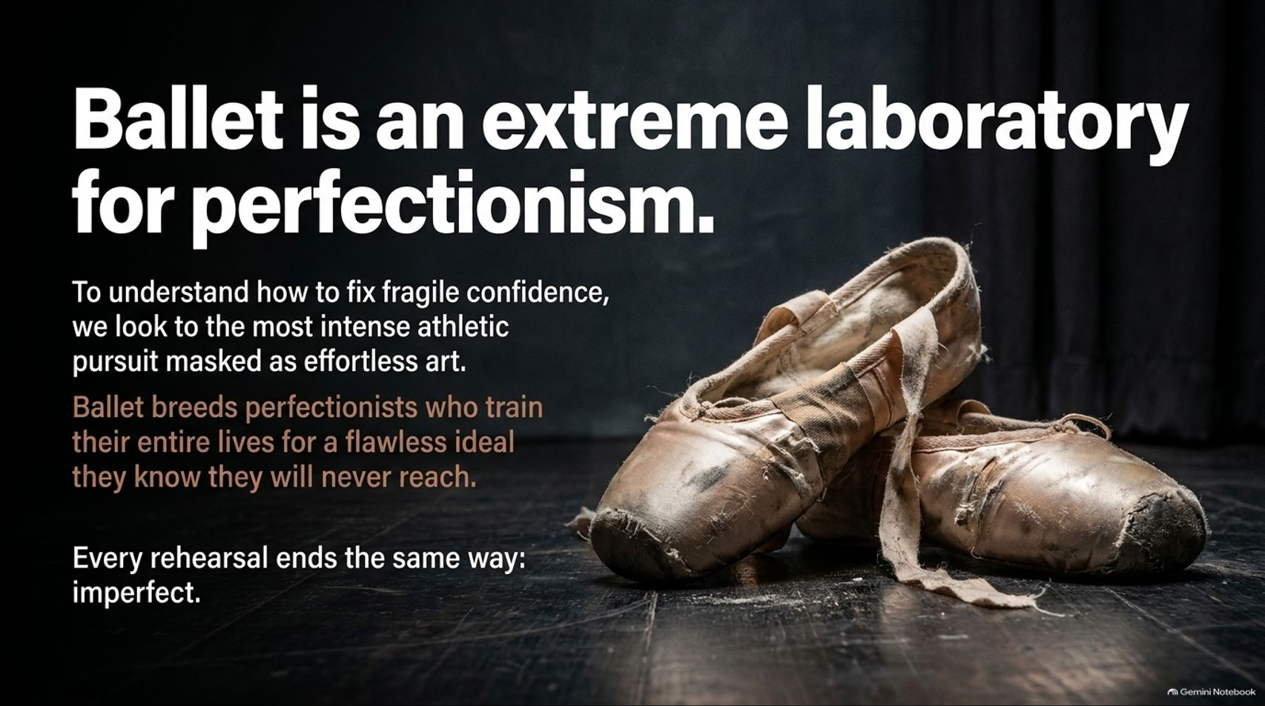
Notes:
Visual: A pair of heavily worn, battered, silk-ribboned pointe shoes resting on a dark theatrical floor. Text highlights: Every rehearsal ends the same way: imperfect.
Suggested Speaking Time: 3 – 4 minutes.
Speaker Notes:
To understand how to fix fragile confidence, we look to the most intense athletic pursuit masked as effortless art: professional ballet.
Ballet breeds perfectionists who train their entire lives for a flawless ideal they know they will never reach. No matter how legendary a dancer becomes, every single rehearsal and class ends the exact same way: imperfect.
Because perfection is mathematically impossible in dance, ballerinas have no choice but to deeply appreciate and obsess over the daily process. They teach us what corporate boardrooms desperately need to learn.

Slide 5
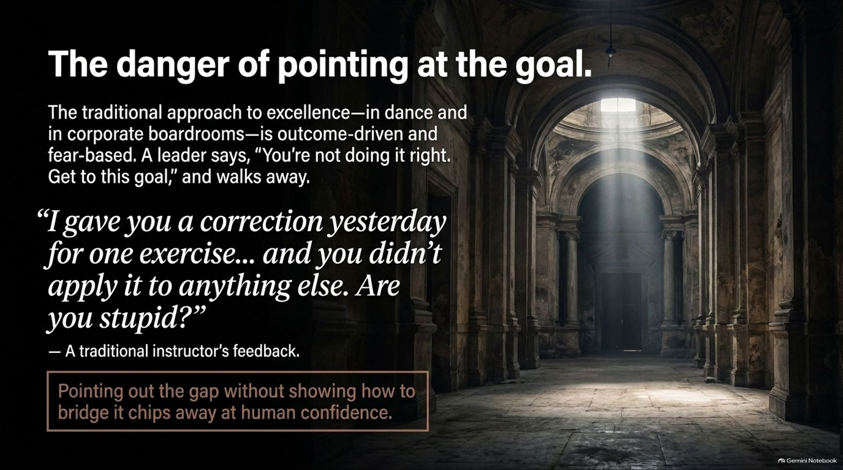
Notes:
Visual: A grand, vaulted ancient architectural hallway lit by a single beam of dramatic overhead sunlight. Text features a blunt quote: “I gave you a correction yesterday for one exercise... and you didn't apply it to anything else. Are you stupid?”
Suggested Speaking Time: 3 – 5 minutes.
Speaker Notes:
The traditional approach to excellence—found in both dance academies and corporate boardrooms—is outcome-driven and fear-based.
A traditional leader or instructor points at an abstract goal, barks, "You're not doing it right. Get to this goal," and walks away. In extreme training environments, instructors might even berate students for failing to connect the dots instantly.
Pointing out a performance gap without showing the human being how to bridge it chips away at human confidence and breeds quiet desperation.

Slide 6
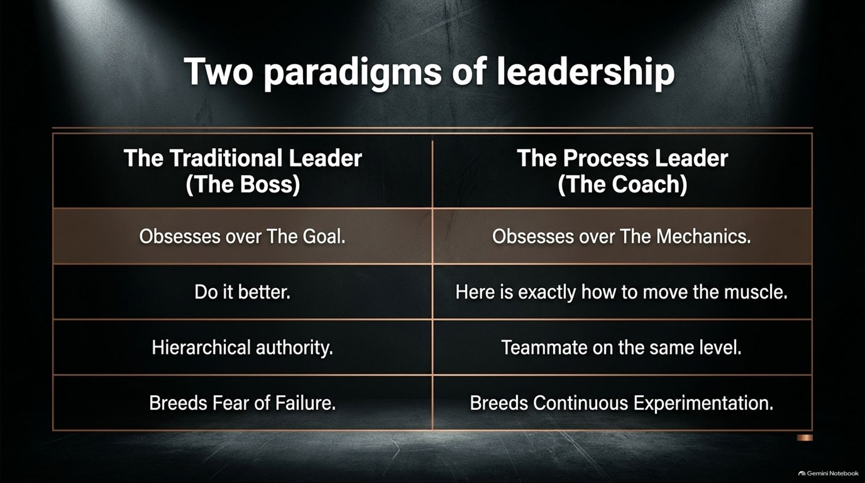
Notes:
Visual: A structured comparison table contrasting The Traditional Leader (The Boss) against The Process Leader (The Coach) across goals, instructions, authority, and cultural output.
Suggested Speaking Time: 3 – 5 minutes.
Speaker Notes:
Let's contrast two distinct leadership paradigms:
The Traditional Leader (The Boss): Obsesses over the goal, commands "Do it better," relies purely on hierarchical authority, and breeds a toxic culture rooted in the fear of failure.
The Process Leader (The Coach): Obsesses over the mechanics, gives precise tactical instruction ("Here is exactly how to move the muscle"), acts as a teammate on the same level, and breeds continuous experimentation and psychological safety. Bosses demand outcomes; coaches architect mechanics.

Slide 7
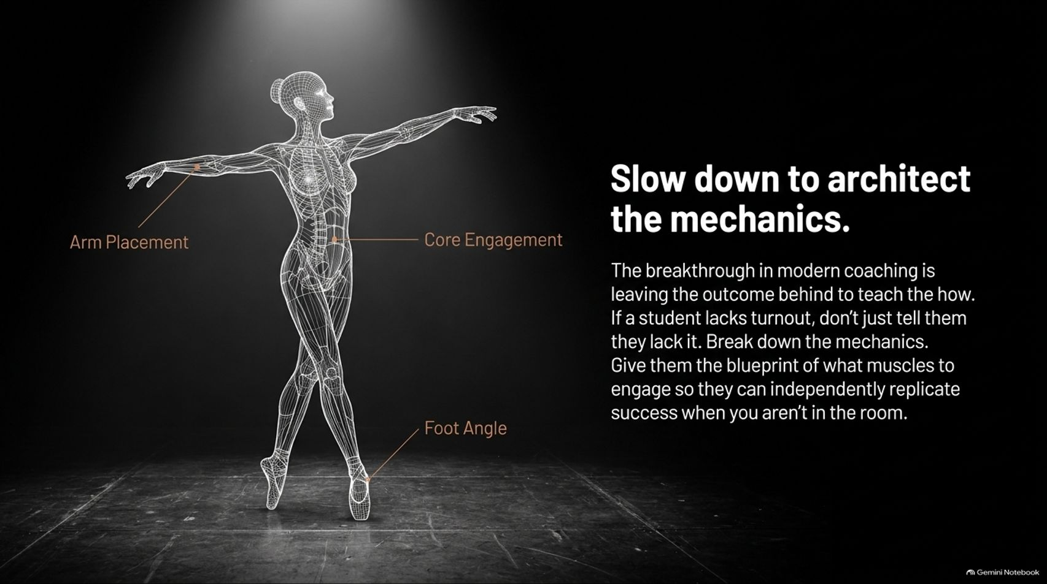
Notes:
Visual: A glowing digital wireframe anatomical rendering of a ballerina in a classical pose, calling out specific mechanics like Arm Placement, Core Engagement, and Foot Angle.
Suggested Speaking Time: 3 – 5 minutes.
Speaker Notes:
The breakthrough in modern coaching is leaving the outcome behind to teach the how.
If a student lacks proper turnout or technique, a poor leader simply tells them they lack it. A master coach breaks down the mechanics.
They provide the precise physical blueprint of what muscles to engage so the individual can independently replicate success when you aren't in the room. Slowing down allows you to architect long-term mastery.

Slide 8
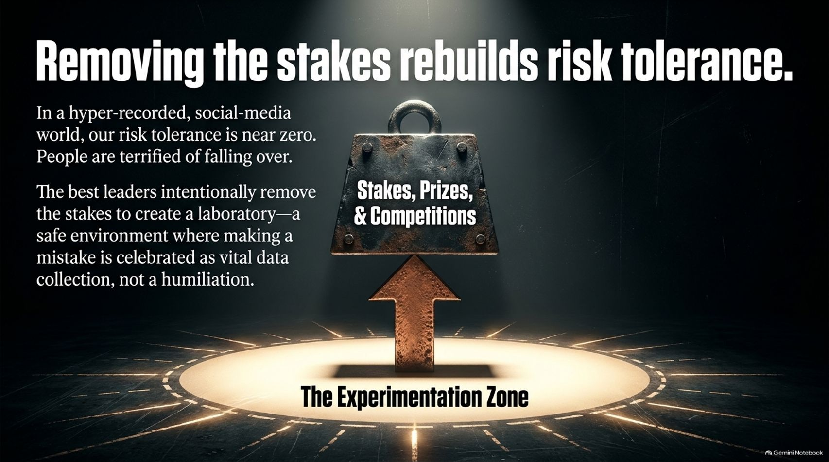
Notes:
Visual: A heavy, industrial iron padlock stamped with Stakes, Prizes, & Competitions, lifted upward by a glowing amber arrow within a clean studio spotlight (The Experimentation Zone).
Suggested Speaking Time: 3 – 5 minutes.
Speaker Notes:
In our hyper-recorded, social-media-driven world, human risk tolerance is near zero. People are utterly terrified of falling over and looking foolish.
The best leaders intentionally remove the stakes to create a laboratory—a safe environment where making a mistake is celebrated as vital data collection, rather than public humiliation.
When you remove prizes, scholarships, and rankings from training environments, students stop posturing and start experimenting. Risk tolerance goes up; breakthroughs follow.

Slide 9
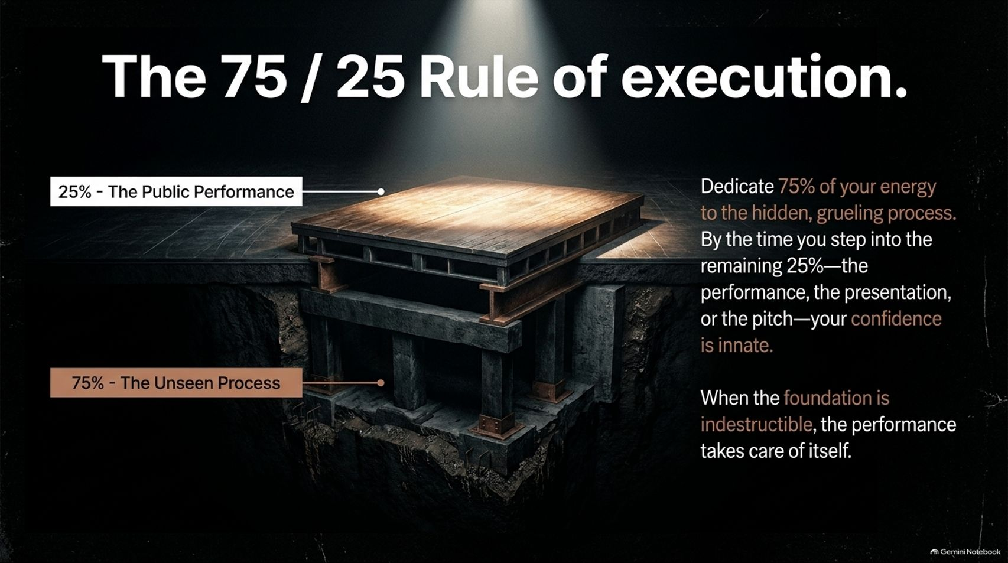
Notes:
Visual: A structural cross-section graphic of a polished wooden stage resting on heavy, rugged subterranean industrial steel and concrete support pillars. 25% - The Public Performance vs. 75% - The Unseen Process.
Suggested Speaking Time: 3 – 5 minutes.
Speaker Notes:
Consider the 75 / 25 Rule of Execution.
Dedicate 75% of your organizational energy to the hidden, grueling, unglamorous process.
By the time you step into the remaining 25%—the public performance, the investor pitch, or the product launch—your confidence is completely innate.
When the subterranean foundation is indestructible, the performance takes care of itself. Stop front-loading the performance; fortify the foundation.

Slide 10
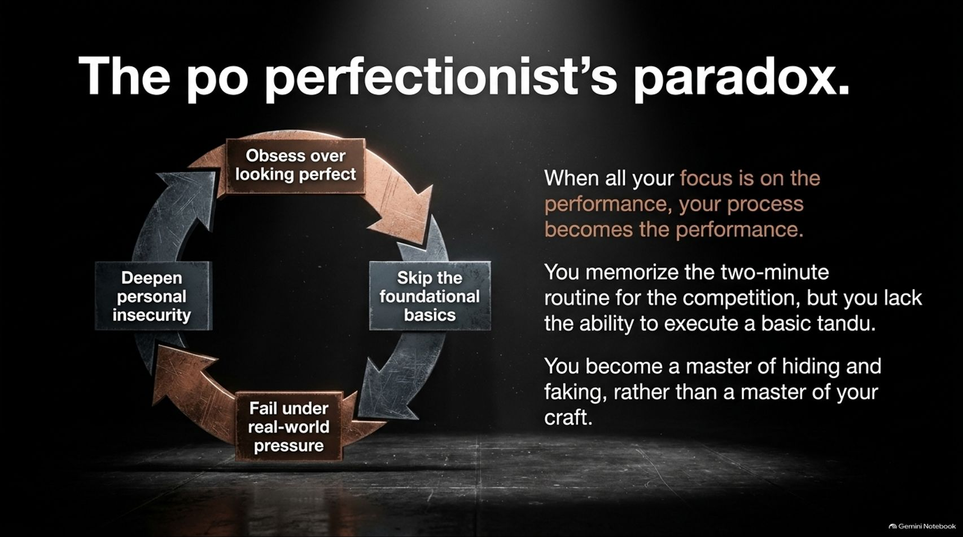
Notes:
Visual: A circular industrial gear loop mapping a self-destructive cycle: Obsess over looking perfect -> Skip the foundational basics -> Fail under real-world pressure -> Deepen personal insecurity.
Suggested Speaking Time: 3 – 5 minutes.
Speaker Notes:
When all your focus is on the performance, your process becomes the performance.
This is the perfectionist's paradox: You memorize a flashy two-minute routine or slide deck for a competition, but you completely lack the ability to execute basic fundamentals (like a dancer's basic tandu).
You become a master of hiding, faking, and polishing optics, rather than a true master of your craft. Under real-world pressure, this fragile veneer shatters.

Slide 11
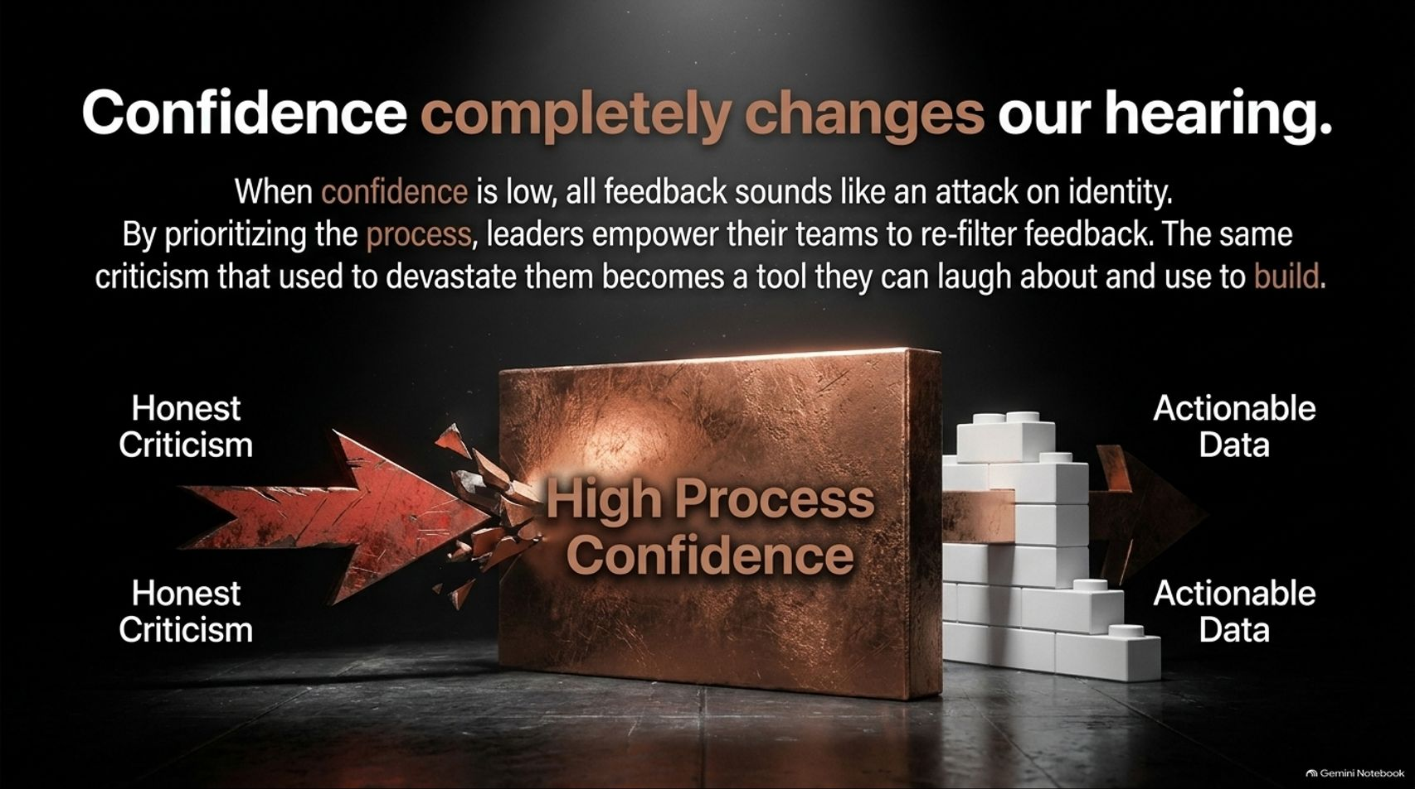
Notes:
Visual: A solid copper barrier labeled High Process Confidence cleanly deflecting sharp, jagged shards of Honest Criticism on one side, transforming them into smooth, constructive blocks of Actionable Data on the other.
Suggested Speaking Time: 3 – 5 minutes.
Speaker Notes:
Here is a profound psychological insight: Confidence completely changes our hearing.
When confidence is low and tied to outcomes, all honest feedback sounds like a personal attack on identity.
By prioritizing the process, leaders empower their teams to re-filter feedback. The exact same rigorous criticism that used to devastate them becomes actionable data they can use to build. High process confidence converts harsh critique into fuel.

Slide 12
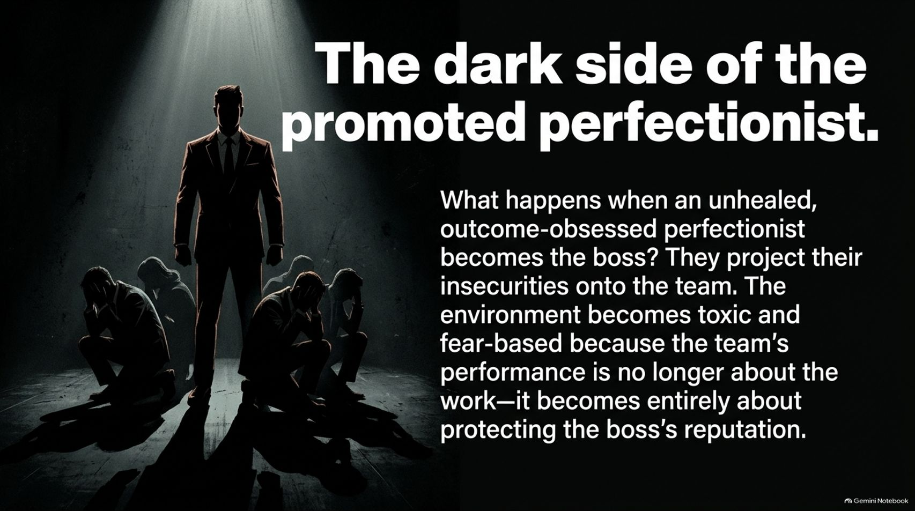
Notes:
Visual: A dramatic illustration of an imposing, shadowy corporate boss in a sharp suit standing tall while junior team members sit hunched over in stress and despair in the shadows.
Suggested Speaking Time: 3 – 5 minutes.
Speaker Notes:
What happens when an unhealed, outcome-obsessed perfectionist gets promoted to run the company or team?
They project their deep personal insecurities onto their subordinates. The environment quickly becomes toxic and fear-based.
Why? Because the team's daily performance is no longer about doing great work—it becomes entirely about protecting the boss's fragile ego and reputation. True leadership heals this cycle rather than weaponizing it.

Slide 13
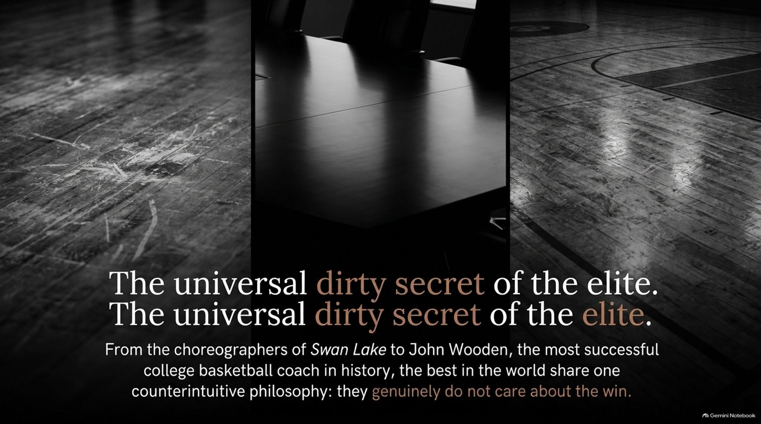
Notes:
Visual: A triptych panel contrasting worn wooden dance floors, a sleek executive boardroom table, and a polished basketball court floor. Text quote: The universal dirty secret of the elite: they genuinely do not care about the win.
Suggested Speaking Time: 3 – 5 minutes.
Speaker Notes:
From the master choreographers of Swan Lake to legendary college basketball coach John Wooden, the most successful icons in the world share one counterintuitive philosophy: they genuinely do not care about the win.
That sounds heretical in a competitive capitalist society. But elite performers know that winning is outside of their direct control; it belongs to the judges, the market, or the referees.
The only thing under their absolute control is the mastery of the craft. When you stop obsessing over the scoreboard, the scoreboard takes care of itself.

Slide 14
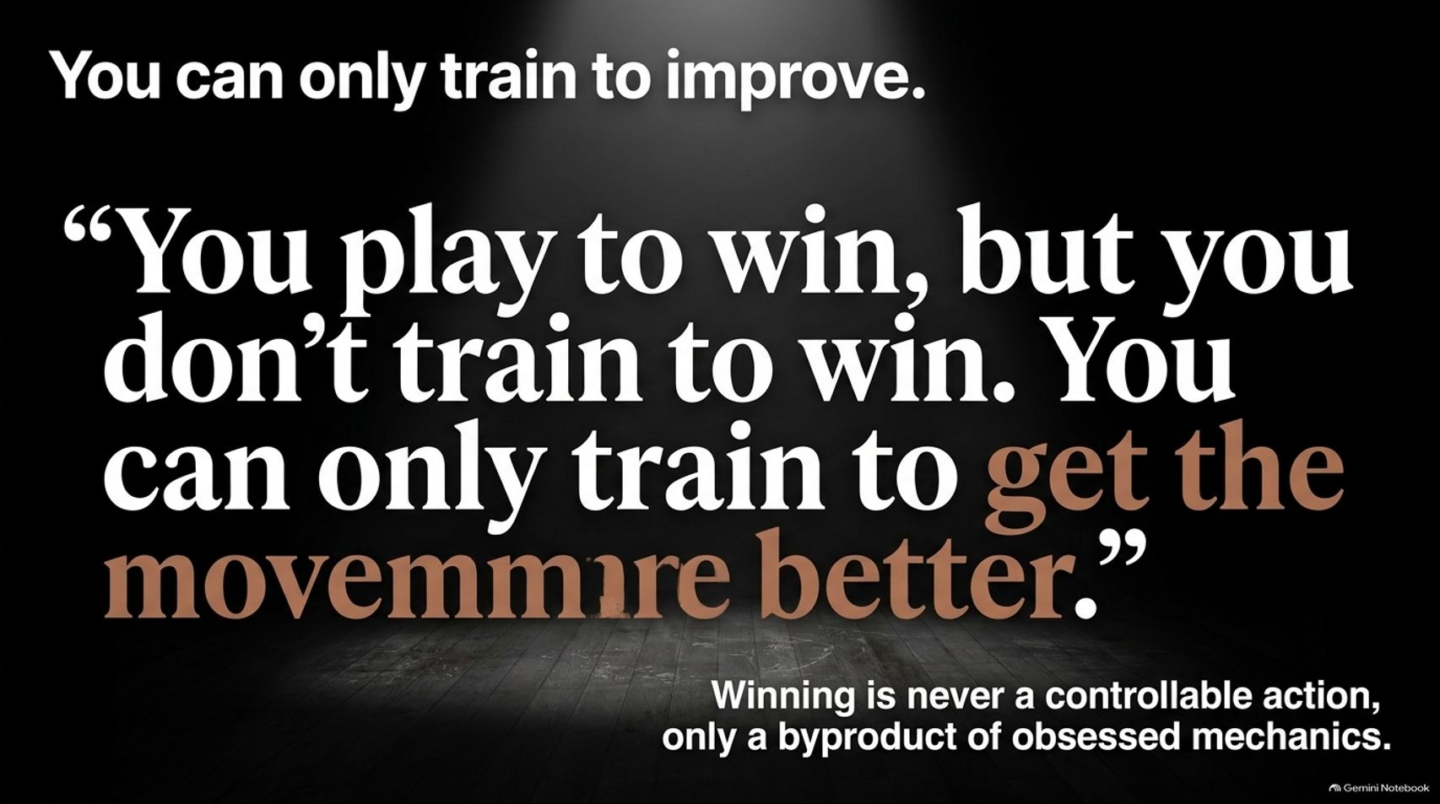
Notes:
Visual: A stark, spotlighted slide featuring a powerful quote set against a dark wooden background: “You play to win, but you don't train to win. You can only train to get the movement better.”
Suggested Speaking Time: 3 – 4 minutes.
Speaker Notes:
As John Wooden famously taught, and as elite dance masters reinforce: “You play to win, but you don't train to win. You can only train to get the movement better.”
You cannot practice the outcome. You can only practice the execution.
Winning is never a controllable action; it is merely a lagging byproduct of obsessed mechanics. If your training sessions are focused purely on the scoreboard rather than skill acquisition, you will crack under pressure.

Slide 15
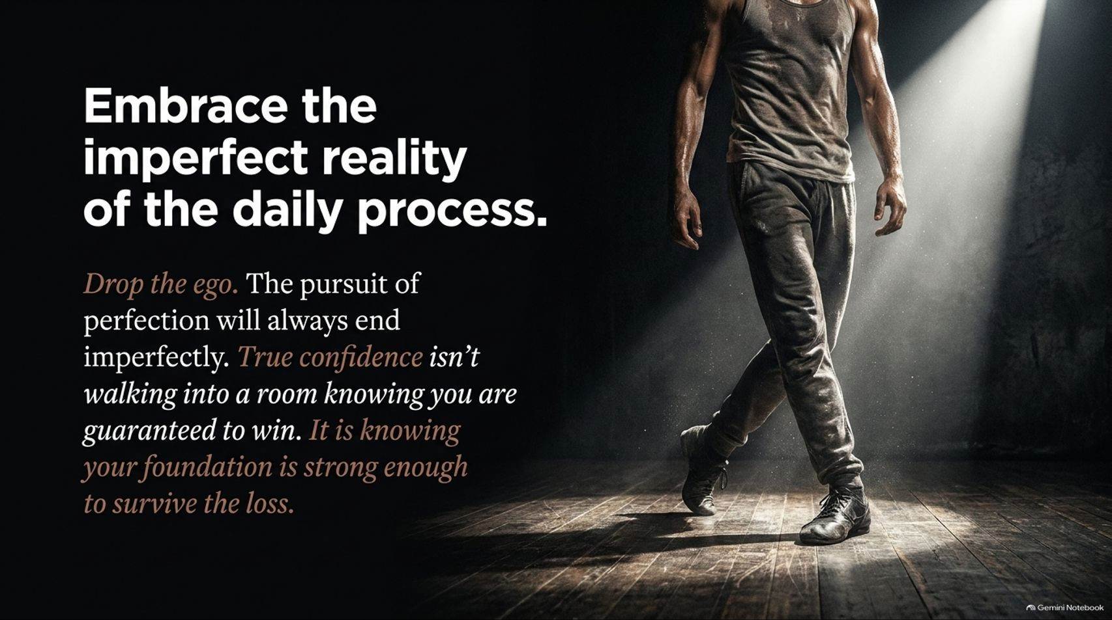
Notes:
Visual: A gritty, muscular dancer walking confidently across a sunlit wooden rehearsal floor in sweatpants and a tank top. Text: Drop the ego... True confidence isn't walking into a room knowing you are guaranteed to win. It is knowing your foundation is strong enough to survive the loss.
Suggested Speaking Time: 3 – 4 minutes.
Speaker Notes:
We must learn to embrace the imperfect reality of the daily process. Drop the ego. The pursuit of perfection will always end imperfectly.
True confidence isn't walking into a room knowing you are guaranteed to win. That is arrogance or delusion.
True confidence is knowing your process foundation is strong enough to survive a loss, absorb feedback, and come back stronger tomorrow.

Slide 16
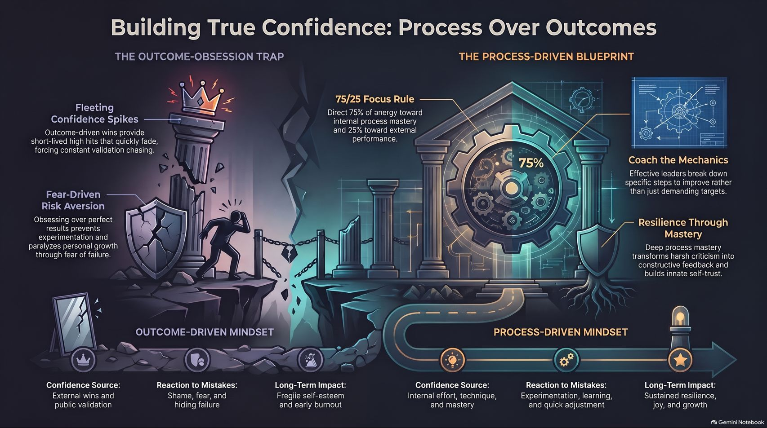
Notes:
Visual: A comprehensive master infographic contrasting the broken, crumbling pillars of the Outcome-Obsession Trap on the left against the fortified, gear-driven fortress of the Process-Driven Blueprint on the right.
Suggested Speaking Time: 3 – 5 minutes.
Speaker Notes:
On our final master summary slide, we bring the entire philosophy together:
On the left, the Outcome-Obsession Trap: fleeting confidence spikes, fear-driven risk aversion, shame when mistakes happen, and early burnout.
On the right, the Process-Driven Blueprint: applying the 75/25 focus rule, coaching the underlying mechanics, transforming criticism into actionable data, and building lifelong resilience through mastery.
Stop chasing the temporary high of the win. Fall hopelessly, obsessively in love with the process. Thank you.

