Slide 1
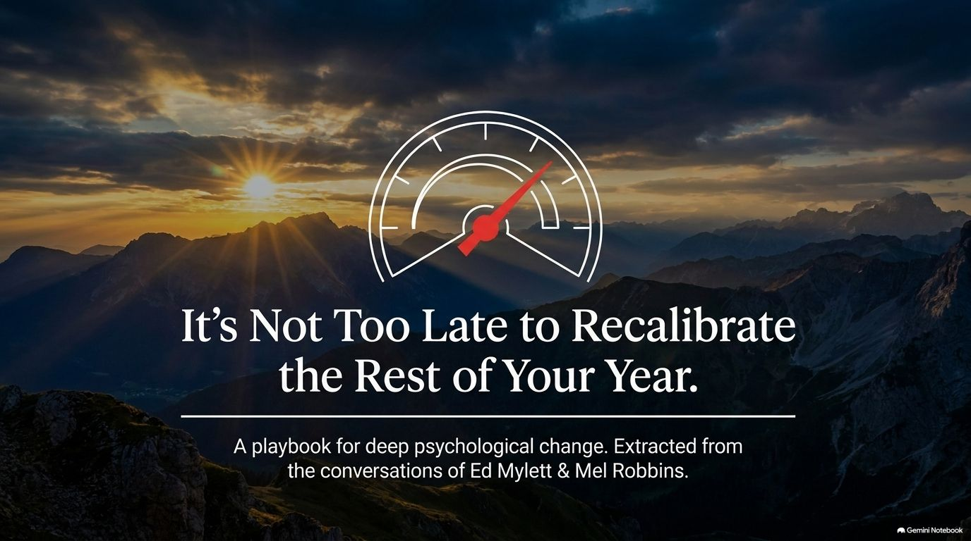
Notes:
Visual: Sunset over mountains with a central speedometer gauge graphic.
Core Theme: Introduction to deep psychological change and personal recalibration based on the dialogues of Ed Mylett and Mel Robbins.
Speaker Notes (Estimated Time: 3–4 minutes):
Opening Hook: Welcome everyone. Begin by asking the audience to take a deep breath. Acknowledge that wherever they are right now—whether they feel stuck, exhausted, or like the best days of their year are behind them—there is a vital truth to embrace: It is not too late.
Establishing Context: Introduce the premise of the session, which extracts powerful psychological frameworks from the conversation between Mel Robbins and Ed Mylett. Remind the audience that mid-course corrections do not require waiting for a new year; they can happen right now.
Setting the Tone: Frame the presentation as a playbook for shedding mental clutter, resetting internal baselines, and discovering that growth comes from elimination, not accumulation.
It’s Not Too Late: The 5 Shifts That Will Change the Rest of Your Year | Ed Mylett
https://www.youtube.com/watch?v=QIqaJtF5g8k

Slide 2
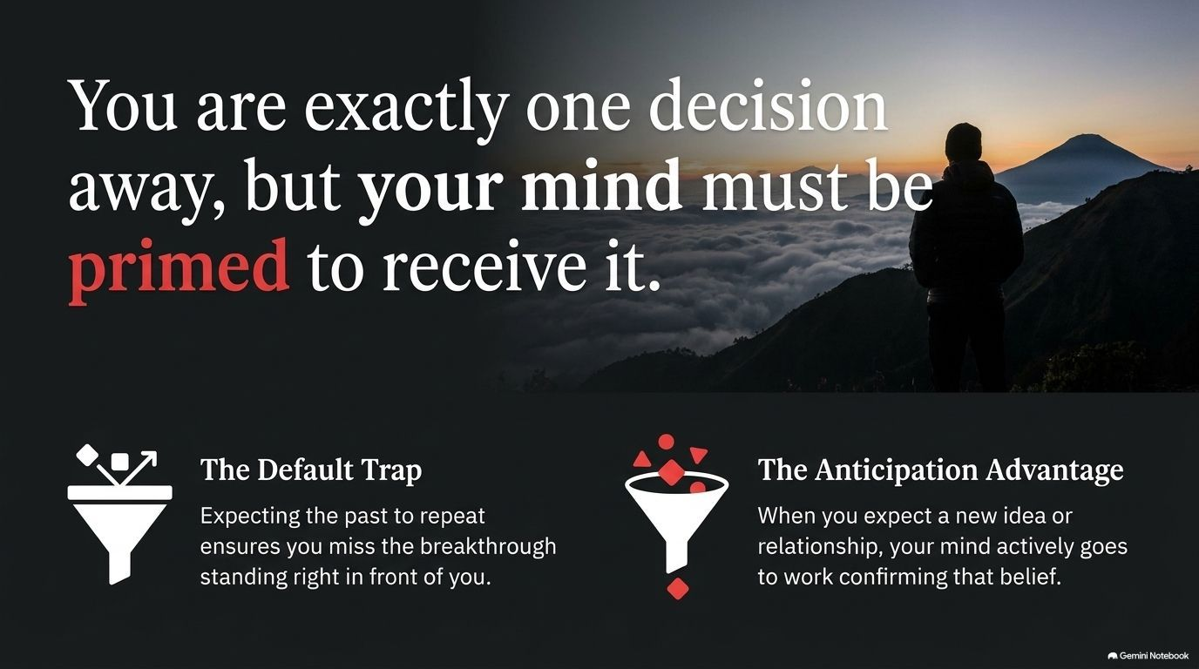
Notes:
Visual: A lone figure looking out over a misty landscape at sunrise with the quote: "You are exactly one decision away, but your mind must be primed to receive it."
Core Theme: The Default Trap vs. The Anticipation Advantage.
Speaker Notes (Estimated Time: 3–5 minutes):
Unpacking the Quote: Emphasize that "one decision away" is not just motivational rhetoric. You are genuinely one breakthrough, one new relationship, or one shift in perspective away from changing your life.
The Default Trap: Explain how expecting the past to repeat itself guarantees you will miss the breakthrough standing right in front of you. Our brains naturally gravitate toward what is familiar to conserve energy.
The Anticipation Advantage: Reference Ed Mylett’s insight that you have to wake up expecting good things to happen. When you actively expect a new idea or breakthrough, your mind goes to work confirming that belief. You don’t even have to fully believe it yet—you just have to give yourself permission to imagine it.

Slide 3
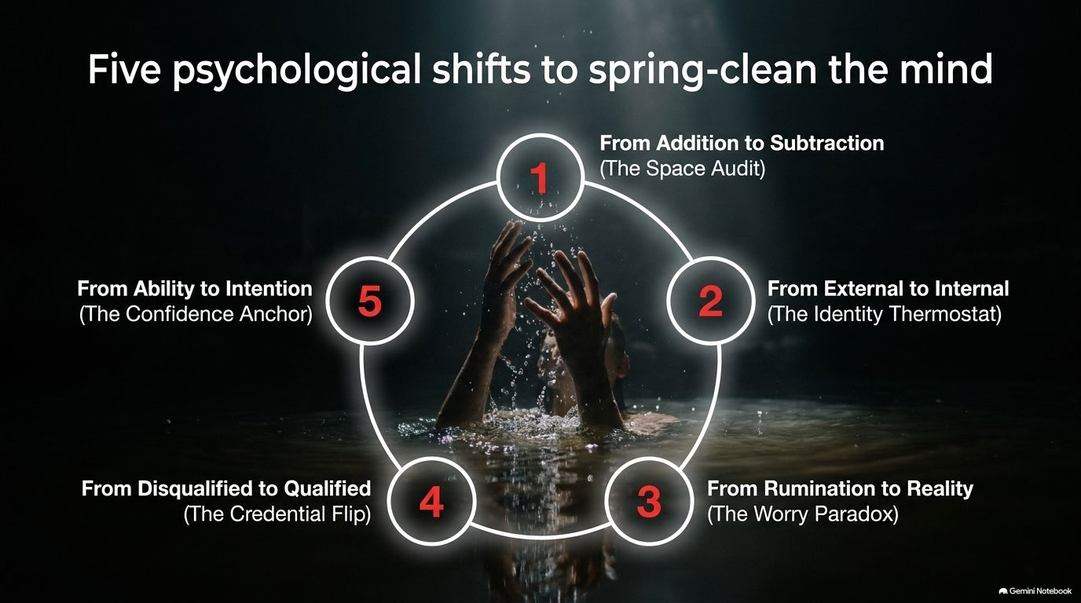
Notes:
Visual: A circular process diagram detailing five key shifts: Space Audit, Identity Thermostat, The Worry Paradox, The Credential Flip, and The Confidence Anchor.
Core Theme: Spring-cleaning the mind for total inner transformation.
Speaker Notes (Estimated Time: 2–4 minutes):
Overview of the Journey: Walk the audience through the roadmap. Real transformation isn't about adding more books, habits, or goals; it is a systematic spring-cleaning of the mind.
Previewing the 5 Steps:
Moving from Addition to Subtraction (The Space Audit).
Moving from External to Internal (The Identity Thermostat).
Moving from Rumination to Reality (The Worry Paradox).
Moving from Disqualified to Qualified (The Credential Flip).
Moving from Ability to Intention (The Confidence Anchor).
Call to Action: Encourage listeners to identify which of these five areas requires the most immediate attention in their lives today.

Slide 4
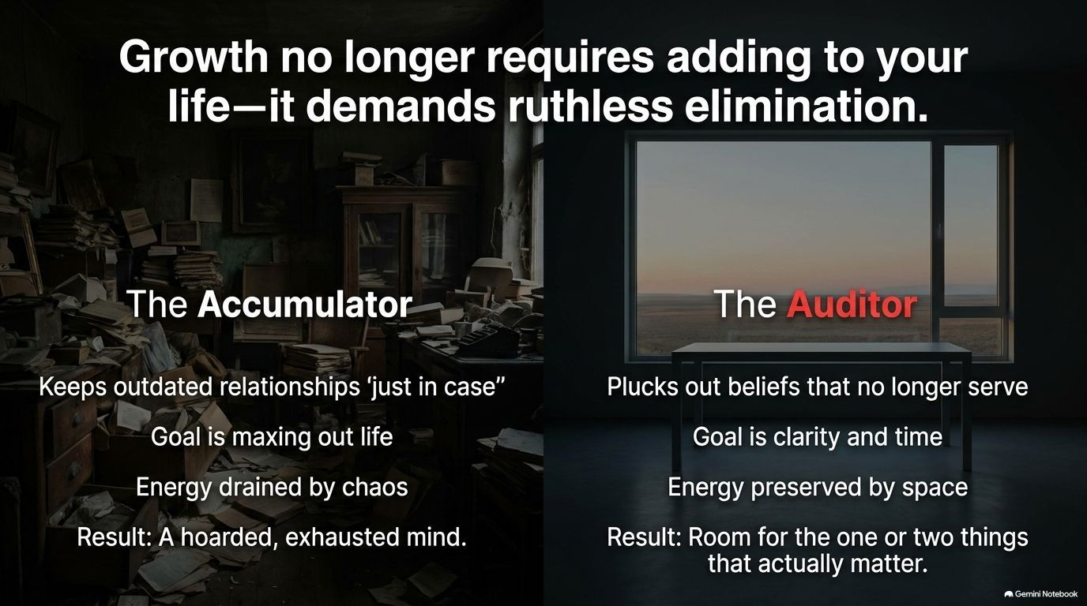
Notes:
Visual: A split screen contrasting "The Accumulator" (cluttered room, exhaustion) with "The Auditor" (clean room, clarity, time).
Core Theme: Growth requires ruthless elimination.
Speaker Notes (Estimated Time: 4–6 minutes):
The Trap of Accumulation: Discuss how many people approach self-improvement like hoarders—adding more commitments, toxic relationships "just in case," and endless goals until they are maxed out and exhausted.
The Auditor Mindset: Shift the perspective toward the auditor who plucks out beliefs, habits, and environments that no longer serve them.
Creating Space: Explain that energy is preserved by creating space. When you clear out the psychological and physical clutter, you finally make room for the one or two things that actually matter.

Slide 5

Notes:
Visual: A feather breaking apart into smaller pieces, annotated with "Toxic environments," "Outdated self-beliefs," and "Chronic anxiety".
Core Theme: The metaphor of the eagle Wilma letting go to soar again.
Speaker Notes (Estimated Time: 3–5 minutes):
The Story: Share Ed Mylett’s powerful story of the bald eagle Wilma on his island. After losing her mate and home, Wilma spent weeks forcefully plucking out her own feathers against a rock.
The Deeper Meaning: She wasn’t destroying herself; she was forcefully creating the space to grow new feathers so she could fly again.
Application: Ask the audience: What "feathers" (outdated self-beliefs, toxic environments, or chronic anxieties) do you need to pluck out of your life to allow a new version of yourself to emerge?

Slide 6
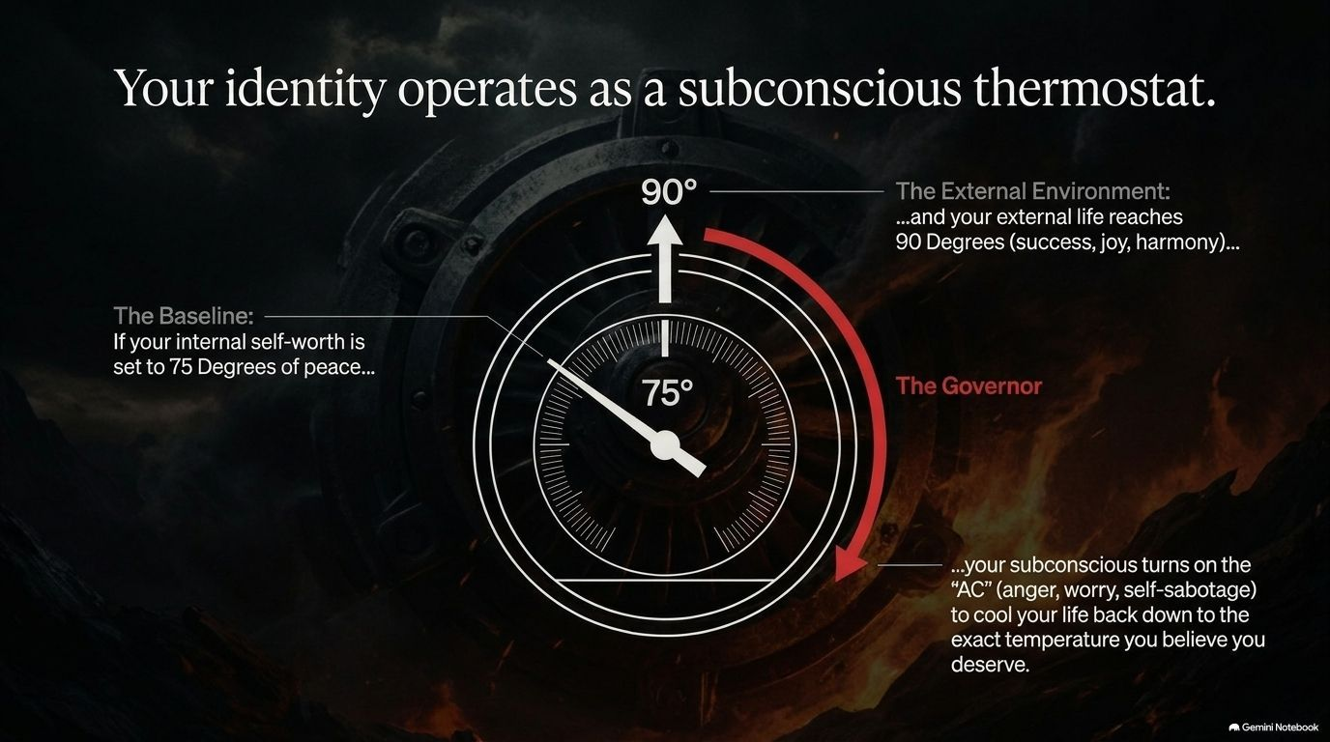
Notes:
Visual: A thermostat gauge graphic set at 75° with annotations explaining the external environment at 90° and the Governor.
Core Theme: Your identity operates as a subconscious thermostat.
Speaker Notes (Estimated Time: 4–6 minutes):
The Thermostat Metaphor: Just like a room's thermostat maintains 75° regardless of whether it is 85° outside, your internal self-worth acts as a subconscious governor.
Self-Sabotage: If your internal self-worth for peace, money, or joy is set at a certain baseline, your subconscious will turn on the "AC" (anger, worry, self-sabotage) to cool your life back down to the exact temperature you believe you deserve.
The Breakthrough: Explain that changing external conditions won't fix your life permanently until you upgrade your internal baseline temperature—what you believe you are truly worth.

Slide 7
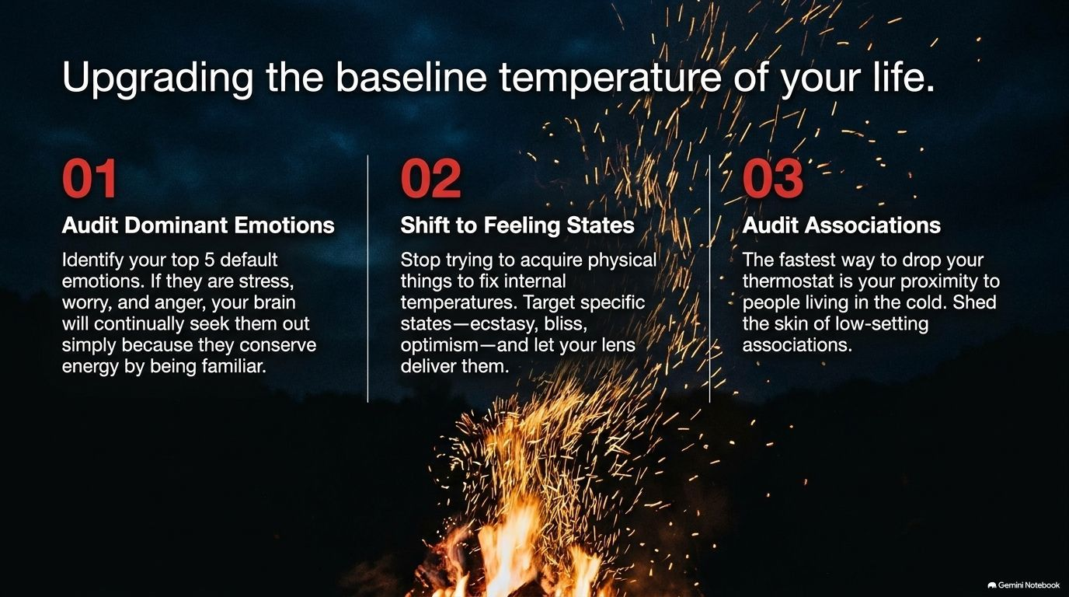
Notes:
Visual: Three steps: (01) Audit Dominant Emotions, (02) Shift to Feeling States, (03) Audit Associations, set against a background of rising fire sparks.
Core Theme: Practical steps to reset your internal thermostat.
Speaker Notes (Estimated Time: 4–5 minutes):
Step 1: Audit Dominant Emotions: Identify your top 5 default emotions (e.g., stress, worry, anger). Recognize that your brain seeks them out because they are familiar, not because they serve you.
Step 2: Shift to Feeling States: Stop trying to acquire physical things to fix internal temperatures. Target specific emotional states—peace, bliss, optimism—and let your lens deliver them.
Step 3: Audit Associations: The fastest way to drop your thermostat is to surround yourself with people living in the cold. Shed the skin of low-setting associations.

Slide 8
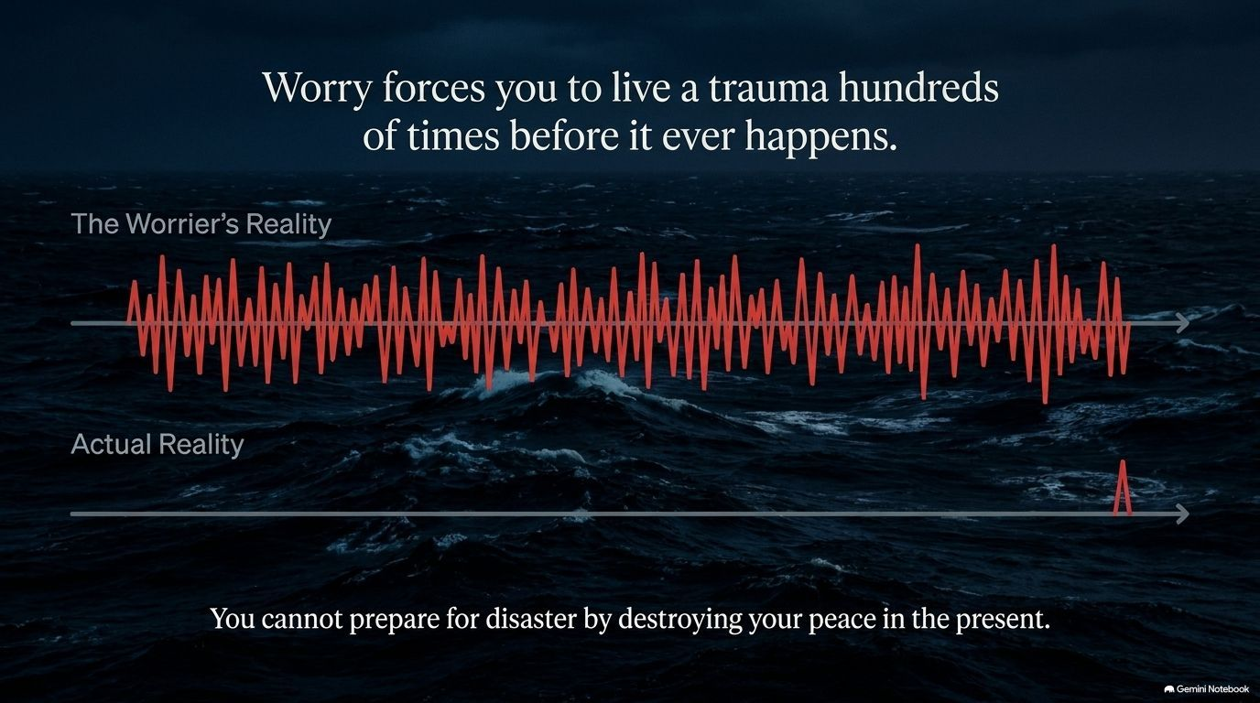
Notes:
Visual: A waveform comparison showing "The Worrier's Reality" (massive jagged spikes across time) versus "Actual Reality" (a flatline with one small spike).
Core Theme: You cannot prepare for disaster by destroying your peace in the present.
Speaker Notes (Estimated Time: 4–6 minutes):
Living a Trauma Hundreds of Times: Highlight Ed Mylett’s confession as a "professional worrier." Explain how worry forces you to live through a disaster hundreds of times in your head before it ever happens—if it happens at all.
The Data of Worry: Point out that 98% of what we worry about is complete fiction or never comes to fruition.
The Physical Toll: Remind the audience that chronic worry and stress break down the body and spirit. True preparation comes from presence, not pre-suffering.

Slide 9
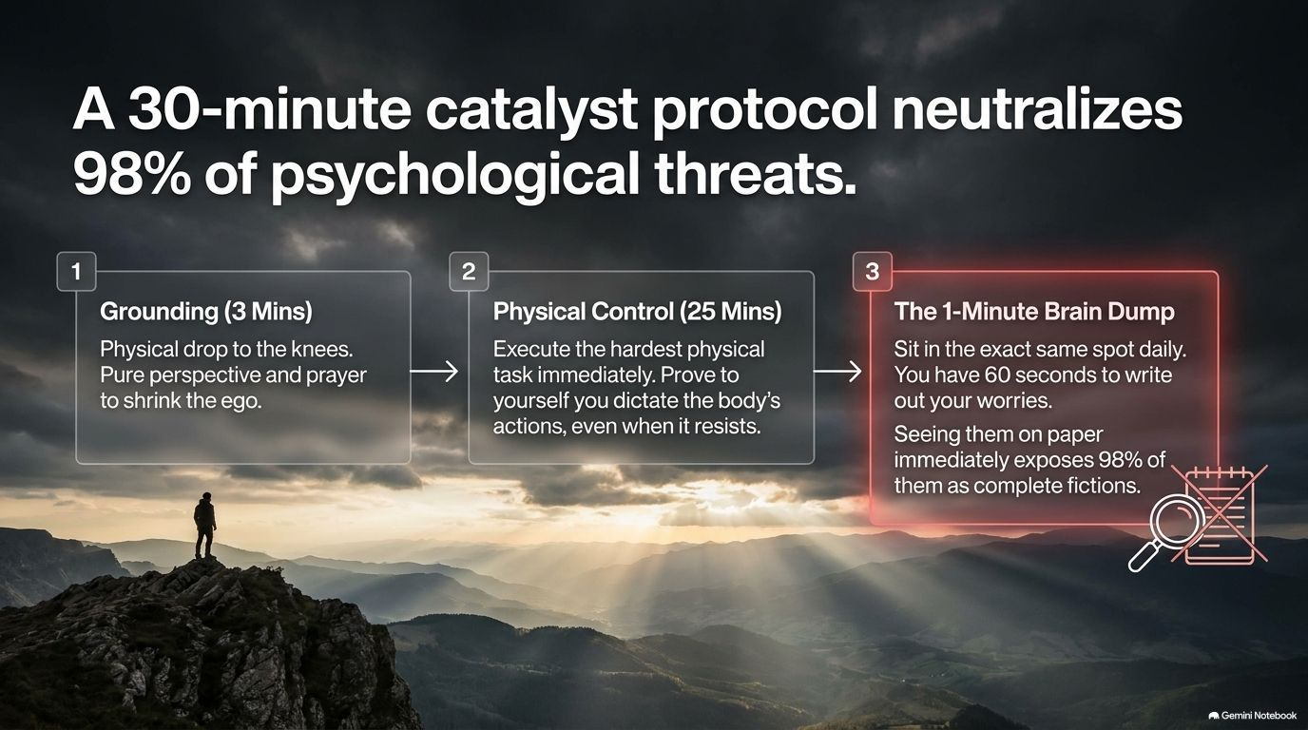
Notes:
Visual: A three-step process timeline: (1) Grounding (3 Mins), (2) Physical Control (25 Mins), (3) The 1-Minute Brain Dump.
Core Theme: A daily 30-minute protocol to neutralize 98% of psychological threats.
Speaker Notes (Estimated Time: 4–5 minutes):
Step 1: Grounding (3 Mins): Start with a physical drop to the knees in prayer or pure perspective to shrink the ego.
Step 2: Physical Control (25 Mins): Execute a rigorous physical task immediately (like a workout) to prove to yourself that you dictate the body’s actions even when it resists.
Step 3: The 1-Minute Brain Dump: Sit in the same spot daily with coffee and write out your worries for 60 seconds. Seeing them on paper immediately disarms them and exposes 98% of them as complete nonsense.

Slide 10
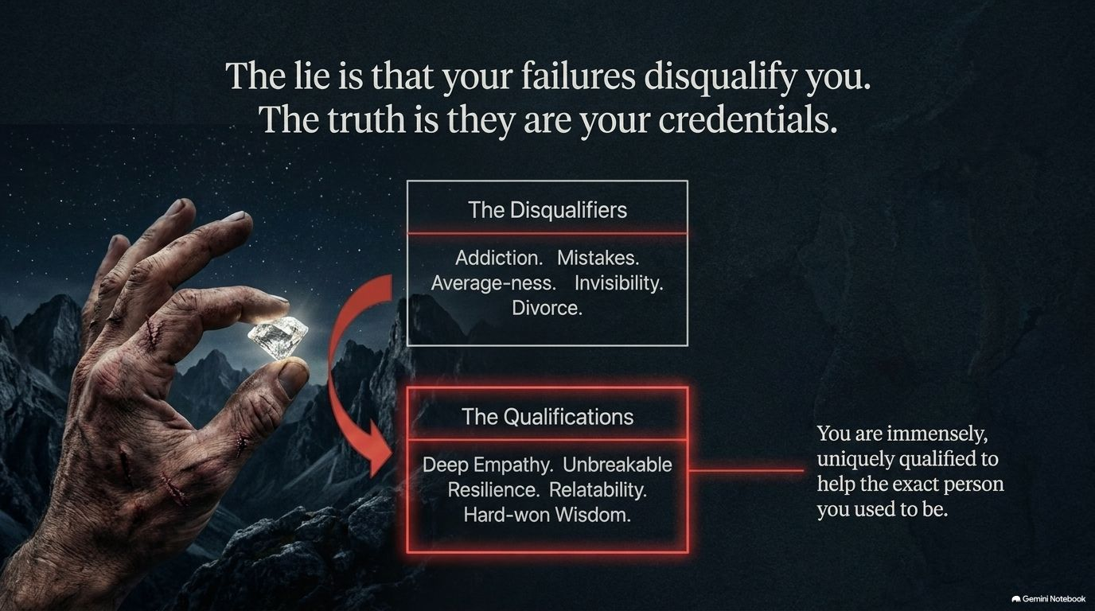
Notes:
Visual: A rugged hand holding a glowing diamond against a dark mountain background, contrasting "The Disqualifiers" with "The Qualifications".
Core Theme: Your failures and past struggles are your greatest credentials.
Speaker Notes (Estimated Time: 4–6 minutes):
The Lie vs. The Truth: The lie is that your failures, addiction, mistakes, divorce, or average-ness disqualify you. The truth is that they are your credentials.
The Power of Shared Experience: Reference the story of the man with 31 days of sobriety who helped Ed’s father. He didn't need a pristine resume; his past struggles qualified him.
Uniquely Qualified: Emphasize that you are immensely, uniquely qualified to help the exact person you used to be.

Slide 11
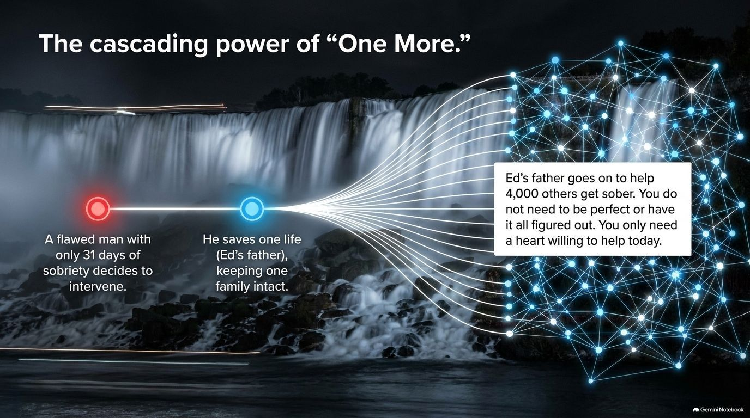
Notes:
Visual: A glowing digital network spreading outward from a single point near a roaring waterfall.
Core Theme: The massive ripple effect of a single intervention.
Speaker Notes (Estimated Time: 3–5 minutes):
The Ripple Effect: Share how a flawed man with just 31 days of sobriety decided to intervene and save Ed’s father. That single act kept a family intact and led Ed’s father to subsequently help over 4,000 others get sober.
Removing the Pressure: You do not need to be perfect or have life entirely figured out. You only need a heart willing to help today.
The Power of "One More Day": Echo the sobriety principle—you don’t have to fix your whole life today; you just have to make the right decision for one more day.

Slide 12

Notes:
Visual: A balance scale comparing "Ability" (cracked rock) against "Intention" (glowing red sphere) atop a mountain peak.
Core Theme: Unshakable confidence stems from your intentions, not your abilities.
Speaker Notes (Estimated Time: 4–6 minutes):
The Trap of Ability: Anchoring your confidence to your skills or intellect breeds chronic insecurity because there will always be someone smarter, faster, or more experienced.
The Bulletproof Anchor: Anchoring your confidence to your pure intention to help is bulletproof. No one can take away the undeniable fact that you are a good person trying to do good.
The Wayne Dyer Lesson: Recall Ed’s encounter on the beach in Hawaii where Wayne Dyer told him to beam with confidence over his intentions, not his performance.

Slide 13

Notes:
Visual: A silhouette of a person standing on a cliff at dawn, surrounded by annotations honoring quiet resilience and everyday grace.
Core Theme: True heroism is found in quiet, enduring grace.
Speaker Notes (Estimated Time: 3–5 minutes):
Redefining Success: The highlight reel of your life isn't awards, wealth, or perfection—it is the quiet grace of still standing after betrayal, loss, or hardship.
Honoring the Unsung Heroes: Celebrate the mothers waking up in the dark, the glue holding families together without credit, and the everyday people carrying immense difficulty with honor.
Unconditional Self-Love: If you have carried heavy burdens, you deserve the grace of unconditional self-love right now.

Slide 14
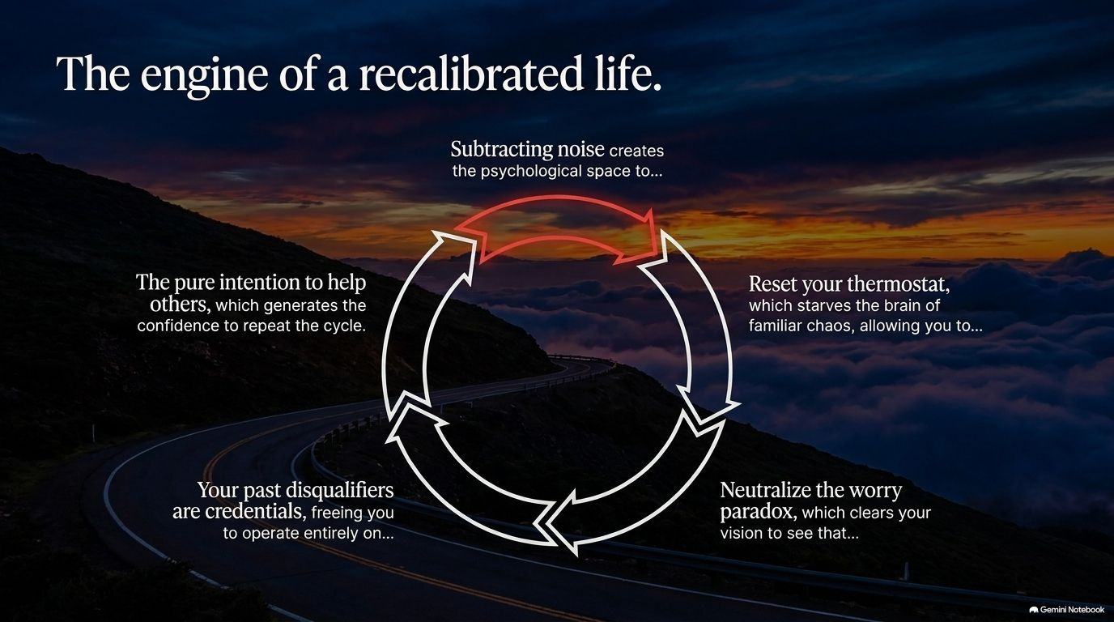
Notes:
Visual: A cyclical roadmap graphic connecting subtraction, thermostat reset, worry neutralization, past credentials, and pure intention.
Core Theme: How all five psychological shifts integrate into a continuous engine of growth.
Speaker Notes (Estimated Time: 3–5 minutes):
Connecting the Pieces: Walk through the flywheel of transformation:
Subtracting noise creates psychological space.
Resetting your thermostat starves the brain of familiar chaos.
Neutralizing the worry paradox clears your vision.
Recognizing past disqualifiers as credentials frees you to operate authentically.
Pure intention to help others generates the unshakeable confidence to repeat the cycle.
Momentum: Emphasize that once this engine starts turning, personal transformation becomes self-sustaining.

Slide 15
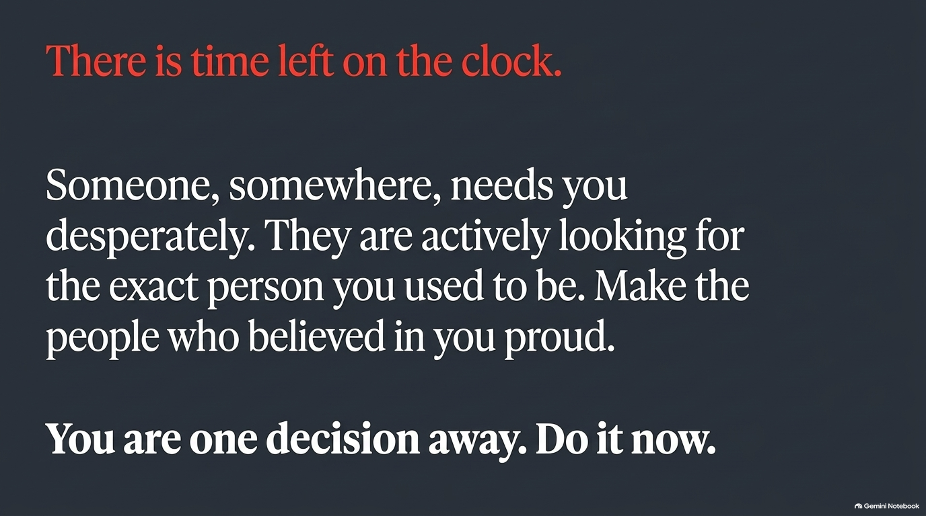
Notes:
Visual: A clean, minimalist dark slide with bold red and white typography emphasizing urgency, purpose, and immediate action.
Core Theme: A final, passionate call to action.
Speaker Notes (Estimated Time: 3–4 minutes):
Urgency: Remind the audience that life is finite and time is ticking. Someone, somewhere, desperately needs the exact person they used to be.
Making Them Proud: Honor the grandparents, mentors, or loved ones who believed in you by becoming the person they knew you could be.
Final Call: Reiterate the core mantra: "You are one decision away. Do it now."

Slide 16
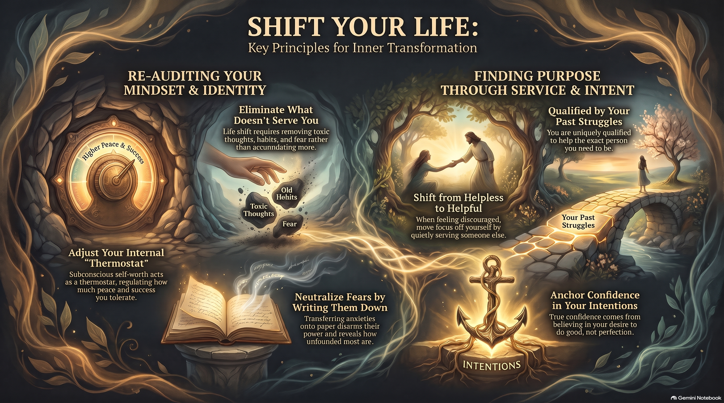
Notes:
Visual: An ornate, warm-toned summary painting integrating the thermostat, subtraction hands, open journal, anchor, and mountain bridge.
Core Theme: A visual and emotional synthesis of inner transformation.
Speaker Notes (Estimated Time: 2–3 minutes):
Closing Synthesis: Bring all core pillars together—re-auditing mindset and identity, adjusting the internal thermostat, writing away fears, and finding purpose through service.
Parting Blessing: Conclude with warmth and encouragement. Remind the room that they are good people capable of extraordinary things, and that the rest of their year is entirely yours to recalibrate.

