Slide 1
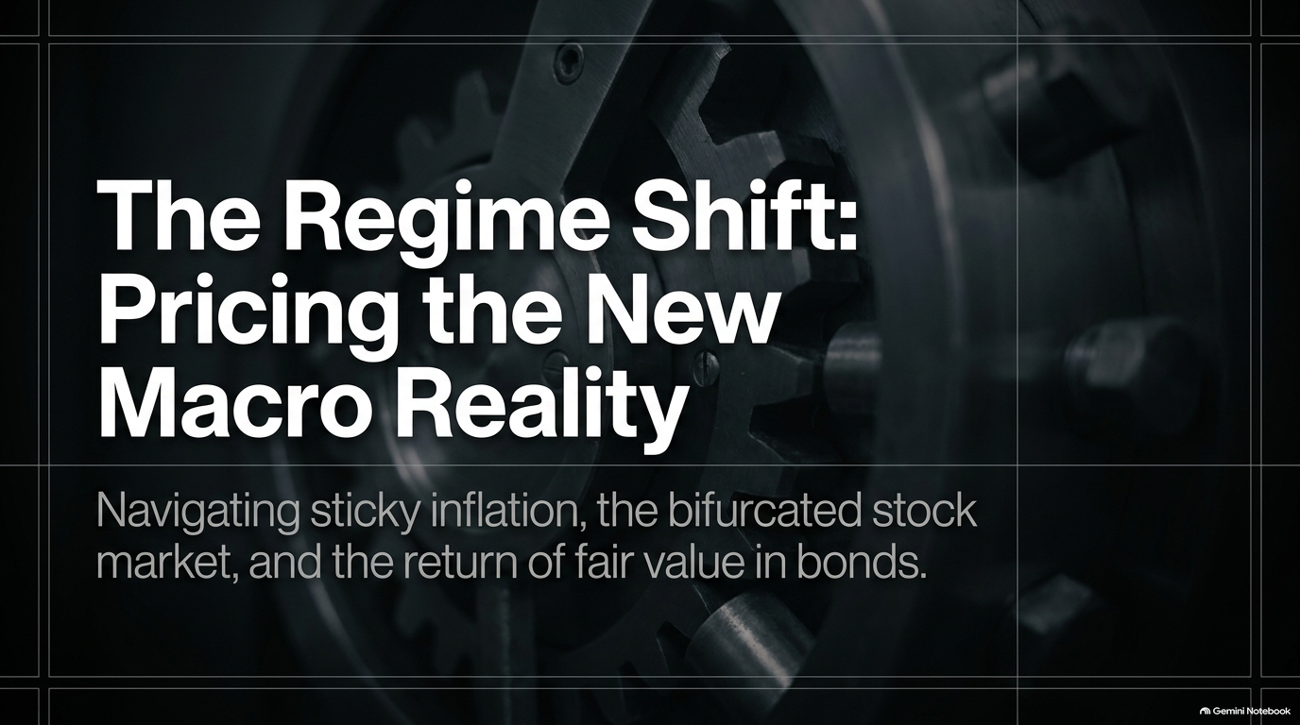
Notes:
Bonds Are Finally Fair Value — What I’m Buying Now
https://www.youtube.com/watch?v=qiRo9UW0x_8
The Bond Pivot: Jim Bianco on Why it’s Time to Start Buying Bonds
https://www.youtube.com/watch?v=SSL8MHDcgd0

Slide 2
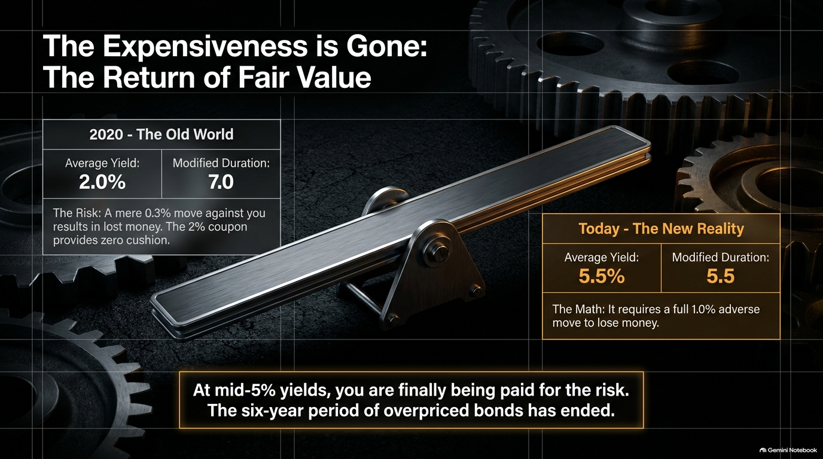

Slide 3
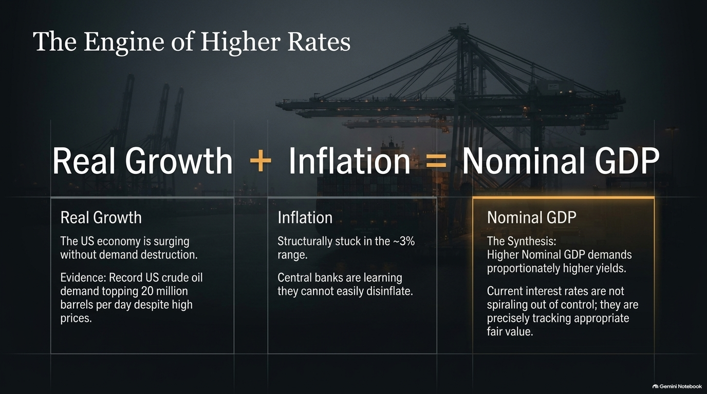

Slide 4
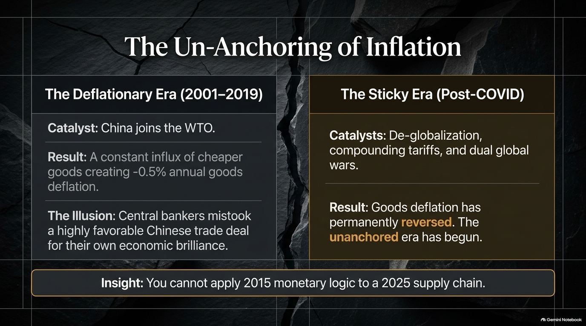

Slide 5
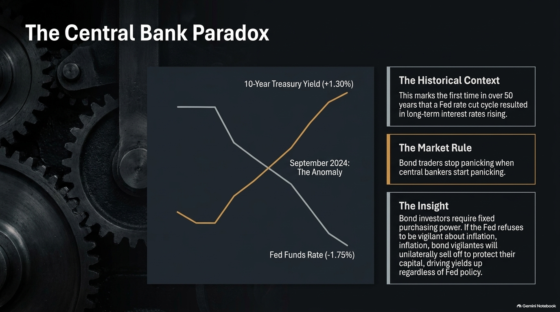

Slide 6
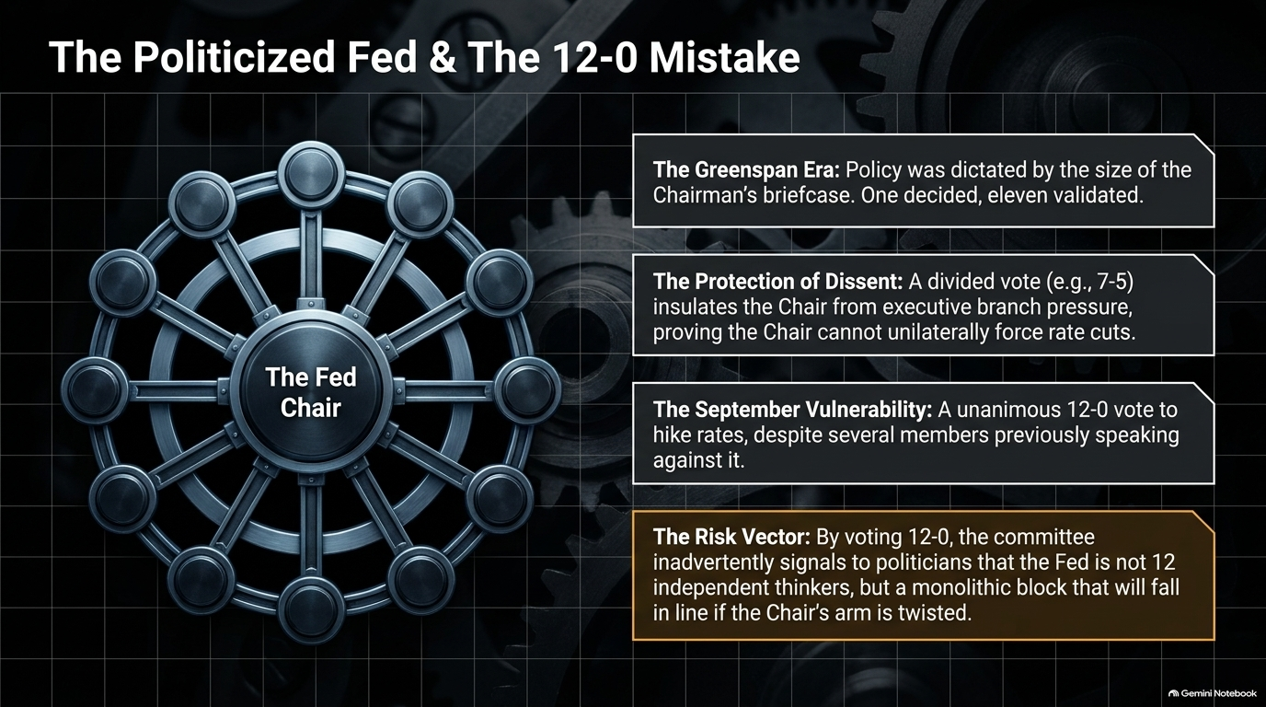

Slide 7
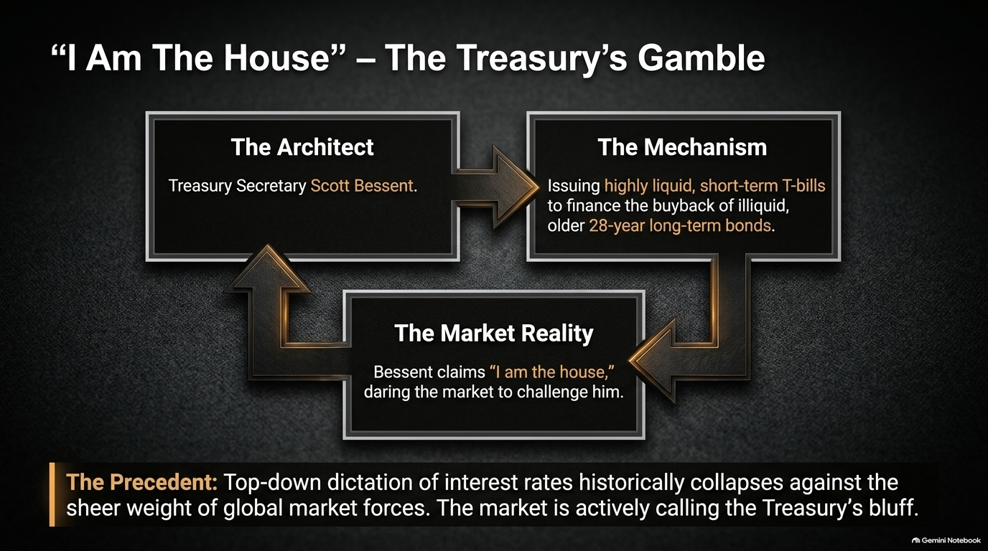

Slide 8
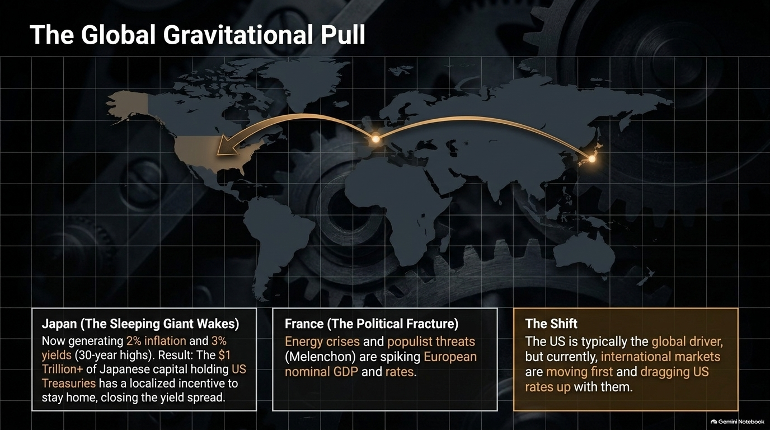

Slide 9
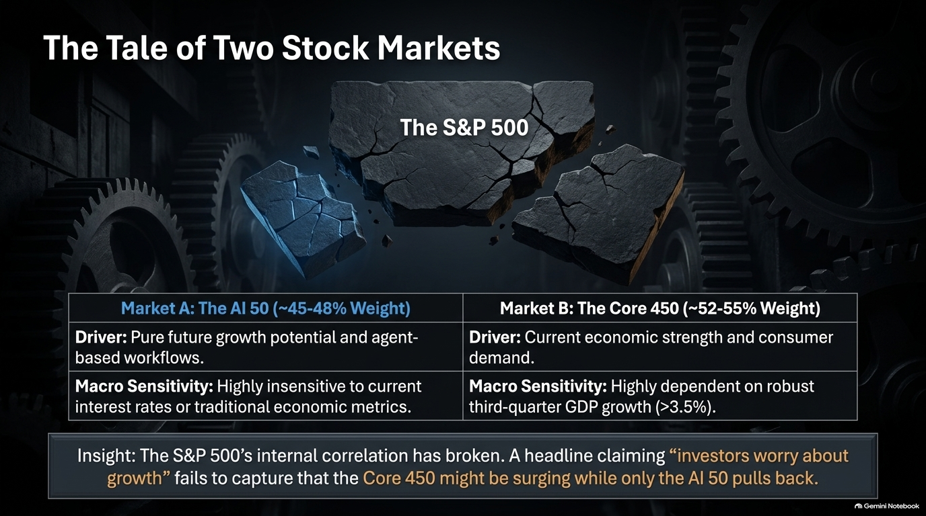

Slide 10
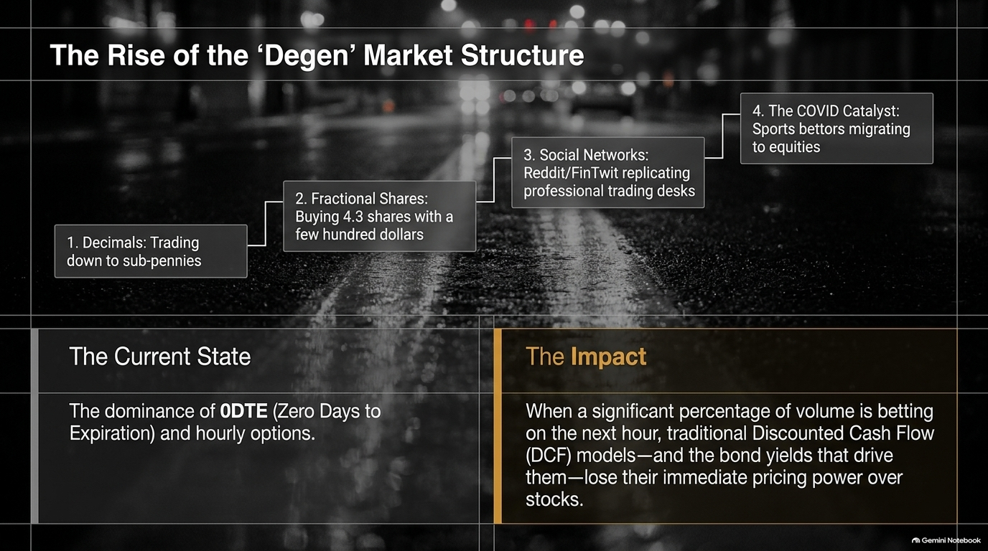

Slide 11
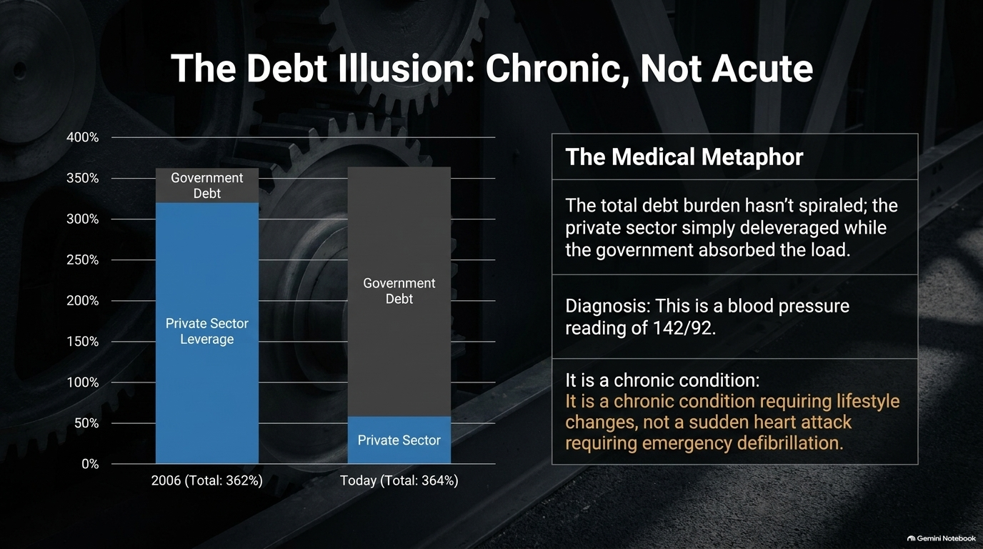

Slide 12
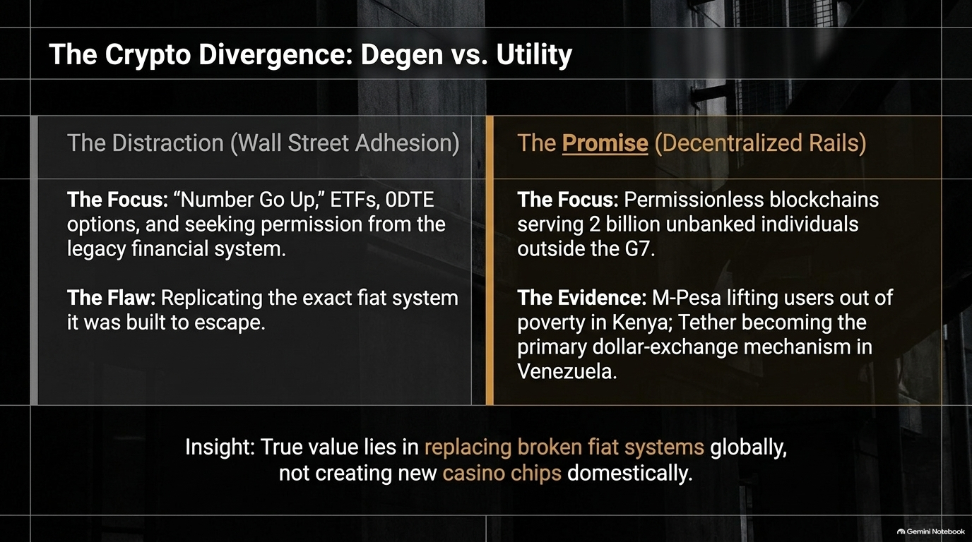

Slide 13
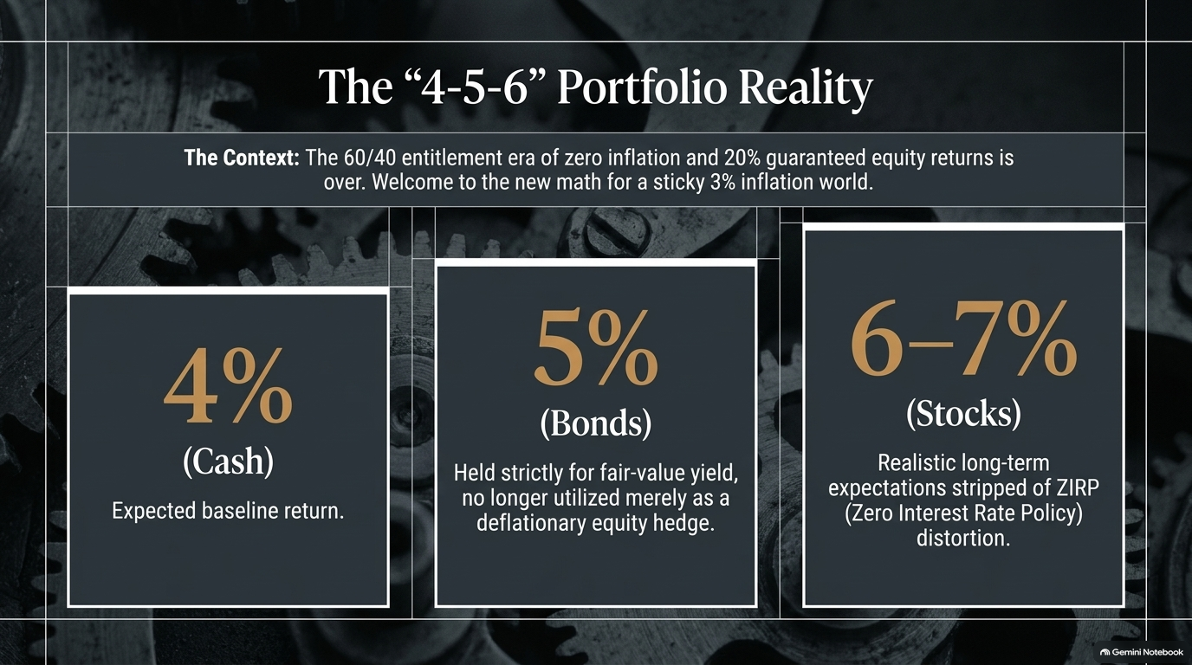

Slide 14


Slide 15
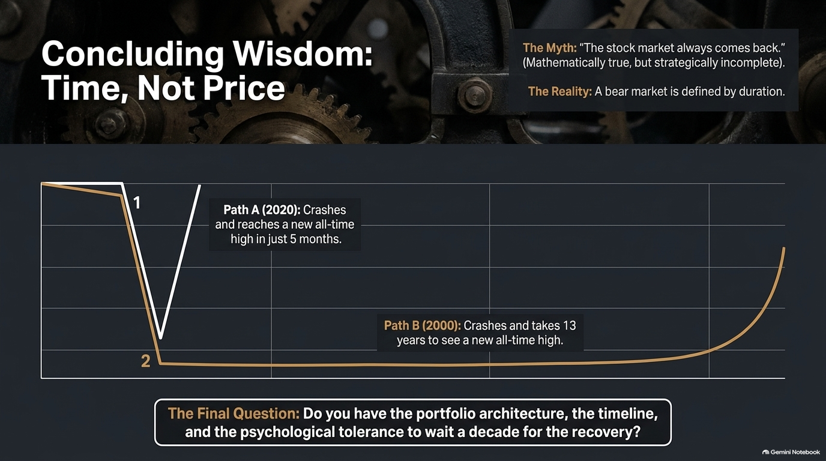

Slide 16
