Slide 1
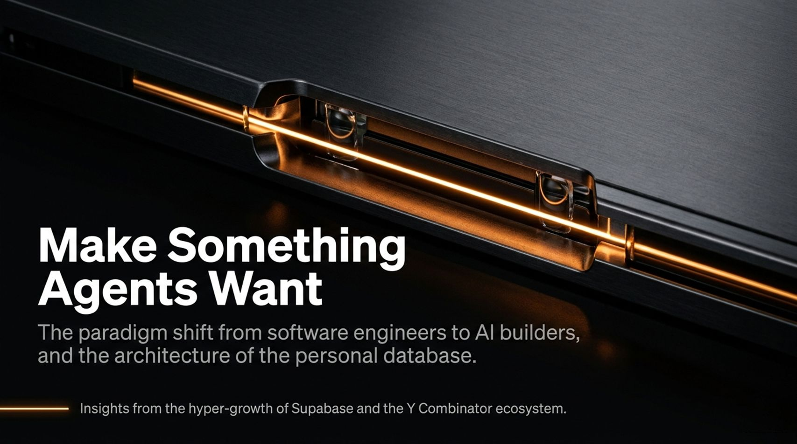
Notes:
Estimated Pacing: 2–3 minutes
Core Objective: Establish the overarching theme—that software development is transitioning from human-centric craftsmanship to agent-driven execution—and frame why this shift changes everything about how we design, build, and consume products.
Speaker Script & Talking Points:
Opening Hook: "Welcome everyone. Today, we are standing at the absolute frontier of a massive paradigm shift in technology. For decades, the constraint in building software has been human labor—writing every line of code, debugging manually, and managing human developers. Today, that constraint is vanishing."
Connecting to the Theme: "As we look at modern agent ecosystems—echoing discussions on how everyone can build software and how backends like Supabase now see the vast majority of new activity initiated by agents—we realize we are no longer building software for humans to code. We are building software for agents to use, consume, and orchestrate."
Transition: "Over the next few minutes, we’ll explore what this means for architecture, product design, APIs, and the future of human judgment in a world where code is cheap and agents do the heavy lifting."
What Happens When Everyone Can Build Software
https://www.youtube.com/watch?v=vl7HiMdGfjo

Slide 2
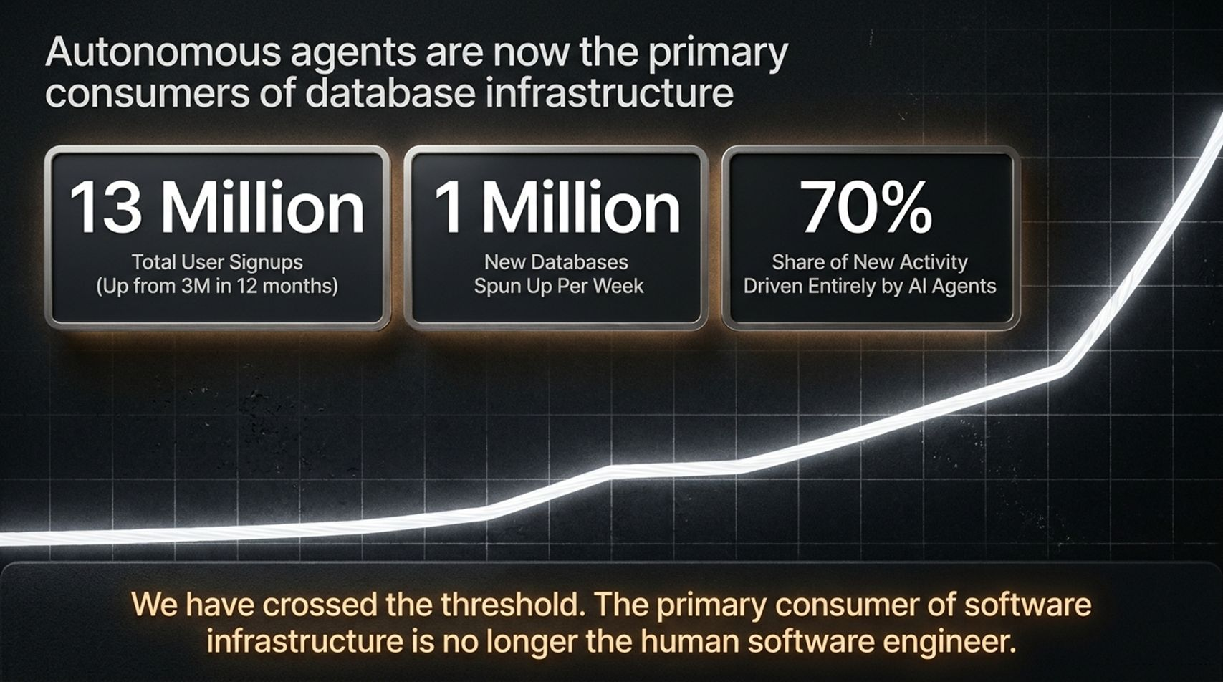
Notes:
Estimated Pacing: 3–4 minutes
Core Objective: Contrast traditional software engineering workflows with the emerging agentic paradigm.
Speaker Script & Talking Points:
Detailed Breakdown: "Let’s look at how software creation used to work. Humans wrote requirements, translated them into specs, wrote code line-by-line, and tested iteratively. It was slow, expensive, and bottlenecked by human typing speed and cognitive load."
The New Reality: "In the agent era, humans shift from being primary writers of code to editors, architects, and directors. Agents act as the primary workforce. They spin up databases, write boilerplate, execute unit tests, and wire services together in seconds."
Key Takeaway: "This means our engineering culture has to adapt. If agents are doing 70% or more of the heavy lifting, our primary job isn't writing syntax anymore—it's establishing clear guardrails, precise context, and bulletproof feedback loops."

Slide 3
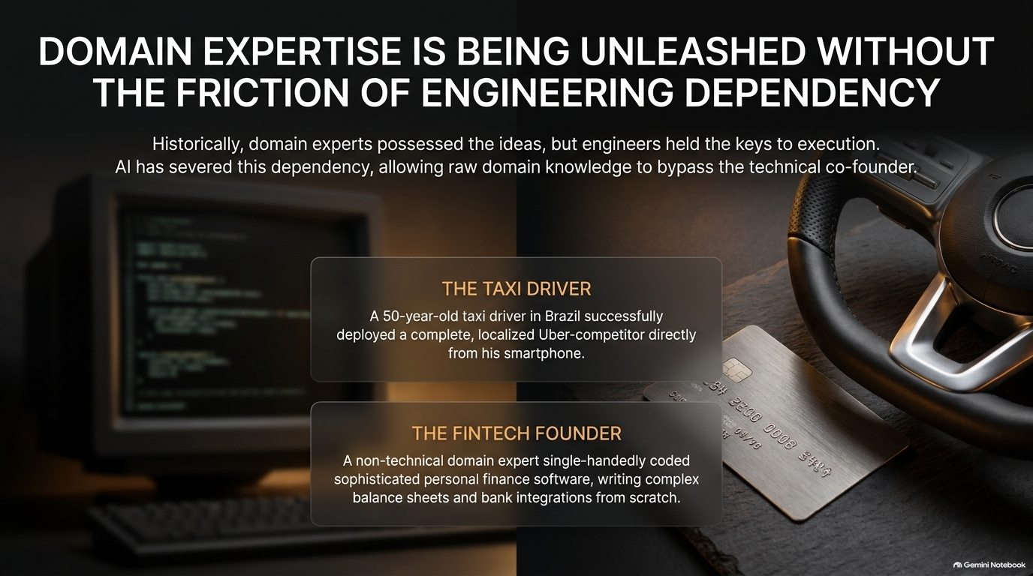
Notes:
Estimated Pacing: 3–5 minutes
Core Objective: Explain how databases and backend infrastructures are being forced to adapt to automated workflows.
Speaker Script & Talking Points:
The Infrastructure Challenge: "Traditionally, backend services were optimized for human developers browsing documentation, clicking around dashboards, and manually running migrations. But what happens when your primary user isn't a human developer, but an autonomous coding agent?"
API & Data Access: "Data platforms like Supabase have highlighted an incredible trend: the majority of new database creation and interaction is now driven entirely by programmatic agents. Agents don't read slick marketing copy or watch 20-minute onboarding videos; they read raw documentation, query schemas programmatically, and expect deterministic errors."
Interactive Discussion Point: "If your API fails or returns ambiguous error messages, a human developer might figure it out through intuition. An agent will hallucinate, loop infinitely, or fail catastrophically. Therefore, backend design for agents must prioritize extreme clarity, high determinism, and instant feedback loops."

Slide 4
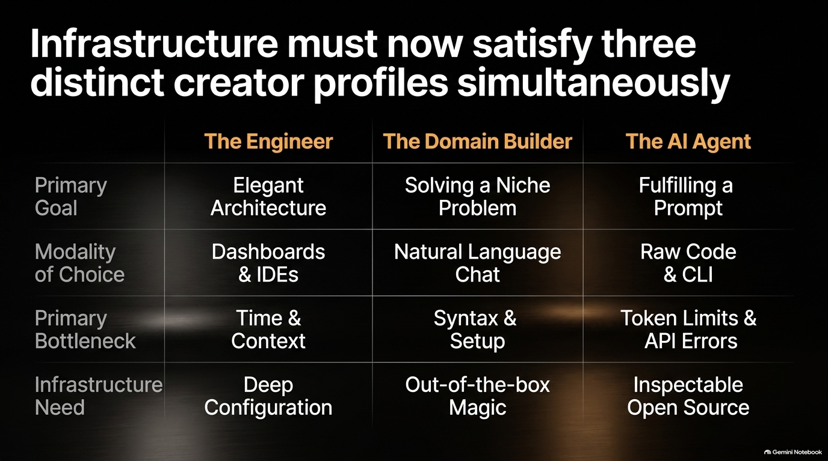
Notes:
Estimated Pacing: 4–5 minutes
Core Objective: Define the principles of "Agent-First" product design and interface structuring.
Speaker Script & Talking Points:
Redefining UX/UI: "When we say 'user experience' today, we usually think of Figma screens, sleek buttons, and smooth CSS transitions. But when building for agents, the 'User' is an LLM with a tool-use loop."
Key Design Pillars for Agents:
Structured Inputs and Outputs: JSON schemas must be pristine. Ambiguity is the enemy of agent reliability.
Predictable State Management: Agents need to know the exact state of a system before taking an action. Hidden side effects break agent execution trees.
Self-Healing Error Messages: When an agent makes a mistake, the error message shouldn't just say 'Error 500'; it must explicitly tell the agent why it failed and how to fix the payload.
Closing Thought: "Great agent products make it effortless for an AI model to reason about its next step without getting stuck in a loop."

Slide 5
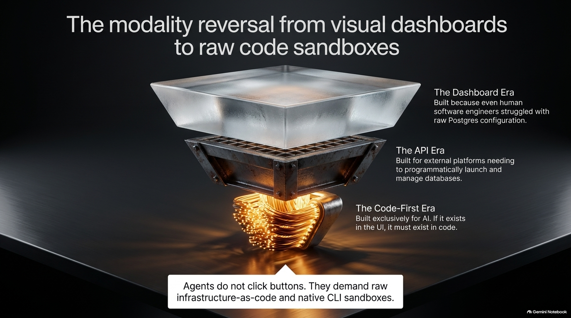
Notes:
Estimated Pacing: 3–4 minutes
Core Objective: Discuss how documentation must evolve from human narratives to machine-parseable artifacts.
Speaker Script & Talking Points:
The Old Documentation Paradigm: "For years, companies competed on having gorgeous, narrative-driven documentation with cute illustrations, tutorials, and blog posts. Humans love narratives; agents love structured facts."
The Shift to Specs: "Agents don't need a welcome guide; they need OpenAPI specs, comprehensive type definitions, clear SDKs, and unambiguous JSON schemas loaded directly into their context window."
Actionable Advice: "If you want your platform or tool to be adopted by coding agents, invest heavily in machine-readable metadata. If an agent can't parse your capabilities in a single API call or structured markdown file, you won't exist in its workflow."

Slide 6
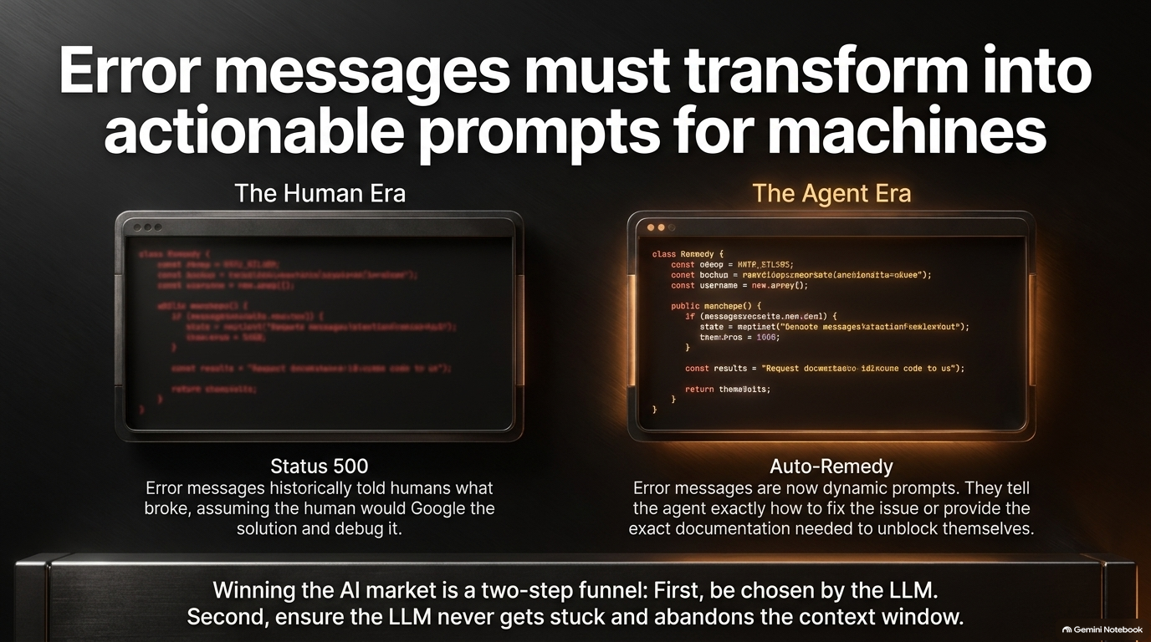
Notes:
Estimated Pacing: 4–6 minutes
Core Objective: Analyze the economic implications of near-zero marginal cost for writing code.
Speaker Script & Talking Points:
The Economic Breakdown: "Think about what happens when the marginal cost of producing lines of code drops close to zero. Historically, software was scarce, so we built massive monoliths and protected them fiercely. Today, software is abundant—almost disposable."
Personal Software Era: "We are moving into an era where personal software—bespoke, single-use utilities built in minutes by an agent for an individual's specific workflow—will be as common as personal documents."
The Real Moat: "When anyone can build software, writing code is no longer a competitive advantage. Your moat is no longer your code; your moat is your data, your unique distribution, your taste, and your judgment about what problems are actually worth solving."

Slide 7
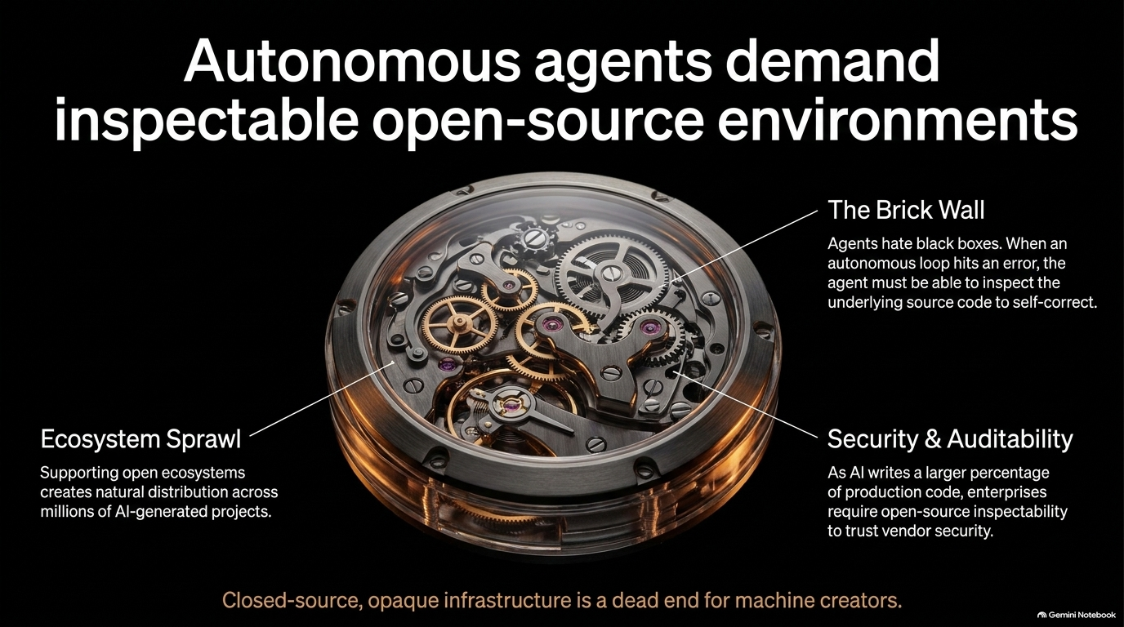
Notes:
Estimated Pacing: 3–5 minutes
Core Objective: Emphasize the critical importance of human curation and product vision when execution barriers collapse.
Speaker Script & Talking Points:
The Role of the Editor: "Just like the rise of desktop publishing didn't make everyone a brilliant novelist, the rise of AI coding agents doesn't make everyone a great product creator. In fact, it creates a massive noise problem."
The Curation Challenge: "When anyone can generate 10,000 lines of code in five minutes, quality becomes completely disconnected from quantity. The winners in this new ecosystem will be those with superior taste, sharp architectural vision, and rigorous editorial judgment."
Guiding Question for the Audience: "Ask yourself: Are you spending your time managing syntax, or are you refining the exact problem definition and user experience that makes the product truly magical?"

Slide 8
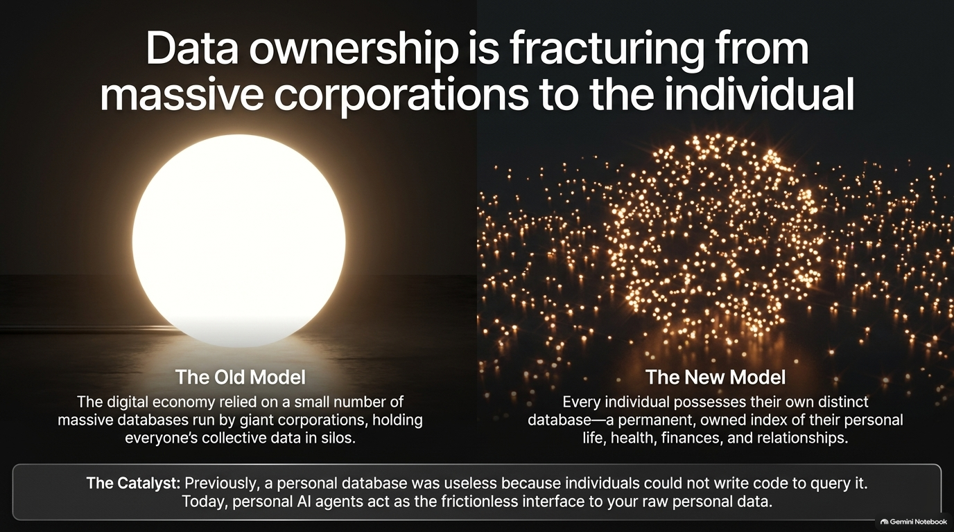
Notes:
Estimated Pacing: 4–5 minutes
Core Objective: Break down technical patterns (e.g., tool use, guardrails, state persistence) required for stable agent execution.
Speaker Script & Talking Points:
Moving Beyond Simple Prompts: "Early agent experiments relied on naive, single-turn prompt chains. Production-grade agent systems require robust architectural patterns."
Core Technical Patterns:
Explicit Tool Boundaries: Give agents sharp, well-defined tools rather than broad, unfocused execution permissions.
Checkpointing and Rollbacks: Because agents will occasionally make mistakes, your system must support easy state rollbacks so human supervisors can revert bad changes instantly.
Deterministic Handoffs: Clearly delineate where deterministic code handles heavy logic and where probabilistic LLMs handle reasoning. Do not let LLMs do math or raw database transactions unaided.

Slide 9
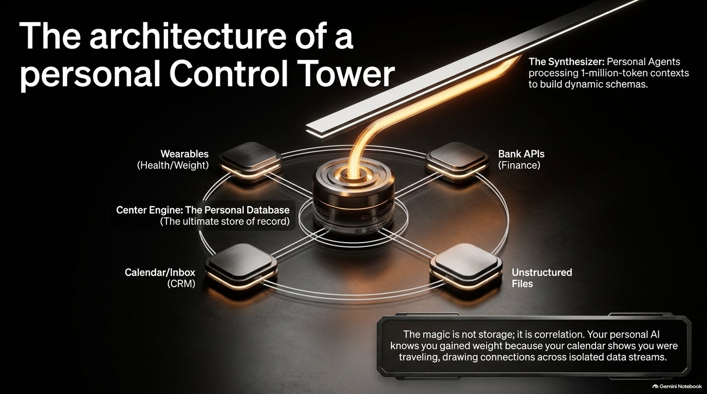
Notes:
Estimated Pacing: 3–5 minutes
Core Objective: Address the difficulties of testing and monitoring agent behavior in production.
Speaker Script & Talking Points:
The Debugging Nightmare: "Traditional software is deterministic: given input $X$, you always get output $Y$. Agents are probabilistic; the same prompt can yield different execution paths depending on context, model updates, or prompt drift."
Building Effective Evals: "To build reliable agent-driven products, you must build comprehensive evaluation suites—running hundreds of automated test scenarios against your agent before shipping updates."
Observability: "You need deep tracing dashboards to see why an agent made a specific decision, which tool calls it invoked, and where it went off the rails. Without observability, debugging an agent in production is like flying blind in a storm."

Slide 10
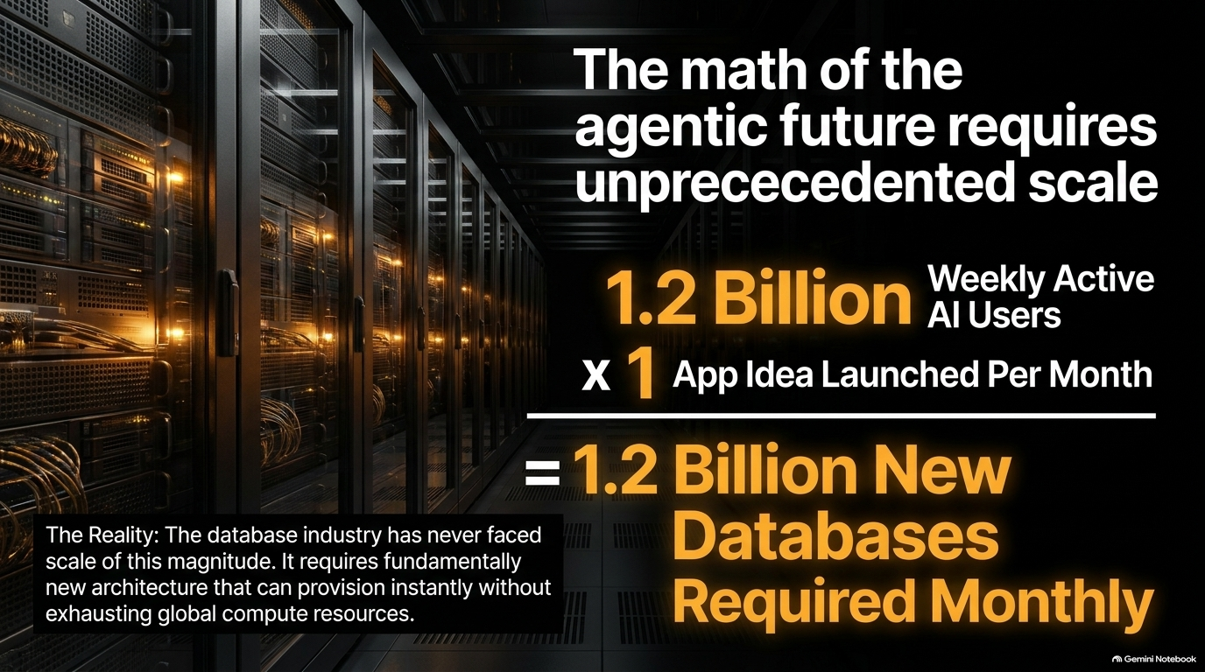
Notes:
Estimated Pacing: 4–5 minutes
Core Objective: Highlight security vulnerabilities (prompt injection, excessive permissions) and how to mitigate them.
Speaker Script & Talking Points:
The Security Paradigm Shift: "When you give an agent the power to write code, execute shell commands, query databases, and call external APIs, you are effectively giving an intern with infinite energy and zero common sense root access to your infrastructure."
Key Risk Factors:
Indirect Prompt Injection: Malicious inputs hidden in web pages or emails that hijack your agent's instructions.
Privilege Escalation: Agents executing destructive operations because their API tokens were too broad.
Defensive Engineering: "Implement strict principle-of-least-privilege boundaries. Sandbox agent execution environments completely, require human-in-the-loop confirmation for high-stakes actions (like dropping tables or sending money), and treat all external data as untrusted."

Slide 11
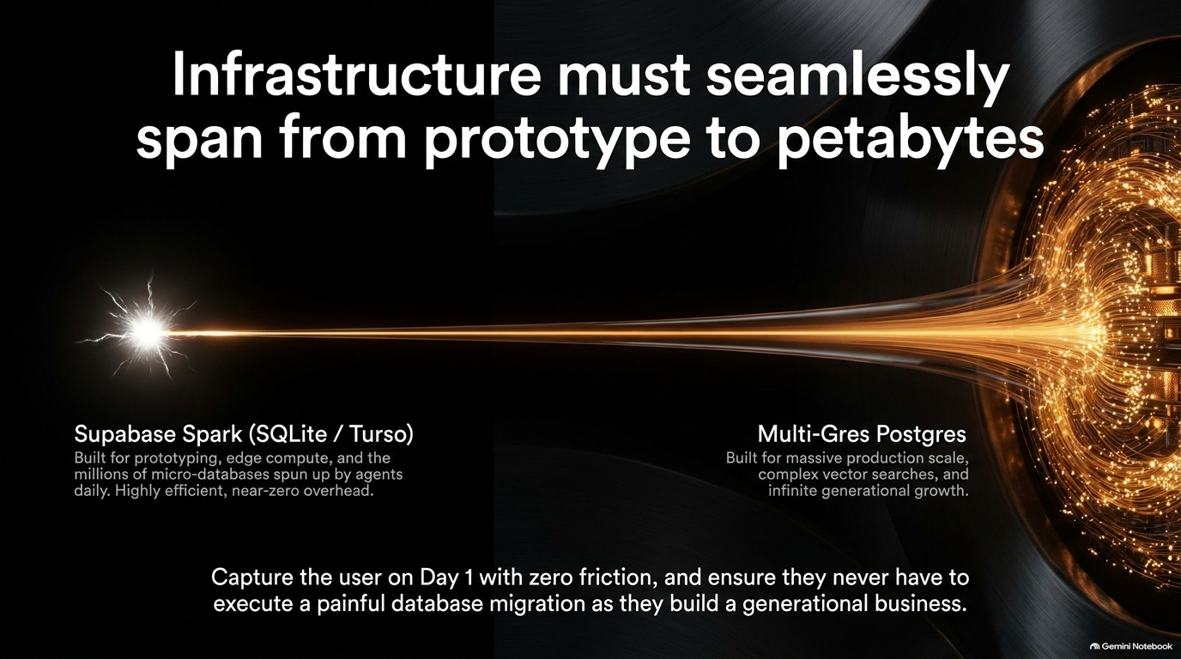
Notes:
Estimated Pacing: 3–4 minutes
Core Objective: Provide actionable guidance on integrating agents into existing engineering and product teams.
Speaker Script & Talking Points:
Culture and Process: "Adopting agent-first development isn't just about buying new tools; it requires a cultural overhaul. Teams need to shift from daily stand-ups focused on ticket status to collaborative reviews focused on prompt architecture, eval metrics, and system constraints."
The Hybrid Team: "Product managers, designers, and domain experts can now write functional prototypes directly using agentic coding tools. Engineering shifts from building every feature from scratch to building the foundational platforms and security frameworks that empower those non-technical builders safely."

Slide 12
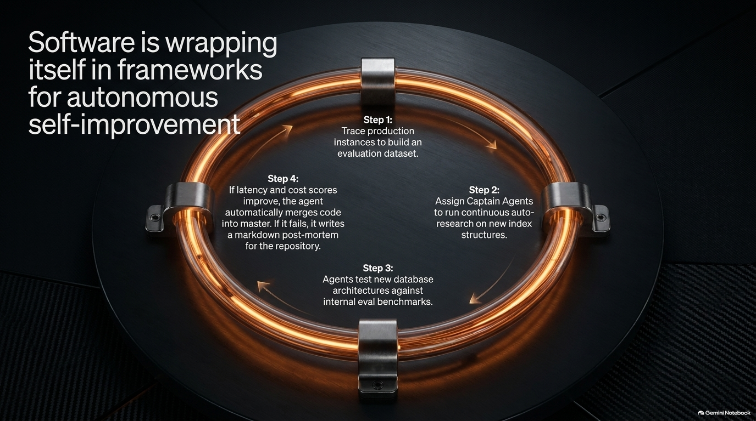
Notes:
Estimated Pacing: 4–5 minutes
Core Objective: Ground theoretical concepts in real-world observations from recent industry deployments.
Speaker Script & Talking Points:
Examining the Landscape: "Looking across modern startups and enterprise rollouts, we see two clear patterns emerging."
The Success Pattern: "Teams that treat agents as junior engineers—providing them with clear specs, strict unit tests, and continuous feedback loops—are seeing 3x to 5x velocity gains in shipping feature sets and MVPs."
The Pitfall Pattern: "Teams that treat agents like magic—handing over unconstrained production access with no evals or guardrails—frequently end up with tangled codebases, broken databases, and massive technical debt that takes humans twice as long to clean up."

Slide 13
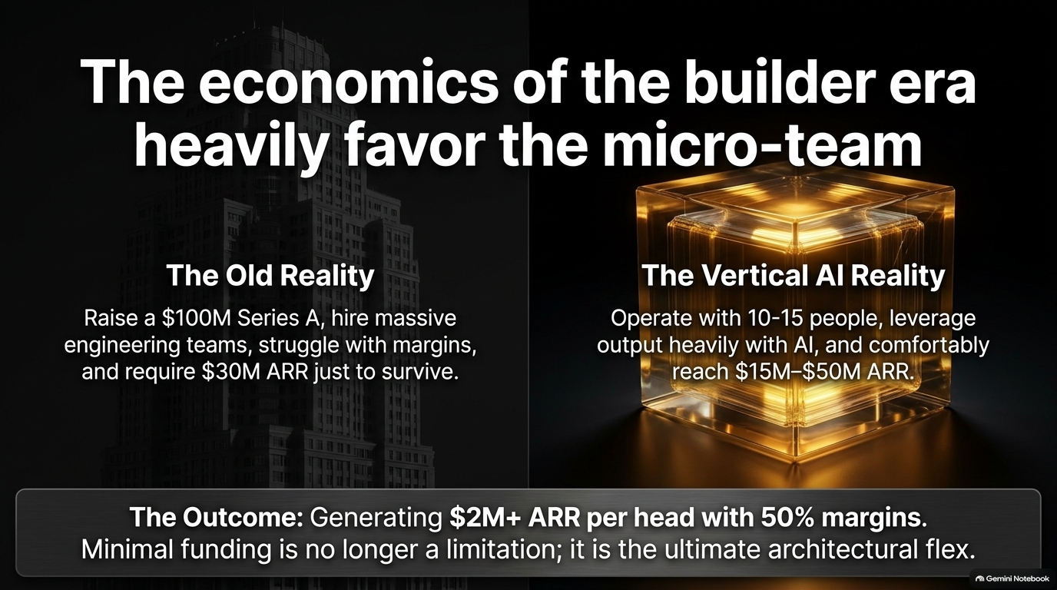
Notes:
Estimated Pacing: 3–4 minutes
Core Objective: Tackle the looming industry anxiety surrounding long-term code maintenance in an agent-generated world.
Speaker Script & Talking Points:
The Core Dilemma: "As industry commentators and YC discussions frequently point out, a massive unanswered question hangs over the agent gold rush: What happens when everyone can build software, but no one can maintain it?"
The Maintenance Debt: "If an agent generates 50 microservices in a weekend, who understands how they interact when a core dependency updates six months from now?"
Our Responsibility: "We cannot just be generators of code; we must build automated maintenance loops, self-documenting architectures, and robust regression tests so that our software ecosystems don't collapse under their own generated weight."

Slide 14
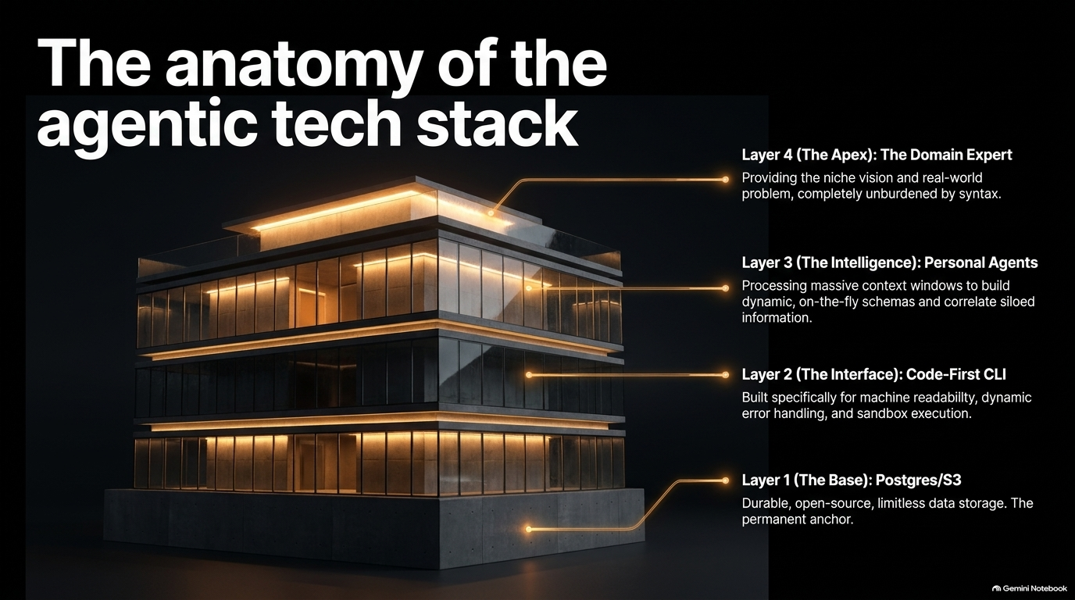
Notes:
Estimated Pacing: 3–4 minutes
Core Objective: Look forward to the next evolution—multi-agent orchestration, continuous background execution, and autonomous organizations.
Speaker Script & Talking Points:
Looking Ahead: "Where does this go next? We are moving past single-developer coding assistants toward multi-agent teams where specialized agents—architects, testers, security auditors, and release managers—collaborate asynchronously."
Continuous Execution: "Soon, software won't just be something we build and deploy; it will be a living organism continuously optimized, patched, and refactored by background agent swarms based on real-time telemetry and user feedback."

Slide 15
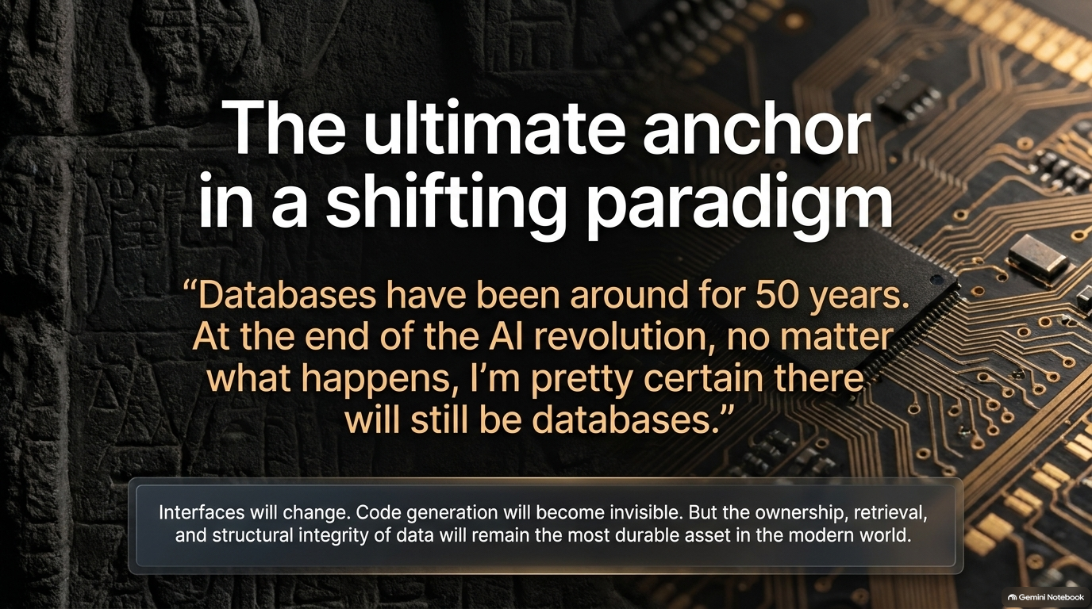
Notes:
Estimated Pacing: 2–3 minutes
Core Objective: Summarize the core message into memorable, actionable takeaways for the audience.
Speaker Script & Talking Points:
Recap of Core Principles:
Build for Agents: Design your APIs, schemas, and documentation to be machine-parseable and deterministic.
Embrace the New Economics: Code is cheap; your taste, product vision, and judgment are your true competitive moats.
Invest in Guardrails: Scale your evals, security sandboxes, and observability before scaling your agent autonomy.

Slide 16
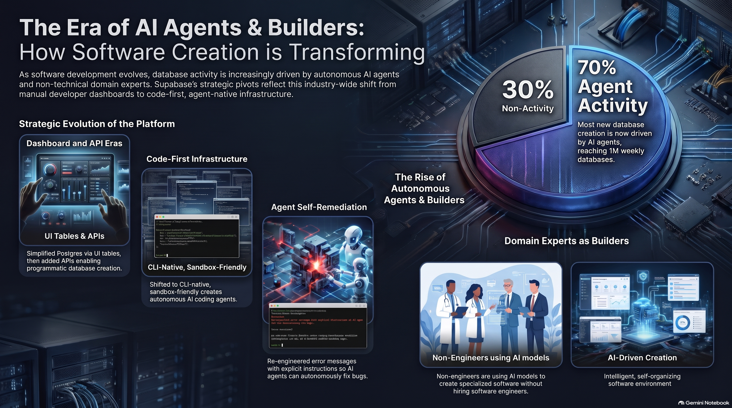
Notes:
Estimated Pacing: Open / 5+ minutes
Core Objective: Open the floor for audience questions and guide their immediate next steps.
Speaker Script & Talking Points:
Closing Remarks: "Thank you for joining this deep dive into building for agents. The tools are evolving every single week, and the best way to understand this shift is to get your hands dirty, build something agent-first, and refine your judgment along the way."
Opening for Questions: "I’d love to hear your thoughts, answer any questions about your current stack, or discuss how you're planning to integrate agents into your workflows. Let's open the floor."

