Slide 1
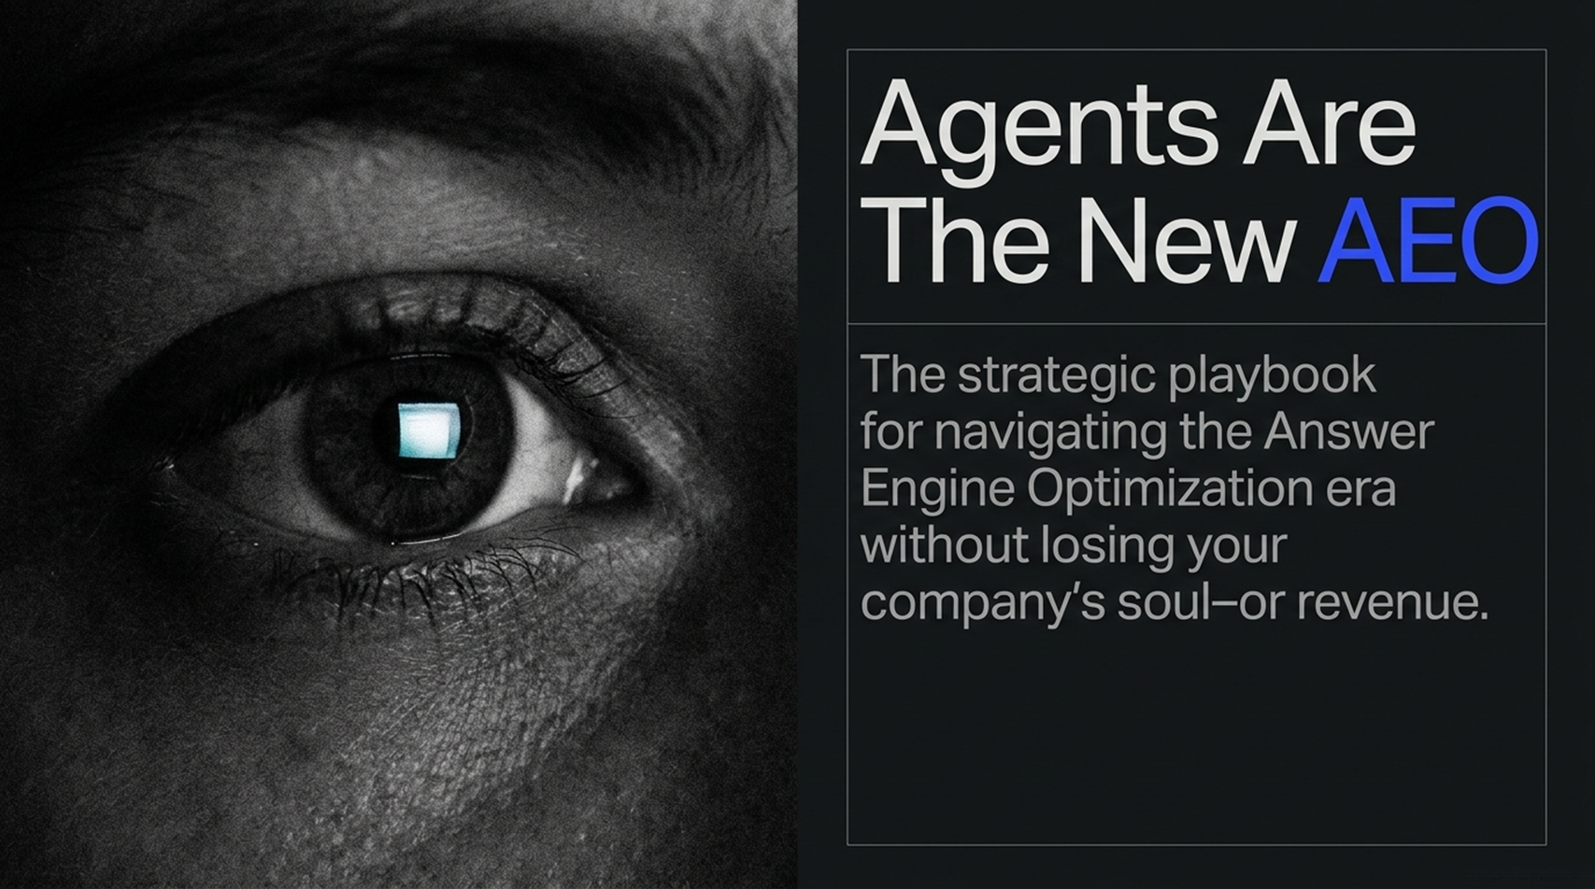
Notes:
Estimated Speaking Time: 3 minutes
Key Talking Points
The Fundamental Transition: Traditional Search Engine Optimization (SEO) relied on blue links, domain authority, and keywords. Today, users and autonomous AI agents demand instant, zero-friction answers.
AEO & GEO: Answer Engine Optimization (AEO) and Generative Engine Optimization (GEO) represent the new frontier of digital visibility.
Agentic Shift: Large Language Models (LLMs) like Claude, Grok, ChatGPT, and specialized agent tools are taking over discovery, recommendation, and action.
Speaker Script
"Welcome everyone. Today we are diving into one of the most critical shifts in digital strategy since the birth of Google itself: The Answer Engine Playbook.
For over two decades, our playbook was clear: rank for keywords, build backlinks, and get users to click blue links onto our websites. But as tech leaders like Eric Siu and Neil Patel recently discussed in their insights on AI agents, the interface between customer intent and business revenue has changed permanently.
We have moved from Search Engines to Answer Engines and autonomous AI Agents. Whether it’s Grok, Claude Duet, ChatGPT, or specialized autonomous agents like Metamuse, users no longer want a list of links to browse—they want a direct answer, a curated recommendation, or an executed task. Over the next hour, we’ll explore what this means for your business, the hidden revenue risks of ignoring AEO, and the practical steps to ensure your brand is the default recommendation by AI agents."
Your Next Customer Could Be an AI Agent
https://www.youtube.com/watch?v=sLiWVtHYJvE

Slide 2
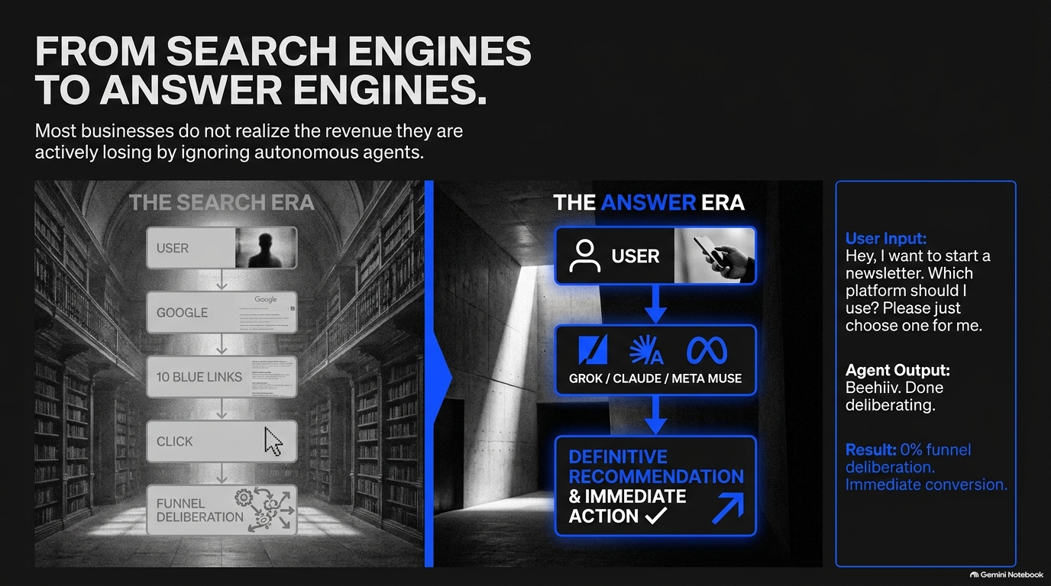
Notes:
Estimated Speaking Time: 4 minutes
Key Talking Points
Direct Recommendations in Action: Agents like Metamuse and Grokbot actively answer high-intent user queries like "Which newsletter platform should I use? Choose one for me" and directly suggest platforms like Beehiiv.
Instant Conversion Loops: Users trust agent recommendations so completely that they make high-dollar purchases instantly without traditional web browsing.
The Cost of Friction: Traditional multi-step conversion funnels are being bypassed by single-prompt executions.
Speaker Script
"To understand why this shift matters so much, let’s look at a real-world example highlighted in Eric Siu’s discussion. A user prompts an AI agent: 'Hey, I want to start a newsletter. Which platform should I use? Please just choose one for me.'
The agent responds instantly: 'Beehiiv. Done deliberating.'
What happens next? The user didn't visit Google, didn't read three affiliate comparison blogs, and didn't look at five pricing tables. They immediately deposited $300 to lock in an annual plan based purely on the agent's single-sentence decision.
This is a radical shift in buying behavior. When AI agents cut out the deliberation phase, the brand that gets recommended wins 100% of the market share for that query. If your product or service isn't optimized to be pulled into the agent's knowledge graph or context window, you don't just lose a position on page one—you lose the customer entirely before you even knew they were shopping."

Slide 3
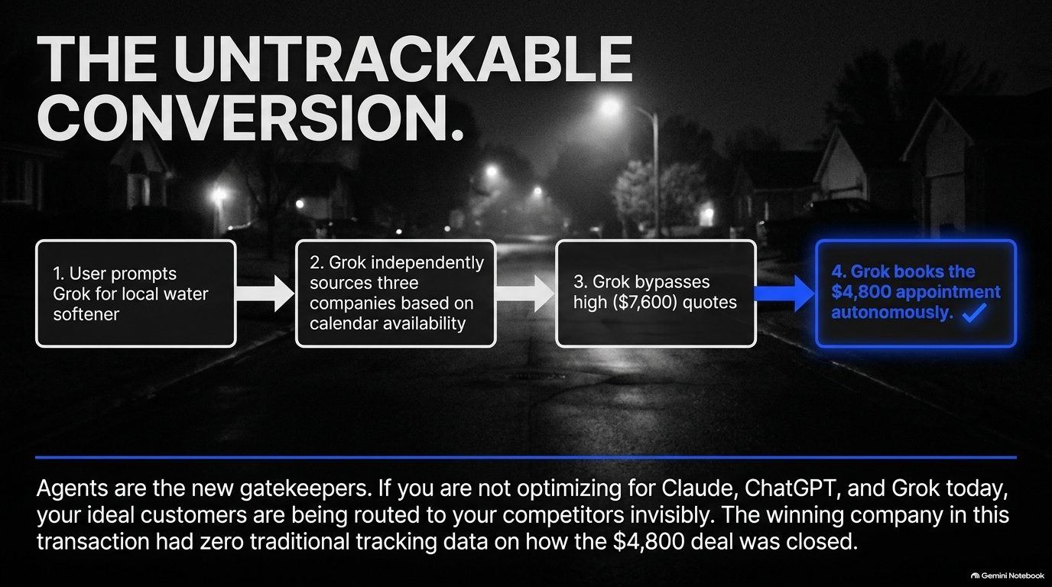
Notes:
Estimated Speaking Time: 5 minutes
Key Talking Points
Bypassing Google for AI Discovery: How consumers are moving from traditional search to conversational discovery engines (e.g., using Grok/Claude for home service quotes).
Price & Efficiency Optimization: Consumers use Grokbot to find, vet, and schedule appointments with local contractors dynamically.
The Invisible Revenue Loss: Businesses winning deals via AI recommendations often have zero attribution tracking and don't realize AI is driving their sales.
Speaker Script
"Let's examine another compelling case study discussed by Neil Patel regarding home service procurement.
A homeowner needed a water softening system installed in Las Vegas. Initially, he Googled local providers and received a quote for $7,600. But instead of continuing with Google, he switched to Grokbot to find and schedule competitive quotes based on his specific availability.
Grok dispatched inquiries, brought in three competing companies, and the homeowner landed a contract for $4,800—saving nearly $3,000.
Here’s the paradox: The winning water softener company got a $4,800 deal completely driven by an AI agent. Yet, like 95% of businesses today, they had no idea! They didn't track it, they didn't know Grok brought them the customer, and they never deliberately optimized their digital presence for AI retrieval.
Imagine how much revenue companies are losing every single day simply because their competitors are getting picked up by these bots while they remain invisible in AI answer engines."

Slide 4
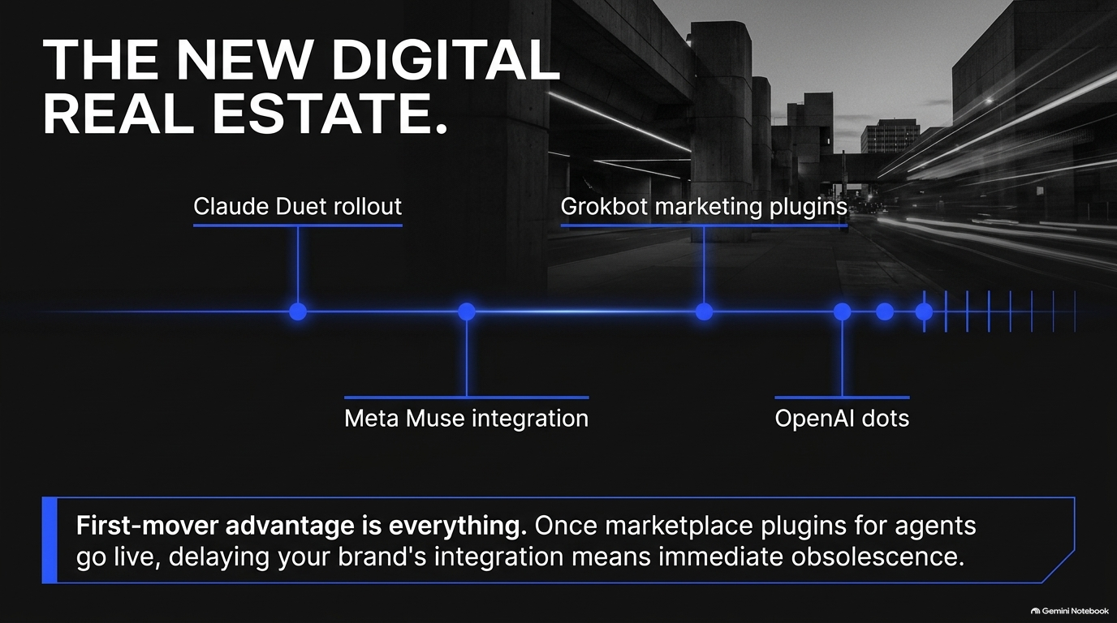
Notes:
Estimated Speaking Time: 4 minutes
Key Talking Points
New Surfaces for Discovery: AI agents operating across dual-screen devices, foldables (e.g., iPhone Duo), screenless interfaces, and AI wearables.
The Cost of Non-Adaptation: Businesses hesitate due to early hardware/channel costs, ignoring the risk of customer churn to early adopters.
Ideal Customer Demographics: Early adopters of expensive AI hardware/surfaces represent high-net-worth, high-intent Ideal Customer Profiles (ICPs).
Speaker Script
"As Answer Engines evolve, so do the hardware surfaces where customers interact with them. Consider new form factors like foldable devices, AI wearables, and dual-screen interfaces like the iPhone Duo.
Whenever new technology or hardware surfaces emerge, business owners often make the excuse: 'It costs money to adapt,' or 'Not enough people own these devices yet.'
But as Neil Patel pointed out, buyers who adopt new AI platforms and premium devices represent the highest-value ICPs in the market. They have disposable income and high purchase intent. If your web experience, API access, or content structuring isn't compatible with these new surfaces and AI clients, you are locking out your most profitable customer segment."

Slide 5
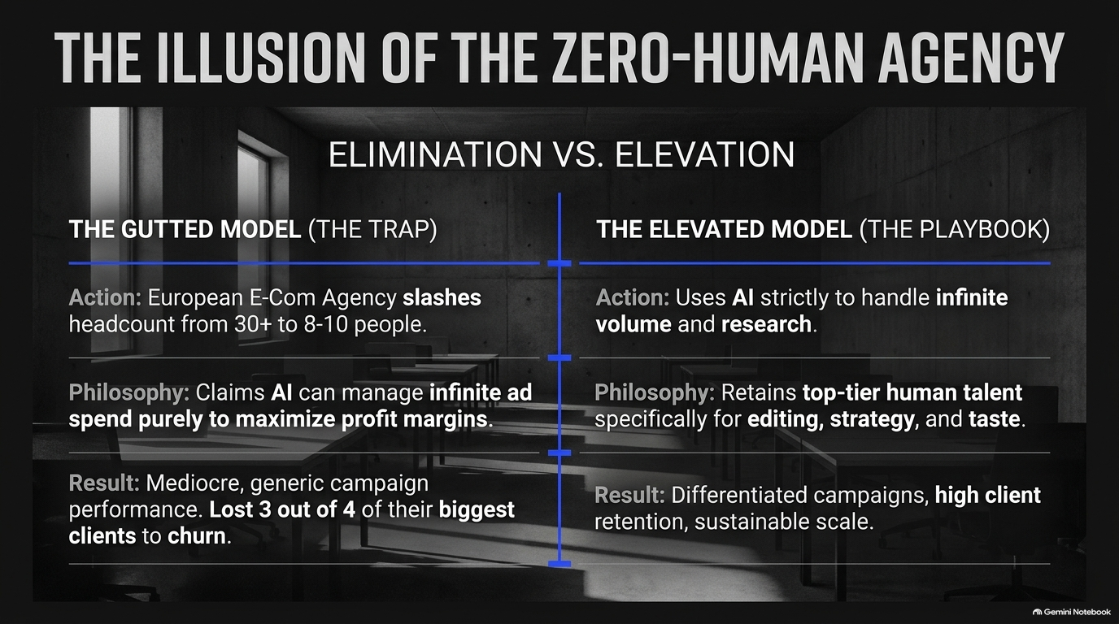
Notes:
Estimated Speaking Time: 5 minutes
Key Talking Points
Closed-Loop AI Lead Generation: AI agents will soon notify businesses: "We sent you 5 closed leads this month. Want to sponsor or advertise to get 50 more?"
Organic Integrity vs. Paid Marketplaces: Why LLM providers must keep organic recommendations objective while building separate sponsored answer marketplaces.
First-Mover Advantage on Connectors & Plugins: Early deployment on Grok, ChatGPT, and Claude connectors creates insurmountable competitive moats.
Speaker Script
"How will Answer Engines monetize? Eric Siu and Neil Patel debated whether AI platforms will offer 'SEO services' directly or build advertising marketplaces.
The consensus is clear: Answer Engine providers must maintain pure algorithmic integrity so users trust their recommendations as unbiased. However, they will aggressively build sponsored marketplaces and closed-loop notification systems.
Imagine your AI agent sending your sales team an automated alert: 'We just routed a $5,000 lead to your booking form. Would you like to sponsor intent queries in our marketplace to receive 10x more leads next month?'
Furthermore, look at Grokbot connectors and platform plugins. Early adopters who integrate their software and product data directly into these connectors gain immediate distribution while competitors are left behind."

Slide 6
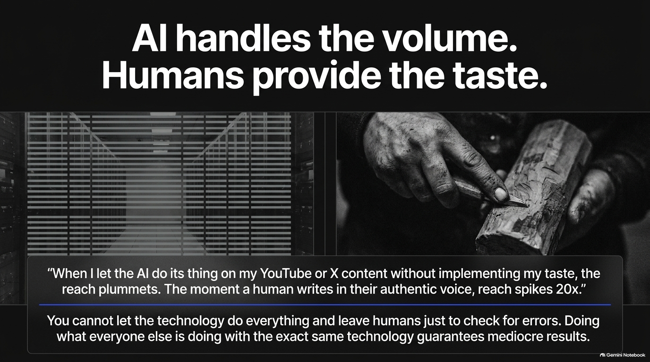
Notes:
Estimated Speaking Time: 5 minutes
Key Talking Points
Automated Lead Identification: AI agents scanning social graphs (LinkedIn, X) to identify ICPs interacting with competitor content.
Hyper-Personalized Outreach Drafts: Agents drafting custom DMs and email angles tailored to specific account behaviors.
Drastic Cost Reductions: Executing complex, multi-touch ABM scans across 100k+ profiles for a fraction of traditional software costs ($15–$25).
Speaker Script
"AEO isn't just passive inbound—it enables aggressive, autonomous outbound marketing.
Eric Siu shared a workflow where he configured a custom agent prompt on Grokbot: 'Identify any ICP-fit decision-makers who interact with our top competitors' posts or ads on LinkedIn and X.'
Within days, the agent identified key decision-makers, analyzed their engagement history, drafted tailored outreach angles, and presented one-click execution options.
Even more remarkably, scanning a database or social graph of over 100,000 followers to extract target CMOs used to cost thousands of dollars in manual data scrubbing. Today, agentic workflows execute this in minutes for under $20. This level of speed and precision gives agile teams an undeniable advantage over traditional outreach methods."

Slide 7
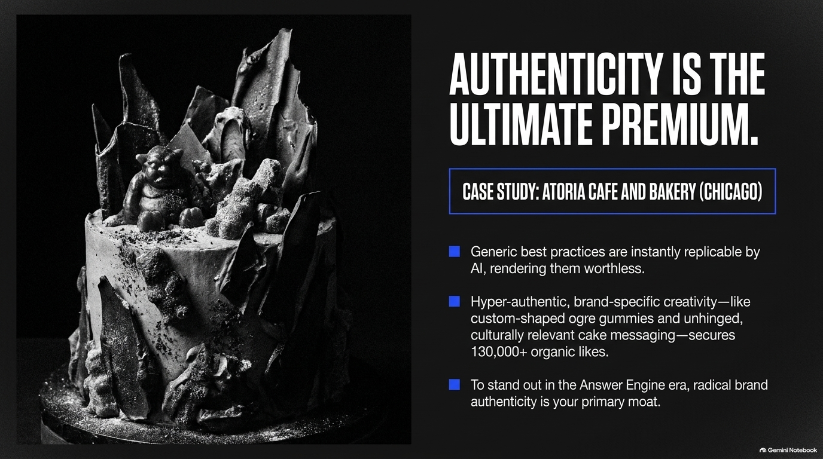
Notes:
Estimated Speaking Time: 6 minutes
Key Talking Points
The Pitfalls of Over-Automation: Extreme headcount reduction and total reliance on AI tools leads to uninspired, generic content and client churn.
Human-in-the-Loop (HITL) Necessity: Why human taste, strategic direction, and editorial oversight are non-negotiable for high-performing campaigns.
Elevating Capabilities: Shifting team focus from low-level manual execution to high-level strategic reasoning and creative direction.
Speaker Script
"There is a dangerous myth floating around the industry right now: the idea that you can replace 80% of your human staff with unvetted AI scripts and achieve better results.
Neil and Eric shared cautionary tales of marketing agencies that slashed staff from 30 down to 8, claiming 'AI does all our campaign execution now.' The result? High client churn, cookie-cutter ad creative, and loss of major accounts.
AI is not about eliminating human talent—it is about elevating human capability. When you remove human taste, strategic nuances, and editorial judgment from YouTube thumbnails, copy, or ad creative, user engagement plummets.
The winning approach is Human-in-the-Loop. Use AI for baseline generation, data synthesis, and rapid iteration, but rely on human leaders for judgment, brand voice, and strategic control."

Slide 8
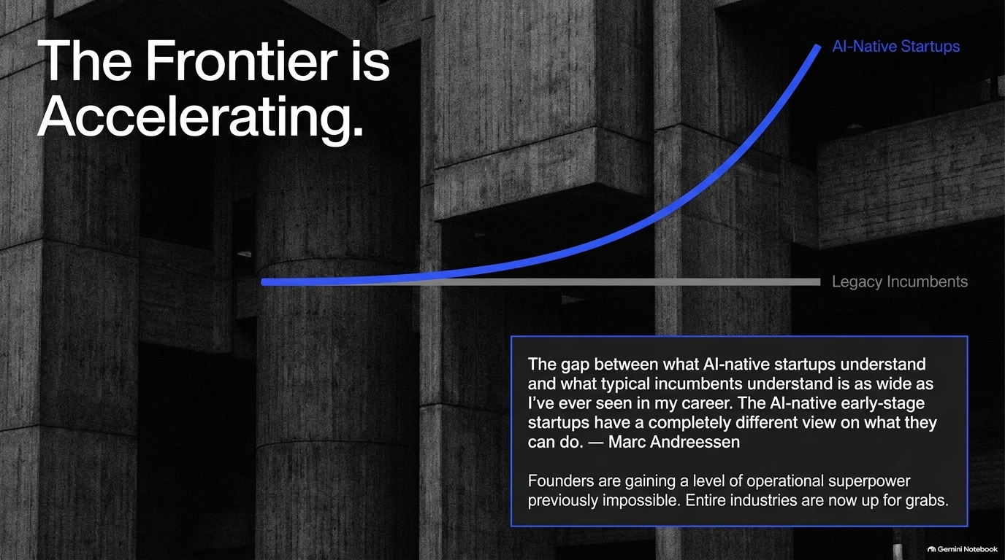
Notes:
Estimated Speaking Time: 4 minutes
Key Talking Points
The Vanity Trap: High view counts (e.g., millions of generic social views) often fail to generate actual bottom-line revenue.
AI Feedback Bias: AI algorithms often push creators toward viral, broad-appeal content rather than targeted B2B conversion content.
Focusing on ICP Revenue: Aligning content creation strictly with purchase intent rather than empty reach metrics.
Speaker Script
"When leveraging AI tools to generate content strategies, you must beware of algorithm bias.
Neil Patel pointed out that AI analytics recommended he produce generic 'clone videos' comparing 'Good vs. Bad CMOs' because they generated 11 million views. But when analyzed through a revenue lens, those 11 million viral views generated $0 in enterprise revenue.
If your AI engines push you toward generic viral content, your team wastes valuable time producing content that doesn't appeal to your actual buyer.
As leaders and marketers, our goal is not to become Tony Robbins or Gary Vaynerchuk in terms of broad brand reach—our goal is to drive bottom-line revenue from our specific Ideal Customer Profile. Never trade brand clarity and conversion focus for empty vanity metrics."

Slide 9
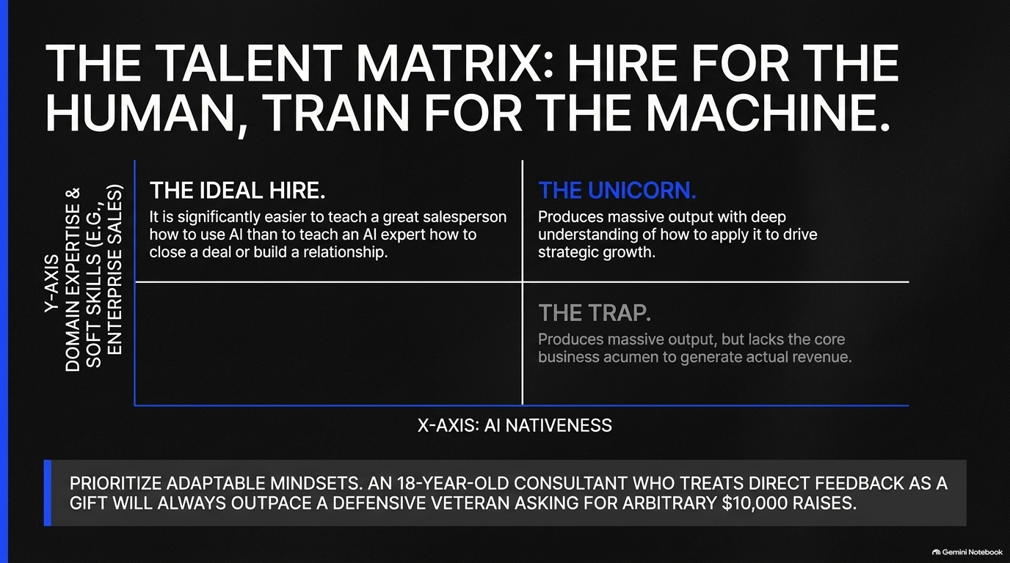
Notes:
Estimated Speaking Time: 4 minutes
Key Talking Points
The Value Disconnect: Agencies charging premium fees based on manual labor versus delivering tangible ROI.
Growth Mindset in Feedback: Cultivating talent that views direct feedback as a learning gift rather than taking a defensive posture.
Aligning Business Incentives: Ensuring external vendors and internal teams align their incentives with measurable business growth.
Speaker Script
"To execute an Answer Engine playbook, you must align your organizational culture and vendor relationships.
On Slide 9, we address vendor and employee alignment. Eric Siu highlighted two contrasting agency mindsets: An 18-year-old consultant who receives direct feedback on low lead conversions, stays humble, and continuously adapts his strategy; compared to an established agency that gets defensive, cites 'effort and brand value,' but fails to move the needle on revenue.
As a client or leader, you pay for outcomes, not excuses or manual hours. In the era of AI-driven efficiency, defensive service providers who rely on legacy billing models will fail. You need agile, feedback-hungry partners who pivot quickly based on real market feedback."

Slide 10
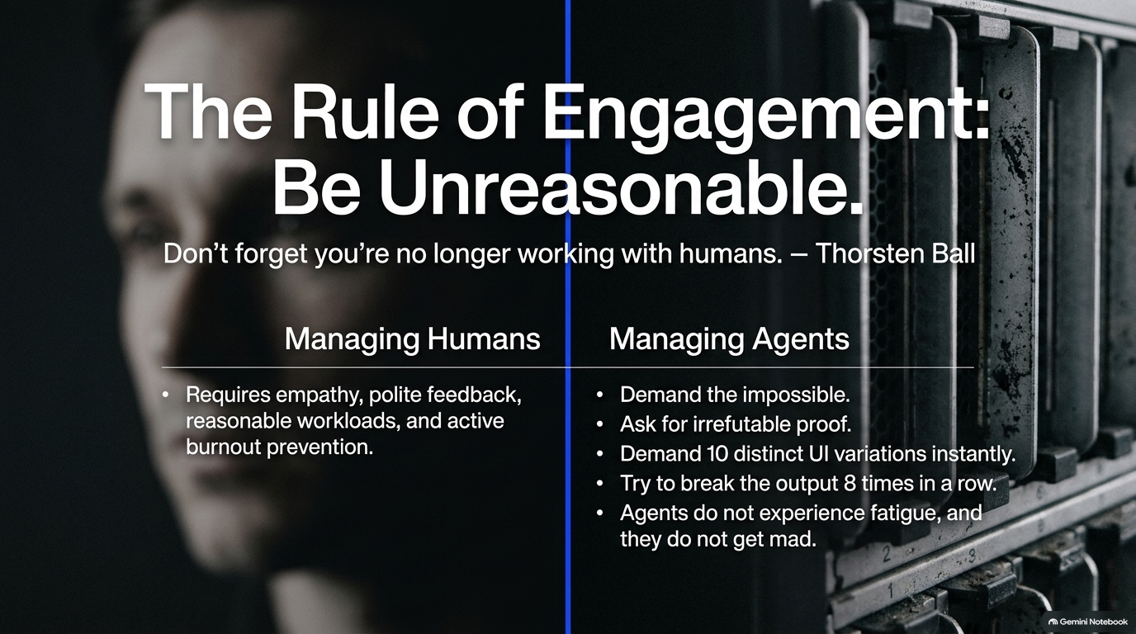
Notes:
Estimated Speaking Time: 4 minutes
Key Talking Points
The Career Pivot: Recognizing when to pivot from a low-margin, high-friction boutique agency to joining high-growth AI organizations.
Upskilling Existing Talent: Hiring for core soft skills (e.g., enterprise sales, strategic thinking) and training team members on AI tools.
The Widening Capability Gap: The growing divide between AI-native professionals and traditional legacy workers.
Speaker Script
"How does the AI revolution impact career trajectories and talent acquisition?
Neil Patel recounted meeting agency founders earning less than $5,000 a month despite generating $1M in revenue, simply because they lacked systems and scale. In today's market, talented specialists—like top-tier video editors, copywriters, or growth strategists—can often create far more enterprise value by bringing their skills into high-growth AI native companies.
When hiring for key roles like enterprise sales, don't demand that candidates be AI experts on day one. It is far easier to teach an exceptional salesperson how to use AI productivity tools than it is to teach an AI engineer how to build deep human trust and close multi-million-dollar contracts."

Slide 11
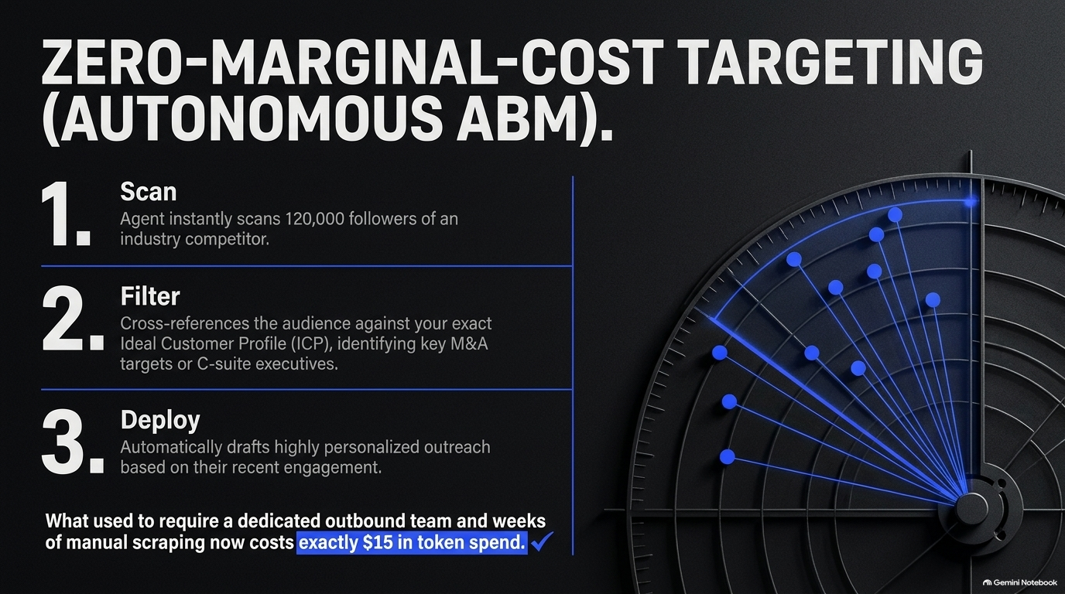
Notes:
Estimated Speaking Time: 5 minutes
Key Talking Points
Massive Infrastructure Investments: Major tech firms spending heavily on AI data center infrastructure (Capex).
The Jevons Paradox in AI Compute: As compute efficiency improves and token costs decline, global demand for AI power expands exponentially.
AI Ubiquity: AI intelligence embedding into every consumer touchpoint, from mobile devices to home appliances and physical robotics.
Speaker Script
"Let's zoom out to the macroeconomic landscape shaping Answer Engines.
Capital expenditure (Capex) in AI data centers is reaching unprecedented levels across Meta, Microsoft, Amazon, and Google. As highlighted in recent discussions, business leaders like Mark Zuckerberg and Big Tech CEOs recognize that in an AI-driven market, under-investing in compute capacity poses a far greater existential threat than over-investing.
We are seeing Jevons Paradox in action: As token costs decrease and inference speed increases, demand doesn't level off—it explodes. AI is embedding itself into every physical and digital surface, including smart home appliances, connected vehicles, and humanoid robotics.
Every item from your refrigerator to your enterprise CRM will run intelligent agents. Your digital presence must be optimized for machine readability across all these touchpoints."

Slide 12

Notes:
Estimated Speaking Time: 4 minutes
Key Talking Points
Forrester Prediction: AI agents are projected to influence or directly manage up to 75% of B2B buying decisions.
Automated Vendor Discovery: Enterprise buyers utilizing AI agents (e.g., Claude, Grok, Metamuse) to perform vendor evaluations, feature matrices, and price checks.
Machine-Readable Brand Footprints: The urgent need for structured data, clear API documentation, and transparent pricing models.
Speaker Script
"Consider this metric from Forrester: AI agents will influence or manage over 75% of all B2B purchasing decisions.
Think about how your enterprise buys software today. Instead of spending weeks filling out RFPs and sitting through sales pitches, B2B procurement teams deploy AI agents to ingest technical documentation, evaluate API capabilities, compare pricing, and benchmark user reviews across hundreds of vendors in minutes.
If your company hides its pricing, buries its product specifications behind gated PDFs, or lacks structured digital documentation, an evaluating AI agent will skip your brand entirely. To win in B2B marketing moving forward, your product data must be open, structured, and instantly readable by machine agents."

Slide 13
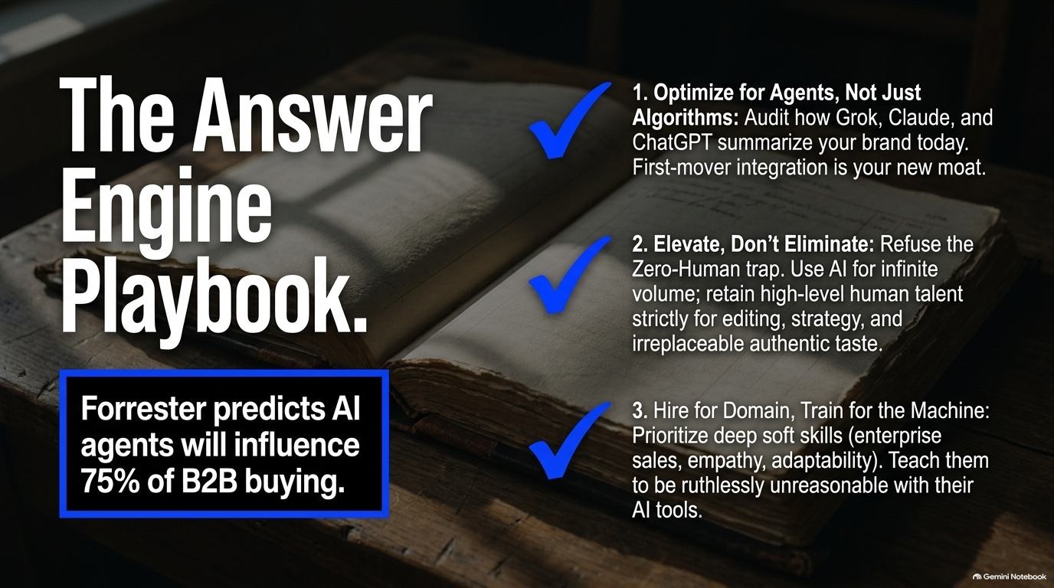
Notes:
Estimated Speaking Time: 5 minutes
Key Talking Points
Step 1: Entity & Schema Authority: Implementing comprehensive schema markups, structured data, and knowledge graph integrations.
Step 2: Unbiased Third-Party Presence: Optimizing brand presence across digital channels, review platforms, and industry publications where AI models collect training data.
Step 3: Direct API & Agent Connectors: Building direct integrations, plugins, and custom agents for ecosystems like Grok, ChatGPT, and Claude.
Speaker Script
"How do we take these insights and turn them into an actionable operational framework? Slide 13 outlines our three-step Answer Engine Playbook:
Establish Schema & Entity Authority: Ensure your website and digital assets use structured data formats (JSON-LD, microdata) that explicitly define your entity relationships, product offerings, and value propositions.
DOMINATE Third-Party Knowledge Sources: LLMs do not rely solely on your official website—they cross-reference third-party platforms, forums, social media, and review sites. If your brand lacks consistent positive mentions across these environments, answer engines will pass you over.
Deploy Native Agent Connectors: Make your product catalog, booking engines, and pricing databases directly accessible via open APIs and LLM plugins. Enable AI agents to complete actions and bookings directly on behalf of users."

Slide 14
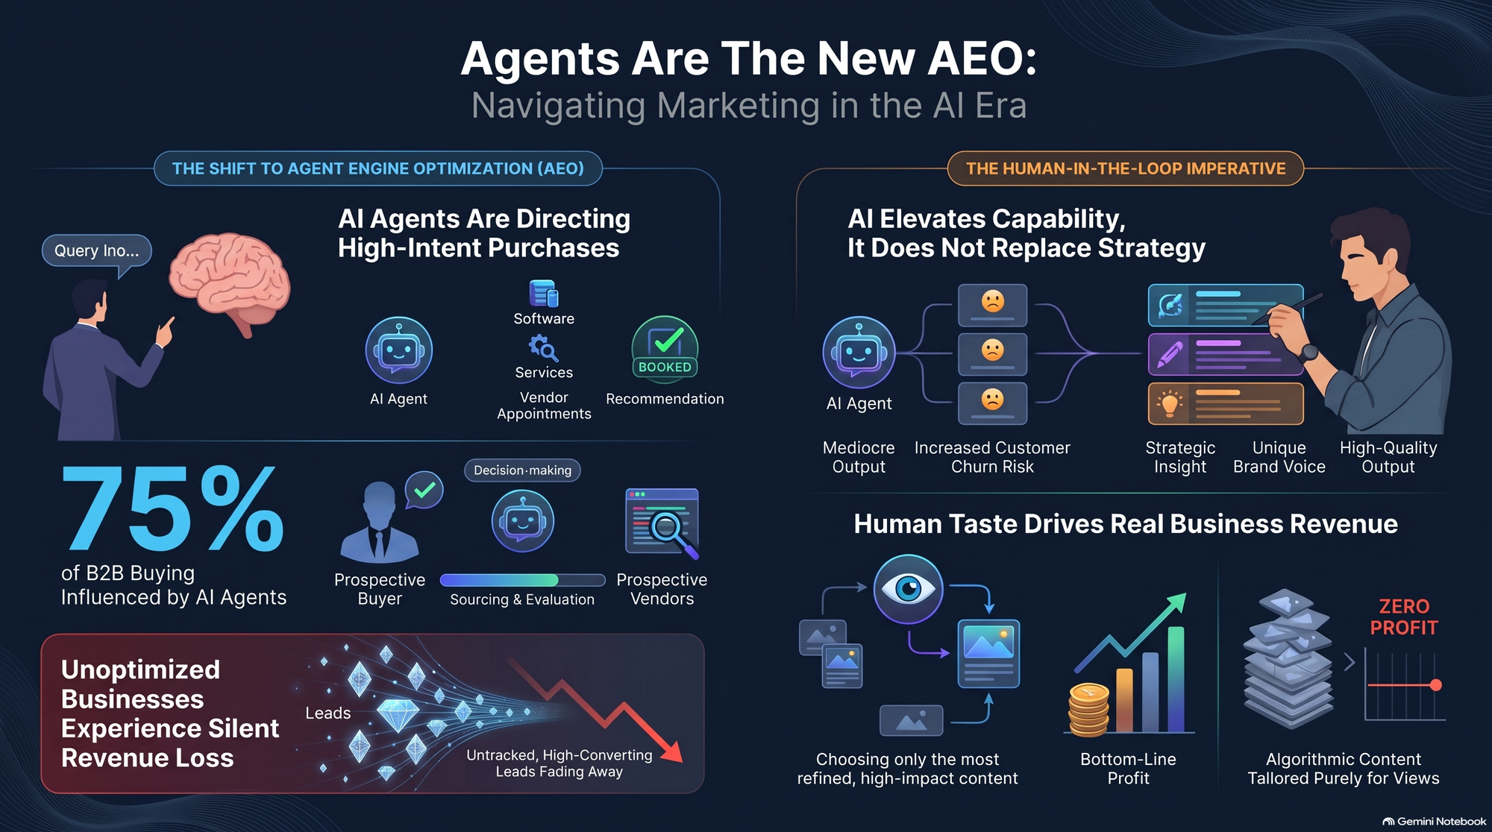
Notes:
Estimated Speaking Time: 3 minutes
Key Talking Points
Summary of Core Takeaways: Answer Engines represent a fundamental shift in how consumers and businesses discover, evaluate, and buy.
The Immediate Imperative: Moving from traditional keyword-centric SEO to conversational, agentic AEO/GEO strategies.
Final Q&A & Action Steps: Inviting organizational alignment and opening the floor for immediate discussion.
Speaker Script
"To wrap up our playbook today:
The transition from Search Engine Optimization to Answer Engine Optimization is not a trend—it is a permanent shift in how decision-makers find solutions.
Understand the Risk of Invisibility: If you aren't recommended by AI answer engines, you lose customer demand before traditional discovery even begins.
Elevate Your Team: Empower your talent with human-in-the-loop AI workflows to scale capacity without sacrificing quality or judgment.
Optimize for Machine Readability: Structure your data, dominate third-party knowledge bases, and integrate direct agent connectors.
Thank you for your time today. Let's open the floor to questions and discuss how we can apply these steps to our upcoming strategy."

