Slide 1
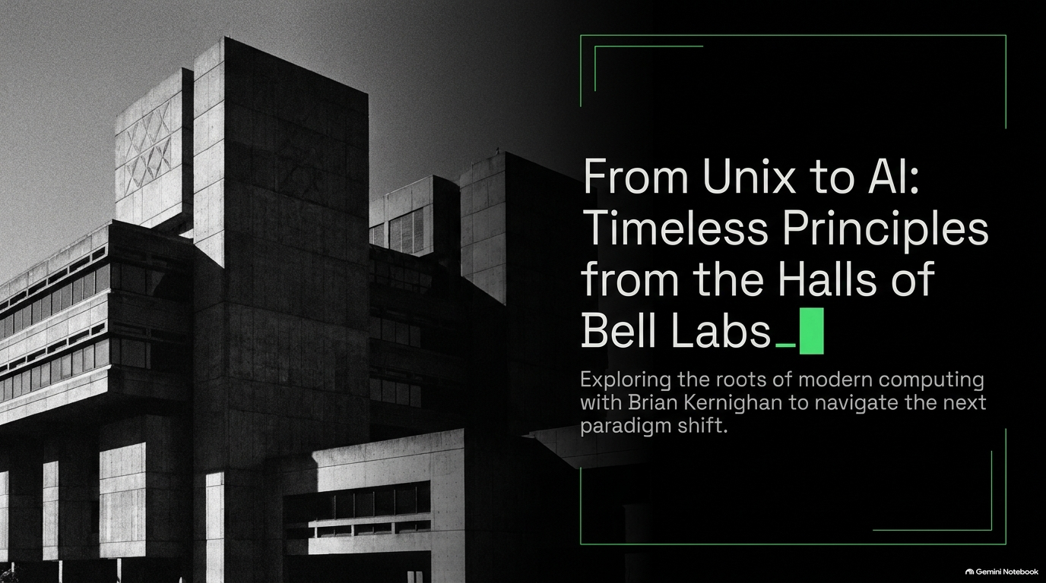
Notes:
Estimated Speaking Time: 2–3 minutes
Key Talking Points:
Welcome the audience and establish the central thesis of the presentation: tracing how the foundational engineering principles born during the golden age of Bell Labs can help us navigate today's massive AI-driven paradigm shift.
Introduce Brian Kernighan—co-author of the original C programming language book (K&R), legendary Member of Technical Staff (MTS) at Bell Labs for over thirty years, and the creator who popularized "Hello, World!".
Emphasize that while technologies change rapidly from Unix to Large Language Models (LLMs), human culture, curiosity, and the fundamentals of problem-solving remain remarkably constant.
Brian Kernighan (Ex-Bell Labs MTS): Inside Bell Labs, The Best Programmer, Why C Won
https://www.youtube.com/watch?v=sMllOlxVgD0

Slide 2
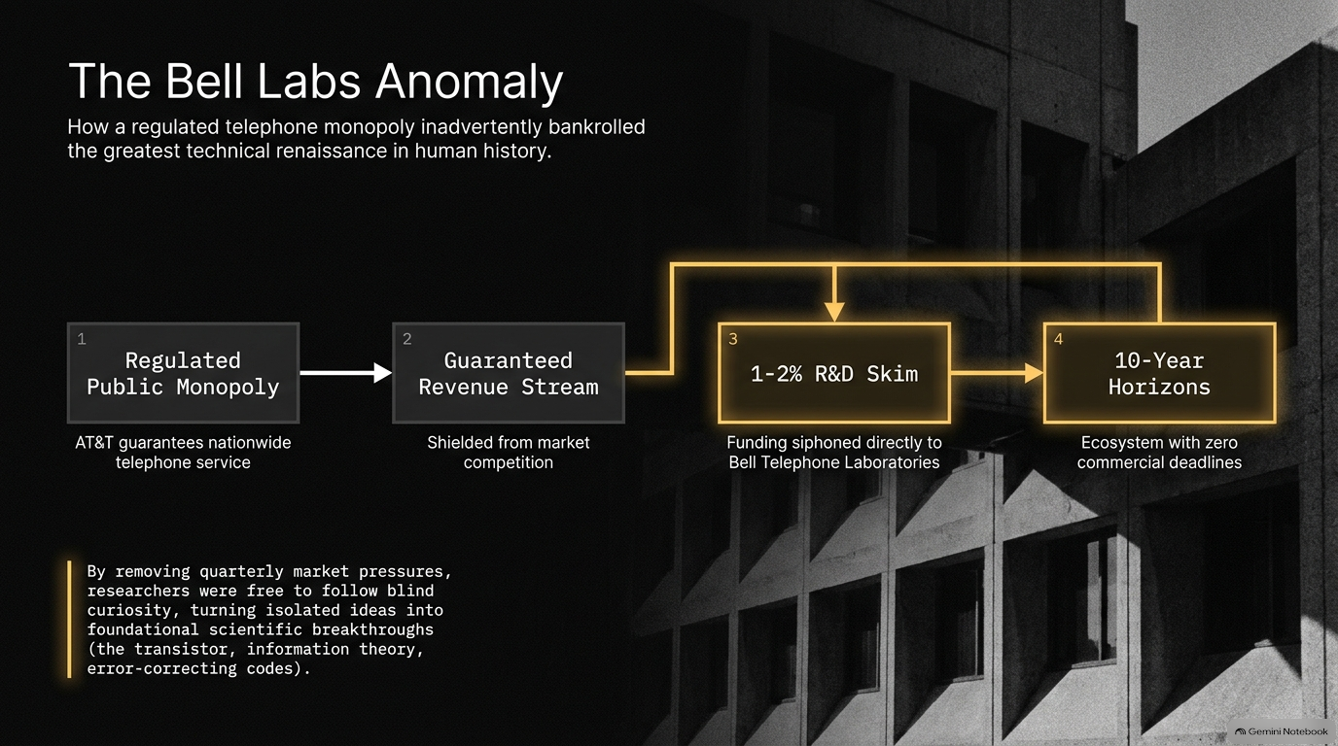

Slide 3
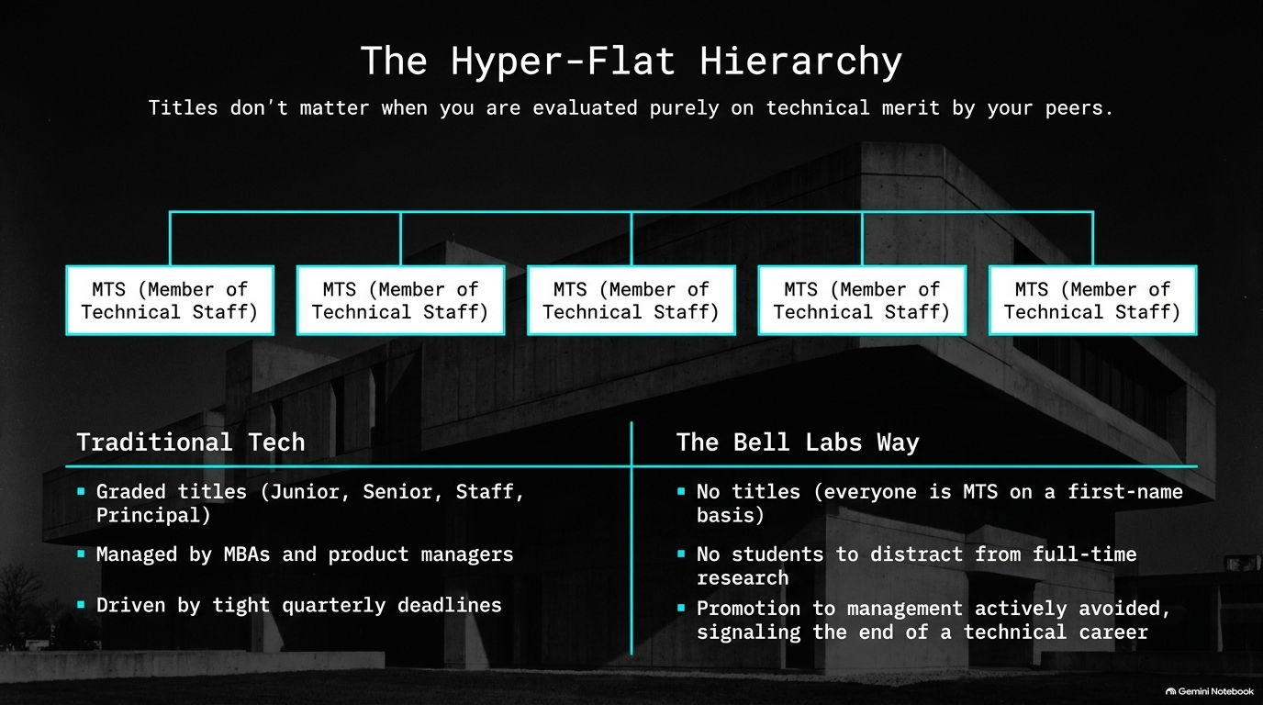
Notes:
Estimated Speaking Time: 3–4 minutes
Key Talking Points:
Traditional Tech vs. Bell Labs: Contrast traditional corporate tech structures—laden with graded titles (Junior, Senior, Staff) and driven by tight quarterly deadlines managed by product managers and MBAs—with the Bell Labs model.
The MTS Standard: At Bell Labs, everyone was technically a "Member of Technical Staff" on a first-name basis. There were no academic or corporate titles floating around.
Zero Distractions: Unlike university professors, researchers had no students to look after, allowing them to focus entirely on full-time research alongside world-class peers.
Avoiding Management: Promotion to management was frequently avoided because it signaled the end of a hands-on technical career that researchers genuinely loved.

Slide 4
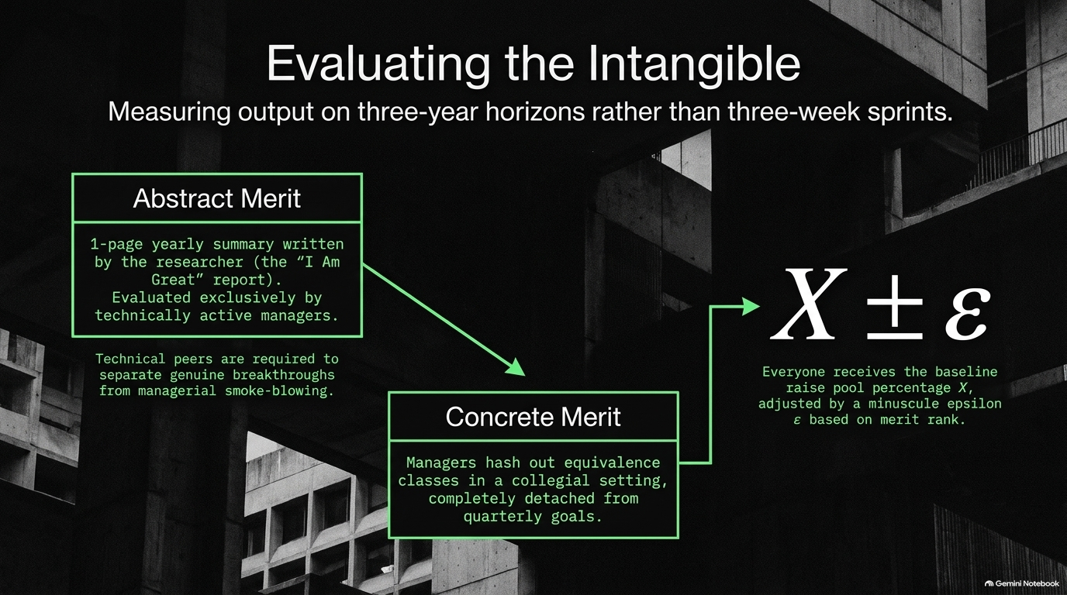
Notes:
Estimated Speaking Time: 4–5 minutes
Key Talking Points:
Abstract Merit ("I Am Great" Report): Accountability was radically lightweight. Once a year, researchers summarized their work on just one side of a single piece of paper.
Peer-Driven Review: These reports were reviewed exclusively by technically active managers and peers who understood the underlying domain well enough to separate genuine breakthroughs from managerial smoke-blowing.
Concrete Merit: Managers hashed out equivalence classes in a collegial setting, completely detached from quarterly metrics.
The Reward Structure: Everyone received the baseline raise pool percentage $X$, adjusted by a minuscule epsilon $\varepsilon$ based purely on peer-reviewed merit ranking.

Slide 5
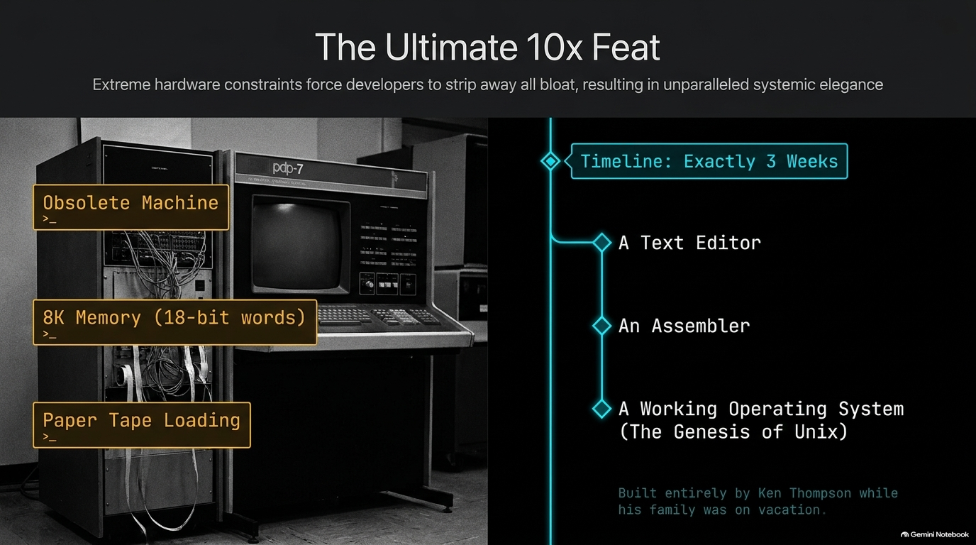
Notes:
Estimated Speaking Time: 4–6 minutes
Key Talking Points:
Severe Hardware Limits: Ken Thompson worked on an obsolete PDP-7 machine featuring a tiny 8KB memory (18-bit words) and paper tape loading.
The Three-Week Miracle: While his family was away in California for three weeks, Thompson built an entire operating environment completely by himself.
What He Built: In just 21 days, he created a text editor, an assembler, and a working operating system—the absolute genesis of Unix.
The Lesson: Extreme hardware constraints forced developers to strip away all bloat, resulting in unparalleled systemic elegance born from pure individual focus.

Slide 6
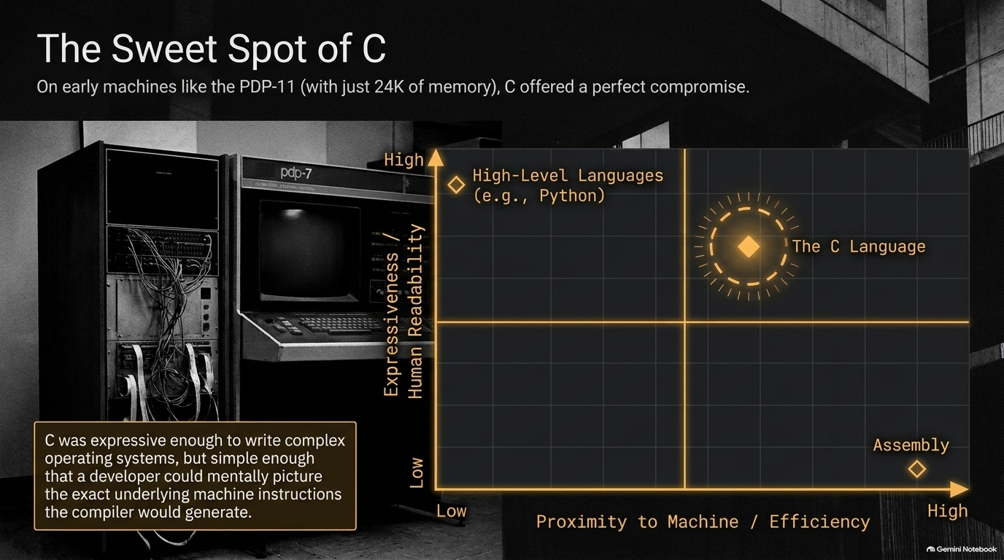
Notes:
Estimated Speaking Time: 3–5 minutes
Key Talking Points:
Navigating the Design Space: Early machines like the PDP-11 had a mere 24KB of memory, forcing engineers to find a delicate balance between machine efficiency and human expressiveness.
The C Language Compromise: C was high-level enough to write complex operating systems and express sophisticated logic, yet simple enough that a developer could mentally picture the exact underlying machine instructions the compiler would generate.
Comparing Paradigms: High-level languages like Python sit high on human readability but lower on bare-metal proximity; assembly sits at maximum machine proximity with low readability. C hit the absolute sweet spot.

Slide 7
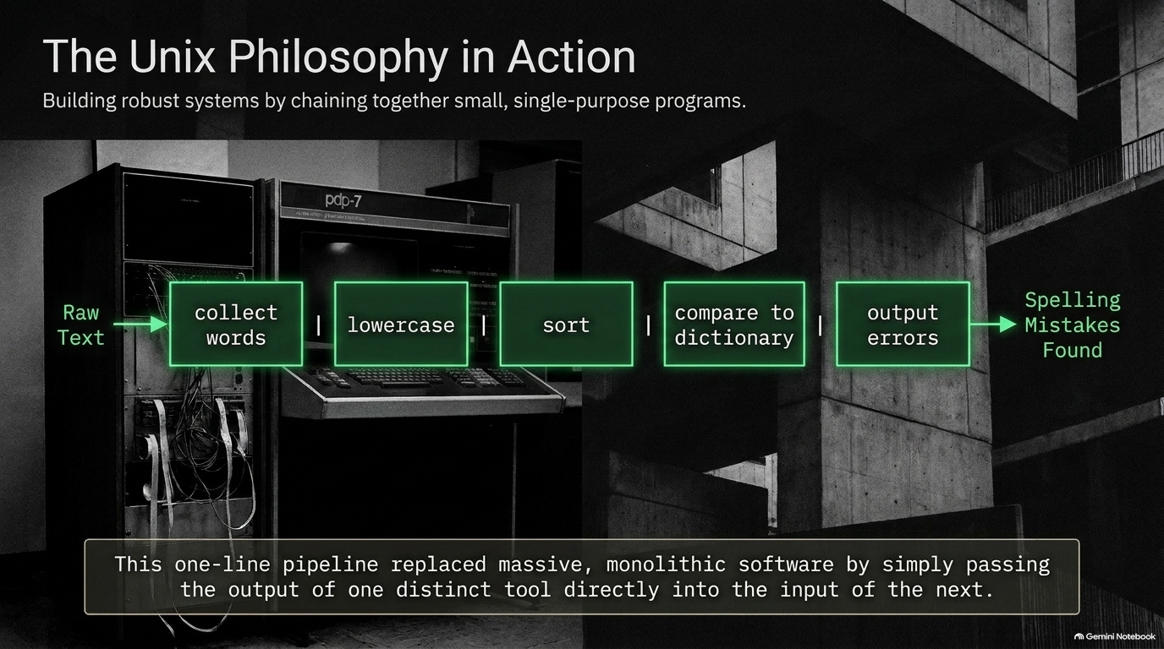
Notes:
Estimated Speaking Time: 3–4 minutes
Key Talking Points:
Modular Design: Instead of building monolithic software packages that tried to do everything, Unix championed small, single-purpose programs.
Pipeline Composition: Illustrated by the classic spelling-checker example: raw text $\rightarrow$ collect words $\rightarrow$ lowercase $\rightarrow$ sort $\rightarrow$ compare to dictionary $\rightarrow$ output errors.
The Power of Pipes: By simply passing the output of one distinct tool directly into the input of the next via a one-line pipeline, developers could solve complex tasks robustly and efficiently.

Slide 8
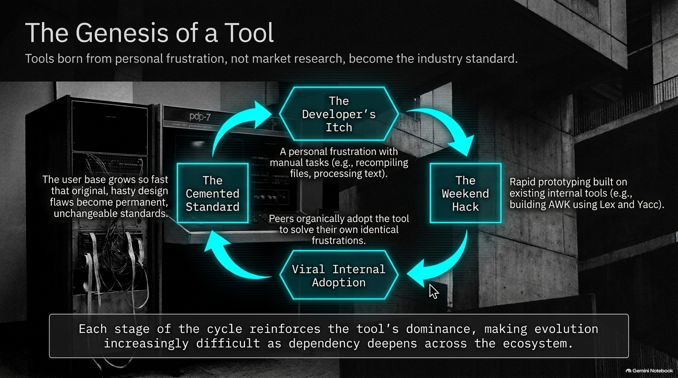
Notes:
Estimated Speaking Time: 3–4 minutes
Key Talking Points:
The Developer's Itch: Great tools are almost never born from market research; they stem from personal frustration with manual tasks, file recompilation, or text processing.
The Weekend Hack: A developer builds a quick prototype over a weekend, often leveraging internal generator tools (such as building AWK using Lex and Yacc).
Viral Internal Adoption: Peers organically adopt the tool to solve their own identical frustrations.
The Cemented Standard: As the user base explodes, original hasty design flaws become permanent, unchangeable industry standards.

Slide 9
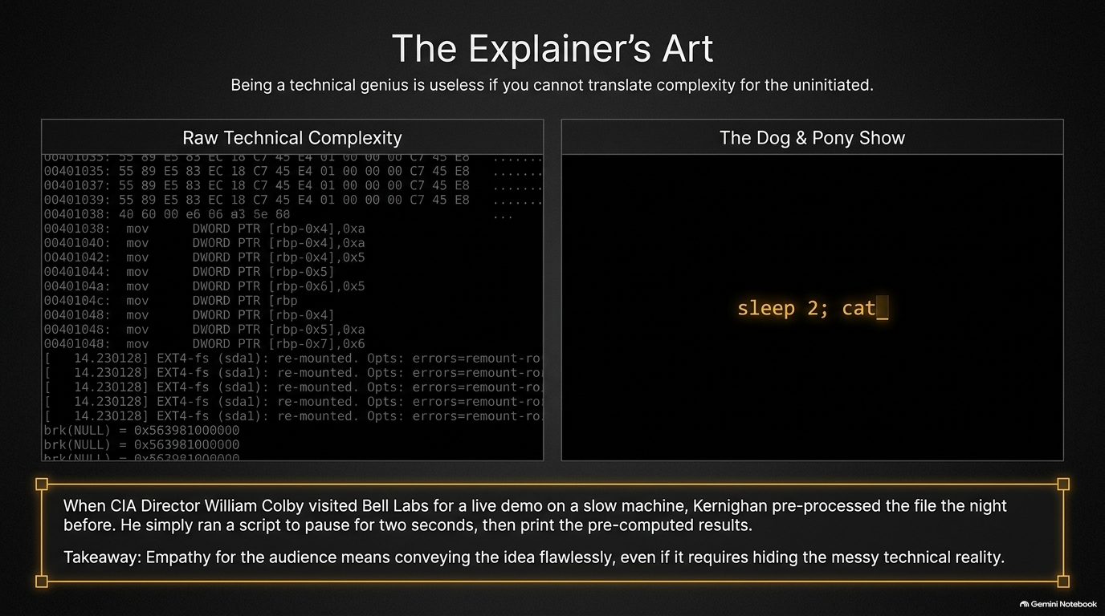
Notes:
Estimated Speaking Time: 3–4 minutes
Key Talking Points:
Translating Complexity: Being a technical genius is entirely useless if you cannot translate profound complexity for an uninitiated audience.
The CIA Director Visit: Kernighan recalls running a live demo for CIA Director William Colby on a notoriously slow machine.
Hiding the Messy Reality: To ensure a smooth demonstration, Kernighan pre-processed the file the night before, running a simple script (sleep 2; cat) to pause for two seconds before displaying the pre-computed results.
The Core Lesson: True empathy for your audience means conveying the idea flawlessly, even if it requires masking raw technical chaos behind the scenes.

Slide 10
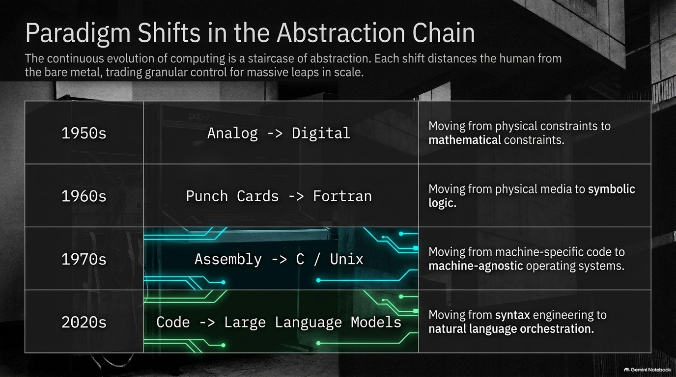
Notes:
Estimated Speaking Time: 4–5 minutes
Key Talking Points:
The Staircase of Abstraction: Computing evolution is a continuous staircase where each major shift distances humans from bare metal, trading granular control for massive leaps in scale.
Historical Transitions:
1950s: Analog to Digital (moving from physical to mathematical constraints).
1960s: Punch Cards to Fortran (moving from physical media to symbolic logic).
1970s: Assembly to C/Unix (moving from machine-specific code to machine-agnostic operating systems).
The Modern Era: 2020s: Code to Large Language Models (moving from syntax engineering to natural language orchestration).

Slide 11
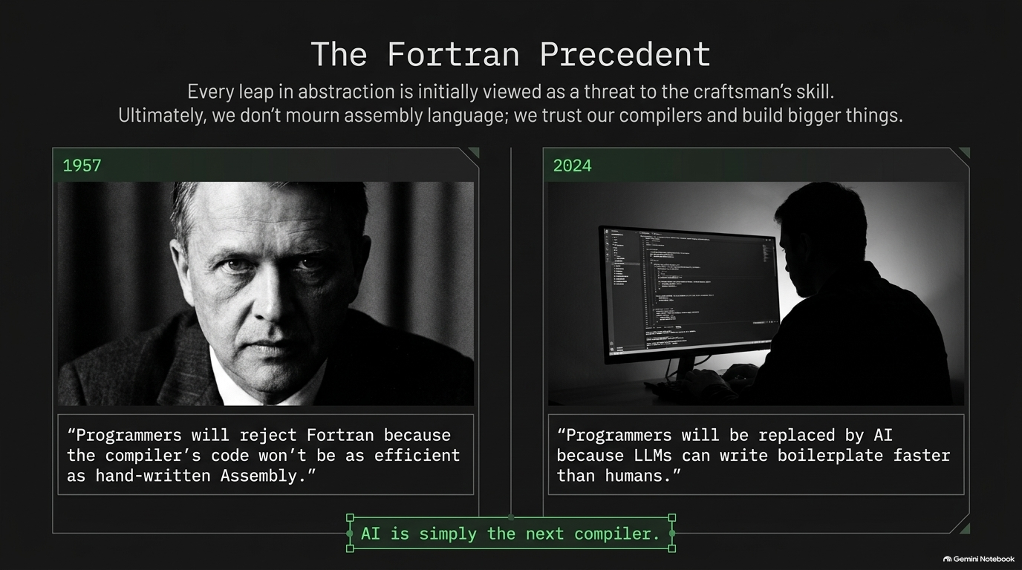
Notes:
Estimated Speaking Time: 3–4 minutes
Key Talking Points:
Historical Anxiety: In 1957, John Backus and his IBM team faced intense skepticism. Programmers feared that "Fortran would be rejected because the compiler's code wouldn't be as efficient as hand-written assembly".
Modern Parallels: In 2024–2026, critics voice a parallel fear: "Programmers will be replaced by AI because LLMs can write boilerplate faster than humans".
The Ultimate Takeaway: Every leap in abstraction is initially viewed as a threat to the craftsman's skill. Ultimately, we do not mourn assembly language; we trust our compilers and build vastly bigger things.

Slide 12
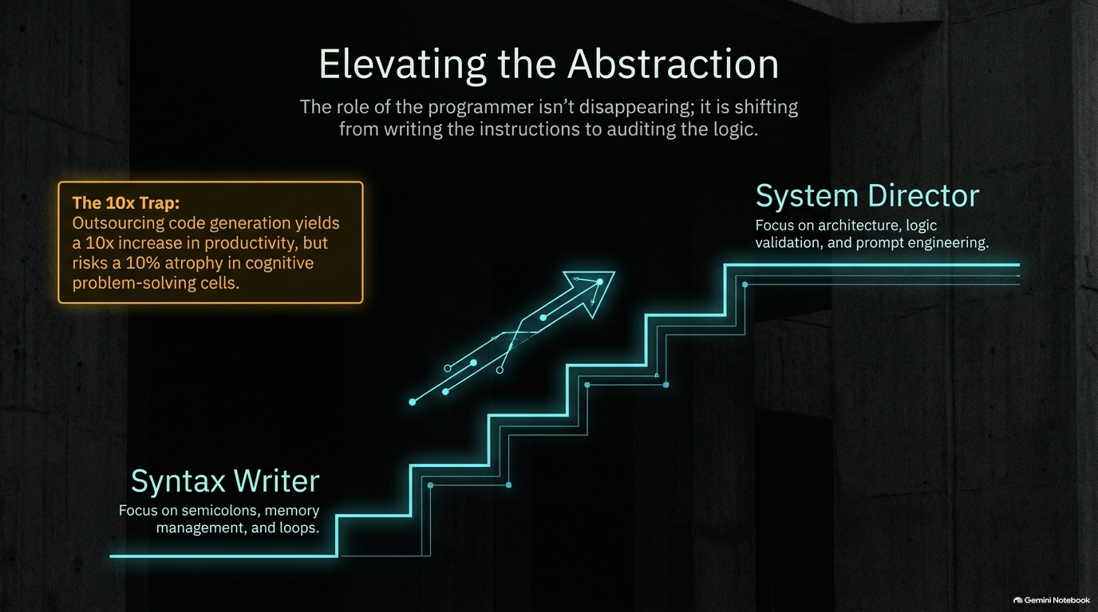
Notes:
Estimated Speaking Time: 3–5 minutes
Key Talking Points:
Role Transformation: The role of the programmer is not disappearing; it is shifting upward from writing low-level instructions to auditing high-level logic.
From Syntax Writer to System Director: Focus shifts away from semicolons, memory management, and loops toward architecture, logic validation, and prompt engineering.
The 10x Trap: While outsourcing code generation yields a massive 10x increase in raw productivity, it introduces the hidden risk of a 10% atrophy in cognitive problem-solving cells if builders stop exercising core mental muscles.

Slide 13
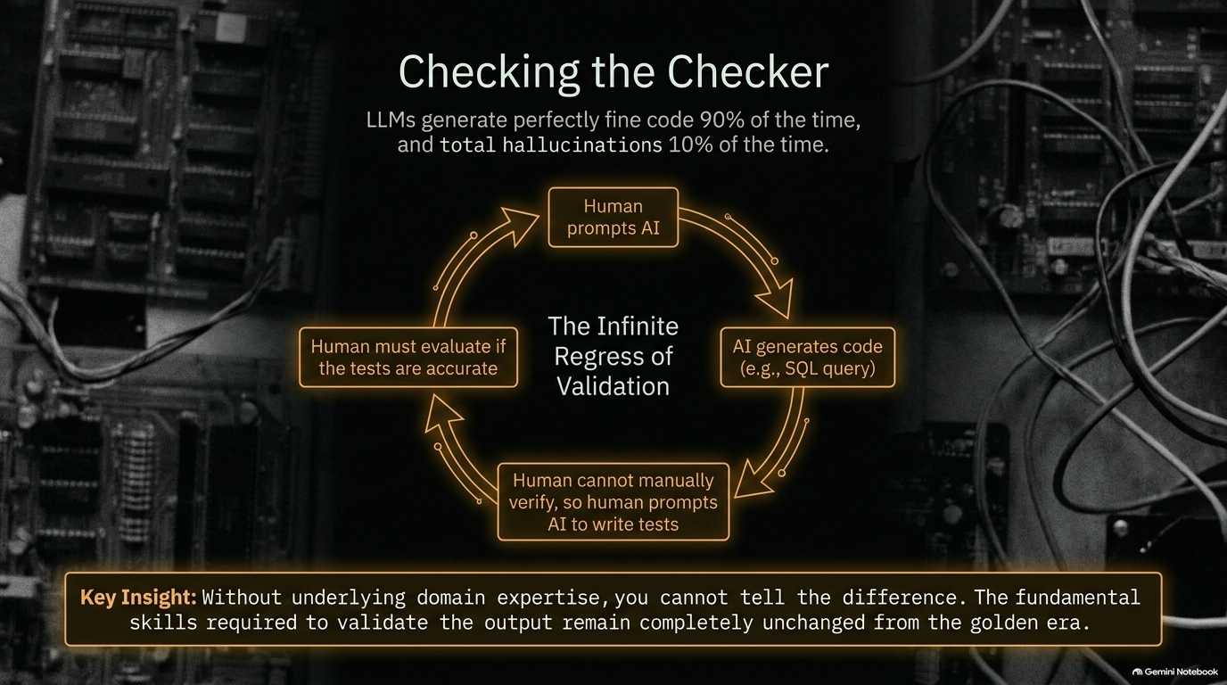
Notes:
Estimated Speaking Time: 4–5 minutes
Key Talking Points:
The Statistical Reality: LLMs generate perfectly functional code 90% of the time, but produce total hallucinations 10% of the time.
The Infinite Regress of Validation: When a human prompts AI to generate code, cannot manually verify it, and then prompts AI to write tests to check the code, a validation loop forms. Who checks the checker?
The Crucial Insight: Without underlying domain expertise, you cannot tell the difference between correct code and a hallucinated failure. The fundamental skills required to validate output remain completely unchanged from the golden era.

Slide 14
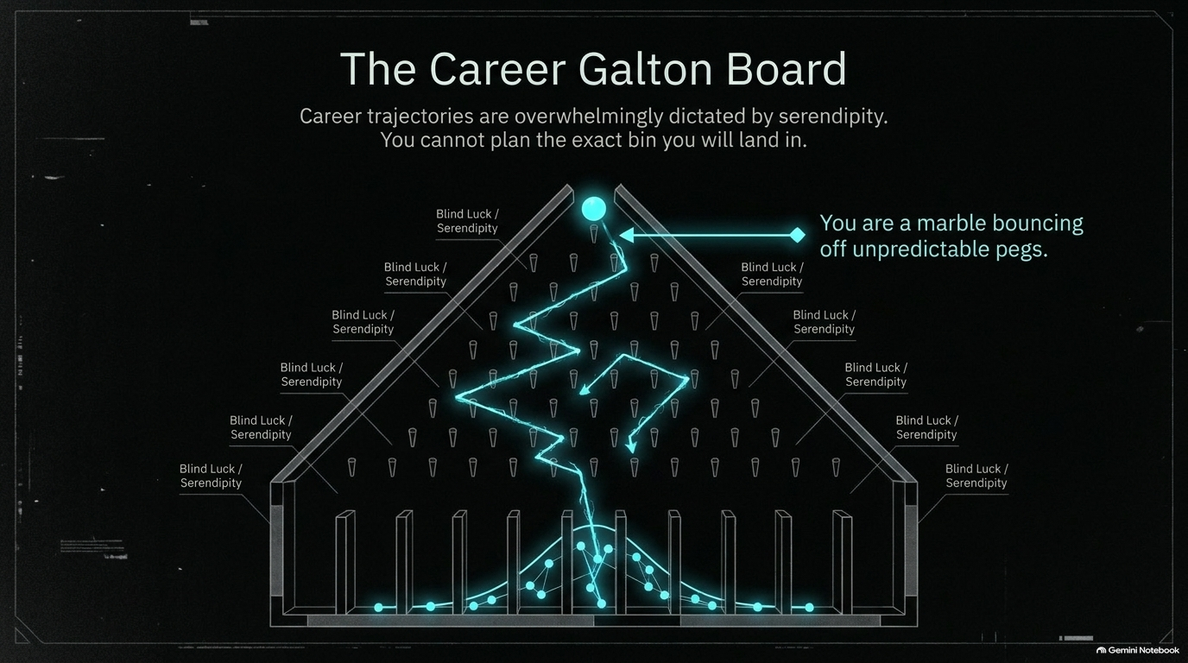
Notes:
Estimated Speaking Time: 3–4 minutes
Key Talking Points:
Embracing Serendipity: Career trajectories are overwhelmingly dictated by chance and circumstance rather than rigid master plans.
The Marble Metaphor: You are like a single marble dropped into the top of a Galton board, bouncing off unpredictable pegs of blind luck.
Unplannable Outcomes: You cannot blueprint the exact final bin you will land in; therefore, stressing over a rigid multi-decade career roadmap is counterproductive.

Slide 15
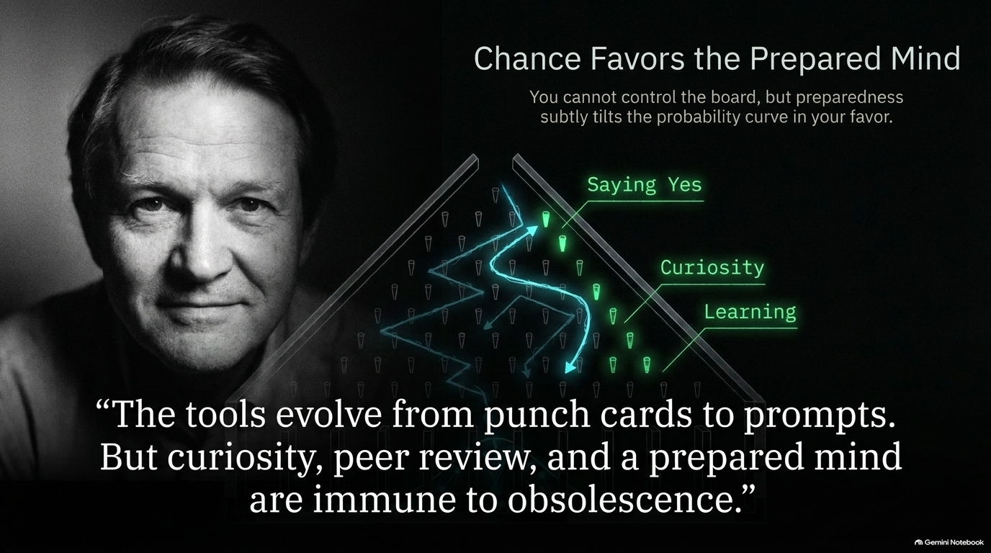
Notes:
Estimated Speaking Time: 3–5 minutes
Key Talking Points:
Tilting the Odds: While you cannot control the physical layout of the board, deep preparation subtly tilts the probability curve in your favor.
Core Pillars: Cultivate curiosity, embrace continuous learning, and practice saying "yes" to unexpected technical challenges.
Immunity to Obsolescence: Quoting the overarching philosophy: "The tools evolve from punch cards to prompts. But curiosity, peer review, and a prepared mind are immune to obsolescence".

Slide 16
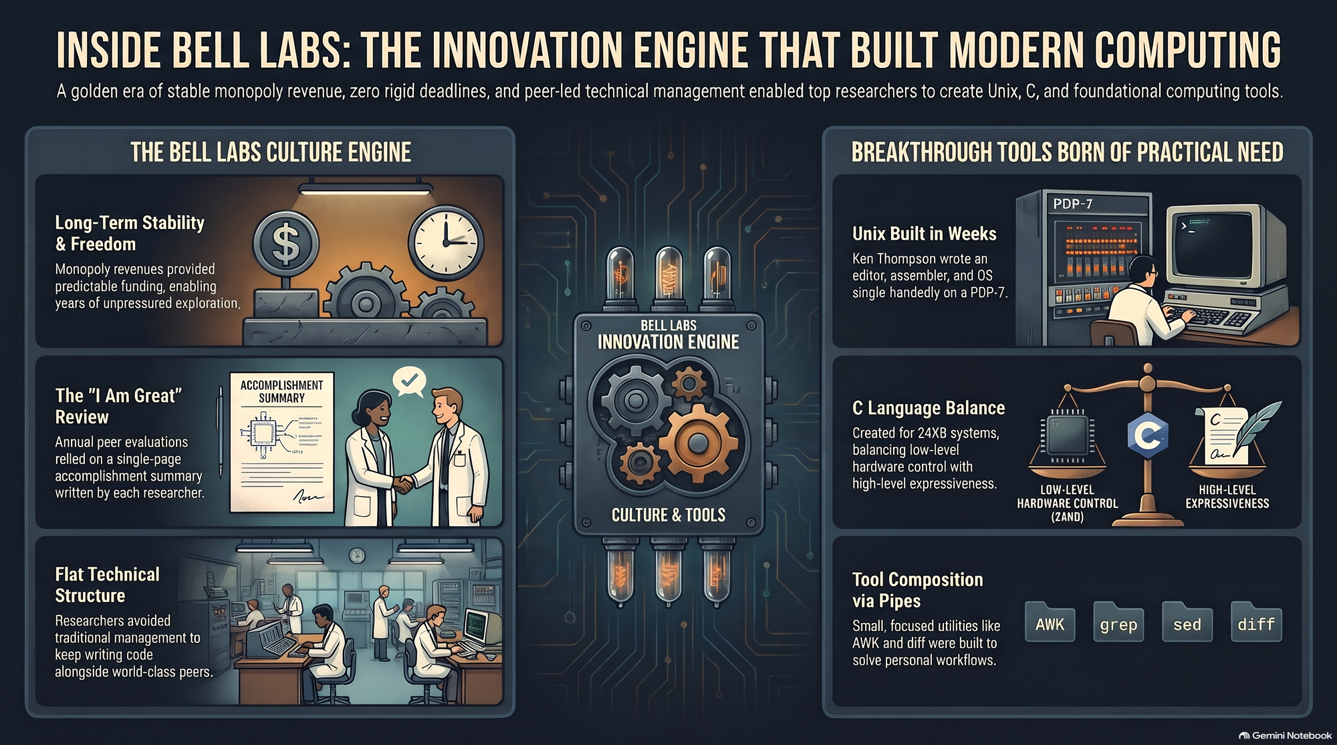
Notes:
Estimated Speaking Time: 3–5 minutes
Key Talking Points:
Comprehensive Summary Slide: Tie together the core pillars covered across the presentation deck.
The Culture Engine: Reiterate the power of long-term monopoly stability, lightweight peer evaluations (the "I Am Great" report), and flat technical structures that keep brilliant minds building code alongside peers.
Tooling Legacy: Remind the audience that breakthrough utilities—from Thompson's 3-week Unix build and C's hardware balance to modular pipe composition—were born from solving real personal frustrations.
Final Charge: Encourage the audience to carry these timeless principles forward into the age of artificial intelligence.

