Slide 1
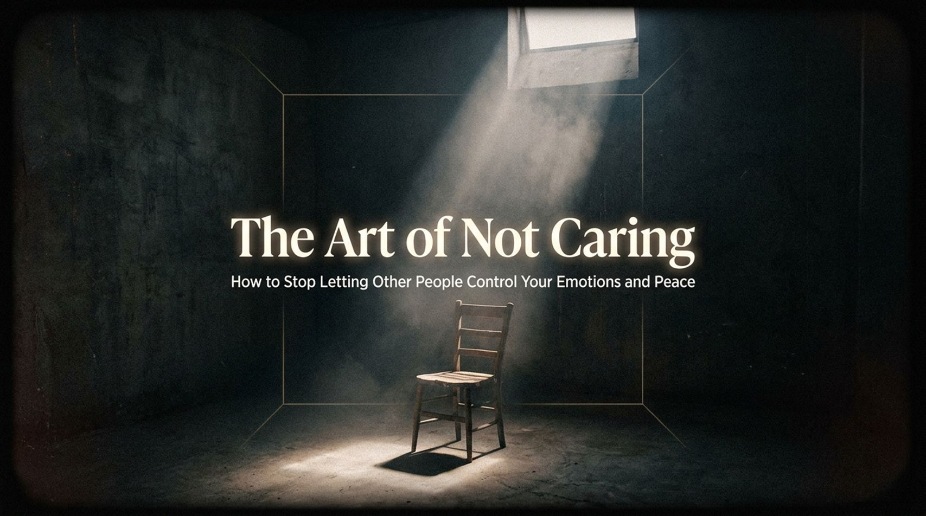
Notes:
Visual: Minimalist concrete room with a single chair illuminated by a beam of light from a high window.
Suggested Duration: 3 – 4 minutes.
Speaker Notes:
Opening Hook: Welcome, everyone. Right now, somewhere in your head, there is a courtroom. Someone said something to you—maybe a week ago, a month ago, or even fifteen years ago—and you are still in there. You are still presenting your case, still explaining yourself to a ghost who walked out of that building a long time ago and hasn't thought about you once.
The Exhaustion Epidemic: And you are so tired. Not the kind of tired that sleep can fix. You could sleep ten hours tonight and wake up carrying the exact same heavy weight. Why? Because this exhaustion isn't coming from your body; it’s coming from the second job you’ve worked unpaid for most of your life: managing what everybody else thinks of you.
Core Premise: Today, we are exploring The Art of Not Caring. This isn't about becoming a sociopath or building a brick wall. It is the precise discipline of knowing what deserves your peace, reclaiming your emotional autonomy, and stopping the endless drain of people-pleasing.
The Art of Not Caring How to Stop Letting Other People Control Your Emotions and Peace | Audiobook
https://www.youtube.com/watch?v=R3K3j0n4-6U

Slide 2
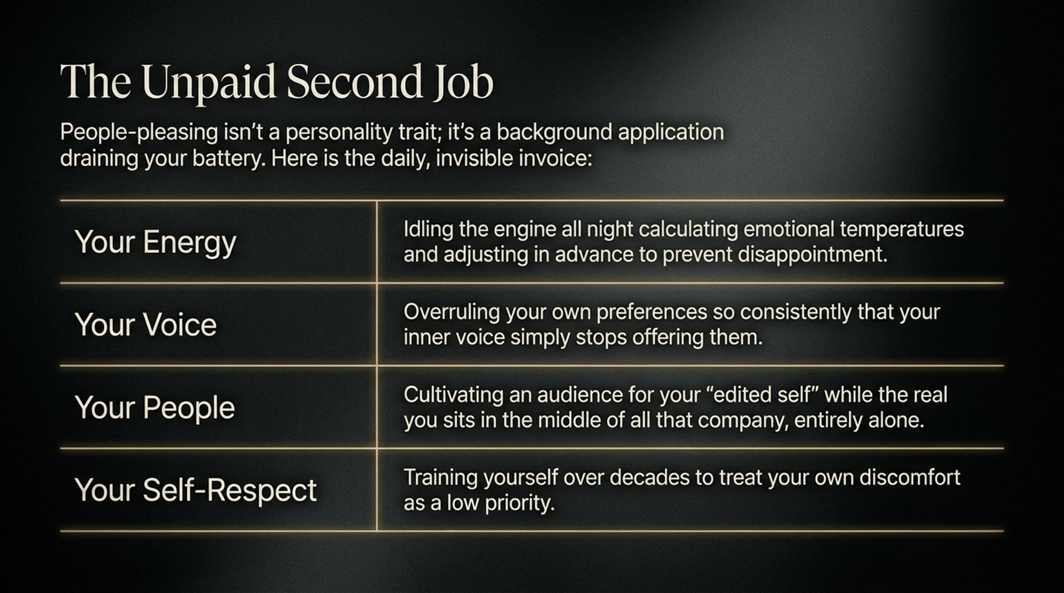
Notes:
Visual: A structured table detailing the invisible, daily costs of people-pleasing across Energy, Voice, People, and Self-Respect.
Suggested Duration: 4 – 5 minutes.
Speaker Notes:
Deconstructing People-Pleasing: People-pleasing isn't a cute personality quirk or an innate sign of kindness; it is a background application draining your battery dry. Let’s look at the daily, invisible invoice you are paying.
Energy & Voice: Look at your energy: you've been idling the engine all night, calculating emotional temperatures and adjusting in advance just to prevent disappointment. Look at your voice: you've overruled your own preferences so consistently that your inner voice has simply stopped offering them.
People & Self-Respect: You cultivate an audience for your "edited self" while the real you sits in the middle of all that company, entirely alone. Across decades, you've trained yourself to treat your own discomfort as a low priority, eroding your core self-respect.

Slide 3
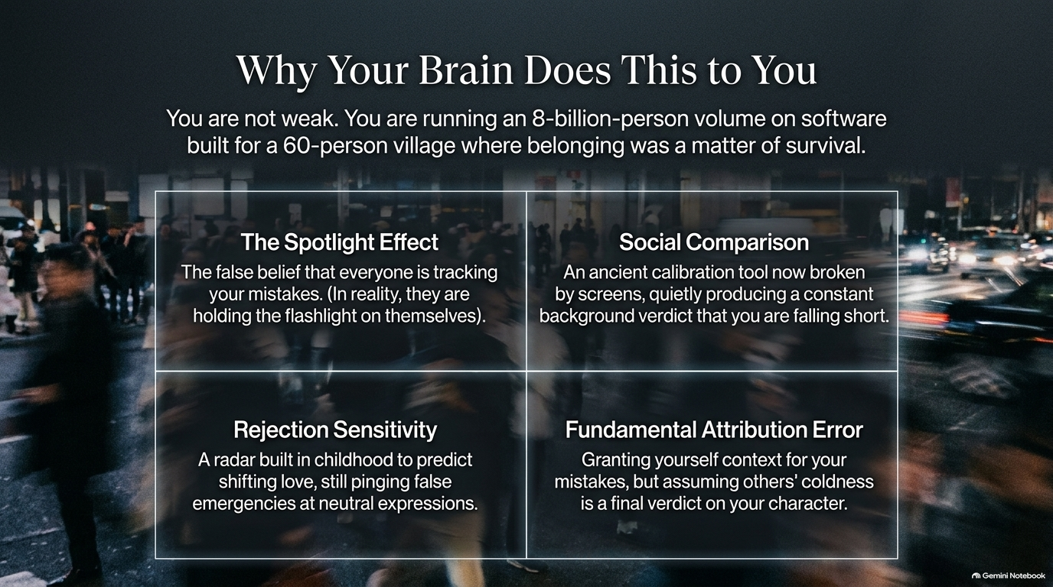
Notes:
Visual: A four-quadrant psychological grid covering the Spotlight Effect, Social Comparison, Rejection Sensitivity, and Fundamental Attribution Error.
Suggested Duration: 4 – 6 minutes.
Speaker Notes:
An Evolutionary Mismatch: You are not weak. You are running an 8-billion-person volume of social pressure on software that was built for a 60-person village where social exclusion meant literal death.
The Four Biases:
The Spotlight Effect: The false belief that everyone is tracking your every mistake, when in reality, they are holding the flashlight entirely on themselves.
Social Comparison: An ancient calibration tool now broken by digital screens, quietly producing a constant background verdict that you are falling short.
Rejection Sensitivity: A radar built in childhood to predict shifting love, still pinging false emergencies at neutral facial expressions.
Fundamental Attribution Error: Granting yourself endless context and grace for your mistakes, but viewing others' coldness as a permanent indictment of their character.

Slide 4
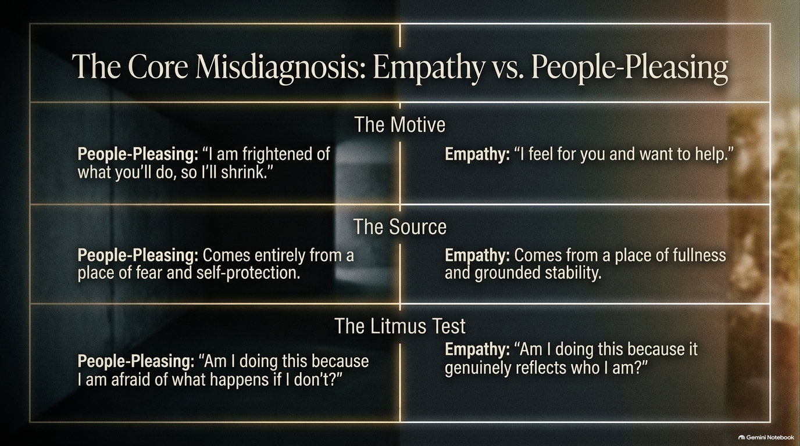
Notes:
Visual: A comparative matrix contrasting the motives, sources, and litmus tests of People-Pleasing versus True Empathy.
Suggested Duration: 4 – 5 minutes.
Speaker Notes:
Clearing the Confusion: We often confuse people-pleasing with empathy because society wraps the former in a moral virtue costume. But they come from entirely different universes.
The Motive and Source: People-pleasing says: "I am frightened of what you'll do, so I'll shrink." It comes entirely from a place of fear and self-protection. True empathy says: "I feel for you and want to help." It comes from a place of fullness, emotional stability, and grounded strength.
The Litmus Test: Ask yourself the ultimate test question: “Am I doing this because I am genuinely aligned, or because I am terrified of what happens if I don't?” If fear is the anchor, it's pleasing, not care.

Slide 5
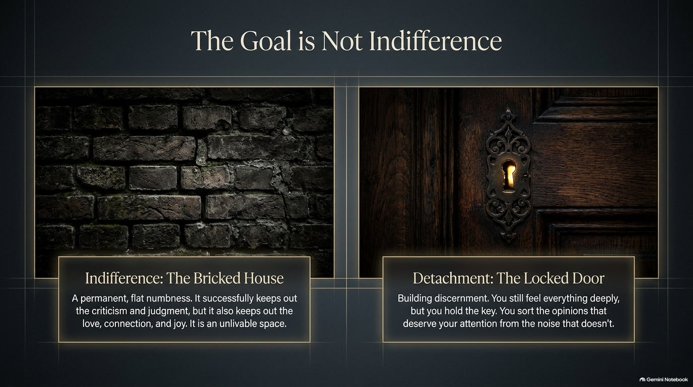
Notes:
Visual: A comparison between a cold, solid "Bricked House" (Indifference) and a warm wooden door with a glowing keyhole (Detachment).
Suggested Duration: 3 – 5 minutes.
Speaker Notes:
The Trap of Numbness: When people hear "stop caring," they think they need to turn into ice. That is Indifference—the Bricked House. A permanent, flat numbness that successfully keeps out criticism and judgment, but also locks out love, connection, and joy. It’s an unlivable space.
The Power of Detachment: The true goal is Detachment—represented by the locked door. You still feel everything deeply, but you hold the key. You build discernment, sorting the opinions and critiques that actually deserve your attention from the background noise that never did.

Slide 6
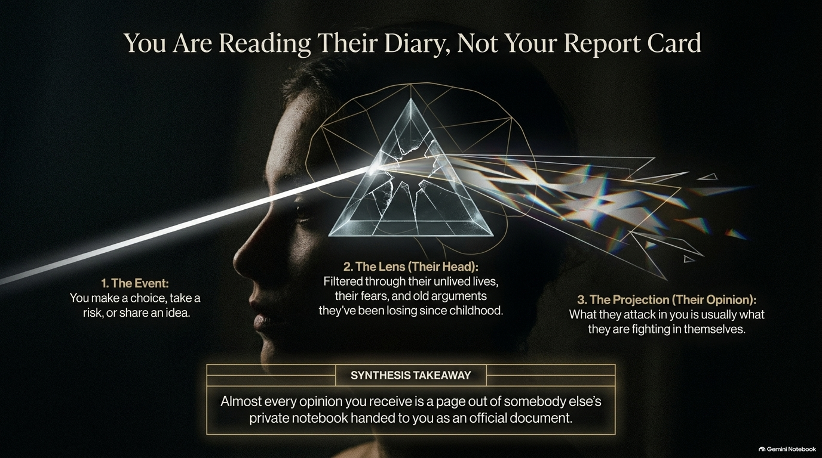
Notes:
Visual: A human silhouette profile with a light prism refracting thoughts through a shattered crystal lens.
Suggested Duration: 4 – 5 minutes.
Speaker Notes:
The Prism of Other People: When someone criticizes you or reacts with hostility, what is actually happening?
The Three Steps: Step 1: You make a choice, take a risk, or share an idea. Step 2: That expression passes through their head—filtered through their unlived lives, their personal fears, and old arguments they've been losing since childhood. Step 3: Their projection emerges. What they attack in you is almost always what they are fighting inside themselves.
The Synthesis: Almost every harsh opinion or toxic judgment you receive is simply a page out of somebody else’s private notebook handed to you as an official government document. Put it back down.

Slide 7
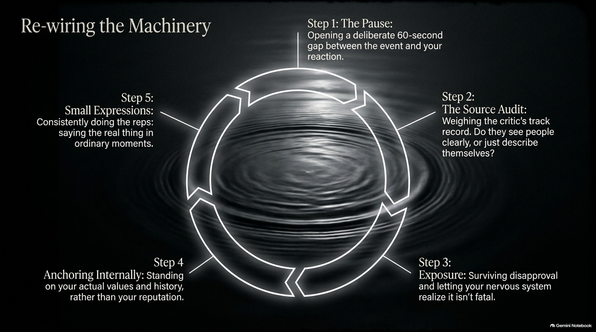
Notes:
Visual: A circular 5-step process diagram centered over calm, rippling water.
Suggested Duration: 4 – 6 minutes.
Speaker Notes:
The 5-Step Protocol: How do we practically re-wire this automatic reactivity?
Step 1: The Pause. Open a deliberate 60-second gap between an external event and your emotional reaction.
Step 2: The Source Audit. Weigh the critic’s track record. Are they seeing reality clearly, or just projecting their own damage?
Step 3: Exposure. Survive disapproval. Let your nervous system realize that someone being mad at you is uncomfortable, but not fatal.
Step 4: Anchoring Internally. Stand on your actual values and history rather than shifting public reputation.
Step 5: Small Expressions. Consistently do the reps by saying the real thing in ordinary, low-stakes moments.

Slide 8
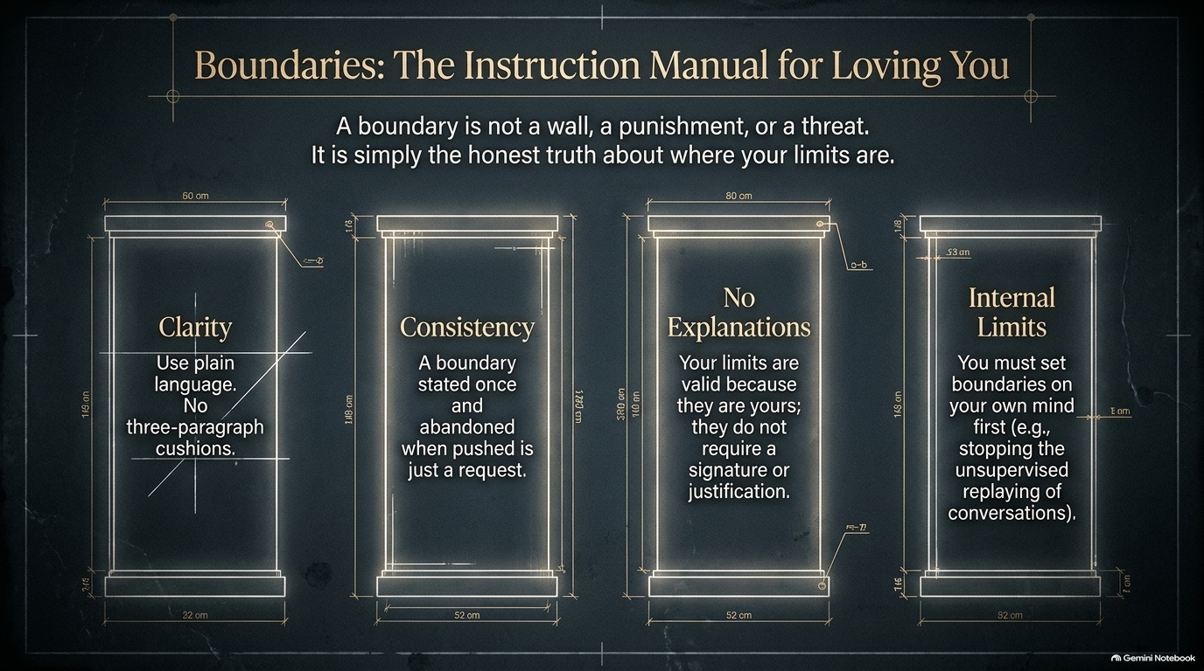
Notes:
Visual: Architectural blueprint drawings of four distinct structural pillars representing Clarity, Consistency, No Explanations, and Internal Limits.
Suggested Duration: 4 – 5 minutes.
Speaker Notes:
Defining a Boundary: A boundary is not a wall, a punishment, or a threat. It is simply the honest truth about where your limits are.
The Four Blueprints:
Clarity: Use plain language. Eliminate three-paragraph emotional cushions or apologies.
Consistency: A boundary stated once and abandoned when pushed is just a polite request.
No Explanations: Your limits are valid because they are yours; they do not require a signature, debate, or notarized justification.
Internal Limits: You must set boundaries on your own mind first—such as stopping the unsupervised, midnight replaying of awkward conversations.

Slide 9
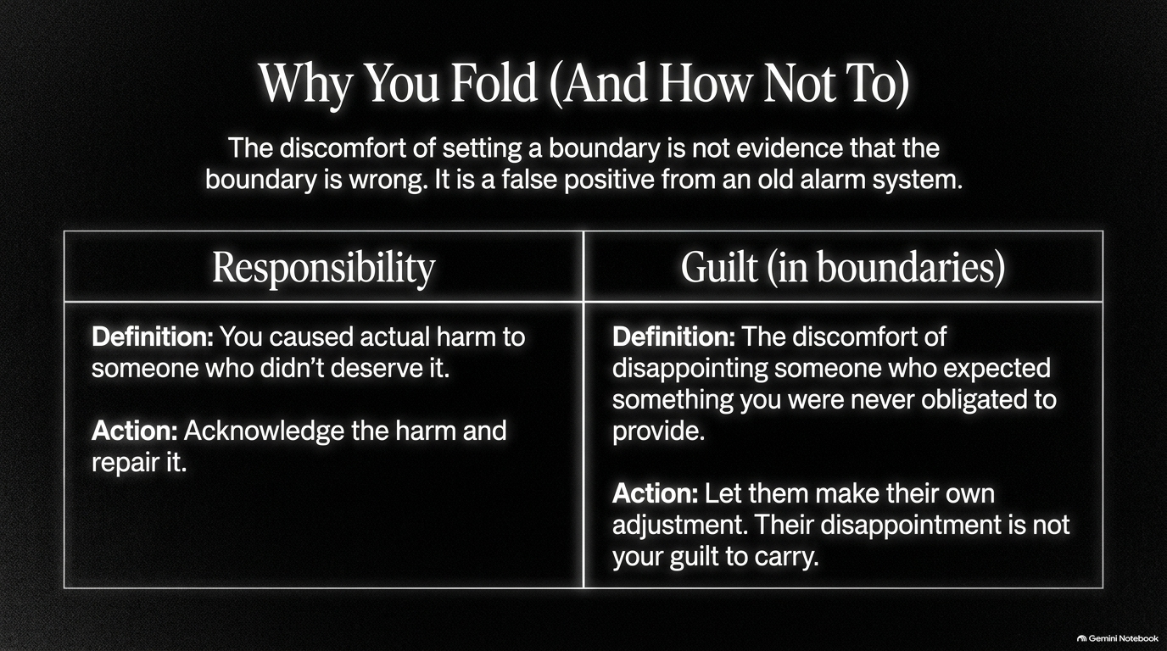
Notes:
Visual: A side-by-side comparison chart defining the stark difference between true Responsibility and manufactured Guilt.
Suggested Duration: 3 – 5 minutes.
Speaker Notes:
The False Alarm: The discomfort you feel when setting a boundary is not evidence that the boundary is wrong. It is simply a false positive blaring from an outdated alarm system.
Responsibility vs. Guilt:
Responsibility means you caused actual, direct harm to someone who didn't deserve it, requiring you to acknowledge and repair it.
Guilt (in the context of boundaries) is merely the discomfort of disappointing someone who expected something you were never obligated to provide. Let them make their own adjustment. Their disappointment is not your guilt to carry.

Slide 10
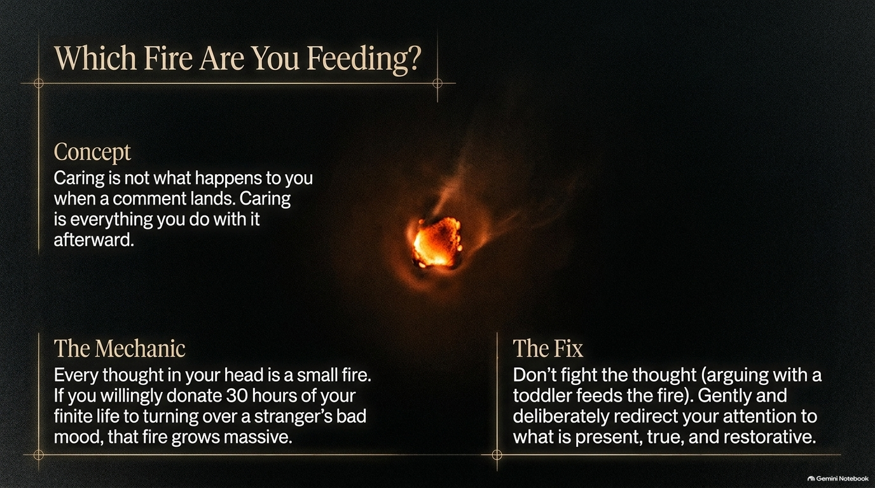
Notes:
Visual: A single, glowing ember burning intensely against a dark background.
Suggested Duration: 3 – 5 minutes.
Speaker Notes:
The Metaphor of the Flame: Caring is not simply what happens to you when an unwanted comment lands; caring is everything you do with it afterward.
The Mechanic: Every intrusive thought in your head is a small spark. If you willingly donate 30 hours of your finite life to turning over a stranger’s bad mood or an insult in your mind, you are pouring gasoline on that fire until it consumes your entire week.
The Fix: Don't fight the thought directly—arguing with a toddler only feeds the fire. Gently and deliberately redirect your attention to what is present, true, and restorative.

Slide 11
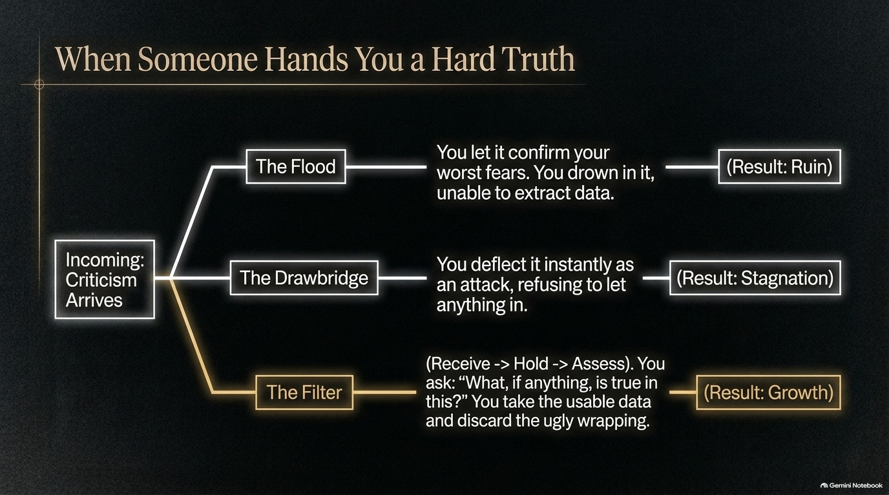
Notes:
Visual: A decision tree branching into three paths: The Flood, The Drawbridge, and The Filter.
Suggested Duration: 4 – 5 minutes.
Speaker Notes:
Three Responses to Criticism: When incoming criticism arrives, we typically default to one of two dysfunctional extremes, or a healthy middle ground.
The Extremes: The Flood means you let the comment confirm your worst fears, drowning in it and ruining your self-worth. The Drawbridge means you instantly deflect it as an attack, refusing to let anything in, leading to permanent stagnation.
The Filter: The third path is Receive $\rightarrow$ Hold $\rightarrow$ Assess. You ask: "What, if anything, is true in this?" You extract the usable data and discard the ugly, emotional wrapping, turning critique directly into growth.

Slide 12
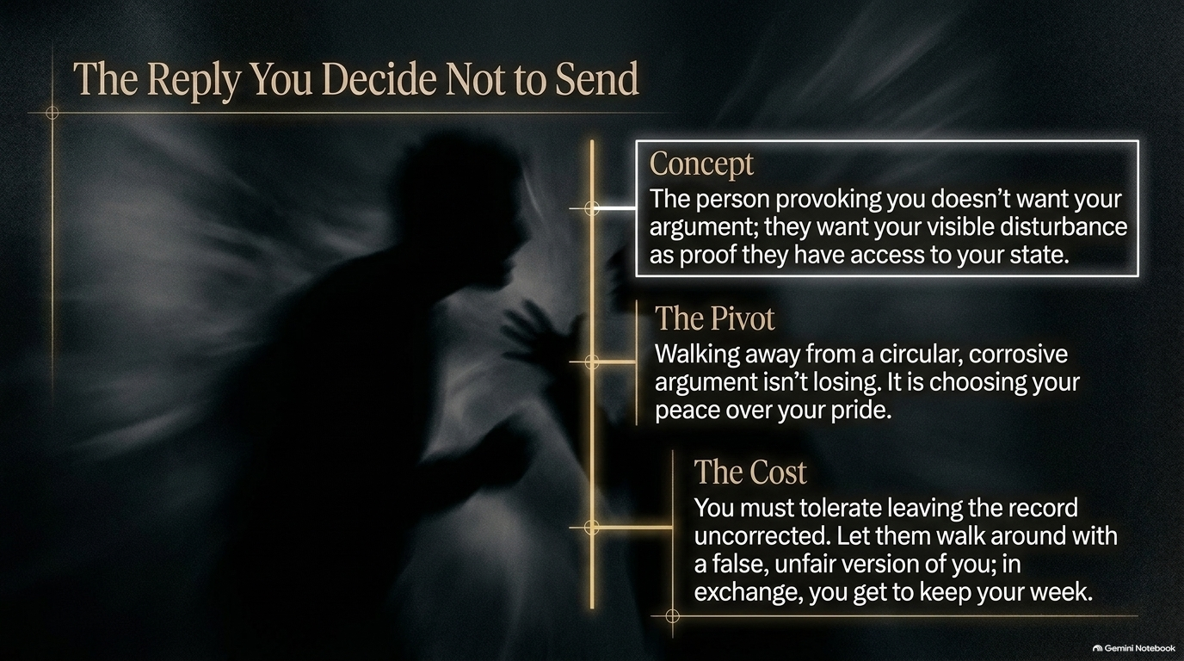
Notes:
Visual: A shadowy silhouette of an argument with a glowing text dialogue box framing the concept of deliberate non-engagement.
Suggested Duration: 3 – 5 minutes.
Speaker Notes:
The Provocateur's Goal: The person provoking you online or in an argument doesn't actually want your logic or your counter-argument; they want your visible disturbance as proof that they have successfully breached your emotional state.
The Pivot: Walking away from a circular, corrosive argument isn't losing—it is choosing your peace over your petty pride.
The Cost: To win this game, you must tolerate leaving the public record uncorrected. Let them walk around with a false, unfair version of you. In exchange, you get to keep your entire week.

Slide 13
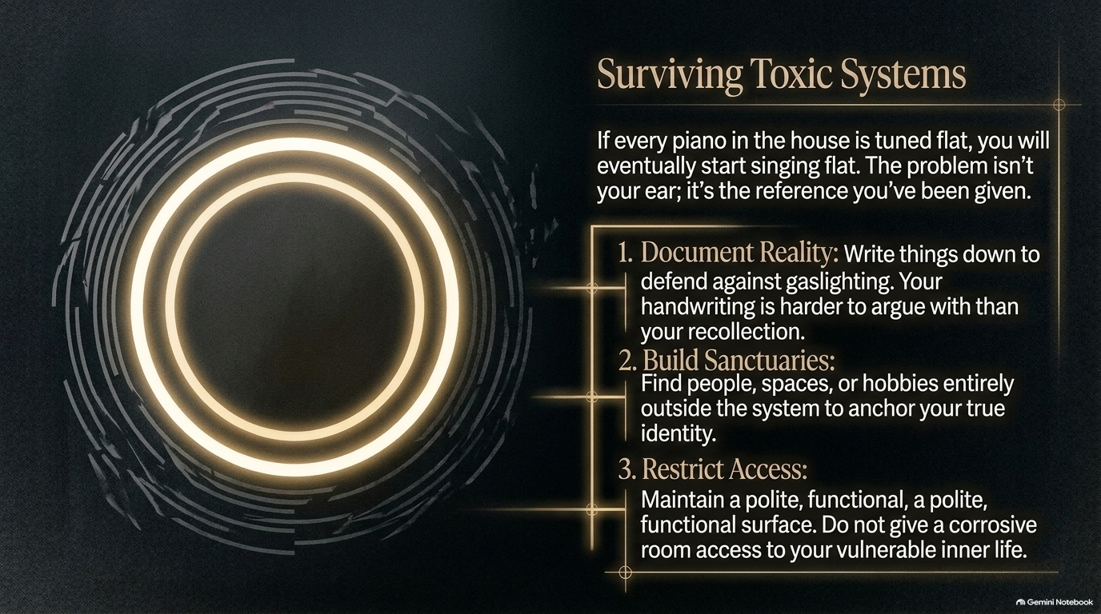
Notes:
Visual: Abstract concentric golden rings glowing against a fragmented, dark structural background.
Suggested Duration: 4 – 6 minutes.
Speaker Notes:
The Tuning Fork Analogy: If every piano in a house is tuned flat, you will eventually start singing flat. The problem isn't your ear; it’s the toxic reference tone you've been given. When you are stuck in a toxic family system or workplace, you need survival rules.
Three Survival Rules:
Document Reality: Write things down to defend against chronic gaslighting. Your handwriting is much harder to argue with than your shaken recollection.
Build Sanctuaries: Find people, spaces, or hobbies entirely outside the toxic system to anchor your true identity.
Restrict Access: Maintain a polite, functional surface. Never give a corrosive environment or toxic person deep access to your vulnerable inner life.

Slide 14

Notes:
Visual: A lone figure standing on a hill overlooking a vast horizon as golden light breaks through dramatic storm clouds.
Suggested Duration: 3 – 5 minutes.
Speaker Notes:
The Exhaustion of Performance: The single most exhausting thing a human being can do is maintain a version of themselves designed purely for someone else’s comfort.
The Shift: When you finally drop the performance, you will lose relationships that were built entirely on your compliance. But in doing so, you clear out the physical and emotional space where true, authentic connection can finally fit. You stop managing your surroundings like a stage manager, and you simply arrive.

Slide 15
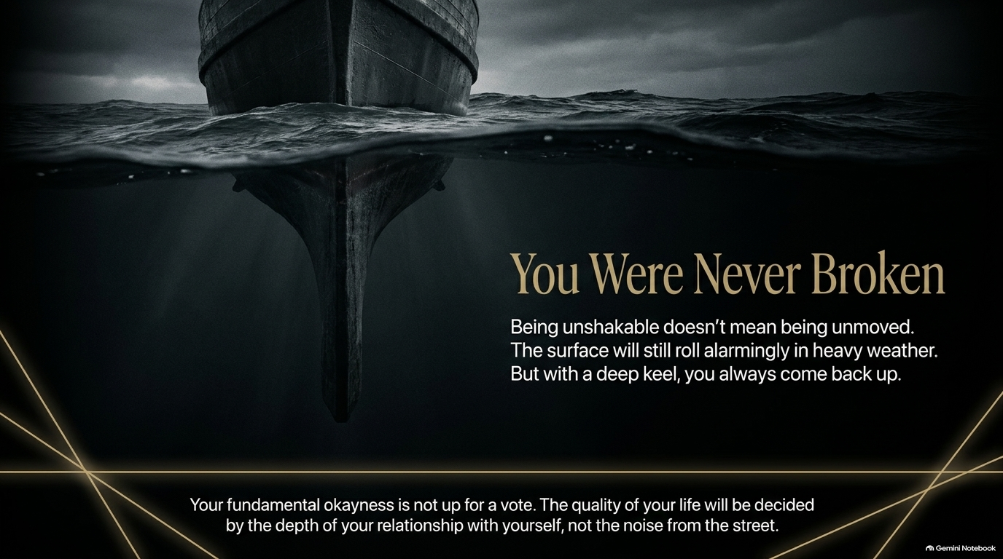
Notes:
Visual: The deep hull of a massive ship cutting through dark, churning ocean waters with a stable keel underneath.
Suggested Duration: 3 – 5 minutes.
Speaker Notes:
The Ship’s Keel: Being unshakable doesn't mean being completely unmovable. The surface of your life will still roll alarmingly in heavy weather. But with a deep, solid keel of self-respect, you always come back up.
The Final Affirmation: Your fundamental okayness is not up for a democratic vote. The quality of your life will be decided by the depth of your relationship with yourself, not by the random noise coming from the street.

Slide 16
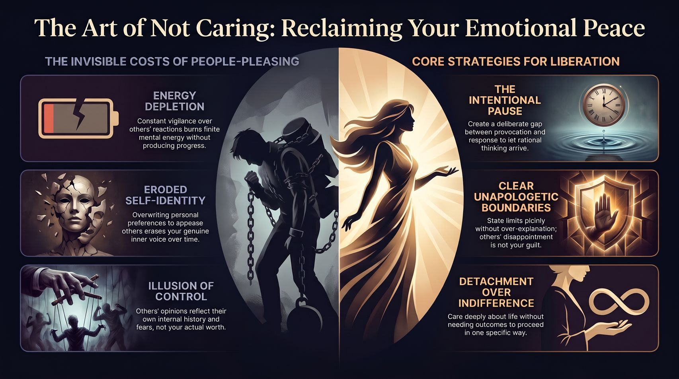
Notes:
Visual: A comprehensive summary split design showing energy depletion on the left and the core strategies for liberation on the right.
Suggested Duration: 4 – 5 minutes.
Speaker Notes:
Reviewing the Journey: Look at where we started: energy depletion, eroded self-identity, and the illusion of control. Look at where we stand now: armed with intentional pauses, clear boundaries, and detachment over indifference.
Closing Challenge: You have been building toward this clarity your entire life. Take one message you've been over-editing in your head tonight, and either send the plain version or delete it entirely. Give one honest answer. Let one small thing go uncorrected.
Final Send-Off: That’s it—just one rep. Your inner world belongs to you. Go live the rest of it.

