Slide 1
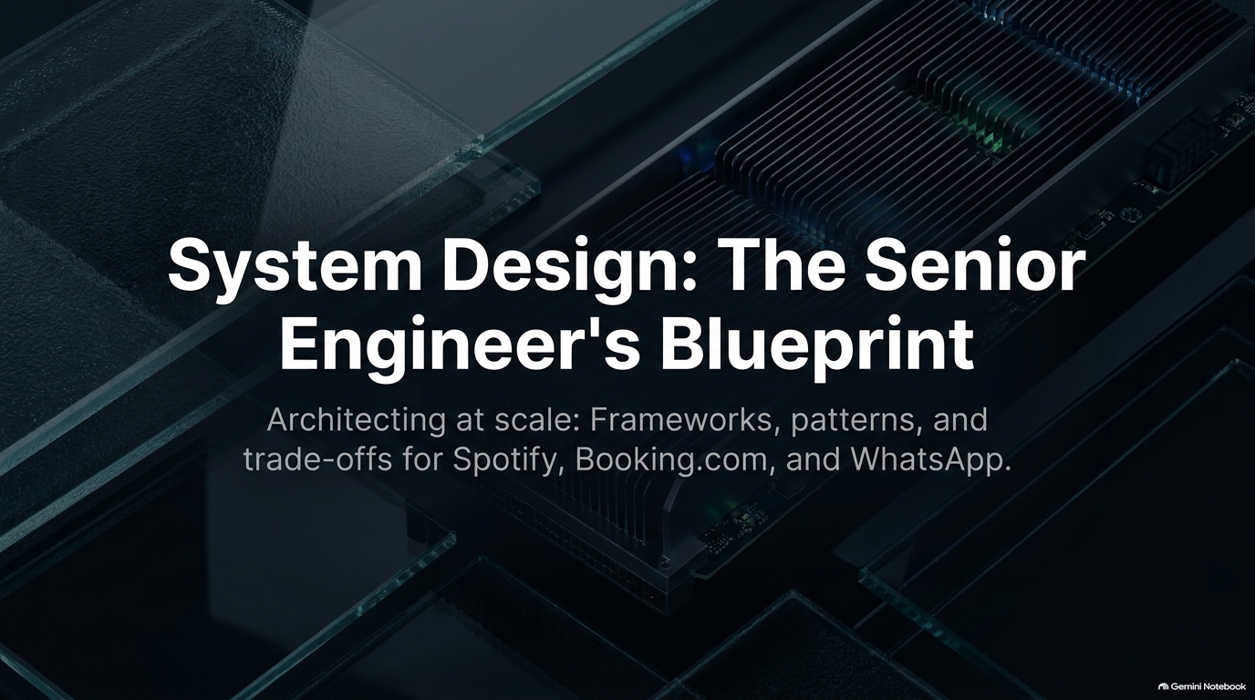
Notes:
Target Pacing: 2 – 3 minutes
Speaker Notes:
Introduction & Hook: Welcome everyone to the complete system design masterclass. Today, we are breaking down how to think like a senior and staff-level software engineer when tackling large-scale architectural challenges.
What We'll Cover: Explain that system design is no longer just for senior roles; it is a critical competency across modern software engineering, appearing in interviews, architectural reviews, and production scaling discussions.
Goal of the Course: Emphasize that the objective isn't to memorize specific architectures, but to master a structured 5-step framework that allows you to handle vague requirements under pressure and defend your trade-offs with confidence.
Design Software Systems Like a Senior Engineer – Complete Course
https://www.youtube.com/watch?v=soTfFFIQQ8U

Slide 2
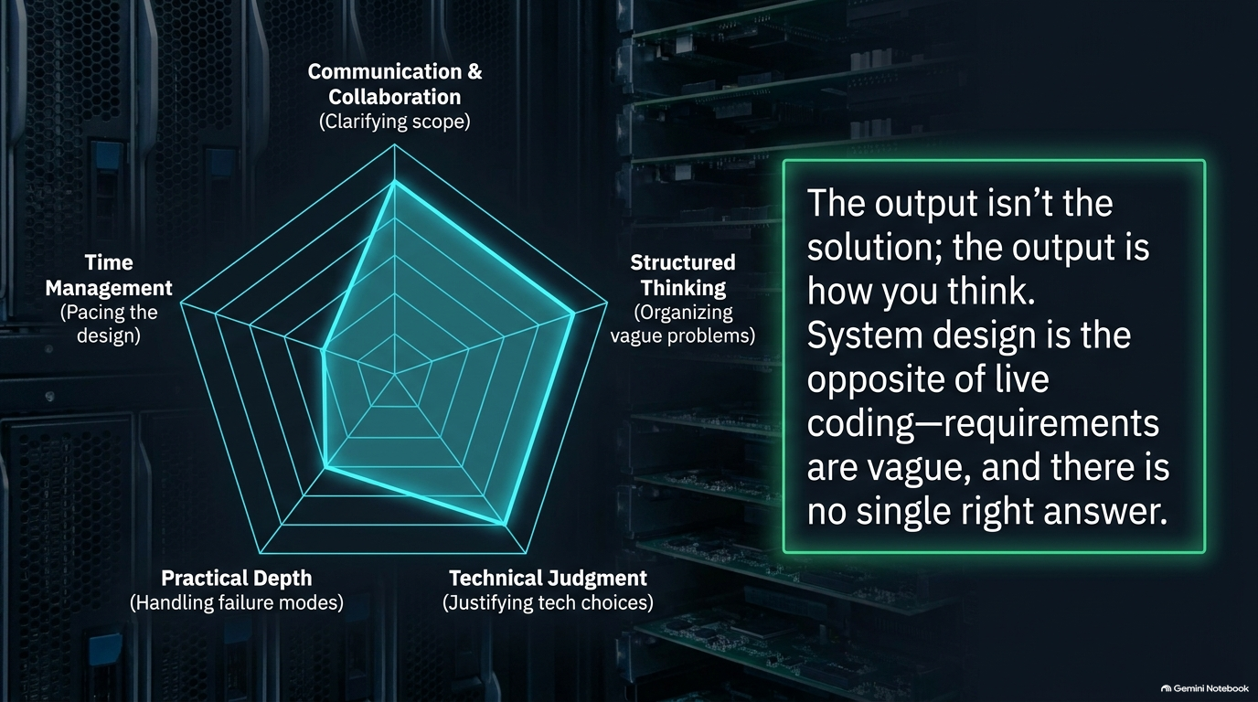
Notes:
Target Pacing: 3 – 4 minutes
Speaker Notes:
Contrast with LeetCode: Highlight the core difference between coding challenges and system design. Coding problems have rigid, deterministic inputs and outputs with automated test cases. System design, by contrast, is ambiguous, open-ended, and rarely has a single "correct" answer.
The Ambiguity Challenge: Explain why engineers struggle initially—they look for clear formulas where none exist.
Mindset Shift: Teach the audience to embrace ambiguity. An interview is not a test where you guess what's in the interviewer's head; it is a collaborative engineering discussion simulating how you would work with a teammate on a real production problem.

Slide 3
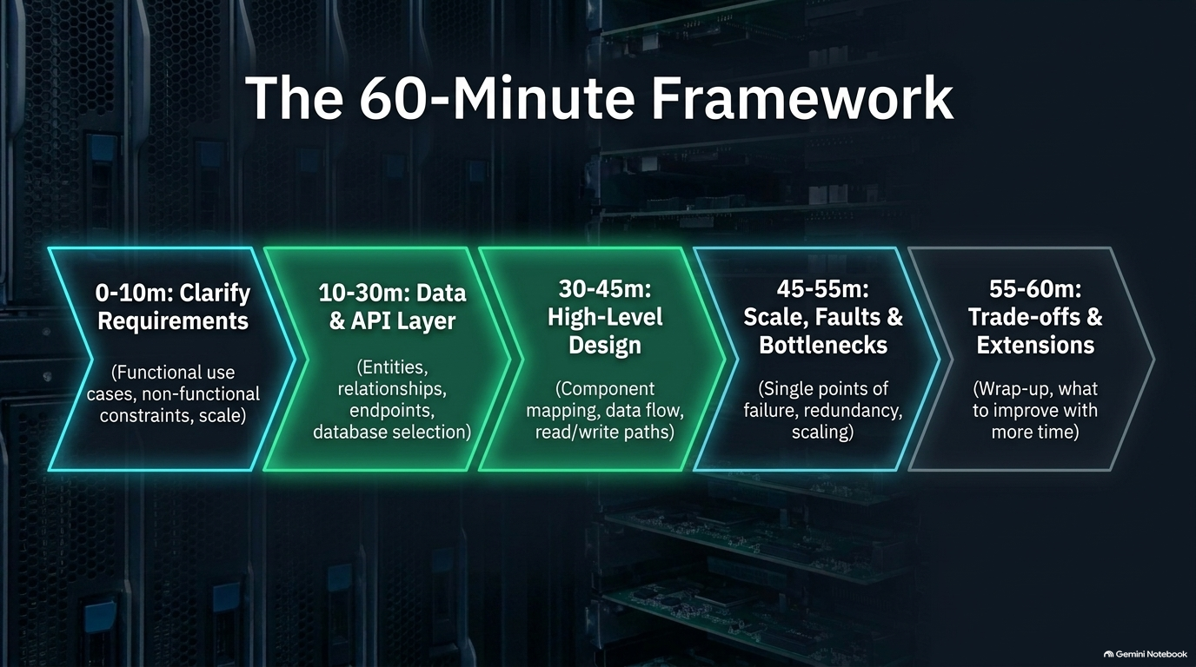
Notes:
Target Pacing: 4 – 5 minutes
Speaker Notes:
Beyond the Diagram: Address the common misconception that candidates are evaluated solely on the final architecture diagram. Introduce the five core evaluation pillars:
Requirements & Scope Clarification
Practical Depth & Architecture Selection
Trade-off Discussion & Justification
Handling Bottlenecks, Scaling, and Failures
Communication, Collaboration, and Time Management
Real-World Parallels: Connect these dimensions back to daily engineering work—if you cannot manage time or discuss trade-offs in an interview, it signals how you operate on a live team.

Slide 4
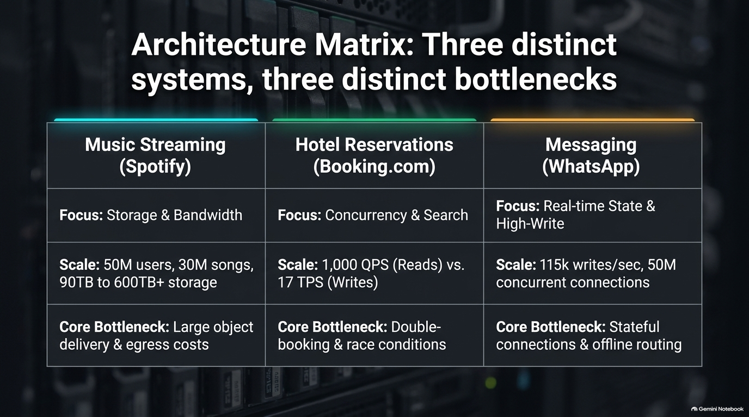
Notes:
Target Pacing: 3 – 4 minutes
Speaker Notes:
The Playbook: Outline the practical roadmap for any system design prompt:
Clarify requirements and constraints.
Back-of-the-envelope estimations and capacity planning.
High-level design (core components and API endpoints).
Deep dive into bottlenecks, data models, and specific challenges.
Wrap up, failure handling, and trade-off summaries.
Pacing Discipline: Emphasize strict adherence to time management so you do not get bogged down in minor database configurations before establishing the high-level architecture.

Slide 5
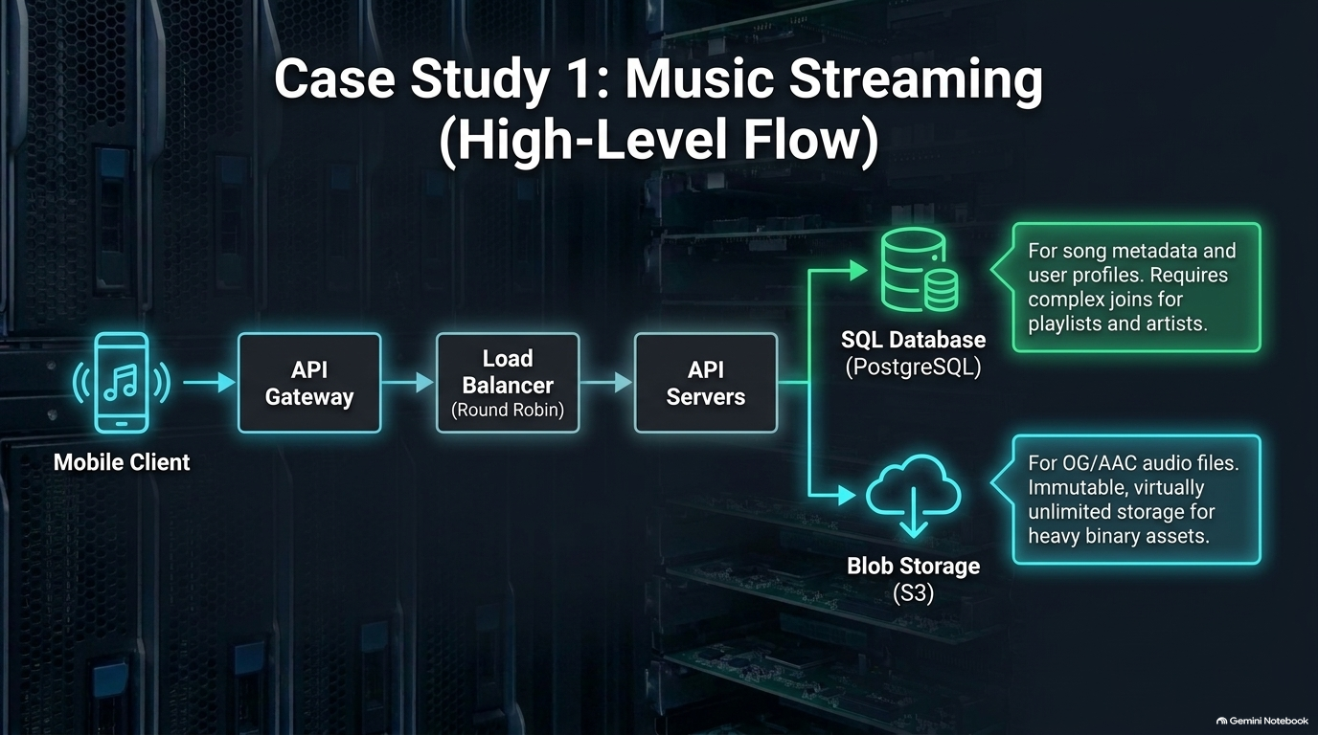
Notes:
Target Pacing: 3 – 5 minutes
Speaker Notes:
Never Jump Straight into Code/Boxes: Explain that starting to draw boxes immediately is a red flag.
Functional Requirements: Identify what features must be supported (e.g., uploading songs, sending real-time messages, searching products).
Non-Functional Requirements (NFRs): Discuss scale, availability (e.g., 99.99%), low latency, consistency versus availability (CAP theorem), and read-heavy versus write-heavy workloads.
Scope Boundaries: Explicitly define what is out of scope for the current session to protect your time budget.

Slide 6
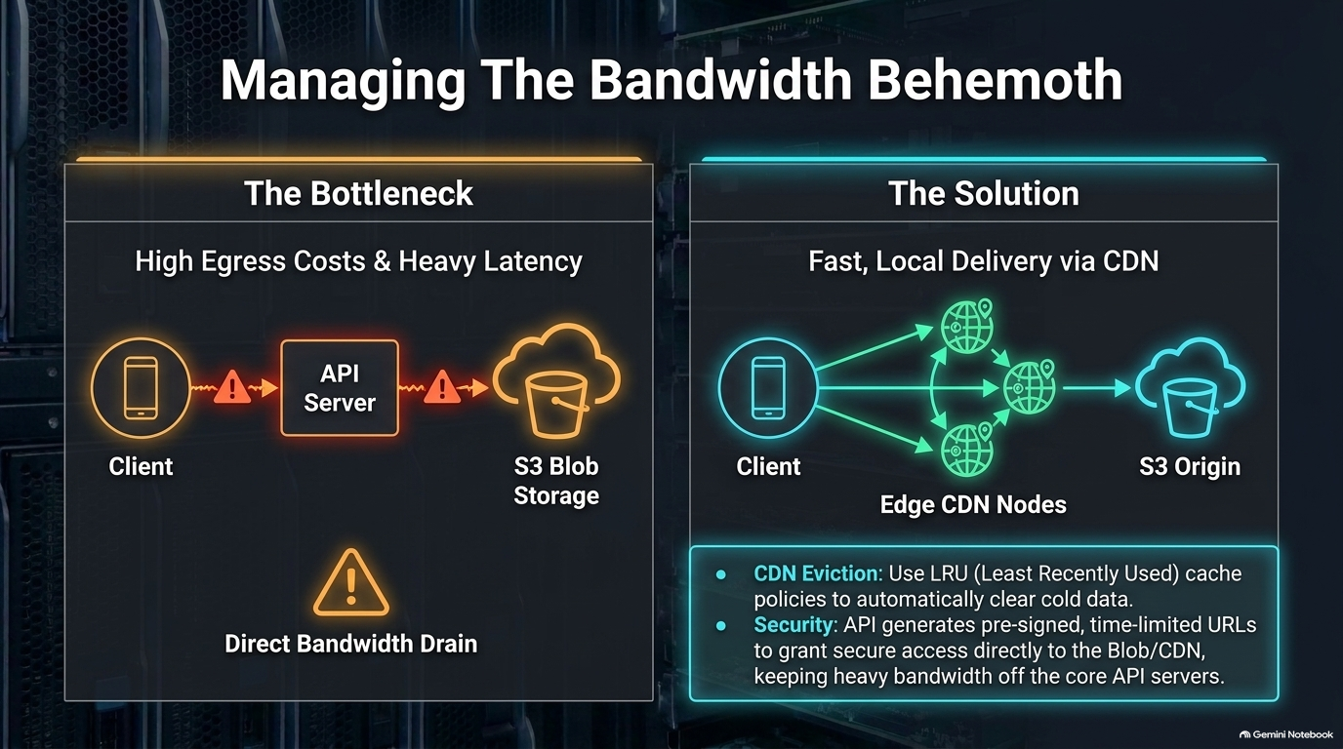
Notes:
Target Pacing: 4 – 6 minutes
Speaker Notes:
Why Numbers Matter: Show how rough estimations dictate your infrastructure choices. Knowing whether you need to handle 100 requests per second or 10 million requests per second completely changes your data storage and caching strategy.
Key Metrics to Remember: Quick review of standard conversion math (seconds per day, bytes to terabytes, QPS calculations for peak vs. average load).
Informing Architecture: Explain how capacity planning justifies introducing components like message queues (e.g., Kafka) or distributed caching layers (e.g., Redis).

Slide 7
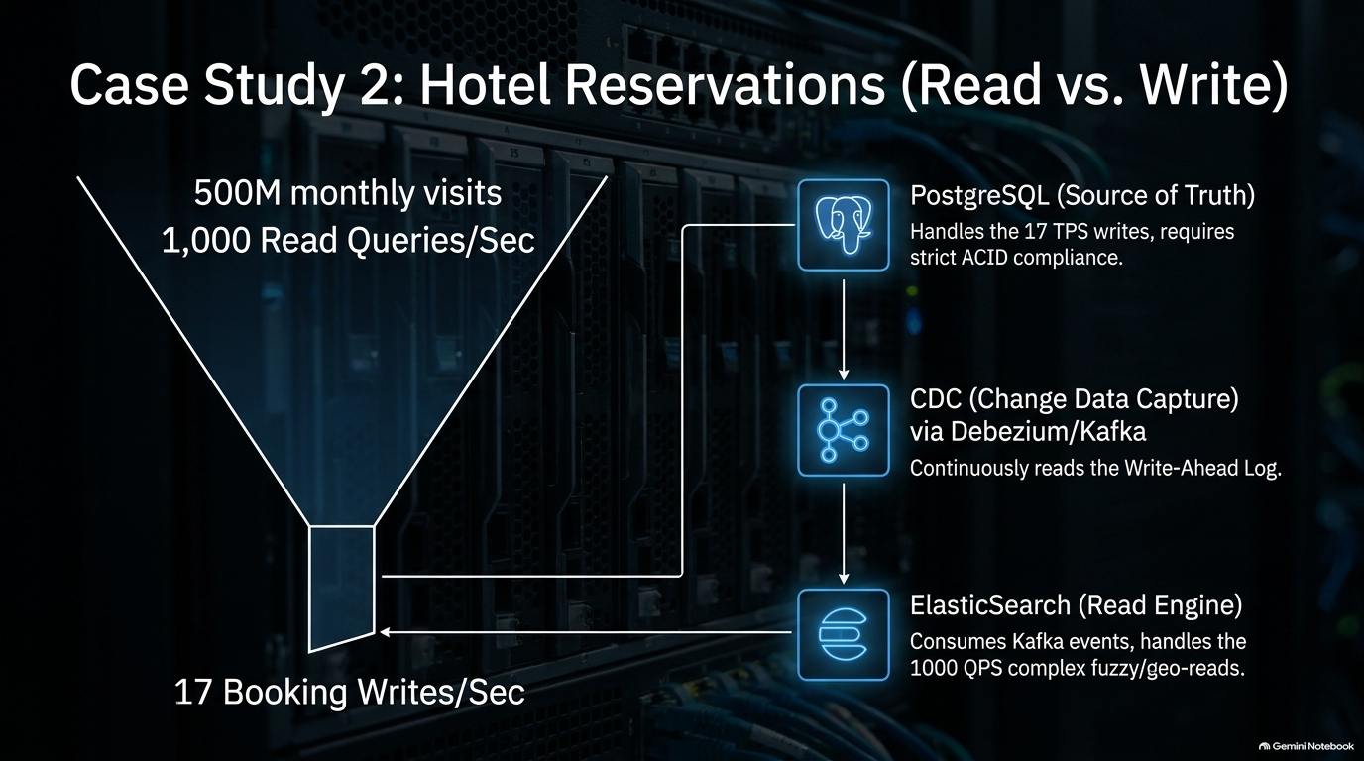
Notes:
Target Pacing: 4 – 6 minutes
Speaker Notes:
The Core Flow: Start simple with clients making requests through a Load Balancer to RESTful or GraphQL API servers.
Load Balancing Strategies: Discuss algorithm choices like Round Robin vs. Least Connections, alongside health-checking mechanisms to maintain high availability.
Data Flow & Interfaces: Define clear API contracts early so the interviewer understands how data moves from client to service layer.

Slide 8
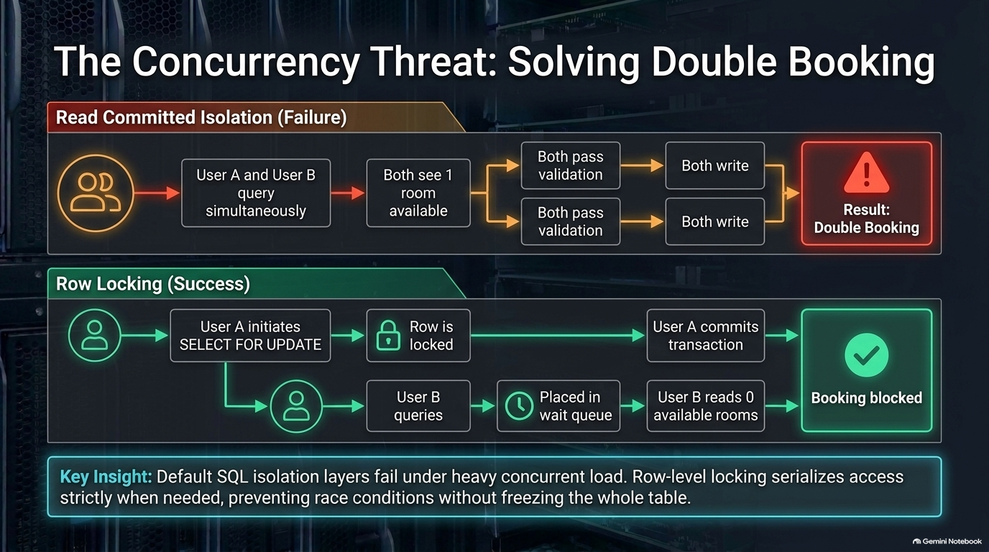
Notes:
Target Pacing: 4 – 6 minutes
Speaker Notes:
The Upload Pipeline: Walk through handling large payloads (like audio files, videos, or documents).
Validation & Security: Route upload requests through API gateways where file size limits and format validations occur before touching primary backend compute nodes.
Object Storage & CDN: Offload heavy binary blobs to distributed object stores (like S3/Cloud Storage) paired with Content Delivery Networks (CDNs) for fast global retrieval.

Slide 9
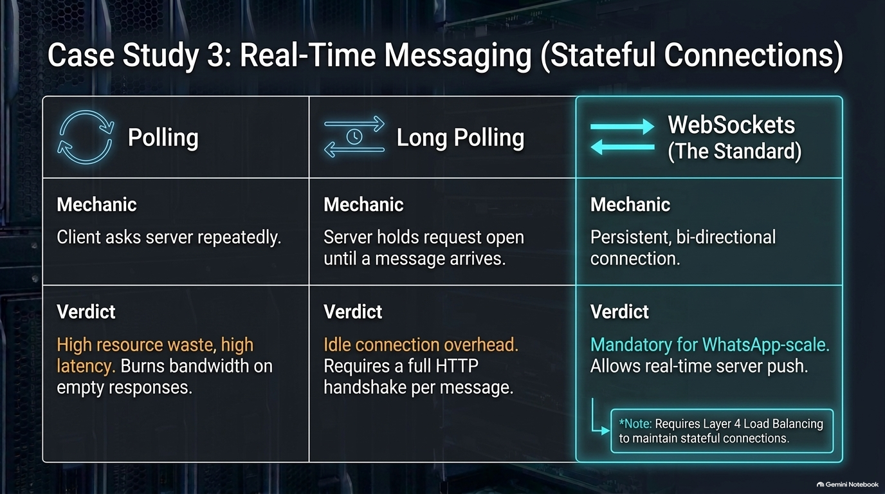
Notes:
Target Pacing: 4 – 6 minutes
Speaker Notes:
Polling vs. WebSockets: Contrast traditional HTTP polling with persistent bi-directional WebSocket connections.
Trade-off Analysis: Acknowledge that while WebSockets provide instant message delivery ideal for chat applications, they consume significantly more memory on server instances compared to stateless HTTP calls.
Connection Management: Discuss scaling chat servers using pub/sub brokers (e.g., Redis) to route messages across distributed server nodes.

Slide 10
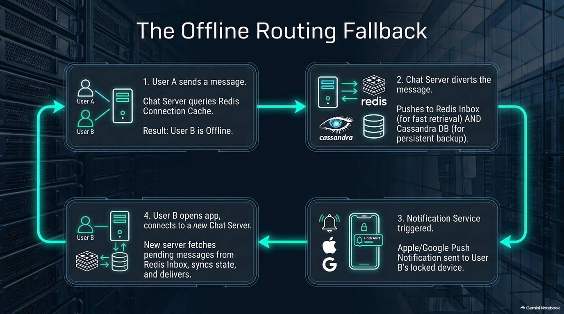
Notes:
Target Pacing: 4 – 6 minutes
Speaker Notes:
Proactive Stress Testing: Once the baseline architecture is stable, put on your critic hat. Where will this system break first?
Common Bottlenecks: Single points of failure in databases, network saturation during traffic spikes, unthrottled API requests, or message queue backpressure.
Mitigation Strategies: Introduce database replication, read/write splitting, database sharding, and rate limiting to protect downstream services.

Slide 11
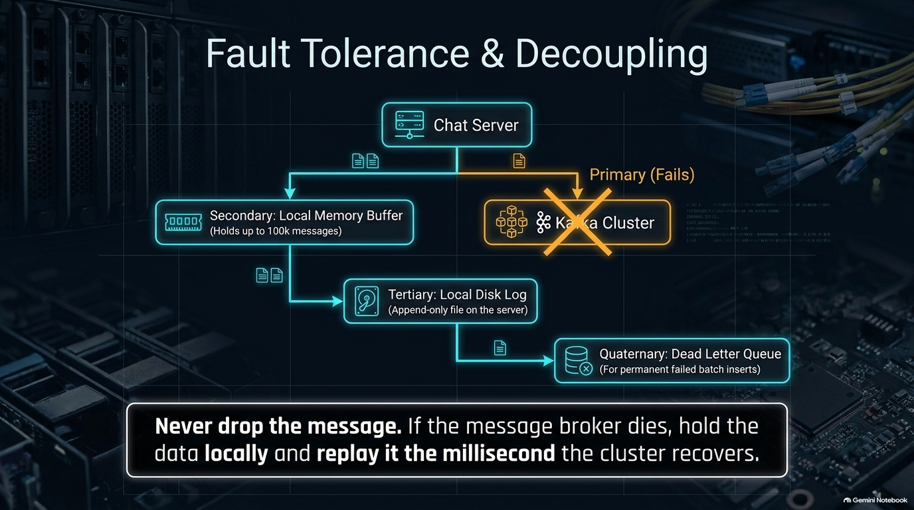
Notes:
Target Pacing: 3 – 5 minutes
Speaker Notes:
The Inevitability of Failure: Reinforce the senior engineering maxim: everything fails all the time. Design for resilience from day one.
Redundancy & Failover: Implement multi-region deployments, active-passive database failovers, and circuit breakers to prevent cascading failures across microservices.
Graceful Degradation: Design features so that if a non-critical service (like recommendations or analytics) goes down, the core user journey remains functional.

Slide 12
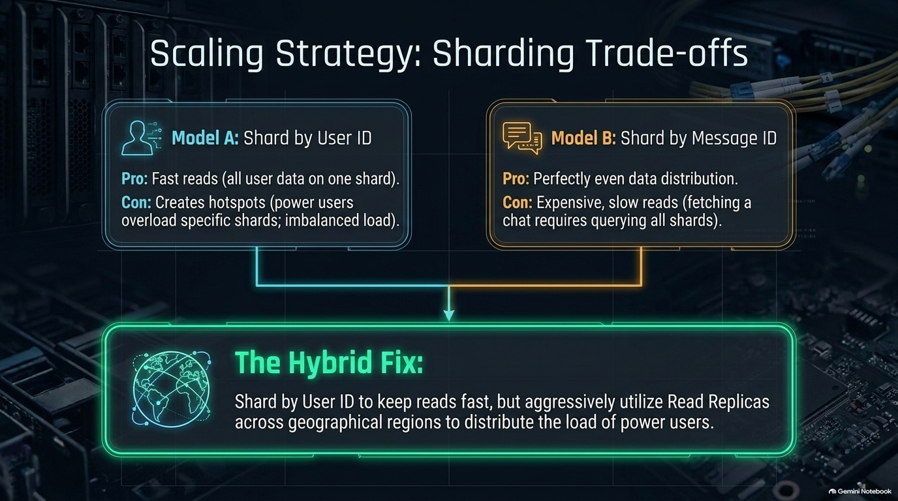
Notes:
Target Pacing: 3 – 4 minutes
Speaker Notes:
Decoupling Deployment from Release: Explain how feature flag stores enable safe, gradual rollouts (e.g., releasing a new UI or backend change to 5% of users first).
Client Version Compatibility: Address how backend chat or API servers handle older mobile/web client versions gracefully by filtering unsupported fields or features based on client app version metadata.

Slide 13
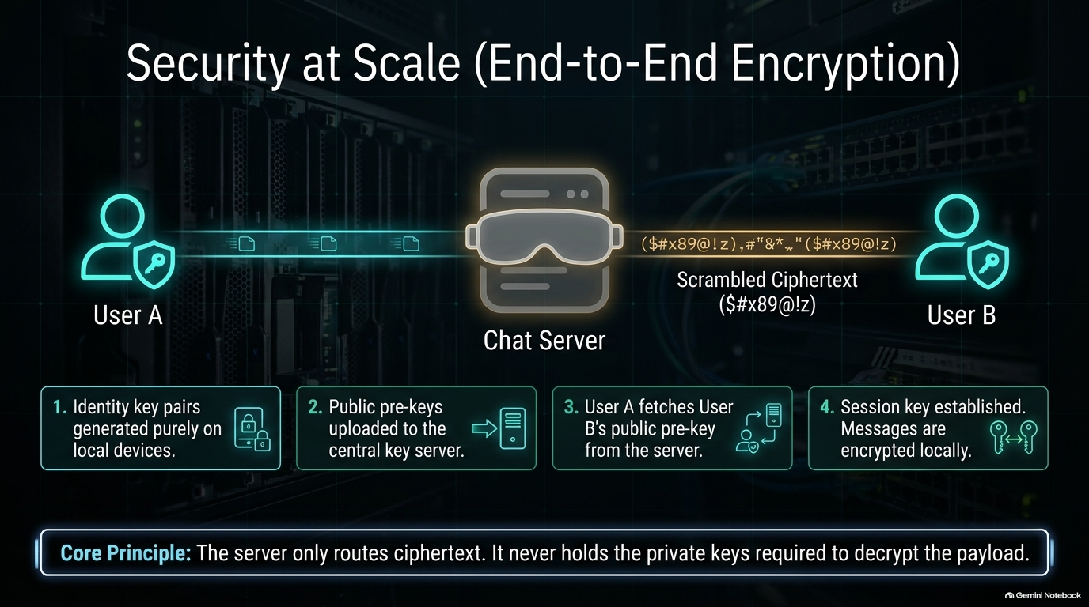
Notes:
Target Pacing: 3 – 5 minutes
Speaker Notes:
No Silver Bullets: Emphasize that every architectural choice carries a cost. Choosing consistency (CP) over availability (AP), SQL over NoSQL, or WebSockets over polling requires defending your rationale based on product requirements.
Articulating Decisions: Teach the audience how to phrase trade-offs to interviewers: "We chose X because of Y, accepting the trade-off of Z, which is acceptable here because our primary constraint is..."

Slide 14
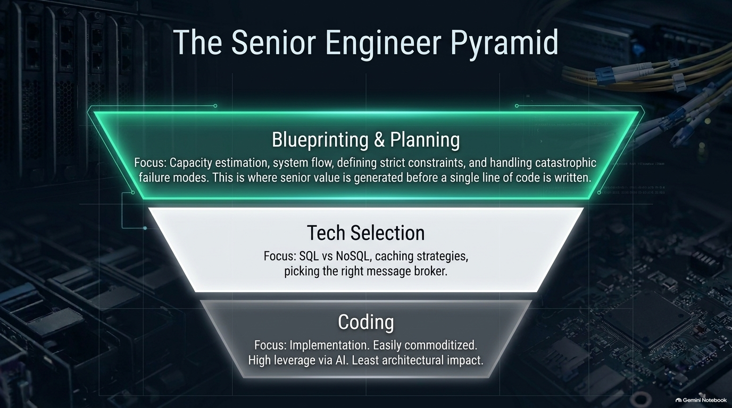
Notes:
Target Pacing: 3 – 4 minutes
Speaker Notes:
Collaborative Dialogue: Remind candidates that interviewers want to see inside their thought process. Thinking silently for 10 minutes creates dead air and anxiety.
Taking Hints: Explain that interviewers will often nudge you if you're heading down an over-engineered path. Treat their feedback as a collaborative team hint rather than a correction of failure.

Slide 15
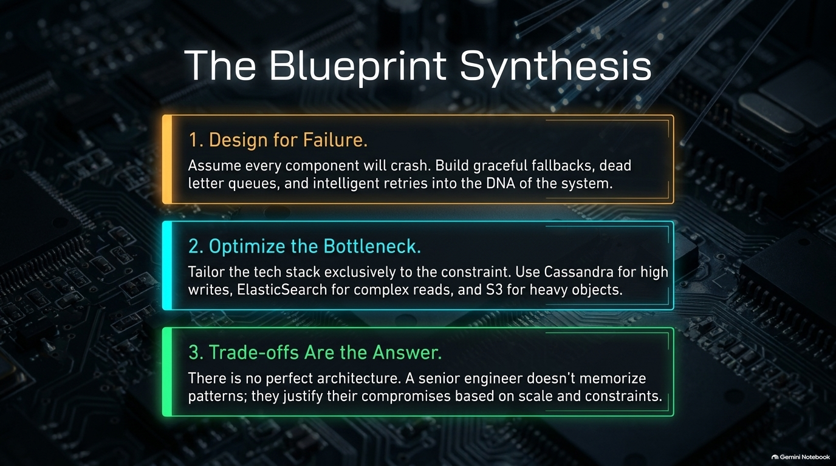
Notes:
Target Pacing: 2 – 3 minutes
Speaker Notes:
Quick Recap: Reiterate the journey from requirements gathering and estimation to high-level design, deep dives, and bottleneck analysis.
Confidence Builder: Reassure the audience that nobody expects a flawless system in a 45-minute window. Evaluators care far more about structured problem-solving and rigorous engineering reasoning than a memorized diagram.

Slide 16
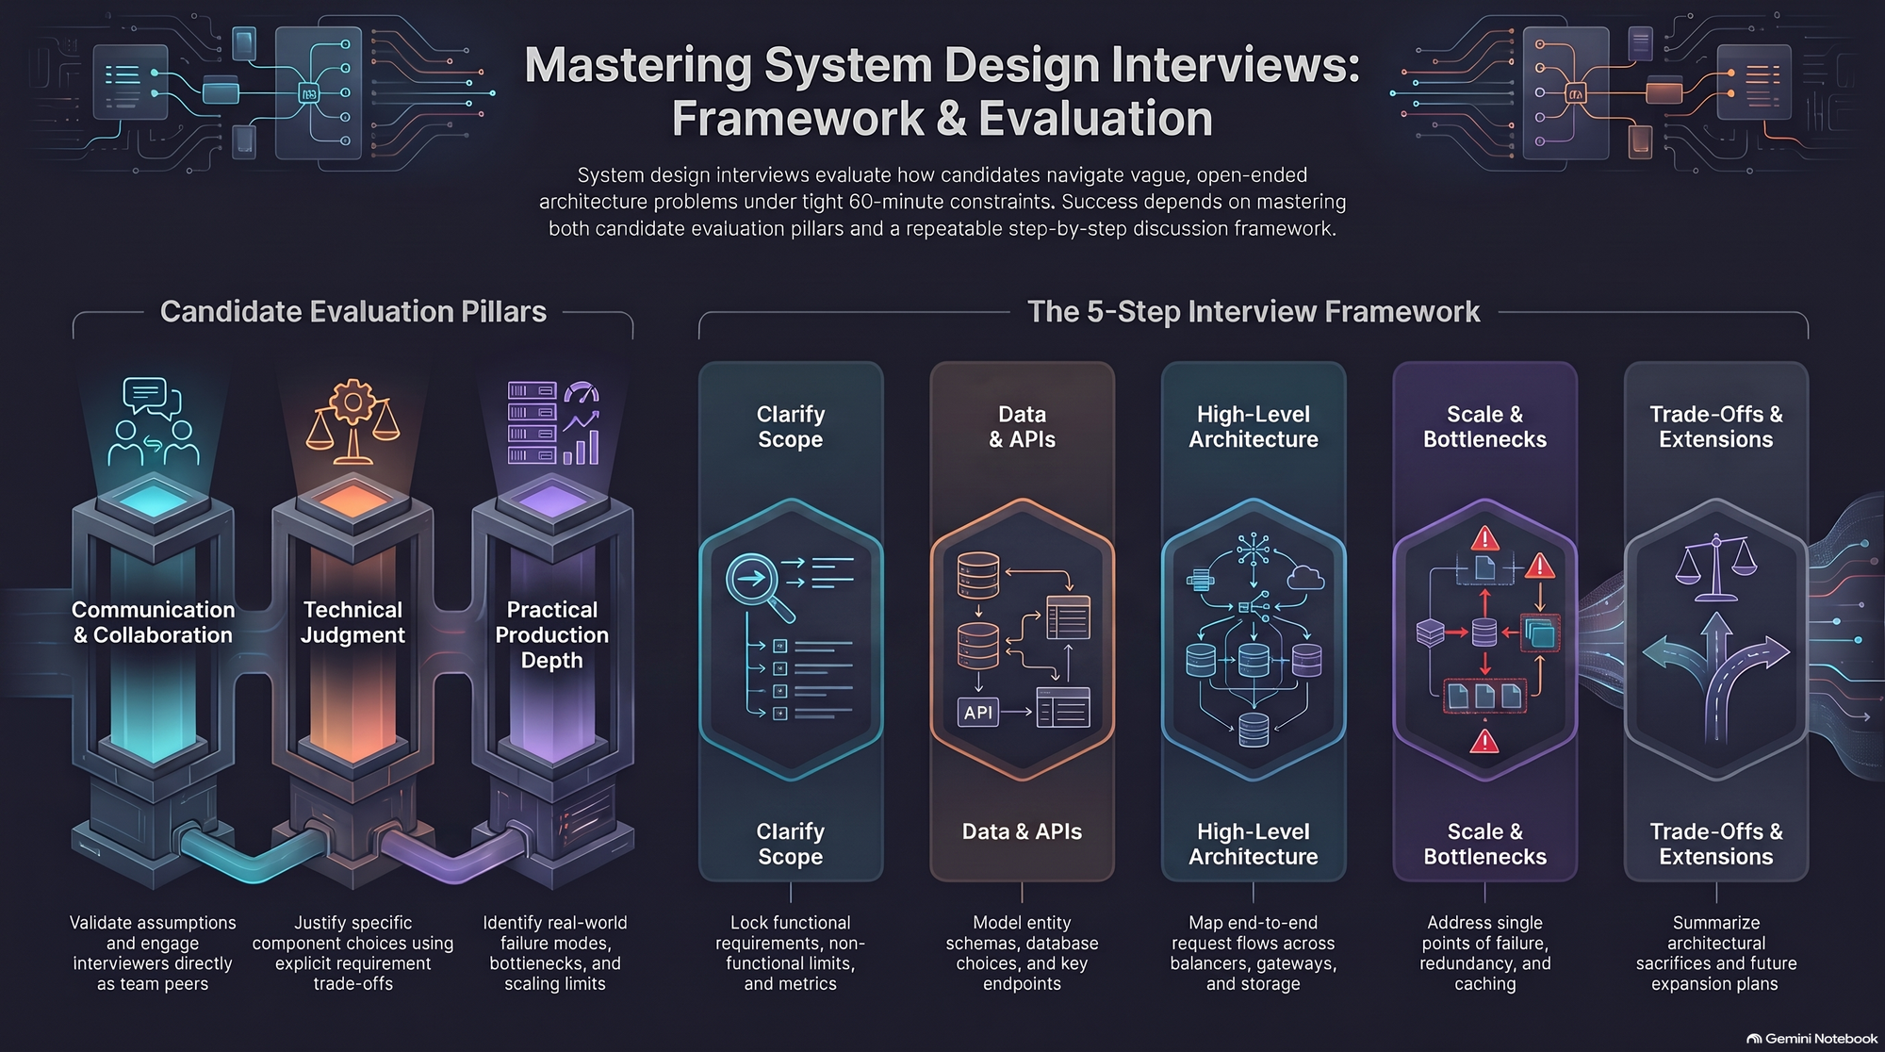
Notes:
Target Pacing: 2 – 3 minutes
Speaker Notes:
Open Floor: Open the room for questions regarding specific system patterns or interview scenarios.
Closing Encouragement: Encourage continuous practice across different production domains (messaging systems, streaming services, booking platforms) to build architectural intuition over time.

