Slide 1
Smart City Waste
Management System

Slide 2
IDEA
The govt. of India has recently launched a smart city project and for these smart cities to be smarter it is necessary that the garbage collection system has to be smarter and in addition to that the people need easy accessibility to the garbage disposing points and garbage collection process has to be efficient in terms of time and fuel cost.
We realize that Garbage causes damage to local ecosystems, and it is a threat to plant and human life. To avoid all such situations we are going to implement a project called IoT Based Smart Garbage.

Slide 3
ABOUT US
Team Name :- Desert_Scorpions
Team Leader:- Hardik Rathore
Member:- Yuvraj Singh

Slide 4
OUR SOLUTION
Current Scenario
Smart Dustbin
As people are getting smarter so are the things. While the thought comes up for Smart cities there is a requirement for Smart waste management. The idea of Smart Dustbin is for the Smart buildings, Colleges, Hospitals and Bus stands. The Smart Dustbin thus thought is an improvement of normal dustbin by elevating it to be smart using sensors and logics. Smart dustbins is a new idea of implementation which makes a normal dustbin smart using ultrasonic sensors for garbage level detection and sending message to the user updating the status of the bin. There is a backend system where Admin can check the status of all the bins and also a driver who will get the status of nearest bins on map.
Bad waste management can easily result in air pollution and soil contamination. They have an adverse effect on human health. It is learnt from the primary survey done in Guwahati, a city in Assam that garbage accumulation causes 41% of the air pollution. They cause air pollution which generally leads to various respiratory problems like COPD, asthma etc. Breeding of mosquitoes and houseflies occur mainly in garbage which are a major cause for various diseases like malaria, dengue, chikungunya etc. This also causes headache, nauseous sensation and increase in the stress level. A city with poor sanitation and smelly environment can never be a healthy place to live in.

Slide 5
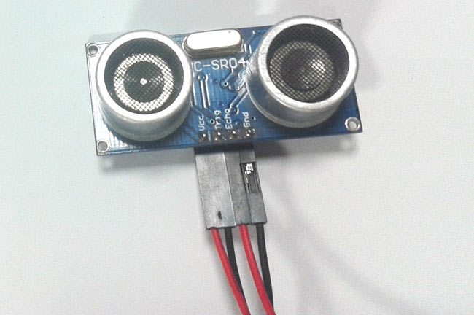
Hardware
HC-SR04 Ultrasonic Sensor:
The Ultra Sonic Sensor is used to measure the distance
with high accuracy and stable readings. It can measure
distance from 2cm to 400cm or from 1 inch to 13 feet.
It emits an ultrasound wave at the frequency of 40KHz
in the air and if the object will come in its way then it
will bounce back to the sensor. By using that time
which it takes to strike the object and comes back,
you can calculate the distance.
The ultrasonic sensor has four pins.Two are VCC and GND which will be connected to the 5V and the GND of the Arduino while the other two pins are Trig and Echo pins which will be connected to any digital pins of the Arduino. The trig pin will send the signal and the Echo pin will be used to receive the signal. To generate an ultrasound signal, you will have to make the Trig pin high for about 10us which will send a 8 cycle sonic burst at the speed of sound and after striking the object, it will be received by the Echo pin.

Slide 6
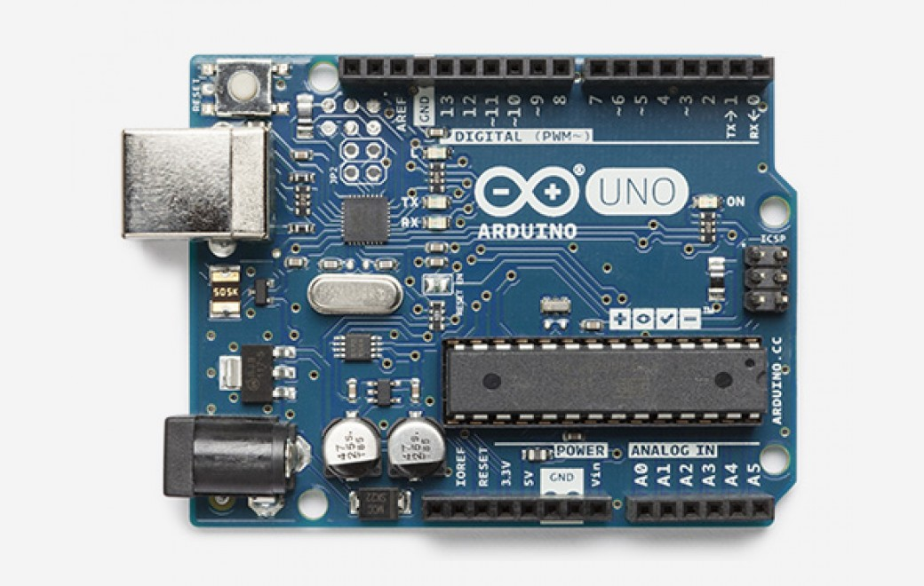
Hardware
Arduino
Arduino is an open-source electronics platform
based on easy-to-use hardware and software.
Arduino Boards are able to read inputs - light on
a sensor, a finger on a button, or a Twitter
message - and turn it into an output – activating a
motor, turning on an LED, publishing something
online. You can tell your board what to do by
sending a set of instructions to the microcontroller
on the board. To do so you use the Arduino
Programming language (based on Wiring),
and the Arduino Software(IDE), based on Processing.
Over the years Arduino has been the brain of thousands of projects, from everyday objects to complex scientific instruments. A worldwide community of makers - students, hobbyists, artists, programmers, and professionals - has gathered around this open-source platform, their contributions have added up to an incredible amount of accessible knowledge that can be of great help to novices and experts alike.

Slide 7
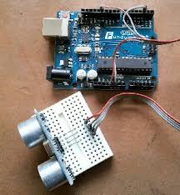
Hardware
How the program works
When the program is loaded the first thing it does is execute the setup() function. The various pins of the Arduino are set to input or output as appropriate. Timer 1 is initialized, the interrupt service routines attached to the appropriate interrupts and the serial port is initialized. The background loop() function then begins to run. Any routines placed in loop() are executed continuously. All of the code required to handle the HC-SR04 and the onboard LED is contained in interrupts routines so the only task in the loop() function is to send the distance measured in centimeters to the serial monitor port every 100 mS. timerIsr() is called every time the timer 1 times out and creates an interrupt. The simplify the code this function calls two more functions. One to handle the trigger pulse and the other one to flash the onboard LED. The trigger_pulse() function is called from timerIsr() every 50 uS and creates a trigger pulse every 4000 calls or 200 mS. The pulse generator is implemented with a simple finite state machine contained in the switch() statement. Every time this routine is called exactly one of the cases is executed. When the count reaches 200 mS the state is changed from 0 to 1 which immediately causes the trigger output to be set high and the state changed to 2. When the function is next called 50 mS later, case 2 is called which resets the trigger output to low and the state reset to 0. echo_interrupt() is called every time the echo input signal changes state and generates an interrupt. The echo input is tested to determine whether this is the start or end of the echo pulse and start and end times recorded accordingly. If the input has changed from high to low then this is the end of the pulse and the duration is computed. The distance_flasher() function is called from timerIsr() every 50 uS. A counter is decremented and if it reaches zero then the onboard LED is toggled and the counter is reloaded with the value of the computed echo pulse duration. This has the effect of flashing the LED faster the closer the object is to the sensor.

Slide 8
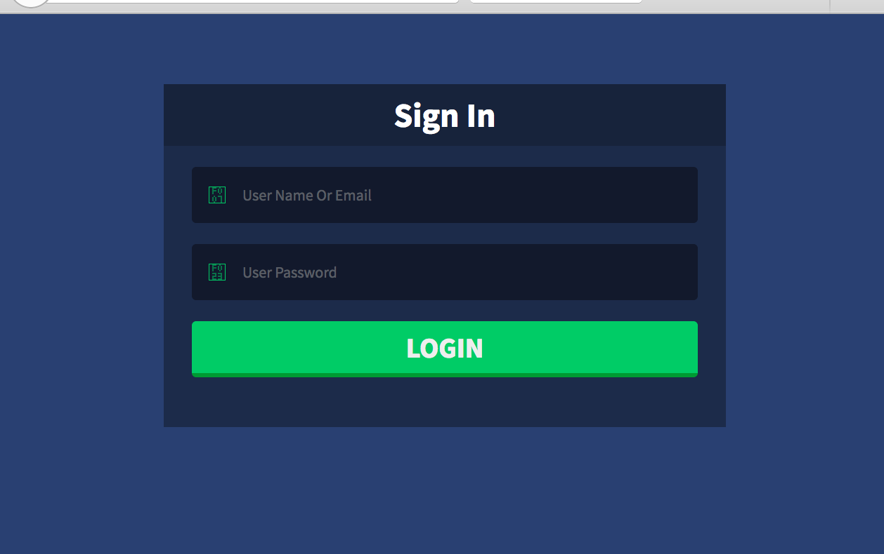
Web Backend To Track All The Dustbins
Admin can login in backend system and track all the dustbins.
Garbage Collector can also access and he will get notify about the nearest bins which are filled.
Using Google Maps direction driver can collect the garbage.

Slide 9
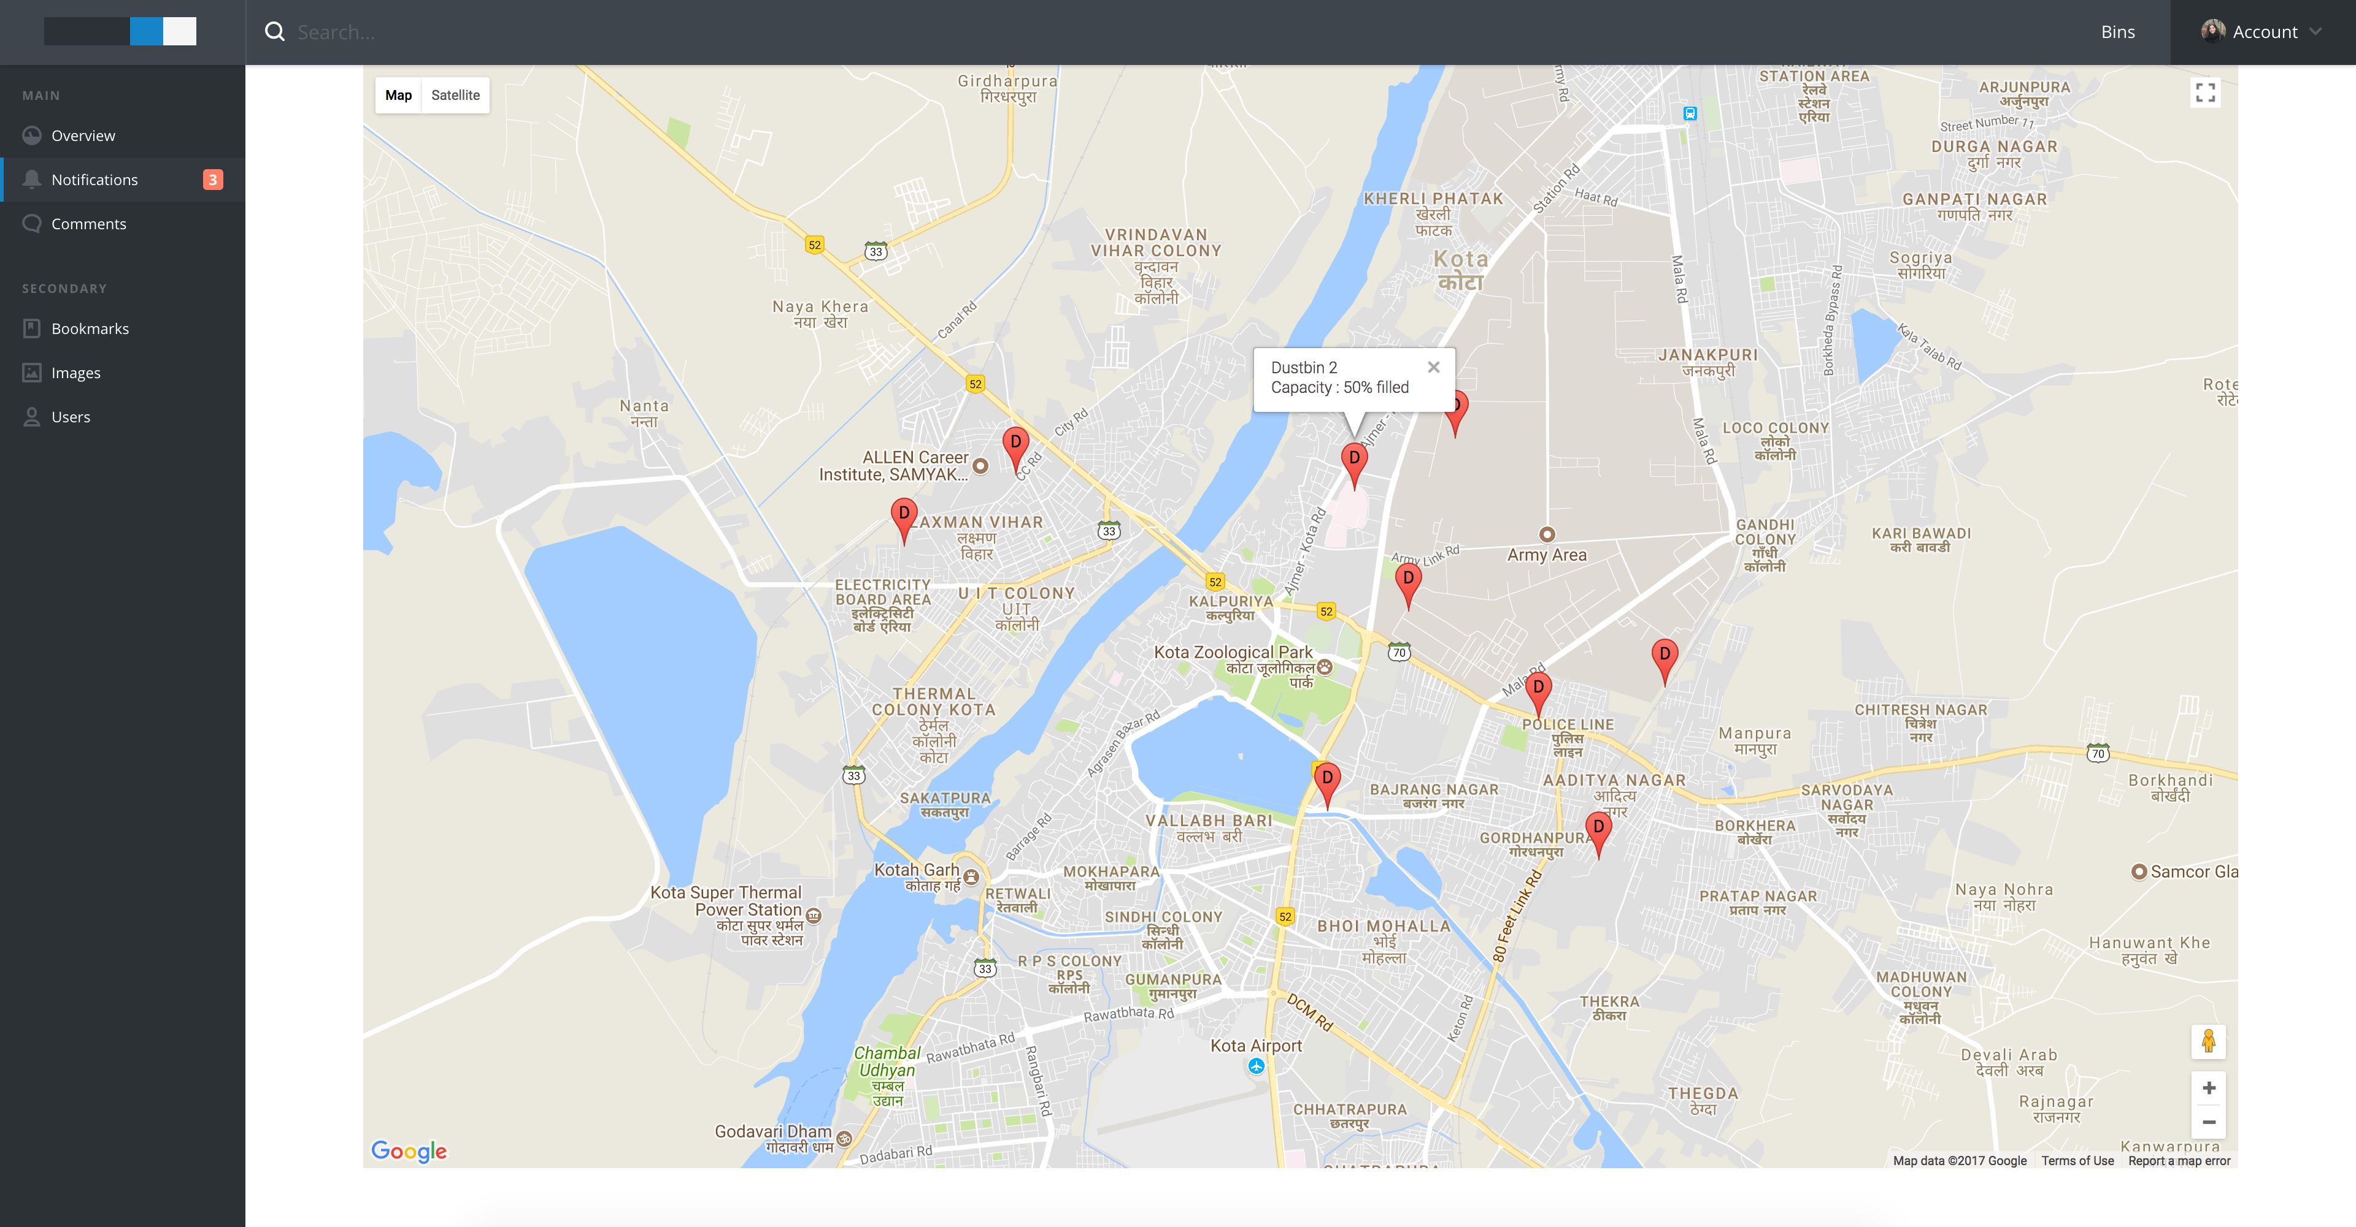

Slide 10
