Slide 1

Emotion Classification through Deep Learning
Matthew Stanfield
George Gabricht
Caleb Pitts
Daniel Tseng

Slide 2
Project Roadmap
Abstract & Overview
Datasets & Augmentation
Model Structure
Results & Improvements
Conclusion

Slide 3



Detecting Human Emotions
The relatively easy task of emotion detection is non-trivial for a computer.
https://media.gettyimages.com/photos/sad-man-in-a-light-blue-tshirt-on-a-white-background-picture-id184918973
https://www.news.ucsb.edu/sites/default/files/styles/article_horizontal/public/images/2014/angry%20face.jpg?itok=w8rAIJs-
https://image.shutterstock.com/image-photo/woman-smiling-perfect-smile-white-260nw-268932410.jpg
Notes:
Matt

Slide 4
Abstract
For our project, we wanted to build a system that could take in webcam feed of a person's face and classify the emotions the person is feeling.
We knew that to accomplish this goal, we needed to learn from the similar approaches to the problem in the past.
Our system is capable of extracting facial images from webcam feed and classifying an emotion based on the image's facial features.
We accomplished this goal with the help of Convolutional Pooling, Data Augmentation, and extensive trials of various models and parameters.
In the end, our model consistently earns a 95% accuracy on Test Data and performs fairly accurately on live data.

Slide 5

Overview
Can we train a neural network to predict an emotion from a picture?
Neural
Network
Happy
https://content.thriveglobal.com/wp-content/uploads/2018/01/Happy_guy.jpg
Notes:
Matt

Slide 6
Project Roadmap
Abstract & Overview
Datasets & Augmentation
Model Structure
Results & Improvements
Conclusion

Slide 7
Our Datasets for the Problem
FER2013
~ 36,000 images
These images span 6 Basic Expressions + Neutral
The dataset images are size (48, 48)
This dataset proved most useful during training.
RAF DB
~ 30,000 images
These images span 6 Basic Expressions as well as 12 Compound Expressions
The dataset images are size (100, 100).
This dataset was too small for its large # of expressions.
EXP-W
~ 90,000 images
These images span 6 Basic Expressions + Neutral
The dataset consisted of many pop culture pictures.
This dataset proved to be less useful during training.
Notes:
RAFDB: http://www.whdeng.cn/RAF/li_RAFDB_2017_CVPR.pdf

Slide 8
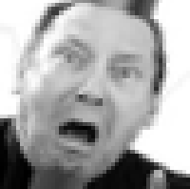
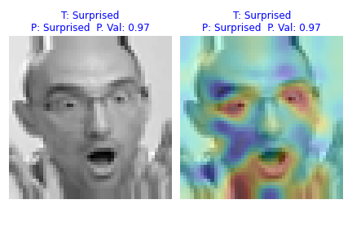
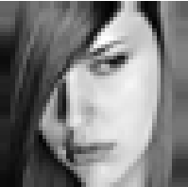
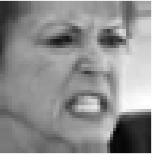
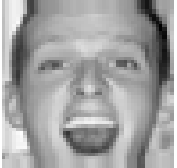
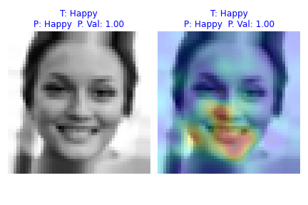
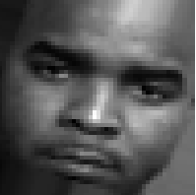
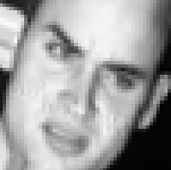
FER2013 Contents
FER2013 contains 35887 grayscale pre-cropped 48x48 images classified in 7 classes
Images per Class
Happy | Neutral | Sad | Fear | Angry | Surprised | Disgust
9073 | 6178 | 6051 | 5262 | 4960 | 3846 | 517
Happy or Angry?
Fear
Surprised
Sad
Angry
Angry
Happy
Neutral
Disgust

Slide 9
Preprocessing and Data Augmentation
In order to accurately process images through convolutional neural networks, a little bit of preprocessing is necessary.
Given an image:
first the face must be isolated and cropped.
next the image must be resized to fit the shape of the training set (48, 48).
lastly, each image must be normalized between 0 and 1 (instead of between 0 and 255).
However, a model is only as strong as its data, and preprocessing only gets you so far.
Many datasets, including the ones we used, are very limited in size.
To combat this issue, data can be augmented to produce similar data to help train the model.
This works especially well w/ images, where simple operations yield valid new data.

Slide 10


Image Augmentation for Limited Size Datasets
Original Image
Initially, to augment our dataset, we simply mirrored our training set, instantly doubling the images.
Keras ImageDataGenerator is a valuable tool we
discovered that allows you to specify margins for rotation, zoom, etc.
Generated Image
This tool generates
a potentially infinite number of images augmented from the original.
The image to the right is an example image generated from the image above using ImageDataGenerator.
Notes:
Matt

Slide 11
Project Roadmap
Abstract & Overview
Datasets & Augmentation
Model Structure
Results & Improvements
Conclusion

Slide 12
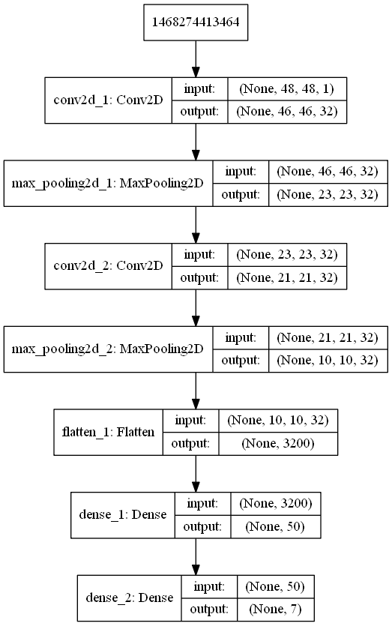
Inspiration
To get a basic idea of where to begin we implemented:
A model very similar to the Sequential MNIST model presented earlier this quarter.
A baseline model very similar to those used in FER2013 Kaggle Competitions.
The diagram to the right is a commonly used model for the MNIST dataset.
From such models, we were able to learn techniques to improve our model.
One such technique, which proves to be very powerful, is Convolutional Pooling

Slide 13
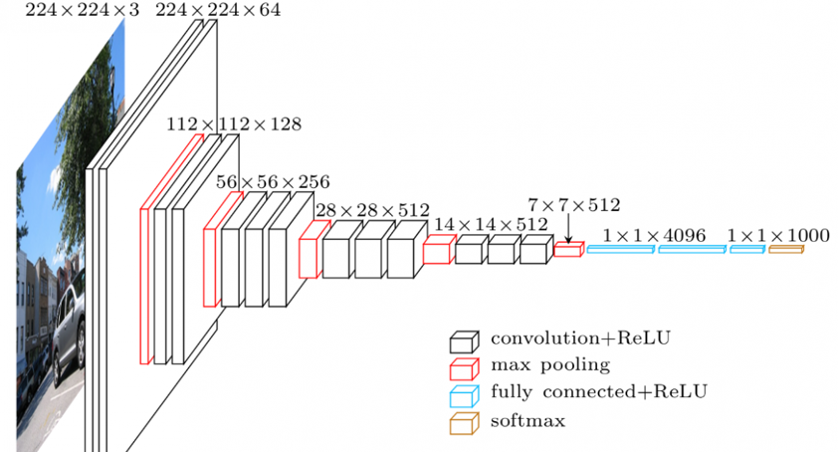
Convolutional Pooling
Convolutional layers in a neural network summarize the presence of features in an input image.
One issue with output feature maps is that they are biased towards the location of features.
A common approach to address this issue is to down-sample the feature maps.
Pooling layers provide an approach to down-sampling by summarizing the presence of features.

Slide 14
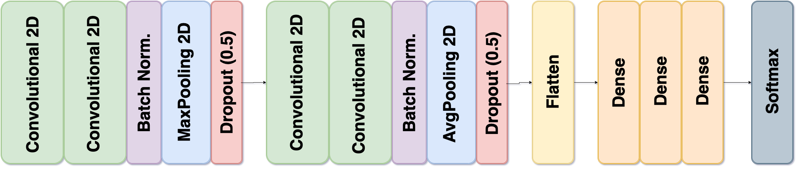
Our Model
Our final model consists of the 15 layers illustrated below.
Convolutional Pooling was used for feature extraction and down-sampling.
Dropout was used with a rate of 0.5 to combat overfitting.
After we flatten the images, 3 dense layers are used to facilitate feature learning, and an emotion is predicted through our softmax output layer.

Slide 15
Project Roadmap
Abstract & Overview
Datasets & Augmentation
Model Structure
Results & Improvements
Conclusion

Slide 16
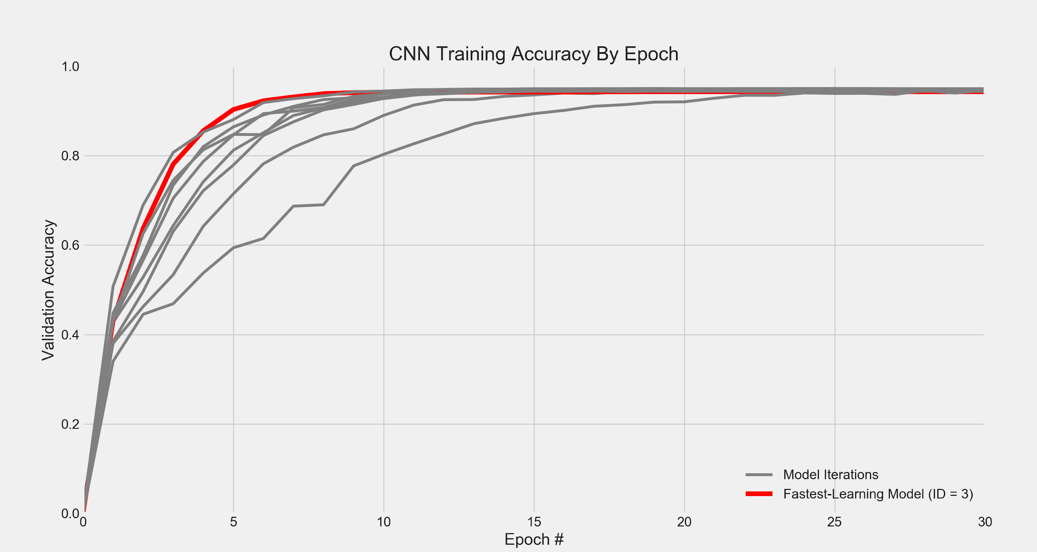
Model Iterations Analysis
We cross-validated 9 different models
across 5 folds
30 epochs each fold
All converged ~ 92% accuracy
Model 3 learned the fastest, achieving ~ 90% accuracy after only 5 epochs

Slide 17
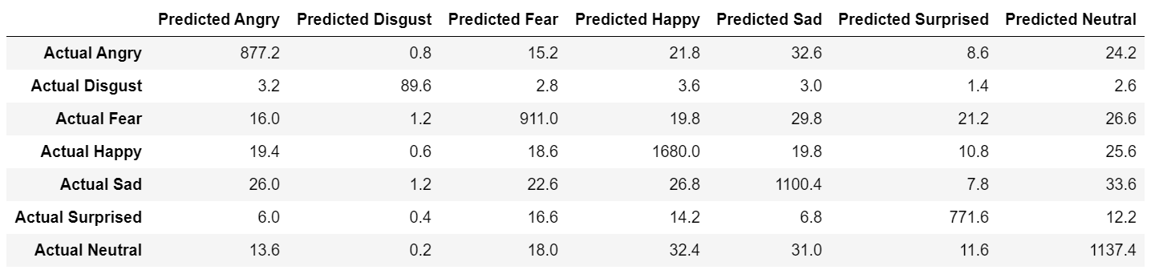
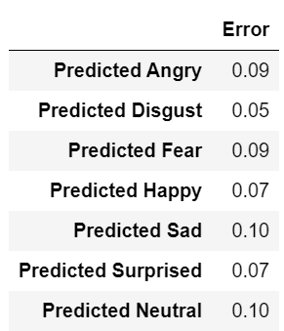
Model Results
Confusion matrix (in counts)
Error by emotion label
Average testing accuracy is 91.5%

Slide 18
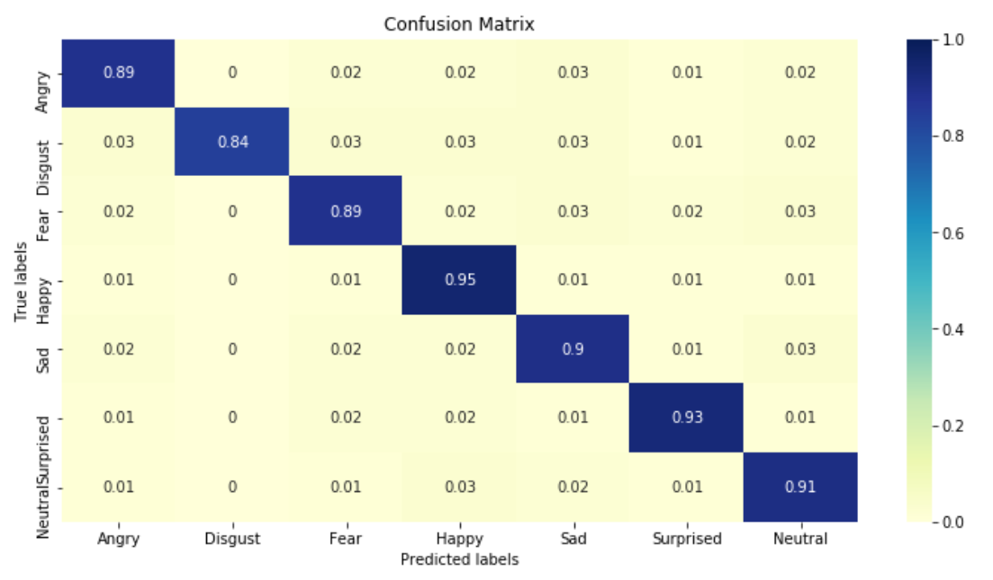
Model Results
Confusion matrix (in proportions)

Slide 19
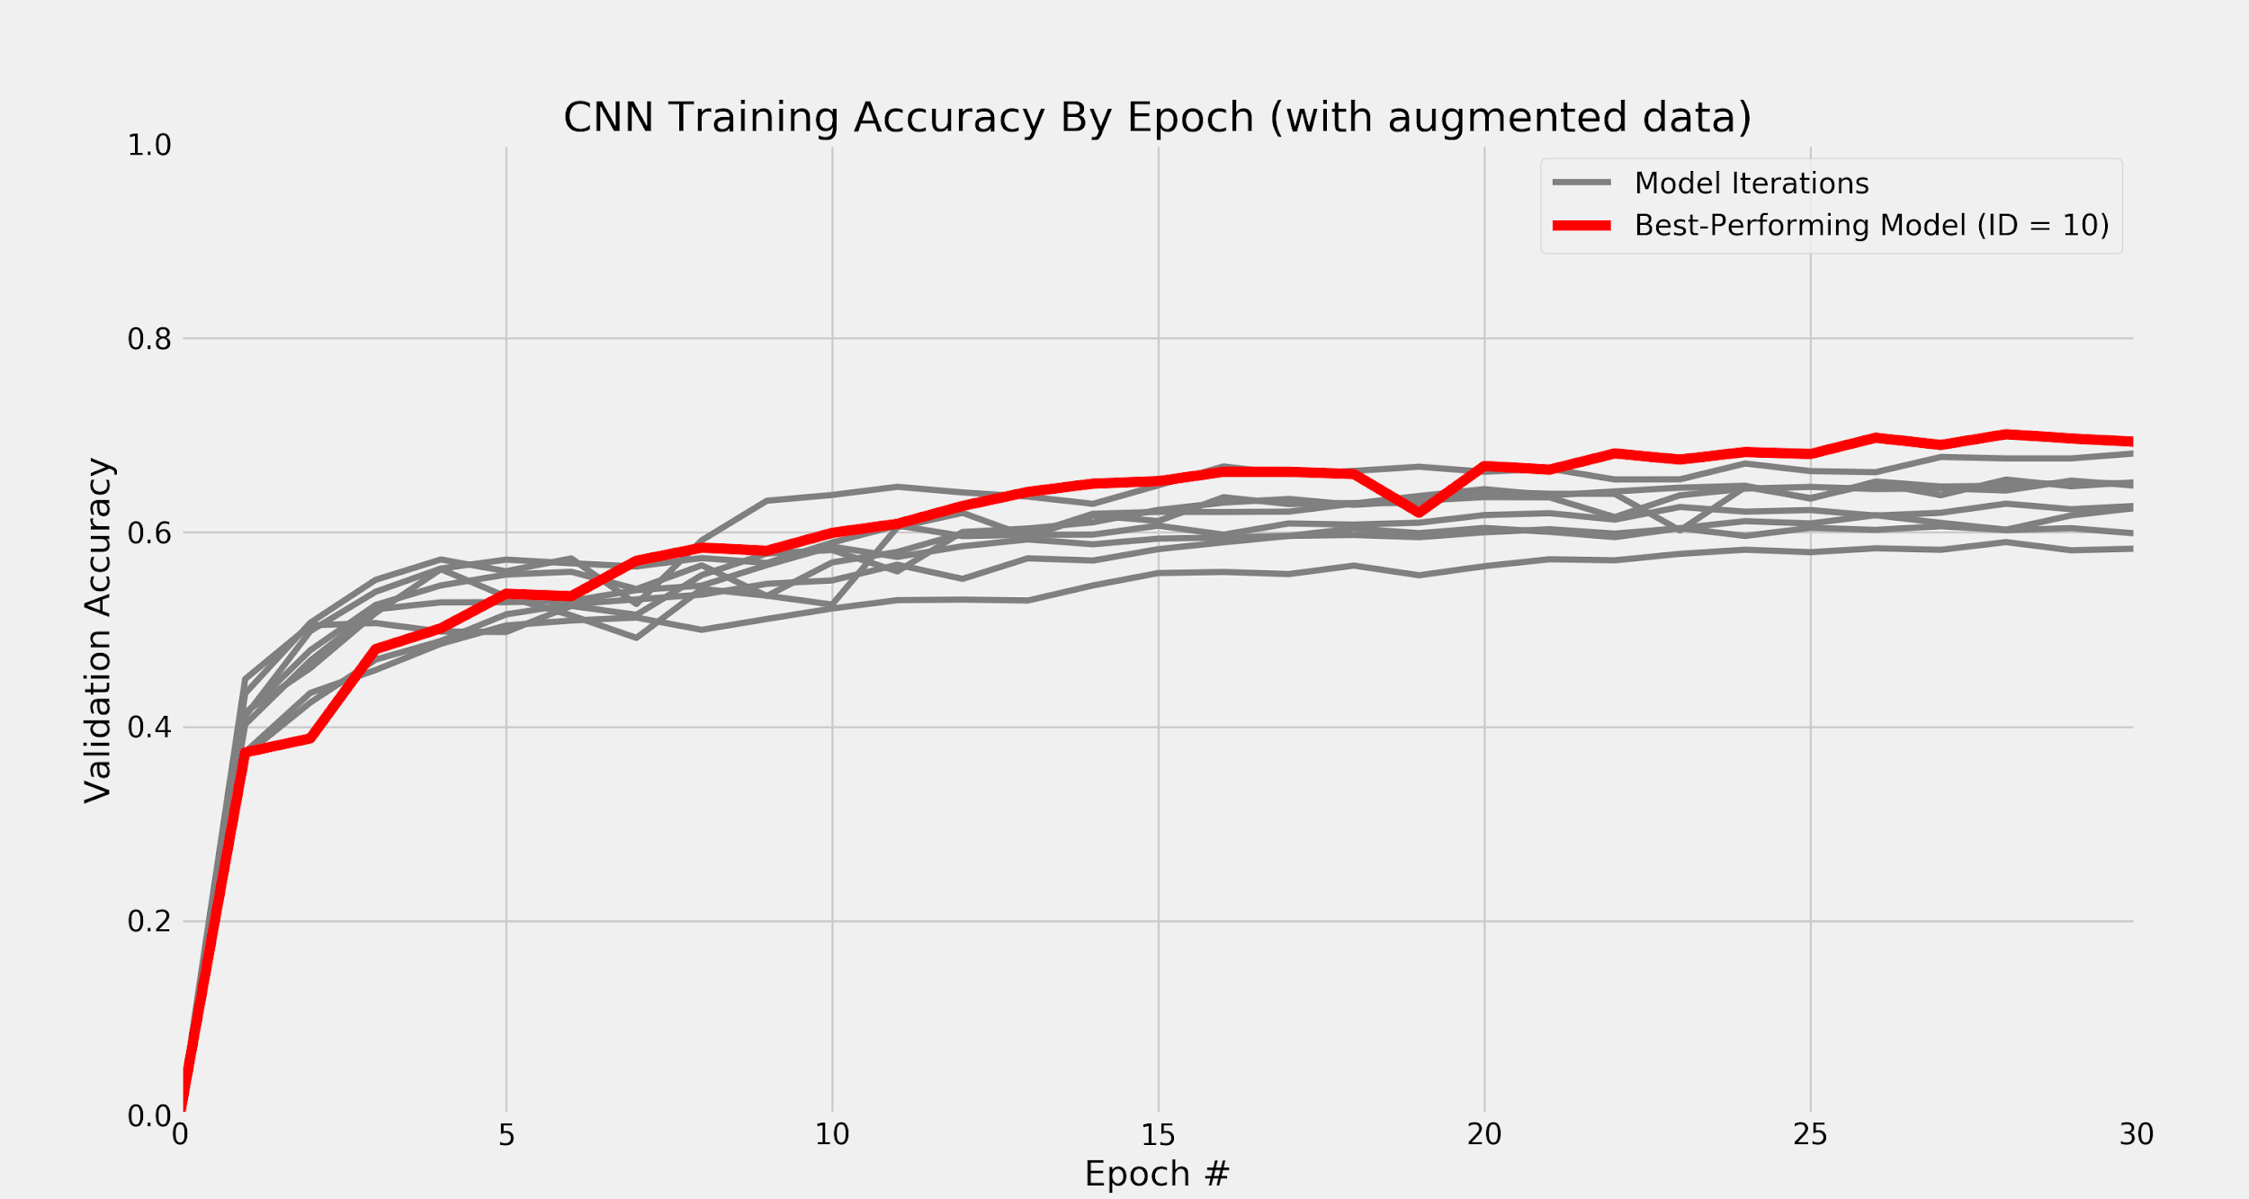
Testing our Models with Other Datasets
Our model performs very well when predicting images similar to the FER2013 dataset.
However, we did not perform so well when tested against other datasets.
Furthermore, our models all seemed to perform poorly on combined datasets with generated training sets, shown to the right.

Slide 20
Project Roadmap
Abstract & Overview
Datasets & Augmentation
Model Structure
Results & Improvements
Conclusion

Slide 21
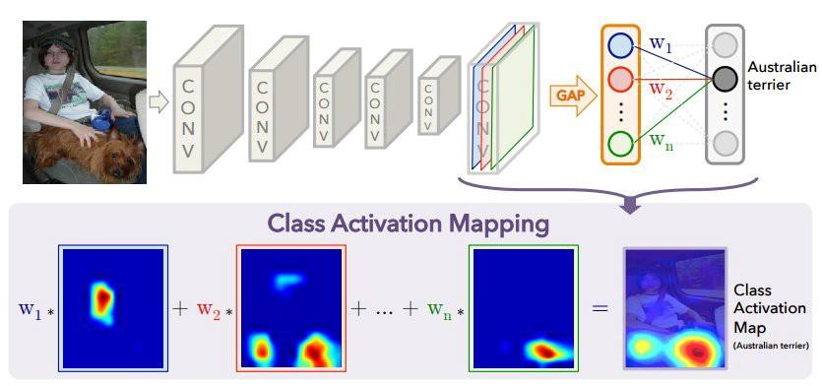
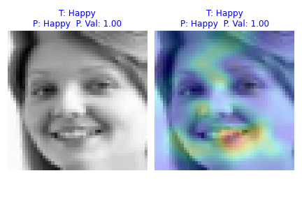
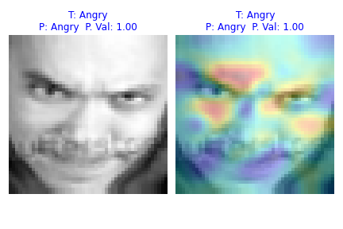
Next Steps: Class Activation Maps
Learning Deep Features for Discriminative Localization
Class Activation Maps made by finding which filters are important
Trends occur in data for specific emotions.
These trends can be used to improve on our model in the long run.
https://www.di.ens.fr/~josef/publications/Oquab15.pdf
https://arxiv.org/abs/1512.04150
Focus on eyes and Mouth
Focus on mouth and teeth
Focus on area around eyes
Notes:
Matt

Slide 22
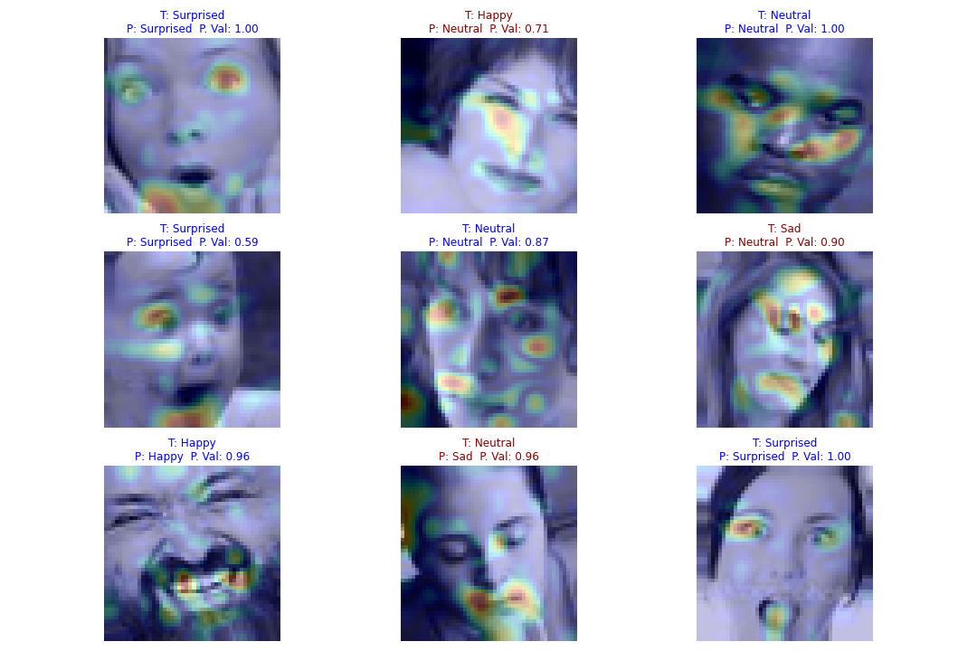
More Class Activation Maps

Slide 23

Demo: Camera Implementation

Slide 24
Summary
Our goal was to classify people's emotions through images with a decent accuracy in real time.
Our model achieves this goal with a 91.5% accuracy and performs fairly well on real time video.
We utilize Convolutional Pooling as well as Keras ImageDataGenerator to help train our model for a wider range of users.
For future projects, we would exploit Class Activation Maps, tackle the issues with combining our datasets.
One possible feature to facilitate video support would be to add LSTM to our model and factor in some features from the last several frames.

Slide 25
Questions?
Thank You

Slide 26
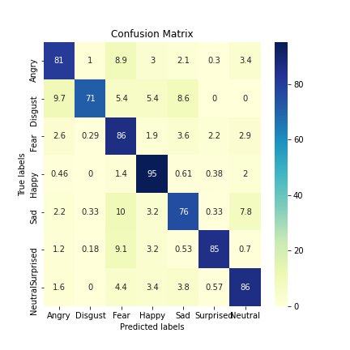
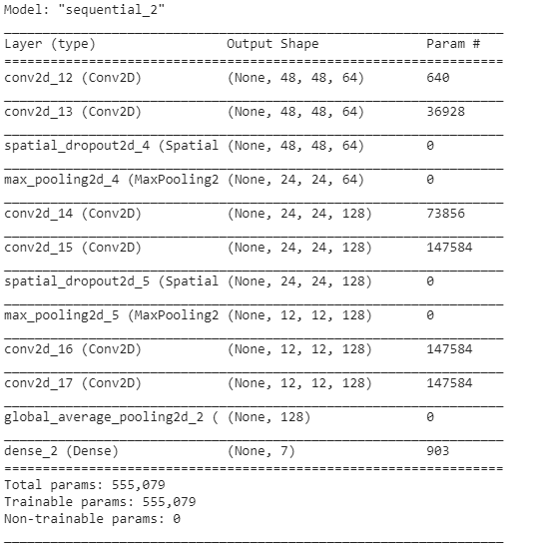
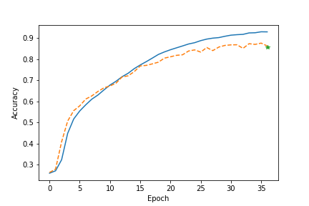
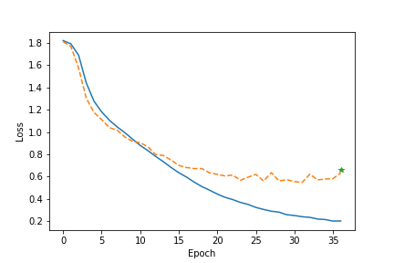
Class Activation Maps NN Structure

