Slide 1


Bioinformatics Summer School
Long-reads Transcriptomics
Mahmud Sami Aydin
Stockholm University,Sweden
LongTREC - The Long-reads TRanscriptome European Consortium
Marie Skłodowska-Curie grant agreement No 101072892

Slide 2
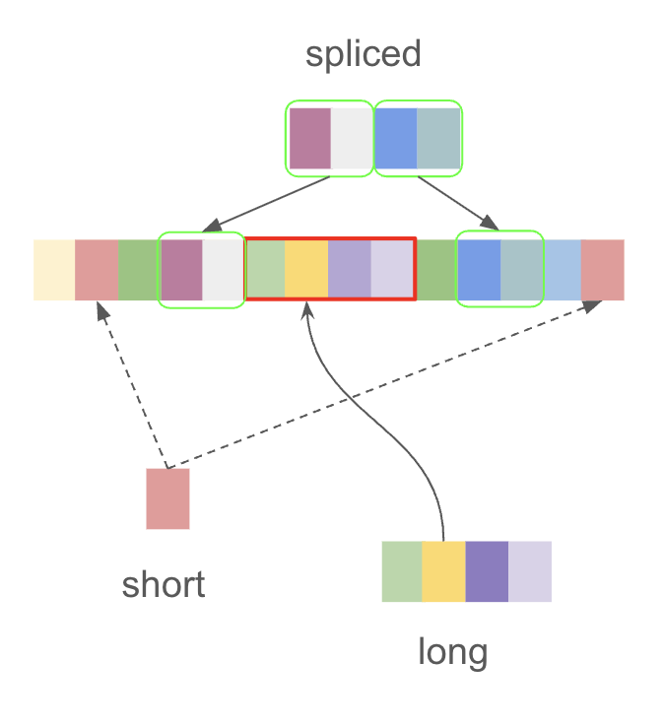
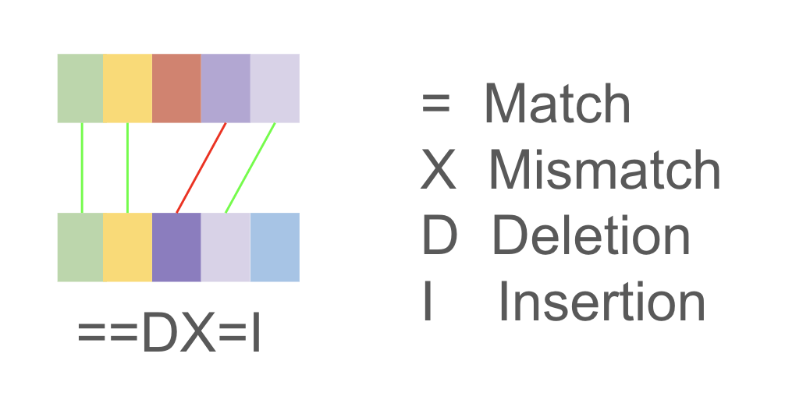
Long-reads Transcriptomics
Introduction to Mapping
Mapping is finding the location of read in reference genome
Alignment is fitting the read to location in the reference
Mapping find candidate locations, Alignment decide best one
Mapping problem includes:
- Short or long reads
- Genomic or spliced reads
Our specific problem is spliced long reads

Slide 3
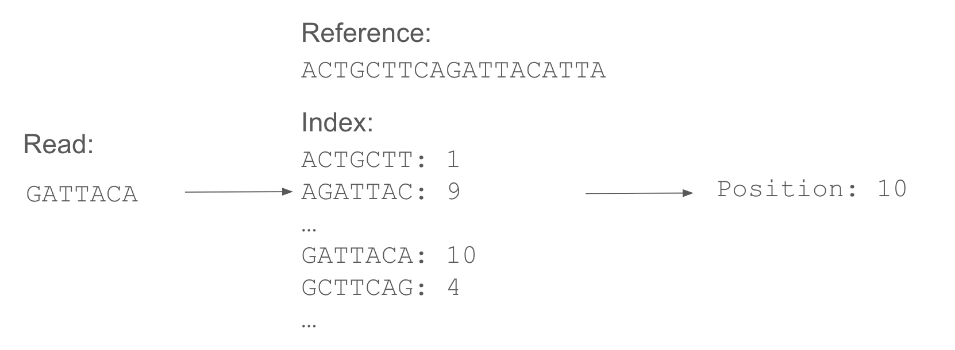
Long-reads Transcriptomics
How is the mapping done?
Key concept is indexing:
“remembering each piece of reference with its position”

Slide 4
Long-reads Transcriptomics
Is it that easy?
Conceptually yes, but:
Reads are long, storing every possible reads with length of 1000 nucleotide requires 4¹⁰⁰⁰ entry.
Every entry become bigger than 125 Byte. Therefore, index size become more than 250 GB for human genome.
Also, in this case we assume reads has fixed length and perfectly match with reference.
In reality, read length is not fixed and there are read errors as well as variation between individuals

Slide 5
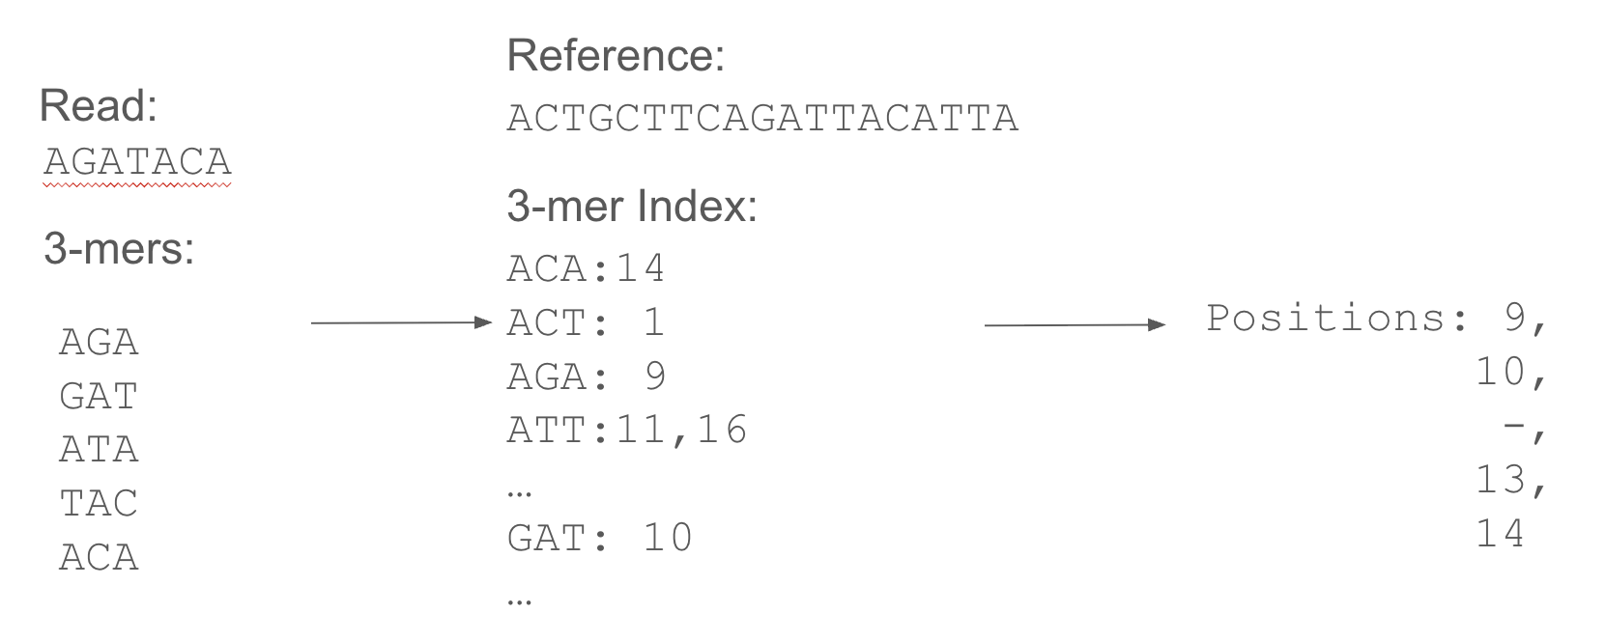
Long-reads Transcriptomics
How can we tolerate the error?
Instead of searching whole read, search pieces (seeds) in read.
Simplest way is using k-mers (k consecutive nucleotides)
Intuitively we see, position of the read around 9 to 16 but what is algorithmic way?

Slide 6
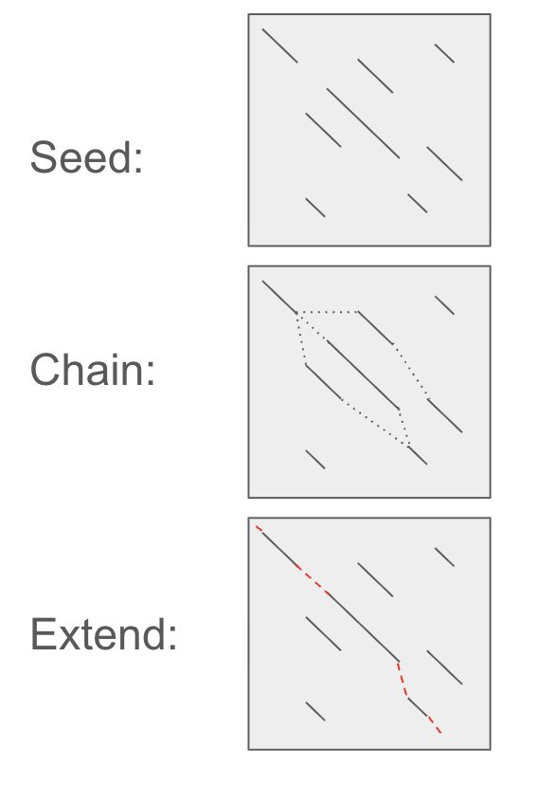
Long-reads Transcriptomics
Seed-Chain-Extend Method
Three step method that find the mapping:
Seeding: Finding the small pieces of read in reference
Chaining: Make optimal chain of seeds by dynamic programming
Extending: Getting whole map by considering margins
This method is not only tolerating the errors or variations
but also splicing by allowing gaps between seeds.

Slide 7
Long-reads Transcriptomics
How should we choose k?
Let’s start with extreme points:
What if we choose k = 1:
We see A,C,G,T everywhere. Chaining is almost impossible since every read contains every 1-mer random position in reference
Probably everything will be mapped everywhere
What if we choose k = 1000:
As discussed previously, it is not error tolerant.
Also, it requires a lot of memory.
What if we choose k = 5:
There are 4⁵ possible k-mer.
Expected random occurrences of every k-mer is around 1000. Therefore, it is too small for our search space
What if we choose k = 15:
It is good enough to eliminate having too many seed.
it can tolerate splicing and errors.

Slide 8
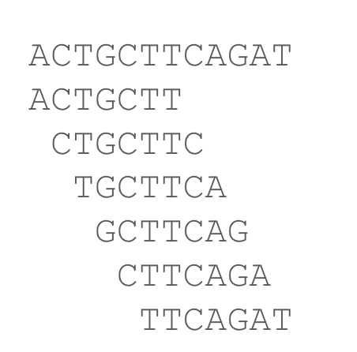
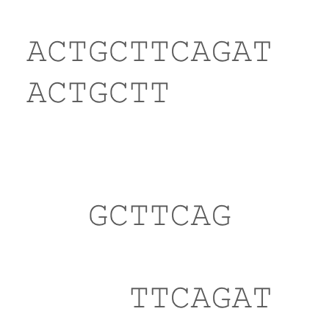
Long-reads Transcriptomics
Is there better way than k-mer index for memory?
K-mer index contains too many repeated information.
Redundancy is good for error tolerance,
But storing too much for small amount of information is problematic
Consistently, selecting some of k-mers provide efficient memory usage
This is called subsampling.
Some subsampling methods are:
Minimizer, Syncmer, Strobemer

Slide 9
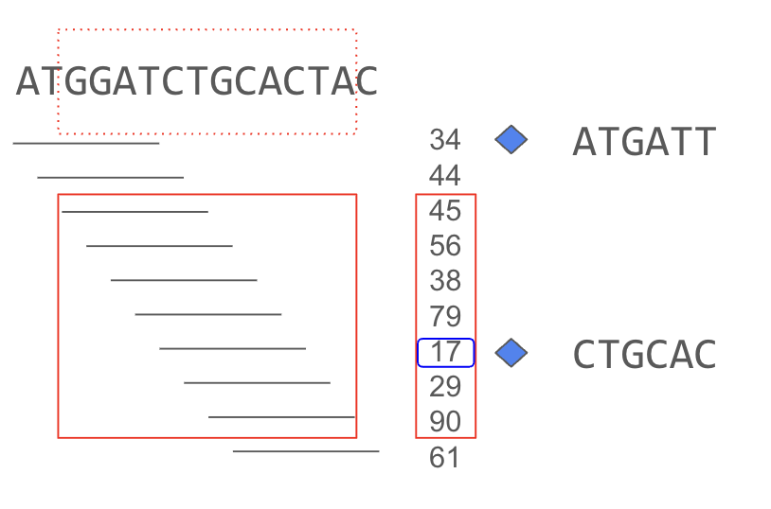
Long-reads Transcriptomics
Minimizer Method
In a context window with size of w smallest k-mer
According to a hash function is selected
as representative of that window.
Each representative k-mer is called minimizer.
In example,
Reference is on top row
Hash function is in the middle column
Blue diamonds show minimizers with their k-mers
w = 12
k = 6

Slide 10
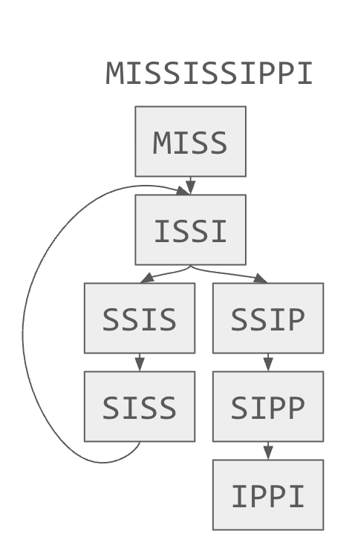
Long-reads Transcriptomics
A graph-based index: de Bruijn Graph
Instead of linear index, having a graph-based index can highlights repetitions and continuations which make search easier.
One graph-based index is de Bruijn Graph:
Making graph of k-mers that are node and adjacent k k-mers has edge between them.
In example,
Graph of Mississippi is generated with k = 4.
We also can search 6-mers with two stepping in one query.

Slide 11
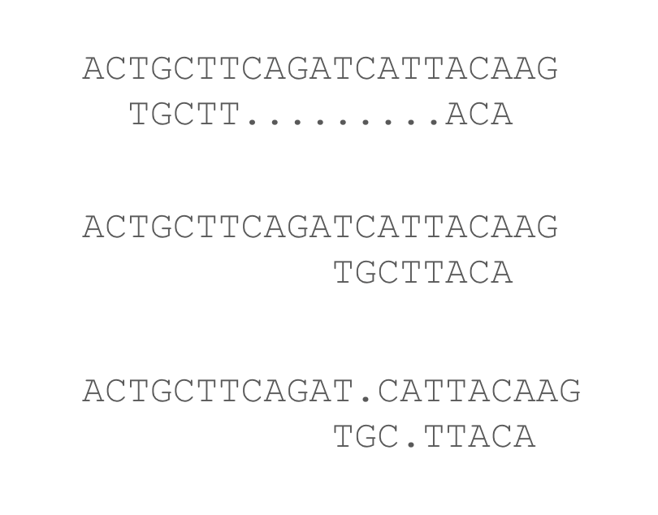
Long-reads Transcriptomics
How does alignment decide best location?
It is completely according to scoring criteria
If gap extension penalty is low, first one become best
like in spliced alignment
If mismatch penalty is low, second one become best
If gap opening penalty is low, last one become best
Therefore, context is import for alignment parameters

Slide 12
Long-reads Transcriptomics
Mapping Tools for Splice long-read RNA
minimap2:
Minimizers
Seed-Chain-Extend
deSALT:
de Bruijn Graph
Sparse Dynamic Programming
Local Refinements
uLTRA:
Seed-Chain-Extend
Multiple Chaining

Slide 13
Long-reads Transcriptomics
Comparison between Tools
minimap2:
State of the art for genomic reads
Low memory consumption
Weakness of short exon detection
deSALT:
Better than minimap2 for short exons
Construction of de Bruijn takes significant times and memory but required ones
Better query time with some limitations
uLTRA:
Good for extremely short exons
It requires more time than others

Slide 14
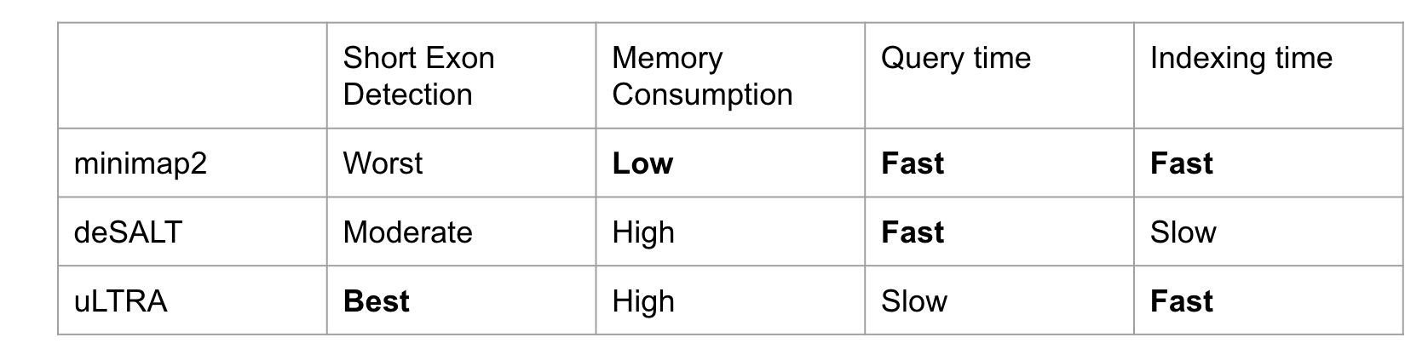
Long-reads Transcriptomics
Comparison between Tools
In hands-out session, we will run minimap2 and uLTRA

Slide 15
Long-reads Transcriptomics
Questions
What is the difference between mapping and alignment?
How should we change k value if long read technology has lower error rate?
What is the strategy that provides efficient memory usage ?

Slide 16


Thank You!
For more information about the LongTREC Summer School:
https://longtrec.eu

