Slide 1
Topic 13 ENTROPY
Thermodynamics: An Engineering Approach
8th Edition Yunus A. Çengel, Michael A. Boles
McGraw-Hill, 2015

Slide 2
Objectives
Apply the second law of thermodynamics to processes.
Define a new property called entropy to quantify the second-law effects.
Establish the increase of entropy principle.
Calculate the entropy changes that take place during processes for pure substances.

Slide 3
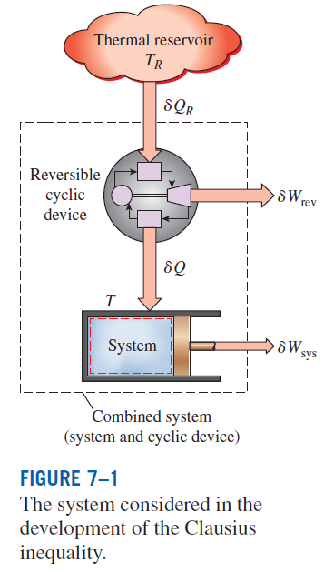
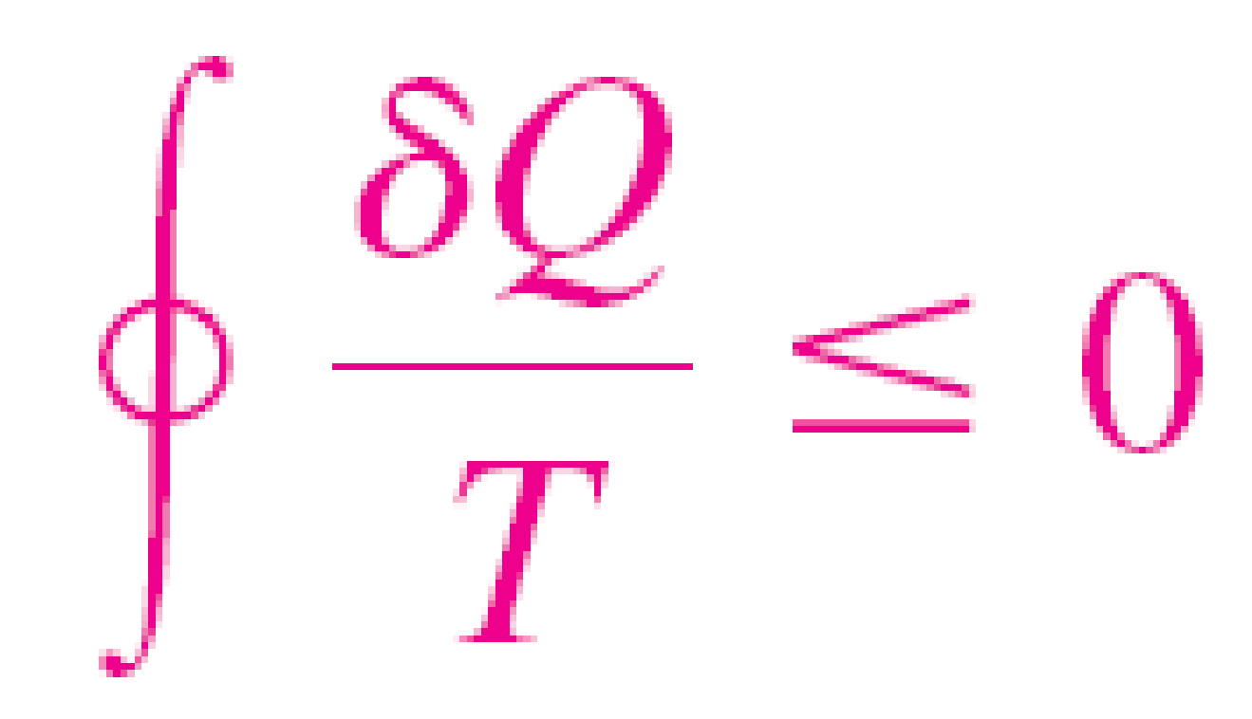
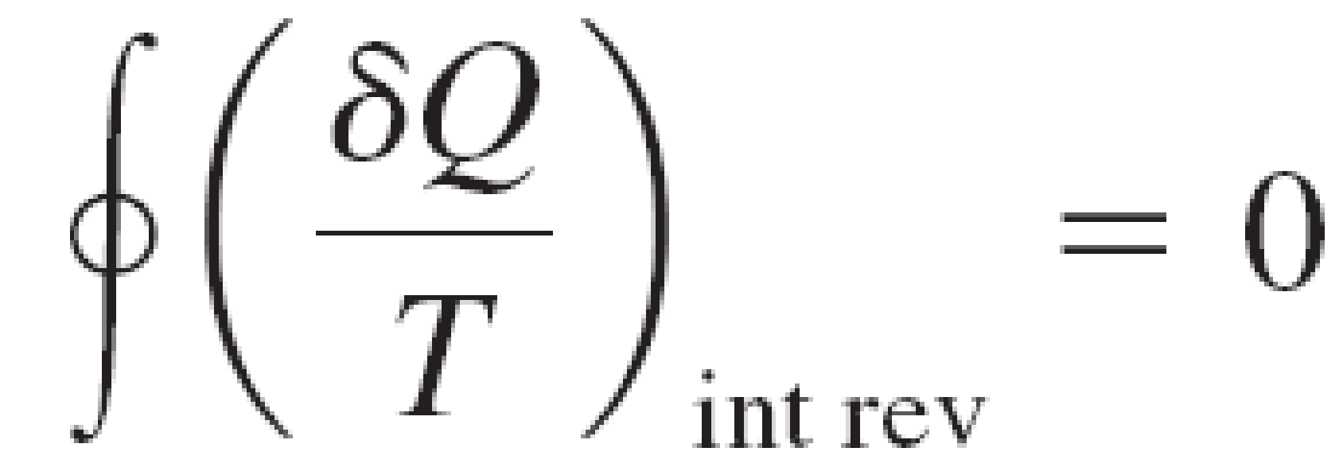
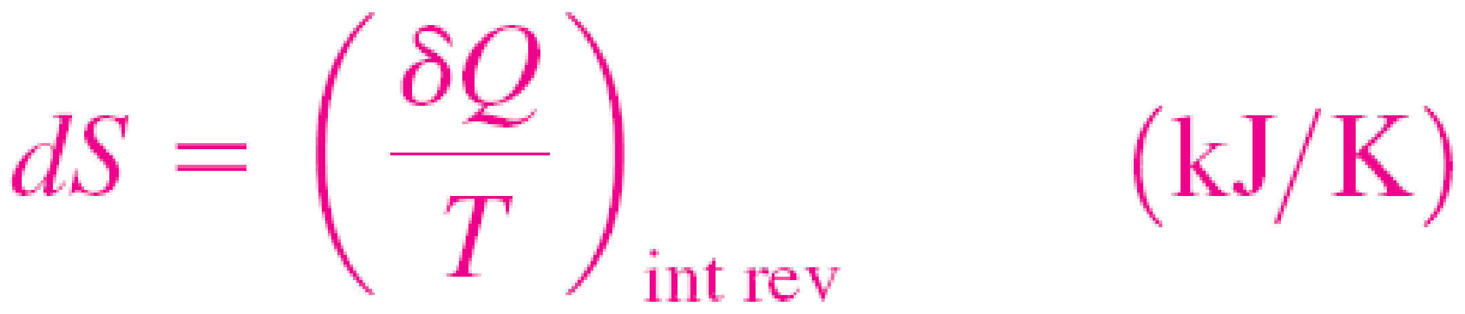
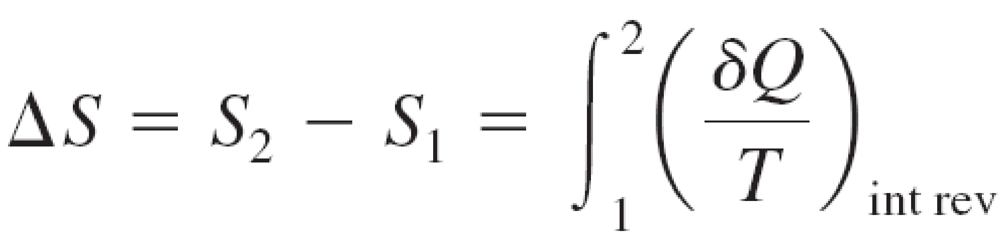
ENTROPY
Clausius inequality
Formal definition of entropy
The equality in the Clausius inequality holds for totally or just internally reversible cycles and the inequality for the irreversible ones.

Slide 4
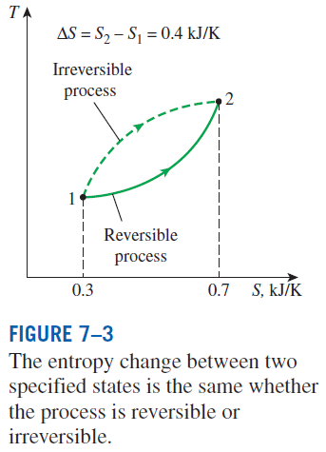
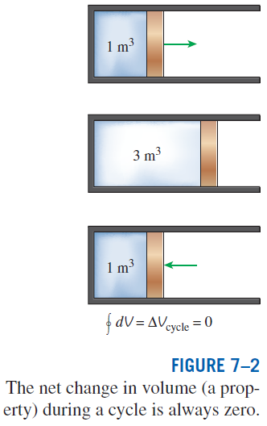
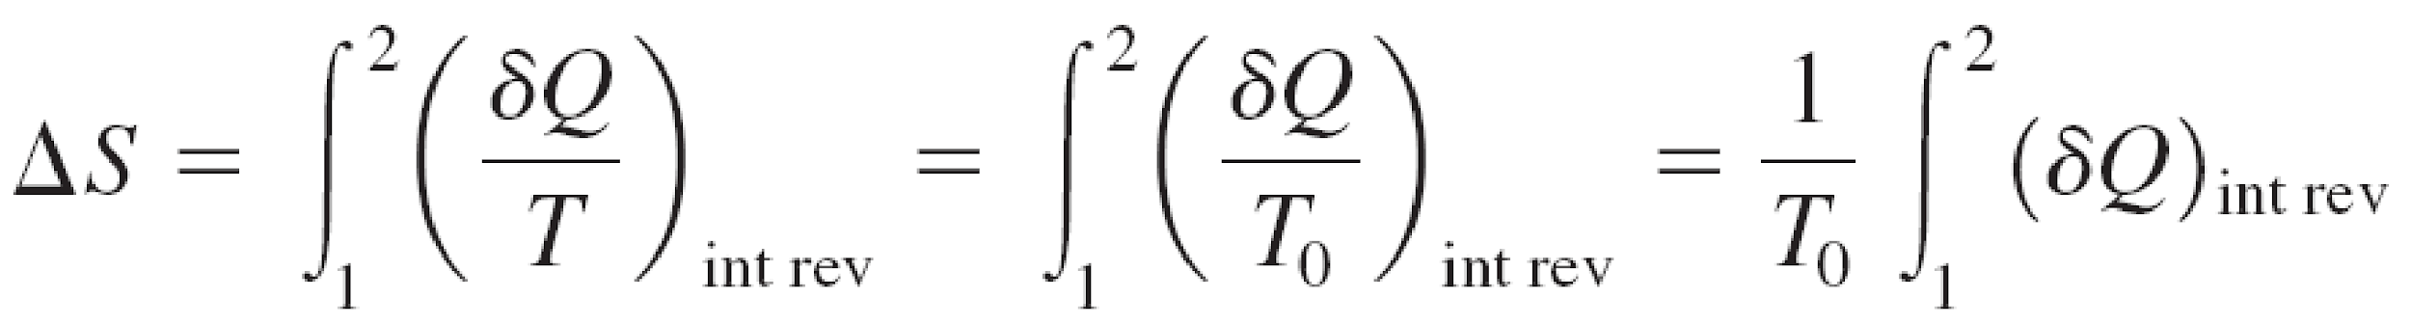
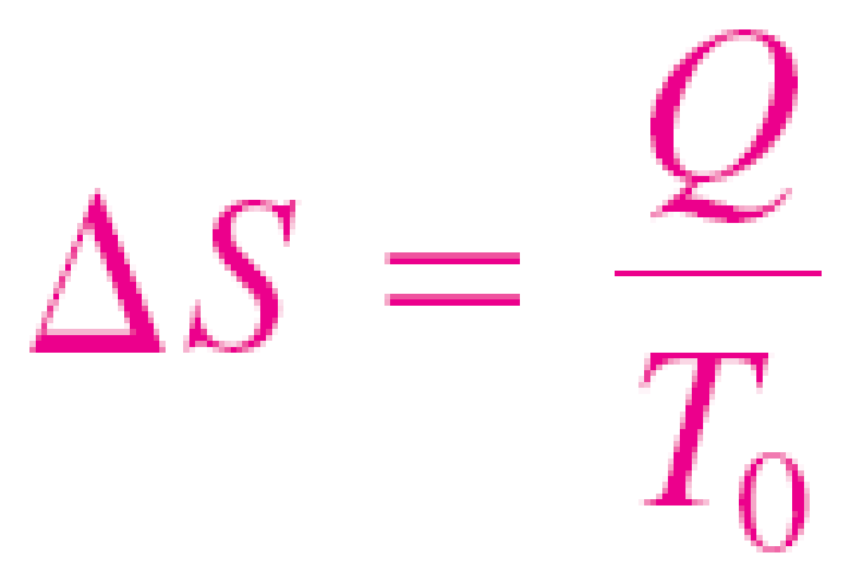
A quantity whose cyclic integral is zero (i.e., a property like volume)
Entropy is an extensive property of a system.
A Special Case: Internally Reversible
Isothermal Heat Transfer Processes
This equation is particularly useful for determining the entropy changes of thermal energy reservoirs.

Slide 5
Entropy Change Example
Solution
A piston cylinder device contains a liquid-vapor mixture of water at 27°C. During a constant pressure process, 750 kJ of heat is transferred to the water. As a result, part of the liquid in the cylinder vaporizes. Determine the entropy change of the water during this process.

Slide 6
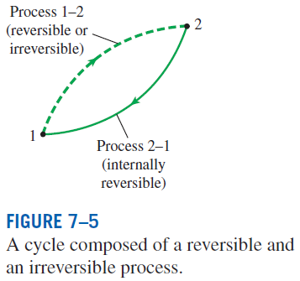


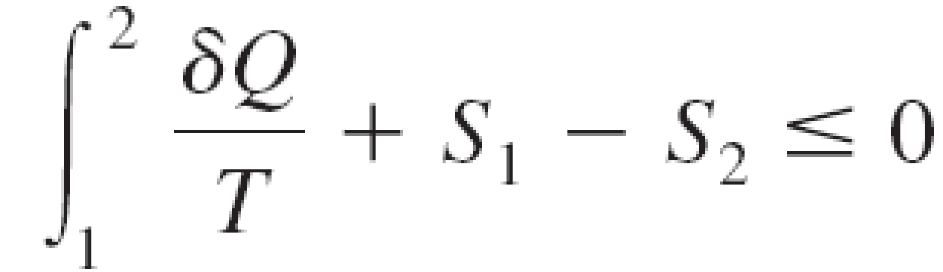

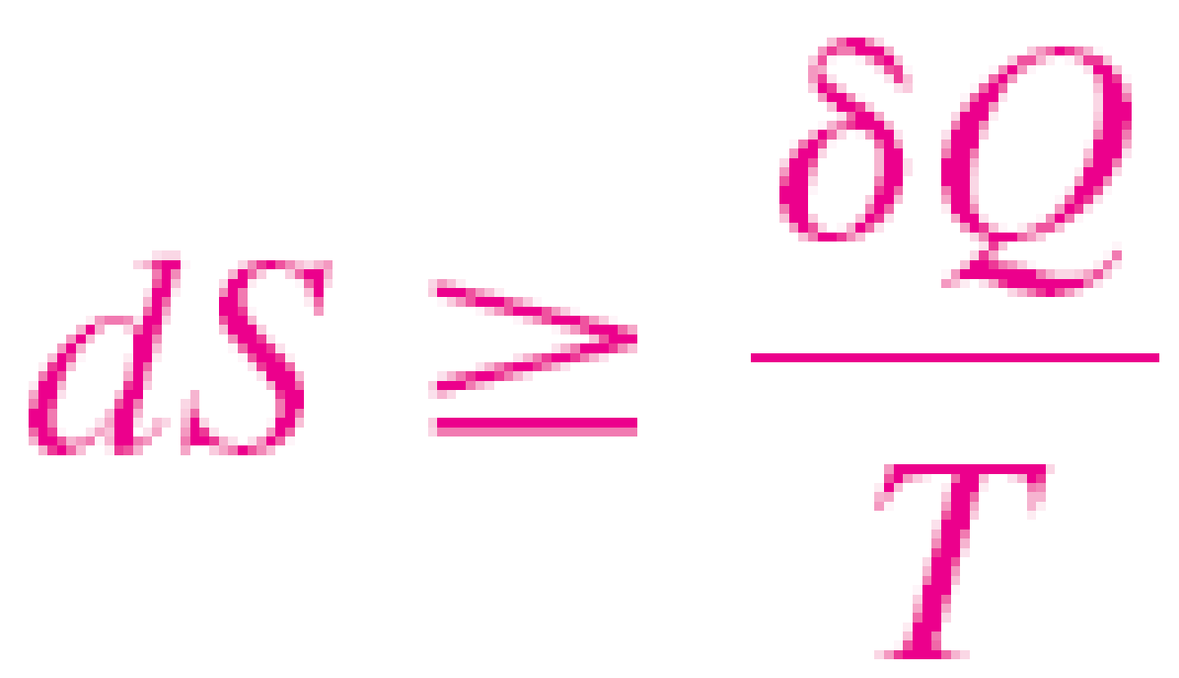
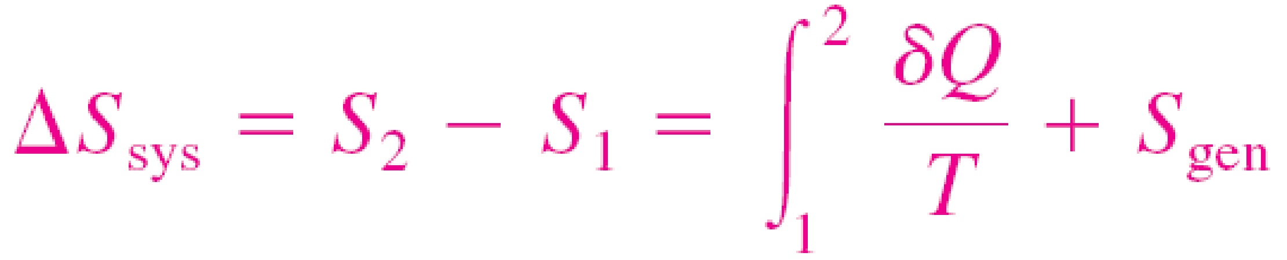
THE INCREASE OF ENTROPY PRINCIPLE
The equality holds for an internally reversible process and the inequality for an irreversible process.
Some entropy is generated or created during an irreversible process, and this generation is due entirely to the presence of irreversibilities.
The entropy generation S_{gen} is always a positive quantity or zero.
Can the entropy of a system during a process decrease?

Slide 7
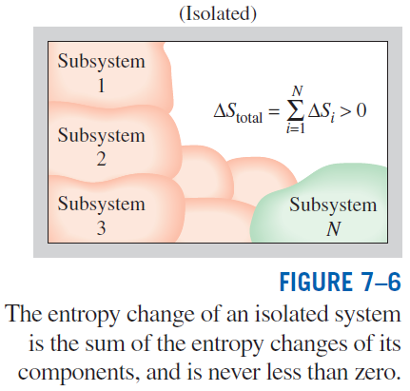
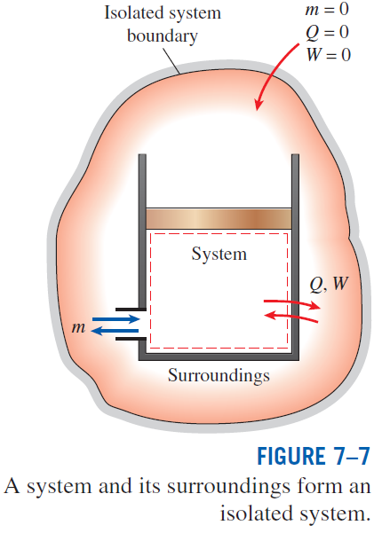
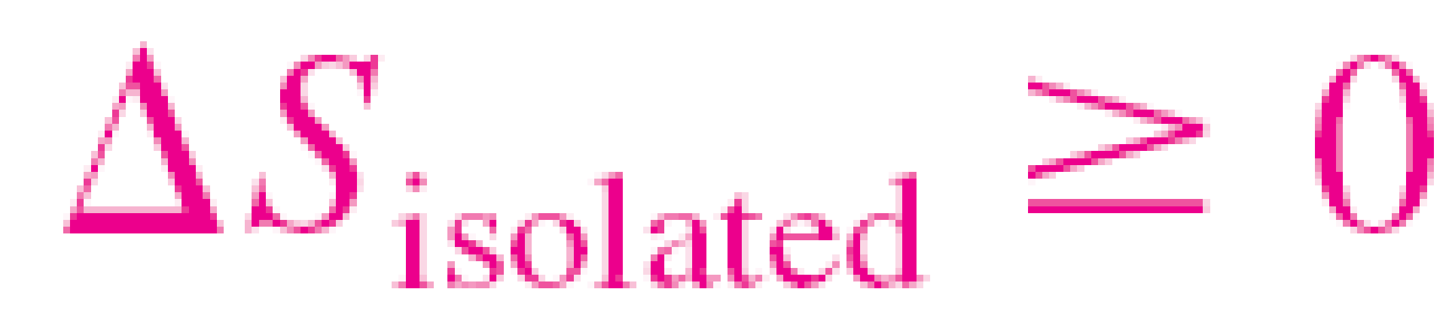
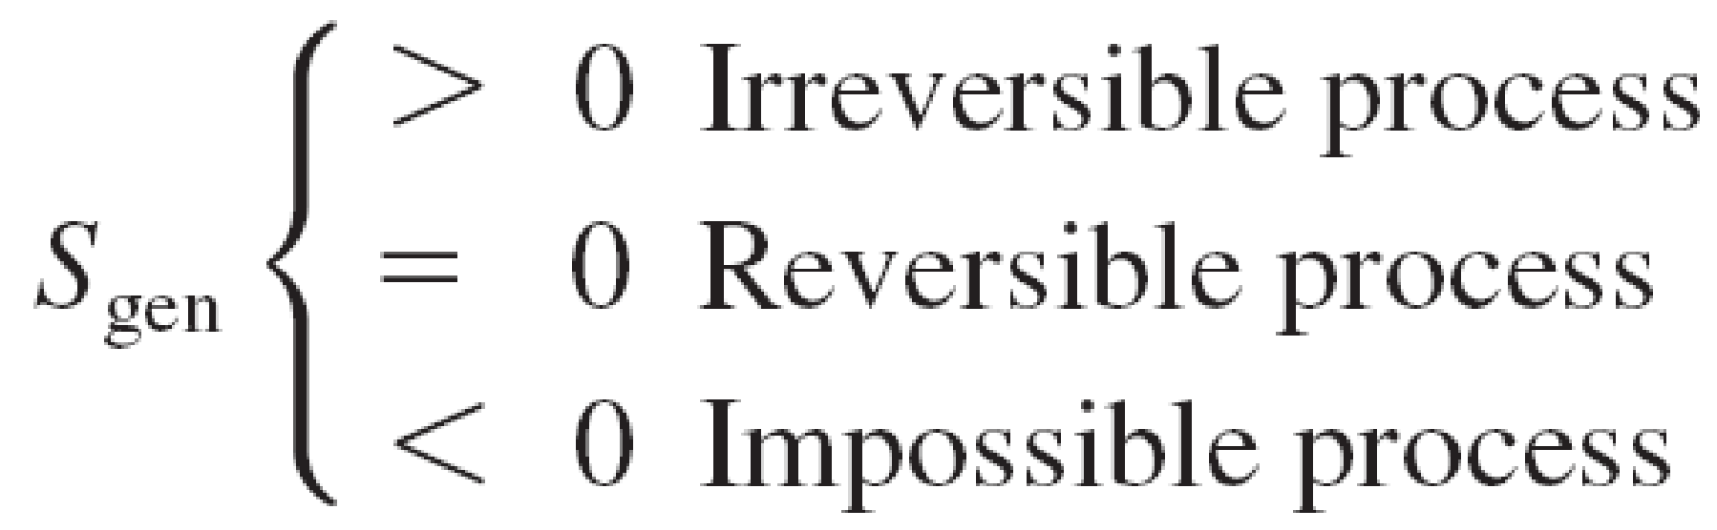
The increase of entropy principle

Slide 8
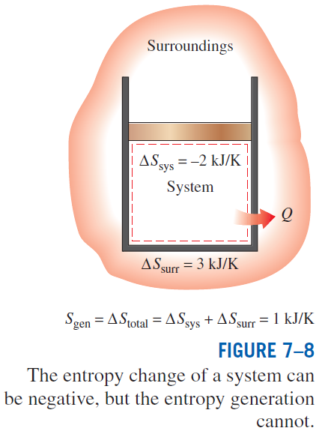
Some Remarks about Entropy
Processes can occur in a certain direction only, not in any direction. A process must proceed in the direction that complies with the increase of entropy principle, that is, S_{gen} ≥ 0. A process that violates this principle is impossible.
Entropy is a nonconserved property, and there is no such thing as the conservation of entropy principle. Entropy is conserved during the idealized reversible processes only and increases during all actual processes.
The performance of engineering systems is degraded by the presence of irreversibilities, and entropy generation is a measure of the magnitudes of the irreversibilities during that process. It is also used to establish criteria for the performance of engineering devices.

Slide 9
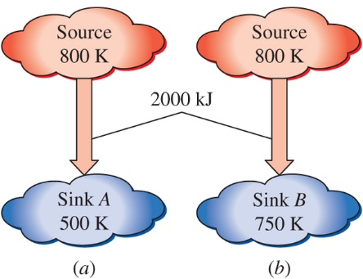
Entropy Generation during Heat Transfer
Solution
A heat source at 800 K loses 2000 kJ of heat to a sink at 500 K and at 750 K. Determine which heat transfer process is more irreversible.

Slide 10
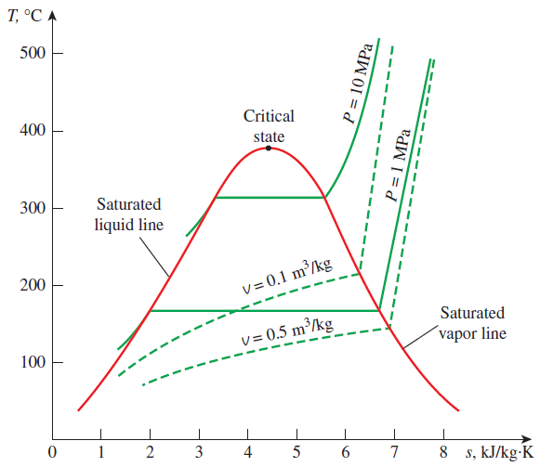
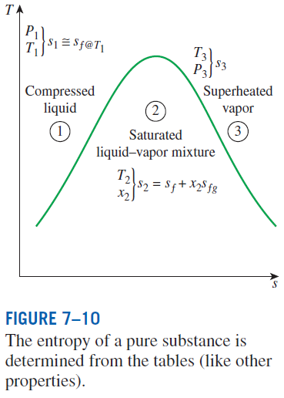

ENTROPY CHANGE OF PURE SUBSTANCES
Entropy is a property, and thus the value of entropy of a system is fixed once the state of the system is fixed.
Entropy change

Slide 11
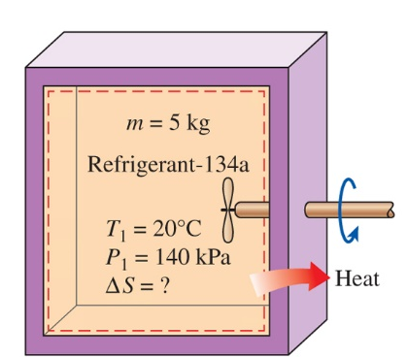
Entropy Change of a Substance in a Tank
Solution
A rigid tank contains 5 kg of R-134a initially at 20ºC and 140 kPa. The R-134a is now cooled while being stirred until its pressure drops to 100 kPa. Determine the entropy change of the R-134a during this process.

Slide 12
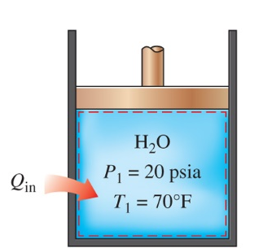
Entropy Change during a Constant Pressure Process
Solution
A piston cylinder device initially contains 3 lbm of liquid water at 20 psia and 70°F. The water is now heated at constant pressure by the addition of 3450 Btu of heat. Determine the entropy change of the water during this process.

Slide 13

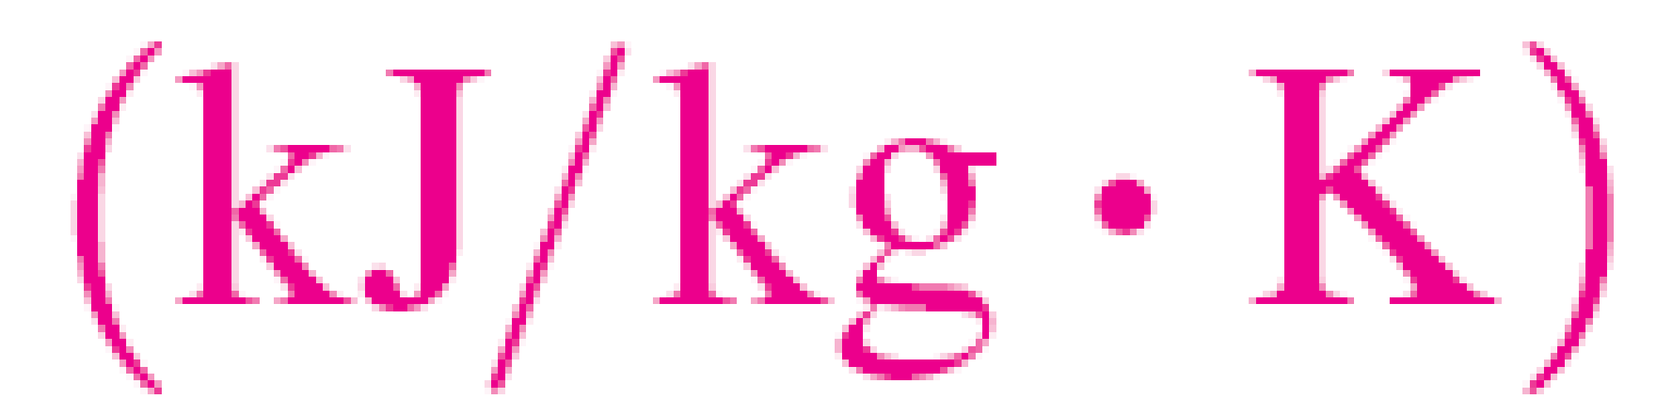
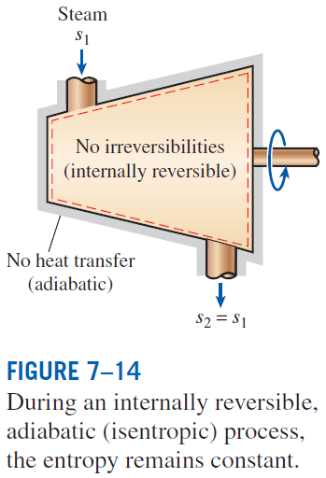
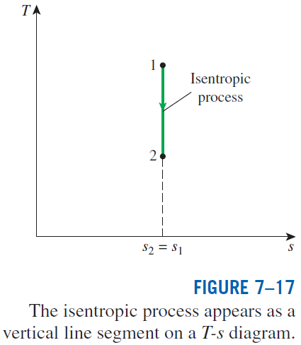
ISENTROPIC PROCESSES
A process during which the entropy remains constant is called an isentropic process.

Slide 14
Expansion of Steam in a Turbine
Solution
Steam enters an adiabatic turbine at 5 MPa and 450°C and leaves at a pressure of 1.2 MPa. Determine the work output of the turbine per unit mass of steam if the process is reversible.

Slide 15
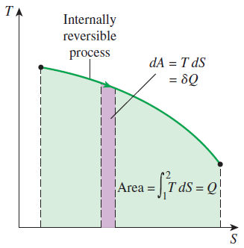
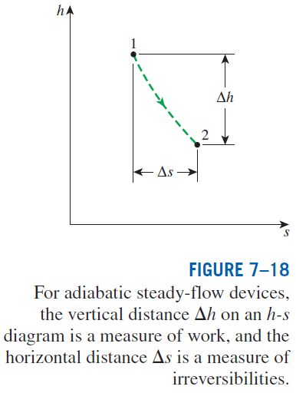
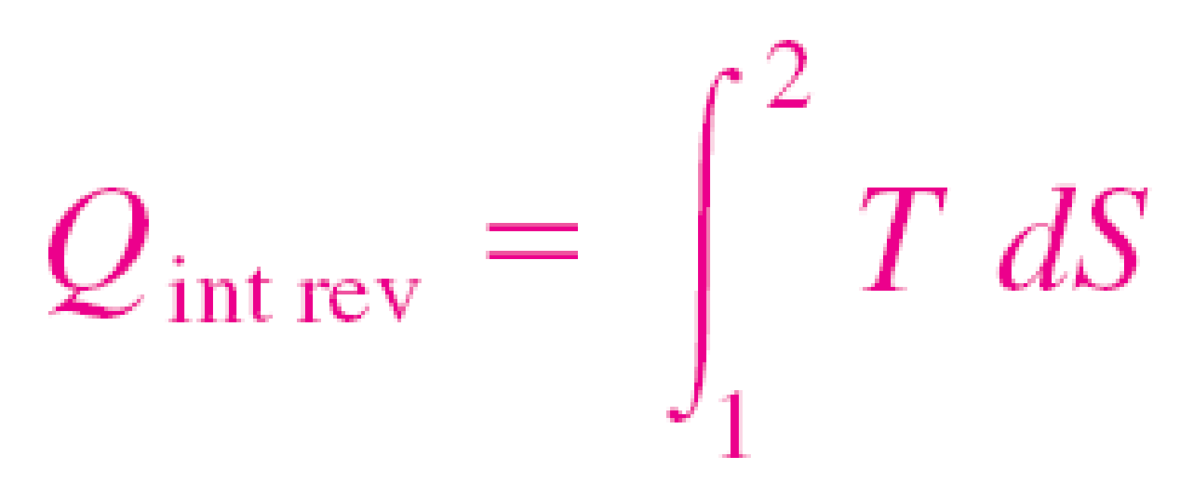

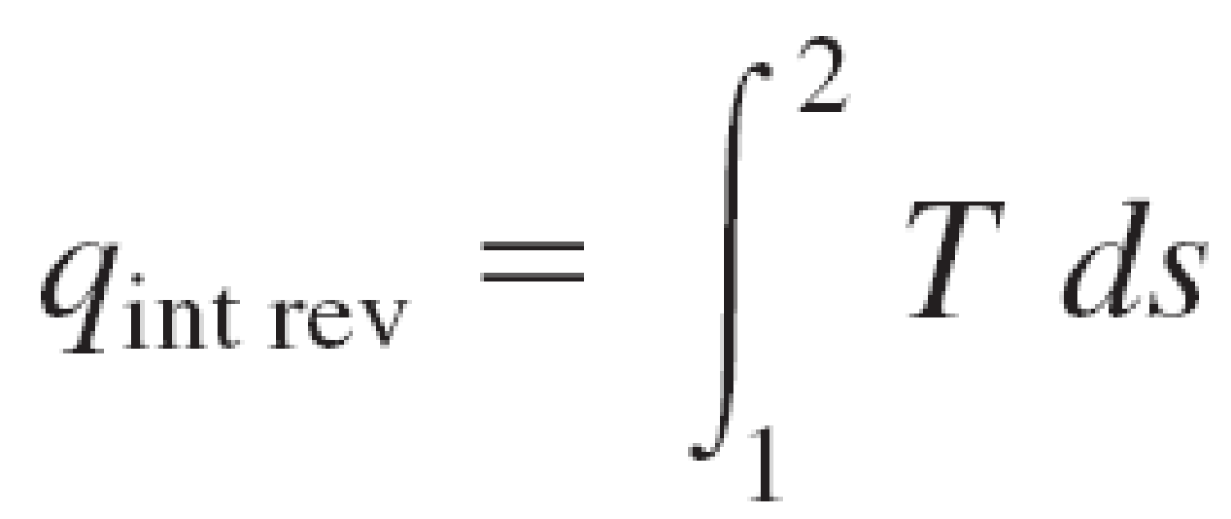
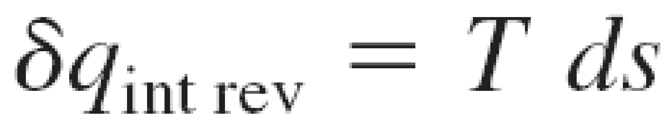

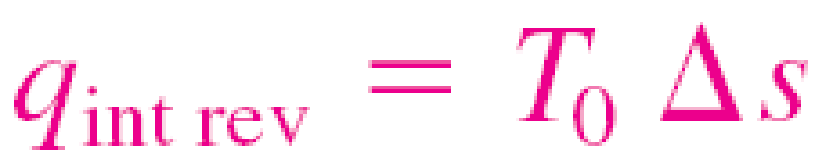
PROPERTY DIAGRAMS INVOLVING ENTROPY
On a T-S diagram, the area under the process curve represents the heat transfer for internally reversible processes.
Mollier diagram: The h-s diagram

Slide 16

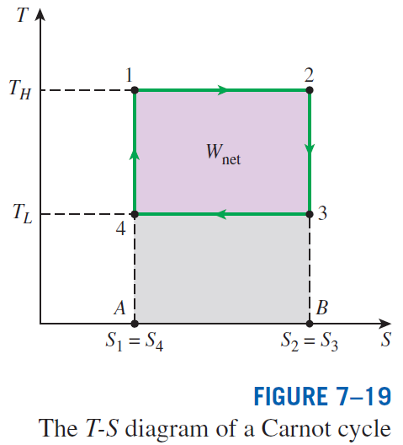

Slide 17
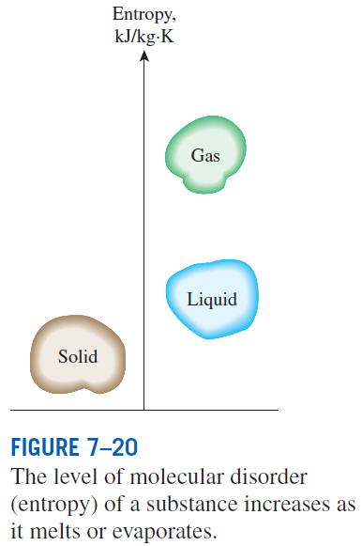


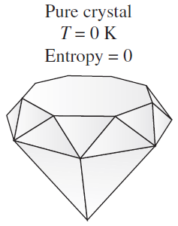
WHAT IS ENTROPY?
Boltzmann relation
W the total number of possible relevant microstates of the system
Gibbs’ formulation
p_{i} sum of all microstates’ uncertainties, i.e., probabilities
Boltzmann constant
A pure crystalline substance at absolute zero temperature is in perfect order, and its entropy is zero (the third law of thermodynamics).

Slide 18
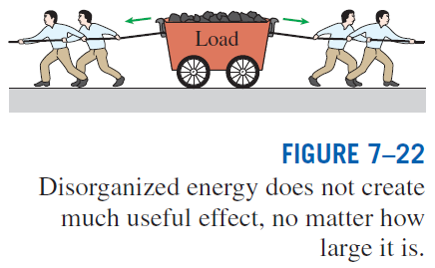
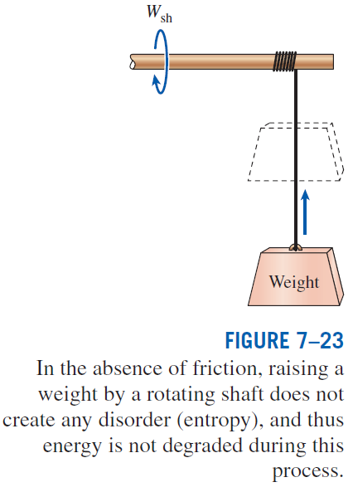

Slide 19
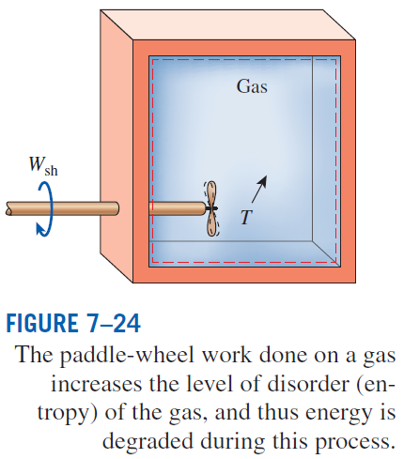
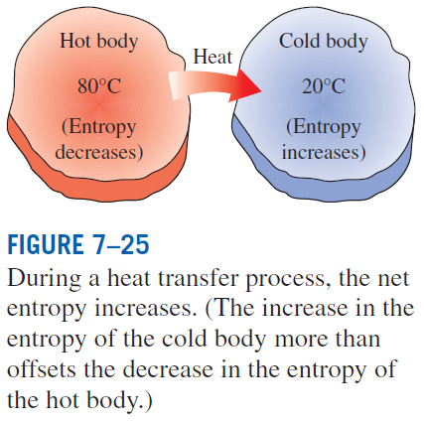

Slide 20
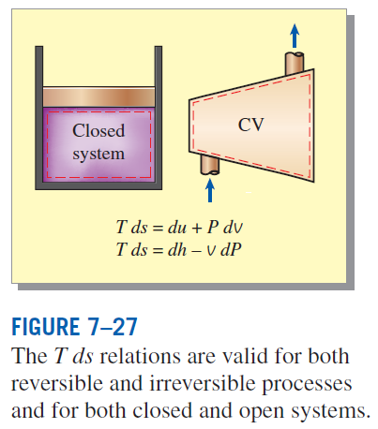
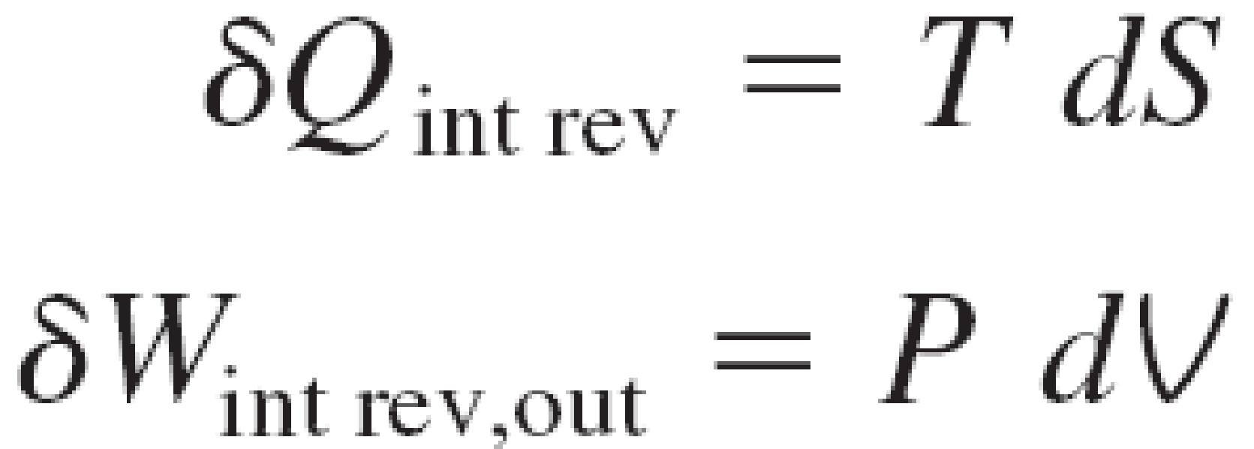

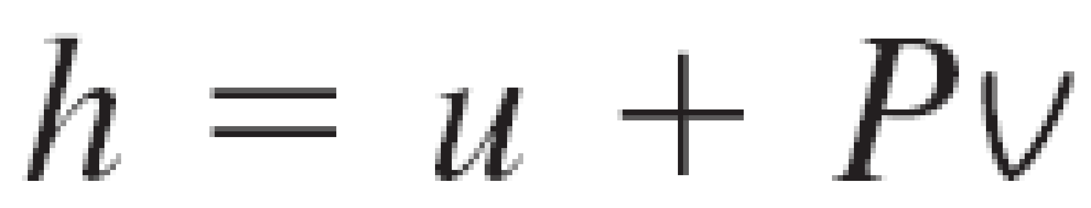


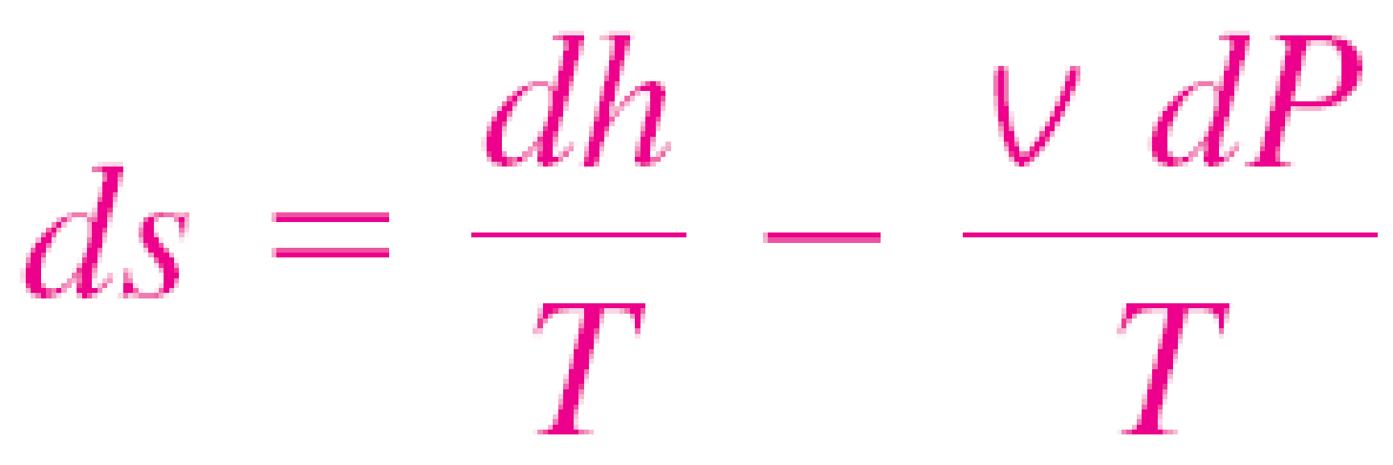
THE T ds RELATIONS
the first T ds, or Gibbs equation
the second Tds equation
Differential changes in entropy in terms of other properties

Slide 21
Summary
Entropy
The Increase of entropy principle
Entropy change of pure substances
Isentropic processes
Property diagrams involving entropy
What is entropy?
The Tds relations

