Slide 1
Topic 1 INTRODUCTION
Thermodynamics: An Engineering Approach
8th Edition Yunus A. Çengel, Michael A. Boles
McGraw-Hill, 2015

Slide 2
Objectives
Identify the unique vocabulary associated with thermodynamics through the precise definition of basic concepts to form a sound foundation for the development of the principles of thermodynamics.
Review the metric SI and the English unit systems.
Explain the basic concepts of thermodynamics such as system, state, state postulate, equilibrium, process, and cycle.
Review concepts of temperature, temperature scales, pressure, and absolute and gauge pressure.
Introduce an intuitive systematic problem-solving technique.

Slide 3
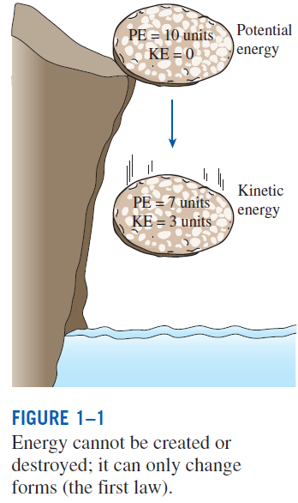
THERMODYNAMICS AND ENERGY
Thermodynamics: The science of energy.
Energy: The ability to cause changes.
The name thermodynamics stems from the Greek words therme (heat) and dynamis (power).
Conservation of energy principle: During an interaction, energy can change from one form to another but the total amount of energy remains constant.
Energy cannot be created or destroyed.
The first law of thermodynamics: An expression of the conservation of energy principle.
The first law asserts that energy is a thermodynamic property.

Slide 4
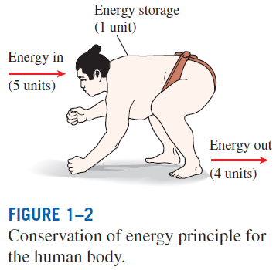
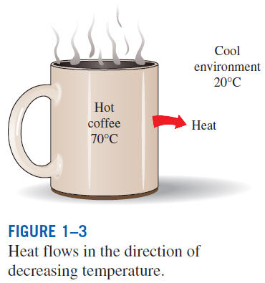
The second law of thermodynamics: It asserts that energy has quality as well as quantity, and actual processes occur in the direction of decreasing quality of energy.
Classical thermodynamics: A macroscopic approach to the study of thermodynamics that does not require a knowledge of the behavior of individual particles.
It provides a direct and easy way to the solution of engineering problems and it is used in this text.
Statistical thermodynamics: A microscopic approach, based on the average behavior of large groups of individual particles.
It is used in this text only in the supporting role.

Slide 5
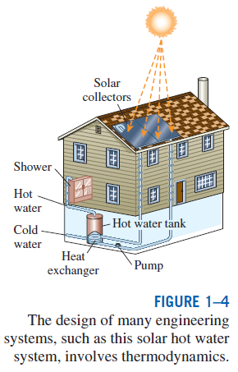
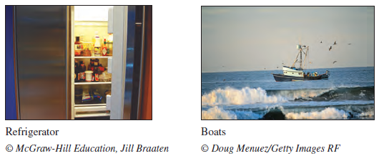
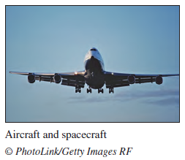
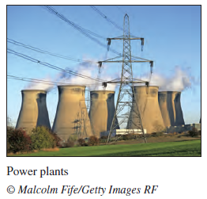
Application Areas of Thermodynamics
All activities in nature involve some interaction between energy and matter; thus, it is hard to imagine an area that does not relate to thermodynamics in some manner.

Slide 6
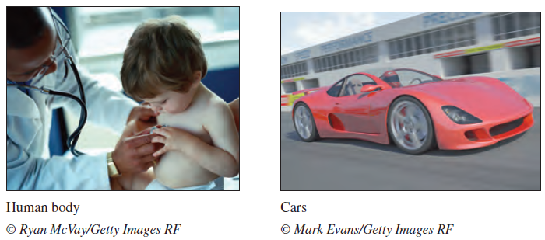
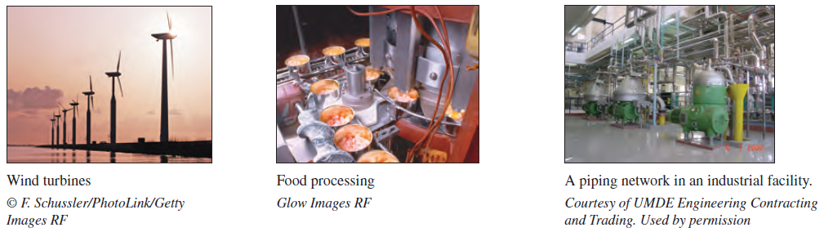

Slide 7
IMPORTANCE OF DIMENSIONS AND UNITS
Any physical quantity can be characterized by dimensions.
The magnitudes assigned to the dimensions are called units.
Some basic dimensions such as mass m, length L, time t, and temperature T are selected as primary or fundamental dimensions, while others such as velocity V, energy E, and volume V are expressed in terms of the primary dimensions and are called secondary dimensions, or derived dimensions.
Metric SI system: A simple and logical system based on a decimal relationship between the various units.
English system: It has no apparent systematic numerical base, and various units in this system are related to each other rather arbitrarily.

Slide 8
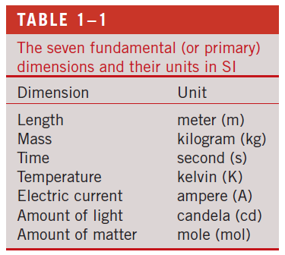
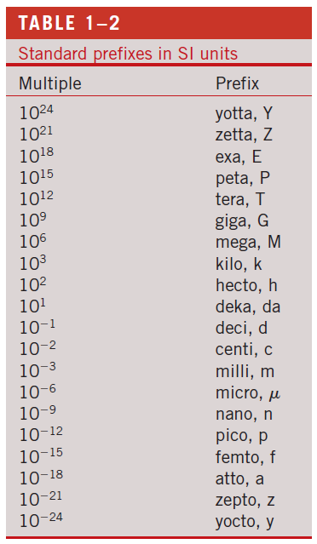

Slide 9
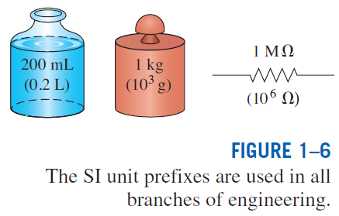

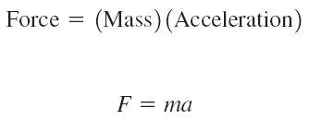
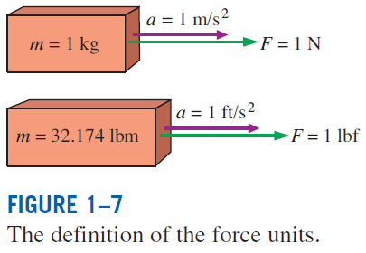

Some SI and English Units
Work = Force × Distance
1 J = 1 N∙m
1 cal = 4.1868 J
1 Btu = 1.0551 kJ

Slide 10
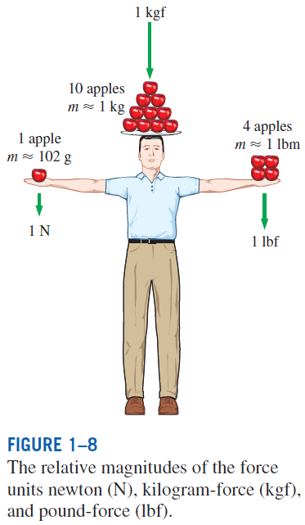
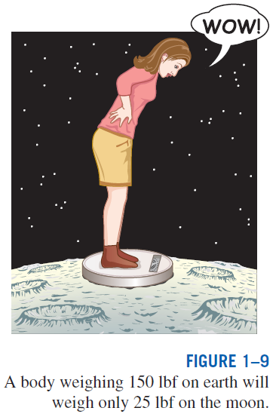

W weight
m mass
g gravitational acceleration

Slide 11
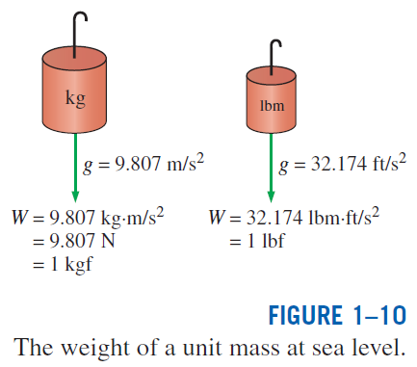
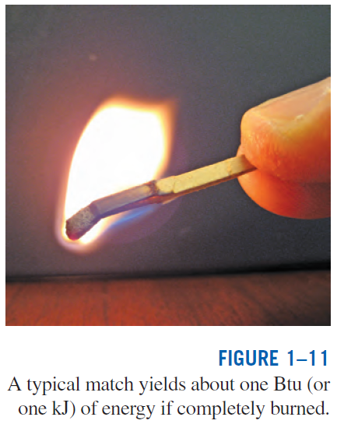

Specific weight γ: The weight of a unit volume of a substance.

Slide 12
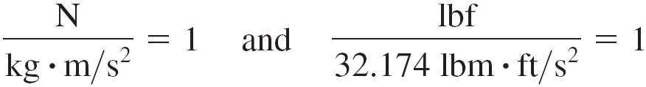
Unity Conversion Ratios
Dimensional homogeneity
All equations must be dimensionally homogeneous.
All nonprimary units (secondary units) can be formed by combinations of primary units.
Force units, for example, can be expressed as
They can also be expressed more conveniently as unity conversion ratios as
Unity conversion ratios are identically equal to 1 and are unitless, and thus such ratios (or their inverses) can be inserted conveniently into any calculation to properly convert units.

Slide 13
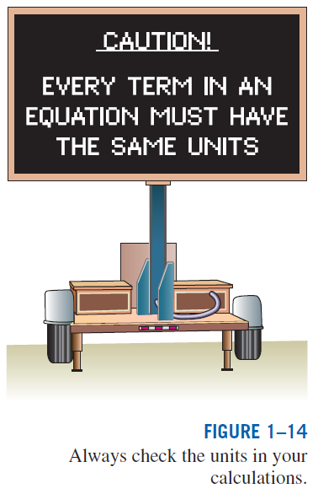
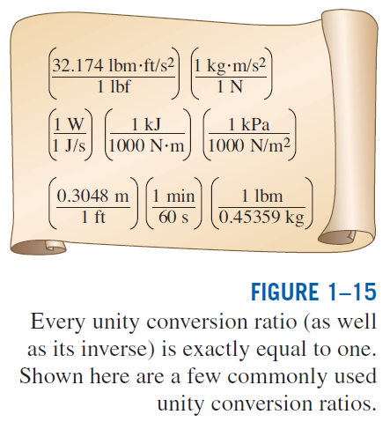

Slide 14
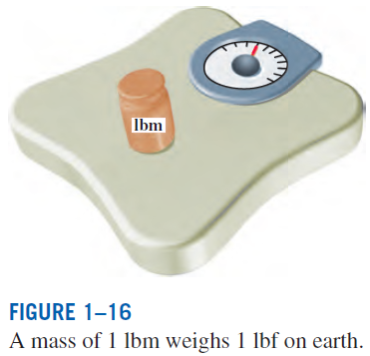
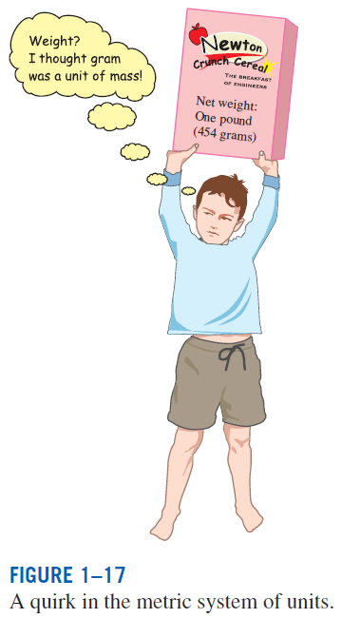

Notes:
I get 4.449816 N from this calculation, or 4.45 N.

Slide 15
Mass and Weight Example
A Lunar Roving Vehicle (LRV) was used on the moon in the last three missions of the Apollo program (Apollo 15, 16, and 17). The LRV weighed 463 lbf on Earth. What is its mass on Earth in pounds-mass? In kilograms? What is its weight on Earth in Newtons? If the weight of the LRV on the Moon is 77 lbf, what is its mass on the Moon? What is the gravity on the Moon (in ft/s² and m/s²)? What is the weight on the Moon in Newtons?
Example 1

Slide 16
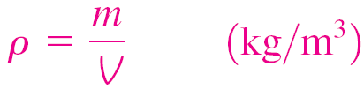
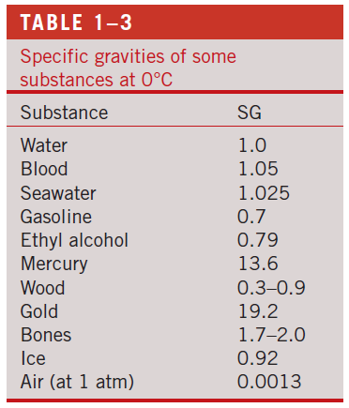
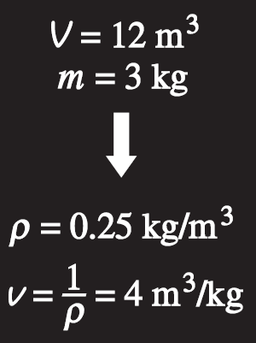

DENSITY AND SPECIFIC GRAVITY
Density
Specific gravity: The ratio of the density of a substance to the density of some standard substance at a specified temperature (usually water at 4°C).
Specific volume
Specific weight: The weight of a unit volume of a substance.
Density is mass per unit volume; specific volume is volume per unit mass.
Notes:
So what weighs more: 1 L of water or 1 L of gasoline?

Slide 17
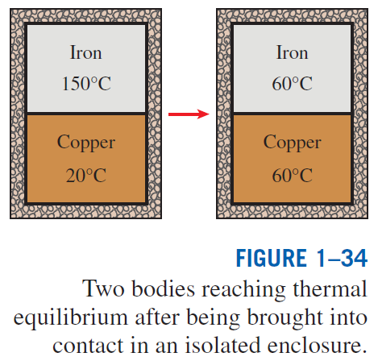
TEMPERATURE AND THE ZEROTH LAW OF THERMODYNAMICS
The zeroth law of thermodynamics: If two bodies are in thermal equilibrium with a third body, they are also in thermal equilibrium with each other.
By replacing the third body with a thermometer, the zeroth law can be restated as two bodies are in thermal equilibrium if both have the same temperature reading even if they are not in contact.

Slide 18
Temperature Scales
All temperature scales are based on some easily reproducible states such as the freezing and boiling points of water: the ice point and the steam point.
Ice point: A mixture of ice and water that is in equilibrium with air saturated with vapor at 1 atm pressure (0°C or 32°F).
Steam point: A mixture of liquid water and water vapor (with no air) in equilibrium at 1 atm pressure (100°C or 212°F).
Celsius scale: in SI unit system
Fahrenheit scale: in English unit system
Thermodynamic temperature scale: A temperature scale that is independent of the properties of any substance.
Kelvin scale (SI) Rankine scale (E)
A temperature scale nearly identical to the Kelvin scale is the ideal-gas temperature scale. The temperatures on this scale are measured using a constant-volume gas thermometer.

Slide 19
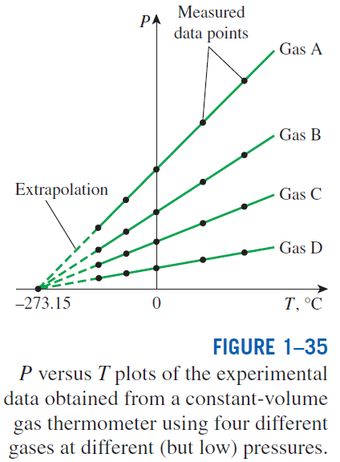
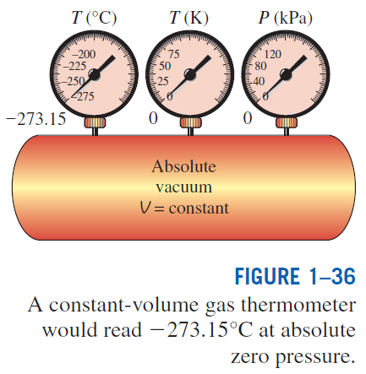

Slide 20
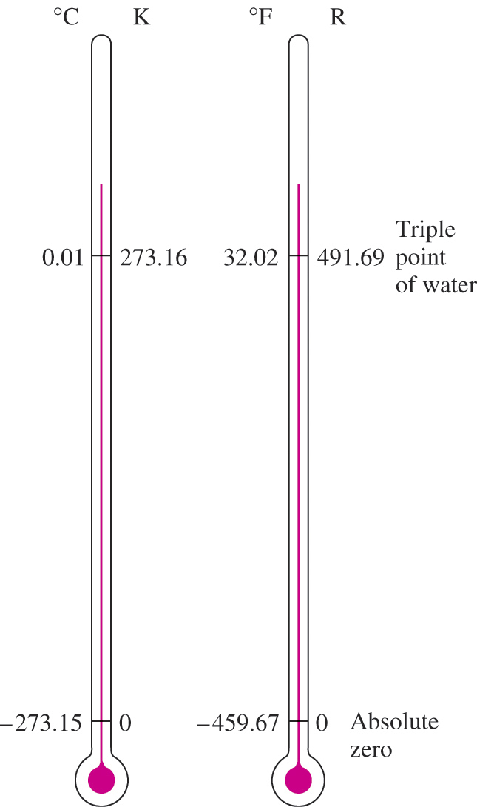
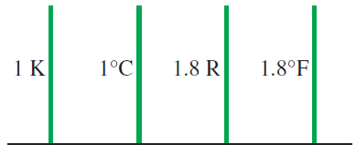
Comparison of temperature scales.
Comparison of magnitudes of various temperature units.
The reference temperature in the original Kelvin scale was the ice point, 273.15 K, which is the temperature at which water freezes (or ice melts).
The reference point was changed to a much more precisely reproducible point, the triple point of water (the state at which all three phases of water coexist in equilibrium), which is assigned the value 273.16 K.
Notes:
Since we only record values to 3 decimal places, then we can just add 273 to C to get K, and 460 to F to get R

Slide 21
The International Temperature Scale of 1990 (ITS-90)
The International Temperature Scale of 1990 supersedes the International Practical Temperature Scale of 1968 (IPTS-68), 1948 (ITPS-48), and 1927 (ITS-27).
The ITS-90 is similar to its predecessors except that it is more refined with updated values of fixed temperatures, has an extended range, and conforms more closely to the thermodynamic temperature scale.
On this scale, the unit of thermodynamic temperature T is again the kelvin (K), defined as the fraction 1/273.16 of the thermodynamic temperature of the triple point of water, which is sole defining fixed point of both the ITS-90 and the Kelvin scale and is the most important thermometric fixed point used in the calibration of thermometers to ITS-90. The unit of Celsius temperature is the degree Celsius (°C).
The ice point remains the same at 0°C (273.15 K) in both ITS-90 and ITPS-68, but the steam point is 99.975°C in ITS-90 whereas it was 100.000°C in IPTS-68.
The change is due to precise measurements made by gas thermometry by paying particular attention to the effect of sorption (the impurities in a gas absorbed by the walls of the bulb at the reference temperature being desorbed at higher temperatures, causing the measured gas pressure to increase).

Slide 22
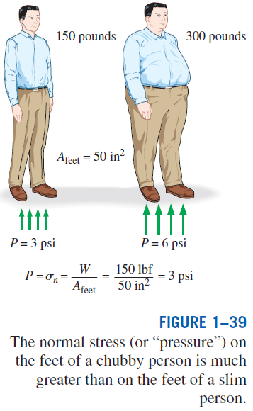

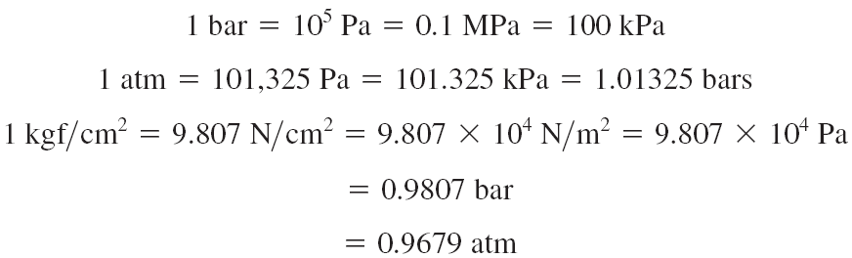
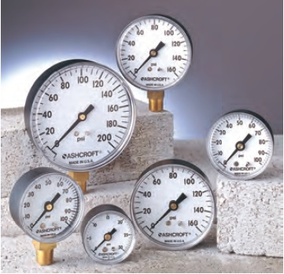
PRESSURE
Pressure: A normal force exerted by a fluid per unit area
Some basic pressure gauges.

Slide 23
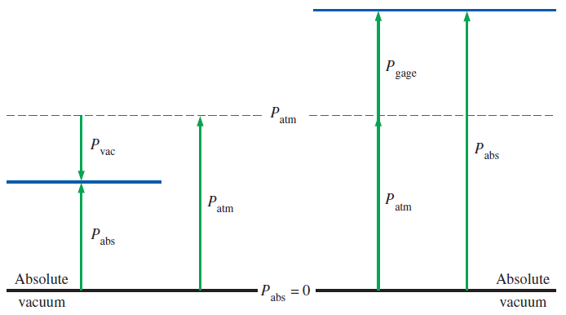
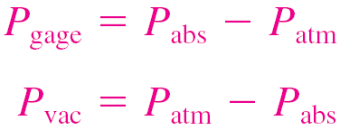
Absolute pressure: The actual pressure at a given position. It is measured relative to absolute vacuum (i.e., absolute zero pressure).
Gauge pressure: The difference between the absolute pressure and the local atmospheric pressure. Most pressure-measuring devices are calibrated to read zero in the atmosphere, and so they indicate gauge pressure.
Vacuum pressures: Pressures below atmospheric pressure.
Throughout this text, the pressure P will denote absolute pressure unless specified otherwise.

Slide 24
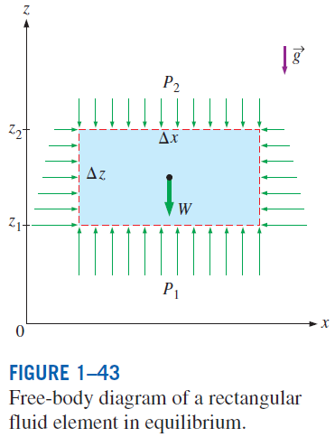
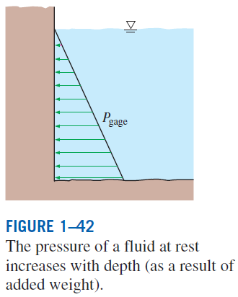
Variation of Pressure with Depth
When the variation of density with elevation is known

Slide 25
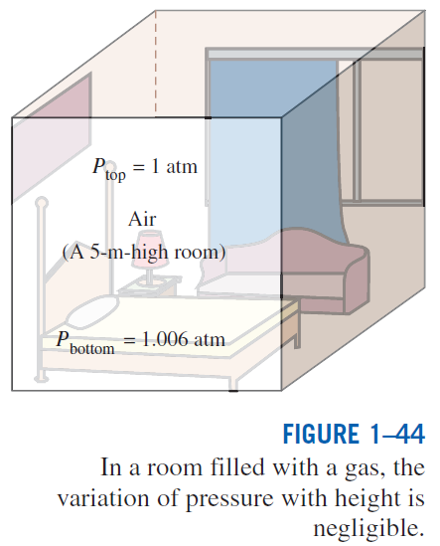
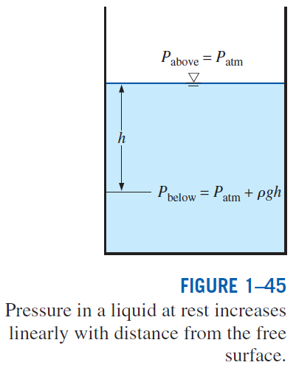

Slide 26
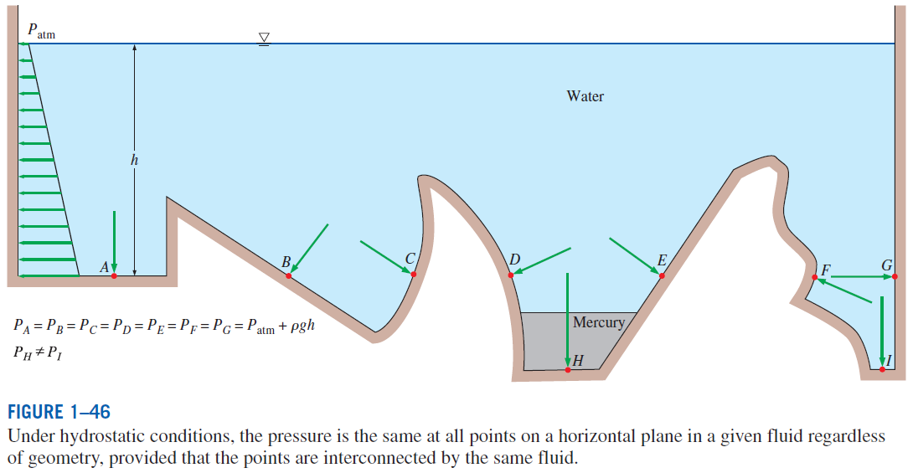

Slide 27
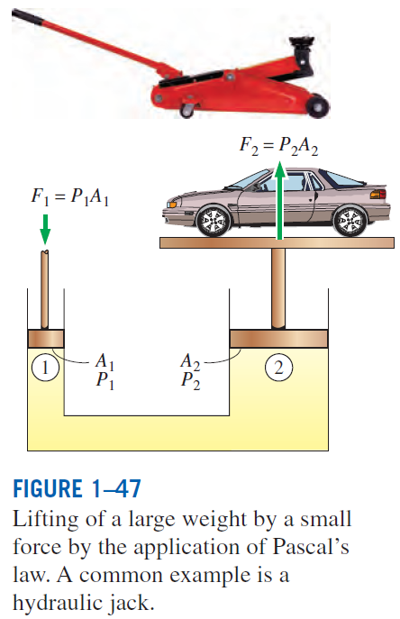
Pascal’s law: The pressure applied to a confined fluid increases the pressure throughout by the same amount.
The area ratio A₂/A₁ is called the ideal mechanical advantage of the hydraulic lift.

Slide 28
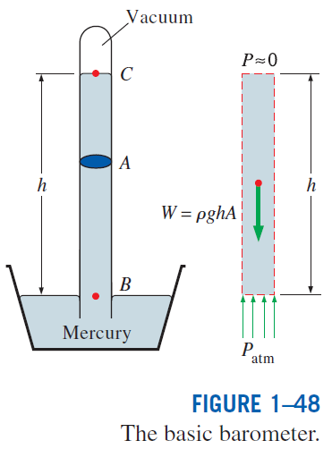

PRESSURE MEASUREMENT DEVICES
The Barometer
Atmospheric pressure is measured by a device called a barometer; thus, the atmospheric pressure is often referred to as the barometric pressure.
A frequently used pressure unit is the standard atmosphere, which is defined as the pressure produced by a column of mercury 760 mm in height at 0°C (ρ_{Hg} = 13,595 kg/m³) under standard gravitational acceleration (g = 9.807 m/s²).

Slide 29
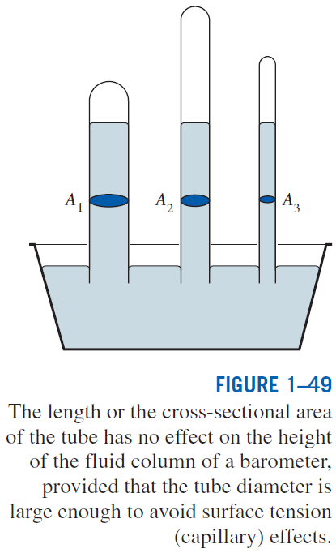
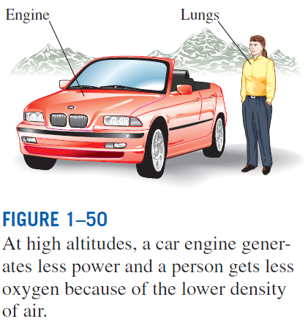

Slide 30
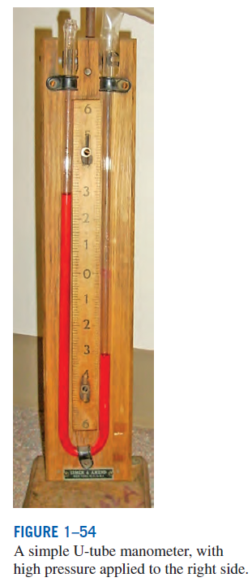
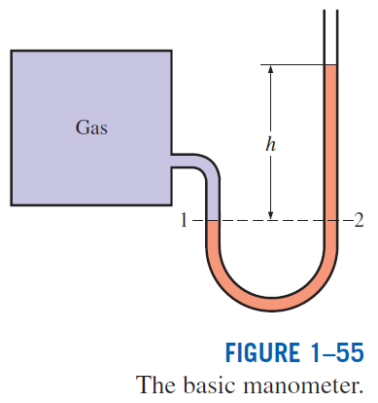

The Manometer
It is commonly used to measure small and moderate pressure differences. A manometer contains one or more fluids such as mercury, water, alcohol, or oil.

Slide 31
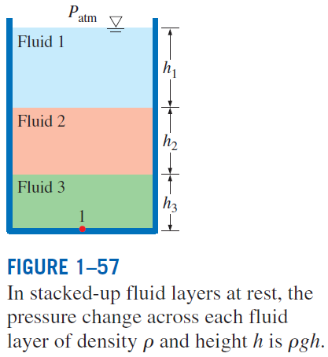
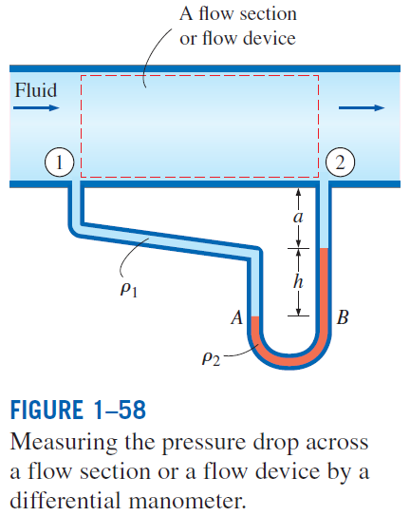


Slide 32
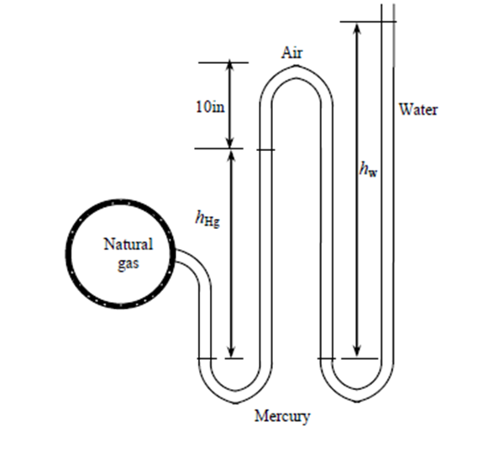
Manometer Example
Determine the absolute and gauge pressure of the natural gas.
Useful information
ρ_{water} = 62.4lbm/ft³
SG_{Hg} = 13.6
SG_{air} = 0.0013
P_{atm} = 14.2 psi
h_{Hg} = 6 in
h_{water} = 27 in
lbf =32.2 lbm ft/s²
Example 2

Slide 33

Other Pressure Measurement Devices
Bourdon tube: Consists of a hollow metal tube bent like a hook whose end is closed and connected to a dial indicator needle.
Pressure transducers: Use various techniques to convert the pressure effect to an electrical effect such as a change in voltage, resistance, or capacitance.
Pressure transducers are smaller and faster, and they can be more sensitive, reliable, and precise than their mechanical counterparts.
Strain-Gauge pressure transducers: Work by having a diaphragm deflect between two chambers open to the pressure inputs.
Piezoelectric transducers: Also called solid-state pressure transducers, work on the principle that an electric potential is generated in a crystalline substance when it is subjected to mechanical pressure.

Slide 34


Slide 35
Summary
Thermodynamics and energy
Application areas of thermodynamics
Importance of dimensions and units
Some SI and English units, Dimensional homogeneity, Unity conversion ratios
Density and specific gravity
Temperature and the zeroth law of thermodynamics
Temperature scales
ITS-90
Pressure
Variation of pressure with depth
The manometer
Other pressure measurement devices
The barometer and atmospheric pressure

