Slide 1
Measurement

Slide 2
Seven Standards of Measurement
Provide the basics for all other units of measurement
Length
Time
Mass
Temperature
Ampere
Candela
Mole

Slide 3
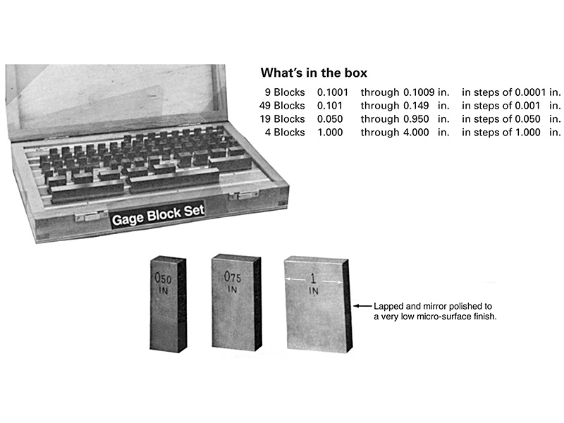
Gage Blocks

Slide 4
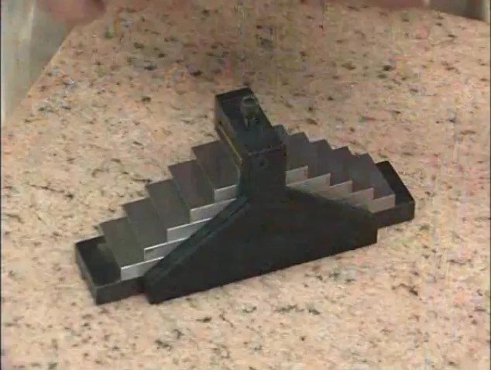
Watch Video Here

Slide 5
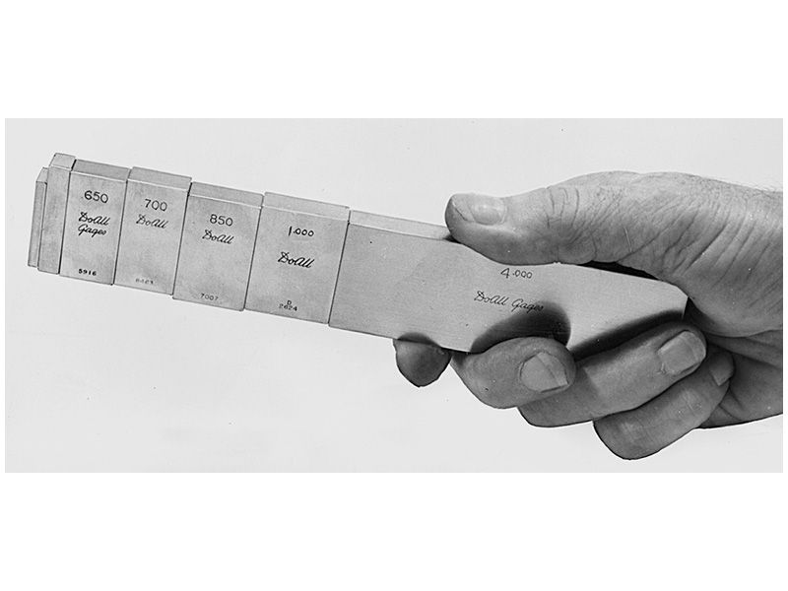
Gage Blocks wrung together

Slide 6
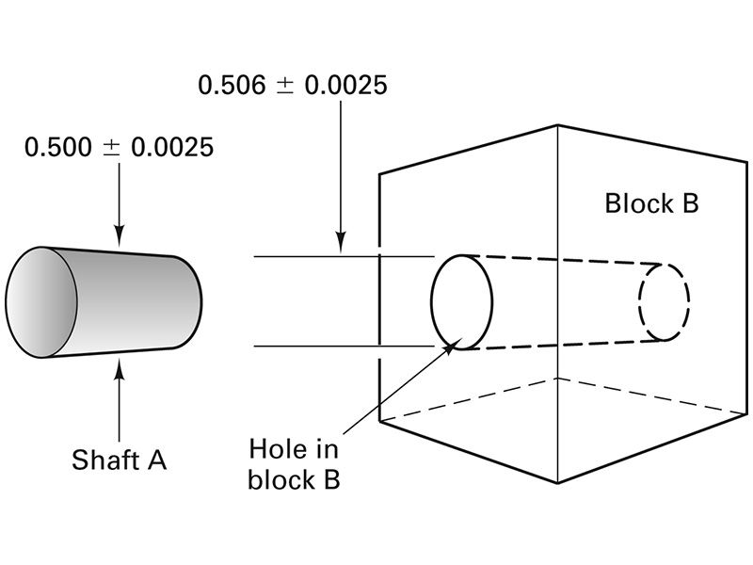
Mated Parts

Slide 7
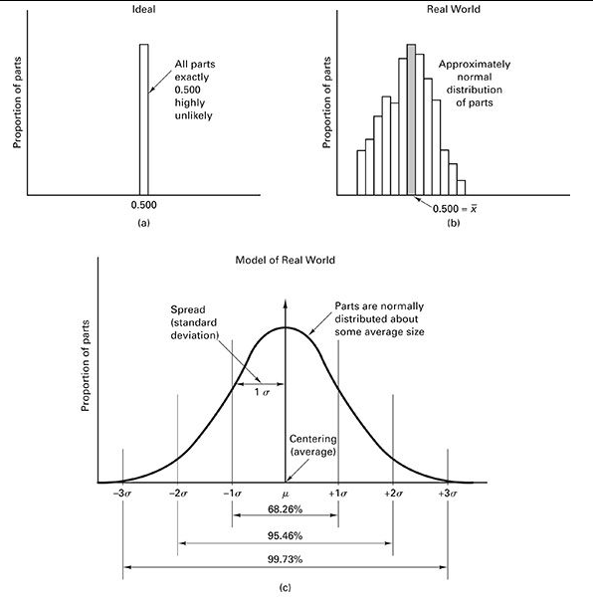
Normal Distribution

Slide 8
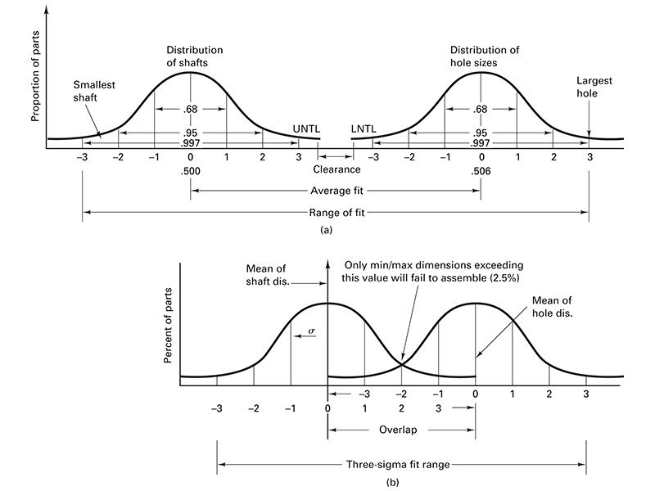
Distributions of Mating Parts

Slide 9
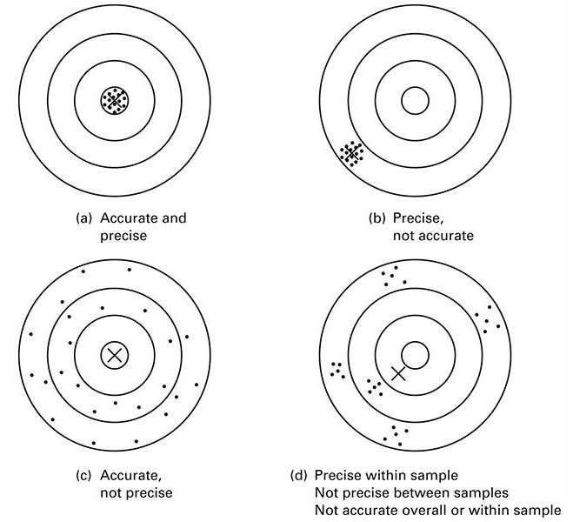
Accuracy Versus Precision

Slide 10
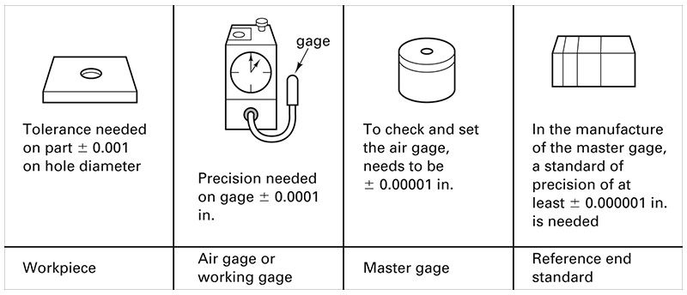
Rule of 10 for Inspection

Slide 11
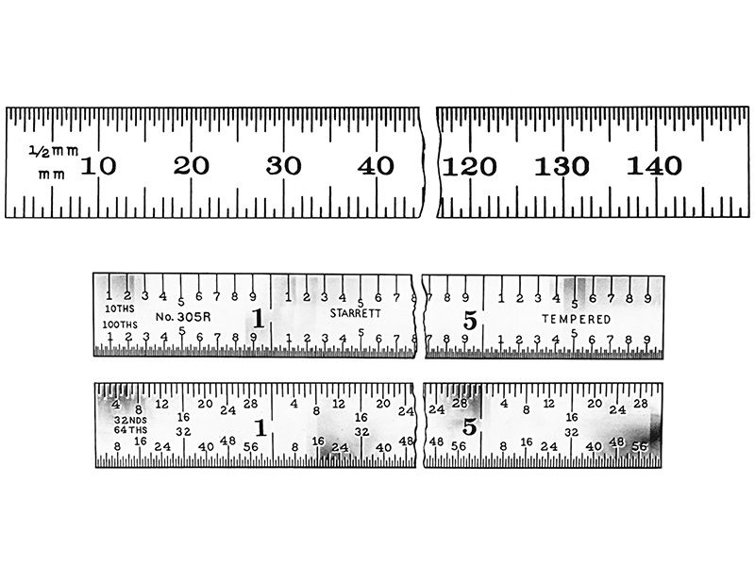
Machinist’s Rules

Slide 12
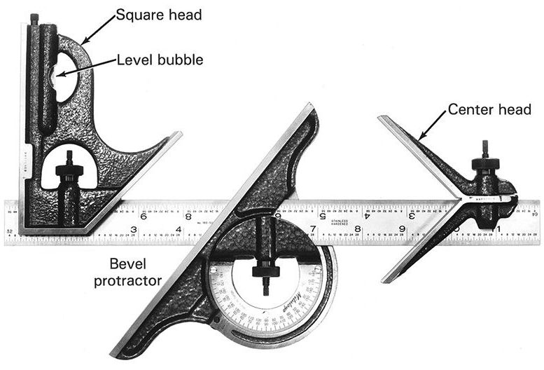
Combination Set

Slide 13
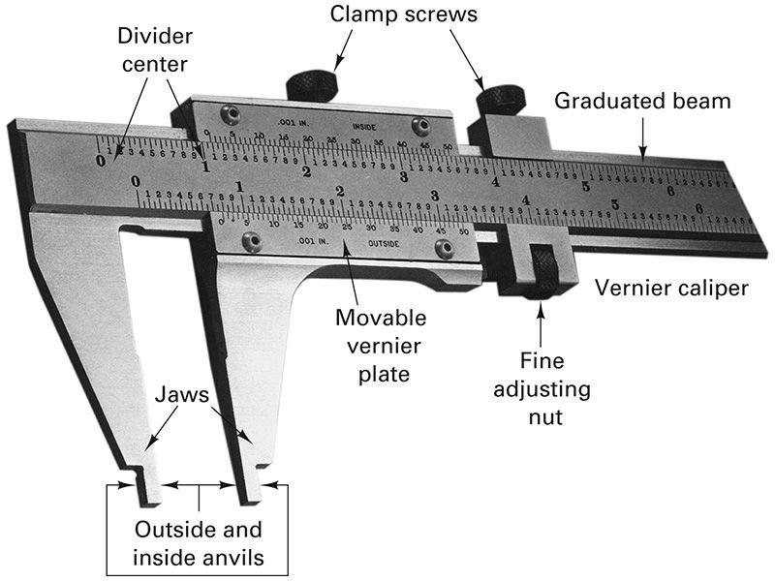
Vernier Caliper

Slide 14
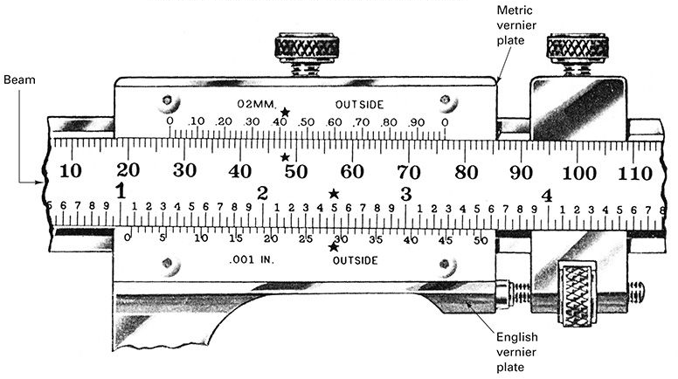
Vernier Caliper Scale

Slide 15
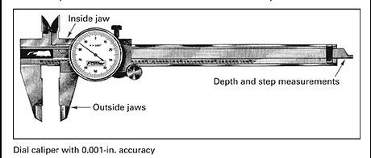
Dial Caliper

Slide 16
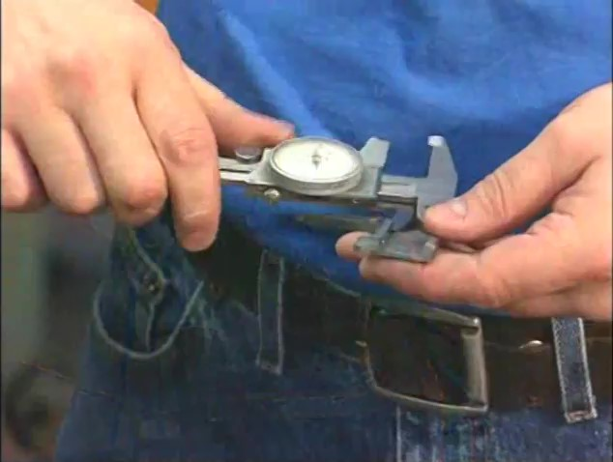
Watch Video Here

Slide 17
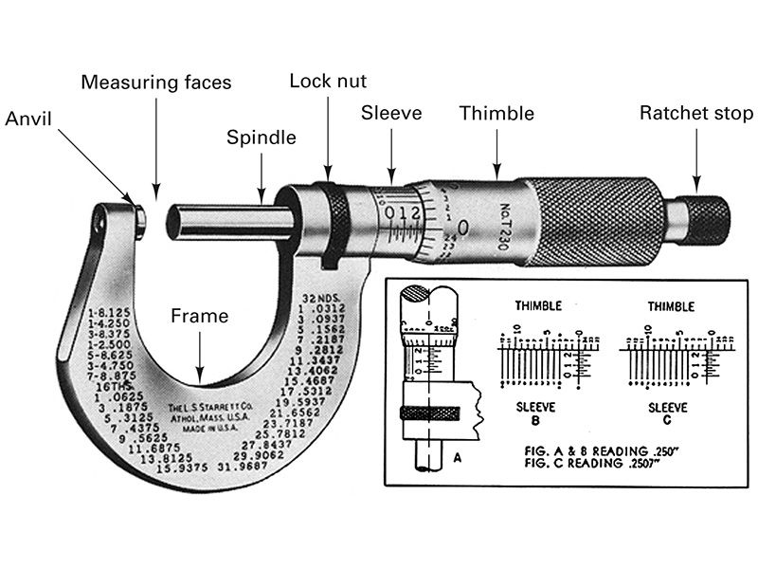
Micrometer

Slide 18
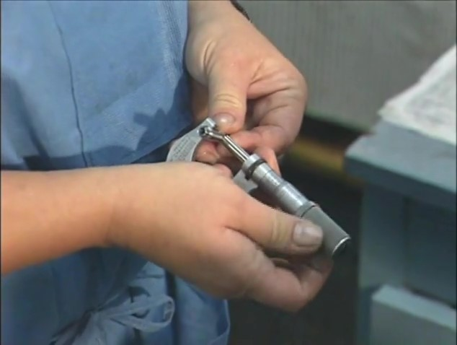
Watch Video Here

Slide 19
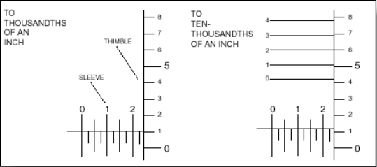
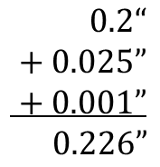
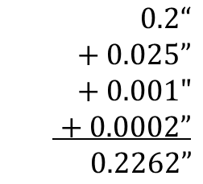
Micrometer
$0.2“$
$+ 0.025”$
$+ 0.001”$
$0.226”$
$0.2“$
$+ 0.025”$
$+ 0.001"$
$+ 0.0002”$
$0.2262”$

Slide 20
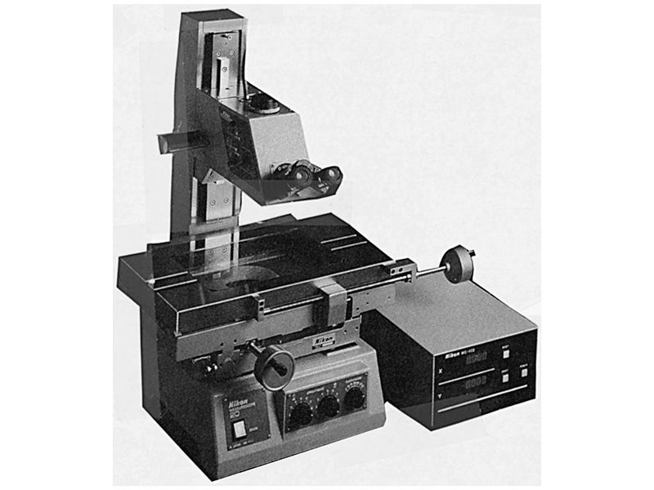
Toolmaker’s Microscope

Slide 21
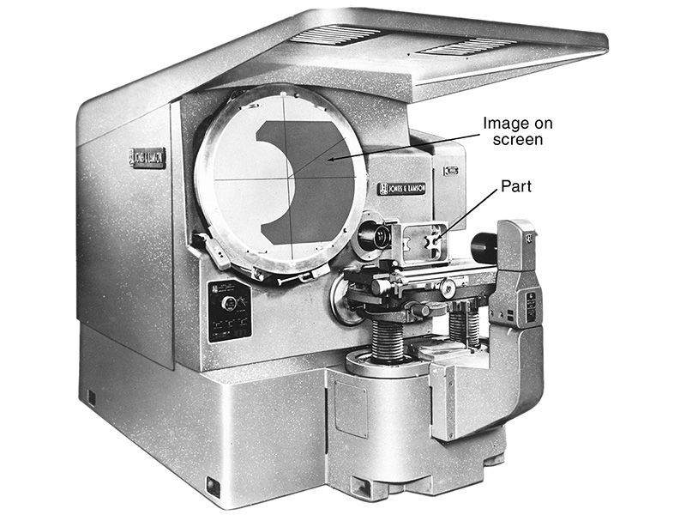
Optical Comparator

Slide 22
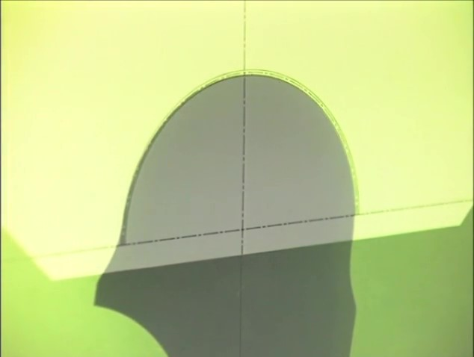
Watch Video Here
Notes:
Optical Comparator

Slide 23
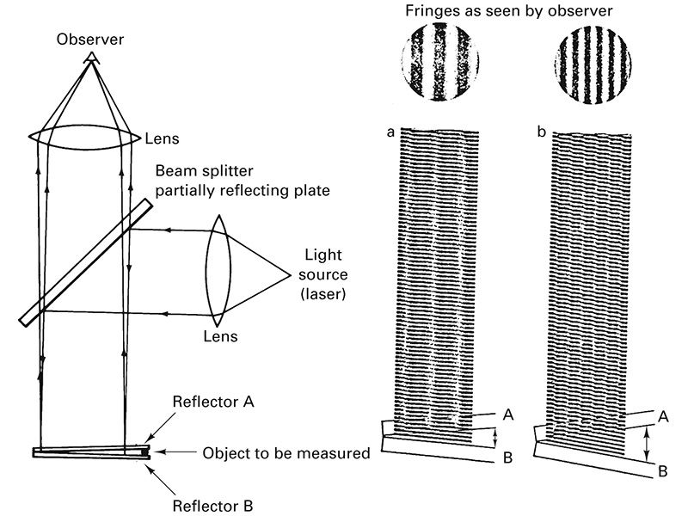
Interferometry

Slide 24
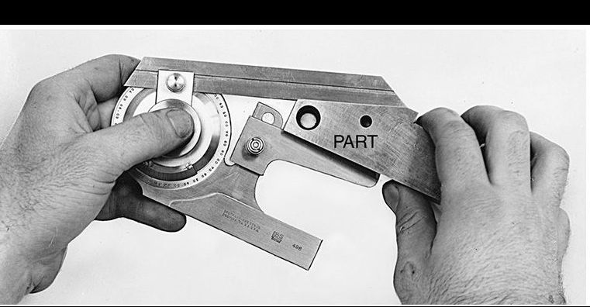
Bevel Protractor

Slide 25
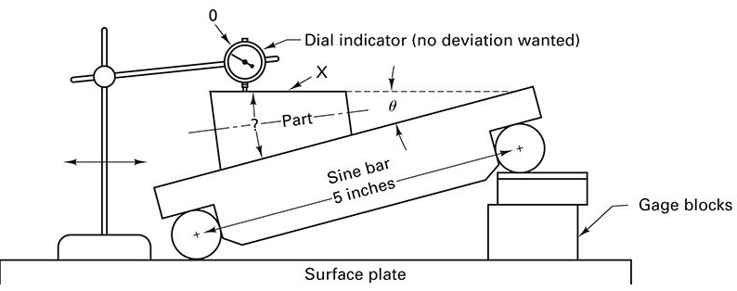
Sine Bar

Slide 26
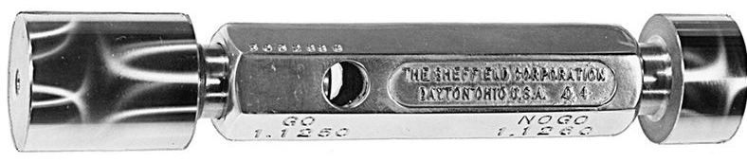
Double-Ended Plug Gage Go/No-Go

Slide 27
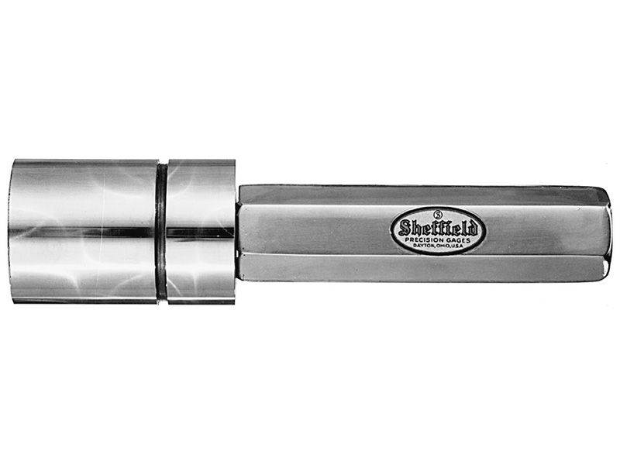
Step-type Plug Gage

Slide 28
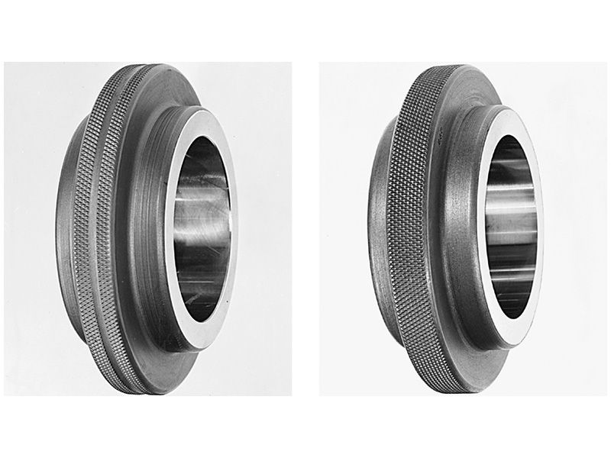
Ring Gages No-Go (max) on left, with knurling groove. Go (min)on right, without groove

Slide 29
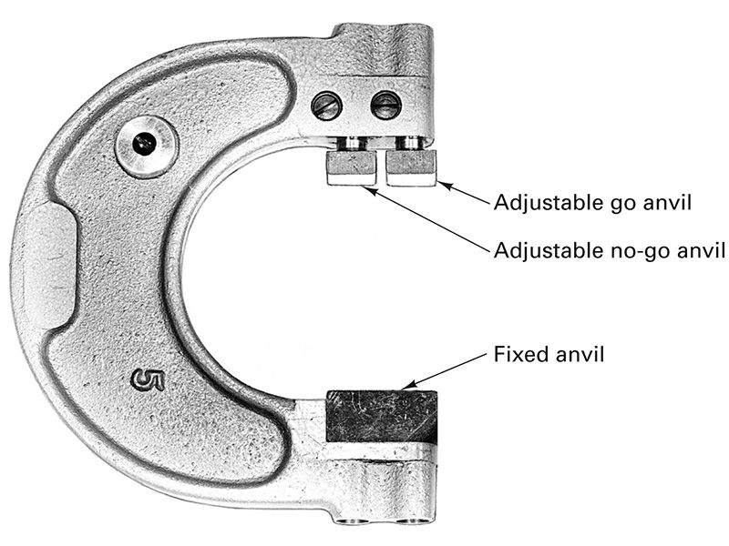
Adjustable Snap Gage

Slide 30
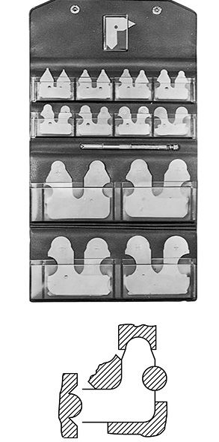
Radius Gages

Slide 31
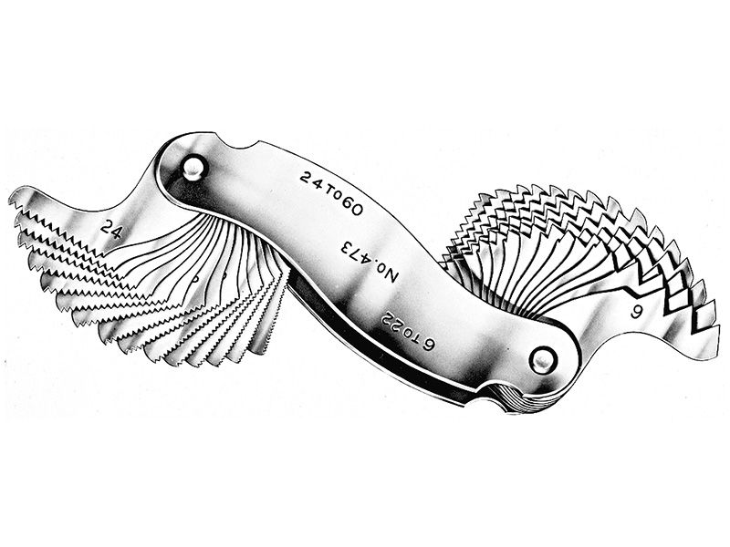
Thread Pitch Gages

Slide 32
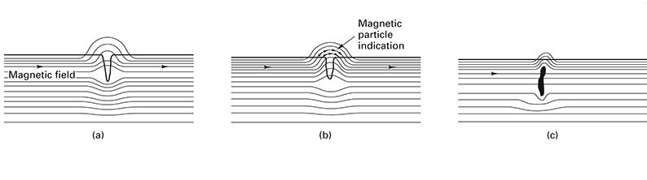
Magnetic Particle Inspection

Slide 33
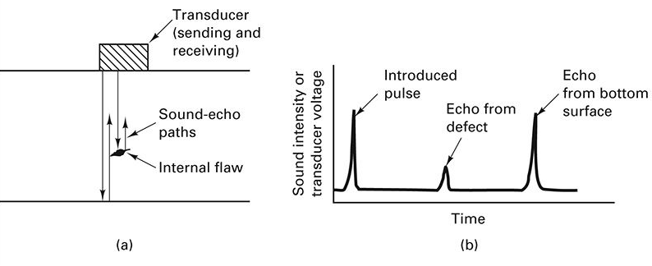
Ultrasonic Inspection

Slide 34
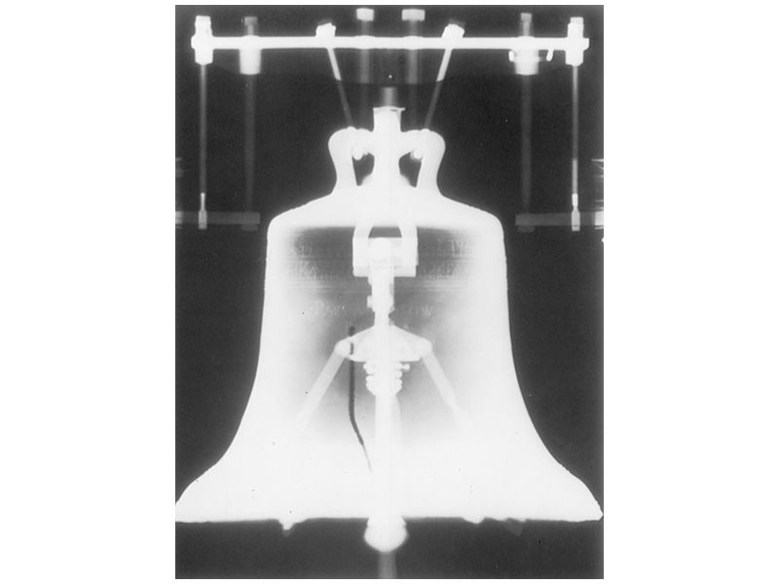
Radiography X-Ray Inspection
Notes:
Liberty Bell crack

