Slide 1
Milling

Slide 2
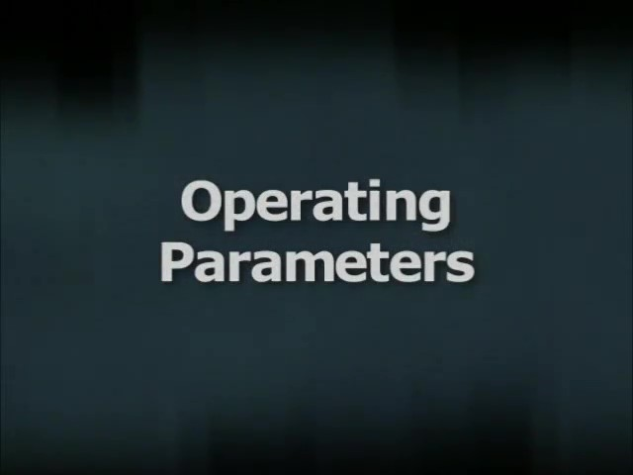
Watch Video Here
Notes:
Operating Parameters

Slide 3
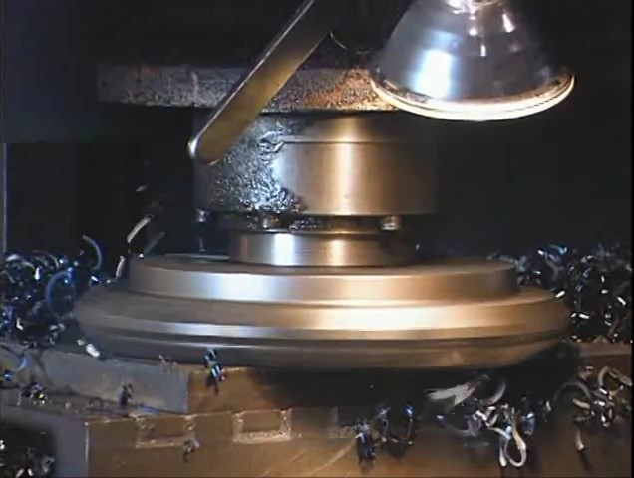
Watch Video Here
Notes:
Cutting Tools

Slide 4
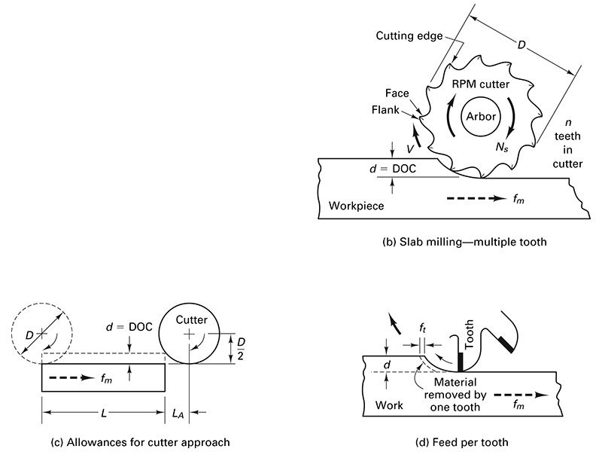
Peripheral (Slab, Side) Milling

Slide 5
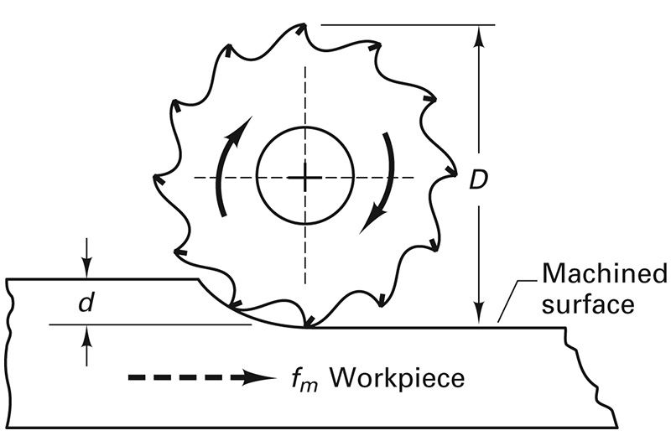
Peripheral (Slab, side) Milling Cutter rotation is for Up Milling

Slide 6
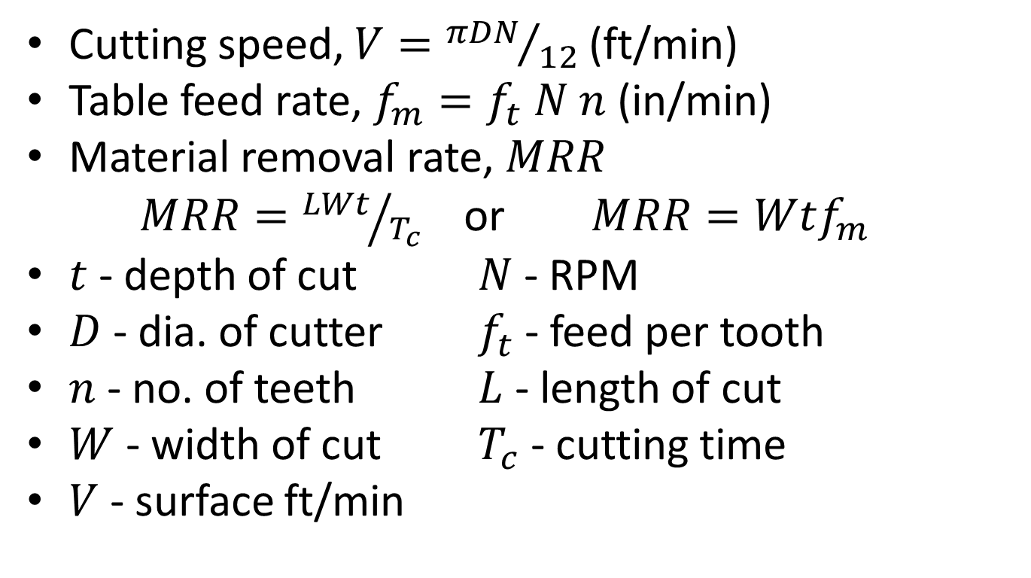
Cutting Parameters: surface parallel to axis of cutter
Cutting speed, $V={πDN}/{12}$ (ft/min)
Table feed rate, $f_{m}=f_{t} N n$ (in/min)
Material removal rate, $MRR$
$MRR={LWt}/{T_{c}}$ or $MRR=Wtf_{m}$
$t$ - depth of cut $N$ - RPM
$D$ - dia. of cutter $f_{t}$ - feed per tooth
$n$ - no. of teeth $L$ - length of cut
$W$ - width of cut $T_{c}$ - cutting time
$V$ - surface ft/min

Slide 7
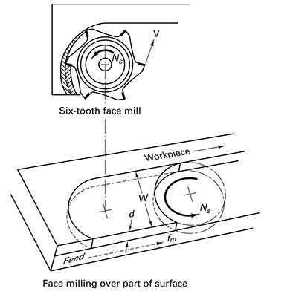
Face (End) Milling

Slide 8
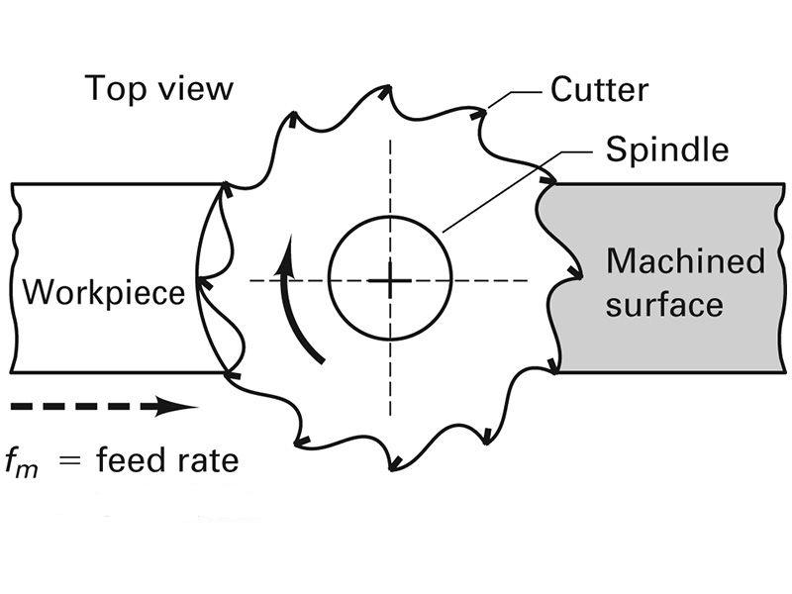
Face Milling (from above)

Slide 9
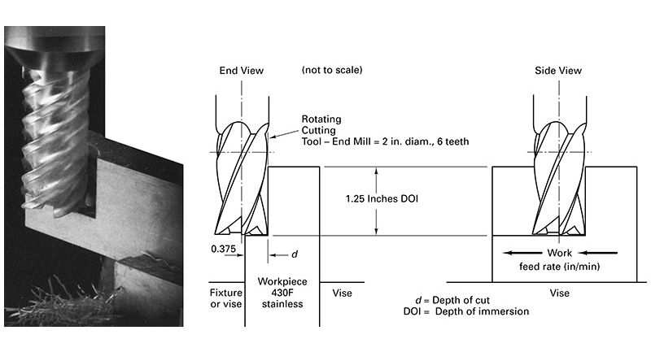
End Milling

Slide 10
1st Milling Method – Up Milling Conventional Milling

Slide 11
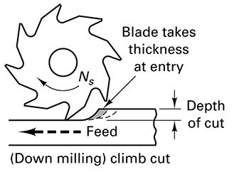
2nd Milling Method – Down Milling Climb Milling

Slide 12
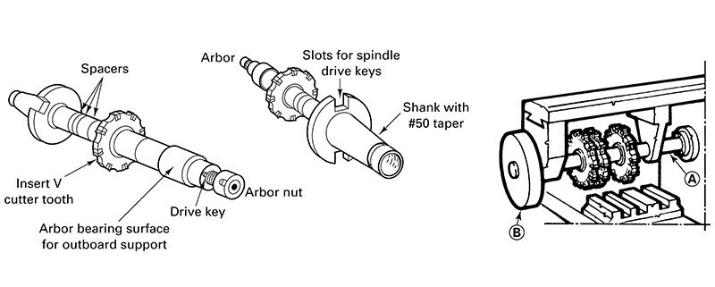
Arbor-type Cutters

Slide 13
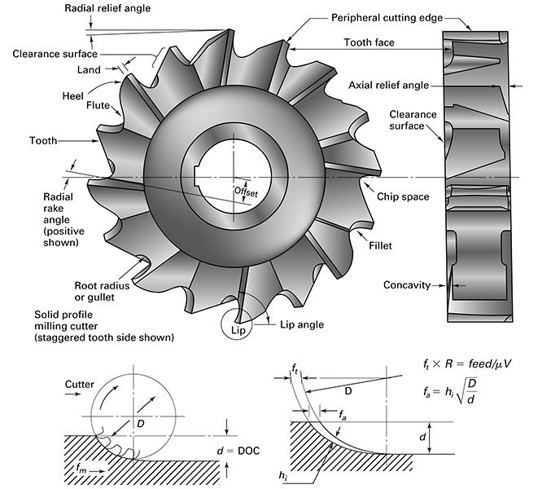
Arbor-Mounted Side Cutter

Slide 14
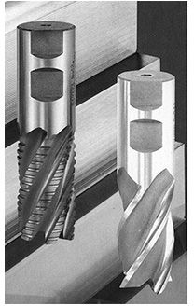
Shank-type Cutters

Slide 15
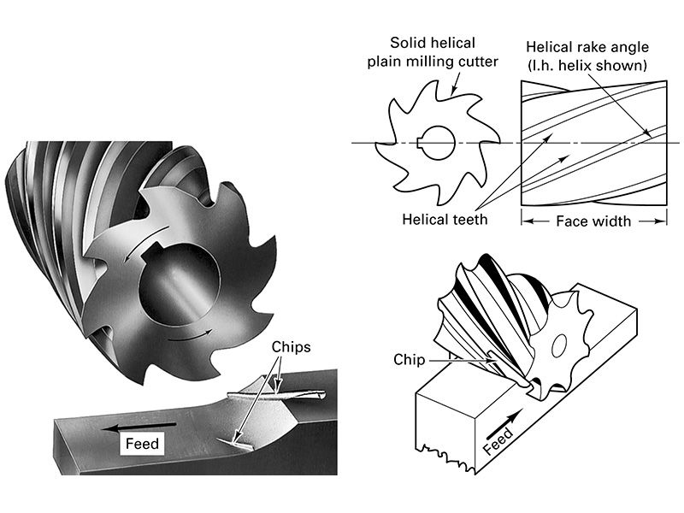
Plain Milling Cutters

Slide 16
Side/Staggered Milling Cutters

Slide 17
Interlocking Slotting Cutters

Slide 18
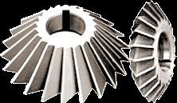
Angle Cutters

Slide 19
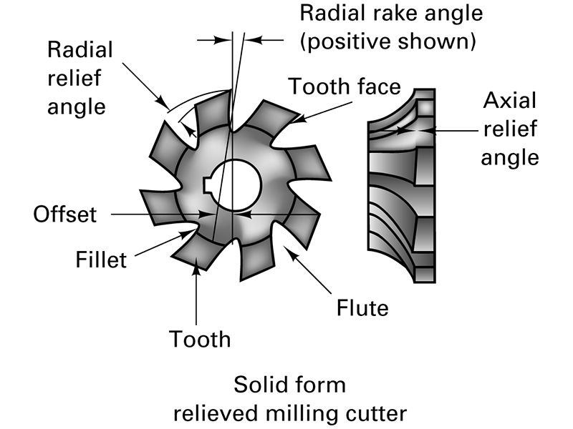
Form Cutters

Slide 20
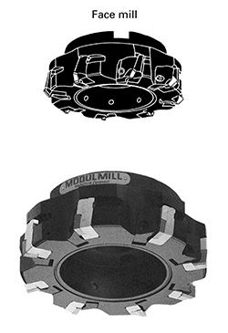
Insert-type Cutters

Slide 21
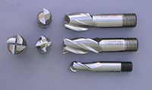
End Mills

Slide 22

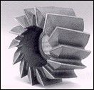
Shell End Mills

Slide 23
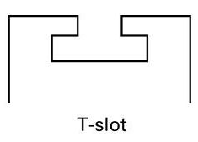
T-slot

Slide 24
Horizontal Milling Machine

Slide 25
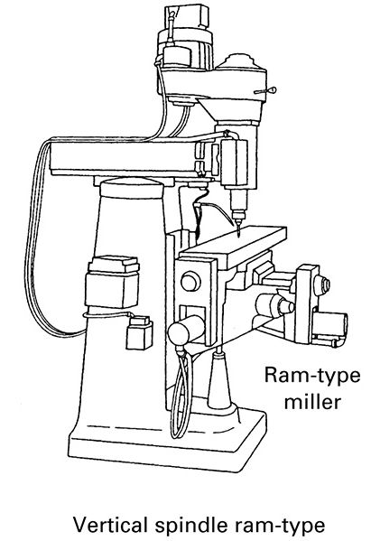
Vertical Milling Machine

Slide 26
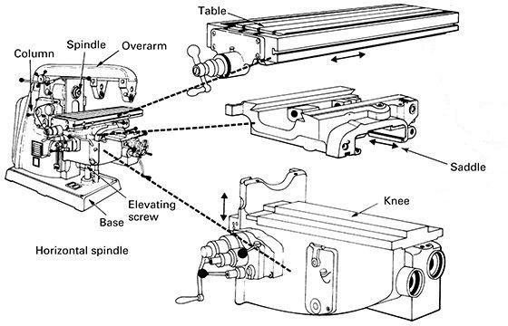
Plain Column and Knee

Slide 27
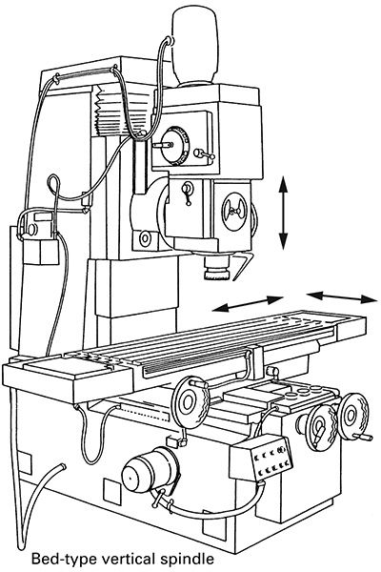
Bed-type Milling Machine

Slide 28
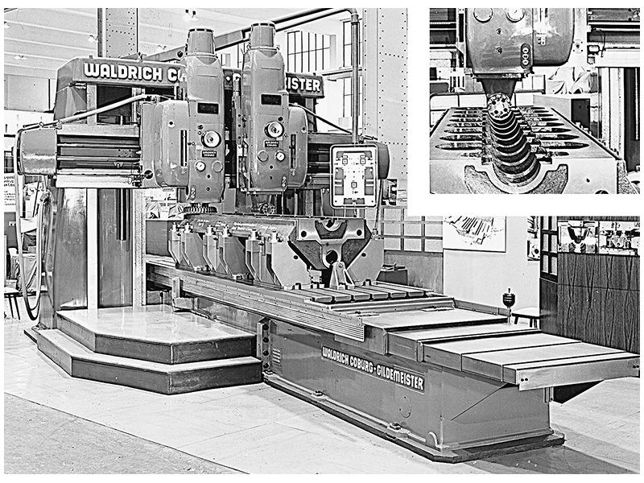
Planer-type Milling Machine

Slide 29
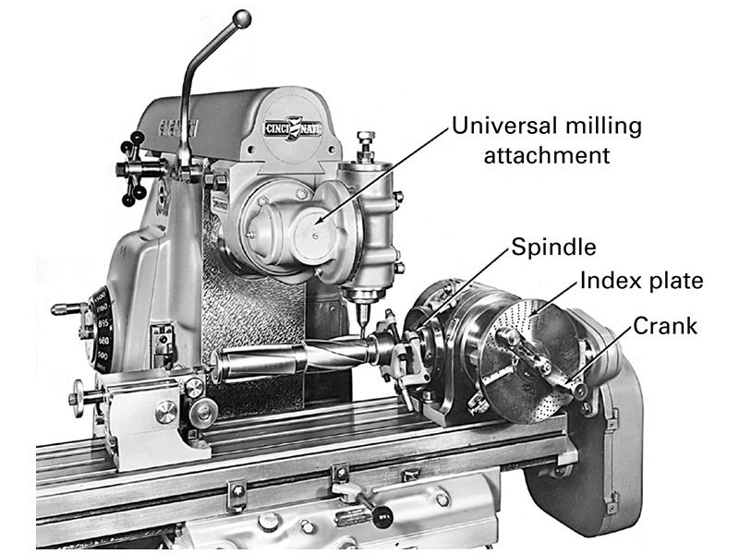
Universal Milling Attachment and Universal Dividing Head

Slide 30
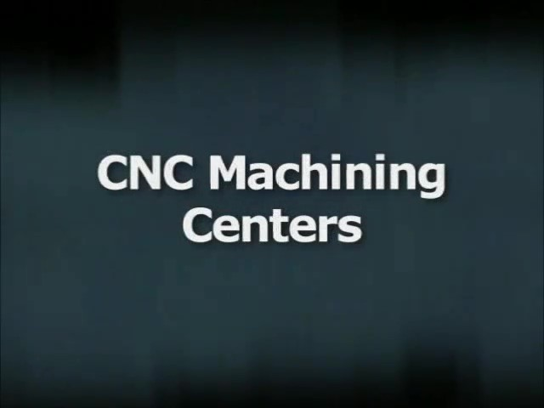
Watch Video Here
Notes:
CNC Machining

