Slide 1
Measurement, Inspection and Testing

Slide 2
Seven Standards of Measurement
Provide the basics for all other units of measurement
Length
Time
Mass
Temperature
Ampere
Candela
Mole

Slide 3
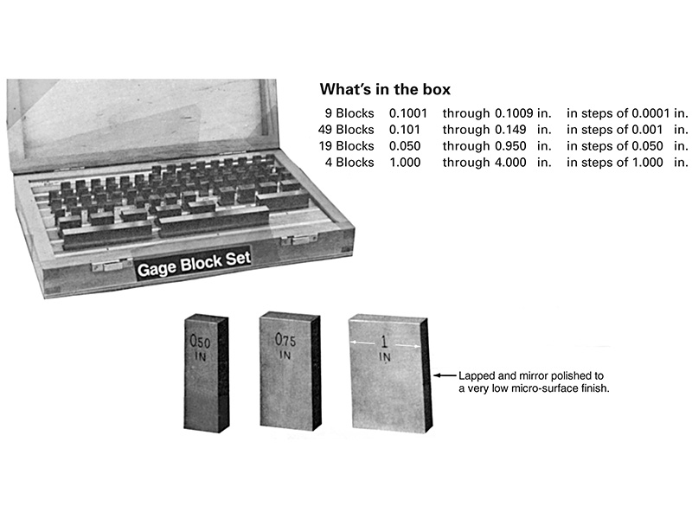
Gage Blocks

Slide 4
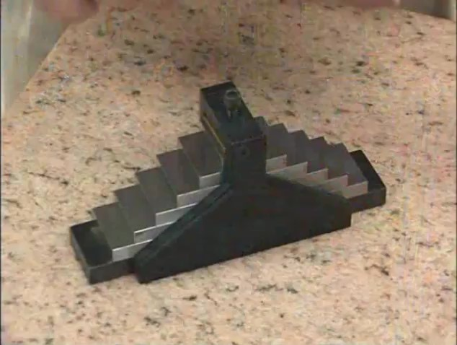
Watch Video Here

Slide 5
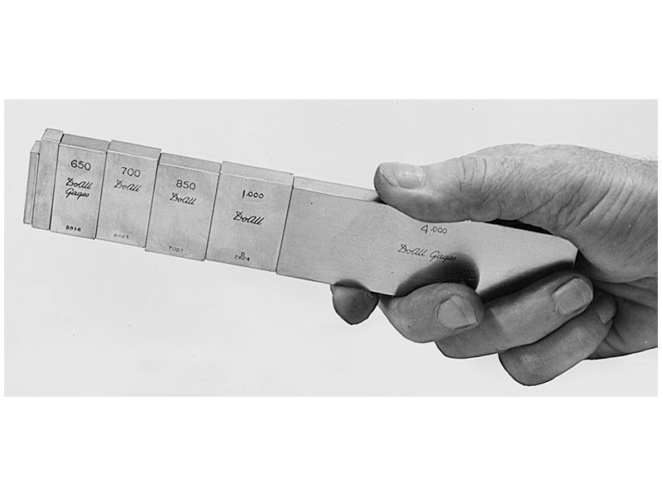
Gage Blocks wrung together

Slide 6
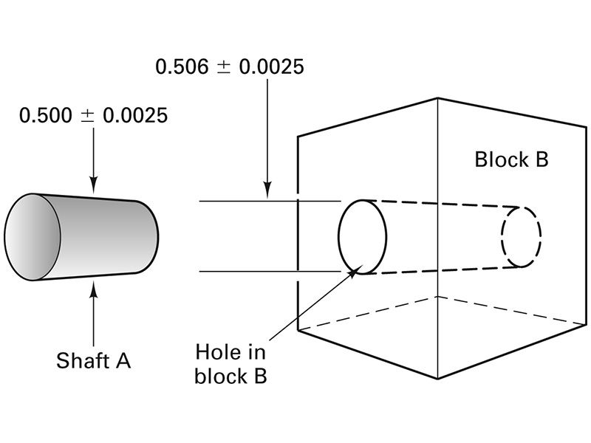
Mated Parts

Slide 7
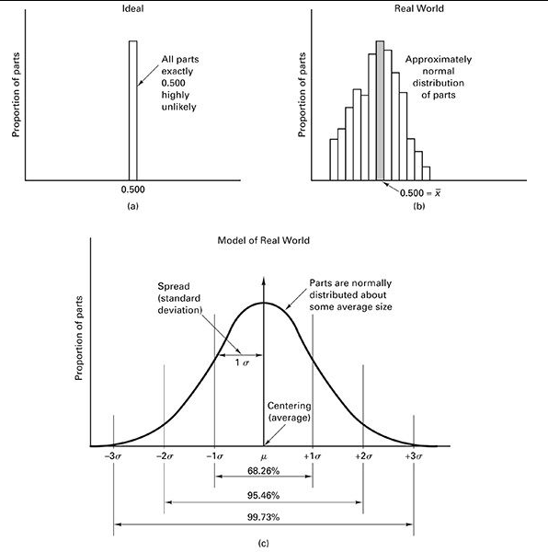
Normal Distribution

Slide 8
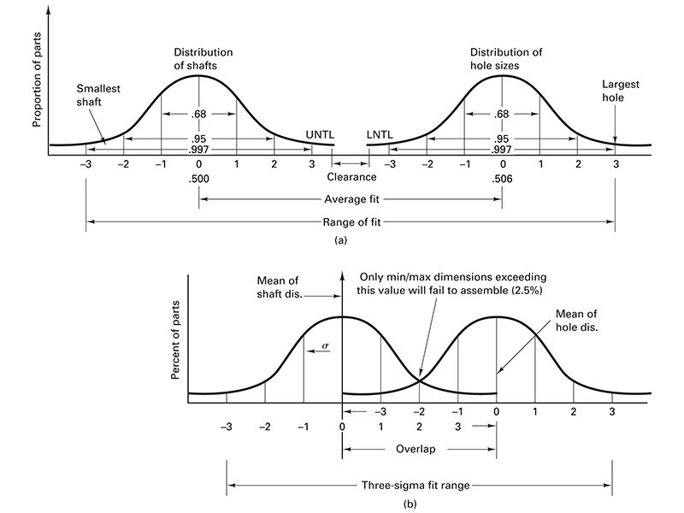
Distributions of Mating Parts

Slide 9
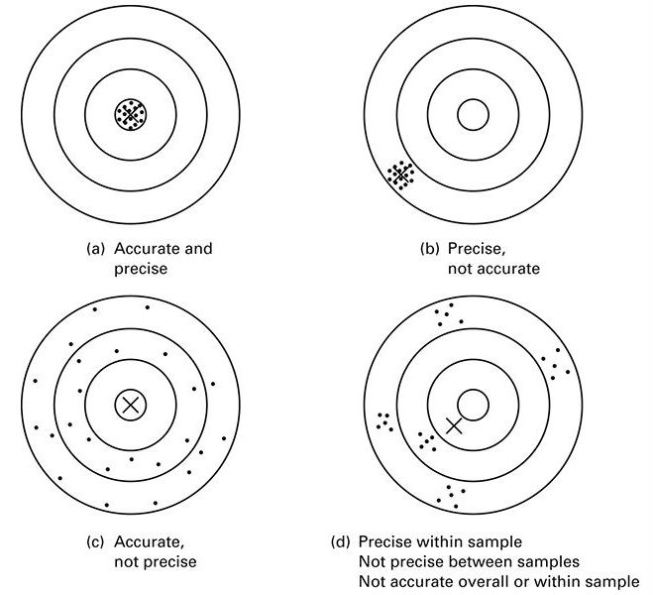
Accuracy Versus Precision

Slide 10
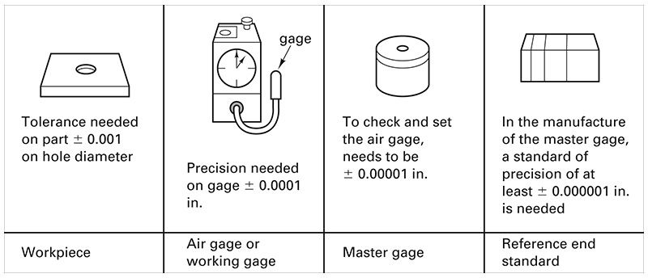
Rule of 10 for Inspection

Slide 11
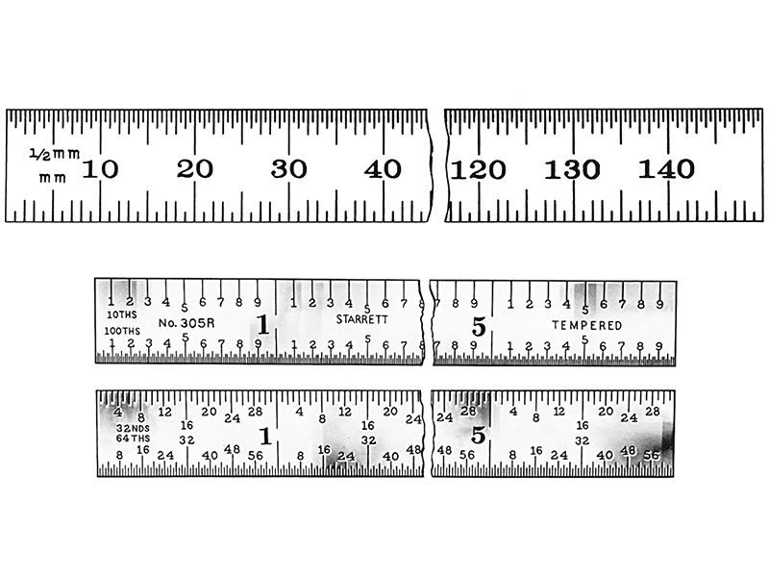
Machinist’s Rules

Slide 12
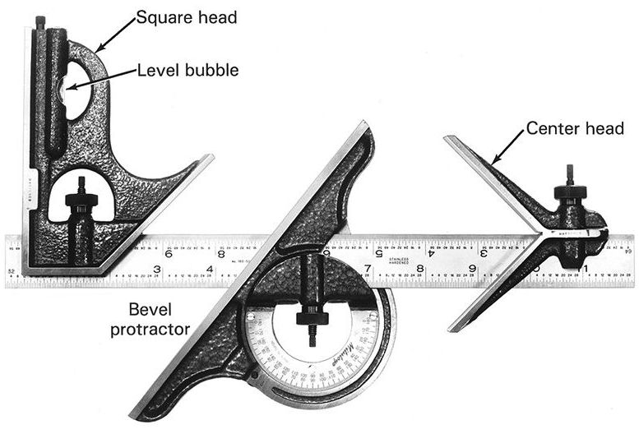
Combination Set

Slide 13
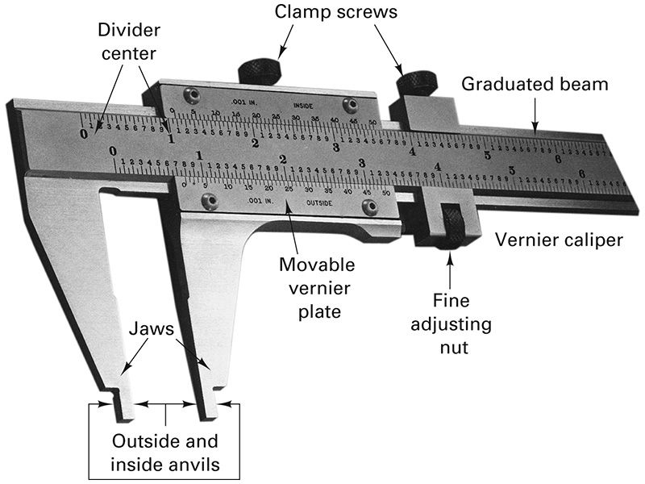
Vernier Caliper

Slide 14
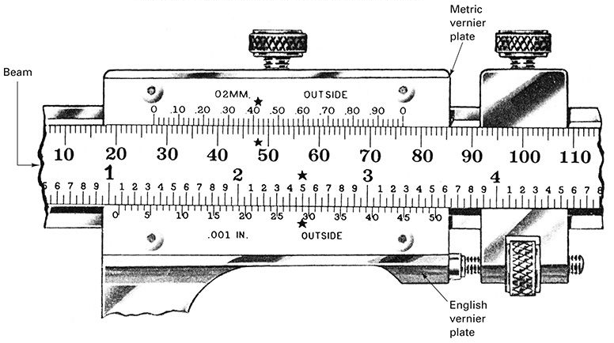
Vernier Caliper Scale

Slide 15
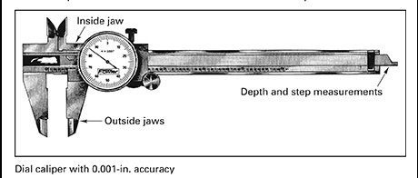
Dial Caliper

Slide 16
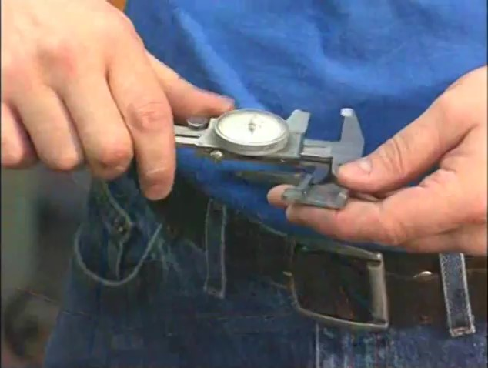
Watch Video Here

Slide 17
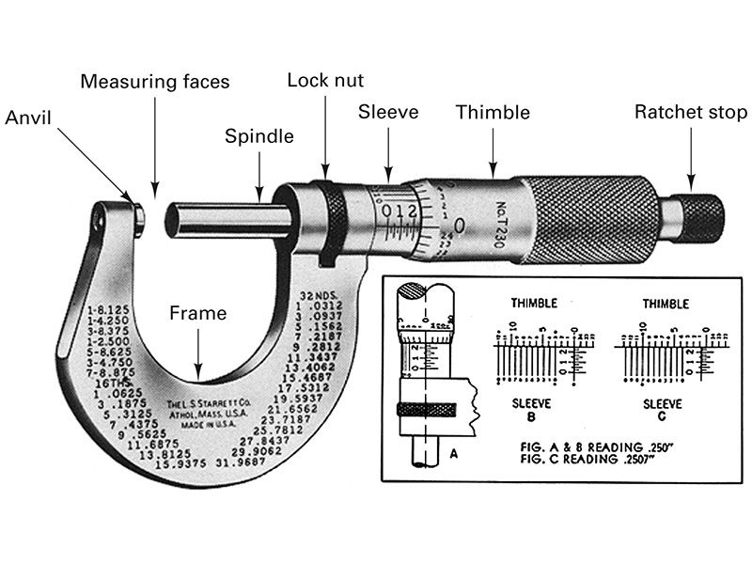
Micrometer

Slide 18

Watch Video Here

Slide 19
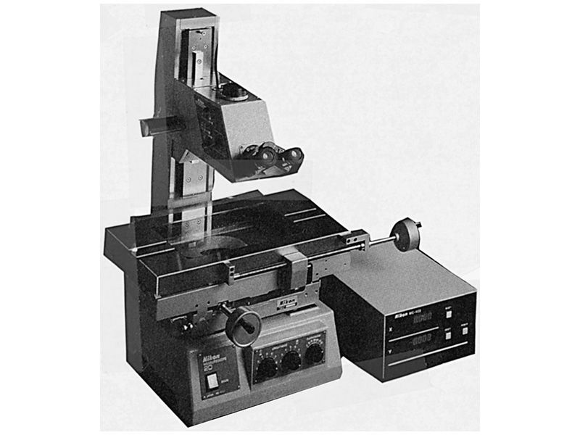
Toolmaker’s Microscope

Slide 20
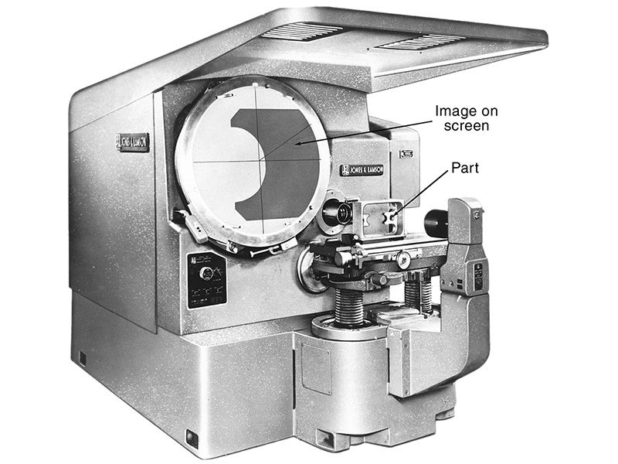
Optical Comparator

Slide 21
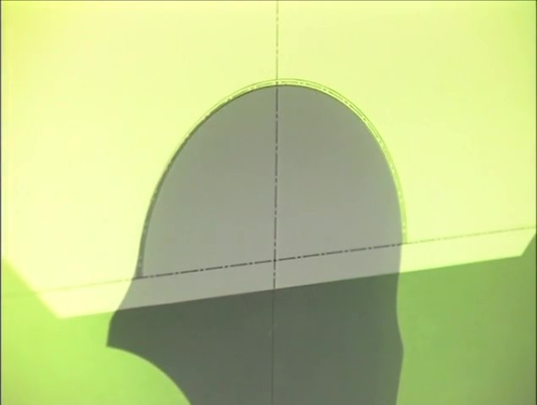
Watch Video Here
Notes:
Optical Comparator

Slide 22
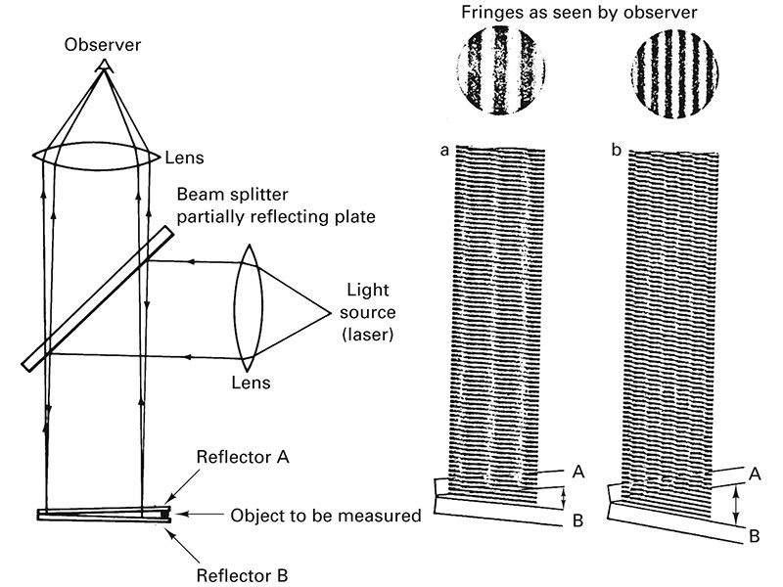
Interferometry

Slide 23
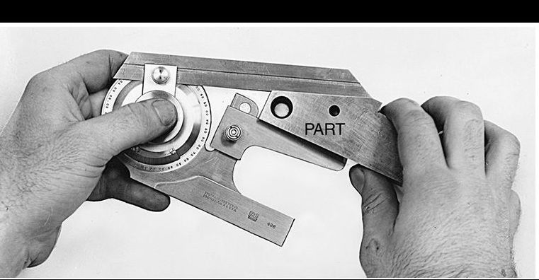
Bevel Protractor

Slide 24
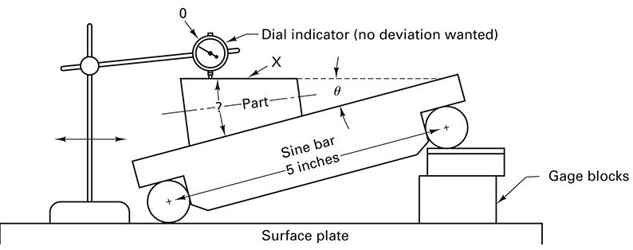
Sine Bar

Slide 25
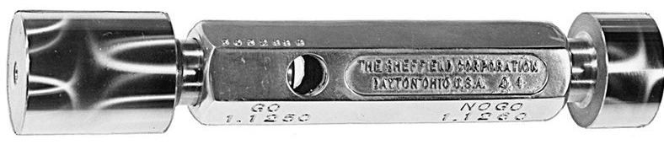
Double-Ended Plug Gage
Go/No-Go

Slide 26
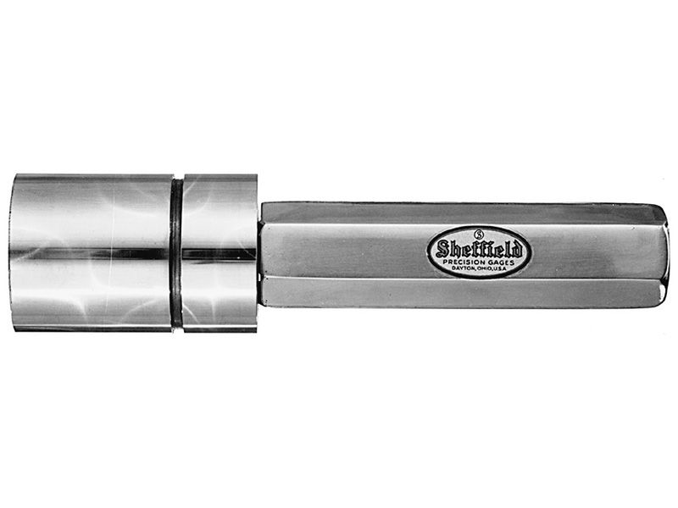
Step-type Plug Gage

Slide 27
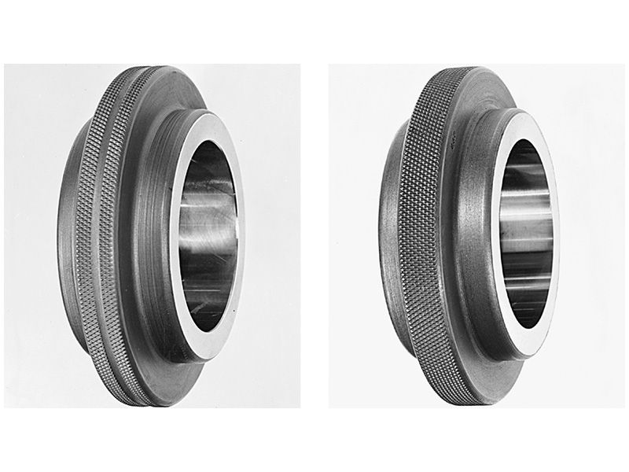
Ring Gages
No-Go (max) on left, with knurling groove.
Go (min)on right, without groove

Slide 28
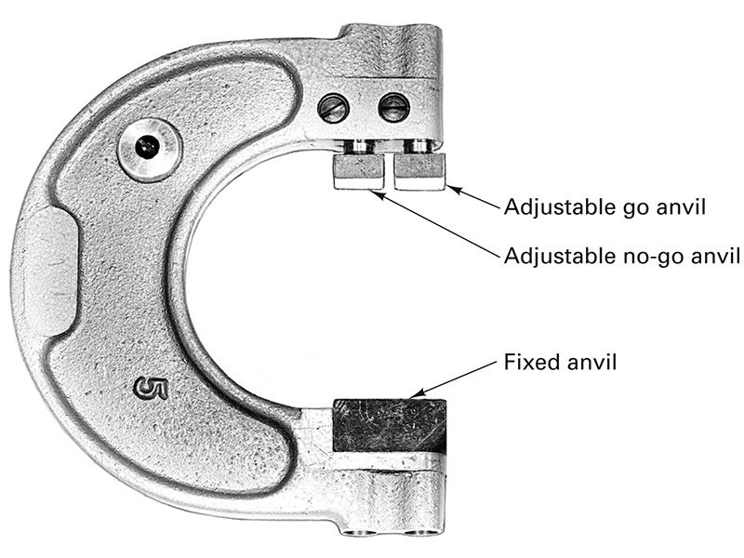
Adjustable Snap Gage

Slide 29
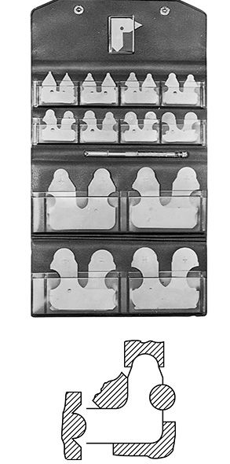
Radius Gages

Slide 30
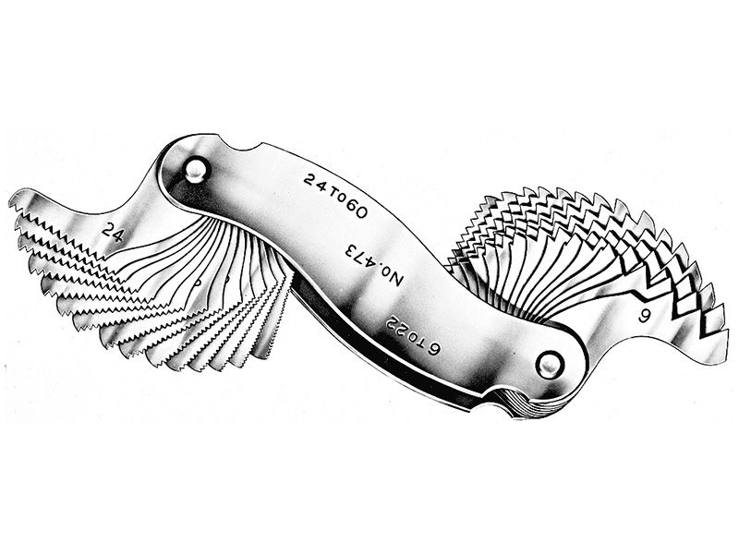
Thread Pitch Gages

Slide 31
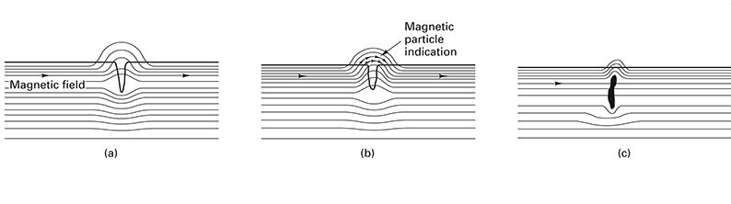
Magnetic Particle Inspection

Slide 32
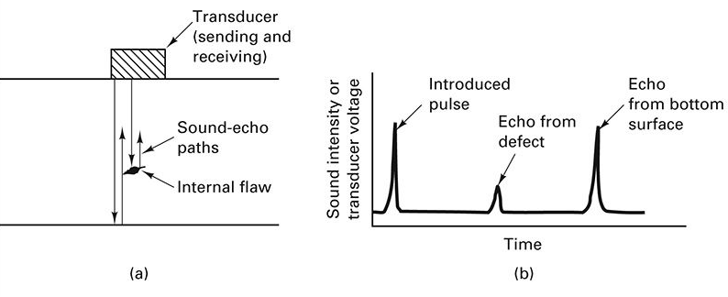
Ultrasonic Inspection

Slide 33
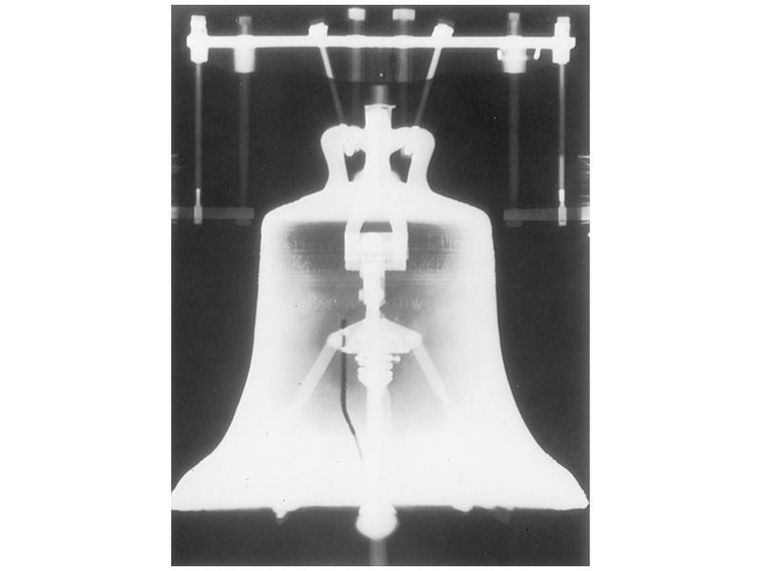
Radiography
X-Ray Inspection
Notes:
Liberty Bell crack

