Slide 1
FAIRMATIC: SUB-TO-QUOTE ANALYSIS
-Long Bui-

Slide 2

TABLE OF CONTENTS
Define
Analyze
Improve
Control
Future Works

Slide 3

Define

Slide 4
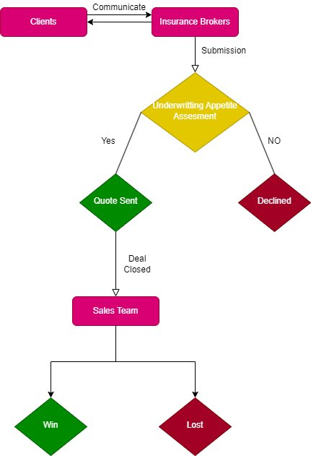
Business Understanding
Insurance brokers will send us a "submission" on behalf of their client.
If the submission fits our underwriting appetite, we provide a quote. If not, we decline it.
If it's a fit, we will provide a quote, and from there it's up to our sales team to ensure we close the business.
From there, we will either close the deal and it gets marked as "Won" or we lose and it gets marked as "Lost".

Slide 5
2. Goals
Trend of sub-to-quote ratio through times
Analyze whether declined reasons affect sub-to-quote rate and discover painpoints on our conversion funnels
Rooms to improve data cleanliness
Other general trendscus

Slide 6

II. Measurements

Slide 7
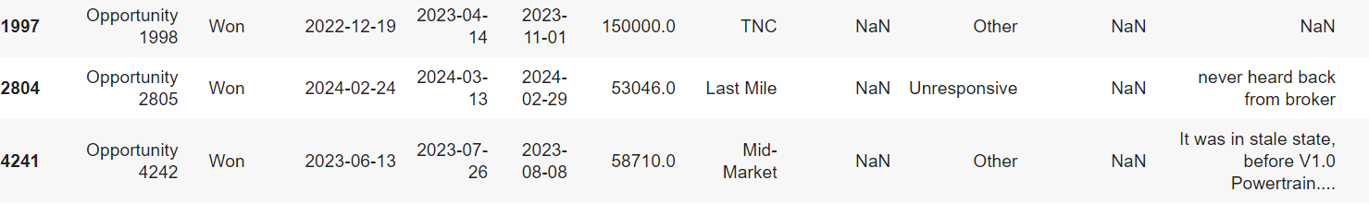
Data Inconsistencies Detected
Some submission has closed and quote date sooner than receiving date
Lost cases have not been updated

Slide 8
Data Inconsistencies Detected​
Solutions: + Applied Auto update mechanics into our CRM models our lock/capture mechanics for date

Slide 9
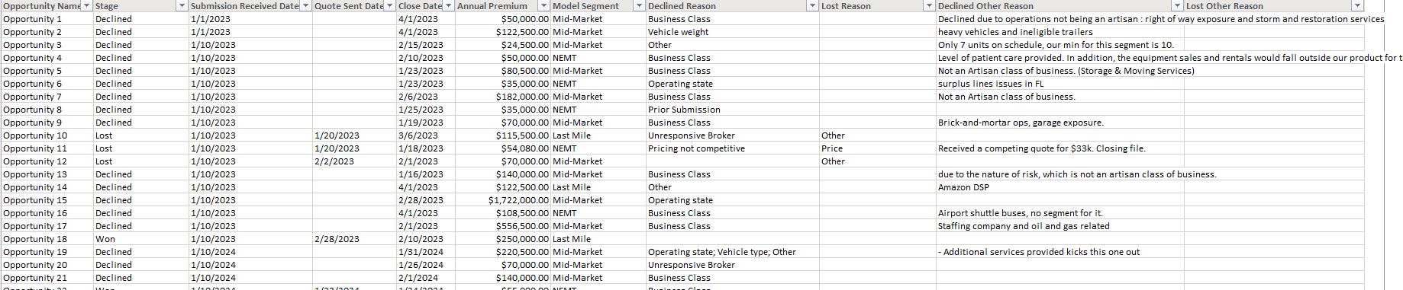
2. Measurements
+ Sub-to-quote ratio = Quote sent / Submissions
+ Time tracked: Closed Date
+ Declined Reasons/Declined Other Reasons: frequencies for each reason

Slide 10
3. Analysis

Slide 11
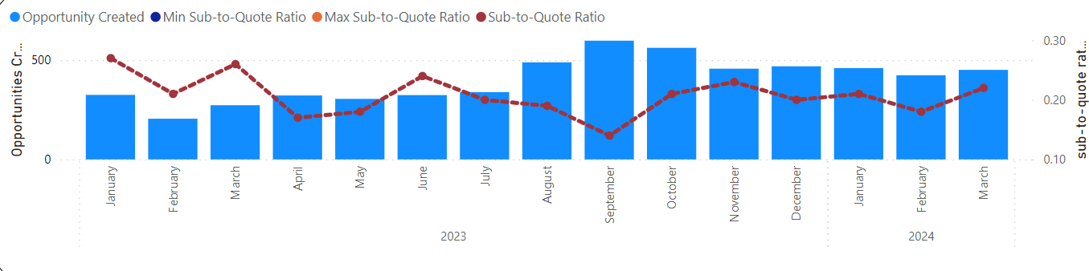
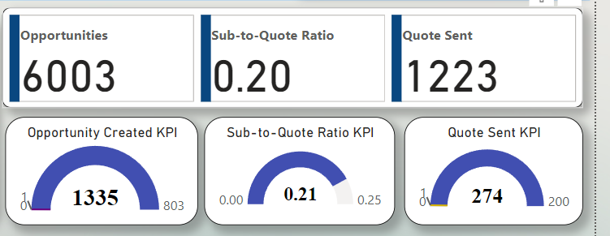
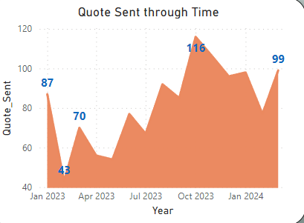
Sub-to-quote Analysis

Slide 12
Trend Analysis:
Submission-to-quote ratio performing reasonably well
Lower than previous year, but exceeds average
Higher volume of opportunities lowers ratio due to economies of scale
Number of quotes and total annual premium increased significantly compared to same quarter last year
Indicates promising growth for Fairmatic in 2024
Seasonality Analysis:
Very high traffic in Q4 (August, September, October)
Submission-to-quote ratio steadily declines during September
Warrants further investigation into causes

Slide 13
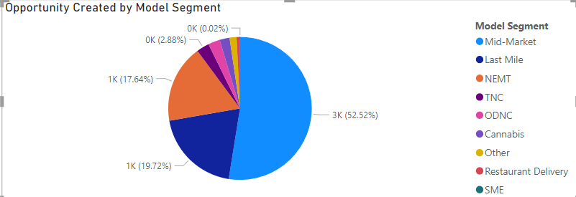
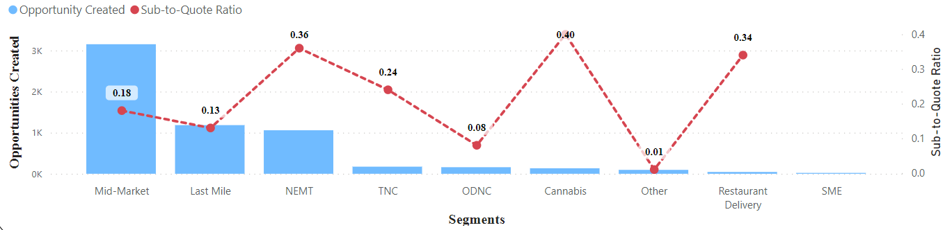
2. Sub-to-quote by Segments
+ Large focus on Mid-Market (52% total)
+ High rate of S2Q ratio on Cannabis, NEMT, and Restaurant Delivery
+ Do the company take Uber into account as one of the potential customers in the field?

Slide 14
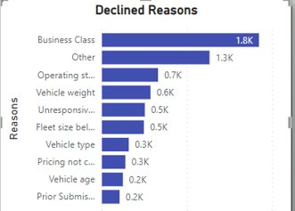
3. Declining Reasons
+ Business Class and Other are the most dominant declined reasons (~3000)
+ Some violated the appetite which could not be avoided (~ 3000): vehicle weight, operating state, fleet size, vehicle type
+ Some technical related: unresponsive brokers (505), prior submission (202), insufficient lead time (151)

Slide 15
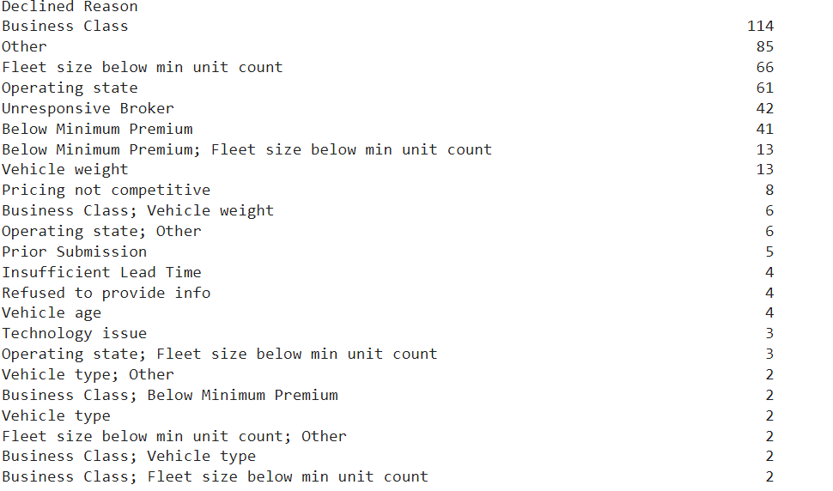
SUBSTANTIALLY DECREASE ON SEP 2023
+ Investigate and see no differences between September 2023 declined reasons comparing to others.
==> Hypothesis: Economics of Scale (the more submission receives, the lower the sub-to-quote ratio is) (may be exponentially increase)

Slide 16
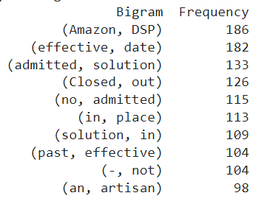
OTHER DECLINED REASONS
+ Amazon DSP being the top mentioned (186)
+ "No admitted solution" also another declined reason being mentioned + "Effective date" --> Past effective date

Slide 17
4. Improvements

Slide 18
Data Cleanliness
+ Lock/ Capture mechanism for data entrance into CRM model
+ Conduct regular data audits and validation
+ Automate ETL pipelines and normalize dataset

Slide 19
2. Key Insights
Fairmatic is witnessing a growth on number of opportunities submission, quotes and annual premium increase in 2024 comparing to 2023
Seasonality growth will focus on Quarter 4 (especially on September, October, November)

Slide 20
2. Key Insights
Sub-to-quote ratio remains around ~ 21% and may stay around permanently
Pain points from declined reasons including business cases, unqualified customers/deals but also contain system slowdown including unresponsive brokers, time exceed, …

Slide 21
5. Future Works

Slide 22
Complete the PowerBI dashboards that report sales condition:
+ Annual Premium and Won/Lost Dashboards
+ Connect declined reasons charts to main dataset through Pivoting or Melting (pandas) to make the dashboard more interactive

Slide 23
2) Analyze Won/Lost Statistics to indentify pain-points on won/lost processes
3) Deeper and more detailed text analysis on declined/other declined reasons

Slide 24
Thank you
The folder included:
+ Final Presentation (Powerpoint) + Final Report (PDF) + interactive dashboard (PowerBI dashboard)
+ Notebook files (codes and analysis)

