Slide 1



Practical Environmental Solutions.
Regulatory Clarity. Project Readiness.
Company
Profile
Environmental permitting · EIA & studies · EMP / CEMP · Compliance & reporting · Waste · Monitoring
ENVIRONMENTAL CONSULTANCY
Saudi-based Category A Environmental Consultancy
Dammam, Eastern Province, KSA · +966 55 477 7412 · info@snc.com.sa
www.sncconsultancy.com

Slide 2

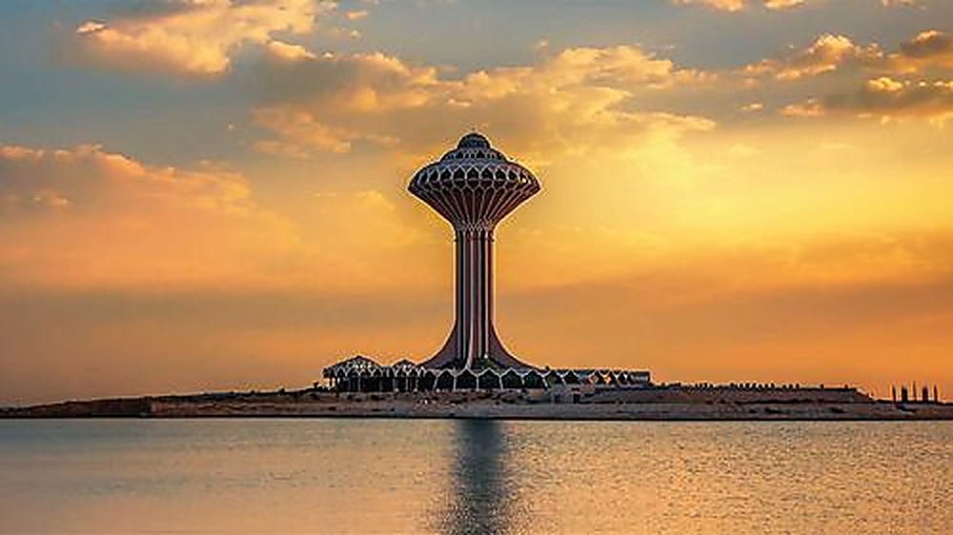

Welcome
SNC Environmental Consultancy is a Saudi-based Category A environmental consultancy headquartered in Dammam, Eastern Province. From a single project to a national portfolio, we help project owners, developers, contractors and operating facilities obtain and maintain environmental approvals with confidence - translating complex NCEC and MEWA requirements into a clear, documented, approval-ready plan.
Dammam, Eastern Province - our home base
ENVIRONMENTAL CONSULTANCY
Licensed · Registered · MEWA-aligned
ALIGNED WITH MEWA ENVIRONMENTAL LAW
NCEC Cat. A License 123456 · CR 2050 123 456 · VAT 3107 234 567 81 · Aligned with MEWA Environmental Law
SNC Environmental Consultancy
2

Slide 3
WHO WE SUPPORT
About SNC
SNC
SNC
SNC
Project Owners & Developers
Operating Facilities
Public & Semi-Government Entities
Supporting projects from early environmental requirements through permitting and documentation.
Supporting active facilities with environmental records, compliance documentation and regulatory coordination.
Environmental consultancy support for public, semi-government and strategic development projects.
Why SNC we are a Saudi-licensed Category A firm that turns environmental complexity into approval-ready documentation — combining hands-on authority experience, multi-sector delivery and full-lifecycle support with accredited, auditable laboratory coordination.
NCEC Cat. A License 123456 · CR 2050 123 456 · VAT 3107 234 567 81 · Aligned with MEWA Environmental Law
SNC Environmental Consultancy
3

Slide 4
GUIDED BY VISION 2030
Our Mission
To provide innovative, data-driven and sustainable environmental solutions that support a greener, more resilient future for industries, governments and communities worldwide.
01
Innovative Solutions
Data-driven environmental solutions that are practical and implementable.
02
Sustainability First
We integrate economic growth with ecological resilience — fostering accountable, sustainable and shared prosperity for every client and community we serve.
Responsible progress that unites strategic innovation with environmental stewardship.
NCEC Cat. A License 123456 · CR 2050 123 456 · VAT 3107 234 567 81 · Aligned with MEWA Environmental Law
SNC Environmental Consultancy
4

Slide 5
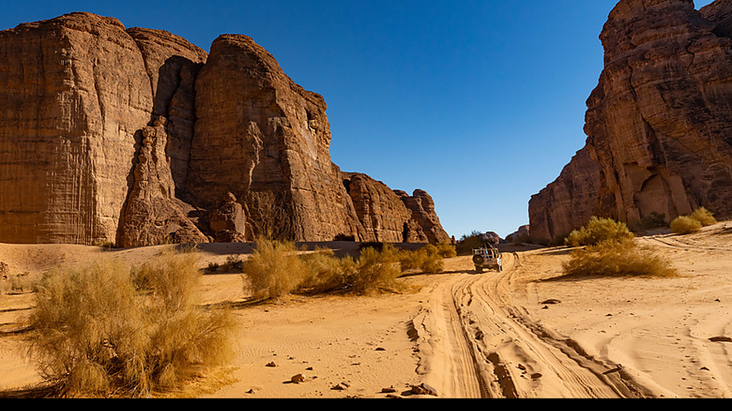
A GREENER, CLEANER FUTURE
Our Vision
We strive to drive responsible progress and become a leader in clean energy solutions — with an international presence and a reputation for excellence.
01
Sustainability
Environmental responsibility for a greener future.
02
Innovation
Through strong partnerships and evidence-based solutions we grow an economy that is accountable, sustainable and built to last.
Adaptability and forward-thinking clean energy solutions.
03
Integrity
Collaboration, transparency, excellence and accountability.
AlUla — the natural environment we help protect
NCEC Cat. A License 123456 · CR 2050 123 456 · VAT 3107 234 567 81 · Aligned with MEWA Environmental Law
SNC Environmental Consultancy
5

Slide 6
THE FULL PROJECT LIFECYCLE IN ONE PLACE
Our Services
SNC
SNC
SNC
Environmental Permitting
EIA & Studies
EMP / CEMP / OEMP
Secure construction and operational permits through managed submissions, authority responses and follow-up.
Environmental Impact Assessments and studies that identify impacts and plan practical mitigation.
Management plans for construction and operation with monitoring and control measures built in.
SNC
SNC
SNC
Compliance & Reporting
Waste Advisory
Monitoring
Environmental records and periodic reporting that keep your facility audit-ready.
Waste management plans and classification guidance aligned to regulatory requirements.
Air, noise, water, soil and sediment monitoring coordinated through accredited laboratories.
NCEC Cat. A License 123456 · CR 2050 123 456 · VAT 3107 234 567 81 · Aligned with MEWA Environmental Law
SNC Environmental Consultancy
6

Slide 7
STRUCTURED FROM SCREENING TO COMPLIANCE
Our Regulatory Approach
A documented, auditable path from first screening through to post-permit compliance — so you maintain control at every stage.
01
Regulatory Screening
02
Documentation Readiness
Early review of project activities, site context and expected permitting requirements.
Preparation of environmental studies, plans, records and supporting documents.
03
Authority Coordination
04
Compliance Continuity
Support during submission, follow-up, clarification and response to comments.
Post-permit support through records, reporting, monitoring and compliance documentation.
NCEC Cat. A License 123456 · CR 2050 123 456 · VAT 3107 234 567 81 · Aligned with MEWA Environmental Law
SNC Environmental Consultancy
7

Slide 8
SCOPED TO PROJECT CLASSIFICATION AND SITE CONDITIONS
Impact & Specialist Studies
Scope & Approach
1
Environmental Impact Assessment (EIA)
2
Environmental Site Assessment (ESA)
Each study is scoped to the project's environmental classification, regulatory requirements and site-specific conditions, so findings hold up to authority review. We identify key receptors, evaluate impacts and build mitigation into the plan — not added on after approval.
Where the project calls for it, specialist inputs cover ecology, biodiversity, hydrology and climate-related assessment — grounded in confirmed project evidence.
3
Ecological Assessment & Sensitivity Screening
4
Biodiversity & Vegetation Baseline Review
5
Habitat Characterization & Field Observation
6
Hydrological, Drainage & Flood Risk Support
7
Climate Vulnerability & Risk Screening
NCEC Cat. A License 123456 · CR 2050 123 456 · VAT 3107 234 567 81 · Aligned with MEWA Environmental Law
SNC Environmental Consultancy
8

Slide 9
SELECTED PROJECTS WITH REFERENCE AND AUTHORITY NUMBERS
Track Record & Delivery
Jubail — Residential Compound
Riyadh — Mixed-Use Development
Client: Al-Suwaket Investment
Client: Mohammed Al Habib Real Estate / Hekayat Al-Tatweer
Ref. No.
SNC/JB-2024-01
Ref. No.
SNC/RY-2024-07
Sector
Residential
Sector
Mixed-Use
Category
1
Category
3
Area
55,000 m²
Area
250,000 m²
Permit / Authority No.
NCEC / EMP-1142-26
Permit / Authority No.
NCEC / EIA-0891-25
Submitted 2025 · Permits issued 2026
Submitted 2025 · Decision expected 2026
EMP preparation, construction & operational permitting, regulatory submission and follow-up.
Environmental documentation and construction permit support with authority coordination.
Permits issued 2026
Approval in progress
95%
50+
5+ yrs
100%
Submission success rate on first review
Environmental documents delivered
Focused environmental practice
Aligned with MEWA Environmental Law
NCEC Cat. A License 123456 · CR 2050 123 456 · VAT 3107 234 567 81 · Aligned with MEWA Environmental Law
SNC Environmental Consultancy
9

Slide 10
SENIOR, TECHNICALLY QUALIFIED CONSULTANTS
Leadership & Team
MA
SA
KA
Mohammed Al-Harbi
Sara Al-Qahtani
Khalid Al-Dossary
Managing Director
Head of Environmental Studies
Senior Compliance Consultant
18+ years in environmental permitting & compliance; ex-authority reviewer of submissions.
PhD in Environmental Science; leads EIA/ESA and biodiversity baseline programs.
Specialist in NCEC submissions, gap reviews and operational compliance documentation.
Accredited Laboratory Network: All sampling and analysis is coordinated through accredited laboratories recognized by SASO/NCA, with documented chain of custody and auditable results.
NCEC Cat. A License 123456 · CR 2050 123 456 · VAT 3107 234 567 81 · Aligned with MEWA Environmental Law
SNC Environmental Consultancy
10

Slide 11
LICENSED, REGISTERED AND MEWA-ALIGNED
Credentials & Standing
NCEC Category A License
Commercial Registration (CR)
VAT Registration
123456
2050 123 456
3107 234 567 81
Environmental consultancy licence from the NCEC. Validity: 2024 – 2027.
Company registered in Dammam, Eastern Province, KSA.
Registered for Value Added Tax — shown on all invoices and correspondence.
Aligned with MEWA Environmental Law
All services are delivered in accordance with the National Center for Environmental Compliance (NCEC) and MEWA requirements.
NCEC Cat. A License 123456 · CR 2050 123 456 · VAT 3107 234 567 81 · Aligned with MEWA Environmental Law
SNC Environmental Consultancy
11

Slide 12
Let's Talk
We are ready to support your environmental goals and project needs.
H
Head Office
Dammam, Eastern Province, Kingdom of Saudi Arabia
E
Email
info@snc.com.sa
M
Mobile
+966 55 477 7412
L
Landline
+966 13 845 0010
W
Web
www.sncconsultancy.com
L
LinkedIn
linkedin.com/company/snc-environmental-consultancy
NCEC Cat. A License 123456 · CR 2050 123 456 · VAT 3107 234 567 81
12

Slide 13
T H A N K Y O U
Practical Environmental Solutions. Regulatory Clarity. Project Readiness.
www.sncconsultancy.com
+966 55 477 7412 · info@snc.com.sa · Dammam, Eastern Province, KSA

