Slide 1




8th Jul-26 – Connect Waikato

Slide 2
The New Zealand video game industry. Why?
01
02
03
04
05
A bunch of creatives and innovators in this country.
Industry tracking very well after govt help.
Collabs & connections are key.
Our strong brand overseas.
How AI can help.

Slide 3
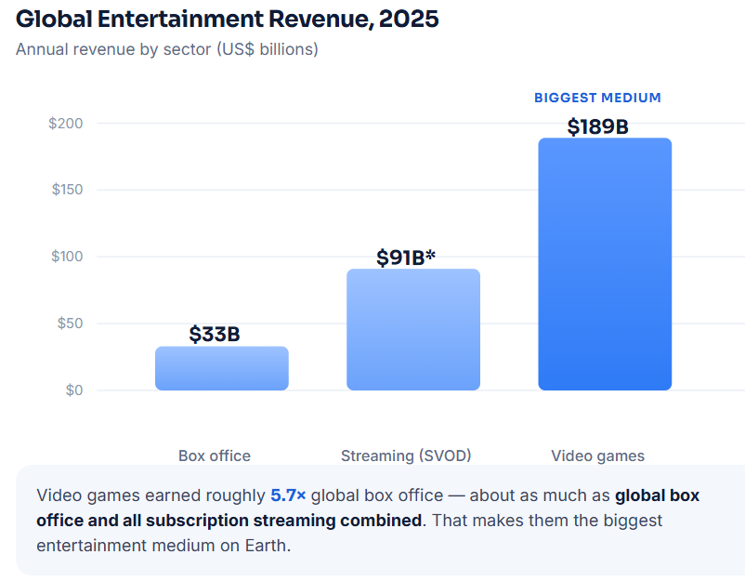
GLOBAL ENTERTAINMENT · 2025
The biggest medium
on Earth

Slide 4
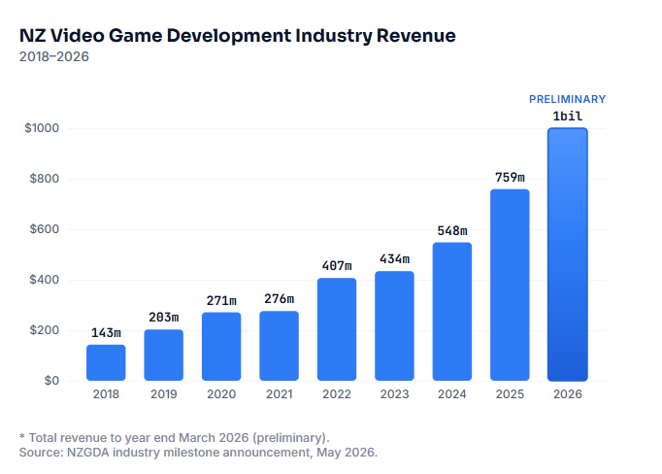
EXPORT
98%
Export dominance
of the revenue in 2025 came from international audiences.

Slide 5
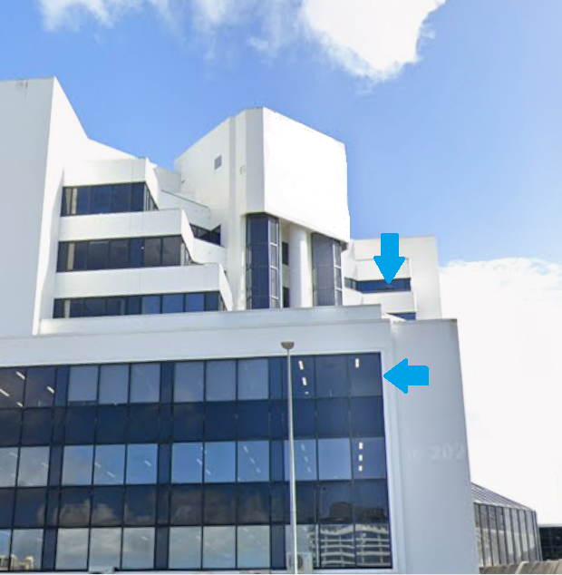
SHOW OF HANDS
Who recognises this building in Hamilton?

Slide 6

SHOW OF HANDS
Recognise this video game?

Slide 7
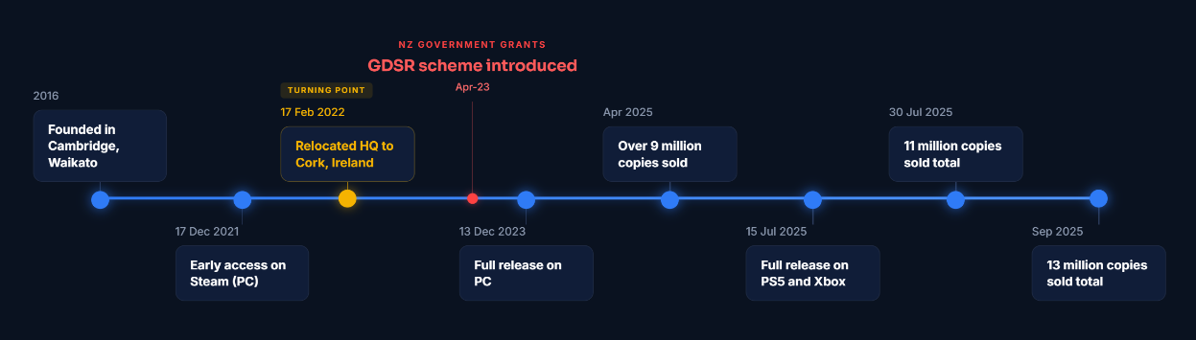
CAMBRIDGE, WAIKATO → THE WORLD
VOID Interactive — Ready or Not

Slide 8
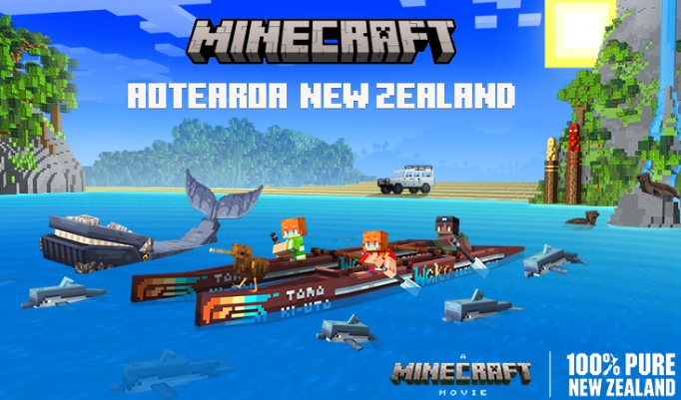
MINECRAFT · NEW ZEALAND
The Waikato in the world’s
biggest game
PURPOSE
Promote NZ as a travel destination.
PARTNERSHIP
Tourism NZ, Warner Bros, Mojang Studios, Piki Studios, and communities around New Zealand.
RELEASE
2025, ahead of the Minecraft movie filmed in the Waikato.
LOCATIONS
Waikato features in the game. Explore Waitomo Caves.
TOURISM NOW
Mid-2026 numbers near pre-pandemic levels.
350m+
units sold. The biggest video game in the world.

Slide 9
THE INDIE OPPORTUNITY
1B+
2–20
Where the indies come in
MOBILE PLAYERS
PEOPLE PER STUDIO
The largest audience, while thousands of new titles hit Steam each year.
True indie teams where one person wears many hats. Suits New Zealand’s SME industry.
$11B
global indie game market value.
EASY TOOLS
DIGITAL STORES + TRUST
Low-code software lets almost anyone build and ship a game. I built my base one in 3 minutes.
Sell direct worldwide and players increasingly prefer indie creativity to big-budget studios.
Millions of developers worldwide, from solo hobbyists to small studios sharing every role.

Slide 10
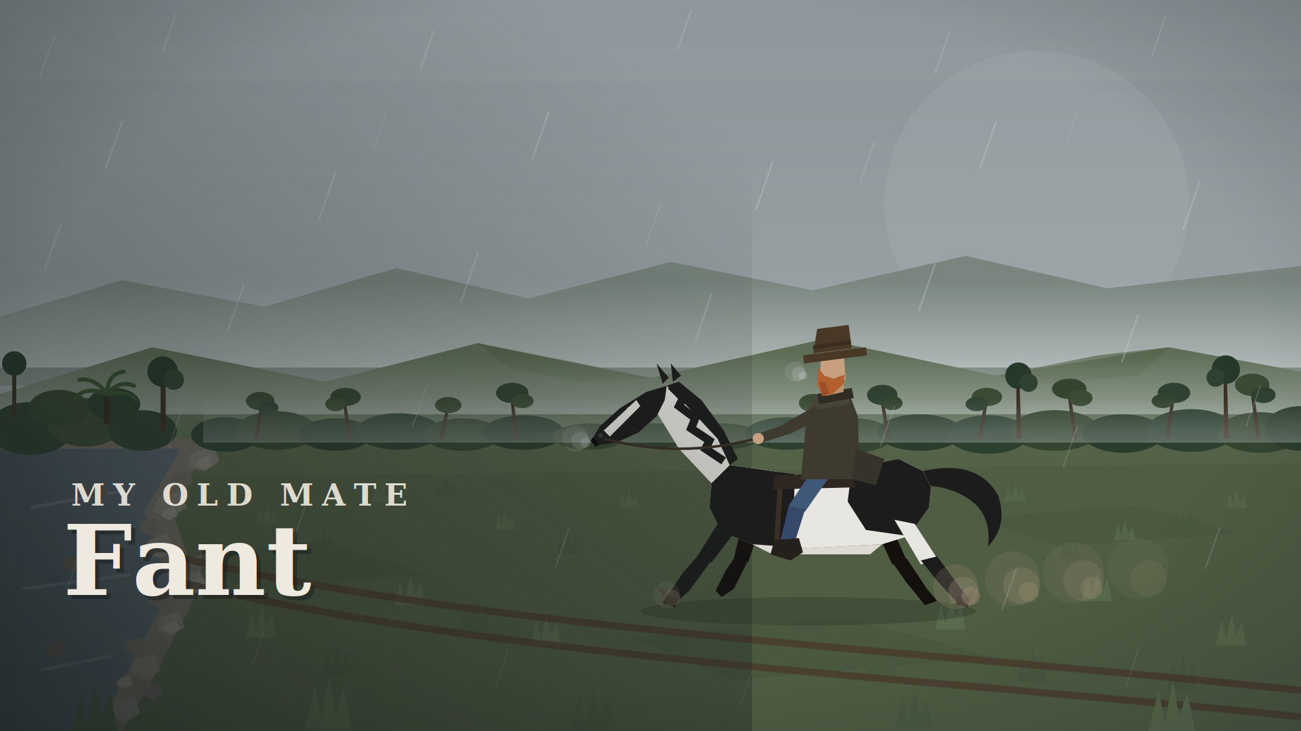
https://www.longcloud.nz/our-work/riverland-yards-the-muster

Slide 11
KEY TAKEAWAYS
What to take home
01
02
03
Games are the biggest entertainment medium on Earth . It's still growing fast.
NZ punches well above its weight. Smashing forecasts 2 years early and growing still , with world-class studios that hopefully now stay in New Zealand.
The tools are cheap and the doors are open. Use AI to do the heavy lifting. Keep the design human.
SO HERE'S MY ONE PIECE OF ADVICE
Making a video game is the new "tell your kids to take up golf or tennis."

Slide 12
References
Slide 3
Slide 4
Slide 7
Newzoo, Global Games Market Report 2025 (games revenue); Gower Street Analytics 2025 (box office); Ampere Analysis 2025 (SVOD streaming).
NZ On Air & NZGDA Game Development Sector Rebate (GDSR) data, 2025 (export share, recipient studios). Whole-industry figure: 95% — NZGDA Industry Survey 2025.
Worthplaying / WCCFTech 2025 (Ready or Not: 9M Apr, 11M Jul, 13M+ by Sept 2025); VOID Interactive + Irish company registry (Cambridge 2016 → Cork 2022); NZ On Air / MBIE, GDSR rebate, 2023.
Slide 8
Slide 9
Tourism New Zealand, Destination NZ Minecraft world, 2025; Guinness World Records / Mojang, 350M copies, 2025; 1News / NZ Film Commission, A Minecraft Movie filmed in Huntly, Waikato, 2025.
Newzoo, Global Games Market Report 2024 (mobile audience); SkyQuest, Indie Game Market 2025 ($11.1B); SteamDB via PC Gamer 2024 (~18k Steam releases/yr); GDC State of the Game Industry (team size).

