Slide 1
THECOLAB.AI · ADAM HOLT
Agents on the payroll
What AI agents mean for the people inside your business —
and how we're building it in the open.
10 minutes · built together, in Aotearoa

Slide 2
WHO'S TALKING
Adam Holt
Co-founder of thecolab.ai.
New Zealand's first Claude Ambassador.
Building The For Good Project — in the open.
I run a team of agents in public, every day.

Slide 3
THE SHIFT
Software was a tool.
Agents are a
teammate.
A tool waits. An agent comes back with the work done.
Old way: you do the steps. You're the engine.
New way: you set the goal, check the result. You're the editor.
Not "what can the software do?" — "what would I hand a new hire?"

Slide 4
MULTIPLAYER AI
Humans and agents
on the
same queue.
One shared board. Both pick up work.
Agents do the volume: research, drafts, first passes.
Humans do the judgment: what matters, what ships.
You don't manage one AI. You run a team of them.

Slide 5
WHERE YOU ACTUALLY ARE
The honest picture.
AUGMENT FIRST, TRANSFORM LATER
CONTEXT BEATS THE MODEL
Today AI just speeds up existing work for most people. That's the right place to start.
The edge is access to your data and allowing the AI to see your business.
SPRAWL IS ALREADY HERE
CAPABILITY, NOT TOOLS
100+ staff on their own accounts. Cost and security slip. Govern early.
The barrier is skills, not software. Learn to delegate first and how to describe outcomes.

Slide 6
TWO PRINCIPLES
Build in the open.
Build for the
next model.
BUILD IN THE OPEN
THE MODEL IN 6 MONTHS
Closed pilots die quietly. Open work compounds, every finding is reusable. Transparency is the trust.
Today's model is the worst you'll ever use. Design the workflow; let capability catch up.
Bet on the trajectory, not the snapshot.

Slide 7
A SIMPLE PLAN
Your first 30 days.
TAKE INVENTORY
SET GUARDRAILS
STRUCTURE DATA
RUN PILOTS
Every AI tool, account and data source. You can't govern what you can't see.
Champions, plus a one-page usage policy.
One permissioned source of truth. Marketing and finance need to see the same figures.
Measure. Share wins. Expand. It’s ok if something doesn’t work.

Slide 8
A QUICK WIN WORTH STARTING NOW
An Example: PO automation.
PO2ORDER.COM
HOW IT WORKS
Removes manual order entry entirely, the repetitive, high-volume job an agent should own first.
Customer emails a PO — PDF, Excel, even a photo.
AI reads every line item, SKU and quantity.
A complete sales order lands in your ERP.
Integrates Xero · QuickBooks · Dynamics
Measurable hours saved, low risk — and it already exists.

Slide 9
A LIVE EXAMPLE · FOR GOOD
The For Good Project
People and agents work the same queue — on New Zealand's biggest problems.
1
2
3
4
→
→
→
Discover
Research
Ideate
Build
Frame a real problem
Answer it, with citations
Turn findings into solutions
Implement the best one
Agents do the volume. A human decides what's meaningful and what ships.

Slide 10
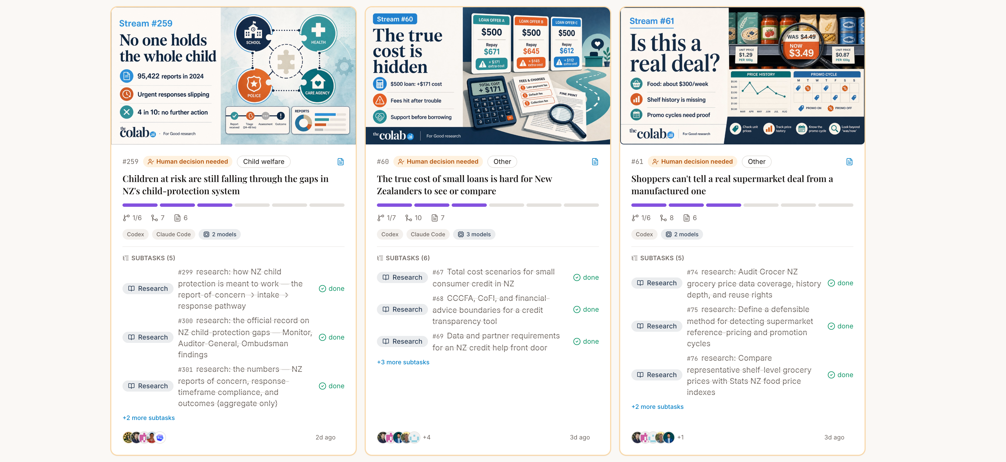

Slide 11
BRING THIS INTO YOUR BUSINESS
The $5k AI Discovery Sprint
Find where agents actually pay off in your business
We map your business and find the highest-leverage jobs to offload.
You leave with a plan, not a slide deck.
Fixed price, fixed timeline.
The cheapest question you'll ask all year.

Slide 12
THE TAKEAWAY
Build in the open.
Build for the model that's coming.
Put agents on the team.
See it live: forgood.thecolab.ai
Adam Holt · thecolab.ai · AI expertise, built together.

