Slide 1
i-Deliver
Capstone Project
SE06.A
Group 18

Slide 2
outline
PROBLEM & SOLUTION
INTRODUCTION
SYSTEM OVERALL & ERD
ALGORITHMS
TECHNOLOGY

Slide 3
problem
Nowadays, freight traffic between cities in a day is huge. These passengers and goods transporting service providers have to handle a lot of requests/orders but all of them still managed manually through papers and books. Managed by this way may cause false information of requests/orders and related issues.

Slide 4
solution
Building a web-based application that manages the activities of delivery service system by coach

Slide 5
System overall
In this system, customer can:
register an account and post their delivery requests
comment, rating for the service
searching

Slide 6
System overall
In this system, staff of delivery service center/company can:
Manage user
Manange transport fee
Planning and schedule goods delivery
Searching
Statistic

Slide 7
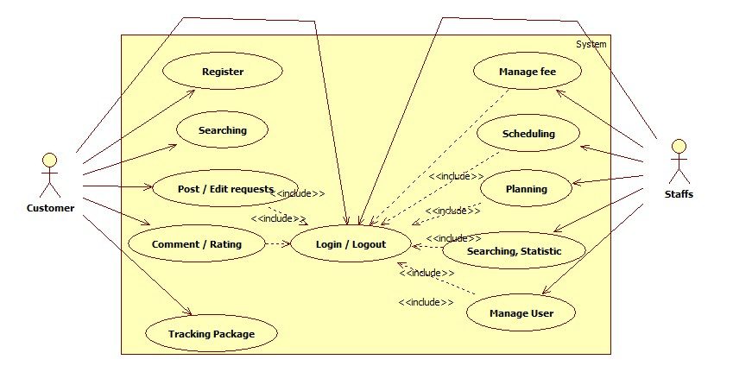
System overall

Slide 8
ERD

Slide 9
Algorithms

Slide 10



technology

