Slide 1
Pascal

Slide 2
Introduction
For this project, my partner and I chose to inspect the language Pascal. We chose this language because we both have previously used it, and because it is related to the development of C/C++ plus which makes it a very interesting language to learn about.

Slide 3
A Brief History of Pascal:
Pascal was developed by Niklaus Wirth in an effort to improve upon ALGOL, more specifically, ALGOL 60.
Wirth began with two proposed languages, Algol X and Algol W.
In 1968, Wirth abandoned Algol X and instead focused on ALGOL W, which would become known as PASCAL upon release in 1970.
“Besides cleaning up or leaving out some of Algol's more obscure features, Pascal added the capability to define new data types out of simpler existing ones. Pascal also supported dynamic data structures; i.e., data structures which can grow and shrink while a program is running.”
http://folk.ntnu.no/haugwarb/Programming/Oberon/oberon_history.html

Slide 4
Section Overview:
Section 2: BASIC FEATURES
Section 3: Tutorial
Section 4: Evaluation

Slide 5
Section 2: BASIC FEATURES
2.1: Introduction
2.2: Paradigm:
2.3: Data Types
2.4: Control Flow
2.5: Subprograms
2.6: Object-orientation

Slide 6
2.1: Introduction
High-level, structured language
Designed to be easy-to-learn
Strongly-typed
Extensive error-checking
Offers several data types including arrays
Allows users to define complex structured data types and structures
https://www.tutorialspoint.com/pascal/pascal_overview.html

Slide 7
2.2 Paradigms
Imperative
Structured
Strongly typed
Static type checking

Slide 8
2.3: Data Types
Standard
User-defined
Structured
Pointer

Slide 9
2.3a: Standard Data Types
Integer: holds whole numbers from -32,768 to 32,767
Longint: holds whole numbers from -2,147,483,648 to 2,147,487,647
Shortint: holds whole numbers from -128 to 128
Real: holds decimal numbers
Character: holds a single character
String: holds text
Boolean: holds true or false

Slide 10
2.3b: User-defined Data Types
Enumerated: specifies values in a list
Subrange: creates a variable that has a value between a certain range

Slide 11
2.3c: Structures:
Array: a collection of elements of one certain data type
Record: a collection of fields that can contain different data types
File
Set: a collection of unique elements in no particular order

Slide 12
2.3d Pointer:
Represents the memory address of some variable

Slide 13
2.4: Control Flow:
Allows use of if then, else statements
Checks conditions through the use of Booleans and comparisons
Comparisons can include: equal to, greater than, less than, greater than or equal to, and less than or equal to
Repeat until loop: runs some code until a condition is met
For loop: executes some code a specific number of times
While do loop: same as the repeat until loop but, it is not required to execute at least once

Slide 14
2.5: Subprograms
Pascal offers two forms of subprogramming: procedures and functions
While functions and procedures are similar the main difference is that functions return a value and procedures do not.
Functions consist of arguments, return type, local declarations, and the function body
Procedures consist of arguments, local declarations, and the procedure body

Slide 15
2.6: Obect-Oriented
Pascal allows for object-oriented programming
It includes features like objects, classes, inheritance, and polymorphism

Slide 16
Section 3: A Brief Tutorial

Slide 17
Section 4: Control Flow
4.1 Simplicity/orthogonality
4.2 Control Structures
4.3 Data types
4.4 Syntax Design
4.5 Support for abstraction
4.6 Expressivity
4.7 Type checking
4.8 Exception handling
4.9 Restricted aliasing

Slide 18
4.1 Orthogonality
A type system is discriminatory if one of its type constructors is “discriminatory”, i.e., it is applicable to some types, but not to others
Non-discriminatory type constructor:○You can create arrays of almost anything, but not of functions

Slide 19
4.1 Simplicity
Because the language is simple and expressive in nature it allows for effective teaching of computer programming techniques
LISP and Prolog have a simple structure for the user, but have an extremely complex underlying run-time system.
Pascal was the king of simplicity (and died of it).

Slide 20
Pascal is Algol-based language and includes many constructs of Algol. Algol 60 is a subset of Pascal. Pascal offers several data types and programming structures. It is easy to understand and maintain the Pascal programs.
Pascal has grown in popularity in the teaching and academics arena for various reasons:
Easy to learn.
Structured language.
It produces transparent, efficient,and reliable programs.
It can be compiled on a variety of computer platforms.

Slide 21
4.2 Control Structures
Pascal uses structure programming language to display the flow of control in an structured manner.
It uses the goto statement/command as standard statements that allow the control to be given to the main program in a recursive manner.
It provides more easy way to represent them without using the semicolon to end the statements written in one line.
Using loops as a control structure.

Slide 22
Pascal Program Struture
program {name of the program}
uses {comma delimited names of libraries you use}
const {global constant declaration block}
var {global variable declaration block}
function {function declarations, if any}
{ local variables }
begin
...end;
procedure { procedure declarations, if any}
{ local variables }
begin
...end;
Begin{ main program block starts}
...end. { the end of main program block }

Slide 23
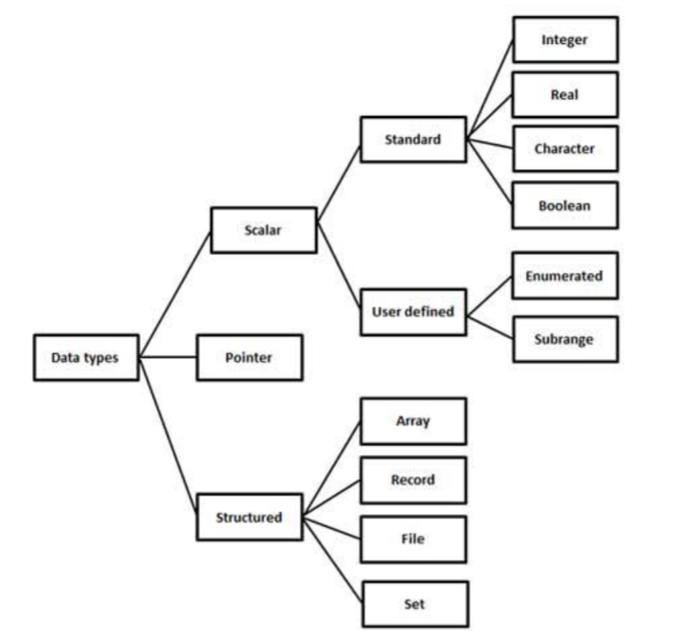
4.3 Data type Pascal data types can be summarized as below in the following diagram:

Slide 24
Data type (continued)
Overview of Pascal Data Types:
Name | Type of Data | Examples
String | Holds Text | 'New York', 'Evan'
Integer | Holds whole numbers | 3, 6, 1024
Real | Holds Decimal Numbers | 3.14, 503.2
Boolean | Holds True or False | TRUE, FALSE
Character | Holds a single character | 'A', 'E’

Slide 25
Type Declarations: The type declaration is used to declare the data type of an identifier.
Ex: type-identifier-1, type-identfier-2 = type-specifier;
Integer Types
Constants
Ex: constIdentifier = contant_value;
Enumerated types Enumerated data types are user-defined data types.
Ex: type
SUMMER = (April, May, June, July, September);

Slide 26
Subrange Types
Subrange types allow a variable to assume values that lie within a certain range.
Ex:
type
Value = 1 … 100;
Number = 0 … 20;

Slide 27
Declaring Arrays
To declare an array in Pascal, a programmer may either declare the type and then create variables of that array or directly declare the array variable
The general form of type declaration of one-dimensional array is :
type
array-identifier = array[index-type] of element-type;
Ex:
type
vector = array [ 1..25] of real;
var
velocity: vector;

Slide 28
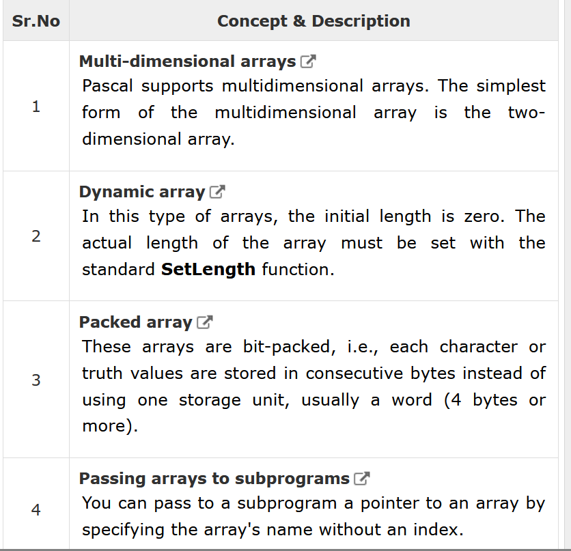

Slide 29
Pascal Pointers
A pointer is a dynamic variable, whose value is the address of another variable, i.e., direct address of the memory location.
The general form of a pointer variable declaration is
type
ptr-identifier = ^base-variable-type;
The pointer type is defined by prefixing the up-arrow of caret symbol (^) with the base type.
Ex: type
Dptr = ^real;
Nptr = ^char;
Var
a,b : Dptr;
C : Nptr;

Slide 30
Types scalar types
fractional numbers (float, double)
discrete or ordinal types, e.g. integers, booleans, characters.
With an ordinal type, each value (except the smallest and largest) has a unique predecessor and successor.

Slide 31

4.4 Syntax Design:
Pascal, in its original form, is a purely procedural language and includes the traditional array of ALGOL-like control structures with reserved words such as if, then, else, while, for, and case ranging on a single statement or a begin-end statements block.
Pascal also has data structuring constructs not included in the original ALGOL 60 types, like records, variants, pointers, enumerations, and sets and procedure/pointers. Such constructs were in part inherited or inspired from Simula 67, ALGOL 68, Niklaus Wirth's own ALGOL W and suggestions by C. A. R. Hoare.

Slide 32
Variable
variable definition is put in a block beginning with a Var keyword, followed by definitions of the variables as follows:
Var
A_variable, B_variable…: Variable_type;

Slide 33
Functions/Procedures
In Pascal, a procedure is set of instructions to be executed, with no return value and a function is a procedure with a return value. The definition of function/procedures will be as follow:
Function Func_Name(params...) : Return_Value;
Procedure Proc_Name(params...);

Slide 34
Defining a Function
procedure name(argument(s): type1, argument(s): type 2, ... );
< local declarations >
begin
< procedure body >
end;

Slide 35
Pascal Statements
Pascal programs are made of statements. Each statement specifies a definite job of the program. These jobs could be declaration, assignment, reading data, writing data, taking logical decisions, transferring program flow control, etc.
Ex: readln(a,b);
C := (a+b)/2;
Size := a*b;
writeln(Size);

Slide 36
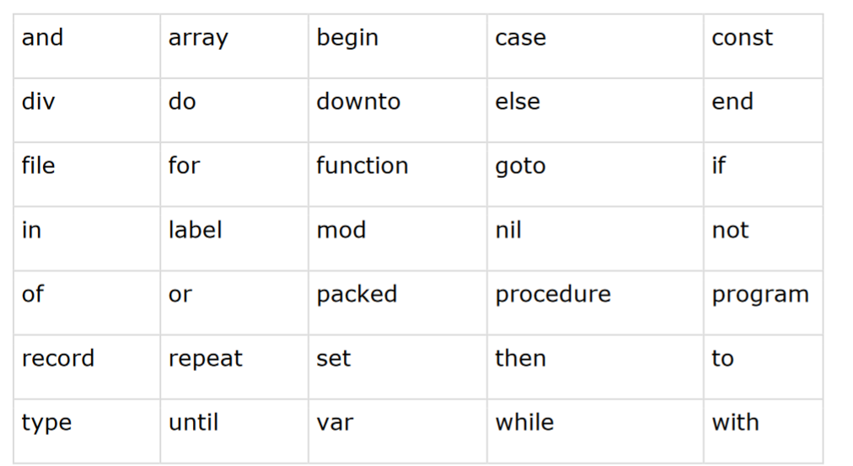
Reserved Words in Pascal

Slide 37
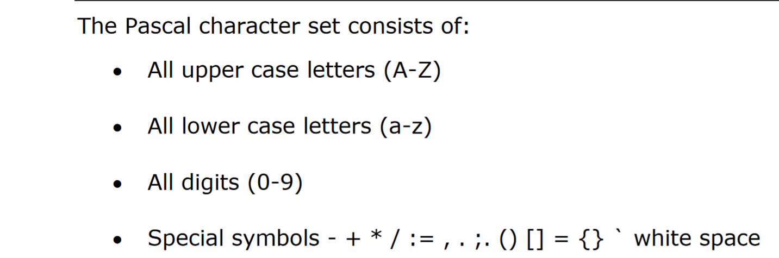
Character Set and Identifiers in Pascal

Slide 38
4.5 Support for abstraction
Data Abstraction − Any representation of data in which the implementation details are hidden (abstracted).
An object is declared using the type declaration. The general form of an object declaration is as follows −
Defining Pascal Objects
type object-identifier = object
private
field1 : field-type;
field2 : field-type;
...
public
procedure proc1;
function f1(): function-type;
end;
var objectvar : object-identifier;

Slide 39
4.6 Expressivity
Pascal is a language is the breadth of ideas that can be represented and communicate.
Pascal allows the programmers to define complex structured data types and build dynamic and recursive data structures, such as lists, trees and graphs.
Pascal offers features like records, enumerations, subranges, dynamically allocated variables with associated pointers and set.
Pascal allows nested procedure definitions to any level of depth. This truly provides a great programming environment for learning programming as a systematic discipline based on the fundamental concept

Slide 40
4.7 Type checking
Type checking is performed at run-time, a term dynamic type checking is applied
Pascal is Strong typed:
It is impossible to break the association of a value with a type from within the framework of the language.
It is impossible to subject a value to an operation which is not acceptable for its type.

Slide 41
Static :
Type Checking during complie-time
Dynamic:
-Type Checking during run-time.
Pascal is almost statically typed.

Slide 42
Pascal has strong type checking on all objects which means that a variable cannot be converted to other type without explicit conversion. Pascal Compiler will catch every single data type mismatch
In Pascal, variant records give a loop-hole in the type-checking.

Slide 43
Dynamic type checking in Pascal
Array range: arrays are defined as mapping from range of ordinal types to some type. Invalid index is a type error, checked at run time
Division by zero: not a type error; a pseudo-type error.
Null pointer reference: not a type error; a pseudo-type error.

Slide 44
4.8 Exception handling
An exception is raised when an error or other event interrupts normal execution of a program. The exception transfers control to an exception handler, which allows you to separate normal program logic from error-handling.
Pascal uses different keywords than some other languages: raise instead of throw, and except instead of catch. Also, as a compiler design choice, each try-block can pair with either an except or finally block, but not both at the same time. You'll need to nest try-blocks if you need except and finally protecting the same code.
Exception handling is appropriate for errors whose chances of occurring are low or difficult to assess, but whose consequences are likely to be catastrophic (such as crashing the application); for error conditions that are complicated or difficult to test for in if...then statements; and when you need to respond to exceptions raised by the operating system or by routines whose source code you don't control. Exceptions are commonly used for hardware, memory, I/O, and operating-system errors.

Slide 45
Try….except
try
AssignFile(F, FileName);
Reset(F); // raises an EInOutError exception if file is not found
except
on Exception do ...
end;

Slide 46
If…
if FileExists(FileName) then // returns False if file is not found; raises no exception
begin
AssignFile(F, FileName);
Reset(F);
end;

Slide 47
Try...finally Statements
Reset(F);
try
... // process file F
finally
CloseFile(F);
end;

Slide 48
4.9 Restricted aliasing
Aliasing refers to the situation where the same memory location can be accessed using different names.
Consider problem:
procedure proc1(var a : integer; var b: integer);
….
proc1(x,x);
proc1(x,glob);

Slide 49
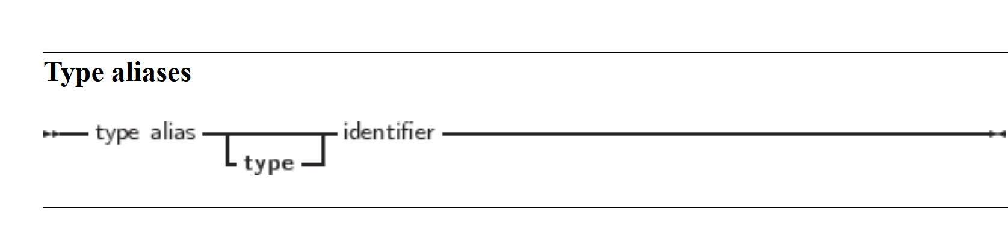
Type aliases are a way to give another name to a type, but can also be used to create real new types. Which of the 2 depends on the way the type alias is defined:

