Slide 1
SVN/GIT Tools
Version Control System for managing source code

Slide 2
Agenda
Course objective
Installation of SVN/GIT
SVN
GIT
Exercises

Slide 3
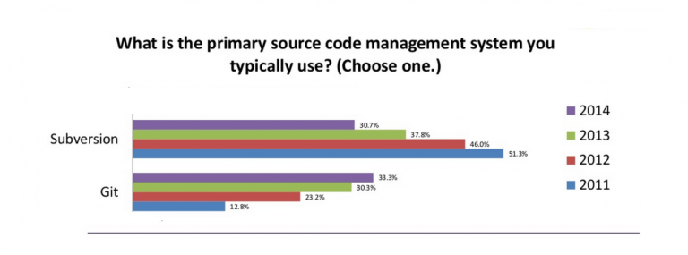
Course Objective
Understanding of version-control-system
Understand the workflow of GIT, SVN
Know how to use GIT,SVN in a team
Can find rootcause, resolve when problems occur.

Slide 4
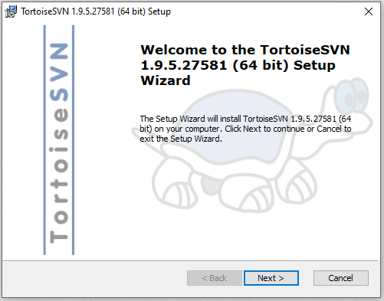
Installation of SVN
You can install Tortoise SVN: Open the drive:
Window: S:\Apps Free\TortoiseSVN
MacOS: S:\Apps Free\SmartSVN
And run installer file

Slide 5
Installation of GIT
You can install Git : - Windows: You can install TortoiseGit, it’s an open-source Git client. (Drive: S:\Apps Free\TortoiseGit) - Mac: On a Mac, you can use a Git client called SourceTree. It is created by Atlassian and is free to use. (Link: S:\Apps Free\SourceTree)
- But if you are a developer and you’re comfortable with console interface. Let use command line to better understand Git. Download the Git installer from the drive: S:\Apps Free\Git
Reference: https://backlog.com/git-tutorial/vn/intro/intro2_1.html

Slide 6
SVN (Subversion)
What is SVN:
SVN is a software Centralized Version Control System(CVCS) distributed under an open source license
Subversion manages files and directories, and the changes made to them, over time
Allows you to recover older versions of your data or examine the history of how your data changed

Slide 7
SVN (Subversion)
Some concepts should know:
Repository: A repository is the heart of any version control system. It is the central place where developers store all their work. Repository not only stores files but also the history. Repository is accessed over a network, acting as a server and version control tool acting as a client.
Working copy: Working copy is a snapshot of the repository. The repository is shared by all the teams, but people do not modify it directly. Instead each developer checks out the working copy. The working copy is a private workplace where developers can do their work remaining isolated from the rest of the team.
Branches: Branch operation is used to create another line of development. It is useful when you want your development process to fork off into two different directions. For example, when you release version 5.0, you might want to create a branch so that development of 6.0 features can be kept separate from 5.0 bug-fixes.

Slide 8

SVN (Subversion)
II. How Subversion works:
Github,Gitlab,Backlog..
Repository
SVN Checkout
SVN Checkout
Commit
Commit
Update
Update
Local working directory
Local working directory
Client A
Client B

Slide 9
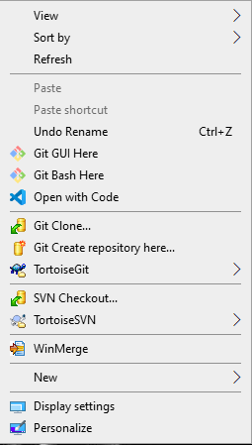
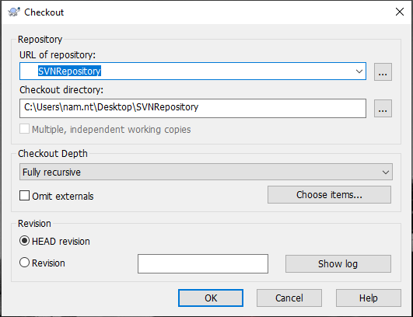
SVN (Subversion)
III. Begin with TortoiseSVN:
Check out : To obtain a working copy you need to do a checkout from a repository. Select a directory in windows explorer where you want to place your working copy. Right click to pop up the context menu and select the command TortoiseSVN → Checkout..., which brings up the following dialog box:
Notes:
More details : https://tortoisesvn.net/docs/release/TortoiseSVN_en/tsvn-dug-checkout.html

Slide 10
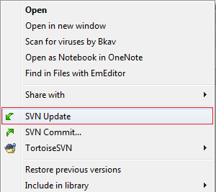
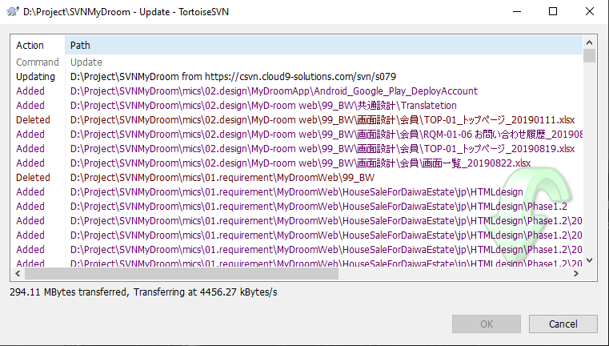
SVN (Subversion)
Update: Update your working copy with changes from SVN Repository. To update, select the files and/or directories you want, right click andselect TortoiseSVN →Update in the explorer context menu.

Slide 11
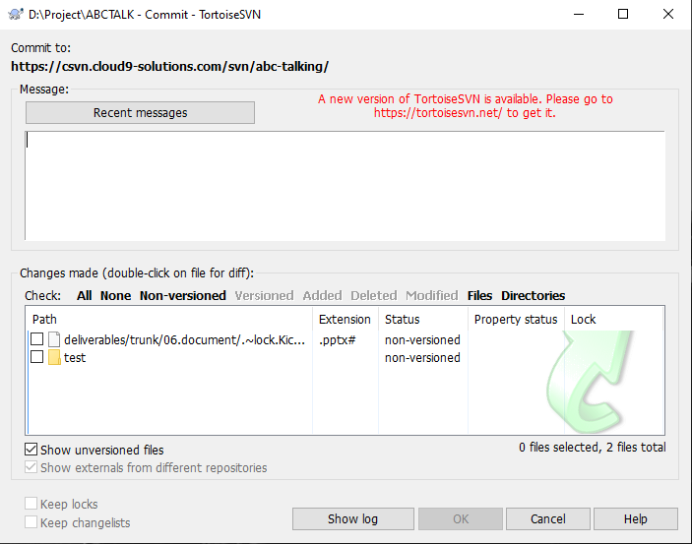
SVN (Subversion)
Committing Your Changes To The Repository: Sending the changes you made to your working copy is known as committing the changes. But before you commit you have to make sure that your working copy is up to date. You can either use TortoiseSVN → Update directly. Or you can use TortoiseSVN → Check for Modifications first, to see which files have changed locally or on the server.
Notes:
More details: https://tortoisesvn.net/docs/release/TortoiseSVN_en/tsvn-dug-commit.html

Slide 12
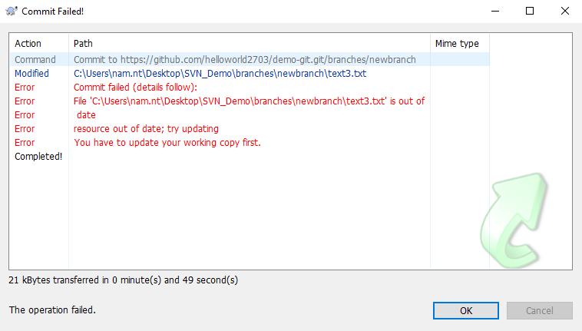
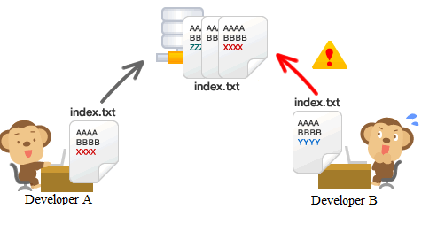
SVN (Subversion)
Resolve Conflict:
When SVN Client A makes changes the content of the index file and has commited up the SVN server reponsitory.
Then SVN Client B also makes changes the content of the index file. And now if B commits this file to the repository, a conflict will occur
SVN commit

Slide 13
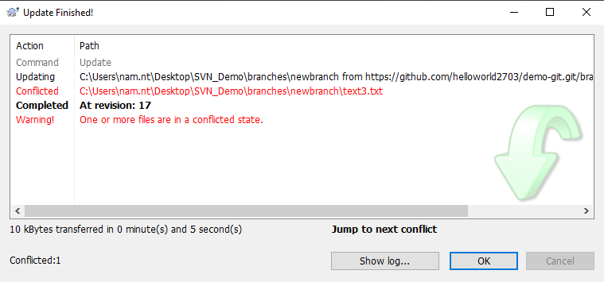
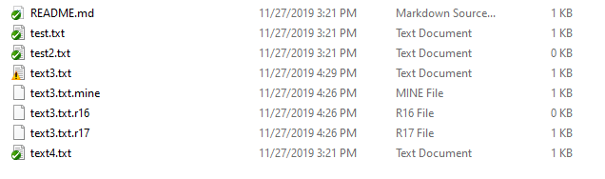
SVN (Subversion)
To resolve conflict:
Let update from repository : SVN Update
Open the file in editor and edit the final result you want. Also, for every conflicted file Subversion places three additional files in your directory.
Make a commit of conflict resolution: commit again.
You should update from repository to check and resolve conflict before commit.
Reference: https://tortoisesvn.net/docs/release/TortoiseSVN_en/tsvn-dug-conflicts.html

Slide 14
SVN (Subversion)
Please refer this link for more features of TortoiseSVN:
English: https://tortoisesvn.net/docs/release/TortoiseSVN_en/
VN: https://tortoisesvn.net/docs/release/TortoiseSVN_vi/

Slide 15
GIT
What is Git:
Git is a distributed version control system (DVCS) for managing source code.
All code and history are stored on the user's computer
Important concepts:
Remote Repository: A repository is the heart of any version control system. It is the central place where developers store all their work. Repository not only stores files but also the history. Repository is accessed over a network, acting as a server and version control tool acting as a client.
Local Repository: A local repository is hosted on a local machine for an individual user.
Commit: The "commit" command is used to save your changes to the local repository.
Branch: Usually when working with Git, Each developer will create a new branch different from the master to develop a new feature.

Slide 16
GIT
II. How Git works:
Github,Gitlab,Backlog..
Repository
Git clone
Client B
Git pull
Working directory
Git add
Client C
Staging area
Git commit
Git push
Local repository
Client A / PC#A

Slide 17
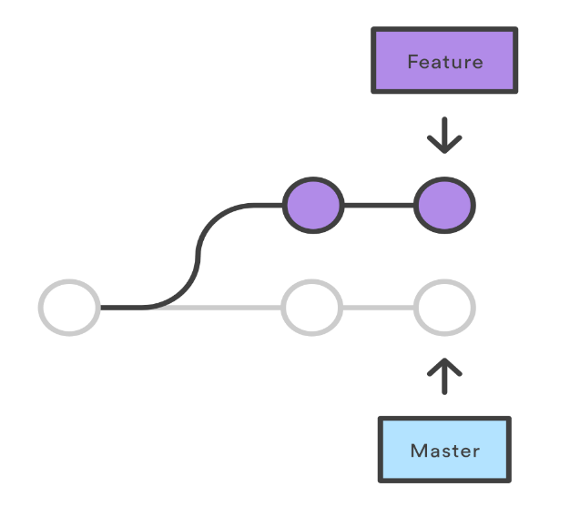
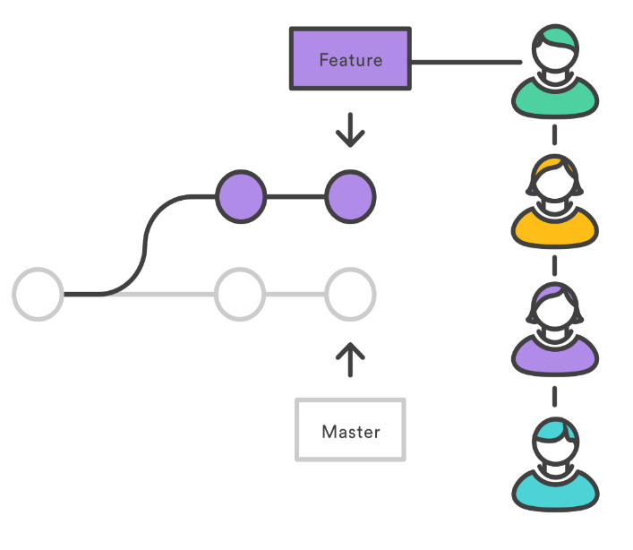
GIT
III. Strength:
Feature Branch Workflow:
Feature branches provide an isolated environment for every change to your codebase.
This facilitates the feature branch workflow popular with many Git users.
More flexible when doing many tasks.
Pull/Merge Request:
It’s simply: I have finished the feature in my branch. Please help me merge it to master.
Help to review code. Prevent a member from destroying the entire project.
Notes:
Pull/Merge Request:
Usually when working with Git, Each developer will create a new branch different from the master to develop a new feature.

Slide 18
GIT
IV. Basic Git commands:
git init: Create a respository
git clone: Clone a repository into a new directory
git pull: Fetch from and integrate with another repository or a local branch
git add & git add . : Add file contents to the index
git commit: Record changes to the repository
git push: Update remote refs along with associated objects
git log: Show commit logs
git diff: Show changes between commits, commit and working tree, etc
git branch: List, create, or delete branches
git checkout: Switch branches or restore working tree files
git merge: Join two or more development histories together
gitk: If you prefer a GUI way of diving into the repository history, you can do so using "gitk" that is shipped along side with Git.

Slide 19
GIT
Resolve Conflict:
When Developer A makes changes the content of the index file and has pushed up the git remote reponsitory.
Then Developer B also makes changes the content of the index file. And now if B pushes the code to the repository, a conflict will occur
Git push

Slide 20
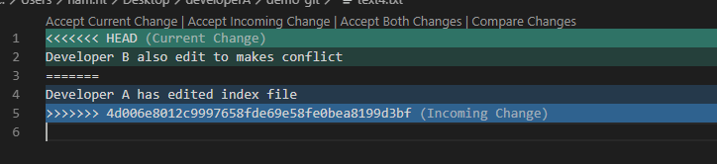
GIT
To resolve conflict:
Let pull code from repository : git pull
Open the file in editor and edit the final result you want
Make a commit of conflict resolution: add, commit and push again.
=> You should pull from repository to check and resolve conflict before push.

Slide 21
Exercises
Question: Different between SVN and Git?
Excercises:
https://learngitbranching.js.org/
https://gitexercises.fracz.com/
Exercise 1 – Prepare basic git environment:
Create remote repository : (github,gitlab..) ex: https://github.com/lsnp/hellogit_.git
Create working copy of hellogit_.git, name “Client_yourName” (git clone)
Exercise 2 – Add new file index.txt in Working Directory and input content file, then push to remote repository (Explain what each step will do)
Exercise 3 – Create a new branch and checkout this branch. Change the index.txt content, view change and push to your branch repository. Merge it to master branch.
Exercise 4 – Find out what has change in file “index.txt” (git log). Then revert the revisions. (git revert)
Exercise 5 – Make the conflict and resolve it.

Slide 22
Thank you

