Slide 1
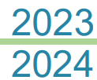
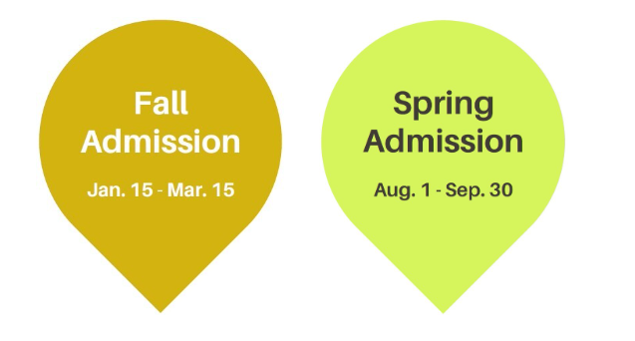
Sun Yat-sen University
Admission Application Guide for International Degree Students

Slide 2
Admission Schedule
Application and Admission Process | Fall semester | Spring semester
Online application service opens for 2023 | 15/01/2023~ 15/03/2023 | 01/08/2023~ 30/09/2023
Selection process | 16/03/2023~ 30/04/2023 | 01/10/2023~ 15/11/2023
Notification of selection result | Before 05/06/2023 | Before 10/12/2023
Admitted applicants reply to offer of admission Issuance of Letter of Acceptance | Before 30/06/2023 | Before 25/12/2023
Notification for waiting list applicants | From 01/07/2023 | From 26/12/2023
Notified waiting list applicants reply to offer of admission Issuance of Letter of Acceptance | Before 15/07/2023 | Before 05/01/2024

Slide 3
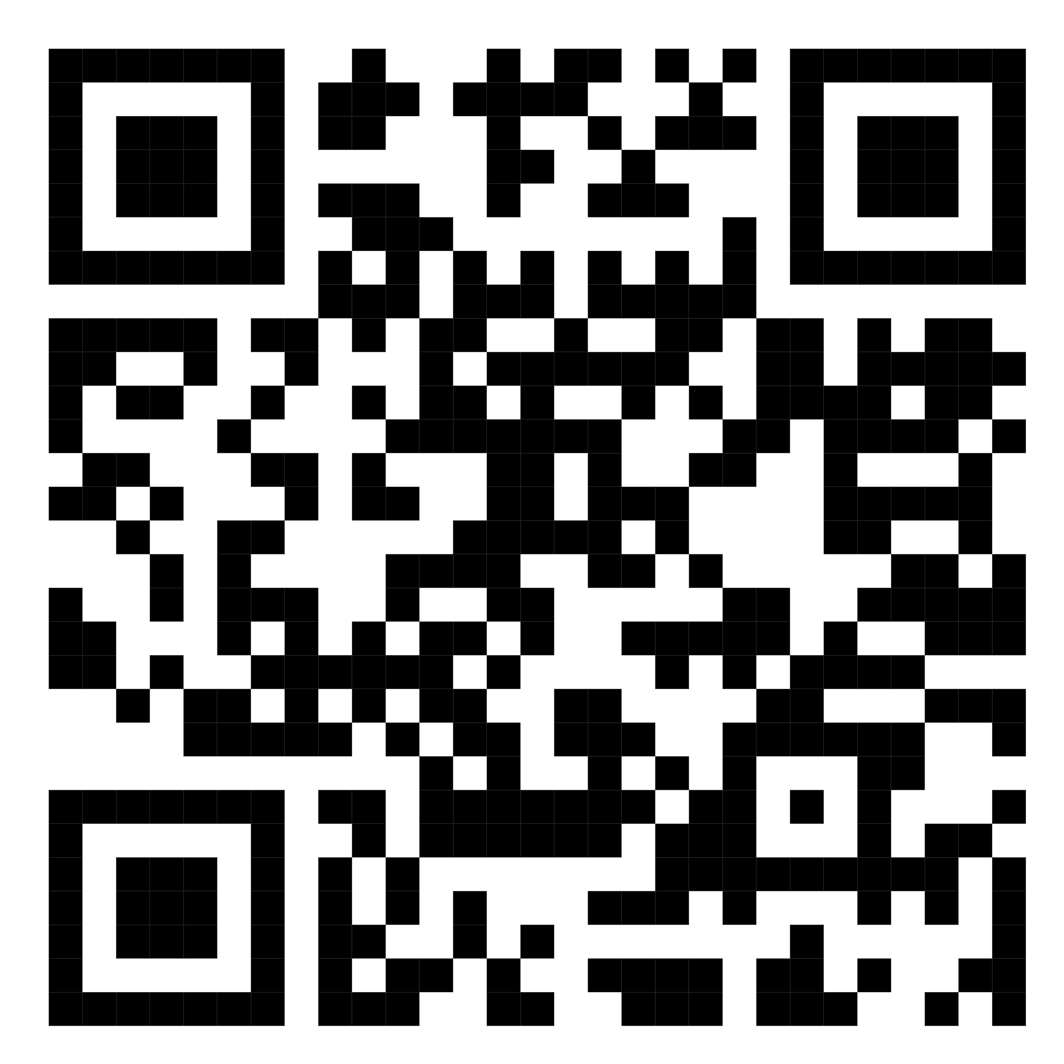
How to Apply
The admission application form can ONLY be completed online. Please visit https://admission.nsysu.edu.tw/eoiaform/passportMember/login
Please complete the application procedure online, upload all required documents and press “Submit.” Only applications completed and received before the application due date can be accepted.
Each applicant may apply for two undergraduate/graduate programs at most and one group within each undergraduate/graduate program at most; when applying for two undergraduate/graduate programs, please submit required documents individually for each program. Applicants accepted for both programs can only choose to enroll in one program.
No documents submitted with the application will be returned regardless of the applicant’s admission status. Please keep personal copies for future reference.

Slide 4
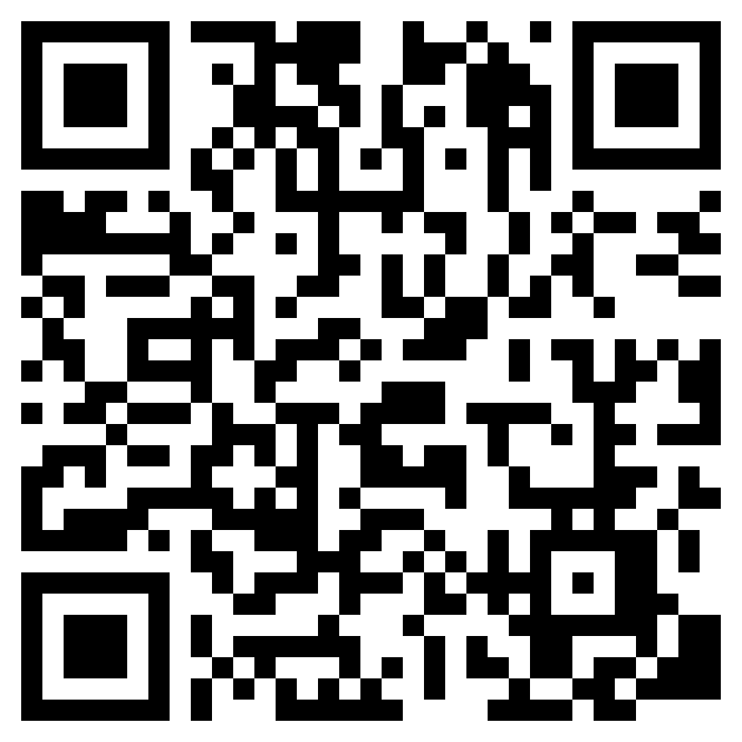
Online Admission Application
Certificate of highest-level official degree certificate and official transcript:
One photocopy (no need authorization) of the official degree certificate in Chinese or English issued by the institution.
For undergraduate programs, please provide a high school official degree certificate; for master’s programs, please provide a bachelor’s official degree certificate; for doctoral programs, please provide a master’s official degree certificate.
If you are currently studying at an institution, please submit proof of enrollment with the institution's anticipated graduation time.
Note: If you are not sure the time to graduate/receive the degree matches with application visa time, please do not apply
Applicants for Ph.D. programs should provide both bachelor’s and master’s official transcripts.
Other materials required for the NSYSU Scholarship for International Students (if applicable): Please refer to https://oia.nsysu.edu.tw/p/412-1308-20732.php?Lang=en for more details.

Slide 5
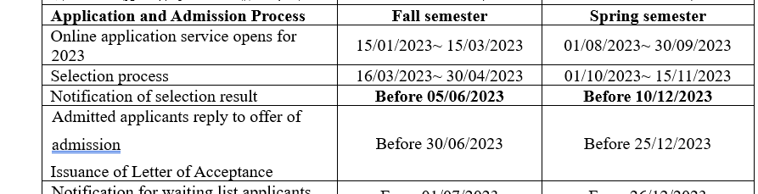
Visa Application
After knowing the result, please prepare the following materials:
Original passport and copy (If you do not have passport or your passport expired, please apply or renew it)

Slide 6
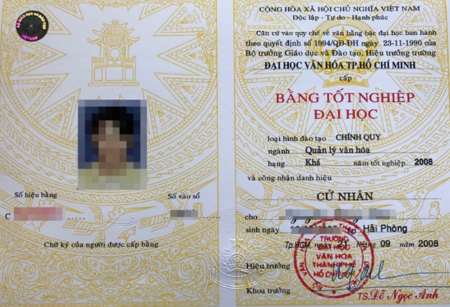
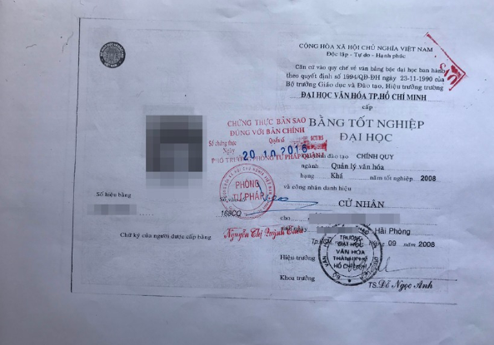
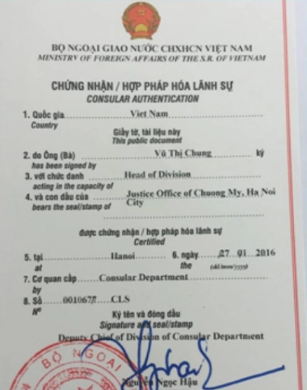
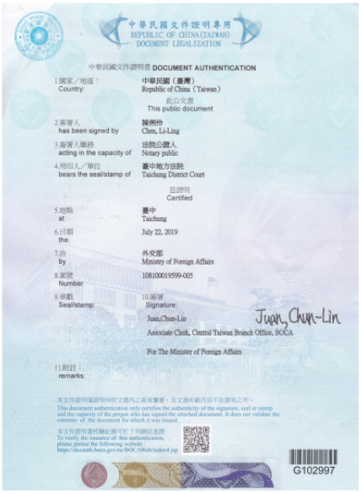
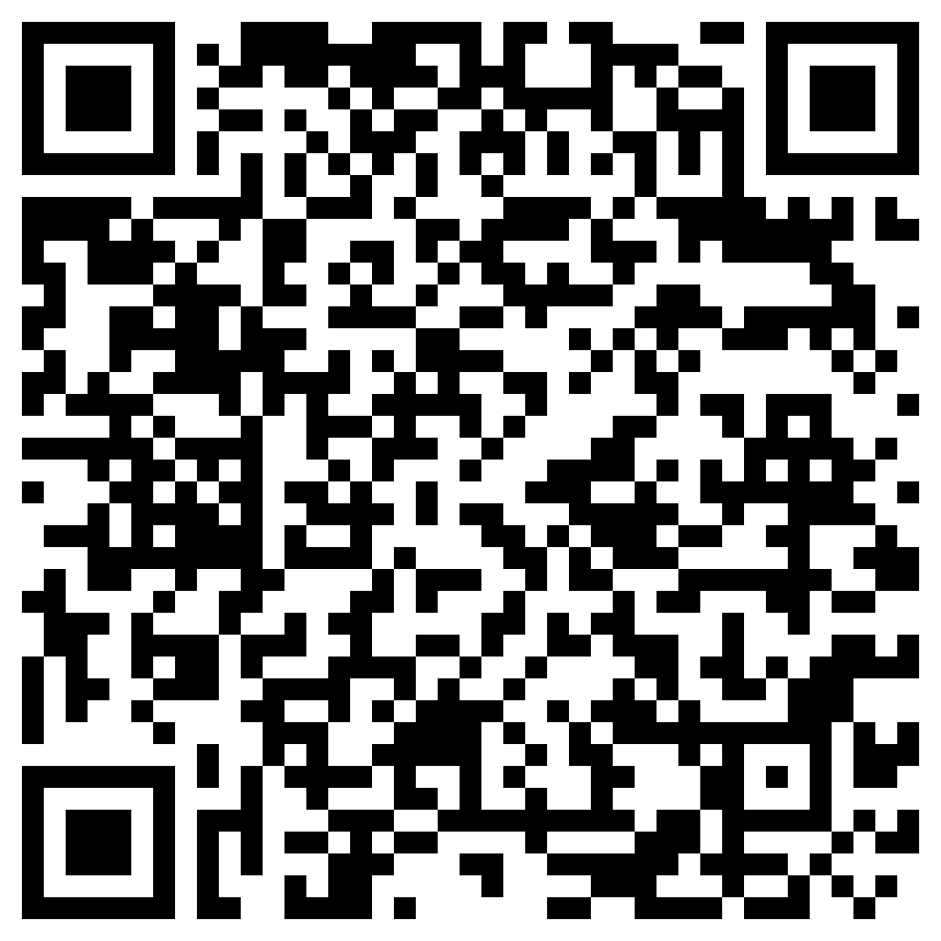
Visa Application
The original and a copy of the highest academic diploma and transcript (the copy of diploma and transcript must be authorized)
The processing of authorization:
Bằng tốt nghiệp bản gốc (tiếng anh hoặc tiếng trung/ dịch thuật)
Phô tô và công chứng (nên làm ở văn phòng công chứng quận 1 Tp HCM)
Hợp pháp hóa lãnh sự ở sở ngoại vụ TPHCM
Xác nhận tại văn phòng văn hóa kinh tế Đài BắcTPHCM
Tham khảo kinh nghiệm làm visa du học thông qua đường dẫn này

Slide 7
Visa Application
Health certificate in the last 3 months: according to the form prescribed by the Taiwan Administrative Sanitation Department and examined at the following designated hospitals: In Ho Chi Minh City: Thong Nhat Hospital, Cho Ray Hospital.
Certificate of foreign language proficiency. TOEFL: iBT 26 or more/ pBT 385 or more/ TOEIC: 375 or more/ IELTS: 3.0 or more. (If you already have a certificate please check the expired time, if the certificate is not available, please spend time to take the exams soon(it will take one month form taking the test to awarded the certificate)

Slide 8
Camera Frame
y
B
A
x
x
z

