Slide 1
Generating Solutions

Slide 2

Lateral Thinking
Vertical Thinking
RANDOM STIMULATION
OSBORN’SCHECKLIST
UNRELATED IDEAS
RELATED IDEAS
OTHER PEOPLE’S VIEWS
FUTURING
The
Brainstorming Process
Free Association
(Unstructured Idea Generation)

Slide 3



Comments That Reduce
Brainstorming to Braindrizzling
That won’t work.
That’s too radical.
It’s not our job.
We don’t have enough time.
That’s too much hassle.
It’s against our policy.
We’ve never done it that way before.
It’s too expensive.
That’s not practical.
We can’t solve this problem.

Slide 4

Mental Blocks
Can bring you to a screeching halt!!!

Slide 5
QUIZ PROBLEM #1:
What is one half of twelve?
Give several different answers.

Slide 6
QUIZ PROBLEM #2:
Trace a path from Point A to Point B.
B
A

Slide 7
The Nine Dot Problem

Slide 8
Two Solutions to the Nine Dot Problem

Slide 9
Another Solution to the Nine Dot Problem

Slide 10

Common Causes of Mental Blocks
  Defining the problem too narrowly.
  Attacking the symptoms and not the real problem.
  Assuming there is only one right answer.
  Getting “hooked” on the first solution that comes to mind.
  Getting “hooked” on a solution that almost works (but really doesn’t).
  Being distracted by irrelevant information, called “mental dazzle.”
  Getting frustrated by lack of success.
  Being too anxious to finish.
  Defining the problem ambiguously.

Slide 11
Stuck
Unstuck

Slide 12
Lateral Thinking
Vertical Thinking
RANDOM STIMULATION
OSBORN’SCHECKLIST
UNRELATED IDEAS
RELATED IDEAS
OTHER PEOPLE’S VIEWS
FUTURING
The
Brainstorming Process
Free Association
(Unstructured Idea Generation)

Slide 13
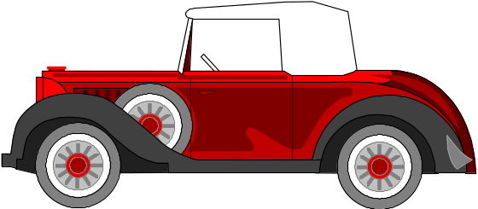

Brainstorming
Exercise
Suggest safe playground equipment that could be made from old cars.

Slide 14
Osborn’s Checklist
for Adding New Ideas
Mag
Rearrange
nify
Com
bine
Minify
Rerraange
Adapt? .......... How can this (product, idea, plan, etc.) be used as is? What are other uses it could be adapted to?
Modify? ........ Change the meaning, material, color, shape, odor, etc.?
Magnify? ...... Add new ingredient? Make longer, stronger, thicker, higher, etc.?
Minify? ........ Split up? Take something out? Make lighter, lower, shorter, etc.? Substitute? ... Who else, where else, or what else? Other ingredient, material, or approach?
Rearrange? .... Interchange parts? Other patterns, layouts? Transpose cause and effect? Change positives to negatives? Reverse roles? Turn it backwards or upside down? Sort?
Combine? ...... Combine parts, units, ideas? Blend? Compromise? Combine from different categories?

Slide 15
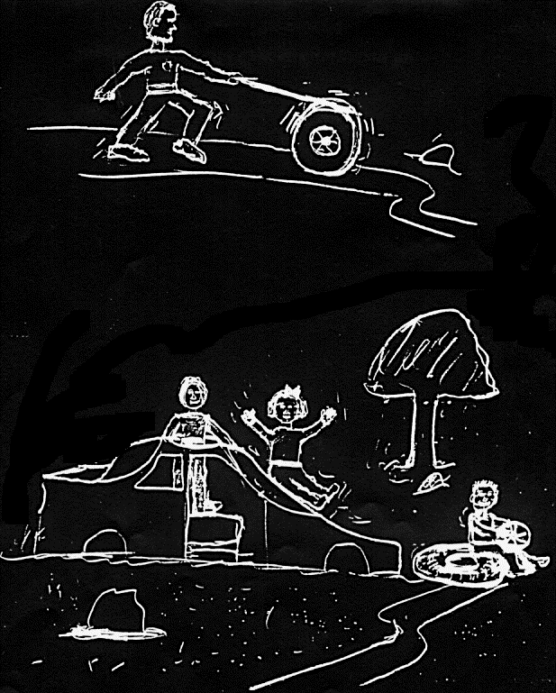

Slide 16
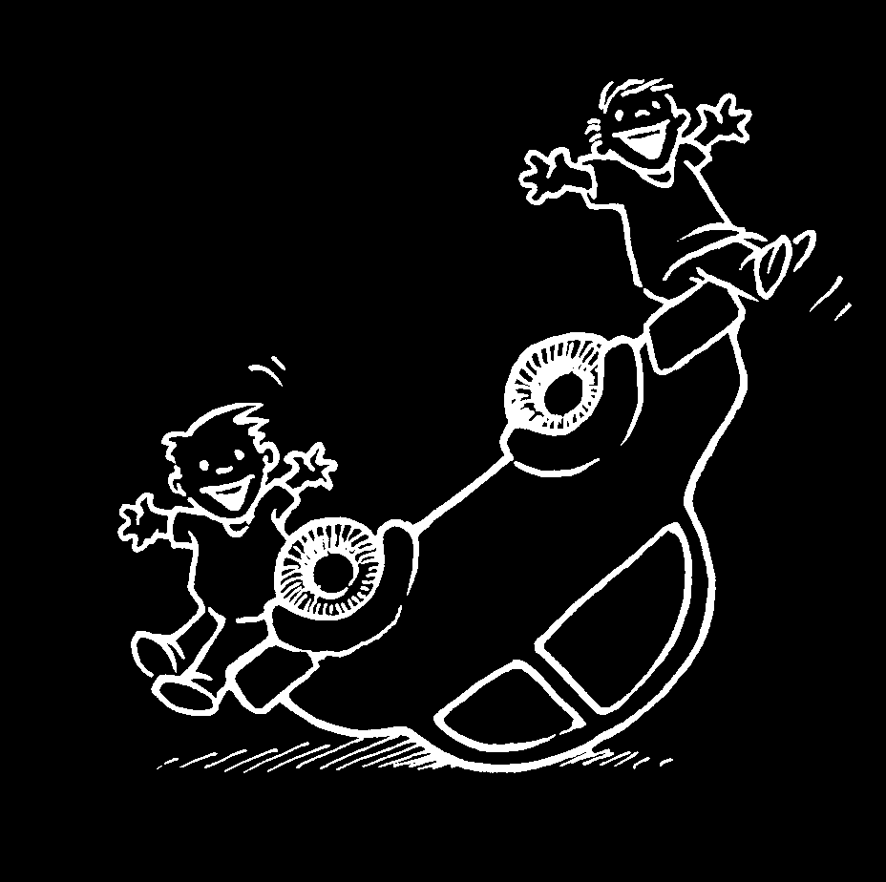
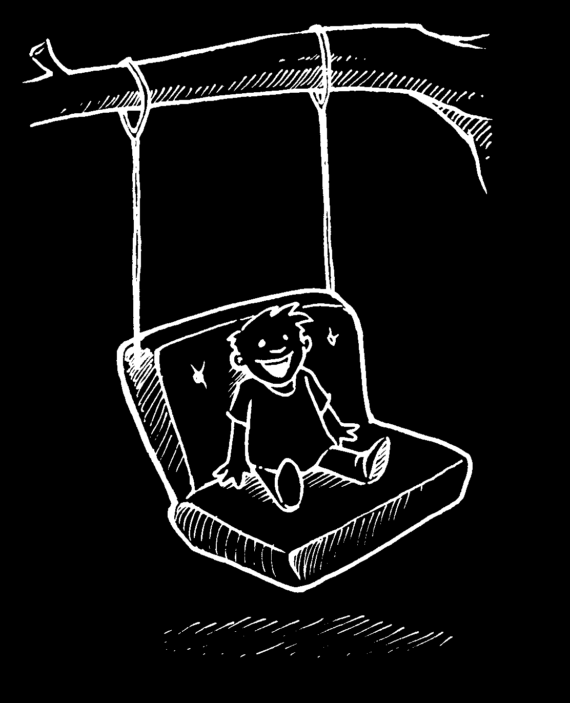
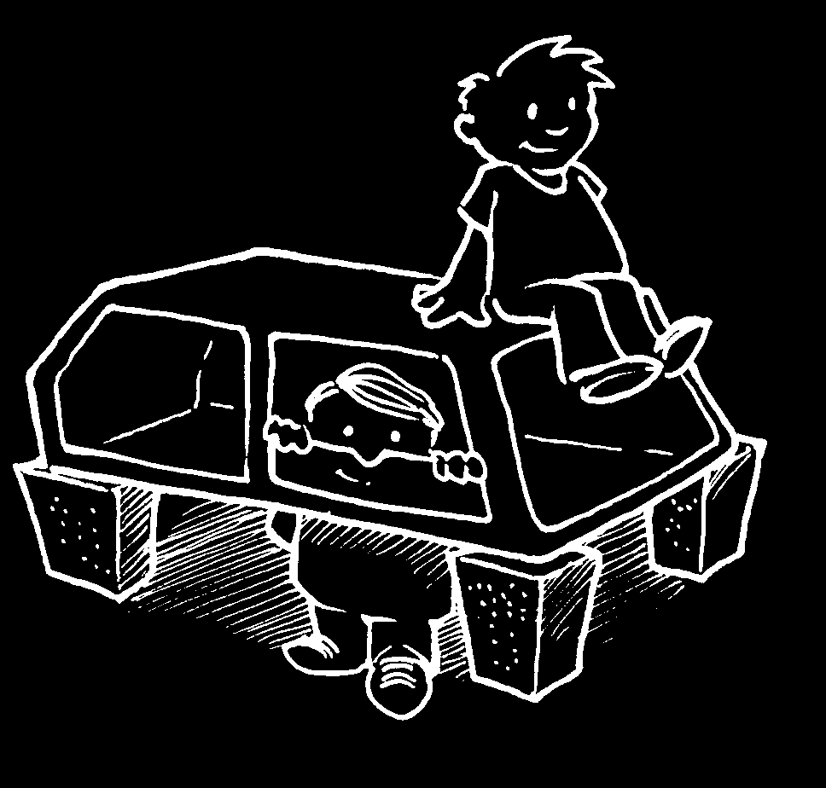
PLAYGROUND EQUIPMENT
FROM OLD CARS
Osborn’s Checklist
Rearrange: Turn the car upside-down and use it as a teeter-totter.
Substitute: use the cars’ seats in swings
Combine: use the side panels and roofs to make a huge canopy or fort.

Slide 17
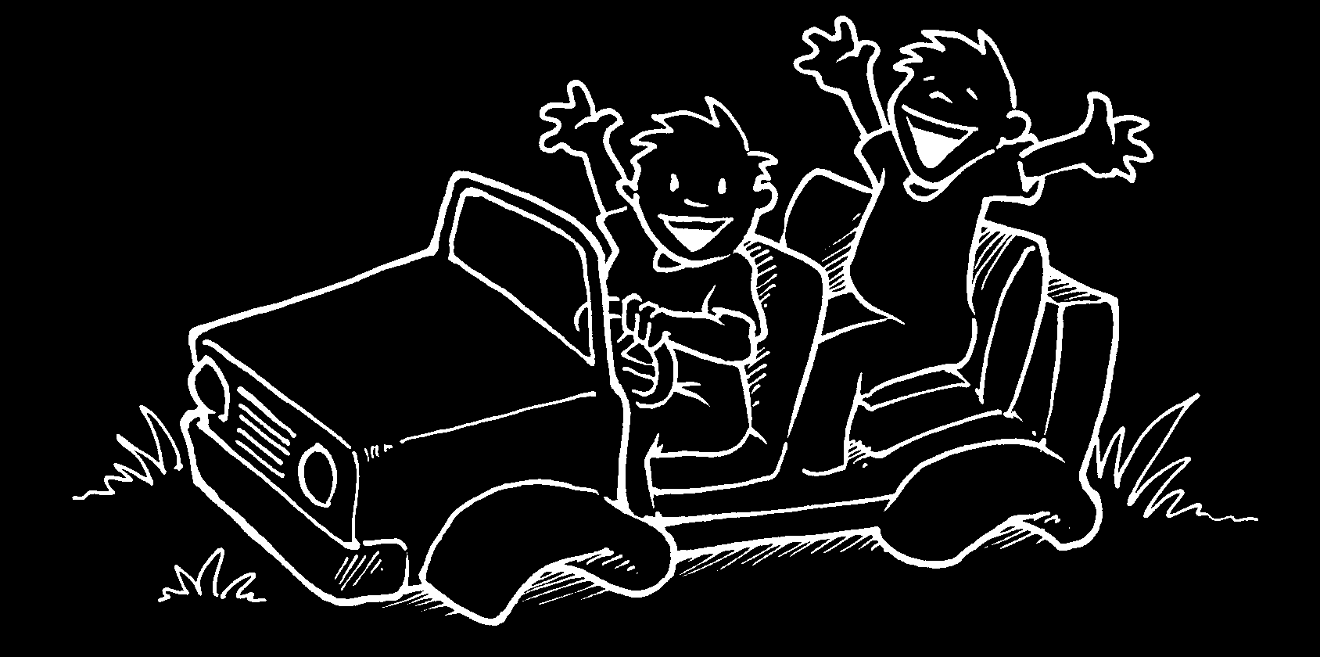
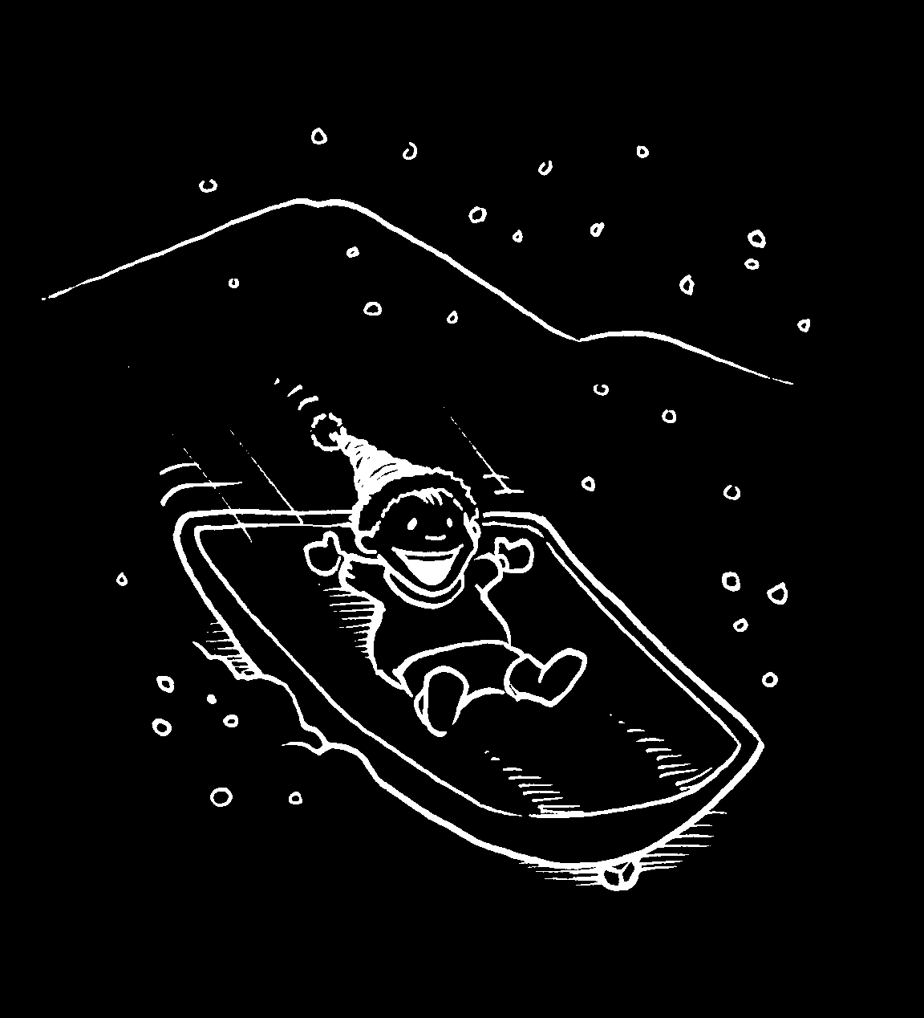
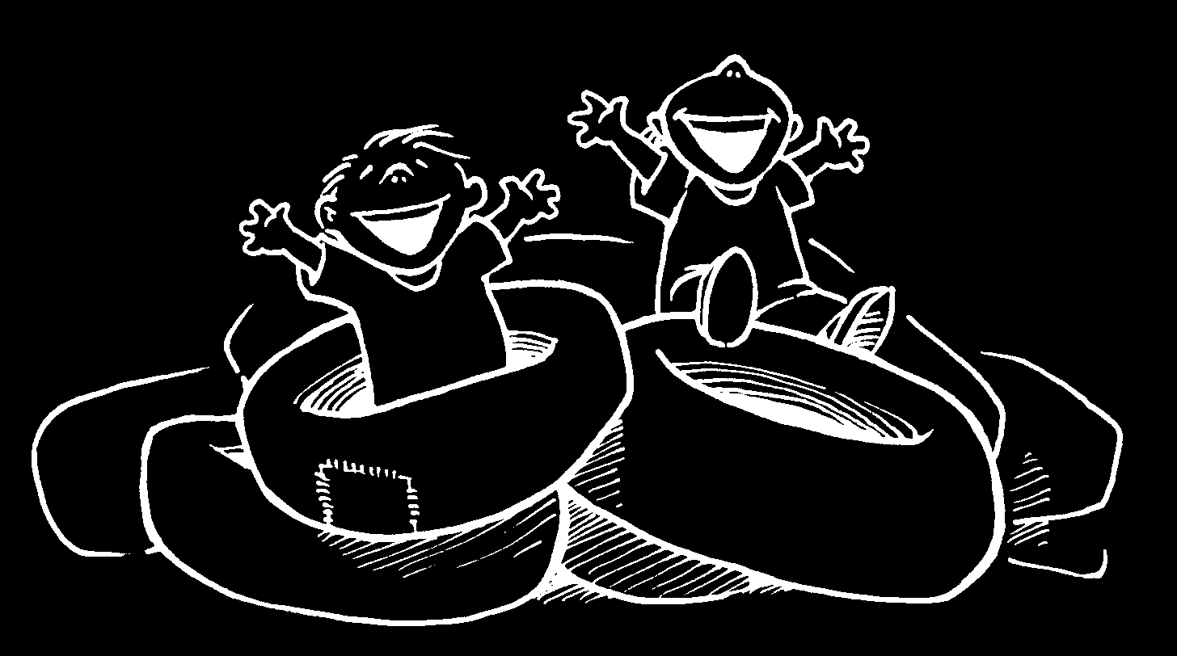
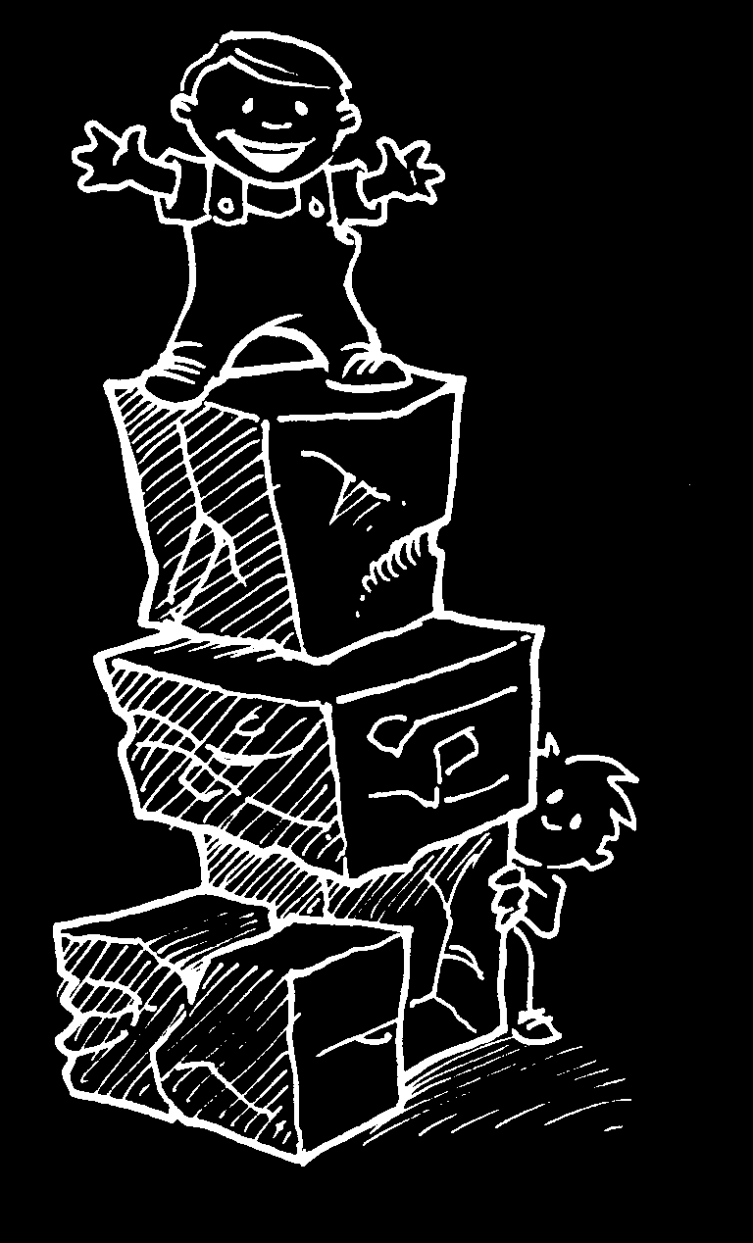
Modify: remove the engine and side panels and make go-carts.
Adapt: take the hood off and use it as a toboggan in winter.
Magnify: over inflate the inner tubes from the tires and use them to create a “romper room” / jumping pit.
Minify: crush the cars into cubes and allow the kids to climb on the blocks.

Slide 18
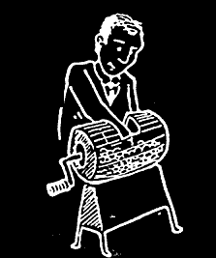
Random Stimulation

Slide 19
Random Stimulation
Words
all, albatross, airplane, air, animals, bag, basketball, bean, bee, bear, bump, bed, car, cannon, cap, control, cape, custard pie, dawn, deer, defense, dig, dive, dump, dumpster, ear, eavesdrop, evolution, eve, fawn, fix, find, fungus, food, ghost, graph, gulp, gum, hot, halo, hope, hammer, humbug, head, high, ice, icon, ill, jealous, jump, jig, jive, jinx, key, knife, kitchen, lump, lie, loan, live, Latvia, man, mop, market, make, maim, mane, notice, needle, new, next, nice, open, Oscar, opera, office, pen, powder, pump, Plato, pigeons, pocket, quick, quack, quiet, rage, rash, run, rigid, radar, Scrooge, stop, stove, save, saloon, sandwich, ski, simple, safe, sauce, sand, sphere, tea, time, ticket, treadmill, up, uneven, upside-down, vice, victor, vindicate, volume, violin, voice, wreak, witch, wide, wedge, x-ray, yearn, year, yazzle, zone, zoo, zip, zap

Slide 20
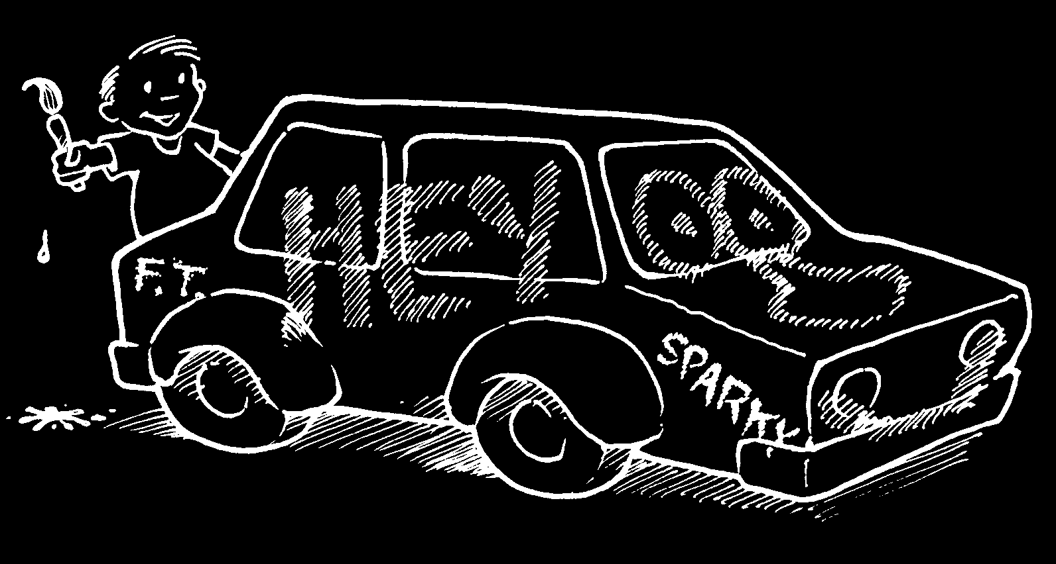
PLAYGROUND EQUIPMENT
FROM OLD CARS
Random Stimulation
random word:
DOCUMENT
DOCUMENT
CAR
PAINT
PAPER
ART
COLORS
ALLOW KIDS TO PAINT GRAFFITI ON CARS

Slide 21
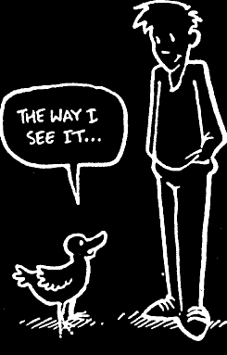
Other People's
Views

Slide 22
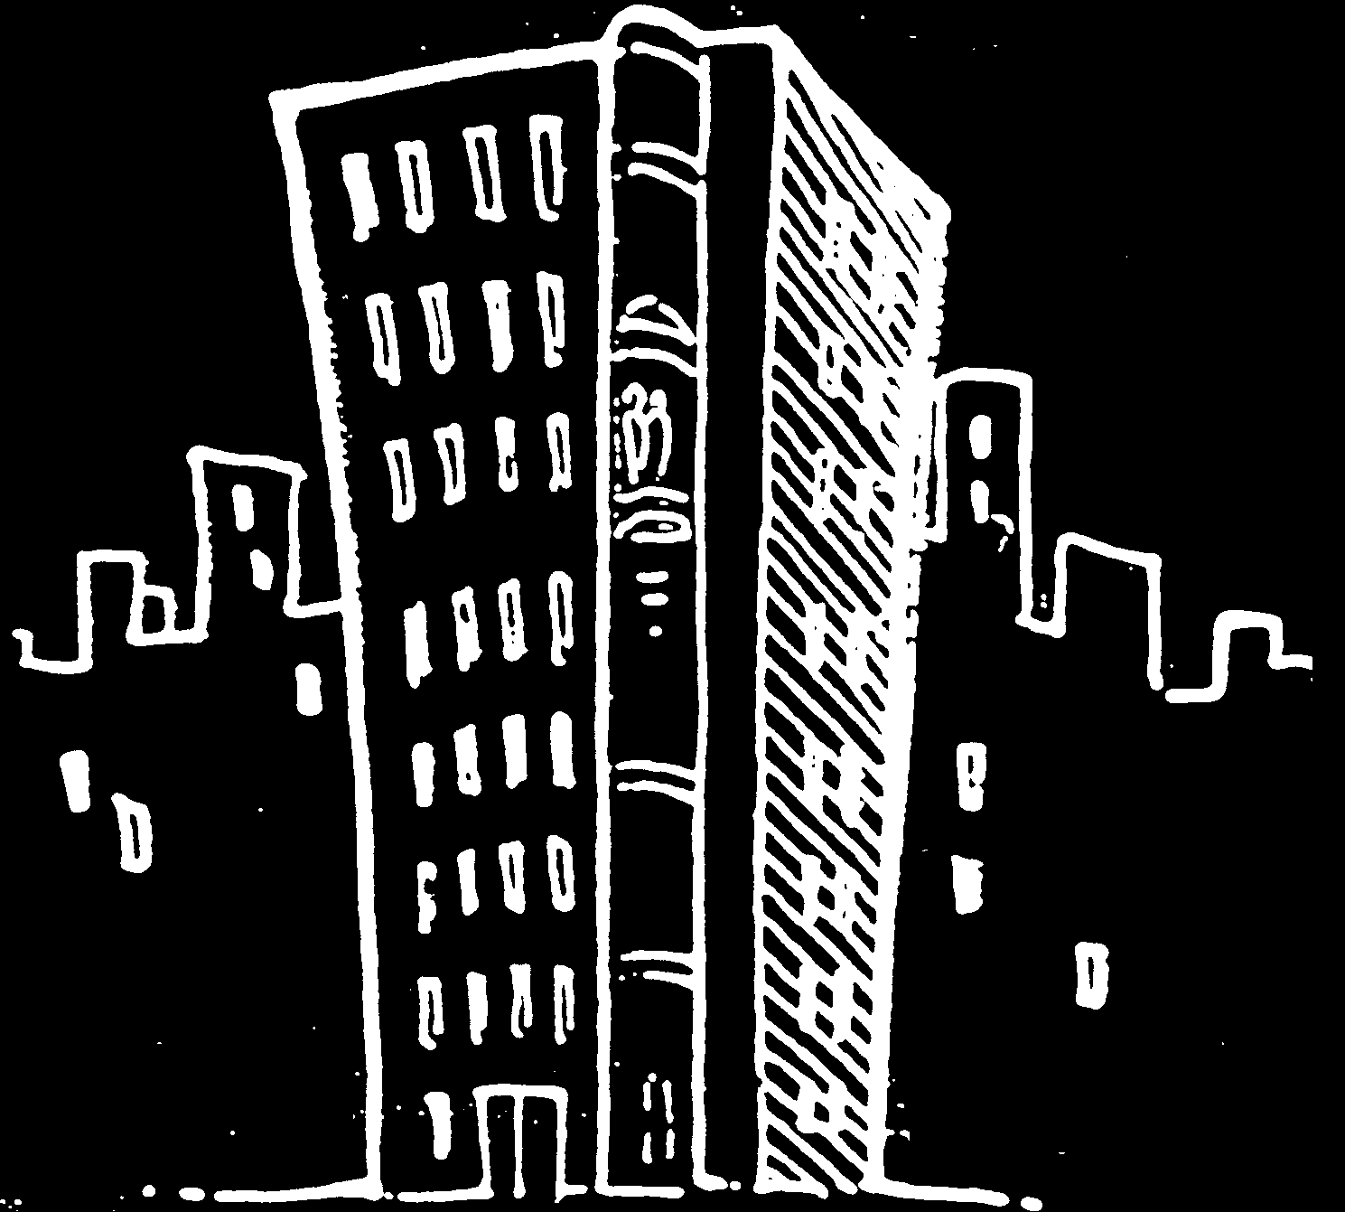
Other People's
Views

Slide 23
Other People's
Views
PLAYGROUND EQUIPMENT FROM OLD CARS
Think about walking around on your knees; how would this change your perspective--that is, imagine the playground from a child’s height.
What was your favorite playground toy? How could this be mimicked with used auto parts?
Example: From a child’s viewpoint, the intact car would be an exciting change to pretend to be a “grown-up.” Just take off the doors and remove other equipment (electrical, etc.) and let the kids pretend to drive. Just leave the car as it is!

Slide 24
Fishbone Diagram
Painting
Let Kids paint graffiti on cars
Paint targets and use to throw balls at
Paint as covered wagon--play cowboys
Whole Car
Teeter totter (upside down)
Go-Cart
Crush and make blocks
Drive as is
Open doors and use as goals for field hockey
Parts
seats-swings
Roof / doors--fort
Tires--jump on
Hood--toboggan
Springs for wobble ride

Slide 25
Fishbone Diagram
PAINTING THE CARS
WHOLE CAR
Police Car
Upside Down
(Cops/Robbers
Teeter Totter
Go–Carts
Covered Wagon
Space Ship
(Cowboys)
Crush into Blocks
(Star Trek)
Open Doors for
Let Kids Paint
Hockey Goals
Graffiti
OLD CARS AS
PLAYGROUND
Tires–Jump On
EQUIPMENT
Roof/Doors–Fort
Springs–Wobble
Ride
Hood–Toboggan
Seats as Swings
PARTS

Slide 26
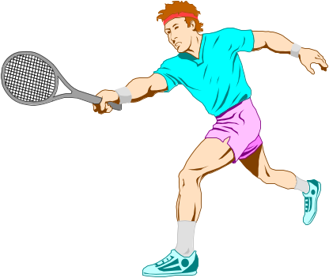
Brainstorming Topics
$
1. How can airlines save money?
2. Ways to increase gas mileage.
3. Ways to dispose of car batteries.
4. Uses for auto tires.
5. What items in a landfill could be re-used?
6. Think of a name for________and prepare an advertising campaign to sell it.
7. List ways to make it easier for people confined to wheelchairs to prepare meals.
8. Make up a game that could be played in zero gravity.
A) For a personal fun sport.
B) For a professional spectator sport.
9. Separating chemicals with items in a first aid kit.

Slide 27

If you are viewing this presentation through your web browser, please click on the back button on your web browser (you might have to click it two or three times) to return to the regular web page.

