Slide 1
ITSS Capstone Project
EcoBike - Group 11

Slide 2
Team members
Member | Student ID | Task | Contribution
Pham Tuan Long | 20205161 | Team leader, overall usecases, assigning task, handle “Return bike” and its related usecase (Payment, refund), implement frontend. Take part in making documentations. | 25%
Dang Trong Luat | 20205187 | Handle administration (pricing change, dock & bike management) , implement backend, design database. Take part in making documentations. | 25%
Dang Hoang Long | 20200357 | Preparing SRS documentation, handle basic view usecase | 25%
Duong Duy Manh | 20205162 | Preparing SDD documentation, handle Bike rental and Deposit usecase | 25%

Slide 3
Table of contents
01
02
03
04
Introduction
Class Diagram
Design Consideration
Demo

Slide 4
01
Introduction

Slide 5
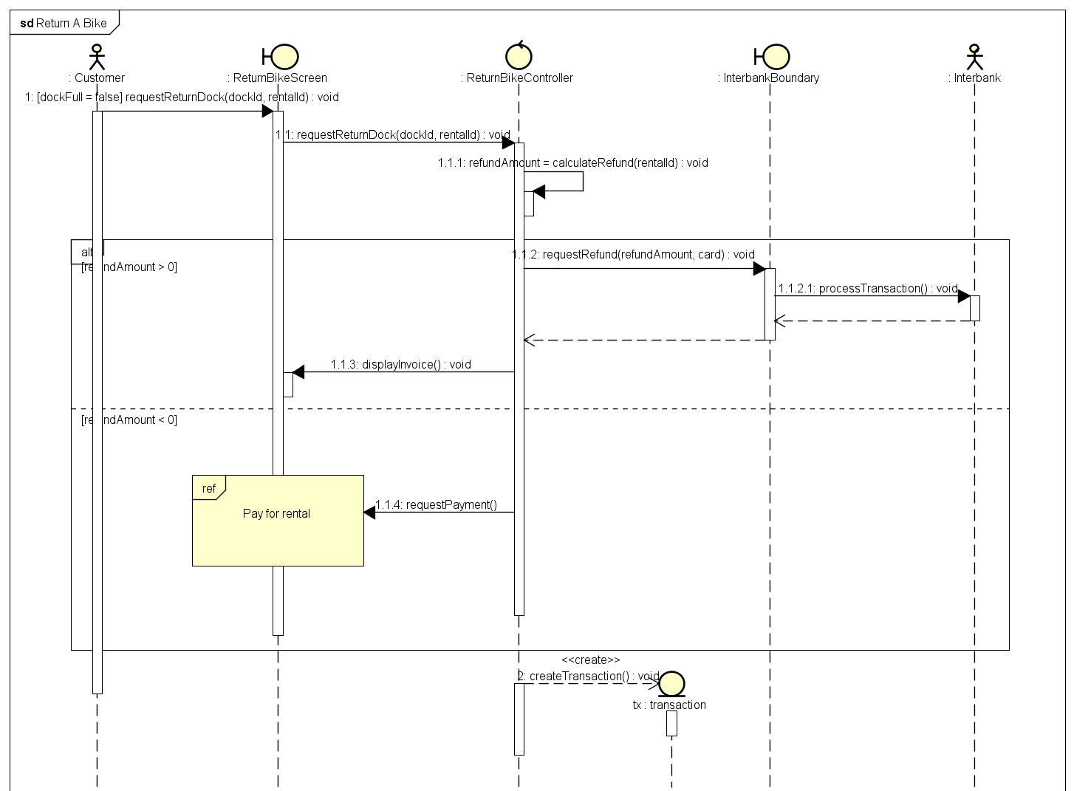
1 Typical Interaction Diagram

Slide 6
02
Class Diagrams

Slide 7
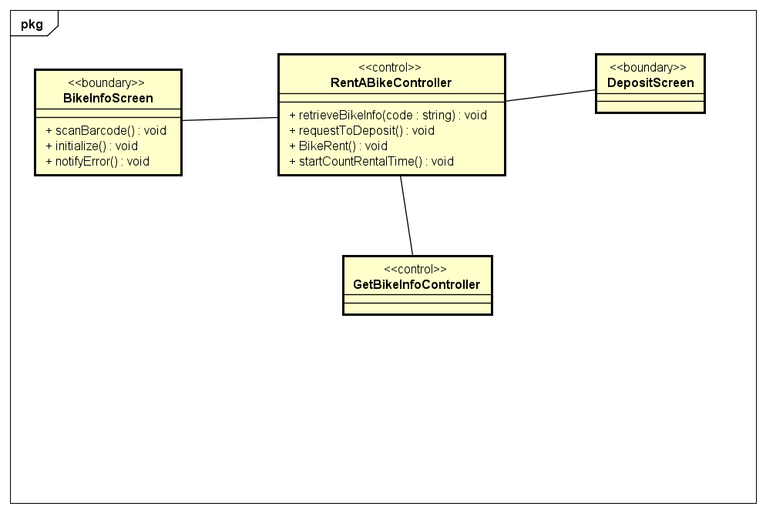

Slide 8
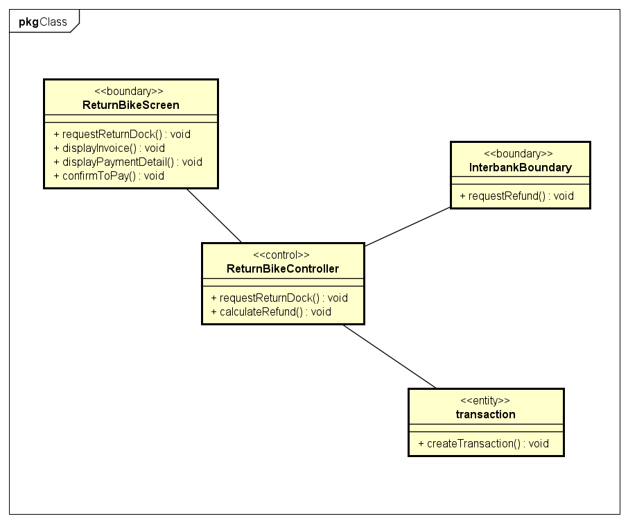
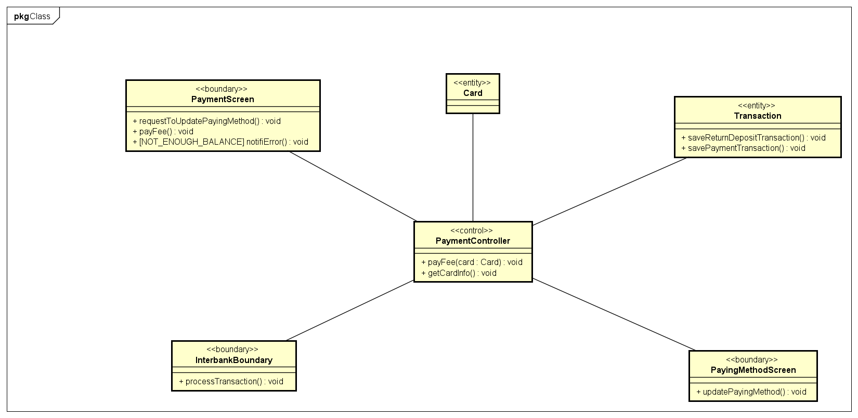

Slide 9
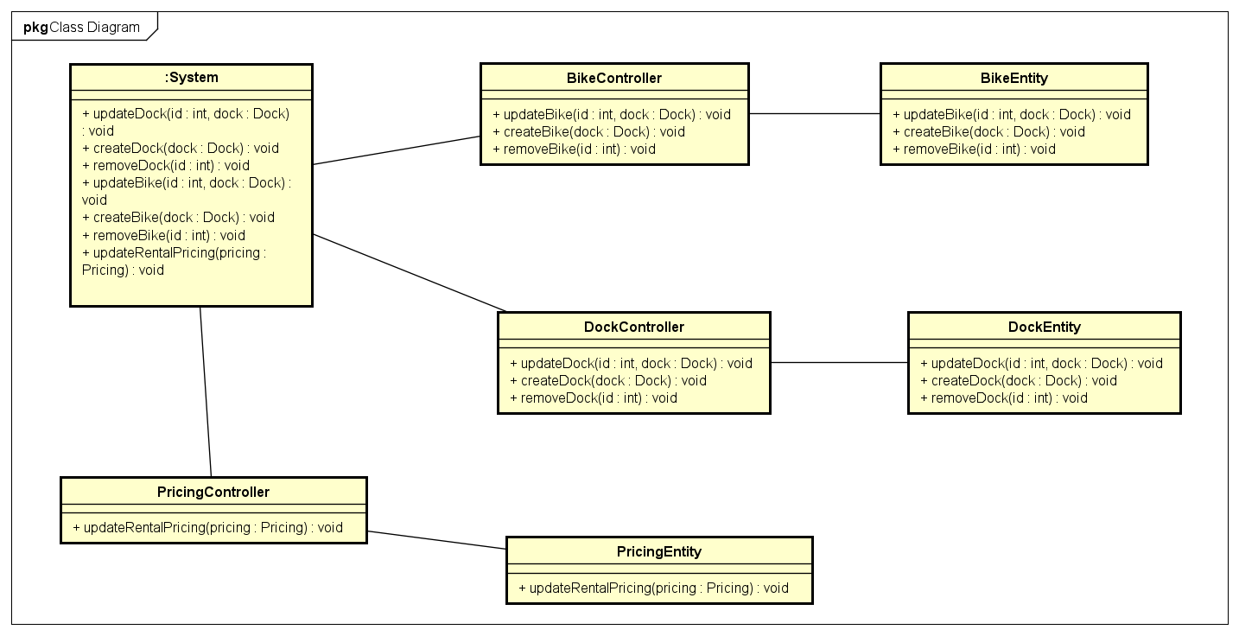

Slide 10
03
Design Consideration

Slide 11
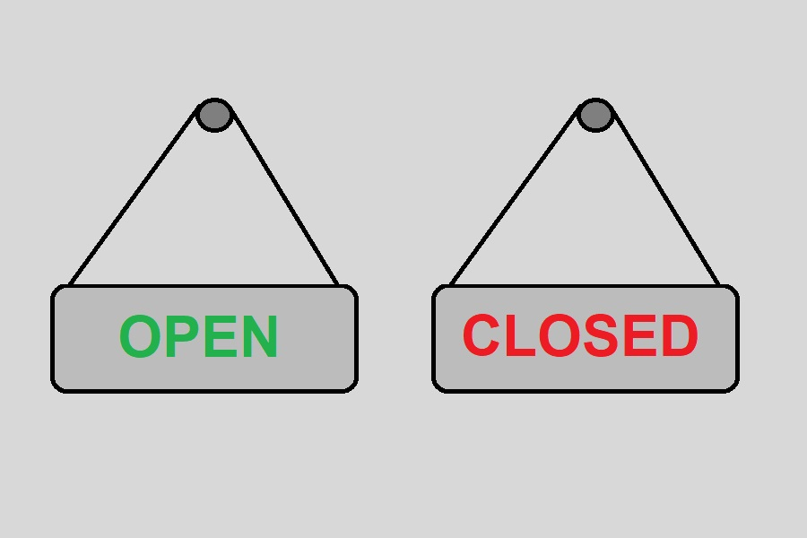
SOLID Principle Possible Violations
Open-Close Principle
The design for bike and pricing class may lead to class modification when new feature introduced

Slide 12
Bike and Pricing OCV
Bike
Pricing
New type of bike with new feature may lead to need of updating the Bike class
New type of pricing with new feature may lead to need of updating the Pricing class

Slide 13
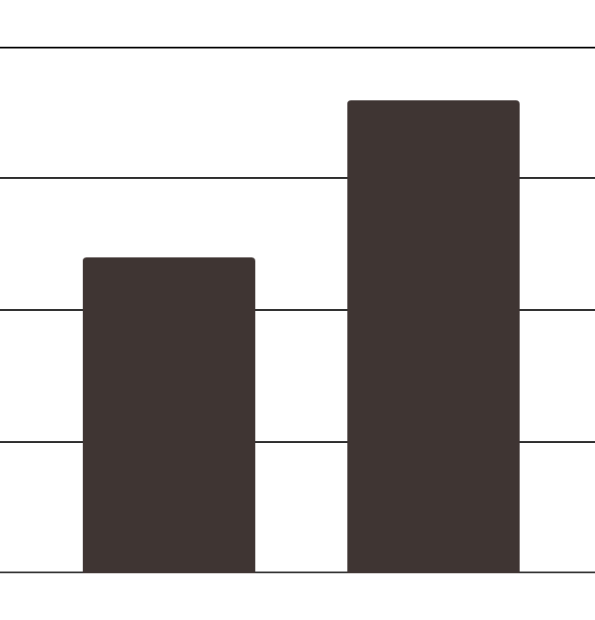
Cohesion and Coupling
Cohesion
how closely the responsibilities of a module or class are related
Coupling
how closely one module or class is connected to another. It's about minimizing dependencies
Communicational Cohesion
Data Coupling

Slide 14
Cohesion and Coupling
The module operates on related data or communicates with other parts of the system.
Communicational Cohesion
The module operates on related data or communicates with other parts of the system.
Data Coupling

Slide 15
04
Demo

Slide 16
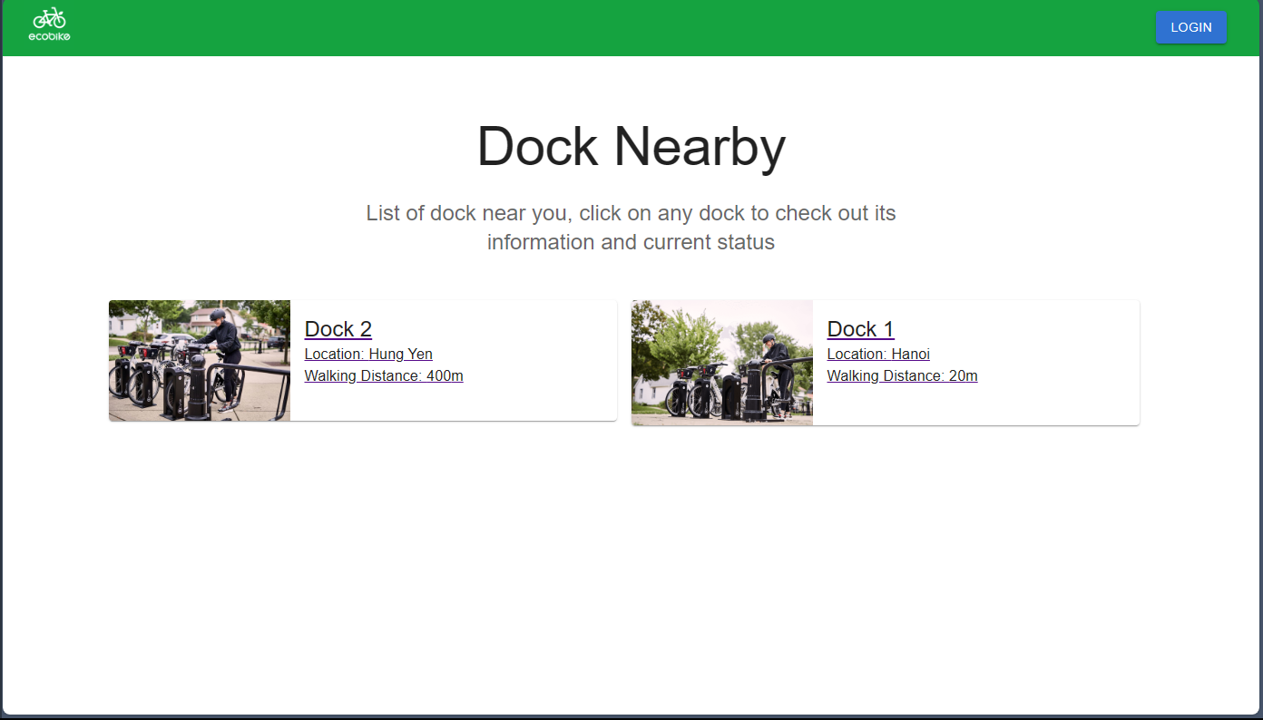

Slide 17
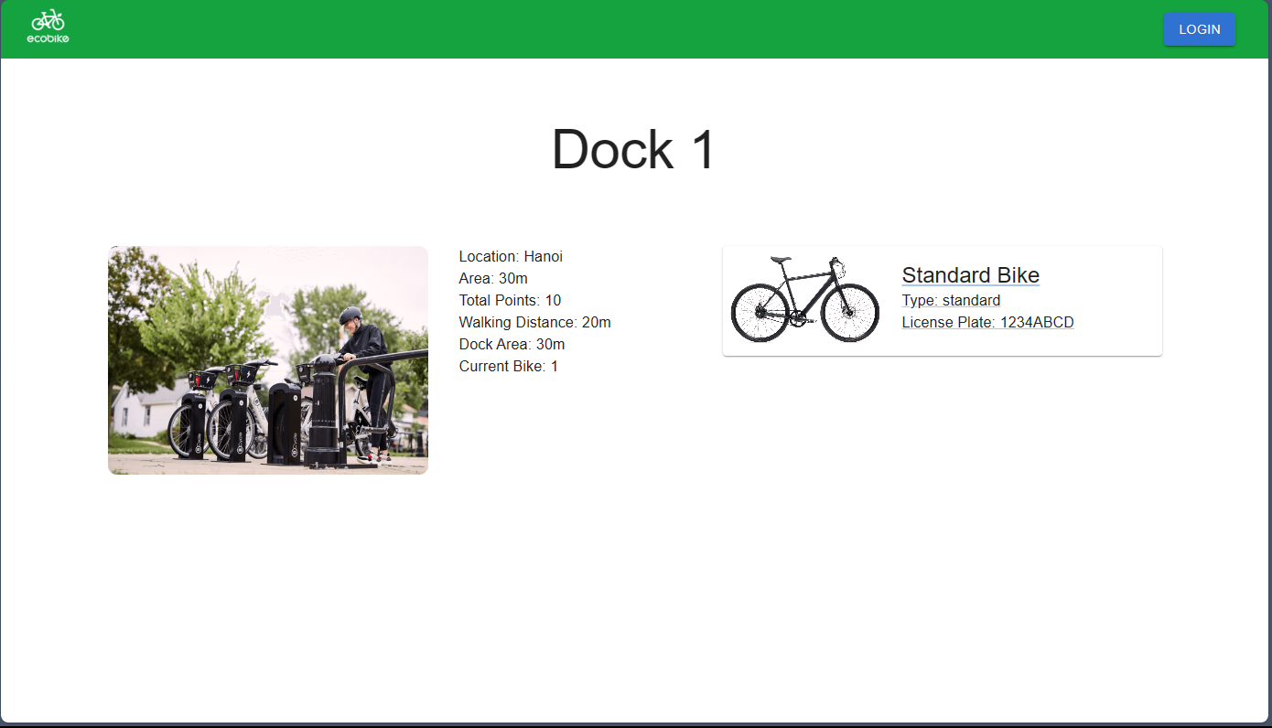

Slide 18
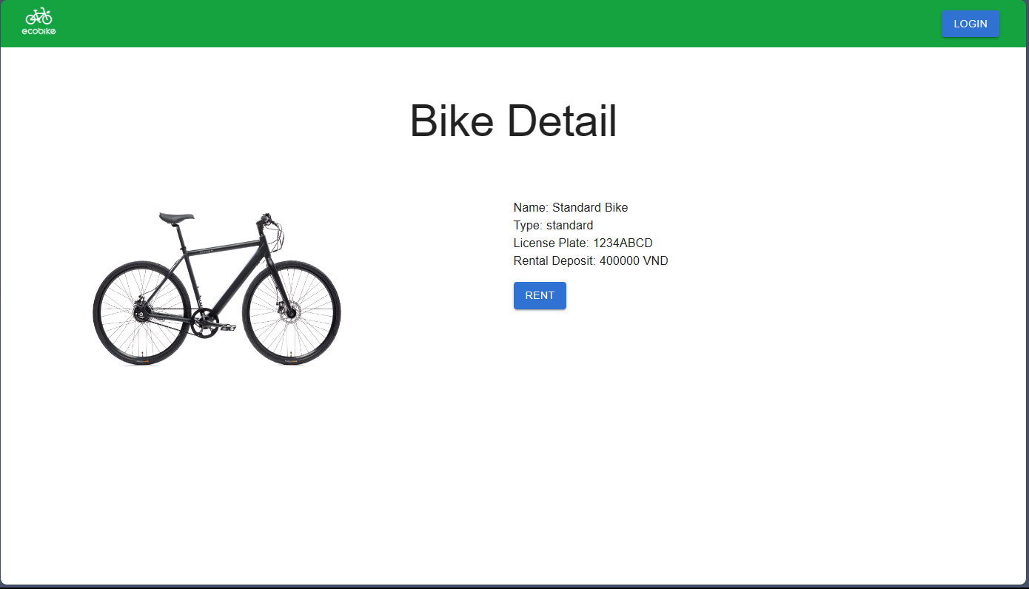

Slide 19
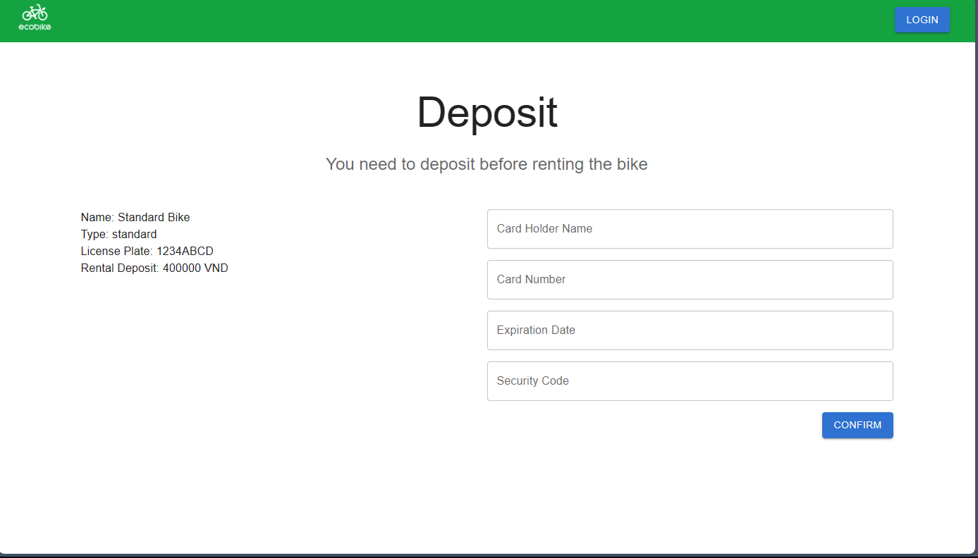

Slide 20
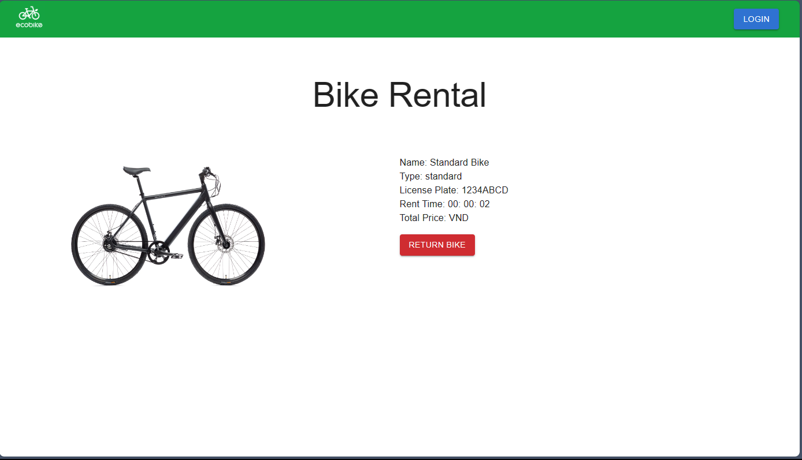

Slide 21
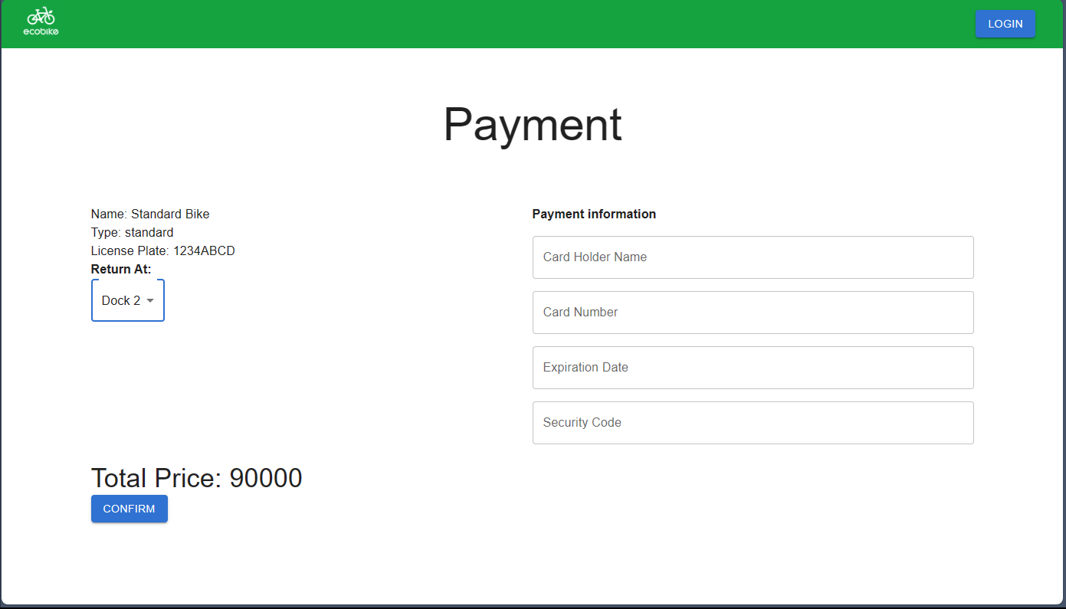

Slide 22
Thank you!

