Slide 1
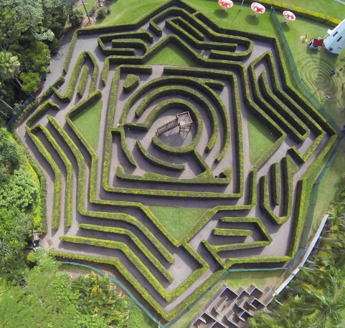
MAZE Solving Robot
MAZE
Group Members: Victor Chu, Keene Hoang and Lucian Nguyen

Slide 2
SECTION Divider:
MAZE
PROJECT DECRIPTION
ROBOT DESIGN
CODE EXPLANATION

Slide 3
Project Description:
Purpose
Application
Challenge

Slide 4
Our Purpose:
Being able to manage to find the way through both simple and complex mazes
detect the object from distance and avoid it by turning left, right or going straight

Slide 5
Robot Application
Explore the jungles, caves and unknown location.
Support rescue operation.
Support domestic job.

Slide 6
Challenge
Solving the maze is NP problems
It is difficult to detect the object accurately.

Slide 7
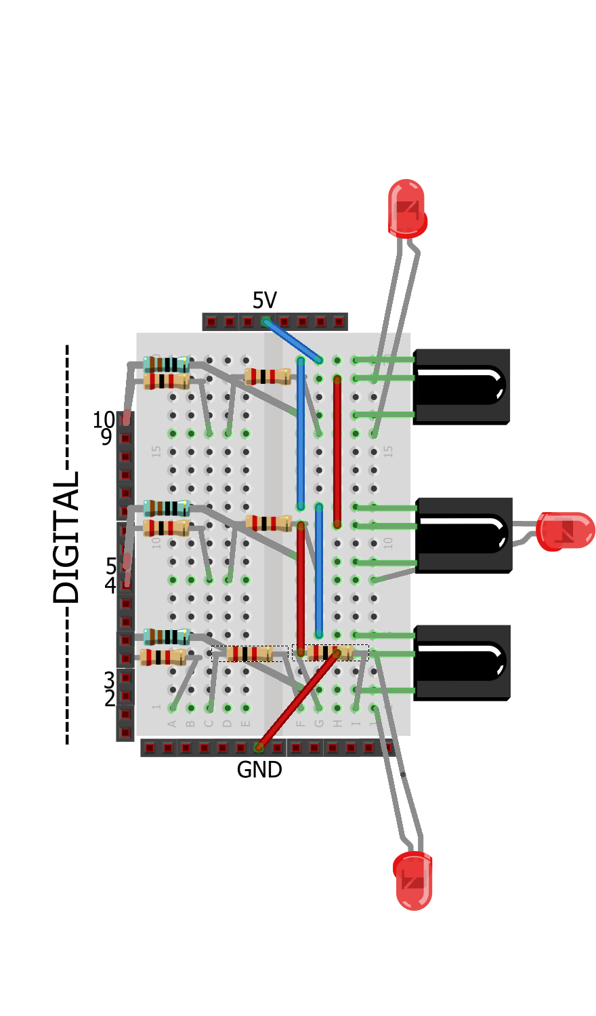
Our Robot Design
Components:
Demonstration:
Board of Education Shield
Arduino Board
3 IR Receivers
3 IR LEDs
Jumper wires
Resistors
Arduino Robots
2 Bluetooth shields

Slide 8
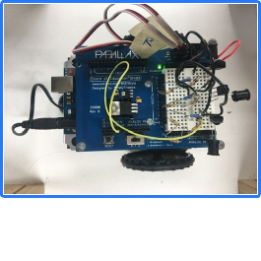

Slide 9
State Option
 | State | State | State | State | State | State | State | State
Left | 0 | 0 | 0 | 0 | 1 | 1 | 1 | 1
Right | 0 | 0 | 1 | 1 | 0 | 0 | 1 | 1
Middle | 0 | 1 | 0 | 1 | 0 | 1 | 0 | 1
Robot | U-shape | Go straight | Right only | Right or Mid | Left only | Left or Mid | T-shape | 3-way

Slide 10
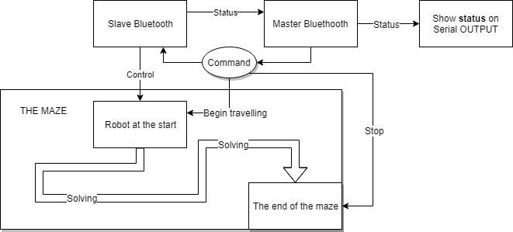
Code Explanation

Slide 11
Thank you for listening
MAZE

