Slide 1
Where our SBA 7(a) risk really sits
Findings and recommendations for the growth plan
Blue Ridge Community Bank | Credit Committee | Prepared by Long Nguyen for Dana Whitfield, SVP Small Business Lending
Notes:
Purpose: show where SBA 7(a) risk sits before we commit to 40% growth, and what guidelines to put in place.

Slide 2
We can grow, but not evenly: the risk is concentrated and mostly predictable
What we found
What we recommend
About 9 in 100 finished SBA loans defaulted (8.7%).
Risk peaks in $150K-$350K loans to businesses under 5 years old.
Express doesn't default more, but small Express loans cost the bank far more per dollar.
Our region runs above average, driven by out-of-state lenders. Local lenders do much better.
Bad loans surface in years 3-7 and lose about 81% of the balance.
Use the risk tier table in approval guidelines: extra review for the 16 High-risk segments.
Keep Express, but add checks or pricing for Express loans under $150K.
Give loans sized exactly at a program limit a second look.
Grow at home first by winning borrowers from out-of-state lenders; Pennsylvania is the natural next state.
Watch every loan most closely in years 2-7.
Notes:
Five recommendations; each is backed by a number on the following slides.

Slide 3
We looked at every SBA 7(a) loan approved nationwide in 2015-2019
Public SBA loan data, status as of 2026
301,889
224,444
8.7%
SBA 7(a) loans approved, FY2015-2019
loans with a final outcome (paid off or charged off)
national default rate: our baseline for every comparison
Default rate = charged-off loans divided by loans that have finished. Cancelled and still-active loans are left out.
Bank loss = amount written off minus the SBA's share. Express has a 50% guarantee; other programs 75-85%.
About 14% of loans are still active, and SBA hides their status. Treat the results as a risk ranking, not a forecast.

Slide 4
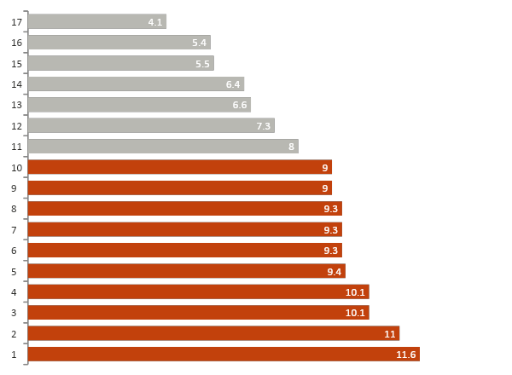
Mid-size loans to young businesses default most; restaurants are only slightly above average
Question 1: Who defaults?
11.1% vs 4.0%
$150K-$350K loans vs $1M+ loans
6.7% vs 10.3%
businesses 5+ years old vs startups. Under 2 years (9.0%) and 2-5 years (9.7%) are nearly as risky as startups
The real line is 5 years in business, not 'startup'.
Restaurants & hotels: 9.3%, but our biggest borrower group ($23.6B lent).
Default rate by industry (orange = above the 8.7% average)
Sectors with 300+ finished loans. Source: SBA 7(a) FOIA data, FY2015-2019.

Slide 5
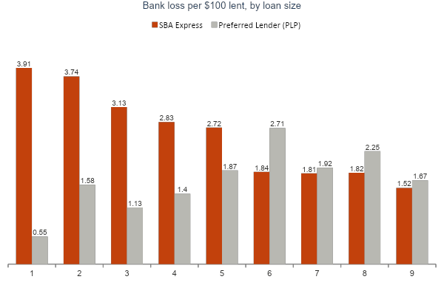
Express doesn't default more, but under $150K it costs the bank more per dollar than PLP
Question 2: Is speed costing us?
8.1% vs 9.2%
default rate: Express vs PLP
$2.58 vs $0.76
bank loss per $100 lent: Express vs PLP (the SBA covers only 50% of an Express loss)
From $150K to $350K, Express cost the bank less than PLP.
PLP loans of exactly $150,000 defaulted at 27.9%, vs about 7-10% just either side.
Loans with a final outcome. Express was capped at $350K in this period (now $500K), so there is no evidence for $350K-$500K Express loans.

Slide 6
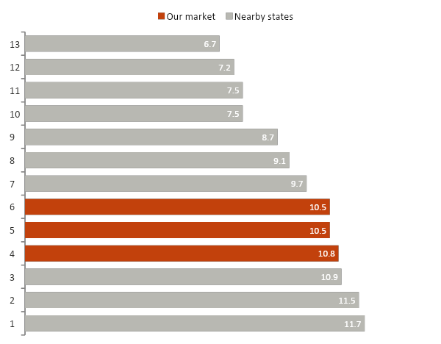
Our region defaults above average for reasons other than loan type; Pennsylvania and Ohio look safer
Question 4: Where should we grow?
10.7% vs 8.7%
VA/DC/MD vs the national default rate
24% worse
than the loan mix in VA/DC/MD predicts (same industries, sizes and programs elsewhere)
Pennsylvania (7.5%, ~1,700 loans a year) and Ohio (6.7%, ~2,900 a year) perform better than their loan mix predicts.
New York, New Jersey and South Carolina are riskier than home.
Default rate among finished loans, by state where the loan is used. DC has only 372 finished loans.

Slide 7
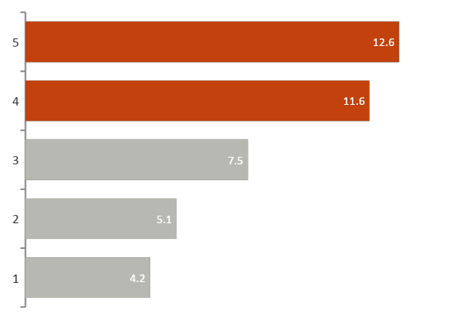
Lenders who know the local market see far fewer defaults, and that is our edge
Question 5: How do we compare with competitors?
3.8%
11.7%
default rate on VA/DC/MD loans made by in-state lenders
default rate on VA/DC/MD loans made by out-of-state lenders
87%
of SBA loans in our region come from out-of-state lenders
Our region's higher default rate is largely a lender-mix effect: with the national mix of in-state lenders, it would be about 8.9%.
'Non-bank' in SBA data means mostly mission lenders; online lenders usually appear through partner banks.
Nationwide default rate by lender type. For the same kind of loan, local banks beat the expected rate by about 40%; national banks were 20% worse.
'Out-of-state' is based on the lender's headquarters, so big banks with local branches count as out-of-state.

Slide 8
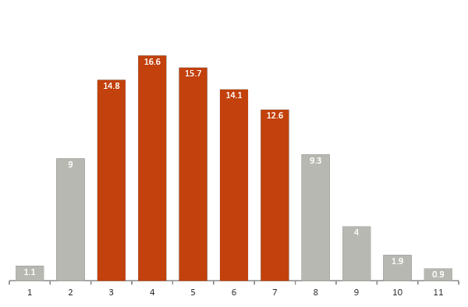
Bad loans surface in years 3-7 and usually lose most of the balance
Question 6: When a loan goes bad, how bad and how fast?
55 months
typical time from approval to charge-off
81% lost
of the loan, typically. After the SBA guarantee the bank keeps about 22% of the loan (45% on Express)
Collateral cuts the loss: 76% lost with collateral vs 90% without.
Credit lines lose the most when they fail (95%).
Share of all charge-offs, by year of the loan's life (orange = years 3-7, 74% of charge-offs)
Charge-off date is when the loan was written off, usually months after payments stopped. Losses are before later recoveries.

Slide 9
A simple risk tier table can go straight into our approval guidelines
Segments = industry x business age x loan size, 300+ finished loans each
16 High
Industry | Business age | Loan size | Default rate | Finished loans
Admin & Support | Under 5 years | $150K-$350K | 18.0% | 880
Other Services | Under 5 years | $150K-$350K | 17.5% | 2,057
Education | Under 5 years | $150K-$350K | 17.1% | 339
Construction | Under 5 years | $150K-$350K | 14.7% | 1,005
Arts & Entertainment | Under 5 years | $150K-$350K | 14.6% | 1,113
Transportation | Under 5 years | $150K-$350K | 14.1% | 447
Wholesale | Under 5 years | $150K-$350K | 13.3% | 607
Restaurants & Hotels | Under 5 years | $150K-$350K | 13.3% | 4,029
segments: 13.1%+ default. 7% of finished loans; 14.8% default rate
Medium
in between: 75% of finished loans; 9.1% default rate
32 Low
High-risk examples: all eight are $150K-$350K loans to businesses under 5 years old. The full table (all tiers) is on the dashboard's Risk Tier tab.
segments: 5.2% or less. 12% of finished loans; 3.7% default rate
High = 1.5x the 8.7% average or more; Low = 0.6x or less. 'Under 5 years' includes startups.

Slide 10
Five changes that let us grow 40% without growing losses at the same pace
1
Build the tier table into approvals
Extra review, pricing or collateral for the 16 High segments (14.8% default vs 8.7% average).
2
Keep Express, fix its small end
Tighter checks or pricing under $150K, where the bank loses $2.72-$3.91 per $100. A ban under $50K would slow half of Express borrowers for 23% of Express losses.
3
Second look at 'limit-sized' loans
PLP loans of exactly $150K defaulted at 27.9%; exactly $350K at 16.8%.
4
Grow at home first, then Pennsylvania
In-state lenders' loans default at 3.8% vs 11.7% for out-of-state lenders, who hold 87% of our market. Pennsylvania: 7.5% default rate.
5
Monitor by loan age
Closer reviews in years 2-7 (most charge-offs land in years 3-7), earlier for Express, loans without collateral and credit lines.

Slide 11
What the data can't tell us yet, and what we need from the committee
Limitations
Next steps
14% of loans are still active; SBA hides their status.
No borrower credit scores or financials in the data.
Losses are before recoveries, so real losses may be a bit lower.
Loans lived through COVID: use results to rank risk, not to forecast.
Question 3 (does requiring collateral or other loan features lower defaults?) is only partly answered: we know collateral cuts the loss, not yet whether it prevents default.
Run the same analysis on Blue Ridge's own SBA book.
Test collateral, term and rate type against default rates within the same program and loan size.
Pilot the tier guidelines for 6 months and track results.
Our ask
Approve the risk tier table and the Express review for a 6-month pilot, and share our internal loan data for the next round.

Slide 12
Appendix: definitions and method
Data: SBA 7(a) FOIA loan file, loans approved FY2015-2019 (Oct 2014 to Sep 2019), status as of 2026. 301,889 loans after removing exact duplicates.
Default rate: charged off / (paid in full + charged off).
Bank loss per $100 lent: amount written off x (1 - SBA guarantee %) / amount lent, on finished loans.
Expected default rate: the national rate for loans with the same industry, loan size and program (plus state, for lender comparisons). Actual / expected shows performance beyond loan mix.
Business age labels changed in FY2018; age comparisons were checked on FY2015-2017 loans and the pattern holds.
Minimum sample: 100 finished loans for a rate, 300 for a risk tier segment.
All figures were recomputed independently in a separate QA check. Interactive dashboard: SBA_Risk_Dashboard_final.twbx (6 tabs).

